Slide 1
Examining Vision Foundation Models for Optical and Radio Astronomy Applications
E. Lastufka
M. Audard, O. Bait, M. Dessauges-Zavadsky, M. Drozdova, T. Holotyak, V. Kinakh, D. Piras, D. Schaerer, S. Voloshynovskiy

Slide 2

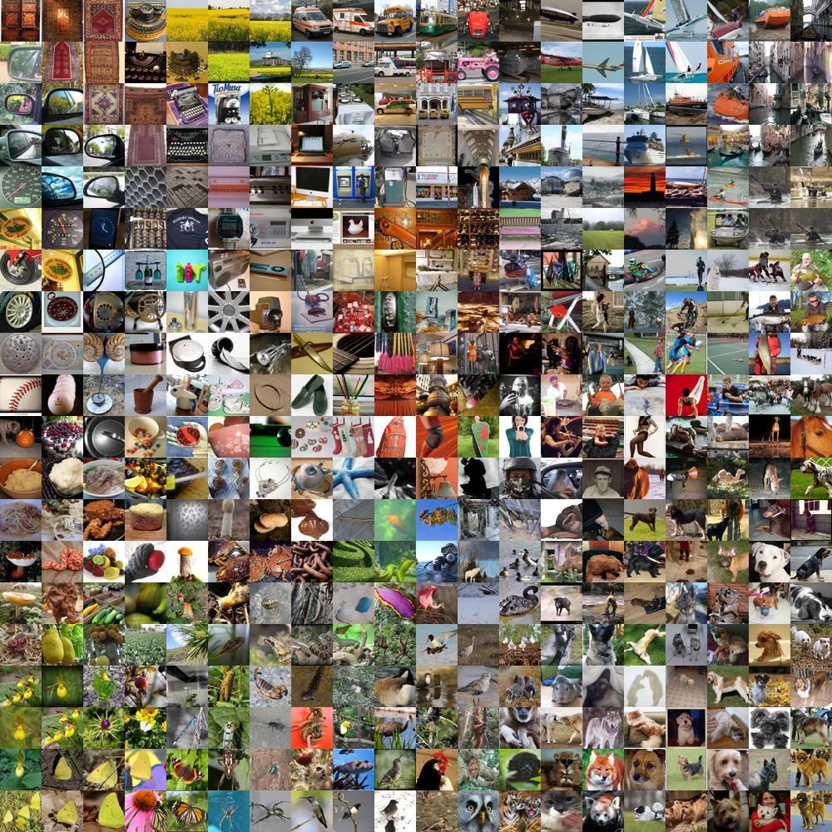
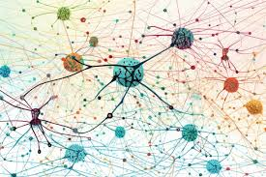
What are vision foundation models?
General-purpose models trained on a large amount (millions to billions) of natural images
Capable of performing or being fine-tuned to perform multiple diverse tasks

Slide 3
What can VFMs be used for?
Machine Learning task | Astrophysics task | Examples
Image reconstruction | Fourier image reconstruction | Schmidt 2020, Drozdova 2023
Object detection | Source detection | Vafaei Sadr 2019, Jia 2023
Object segmentation | Source characterization | Farias 2020, Sortina 2023
Image or object classification | Source classification | Burke 2019, Riggi 2023
Instance segmentation | Instance segmentation | Hausen & Robertson 2022
Anomaly detection | Object/event discovery | Lochner & Bassett 2021

Slide 4
What can VFMs be used for?
Machine Learning task | Astrophysics task | Examples
Image reconstruction | Fourier image reconstruction | Schmidt 2020, Drozdova 2023
Object detection | Source detection | Vafaei Sadr 2019, Jia 2023
Object segmentation | Source characterization | Farias 2020, Sortina 2023
Image or object classification | Source classification | Burke 2019, Riggi 2023
Instance segmentation | Instance segmentation | Hausen & Robertson 2022
Anomaly detection | Object/event discovery | Lochner & Bassett 2021
All these tasks can be facilitated using VFMs!

Slide 5
What can VFMs be used for?
Machine Learning task | Astrophysics task | Examples
Image reconstruction | Fourier image reconstruction | Schmidt 2020, Drozdova 2023
Object detection | Source detection | Vafaei Sadr 2019, Jia 2023
Object segmentation | Source characterization | Farias 2020, Sortina 2023
Image or object classification | Source classification | Burke 2019, Riggi 2023
Instance segmentation | Instance segmentation | Hausen & Robertson 2022
Anomaly detection | Object/event discovery | Lochner & Bassett 2021
All these tasks can be facilitated using VFMs!
… but hardly anyone does it

Slide 6
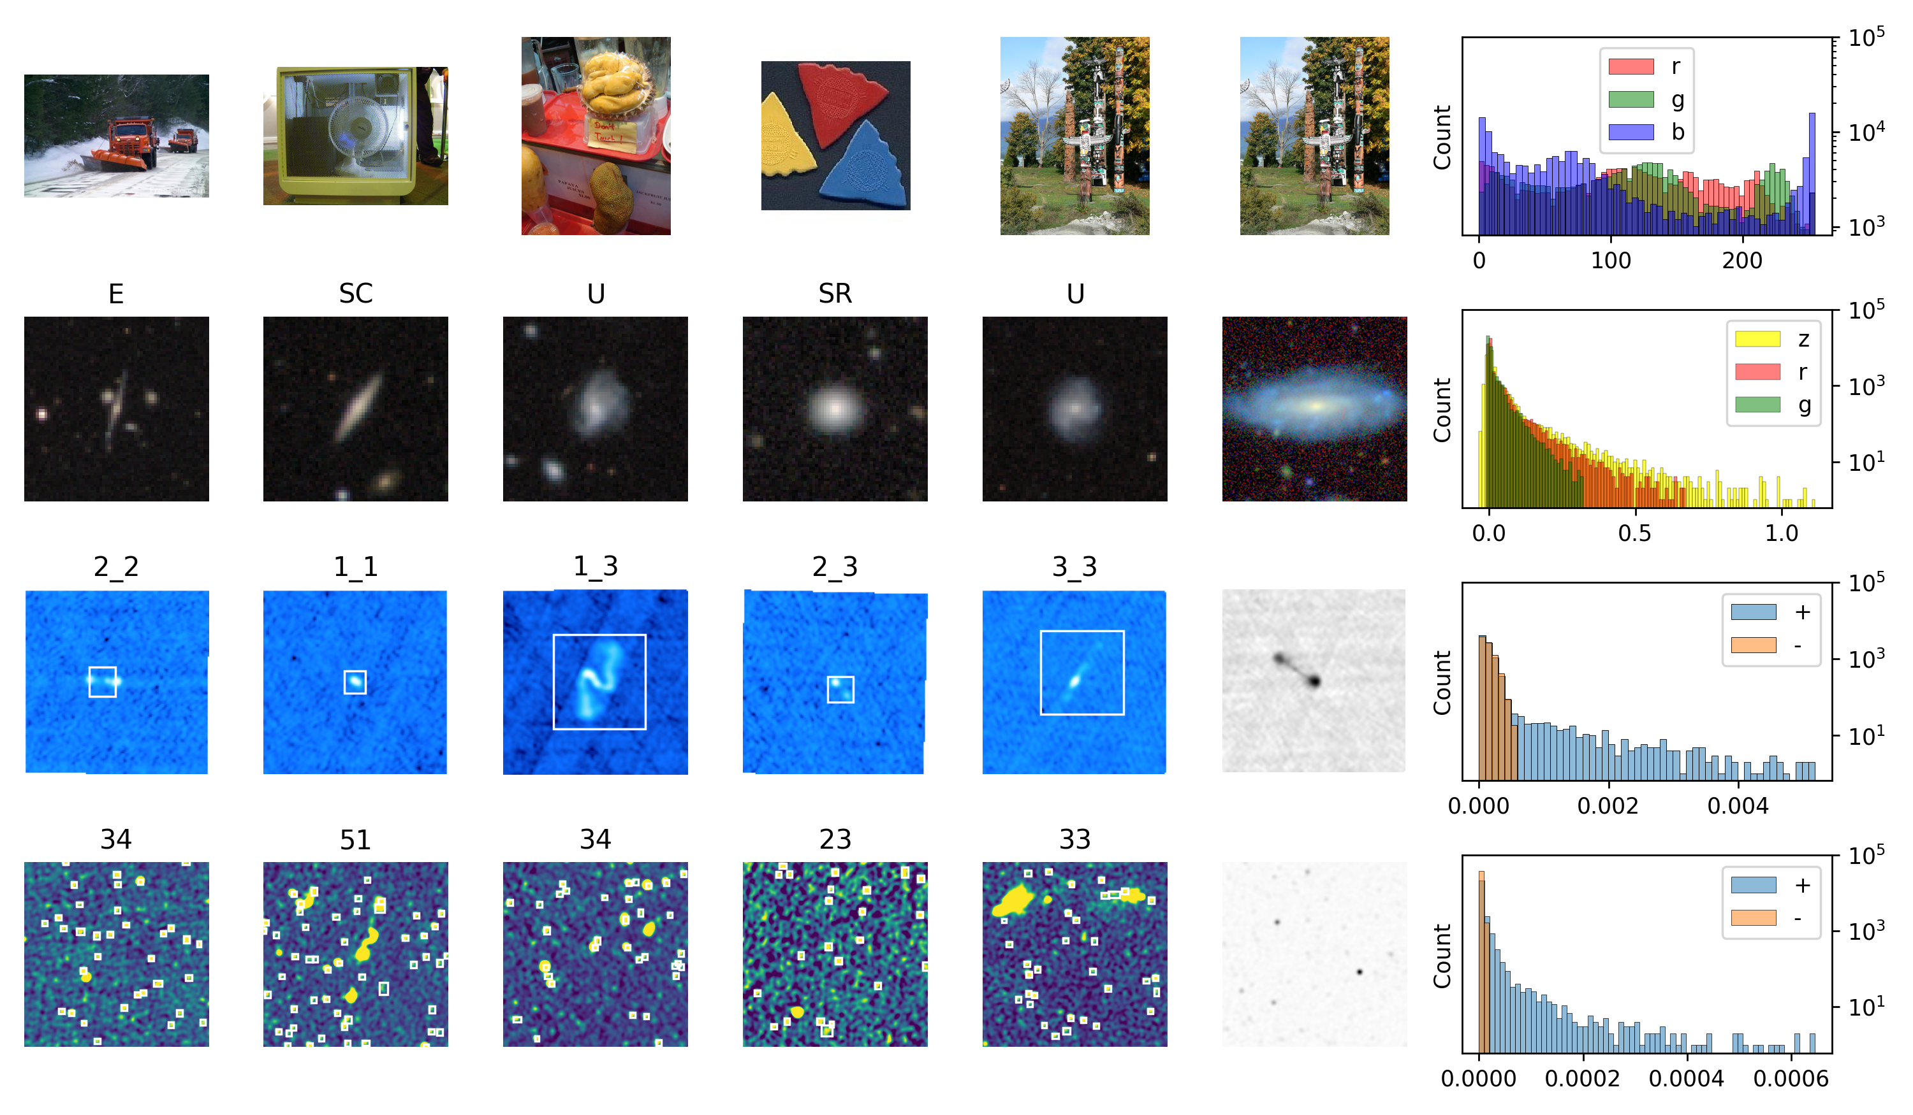
Our data is just too different…

Slide 7
Our data is just too different…
… a problem known in computer science as “distribution shift”

Slide 8
Are standard VFMs useful for astrophysics?

Slide 9
Yes*
*short answer

Slide 10
Types of VFMs
Many factors contribute to differences between VFMs! These include: training data, architecture, training objective
Self-supervised
Weakly-supervised
Distillation
Trained on a single modality (images)
Different types of losses possible
Trained using multiple modalities (ex: images + text)
Contrastive loss
Agglomerate representations from many existing models
Various weighting methods

Slide 11
VFMs that we studied
Model | Architecture | Parameters | Pre-training Dataset | Training Objective
MAE | ViT-Base, 16x16 | 86M | ImageNet-1k | Reconstruction
MSN | ViT-Base, 16x16 | 86M | ImageNet-1k | Predict masked patches
DINOv2 | ViT-Base, 14x14 | 86M | LVD-142M | Local-to-global
ResNet-50 | ResNet-50 | 25.6M | ImageNet-1k | Image classification
ResNet-18 | ResNet-18 | 11.5M | ImageNet-1k | Image classification
SigLIP | ViT-Base, 16x16 | 86M | Web-LI (English) | Image-text pairs
AM-RADIO | ViT-Base, 16x16 | 98.2M | various | Knowledge distillation

Slide 12
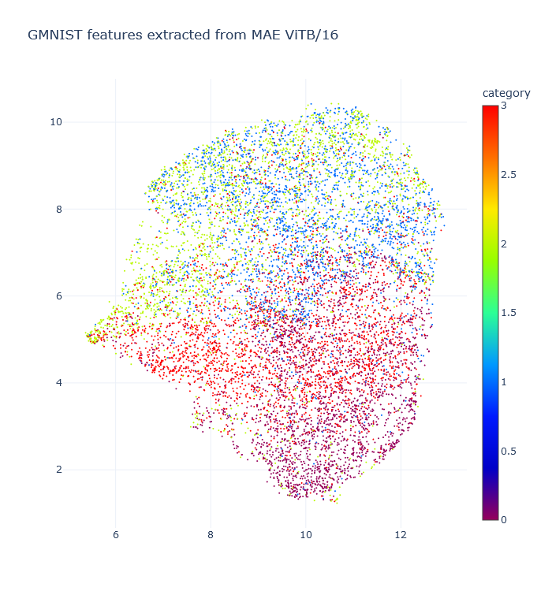
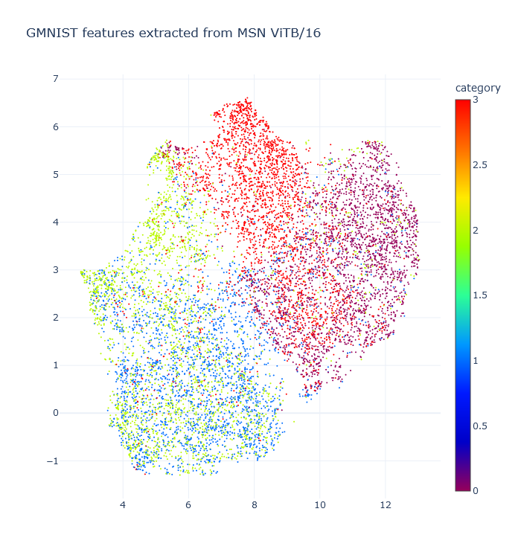
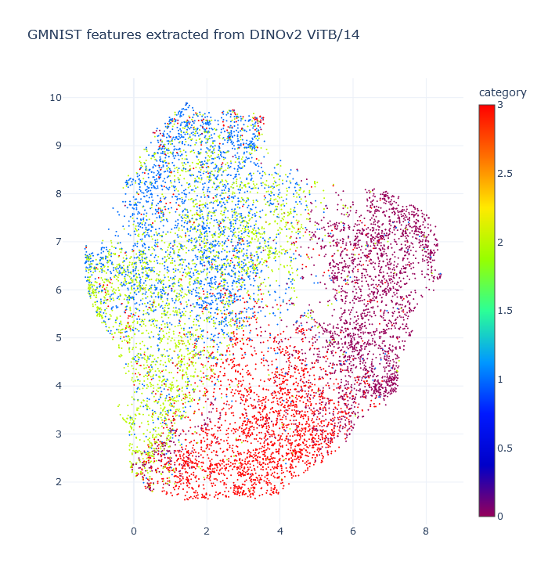
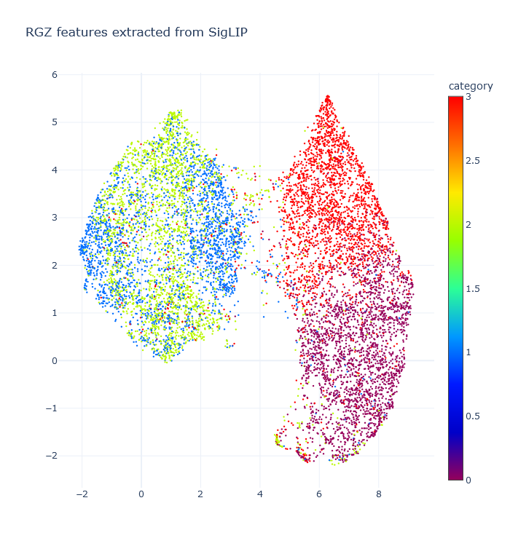
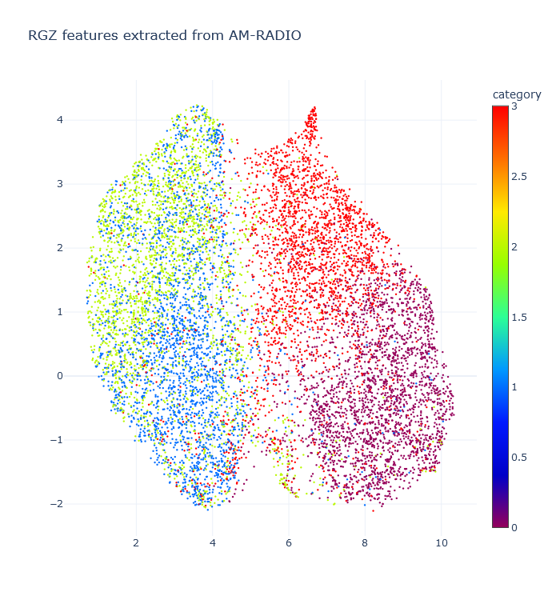
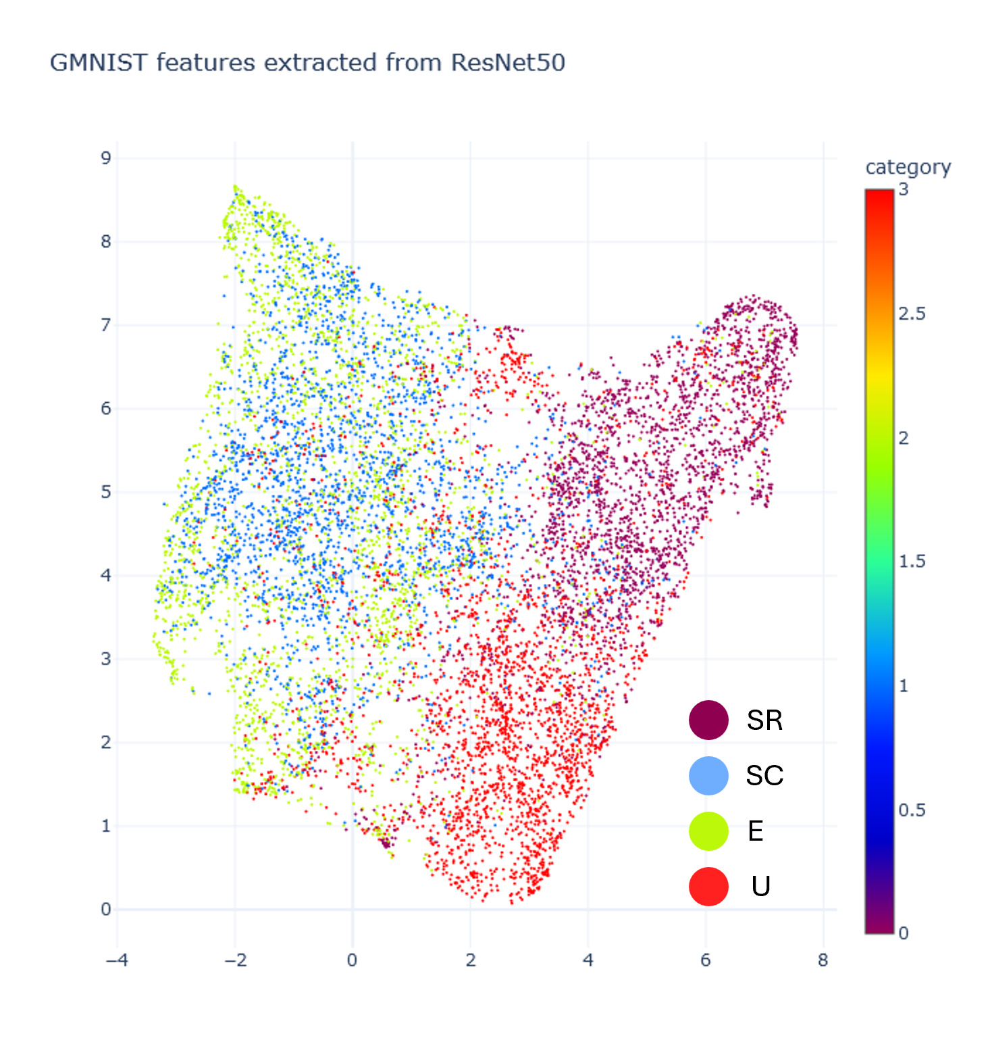
Illustration: VFMs are not all the same!
MAE
MSN
Dino v2
UMAP latent space representation for GalaxyMNIST dataset (optical images, 4 morphology classes)
SigLIP
AM-RADIO
ResNet-50

Slide 13
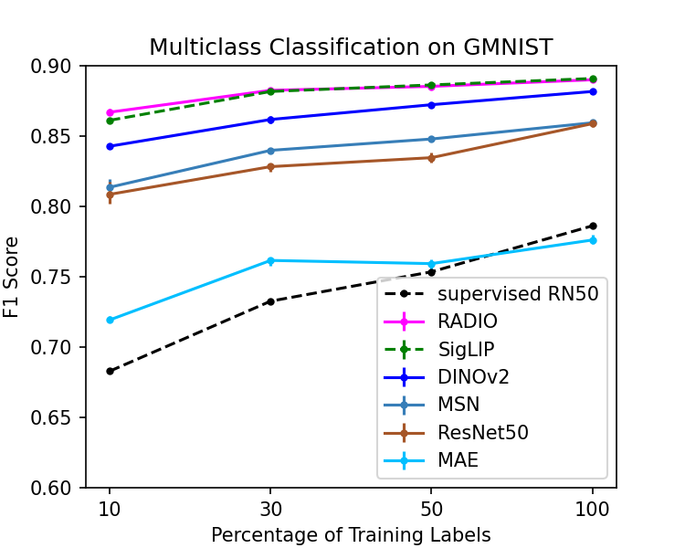
Example: Optical galaxy morphology classification
F1 score: harmonic mean of precision and recall - higher is better
Compare against fully supervised training (only show the best supervised result)
MAE’s reconstruction objective is not very useful for classification
Almost all VFMs out-perform supervised training, for any number of labeled examples!

Slide 14
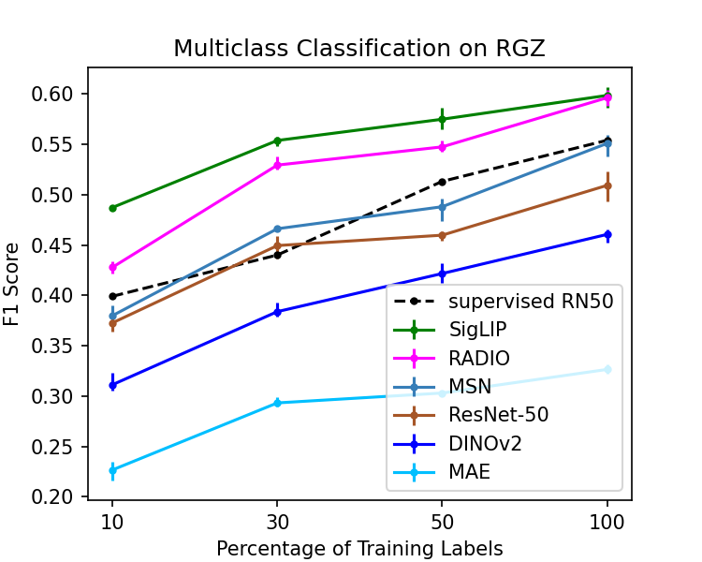
Example: Radio galaxy morphology classification
F1 scores are much lower than for GMNIST!
Only SigLIP and AM-RADIO regularly out-perform supervised training

Slide 15
Distribution shift, revisited
Why are optical galaxies so much easier to classify?

Slide 16
Improving performance by mitigating distribution shift
Align the downstream task data to the training data
Align the model to the downstream task data
Crop and re-size so that central galaxy occupies larger percentage of the image
Add a whitening layer to normalize representations
Change the model patch size
More model parameters, either in the backbone or projection head
Fine-tune the backbone efficiently
Full fine-tuning of the backbone

Slide 17
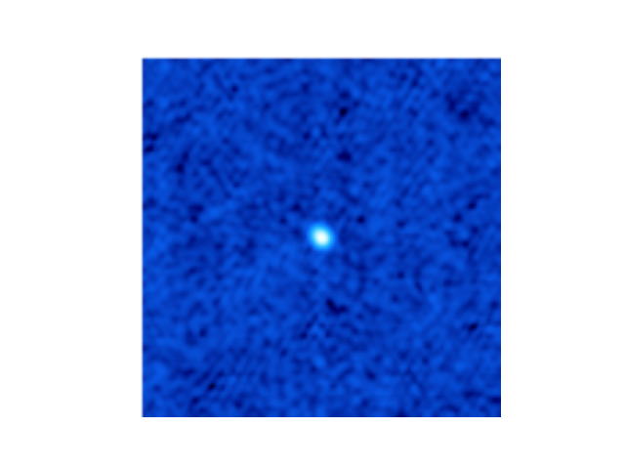
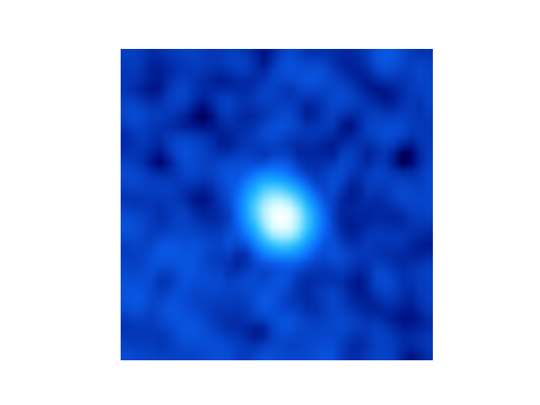
Align the downstream task data to the training data
Technique | ResNet-50 F1 | AM-RADIO F1
Crop close to center source | 0.643 (+1.32) | 0.705 (+0.115)
Resize image to 320x320 | 0.481 (-0.031) | 0.630 (+0.041)
Resize image to 480x480 | 0.465 (-0.046) | 0.666 (+0.080)
Resize image to 512x512 | 0.454 (-0.057) | 0.667 (+0.078)

Slide 18


Align the model to the downstream task data
Projection head
Technique | ResNet-50 F1 | AM-RADIO F1
Whitening Layer | 0.519 (+0.008) | 0.603 (+0.013)
MLP(larger projection head) | 0.526 (+0.015) | 0.623 (+0.034)
ResNet-101/ViT-Large (larger backbone model) | 0.486 (-0.025) | 0.625 (+0.036)
ResNet-152/ViT-Huge (much larger backbone model) | 0.486 (-0.026) | 0.653 (+0.063)
Efficient fine-tuning (LoRA) | 0.674 (+0.163) | 0.692 (+0.102)
Full fine-tuning | 0.737 (+0.226) | 0.721 (+0.132)
VFM backbone

Slide 19
Align the model to the downstream task data
Projection head
Technique | ResNet-50 F1 | AM-RADIO F1
Whitening Layer | 0.519 (+0.008) | 0.603 (+0.013)
MLP(larger projection head) | 0.526 (+0.015) | 0.623 (+0.034)
ResNet-101/ViT-Large (larger backbone model) | 0.486 (-0.025) | 0.625 (+0.036)
ResNet-152/ViT-Huge (much larger backbone model) | 0.486 (-0.026) | 0.653 (+0.063)
Efficient fine-tuning (LoRA) | 0.674 (+0.163) | 0.692 (+0.102)
Full fine-tuning | 0.737 (+0.226) | 0.721 (+0.132)
VFM backbone

Slide 20
Align the model to the downstream task data
Projection head
Technique | ResNet-50 F1 | AM-RADIO F1
Whitening Layer | 0.519 (+0.008) | 0.603 (+0.013)
MLP(larger projection head) | 0.526 (+0.015) | 0.623 (+0.034)
ResNet-101/ViT-Large (larger backbone model) | 0.486 (-0.025) | 0.625 (+0.036)
ResNet-152/ViT-Huge (much larger backbone model) | 0.486 (-0.026) | 0.653 (+0.063)
Efficient fine-tuning (LoRA) | 0.674 (+0.163) | 0.692 (+0.102)
Full fine-tuning | 0.737 (+0.226) | 0.721 (+0.132)
VFM backbone

Slide 21
Align the model to the downstream task data
Projection head
Technique | ResNet-50 F1 | AM-RADIO F1
Whitening Layer | 0.519 (+0.008) | 0.603 (+0.013)
MLP(larger projection head) | 0.526 (+0.015) | 0.623 (+0.034)
ResNet-101/ViT-Large (larger backbone model) | 0.486 (-0.025) | 0.625 (+0.036)
ResNet-152/ViT-Huge (much larger backbone model) | 0.486 (-0.026) | 0.653 (+0.063)
Efficient fine-tuning (LoRA) | 0.674 (+0.163) | 0.692 (+0.102)
Full fine-tuning | 0.737 (+0.226) | 0.721 (+0.132)
VFM backbone

Slide 22
Align the model to the downstream task data
Projection head
Technique | ResNet-50 F1 | AM-RADIO F1
Whitening Layer | 0.519 (+0.008) | 0.603 (+0.013)
MLP(larger projection head) | 0.526 (+0.015) | 0.623 (+0.034)
ResNet-101/ViT-Large (larger backbone model) | 0.486 (-0.025) | 0.625 (+0.036)
ResNet-152/ViT-Huge (much larger backbone model) | 0.486 (-0.026) | 0.653 (+0.063)
Efficient fine-tuning (LoRA) | 0.674 (+0.163) | 0.692 (+0.102)
Full fine-tuning | 0.737 (+0.226) | 0.721 (+0.132)
VFM backbone

Slide 23
Improving performance by mitigating distribution shift
Technique | ResNet-50 F1 | AM-RADIO F1
Whitening Layer | 0.519 (+0.008) | 0.603 (+0.013)
MLP(larger projection head) | 0.526 (+0.015) | 0.623 (+0.034)
ResNet-101/ViT-Large (larger backbone model) | 0.486 (-0.025) | 0.625 (+0.036)
ResNet-152/ViT-Huge (much larger backbone model) | 0.486 (-0.026) | 0.653 (+0.063)
Resize image to 320x320 | 0.481 (-0.031) | 0.630 (+0.041)
Resize image to 480x480 | 0.465 (-0.046) | 0.666 (+0.080)
Resize image to 512x512 | 0.454 (-0.057) | 0.667 (+0.078)
Crop close to center source | 0.643 (+1.32) | 0.705 (+0.115)
Efficient fine-tuning (LoRA) | 0.674 (+0.163) | 0.692 (+0.102)
Full fine-tuning | 0.737 (+0.226) | 0.721 (+0.132)

Slide 24
Are standard VFMs useful for astrophysics?

Slide 25
Yes
There are so many pre-trained VFMs available, that there is no reason not to start with one! However, some models are more suited to particular tasks and datasets than others.
Questions to consider:
How much distribution shift?
Which downstream task?
What resources (labeled data, compute, personnel) are available?
Is it more effective to align your data to the training data, or the model to your data?

Slide 26


Full results – paper & code
https://arxiv.org/abs/2409.11175
https://github.com/elastufka/fm4astro
Code:

