Slide 1
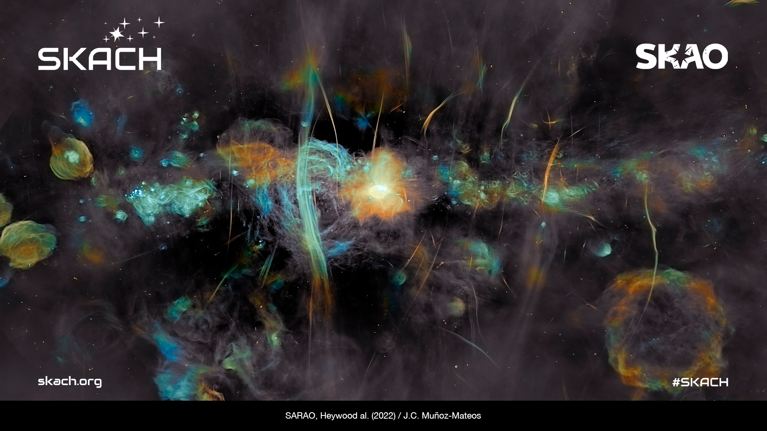
SKACH: A Look Ahead at 2025-2028
Carolyn Marie Crichton
January 27, 2025

Slide 2

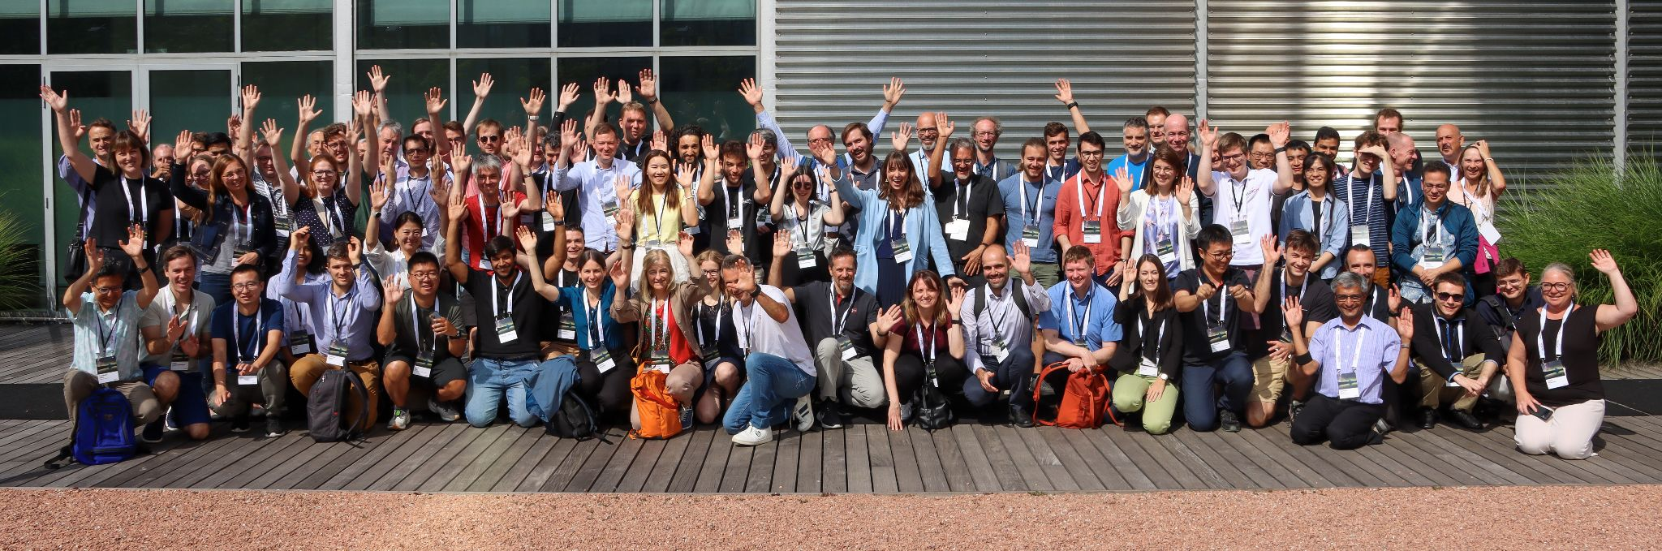
Welcome to New Members!

Slide 3










Vision
Further Swiss leadership in the global radio astronomy community.
Switzerland joined the SKAO on January 19, 2022
SKACH is primarily funded by the State Secretariat for Education, Research and Innovation (SERI). Work within the consortium also leverages funding from external grants such as AstroSignals SINERGIA, SNF Bilateral, PASC, and Horizon Europe.
Mission
Ensure meaningful contributions to the SKAO and SRCs through the development and delivery of cutting-edge Swiss solutions to key science goals, big data research, technology, and services.

Slide 4
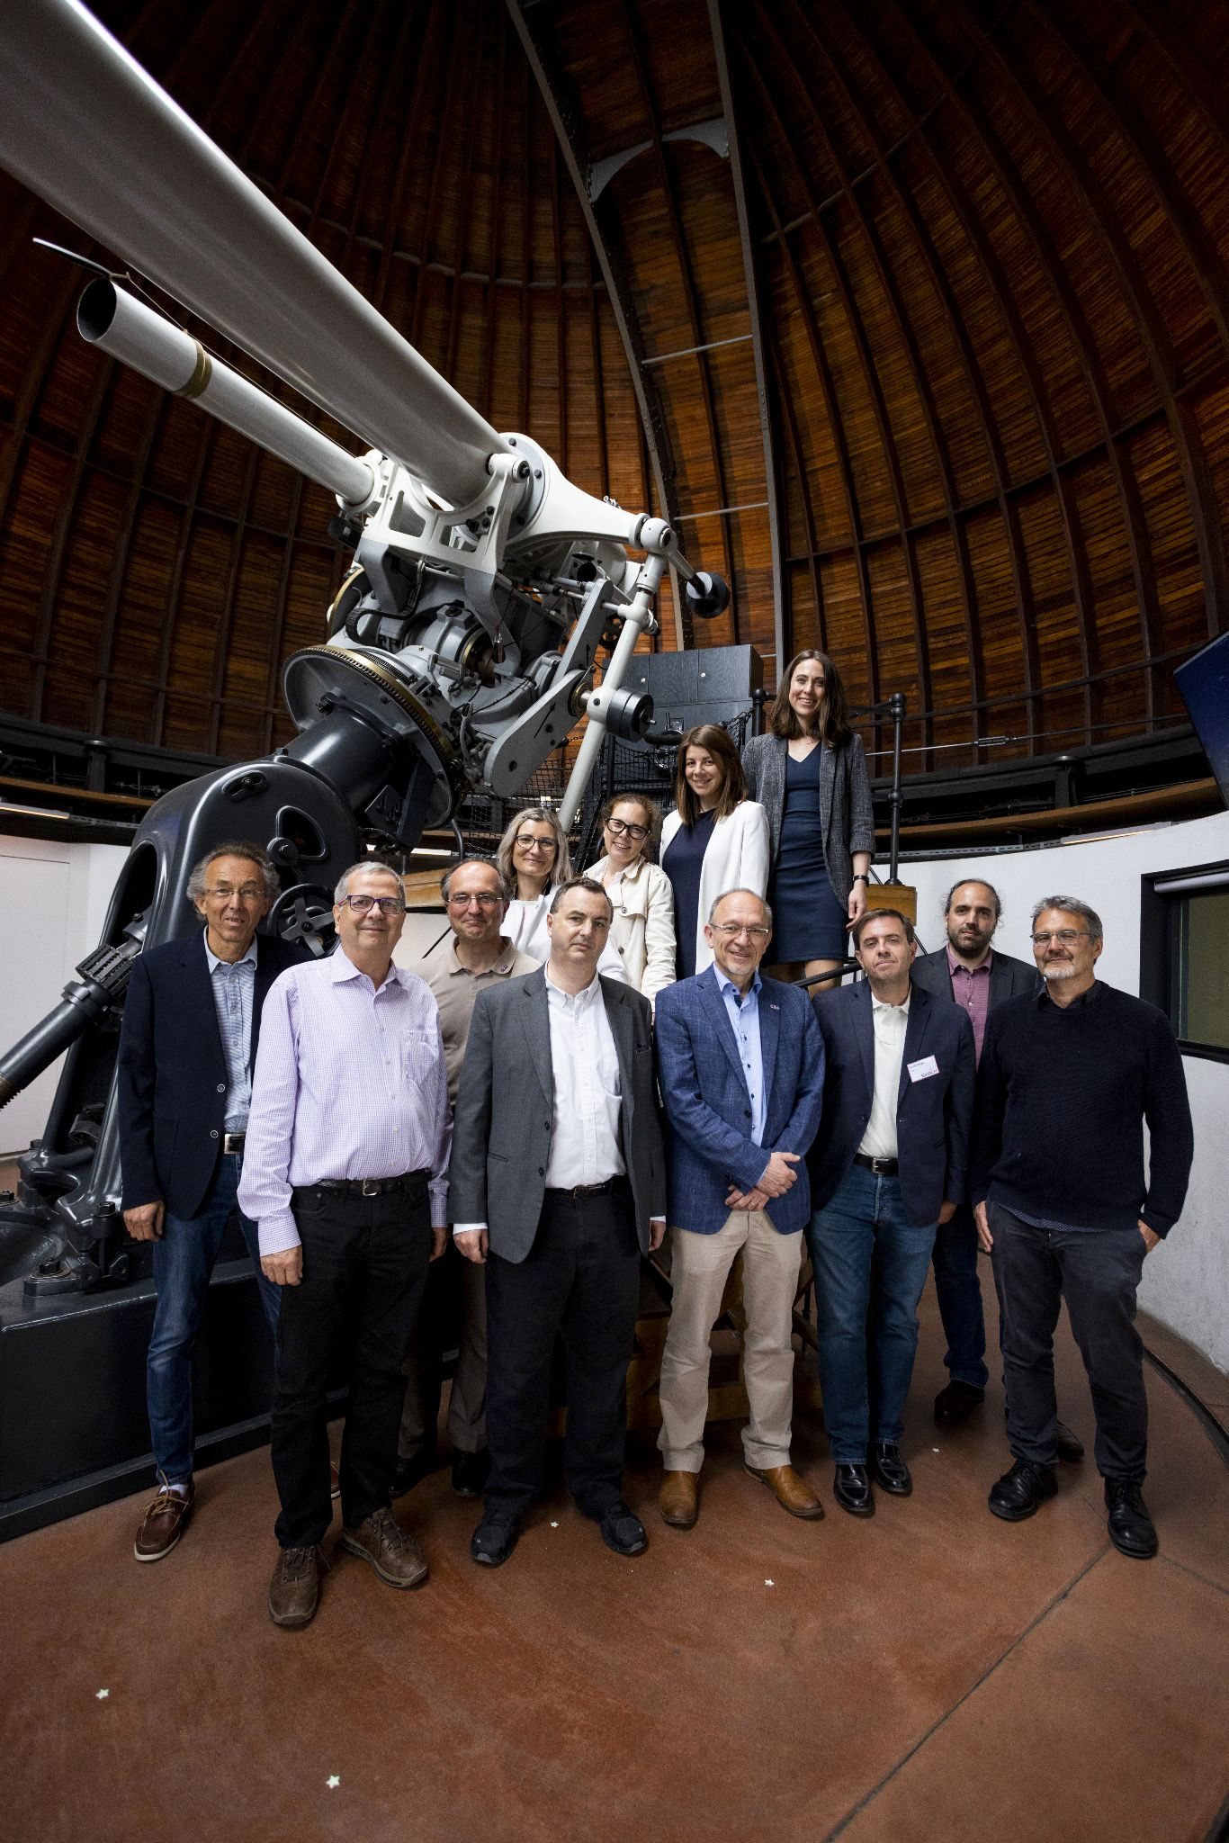
The SKACH Board is comprised of one voting member from each institution & is responsible for managing SKAO related activities.
Chair: Ms. Carolyn Marie Crichton
Co-Chair: Ms. Rohini Joshi
Voting Members
Prof. André Csillaghy (FHNW)
Prof. Alexandre Refregier (ETHZ)
Prof. Daniel Schaerer (UniGe)
Dr. Elena Gavagnin (ZHAW)
Dr. Evelina Breschi (HES-SO)
Prof. Florina Ciorba (UniBas)
Prof. Jean-Paul Kneib (EPFL)
Prof. Lucio Mayer (UZH)
Dr. Mark Sargent (ISSI)
Mr. Pablo Fernandez (CSCS)
Observer: Susanne Wampfler (UniBern)
The SKACH Board. Left to Right: Top: Daniel Schaerer, Jean-Paul Kneib, Florina Ciorba, Evelina Breschi, Elena Gavagnin, Carolyn Marie Crichton Bottom: André Csillaghy, Alexandre Refregier, Stefan Kögl, Lucio Mayer, Pablo Fernandez

Slide 5
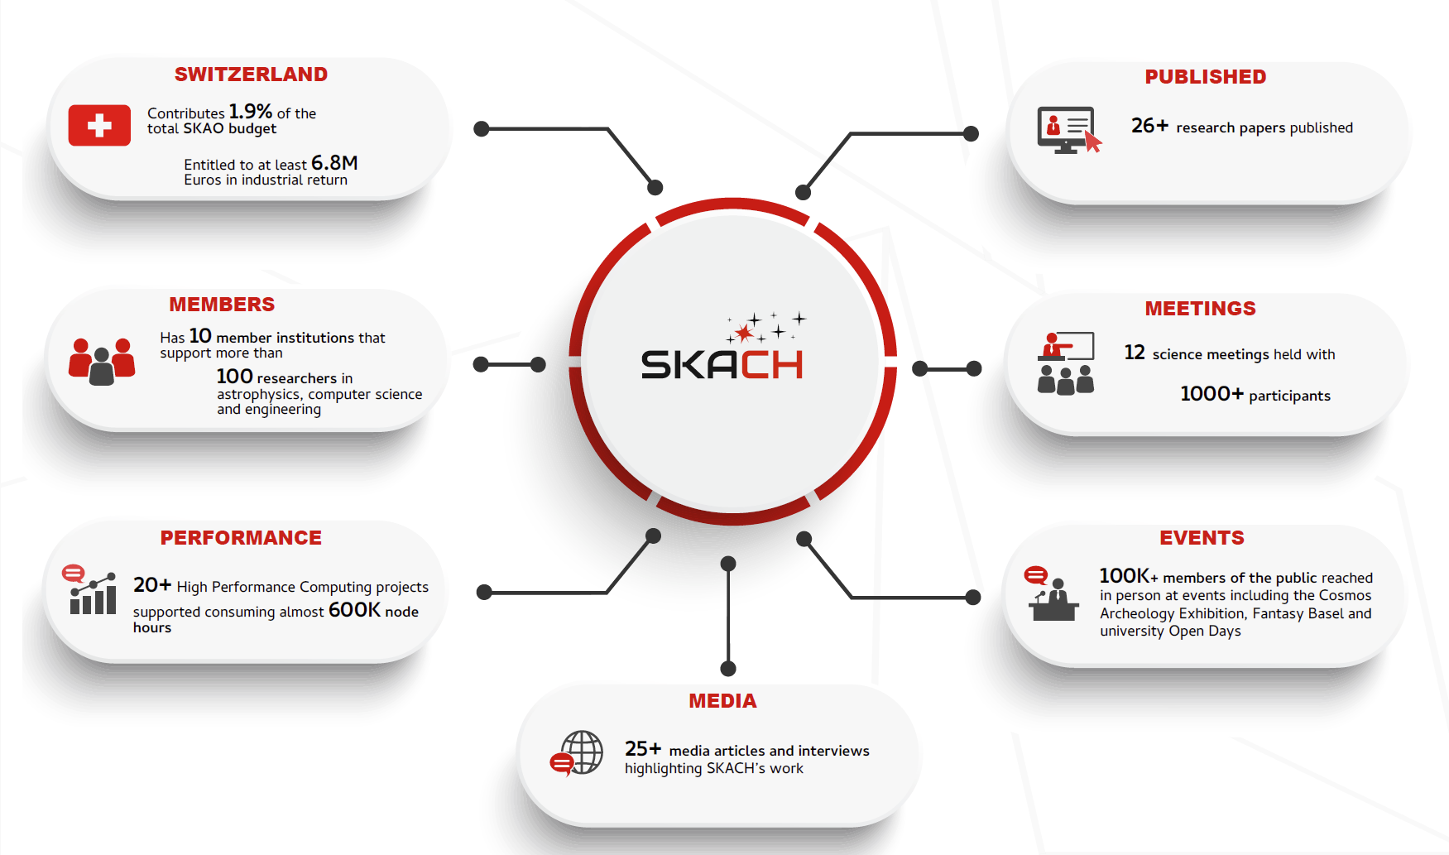

Slide 6
Progress of the SKACH Consortium
2025
2026
2027
2028
Year 1:
Structure Adjustments, SRC V0.1, Swiss Science Priorities, and Funding Allocation Announcements (FLARE, SNSF)
Year 2:
SRC V0.2 and V0.3, Precursor Science, Finalize Written Communications Plan, Strategize Long-term Consortium Funding
Year 3:
SRC V1 Beta, Continue Long-term Funding Strategy and Proposal Writing
Year 4:
SRC V1, SKAO AA* Data, Results and Papers, Planning for Next 4-years

Slide 7
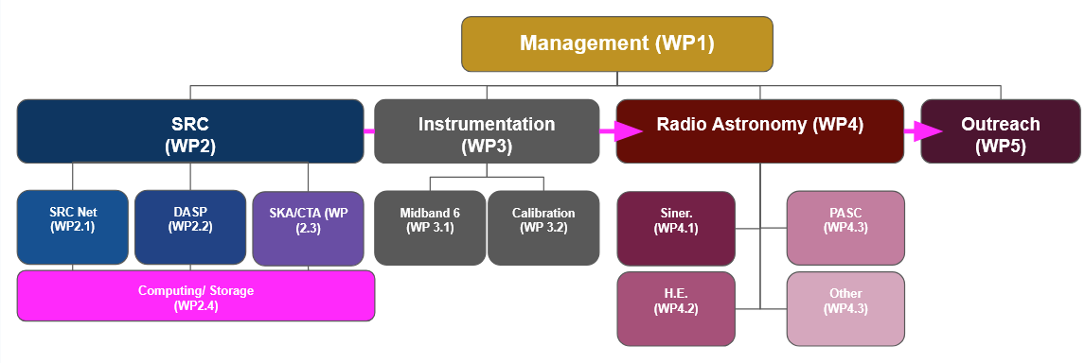
2025-2025 SKACH Work Packages

Slide 8
Short-term Items
Weekly Meetings
For Content, we are having 4 categories of talks:
  Guest speakers: Please feel free to add a guest speak and the topic you would like them to speak on to any week. I will do the chasing to confirm with them, I just need to know who to contact and for what topic
  General overview/Science 101: Think "What is interferometry?" or "What are the basics of ML?"
  Status update: These are the research updates you know and love, but with more time in between to hear real results.
  SKAO update: These will be updates from Council, SKAO Science, SEAC, Construction, PI Planning etc.
We are asking that everyone receiving SERI funding signs up for AT LEAST 1-2 updates annually (this can be 101 or status update). Those with other funding participating in SKACH are welcome to present, and more frequent status updates are also great!Sign-up here: https://docs.google.com/spreadsheets/d/1i-lujSXLnugzpgzb0jWLZXYl2BVSbuJj5-UbI3u9E6c/edit?usp=sharing
PAERI Conference - 27 - 29 November - Morges
Winter Meeting 2025 - Jan. 27/28- Bern - should follow by SKA Days
SKAO Council - 18-19, 2025
Cosmology on Safari - June?
PI Planning - June 2025
SKA Days - TBD - Winterthur
Awards

Slide 9
Short-term Items: Upcoming Meetings
Science Meeting with SKAO Council - March 17, 2025 - UZH
Opportunity to show off SKACH Science to Council Members - Different types of institutions and collaborations - Show common Effort
Collaboration with SKACH - Carolyn Crichton (and other?)
Swiss Science Priorities - Jean-Paul Kneib (and other?)
SPH-EXA - Lucio Mayer, Florina Ciorba
Maybe consider “Science Tools”
Karabo - Andre Csillaghy (and other?)
AI Developments - Elena Gavagnin and Philipp Densel (could co-present with others?), UniGe?
SRC Net - Rohini Joshi (and other? Pablo Llopis? /UniGe/CSCS
Lightning talks from students
Cosmology on Safari - 1-7 June, 2025
SKAO Science Meeting 16-20 June 2025
PI Planning - June 2025
SKA Days - 25, 26, 27 August - Winterthur

Slide 10
Short-term Items: Awards
Will Start SKACH Awards at SKA Days
Announcement in May
Let us know if you have ideas for categories (ie Best SKACH Funded PhD Thesis)

Slide 11
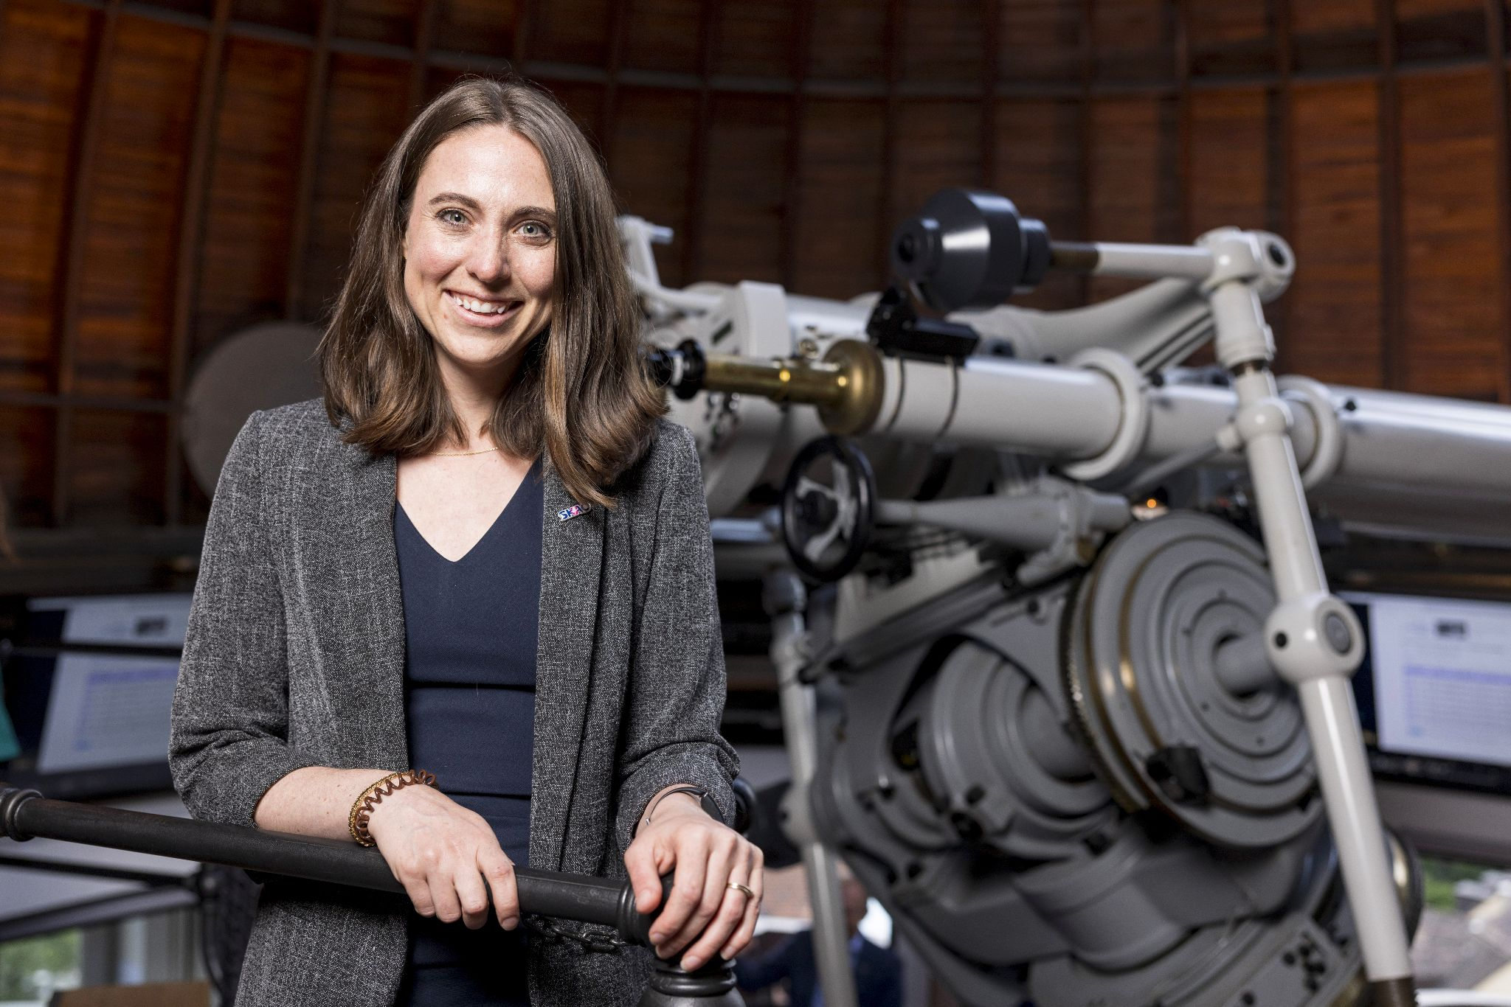
Contact Me:
Carolyn.Crichton@EPFL.ch

