Slide 1
SKACH
Science Priority Workshop
Jean-Paul Kneib (EPFL)

Slide 2
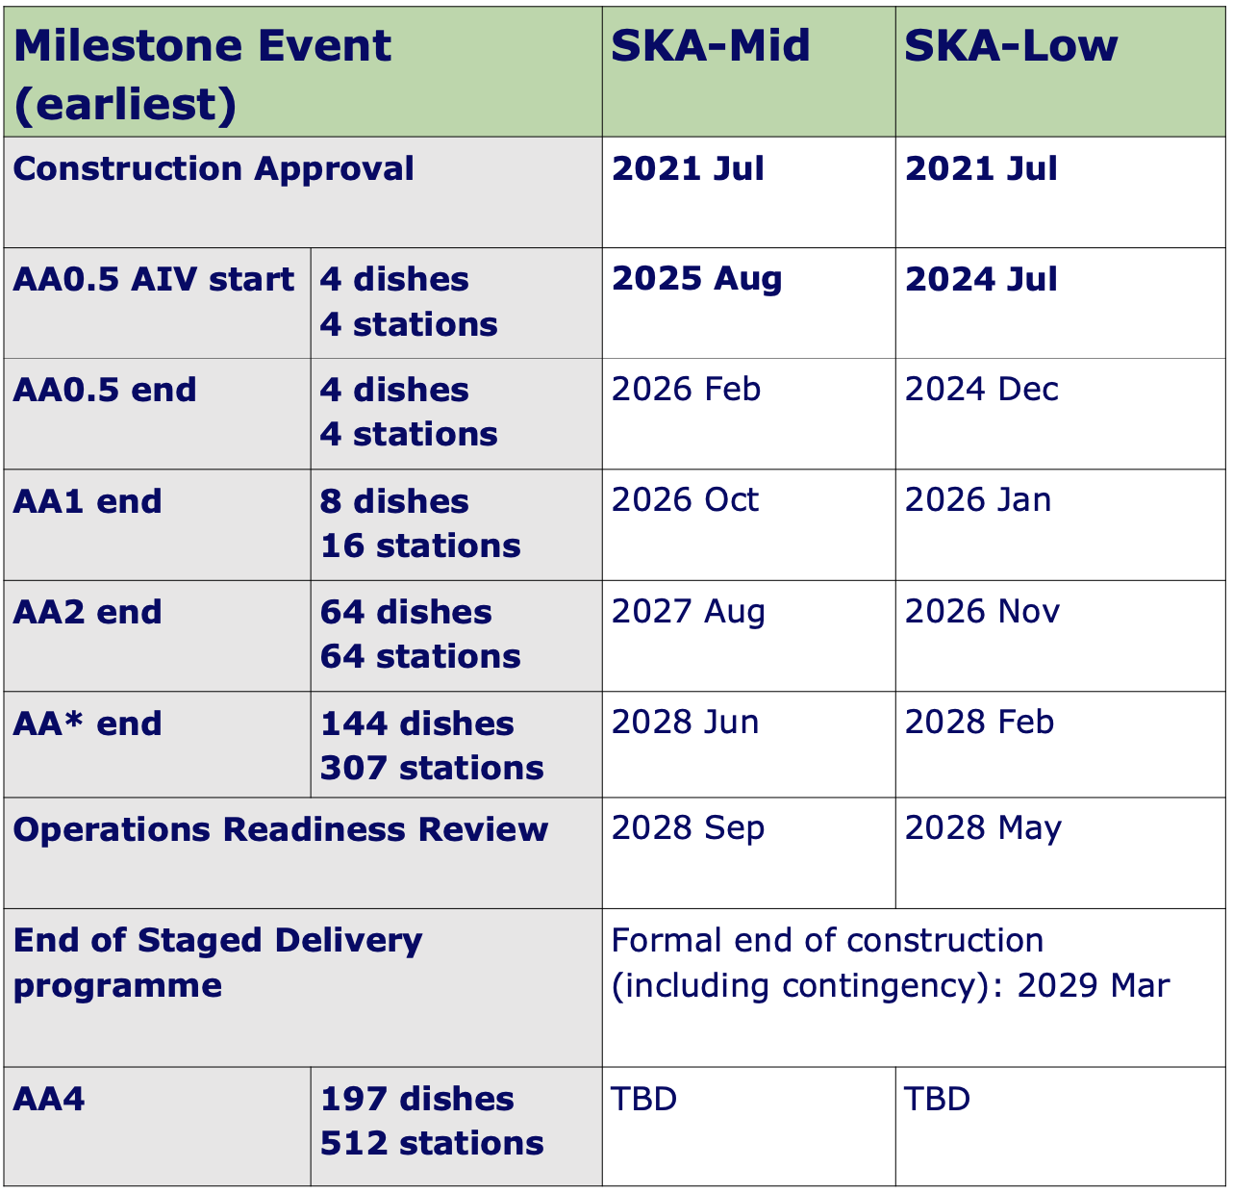
2026 – first SKAO data
2028 – operation starts
Call for proposals ~2027
Are we ready?

Slide 3
Split in different groups lead by astro-scientists, other distribute evenly between different groups for example in the following way:
EOR - 21cm tomography at Low frequency - first detection (Michele Bianco)
Cluster of galaxies - understanding the key ingredients in the cluster formation (Emma Tolley+Nicola Cerardi)
Galaxy-BH co-evolution and formation - mapping 21cm galaxy halo across time (Mark Sargent + Mirka Dessauges)
Pulsar search [for Pulsar Timing Array] (Piyush)
Lensed Galaxies (Philip Denzel+JPK)

Slide 4
Question to address for your science project:
Title and abstract of the project
What SKAO observations are required? Depth, field of view, frequency range ...
Any supporting observation needed? (e.g. Euclid imaging, 4MOST spectroscopy, follow-up observation …)
What simulation are required? Which kind?
What type of data analysis is needed? Software exists? Scalable?
Which partners in SKAO community to connect with?
What could be done with precursor data or simulations before SKAO data comes in?
What would be the next steps to get ready and submit a proposal?

Slide 5
20 minutes to brainstorm and answer to the questions (a few lines max per questions)
Then quick presentation (5min) of the answers and what you have learned

