Slide 1
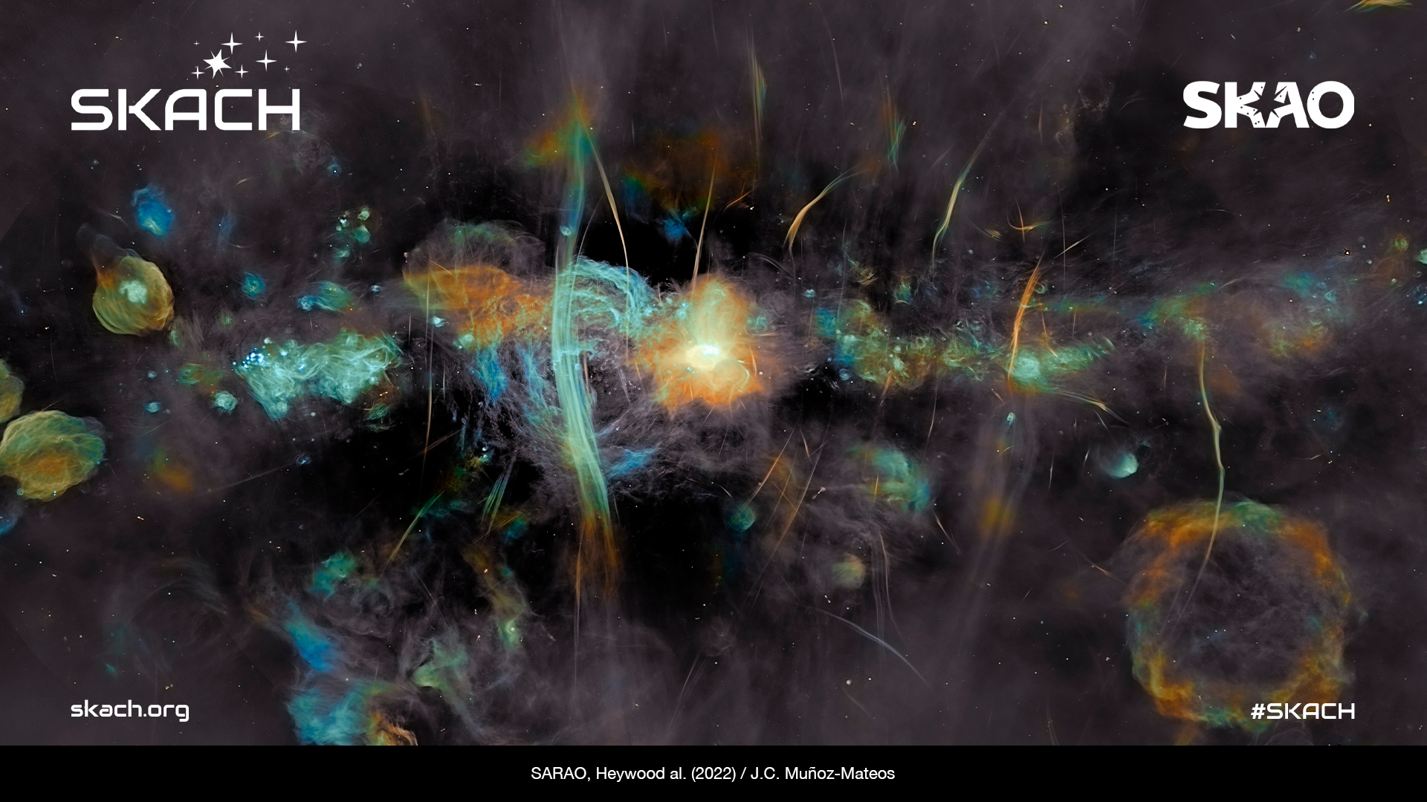
SKACH
Outreach and Communications
January 2025

Slide 2


Priorities 2025-2026
Objectives:
Build awareness of SKACH in Switzerland outside a scientific audience
Bring Radio Astronomy and SKACH associated fields (computer science, engineering etc.) to a wide public audience, particularly young people (STEM for Girls)
Promote the SKAO and Switzerland’s contributions
Promote, when possible, Switzerland’s Industrial Return partners
Fundraising

Slide 3
Key products and collaborations 2025 - 2026
Branded radio astronomy 101 content – kicked off by Radio Cosmos
Broader imagery and summaries of consortium members work and contributions
SKACH Media Kit (German, French Italian)
Shared Skies – SKAO indigenous art exhibition?
Astronomy on Safari Media visit?
Salome Project

Slide 4
Key events 2025 - 2026
MINT Vaud, EPFL February
Fantasy Basel, Basel Messe May
Astronomy on Safari Media Visit, South Africa June?
Arcana Vaud, October
Shared Skies – SKAO indigenous art exhibition? Digital?

Slide 5
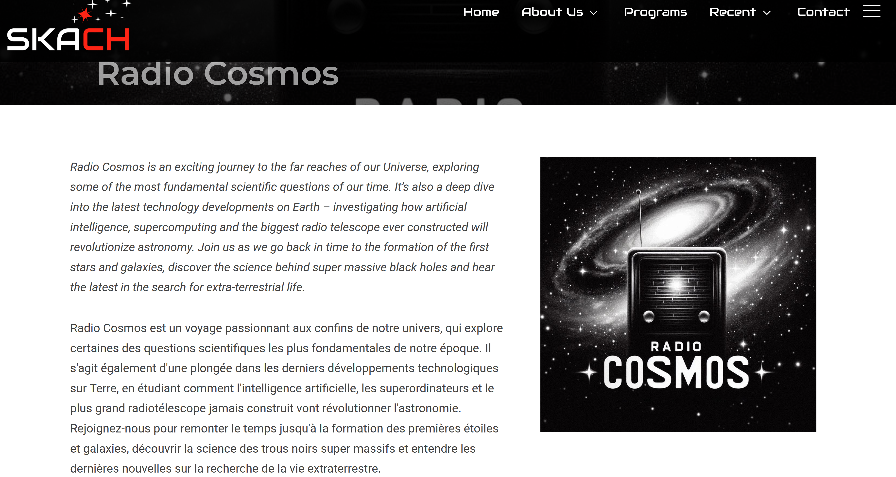

Slide 6
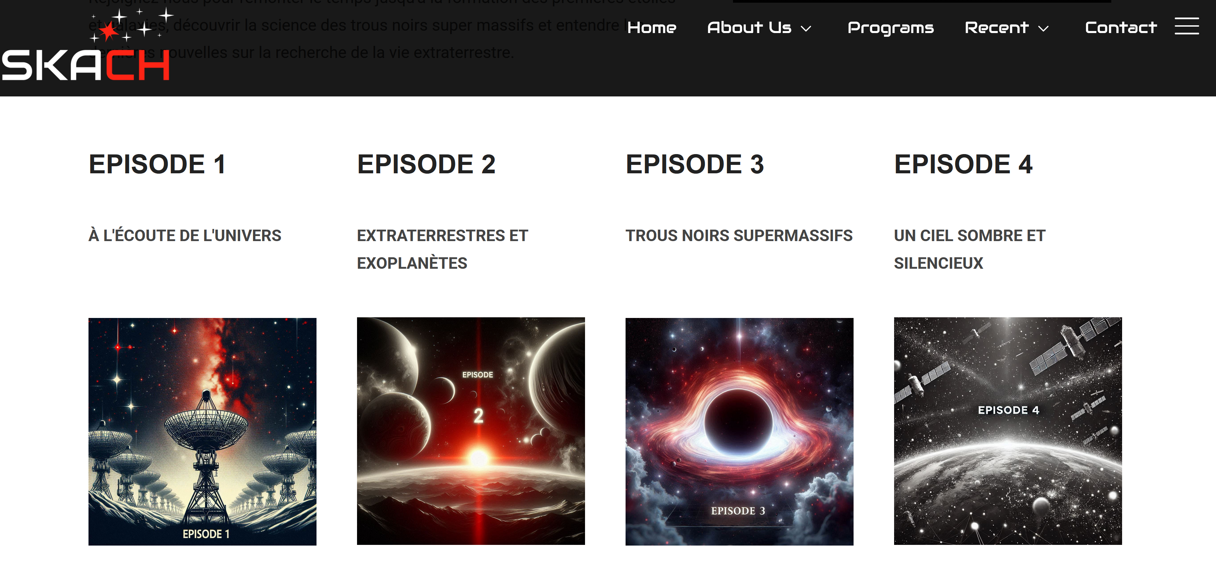
Huge thanks to:
Mark Sargent
Emma Tolley
Hugo and Jan at Powell Media
Carolyn Crichton and Jean-Paul Kneib

Slide 7
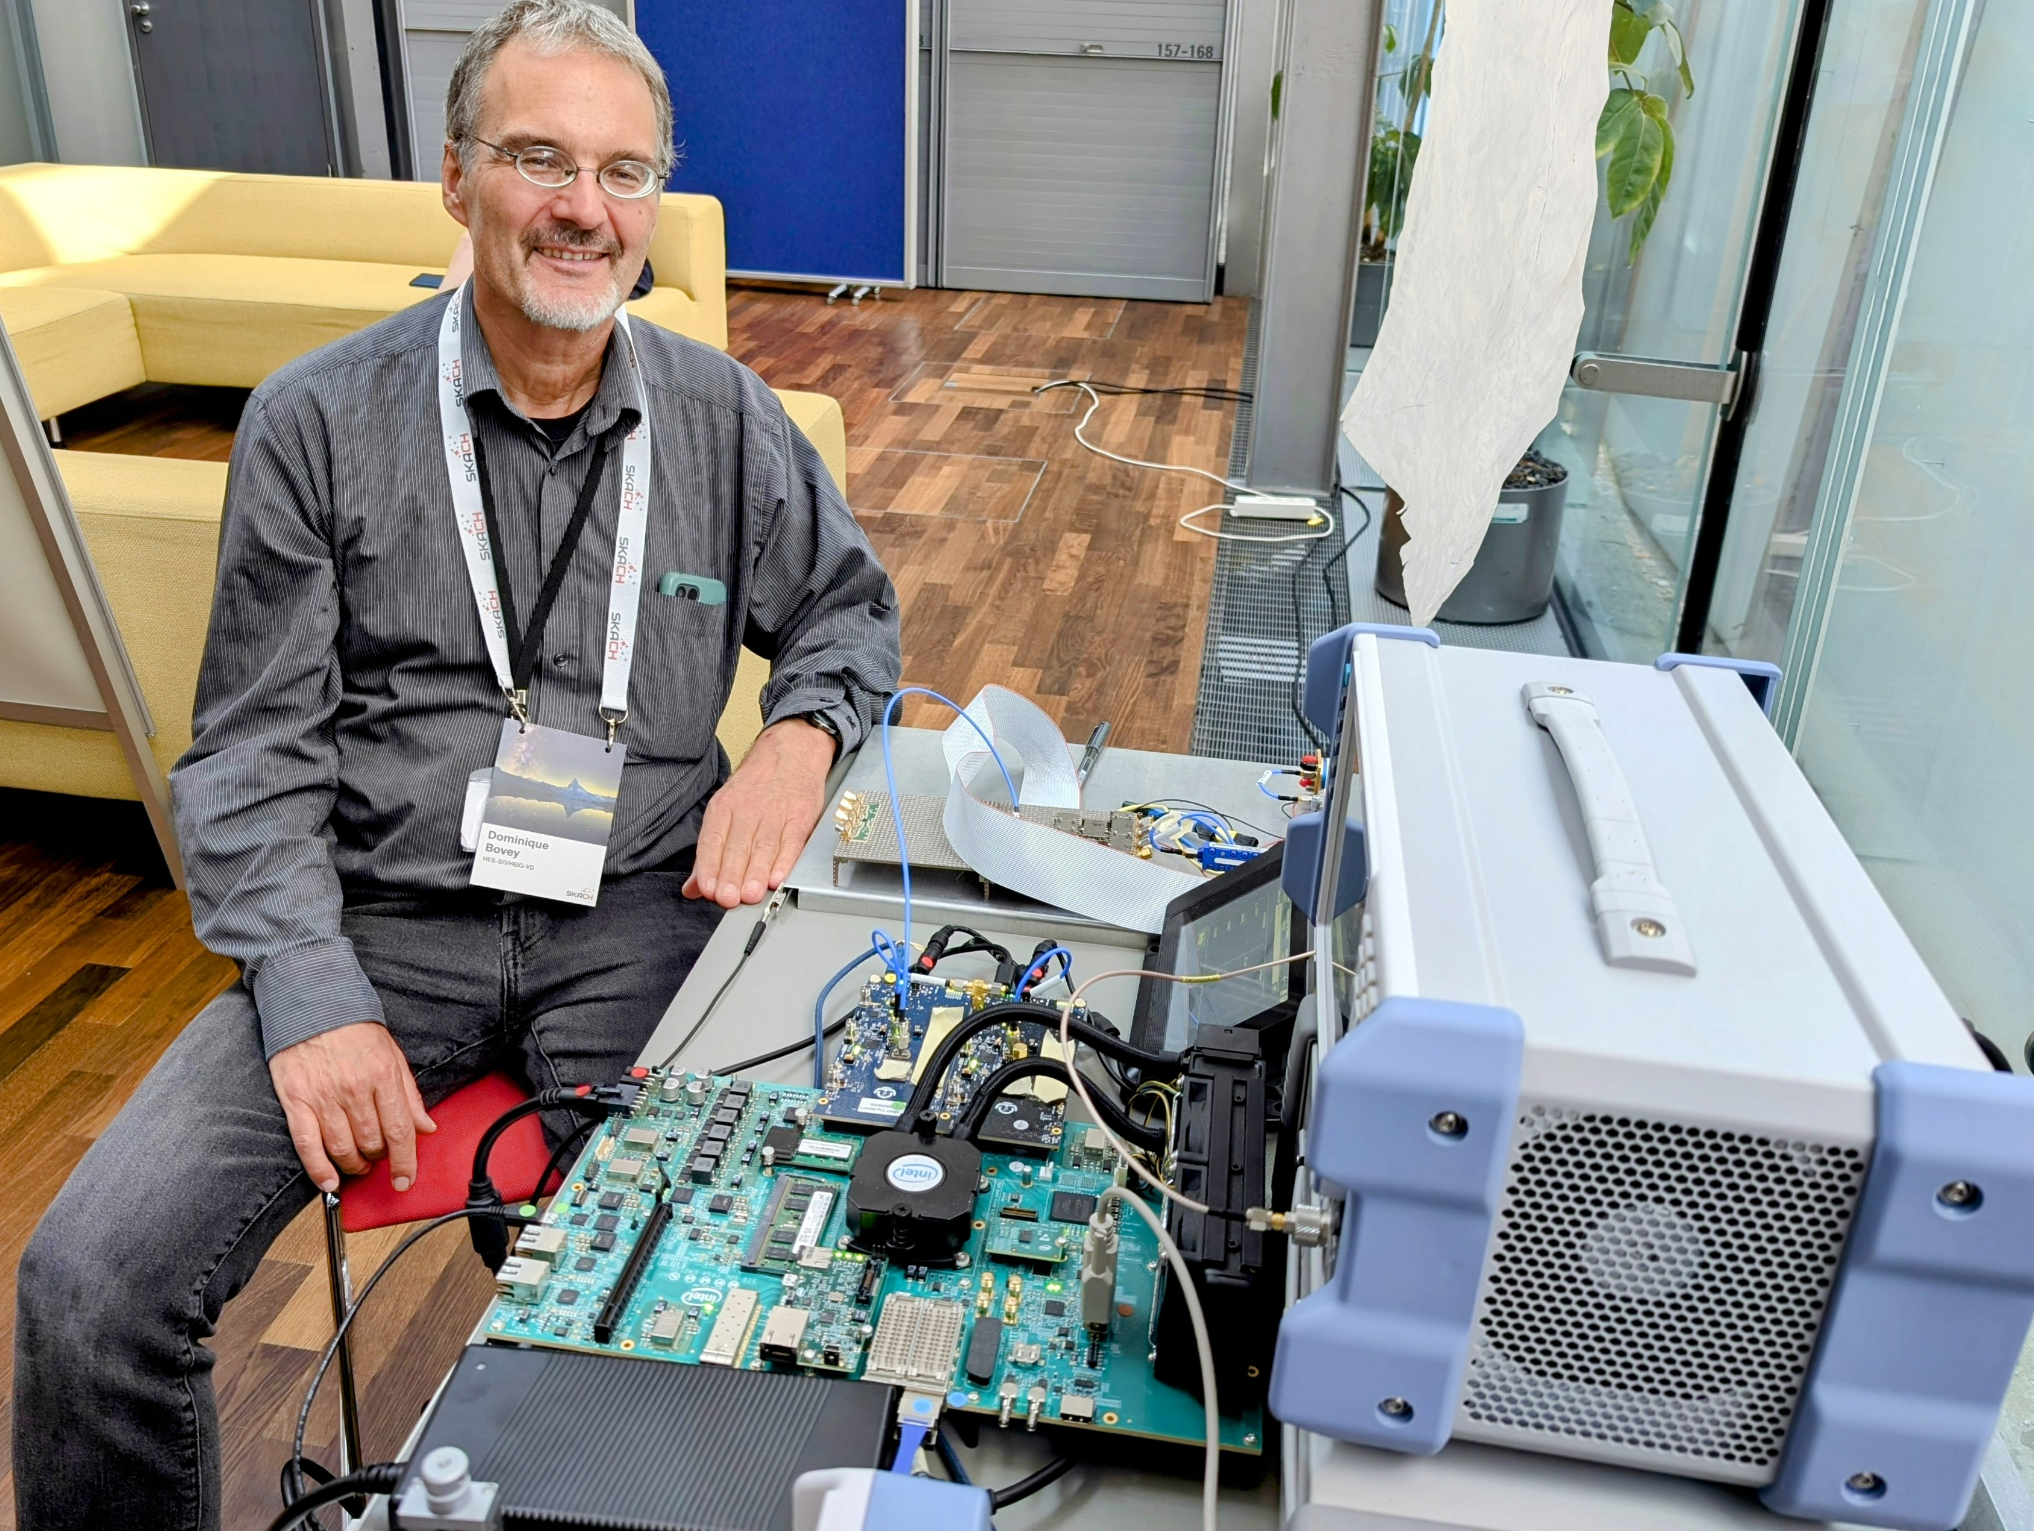

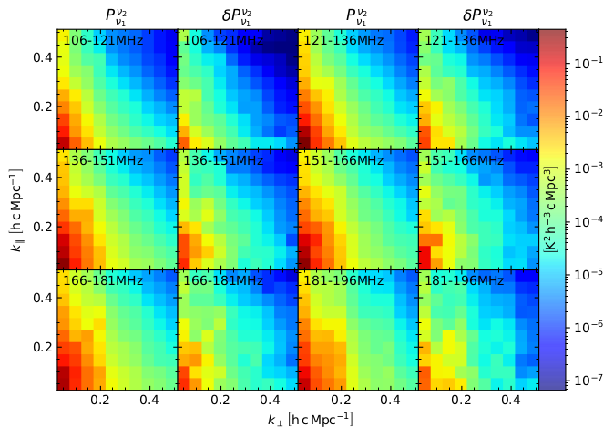
Visuals and summaries of consortium members’ work and contributions
Liaise with all consortium members to set a timetable for visits to gather video and other content
Visits to SKACH consortium members to film and gather other content available

Slide 8
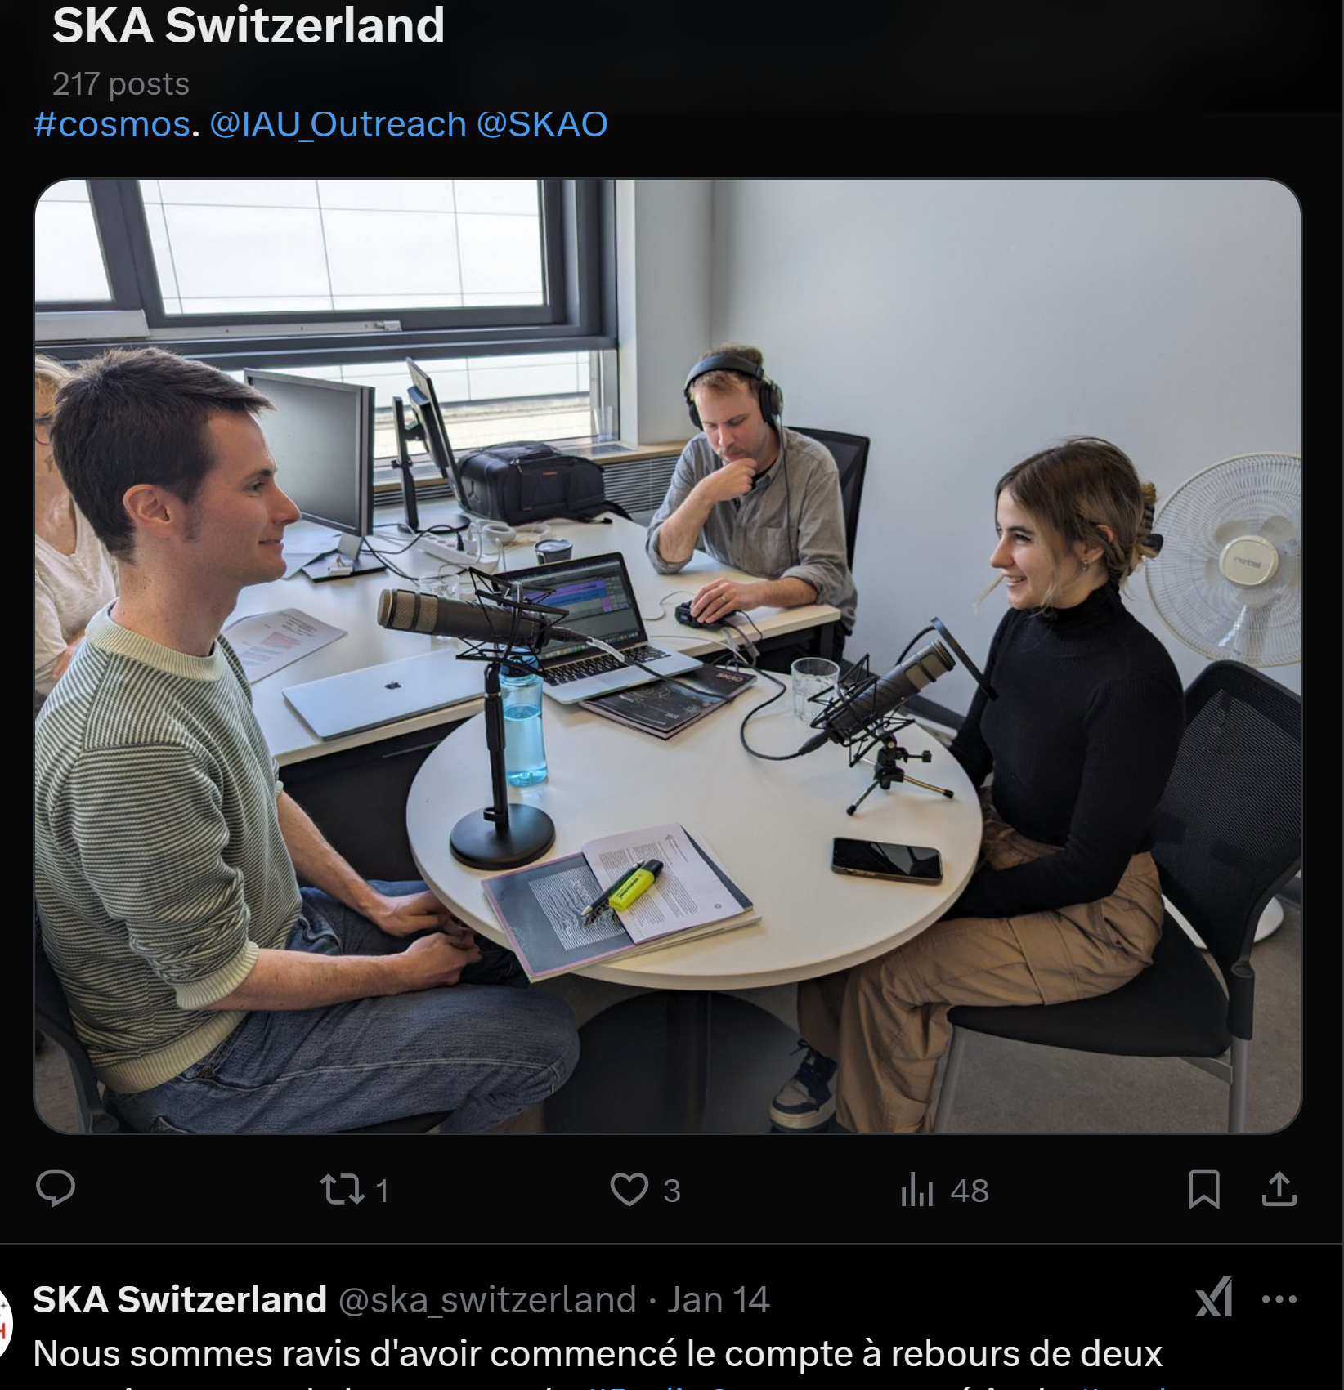
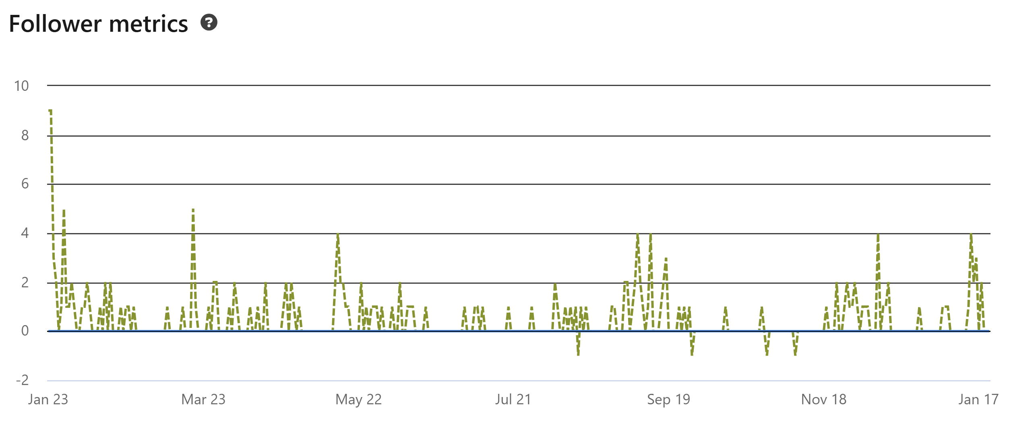
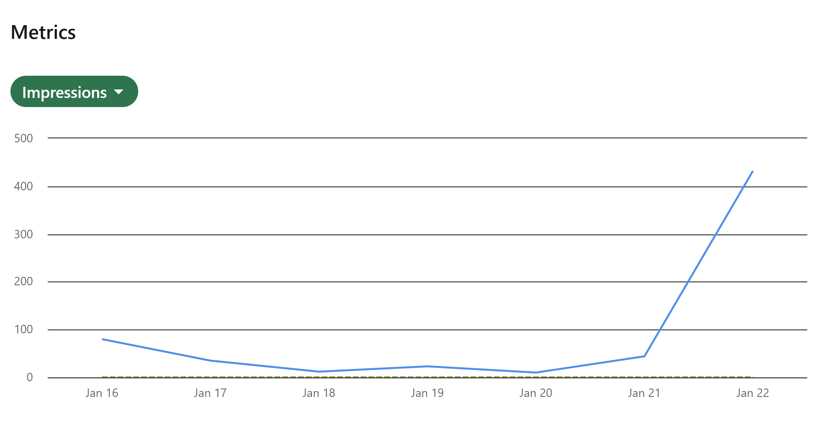
The Social Network Problem
SKACH Social Media:
LinkedIn - 571 followers, up 200 in 12 months
Twitter – 148 followers

Slide 9
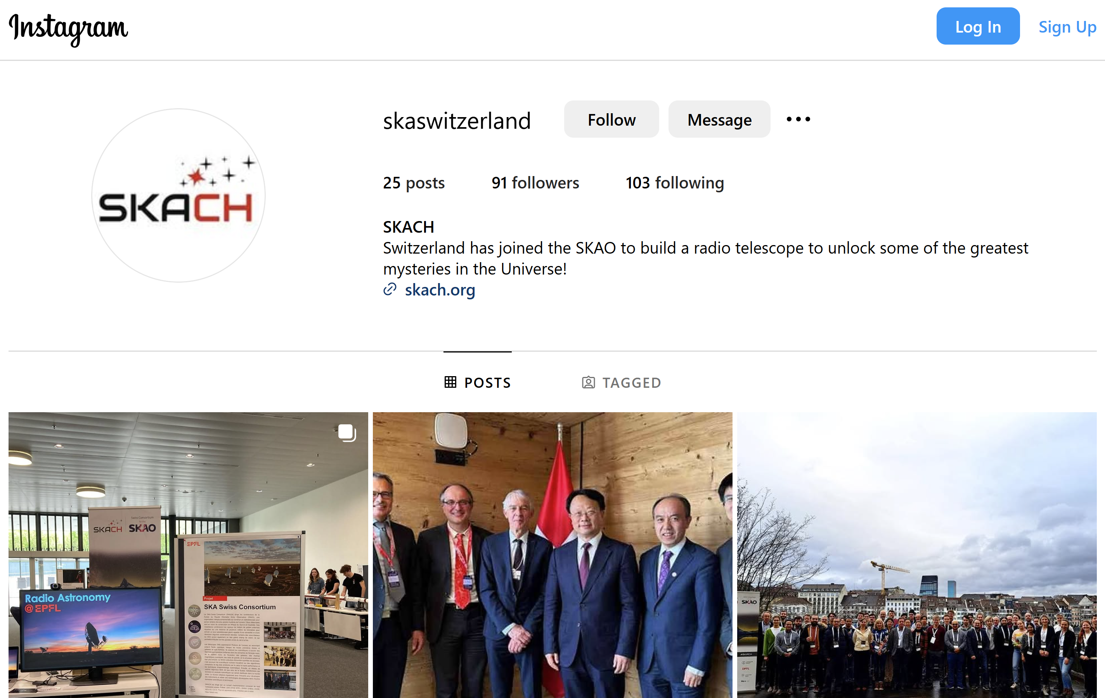


The Social Network Problem
Alternatives to X/Twitter

Slide 10
Communications and Outreach 2025-2026
How you can participate
Share any new research or story ideas
Feel free to use any SKACH resources that are developed
Facilitate a SKACH visit to your institution to gather content and meet key communications contacts
Help out at SKACH attended public events near you
Always get in touch if you need support or assistance

Slide 11
Questions?

