Slide 1
Karabo Update
SKA Digital Twin Pipeline
Simon Felix SKACH Winter Meeting January 27th 2025
Notes:
1

Slide 2
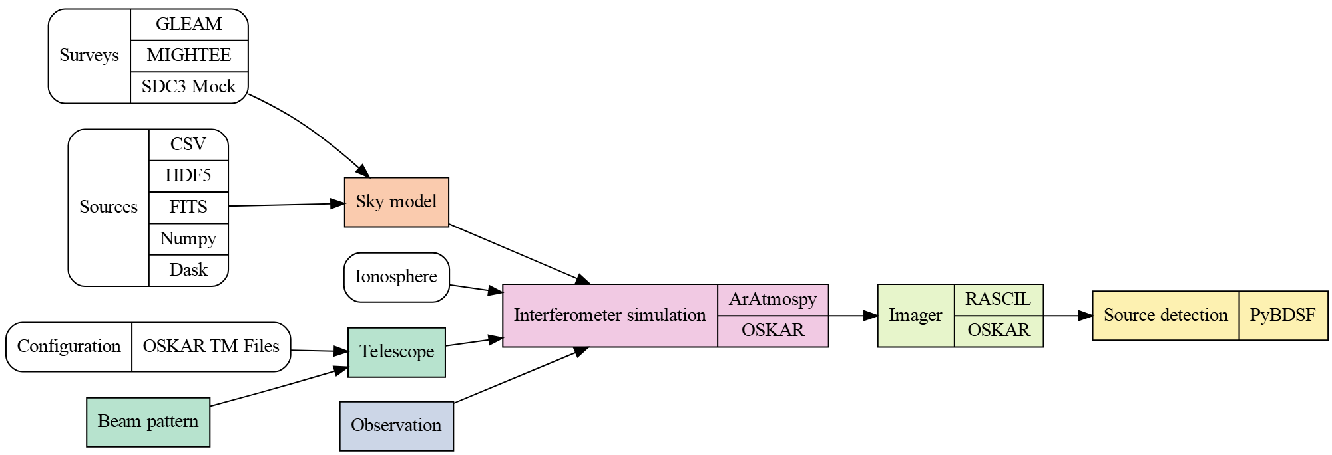
Karabo Architecture

Slide 3
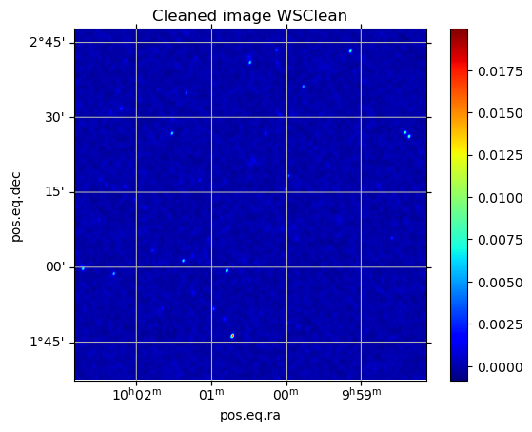
Updates
Support for IVOA ObsCore & RUCIO metadata
Added more telescope configurations (SKA, ALMA cycles 9-11)
Default to CASA Measurement Sets
Improved documentation
Better telescope handling in Oskar vs. RASCIL
Collaboration with SKAO operation scientists
→ Generated test data for SRCnet
Ran on PizDaint @ CSCS
Code in examples/SRCNet_v0.1_simulation*.py
Simulated with AA* SKA-MID AA* and MeerKAT
3+ TB Available in the SwissSRC

Slide 4
Outlook
Upgrade to Python 3.10 & libraries
Integration of Chris Finlay’s RFIsim
Better support for non-gaussian beams
Integration of casacore
Publication on the finish line
Future of RASCIL is unclear
WS CLEAN
OSKAR
Mosaicing
RFIsim
tools21cm
MIGHTEE

