Slide 1


The future of cosmological likelihood-based inference
Davide Piras (and many others)

Slide 2
But first… let me apologise
Notes:
Present you and work. Mention collaborators. Mention that you are open to questions, and that data science includes ML, etc.

Slide 3
But first… let me apologise
Last SKACH meeting was not too long ago…
Notes:
Present you and work. Mention collaborators. Mention that you are open to questions, and that data science includes ML, etc.

Slide 4
But first… let me apologise
Last SKACH meeting was not too long ago…
… hence results are somewhat incremental

Slide 5
But first… let me apologise
Last SKACH meeting was not too long ago…
… hence results are somewhat incremental
So please have some (new) jokes in return
Notes:
Present you and work. Mention collaborators. Mention that you are open to questions, and that data science includes ML, etc.

Slide 6
The future of cosmological likelihood-based inference
Davide Piras (and many others)

Slide 7
What do you mean with Bayesian inference?
inference

Slide 8
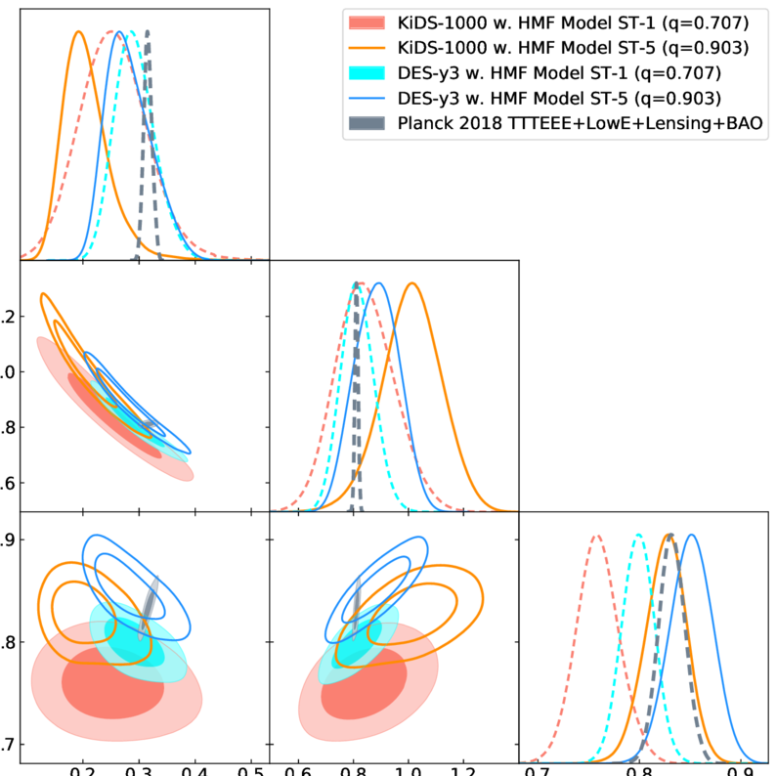
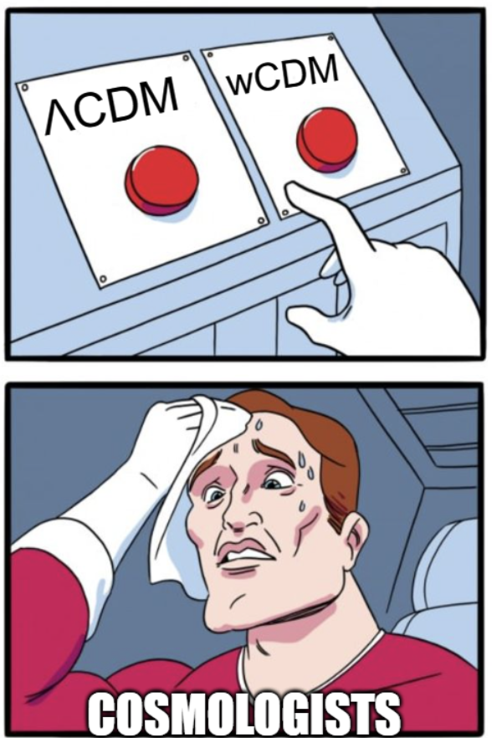
What do you mean with Bayesian inference?
Posterior contours Model selection

Slide 9
What do you mean with Bayesian inference?
Posterior contours
posterior = likelihood x prior
posterior =
evidence

Slide 10
What do you mean with Bayesian inference?
Posterior contours
posterior = likelihood x prior
posterior =
evidence

Slide 11
What do you mean with Bayesian inference?
Model selection
posterior = likelihood x prior
posterior =
evidence
Model with highest evidence is favoured

Slide 12
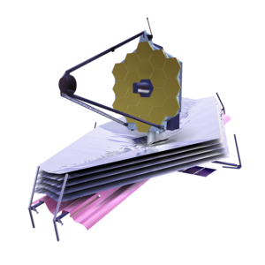
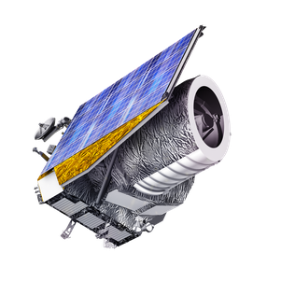
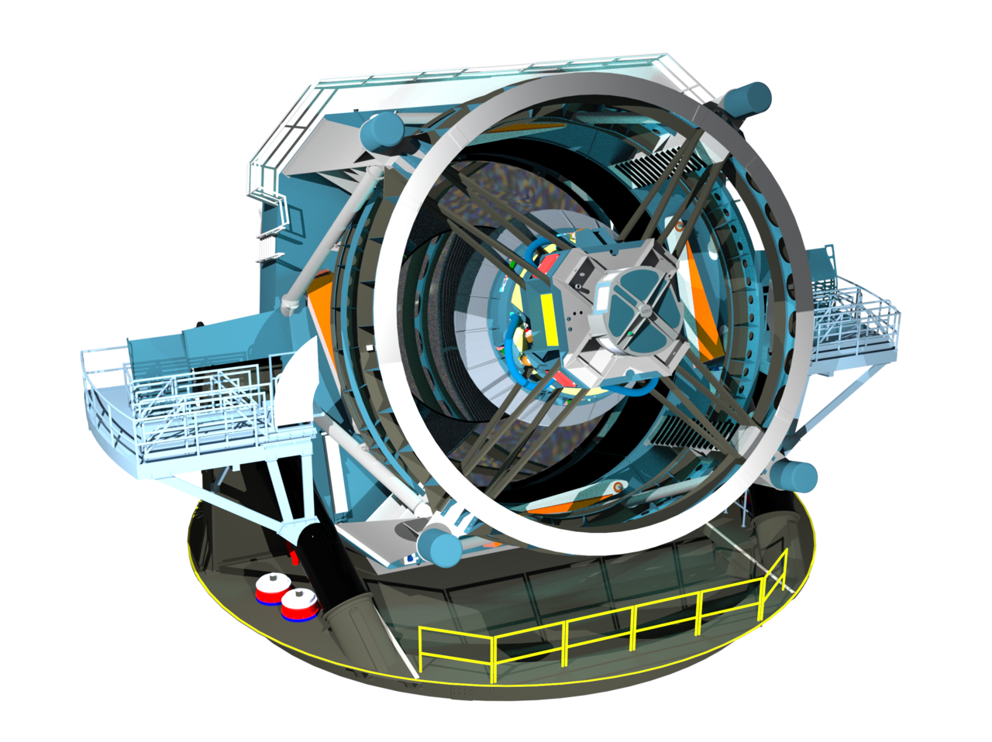
Big data incoming
JWST
Dec 2021
100 TB
Euclid
Jul 2023
>700 TB
Vera Rubin Observatory
Jul 2025
500000 TB
Notes:
Present you and work. Mention collaborators. Mention that you are open to questions, and that data science includes ML, etc.

Slide 13
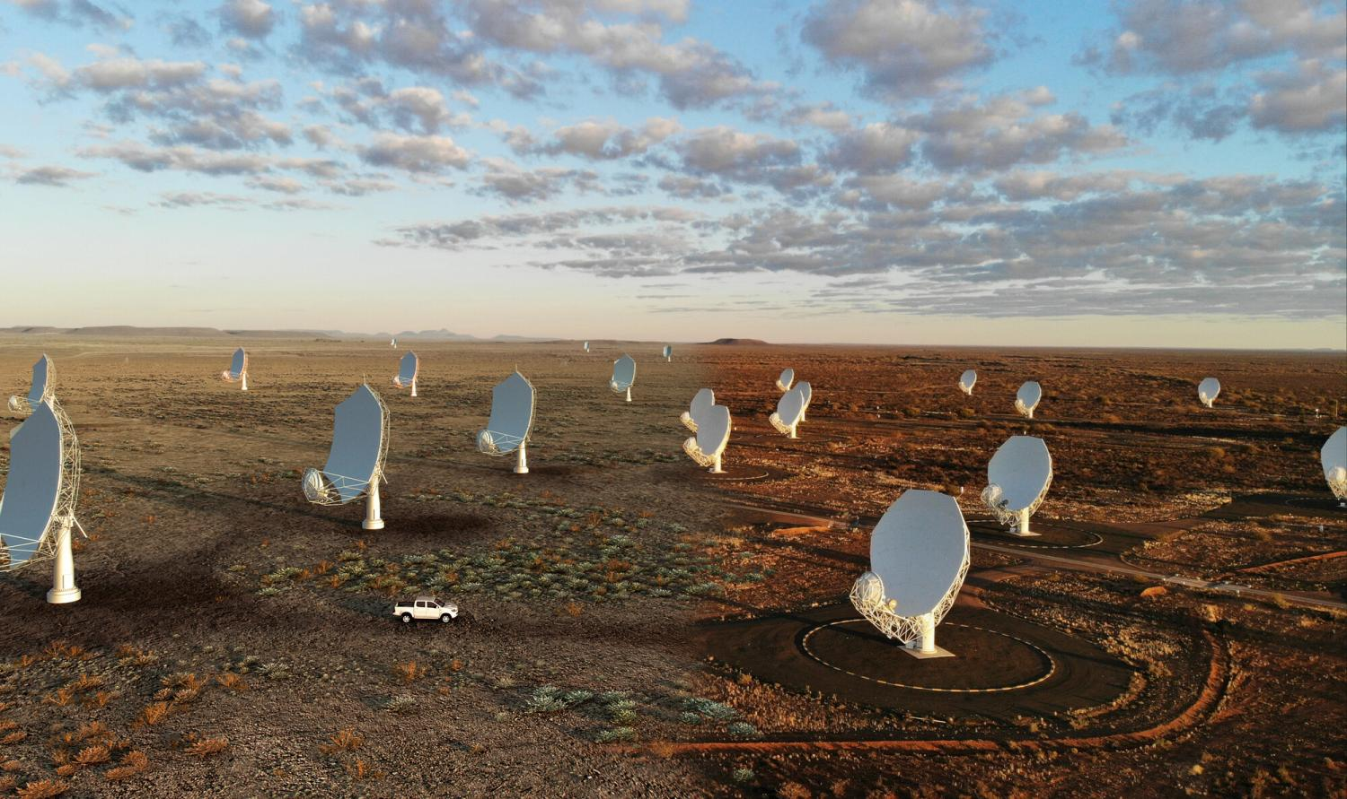
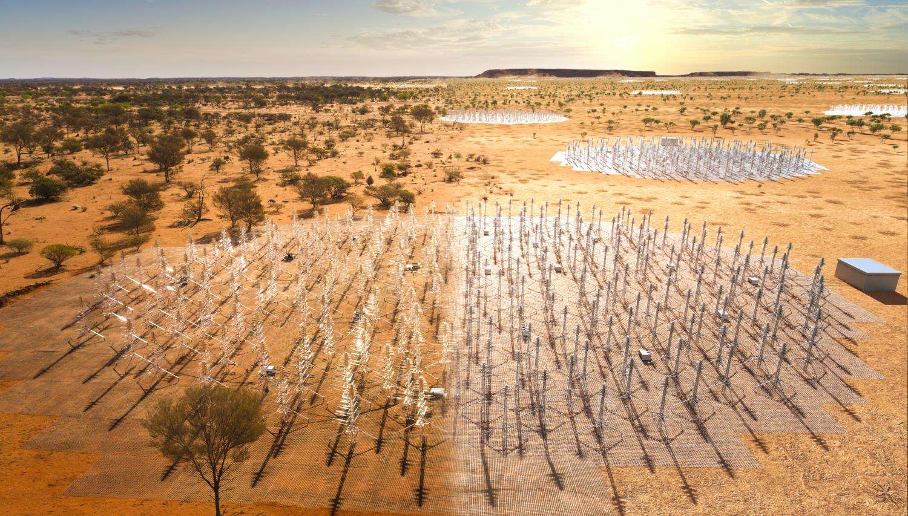
Big data incoming
JWST
Dec 2021
100 TB
Euclid
Jul 2023
>700 TB
SKA
2028?
40000000000 TB
Vera Rubin Observatory
Jul 2025
500000 TB
Notes:
Present you and work. Mention collaborators. Mention that you are open to questions, and that data science includes ML, etc.

Slide 14
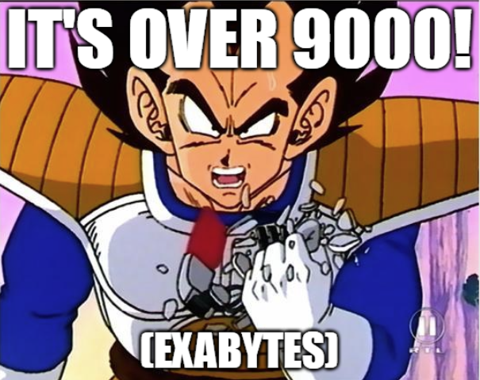
Big data incoming
Notes:
Present you and work. Mention collaborators. Mention that you are open to questions, and that data science includes ML, etc.

Slide 15
What do we need?
Accurate and precise pipeline

Slide 16
What do we need?
Accurate and precise pipeline
Fast pipeline

Slide 17
What do we need?
Accurate and precise pipeline
Fast pipeline
Robustness to different simulations and likelihoods

Slide 18

The future paradigm
emulation

Slide 19

CosmoPower: flexible emulation of
cosmological power spectra
Code available
Notes:
Present yourself. You are going to talk about generative methods in Cosmology, as the title suggests. Mention other people that work with you.

Slide 20
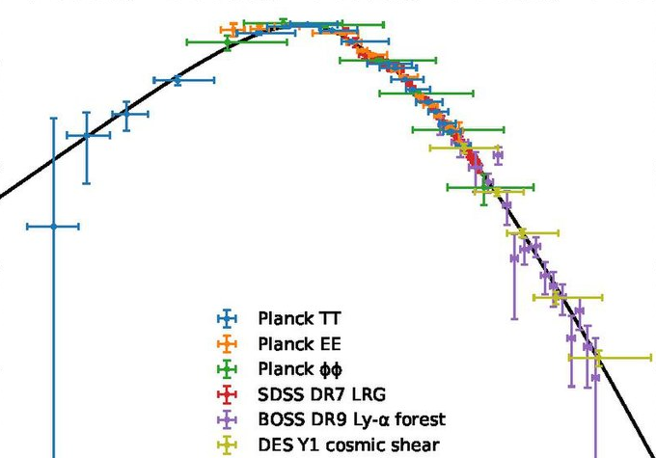
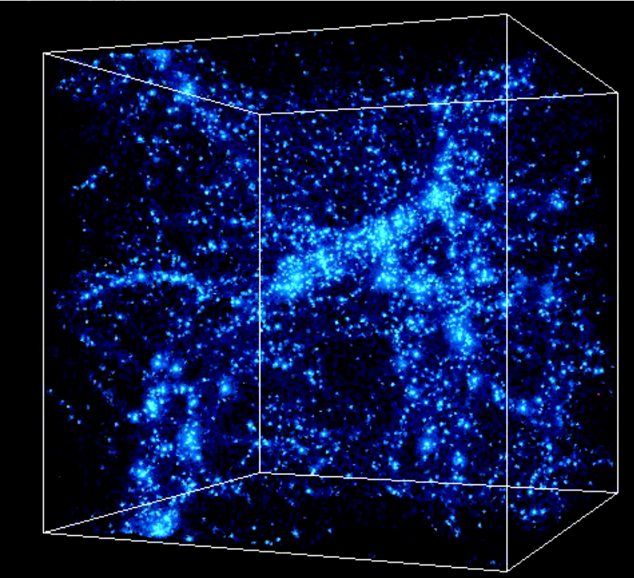

CosmoPower: flexible emulation of
cosmological power spectra
DISTILL
Theory
Measurements
Notes:
Present yourself. You are going to talk about generative methods in Cosmology, as the title suggests. Mention other people that work with you.

Slide 21
CosmoPower: flexible emulation of cosmological power spectra
Create labelled
training data
(
, ϴ)
Theory
cosmological parameters
Notes:
Present yourself. You are going to talk about generative methods in Cosmology, as the title suggests. Mention other people that work with you.

Slide 22
CosmoPower: flexible emulation of cosmological power spectra
Create labelled
training data
Train model
Theory
simple neural network
ϴ
Notes:
Present yourself. You are going to talk about generative methods in Cosmology, as the title suggests. Mention other people that work with you.

Slide 23
CosmoPower: flexible emulation of cosmological power spectra
Create labelled
training data
Train model
Plug trained model into likelihood
Notes:
Present yourself. You are going to talk about generative methods in Cosmology, as the title suggests. Mention other people that work with you.

Slide 24
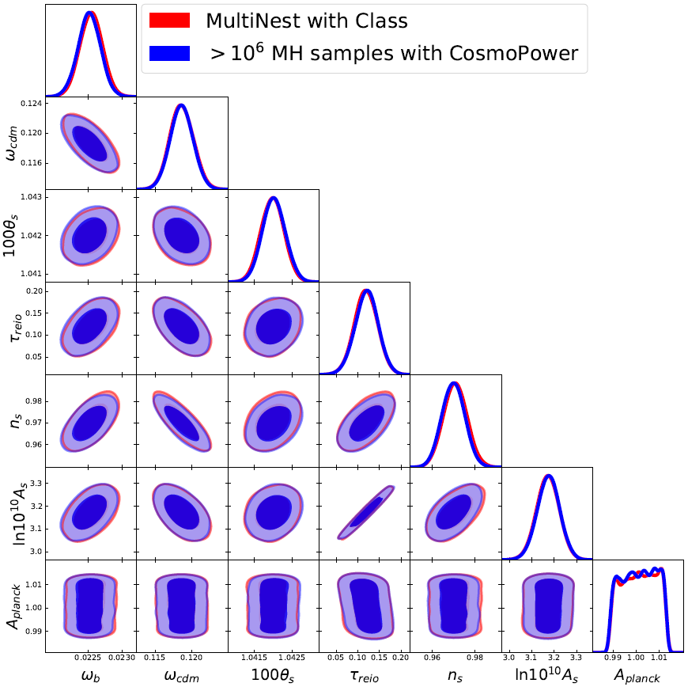
CosmoPower: flexible emulation of cosmological power spectra
Standard analysis (48 CPUs, few hours)
CosmoPower (1 GPU, 15 seconds)
Planck 2018
Spurio Mancini, Piras et al., MNRAS, 2021
Notes:
Present yourself. You are going to talk about generative methods in Cosmology, as the title suggests. Mention other people that work with you.

Slide 25

The future paradigm
emulation
+
differentiable programming

Slide 26

CosmoPower-JAX
JAX implementation of CosmoPower
+
=
Code available
Notes:
Present yourself. You are going to talk about generative methods in Cosmology, as the title suggests. Mention other people that work with you.

Slide 27
What is JAX?
Latest Google framework for machine learning
Notes:
Present yourself. You are going to talk about generative methods in Cosmology, as the title suggests. Mention other people that work with you.

Slide 28
What is JAX?
Latest Google framework for machine learning
Allows for fast automatic differentiation on GPU
Notes:
Present yourself. You are going to talk about generative methods in Cosmology, as the title suggests. Mention other people that work with you.

Slide 29
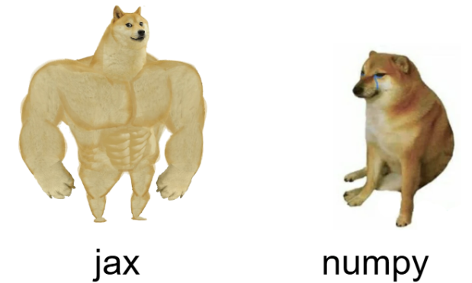
What is JAX?
Latest Google framework for machine learning
Allows for fast automatic differentiation on GPU
Essentially, NumPy on steroids
Notes:
Present yourself. You are going to talk about generative methods in Cosmology, as the title suggests. Mention other people that work with you.

Slide 30
CosmoPower-JAX
JAX implementation of CosmoPower
Can run Hamiltonian Monte Carlo
+
=
Notes:
Present yourself. You are going to talk about generative methods in Cosmology, as the title suggests. Mention other people that work with you.

Slide 31
CosmoPower-JAX
JAX implementation of CosmoPower
Can run Hamiltonian Monte Carlo
+
=
Hamiltonian Monte Carlo relies on derivatives of the likelihood
Notes:
Present yourself. You are going to talk about generative methods in Cosmology, as the title suggests. Mention other people that work with you.

Slide 32

The future paradigm
emulation
+
differentiable programming
+
gradient-based samplers

Slide 33
Next-generation survey analysis in JAX
Notes:
Present yourself. You are going to talk about generative methods in Cosmology, as the title suggests. Mention other people that work with you.

Slide 34
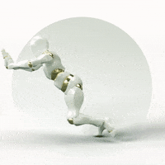
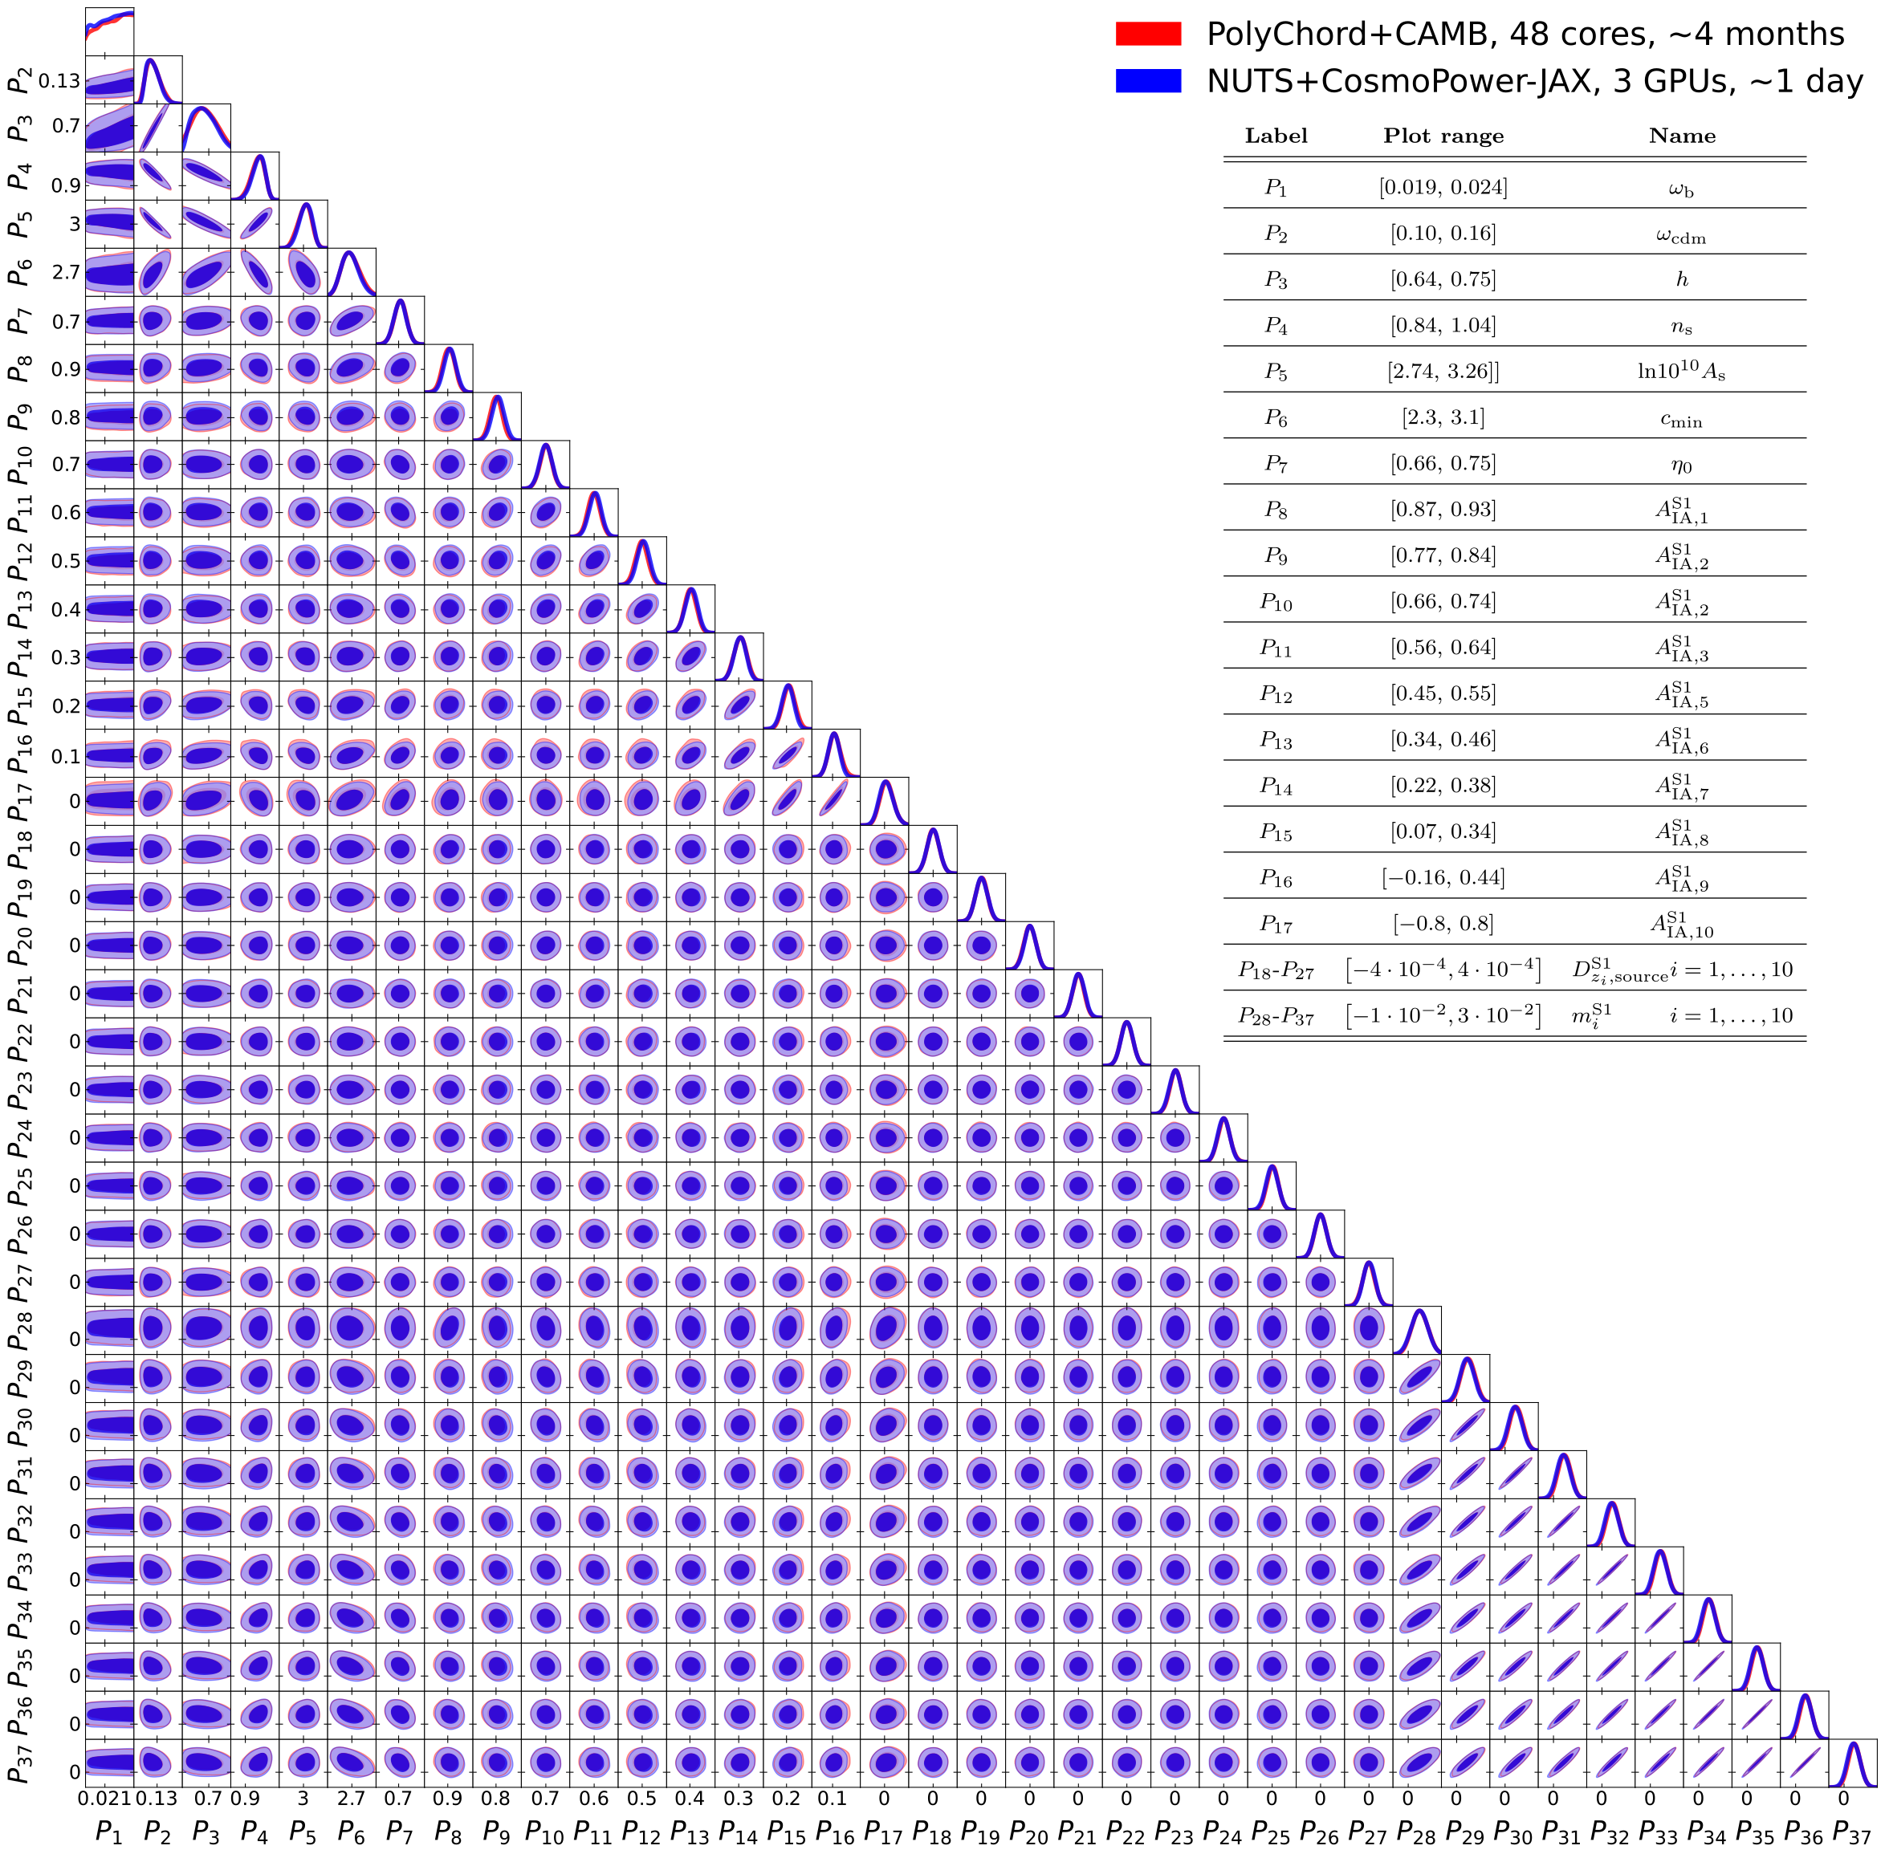
Next-generation survey analysis in JAX
Standard MCMC (48 CPUs, 4 months)
Hamiltonian MC + JAX emulator (3 GPUs, 1 day)
Cosmological parameters
Standard MCMC (cobaya, 48 cores, 4 months)
Hamiltonian MC (JAX emulator, 3 GPUs, 1 day)
Cosmic shear
(37 parameters)
Intrinsic alignment
Cosmic shear only
(37 parameters)
Redshift shift
Multiplication bias
Notes:
Present yourself. You are going to talk about generative methods in Cosmology, as the title suggests. Mention other people that work with you.

Slide 35

Joint survey analysis in JAX
Standard MCMC (48 CPUs, about 6 years)
Hamiltonian MC + JAX emulator (3 GPUs, 3 days)
3x(3x2)points statistics analysis:
157 parameters!
Piras & Spurio Mancini, Open Journal of Astrophysics, 2023
Notes:
Present yourself. You are going to talk about generative methods in Cosmology, as the title suggests. Mention other people that work with you.

Slide 36


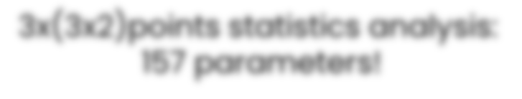
Standard MCMC (48 CPUs, about 6 years)
Hamiltonian MC + JAX emulator (3 GPUs, 3 days)
Notes:
Present yourself. You are going to talk about generative methods in Cosmology, as the title suggests. Mention other people that work with you.

Slide 37

Standard MCMC (48 CPUs, about 6 years)
Hamiltonian MC + JAX emulator (3 GPUs, 3 days)
Notes:
Present yourself. You are going to talk about generative methods in Cosmology, as the title suggests. Mention other people that work with you.

Slide 38
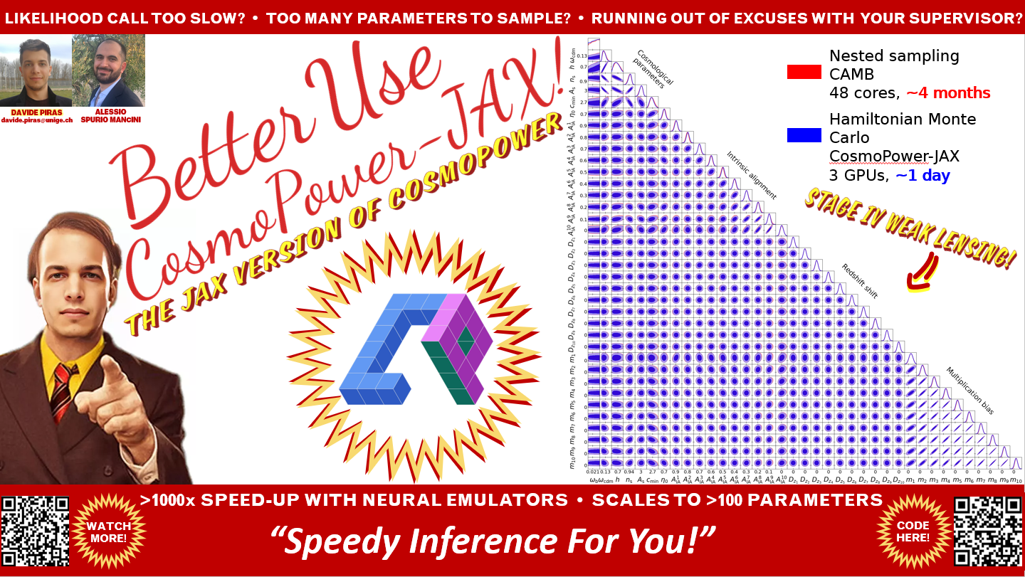

Slide 39

The future paradigm
emulation
+
differentiable programming
+
gradient-based samplers
+
harmonic

Slide 40
What about model selection?
Estimate Bayesian evidence with harmonic
Notes:
Present yourself. You are going to talk about generative methods in Cosmology, as the title suggests. Mention other people that work with you.

Slide 41
What about model selection?
Estimate Bayesian evidence with harmonic
Based on harmonic mean estimator + normalizing flows
Notes:
Present yourself. You are going to talk about generative methods in Cosmology, as the title suggests. Mention other people that work with you.

Slide 42
What about model selection?
Estimate Bayesian evidence with harmonic
Based on harmonic mean estimator + normalizing flows
Robust and scalable code publicly available
Notes:
Present yourself. You are going to talk about generative methods in Cosmology, as the title suggests. Mention other people that work with you.

Slide 43
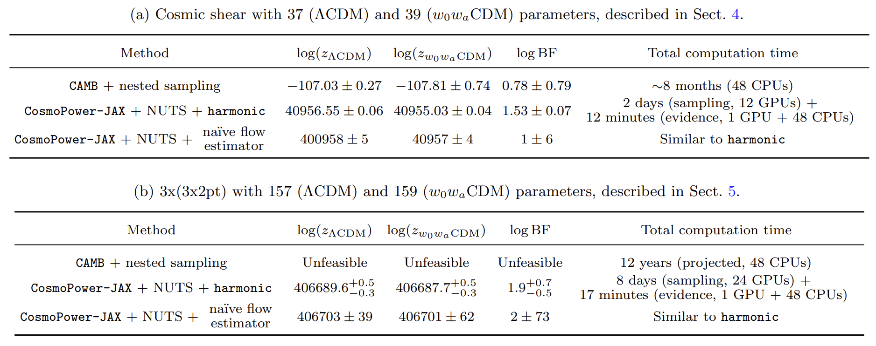
What about model selection?
Piras et al., Open Journal of Astrophysics, 2024
Notes:
Present yourself. You are going to talk about generative methods in Cosmology, as the title suggests. Mention other people that work with you.

Slide 44
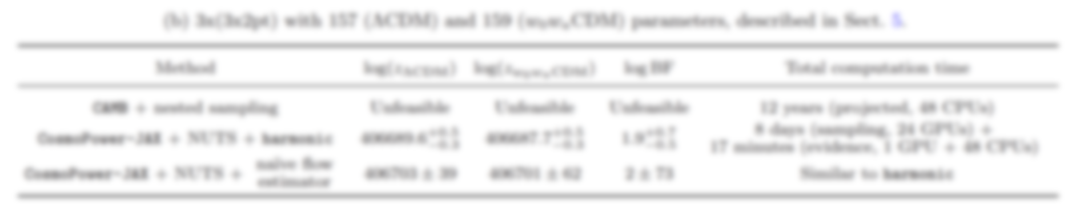
What about model selection?
Piras et al., Open Journal of Astrophysics, 2024
Notes:
Present yourself. You are going to talk about generative methods in Cosmology, as the title suggests. Mention other people that work with you.

Slide 45
The future of model selection
Extension based on Savage-Dickey density ratio incoming!
Notes:
Present yourself. You are going to talk about generative methods in Cosmology, as the title suggests. Mention other people that work with you.

Slide 46
The future of model selection
Extension based on Savage-Dickey density ratio incoming!
More practical for nested models
Notes:
Present yourself. You are going to talk about generative methods in Cosmology, as the title suggests. Mention other people that work with you.

Slide 47
Conclusions

Slide 48
Conclusions
emulation

Slide 49
Conclusions
emulation
+
differentiable programming

Slide 50
Conclusions
emulation
+
differentiable programming
+
gradient-based samplers

Slide 51
Conclusions
emulation
+
differentiable programming
+
gradient-based samplers
+
harmonic

Slide 52
Conclusions
emulation
+
differentiable programming
+
gradient-based samplers
+
harmonic
=
the future of likelihood-based inference
Happy to collaborate!

Slide 53


Slide 54
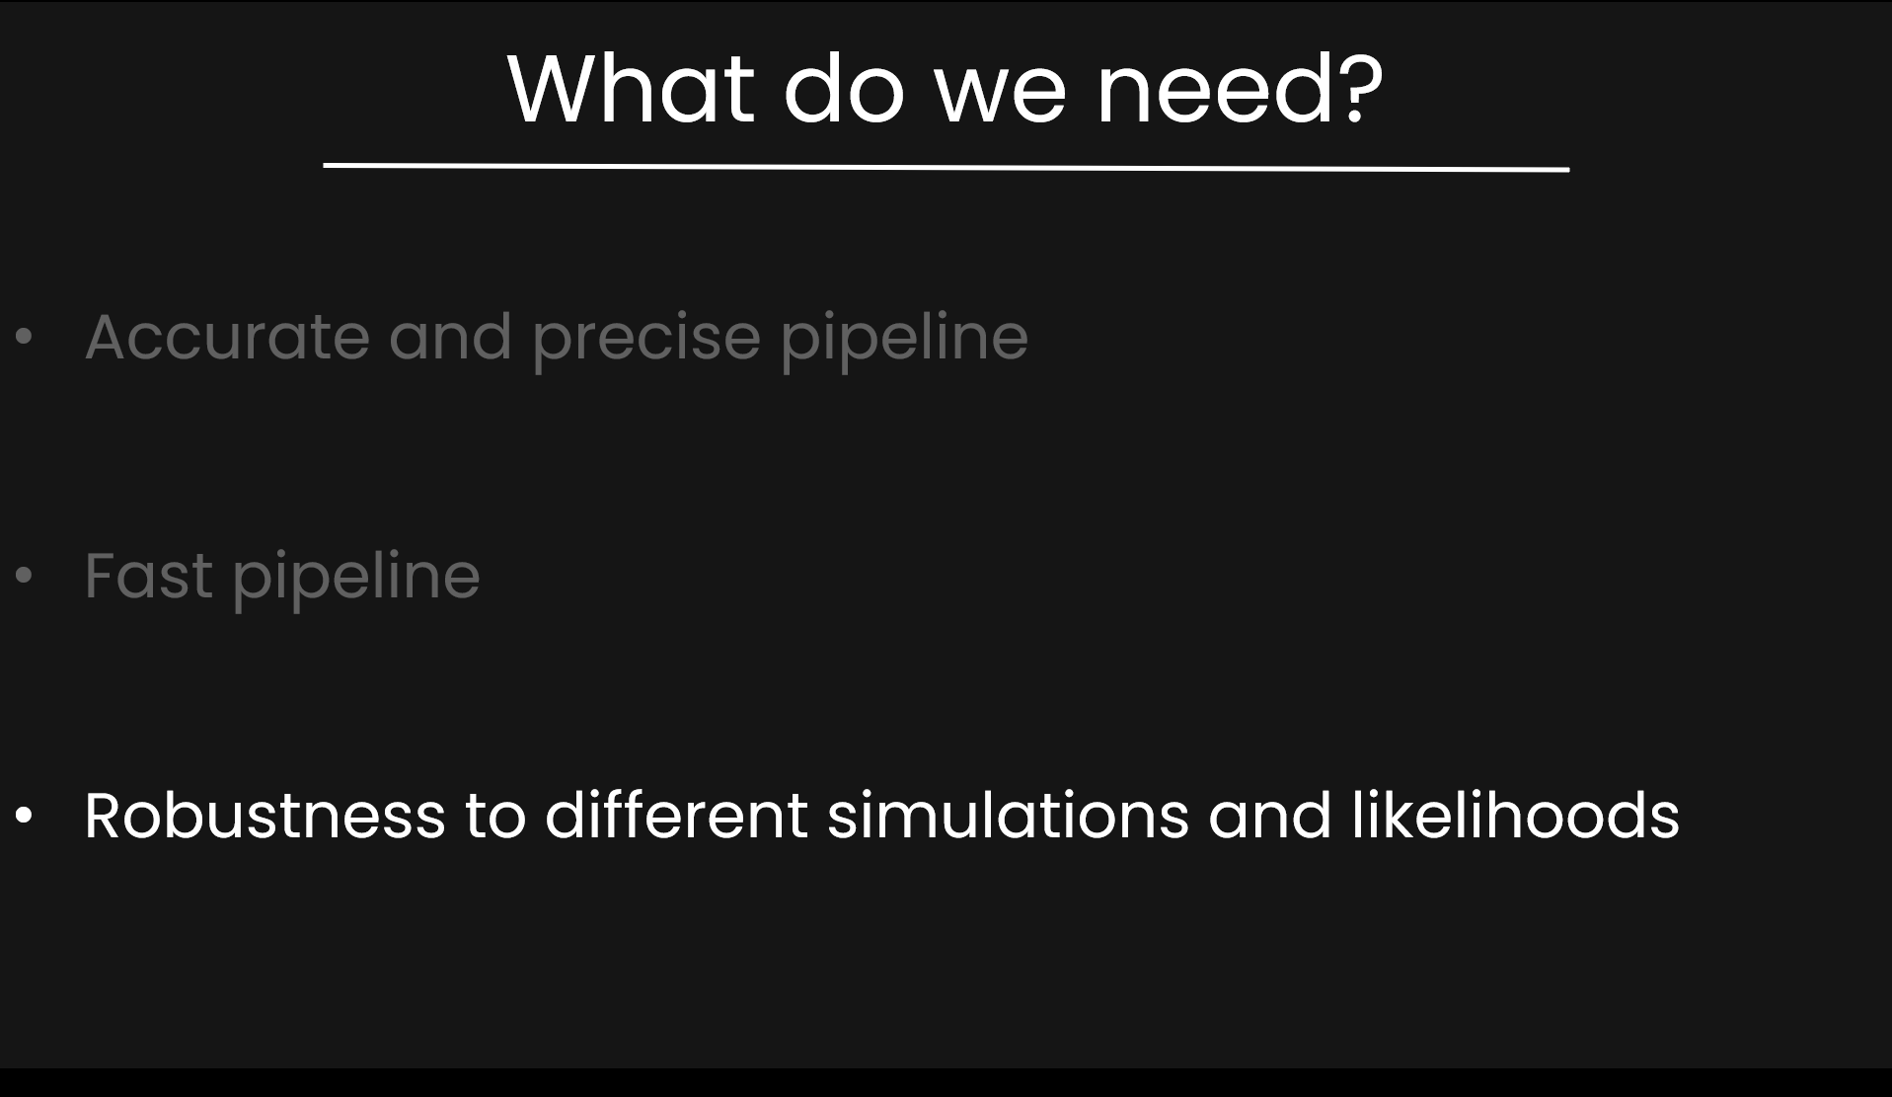

Slide 55
Robustness to different simulations and likelihoods
Train on multiple simulations with domain adaptation

Slide 56
Robustness to different simulations and likelihoods
Train on multiple simulations with domain adaptation
Implement simulation-based inference (SBI)

Slide 57
Robustness to different simulations and likelihoods
Train on multiple simulations with domain adaptation
Implement simulation-based inference (SBI)
Work in progress (hopefully)!
Happy to collaborate!

Slide 58
Extra slides

Slide 59



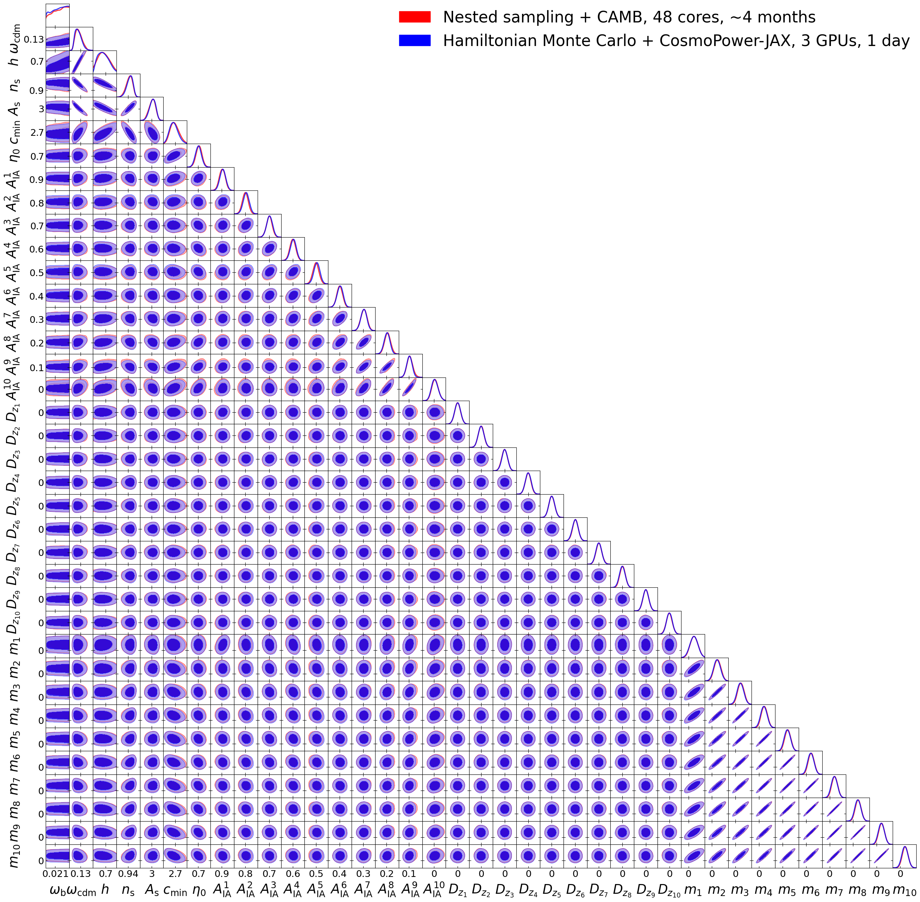






LIKELIHOOD CALL TOO SLOW? • TOO MANY PARAMETERS TO SAMPLE? • RUNNING OUT OF EXCUSES WITH YOUR SUPERVISOR?
Nested sampling
CAMB
48 cores, ~4 months
Hamiltonian Monte Carlo
CosmoPower-JAX
3 GPUs, ~1 day
Cosmological parameters
DAVIDE PIRAS
davide.piras@unige.ch
ALESSIO
SPURIO MANCINI
Intrinsic alignment
Redshift shift
Multiplication bias
>1000x SPEED-UP WITH NEURAL EMULATORS • SCALES TO >100 PARAMETERS
“Speedy Inference For You!”
WATCH MORE!
CODE HERE!

