Slide 1
SWISS: Huckleberry Thums, Chris Finlay, Emma Tolley
AUSTRALIA: Dylan Grigg, Steven Tingay
27th January 2025
First Demonstration of TABASCAL
on Real Data

Slide 2
Outline of this presentation
1
Introduction
3
Simulations
Satellites (Starlink)
Impact of Radio Astronomy
RFI subtraction on simulated data.
2
Methods & theory
4
Real Data
Datasets
tabascal theory
RFI subtraction on real data from the EDA2 telescope.

Slide 3
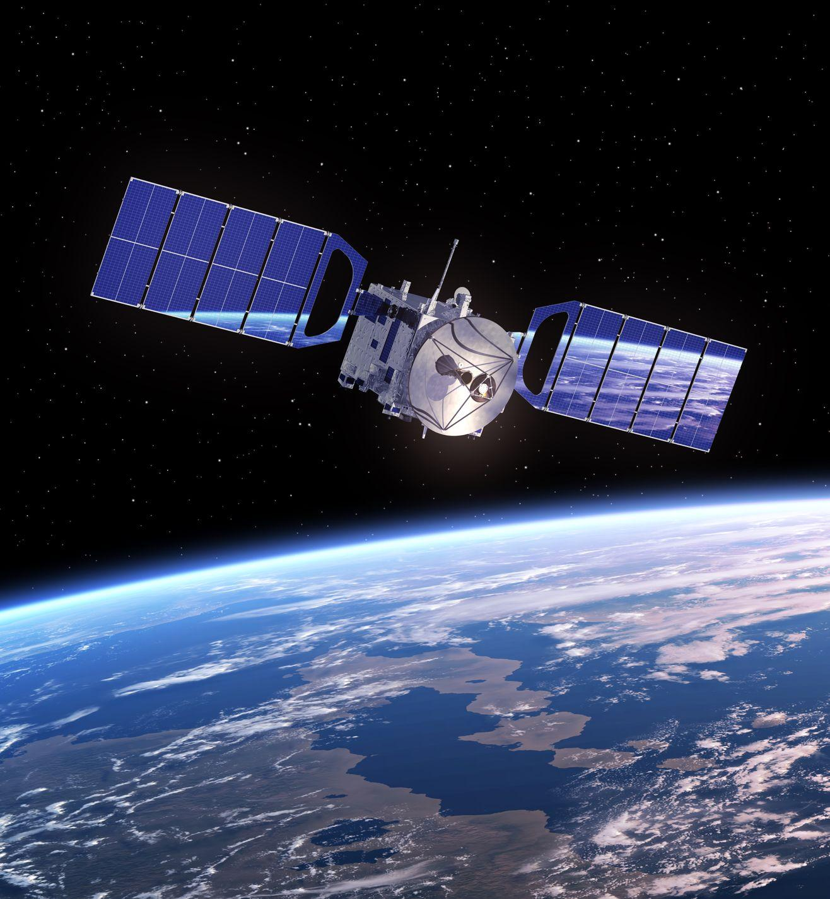
INTRODUCTION & BACKGROUND
Satellites
Impacts on Radio Astronomy
Image source: pixalytics.com
1

Slide 4
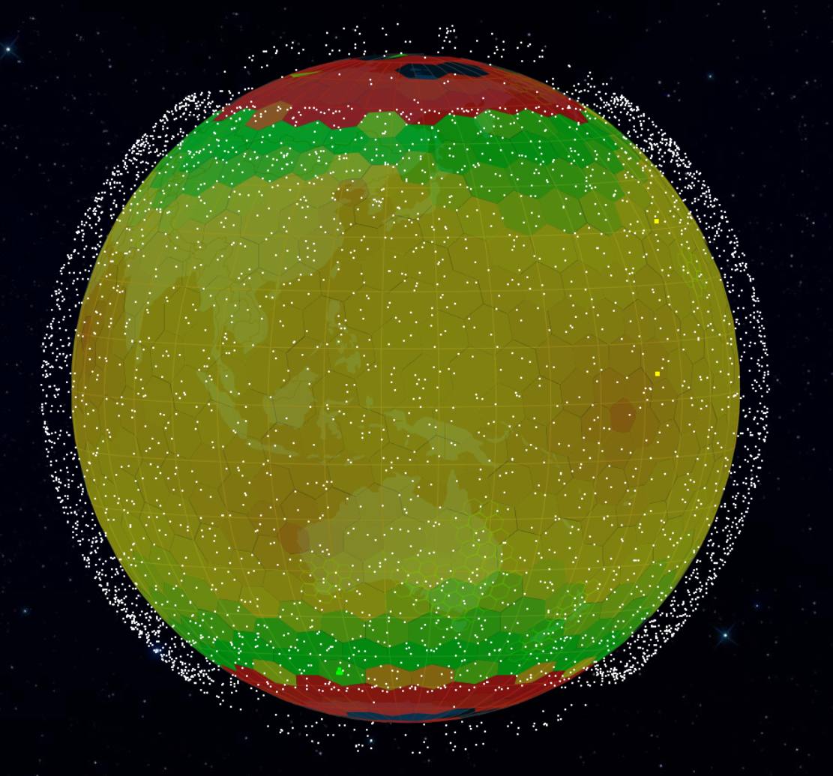
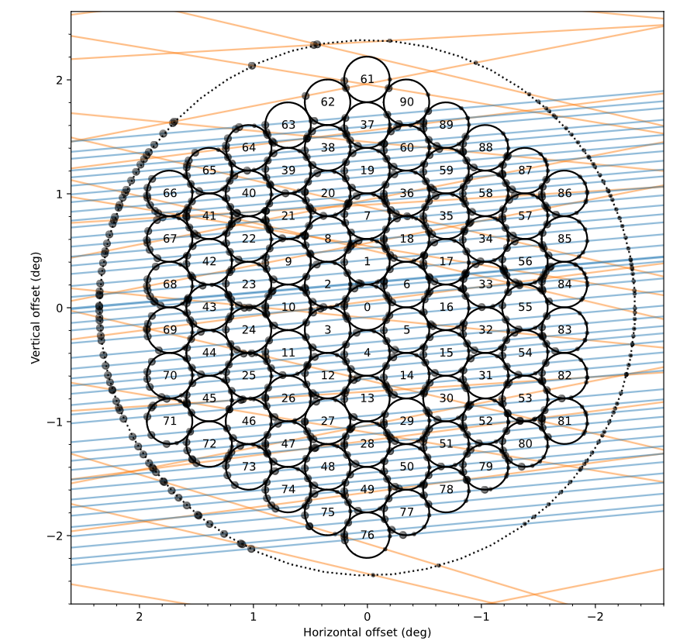
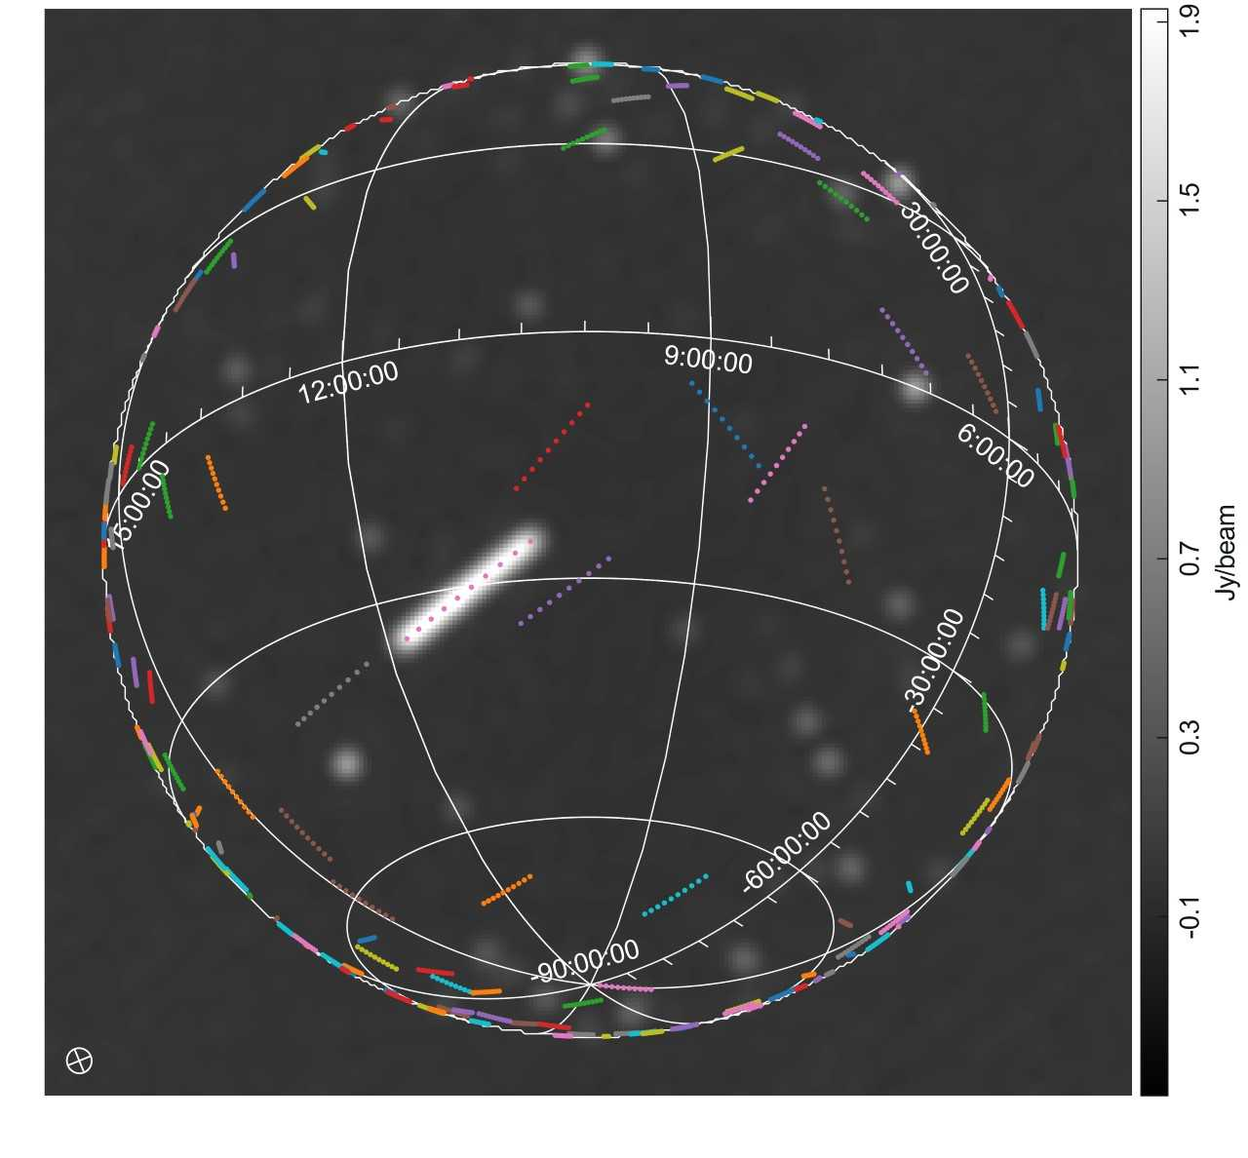
Satellites
Left: Starlink map taken on 2024-12-14
Bottom: Starlink tracks over the LOFAR core station (left) and simulated data with satellite predicted positions (right)
satellitemap.space
F. Di Vruno et al. (2023)
2

Slide 5
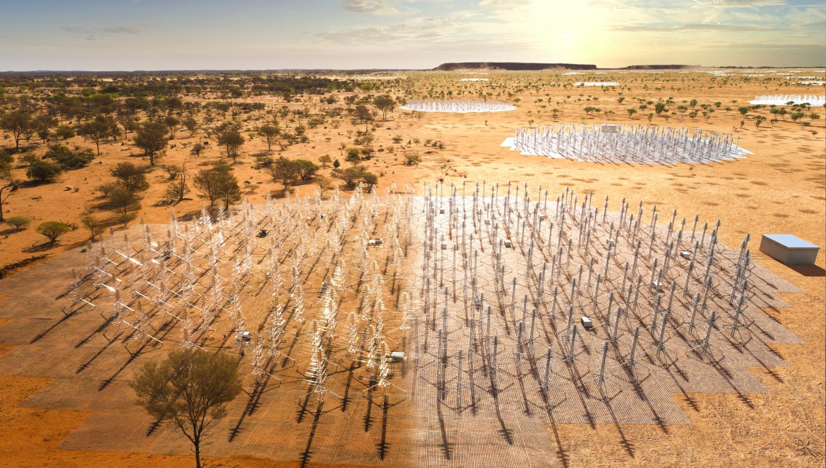
Case of the SKA-Low
SKA-Low frequency range: 50 MHz - 350 MHz
Protected bands within this range: 73 - 74.6 MHz, 150.05 - 153 MHz, 225 - 235 MHz, 322 - 328.6 MHz
UEMR found in protected bands (Bassa 2024), (Di Vruno 2023),
skao.int
3

Slide 6
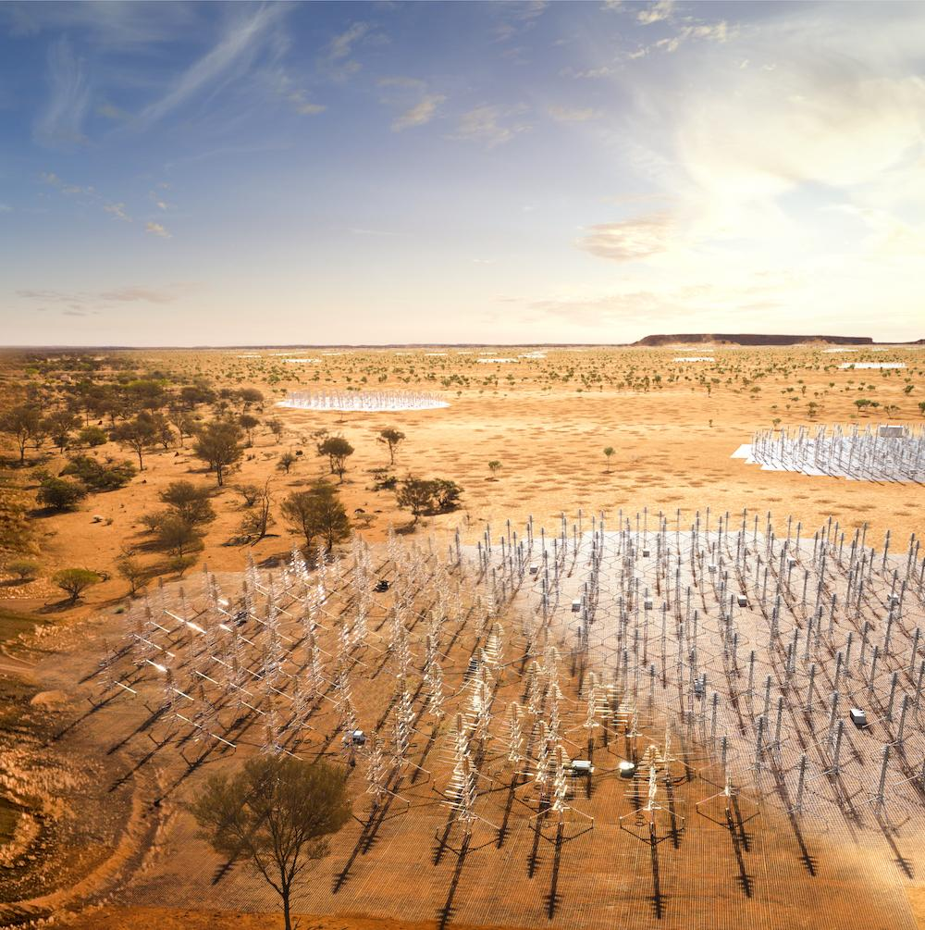
METHODS
Dataset
TABASCAL theory
Image source: skao.int
4

Slide 7
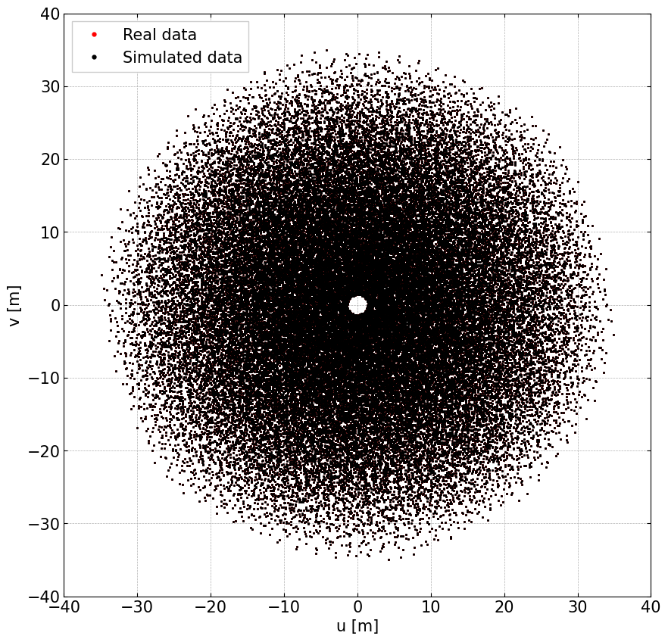
The Simulated and Real Data
EDA2 telescope
20 s whole-sky observation containing 10 time steps
Single frequency of 160.1563 MHz, 781.25 kHz bandwidth
UEMR detected at 159.4 MHz from the Starlink satellite NORAD 55695
Right: plot of the baseline coordinates
5

Slide 8
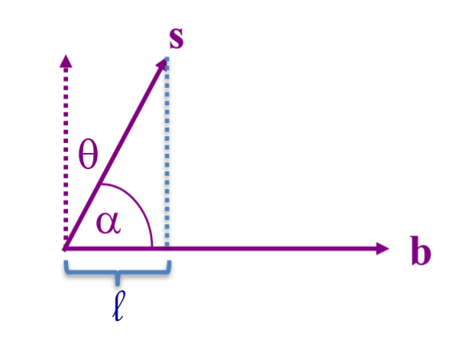
TABASCAL: Basic Theory
Radio interferometry data: visibilities
Bayesian inference
Likelihood:
Posterior
Product of the priors (assumed independent)
Normalisation (evidence)
6

Slide 9
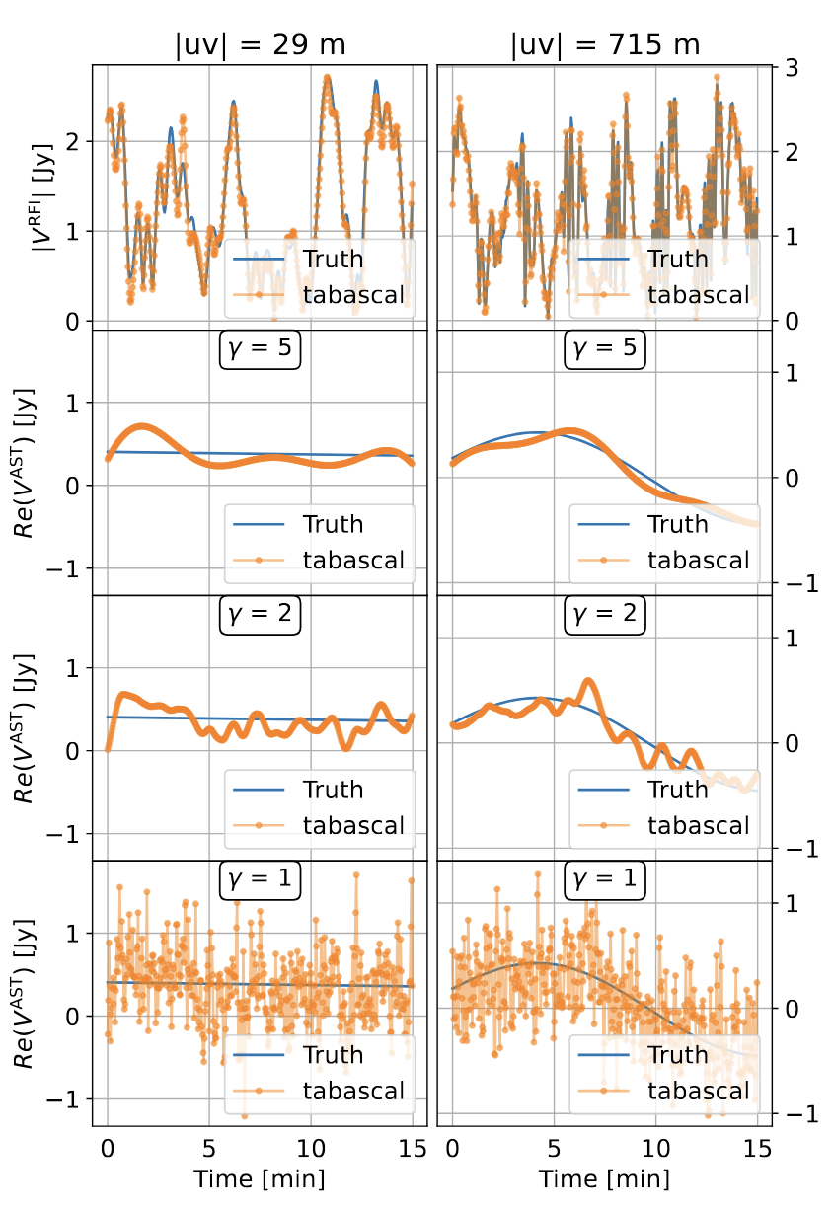
TABASCAL: Basic Theory
Each signal (astronomical, gains, RFI) is modeled as a Gaussian process
Astronomical visibility model
Prior:
Power spectrum:
Satellite trajectories modeled with TLEs using SGP4
7

Slide 10
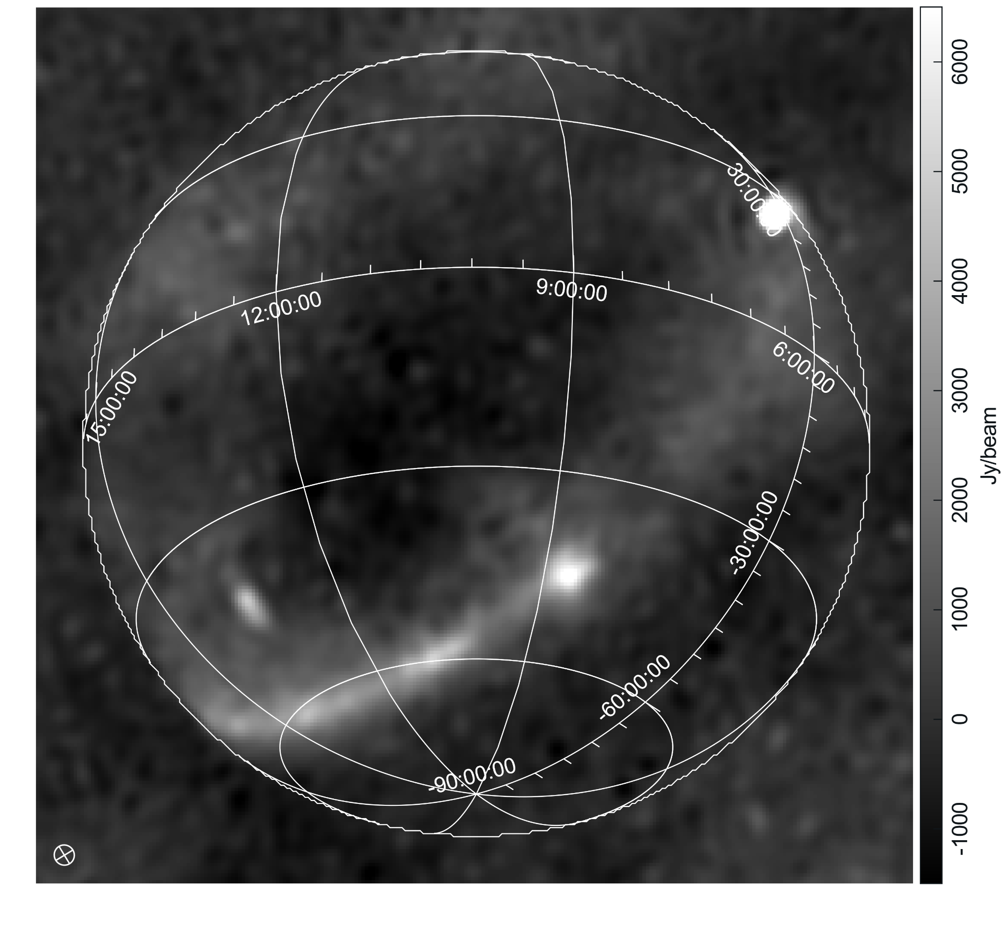
RESULTS & DISCUSSION
Simulations
Real Data
8

Slide 11
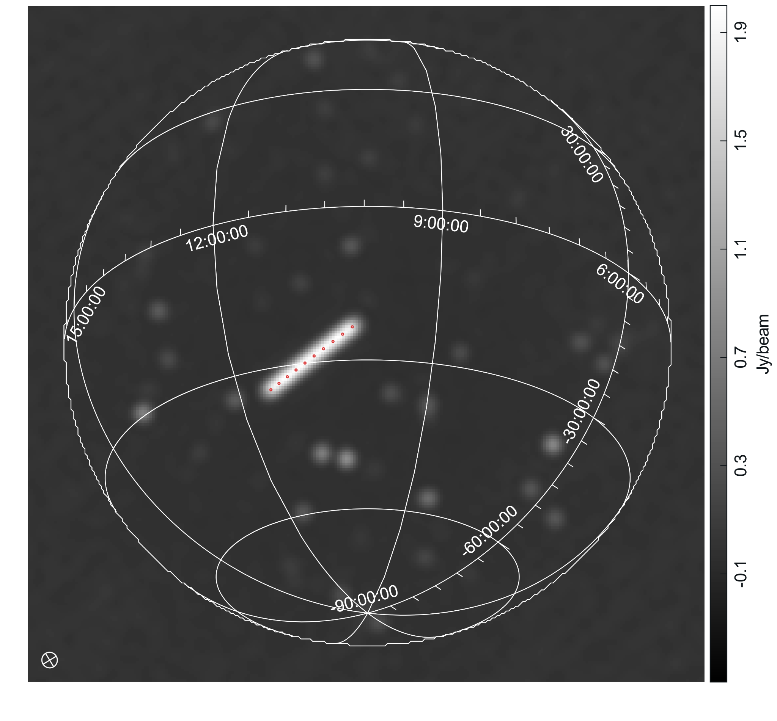
Simulated Data: Obtaining an Image
Left: cleaned image of the simulated data
Starlink satellite NORAD 55695 can be seen as a bright streak
Confirmed by TLE-predicted positions (red points)
9

Slide 12
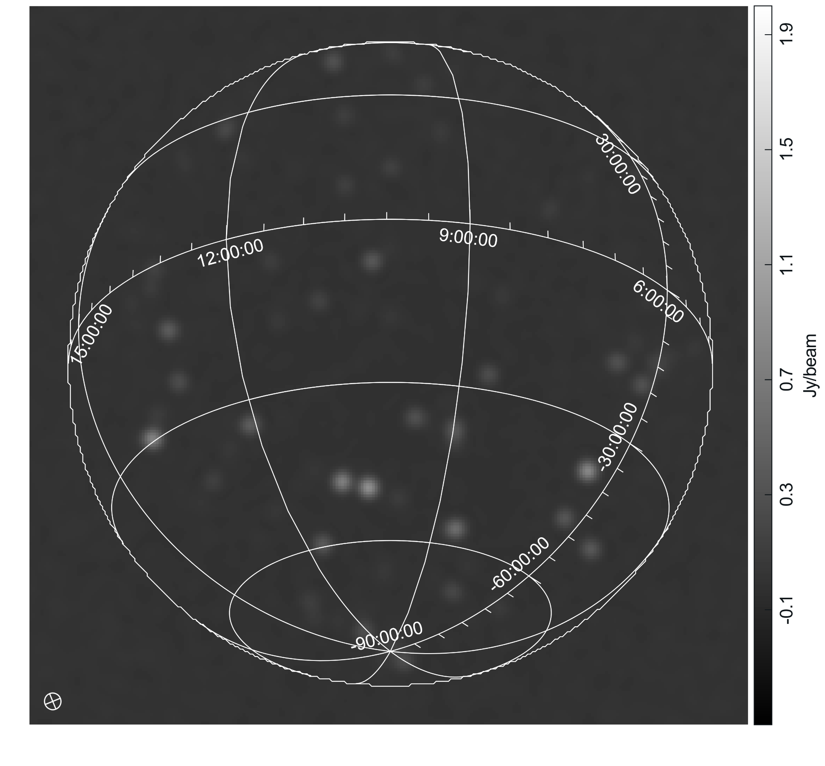
Simulated Data: RFI Subtraction
Predicted Data Image
Simulated Data Image
10

Slide 13
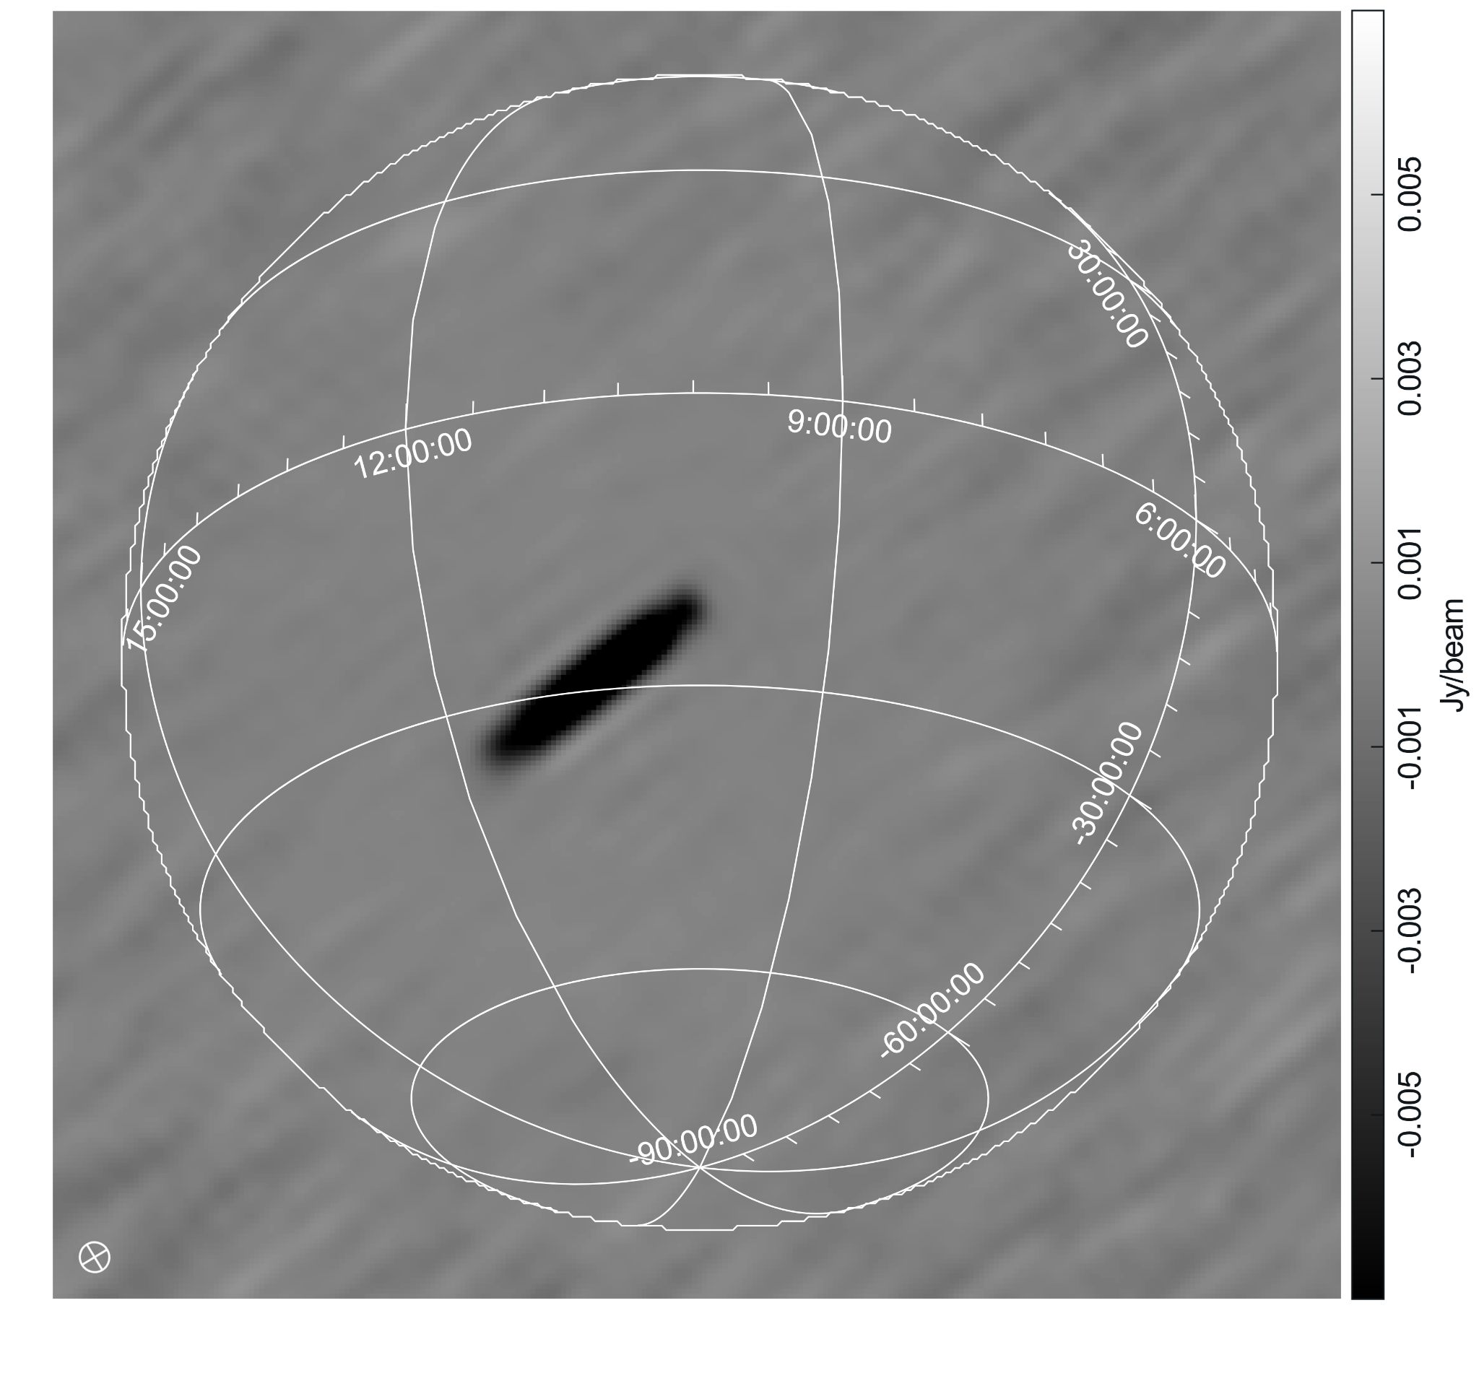
Simulated Data: Analysis of the Results
Left:
Predicted - True astronomical signal
Residual negative streak
Maximum Absolute Difference:
20 mJy/beam
Image noise:
350 mJy/beam
11

Slide 14
RESULTS & DISCUSSION
Simulations
Real Data
12

Slide 15
Real Data: Obtaining an Image
Left: cleaned image of the real data
We might ask: is there any RFI in this image?
We expect a satellite: good idea to time-difference
13

Slide 16
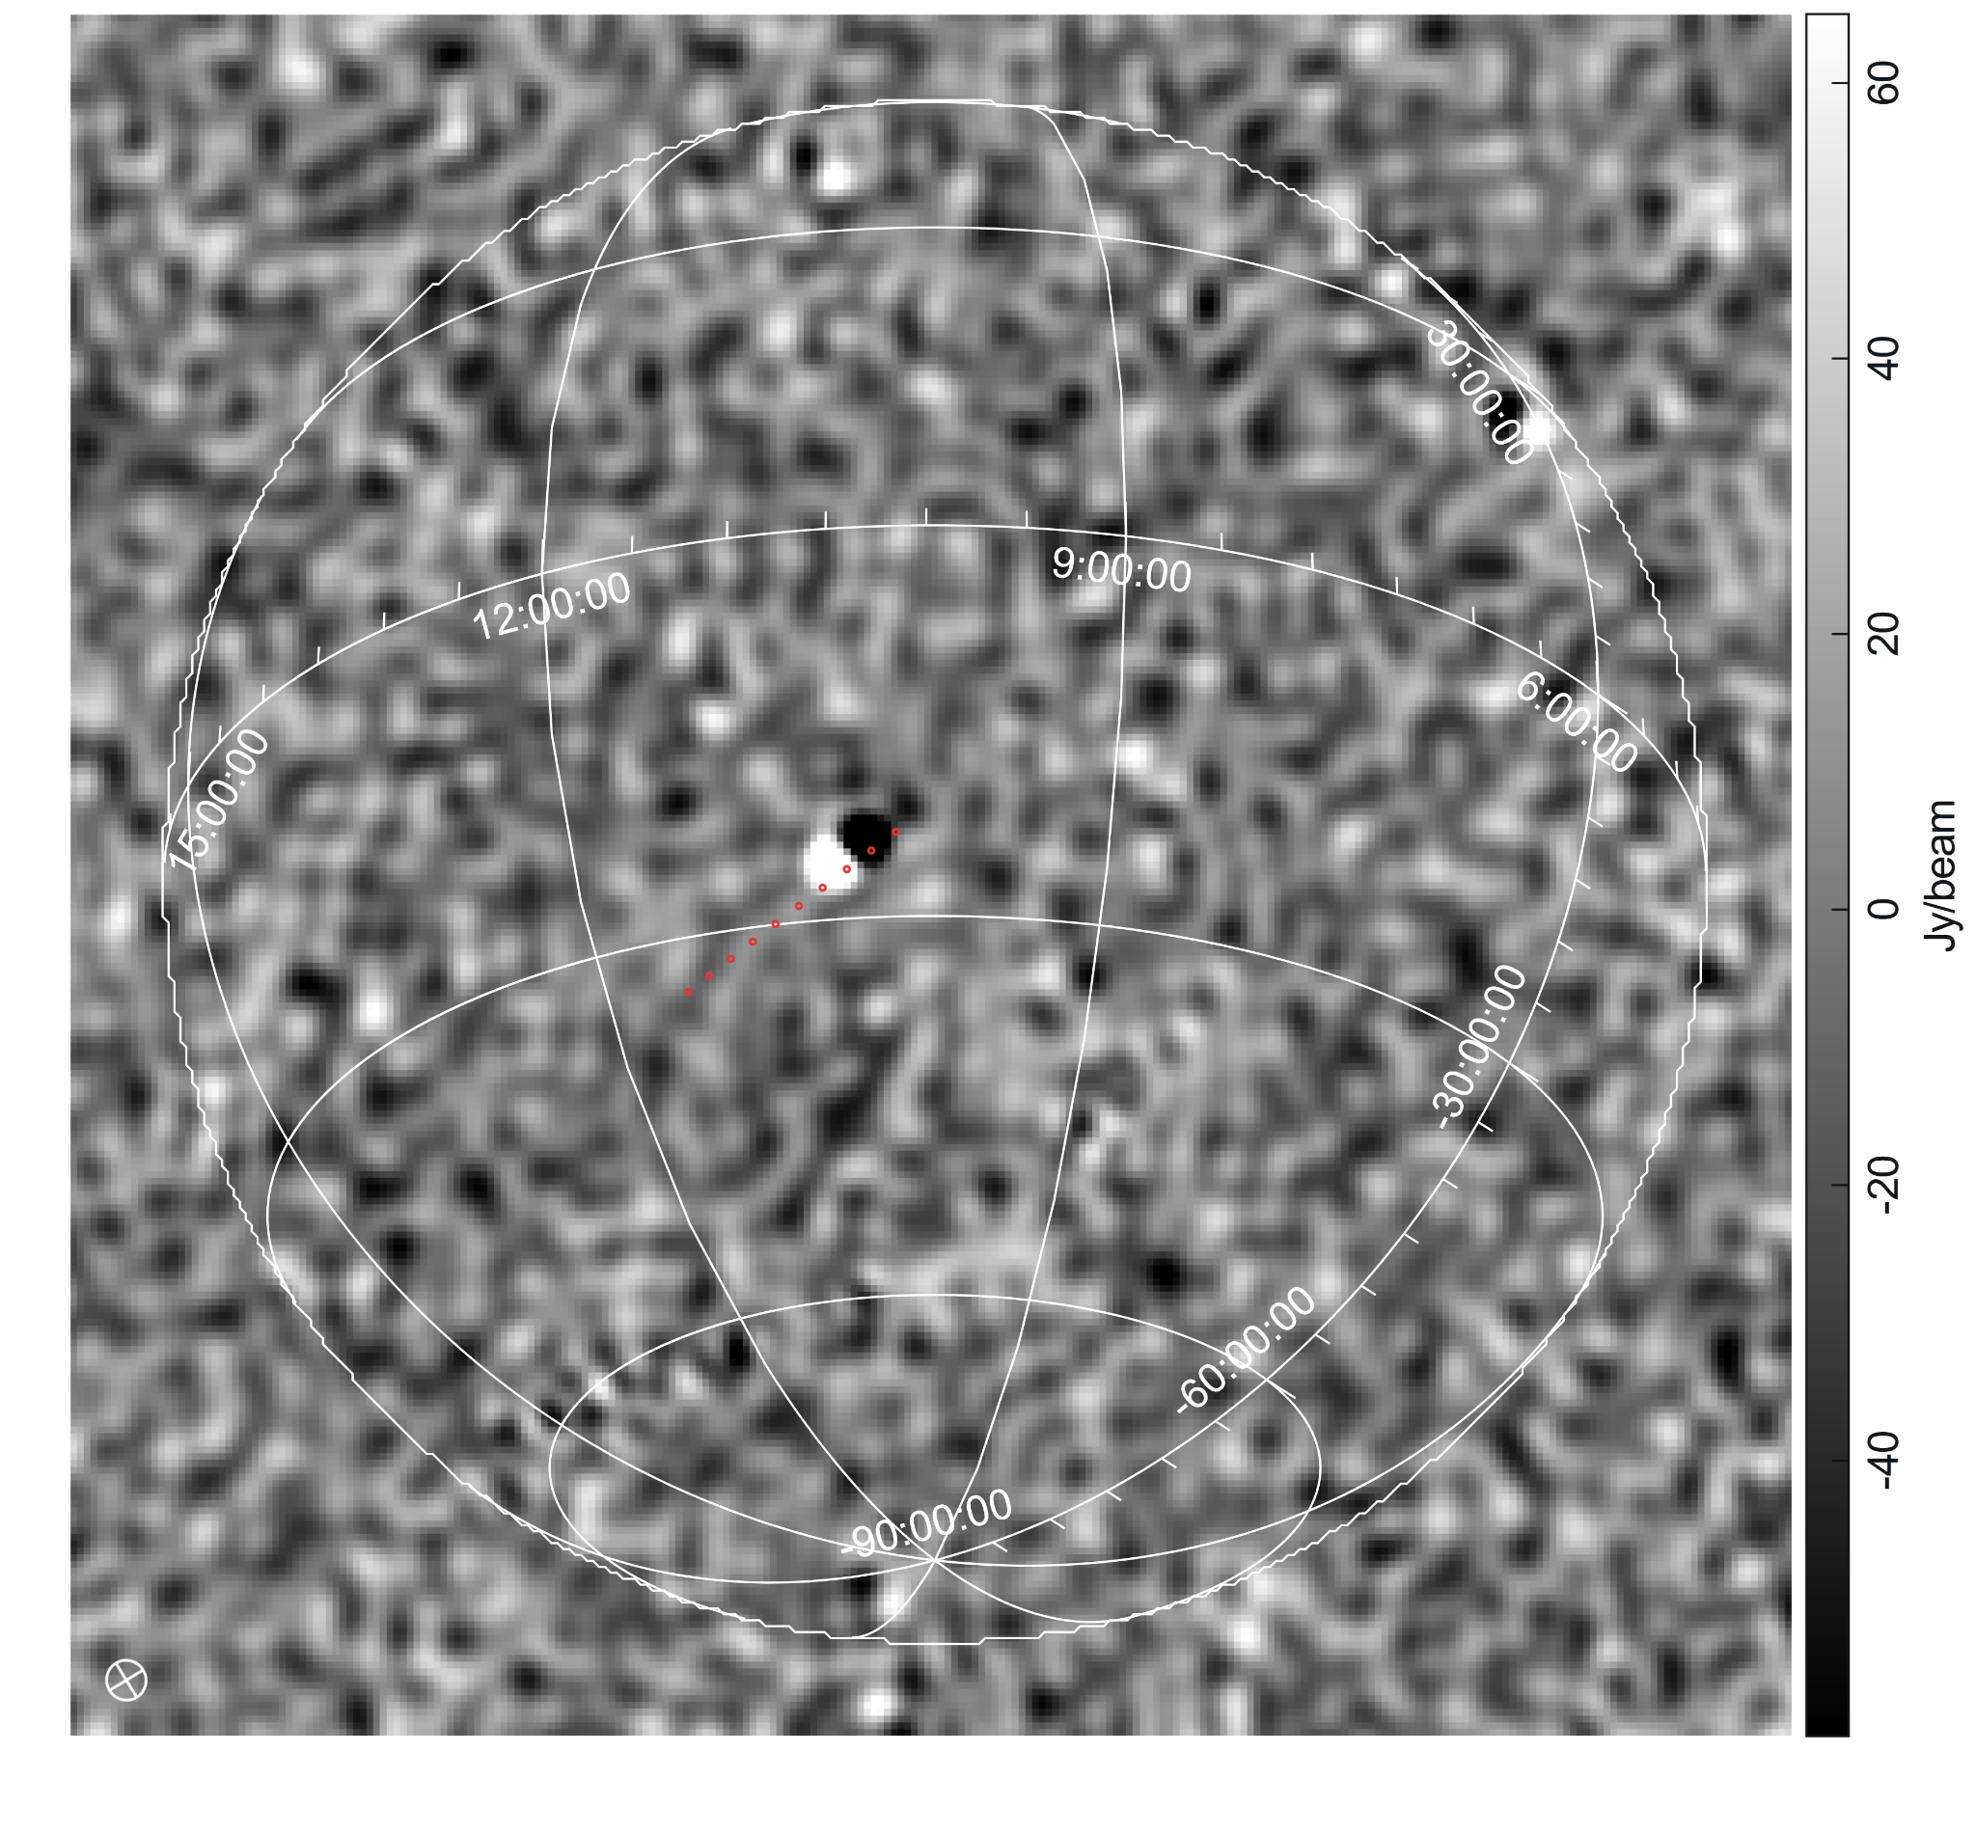
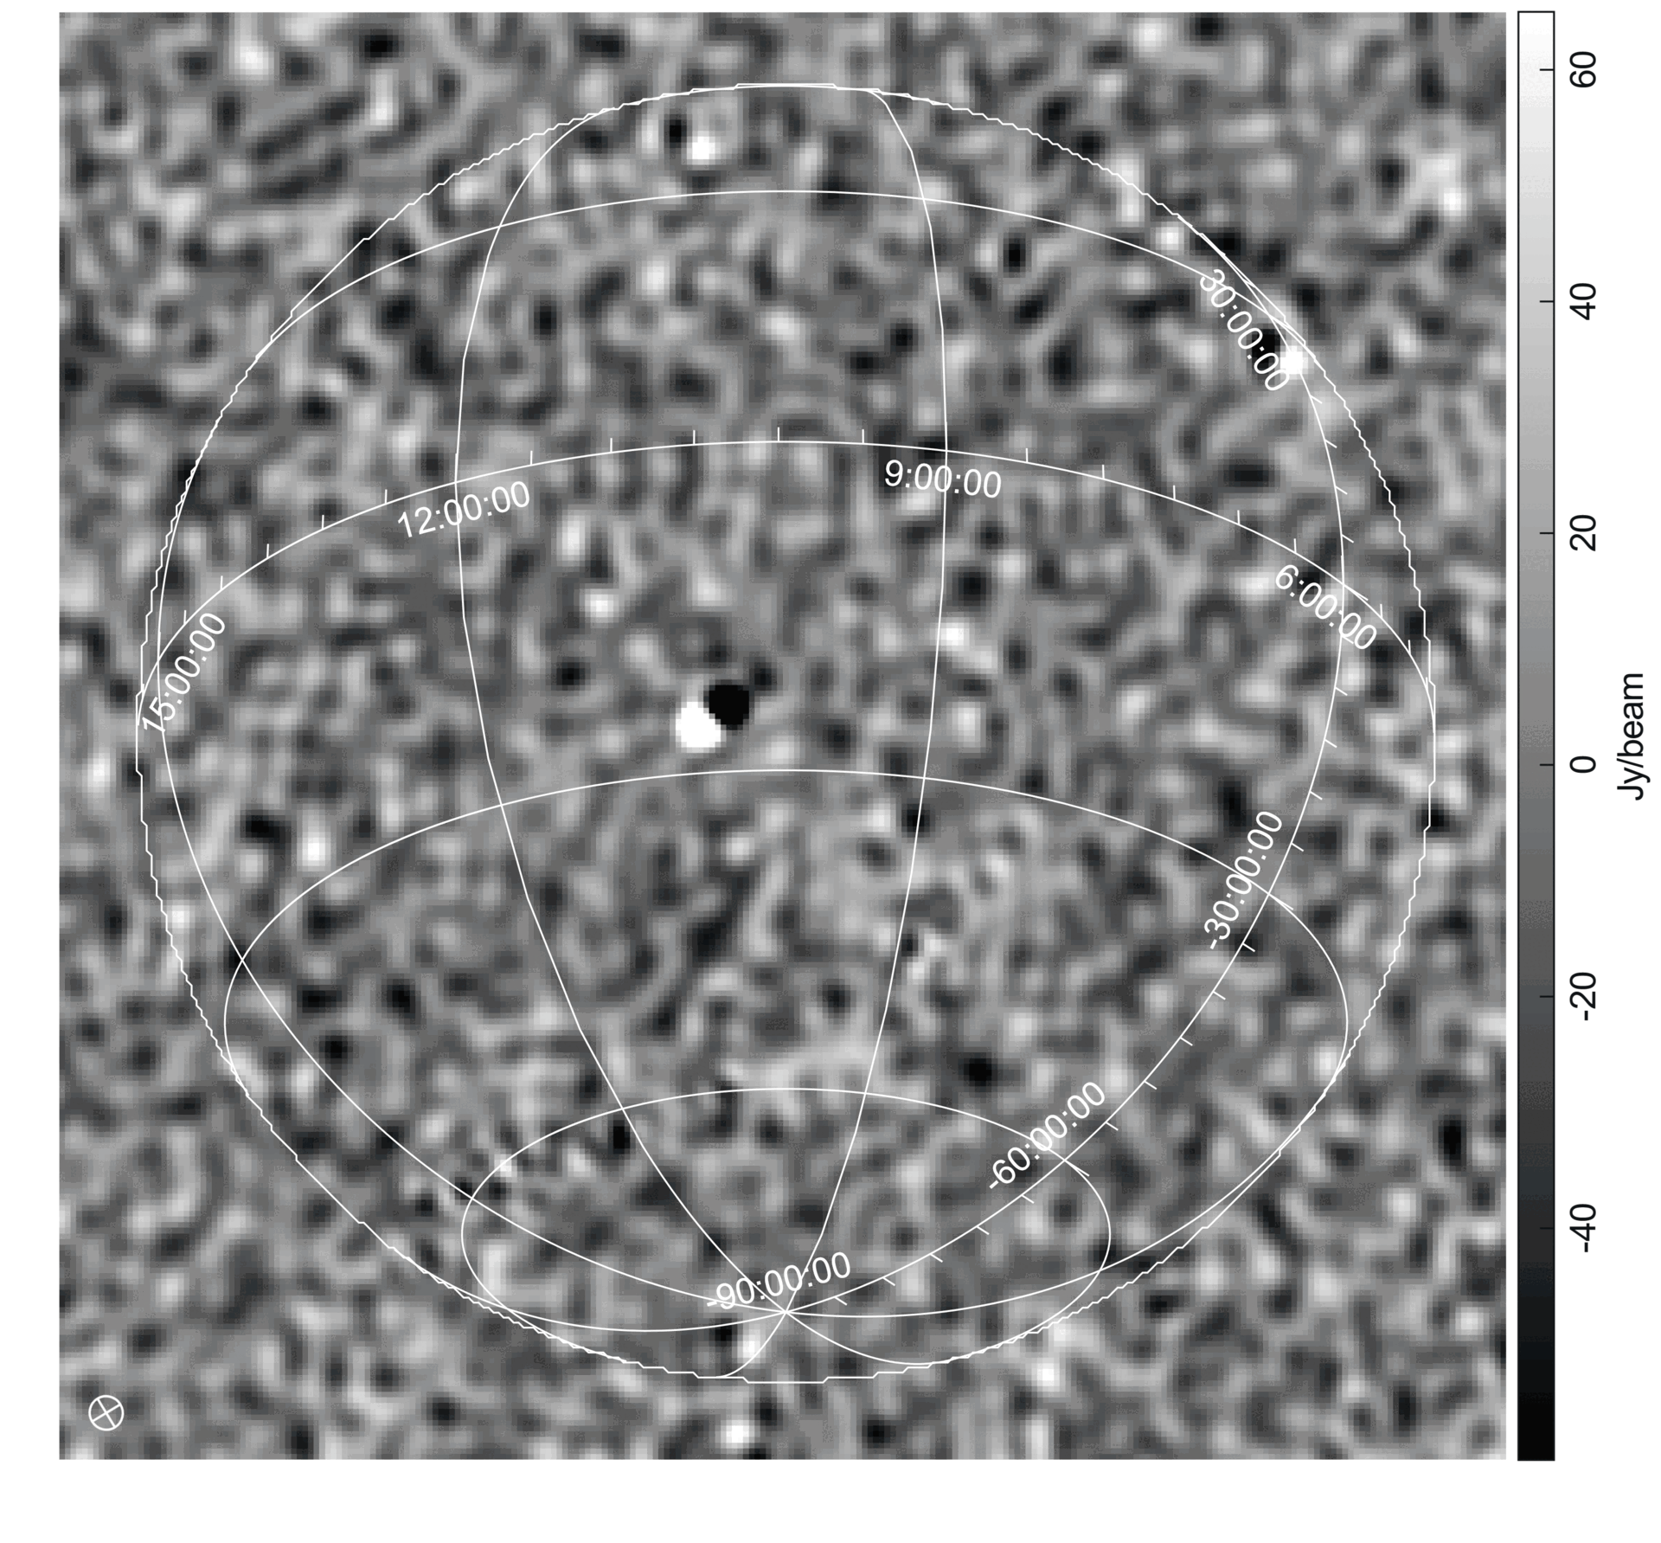
Real Data: Time Differencing
Left:
Time-differenced image of the real data.
Dipole can be seen: the source has moved between the two time steps
Slight offset with TLE-predicted positions
14
Notes:
Mention dipole can be seen after differencing consecutive time steps because starlink satellites are in LEO so move quickly

Slide 17
Real Data: Predicted Astronomical Sources
Predicted Data Image
Real Data Image
15

Slide 18
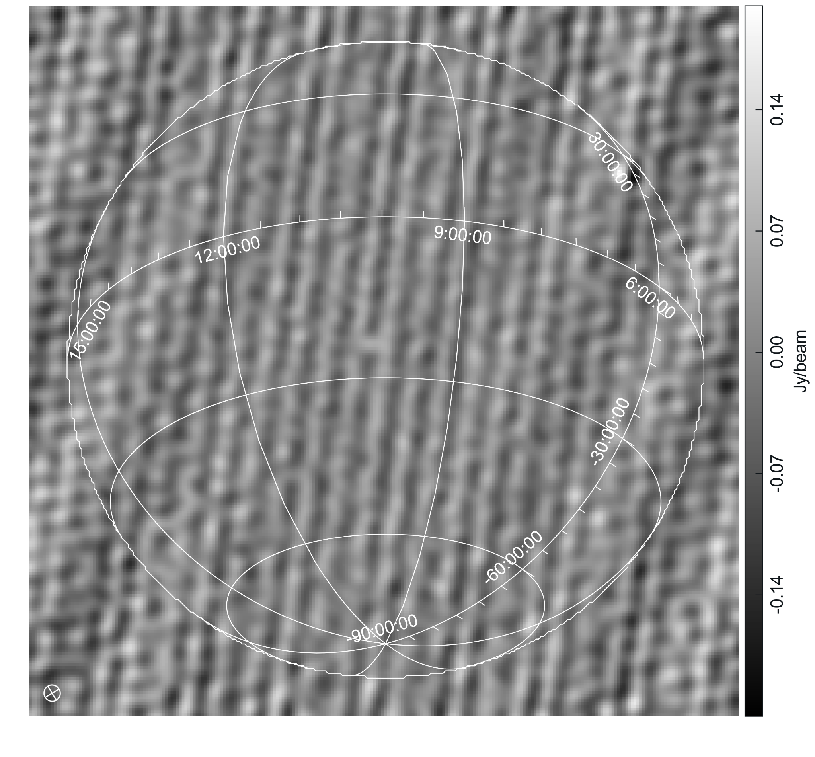
Real Data: Ast. Source Prediction Accuracy
Left: time-differenced image of the tabascal-predicted astronomical signal
The satellite (dipole) does not appear: it has been removed
Banding artefacts: one (likely more) baseline is dominant in the visibilities
STD : 0.04 Jy/beam
Image noise: 300 Jy/beam
16

Slide 19
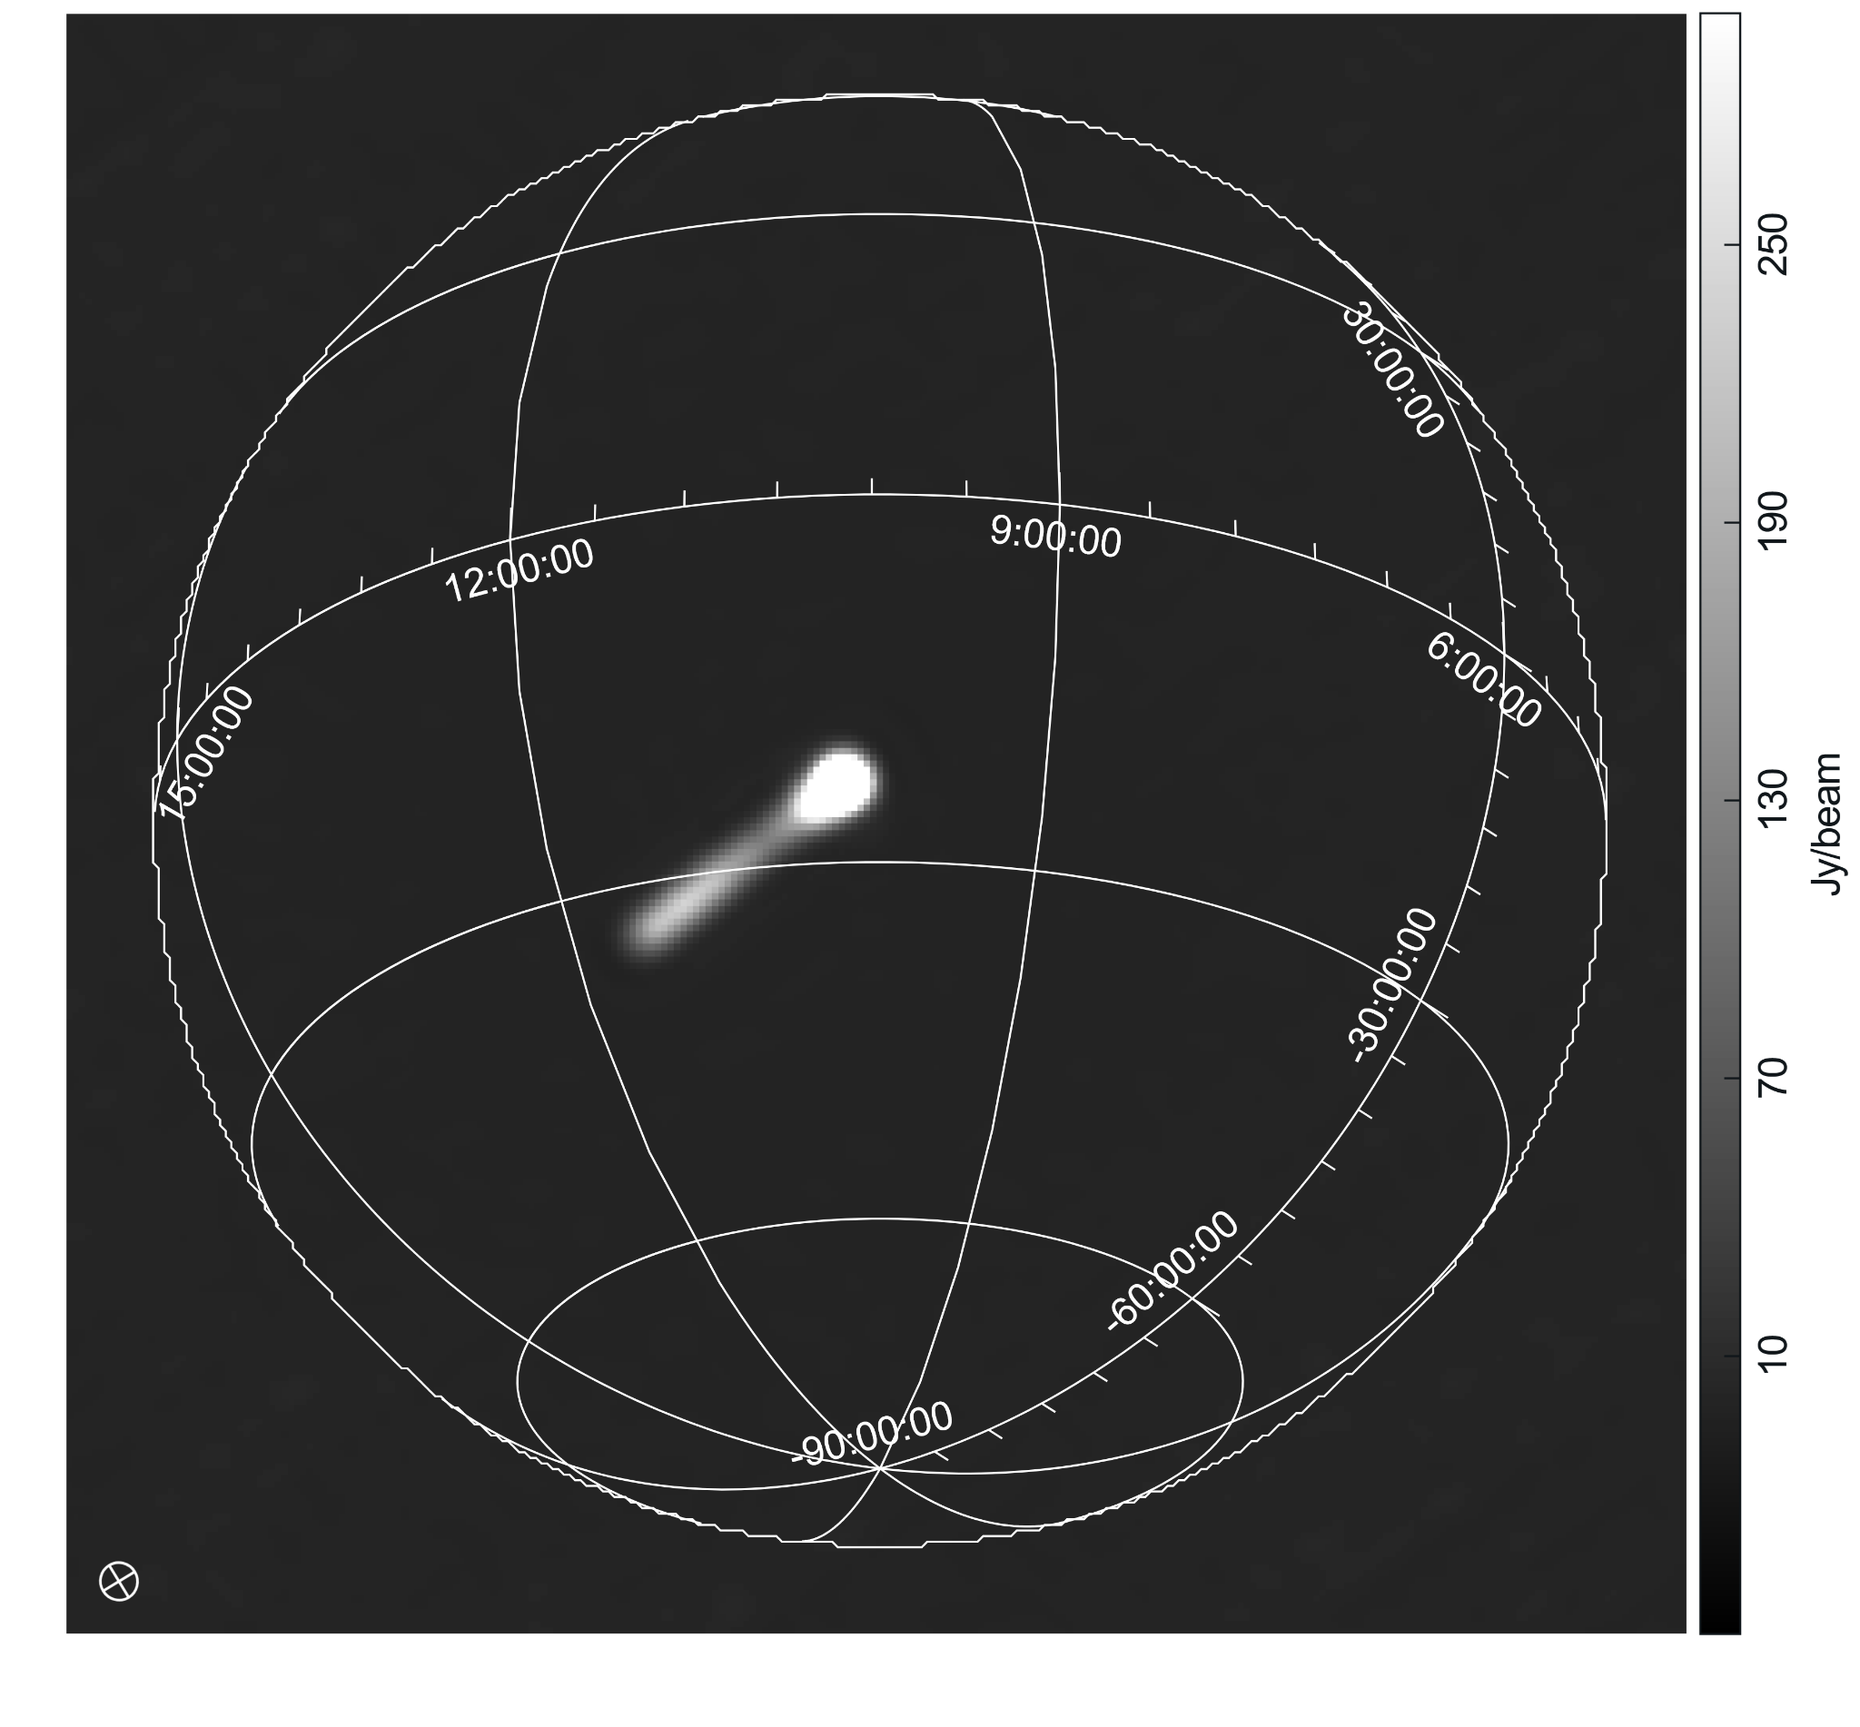
Real Data: Predicted RFI
Left: cleaned image of tabascal-predicted RFI
Dimming is observed
Peak intensity: 1350 Jy/beam
17

Slide 20
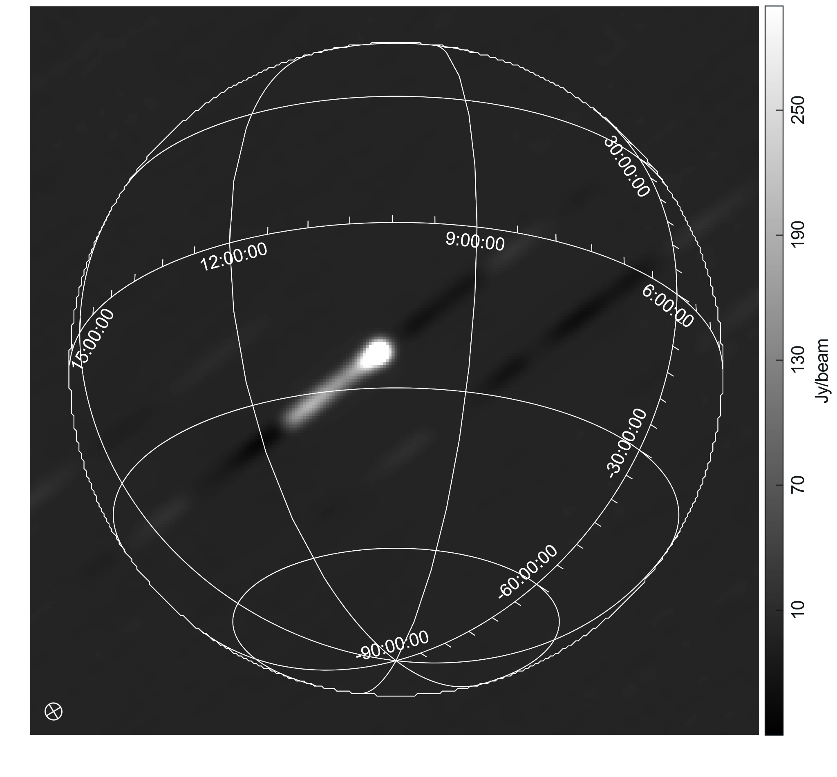
Real Data: “True” RFI
Left:
Real data - tabascal astronomical signal (“true” RFI)
Some artifacts but insignificant (below the image noise)
Peak intensity: 850 Jy/beam (lower than the predicted RFI, but higher than the image noise)
18

Slide 21
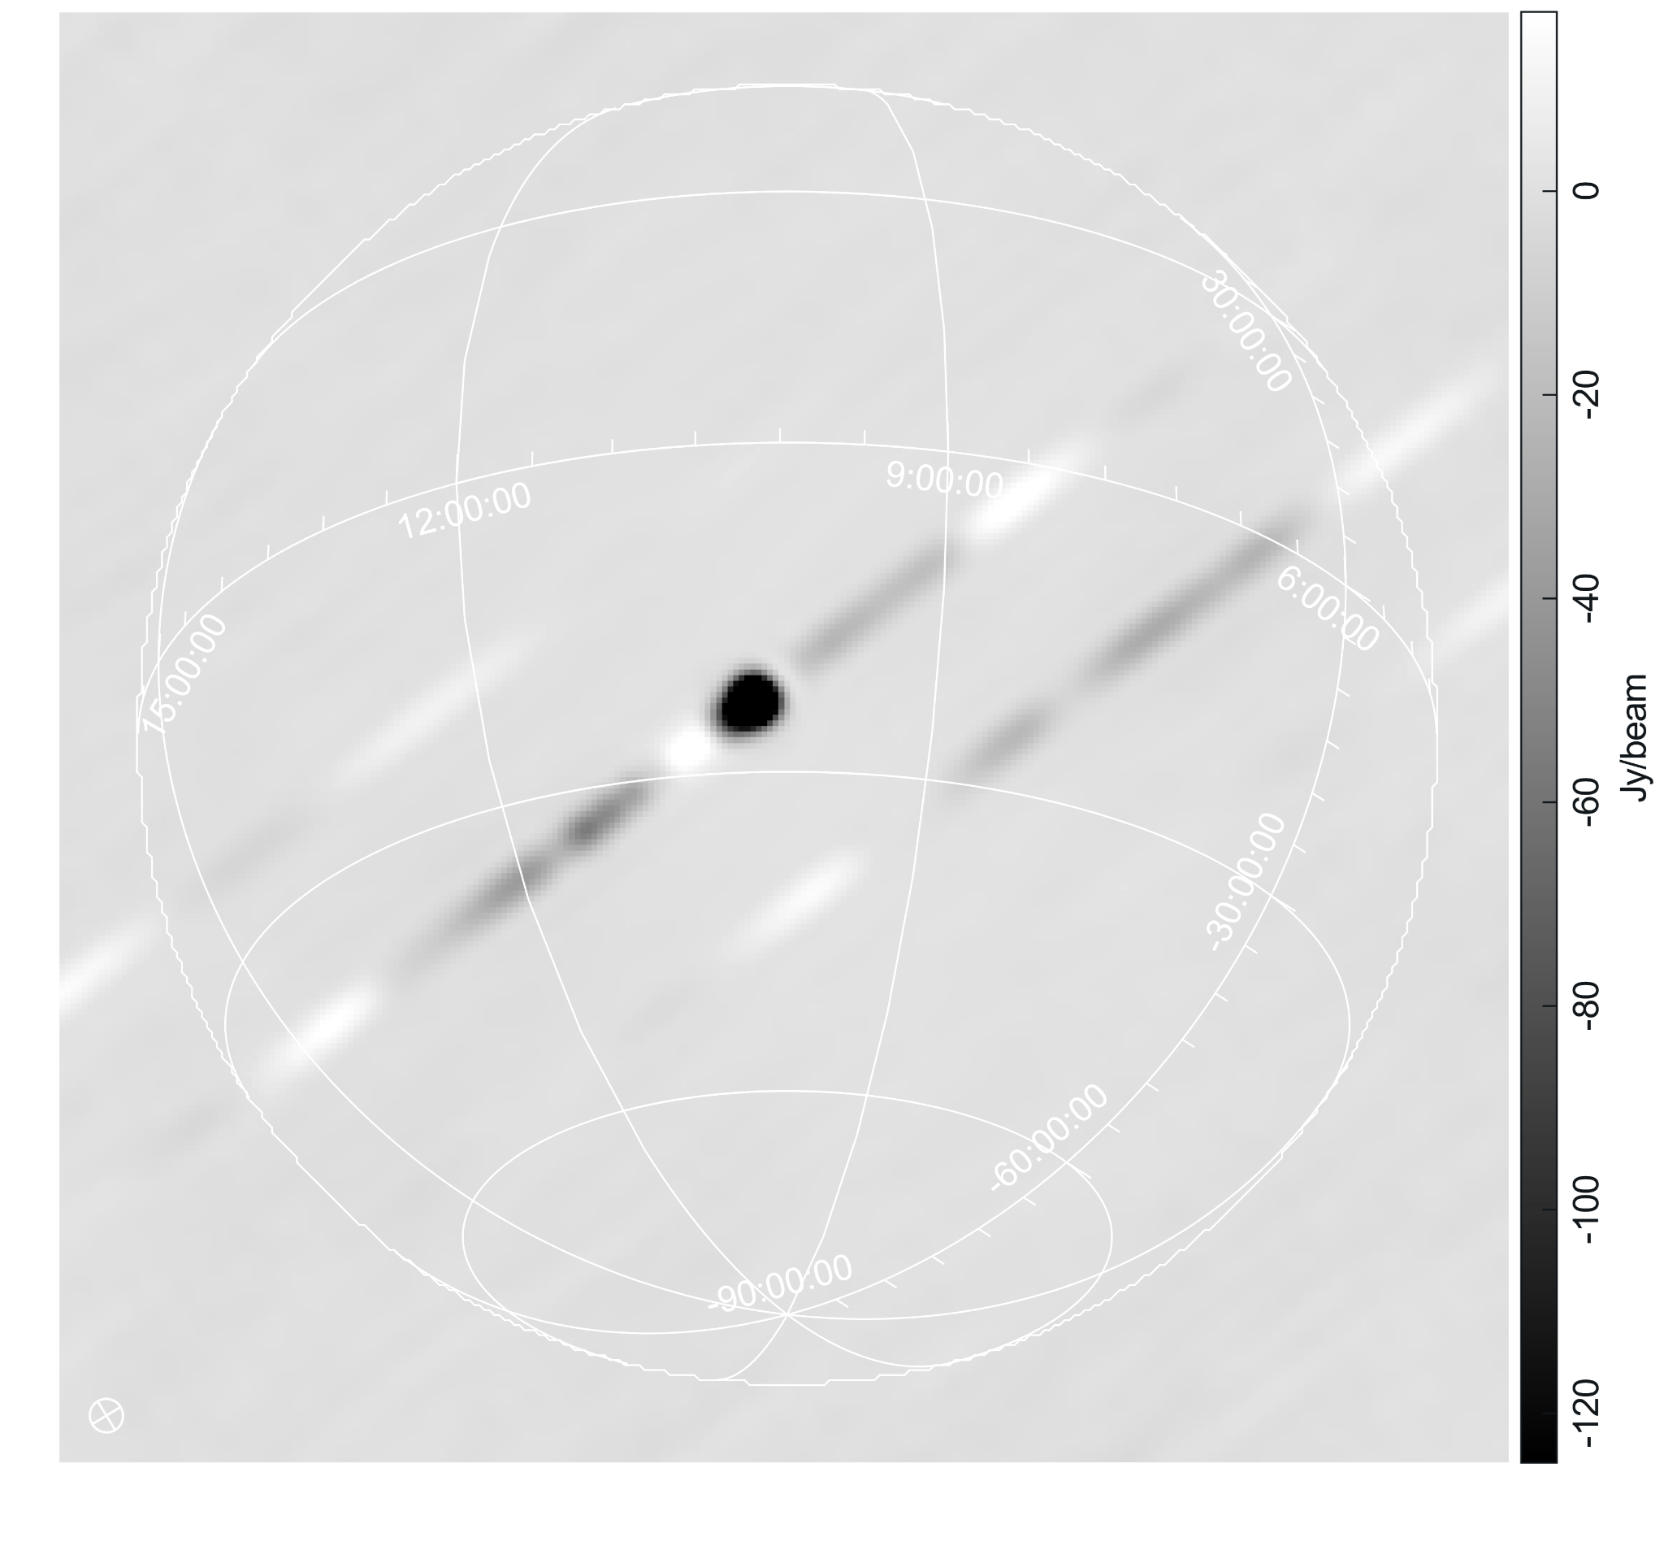
Real Data: RFI Source Prediction Accuracy
Left: real data - predicted astronomical sources - predicted RFI source
RFI is not completely removed
Min. intensity: - 540 Jy/beam
Real data subtracted by predicted ast. Sources (true RFI)
Predicted RFI
19

Slide 22
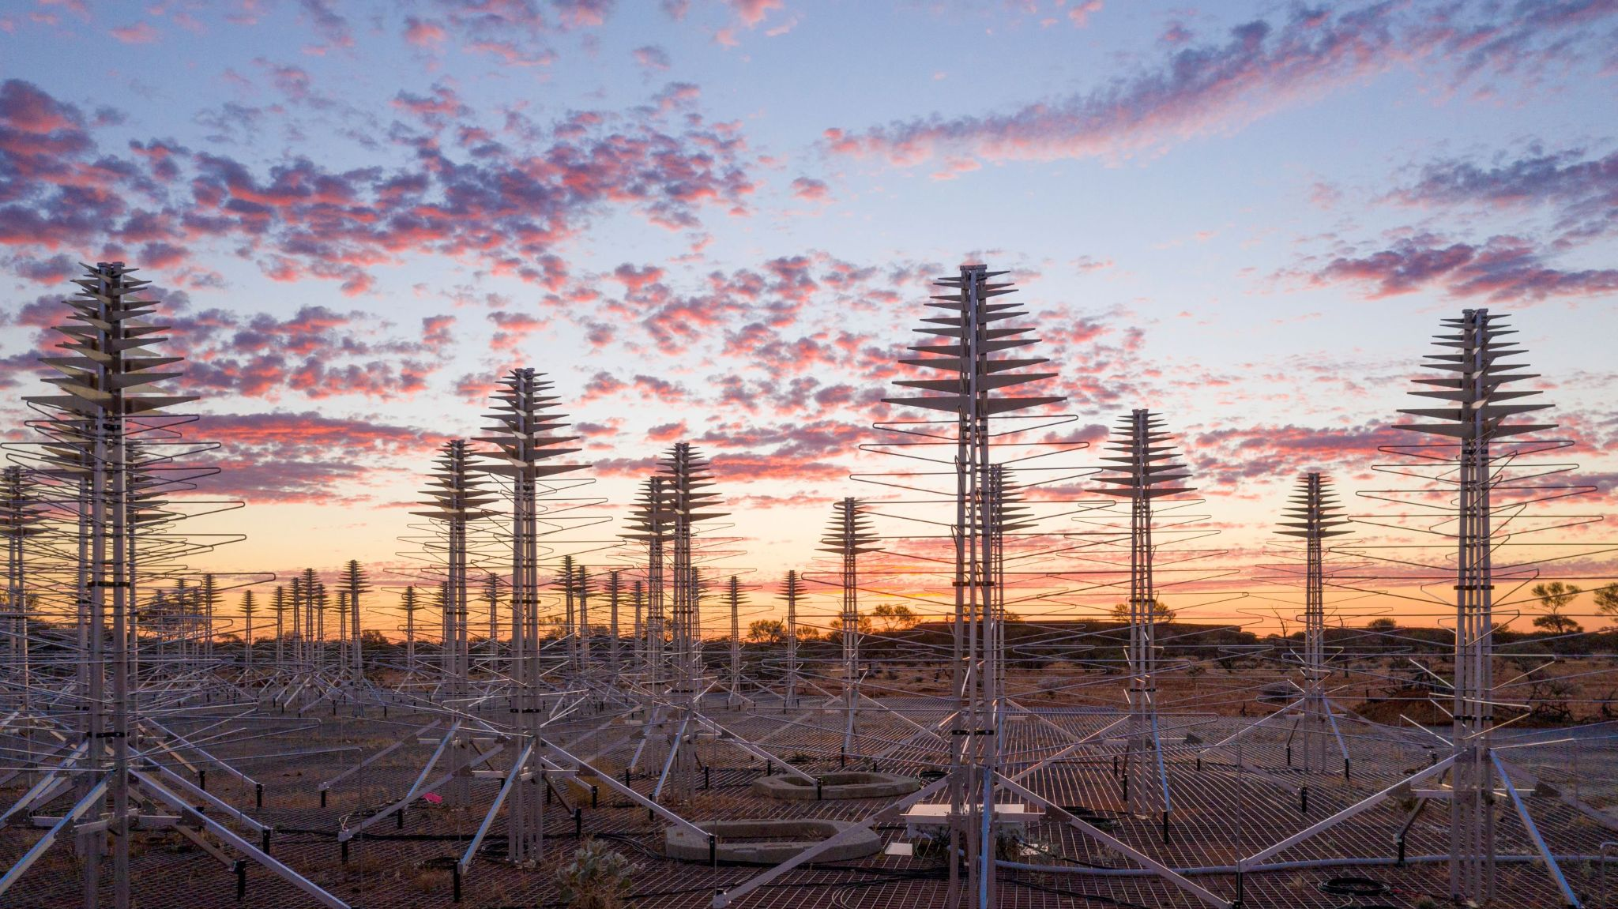
SUMMARY
Simulation Results
Excellent
Real Data Results
Very Good
Understanding needed
Future Work
Get Huckleberry back
Others are welcome!
Image source: Western Australian Museum
20

Slide 23
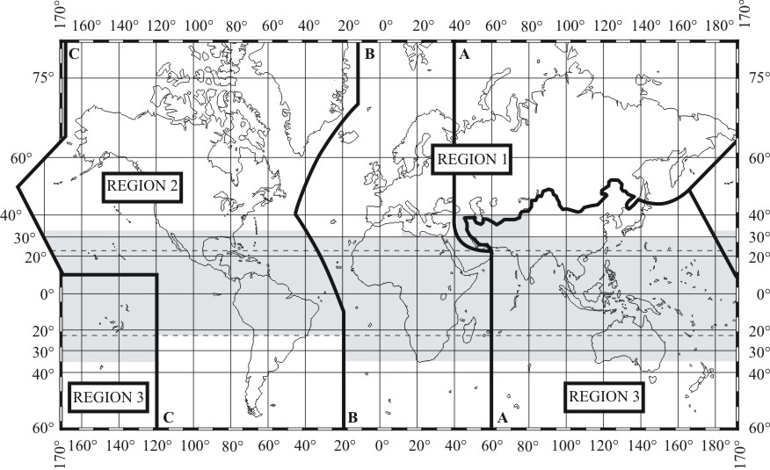
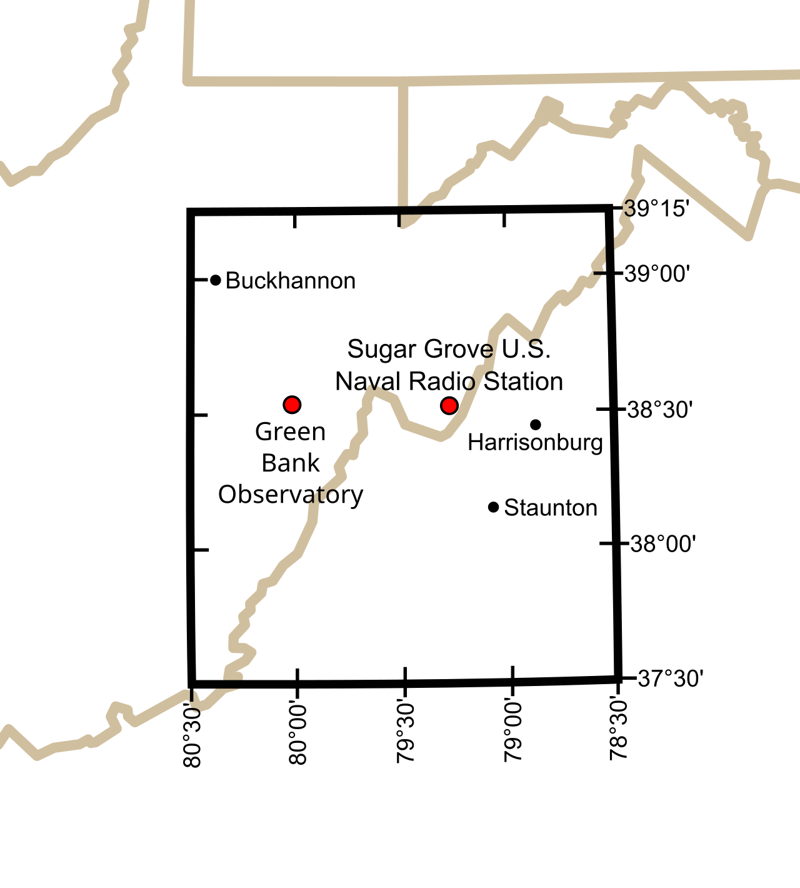
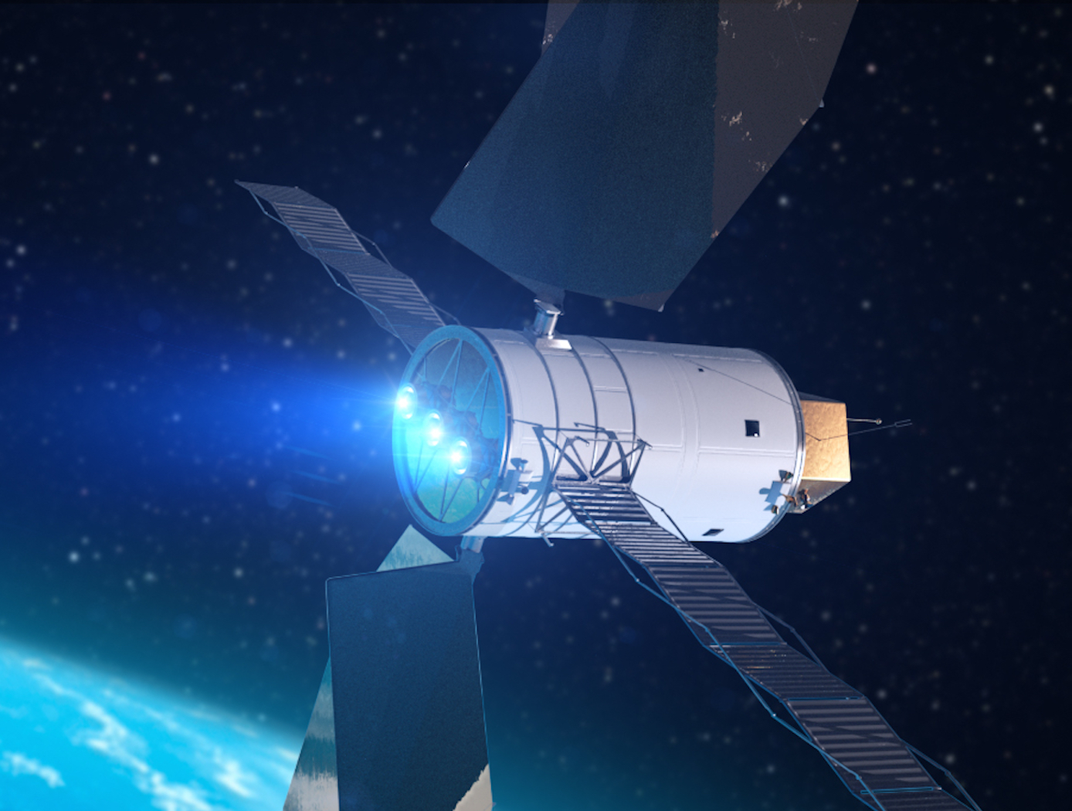
Radio Frequency Interference
Satellites: two types of Electromagnetic Radiation (EMR)
IEMR (Intended)
UEMR¹ (Unintended)
IEMR: regulated by governments and international bodies (ITU-R)
Radio quiet zones
Allocated frequencies
Protected frequency bands
science.nrao.edu
technology.nasa.gov
NASA Spectrum Management Office
¹Terminology from Di Vruno et al. (2023)
3

Slide 24
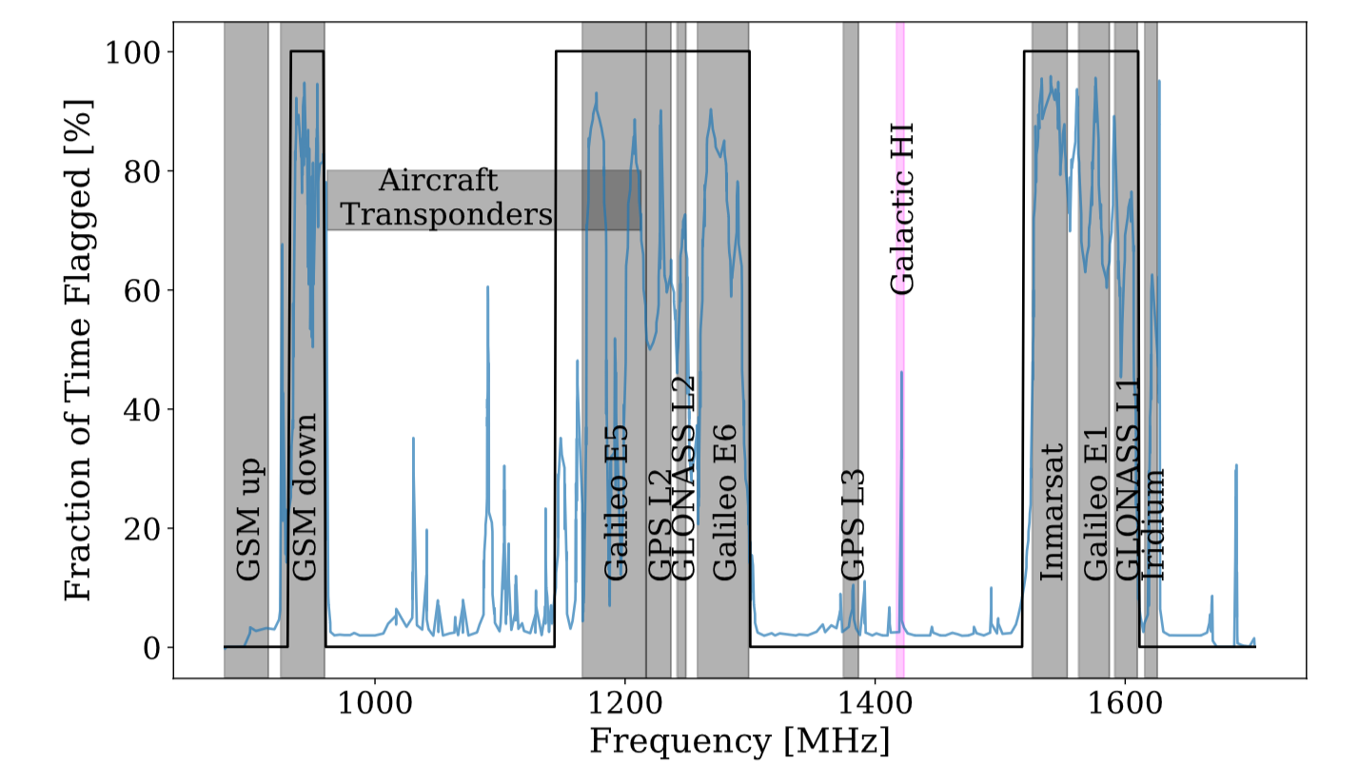
RFI Mitigation Methods
Left: Meerkat contaminated frequency channels in the L band
Flagging: currently the most common method for mitigating RFI
To summarize: there is a great need for effective RFI removal
Sihlangu et al. (2022)
5

Slide 25
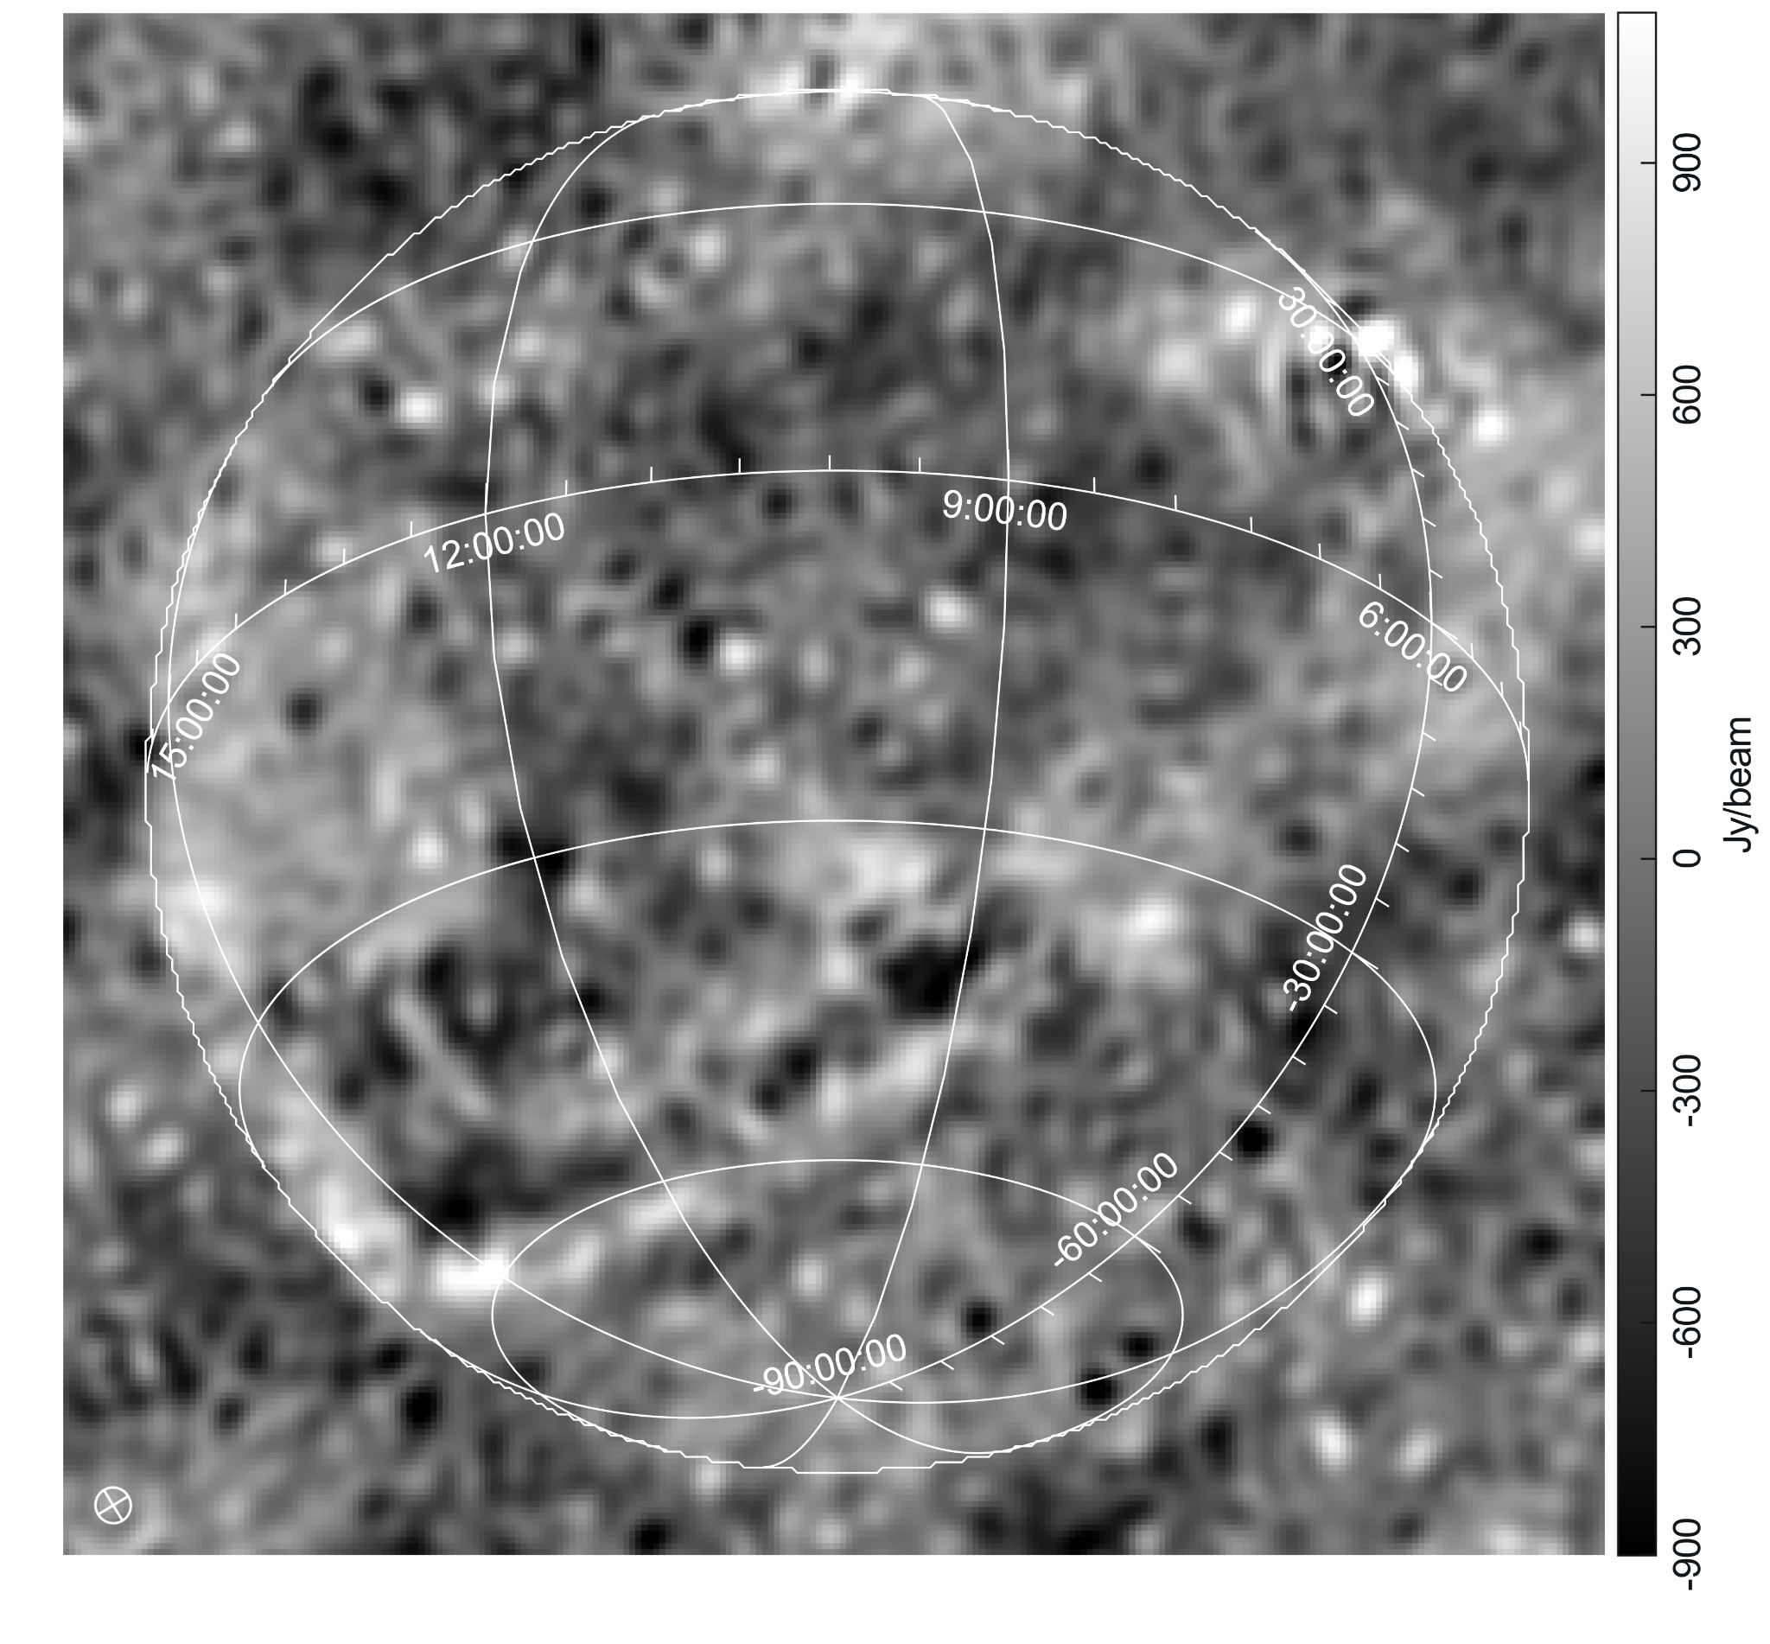
Imaging
Imaging using WSClean¹
YY polarisation
Residual images allowed the evaluation of the image noise (right)
The white grid is an astronomical projection of the visible sky. Synthesized beam width is shown bottom left.
Image details: 256x256 px, 30 arcmin scale
¹(Offringa, 2014)

Slide 26
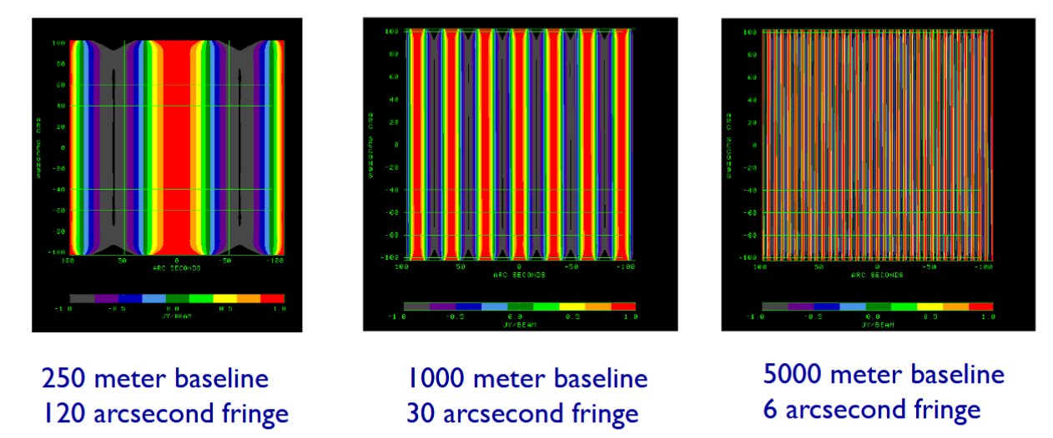
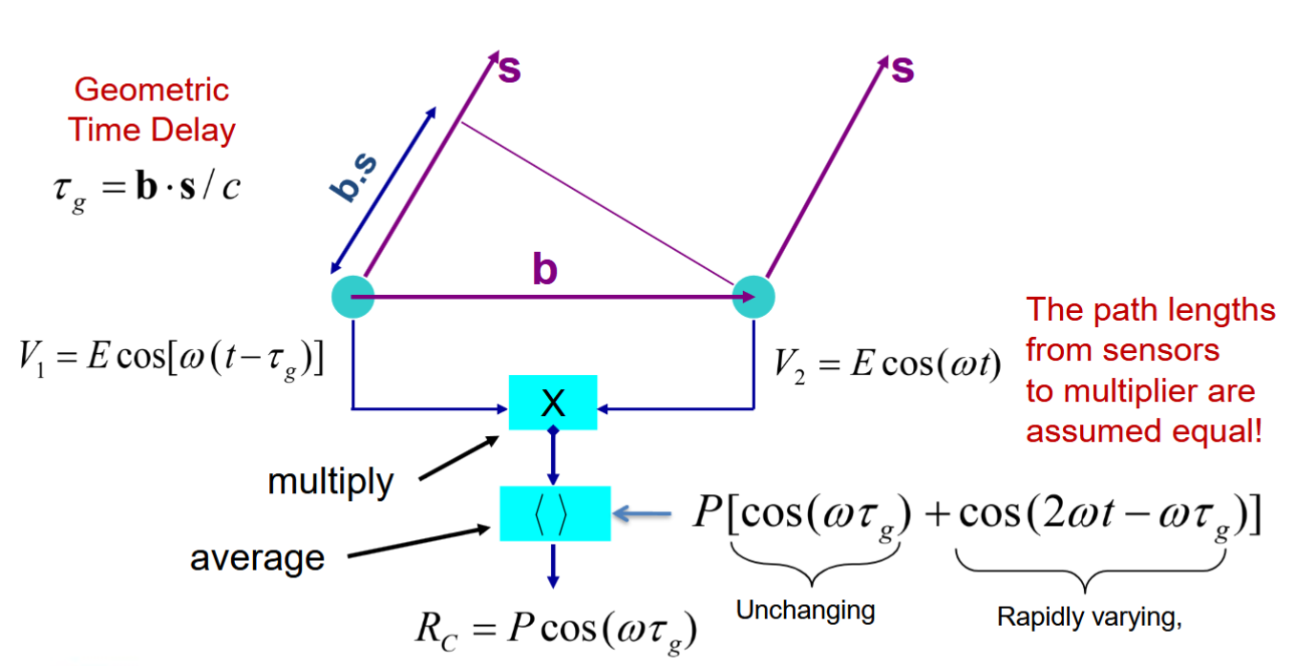
Radio Interferometry
Ideal radio interferometer
NRAO

Slide 27
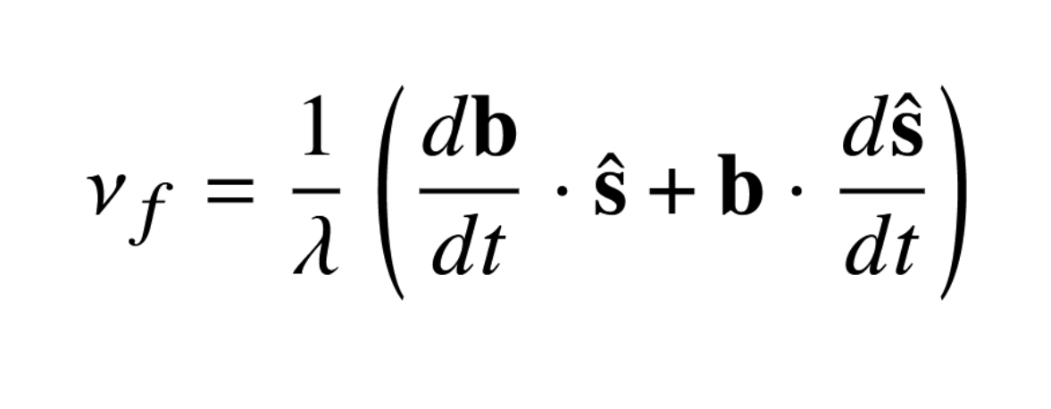
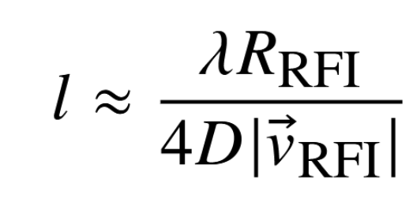
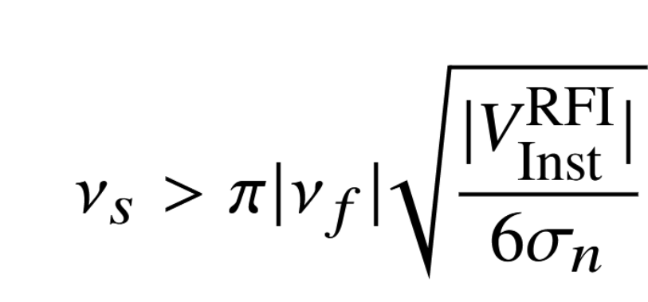
Satellite Considerations
Fringe frequency of a satellite
Change in baseline due to Earth rotation
Satellite's apparent angular velocity
Correlation time scale of a satellite
Sampling rate for calculating visibility integral

Slide 28
TABASCAL: Basic Theory
Gain prior:
RFI model (trajectory modeled using TLE with SGP4)
Visibility model:
Geometric phase delay:
Prior:
Running tabascal
Initial values from prior or estimates
Prior parameters
Optimization parameters

Slide 29
Computational Scaling
Using consumer level CPU, no GPU: ~ 30 s run time
Computation time scales linearly with # of baselines, time steps, frequencies and length of the longest baseline
For the same number of time steps:
SKA-Low: 512 stations, maximum baseline length of 74 km: ~ 70 hours
Inner core stations, 2 km in diameter: ~ 2 hours

Slide 30
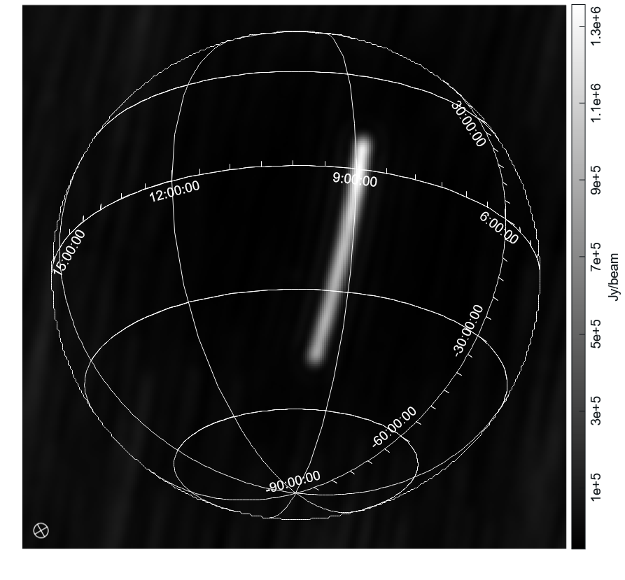
Brighter RFI
60 s observation at ~ 130 MHz
NORAD 59051
RFI dominating the visibilities

