Slide 1
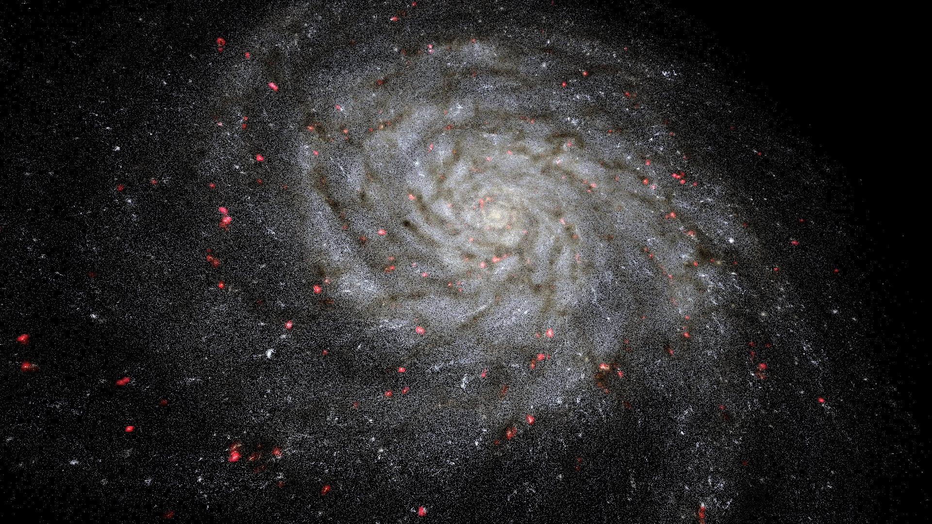
VIRUP : Project Update
Florian CABOT
Winter Meeting 27.01.2025

Slide 2
OUTLINE
Reminder about what VIRUP is
Repositories Work in Progress
Special Dataset type : Cosmological simulations

Slide 3
REMINDER : GOALS
Originally :
Make a VR real-time rendering application
Aggregate data from multiple large datasets
Help develop an intuition for the sense of scale in the Universe
Added over the years :
Multimodality
Pre-rendered movies
More complex types of data (volumetric, dynamic, planetary science, etc...)

Slide 4
VIRUP

Slide 5
VOLUMETRIC VISUALIZATION

Slide 6
FUTURE
Waiting for feedback on an SNSF Agora proposal with Tanya Petersen and Yves Revaz
Focus on putting VIRUP in the hands of as many people as possible
Use social media and public events more
Distribute data in a more accessible way to propose more datasets
Allow scientists to publish their data themselves or use the tool for their own outreach communication
Experiment with generative AI and voice recognition for automatic guidance through the data
Support even more hardware
Dynamic cosmological simulations

Slide 7
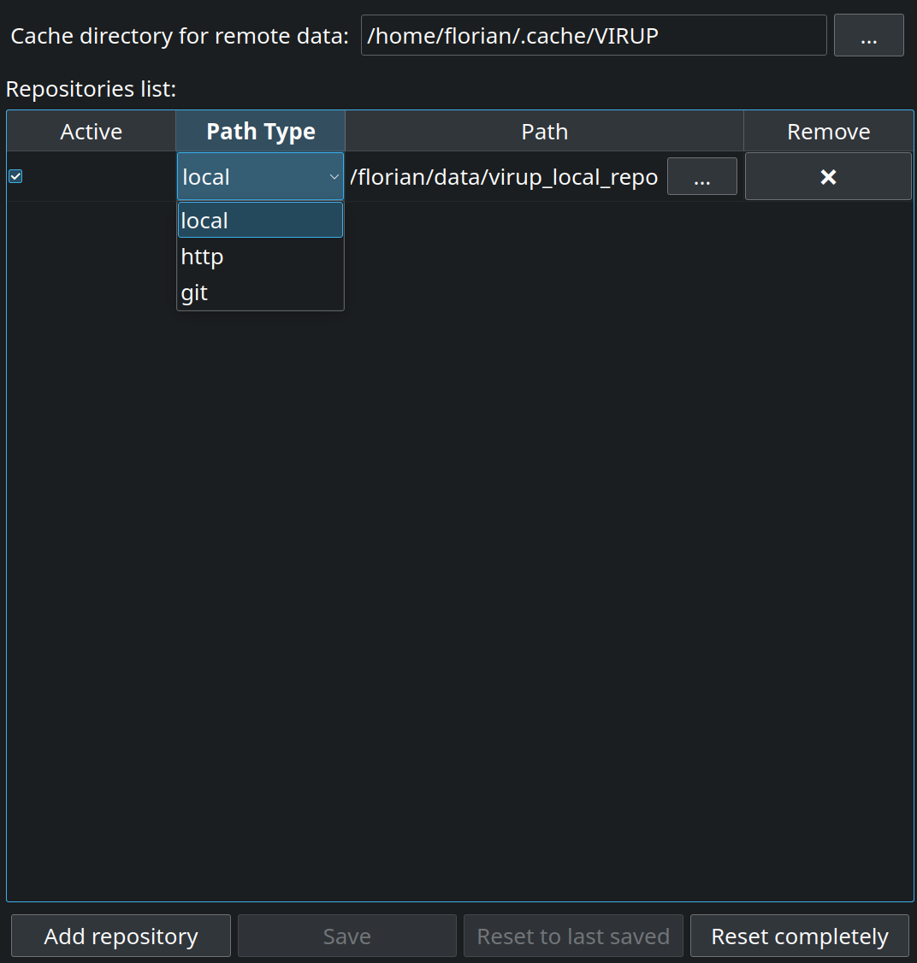
REPOSITORIES : REGISTRY

Slide 8
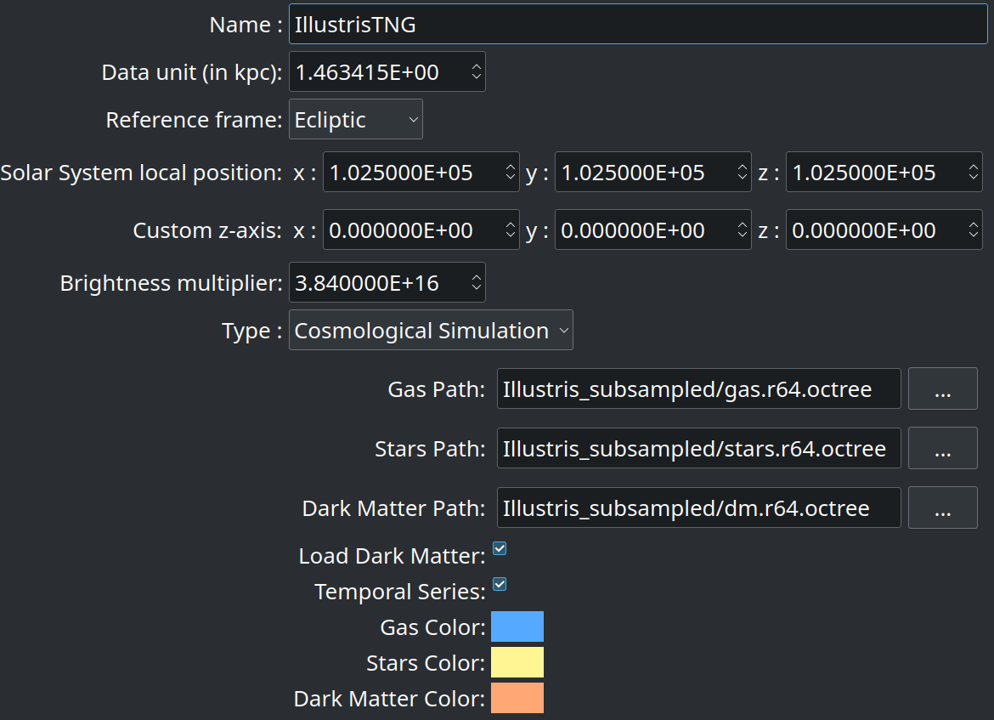
DATASET EXAMPLE : COSMO. SIM.

Slide 9
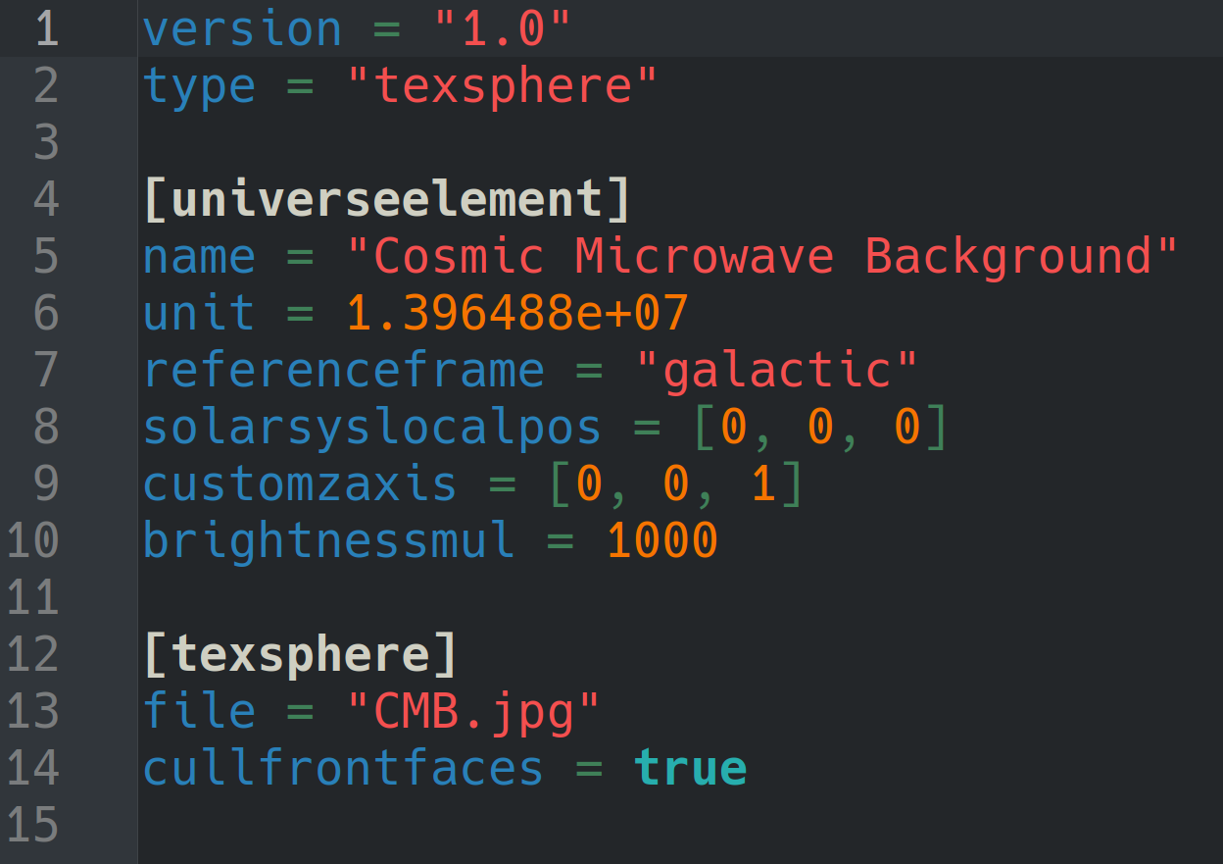
DATASET EXAMPLE : TEXTURED SPHERE

Slide 10
COSMOLOGICAL SIMULATIONS
They are usually very large (tens of gigabytes at least just for positional data)
They require acceleration structures to be rendered in real time to only render what is required for the current frame (requires fast loading independently of the storage technology)
=> We need a preprocessing step

Slide 11
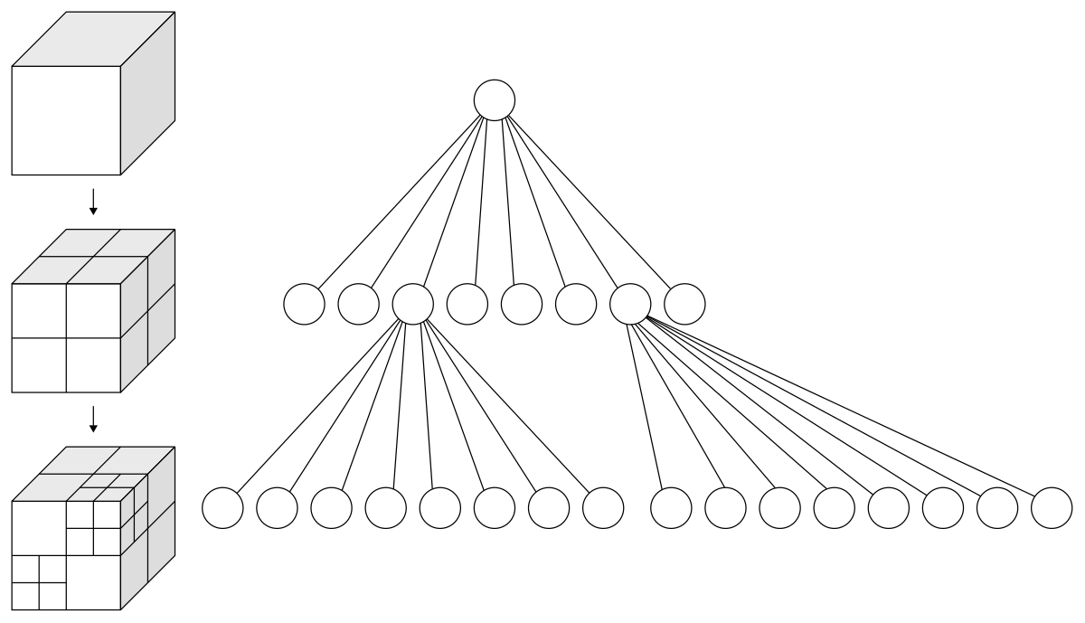
OCTREE ACCELERATION STRUCTURE
Wikipedia/Octree

Slide 12
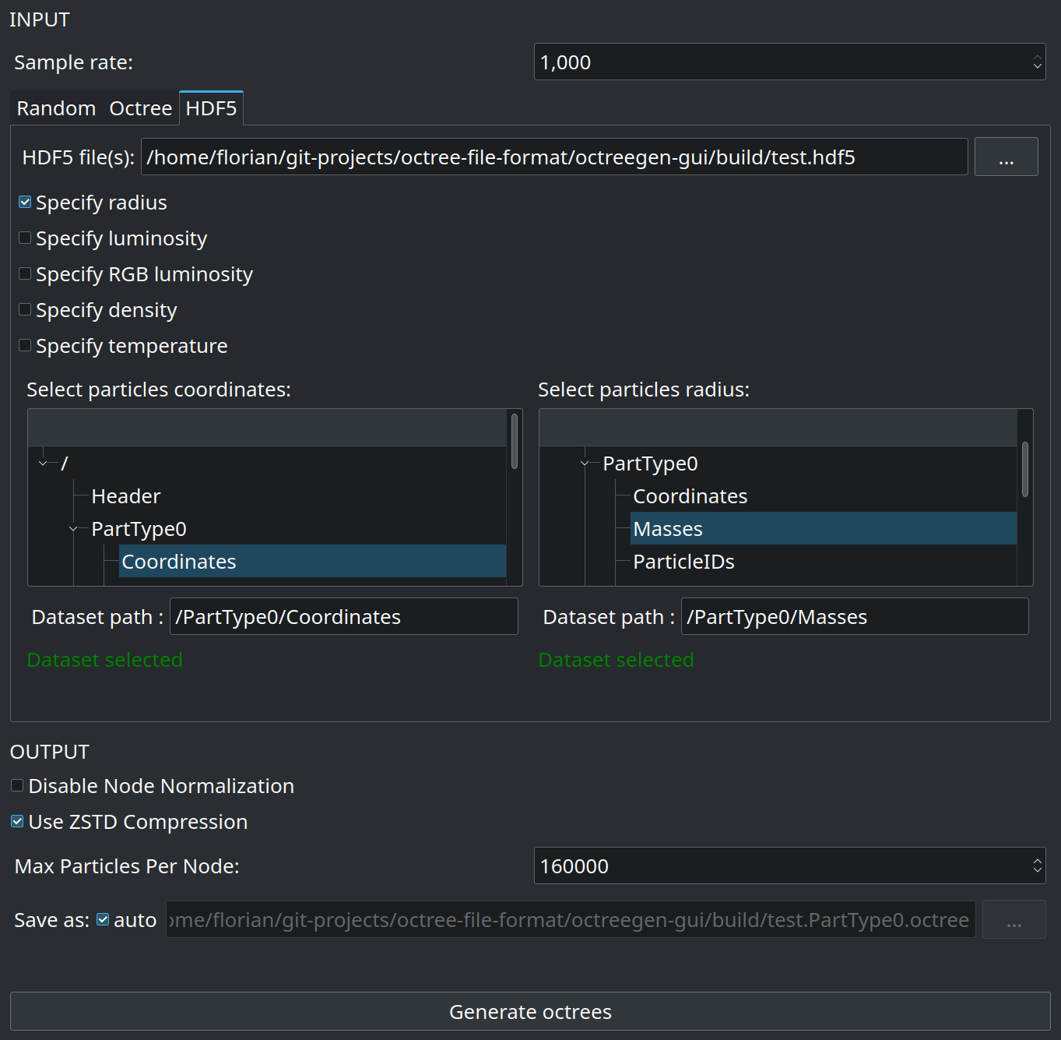
OCTREEGEN : GUI

Slide 13
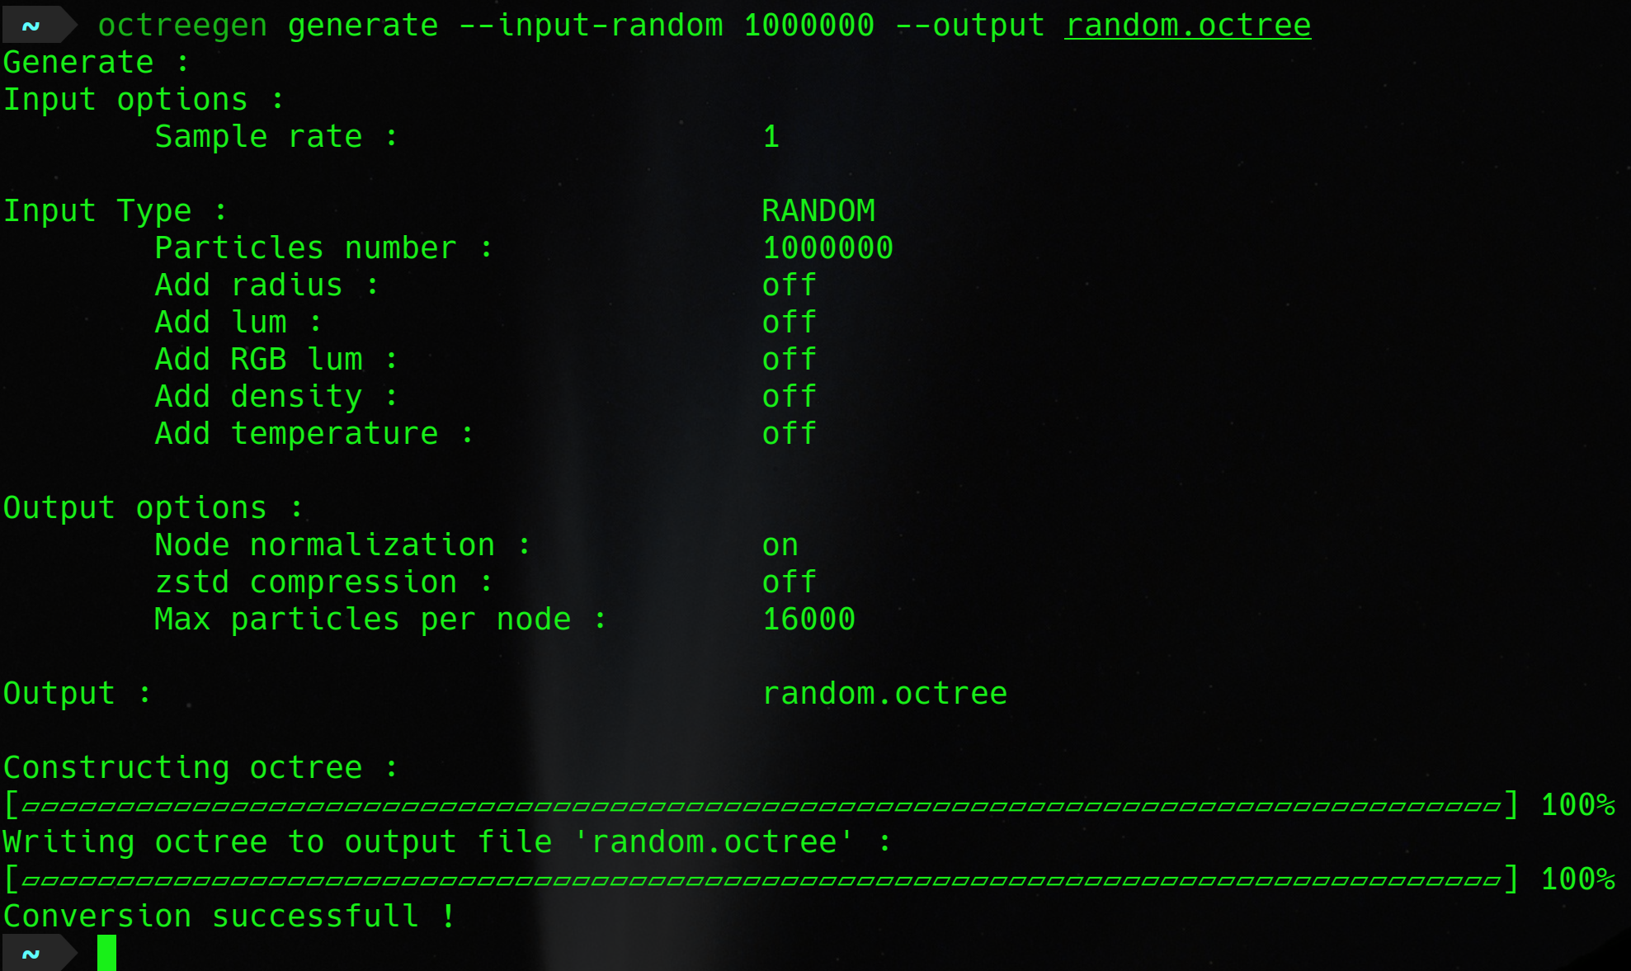
OCTREEGEN : CLI

Slide 14
FUTURE
Waiting for feedback on an SNSF Agora proposal with Tanya Petersen and Yves Revaz
Focus on putting VIRUP in the hands of as many people as possible
Use social media and public events more
Distribute data in a more accessible way to propose more datasets
Allow scientists to publish their data themselves or use the tool for their own outreach communication
Experiment with generative AI and voice recognition for automatic guidance through the data
Support even more hardware
Dynamic cosmological simulations

Slide 15
Thank you !
go.epfl.ch/VIRUP
Florian CABOT
27.01.2025

