Slide 1
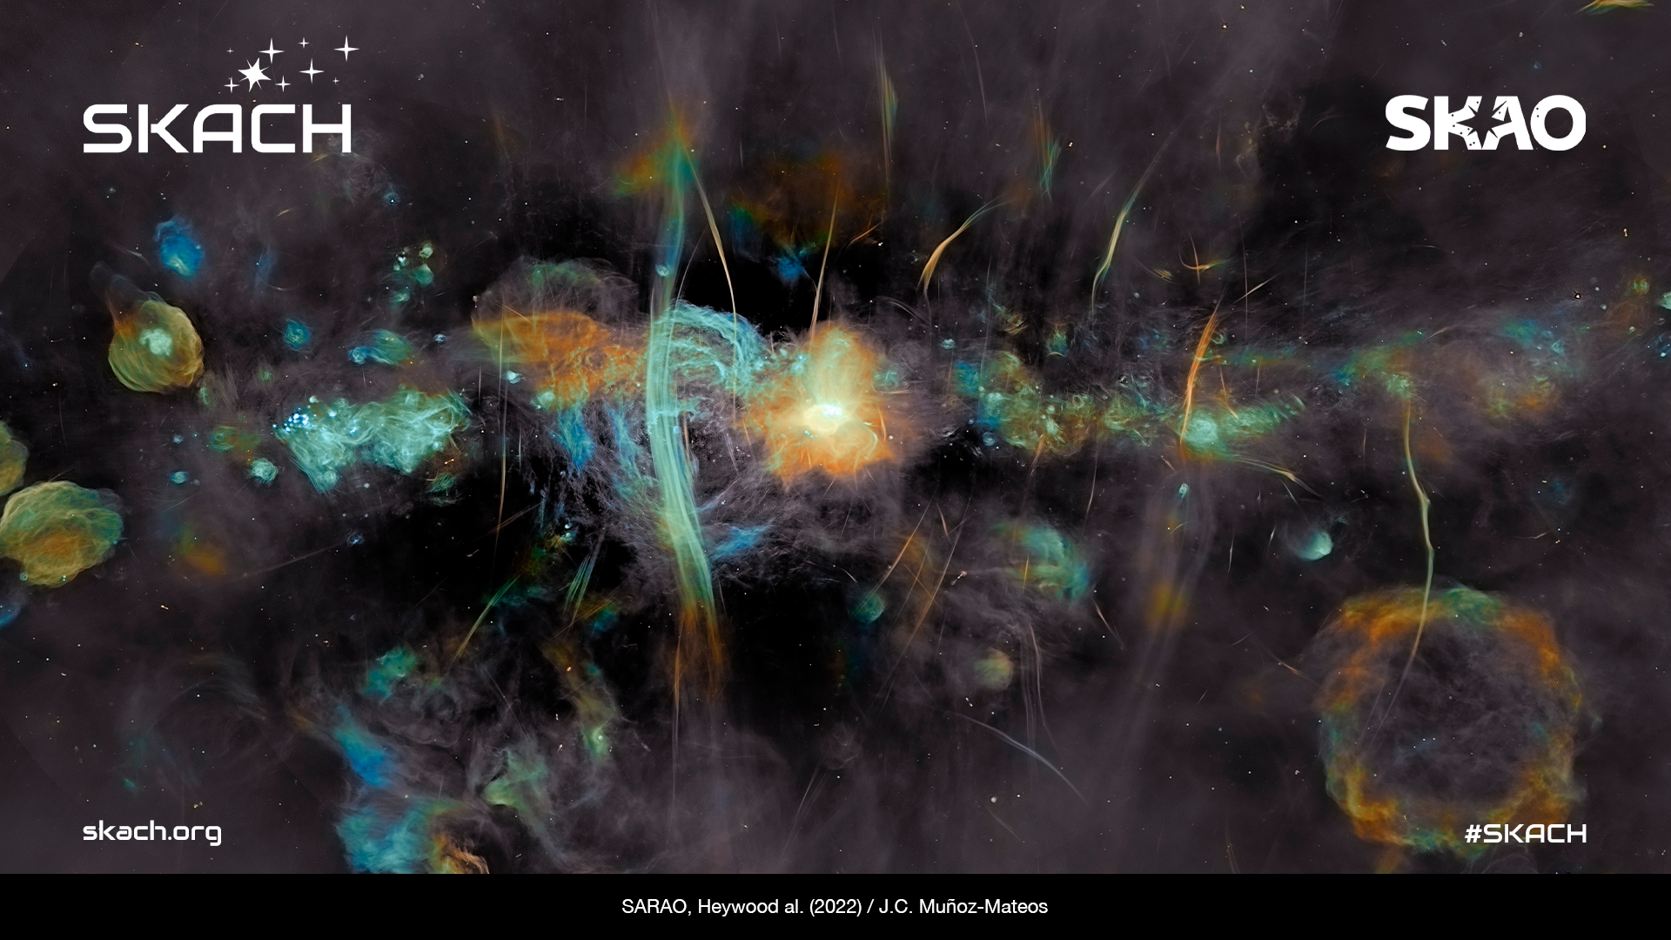
SKACH Consortium and Collaboration
Carolyn Marie Crichton
17 March 2025

Slide 2

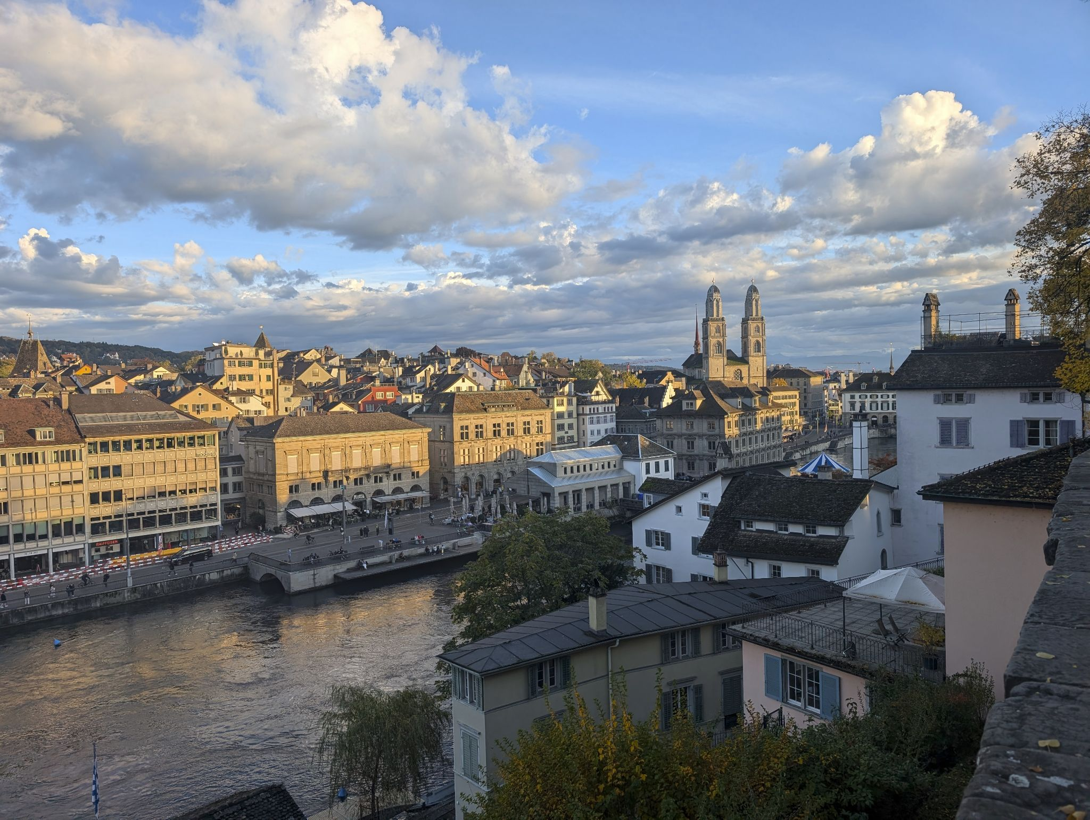
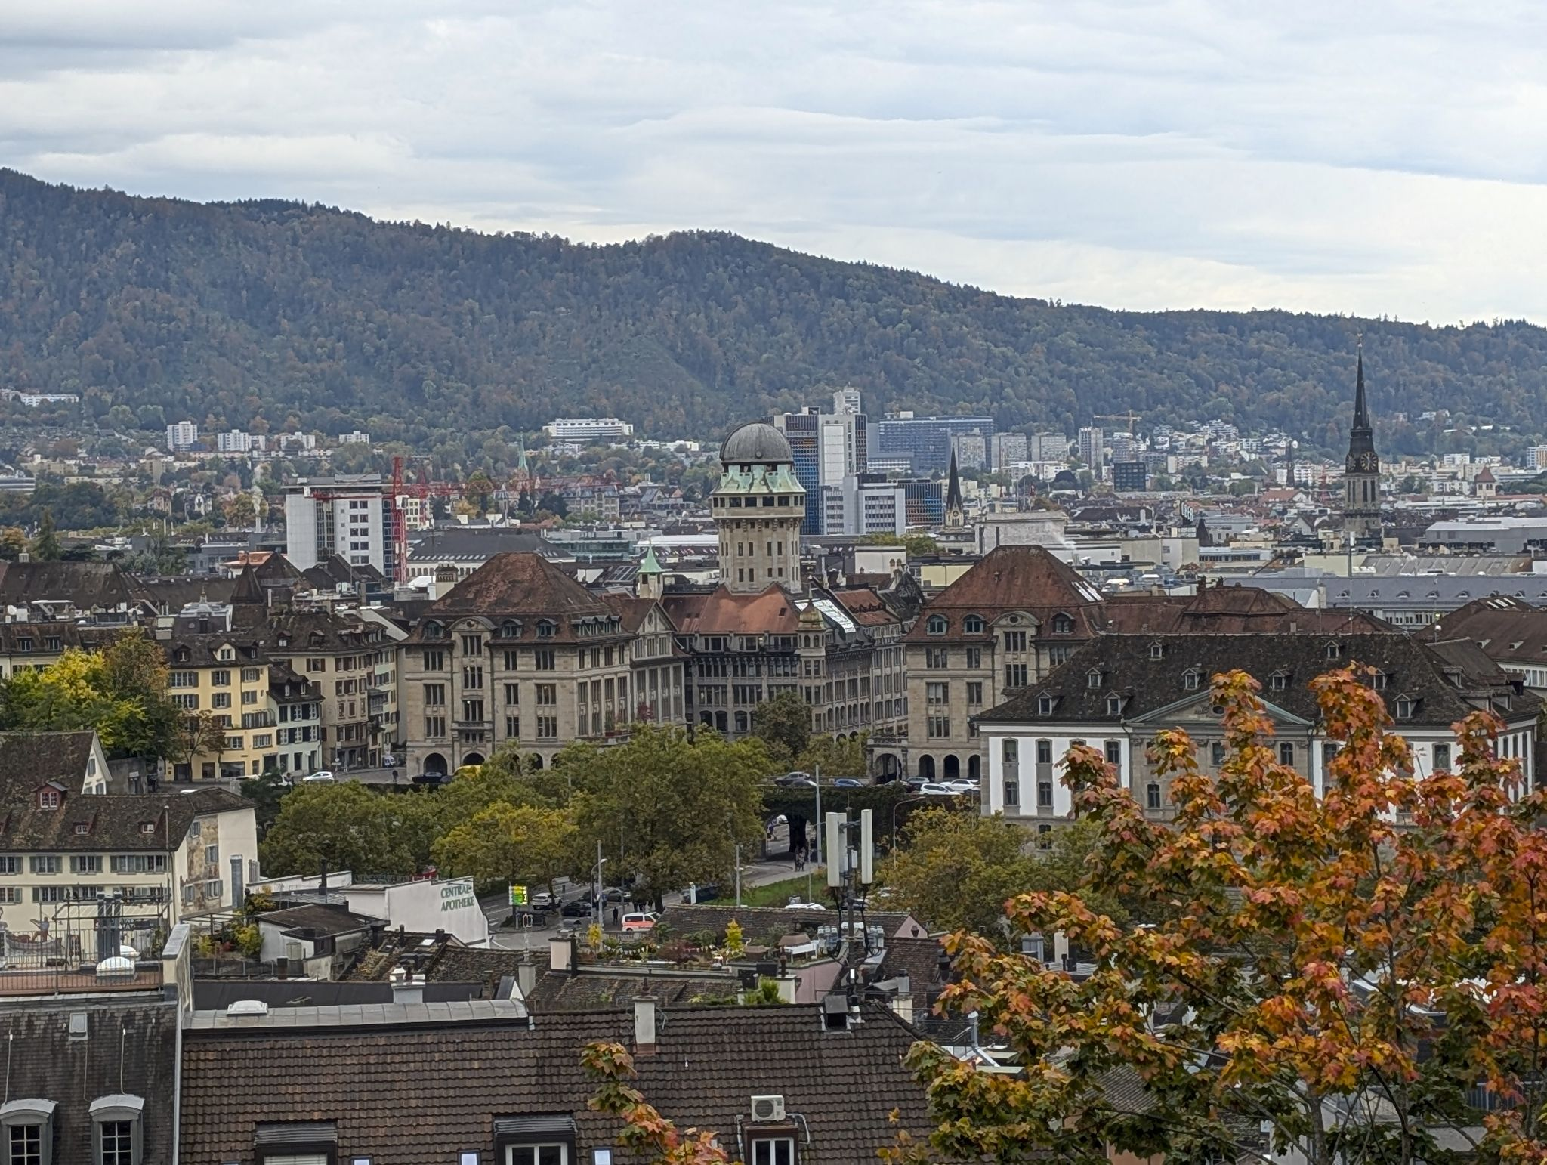
Welcome!

Slide 3
Agenda
9:30 Coffee
10:00 Collaboration with SKACH
10:15 Swiss Science Priorities
10:35 SPH-EXA
10:55 Astrophysics and Cosmology
11:10 Group Photo and Moring Break
11:40 AI Developments
12:00 CSCS Infrastructure for SRCs
12:15 SRCNet
12:30 Lightning talks
12:45 HPC
13:00 Lunch
14:00 Science Tool demonstrations
14:45 Towards MID-band 6
15:00 Opportunities in Africa
15:30 Einstein Tour Group 3
16:30 Einstein tour Group 1 & 2
18:30 Apero

Slide 4










Vision
Further Swiss leadership in the global radio astronomy community.
Switzerland joined the SKAO on January 19, 2022
SKACH is primarily funded by the State Secretariat for Education, Research and Innovation (SERI). Work within the consortium also leverages funding from external grants such as AstroSignals SINERGIA, SNF Bilateral, PASC, and Horizon Europe.
SKACH is a strong consortium of 10 research institutions:
Mission
Ensure meaningful contributions to the SKAO and SRCs through the development and delivery of cutting-edge Swiss solutions to key science goals, big data research, technology, and services.

Slide 5
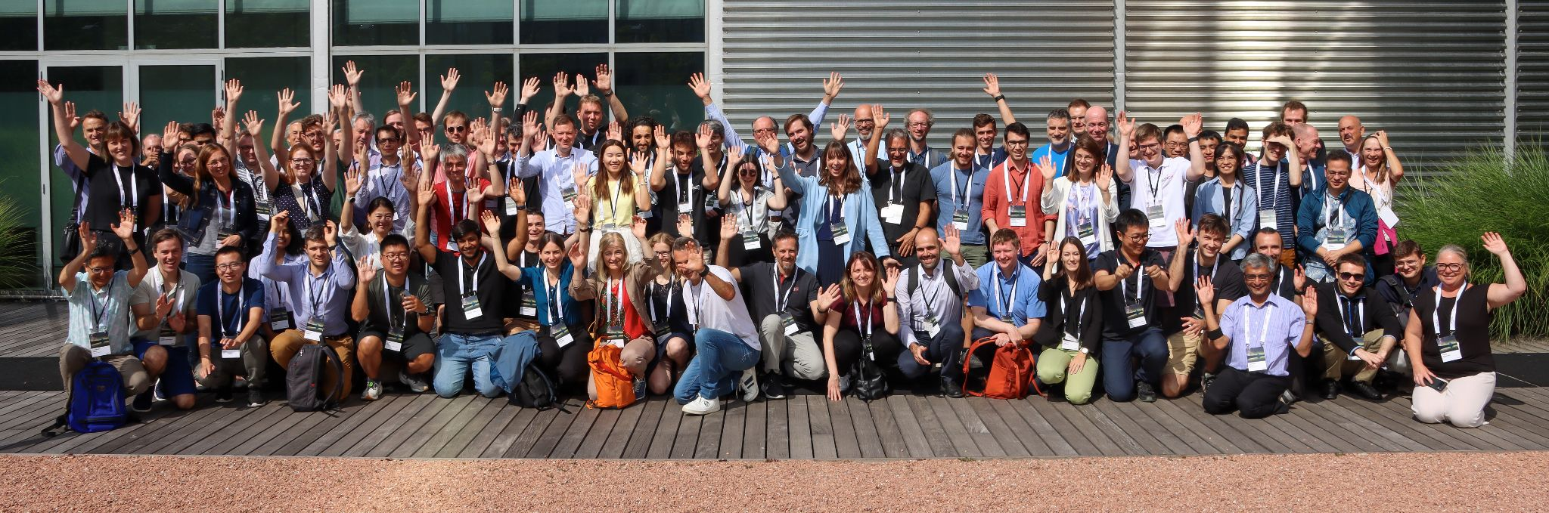
Members
Over 100 individual members from participating institutions across Switzerland! This interdisciplinary group is made up of astronomers, computer scientists, data scientists, engineers, and students!

Slide 6
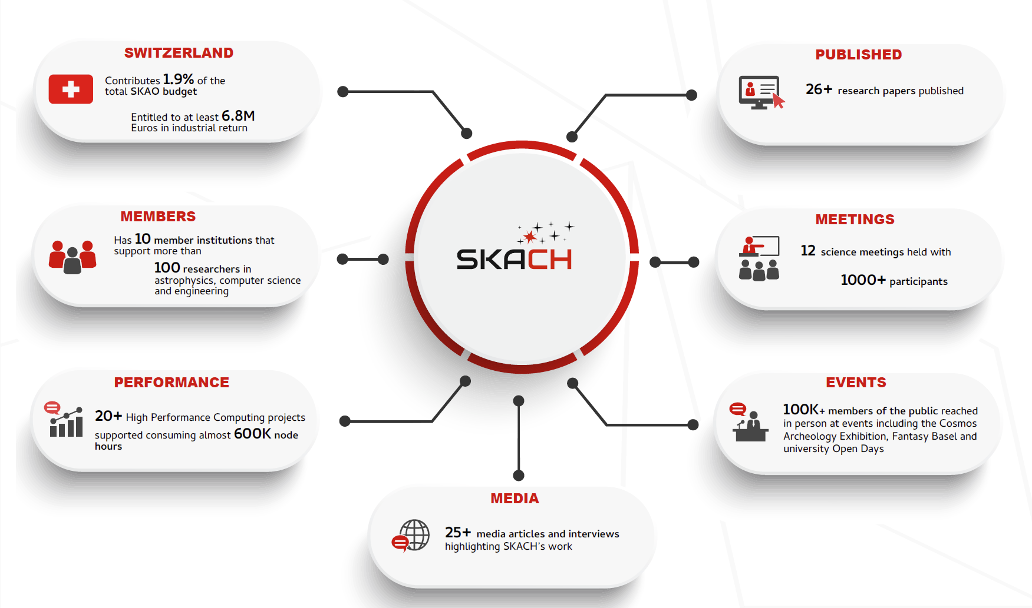

Slide 7
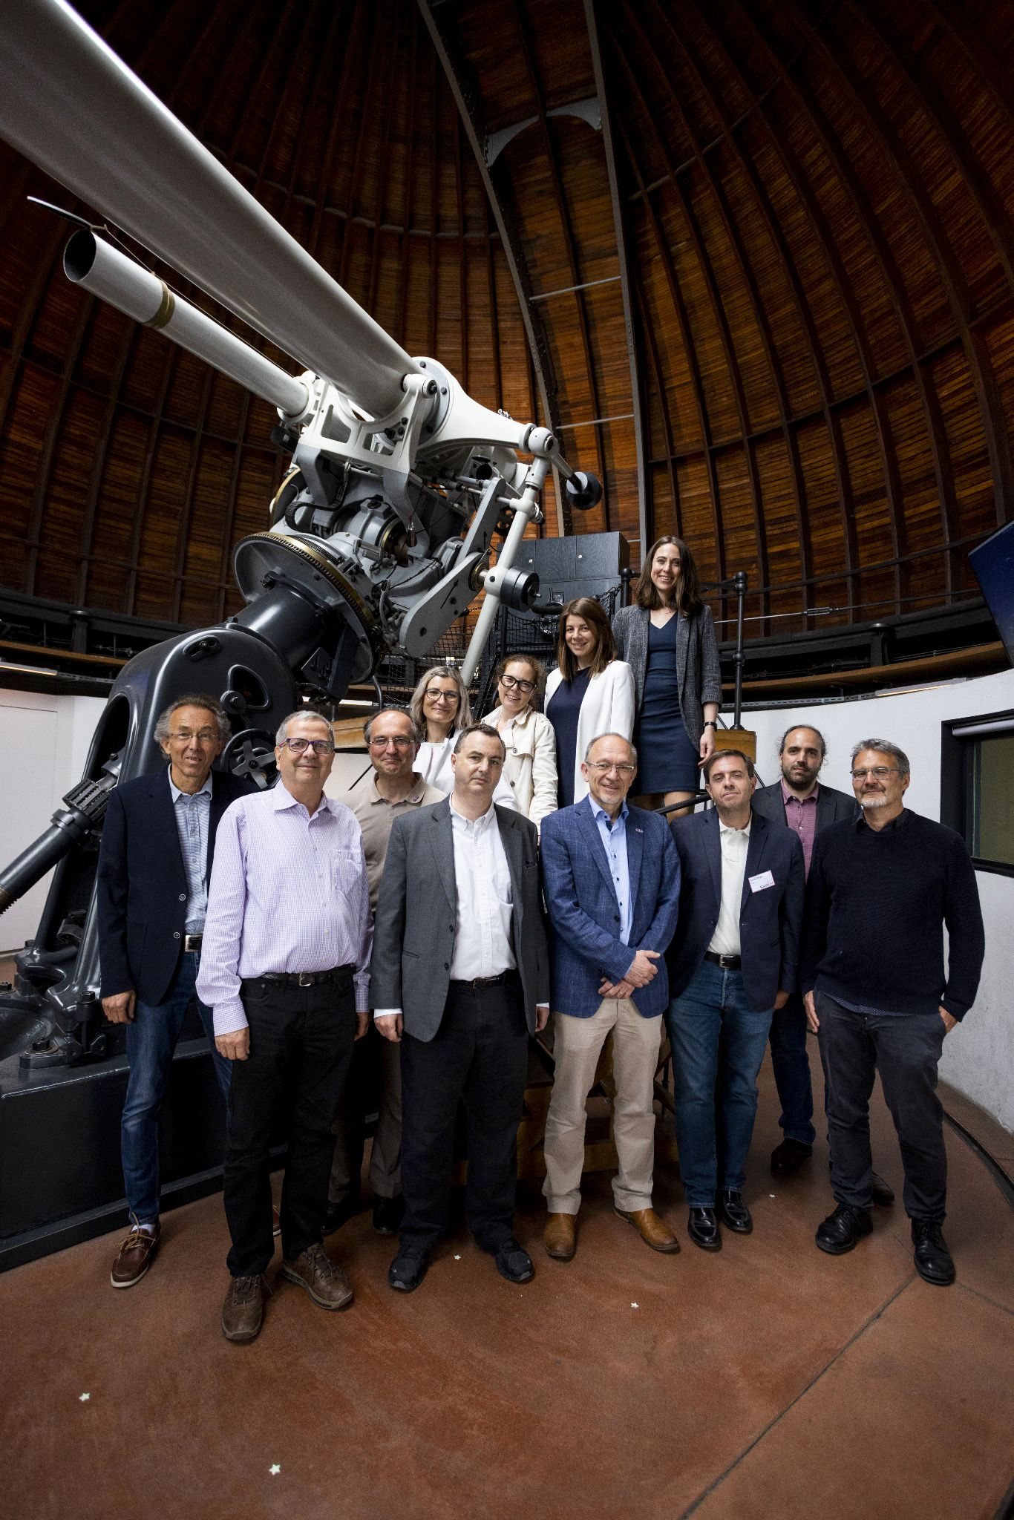
The SKACH Board is comprised of one voting member from each institution & is responsible for managing SKAO related activities.
Chair: Ms. Carolyn Marie Crichton
Co-Chair: Ms. Rohini Joshi
Voting Members
Prof. André Csillaghy (FHNW)
Prof. Alexandre Refregier (ETHZ)
Prof. Daniel Schaerer (UniGe)
Dr. Elena Gavagnin (ZHAW)
Dr. Evelina Breschi (HES-SO)
Prof. Florina Ciorba (UniBas)
Prof. Jean-Paul Kneib (EPFL)
Prof. Lucio Mayer (UZH)
Dr. Mark Sargent (ISSI)
Mr. Pablo Fernandez (CSCS)
Observer: Susanne Wampfler (UniBern)
The SKACH Board. Left to Right: Top: Daniel Schaerer, Jean-Paul Kneib, Florina Ciorba, Evelina Breschi, Elena Gavagnin, Carolyn Marie Crichton Bottom: André Csillaghy, Alexandre Refregier, Stefan Kögl, Lucio Mayer, Pablo Fernandez

Slide 8
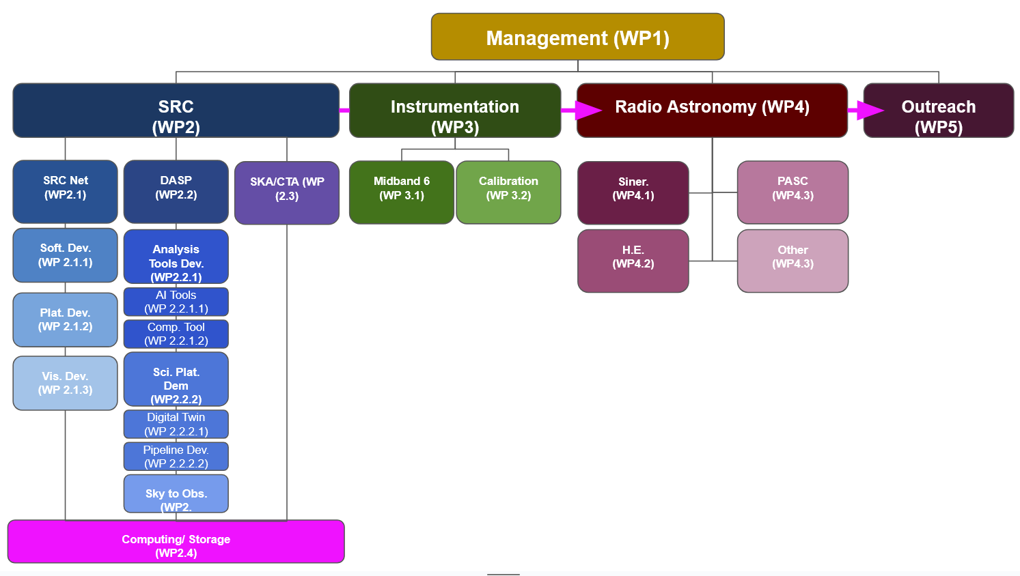
2025-2028 Work Breakdown Structure

Slide 9
Progress of the SKACH Consortium
2025
2026
2027
2028
Year 1:
Structure Adjustments, Certified SRC V0.1 node, Swiss Science Priorities, and Funding Allocation Announcements (FLARE, SNSF)
Year 2:
SRC V0.2 and V0.3, Precursor Science, Finalize Written Communications Plan, Strategize Long-term Consortium Funding
Year 3:
SRC V1 Beta, Continue Long-term Funding Strategy and Proposal Writing
Year 4:
SRC V1, SKAO AA* Data, Results and Papers, Planning for Next 4-years

Slide 10
Immediate Collaborative Areas -
Ongoing Efforts
SRC collaboration with the Chocolate Team
  IAA in Granada
  Curtin University
  UK SRC
  INAF
Science Data Challenge
  Sweden
Bilateral Grants
  South Africa
Switzerland is looking at future Mid-band 6
  UK
  Sweden
  Japan

Slide 11
Upcoming Meetings
Cosmology on Safari - 1-7 June, 2025
SKAO Science Meeting 16-20 June 2025
SKA Days - 25, 26, 27 August 2025 - Winterthur
Cosmology in the Alps - March 2026

Slide 12
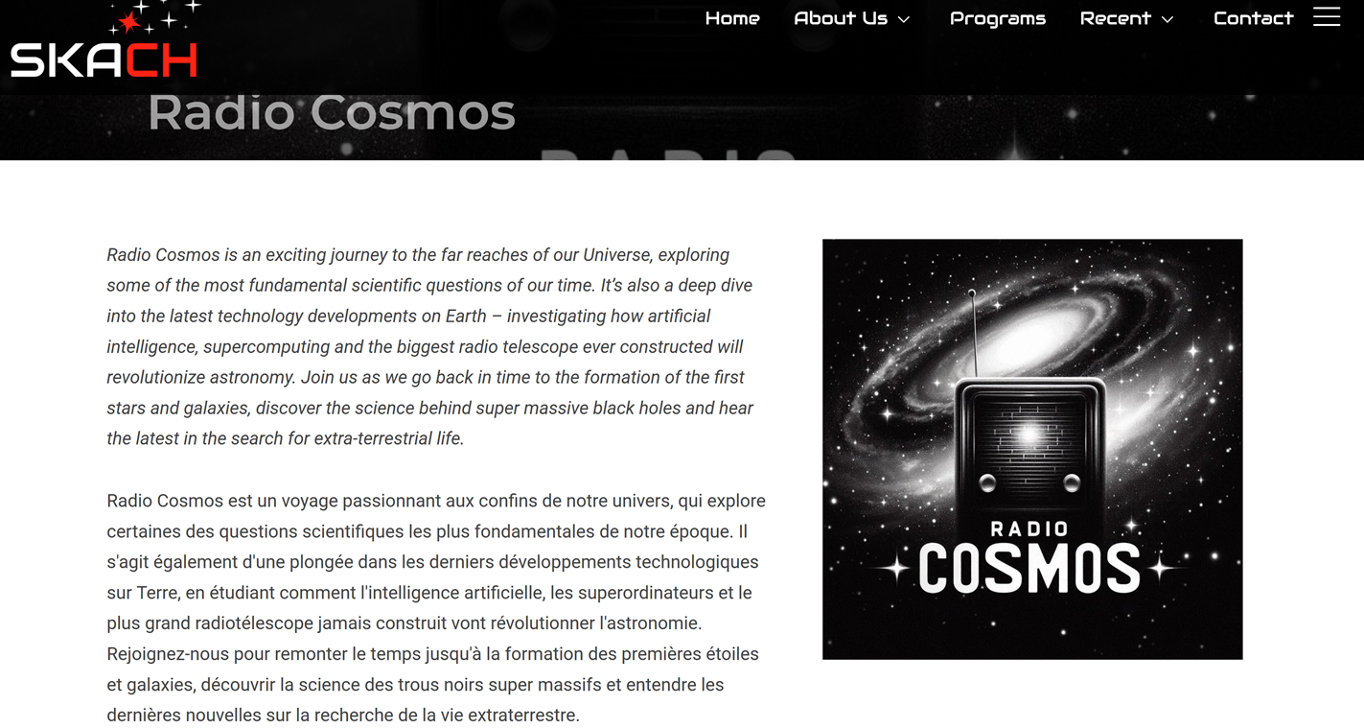

Slide 13
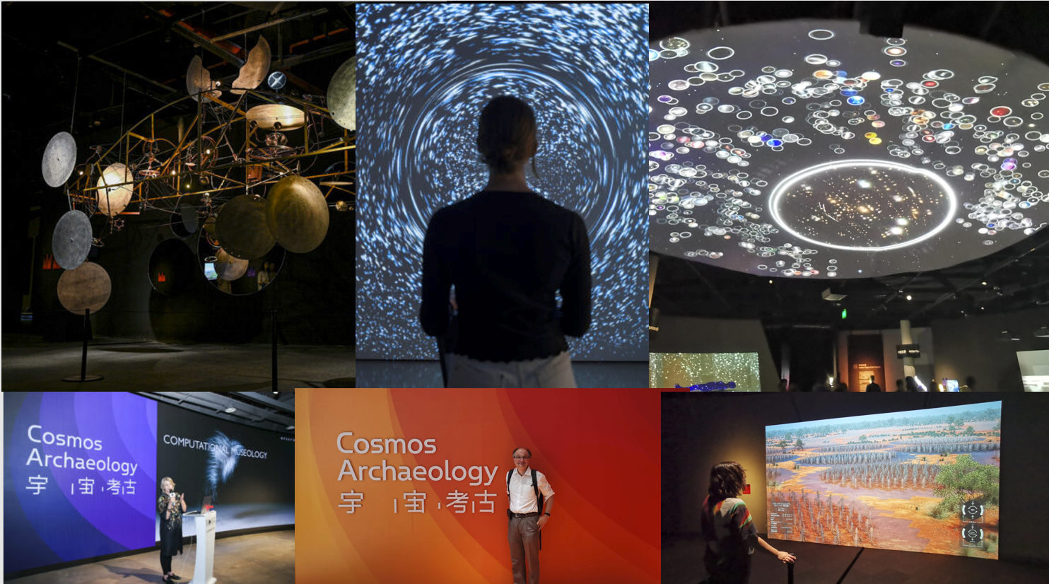

Slide 14
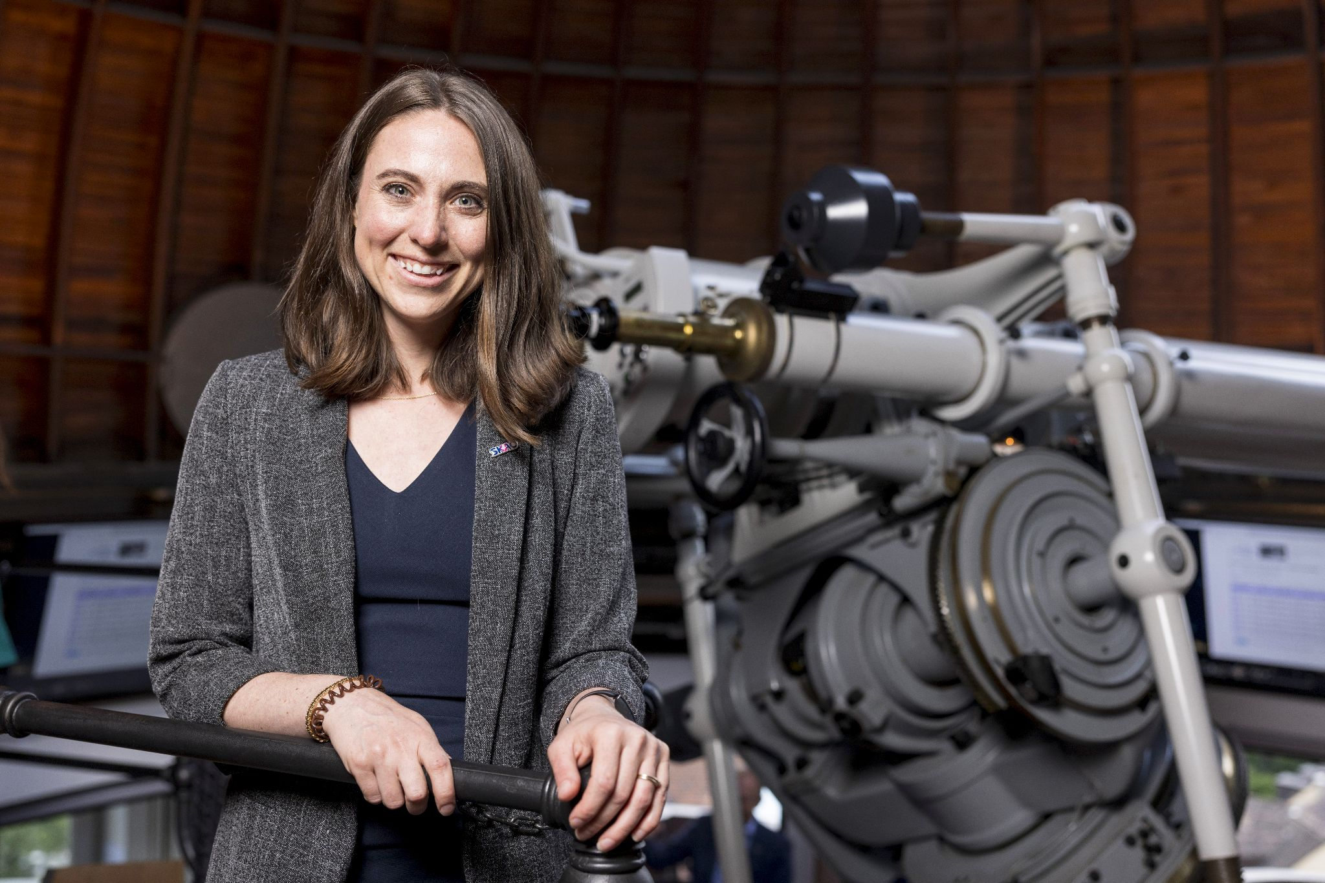
Contact Me:
Carolyn.Crichton@EPFL.ch

