Slide 1
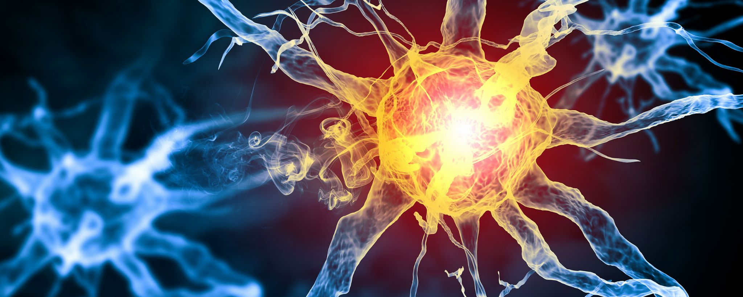
AI Developments in SKACH
SKAO Council Science Meeting
Mar 17, 2025
Philipp Denzel & Elena Gavagnin
ZHAW Zurich University of Applied Sciences

Slide 2










Overview
Detecting & Classifying Sources
Emulating Simulations - Domain Transfer - Image Artefacts Cleaning
Accelerating Numerical Simulations
Statistical Inference

Slide 3
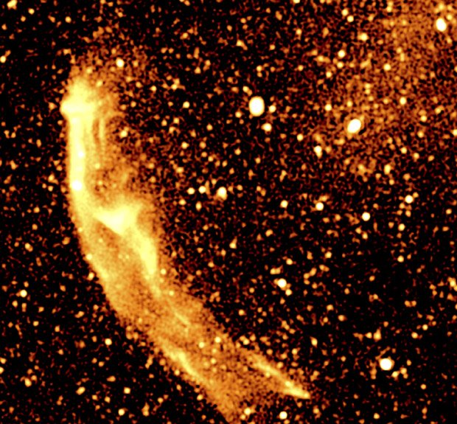
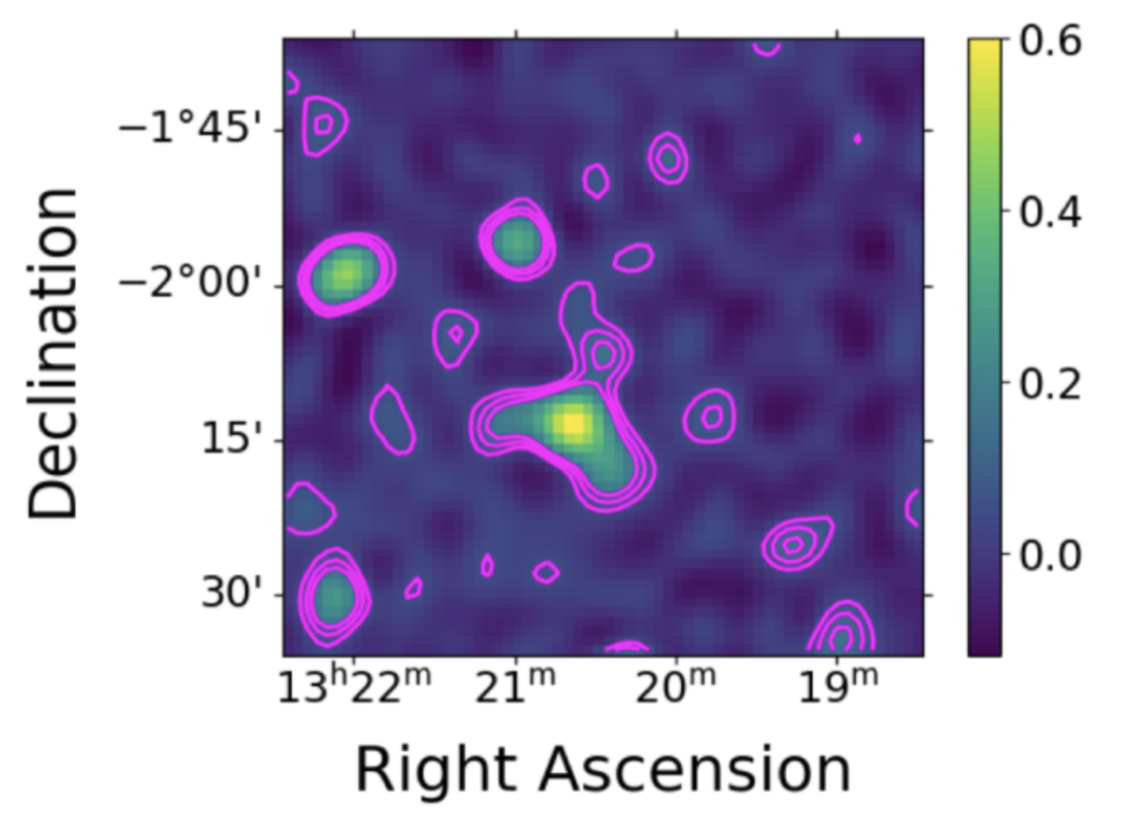
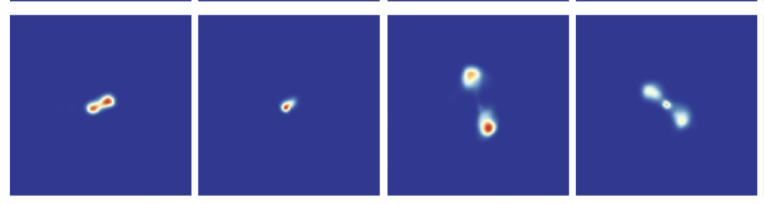
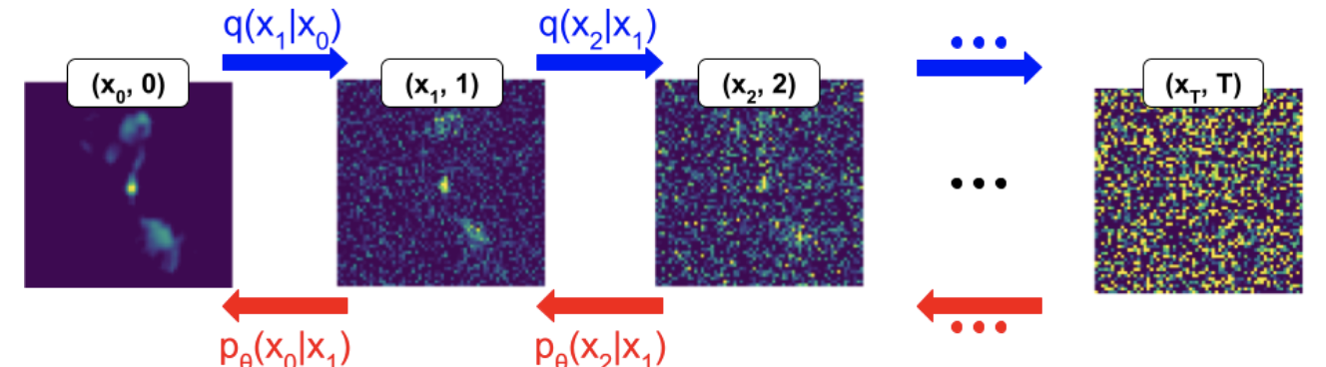
Identifying diffuse radio emission in real data
(Mishra, Bredberg, Poitevineau & Tolley)
Galaxy cluster diffuse emission: unique probe of cluster cosmic ray physics & magnetic fields
Typically studied through targeted observations pre-selected using xray or millimeter observations => can we do an unbiased survey using AI to identify cluster diffuse emission in an automated way?
Dataset is very small, so use generative augmentation
Exploring data from MeerKAT (M. Bredberg) and MWA (A.Mishra)
Proof-of-concept on FRII galaxies (M. Bredberg)
Diffusion-supported classifier with a multi-head attention block discovered 11 new candidates in MWA data (Mishra+ arXiv: 2411.15559)
Developing diffusion model on MeerKAT radio galaxies & diffuse emission to support future research (R. Poitevineau)

Slide 4
Foundation models and radio astronomy
(Lastufka et al.)
Foundation models are large models trained to capture general characteristics from an abundance of data. These representations can be used as a starting point for many different downstream tasks.
Training requires millions to billions of data samples and many GPUs; therefore state-of-the-art foundation models all come from industry
Can industry-produced vision foundation models, trained on natural images, learn representations that are useful for astrophysics images and tasks?
Do models fine-tuned on astrophysics images provide any advantage? How can such models be efficiently trained on SKA-precursor data (and eventually SKA data)?

Slide 5
Foundation models and radio astronomy
(Lastufka et al.)
Can industry-produced vision foundation models, trained on natural images, learn representations that are useful for astrophysics images and tasks?
Until Now:
Models trained on natural images thought to be insufficient for scientific data
However, there was no thorough investigation or use of modern foundation models; conclusions drawn mainly from ResNets trained for image classification
Our work: paper
Investigated modern architectures pre-trained on 1B+ datasets and various training objectives
Showed that conventional models can be adapted for optical and radio images and lead to performance improvements in morphology classification and source detection

Slide 6
Foundation models and radio astronomy
(Lastufka et al.)
Do models fine-tuned on astrophysics images provide any advantage? How can such models be efficiently trained on SKA-precursor data (and eventually SKA data)?
Until Now:
Preliminary results only from Galaxy Zoo trained multi-purpose models
Lack of diverse evaluation tasks and datasets limits progress
Results from other fields (Earth observation, biomedical imaging) show that performance gain from domain-specific training is minimal compared to compute required to train
Our work: paper
Demonstrated that cutouts from widefield MeerKAT images, containing tens of sources, can be used as training data
This reduces the need for highly curated Galaxy Zoo datasets that take years to create
Problem of few evaluation tasks and datasets remains; Galaxy Zoo still needed for those

Slide 7
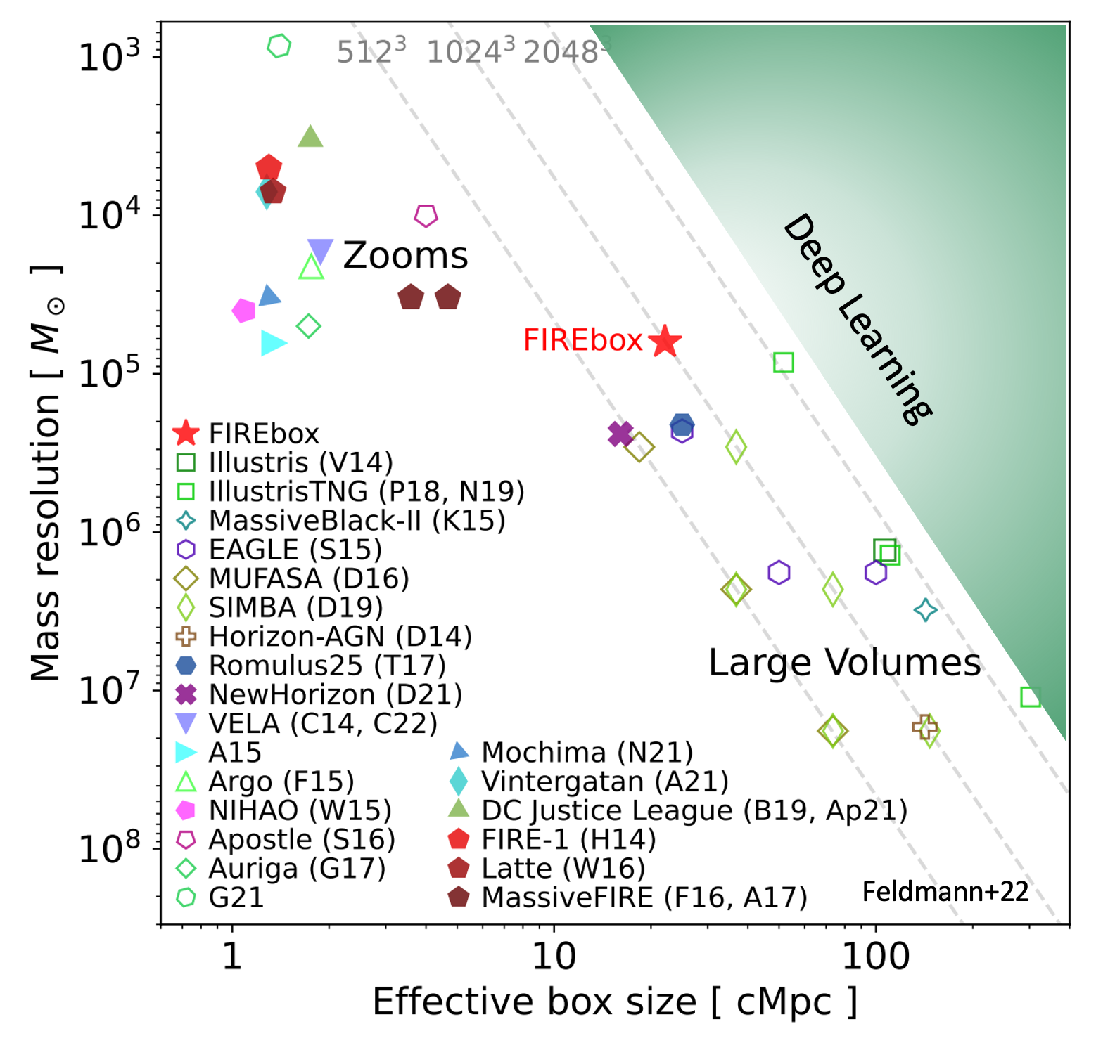
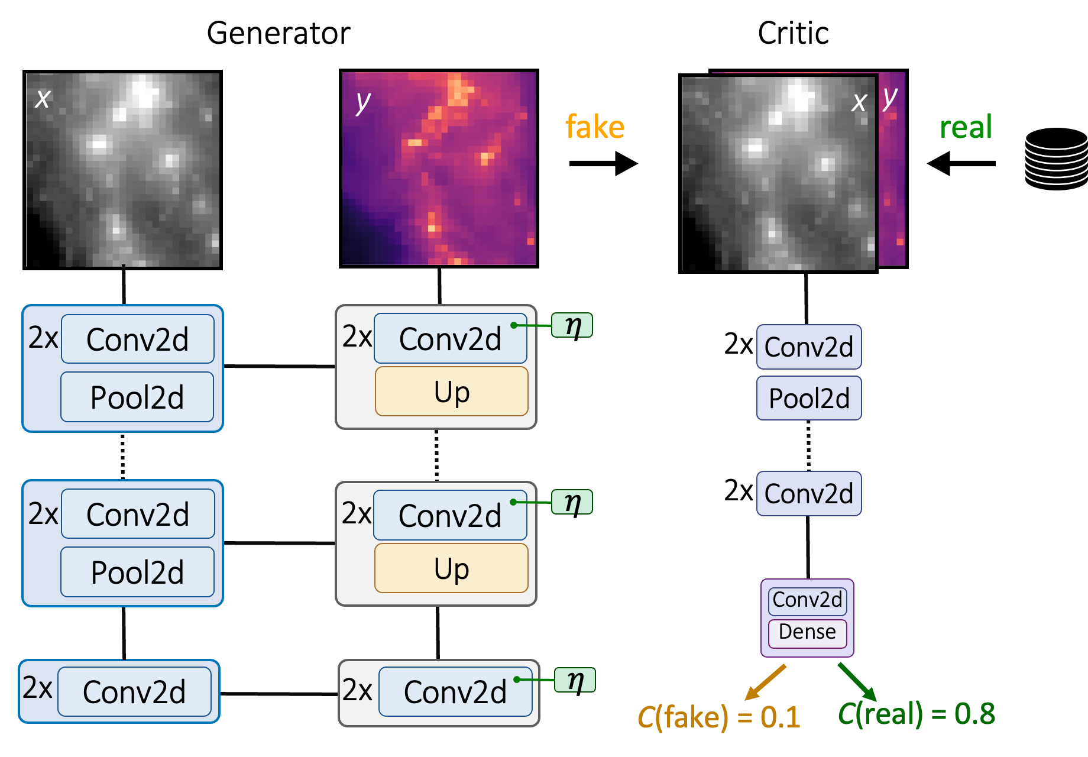
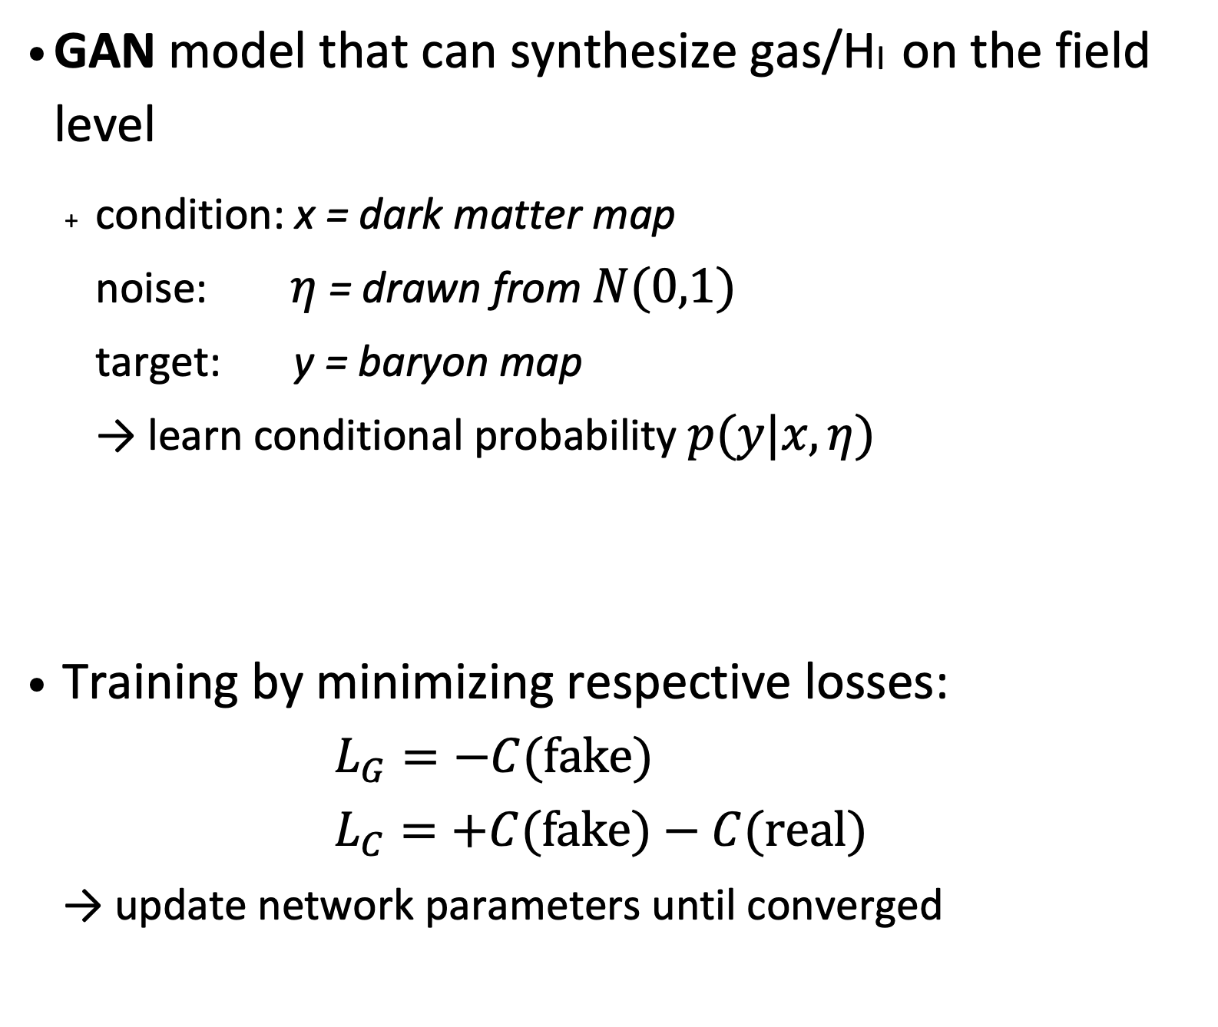
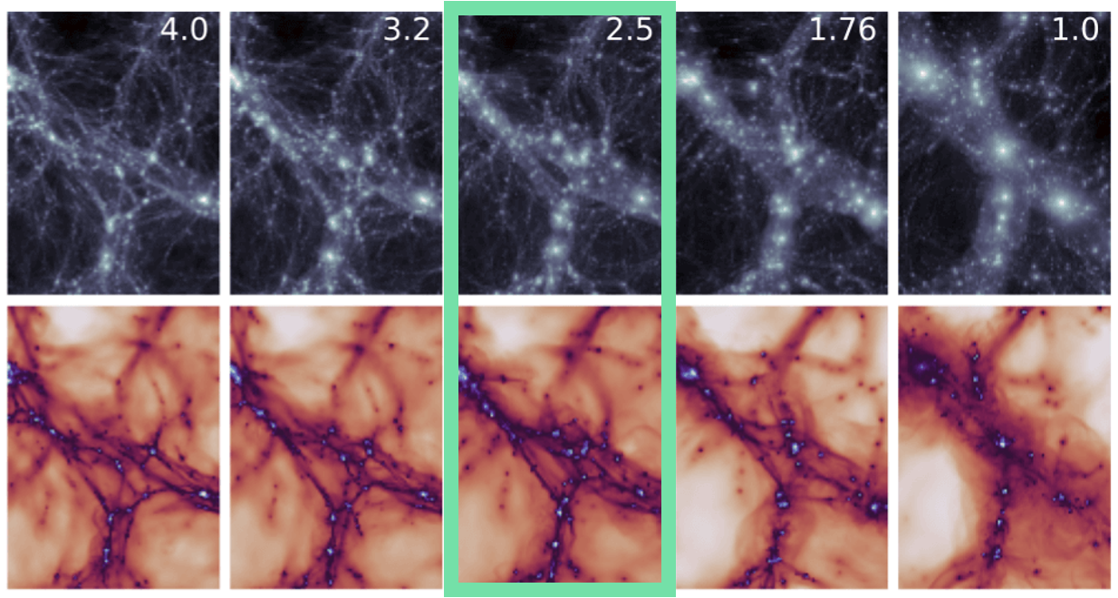
EMBER 1 & 2 - Framework for simulation-based baryon emulation
(Bernardini et al.)
Learning across redshifts

Slide 8
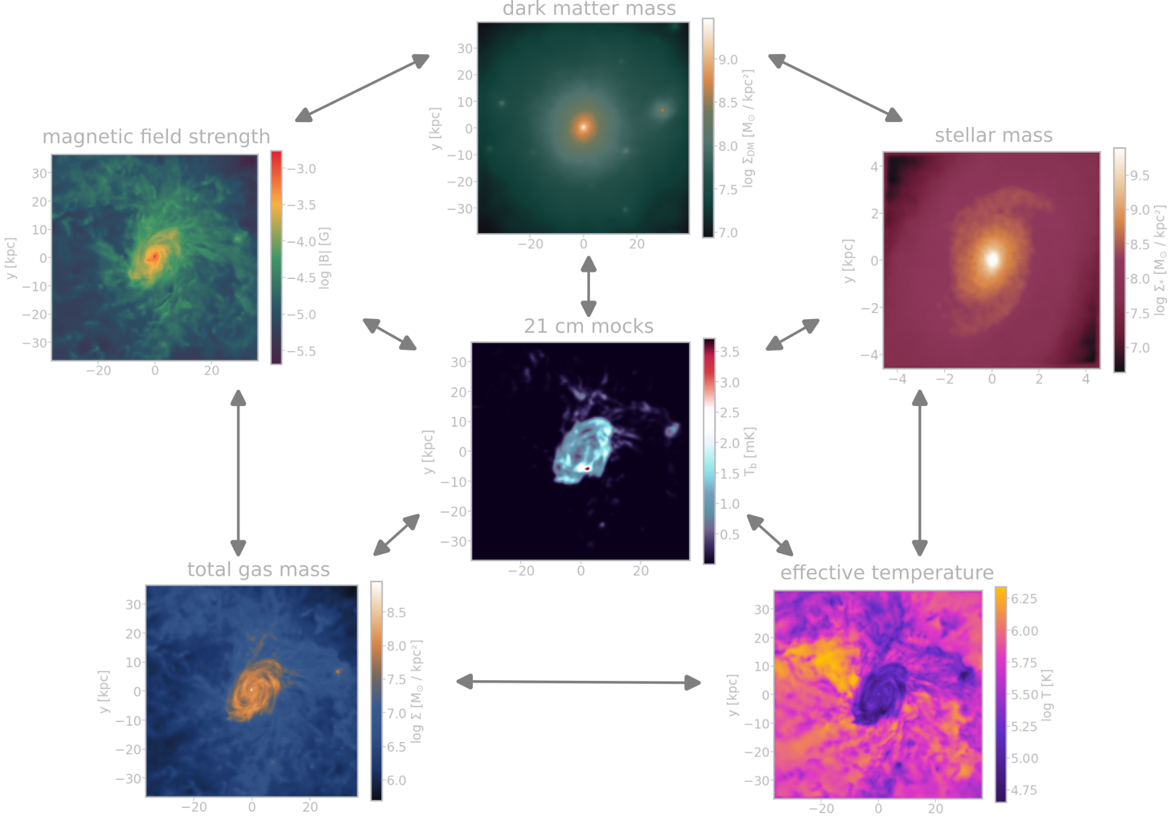
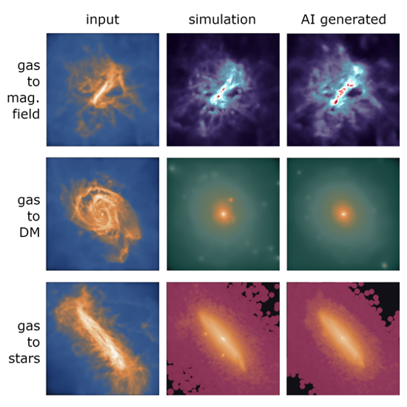
Domain mapping in hydrodynamical simulations
(Denzel, Schilling & Gavagnin)
Learn physical properties of galaxies from simulations (e.g. IllustrisTNG):
connect observables (stars, gas emissions) with the correspondent “unobservable” domains (dark matter, magnetic field strength, etc.)
Domain-translation generative neural networks
  U-Nets
  GANs
  Diffusion models
Realistic radio sky
model from simulations
with Karabo
Denzel et al. (2025, in prep.)

Slide 9
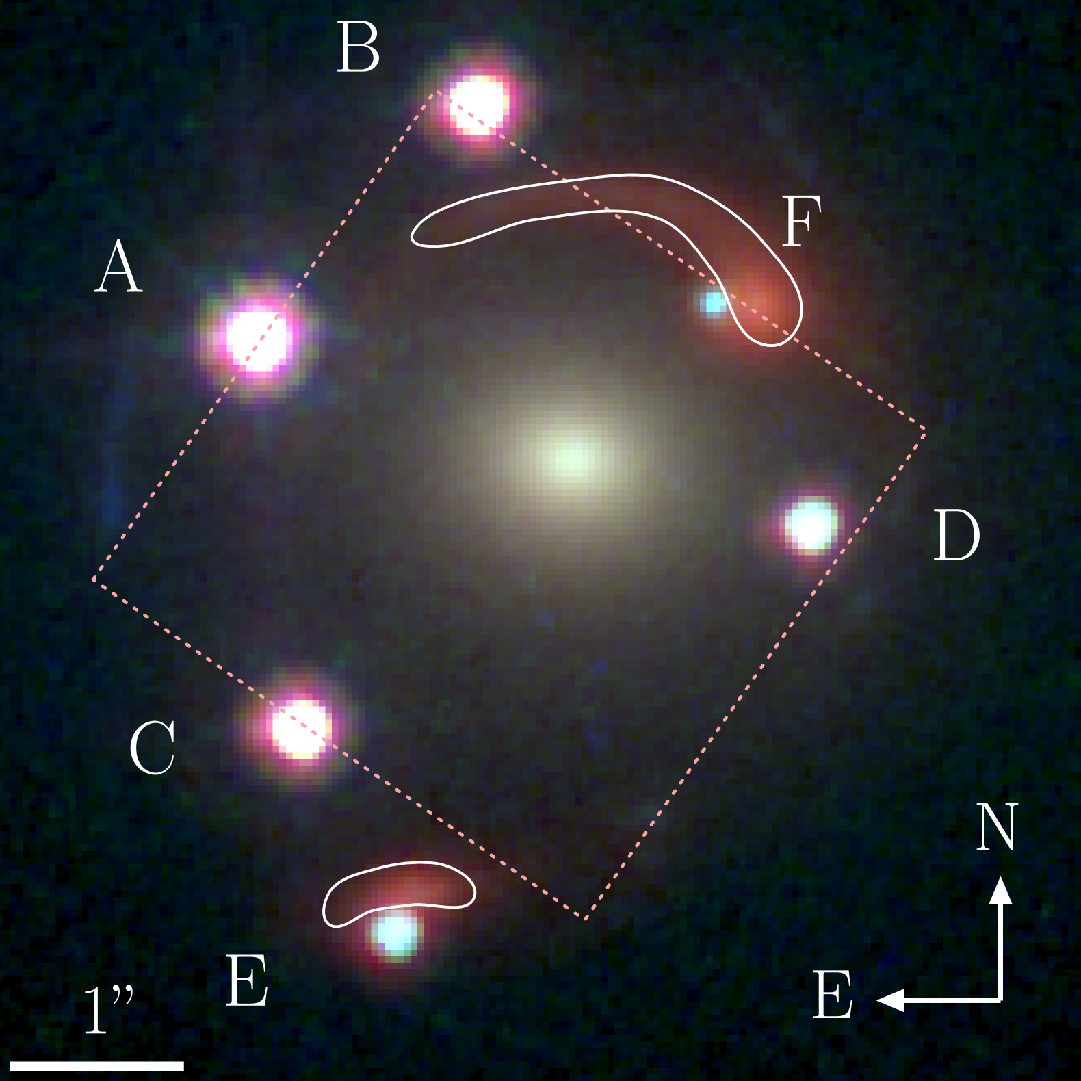
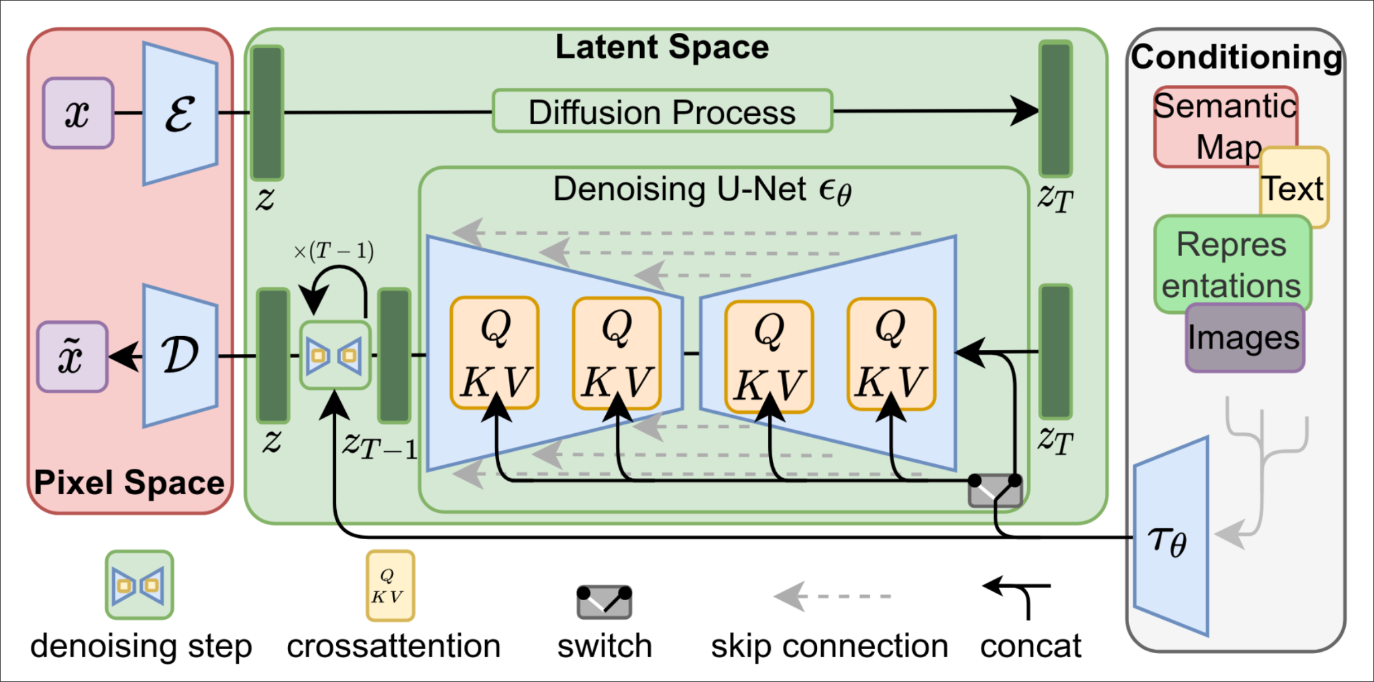
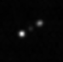
AI for Gravitational Lenses
Identification with foundation models:
~10⁵ lens detections from SKA-MID (Band 2) wide-field survey
Difficulties: false-positives → only 1 in 10 lenses identified with performance
Foundation models could improve detection rates
Follow-ups with Band 6 & VLBI:
promising scientific discoveries (see
McKean et al. 2015
or Hartley et al. 2019)
Modelling lens priors with latent diffusion:
Realistic galaxy mass distributions for lens observations
Estimate galaxy prior
from simulations using
generative models
Dux et al. (2024)
Lens or AGN lobes? - from Denzel et al. (2025, in review)
Rombach et al. (2022)

Slide 10
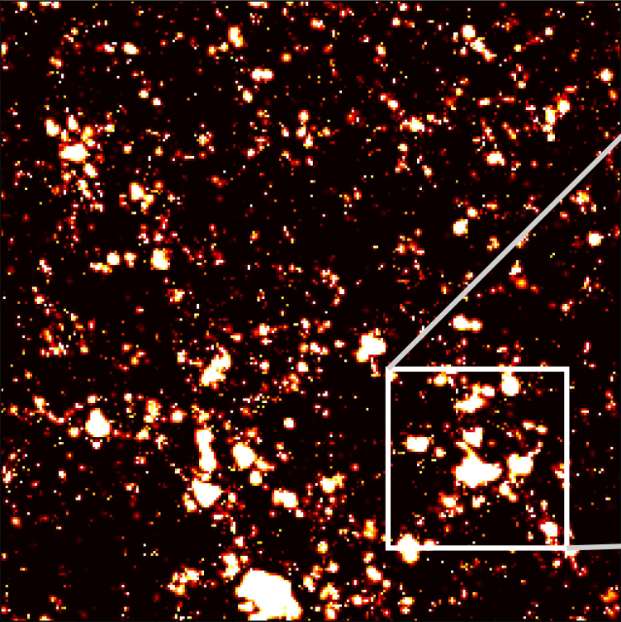
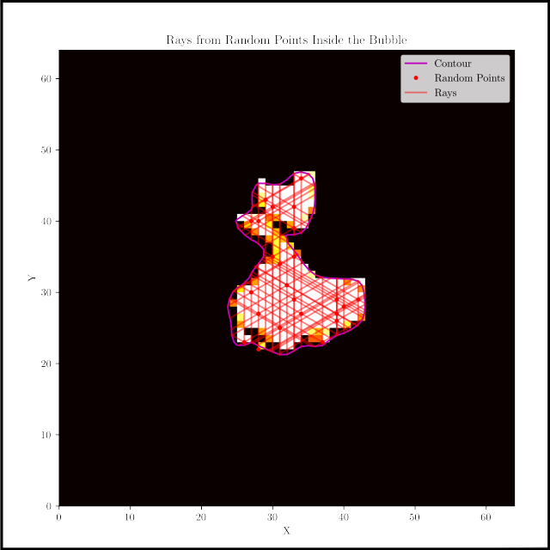
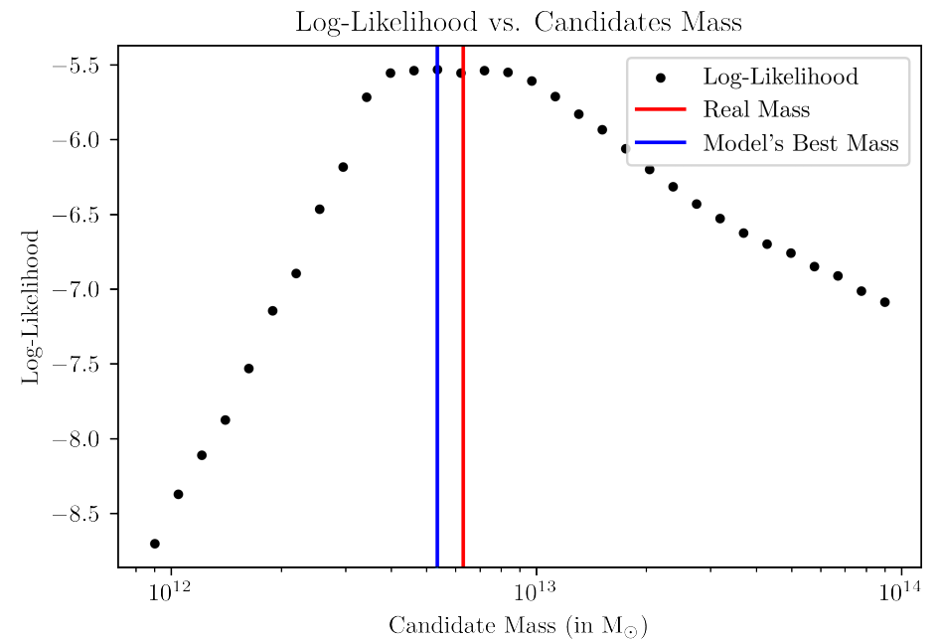

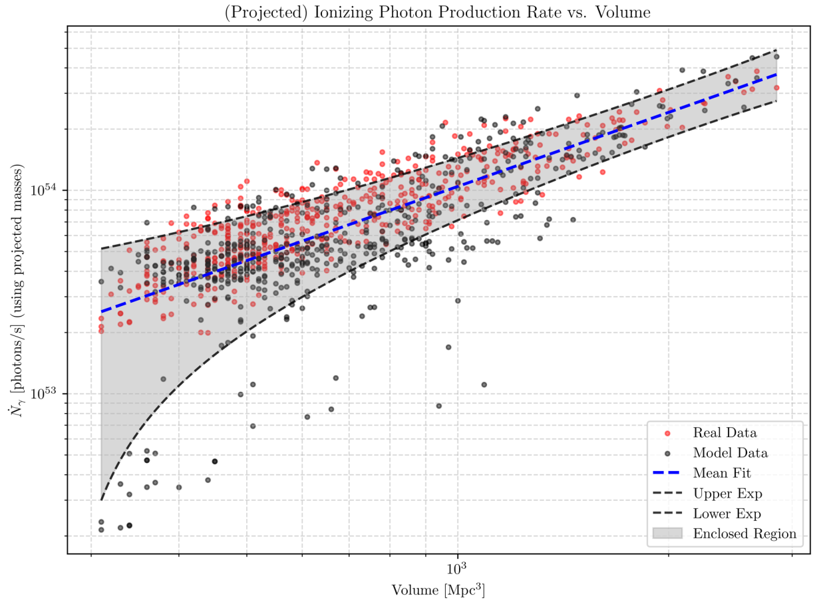
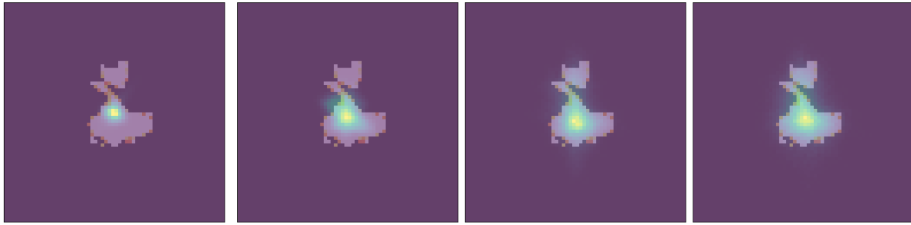
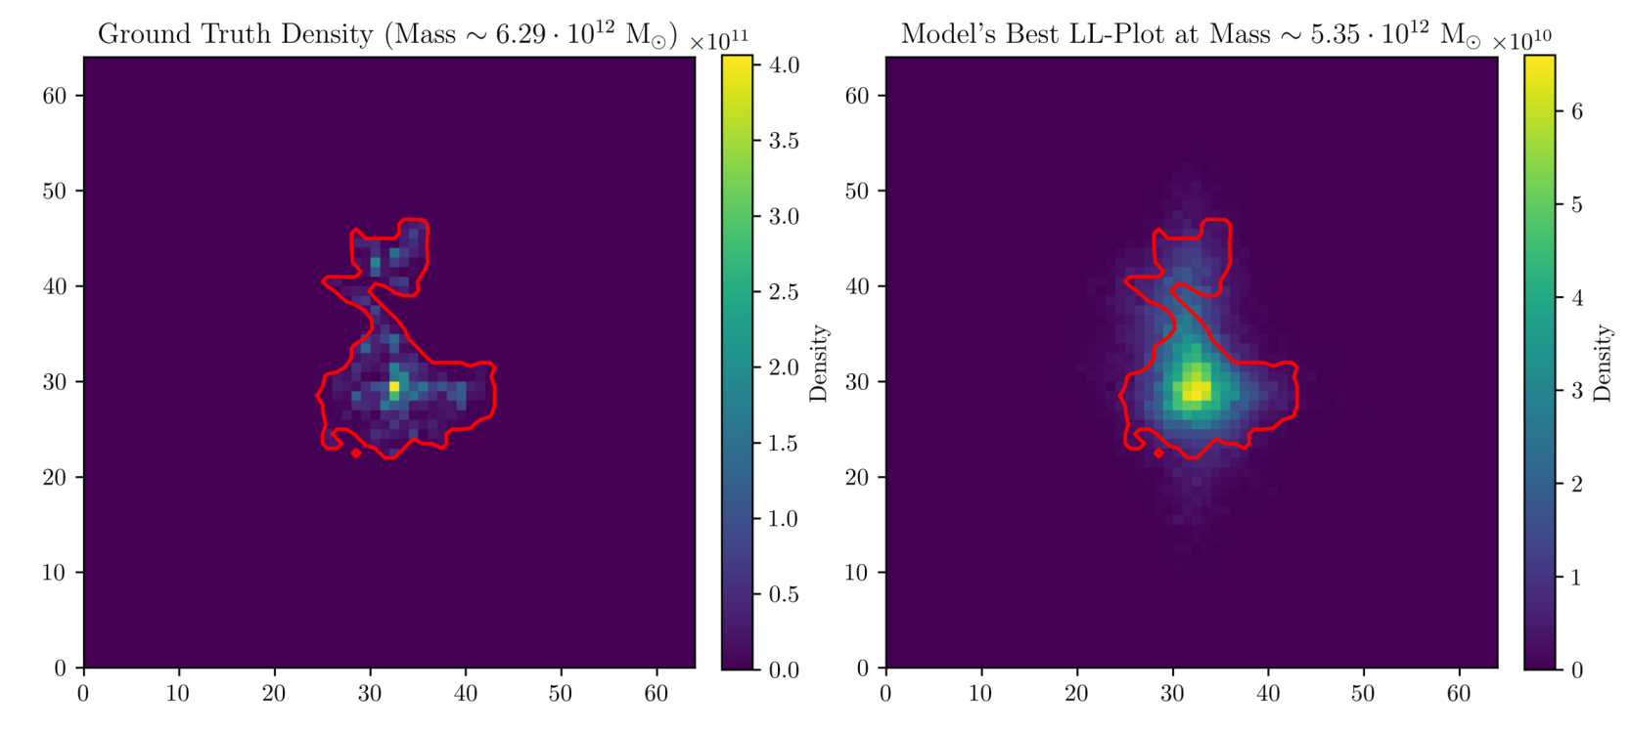
Normalizing Flow for JWST and SKA-Low Observations
(Bianco et al.)
Locate ionizing high-z sources in HII regions
Without AI this process is intense & approximate
GLOW:
probability position of the ionizing sources based on the HII region shape
conditional vectors
GLOW

Slide 11

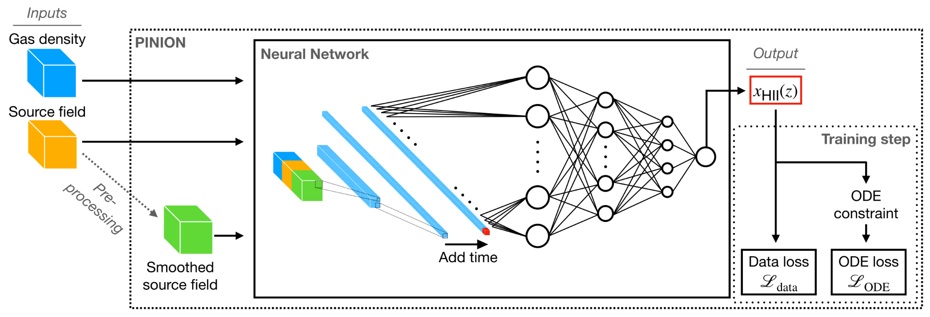

Physic Informed Neural Network for EoR
(Bianco et al. 2022)
Physics Informed Neural Network (PINN) to speed-up the simulation of computationally expensive cosmological Reionization simulations.
Physics Loss:

Slide 12
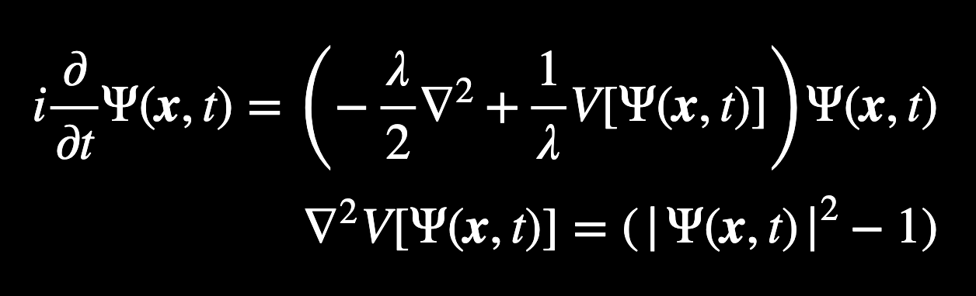
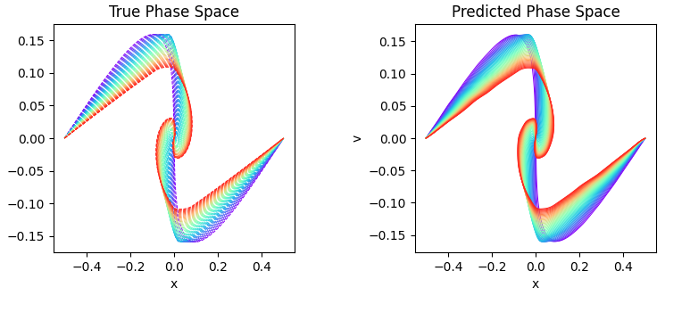
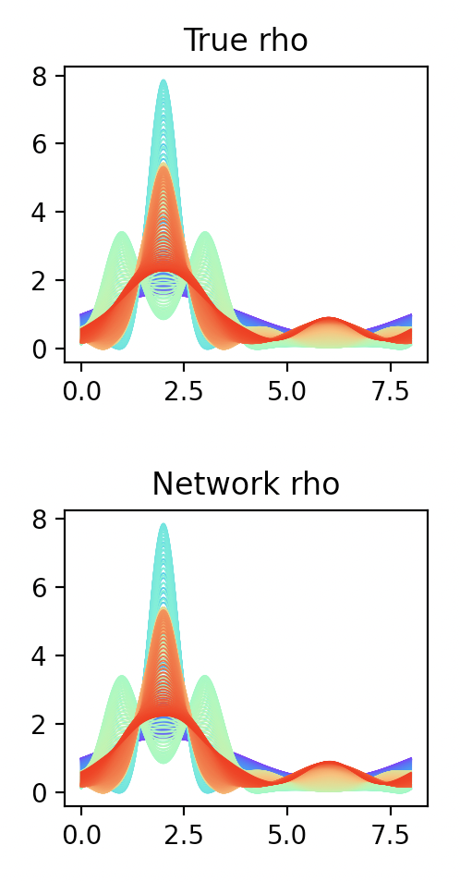
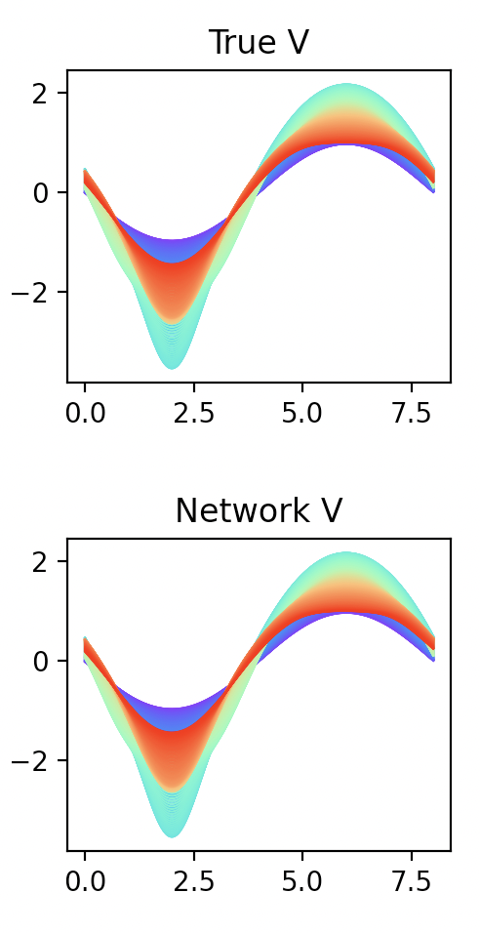
Physics informed machine learning for cosmological simulations
(Mishra, Cerardi & Tolley)
Dynamical equations of Fuzzy Dark Matter
Physics-informed neural network: Use physics constraints as an additional loss term during network training
Smooth, differentiable, gridless predictions for dark matter density
Network learns the physics of Fuzzy Dark Matter (A. Mishra)
Use Kolmogorov-Arnold networks to model the singularities of Cold Dark Matter (N. Cerardi)

Slide 13

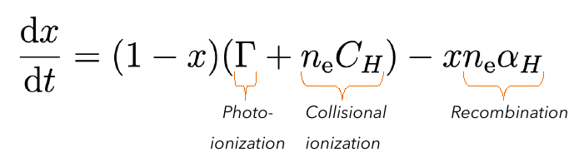
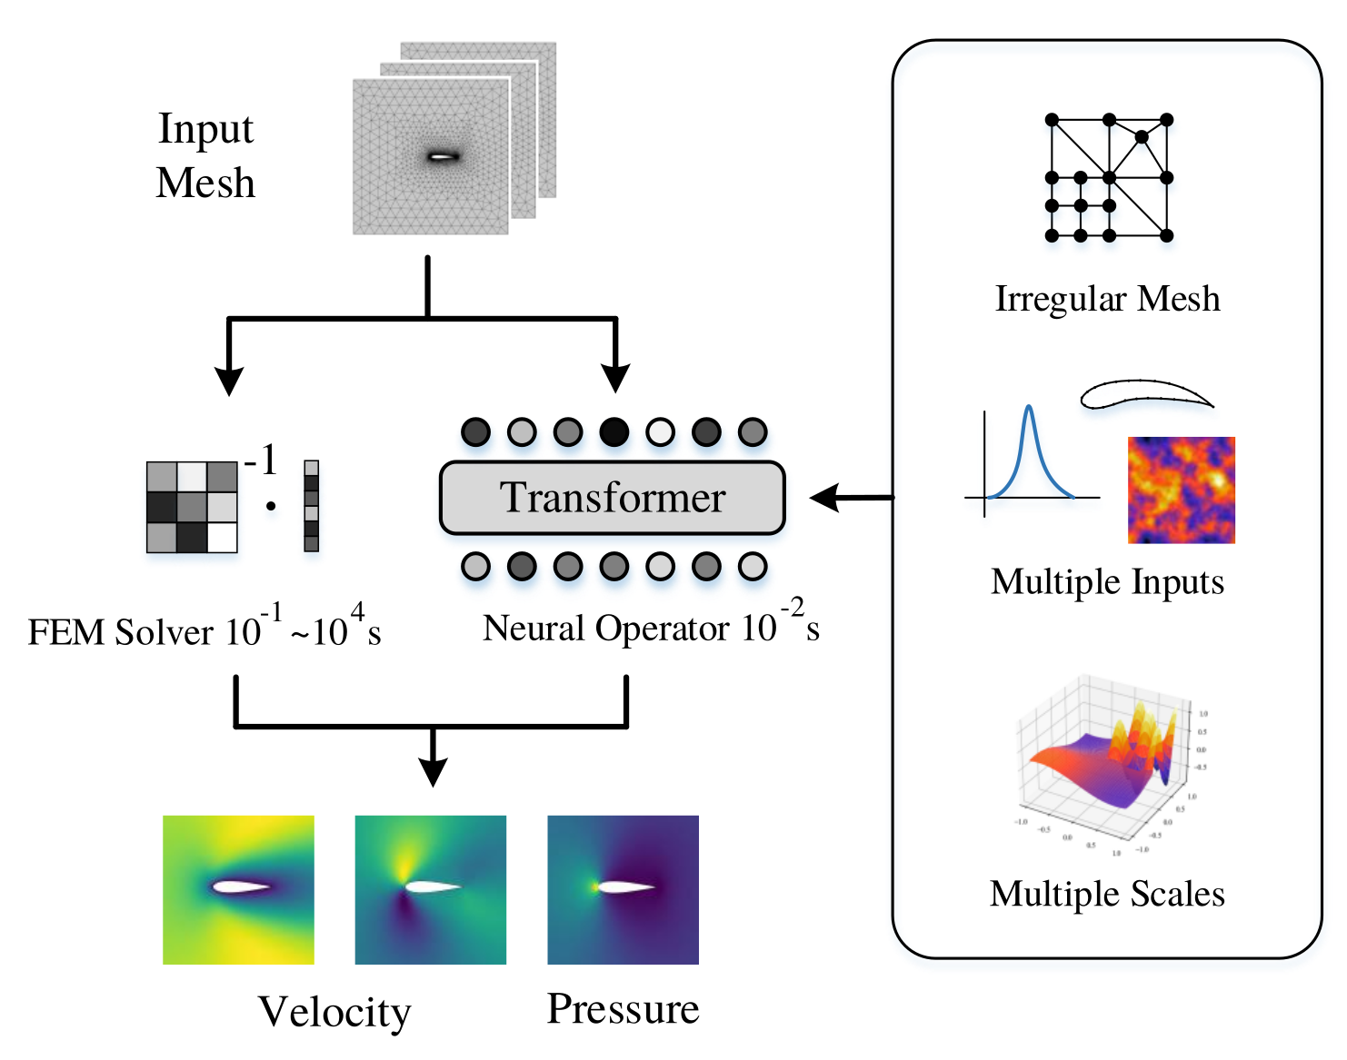
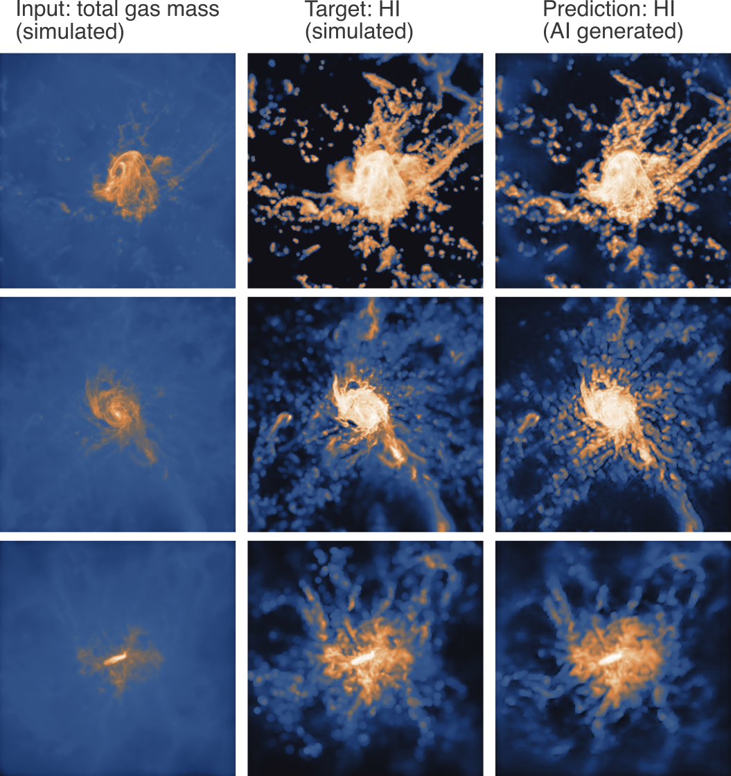
Radiative Transfer Simulations for SKA
(Bianco et al.)
Solve ODE chemistry to simulate the evolution of neutral hydrogen during EoR:
similarly for H II, He I, and He II
Combination of generative models (Denzel et al., in prep.) and neural operators
Hao et al. (2023)

Slide 14
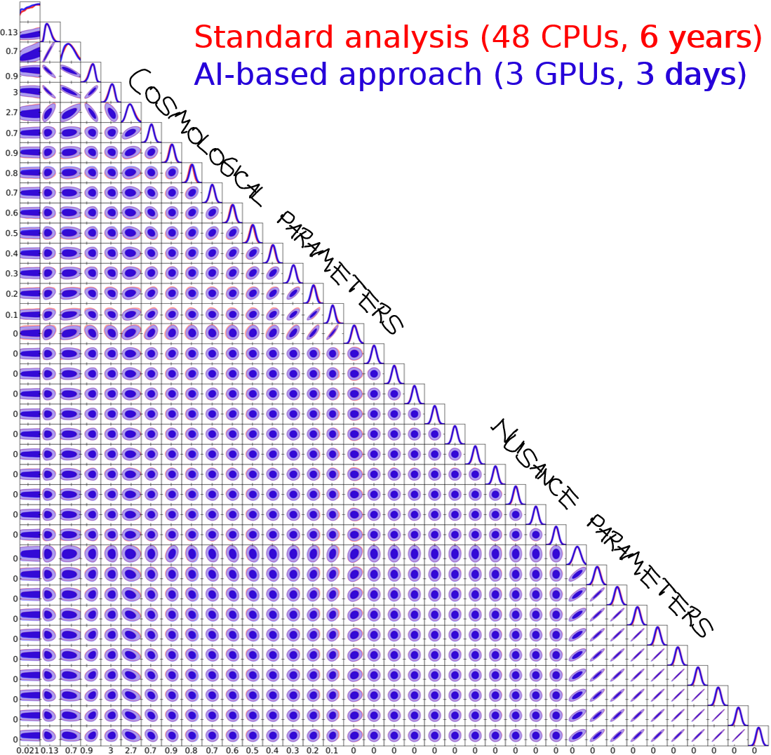
Cosmological likelihood-based inference
(Piras et al.)
Without AI, analysis of next-generation
experiments like SKA will take too long
Solution: combine modern sampling techniques
with machine learning emulators
Analysis time goes from years to days

Slide 15
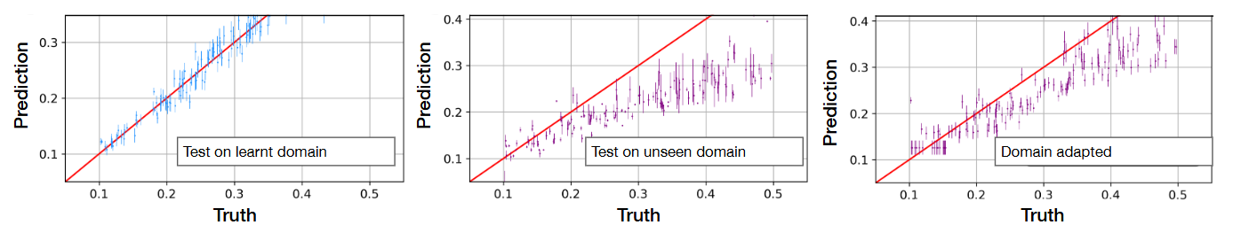
Robust simulation-based inference
(Piras et al.)
AI algorithms tend to overfit the data,
affecting the robustness of the results
Solution: develop domain-adapted AI algorithms,
encouraging the neural network to generalise
Achieves robustness without compromising
accuracy, while using fewer resources

Slide 16
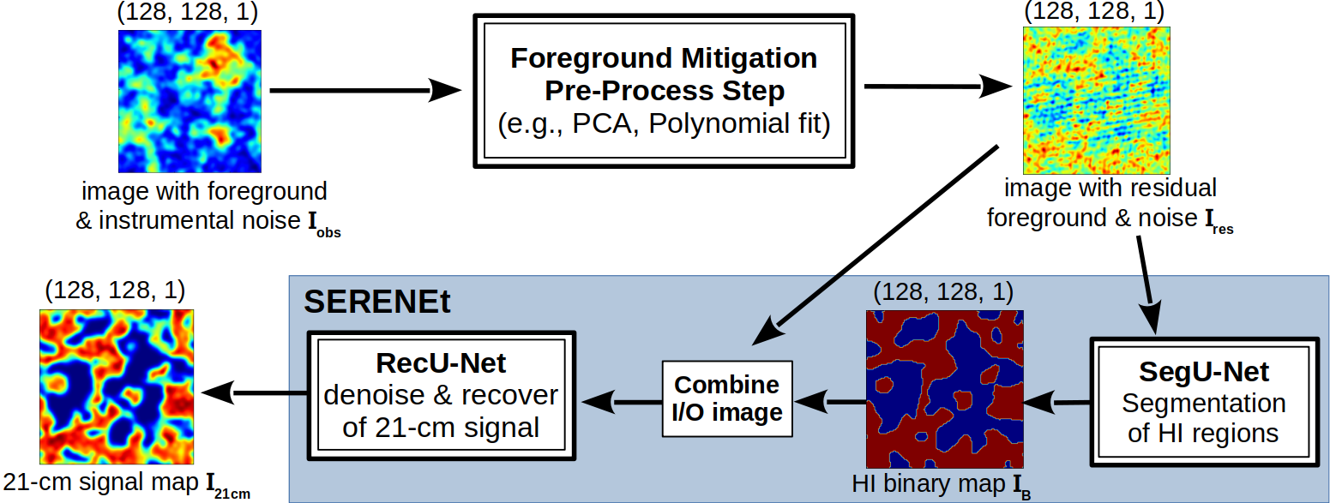
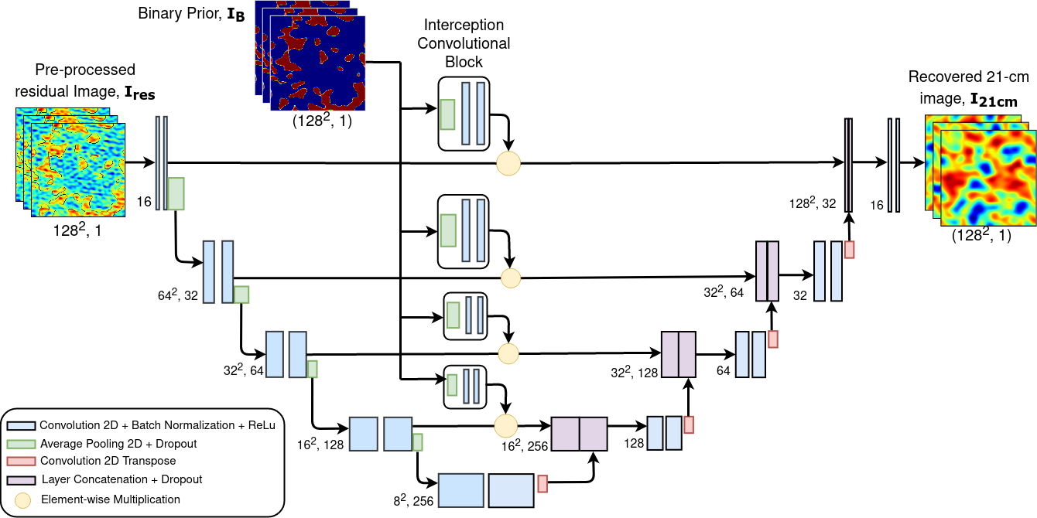

SKA Data Challenge 3: Incubator for new collaborations
SDC3a: national SKACH collaboration
SERENEt (Bianco et al. 2024)
  image preprocessing
  mock observations with Karabo
  double U-Net-based approach
9th place with 1 of 3 submissions

Slide 17

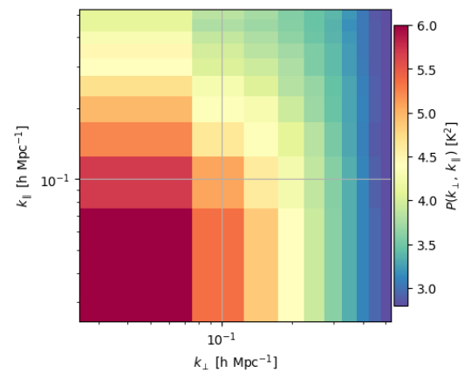
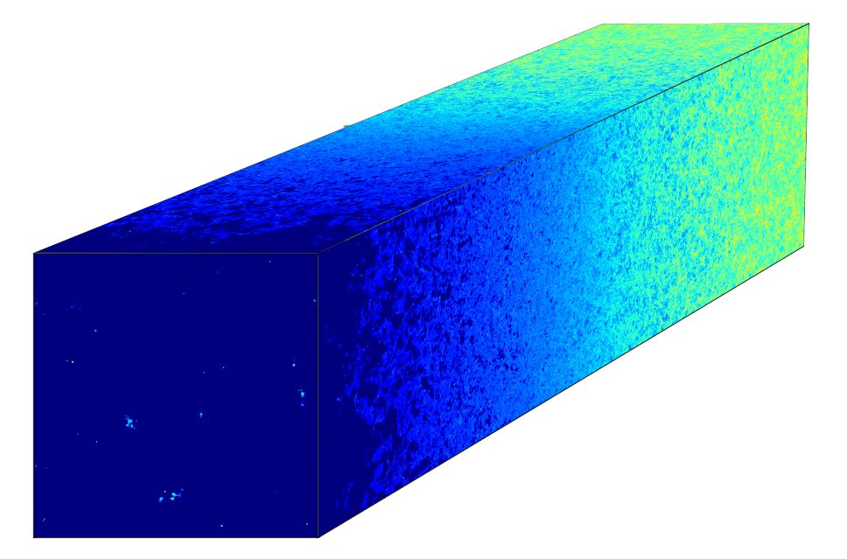

SKA Data Challenge 3: Incubator for new collaborations
SDC3b: international collaboration between SKAO "newcomers"
two SEarCH strategies
2D Pk
21-cm
lightcone
Modern
Traditional
Forward model
and Simulations
SDC3b Data
with BEoRN @ UZH
Model residual foreground & systematics (?)
MCMC inference
Model summary statistic
@ ETHZ, UniGe
EPFL
@ ETHZ, Stockholm
Prediction
(z, x_{HI}± Δx_{HI})
SBI & ML
@ UniGe, HES-SO, ZHAW, FHNW, Chalmers

Slide 18
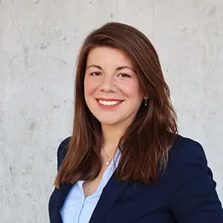
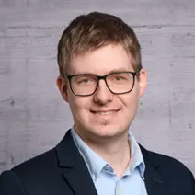
AI developments in SKACH
AI tools being developed at all fronts:
  Observations: detection & classification of radio sources, image cleaning
  Simulations: emulation, HPC, bridge between theory & observations
  Data analysis: statistical inference, efficient data processing
AI is a universal tool when things cannot be formally described
Develops at a fast pace:
  collaborations with experts from computer science, astrophysics, and radio astronomy essential
More about AI developments for SKAO upcoming:
  SKAO science book's AI chapter by Denzel, Gavagnin, Heneka & Schilling
Elena Gavagnin
elena.gavagnin@zhaw.ch
Philipp Denzel
philipp.denzel@zhaw.ch

