Slide 1



The Karabo pipeline as simulation tool for SKA
Andreas Wassmer, André Csillaghy, and the Karabo team
Joint work between FHNW, ETH Zurich, and SKACH
This work has been supported by SKACH and by an Open Reseach Data grant from Swissuniversities, AstroORDAS

Slide 2
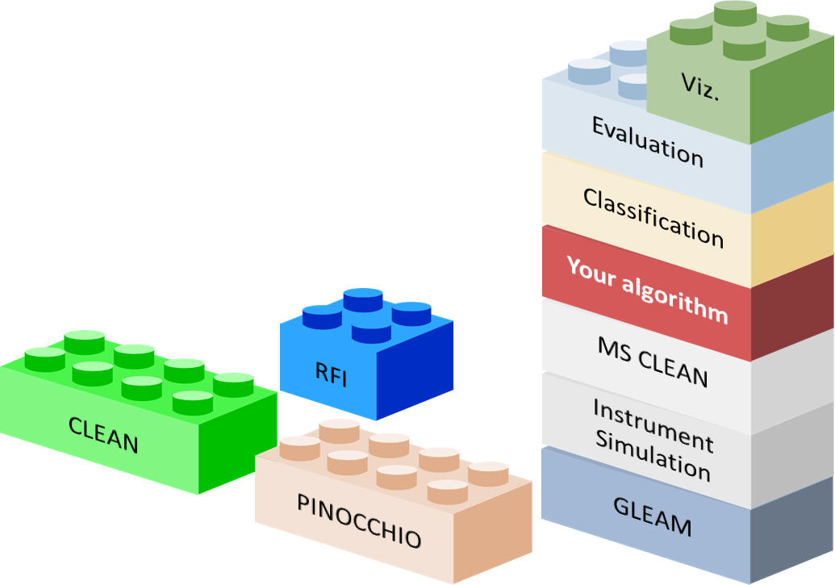
Motivation
If you are new to the field, learning, transitioning from another domain, or only occasionally involved.... you might need a little help with the SKA…
and, we don’t have an SKA to play with yet ☺
Karabo should make your life easier
A versatile tool which mimics the major functionality of «the system» helps you take the right decision early and helps to understand the different pieces of the system.
It provides an accessible entry point to the world of interferometry
Helps developing and testing new ideas
Supports comparison of algorithms
Supports scientists in general

Slide 3

Try it yourself!
Link to the Jupyter notebook:
https://bit.ly/karabo-demo
once the session has started, go to
notebooks → 1_start_here_example → first_pipeline_example
This contains the code and documentation of this demonstration.
It is made available on the RenkuLab platform as an open science tool, a facility of the Swiss Data Science Center SDSC
Karabo is available at:
https://i4ds.github.io/Karabo-Pipeline/

Slide 4
A simple interferometer pipeline
Simulate a portion of the sky
Create a «digital twin» of the telescope
Set the parameters of the observation
Run the simulation
Create an image
Clean this image
https://bit.ly/karabo-demo

Slide 5
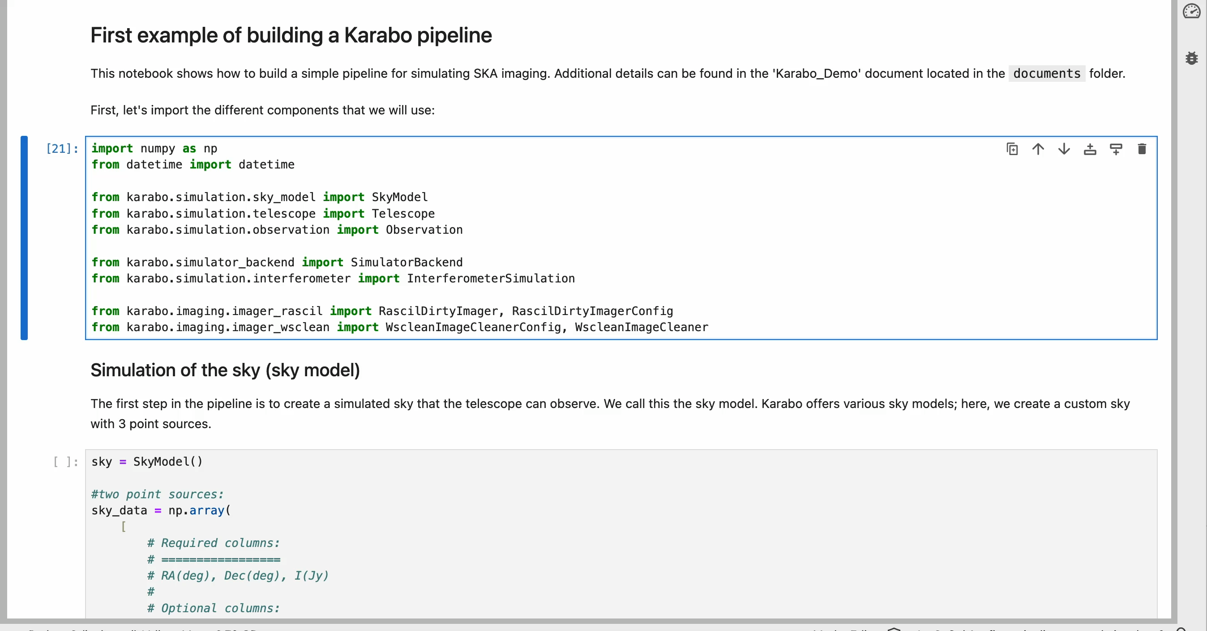

Slide 6
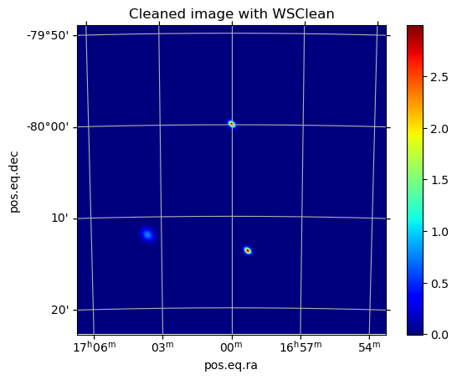

Slide 7
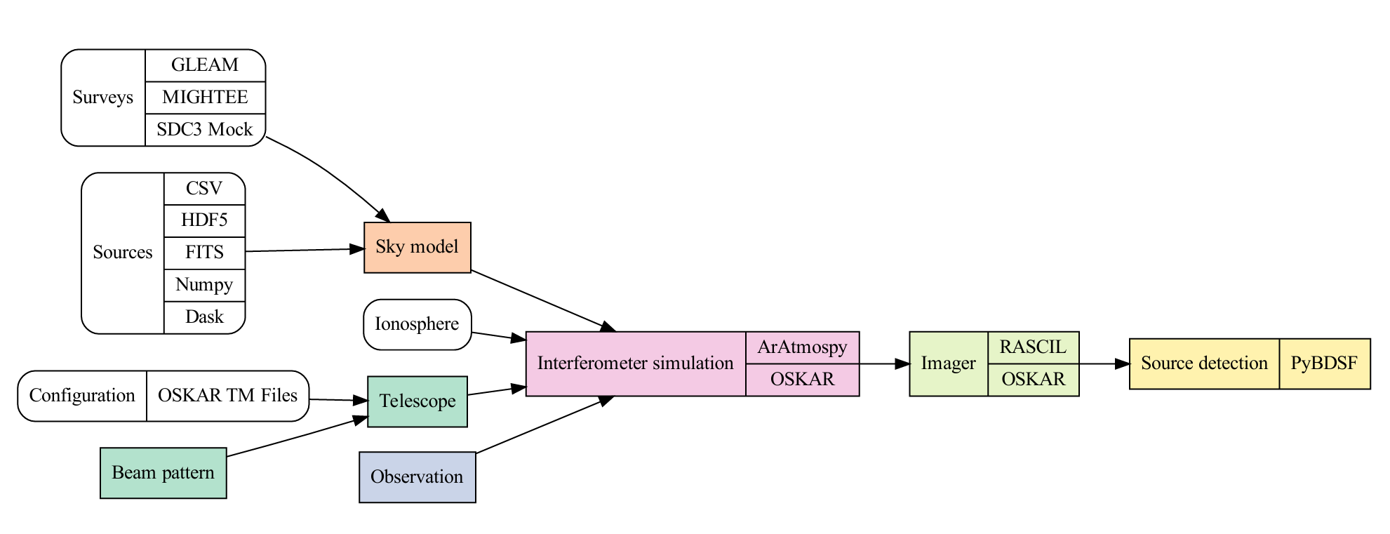
The Karabo Pipeline

Slide 8
Thank you!

