Slide 1
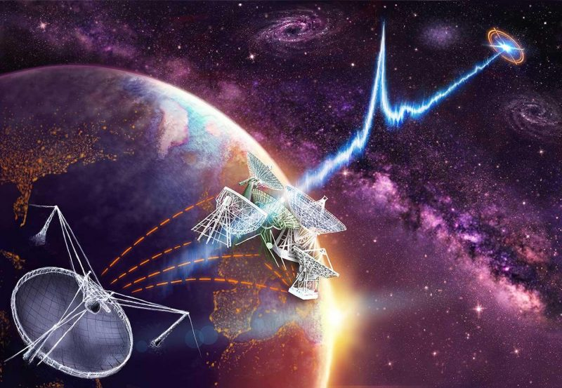



Fast Radio Bursts and Cosmology
Amanda Weltman
University of Cape Town
Cosmology in the Alps
Les Diablerets
March 2026
Collaborators: B Gaensler, B Stappers, M Caleb, M.Santos,Y-Z Ma, J Sievers, J Murugan, S Tendulkar
S Kalita, E. Platts, T Walters, S Bhatporia, A Wild, J Gordin, S Kandhai
HIRAX Collaboration, MeerKAT
High Energy Physics, Cosmology & Astrophysics Theory

Slide 2
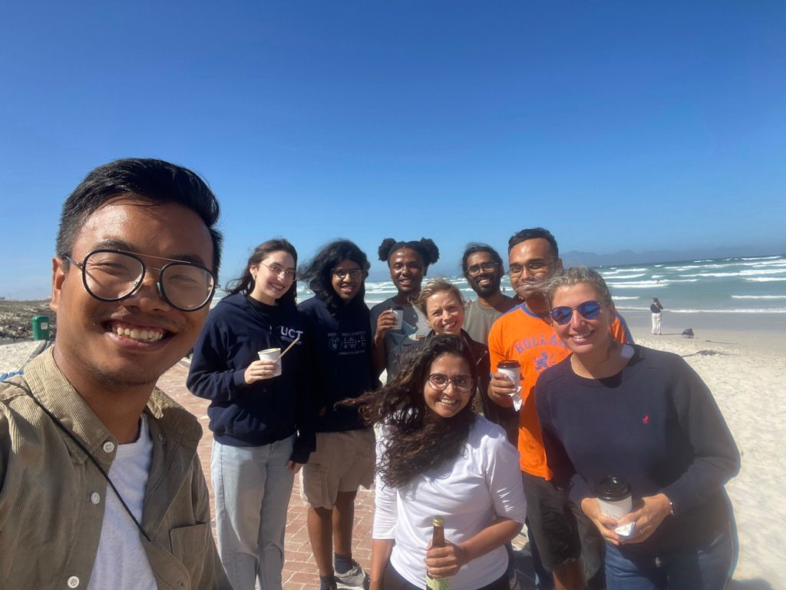
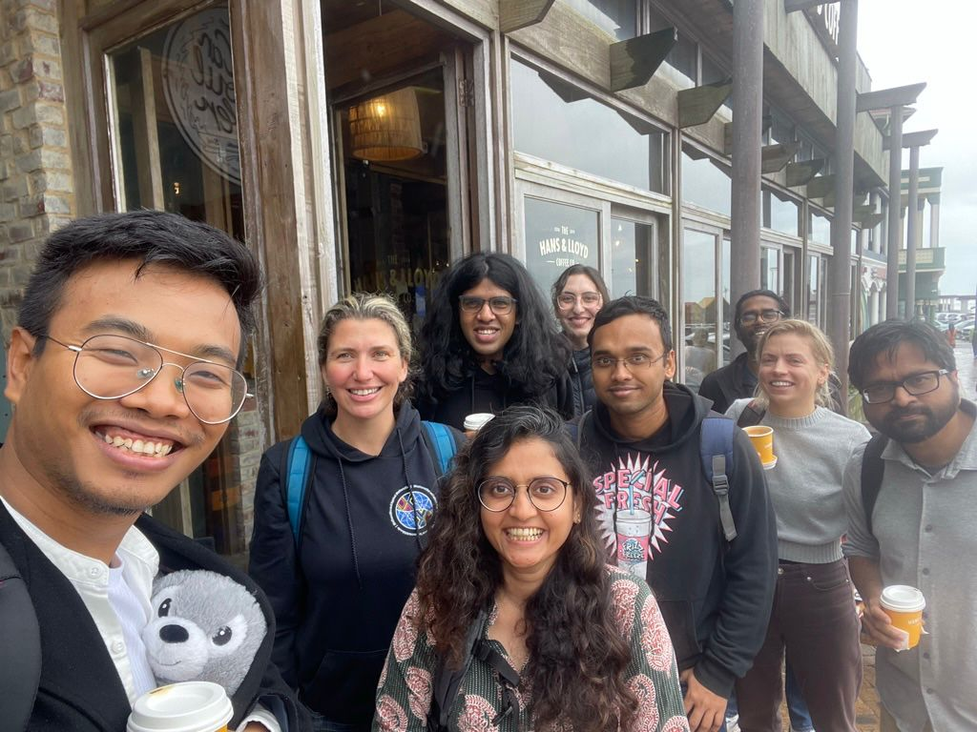
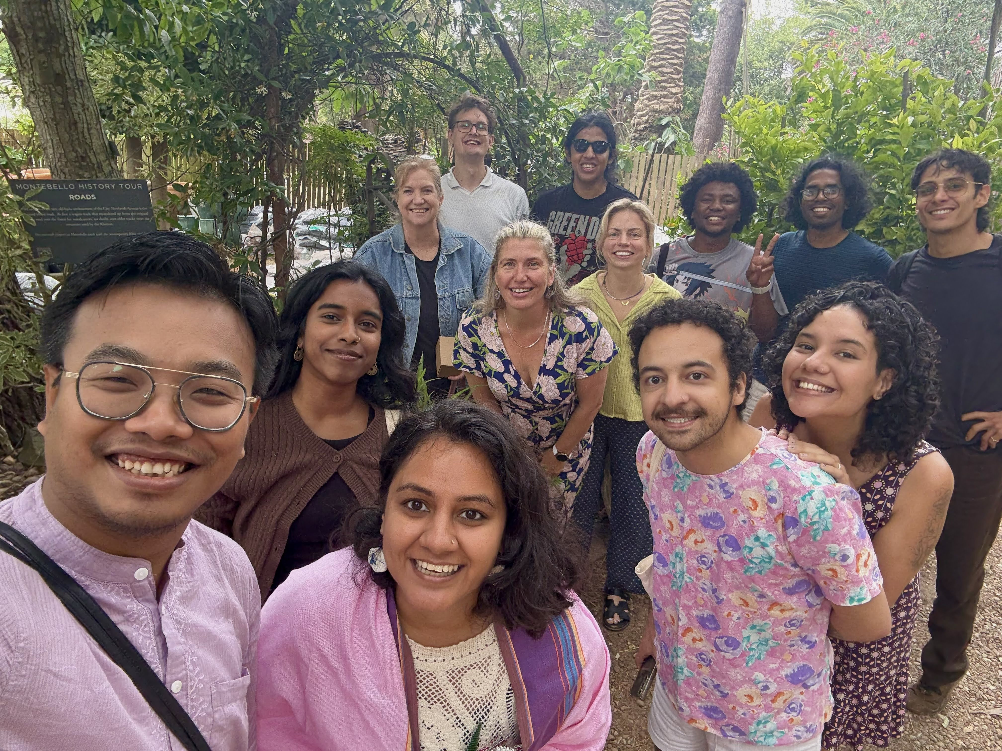


We are
hiring
postdocs!
High Energy Physics, Cosmology & Astrophysics Theory

Slide 3
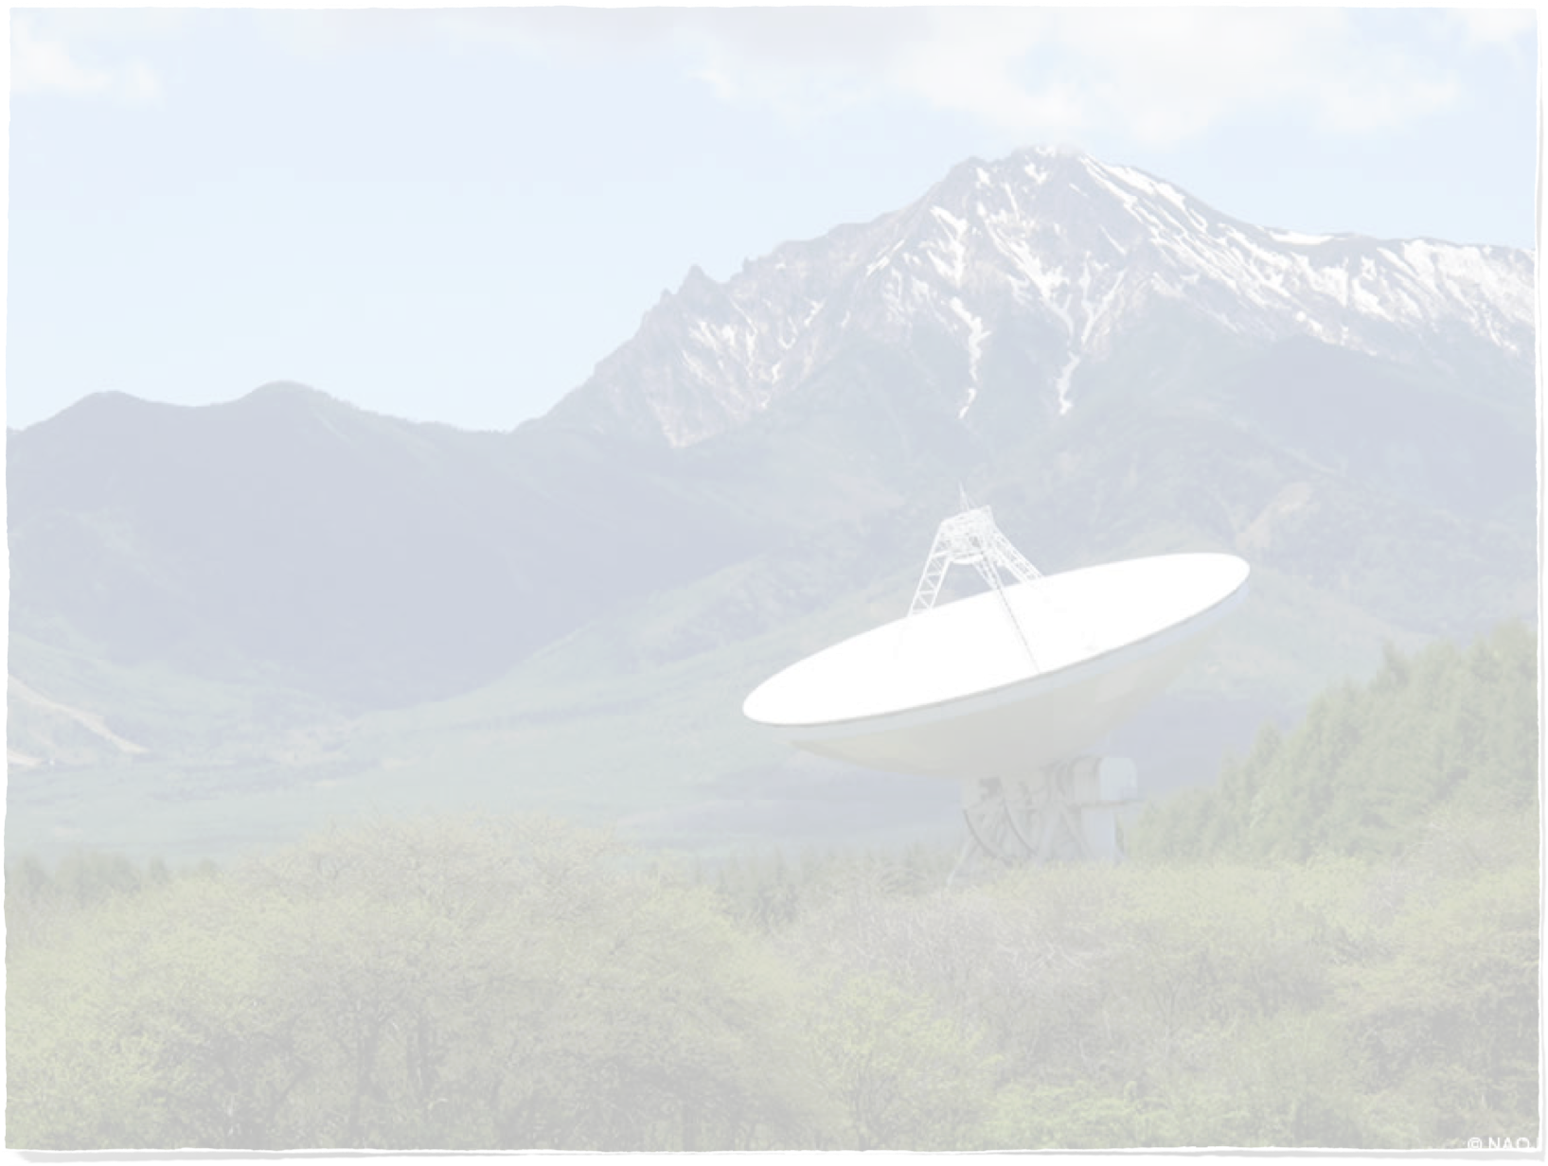
Outline
Cosmology - towards concordance or crisis?
The way forward
A novel astrophysical source - Fast Radio Bursts
Radio Cosmology
HIRAX experiment
The sky is a fabulous experimental play ground for high energy physics
Connection between high energy physics, small scale physics & large scale observations
Nobeyama 45m Radio telescope

Slide 4
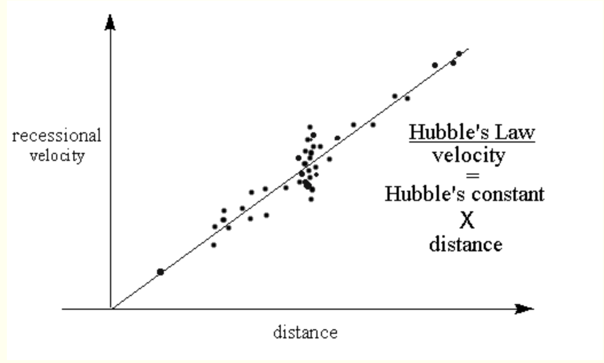

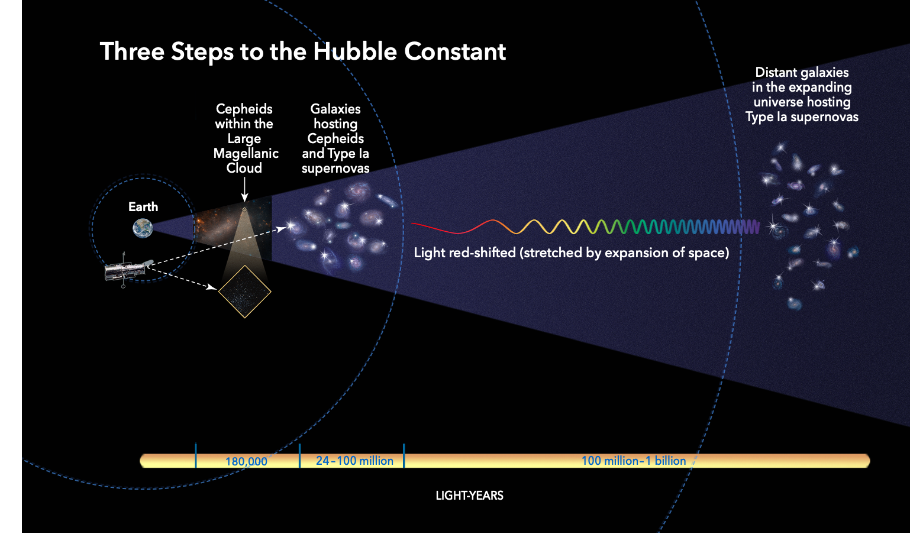
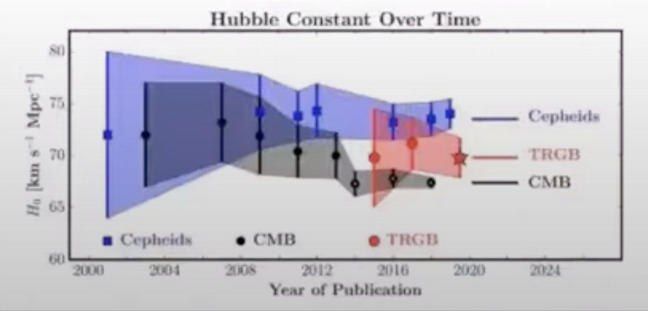

Open problems
Nature of Dark Energy
Nature of Dark Matter
Inflation candidate
Missing baryons
Galaxy formation
More data - tensions
What is the Hubble Constant?
NASA
Freedman et.al. 2019
From philosophy to precision to crisis?

Slide 5
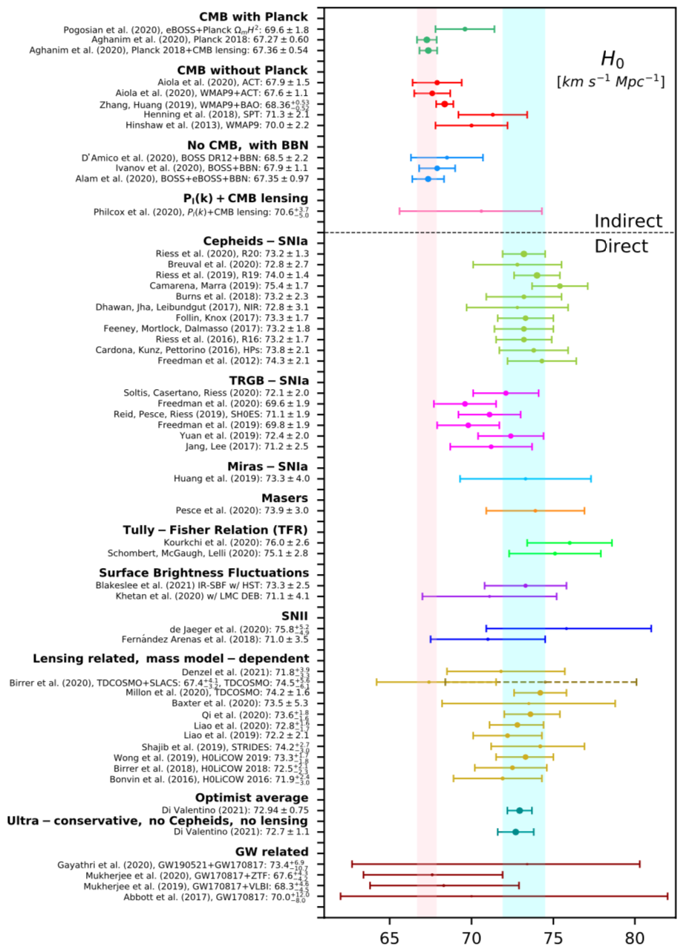
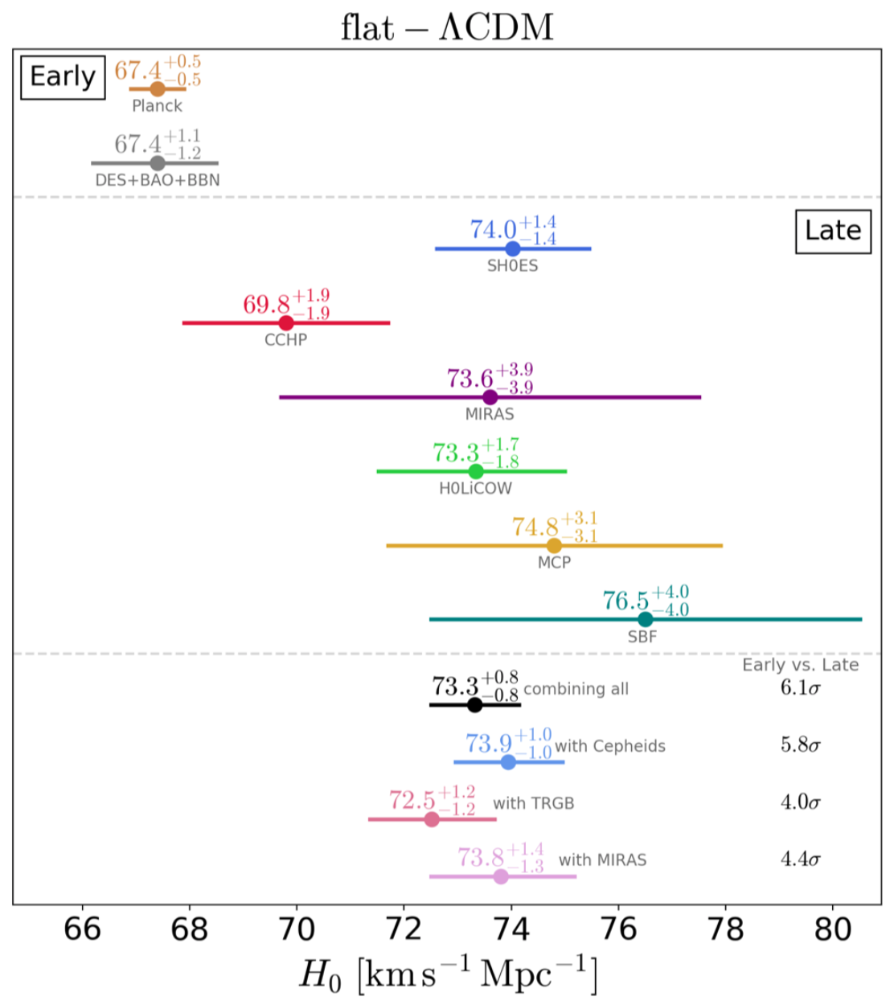
Verde, Treu & Riess, 2019
SHOES 2021 range
(Cepheids)
Planck 2018 range
(CMB)
Di Valentino et.al. 2021

Slide 6





Solutions
Relook at existing data
methods
analysis
New physics:
Beyond Standard Model
i.e. a new particle/field
New probes :
Lab experiments
Direct + Indirect
Astrophysics
Cosmic Frontier
New theory
Dark Energy
Dark Matter
Hubble Tension
Test against all known observations
Make new predictions
Use new observations to rule out/constrain

Slide 7
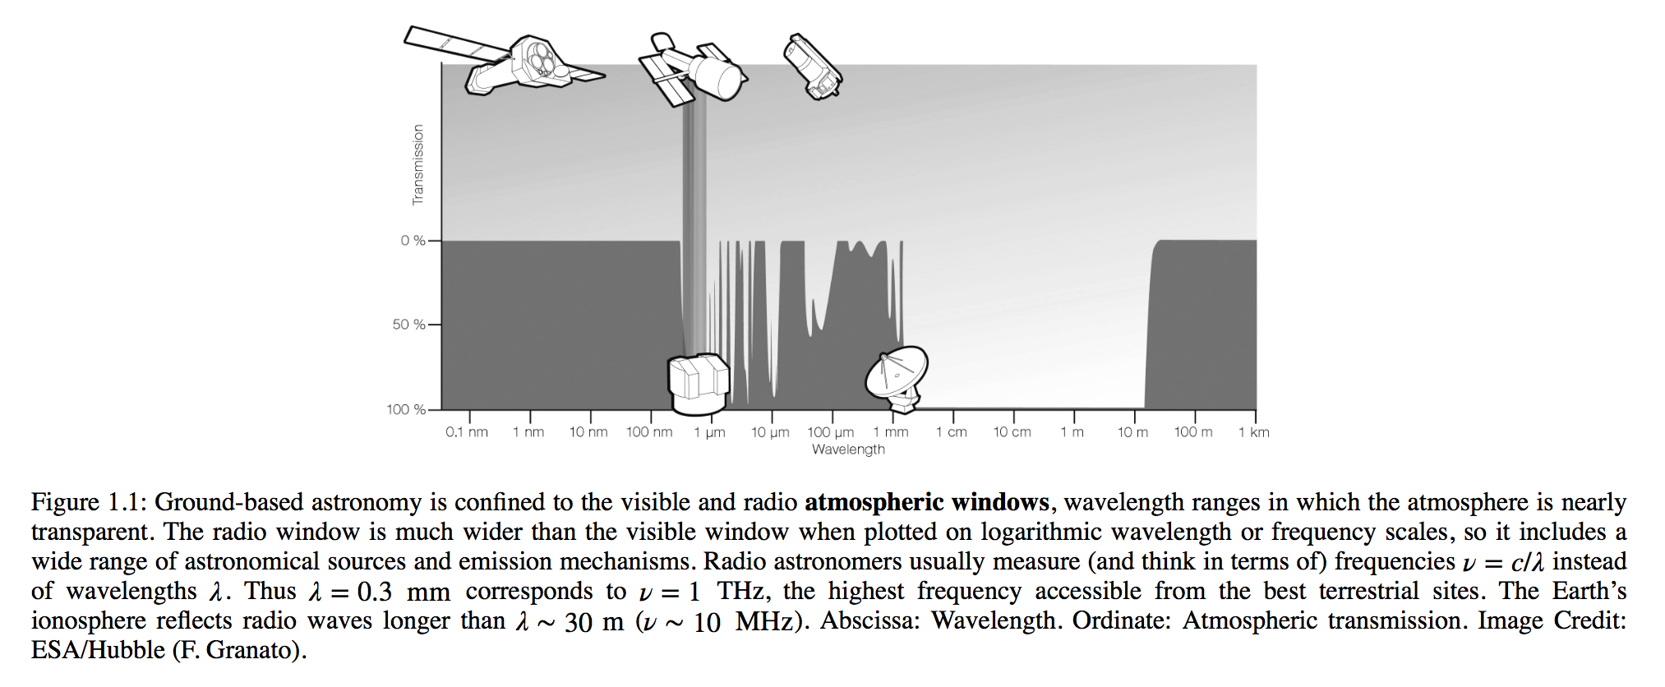
Radio to the rescue
Discovered by Jansky in 1930’s to get rid of noise to improve telephones for Bell labs
Extremely weak - Add them all up (except solar) - not enough to melt a snowflake!
Low Frequencies, long wavelengths ~ 10 MHz —> 1 THz
Large wavelengths - good because goes straight through dust
Low energy —> hyperfine splitting ——> 21 cm HI line.
Optical and radio - ground based. Atmosphere absorbs IR, UV, X-ray, Gamma-ray.
CMB, pulsars, quasars, radio galaxies, neutron stars, evidence for DM, indirect evidence
for gravitational radiation, strong lensing, exoplanets ——-> What is next?

Slide 8

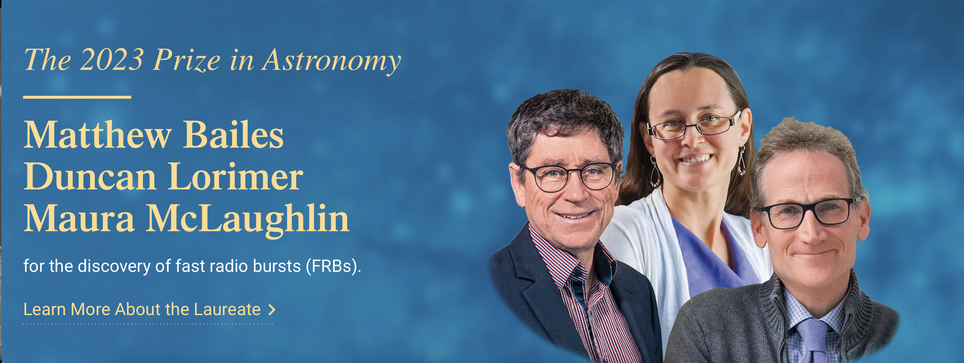
Fast Radio Bursts

Slide 9
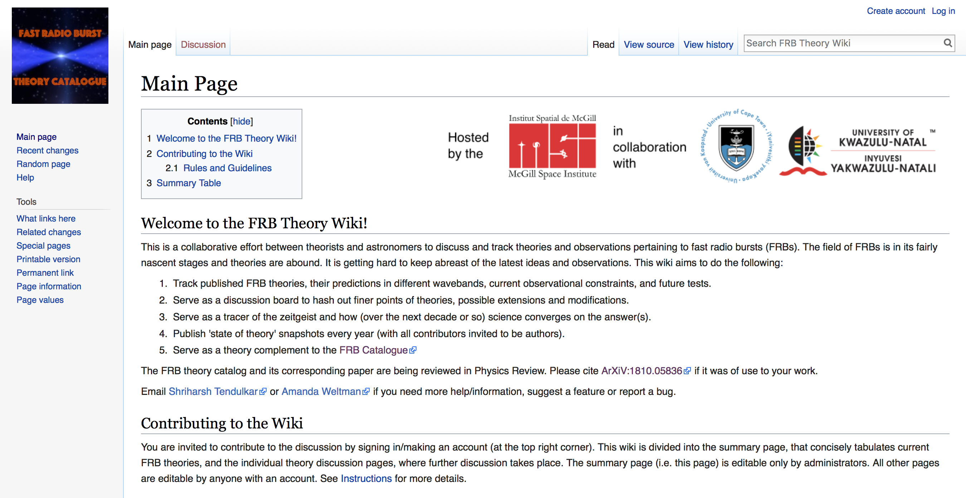
FRBs
Transients, recently discovered (2007), from ~few to ~few hundred in few years
Progenitor mechanism is currently unknown, strong hints from magnetars
Number of classes is unknown, some have been observed to repeat
Very bright (~Jy) and brief (~ms)
Possibility for new science and discovery!
Living Theory Catalogue - frbtheorycat.org
Progenitor mechanisms
Use FRBs as cosmological yardsticks
Use FRBs + Cosmology to find missing baryons
Understand substructure
Platts, AW, Walters, Tendulkar, Gordin, & Kandhai, 2018
da Costa Santos, Gordin and AW 2018
Kalita, AW 2022
Walters, AW, Gaensler, Ma & Witzemann 2017
Kalita, Bhatporia, AW 2023
Kalita, Bhatporia, AW 2024
Walters, Sievers, Ma & AW 2019
Platts, …, AW et.al. 2020
GZ effect and Gravitational Waves
Kalita & AW 2022
Topological Data Analysis to understand FRB catalogue
Modified gravity and lensing
Kalita, Bhatporia & AW 2023
Bhatporia, Walters, Murugan & AW 2023
An FRB in our own galactic backyard
AW & Walters, Nature News & Views 2020

Slide 10
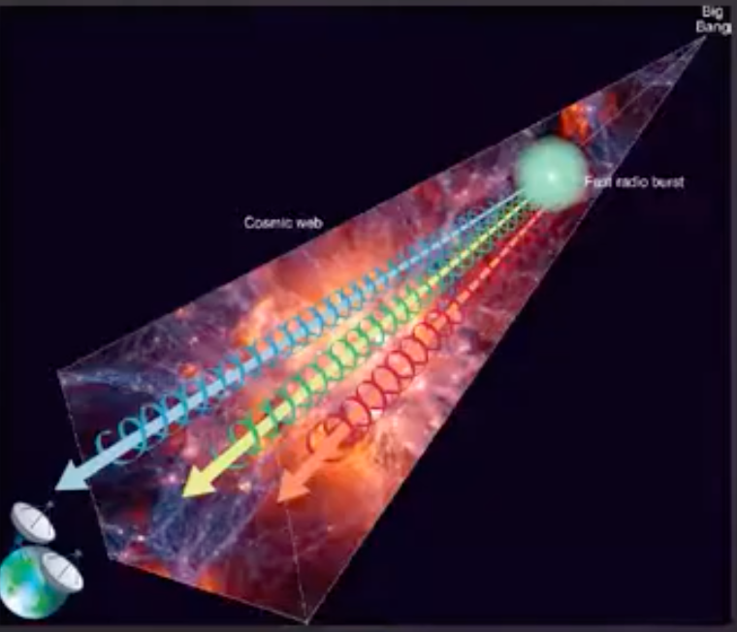

What do we know about FRBs?
Millisecond duration pulses
Frequency range ~ 300 MHz - 8 GHz
Several localised to hosts
Only fraction of parameter space observed
Tens of thousands expected per day in the sky
Some known to repeat, some appear to have periodic repetitions
Out to at least low cosmological redshifts, extragalactic
Excellent tracers of their source environment
Polarisation - some linear, some circular possibly from propagation
Detangle host effects and IGM effects, big uncertainties in the DM
Outlier DMs too
How far out in redshift? Up to z=2.148 ! MeerKAT discovery 2025
Loads of theories - more than one mechanism possible
Magnetars appear to be a compelling source

Slide 11
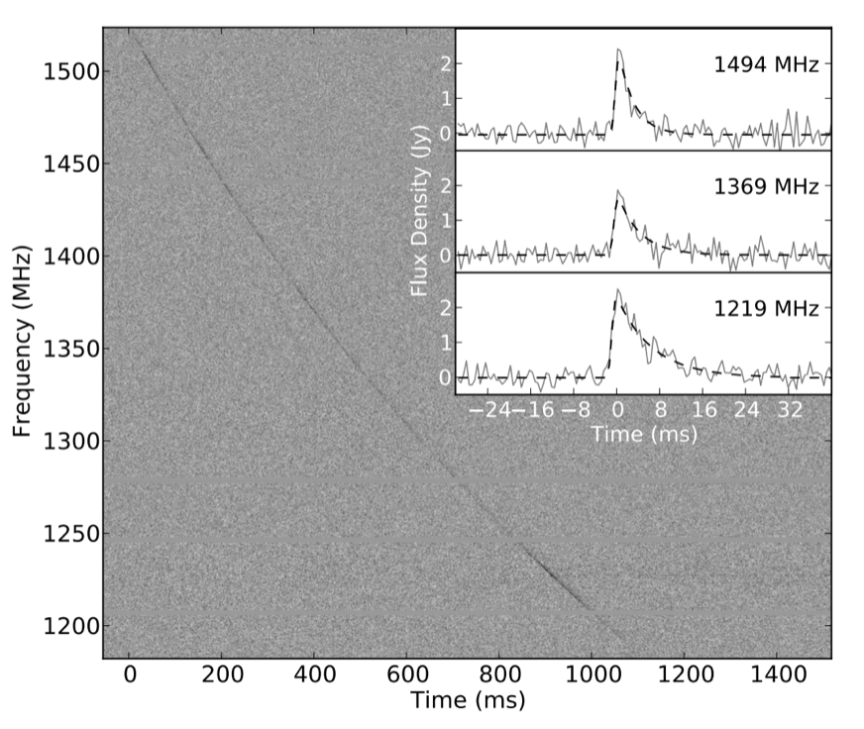

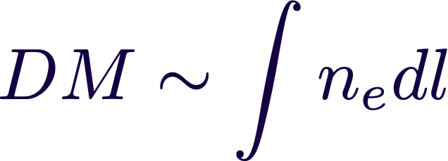
Dispersion Measure
Brief pulse in the radio (ms)
Delay in arrival time ~
Propagation through cold plasma
Dispersion Measure contains info about the distribution of electrons from source to observer
Large DM —-> Source must be extragalactic
So far FRBs appear to have a host galaxy
Tendulkar et. al. 2017

Slide 12

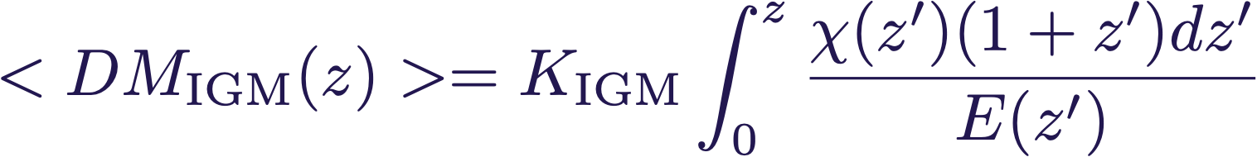

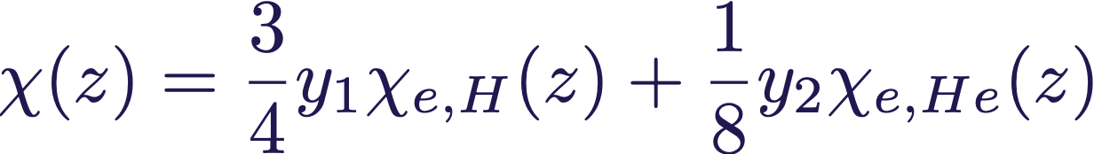
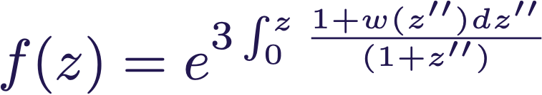
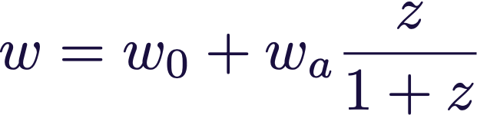
Cosmology with FRBs
Yang & Zhang, 2016
Walters, AW, Gaensler, & Ma, Witzemann 2018
DM(z) as a probe of cosmology?
Question - Can we get better low redshift curvature constraints?
SN1a alone give
Average DM to deal with inhomogeneous IGM
baryon mass fraction
H, He mass fraction, ionization fraction
growth depends on DE EOS
Parametrise Equation of State :

Slide 13
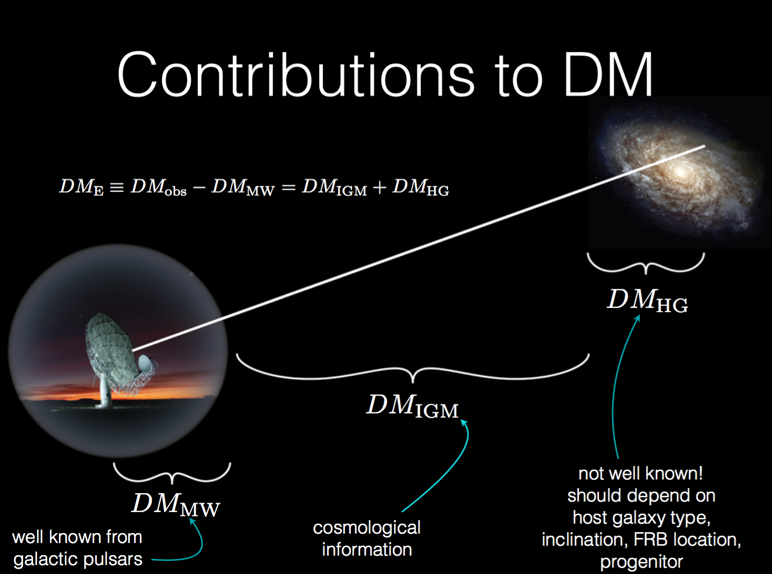
Slide by A. Walters

Slide 14

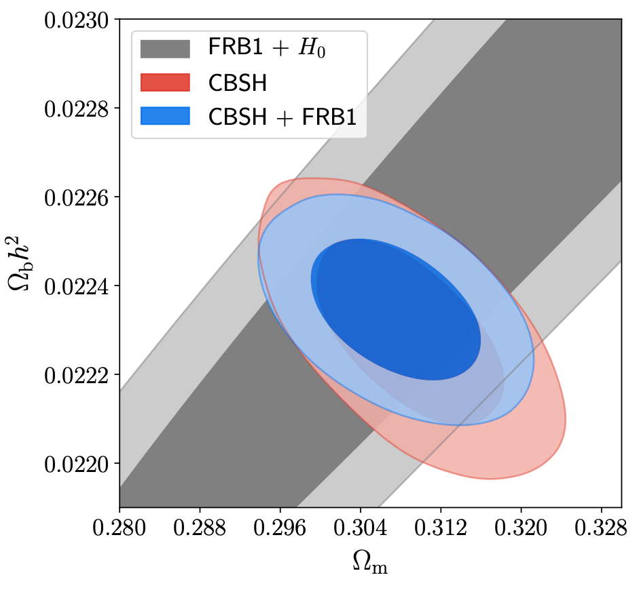
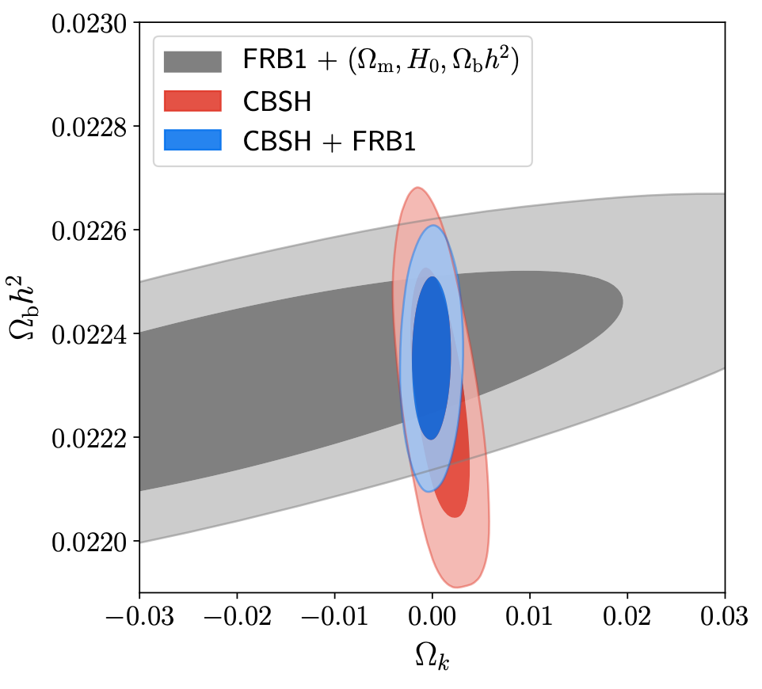

Cosmology with FRBs
Walters, AW, Gaensler, Ma & Witzemann, 2017
Simulate an FRB catalogue with errors from a HIRAX-like survey
Consider ~ 1000 FRBs with associated redshift 0<z<3
Forecast using MCMC + combine with CMB, BAO, SNe, H0
Flat CDM
Non-Flat CDM
Novel constraint of independent of high redshift (CMB/BBN)
Limited by HG and IGM uncertainties

Slide 15
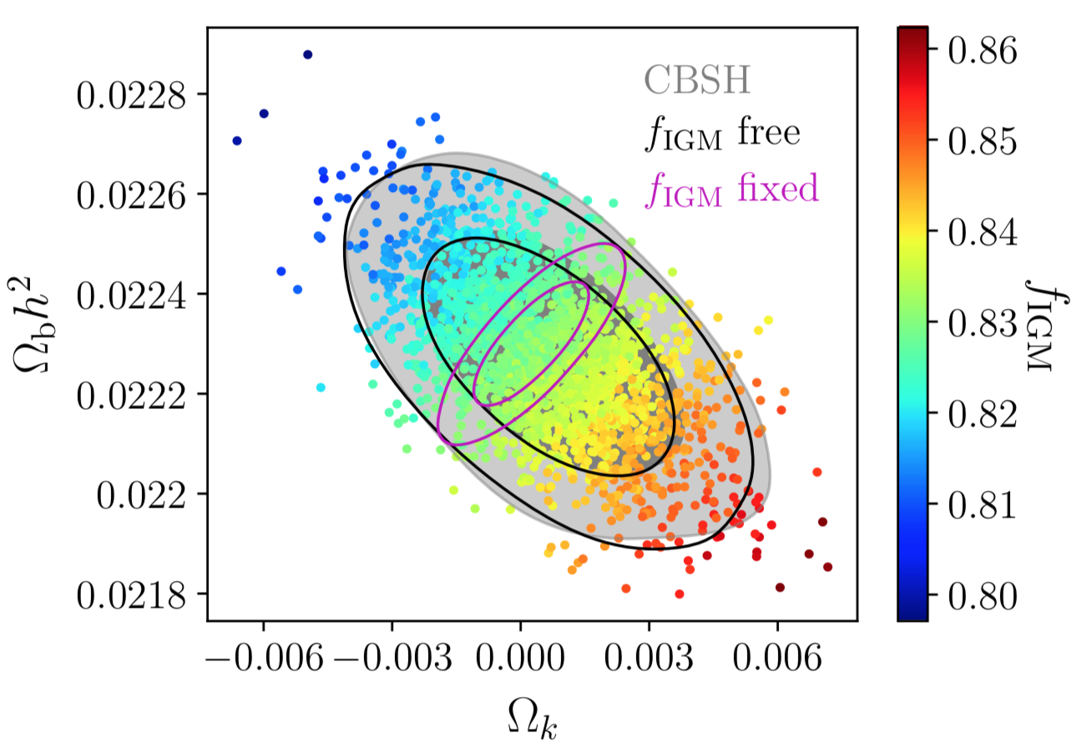
Missing Baryons
Missing Baryon problem
BBN, CMB constraints baryons ~ 4.85% of total
Adding up baryons ~ 70% of total. ~ 30% “missing” - expected to be in WHIM
Walters, Sievers, Ma & AW 2019
Including f_IGM as a free parameter - all constraints prior dominated
BUT get a percent level constraint on f_IGM
Given precision cosmo constraints, DM(z) can constrain f_IGM
Measuring f_IGM ~0.8 would alleviate the missing baryon problem
FRBs are thus a novel way to measure the diffuse baryons in the IGM

Slide 16
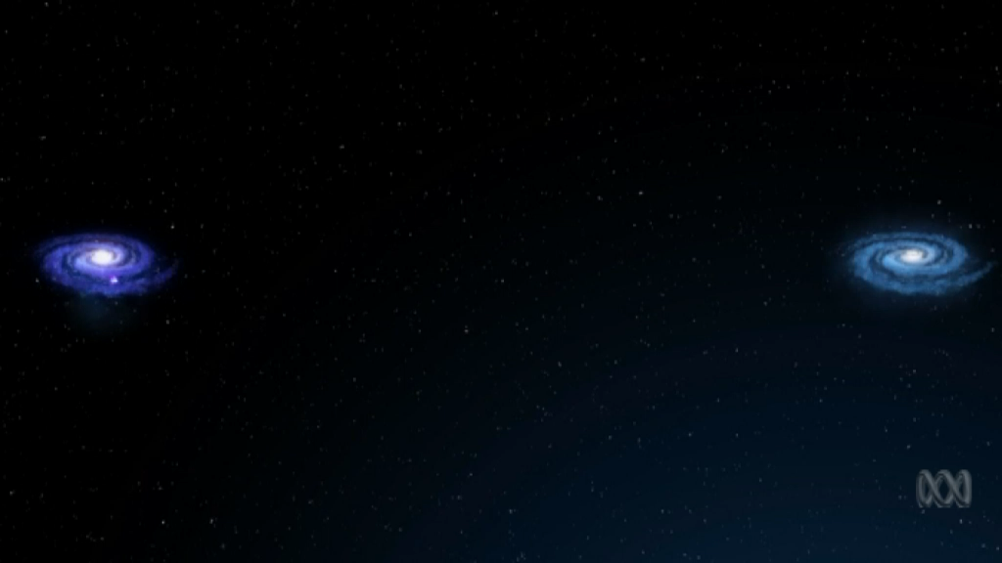
Missing Baryons
A census of baryons in the Universe from localized fast radio bursts
J.-P. Macquart et. al. Nature 2020
DONE!
Using four new localizations in host galaxies at redshifts 0.291, 0.118, 0.378 and 0.522.
Observations by ASKAP with the Very Large Telescope in Chile to help with
distance measurement to the galaxy.
ICRAR

Slide 17
4 localised FRBs
S. Bhandari et. al. 2020
4 new FRBs localised
Redshifts 0.291, 0.118, 0.378 and 0.522
All are near the edge of their host galaxies
All are massive galaxies that are still star forming, similar to ours
Hints about progenitors possible
Anything that should be evenly spread with matter becomes unlikely - eg. cosmic strings.
Not supermassive black holes
Most likely from mergers - neutron stars/magnetars

Slide 18
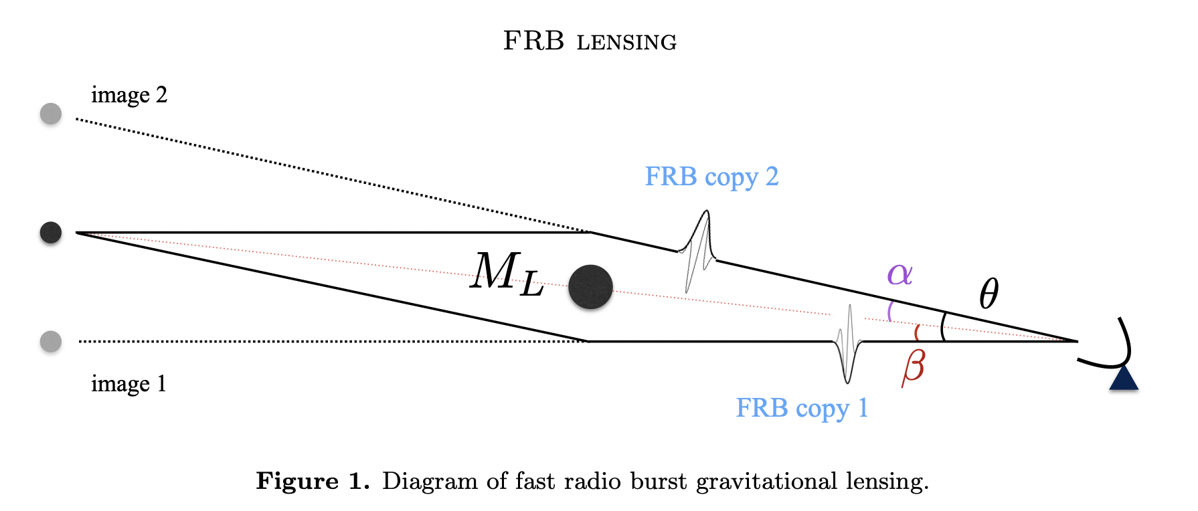
FRB Opportunities - Dark Matter
Compact objects as DM candidates? 10 - 100 solar mass range?
Least constrained but compelling due to LIGO/VIRGO
Transients as testing ground - search for FRB echoes
Strong gravitational lensing of FRBS by MACHOS - repeated FRBs with time delay
Microlensing would give double peaked FRBs
Munoz et. al. 2016
FRBs can give us ~ 15 orders of magnitude in lens mass —-> time delay up to years!
Voltage data is phase preserving. Knowing the redshift of the host is important.
Connor & Ravi 2022

Slide 19
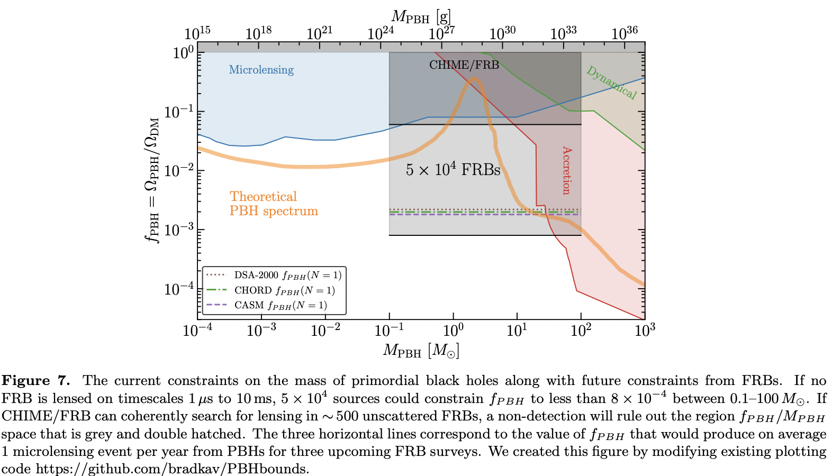

FRB Opportunities - Dark Matter
First Constraints on Compact Dark Matter from Fast Radio Burst Microstructure, Mawson et. al. 2020
ASKAP - burst substructure to 15 microsecond timescales in redshift range 0.3-0.5
Requires 130 FRBs to improve on current <35% MACHO constraints.
Use existing FRB data, need to break substructure vs lensing degeneracy - use dynamic spectra
——> no evidence from 110 FRBs
Constraints on Compact Dark Matter with Fast Radio Burst Observations Liao et. al. 2020
CHIME Constraints - Leung et. al. 2022
Use coherent delay VLBI technique to break degeneracy between pulse morphology and lensing
Coherent lensing is a sensitive probe of sub-solar mass PBHs—-> no evidence from 172 FRBs
Connor & Ravi 2022

Slide 20
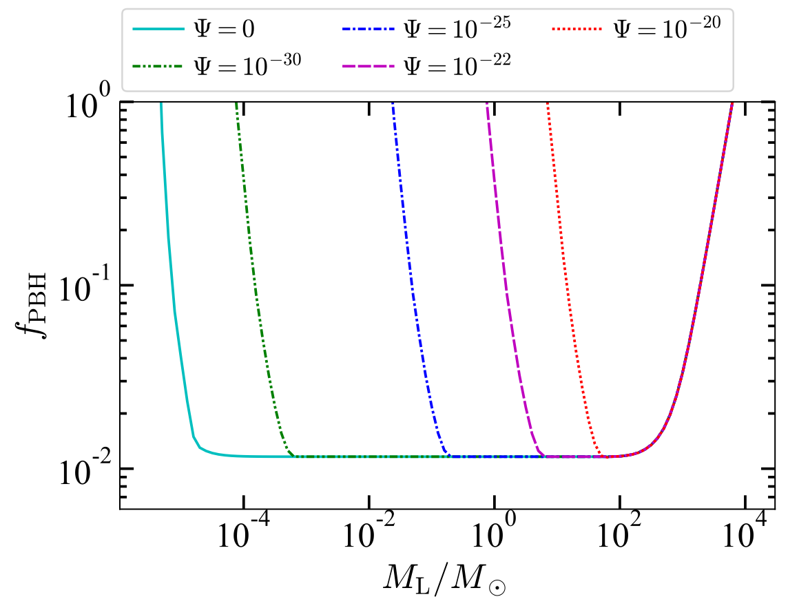
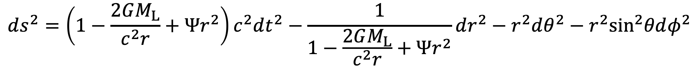
FRB Lensing + Modified Gravity
FRB lensing can help in constraining fraction of primordial mass black holes made of dark matter.
Modified gravity acts like a scattering screen in the path of light ray.
This result will be improved by HIRAX, which will soon be able to detect a lot more FRBs in the Southern sky.
$$ds^{2}=\left(1−\frac{2GM_{L}}{c^{2}r}+Ψr^{2}\right)c^{2}dt^{2}−\frac{1}{1−\frac{2GM_{L}}{c^{2}r}+Ψr^{2}}dr^{2}−r^{2}dθ^{2}−r^{2}\sin^{2}θdφ^{2}$$
Kalita, Bhatporia & Weltman
JCAP (2023) 11, 059
Leung et al. (2022) PRD 106, 043017

Slide 21
FRB Opportunities - Dark Energy
Dark Energy - Zhou et. al. 2014
If i) plenty FRBs in narrow redshift bins, ii) plenty FRBs above z~3, iii) can ignore host contributions to DM —-> can constrain EoS of Dark Energy
If plenty FRB/GRB associations - use FRB for DM, GRB for z ——> can constrain EoS of Dark Energy
Use FRBs to break distance degeneracies in the CMB —-> better constrains on H0 and Dark Energy.
10 000 FRBs with redshift ——> better constraints than BAO!
FRBs + Gravitational Waves provide low redshift verification of CMB + BAO.
Dark Energy - Gao, Li, Zhang 2014
Dark Energy - Zhou et. al. 2020

Slide 22
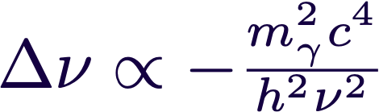

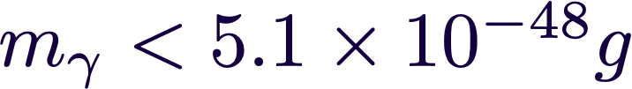
Fundamental Physics Opportunities
Limits on the WEP and Photon Mass with FRB121102
Sub-Pulses Xing et. al. 2019
Photon mass limits from DM - Bonetti et. al. 2016
Constrain the photon mass, test Einstein’s Weak Equivalence Principle
WEP - Universality of Free Fall - freely falling objects fall at the same acceleration independent of their composition
Idea : Photons of different energies follow different trajectories - produce differential time delay
Test : time delay of different frequency components - due to DM + Special relativity + photon mass + WEP violating component
Substructure in 121102 offers potential to constrain both WEP violation + photon mass
PPN parameter:
Future - use substructure of more repeaters, use downward drift, multiple FRBs, higher z repeaters

Slide 23
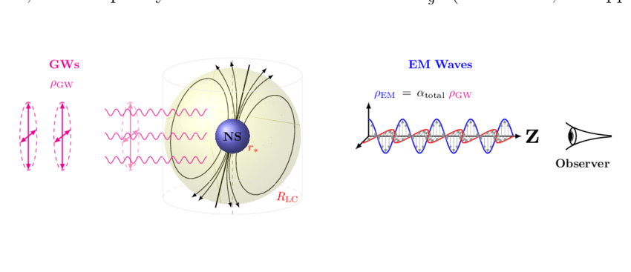
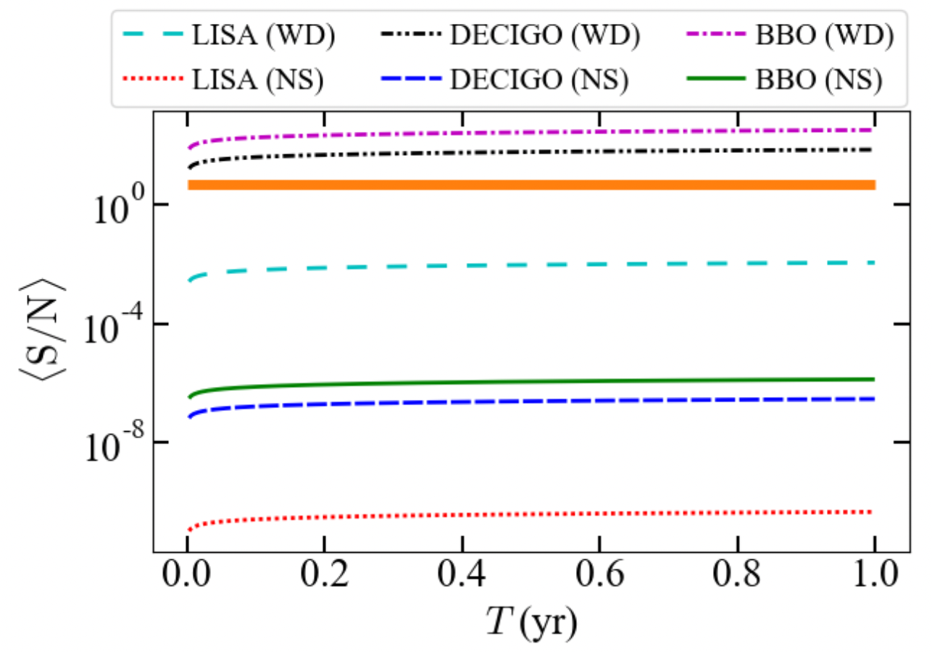
Gravitational Wave detection as FRB lab
Kushwaha et. al. 2022
Gertsenshtein-Zel’dovich effect - when GW move through the magnetosphere of pulsars, energy conversion from GW to EM waves
Produces bursts of EM waves in the GHz range ——-> possibly FRBs?
Effect detectable by future Gravitational wave detectors ? Likely only space based…
Kalita & Weltman 2022

Slide 24

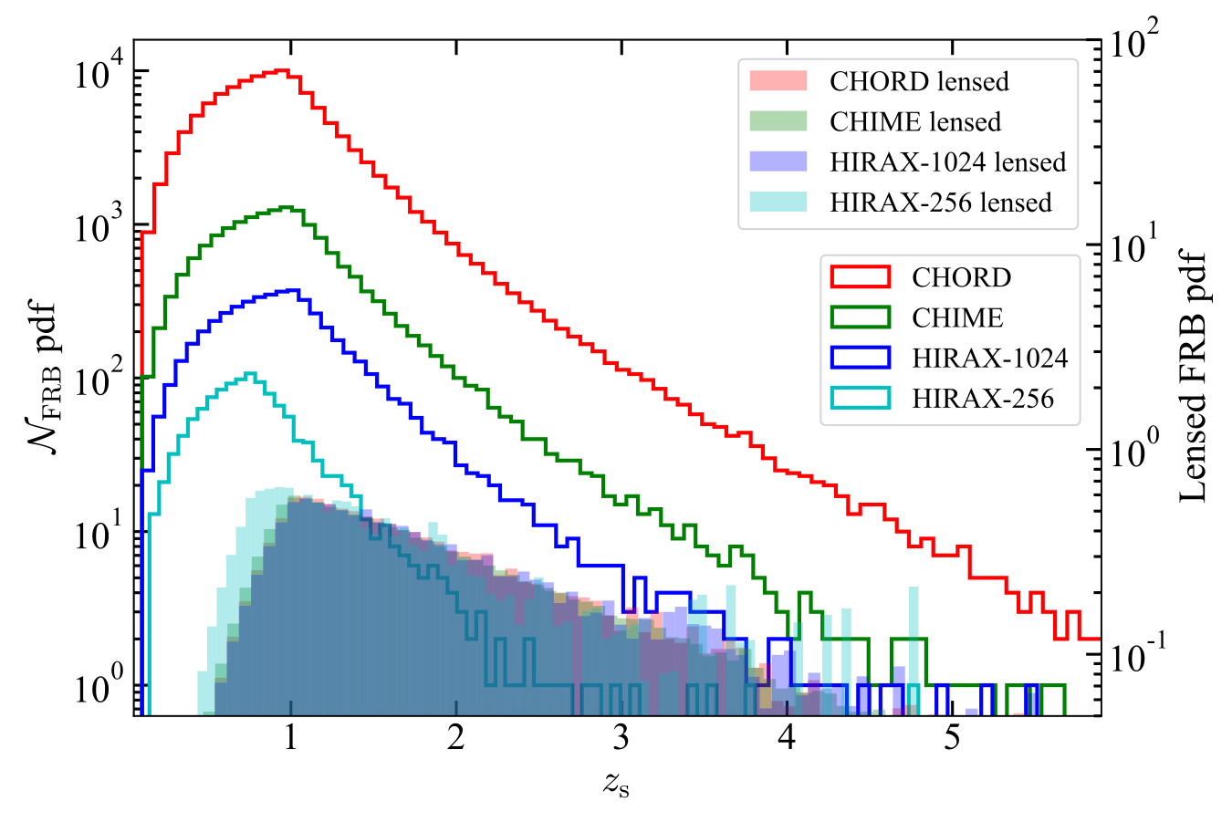
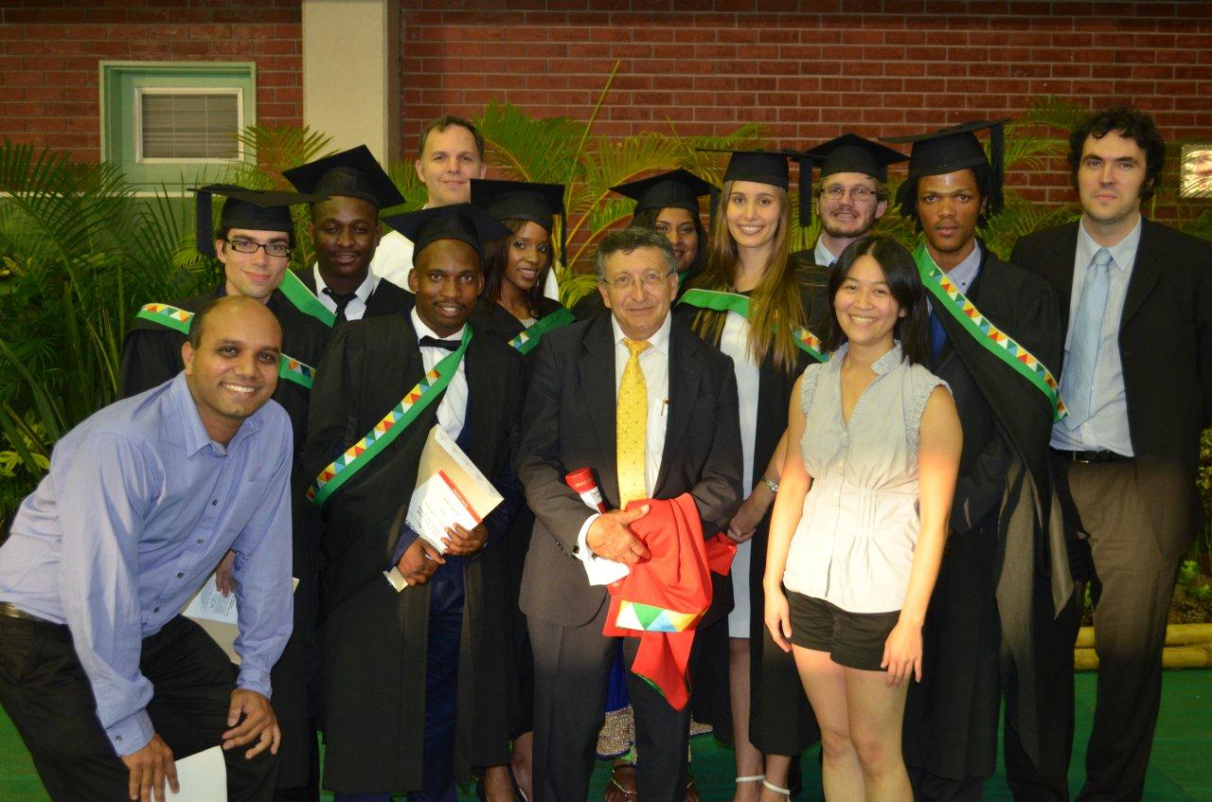
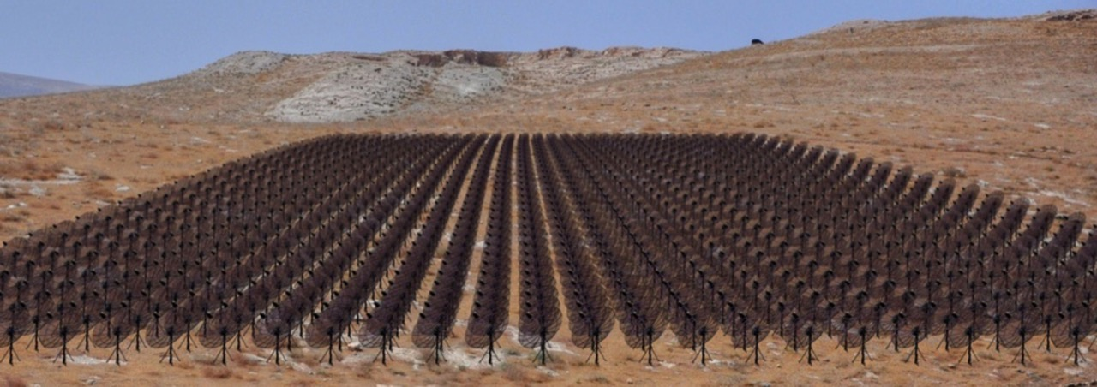
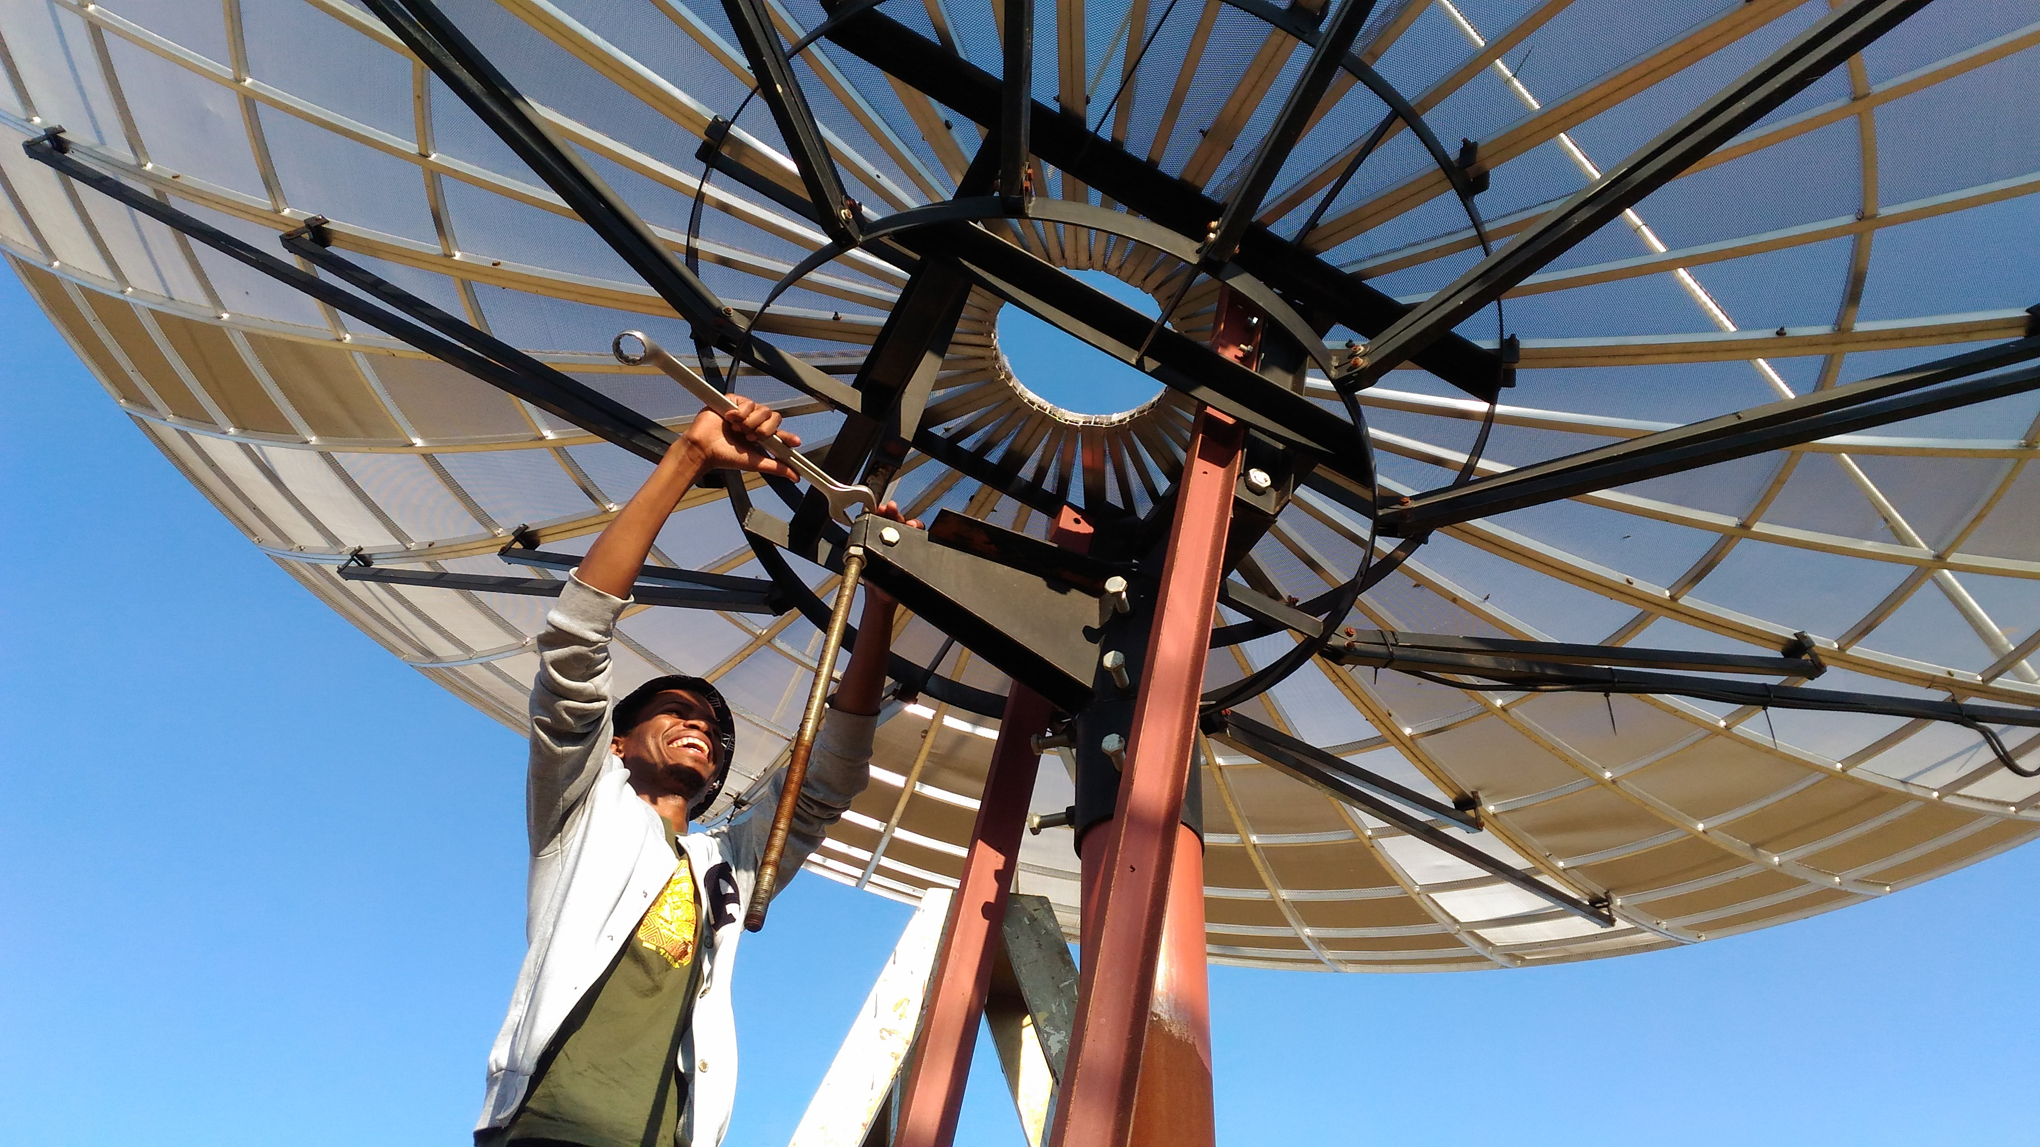
HIRAX
L. Newburgh, et.al 2016
Hydrogen Intensity and Real time Analysis eXperiment
1024 6 m dish array (eventually)
400 - 800 MHz radio interferometer
Intensity mapping of BAO at z ~ 0.8 - 2.5
observe unresolved sources via redshifted 21cm line
make maps of Large Scale Structure
characterise expansion history of the universe
ideal to probe dark energy
cross correlate with other cosmological surveys
S. Kalita, S. Bhatporia, AW 2024
Transients - pulsars and fast radio bursts
FRBs - short (~ms), bright ( ~Jy), radio transients, likely cosmological
complementary to CHIME - South, lower RFI, no snow

Slide 25
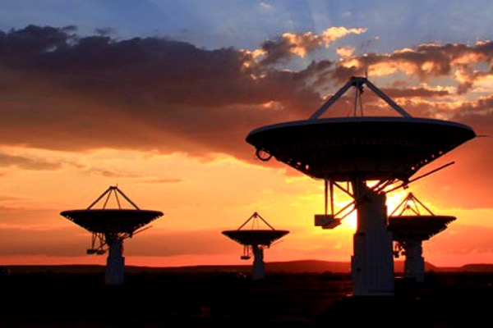
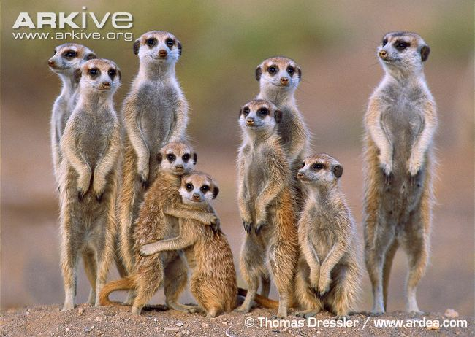
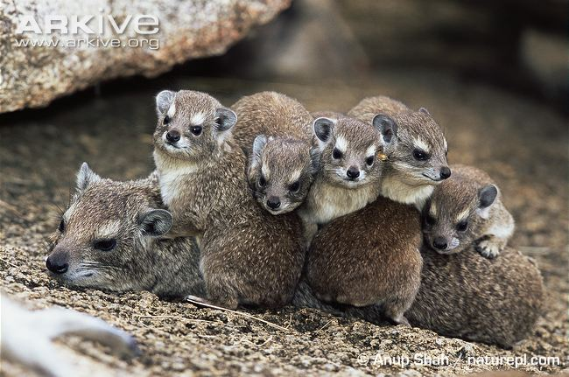
MeerKAT
Meerkats
KAT-7
HIRAX
Hyrax/Dassies

Slide 26
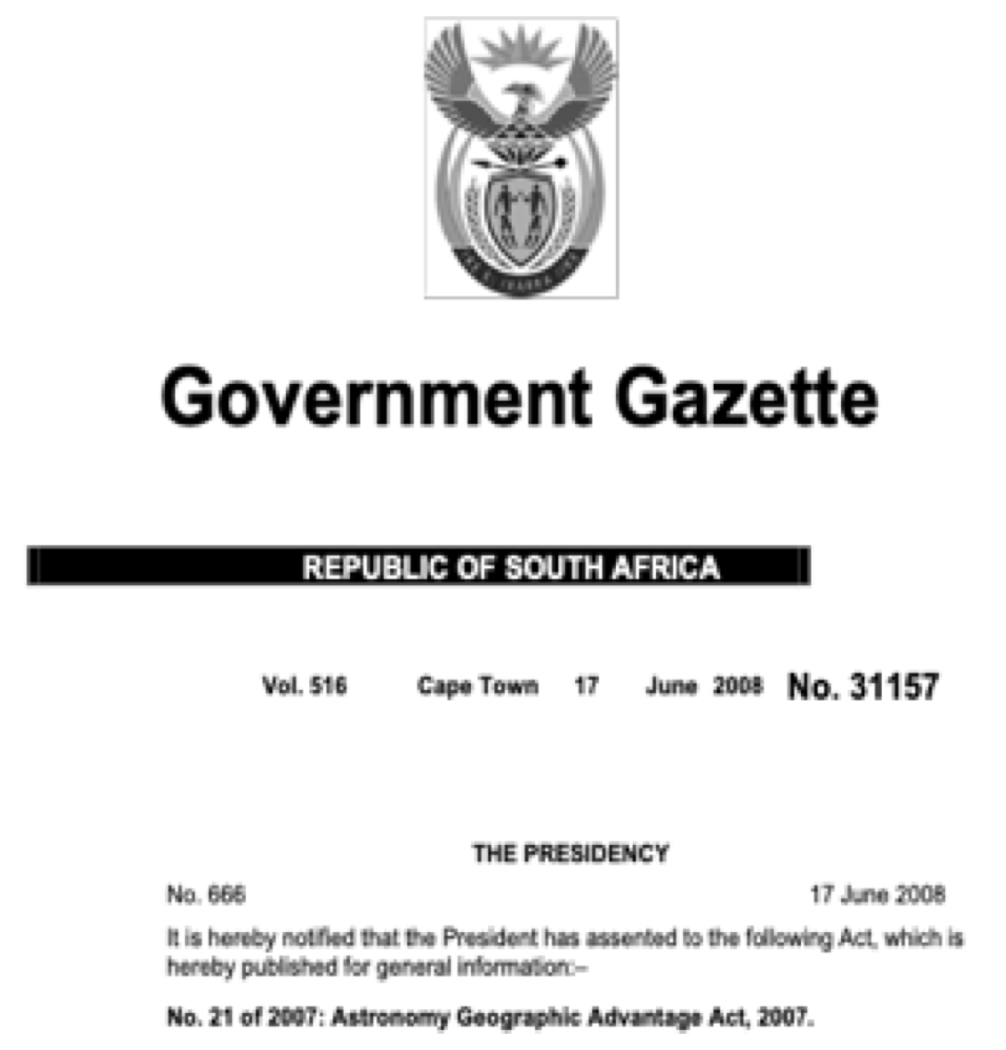
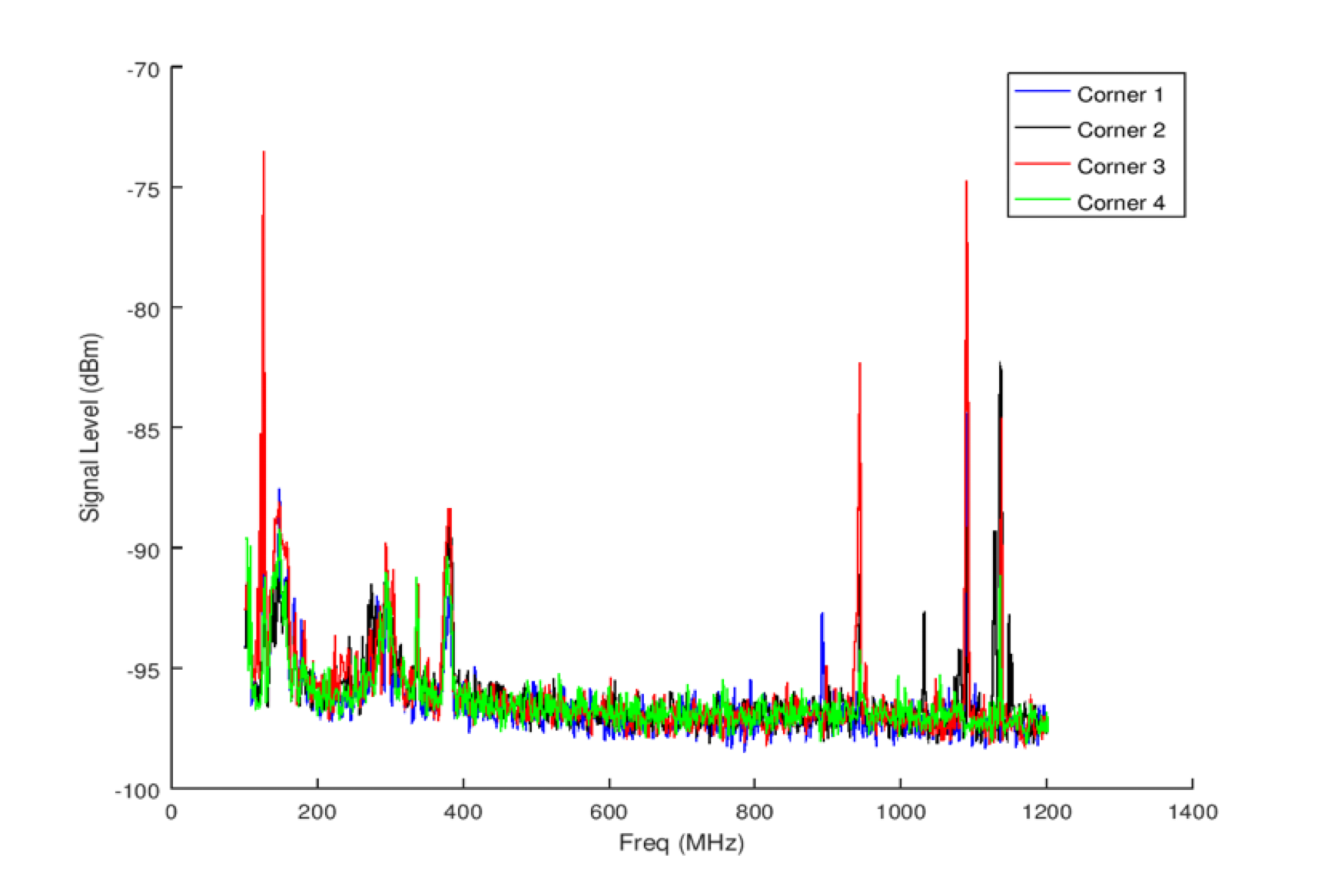

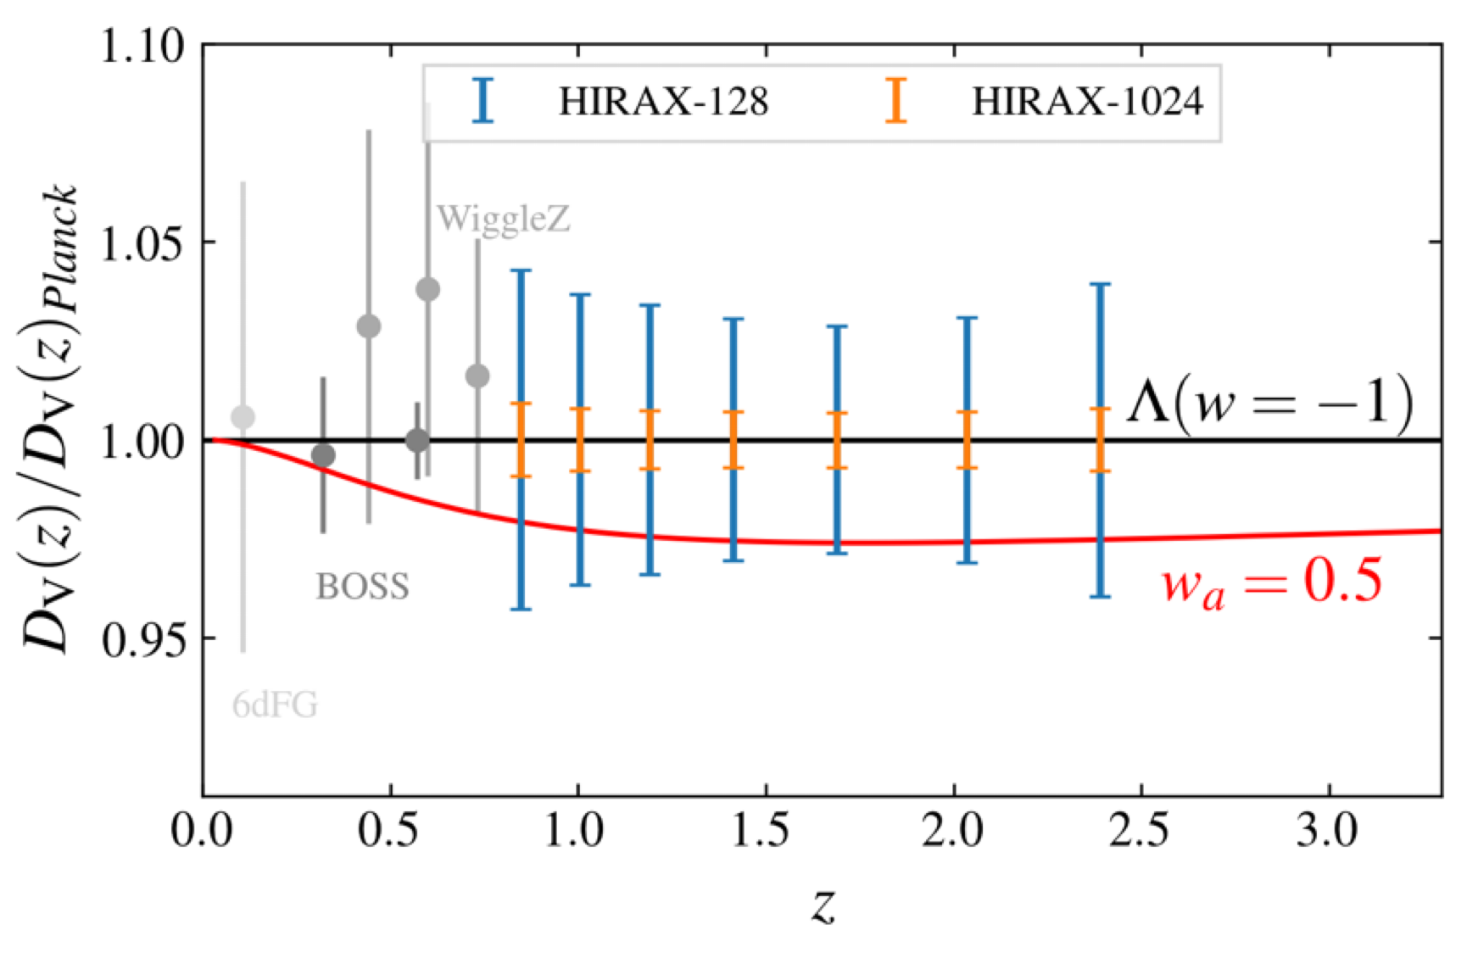
Radio Frequency Interference
http://www.acru.ukzn.ac.za/~hirax

Slide 27
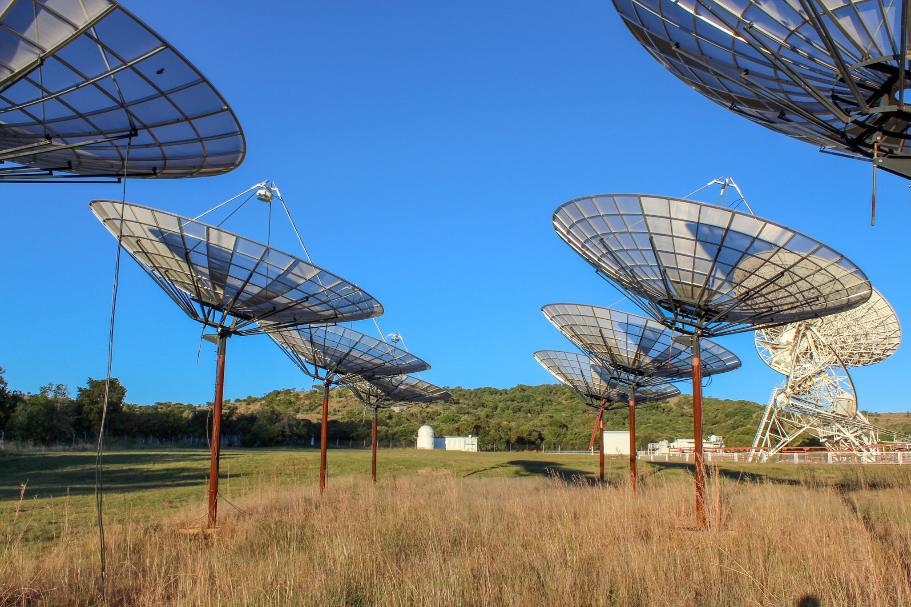
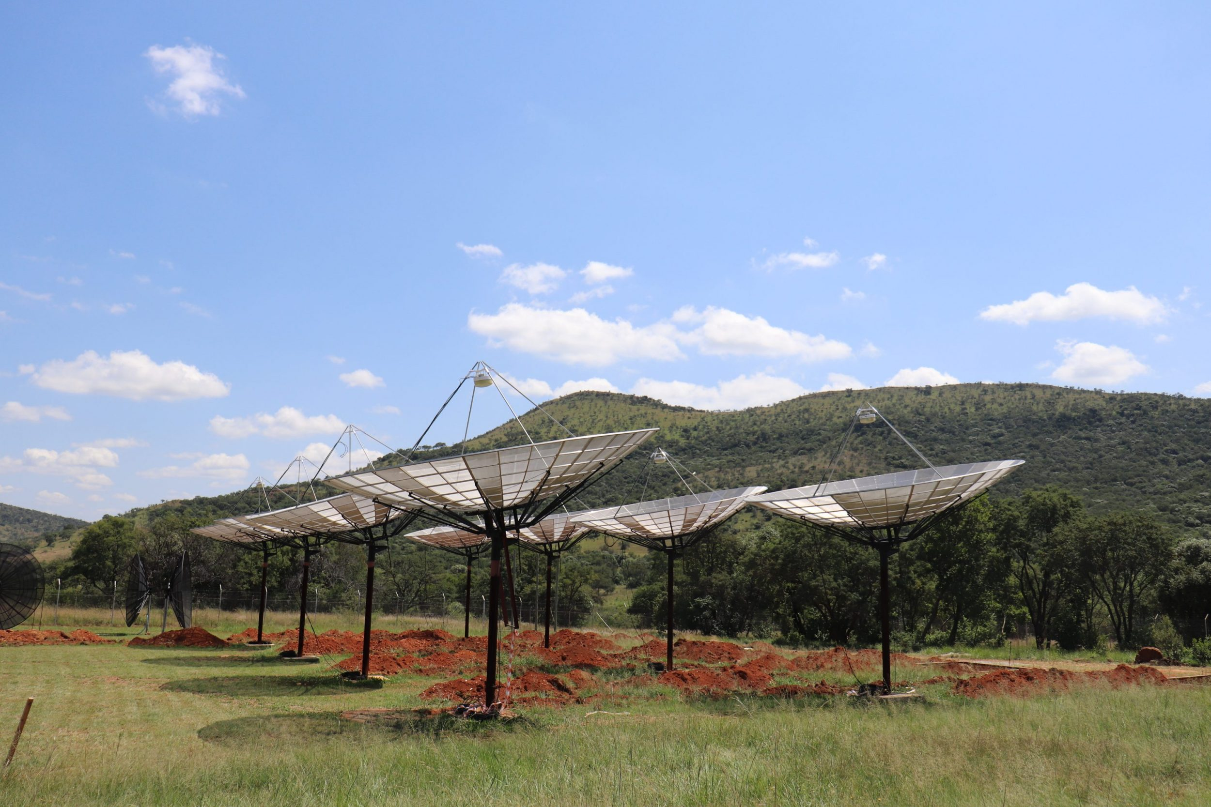
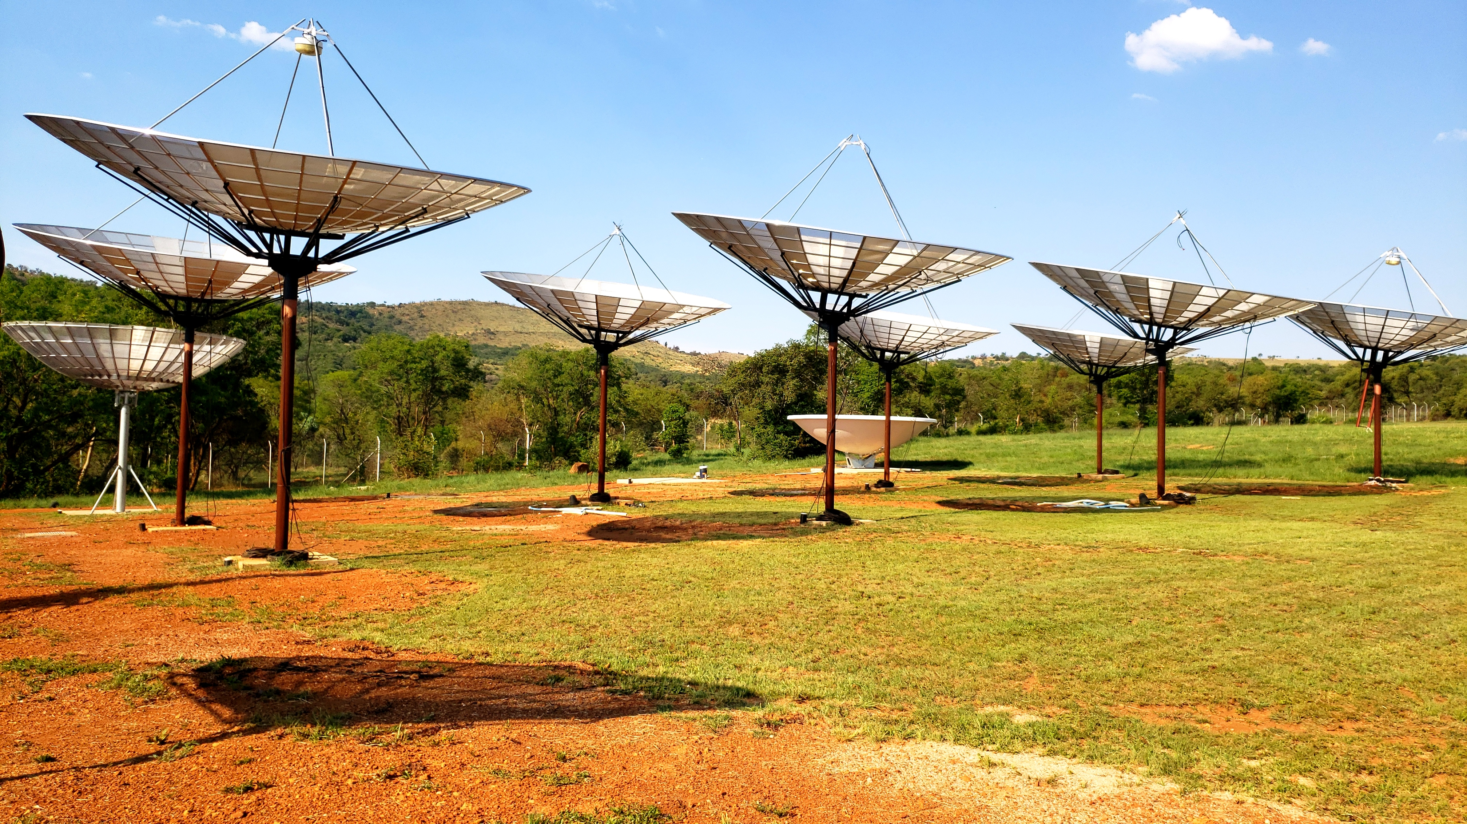
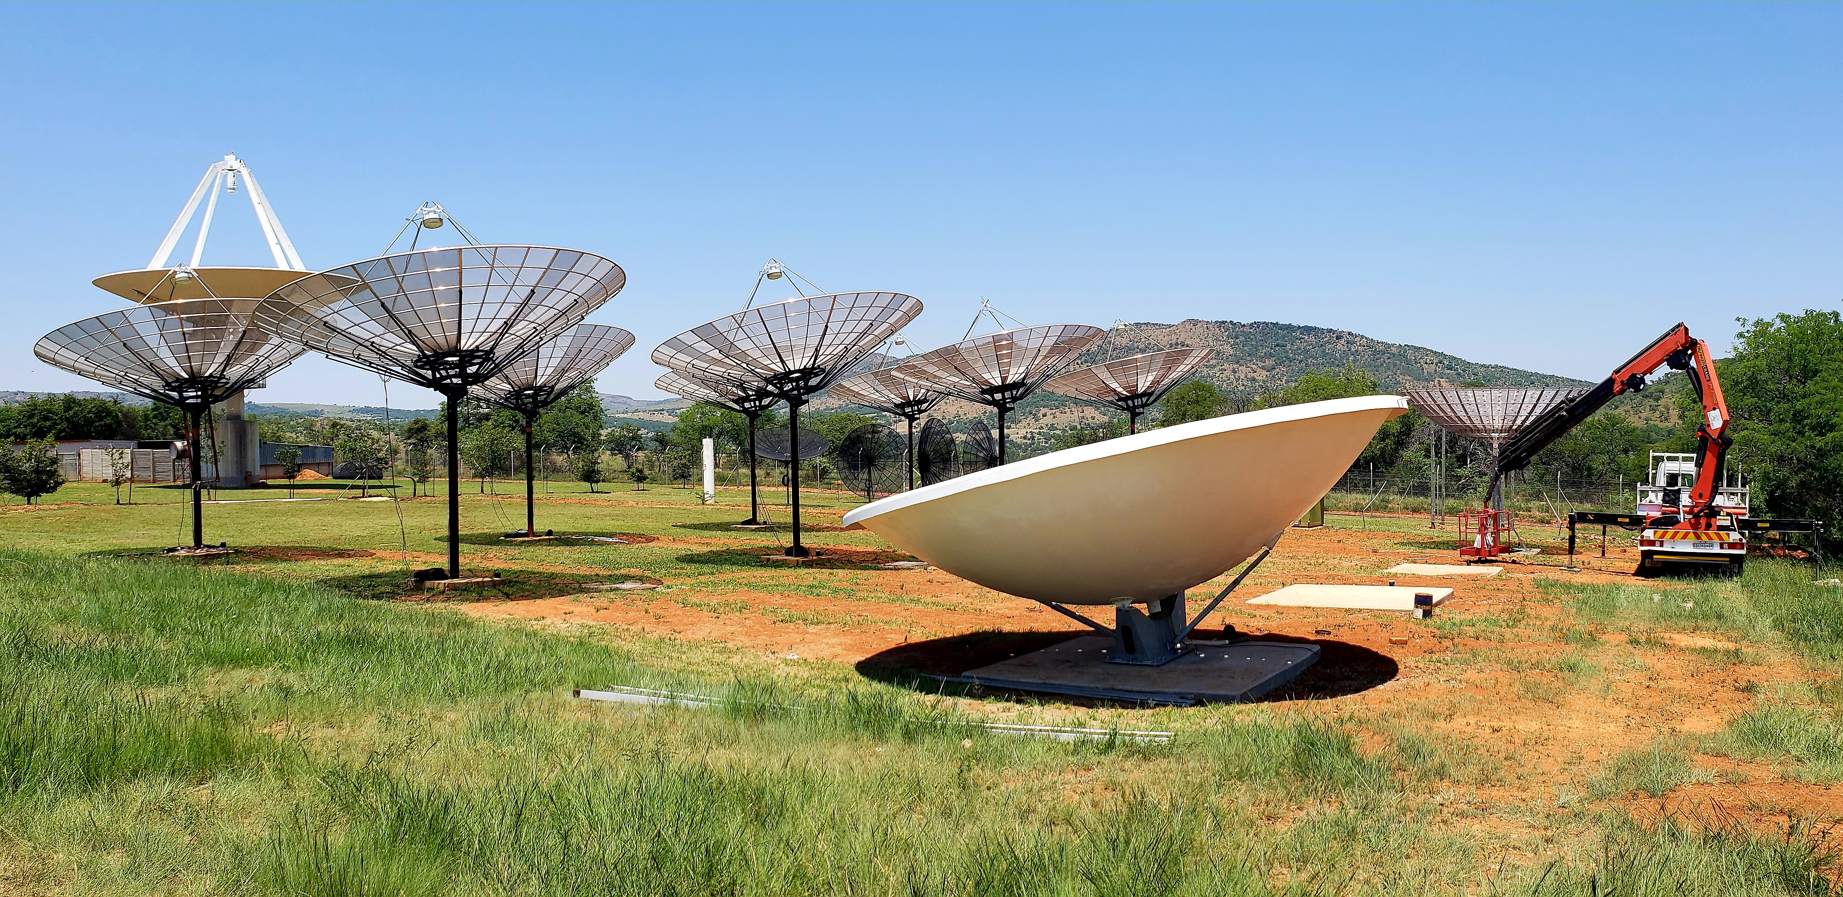
8 - element Array

Slide 28
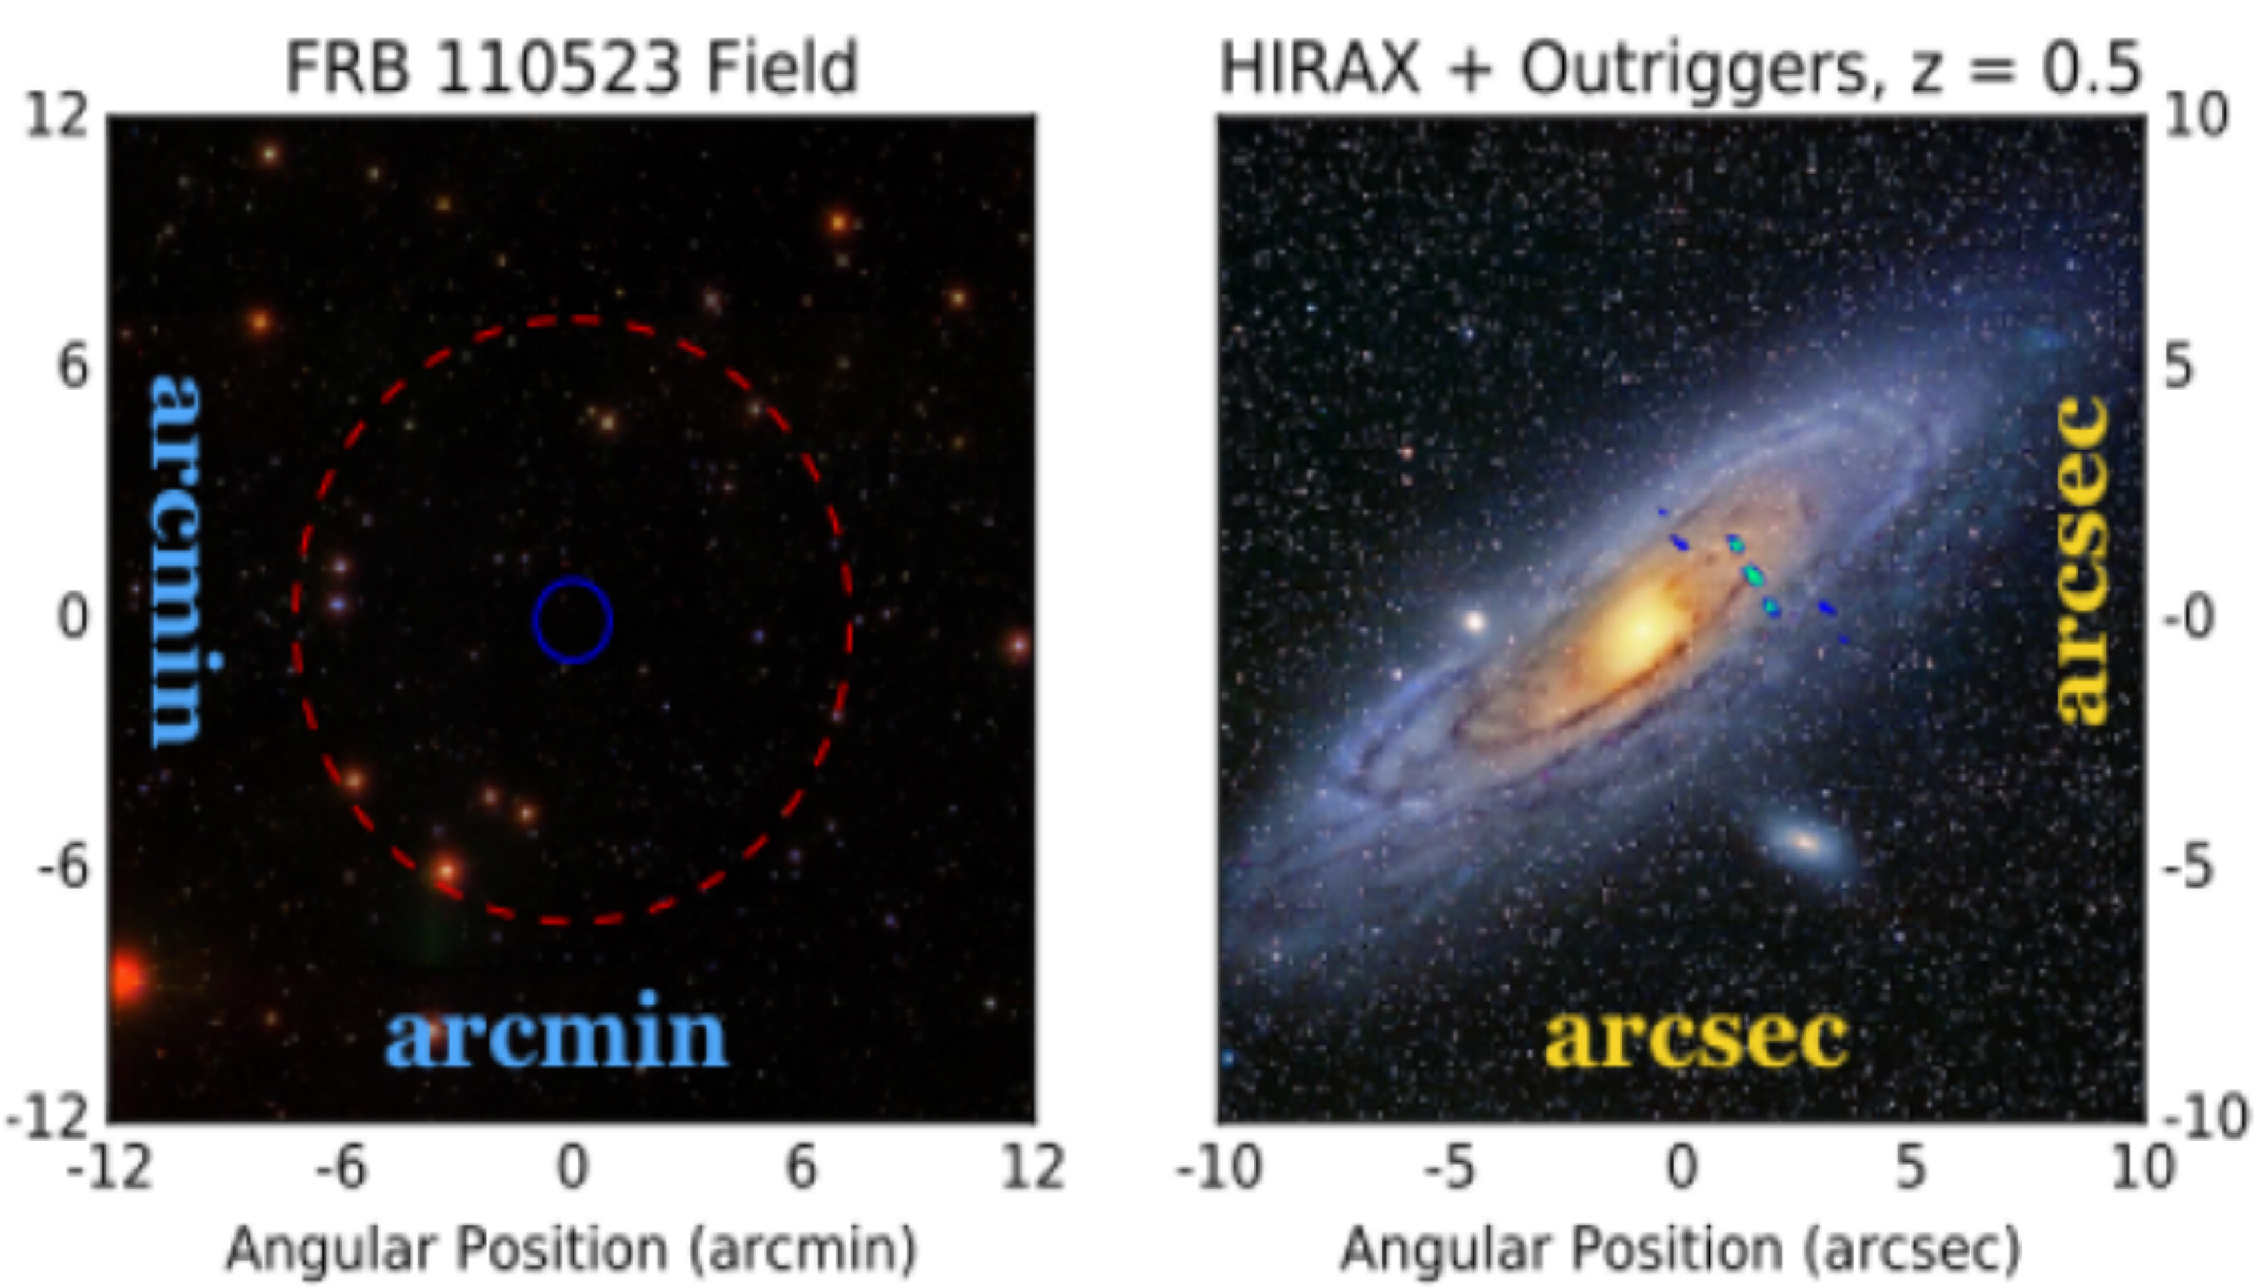
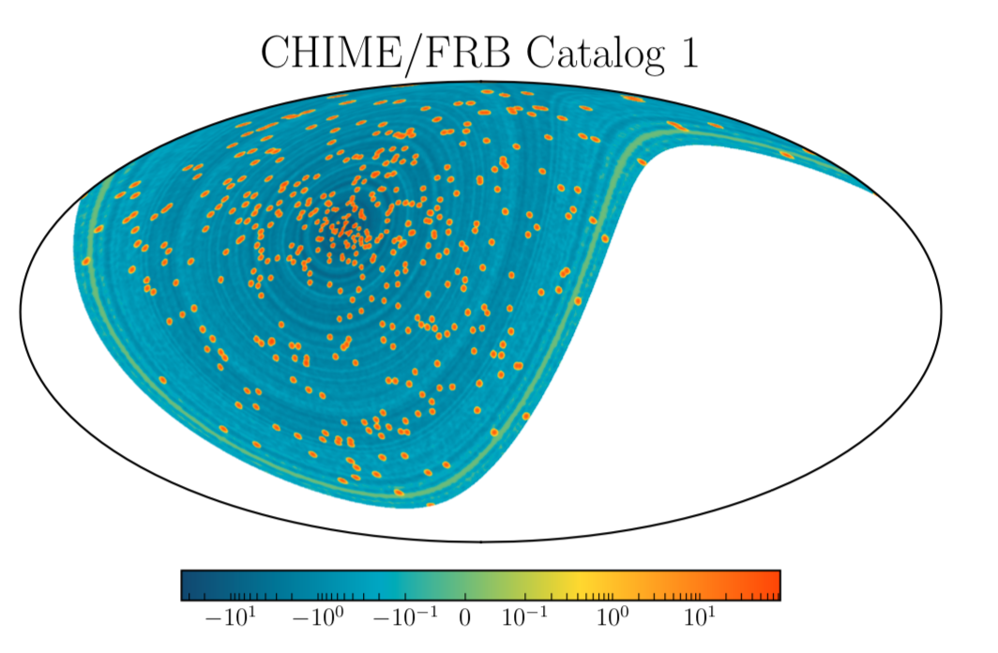
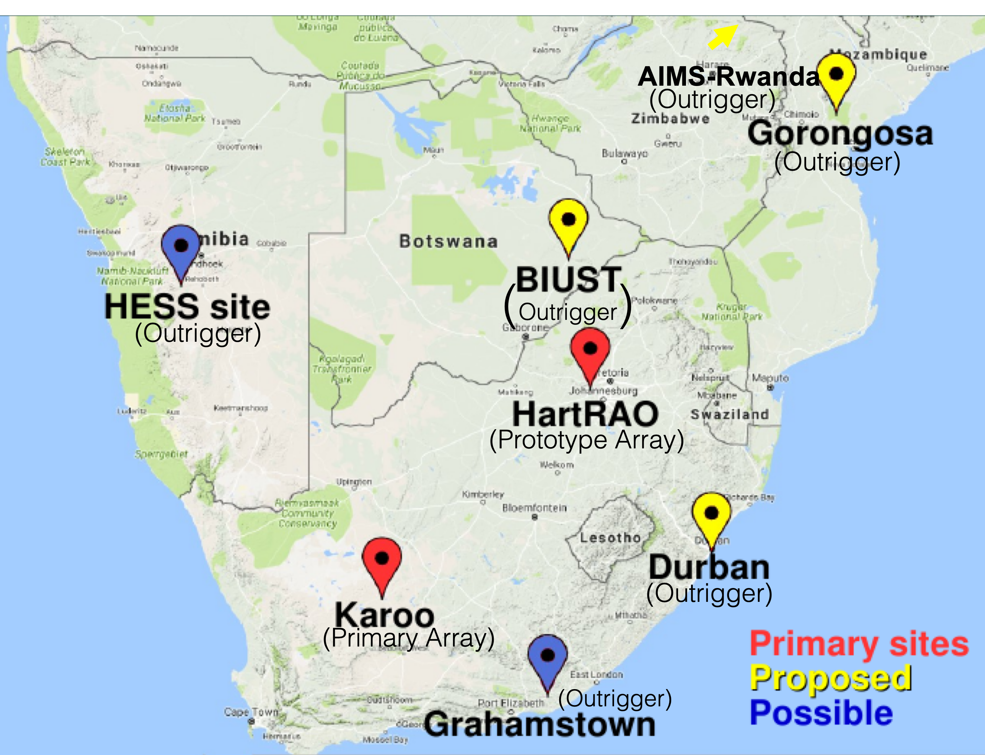
Localisation
Outriggers are very important
Interferometer arrays + outrigger - same resolution as a single dish of width the max distance
CHIME - 50 milliarcsecond resolution
Help understand the subpopulations?
FRB Localization with main Array
Array plus outriggers
CHIME/FRB Catalog 1 Results Rafiei-Ravandi et.al. 2020
Key to identify, classify, localise FRBs

Slide 29

There is no Typical FRB
C-H Niu et. al. 2022
FRB 20190520B detected with the Five-hundred-meter Aperture Spherical radio Telescope (FAST)
Localised with the Very Large Array (VLA)
Co-located with persistent radio source —-> dwarf host galaxy
Host identified with an optical image using Canada-France-Hawaii Telescope (CFHT) MegaCam
Redshift Host DM:
Properties that help:
repeating burst - 75 bursts detected in 18.5 h
Caution for Cosmology!

Slide 30








Fast Radio Bursts
Living Theory Catalogue - frbtheorycat.org
Identify FRBs
precision science
HIRAX
51 Theories! None explain all observations
Including some highly theoretical,
e.g. cosmic strings
da Costa Santos, Gordin and AW 2018
Newburgh, … AW et.al. 2016
Platts, AW, Walters, Tendulkar, Gordin, & Kandhai, 2018
Kuhn, … AW et.al. 2021
Kalita, AW 2022
Dark Energy
Dark Matter
Use FRBs as cosmological
yardsticks
Photon Mass
Walters, AW, Gaensler, Ma
& Witzemann, 2017
Potentially powerful cosmic probes
Kalita, Bhatporia, AW 2024
Kalita, Bhatporia, AW 2024
He Reionisation
Intergalactic Magnetic Fields
Study specific FRBs
Develop techniques to understand sub structure
MeerKAT
HIRAX etc
Use FRBs + cosmology observations to solve open astrophysics problems - e.g. find the missing baryons
Platts, …, AW et.al. 2020
Walters, Sievers, Ma & AW 2019
Kalita, Bhatporia, AW 2023

Slide 31

ML problem
daily, need to identify in real time
Low S/N in data - we need to remove RFI
High false positive rate
Identify faint and far away bursts
Machine learning solution?
Train an imaging algorithm (CNN) to recognise an FRB in the data
Identify FRBs, identify a golden sample
Accurately identify DM + location
Standardising detection algorithms - FRB Olympics
How?
Use false positives from known data
Use existing FRBS
Simulate FRBs and inject them
Use pulsar to test algorithms - 98%
Fast Radio Burst Science is an area rich with interesting open problems!

Slide 32
Wishlist
Large numbers of bursts observed - better statistics (10k per day!) (>4000 so far)
Thousands, can cross correlate with galaxy surveys
Large number of bursts localised (>100 so far) - redshift info, location within galaxy
Possible to understand the galaxies of origin
High redshift bursts localised - excellent for Dark Energy !
Multimessenger counterparts - multiwavelenth, gravitational waves, neutrinos
RM info… learn more about the IGM
Repeaters (>200 so far), periodicity, classes…?
Advances in Cosmology are intertwined with Astronomy

Slide 33
Lessons from FRBs
Discovered using high time resolution data with ~ 1000 frequency channels.
Many discovered in archival data.
Found not because of a tech innovation, but because attitude shift to look for them. Tech innovation needed next.
The first one, or few are not representative.
Limited resources/data introduce bias into what is followed up, theories etc
Keep searching even if we see nothing.
Look across wavelengths, messengers, parts of the sky for data, localisations.
If we cannot set aside our biases, we will find what we are searching for!
Proceed with caution when using astrophysics as a laboratory.
"If you are receptive and humble, mathematics will lead you by the hand.” — Paul Adrien Dirac (1902 - 1984)

Slide 34



