Slide 1
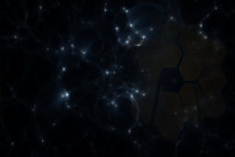


Synergies between Cosmic Reionization and JWST Galaxy Surveys
The Role of Bright Galaxies and Strong Feedback
Ankita Bera
CTC Post-Doctoral Fellow
University of Maryland, College Park
Collaborators: Sultan Hassan, Robert Feldmann, Romeel Davé, Kristian Finlator
arXiv: 2511.19600
ankitabm@umd.edu

Slide 2
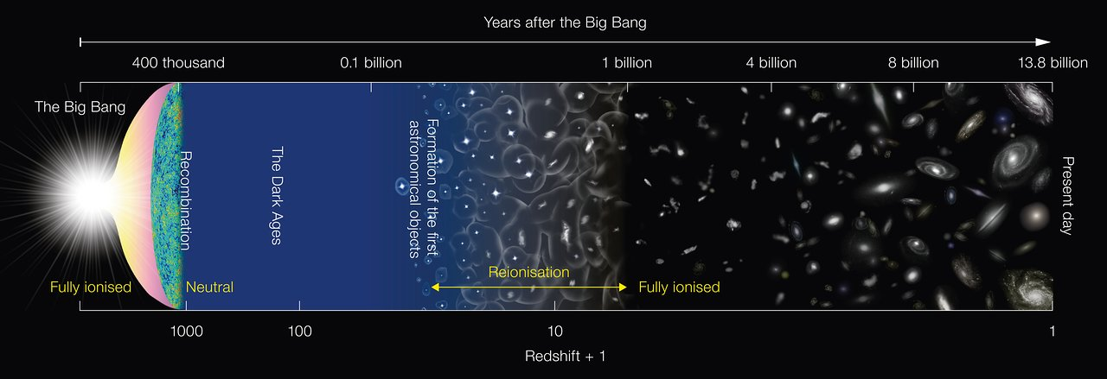
Cosmic Dawn & Epoch of Reionization
Credit: NAOJ
Cosmology in the Alps, March 18, 2026
Synergies between Reinization & JWST galaxy surveys
Ankita Bera (ankitabm@umd.edu)

Slide 3
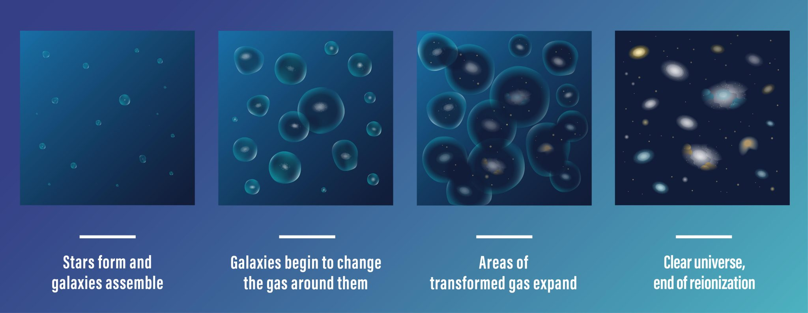
Cosmic Dawn & Epoch of Reionization
Credit: NAOJ
Credit: M. Alvarez, R. Kaehler, T. Abel
Cosmology in the Alps, March 18, 2026
Synergies between Reinization & JWST galaxy surveys
Ankita Bera (ankitabm@umd.edu)

Slide 4
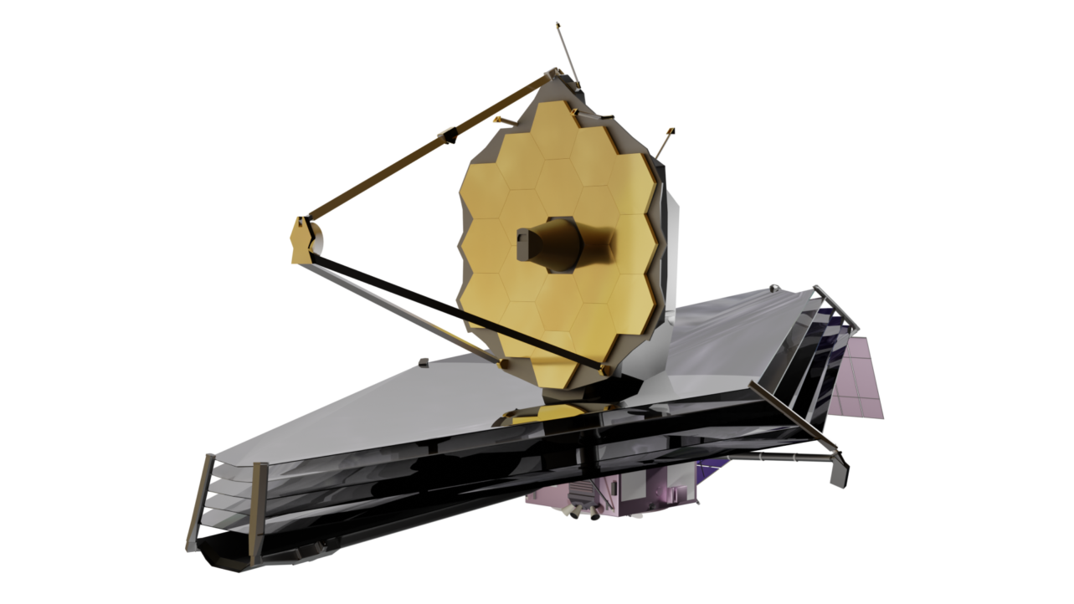
Cosmic Dawn & Epoch of Reionization
Credit: NAOJ
Credit: M. Alvarez, R. Kaehler, T. Abel
Cosmology in the Alps, March 18, 2026
Synergies between Reinization & JWST galaxy surveys
Ankita Bera (ankitabm@umd.edu)

Slide 5
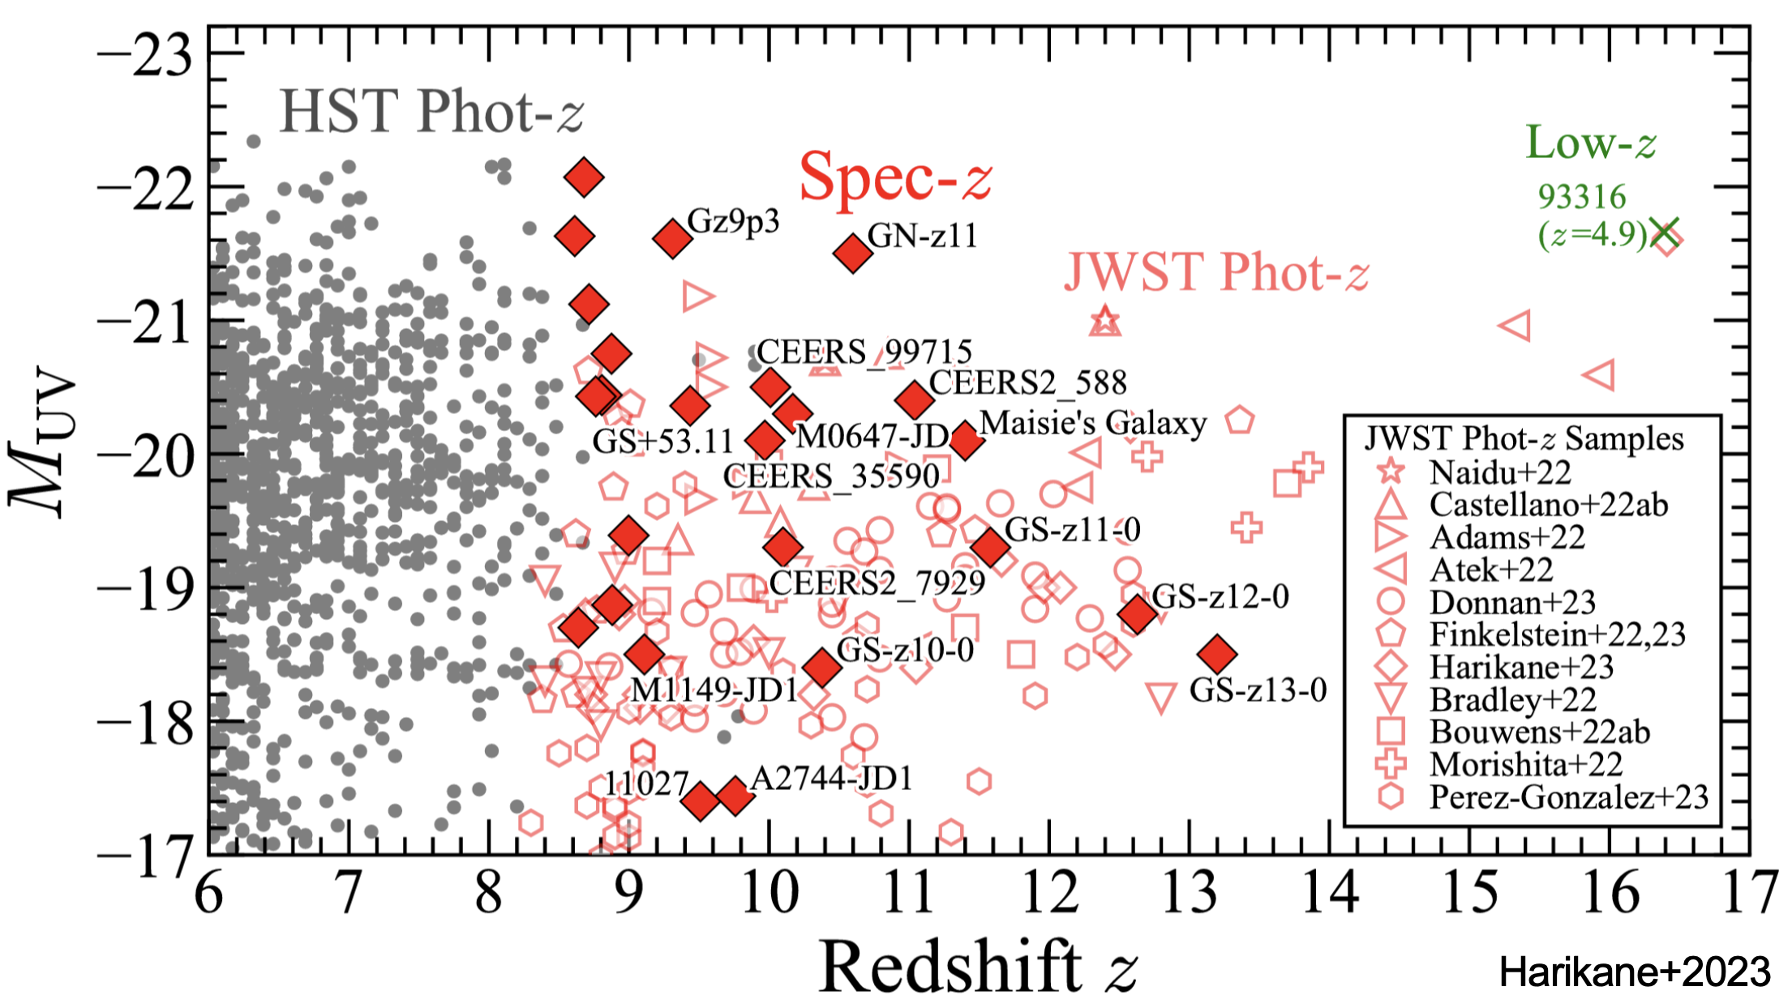
The JWST Revolution
Elevated UV luminosity functions challenge existing models
Bright
Overabundance of bright galaxies
JWST surveys (JADES, CEERS, COSMOS-Web) reveal more UV-bright galaxies than predicted at z > 9
Steep faint-end slopes
Faint
UVLF faint-end slope α ≲ −2.3, extending to MUV ~ −17
Late universe
Early universe
$$z∼14$$
JWST pushes UVLF measurements
to unprecedented redshifts
Cosmology in the Alps, March 18, 2026
Synergies between Reinization & JWST galaxy surveys
Ankita Bera (ankitabm@umd.edu)

Slide 6
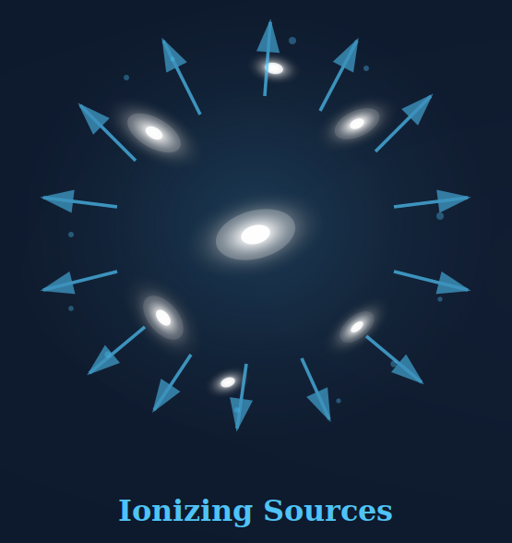
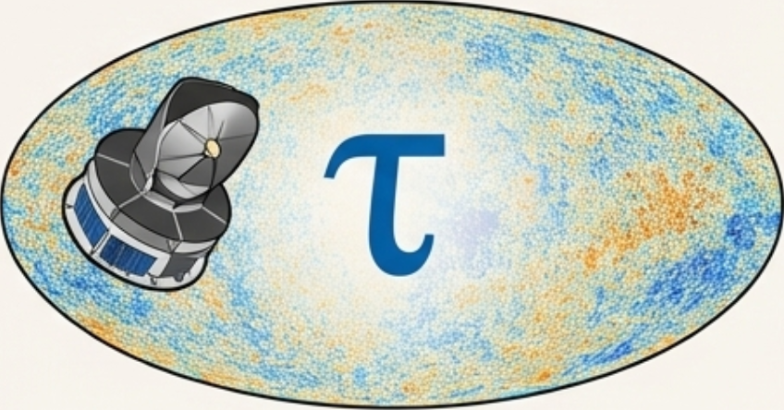
Reionization - JWST Tension
Elevated UV luminosity functions challenge existing models
Bright
Overabundance of bright galaxies
JWST surveys (JADES, CEERS, COSMOS-Web) reveal more UV-bright galaxies than predicted at z > 9
Steep faint-end slopes
Faint
UVLF faint-end slope α ≲ −2.3, extending to MUV ~ −17
Late universe
Early universe
Photon-budget tension
Elevated UVLFs may overshoot CMB optical depth τ constraints (Muñoz+ 2024)
Tension
JWST
Planck
Cosmology in the Alps, March 18, 2026
Synergies between Reinization & JWST galaxy surveys
Ankita Bera (ankitabm@umd.edu)

Slide 7
Reionization - JWST Tension
Elevated UV luminosity functions challenge existing models
Bright
Overabundance of bright galaxies
JWST surveys (JADES, CEERS, COSMOS-Web) reveal more UV-bright galaxies than predicted at z > 9
Steep faint-end slopes
Faint
UVLF faint-end slope α ≲ −2.3, extending to MUV ~ −17
Late universe
Early universe
Photon-budget tension
Elevated UVLFs may overshoot CMB optical depth τ constraints (Muñoz+ 2024)
Need for new physics
Tension
Bursty star formation, top-heavy IMFs, high star formation efficiency, reduced dust, and so on …
JWST
Planck
Dekel+ 2023, Sun+ 2023, Ferrara+ 2023, Boylan-Kolchin 2023, Trinca+ 2024, Maiolino+ 2024, Shen+ 2024…
Cosmology in the Alps, March 18, 2026
Synergies between Reinization & JWST galaxy surveys
Ankita Bera (ankitabm@umd.edu)

Slide 8
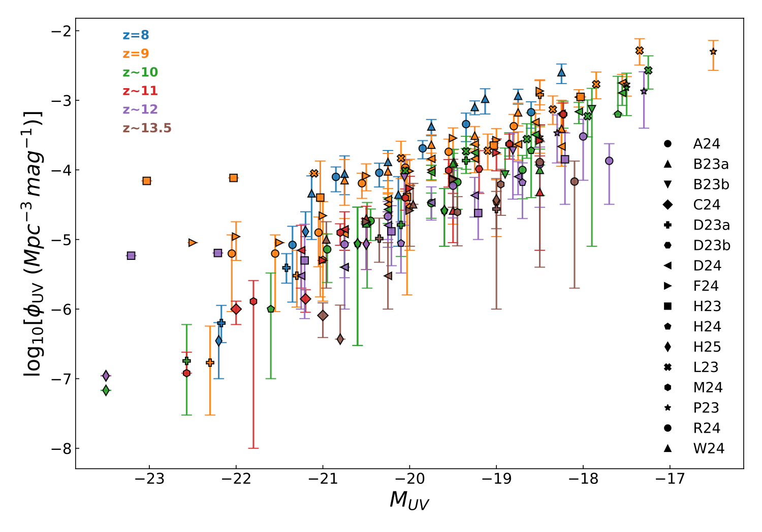

Reconciling galaxy surveys with IGM observables
JWST Galaxy Surveys
UV Luminosity Function ($ϕ_{UV}$)
→ Galaxy number density vs. magnitude
UV Luminosity Density ($ρ_{UV}$)
→ Integrated star formation tracer
UVLF compiled
Credit: Enrico Garaldi
Cosmology in the Alps, March 18, 2026
Synergies between Reinization & JWST galaxy surveys
Ankita Bera (ankitabm@umd.edu)

Slide 9
Reconciling galaxy surveys with IGM observables
JWST Galaxy Surveys
Reionization Observables
UV Luminosity Function ($ϕ_{UV}$)
→ Galaxy number density vs. magnitude
UV Luminosity Density ($ρ_{UV}$)
→ Integrated star formation tracer
Ionizing emissivity (${\overset{·}{N}}_{ion}$)
→ From QSO absorption spectra
Neutral fraction ($x_{HI}$)
→ Damping wings, LAEs, Lyα forest
Thomson optical depth ($τ$)
→ Planck CMB: τ = 0.054 ± 0.007
⟷
Joint
Calibration
UVLF compiled
Credit: Enrico Garaldi
Cosmology in the Alps, March 18, 2026
Synergies between Reinization & JWST galaxy surveys
Ankita Bera (ankitabm@umd.edu)

Slide 10
Source Model: Non-linear ionization rate
A flexible, physically-motivated framework (Hassan+ 2016, Bera+ 2023); from hydrodynamic simulations of reionization (Davé+ 2013, Finlator+2015)
$$\frac{R_{ion}}{M_{h}}∝f_{esc}M_{h}^{C}exp(-(M_{h}/B)^{3})(1+z)^{D}$$
fesc
A
B
C
D
Photon escape fraction
Amplitude
Quenching Mass
Mass Index
z-Evolution
Scales ionizing
emissivity uniformly
Minimum Mh for
ionizing radiation
Slope of Rion–Mh
relation
Feedback strength
& redshift evolution
+ Sheth-Tormen HMF • Metallicity-dependent emissivity (Finlator+ 2011) • redshift-dependent mass-weighted metallicity (Madau & Fragos 2017)
Cosmology in the Alps, March 18, 2026
Synergies between Reinization & JWST galaxy surveys
Ankita Bera (ankitabm@umd.edu)

Slide 11
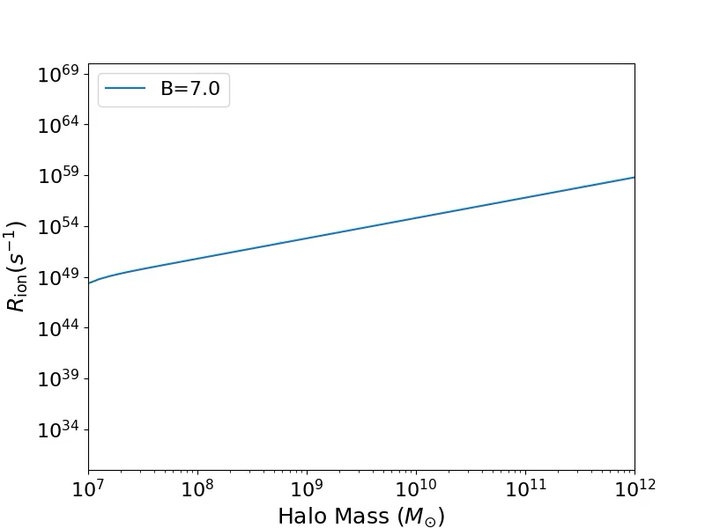
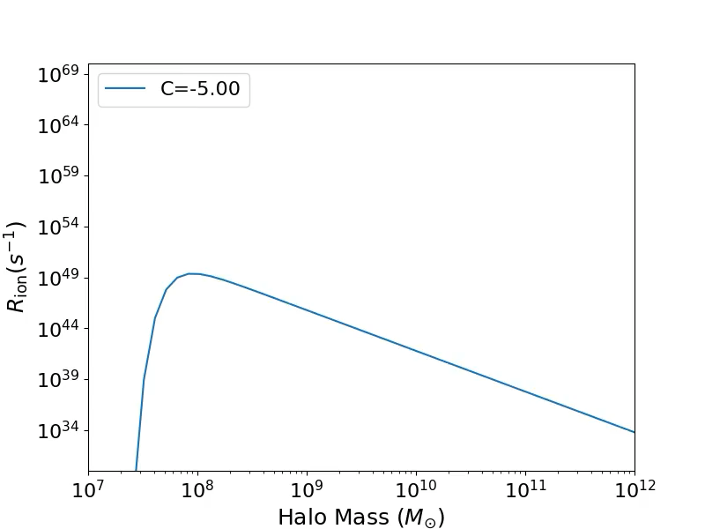
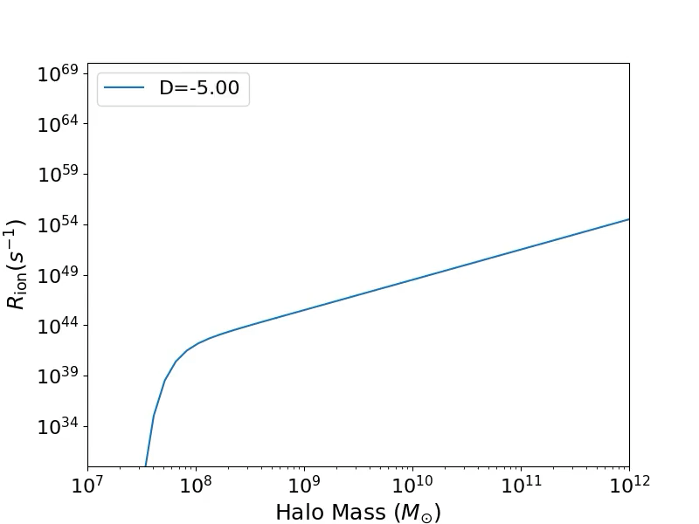
Source Model: Non-linear ionization rate
A flexible, physically-motivated framework (Hassan+ 2016, Bera+ 2023); from hydrodynamic simulations of reionization (Davé+ 2013, Finlator+2015)
fesc
A
B
C
D
Photon escape fraction
Amplitude
Quenching Mass
Mass Index
z-Evolution
Scales ionizing
emissivity uniformly
Minimum Mh for
ionizing radiation
Slope of Rion–Mh
relation
Feedback strength
& redshift evolution
+ Sheth-Tormen HMF • Metallicity-dependent emissivity (Finlator+ 2011) • redshift-dependent mass-weighted metallicity (Madau & Fragos 2017)
Cosmology in the Alps, March 18, 2026
Synergies between Reinization & JWST galaxy surveys
Ankita Bera (ankitabm@umd.edu)

Slide 12
Bayesian Inference & MCMC
Joint calibration to multiple observables using emcee
P(θ|D) ∝ L(D|θ) × π(θ)
Observational Data
UVLF ($ϕ_{UV}$)
16 JWST surveys, z~8-14
Gaussian likelihood for each dataset
$$ρ_{UV}$$
Total likelihood = product over independent datasets
post-JWST, z > 8
$${\overset{·}{N}}_{ion}$$
Affine-invariant MCMC sampler (emcee)
Becker+13/21, Gaikwad+23
Uniform/log-uniform priors on parameters
$$x_{HI}$$
18+ studies, z~5-11
Convergence via integrated autocorrelation time
τ (CMB)
Planck 2018
Cosmology in the Alps, March 18, 2026
Synergies between Reinization & JWST galaxy surveys
Ankita Bera (ankitabm@umd.edu)

Slide 13
Model Variants
Five calibration strategies spanning weak to strong feedback
Model | Constraints | Free Params | D (feedback) | Key Feature
EoR | Ṅion + xHI + τ | fesc, C | 2.28 (fixed) | Fiducial reionization
EoR-ϕUV-wf | ϕUV + Ṅion + xHI + τ | fesc, C | 2.28 (fixed) | Weak feedback + UVLF
EoR-ρUV-wf | ρUV + Ṅion + xHI + τ | fesc, C | 2.28 (fixed) | Weak feedback + ρUV
EoR-ϕUV-sf | ϕUV + Ṅion + xHI + τ | fesc, A, C, D | 5.33 ± 0.13 | Strong feedback + UVLF
EoR-ρUV-sf | ρUV + Ṅion + xHI + τ | fesc, A, C, D | 6.77 ± 1.05 | Strong feedback + ρUV
Key Insight: Strong-feedback models (D ~ 5–7) favor massive galaxies (Mh ≳ 10¹⁰ M☉) with high fesc ~ 0.5–0.6, while weak-feedback models prefer faint galaxies with lower fesc ~ 0.15–0.17.
Cosmology in the Alps, March 18, 2026
Synergies between Reinization & JWST galaxy surveys
Ankita Bera (ankitabm@umd.edu)

Slide 14
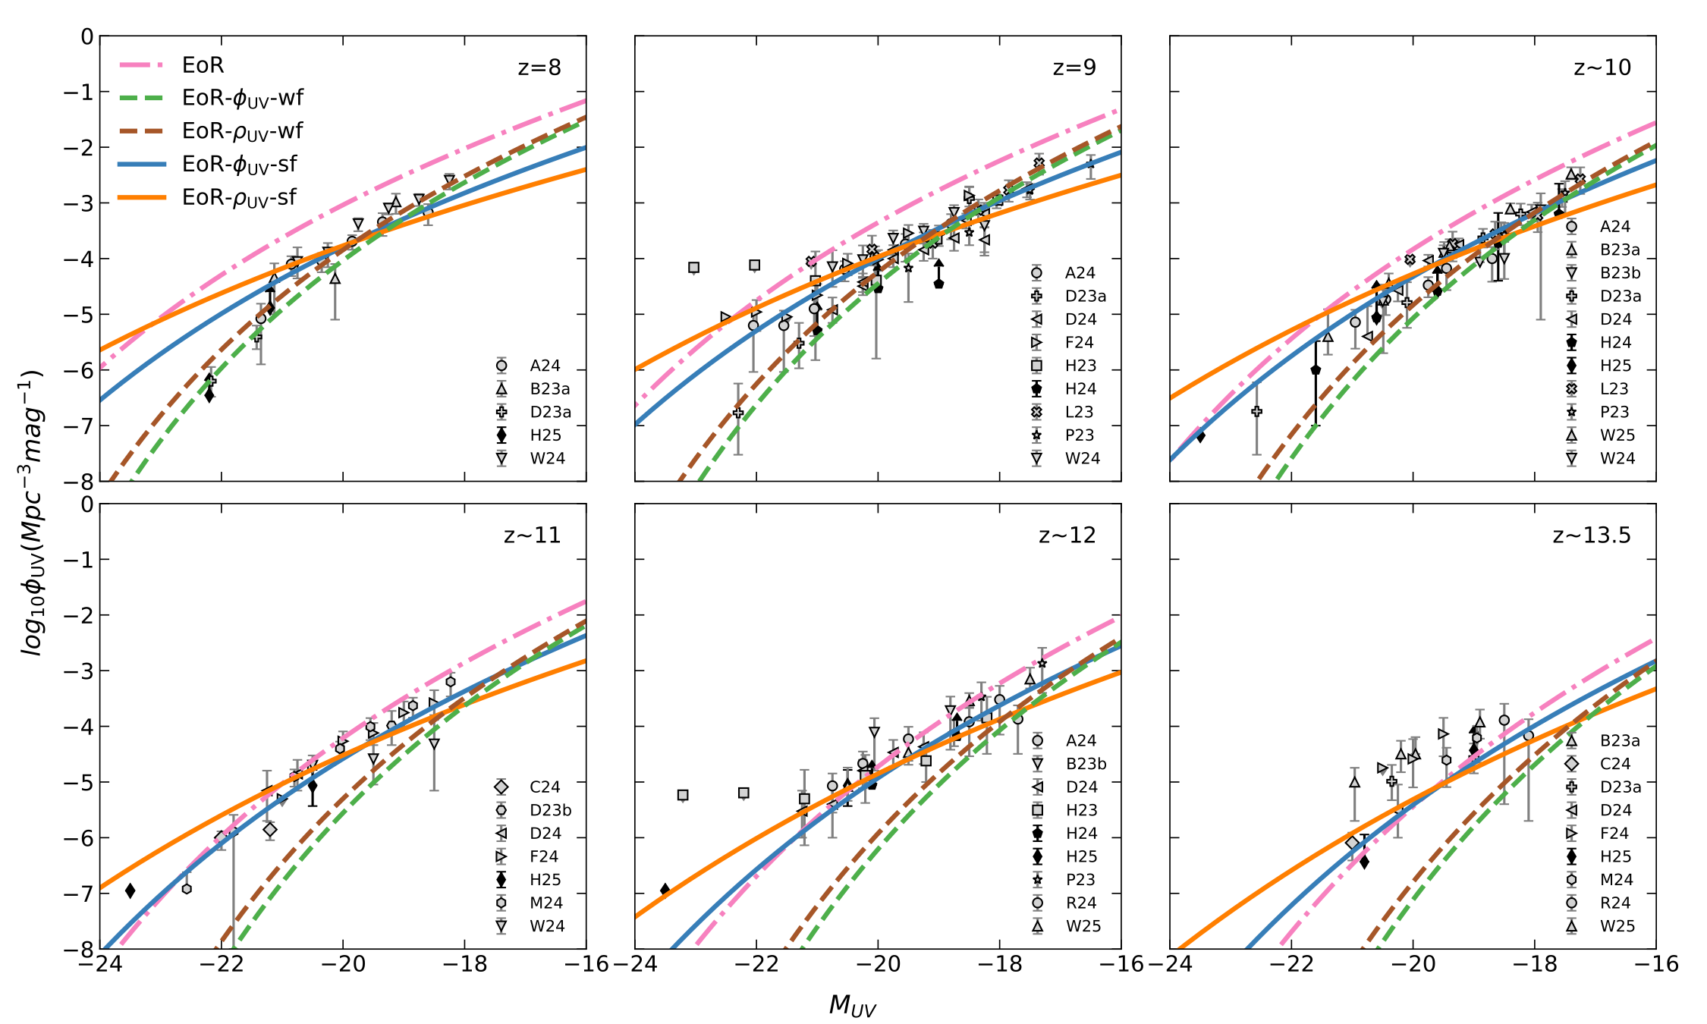
UV Luminosity Functions: Models vs. Data
Weak Feedback (wf)
Good fit at z < 10
Underpredicts bright end at z > 10
Dashed green/brown lines
Strong Feedback (sf)
Excellent at z ≥ 10
Overestimates bright end at z < 9
Solid blue/orange lines
$$R_{ion}∝(1+z)^{5}$$
• Gray = photometric
• Black = spectroscopic
Cosmology in the Alps, March 18, 2026
Synergies between Reinization & JWST galaxy surveys
Ankita Bera (ankitabm@umd.edu)

Slide 15
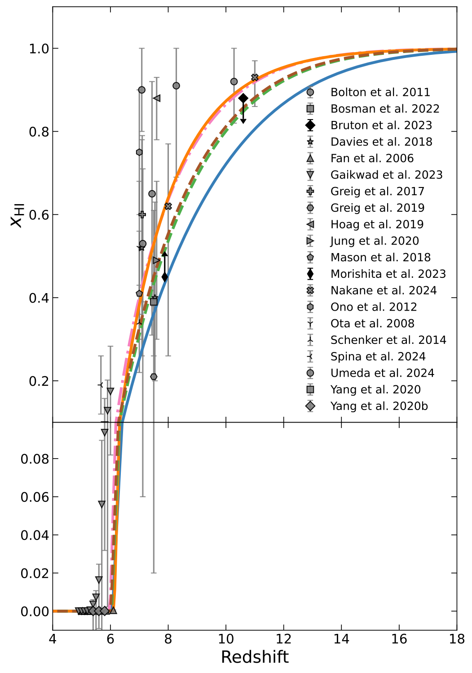
Reionization Timeline
All models complete reionization by z ~ 6, but with different timelines
— Strong feedback: EoR+UVLF — Strong feedback: EoR+UV density - - Weak feedback:EoR+UVLF
- - Weak feedback: EoR+UV density -.- EoR only
Neutral Hydrogen Fraction
Cosmology in the Alps, March 18, 2026
Synergies between Reinization & JWST galaxy surveys
Ankita Bera (ankitabm@umd.edu)

Slide 16
Reionization Timeline
All models complete reionization by z ~ 6, but with different timelines
Rapid Reionization
— Strong feedback: EoR+UVLF — Strong feedback: EoR+UV density - - Weak feedback:EoR+UVLF
- - Weak feedback: EoR+UV density -.- EoR only
Midpoint of Reionization
Neutral Hydrogen Fraction
Cosmology in the Alps, March 18, 2026
Synergies between Reinization & JWST galaxy surveys
Ankita Bera (ankitabm@umd.edu)

Slide 17
Reionization Timeline
All models complete reionization by z ~ 6, but with different timelines
Rapid Reionization
— Strong feedback: EoR+UVLF — Strong feedback: EoR+UV density - - Weak feedback:EoR+UVLF
- - Weak feedback: EoR+UV density -.- EoR only
Extended Reionization
Midpoint of Reionization
Constrained by JWST UVLF : Early onset (z~16–18), extended & gradual reionization
→
Neutral Hydrogen Fraction
Cosmology in the Alps, March 18, 2026
Synergies between Reinization & JWST galaxy surveys
Ankita Bera (ankitabm@umd.edu)

Slide 18
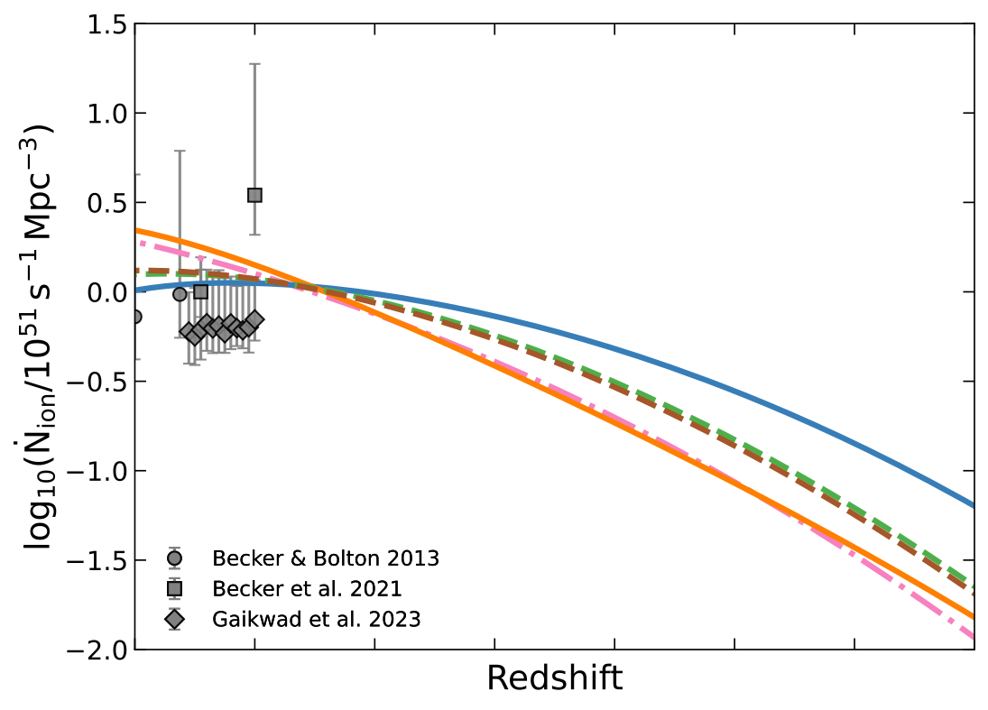
Reionization Timeline
All models complete reionization by z ~ 6, but with different timelines
Rapid Reionization
— Strong feedback: EoR+UVLF
— Strong feedback: EoR+UV density
- - Weak feedback:EoR+UVLF
- - Weak feedback: EoR+UV density
-.- EoR only
Extended Reionization
Midpoint of Reionization
Ionizing Emissivity Ṅion
Constrained by JWST UVLF : Early onset (z~16–18), extended & gradual reionization
→
Neutral Hydrogen Fraction
Cosmology in the Alps, March 18, 2026
Synergies between Reinization & JWST galaxy surveys
Ankita Bera (ankitabm@umd.edu)

Slide 19
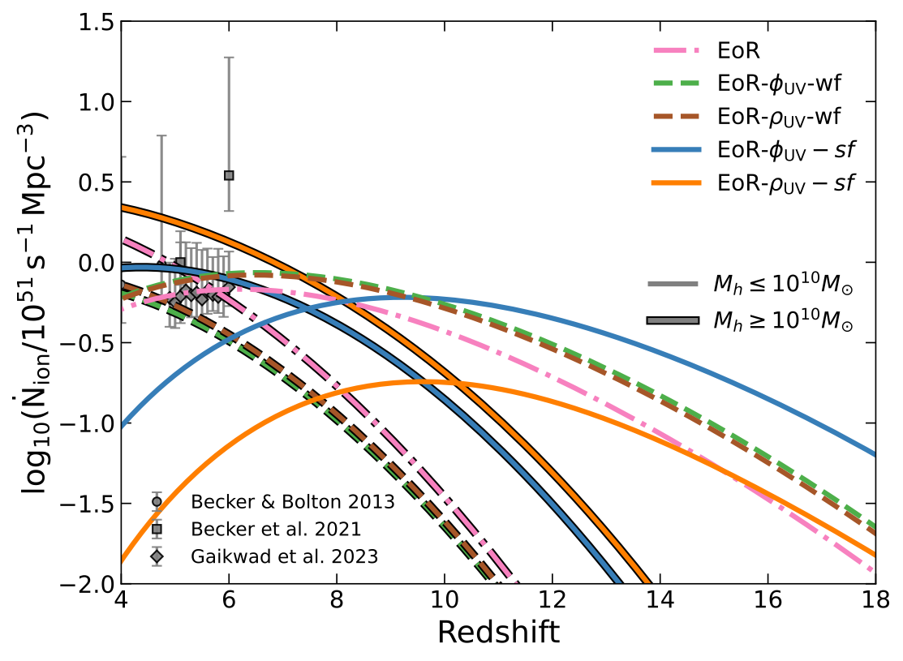
Reionization Timeline
All models complete reionization by z ~ 6, but with different timelines
Rapid Reionization
Extended Reionization
Midpoint of Reionization
Ionizing Emissivity Ṅion
Constrained by JWST UVLF : Early onset (z~16–18), extended & gradual reionization
→
Neutral Hydrogen Fraction
Cosmology in the Alps, March 18, 2026
Synergies between Reinization & JWST galaxy surveys
Ankita Bera (ankitabm@umd.edu)

Slide 20
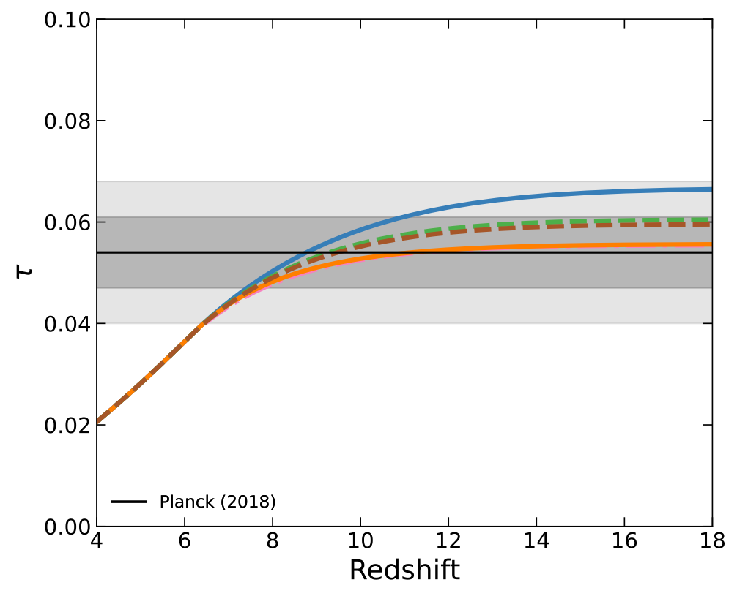
Reionization Timeline
All models complete reionization by z ~ 6, but with different timelines
Rapid Reionization
Extended Reionization
Midpoint of Reionization
Ionizing Emissivity Ṅion
Thomson Optical Depth τ
Constrained by JWST UVLF : Early onset (z~16–18), extended & gradual reionization → τ within 2σ of Planck →
Neutral Hydrogen Fraction
Cosmology in the Alps, March 18, 2026
Synergies between Reinization & JWST galaxy surveys
Ankita Bera (ankitabm@umd.edu)

Slide 21
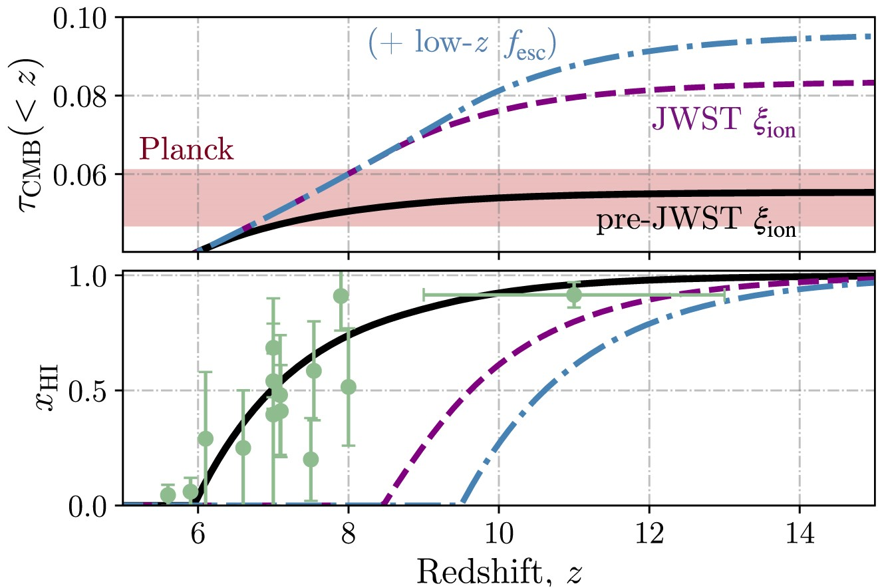
Reionization Timeline
All models complete reionization by z ~ 6, but with different timelines
Rapid Reionization
Extended Reionization
Midpoint of Reionization
Muñoz et al. 2024
Thomson Optical Depth τ
Constrained by JWST UVLF : Early onset (z~16–18), extended & gradual reionization → τ within 2σ of Planck → resolves photon-budget crisis
Neutral Hydrogen Fraction
Cosmology in the Alps, March 18, 2026
Synergies between Reinization & JWST galaxy surveys
Ankita Bera (ankitabm@umd.edu)

Slide 22
Key Findings
1
Weak feedback models struggle at z > 9
C ~ 0.15, D = 2.28 → faint galaxy-dominated, good at z < 10 but misses the bright-end excess
2
Strong feedback models capture high-z UVLF
C ≳ 0.6, D ~ 5–7 → massive galaxy-dominated with fesc ~ 0.5–0.6, matches z ≥ 10 observations
3
Extended reionization resolves photon-budget crisis
EoR-ϕUV-sf: reionization from z ~ 16 to z ~ 6, optical depth within 2σ of Planck (τ = 0.054 ± 0.007)
4
All models complete reionization by z ~ 6
Consistent with Lyα forest, quasar damping wings, and CMB constraints — no very-late scenarios favored
Cosmology in the Alps, March 18, 2026
Synergies between Reinization & JWST galaxy surveys
Ankita Bera (ankitabm@umd.edu)

Slide 23
Physical Interpretation of Feedback
What drives the D parameter? Democratic vs. oligarch reionization
Weak Feedback (D = 2.28)
Strong Feedback (D ~ 5–7)
"Democratic" picture
"Oligarch" picture
Mild redshift evolution
1
Enhanced SN feedback at high z
Rion ∝ (1+z)^2.3 — moderate feedback from RT simulations (Hassan+ 2016, 2017)
Low metallicity → reduced cooling → energy couples more effectively to gas
Faint galaxies dominate
vs
2
Radiative feedback suppresses low-mass halos
Low-mass halos (Mh ≲ 10¹⁰ M☉) provide the bulk of ionizing photons
UV background photoheats Mh ≲ 10⁹ M☉ → shifts sources to massive systems
SN + photoheating feedback
3
Bursty star formation histories
Stellar feedback scales mildly with z; star formation not strongly suppressed
Rapid UV variability mimics stronger feedback when time-averaged
Low escape fraction
4
Mass-dependent fesc rising with z
fesc ~ 0.15–0.17 sufficient when many faint sources contribute
fesc ~ 0.5–0.6 in massive halos; feedback-driven channels facilitate photon escape
Consistent with
Combined effect captured by D ~ 5–7
Finkelstein+ 2019, Robertson+ 2015 — faint galaxies collectively drive reionization
Consistent with Naidu+ 2020; Cannot individually disentangle
Cosmology in the Alps, March 18, 2026
Synergies between Reinization & JWST galaxy surveys
Ankita Bera (ankitabm@umd.edu)

Slide 24
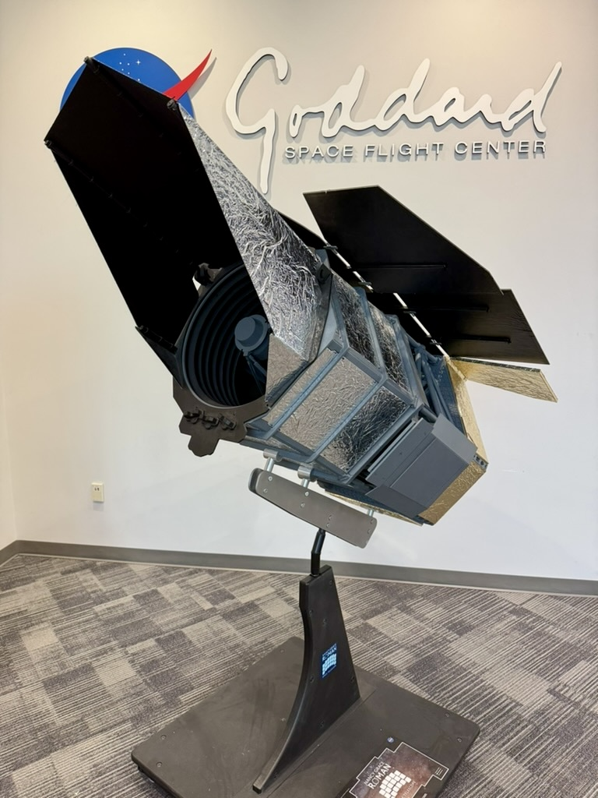
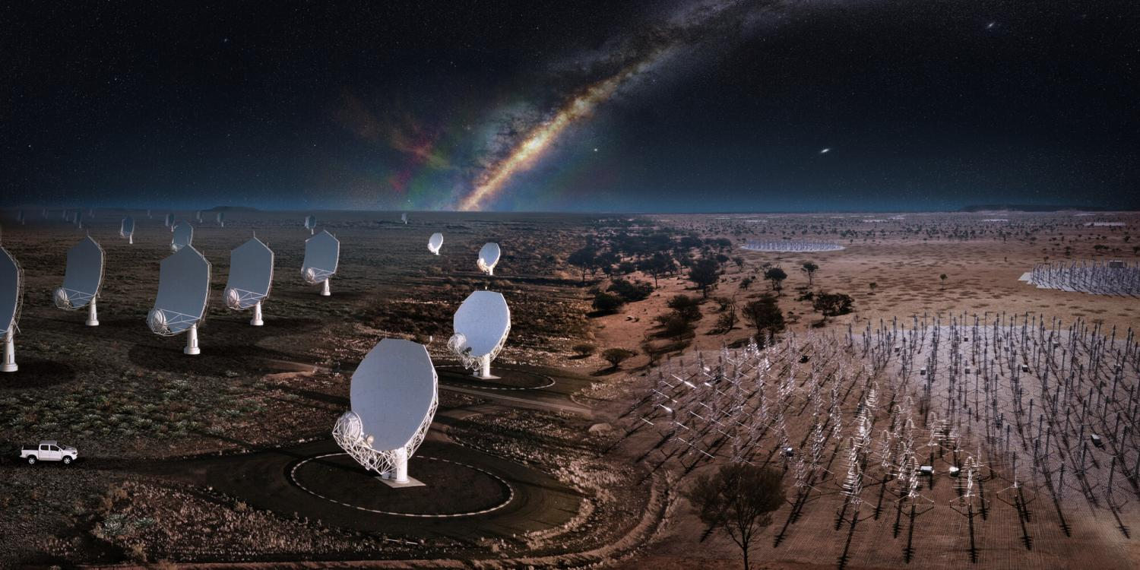
Future Outlook
How upcoming facilities will sharpen reionization constraints
+
Nancy Grace Roman Space Telescope
Square Kilometre Array (SKA-Low)
Wide-Field IR Survey
21-cm Tomography
Unprecedented galaxy statistics
Spatially resolved 21-cm maps
Wide-field coverage → large cosmic volumes at z ~ 7–12, orders of magnitude more galaxies than JWST deep fields
Directly image how ionized bubbles expand around early sources → map reionization morphology
Precise UVLF bright end
Distinguish reionization timelines
Constrain bright & intermediate-luminosity galaxies
Extended (z ~ 16→6) vs. rapid (z ~ 8→6) histories produce distinct 21-cm power spectra → direct test of our wf vs. sf models
Galaxy clustering & environments
Feedback-regulated physics
Measure galaxy bias & large-scale structure around early ionizing sources
Cross-correlate 21-cm signal with galaxy surveys → pin down emissivity, and which halo masses drive reionization
Cosmology in the Alps, March 18, 2026
Synergies between Reinization & JWST galaxy surveys
Ankita Bera (ankitabm@umd.edu)

Slide 25
Thank You
Questions? Comments?
Ankita Bera
CTC Post-Doctoral Fellow
University of Maryland, College Park
ankitabm@umd.edu
arXiv: 2511.19600, arXiv: 2209.14312

Slide 26
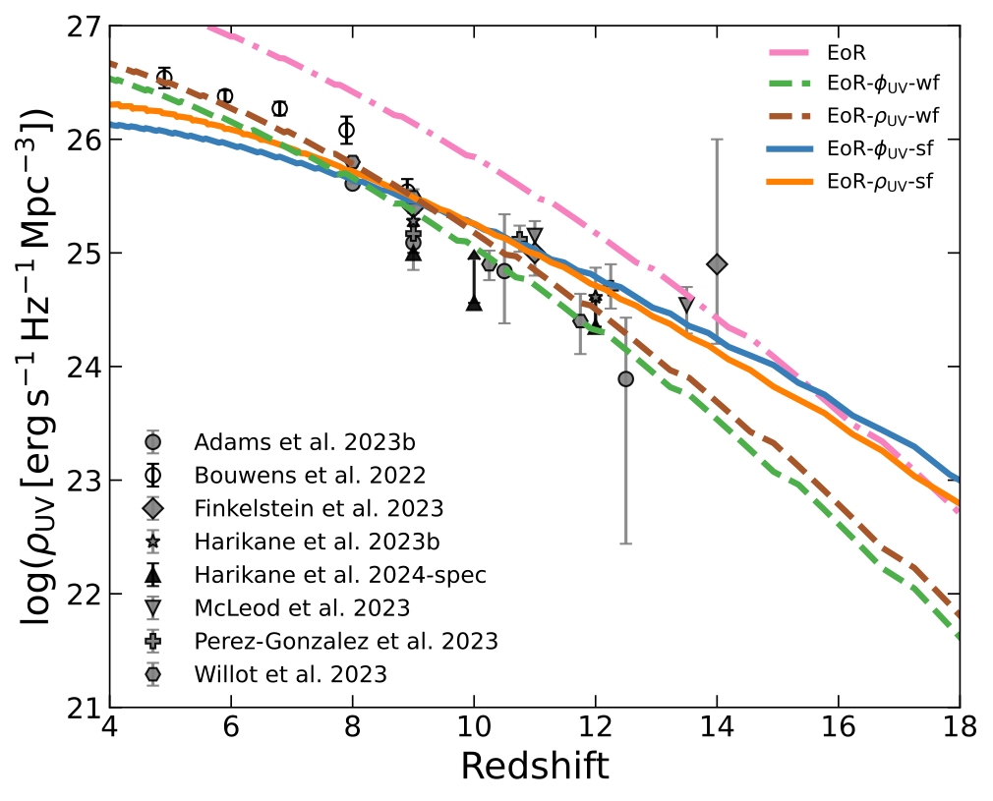
UV Luminosity Density & Star Formation Rate
sf models reproduce observed ρUV at z ~ 8–12
$ρ_{UV}$ evolution
Cosmology in the Alps, March 18, 2026
Synergies between Reinization & JWST galaxy surveys
Ankita Bera (ankitabm@umd.edu)

Slide 27
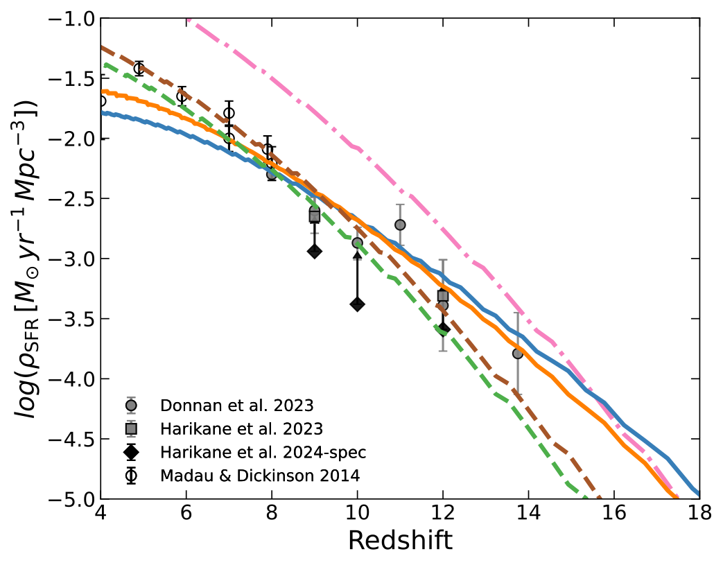
UV Luminosity Density & Star Formation Rate
sf models reproduce observed ρUV at z ~ 8–12
$ρ_{UV}$ evolution
$ρ_{SFR}$ evolution
Cosmology in the Alps, March 18, 2026
Synergies between Reinization & JWST galaxy surveys
Ankita Bera (ankitabm@umd.edu)

Slide 28
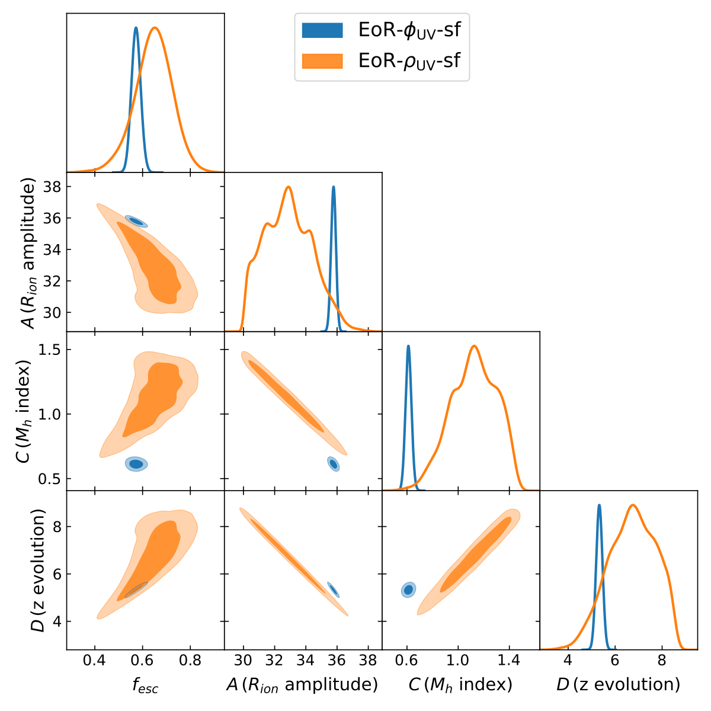
Parameter Constraints
Posterior distributions from joint fits to EoR + JWST data
Strong-feedback models (fesc, A, C, D)
Cosmology in the Alps, March 18, 2026
Synergies between Reinization & JWST galaxy surveys
Ankita Bera (ankitabm@umd.edu)

Slide 29
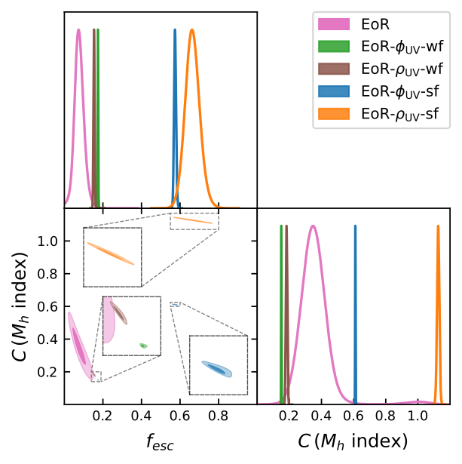
Parameter Constraints
Posterior distributions from joint fits to EoR + JWST data
Strong-feedback models (fesc, A, C, D)
All models: fesc vs. C plane
Cosmology in the Alps, March 18, 2026
Synergies between Reinization & JWST galaxy surveys
Ankita Bera (ankitabm@umd.edu)

Slide 30

JWST UV Luminosity Functions
Comprehensive compilation across z ~ 8 – 14
Data Summary
16+ independent surveys
including JADES, CEERS, COSMOS-Web, PEARLS, NGDEEP
6 redshift bins
z = 8, 9, ~10, ~11, ~12, ~13.5
Key features:
• Steep faint-end slope (α ≲ −2.3)
• Bright-end excess vs. pre-JWST
• Gray = photometric
• Black = spectroscopic
Cosmology in the Alps, March 18, 2026
Synergies between Reinization & JWST galaxy surveys
Ankita Bera (ankitabm@umd.edu)

