Slide 1



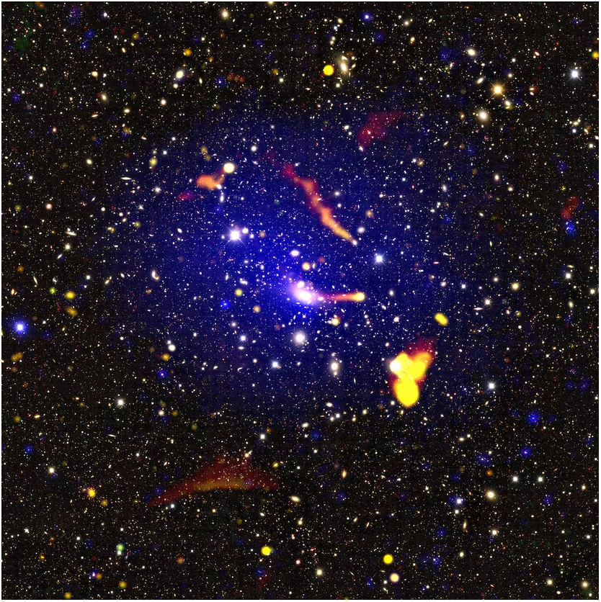
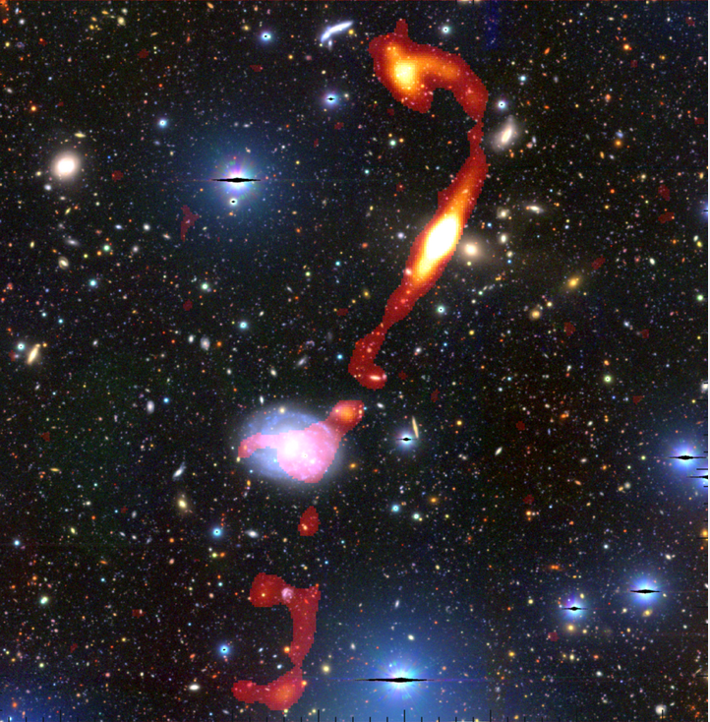
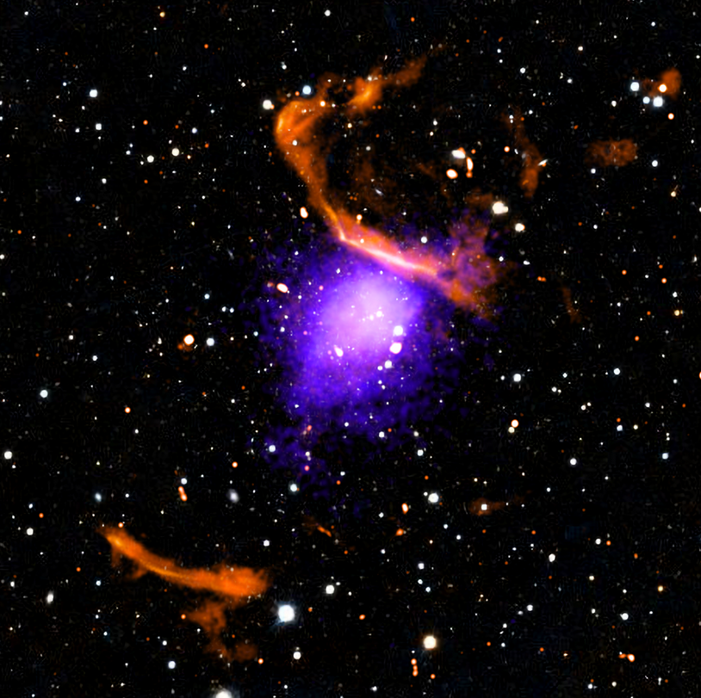
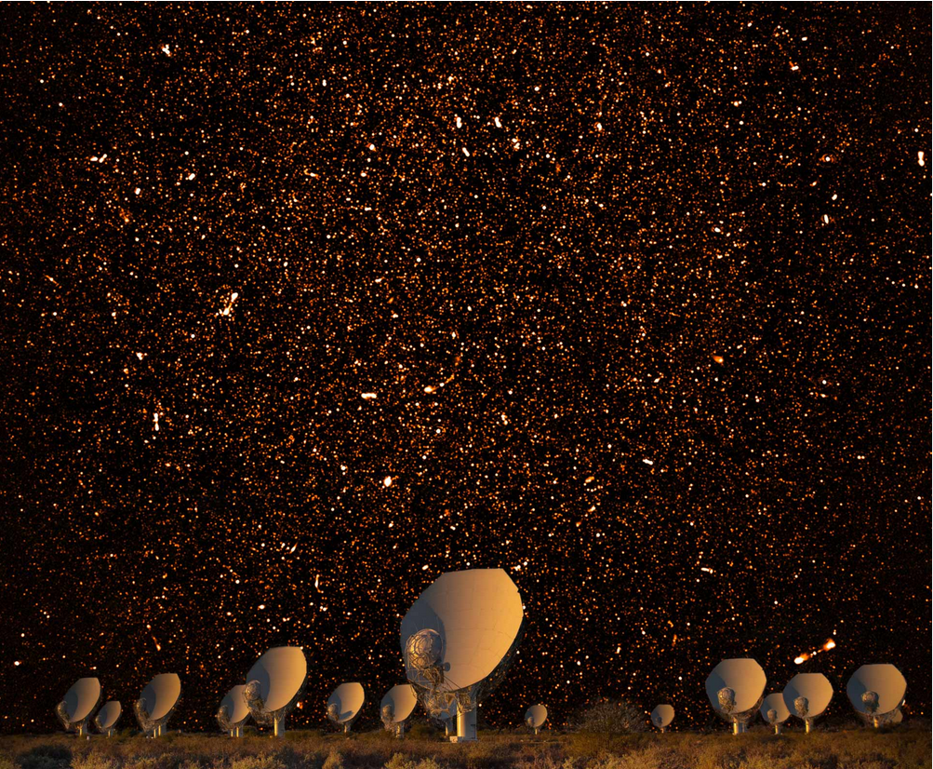
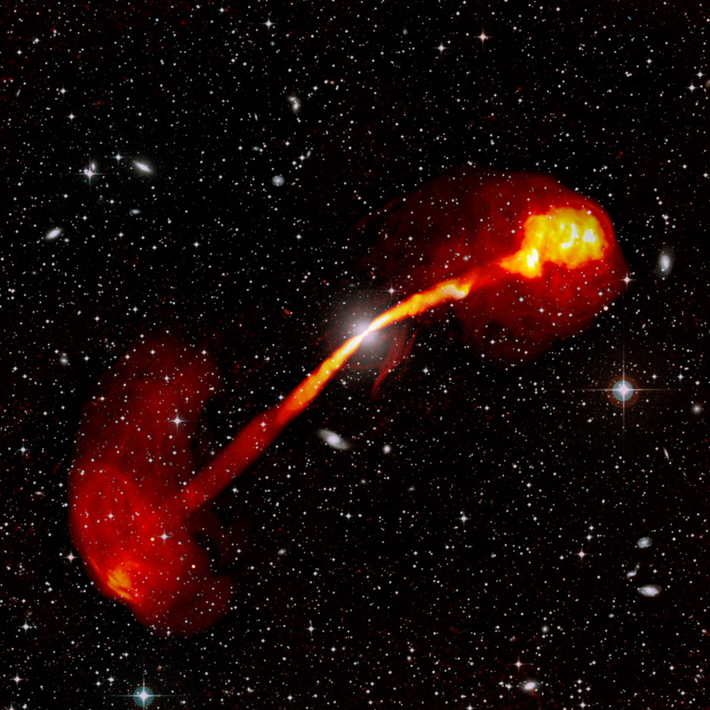
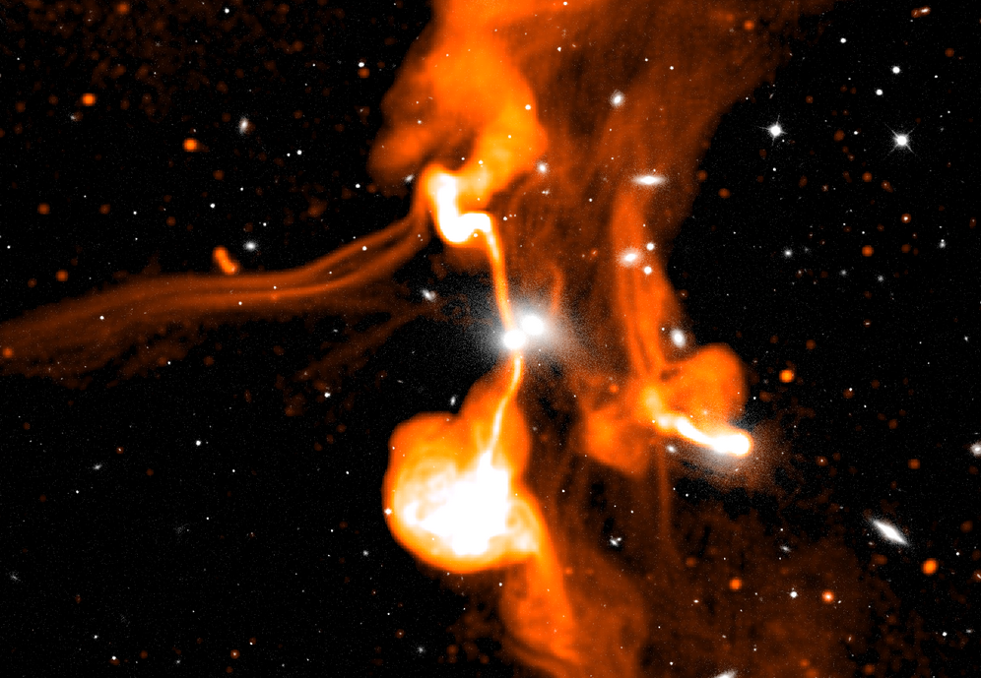
MeerKAT observations of the Saraswati supercluster (MOSS): Galaxy evolution of core clusters.
Noise

Slide 2

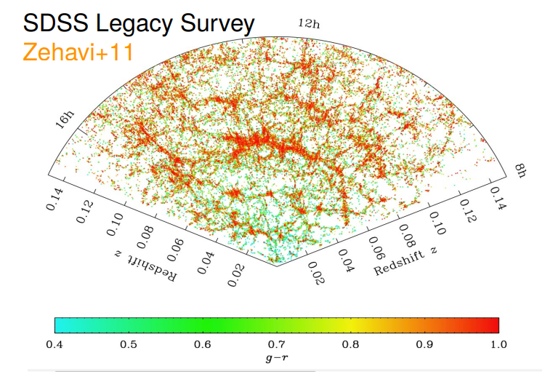
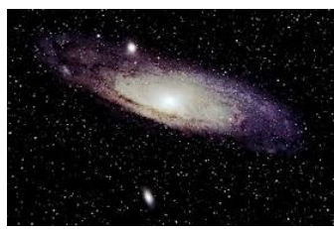
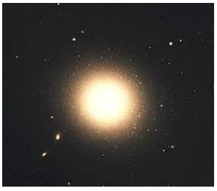
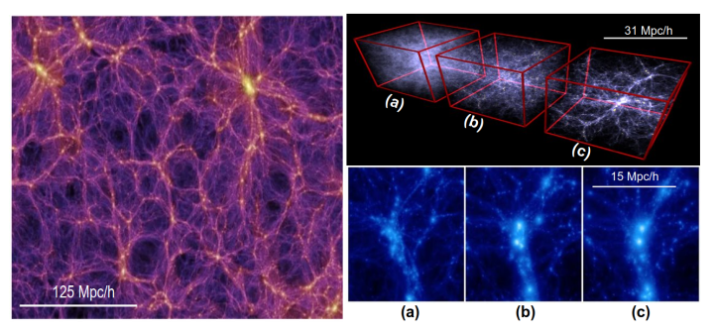
Galaxy evolution: simple picture
Galaxies travel from less dense to high desne regions as they transverse the cosmic web.
Dense environments contain early type (E and S0) red faint passive systems.
Lower dense environments contain late-type blue active spiral galaxies.
Notes:
Cosmic web is made up of LSS: Field, groups, clusters, filaments and sheets. Galaxies travel from less dense to high desne regions as they transverse the cosmic web. As galaxies traverse the cosmic web, they are subjected to a number of interactions that include tidal interactions, cluster merging, ram pressure stripping, etc. These all change the proeprties of galaxies. At the core of clusters we also have the ICM gas, AGN activity, etc that play a role
Galaxy environment depends on the scale. Galaxy undergo various processes such as Tidal interactions, cluster merging, dynamical friction, ram-pressure stripping (ICM)
Cluster are generally hostile environments due to large number of galaxies, ICM, ongoing mergers and AGN activity.
Dense environments contain early type (E and S0) red faint passive systems whereas lower dense environments contain brighter blue active spiral galaxies

Slide 3
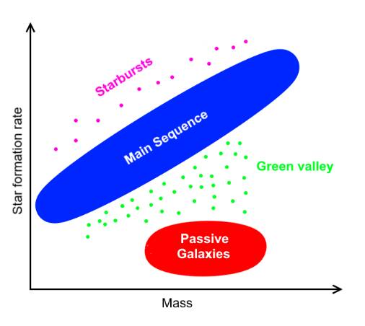
Galaxy evolution: The star forming main sequence
Most star forming galaxies are observed to obey a tight correlation between their SFR and stellar masses.
Star bursts galaxies or AGN will appear above while quiescent (low-SFG) will appear below.
Transitional green valley could be in the process of being quenched that impact their transition time.
Notes:
Most star forming galaxies are observed to obey a tight correlation between their SFR and stellar masses called the Main Sequence (MS)
Most of stellar mass in universe comes from star forming galaxies
Star bursts galaxies will appear slightly above (phase rather than a type) while quiescent (low-SFG) will appear below.
Giant ellipticals evolved from progenitor SFG at z ~ 3
Transitional green valley could be in the process of being quenched that impact their transition time

Slide 4
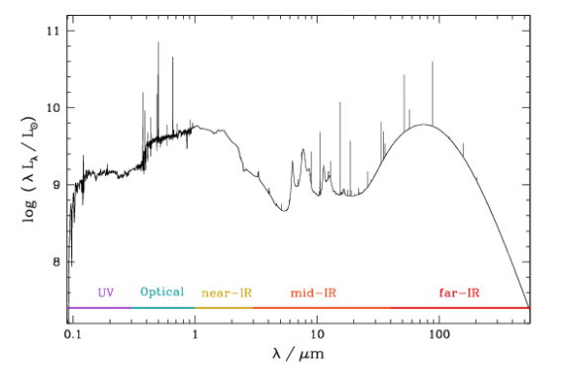
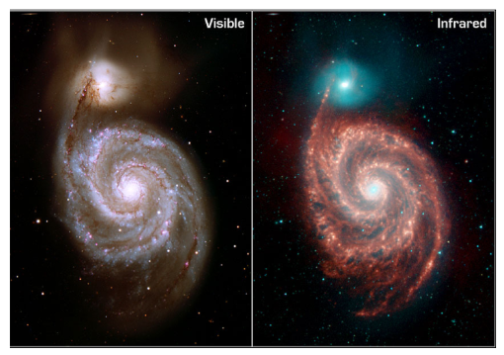
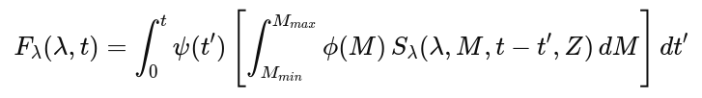
Traditional estimates of the star formation rate: SEDs
Visible to Infrared Colour used to determine the Spectral Energy Distribution (SED).
SED models heavily influenced by dust attenuation models -> have many flaws.
Radio seen as an dust-free tracer for the star formation rate.
mass
metallicity
age
Dust
SFR
Notes:
Most star forming galaxies are observed to obey a tight correlation between their SFR and stellar masses called the Main Sequence (MS)
Most of stellar mass in universe comes from star forming galaxies
Star bursts galaxies will appear slightly above (phase rather than a type) while quiescent (low-SFG) will appear below.
Giant ellipticals evolved from progenitor SFG at z ~ 3
Transitional green valley could be in the process of being quenched that impact their transition time

Slide 5
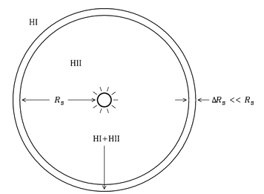
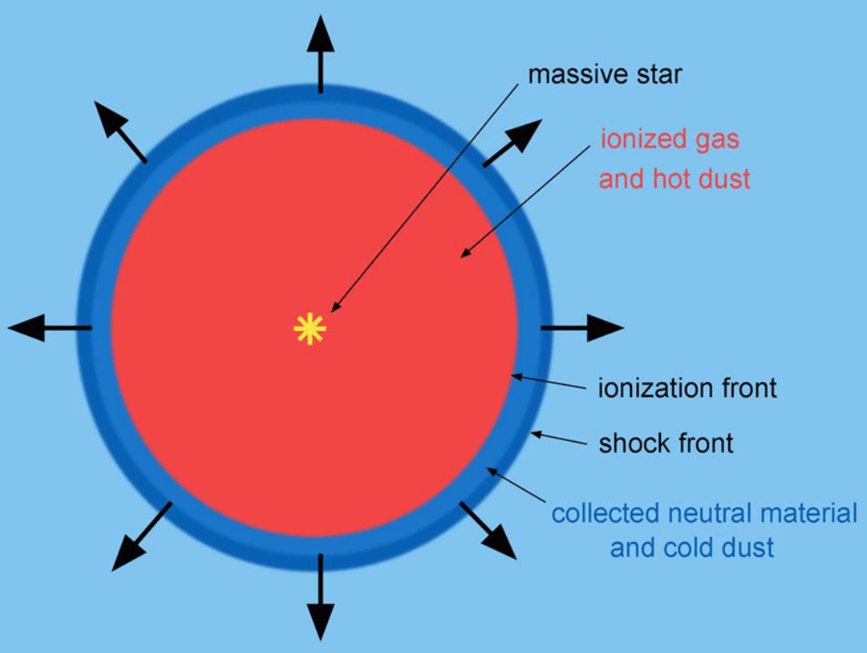
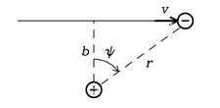
Radio emission as a tracer of star formation: free-free
Radio continuum emission from SFG’s are can be both thermal and non-thermal in nature.
Star formation rate (SFR) -> Driven by availability of dense molecular gas (HII regions) and supernovae
Free-free emission dominant at higher frequencies > 30GHz.
Star-forming galaxies (SFG)
Free-free thermal emission
Ionized HII regions
Flat spectrum
Instant tracer of SFR (~10 Myr)
Notes:
Radio continuum emission from SFG’s are both thermal and non-thermal
Star formation rate (SFR) -> Driven by availability of dense molecular gas (HII regions) and supernovae
Supernova shocks accelerate CR electrons that gyrate in magnetic field -> non-thermal emission -> Dominant at GHz frequencies -. Delayed tracer
Columb interactions of e- and p+ in HII regions ionized by hot young stars - > free-free emission. ~x 10 times fainter -> challenging to observe at Ghz frequencies (since a ~ -0.2) -> dominant at > 30 GHz
If we know star formation history and Initial Mass Function (IMF) we can use stellar evolution models -> describe how stars of different masses evolve over time

Slide 6
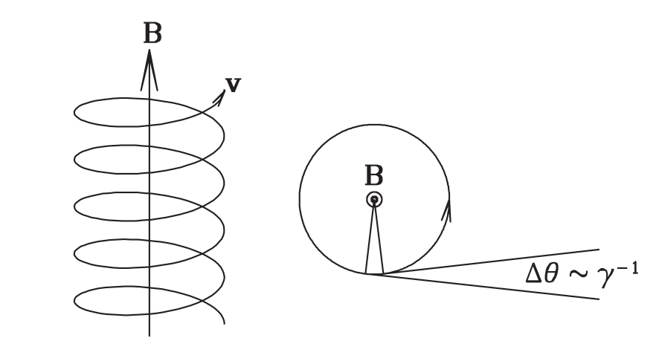
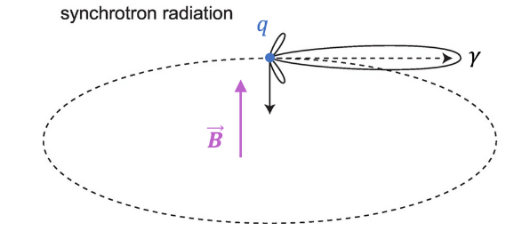
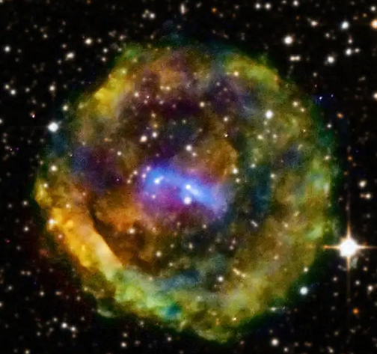
Radio emission as a tracer of star formation: synchrotron
Radio continuum emission from SFG’s are both thermal and non-thermal in nature.
Supernovae only occurs for high mass stars (~10% of total). From IMF we can infer entire SFR.
Synchrotron emission dominant at lower frequencies 1-10 GHz.
Star-forming galaxies (SFG)
Synchrotron non-thermal
Supernovae type1a,1b
Steep spectrum
Delayed tracer of SFR (30-100 Myr)
Notes:
Radio continuum emission from SFG’s are both thermal and non-thermal
Star formation rate (SFR) -> Driven by availability of dense molecular gas (HII regions) and supernovae
Supernova shocks accelerate CR electrons that gyrate in magnetic field -> non-thermal emission -> Dominant at GHz frequencies -. Delayed tracer
Columb interactions of e- and p+ in HII regions ionized by hot young stars - > free-free emission. ~x 10 times fainter -> challenging to observe at Ghz frequencies (since a ~ -0.2) -> dominant at > 30 GHz
If we know star formation history and Initial Mass Function (IMF) we can use stellar evolution models -> describe how stars of different masses evolve over time

Slide 7

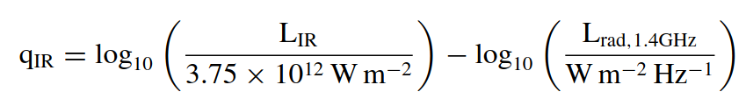

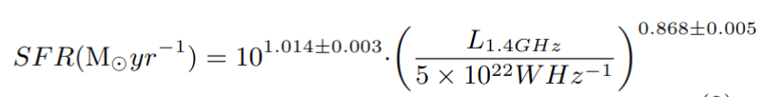
Calculating total SFR from radio flux
There exists a tight correlation between total IR luminosity and radio luminosity -> Both SFR tracers.
UV light from young hot massive stars are absorbed and re-emitted at IR.
Supernovae produces radio emission dominant at GHz frequencies.
Notes:
There exists a tight correlation between total IR luminosity and radio luminosity -> Both SFR tracers.
UV light from young hot massive stars are absorbed and re-emitted at IR.
Supernovae produces radio emission dominant at GHz frequencies.
Does the relatio q_IR hold for all redshifts? This is currently debated

Slide 8
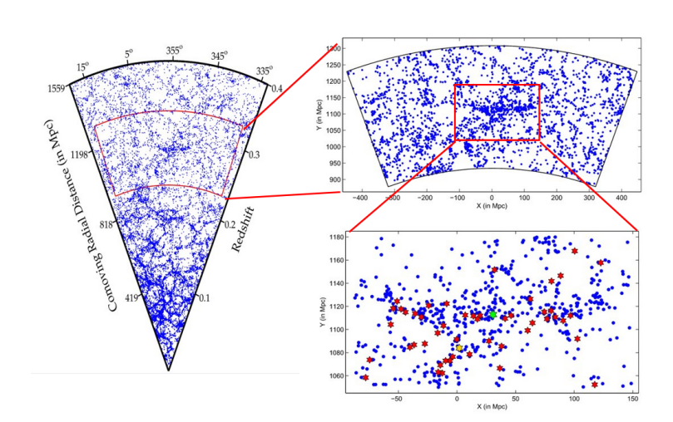
Saraswati supercluster
One of the most significant density enhancements found at medium redshifts (z ~ 0.27)
Contains over 40 galaxy cluster and groups. The 2 largest galaxy clusters comprise 20% of its total mass.
Galaxy clusters
Core clusters
Notes:
Superclusters are the largest over-dense, unbound and non-virialized systems in the universe. Virgo, BOSS great wall, Laneika

Slide 9
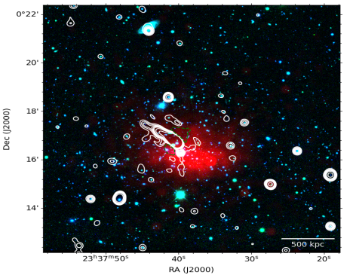
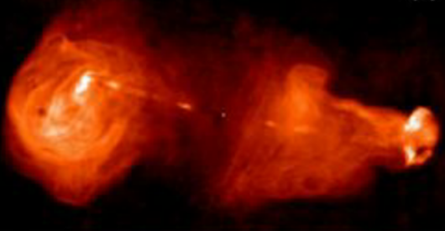
Core galaxy clusters: Abell 2631
A2631 is the largest galaxy cluster situated at the core.
Bright x-ray gas and no diffuse cluster wide radio emission.
Radio galaxy
ICM gas
Notes:
Superclusters are the largest over-dense, unbound and non-virialized systems in the universe. Virgo, BOSS great wall, Laneika
Peripheral radio relics indicative of recent cluster merger event.

Slide 10
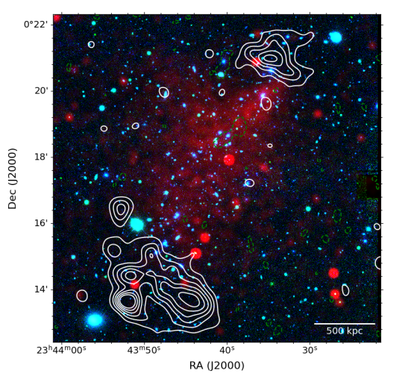
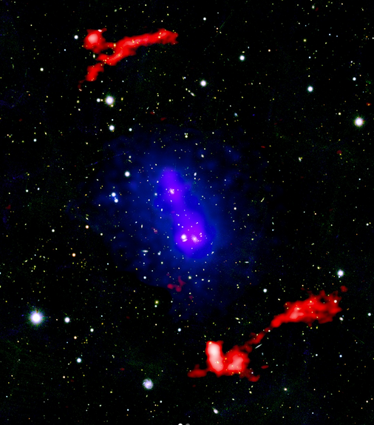
Core galaxy clusters: Zwcl2341
Zwcl2341 is the 2nd largest galaxy cluster situated at the core.
Contains cluster wide diffuse radio relic emission.
ICM gas
Radio Relics
Notes:
Superclusters are the largest over-dense, unbound and non-virialized systems in the universe. Virgo, BOSS great wall, Laneika
Peripheral radio relics indicative of recent cluster merger event.

Slide 11
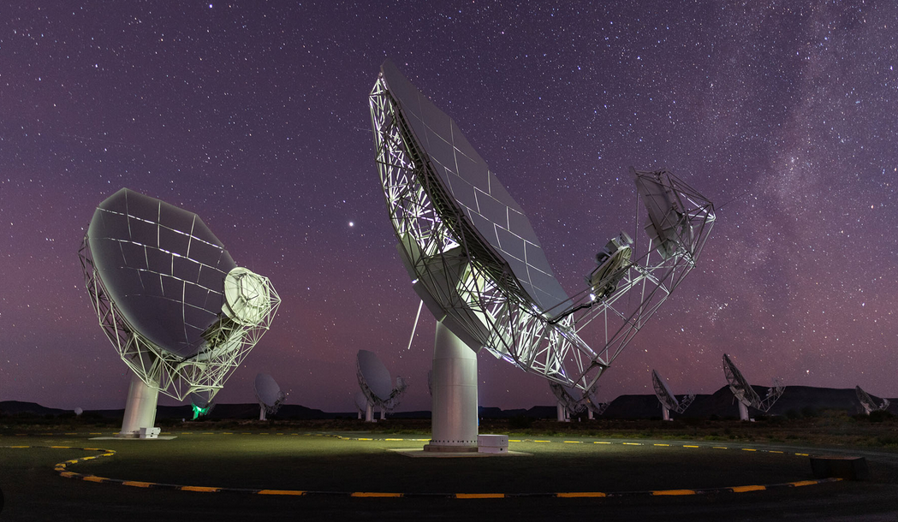
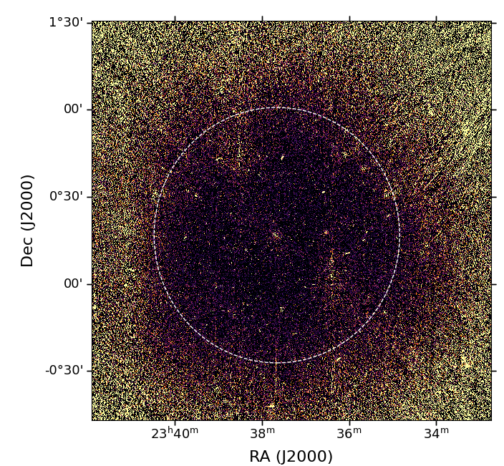

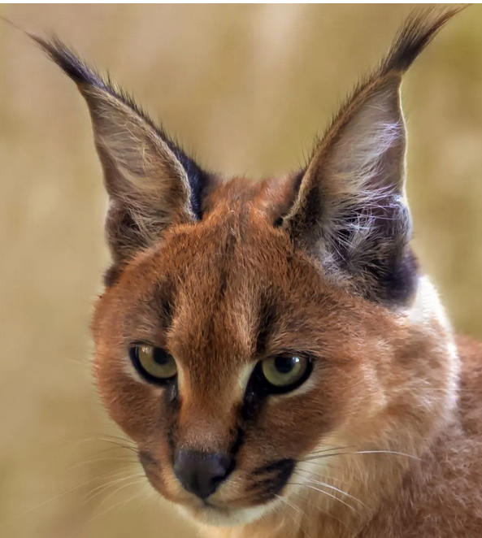

MeerKAT observations
Each cluster observed for 8 hour observations (4096 channels, 16s int time) with MeerKAT.
8 arcsec resolution and 10uJy noise.
Data reduction (calibration, flagging, imaging) procedure performed with Caracal.

Slide 12
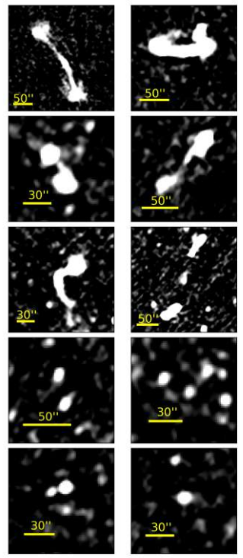
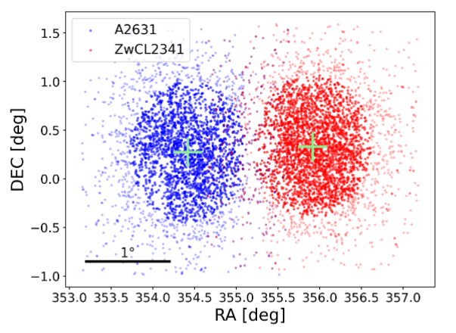
Catalog creation: Source types
resolved
unresolved

Slide 13

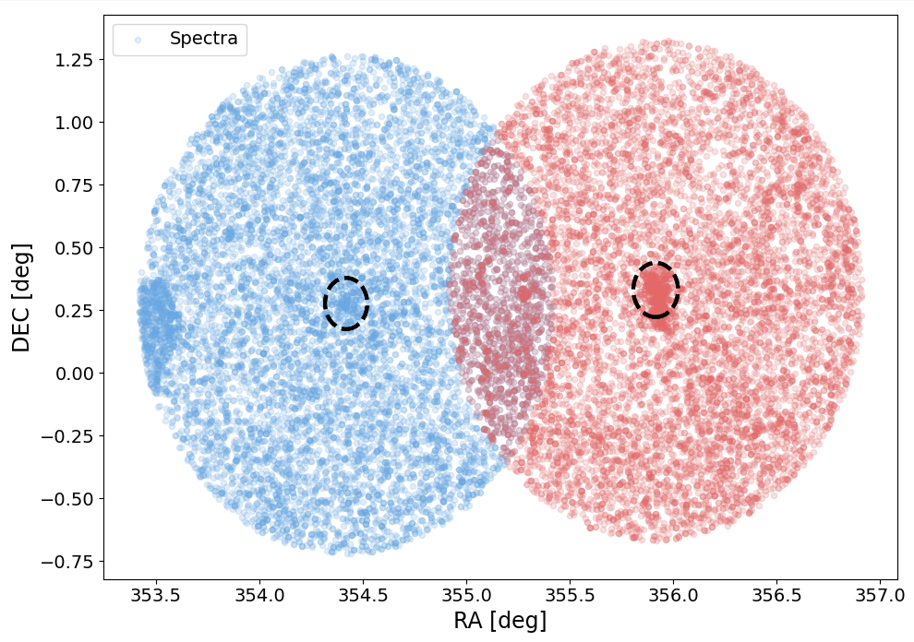



Combining Radio with optical
Current radio data contains measured flux density of each radio source -> combine with optical to obtain z and colours.
To obtain the spectroscopic redshifts and colour we search using VIZIER, SIMBAD, NED, DESI, SDSS databases to obtain a full sample.
Spectra + photometry
Radio

Slide 14


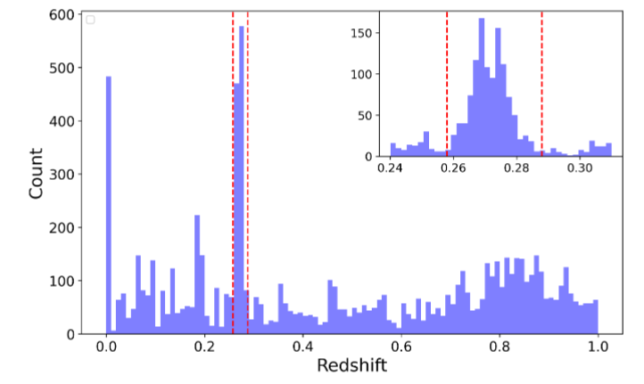
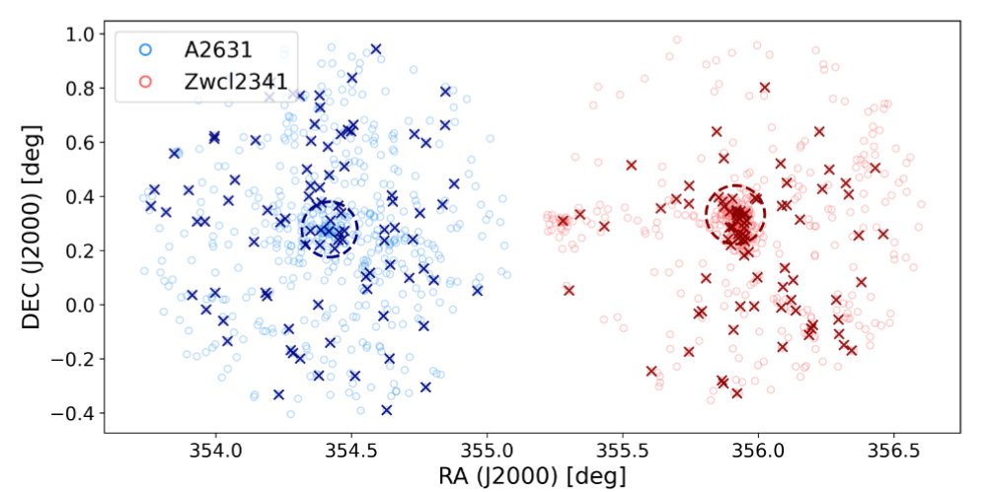
Cluster membership selection
Galaxy redshift distribution can indicate if a cluster of galaxies exist.
Galaxies bounded to the cluster should fall within 3 sigma of velocity dispersion.
Main peak
Notes:
Plot the redshift distribution of all galaxies situated in a cone around centre.
If a galaxy cluster exists then we should see a peak in the redshift distribution at the cluster redshift.
We can zoom into the main peak to get an estimate of the cluster members.
A more robust method would be the clipping method: Iteratively estimating sigma_cluster from an initial sample of redshifts
3 sigma means we are selecting galaxies that are gravitationaly boundsot clsuter

Slide 15
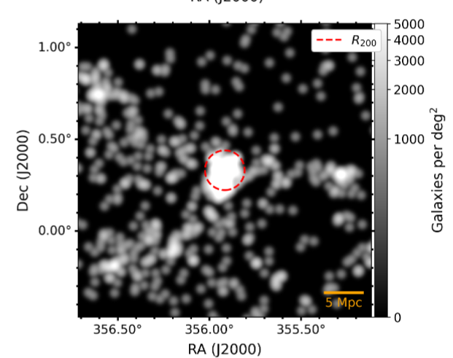
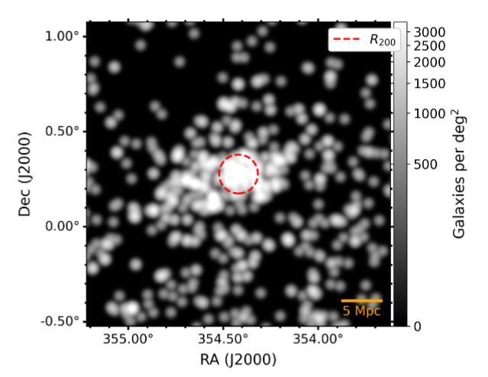
Spectroscopic member density distribution
We plot the density distribution of spectroscopic member galaxies for both clusters.

Slide 16
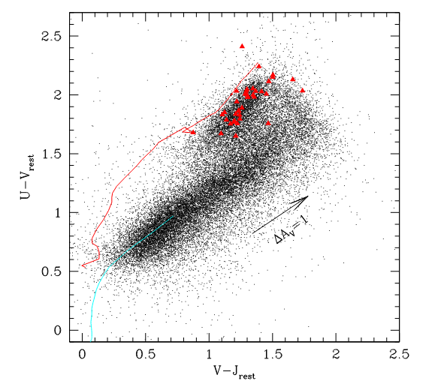
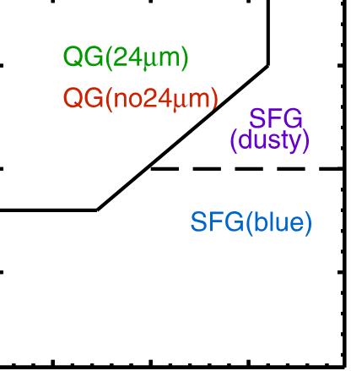
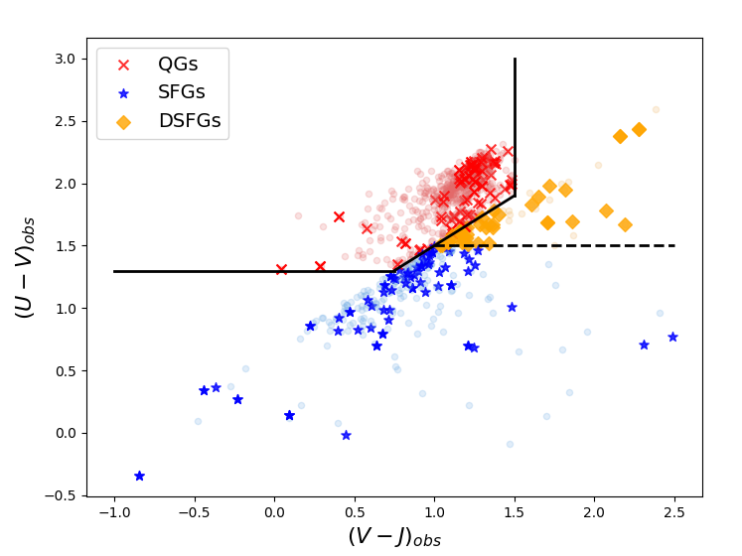
Galaxy classification: UVJ optical color-color diagram
The U and V bands are sensitive to the hot temperature emitted by young stars.
If no dust were present in the universe then we could just use U and V to separate young hot (blue) stars from older faint (red) stars.
Notes:
There are a number of tools available for us that use the photometry (magnitudes) to classify our sample of cluster member galaxies.
The most common of which is the U-V , V-J diagram. The U and V bands are sensitive to the hot temperature emitted by young stars
If no dust were present in the universe then we could just use U and V to separate young hot (blue) stars from older faint (red) stars.

Slide 17
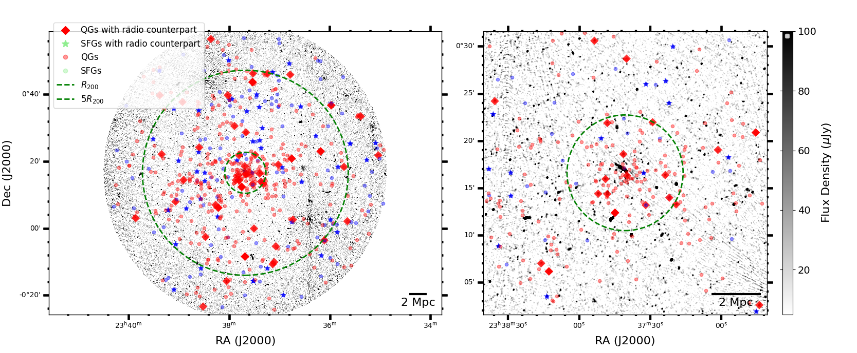
A2631 galaxy member distribution + classifications

Slide 18
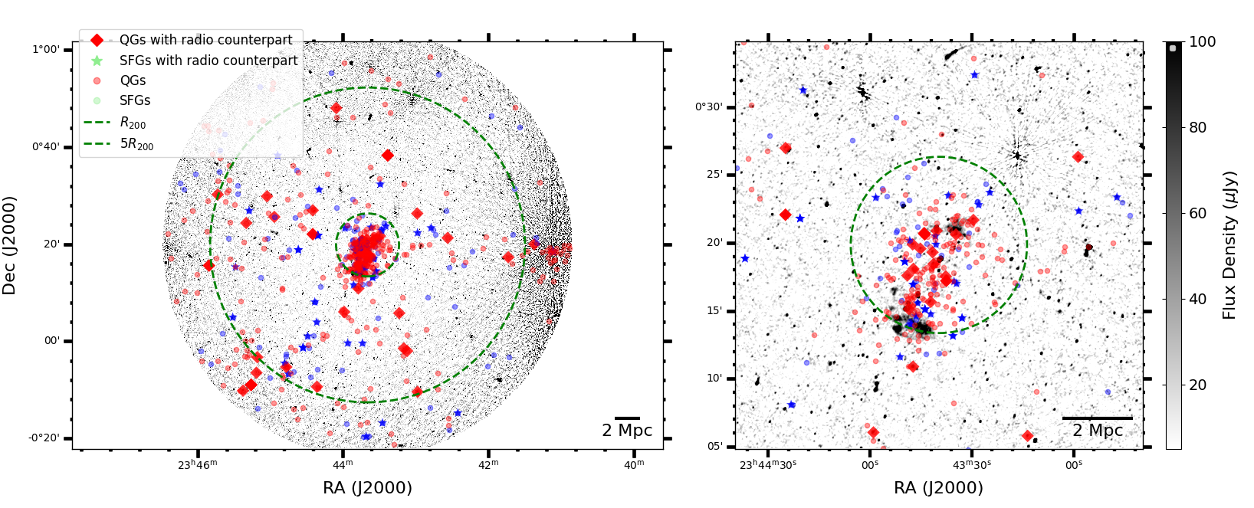
Zwcl2341 galaxy member distribution + classifications

Slide 19
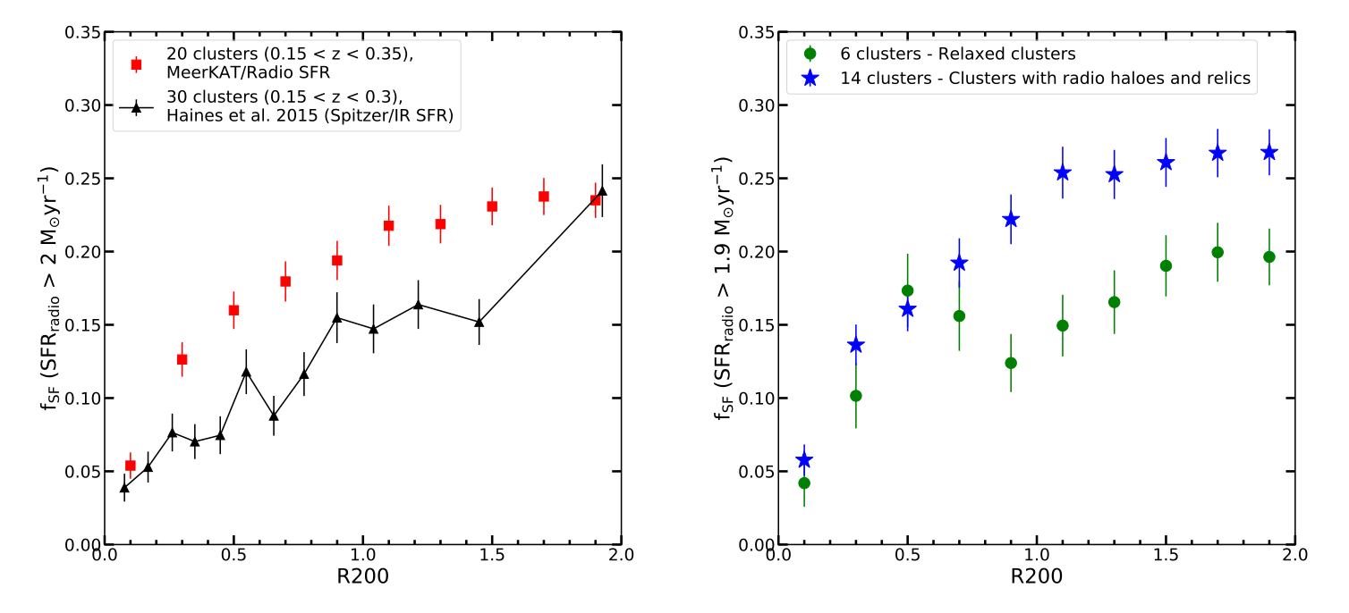
Trends regarding fraction of star forming galaxies
Fraction of SFGs seems to decreasing as clusters fall from outskirts to core
Does the dynamical state of a cluster influence this trend?

Slide 20
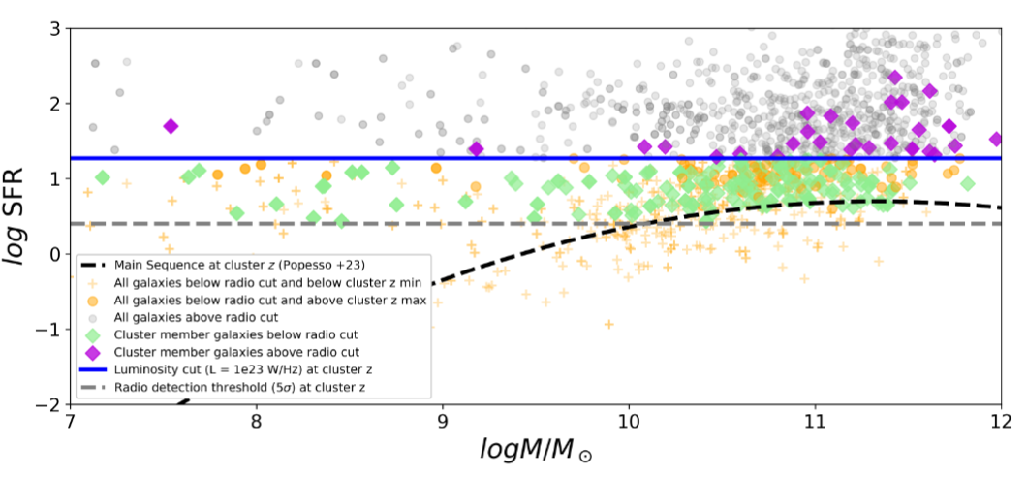
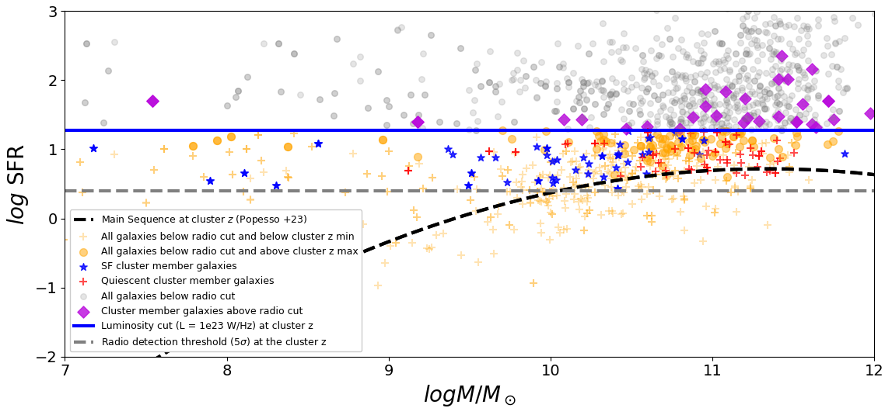
The star forming main sequence + classifications
We plot MS using radio flux
We also include galaxy classification from UVJ to see
Our radio sensitivity does not allow us to probe the entire MS.
RL cut
Radio sensitivity
Notes:
Most star forming galaxies are observed to obey a tight correlation between their SFR and stellar masses called the Main Sequence (MS)
Most of stellar mass in universe comes from star forming galaxies
Star bursts galaxies will appear slightly above (phase rather than a type) while quiescent (low-SFG) will appear below.
Giant ellipticals evolved from progenitor SFG at z ~ 3
Transitional green valley could be in the process of being quenched that impact their transition time

Slide 21
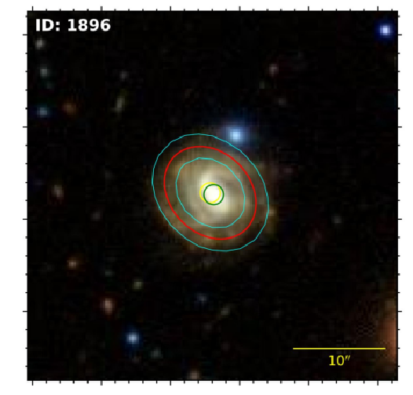
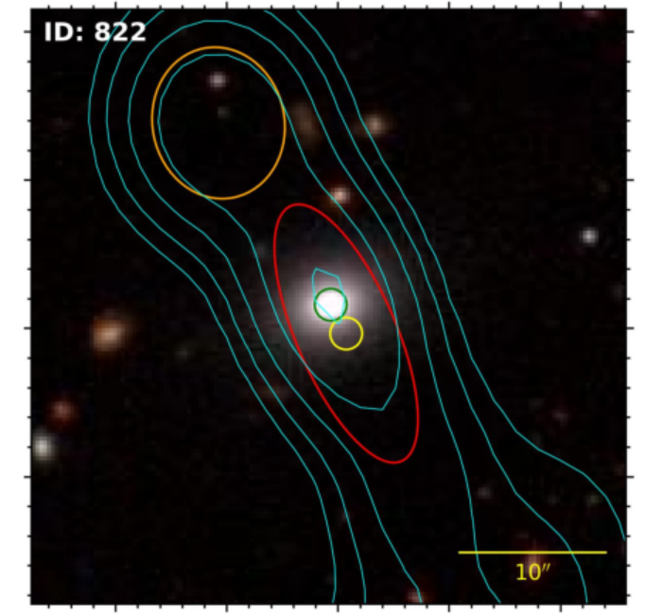
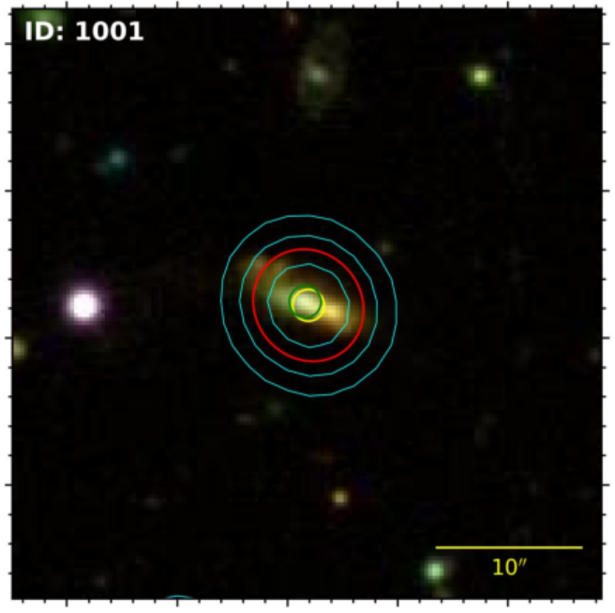
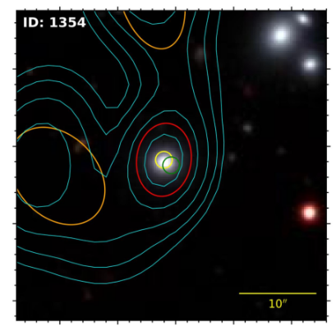
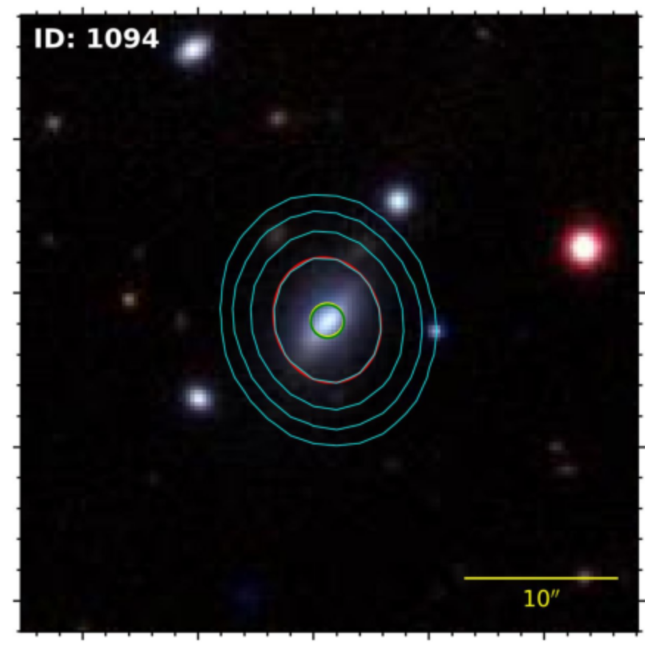




Radio flux origin of Quiescent galaxies
Some galaxies show complex radio emission associated with the optical source.
The origin of their radio flux is therefore not clear.
Radio source size
Optical pos
radio pos
Radio contour
Notes:
Most star forming galaxies are observed to obey a tight correlation between their SFR and stellar masses called the Main Sequence (MS)
Most of stellar mass in universe comes from star forming galaxies
Star bursts galaxies will appear slightly above (phase rather than a type) while quiescent (low-SFG) will appear below.
Giant ellipticals evolved from progenitor SFG at z ~ 3
Transitional green valley could be in the process of being quenched that impact their transition time

Slide 22
Thank you
Noise

