Slide 1
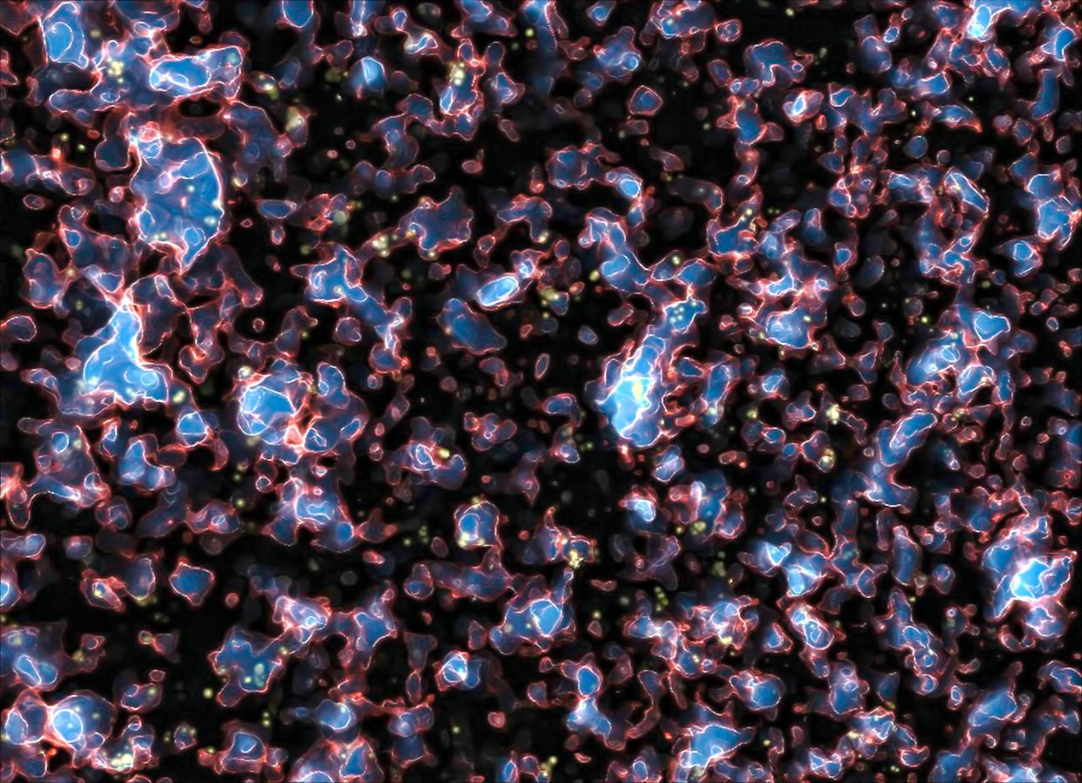


Forecasting SKA Constraints on the Epoch of Reionisation with the Triangle Correlation Function
Cosmology in the Alps Conference 2026
Liliane Crascall-Kennedy
with Adélie Gorce and Marian Douspis
Institut d'Astrophysique Spatiale
lilian.crascall-kennedy@universite-paris-saclay.fr

Slide 2

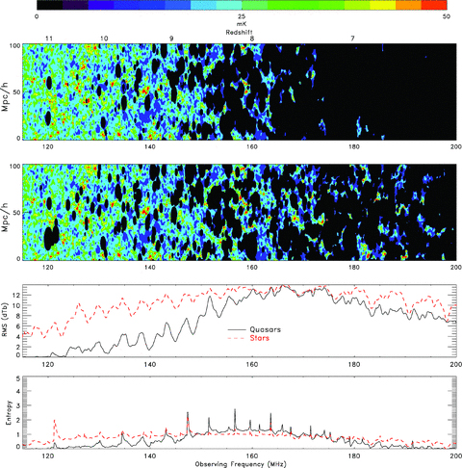
A Brief Introduction to EoR Morphology
2
Early Universe
Late Universe
Key:
z ~ 20
z ~ 10
z ~ 5
Ionising Source (eg galaxy);
Ionised bubble (HII);
Neutral Hydrogen (HI)
Early stages (z~20): isolated ionised bubbles
Middle stages (z~10): bubbles begin to merge
Late stages (z~5): Large connected ionised regions (neutral islands remain)
Simulation of 21cm emission during the EoR:
21cm Radiation Intensity, mK
Rajat et al. 2009
low
high
Goal of PhD: What can the morphology and evolution of ionised regions tell us about the Epoch of Reionisation?
Coloured background = 21cm emission from neutral H
Redshift
7
6
11
10
9
8
100
Black regions = ionised H (does not emit 21cm)
Mpc/h
0
Early Universe
Late Universe

Slide 3
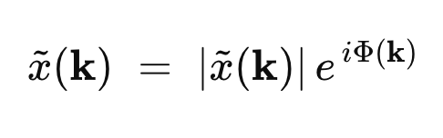
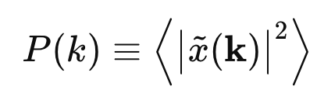
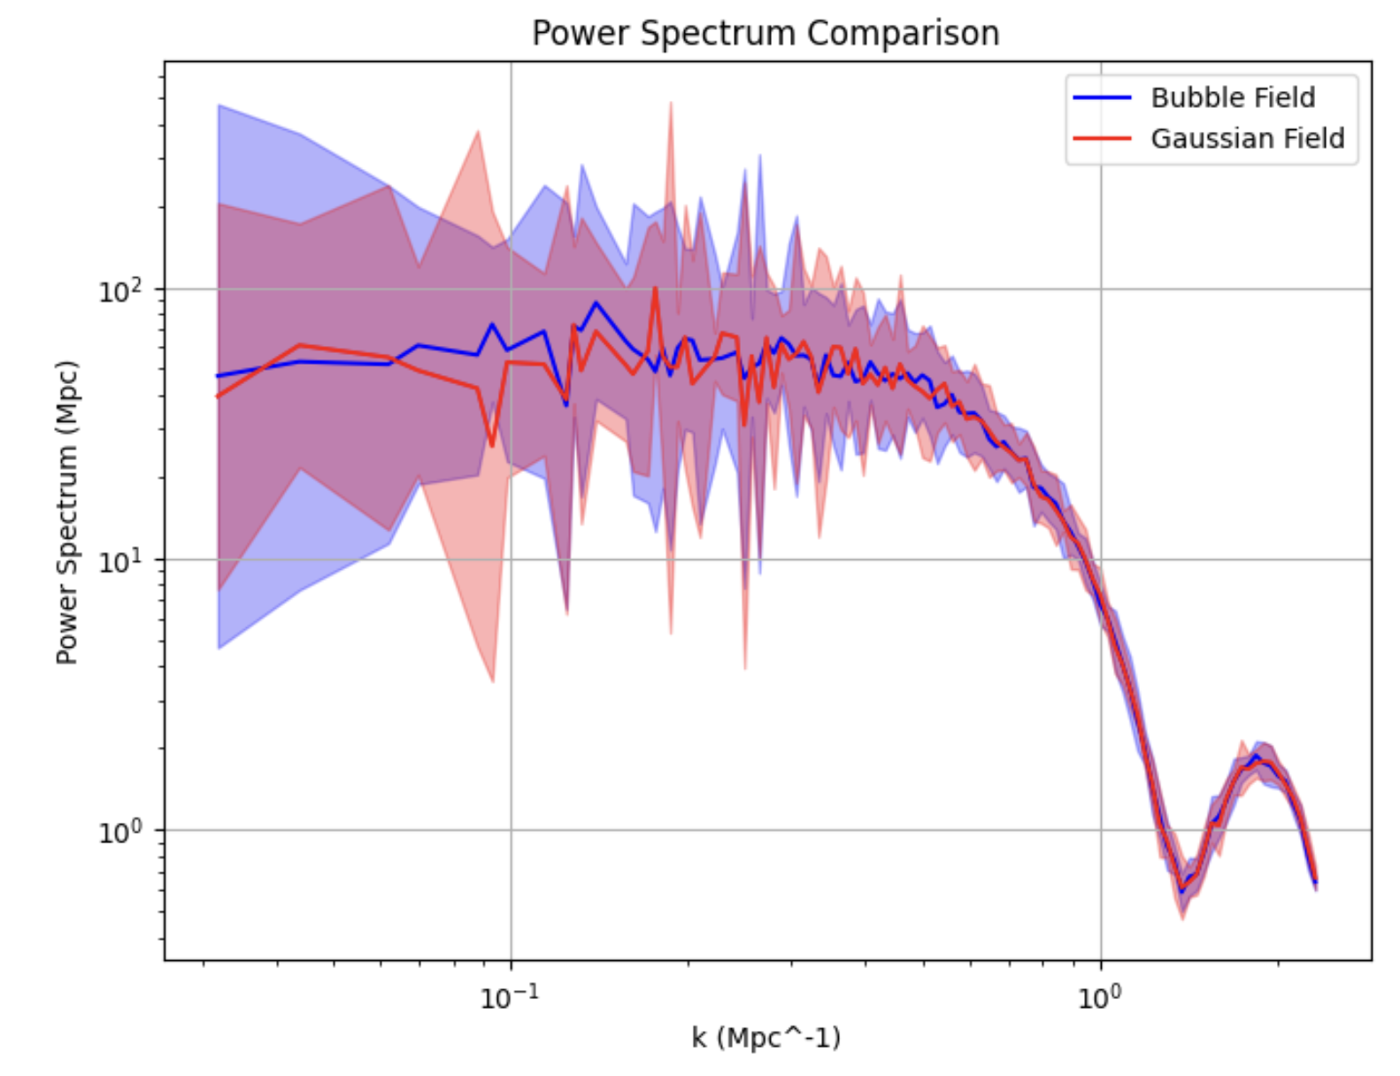
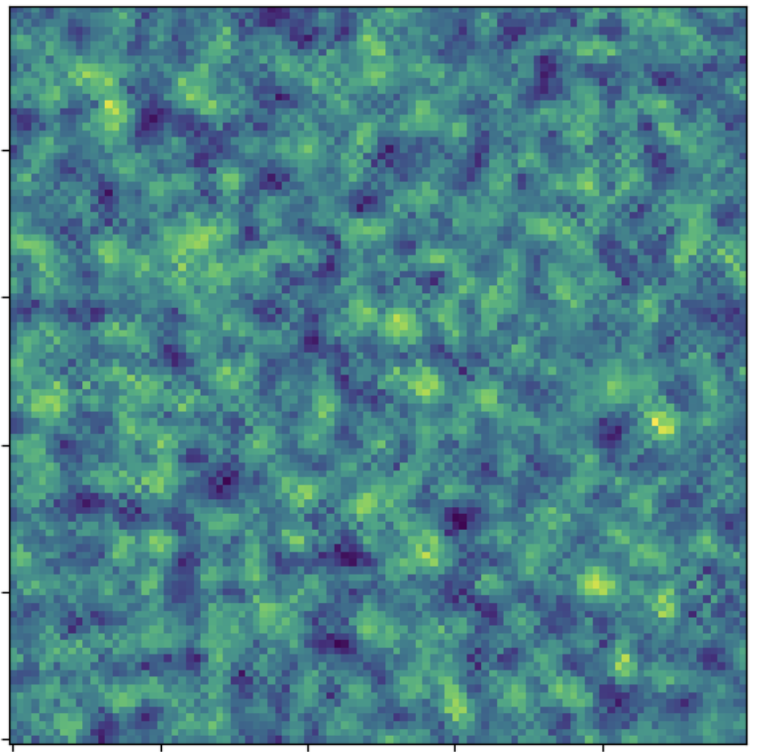
Going Beyond the Power Spectrum
3
Field in Fourier space:
The PS tells us how strongly two points in the field, x, separated by distance r, are correlated
Amplitude
Phase Term
-> PS contains only the amplitude of the Fourier modes, but ignores the phase information (which is where the morphological information lies).
PS:
Power Spectrum Comparison
The PS is blind to shape and non-gaussian structure. To capture the morphology, we need a phase-sensitive statistic.
Model Reionisation Field
Power Spectrum Amplitude
The Triangle Correlation Function
k (Mpc⁻¹)
Gaussian Field

Slide 4
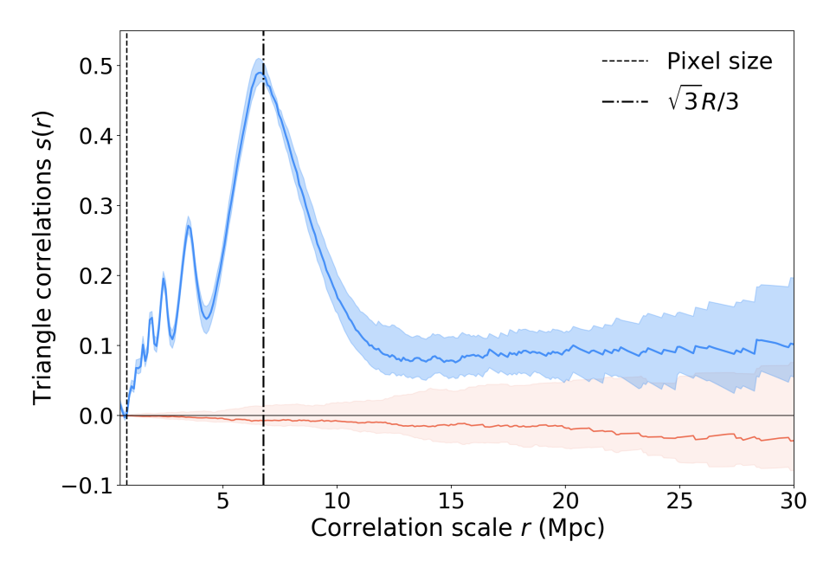

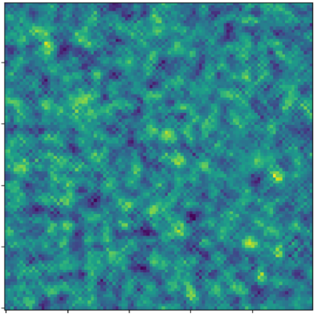
The Triangle Correlation Function (TCF)
4
Triangle Correlation Function
Pixel resolution
Measures how often specific triangle configurations occur
Peaks in the TCF correspond to the radius of the bubbles
The amplitude of the peak corresponds to the number of bubbles in the box
Radius of
bubbles
TCF Amplitude
Length of Side of Triangle (Mpc)
Adélie Gorce 2020
The TCF specifically probes the non-gaussian information in the field
Model Reionisation Field
Model Reionisation Field
Model Reionisation Field
Gaussian Field

Slide 5
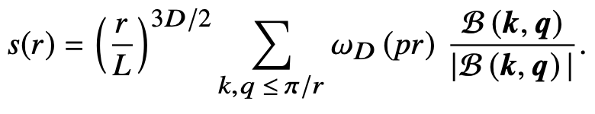
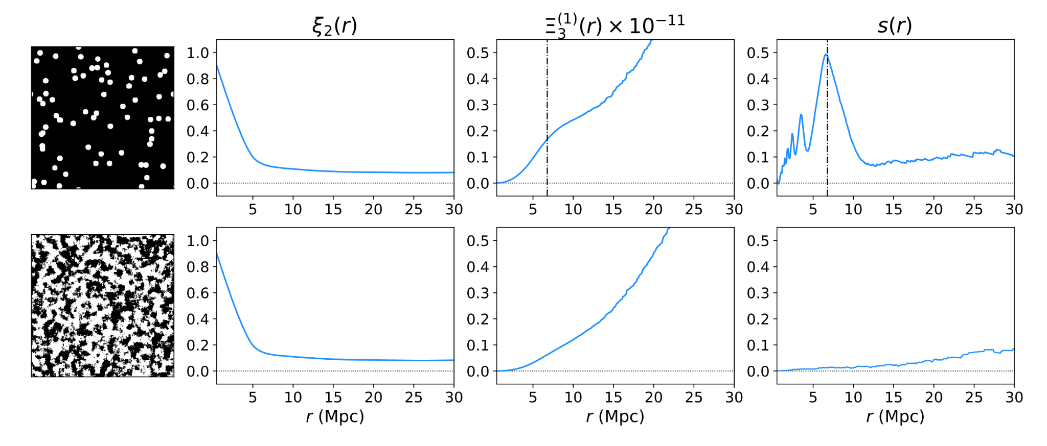
The TCF vs The Bispectrum
5
The TCF differs from the Bispectrum as it retains only the phase information of the field
This isolates the geometry of the field
TCF
The Bispectrum divided by its amplitude
2pt correlation function
3pt correlation function
TCF
Adélie Gorce 2020

Slide 6
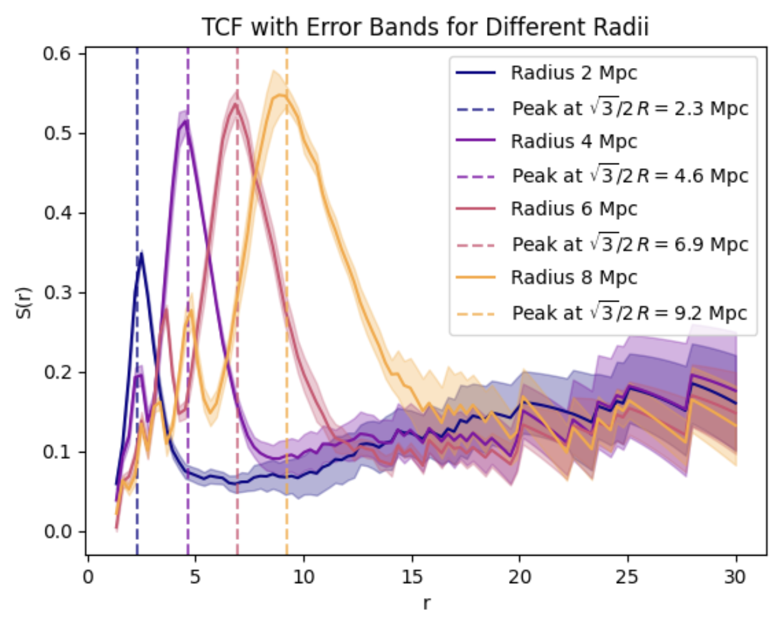
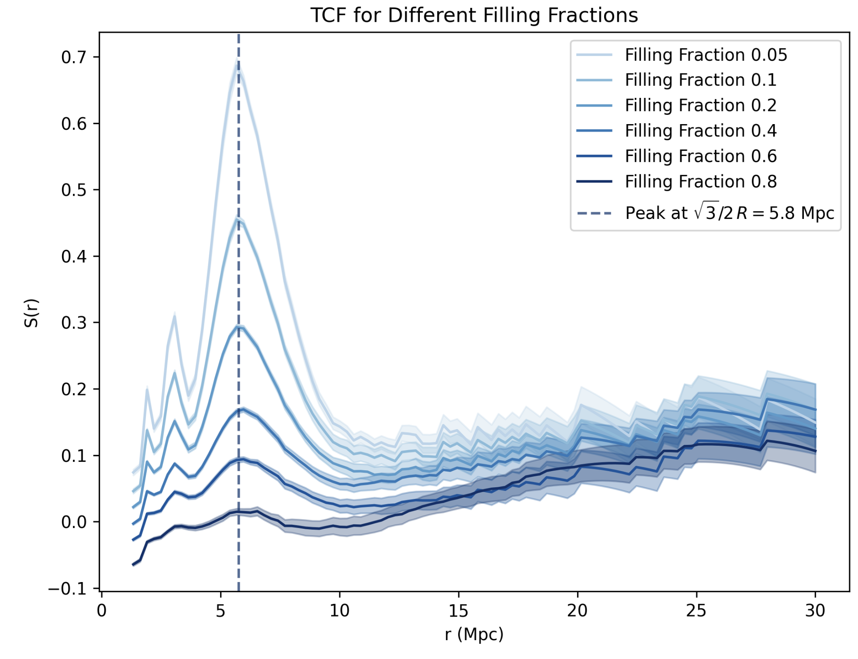




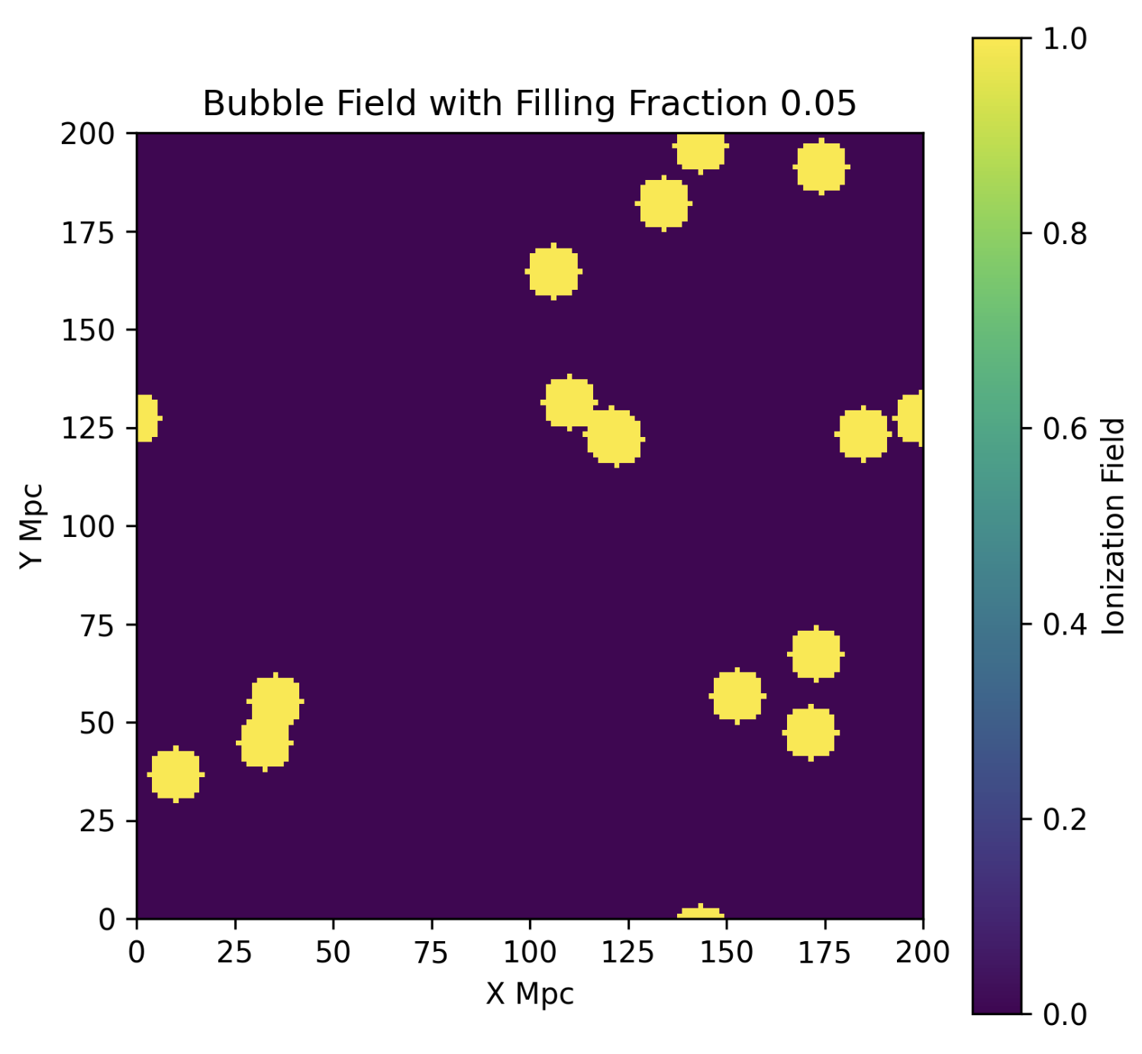
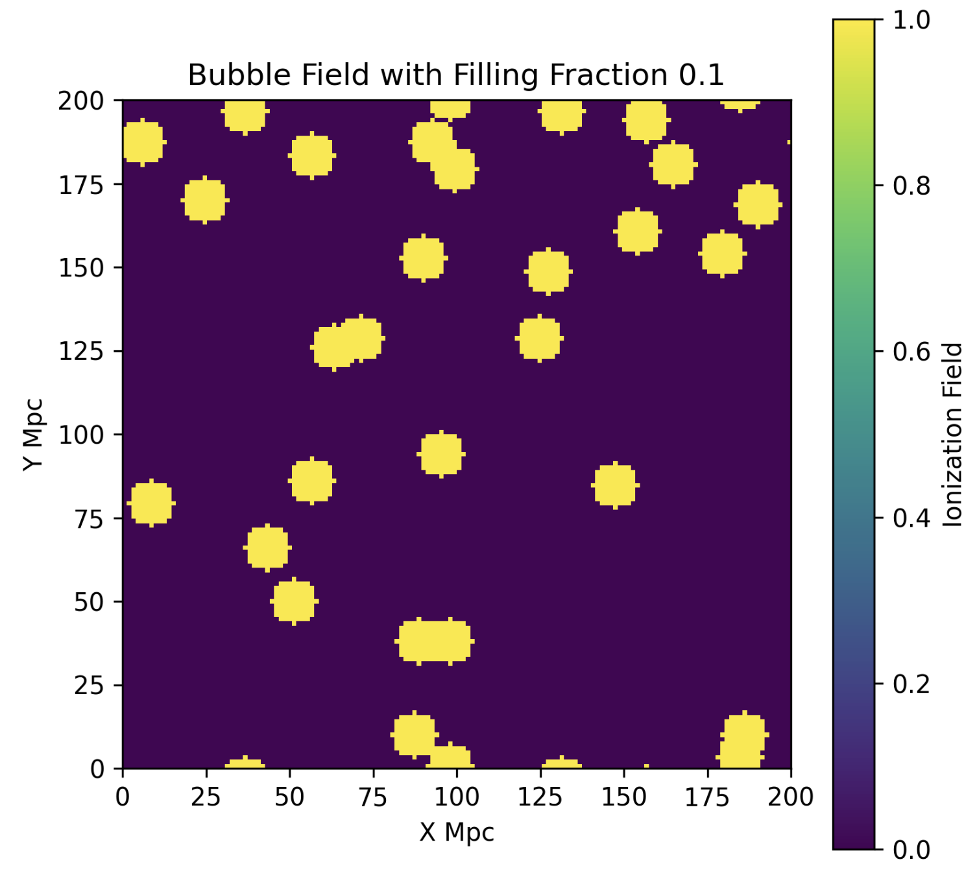
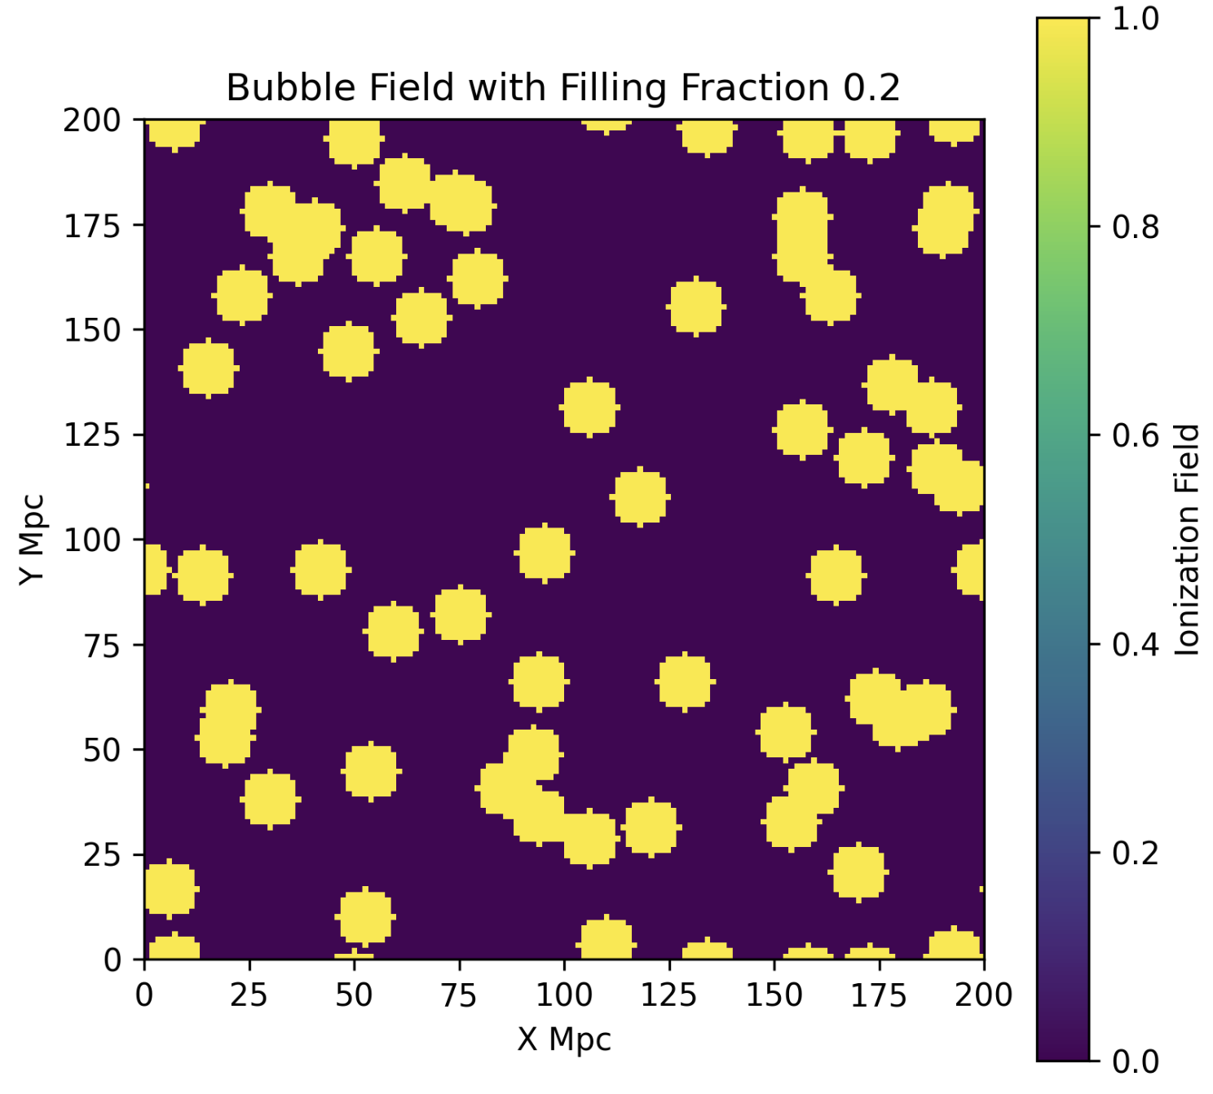
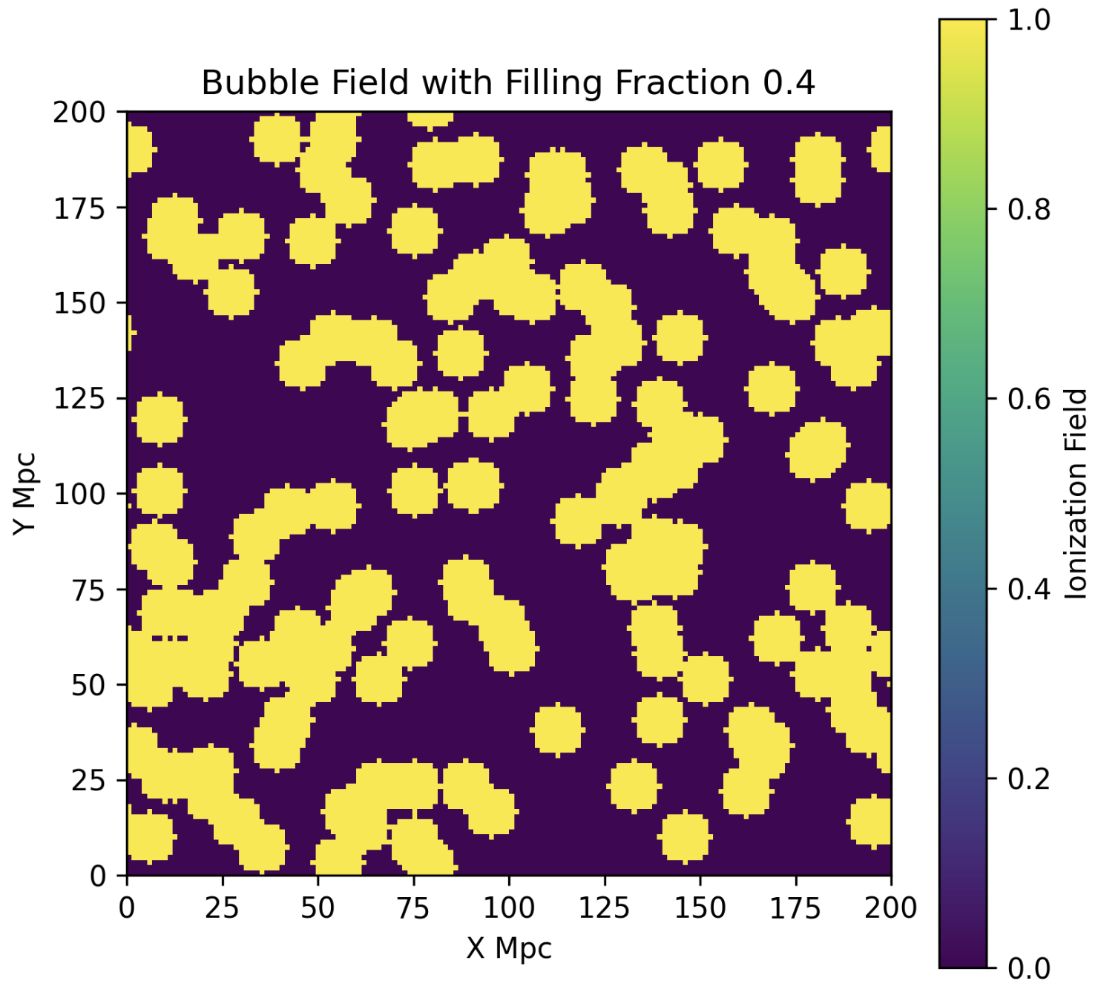
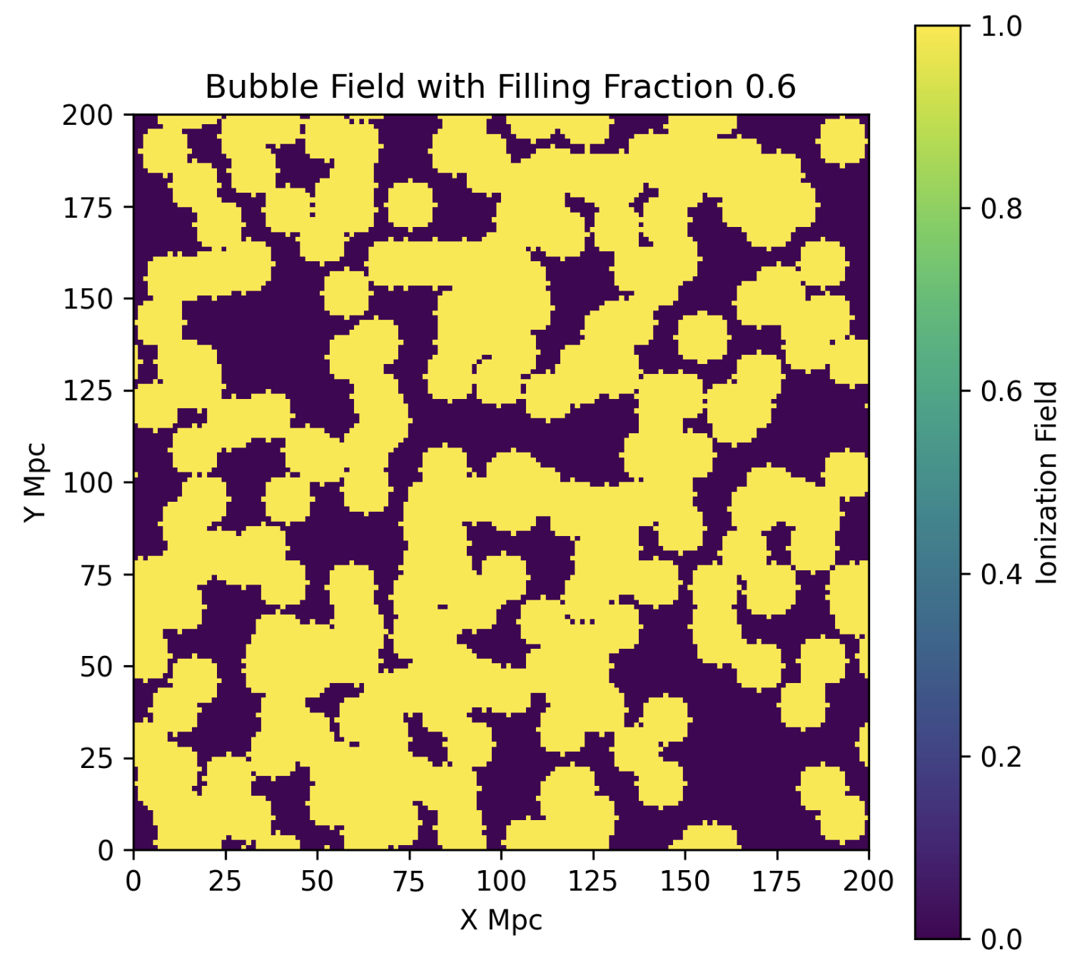
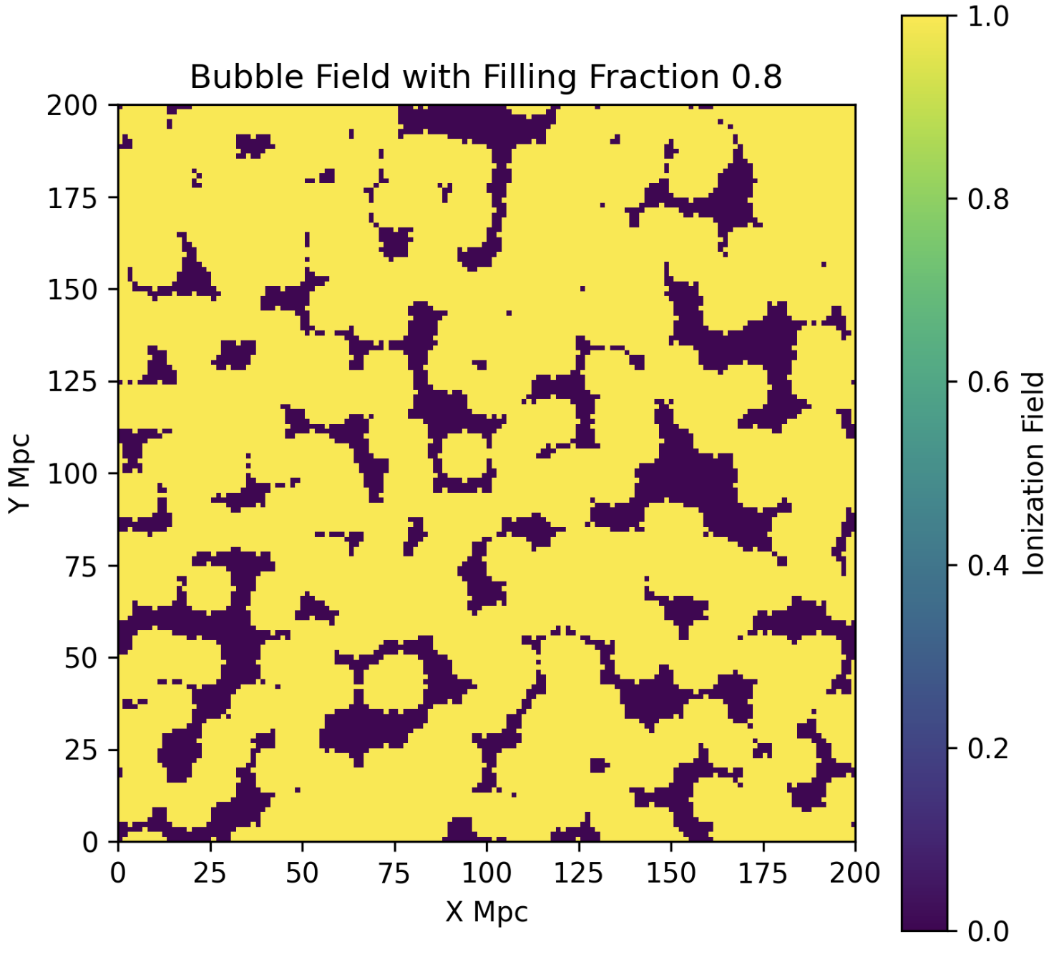
How does the TCF Encode Bubble Morphology?
6
- The TCF directly probes physical properties of the ionised bubble field.
Bubble Radius → TCF Peak Position
Ionised Fraction → TCF Amplitude
Radius = 2Mpc
Peak Radius
Radius = 4Mpc
Peak Radius
Radius = 6Mpc
Peak Radius
TCF Amplitude
Radius = 8Mpc
TCF Amplitude
Peak Radius
R (Mpc)
R (Mpc)
Field 1: radius = 2 Mpc
Field 2: radius = 4 Mpc
Field 3: radius = 6 Mpc
Field 4: radius = 8 Mpc
Field 1: ff = 5%
Field 2: ff = 10%
Field 1: ff = 20%
Field 4: ff = 40%
Field 5: ff = 60%
Field 6: ff = 80%

Slide 7
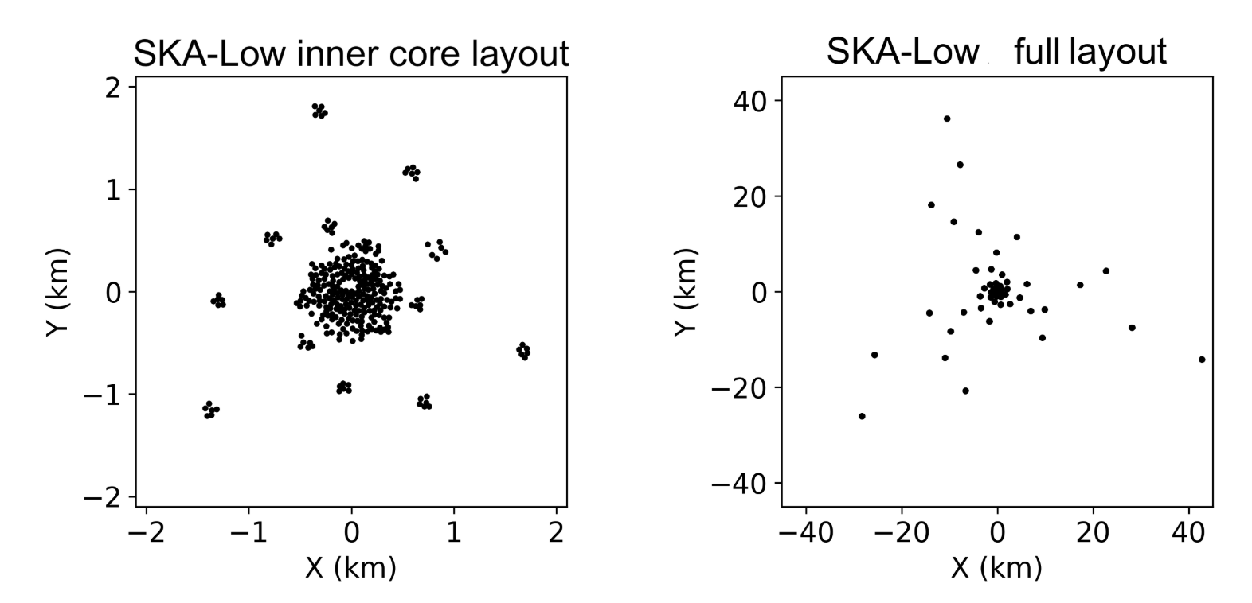
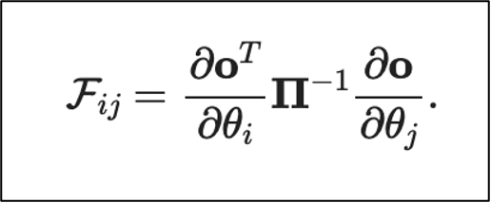
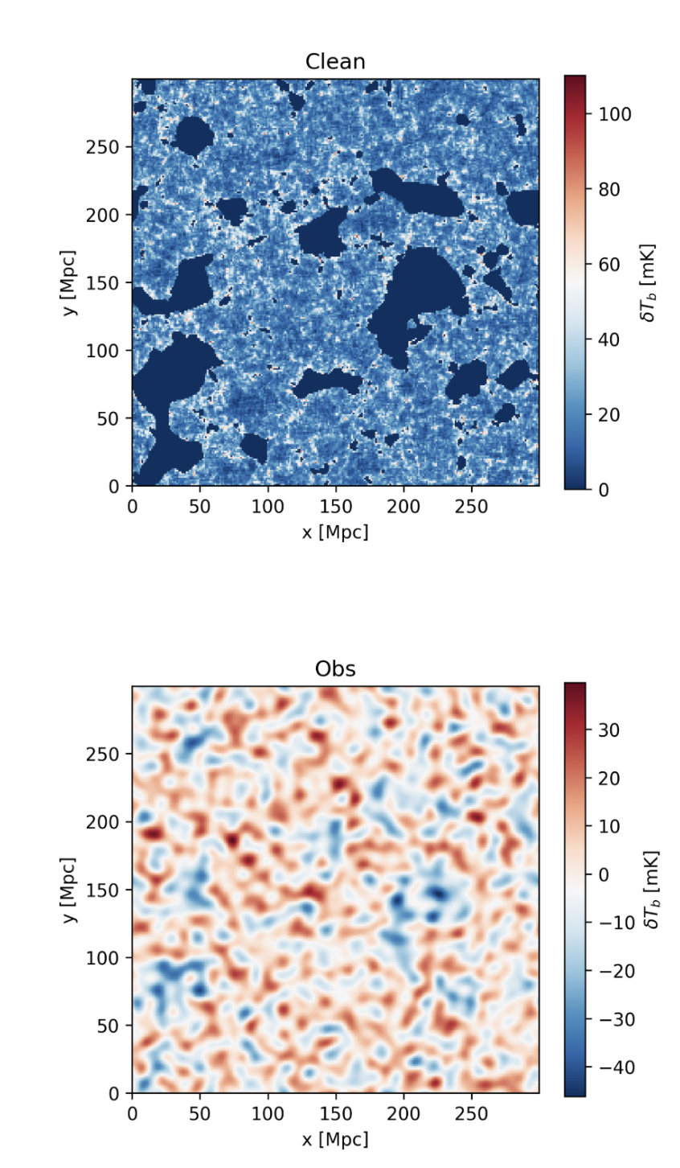
The Fisher Forecast
Fisher forecast = a method to estimate how precisely we can measure model parameters from a given observable, based on how sensitive that observable is to changes in the parameters and how much noise is expected
θ = parameters that are changed in the simulation (eg HII factor)
Π = The uncertainty in the TCF (due to inherent scatter and noise)
o = The observable = the TCF
Goal: How tightly can we constrain the parameters, assuming a given experiment and noise level.
Section 2: Can the TCF Constrain EoR Parameters?
7
Goal: Determine whether the TCF can constrain astrophysical parameters of the EoR even with realistic SKA noise.
Observable, TCF
Pipeline:
EoR Simulation (21cmFAST)
↓
Mock SKA Observation
↓
Compute TCF
↓
Fisher Forecast
↓
Parameter Constraints
Planned layout of the SKA antennae in Australia
Noise Matrix
Astrophysical parameters, θj
X (Mpc)
X (Mpc)
+SKA noise and smoothing
AA4, 1000hrs
(tools21cm)
Y (Mpc)
Y (Mpc)
Y (Mpc)

Slide 8
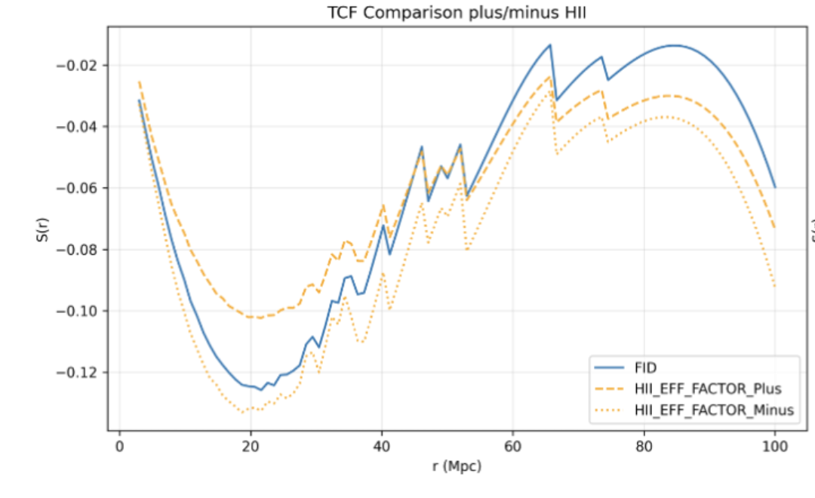
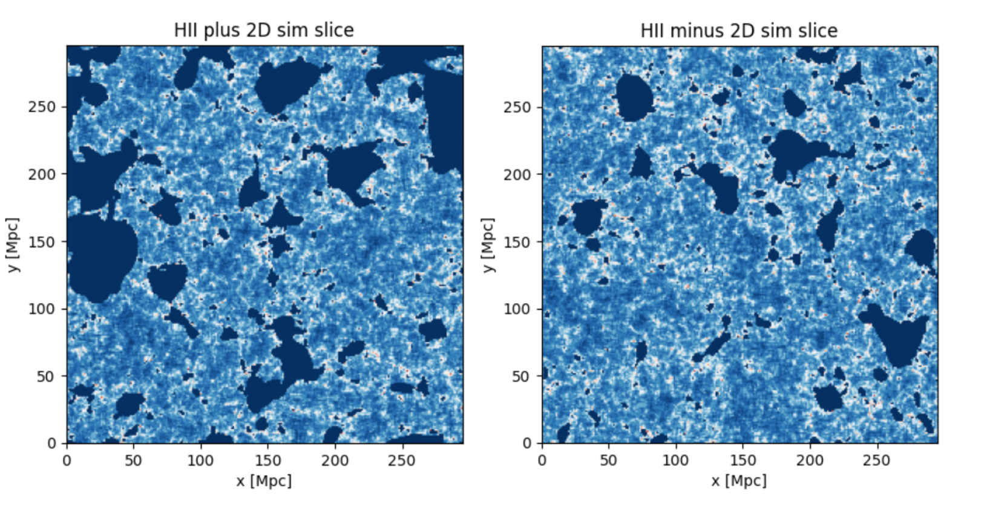
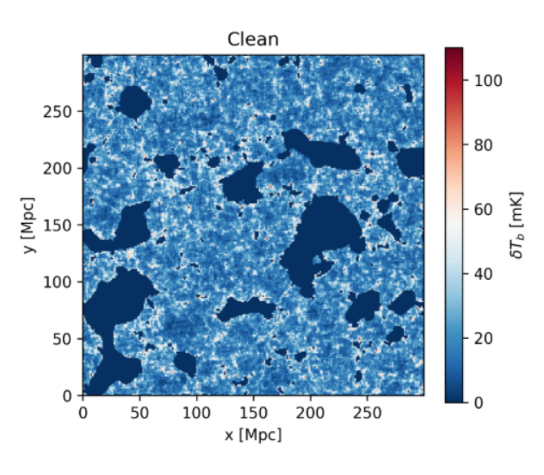
The TCF on 21cmFAST Simulations
8
21cmFAST - a semi-numerical simulation that generates 3D 21-cm intensity maps of the EoR for a given set of astrophysical parameters:
Upper ξ
Lower ξ
Virial temperature of the dark matter halos, T_{vir}
Ionising efficiency of the galaxy, ξ
Maximum ionised bubble radius, R_{max}
Fid ξ
Comparison TCF
Lower ξ
Fiducial ξ
Upper ξ
TCF Amplitude
A. Mesinger et al. 2010
21cm Intensity
R (Mpc)
-> Increasing the ionising efficiency, ξ, decreases the TCF peak amplitude
-> TCF can quantify changes in astrophysical parameters

Slide 9
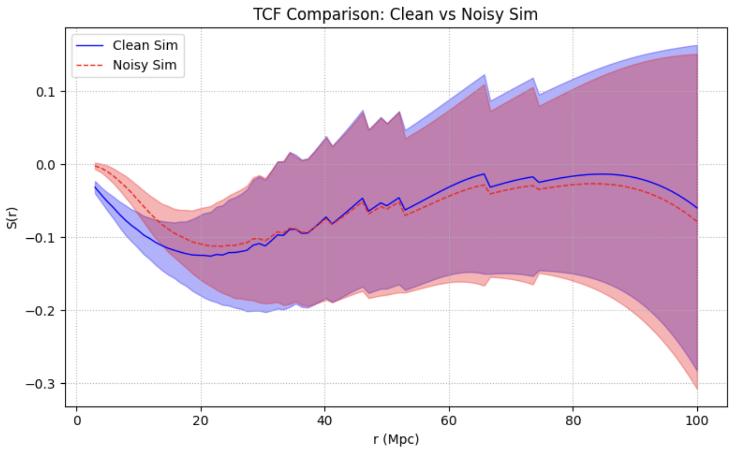
The TCF Response to SKA Noise
9
The next step is to add noise to the simulations to mimic future SKA maps – Can the TCF still extract the astrophysical signal?
With realistic SKA noise, the ionised regions in 21-cm maps become almost invisible to the eye.
→ The TCF can still extract the EoR signal from noise dominated data
Clean Simulation Slice
X (Mpc)
+ SKA noise
Y (Mpc)
Observed Simulation Slice
TCF Amplitude
X (Mpc)
Y (Mpc)
R (Mpc)

Slide 10
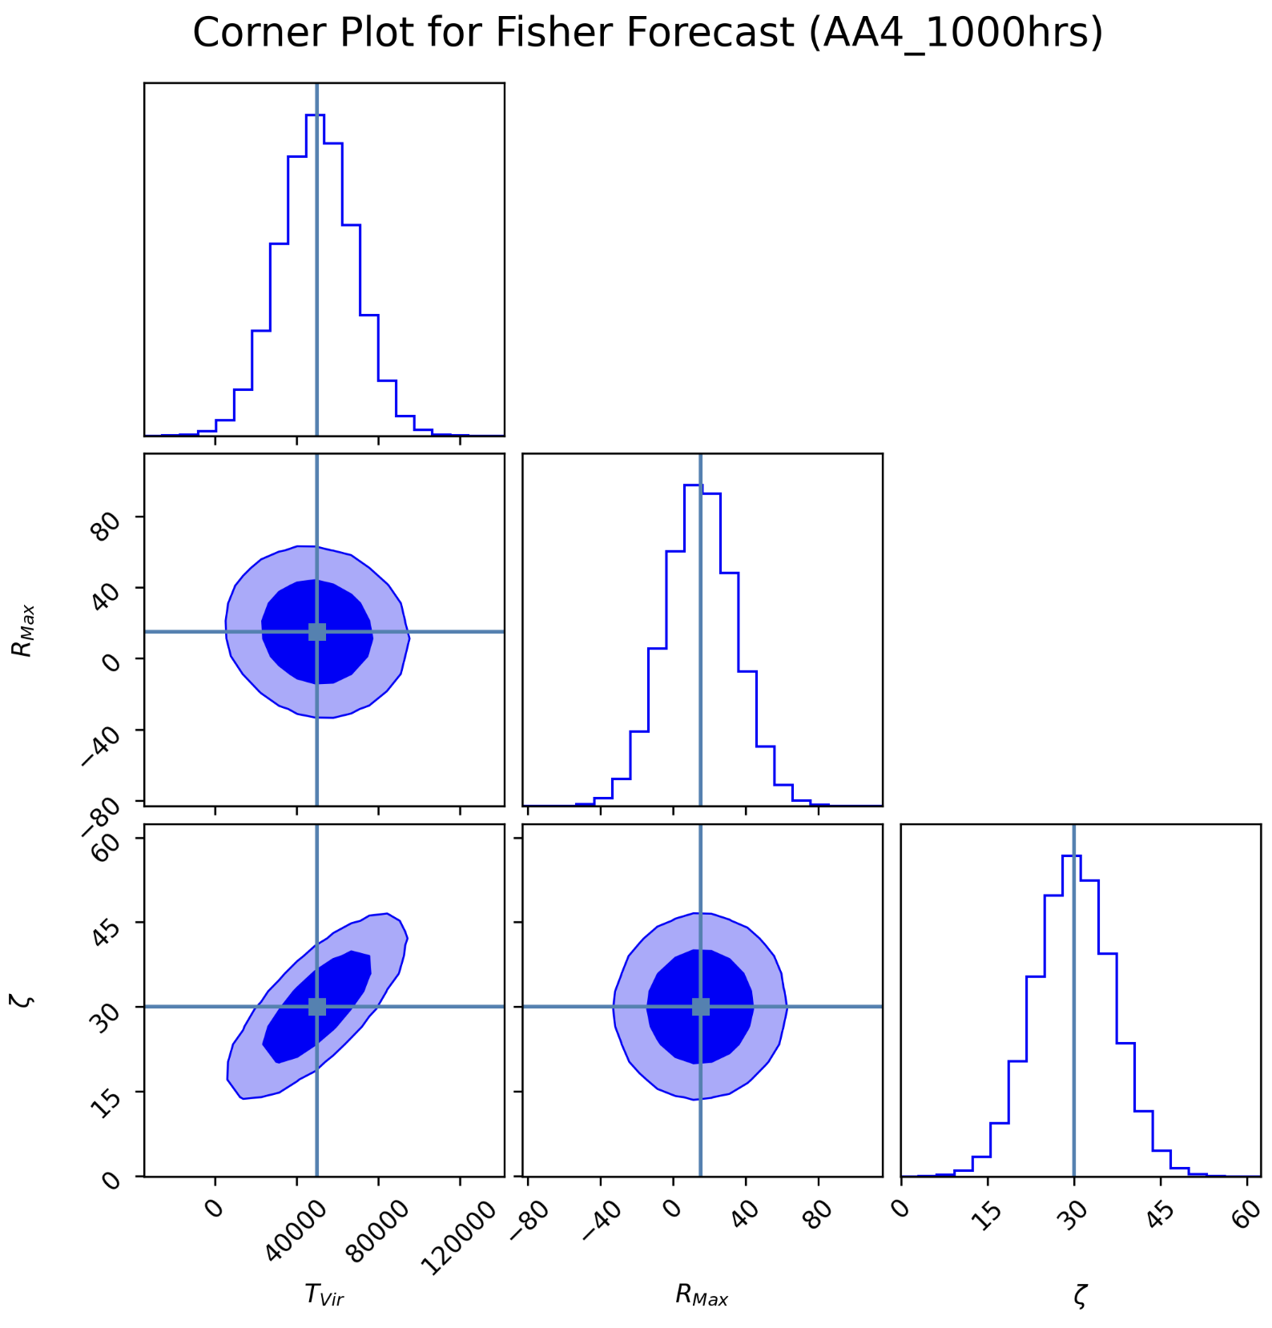
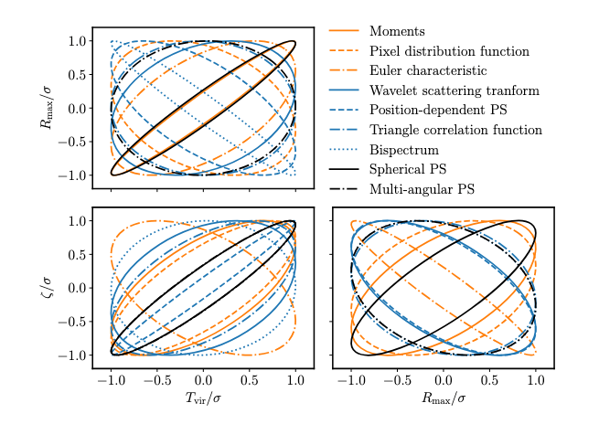
Fisher Forecast Results
10
What we find:
TCF provides meaningful constraints on EoR parameters
Combining the TCF with other statistics could further break degeneracies
1 sigma confidence
2 sigma confidence
Truth values
Comparison between different inference statistics
Max Bubble Radius
Ionising Efficiency
SKA White Book 2025
Limitations of the Fisher Forecast:
represents best-case constraints
Virial Temperature of Halos
Max Bubble Radius
Ionising Efficiency

Slide 11
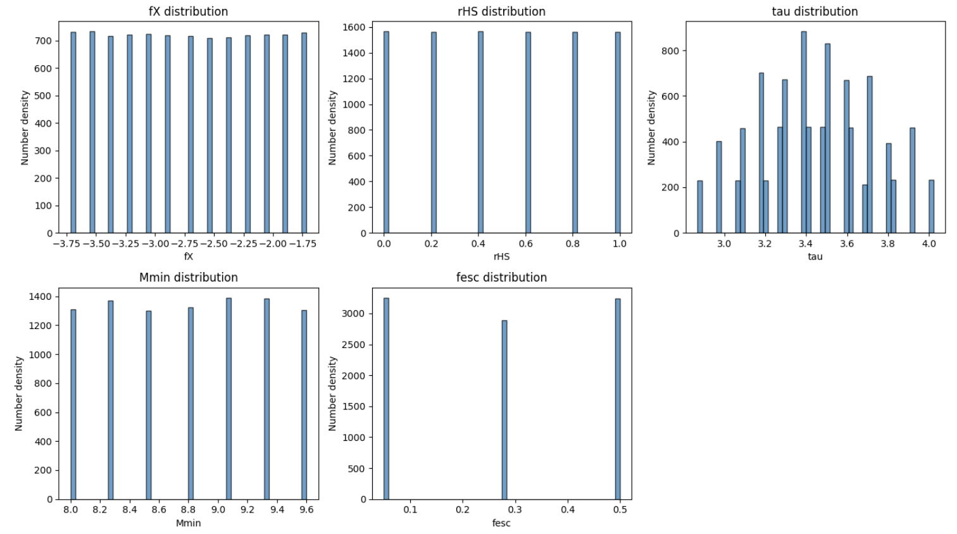
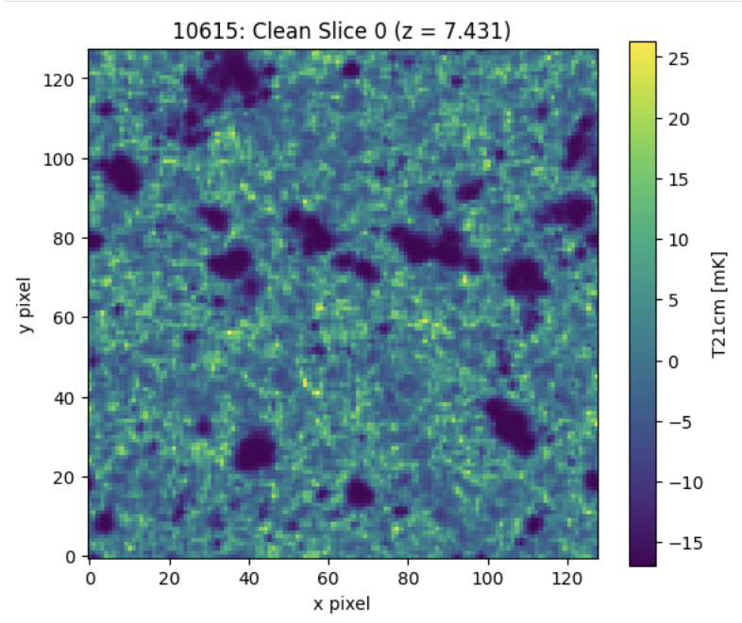
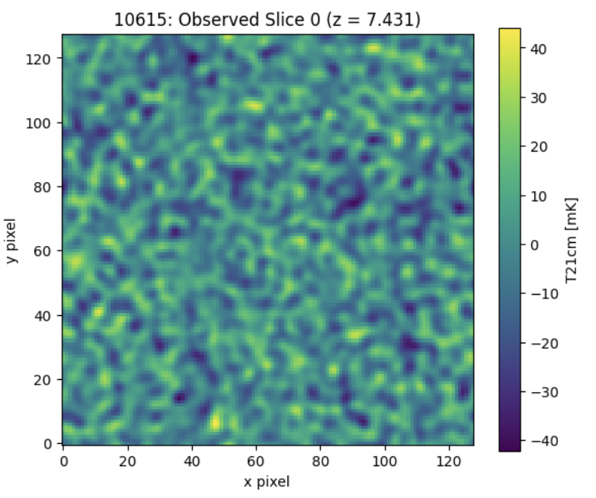
Section 3: MCMC Analysis, using the LoReLi simulations
11
LoReLi - a database of radiative-hydrodynamics simulations of the EoR 21 cm signal generated with the LICORICE code to explore astrophysical parameter space:
Sampled Parameter Space
X-ray efficiency, fX
Hard X-ray fraction, rHS
Gas-to-star conversion timescale, tau
Minimum mass of Dark Matter halos, Mmin
Ionising photons escape fraction, fesc
LoReLi simulation slice
LoReLi simulation slice with noise
R. Meriot, B. Semelin, 2023
Pipeline:
Compute TCF of the 10,000 LoReLi slices
Train emulator to predict TCF for any set of parameters
Use to run an MCMC infrernce
X (Mpc)
21cm Radiation Intensity
21cm Radiation Intensity
X (Mpc)
Y (Mpc)
Y (Mpc)

Slide 12
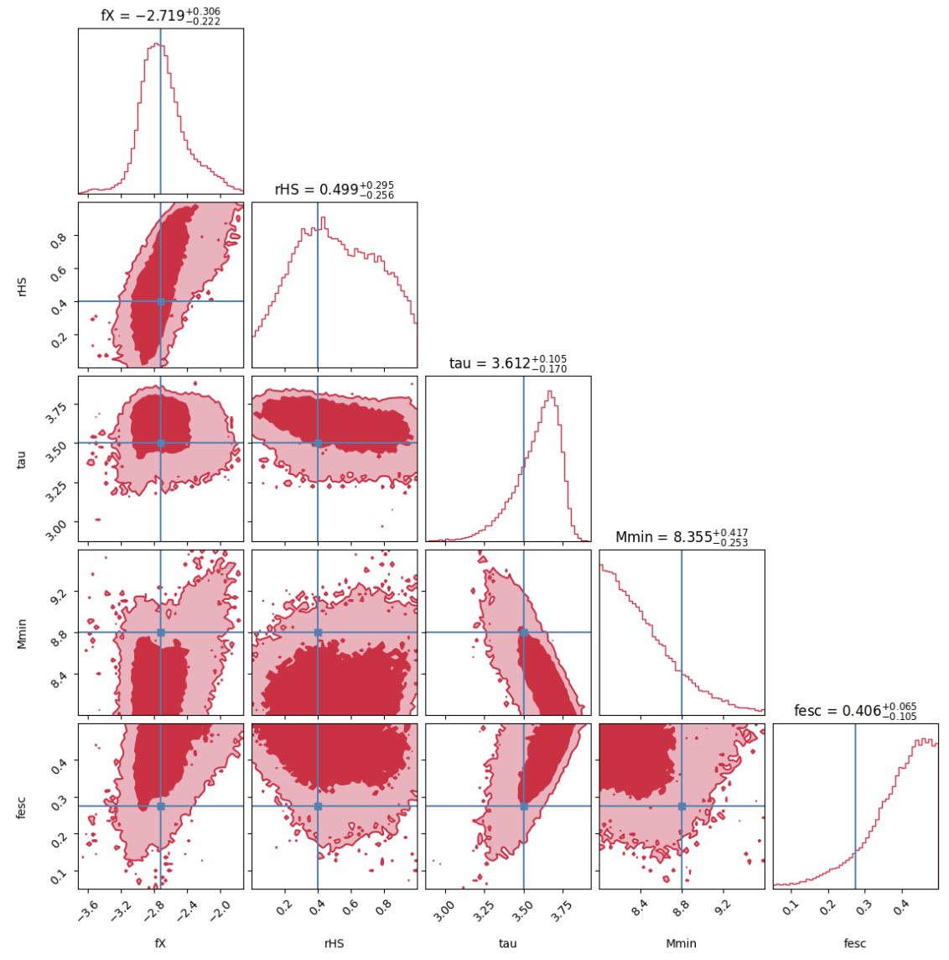
Results of the MCMC Inference
12
MCMC Inference Corner Plot
PRELIMINARY
- Currently the MCMC successfully recovers fX (X-ray efficiency) to within 1 sigma and the other parameters to within 2 sigma
- Degeneracies between parameters remain
- Demonstrates the inference potential of the TCF
- Still progress to be made refining the pipeline
1 sigma confidence
2 sigma confidence
Hard X-ray
fraction
Truth values
Gas-To-Star timescale
Min Dark Matter Halo Mass
Ionising Photons Escape Fraction
X-ray Efficiency
Hard X-ray
fraction
Gas-To-Star timescale
Min Dark Matter Halo Mass
Ionising Photons Escape Fraction

Slide 13
Summary and Outlook
13
Key Takeaways:
  The TCF enables inference of EoR astrophysical parameters from the morphology of ionised regions.
  Fisher Forecast contribution to SKA white book, proof of constraining power of TCF on key astrophysical parameters
  Parameter inference is possible using the TCF with an emulator + MCMC
Next steps:
  Explore the EoR evolution over multiple redshifts
  Simulation Based Inference (SBI) – relaxes assumption that likelihood is gaussian
  Publishing results (comparison of Fisher, MCMC and SBI)

Slide 14
Thank you for Listening!

Slide 15
Back Up Slides

Slide 16
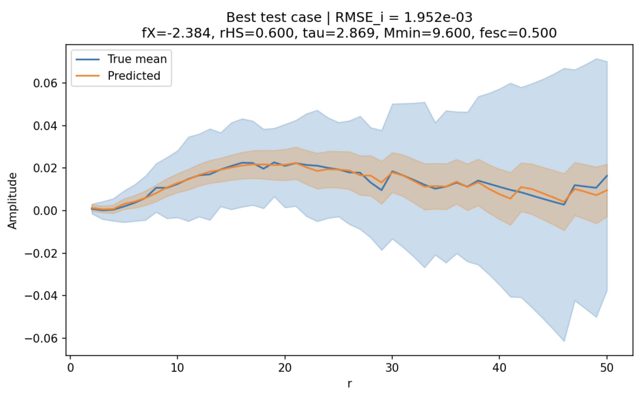
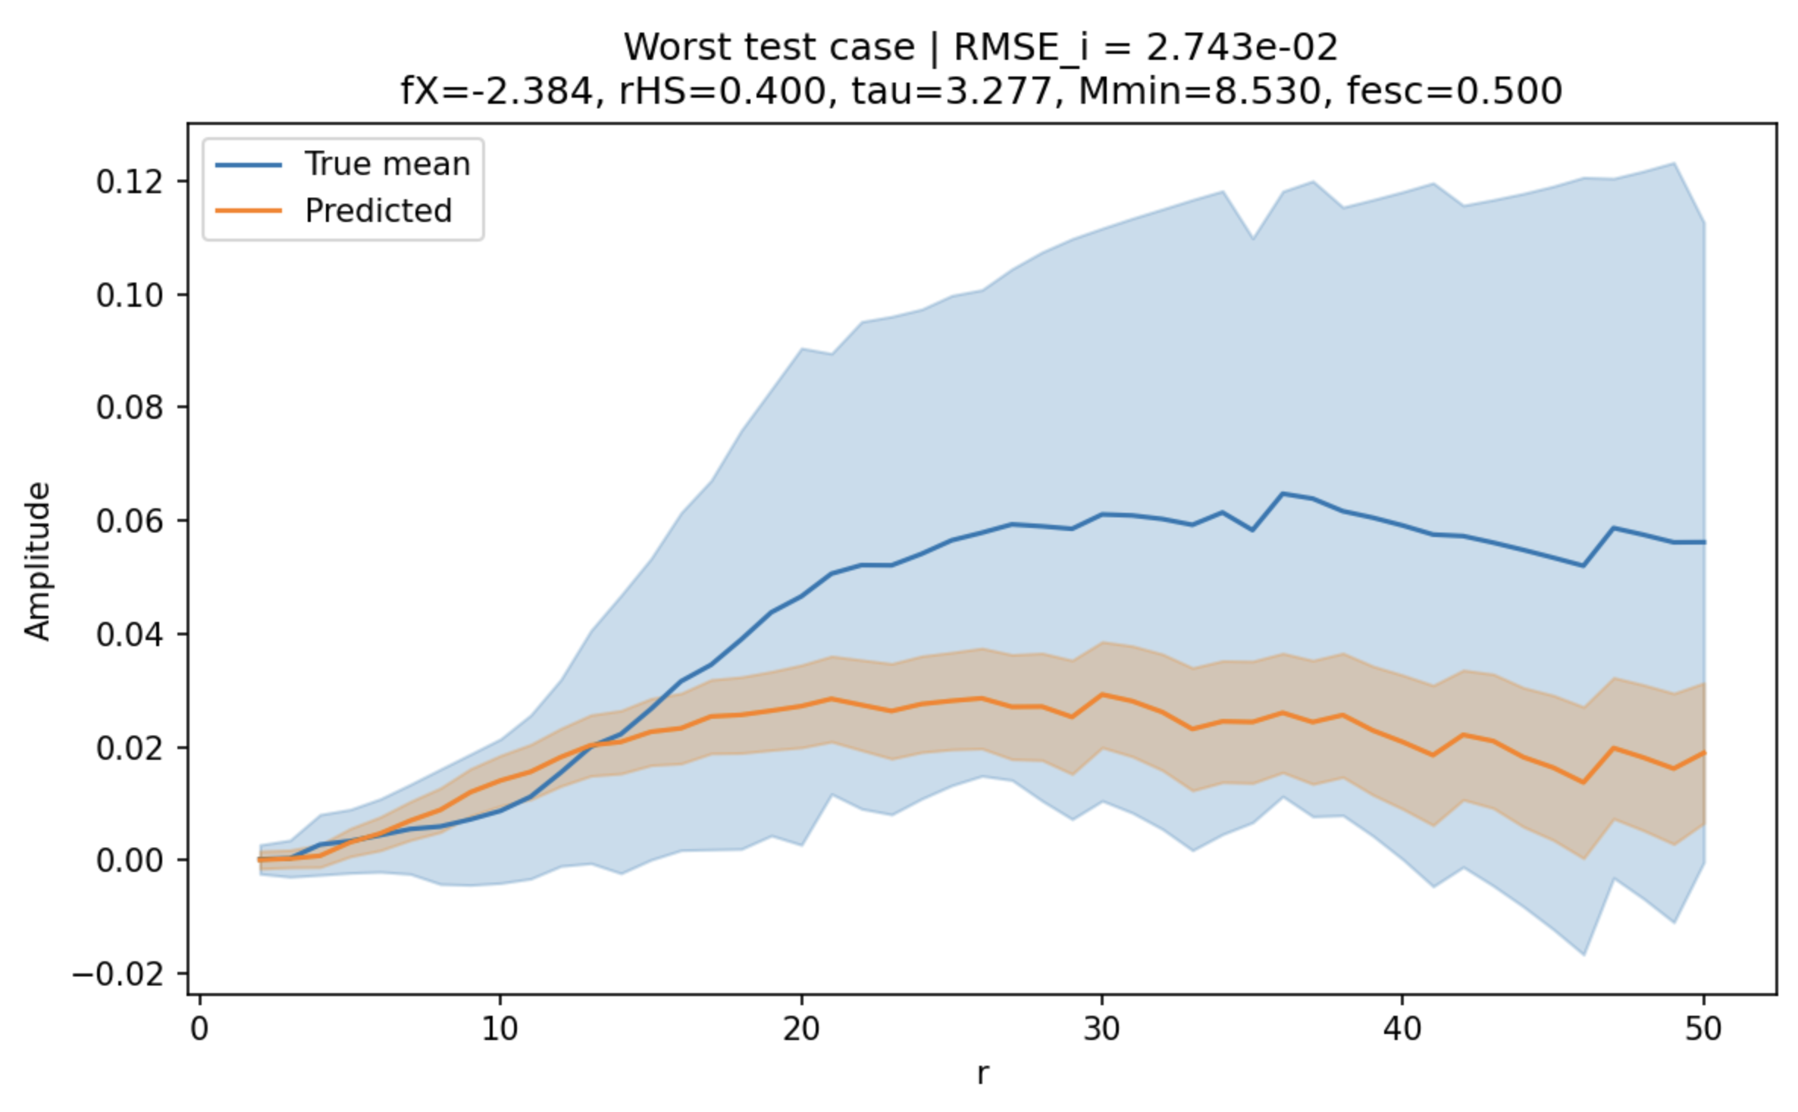
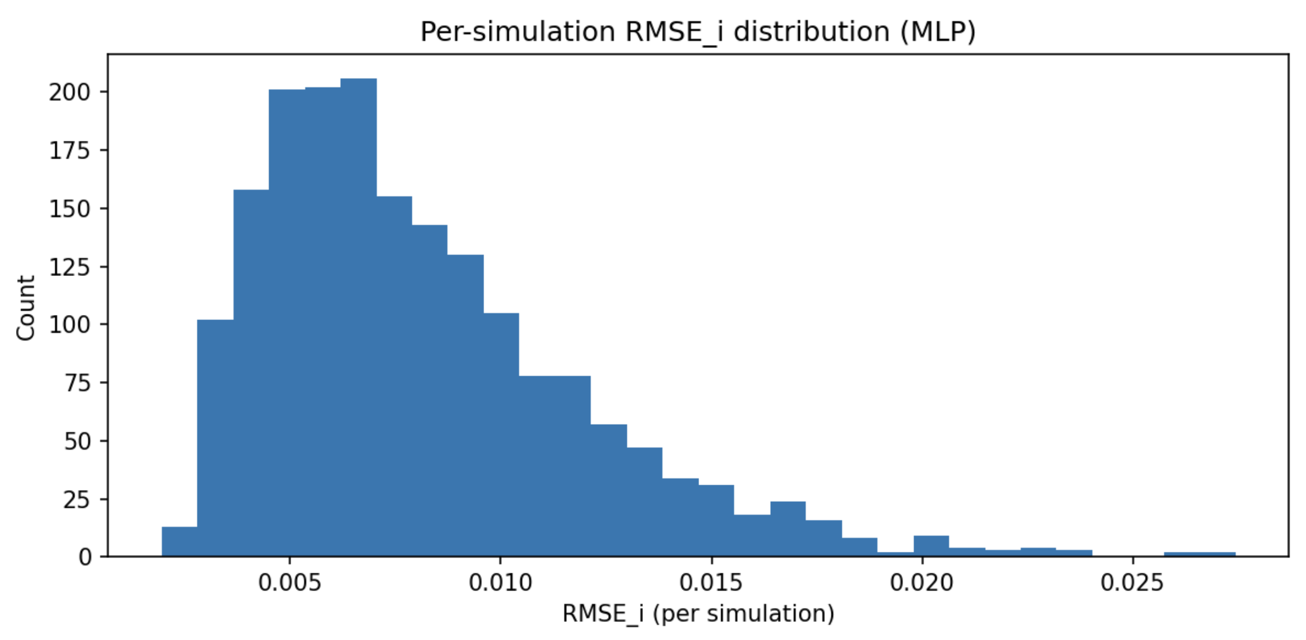
Using an Emulator
The Emulator:
  Neural network, mlp model
  8000 LoReLi simulations
  2000 held-out test simulations
  Resulting RMSE of ~0.006 (<10% error)

Slide 17
The Challenge of the EoR 2: Noisy Data
4
- The 21cm observations of the EoR from the SKA will be largely dominated by noise
- Extracting meaningful information from behind the noise will be a challenge
Conclusion: We need to use statistics to extract astrophysical and cosmologyical information from the noisy and highly non-gaussian data
+noise
The Triangle Correlation Function
Cite tools 21cm, 21cmfast, loreli

