Slide 1
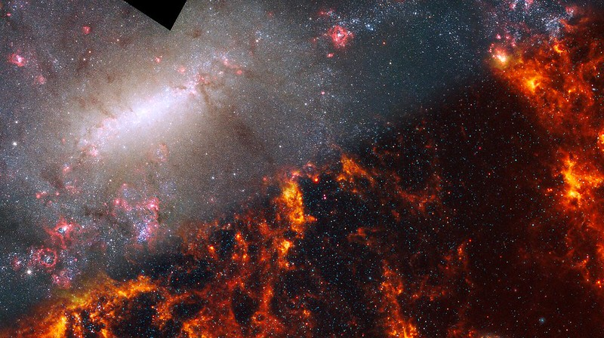

Validating initial SKA-low AA* 21cm measurements through cross-correlation with line intensity maps during reionization
Yilong Zhang (张艺泷)
Cosmology in the Alps 2026
Image: NGC 5068 (Hubble + Webb)
Notes:
Cover

Slide 2
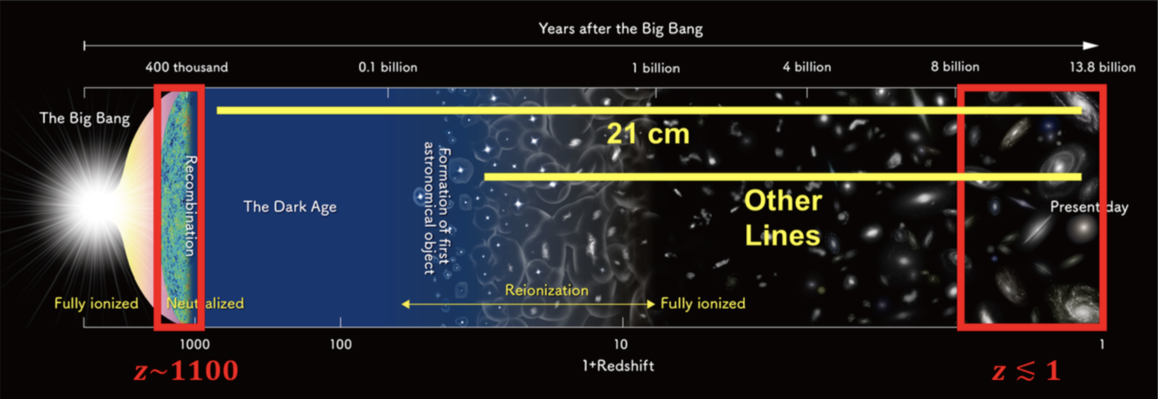
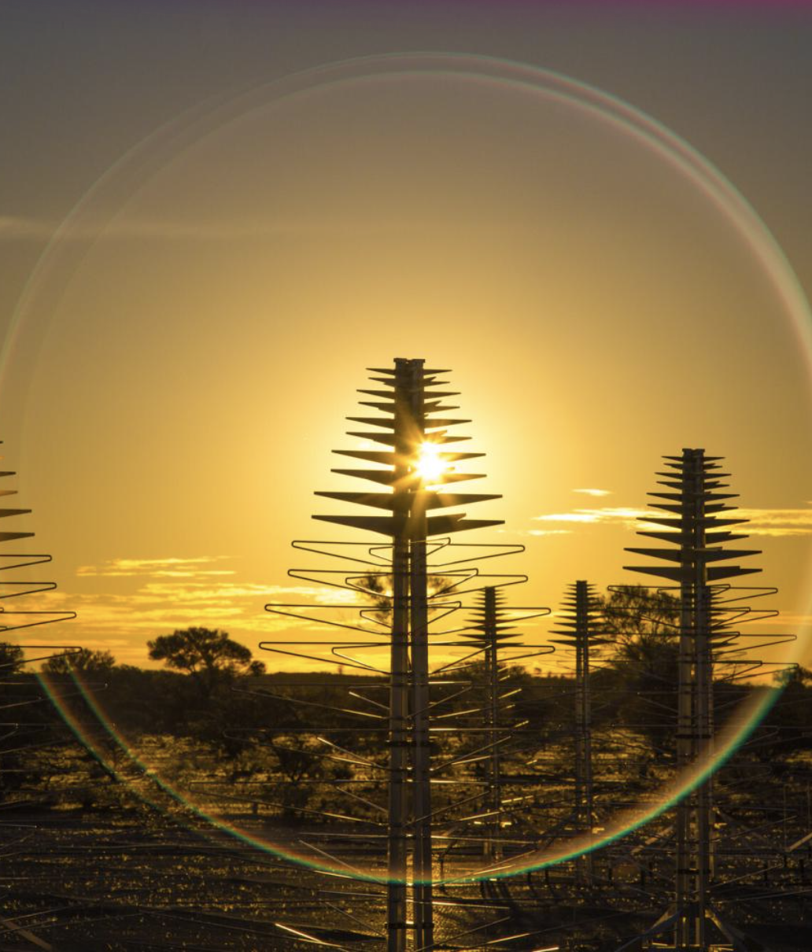
21cm Cosmology
image credit: NAOJ
Notes:
Template e guide lines

Slide 3
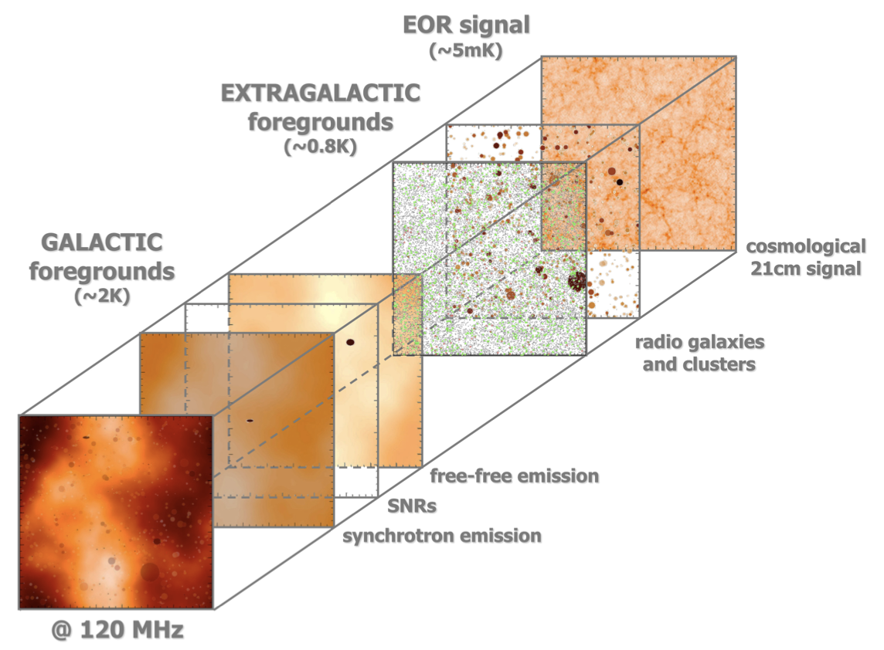
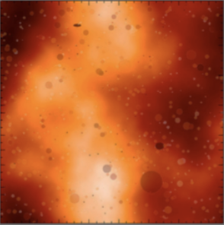
Motivation
Technical Challenge
image: V. Jelić, 2008
Notes:
Template e guide lines

Slide 4
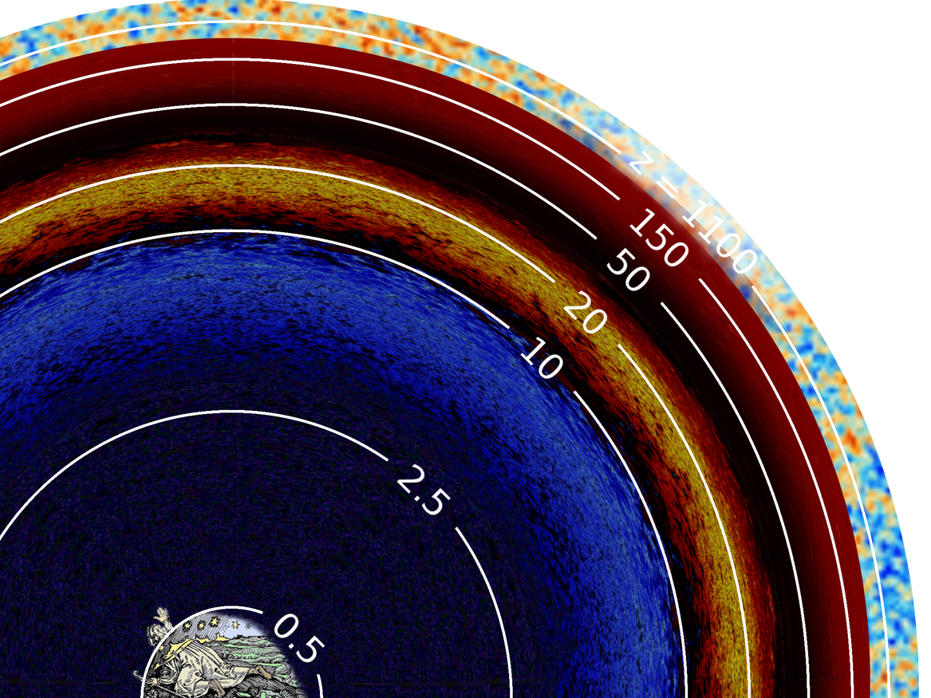
Image Credit: Cynthia Chiang
Notes:
Template e guide lines

Slide 5
Image Credit: Cynthia Chiang
Notes:
Template e guide lines

Slide 6
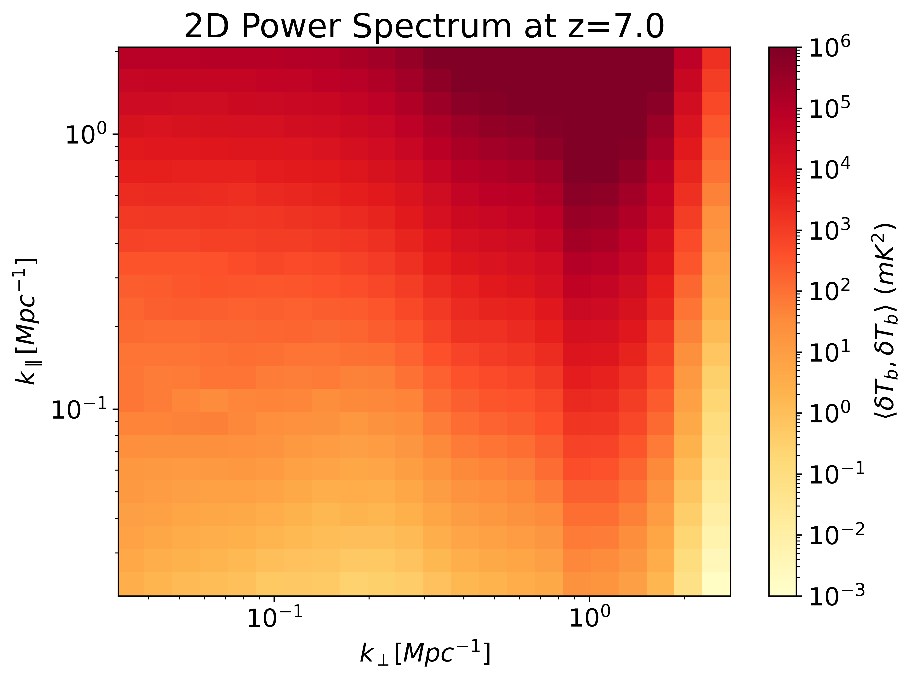
Technical Challenge
?
Image Credit: Cynthia Chiang
Notes:
Template e guide lines

Slide 7
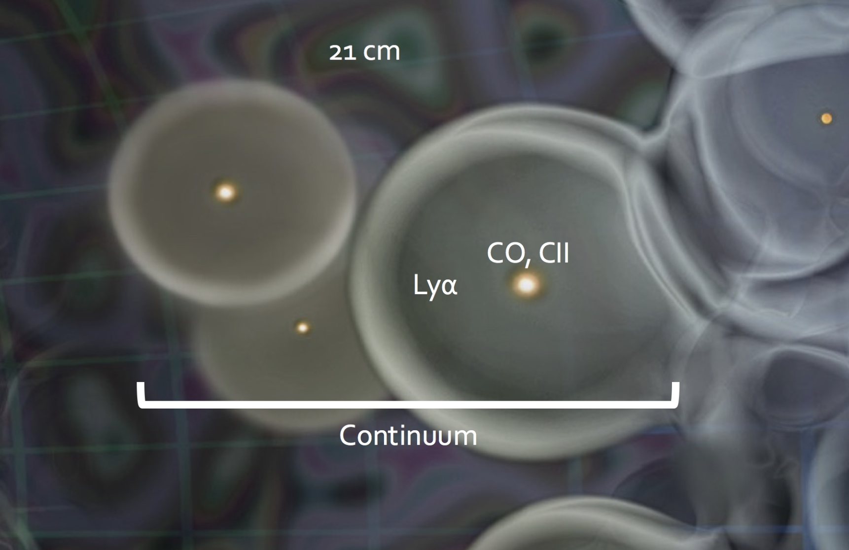
Motivation
(E. D. Kovetz, et al. 2017)
Notes:
Template e guide lines

Slide 8
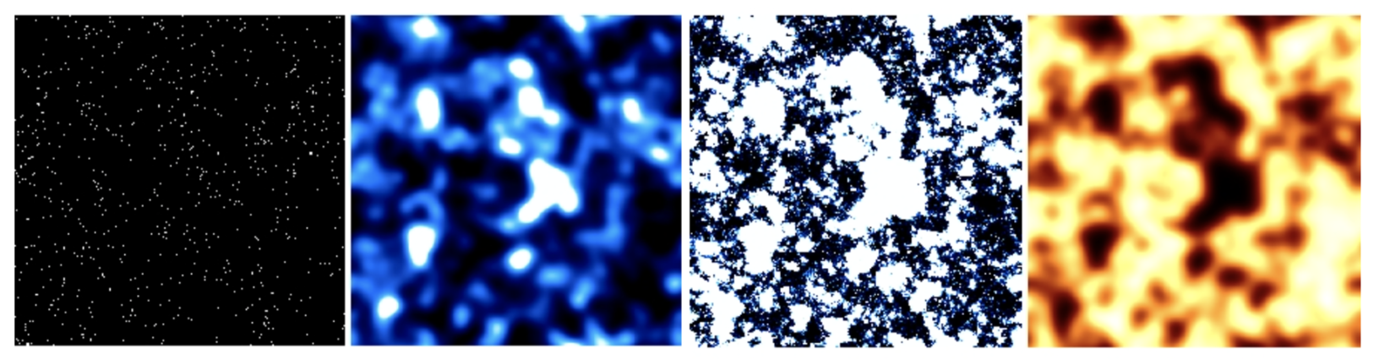
Motivation
Cross-correlation Technique
The contaminants of 21cm and LIM fields should be uncorrelated.
The 21cm and LIM fields are anti-correlated on large scales during EoR.
The cross power spectrum would verify the initial claims of 21cm detection.
Complete our understanding of the reionization process.
EoR galaxies
LIM of CO(2-1)
Ionization field
21cm signal
(E. D. Kovetz, et al. 2017)
Notes:
Template e guide lines

Slide 9

Science Objectives
Develop a forward-modeling pipeline to simulate [CII] LIM and 21cm field simultaneously
Find an observation strategy to maximum the SNR of the cross correlation detection
Wait…
By Copyright for the animated character is held by Adult Swim.
Notes:
Template e guide lines

Slide 10
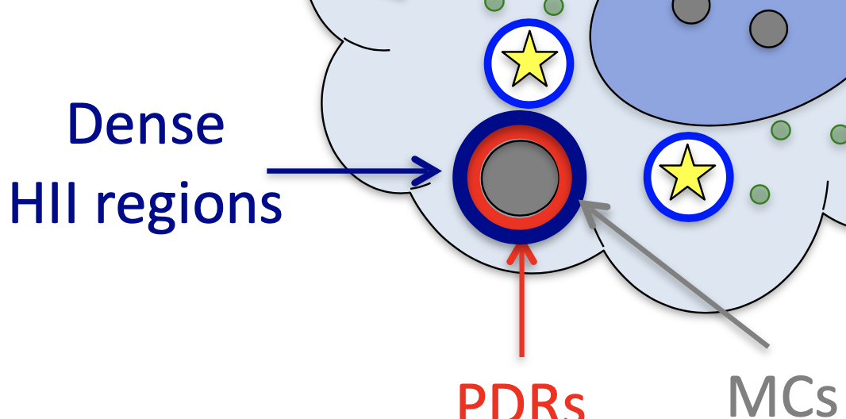

[CII] line (1900 GHz 158 μm)
What is [CII] line?
[CII]
ionized carbon fine structure line (²P3/2 —> ²P1/2);
an evidence of cooling in a gas cloud warmed by far ultraviolet light;
observed in cooling clouds, photodissociation regions (PDR);
closely related to the star forming process.
By Copyright for the animated character is held by Adult Swim.
Notes:
Template e guide lines

Slide 11
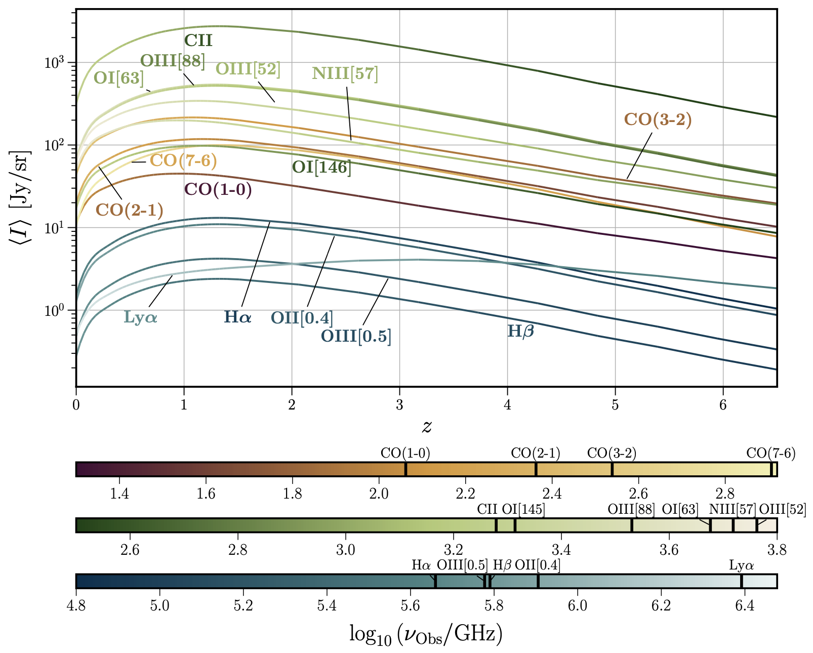
[CII] line (1900 GHz, 158 μm)
Why [CII]?
(J. L. Bernal · E. D. Kovetz)
By Copyright for the animated character is held by Adult Swim.
Notes:
Template e guide lines

Slide 12

Let’s do it!
By Copyright for the animated character is held by Adult Swim.
Notes:
Template e guide lines

Slide 13
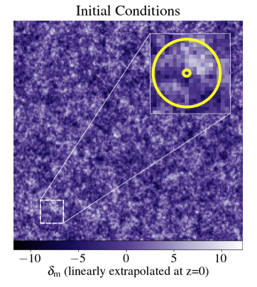
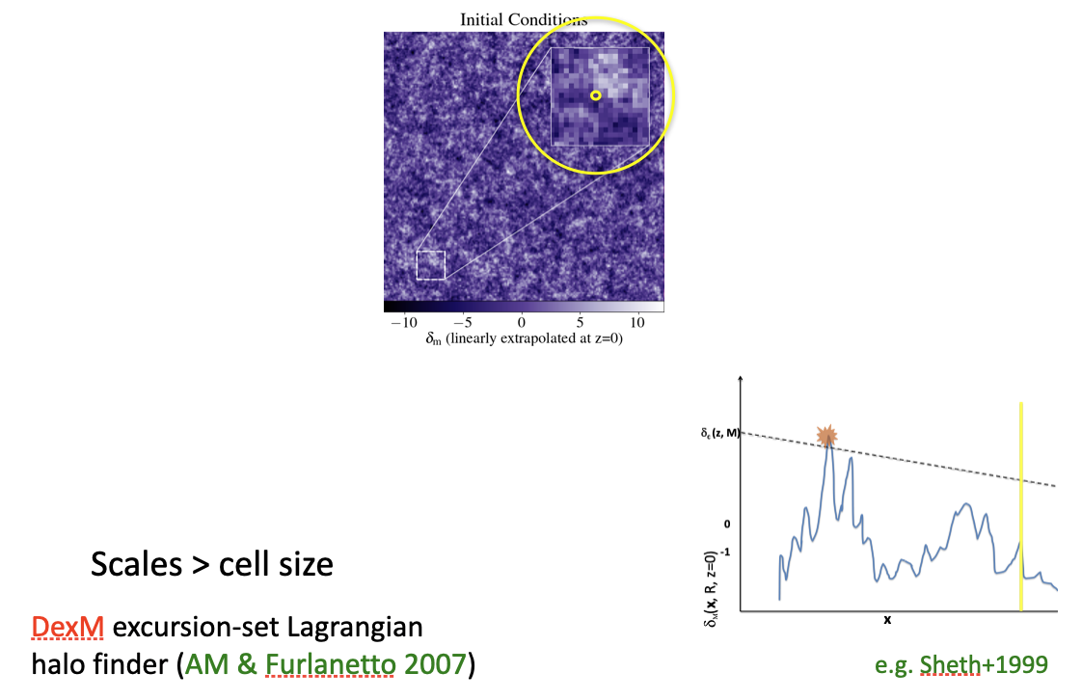
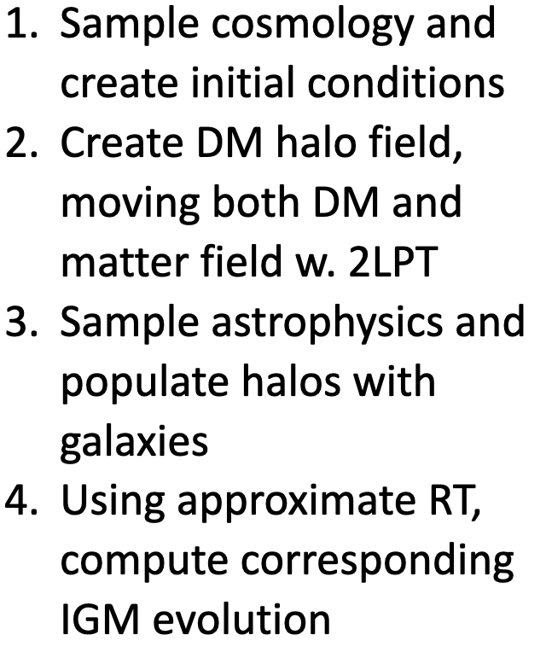
Simulate Halo Field
21cmFAST-v4*
*Davies, Mesinger, Murray (2025)
Notes:
Template e guide lines

Slide 14
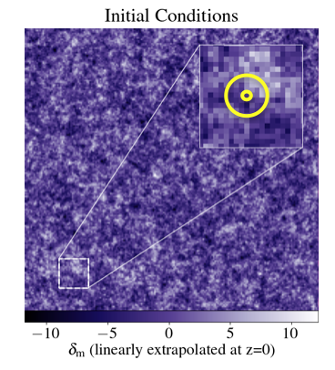
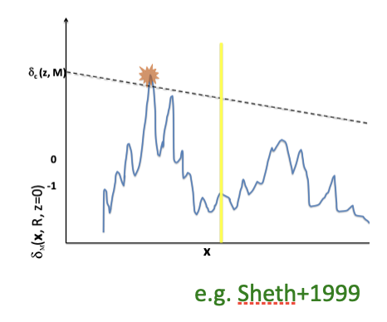
Simulate Halo Field
21cmFAST-v4*
*Davies, Mesinger, Murray (2025)
Notes:
Template e guide lines

Slide 15
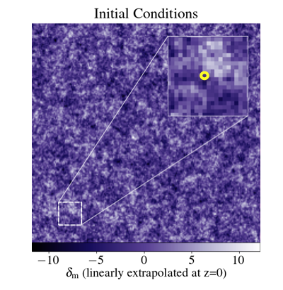
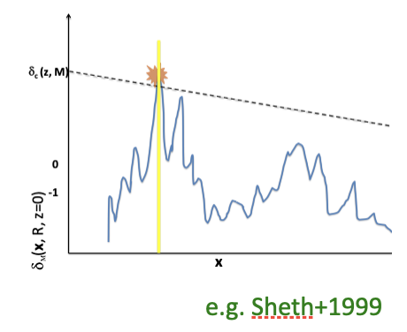
Simulate Halo Field
21cmFAST-v4*
*Davies, Mesinger, Murray (2025)
Notes:
Template e guide lines

Slide 16
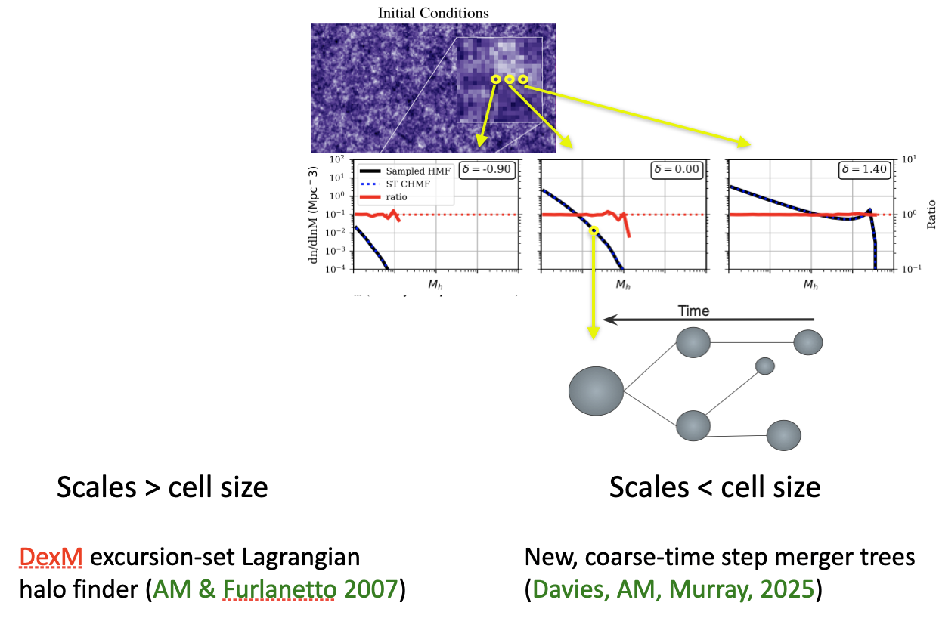

Simulate Halo Field
21cmFAST-v4*
Fast!
Allow stochasticity!
*Davies, Mesinger, Murray (2025)
By Copyright for the animated character is held by Adult Swim.
Notes:
Template e guide lines

Slide 17
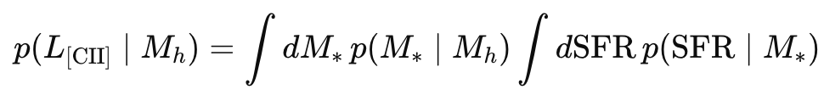
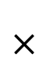
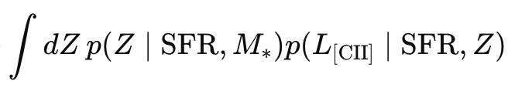
Simulate [CII] Field
[CII] line intensity mapping simulation
(SHMR)
(SFMS)
(FMR)
(CII luminosity scaling relation)
Notes:
Template e guide lines

Slide 18
Simulate [CII] Field
Stellar-to-halo mass relation
(SHMR)
(SFMS)
(FMR)
Notes:
Template e guide lines

Slide 19
Simulate [CII] Field
Star formation main sequence
(SHMR)
(SFMS)
(FMR)
Notes:
Template e guide lines

Slide 20
Simulate [CII] Field
Star formation main sequence
(SHMR)
(SFMS)
(FMR)
Notes:
Template e guide lines

Slide 21
Simulate [CII] Field
Star formation main sequence
(SHMR)
(SFMS)
(FMR)
Notes:
Template e guide lines

Slide 22
Simulate [CII] Field
Fundamental Metallicity Relation
(SHMR)
(SFMS)
(FMR)
Notes:
Template e guide lines

Slide 23
Simulate [CII] Field
[CII] scaling relation
(SHMR)
(SFMS)
(FMR)
Notes:
Template e guide lines

Slide 24
Simulate [CII] Field
[CII] scaling relation
Easy to be calibrated!
(SHMR)
(SFMS)
(FMR)
By Copyright for the animated character is held by Adult Swim.
Notes:
Template e guide lines

Slide 25
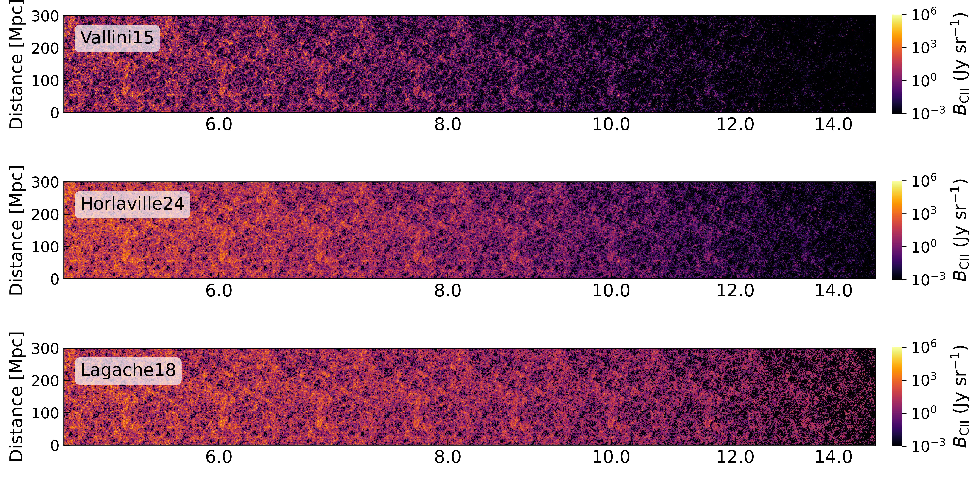
Simulate [CII] Field
[CII] brightness density lightcones
Allow flexibility!
By Copyright for the animated character is held by Adult Swim.
Notes:
Template e guide lines

Slide 26
The Intrinsic Cross-correlation
Does the anti-correlation really exist in intrinsic 21cm and [CII] field?
By Copyright for the animated character is held by Adult Swim.
Notes:
Template e guide lines

Slide 27
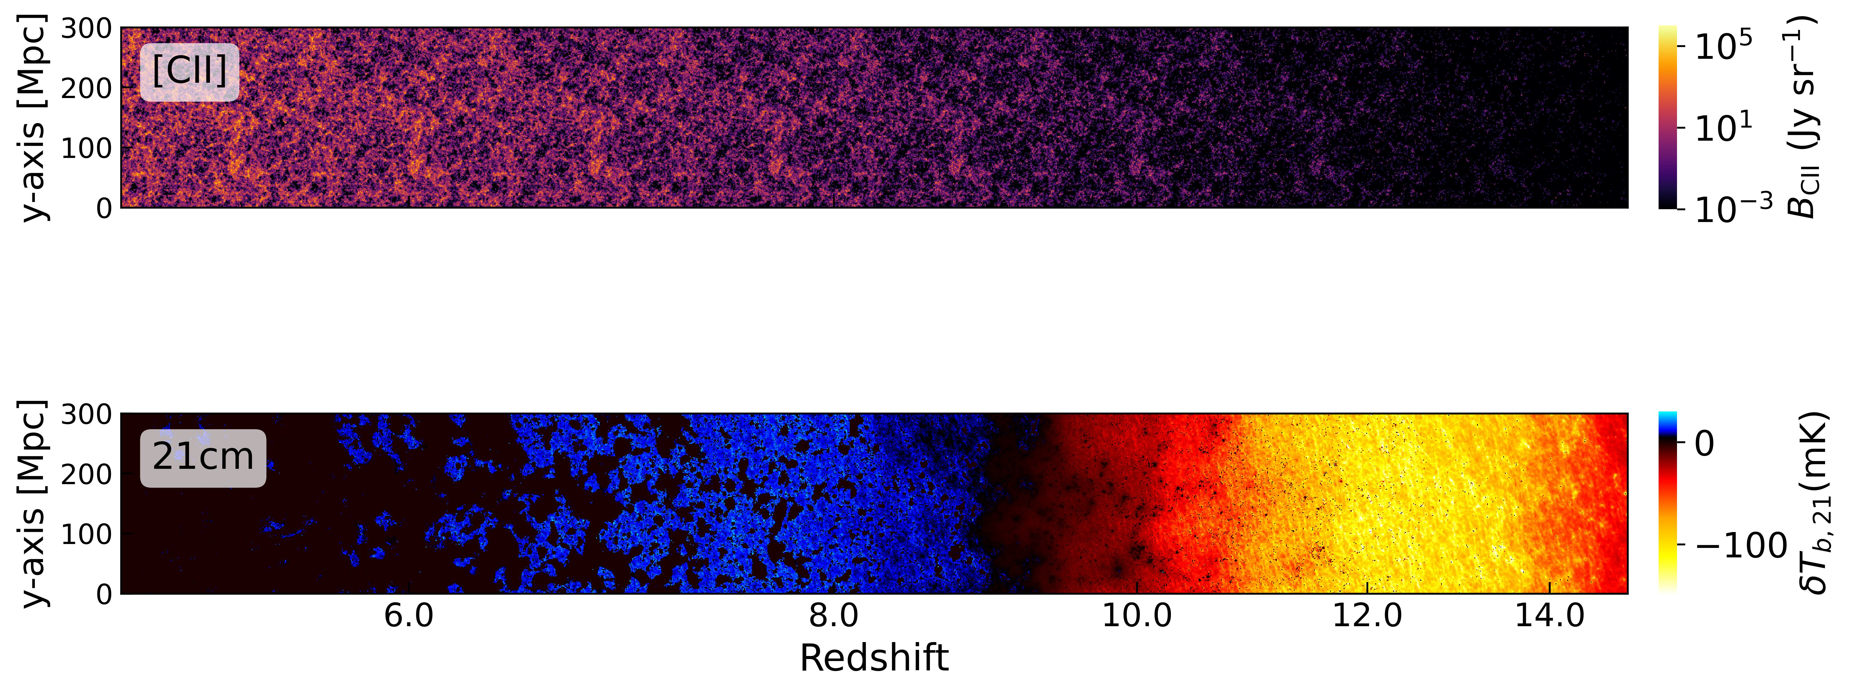
The Intrinsic Cross-correlation
Notes:
Template e guide lines

Slide 28
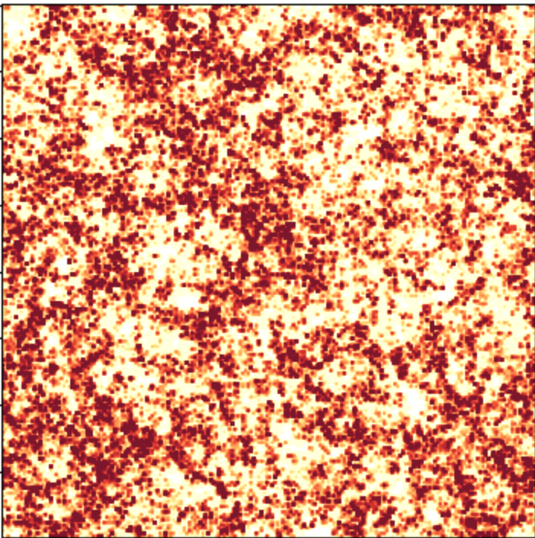
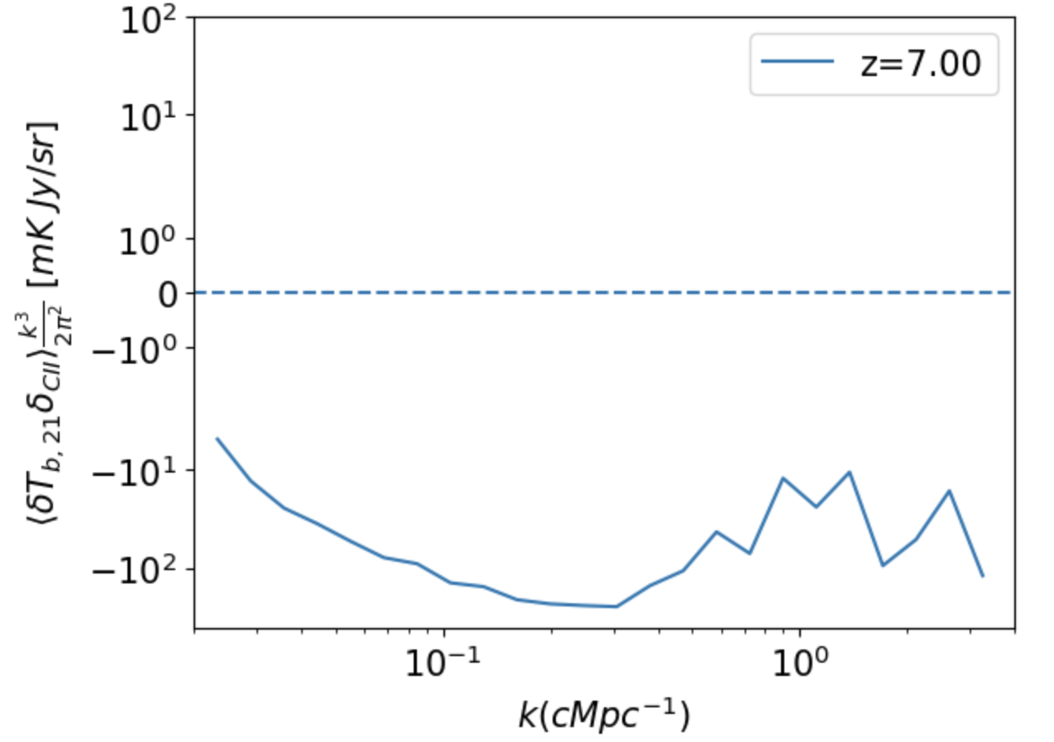
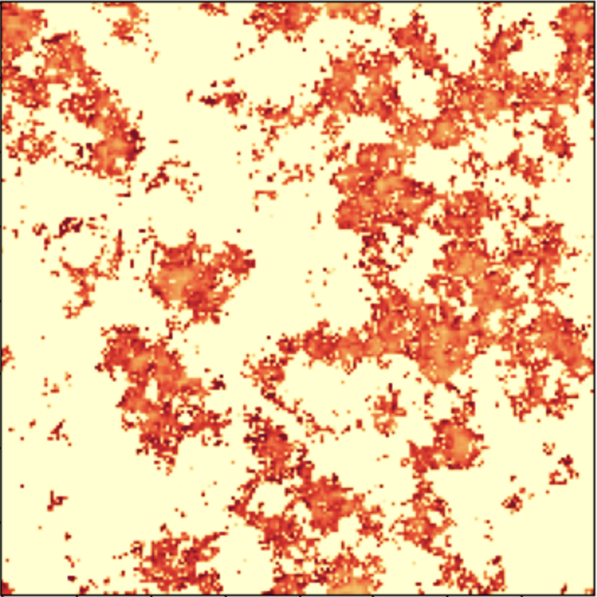
The Intrinsic Cross-correlation
During EoR
Notes:
Template e guide lines

Slide 29
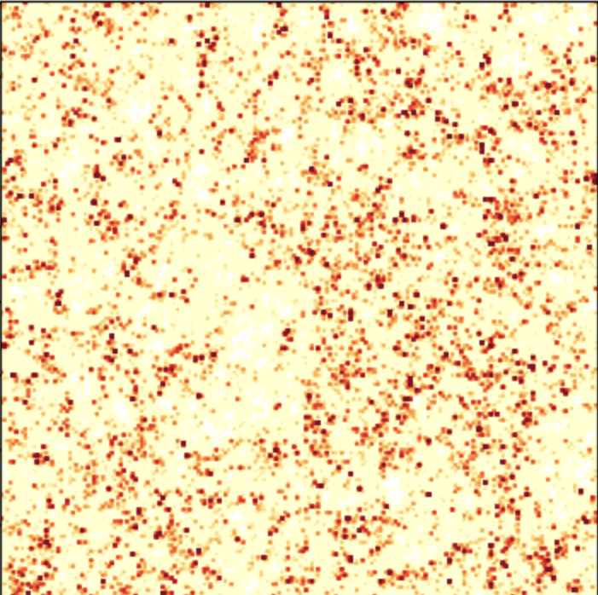
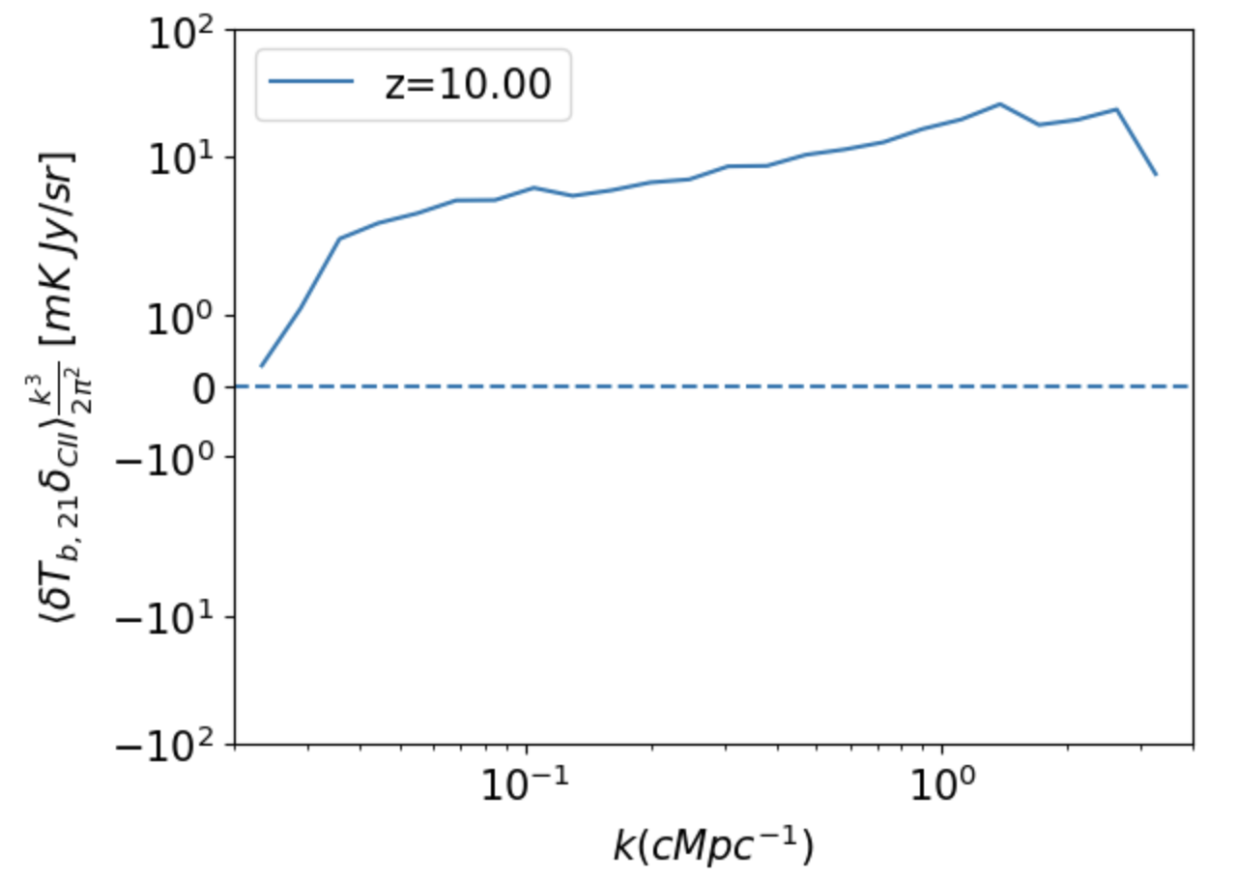
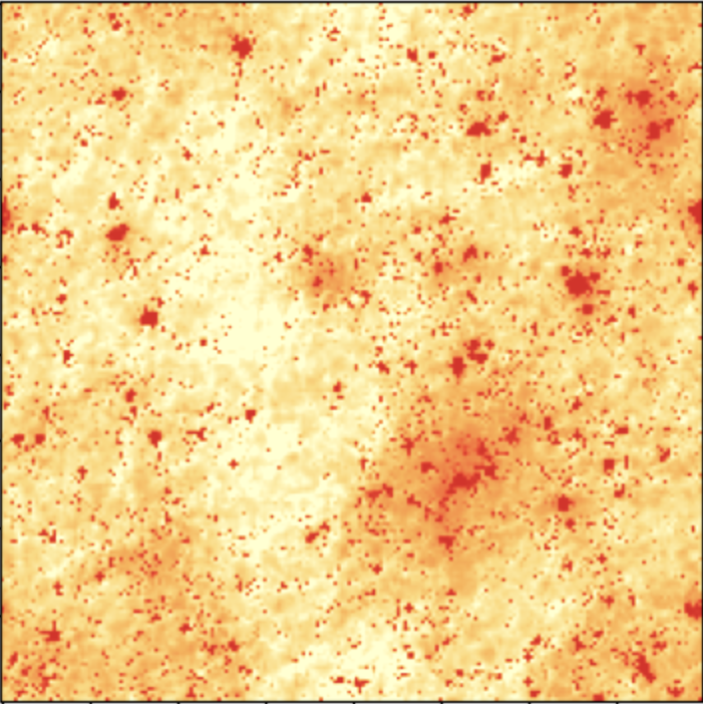
The Intrinsic Cross-correlation
During X-ray heating
Notes:
Template e guide lines

Slide 30
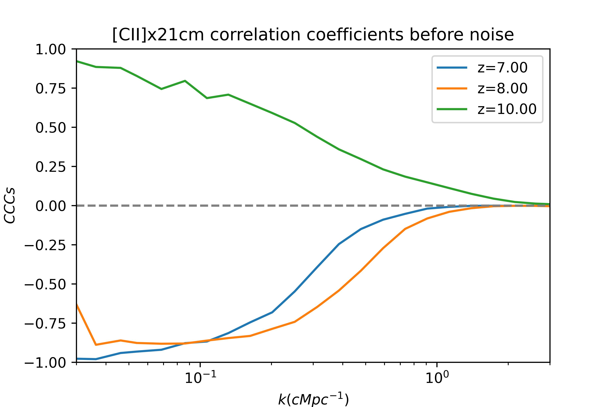
The Intrinsic Cross-correlation
[CII]-21cm correlation coefficients
Notes:
Template e guide lines

Slide 31
Mock Observation
Can we detect this anti-correlation in real observation?
By Copyright for the animated character is held by Adult Swim.
Notes:
Template e guide lines

Slide 32
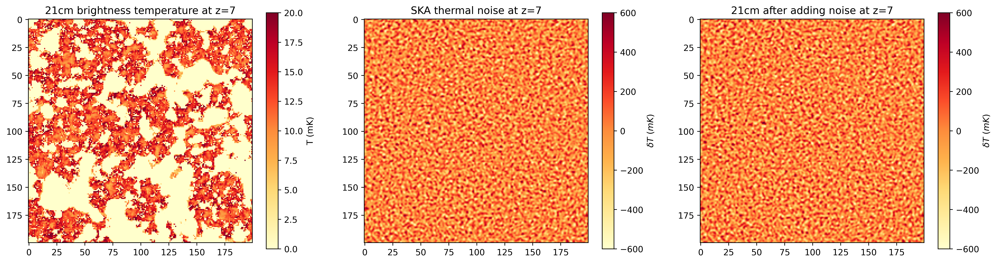
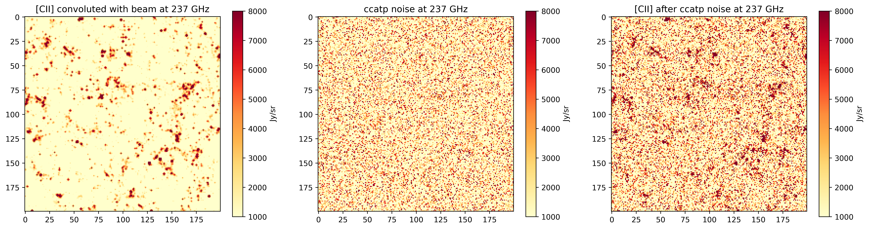
Observational Fields
Add instrumental effects
By the way, our human visual system does do an approximate 2D Fourier transform to analyze what we see.
[CII]
21cm
By Copyright for the animated character is held by Adult Swim.
Notes:
Template e guide lines

Slide 33
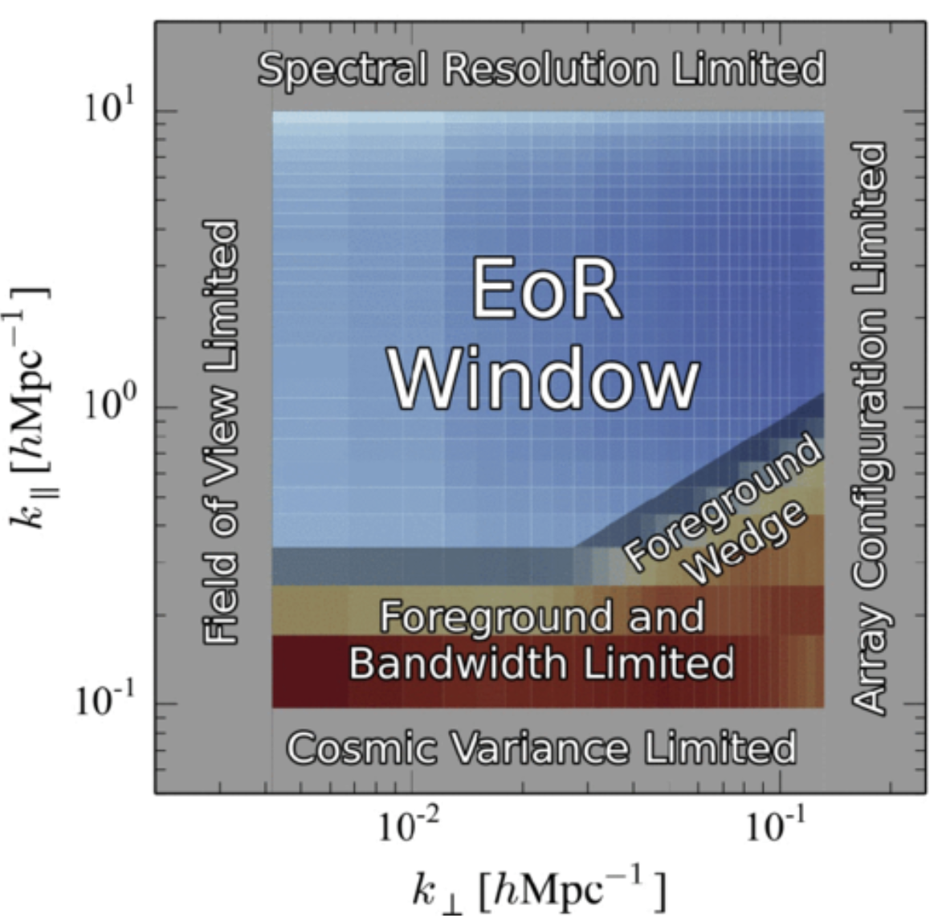
Survey Strategy Limitation
(A. Liu, et al. 2014)
Notes:
Template e guide lines

Slide 34
Survey Strategy Limitation
(A. Liu, et al. 2014)
Notes:
Template e guide lines

Slide 35
Survey Strategy Limitation
(A. Liu, et al. 2014)
Notes:
Template e guide lines

Slide 36
Survey Strategy Limitation
(A. Liu, et al. 2014)
Notes:
Template e guide lines

Slide 37
Survey Strategy Limitation
(A. Liu, et al. 2014)
Notes:
Template e guide lines

Slide 38
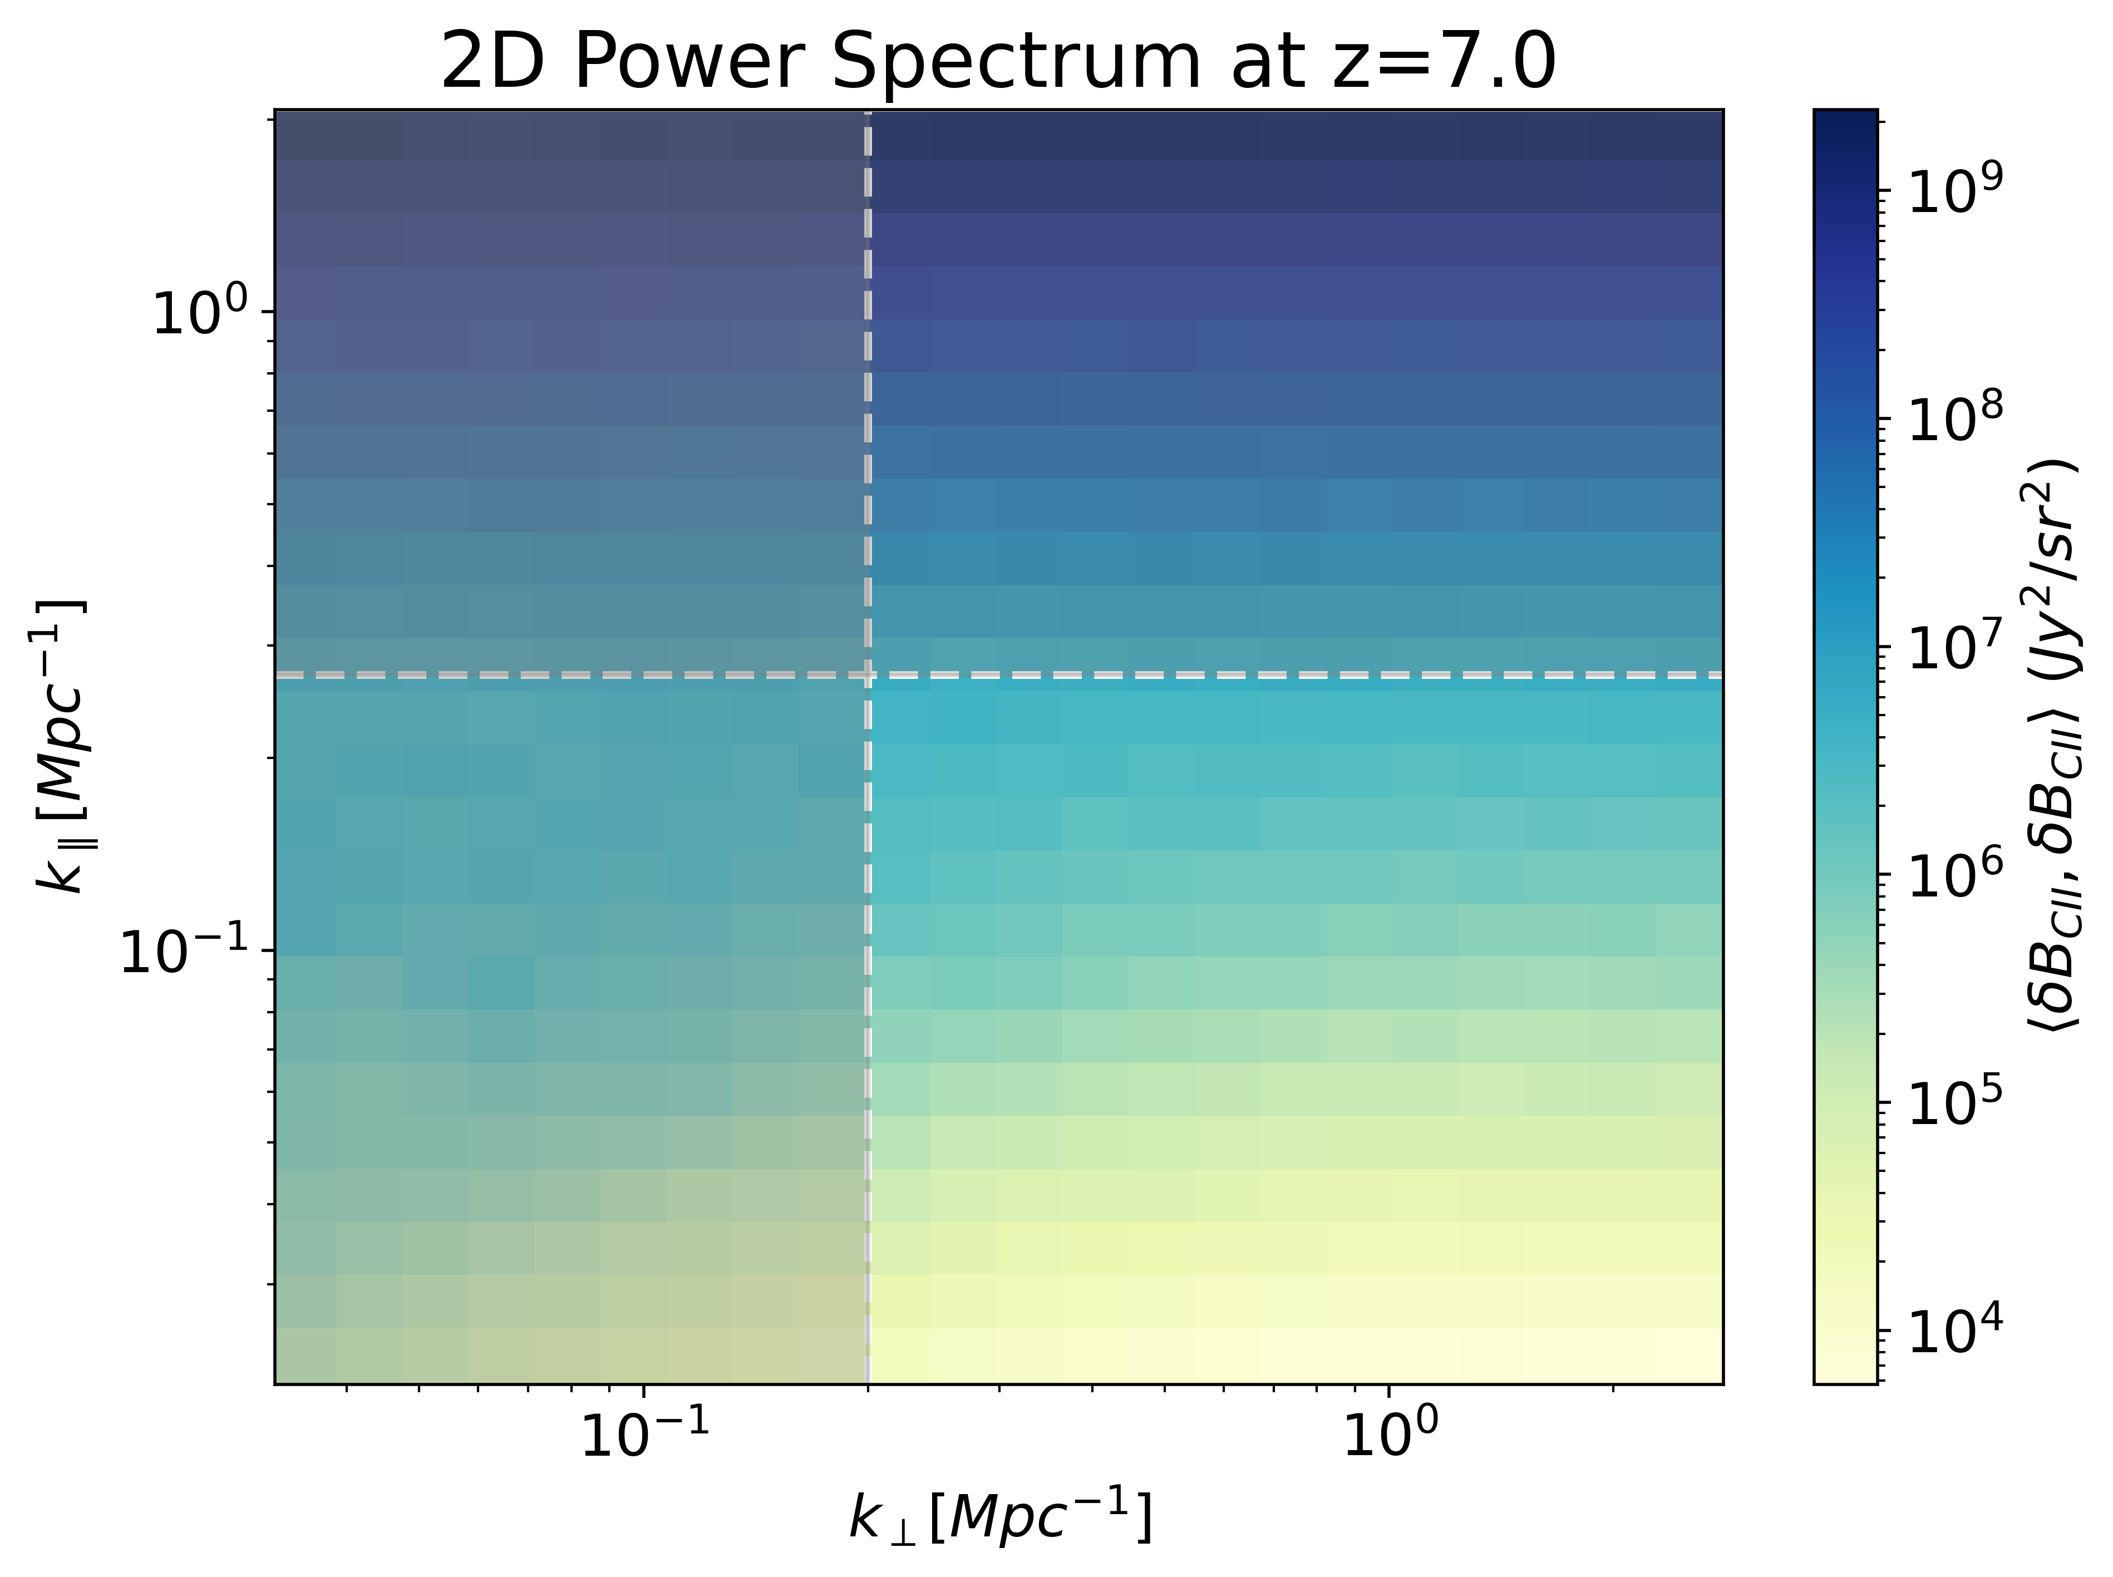
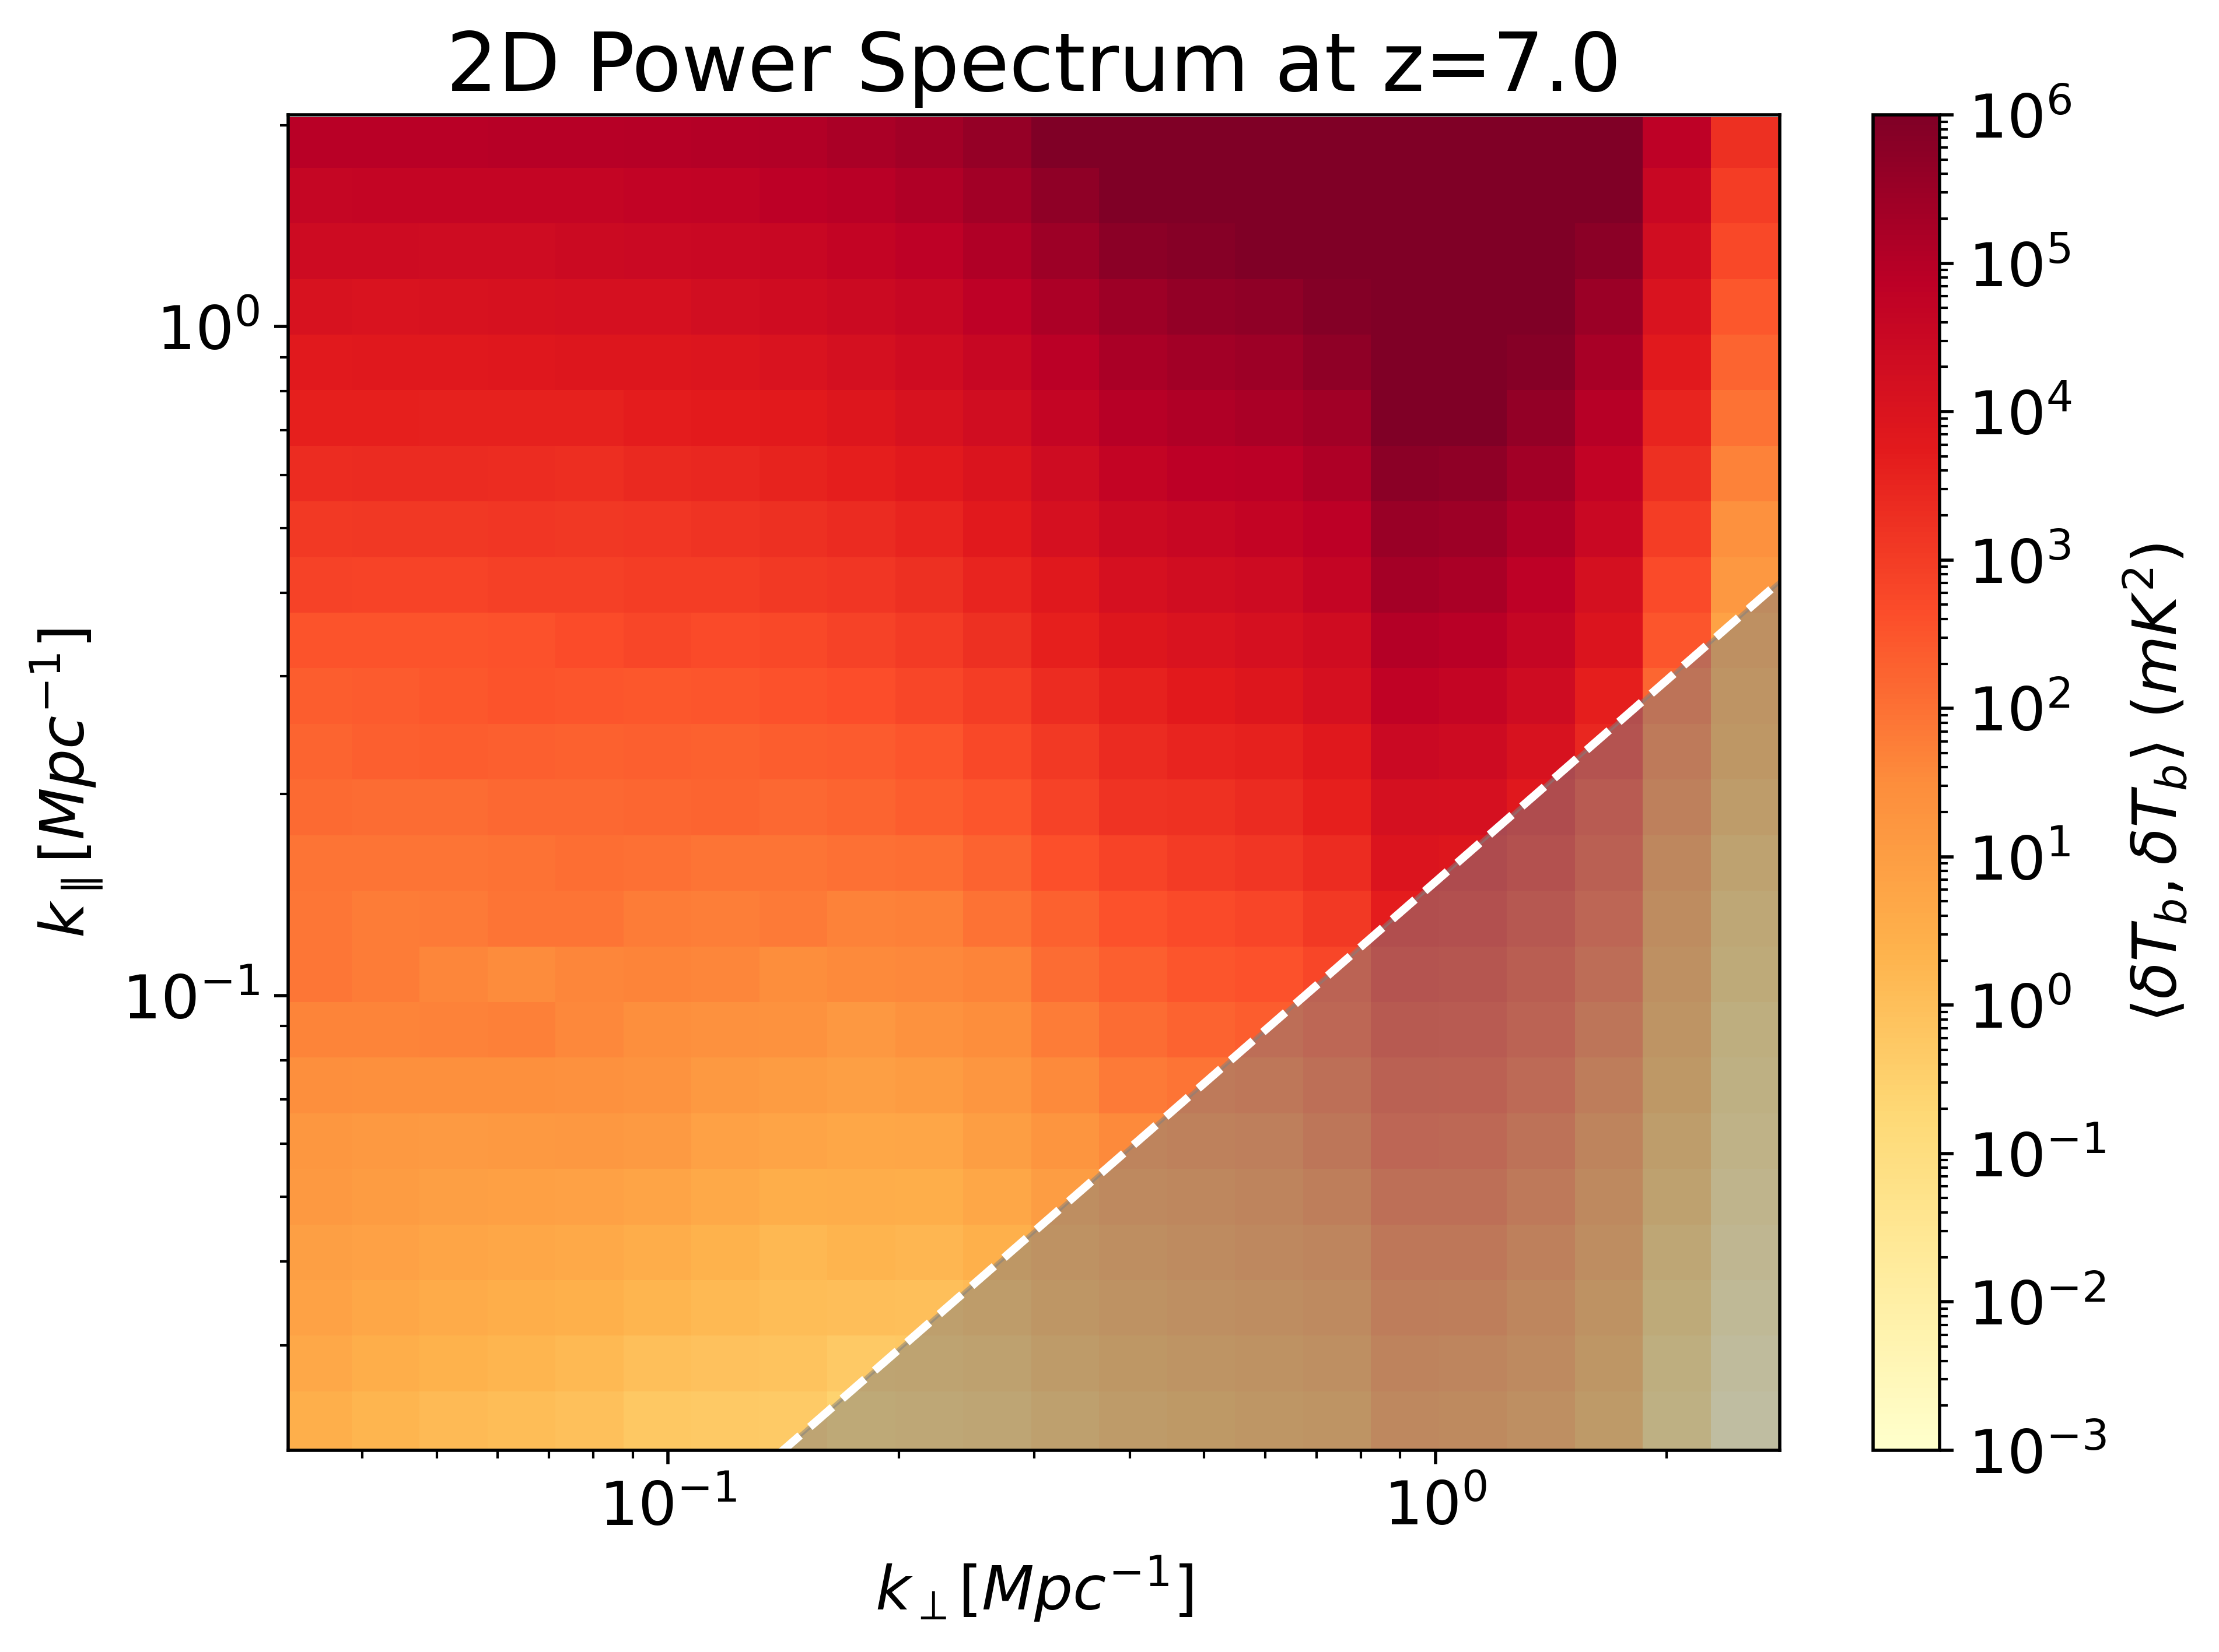
Survey Strategy Limitation
EoR Window
Frequency Resolution
LIM
Window
FoV Limit
Foreground Wedge
[CII]
21cm
Notes:
Template e guide lines

Slide 39
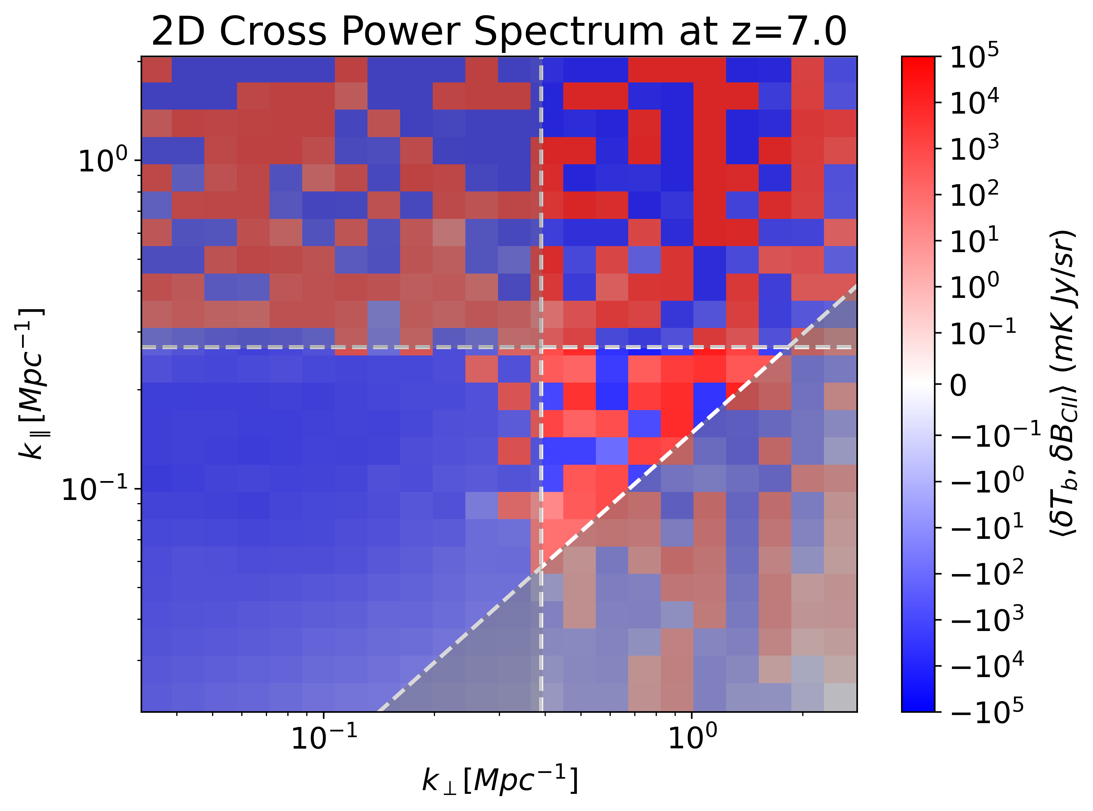
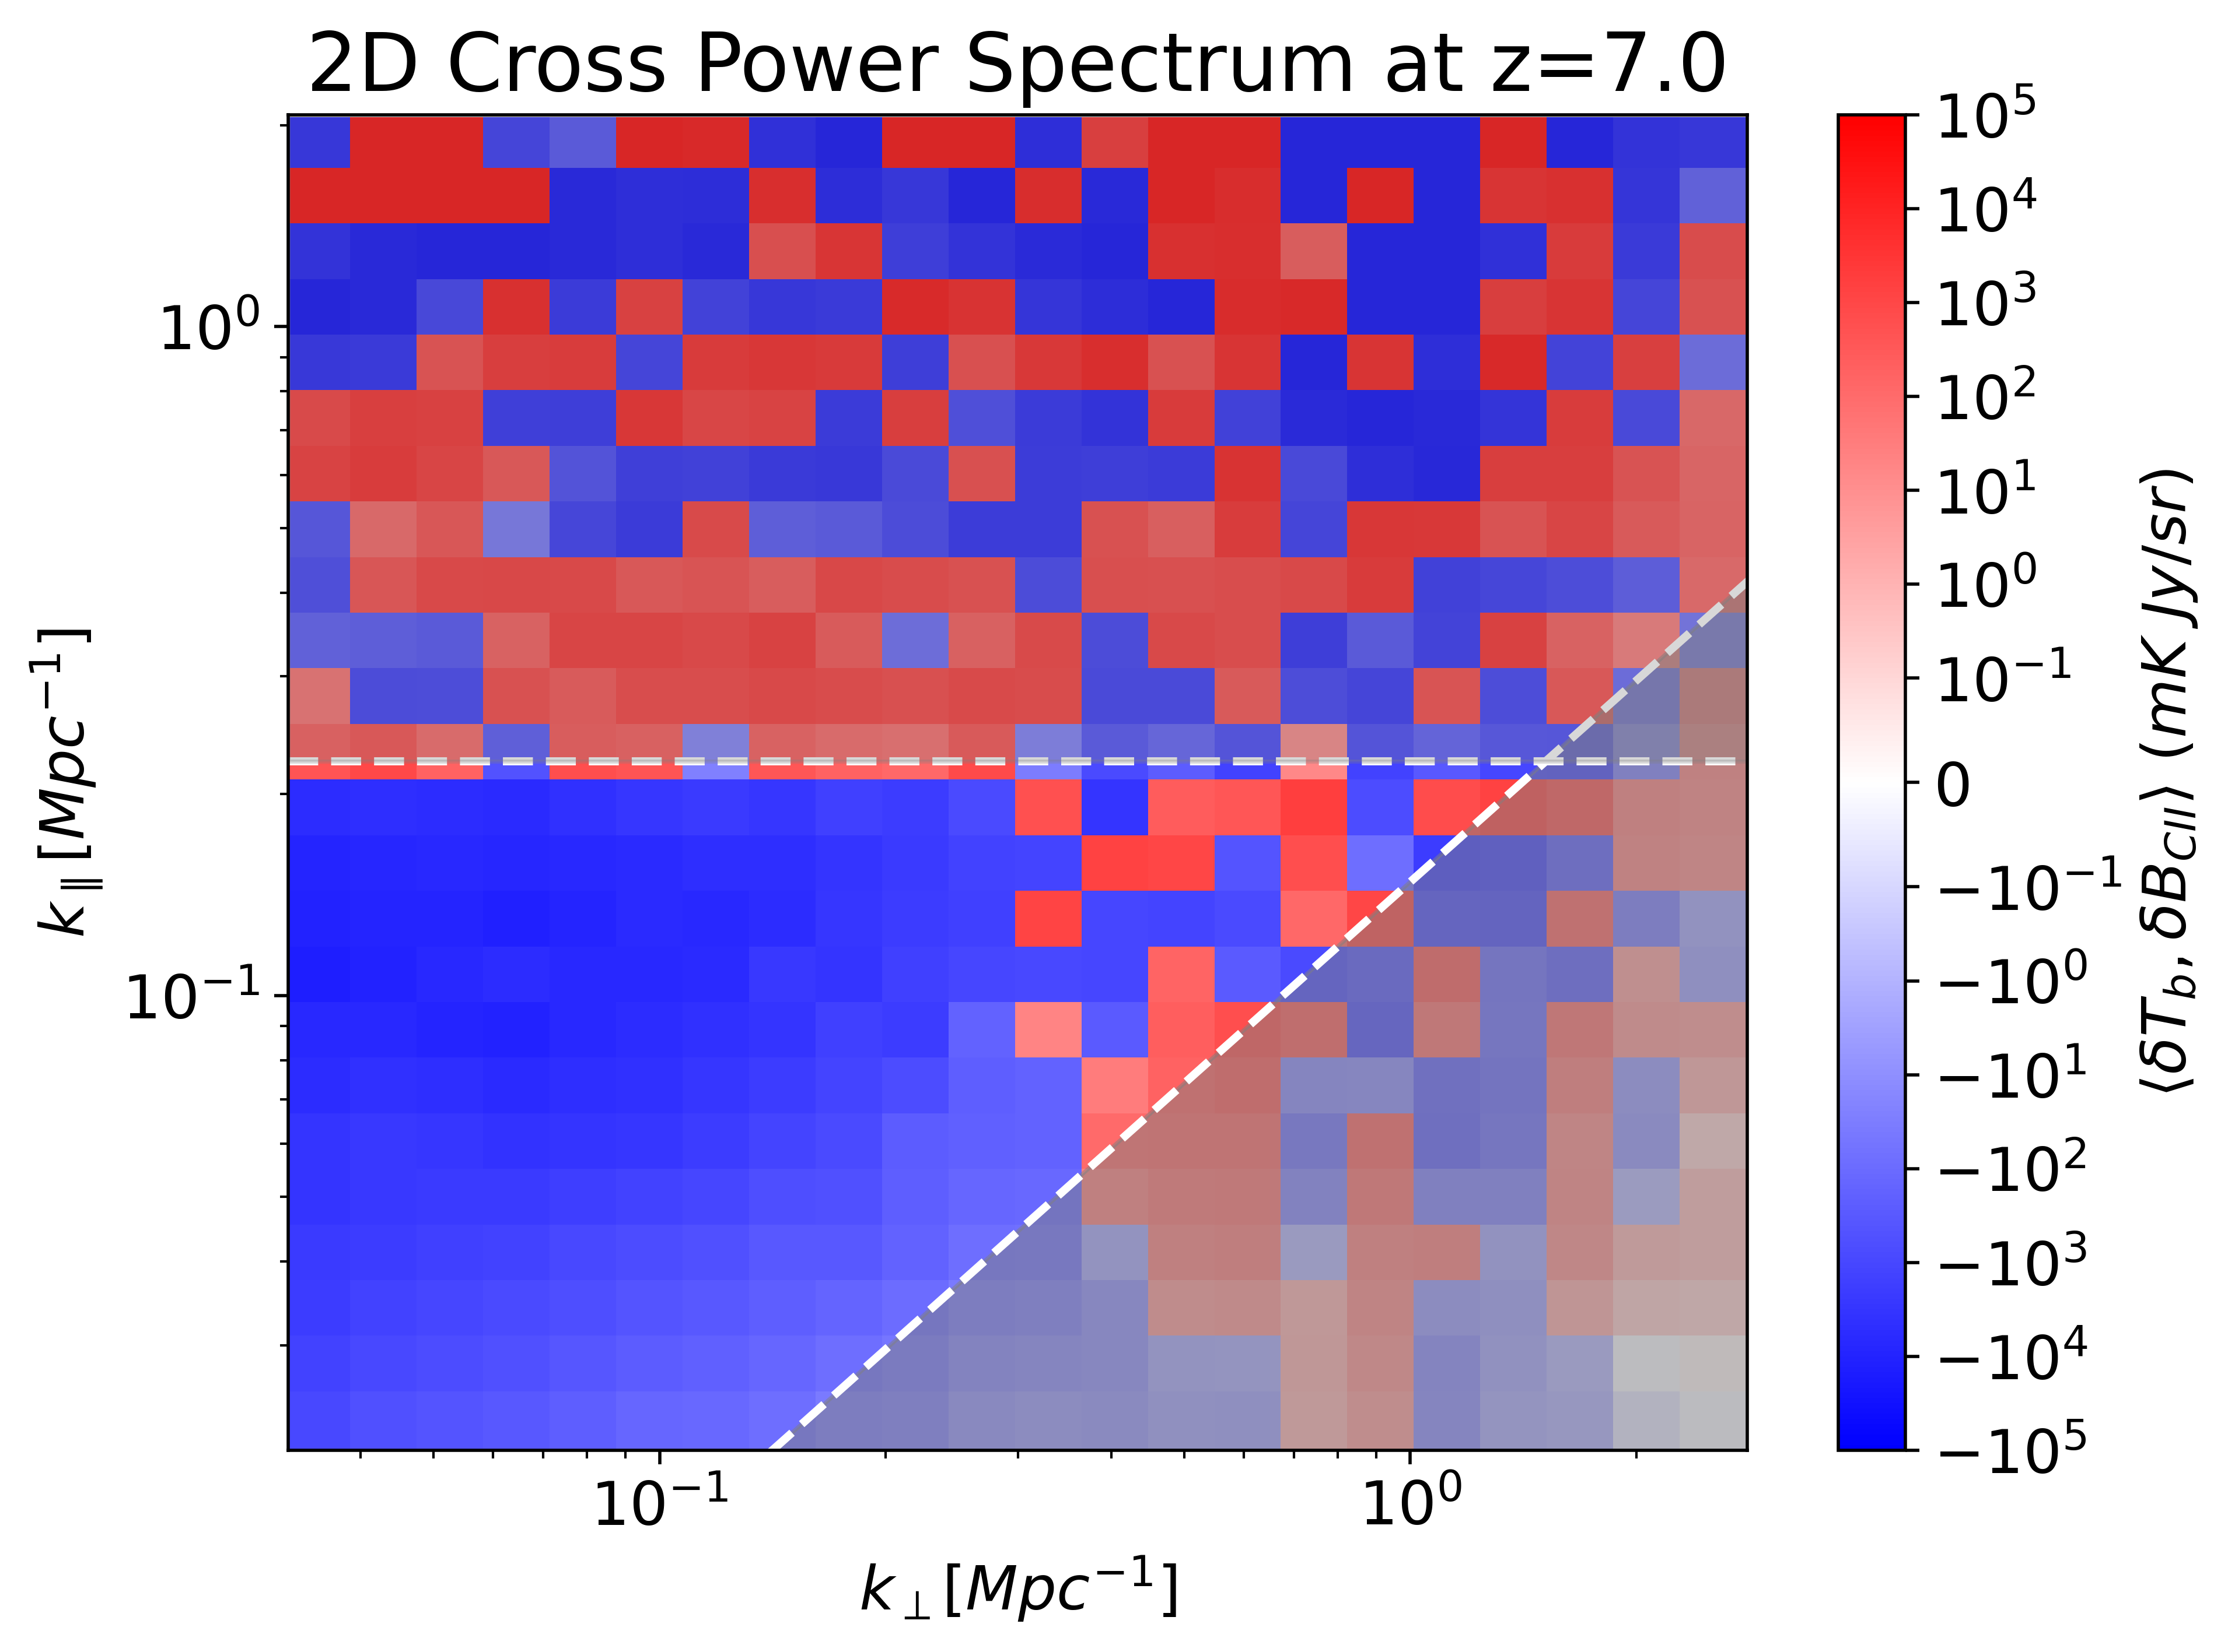
Cross-Power Spectrum
SKA-LOW AA* & TIME
SKA-LOW AA* & CCATp/FYST
TIME Frequency Resolution
CCATp Frequency Resolution
Foreground Wedge
TIME FoV Limit
Foreground Wedge
TIME: R = 120, Survey Area = 0.01 deg²
CCATp: R = 100, Survey Area = 4 deg²
Notes:
Template e guide lines

Slide 40
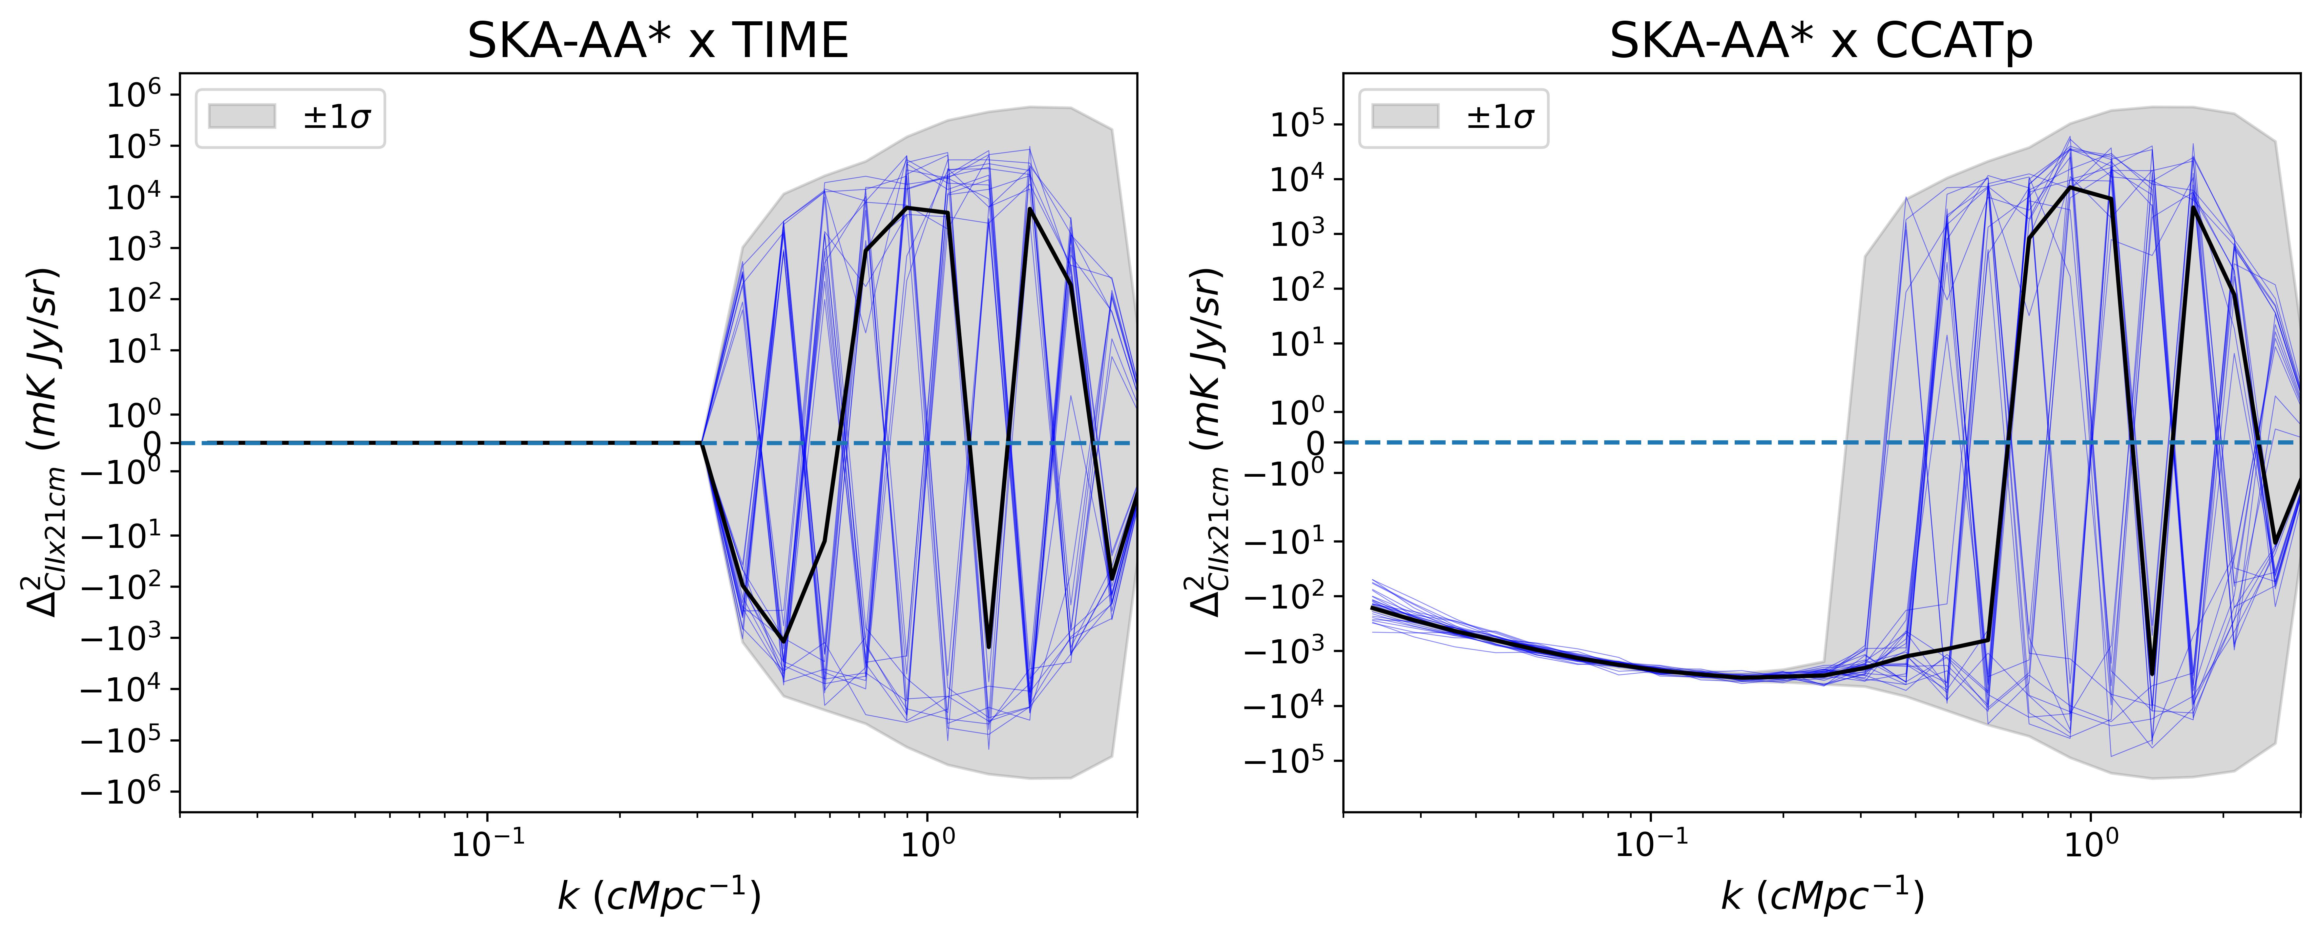
20 Cross-Power Spectrums
Notes:
Template e guide lines

Slide 41
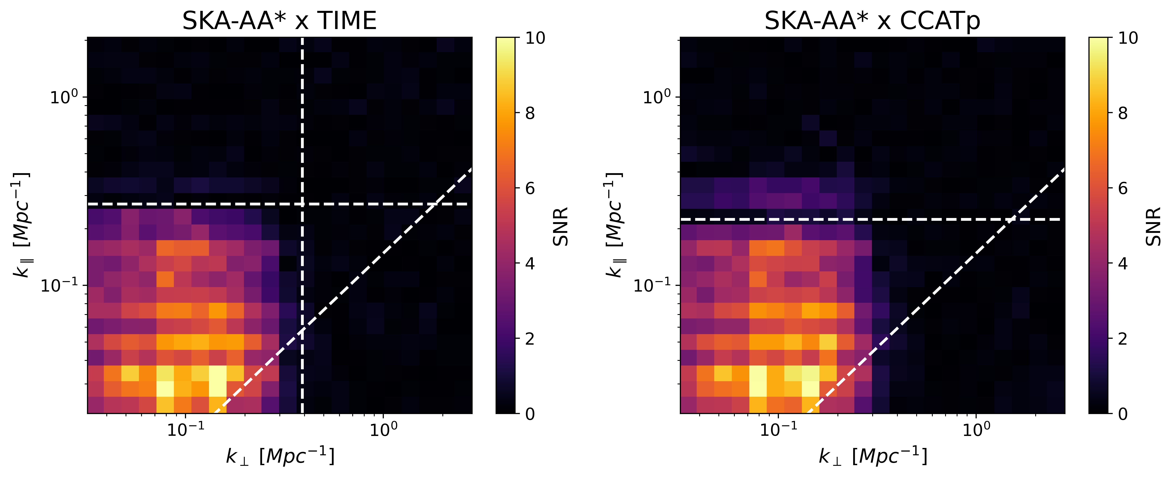
Signal-to-noise Ratio
Notes:
Template e guide lines

Slide 42
Survey Strategy Optimization
How should we adjust the observational strategy to maximize the SNR?
By Copyright for the animated character is held by Adult Swim.
Notes:
Template e guide lines

Slide 43
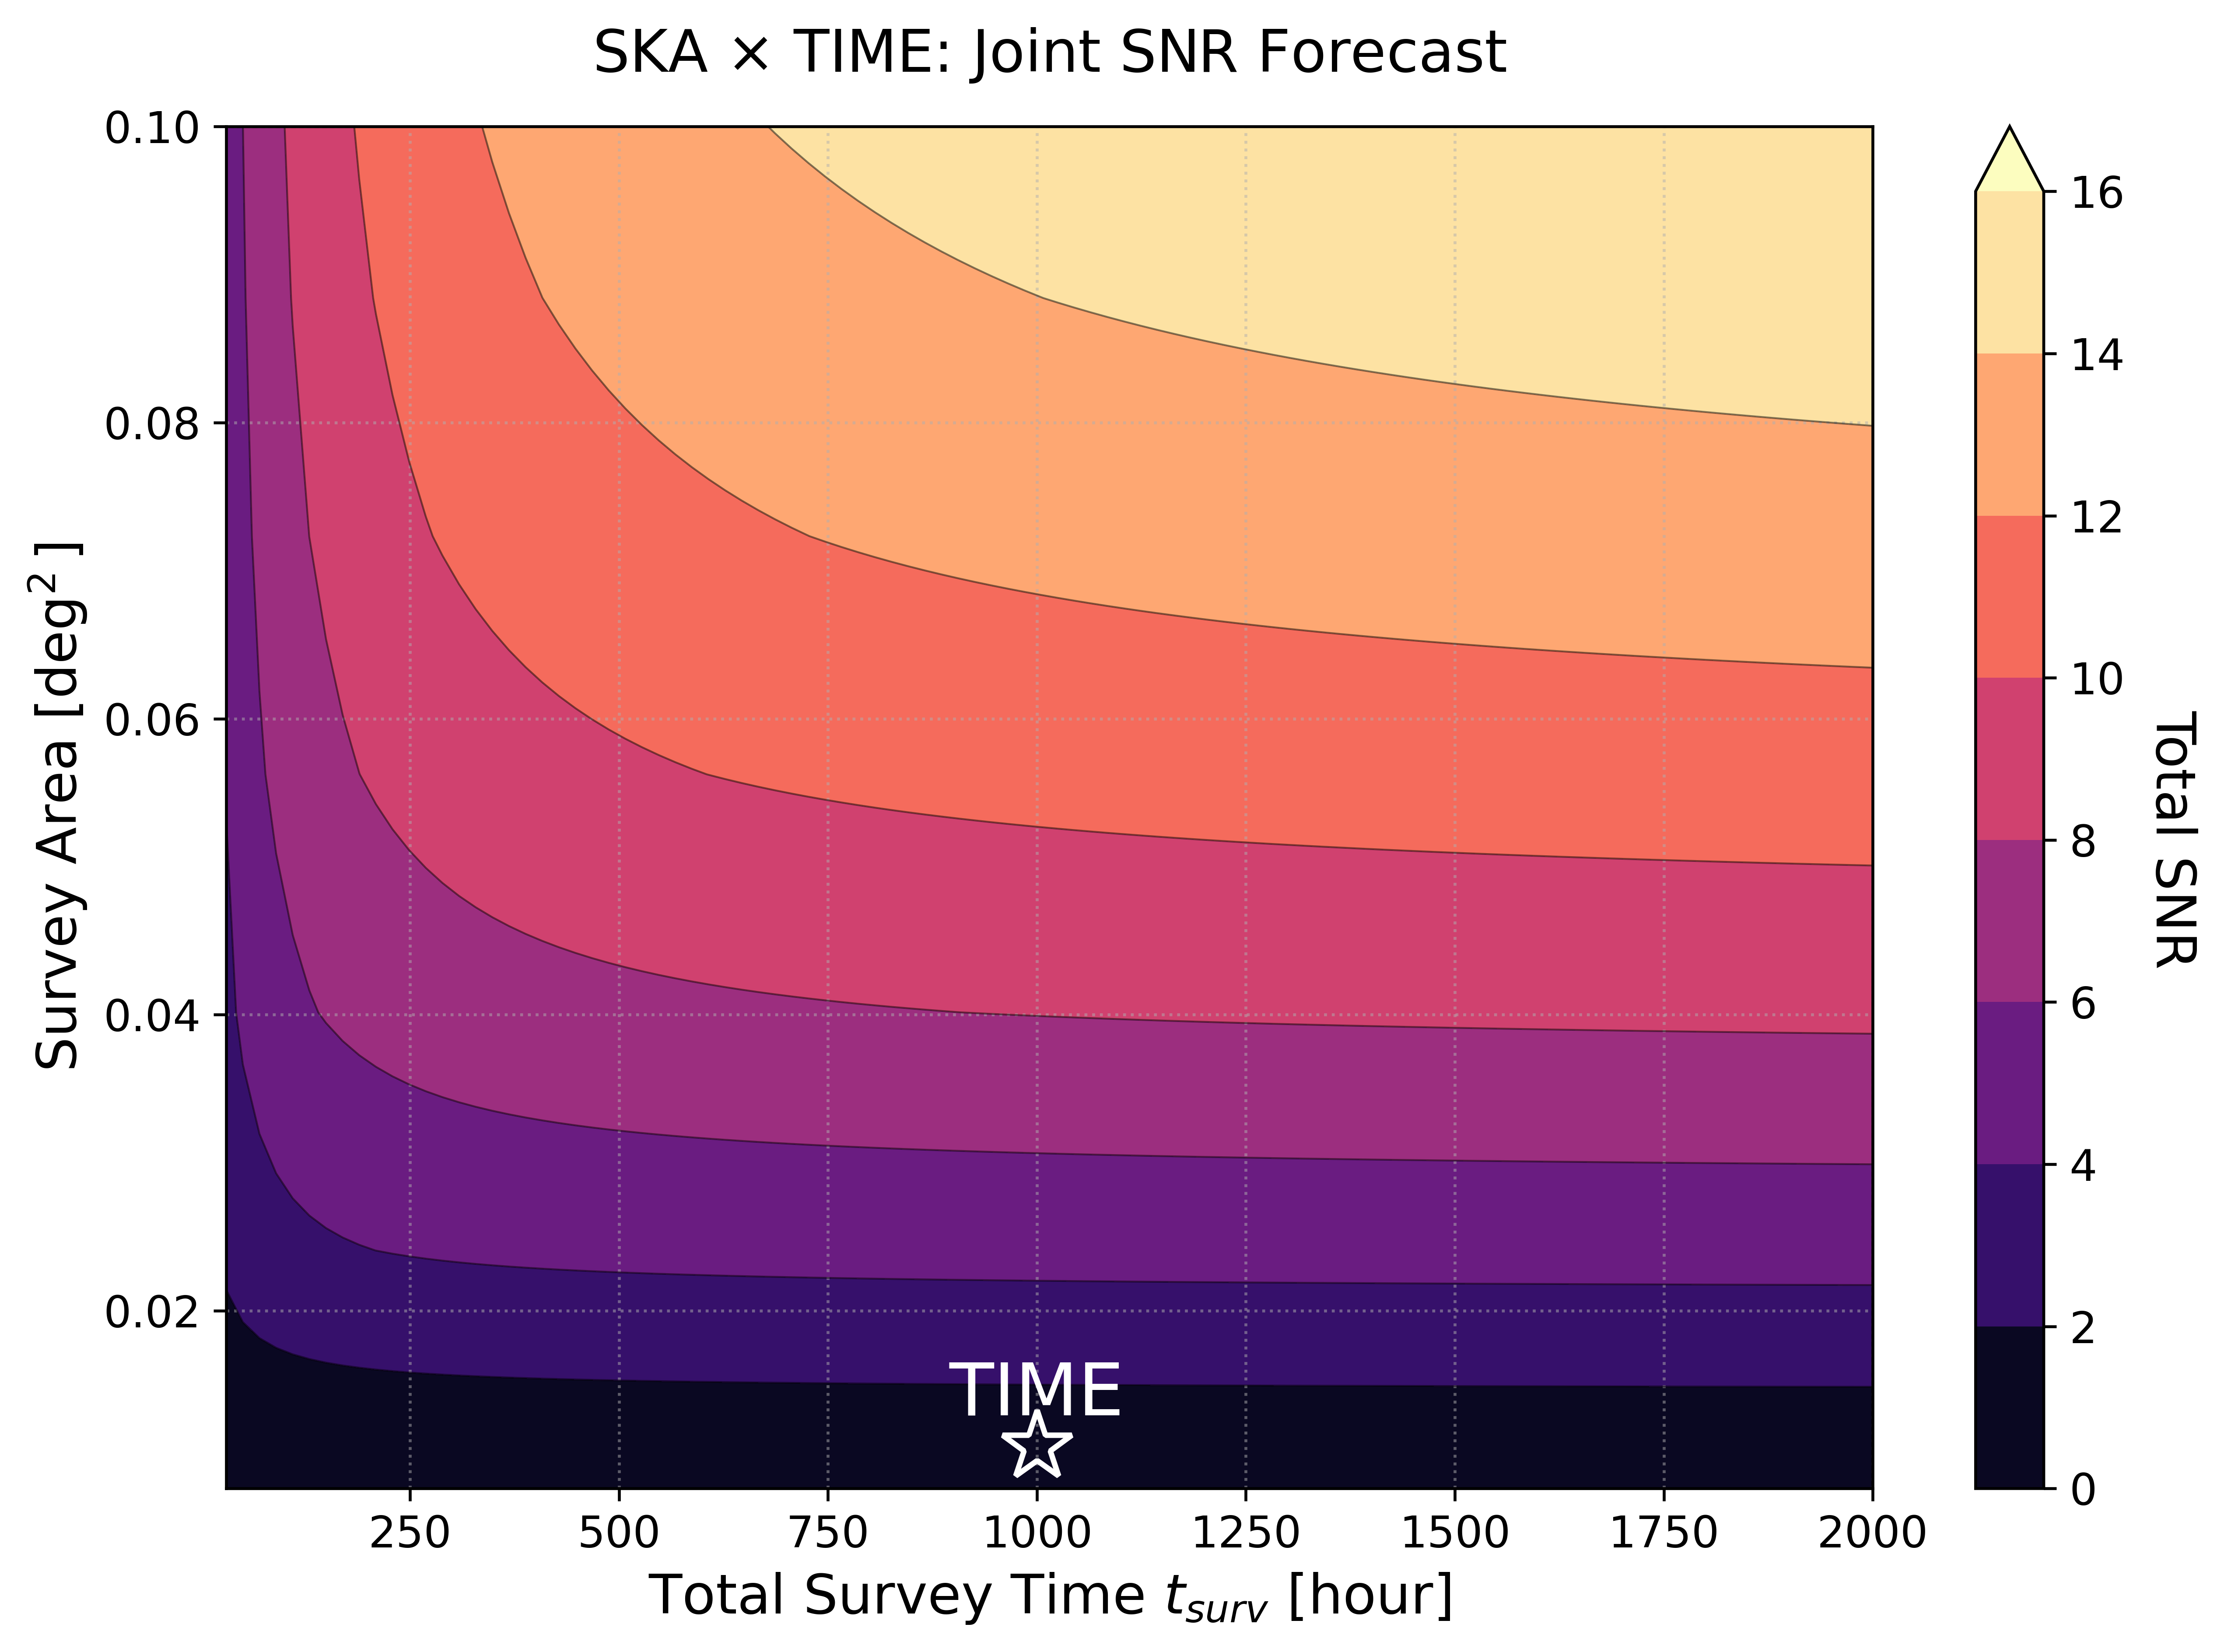
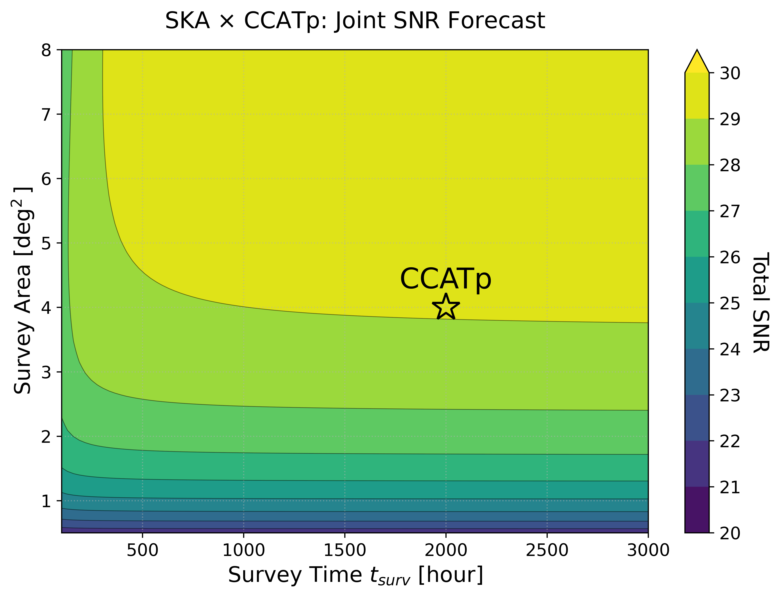
Survey Strategy Optimization
Notes:
Template e guide lines

Slide 44
Conclusions
We develop a semi-empirical pipeline for simultaneously forward modeling 21cm, [CII] LIMs as well as the instrumental noise from different surveys.
Our simulation successfully captures the sign change in the cross-correlation between the 21cm and [CII] fields across different stages of the EoH and EoR.
We demonstrate that a high signal-to-noise ratio detection of the 21cm-[CII] cross-correlation is possible by combining SKA-Low AA* with the future LIM survey CCATp/FYST.
A larger survey area will be critical for future line-intensity mapping experiments aiming to achieve this joint detection.
Notes:
Template e guide lines

Slide 45

Thanks！
By Copyright for the animated character is held by Adult Swim.
Notes:
Template e guide lines

Slide 46
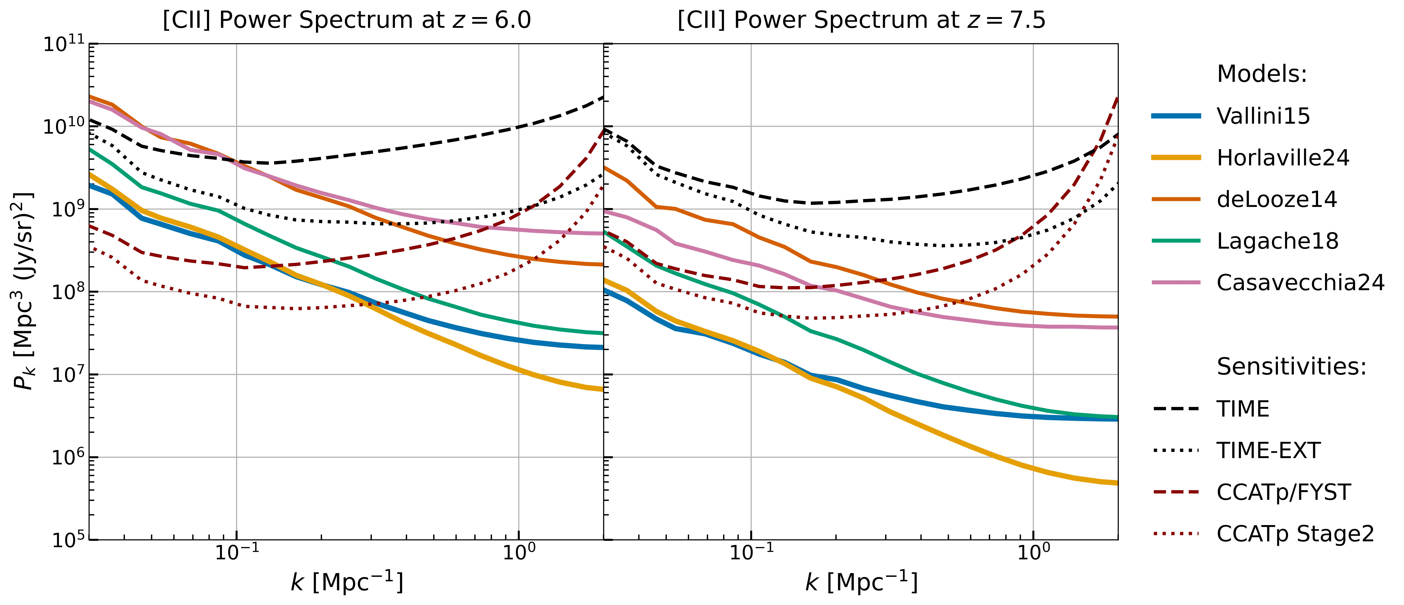
Detectability of [CII] Signal
[CII] auto power spectrum vs. noise power spectrum
Notes:
Template e guide lines

Slide 47
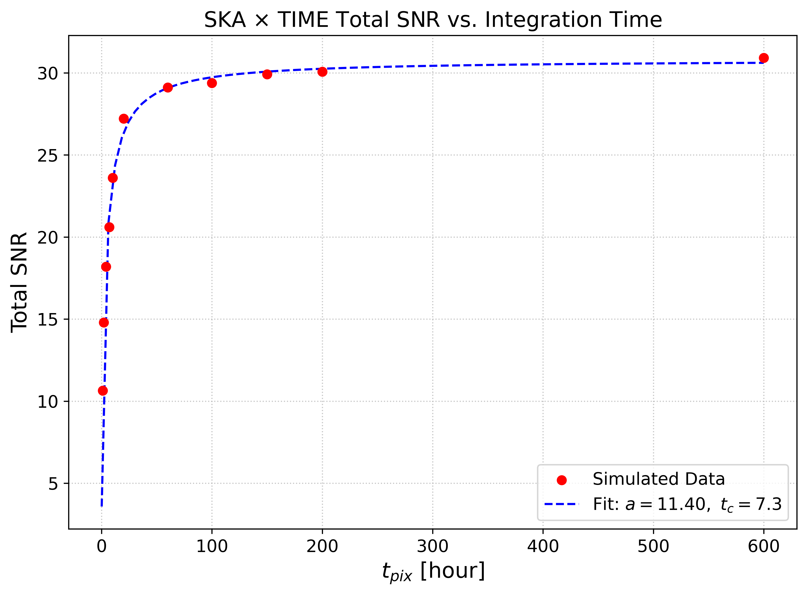
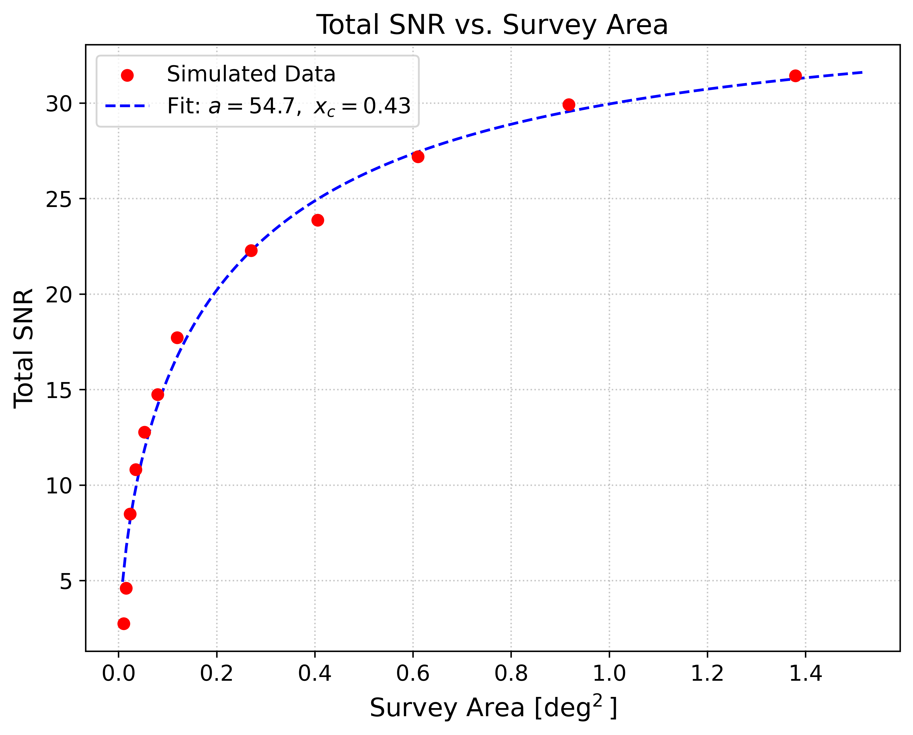
Survey Strategy Optimization
Notes:
Template e guide lines

