Slide 1


Tracing the cosmic origins
Can we reconstruct the primordial density field from EoR maps?
Anchal Saxena
In collaboration with: P. Daniel Meerburg (University of Groningen), Guochao Sun (Northwestern University), Tzu-Ching Chang (JPL, Caltech) and Lluís Mas-Ribas (University of California)
Cosmology in the Alps 2026
17.03.2026

Slide 2
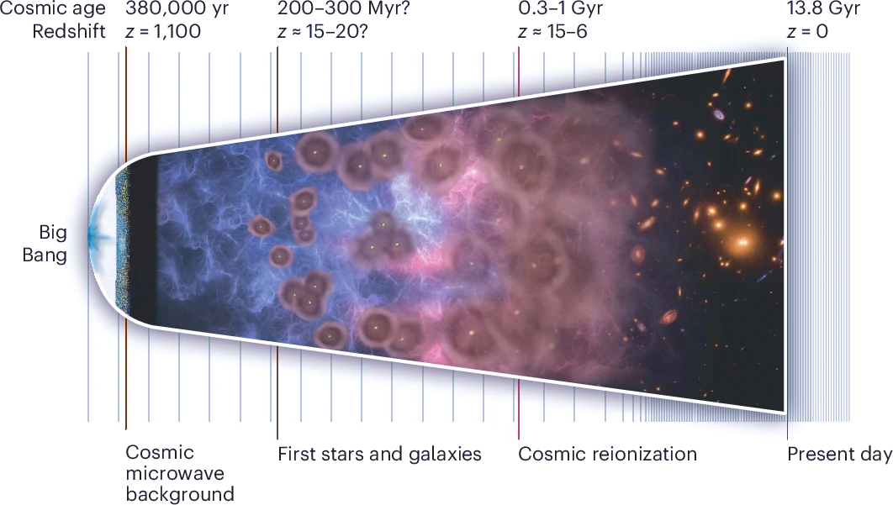
Why go back to the beginning?
1

Slide 3

Why go back to the beginning?
21cm
Non-linear structure formation Astrophysical processes
Coupled Fourier modes
Information is distributed into higher-order statistics
Recover lost information?
CO(1-0)
1

Slide 4
Why these two tracers?
Two imperfect witnesses are better than one
21-cm signal traces neutral, low-density regions.
2

Slide 5
Why these two tracers?
Two imperfect witnesses are better than one
21-cm signal traces neutral, low-density regions.
CO(1-0) traces overdense, star-forming regions.
2

Slide 6
Why these two tracers?
Two imperfect witnesses are better than one
21-cm signal traces neutral, low-density regions.
CO(1-0) traces overdense, star-forming regions.
During reionization, they are complementary and anti-correlated.
2

Slide 7
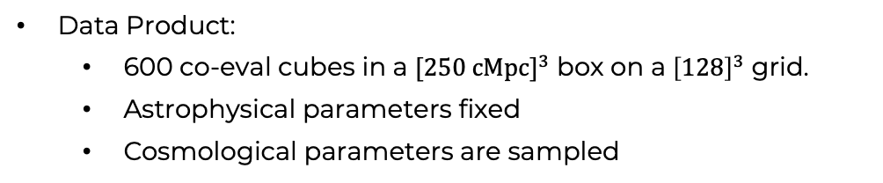
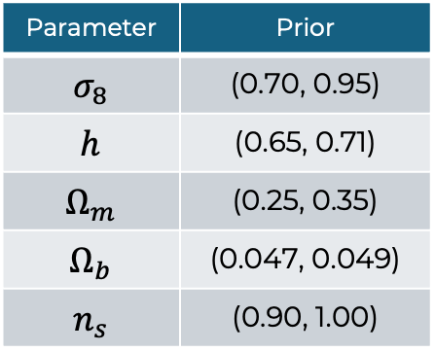
Forward model
Forward Model
ML?
Parameter | Prior
$$σ_{8}$$ | (0.70, 0.95)
$$h$$ | (0.65, 0.71)
$$Ω_{m}$$ | (0.25, 0.35)
$$Ω_{b}$$ | (0.047, 0.049)
$$n_{s}$$ | (0.90, 1.00)
Mas-Ribas et al. (2022), Sun et al. (2025)
Simulate 21-cm and CO(1-0) at $z∼8$using LIMFAST
Data Product:
600 co-eval cubes in a ${[250 cMpc]}^{3}$ box on a ${\left[128\right]}^{3}$ grid.
Astrophysical parameters fixed
Cosmological parameters are sampled
3

Slide 8
THE ML engine: U-Net
Gagnon-Hartman et al 2021, Kennedy et al 2024, Biano et al. 2024, Shi et al. 2024, Flöss et al. 2024, Gao et al. 2025
4

Slide 9
Noiseless analysis: Reconstruction (Sample #1)
5

Slide 10
Noiseless analysis: Reconstruction (Sample #1)
5

Slide 11
Noiseless analysis: Reconstruction (Sample #1)
5

Slide 12
Noiseless analysis: Reconstruction (Sample #1)
5

Slide 13
Noiseless analysis: Reconstruction (Sample #1)
Post-reconstruction
Pre-reconstruction
5

Slide 14
Noiseless analysis: Reconstruction (Sample #2)
6

Slide 15
Noiseless Analysis: Dependence on ionization state
Applied trained U-Net to 100 independent test samples
Thanks to the fast inference time
7

Slide 16
Noisy analysis
Instrumental Noise
Finite angular resolution
Beam smoothing
SKA1-Low COMAP-ERA
8

Slide 17
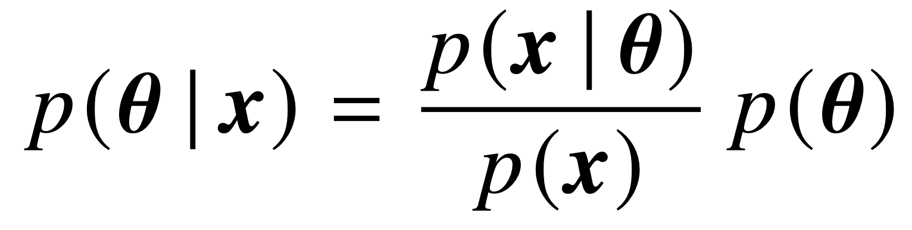
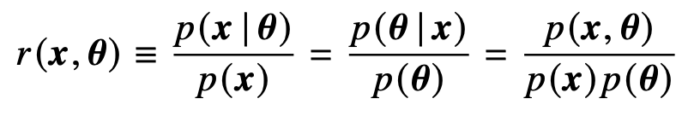

Does it matter for cosmology?
Bayes theorem:
Likelihood
Posterior
Prior
Evidence
Classical inference $→$ Full joint posterior $→$ Computationally expensive!
Marginal Neural Ratio Estimation
swyft (Miller et al. 2021)
Simulation Based Inference
9

Slide 18
Cosmological parameter constraints
Noiseless Summaries
Noisy Summaries
10

Slide 19
Information gain: an ensemble of observations
Noiseless Summaries
Noisy Summaries
11

Slide 20
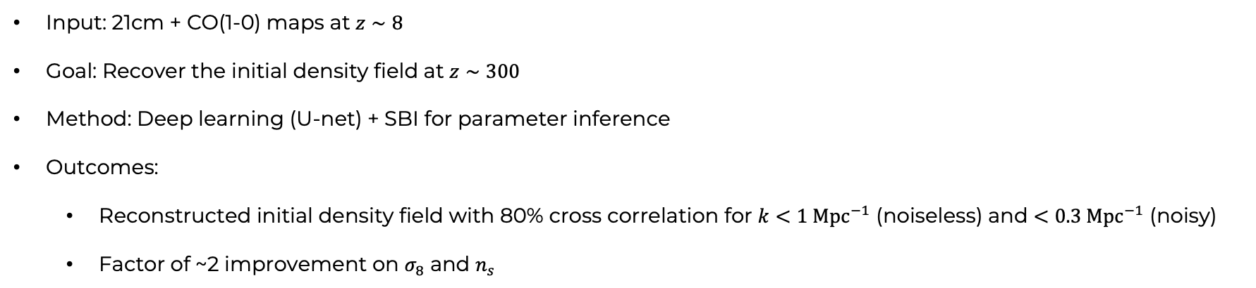
summary
Rewinding the universe with intensity mapping
Input: 21cm + CO(1-0) maps at $z∼8$
Goal: Recover the initial density field at $z∼300$
Method: Deep learning (U-net) + SBI for parameter inference
Outcomes:
Reconstructed initial density field with 80% cross correlation for $k<1 Mpc^{−1}$ (noiseless) and $<0.3 Mpc^{−1}$ (noisy)
Factor of ~2 improvement on $σ_{8}$ and $n_{s}$
FUTURE OUTLOOK
Vary astrophysical parameters
From single to multiple redshifts
More realistic observational effects
12

Slide 21
BACKUP

Slide 22
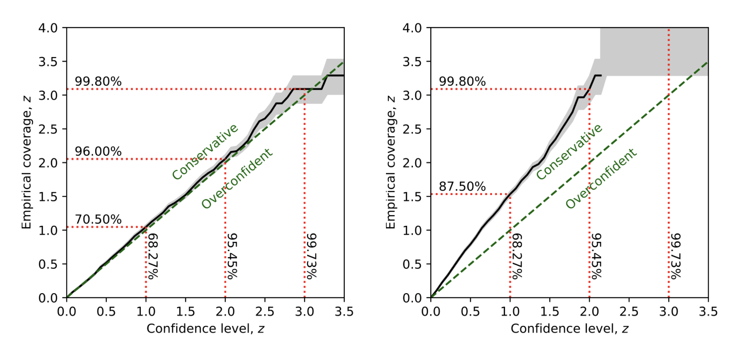

Slide 23
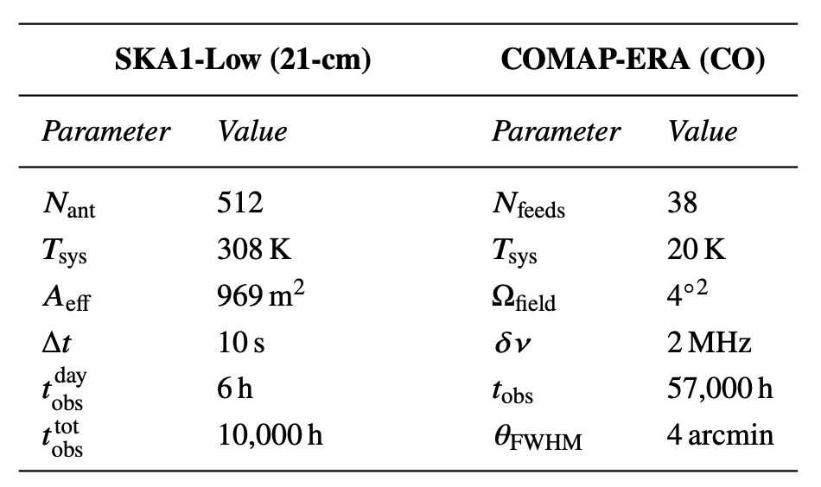
14

Slide 24
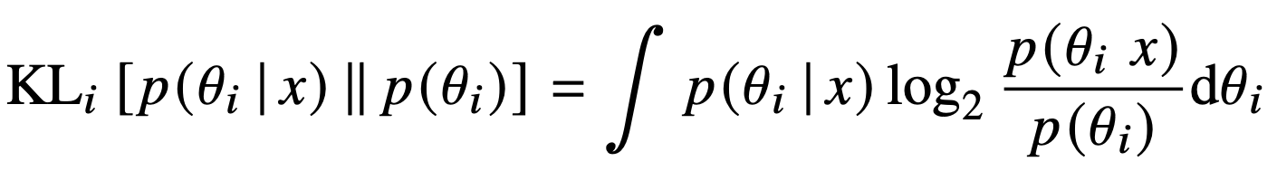
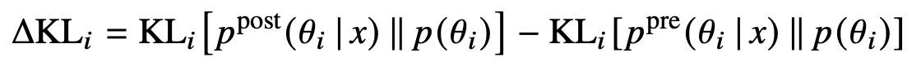
Noiseless Summaries

Slide 25
Noisy Summaries
13

