Slide 1
RADIO RECOMBINATION LINE CONTAMINATION IN POST-REIONIZATION HI INTENSITY MAPPING
Pip Samuel Petersen (he/him)
Matt McQuinn & Yakov Faerman
University of Washington
Cosmology in the Alps – Les Diablerets

Slide 2
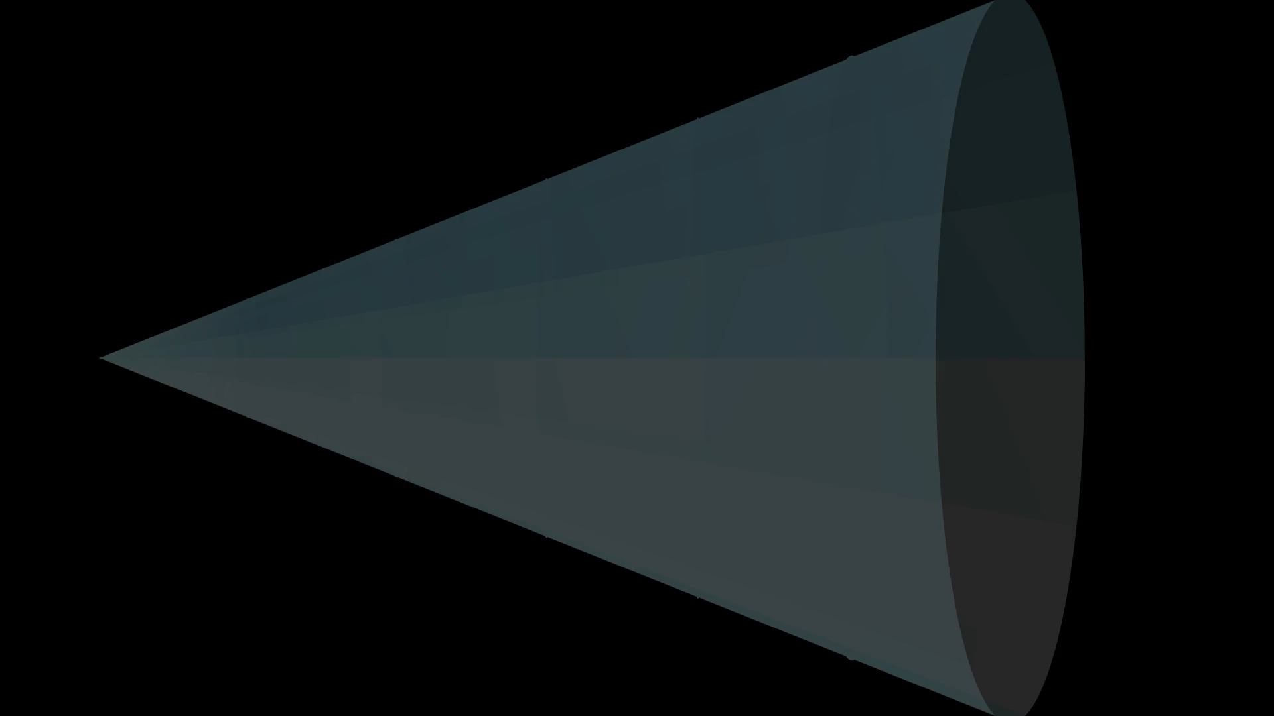
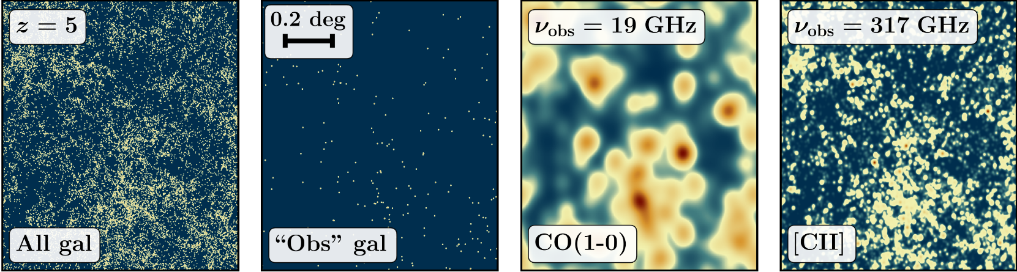
Intensity Mapping can sample fainter sources and deeper redshifts than traditional galaxy surveys
Bernal & Kovetz 22
Low resolution but more sources

Slide 3





21 cm experiments have unique science…
with shared goal of mapping neutral hydrogen well enough to measure baryon acoustic oscillations

Slide 4
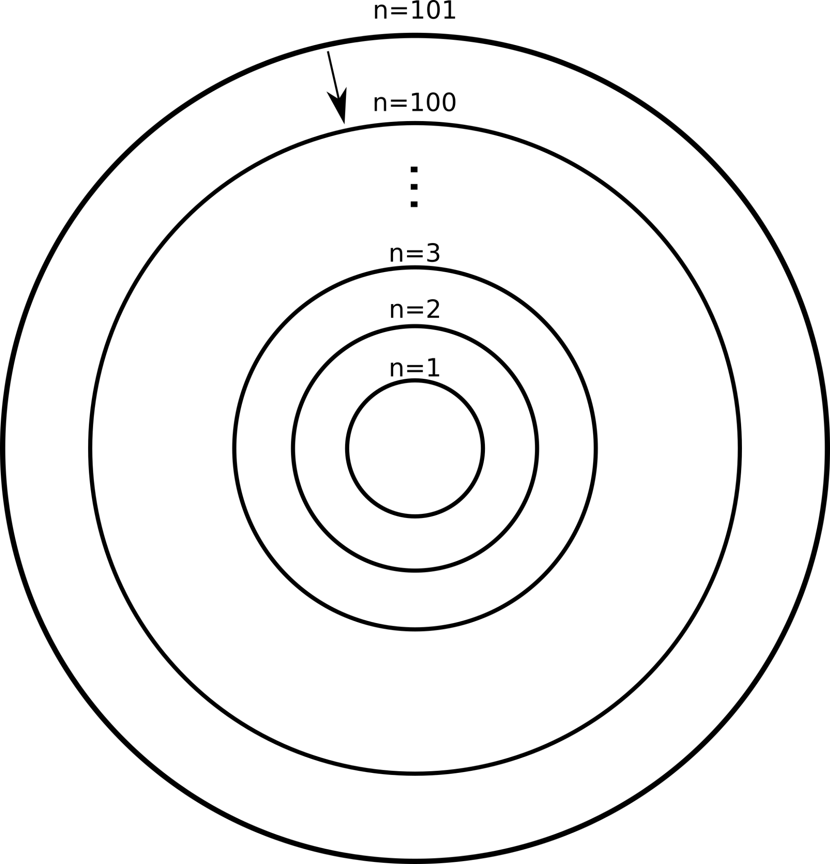

What are Radio Recombination Lines (RRL) and how are they produced?
RRL 𝜸 (~6.3 GHz)
Hydrogen Lines with very high quantum number (n > 50) and usually Δn = 1

Slide 5
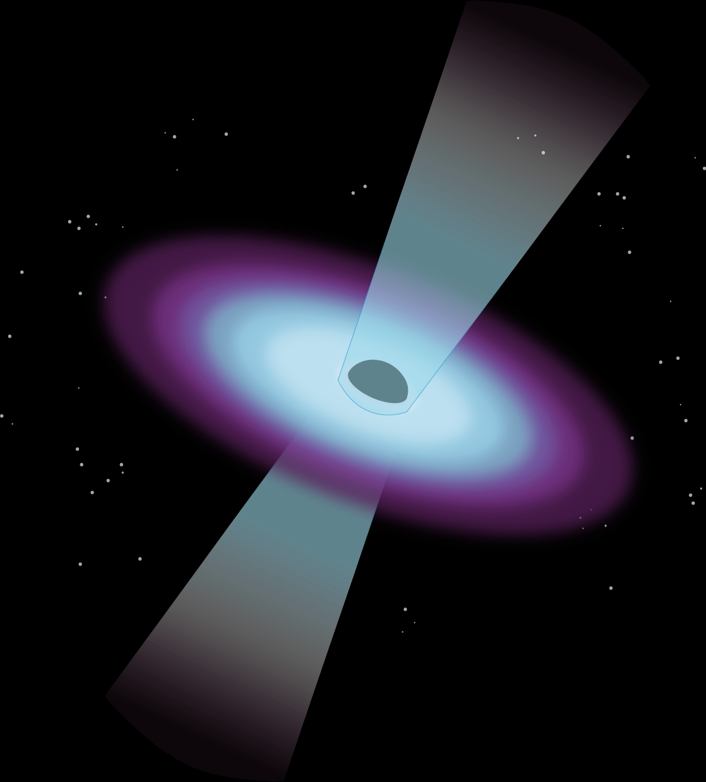
Radio Recombination Lines…
Are produced in HII regions
Either from emission or absorption of background continuum
And can come from any (post-reionization) redshift

Slide 6

Example: Which lines are capable of contaminating the CHIME band?
ν_{(n=253)}= 403 MHz
ν_{(n=105)}= 5600 MHz
ν_{(n=105)} / (1 + 6) = ~800 MHz
RRLs with 105 < n < 253 can contaminate CHIMEs 21 cm signal
LOFAR
TianLai
BINGO
DSA-2000
FAST
SKA1-MID
CHORD
PUMA
CHIME/HIRAX
Notes:
can include the approximation of n^3

Slide 7
And so we can ask…
If HII regions at all redshifts produce RRLs, how might they contaminate any 21cm intensity mapping observation?

Slide 8
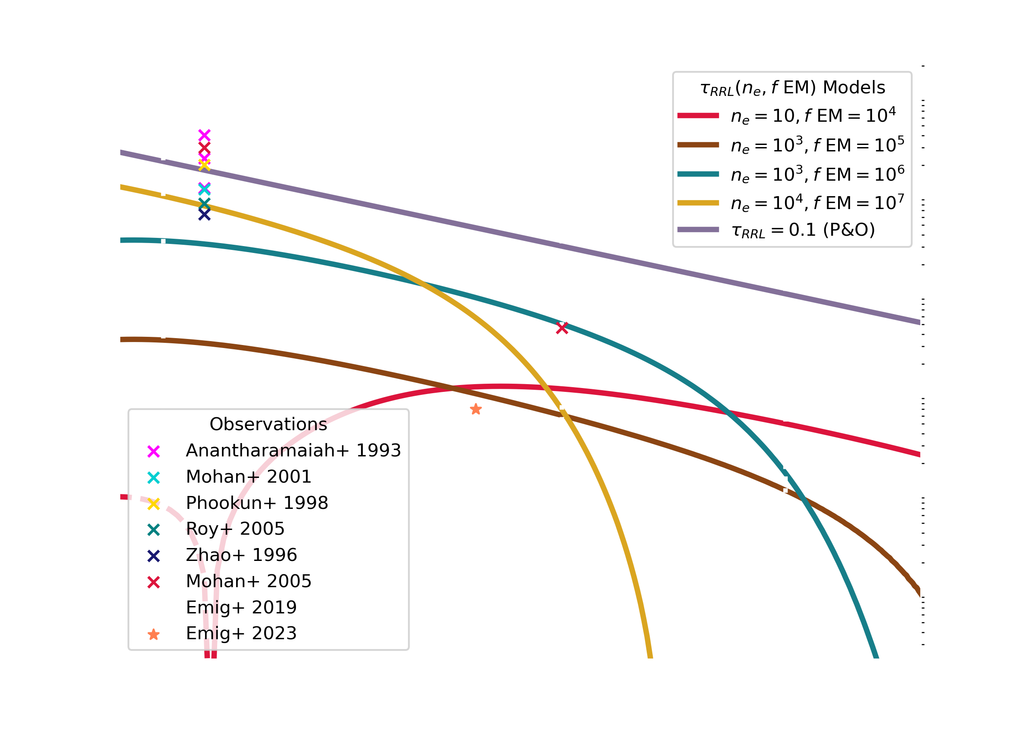
We need to explore different optical depth models…
Observations are in integrated optical depth (described by properties of HII region, and departure from LTE)

Slide 9
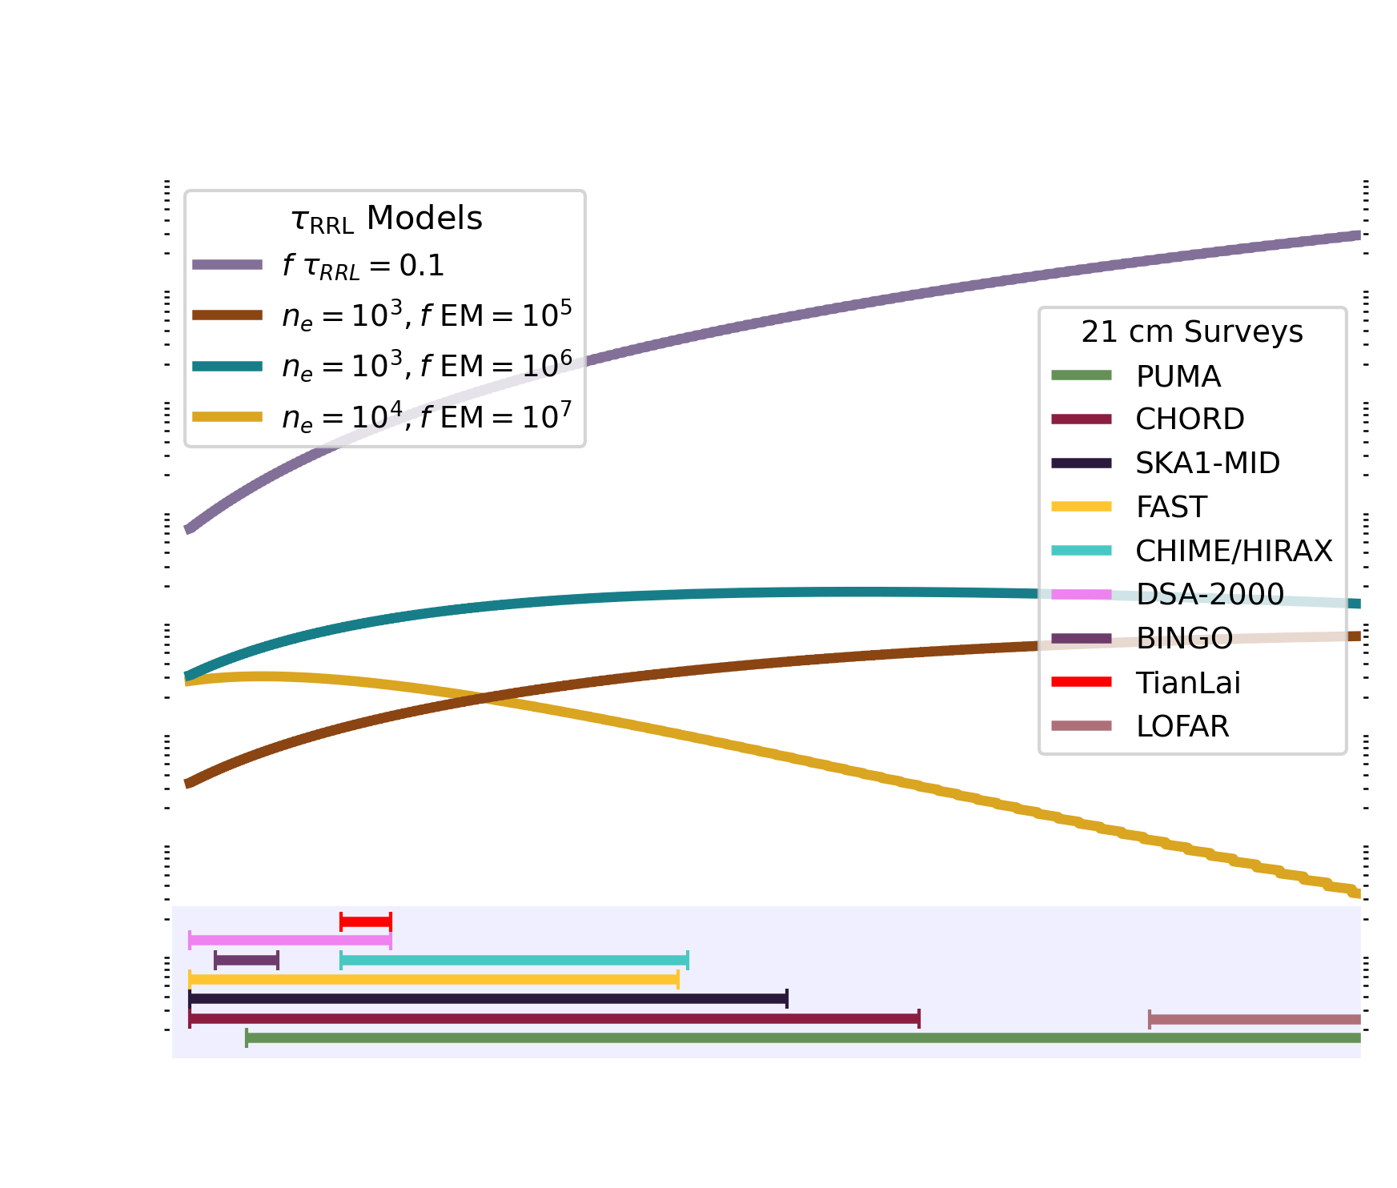
Using these models, how do the brightness temperatures from RRLs and 21 cm compare?

Slide 10
RRL Auto-Power Spectrum
($P_{RRL}$)
21–RRL Cross-Power Spectrum
($P_{21−RRL}$)
RRL–RRL Cross-Power Spectrum
($P_{RRL−RRL}$)
How each RRL correlates with itself
How the 21 cm signal correlates every RRL
How each RRL correlates with every other RRL

Slide 11
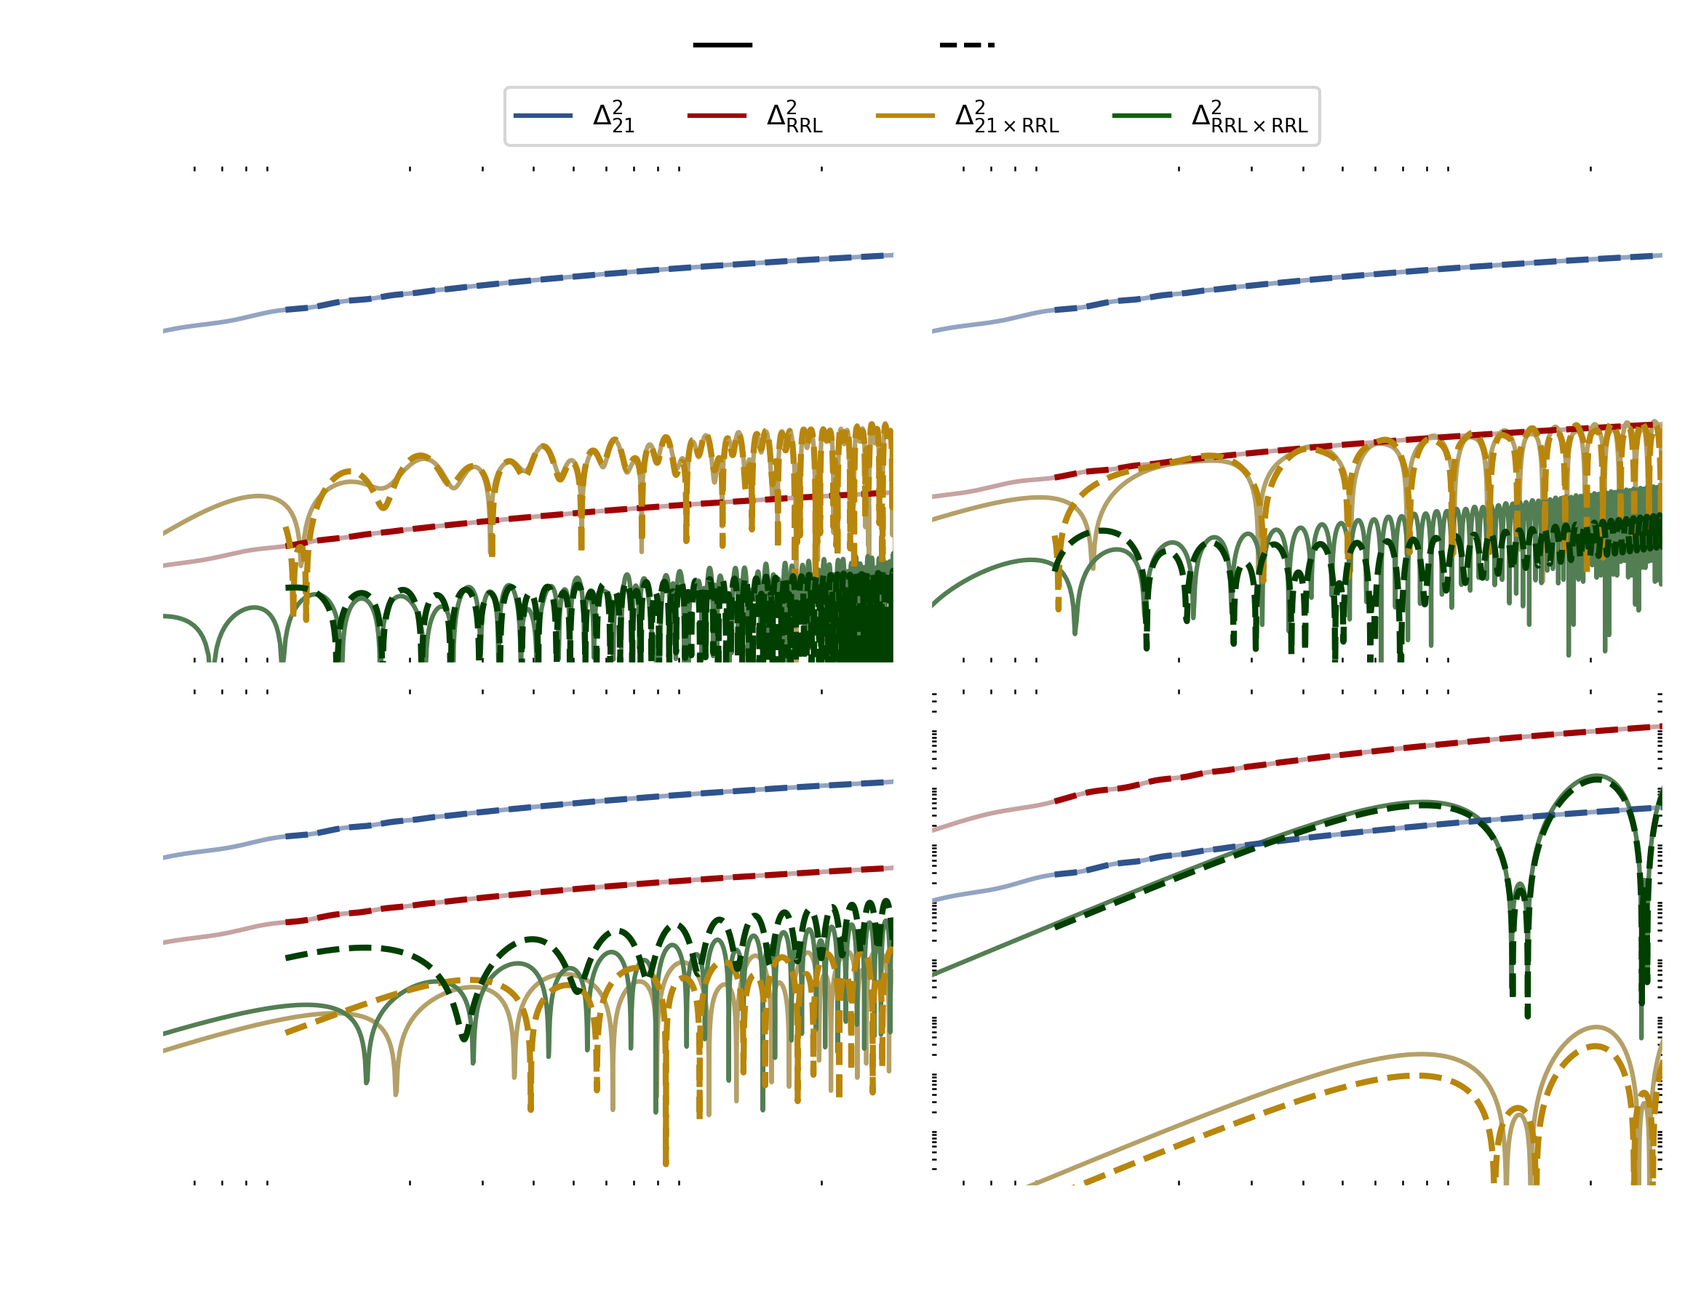
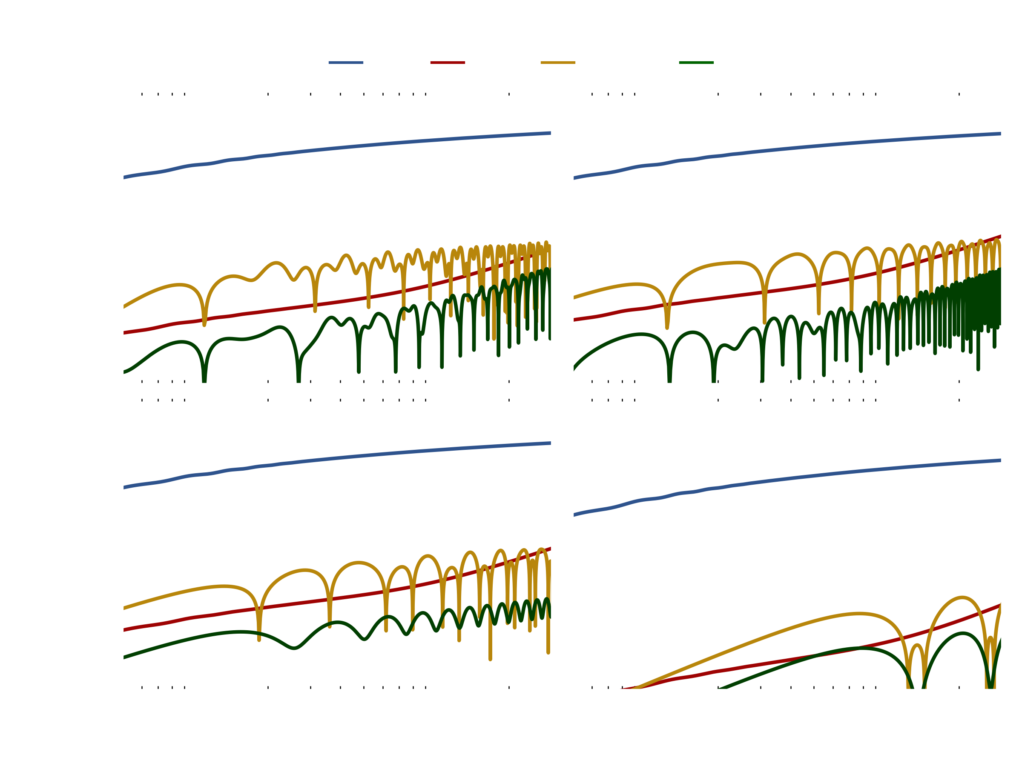

Individual types of RRL power spectra (unitless):
$$n_{e}={10}^{3} {cm}^{−3}$$
$$EM={10}^{6}{cm}^{−6}pc$$
Lines close in physical (redshift) space, create oscillations in the power spectrum

Slide 12

Individual types of RRL power spectra (unitless):
$$n_{e}={10}^{3} {cm}^{−3}$$
$$EM={10}^{6}{cm}^{−6}pc$$
Notes:
offset of the lines give you a characteristic size in the universe
Surface brightness dimming (not super important but ask at the end if you want)

Slide 13
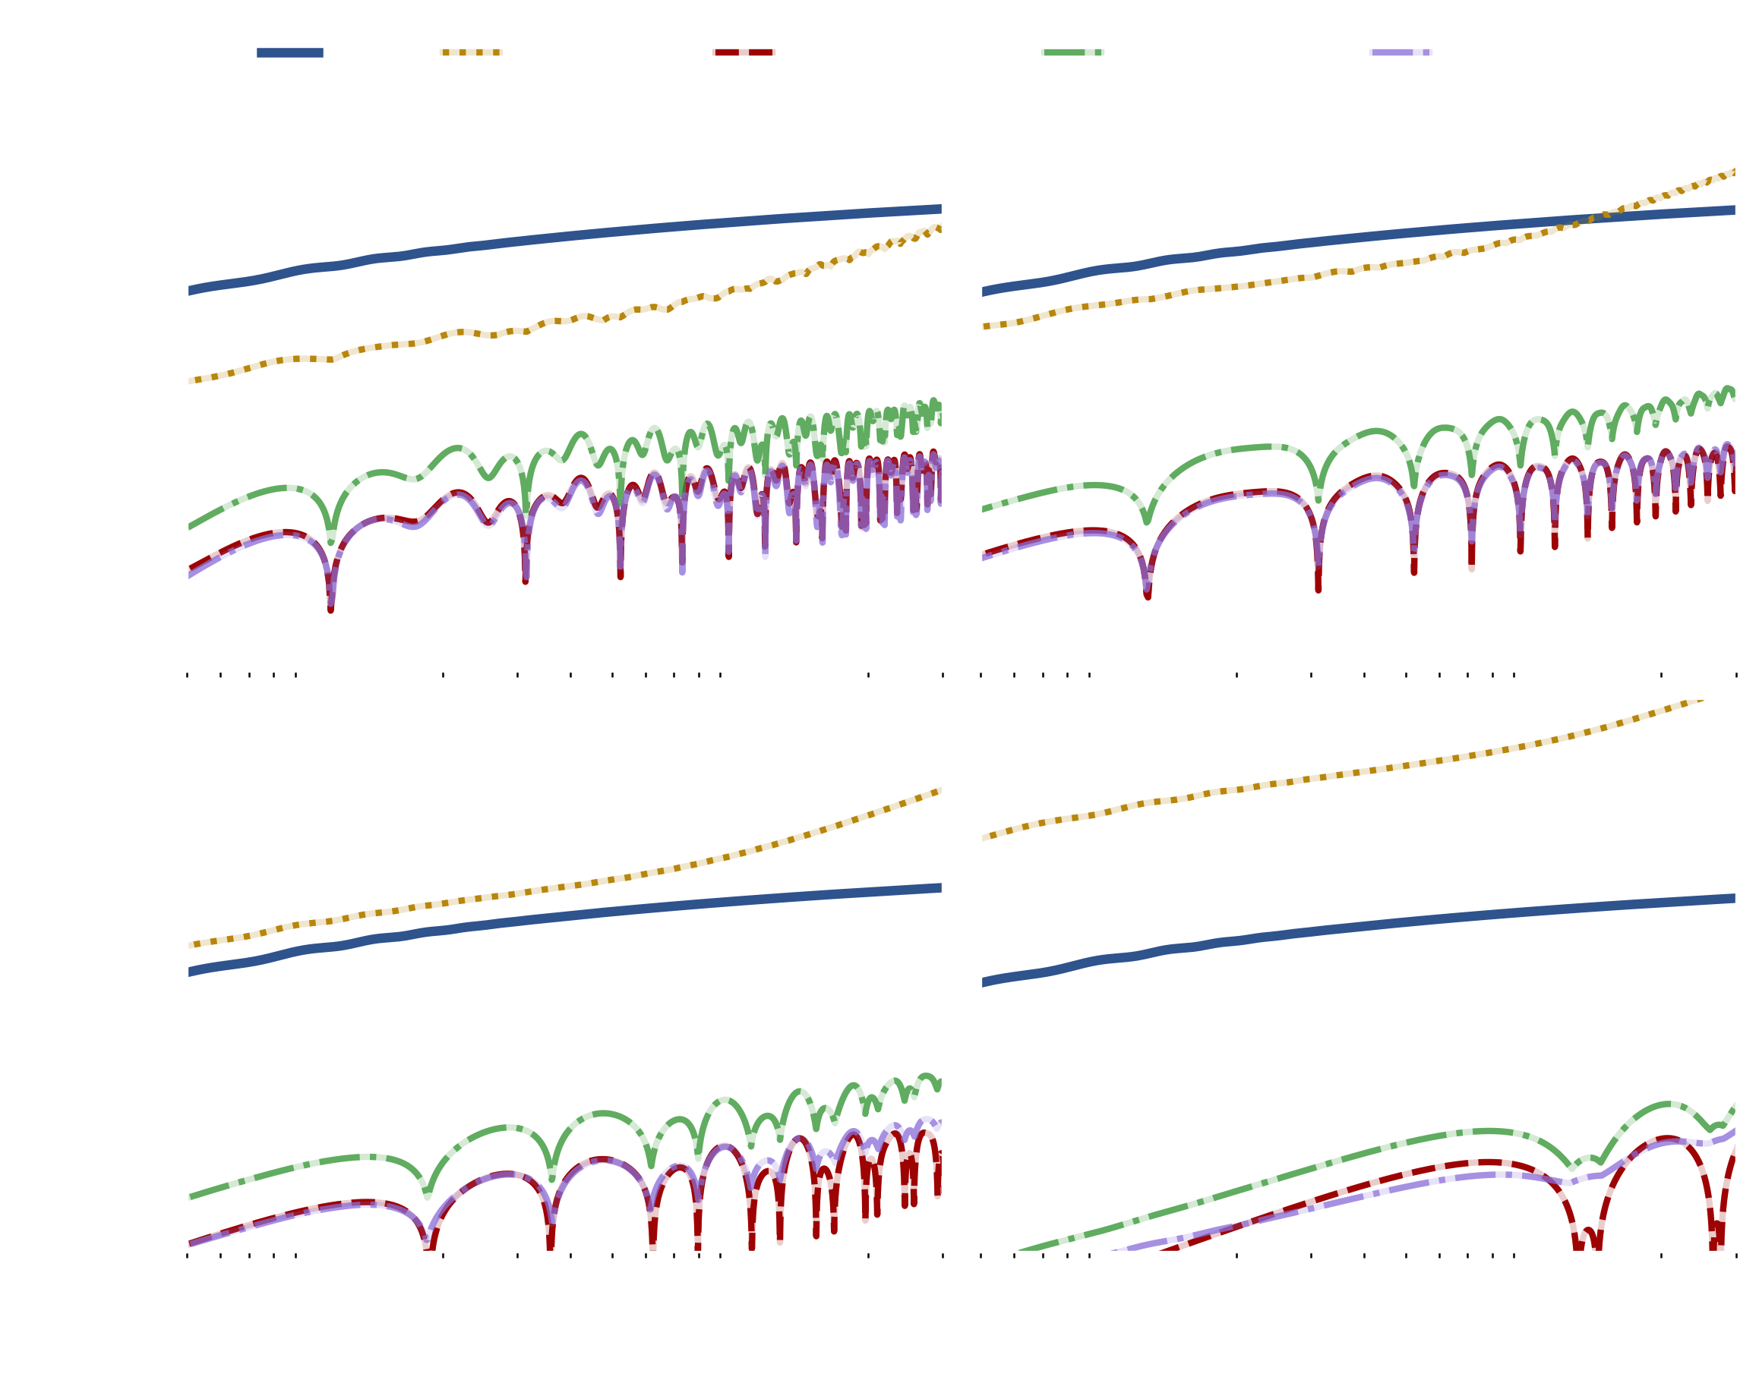
Combined RRL power spectra (unitless):
Certain optical depth models can even result in a power spectrum that exceeds the 21cm signal
Notes:
Change the green color

Slide 14
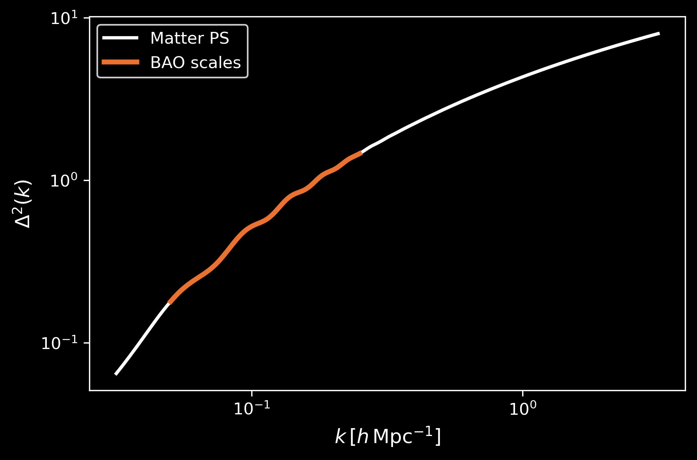
BAO appears as small ‘wiggles’ in the matter power spectrum…
and in our model in the 21 cm and RRL auto-power spectrum

Slide 15


Combining a ‘smooth’ power spectrum with small oscillations from RRLs shifts the BAO peaks ($Δ$k)

Slide 16
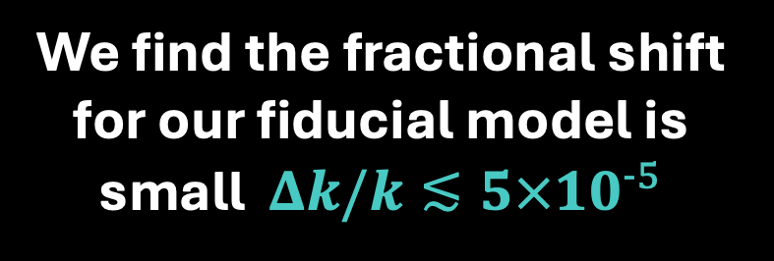

Current Experiments:
Future Experiments:
DESI DR2 have reduced combined BAO precision to ~0.3%
Cosmic variance sets floor for achievable BAO precision at $∼{10}^{−3}$
Therefore, RRL contamination is well below the level that would bias BAO measurements in 21 cm intensity mapping surveys.
We find the fractional shift for our fiducial model is small $Δk/k≲{5×10}^{−5}$

Slide 17

Conclusions
Existing optical depth models predict large RRL contamination in the 21 cm power spectrum
Cross-power spectra from RRLs produce oscillatory features in the power spectrum
RRL contamination shifts the BAO scale by only $∼3×{10}^{−5}$, well below the $∼{10}^{−3}$ precision limit set by cosmic variance
Thank you!
Notes:
RRL contamination shifts the BAO scale by only $∼3×{10}^{−5}$, well below the $∼{10}^{−3}$ precision limit set by cosmic variance.

Slide 18
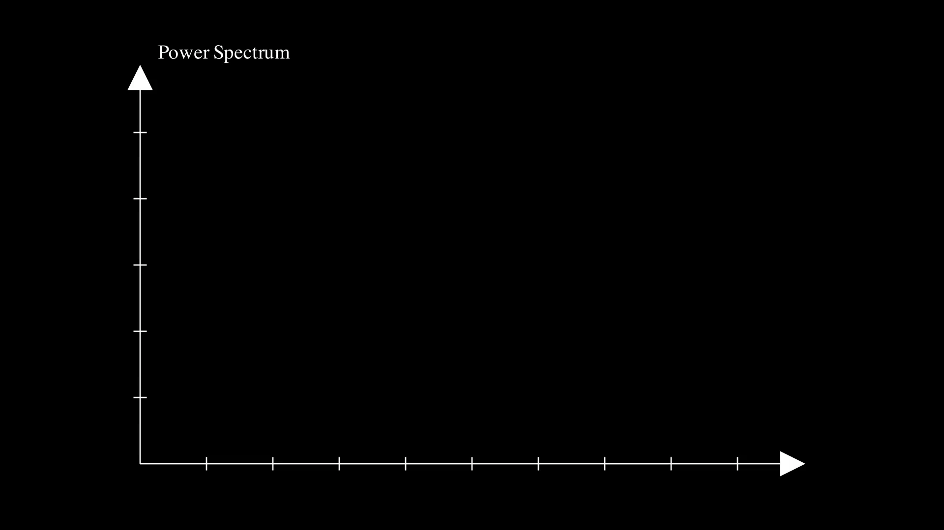

Slide 19
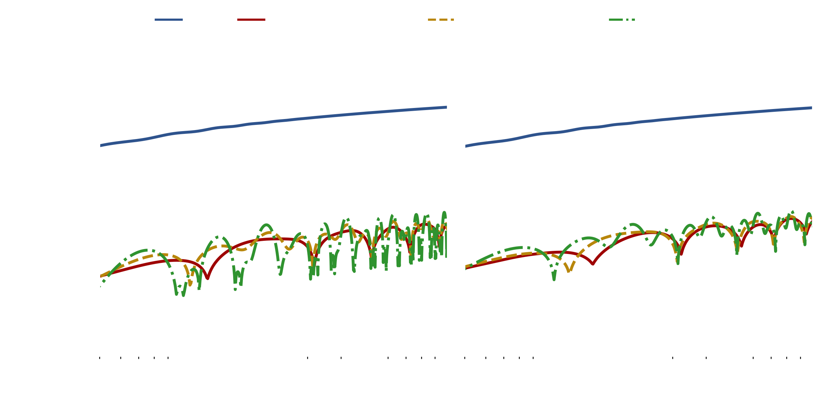


And we can see how observational bandwidths impact contamination
$$k_{⊥}=0.0$$
$$n_{e}={10}^{3} {cm}^{−3}$$
$$EM={10}^{6}{cm}^{−6}pc$$

Slide 20
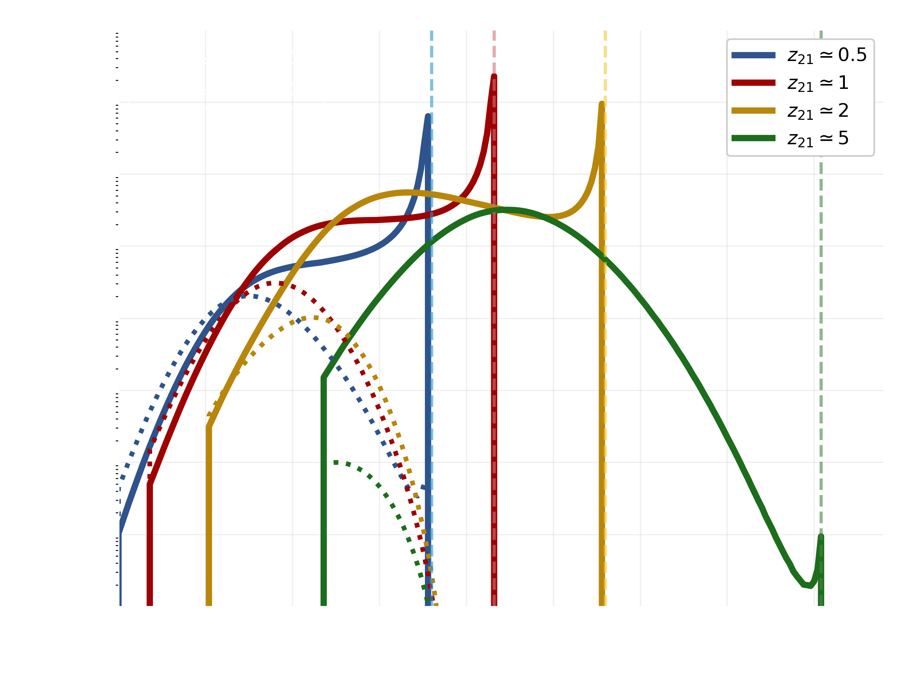
Testing which lines contaminate each 21cm

Slide 21
