Slide 1
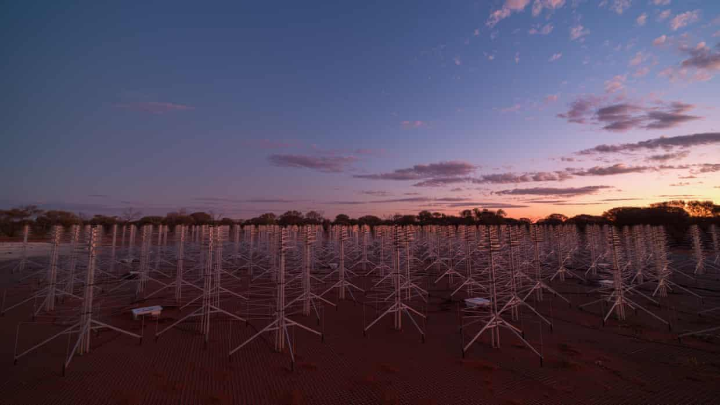
Satellite Mega-Constellations:
The Risks for the Radio Astronomy/Cosmology and a Potential Solution with TABASCAL
Chris Finlay (EPFL)
Bruce Bassett (UCT/Wits), Dylan Grigg (Curtin/ DUG), Martin Kunz (UNIGE), Nadeem Oozeer (Rhodes), Steven Tingay (ICRAR/Curtin),
Emma Tolley (EPFL)
© SKAO

Slide 2
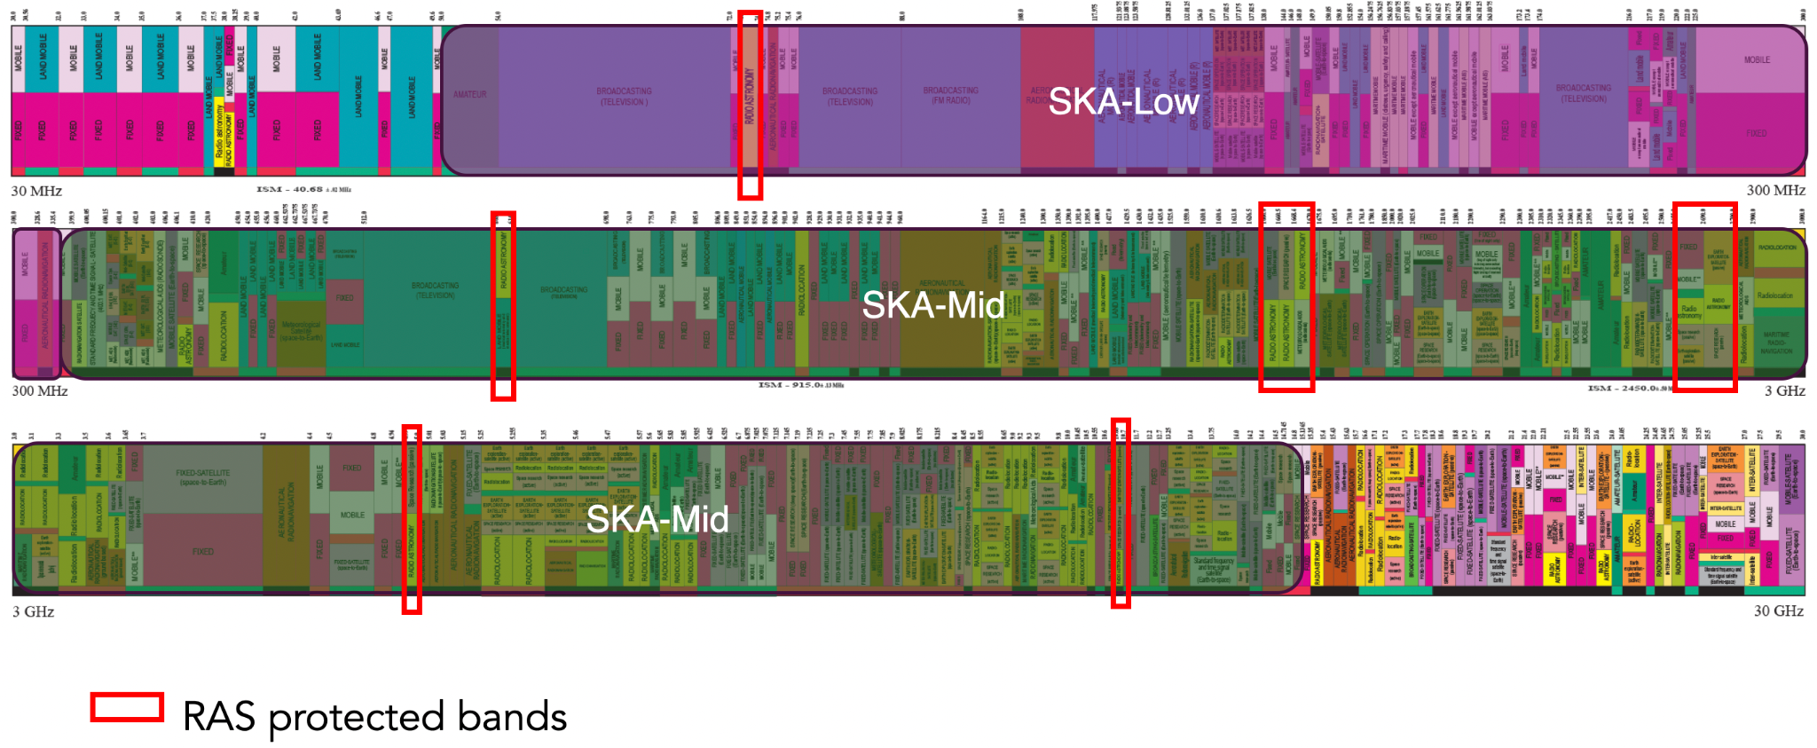
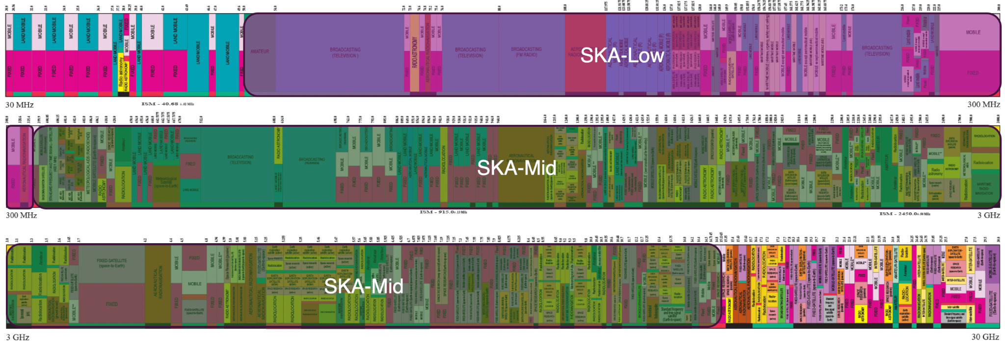
The Radio Spectrum is Crowded

Slide 3
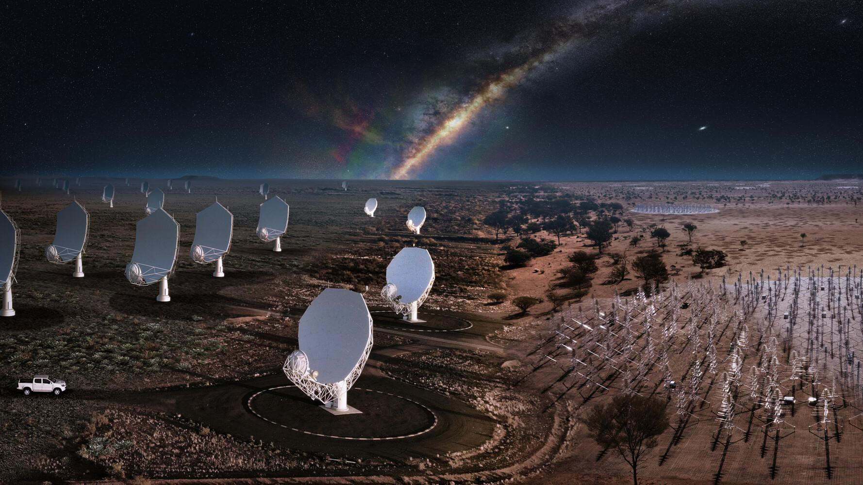
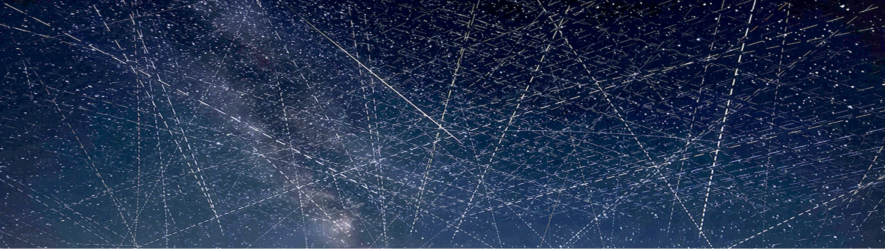
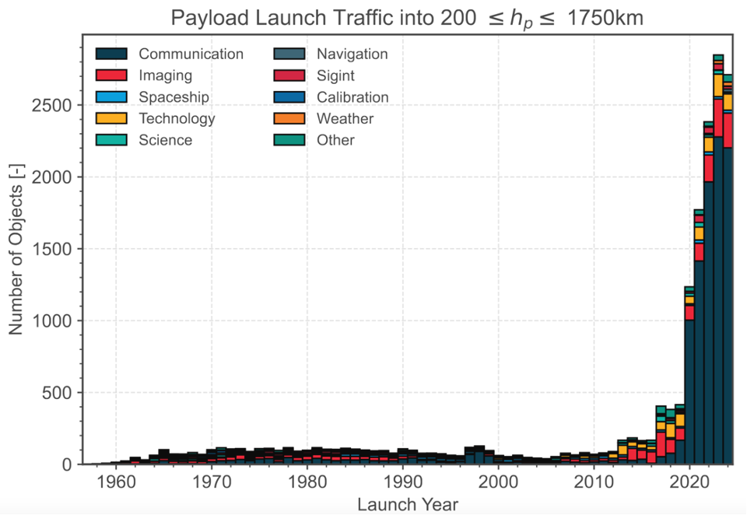
© Alan Dyer/AmazingSky.com
© SKAO

Slide 4
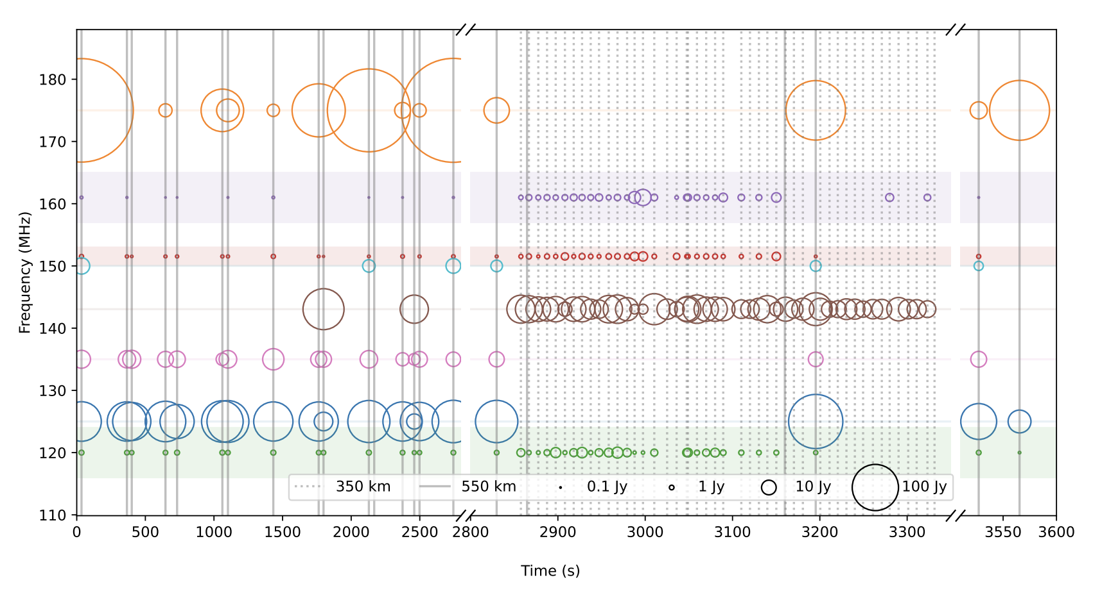
Unintended Electromagnetic Radiation (UEMR)
Starlink detection above LOFAR
110 - 188 MHz
Narrowband and broadband emission
Some reflections
RA protected band
Di Vruno et al. 2023

Slide 5

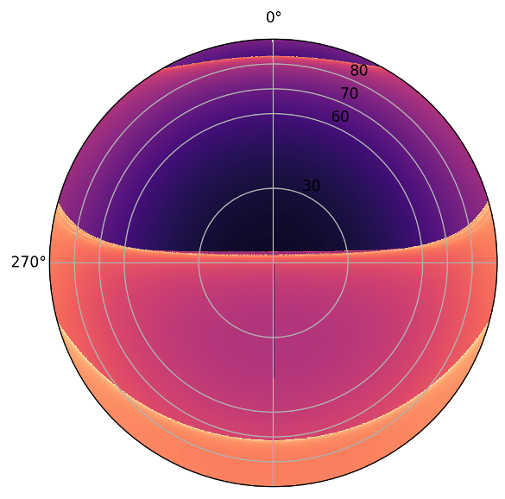
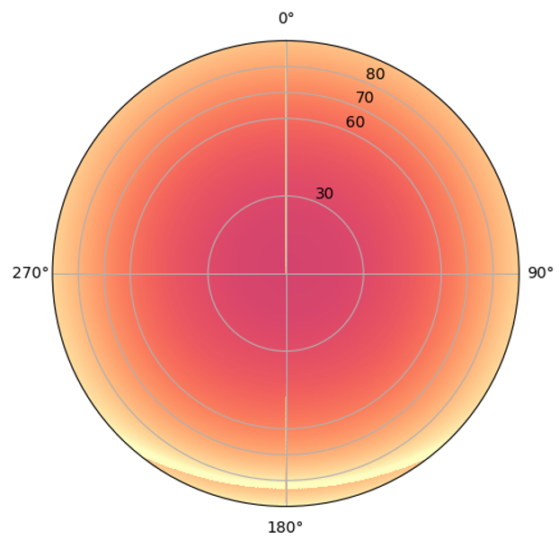
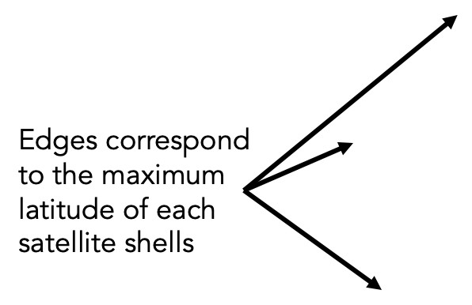
Starlink Sky Occupancy based on 6 orbit shells
(Cerardi+ in prep)
Above LOFAR
Above SKA-Low
Sats /h

Slide 6
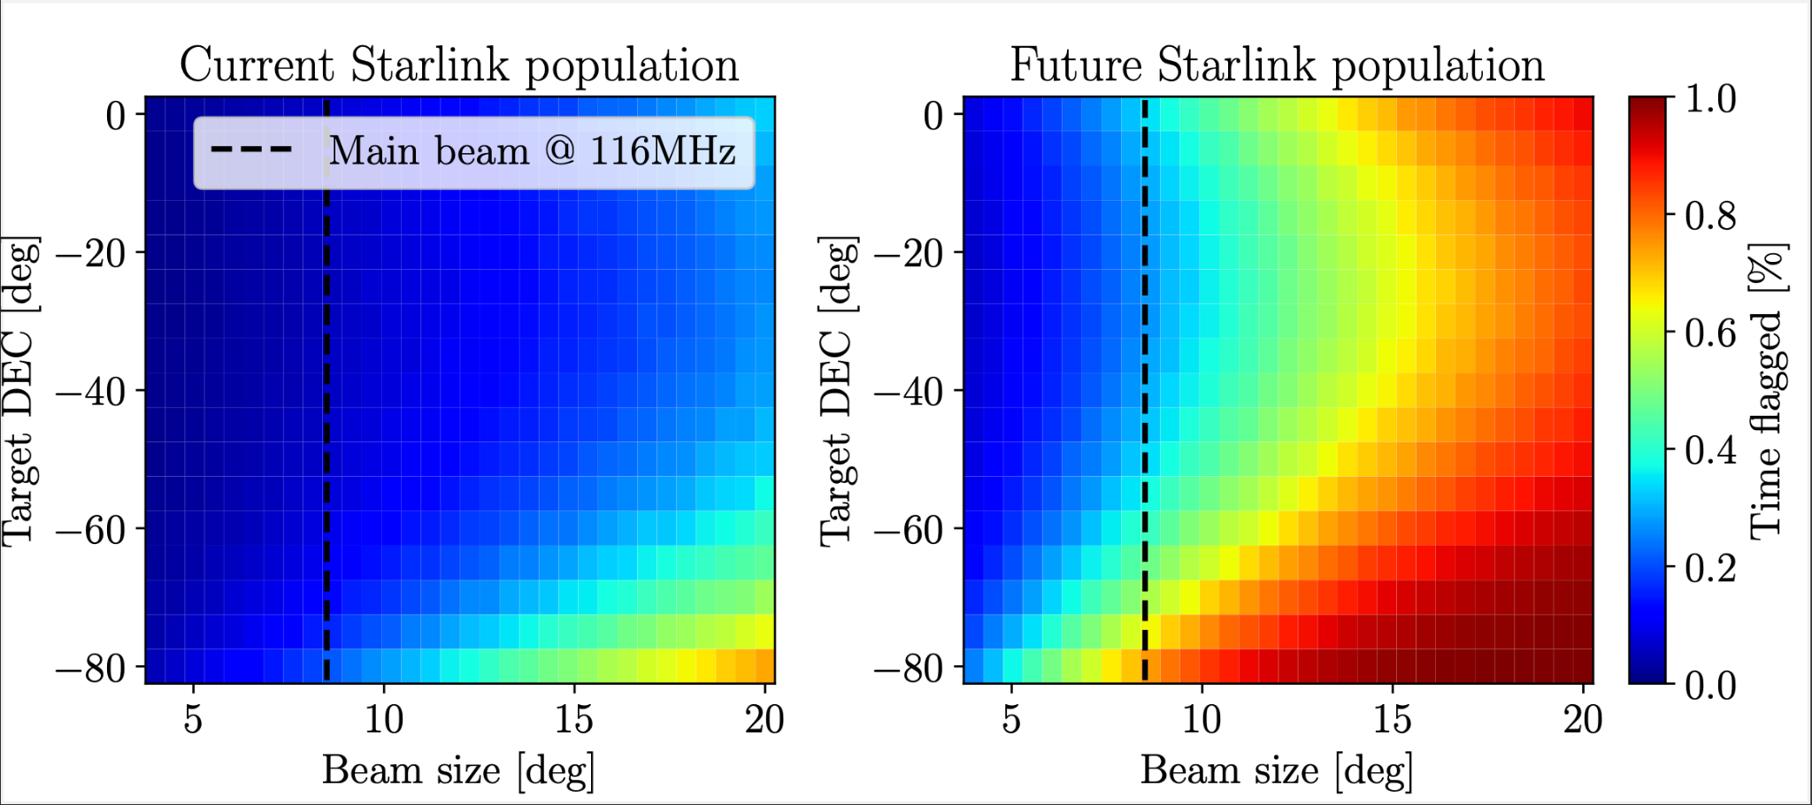
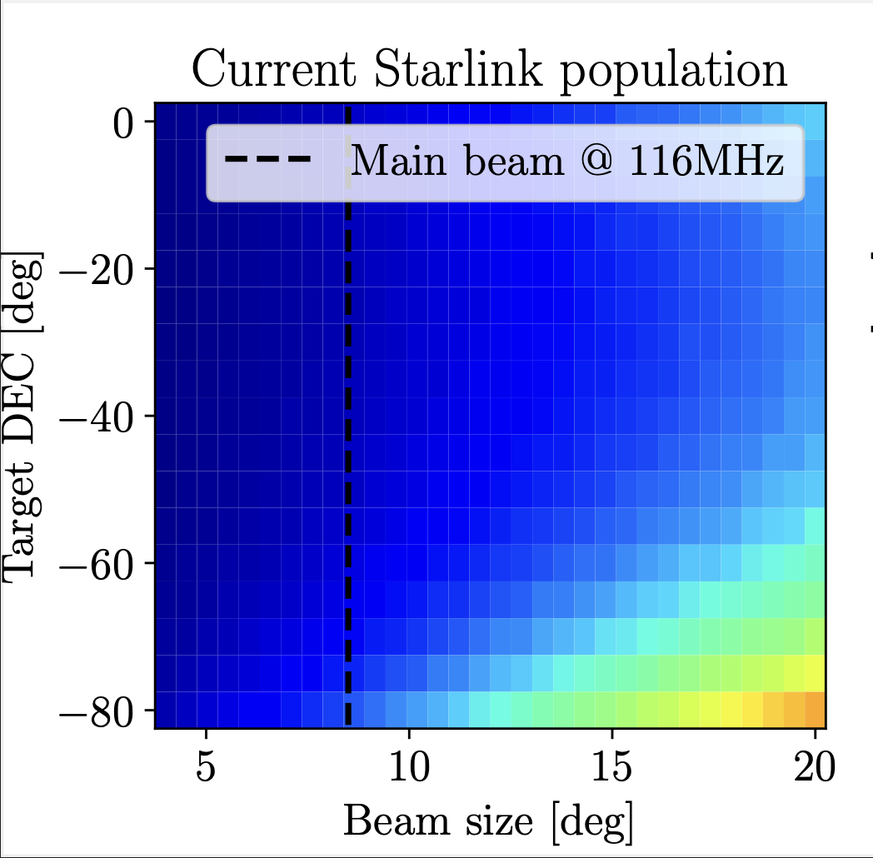
© Alan Dyer/AmazingSky.com
7’000 Starlink
40’000 Starlink
(Cerardi+ in prep)
© SKAO

Slide 7
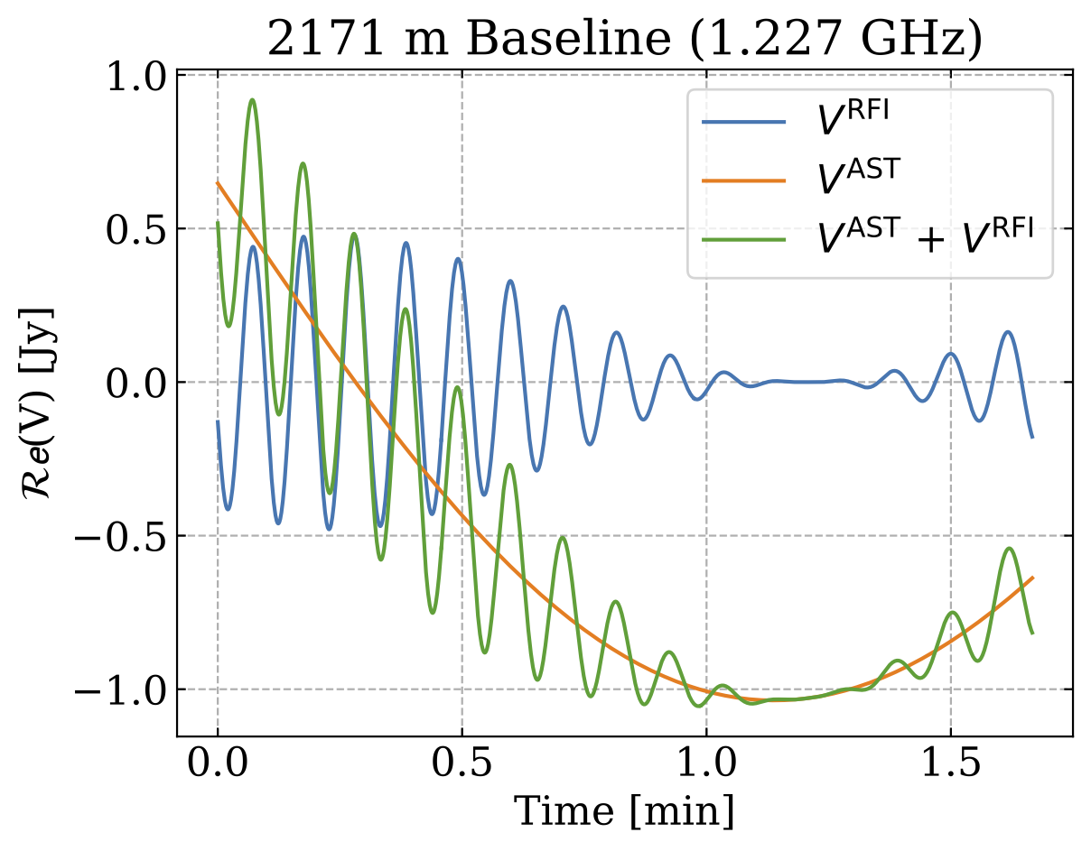
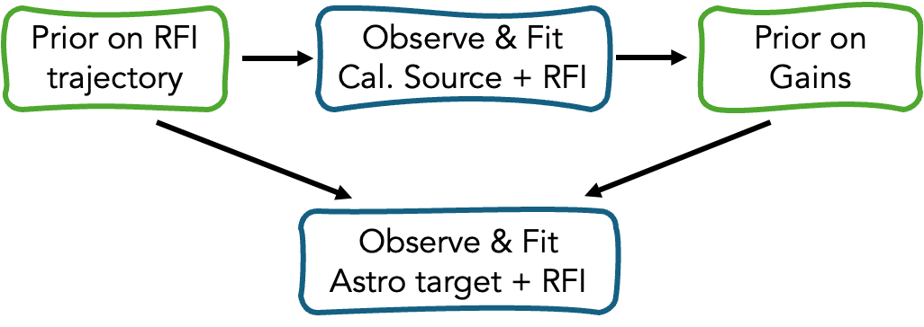
Trajectory-based RFI subtraction and calibration
TABASCAL - arXiv:2301.04188 (MNRAS 2023), arXiv:2502.00106 (A&A 2025)
Bayesian forward model for RFI signal, astronomical signal, and antenna gains
Use RFI trajectories to separate astronomical and RFI signals
Funded by PASC (2025-2028) to scale to Tier-0 HPC clusters

Slide 8
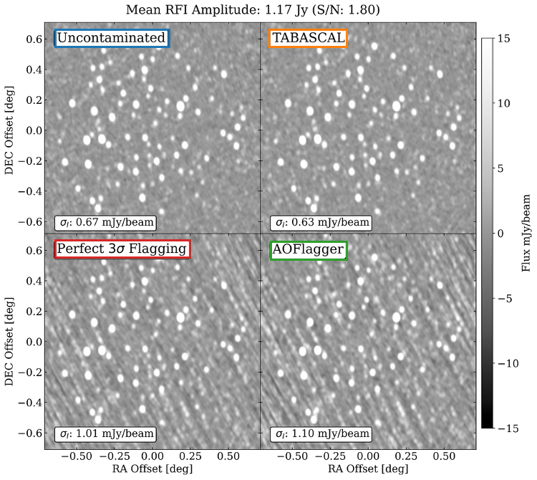
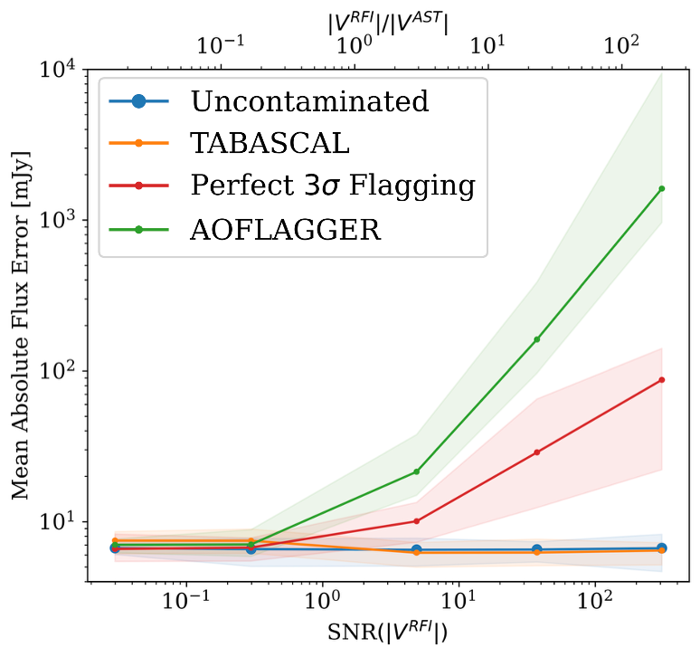
MeerKAT simulated data results
Finlay et al. 2025

Slide 9
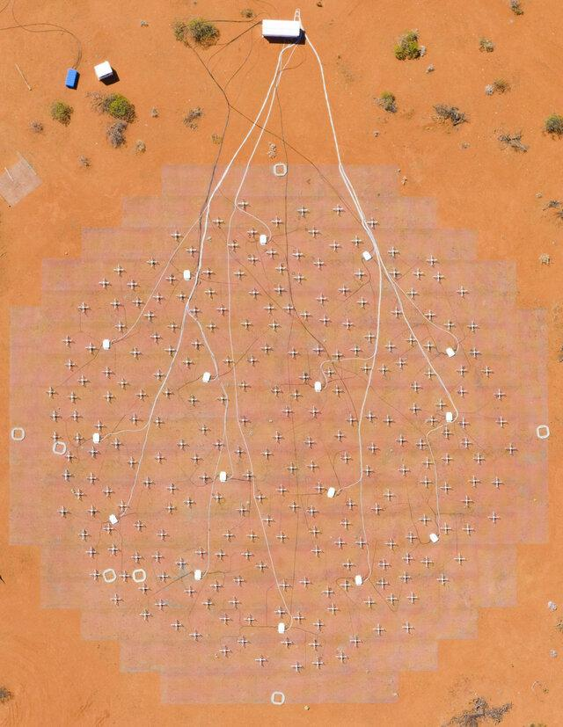
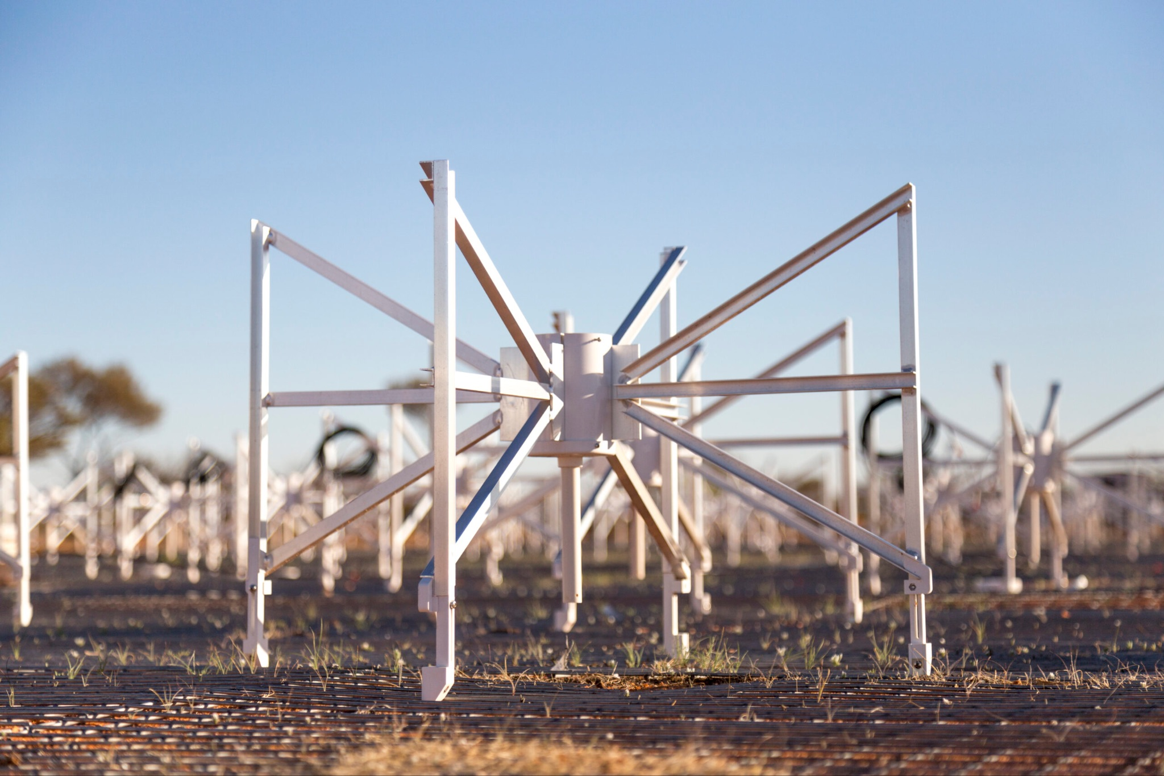
Engineering Development Array 2 - EDA2
SKA-Low Station from MWA dipoles
Used as an interferometer in our data
29 days - 1806 unique starlink sats

Slide 10
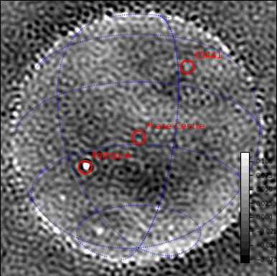

Starlink V2-Mini Observation - 144 s, 170.3 MHz
Raw Data
RFI Subtracted Data

Slide 11
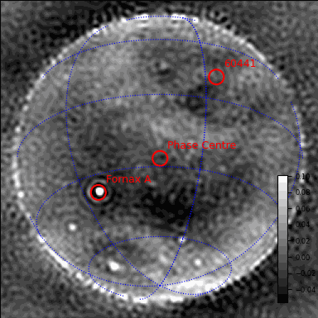
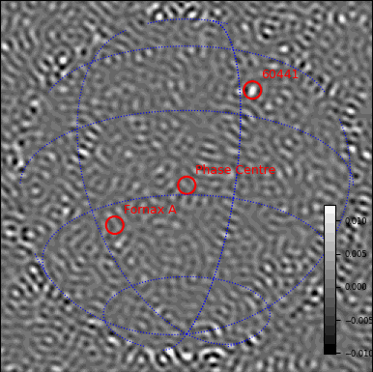
Starlink V2-Mini Observation - 144 s, 170.3 MHz
Astronomical Estimate
RFI Estimate

Slide 12
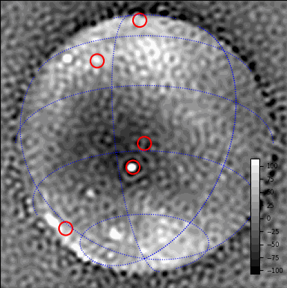
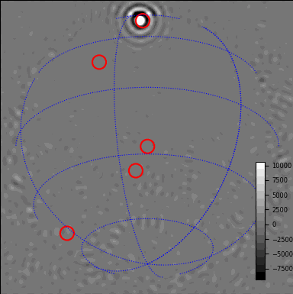
Solrad 7b Observation - Raw Data
Weak Contamination
Strong Contamination

Slide 13
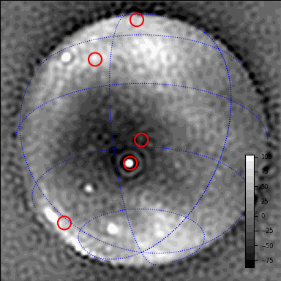

Solrad Observation - Astronomical Estimate
Weak Contamination
Strong Contamination

Slide 14
Notable Achievements (Conclusions)
Upcoming Work
First successful demonstration on real data
Custom CUDA kernels and various optimisations
64 -> 512 ant. on a single GPU (1 channel, 5 min., 32 sats)
~ 3x faster optimization loop
Modular model definitions from a config file
Scaling up - multi-GPU implementation
More real data - more satellites, other telescopes, etc.

Slide 15
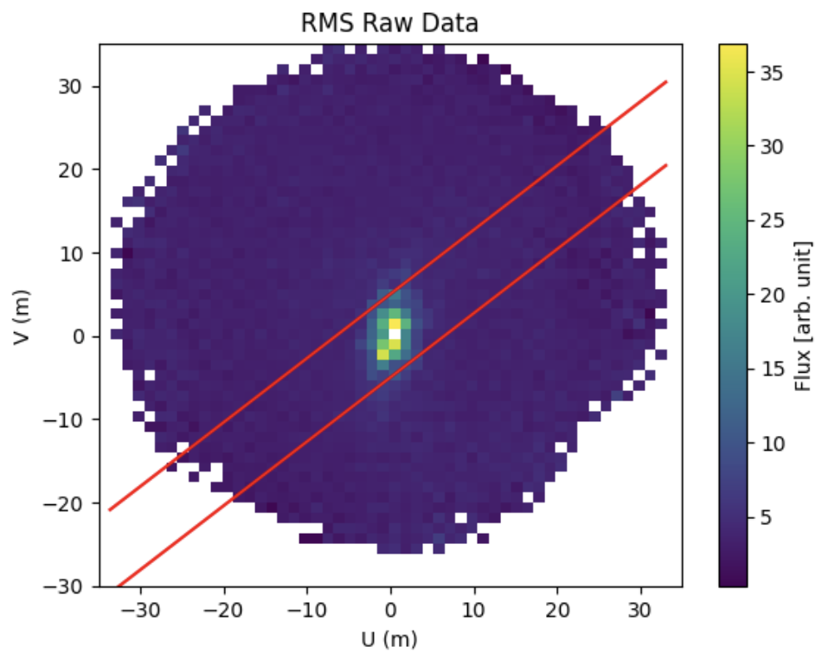
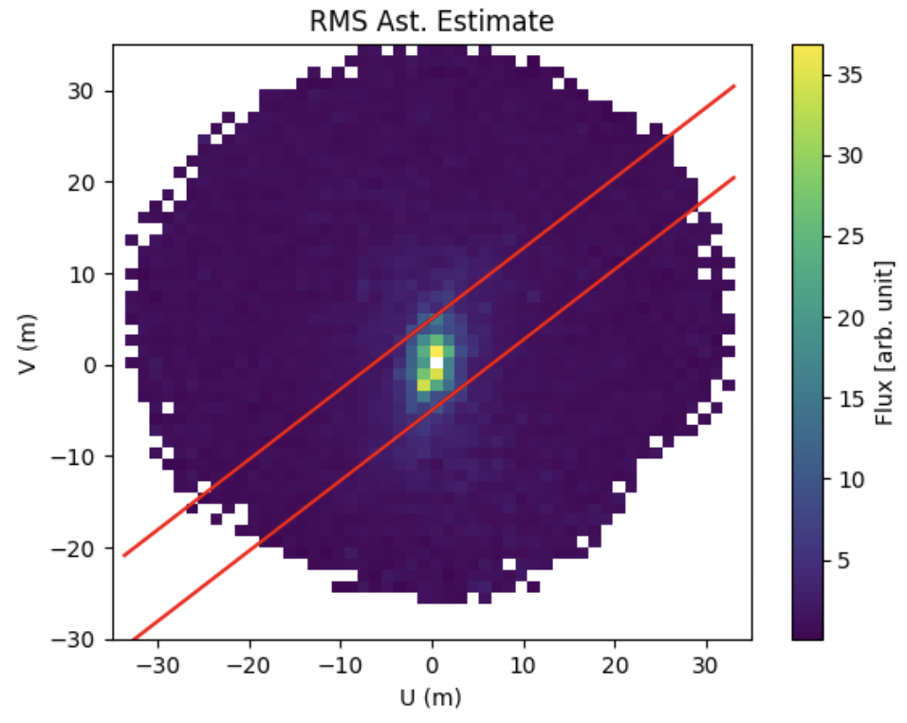
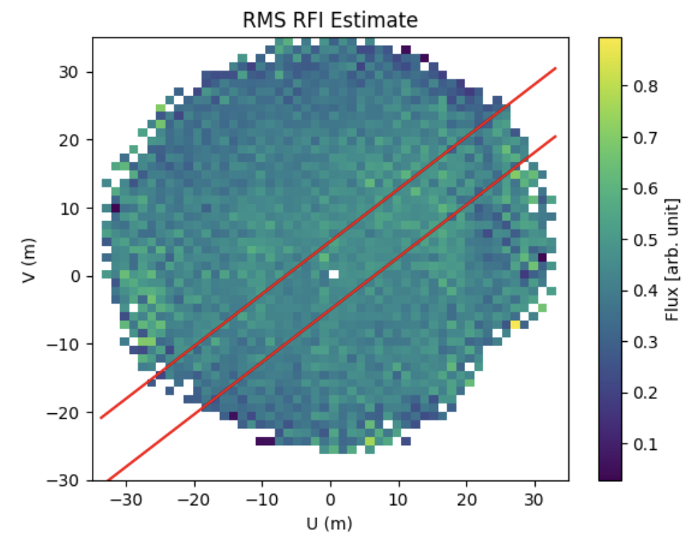
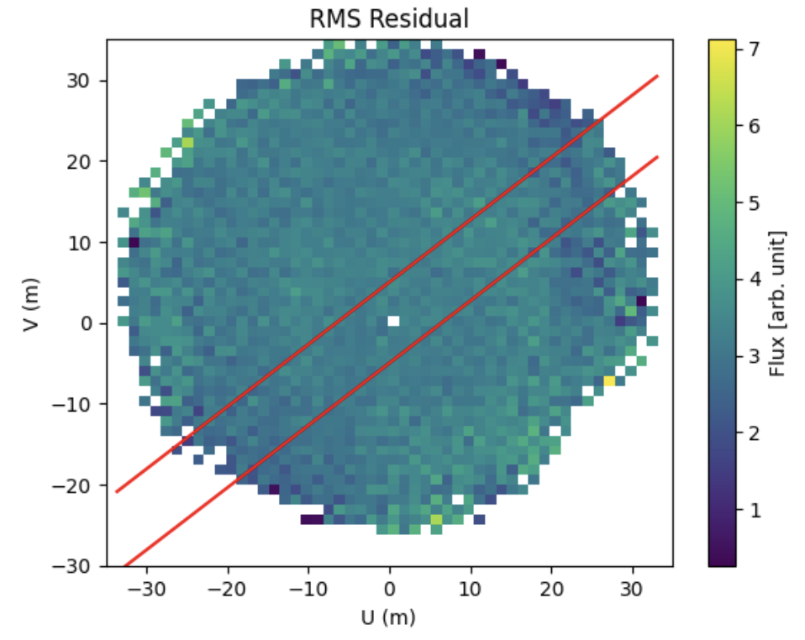
Starlink V2-Mini Observation - RMS

Slide 16
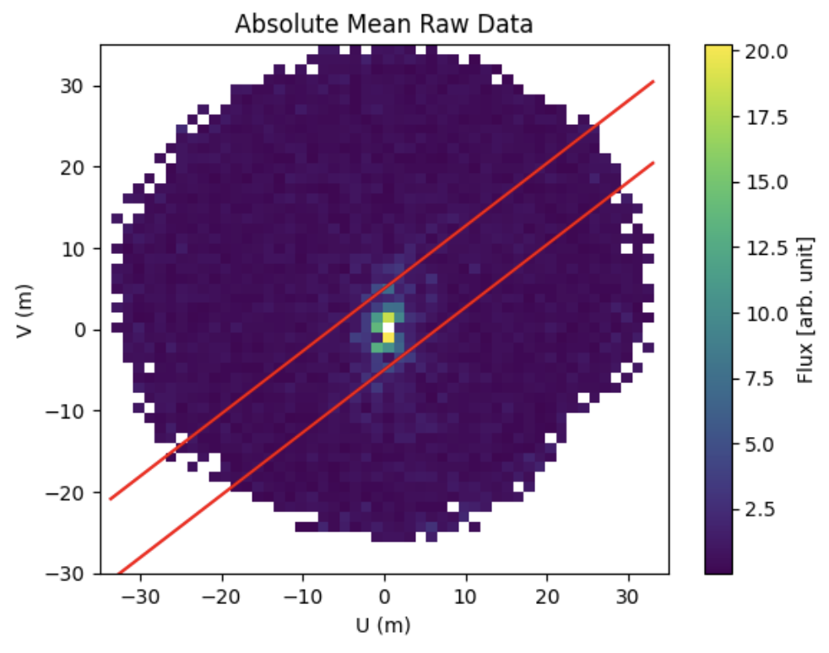

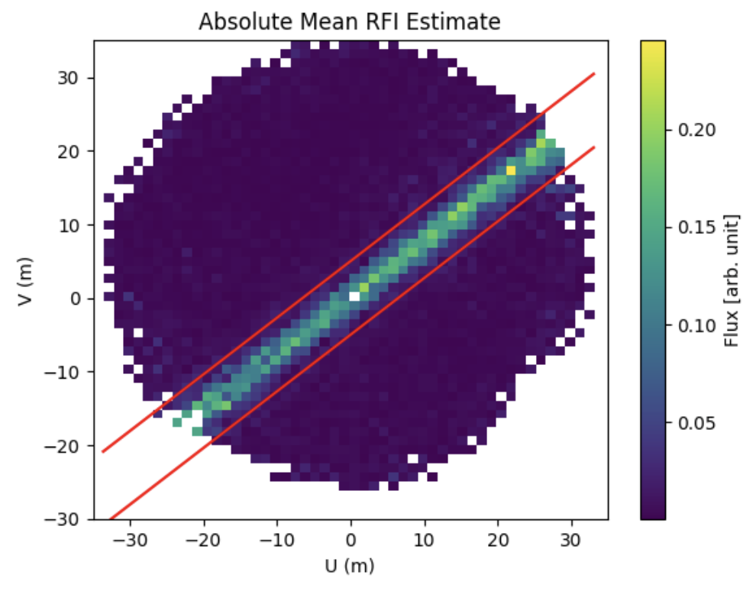
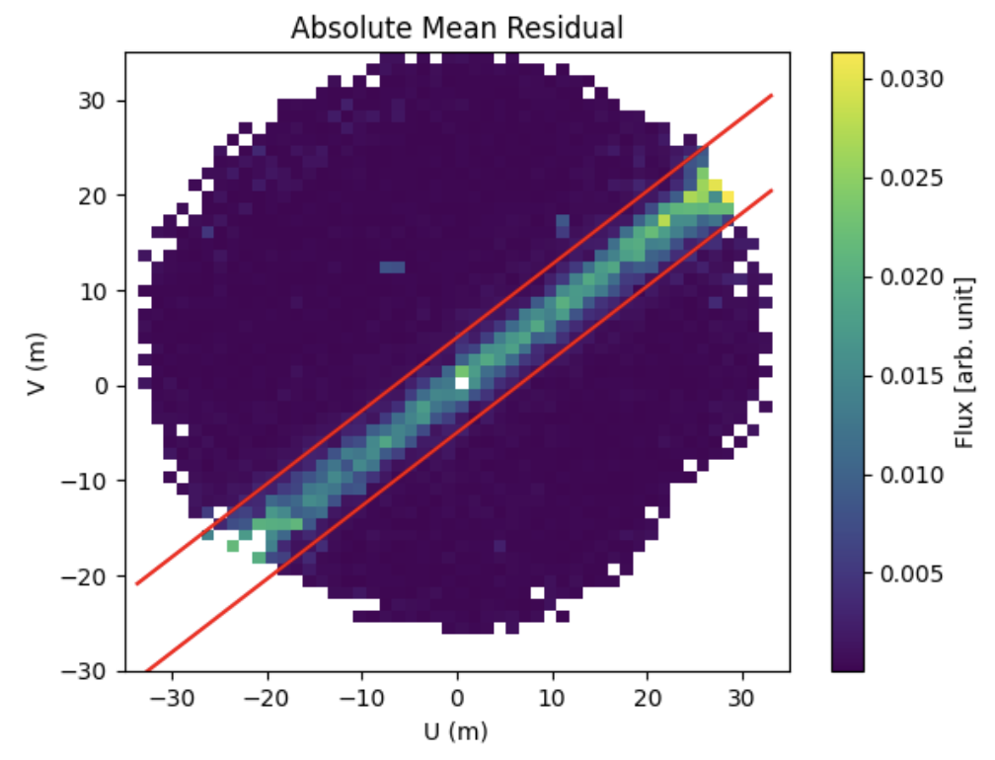
Starlink V2-Mini Observation - Absolute Mean

Slide 17
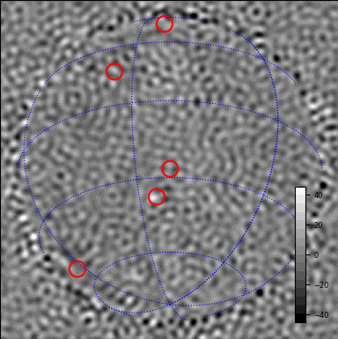
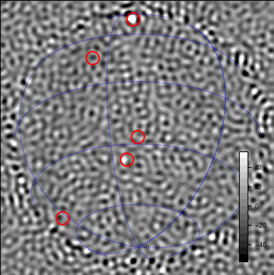
Solrad Observation - Residual (unmodelled) signal
Weak Contamination
Strong Contamination

