Slide 1
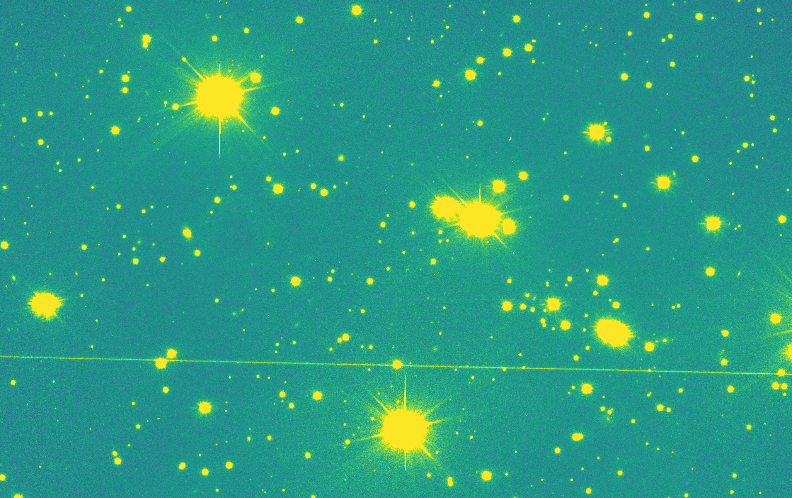
Someone’s Noise is Someone else’s Signal
Leveraging Satellite Contamination for Space Debris Research and Space Sustainability
Elisabeth Rachith
Stephan Hellmich
Cosmology in the Alps
19.03.2026

Slide 2
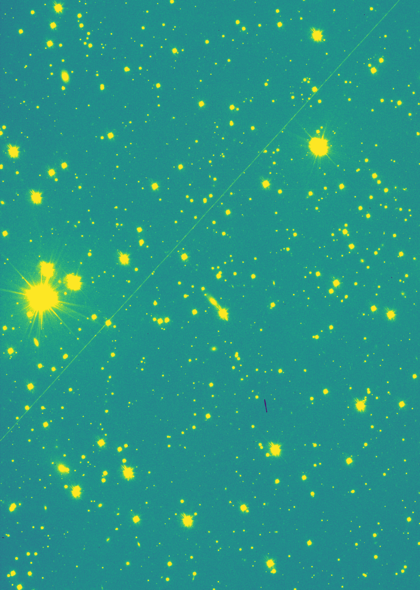
Introduction
Interest in archival data

Slide 3
Interest in archival data
Physical characterization of space objects often lacking
No need for dedicated observations
Large amount of data free of access
High sensitivity and resolution (compared to standard SSA facilities)
Insight into the evolution over time of the debris population

Slide 4
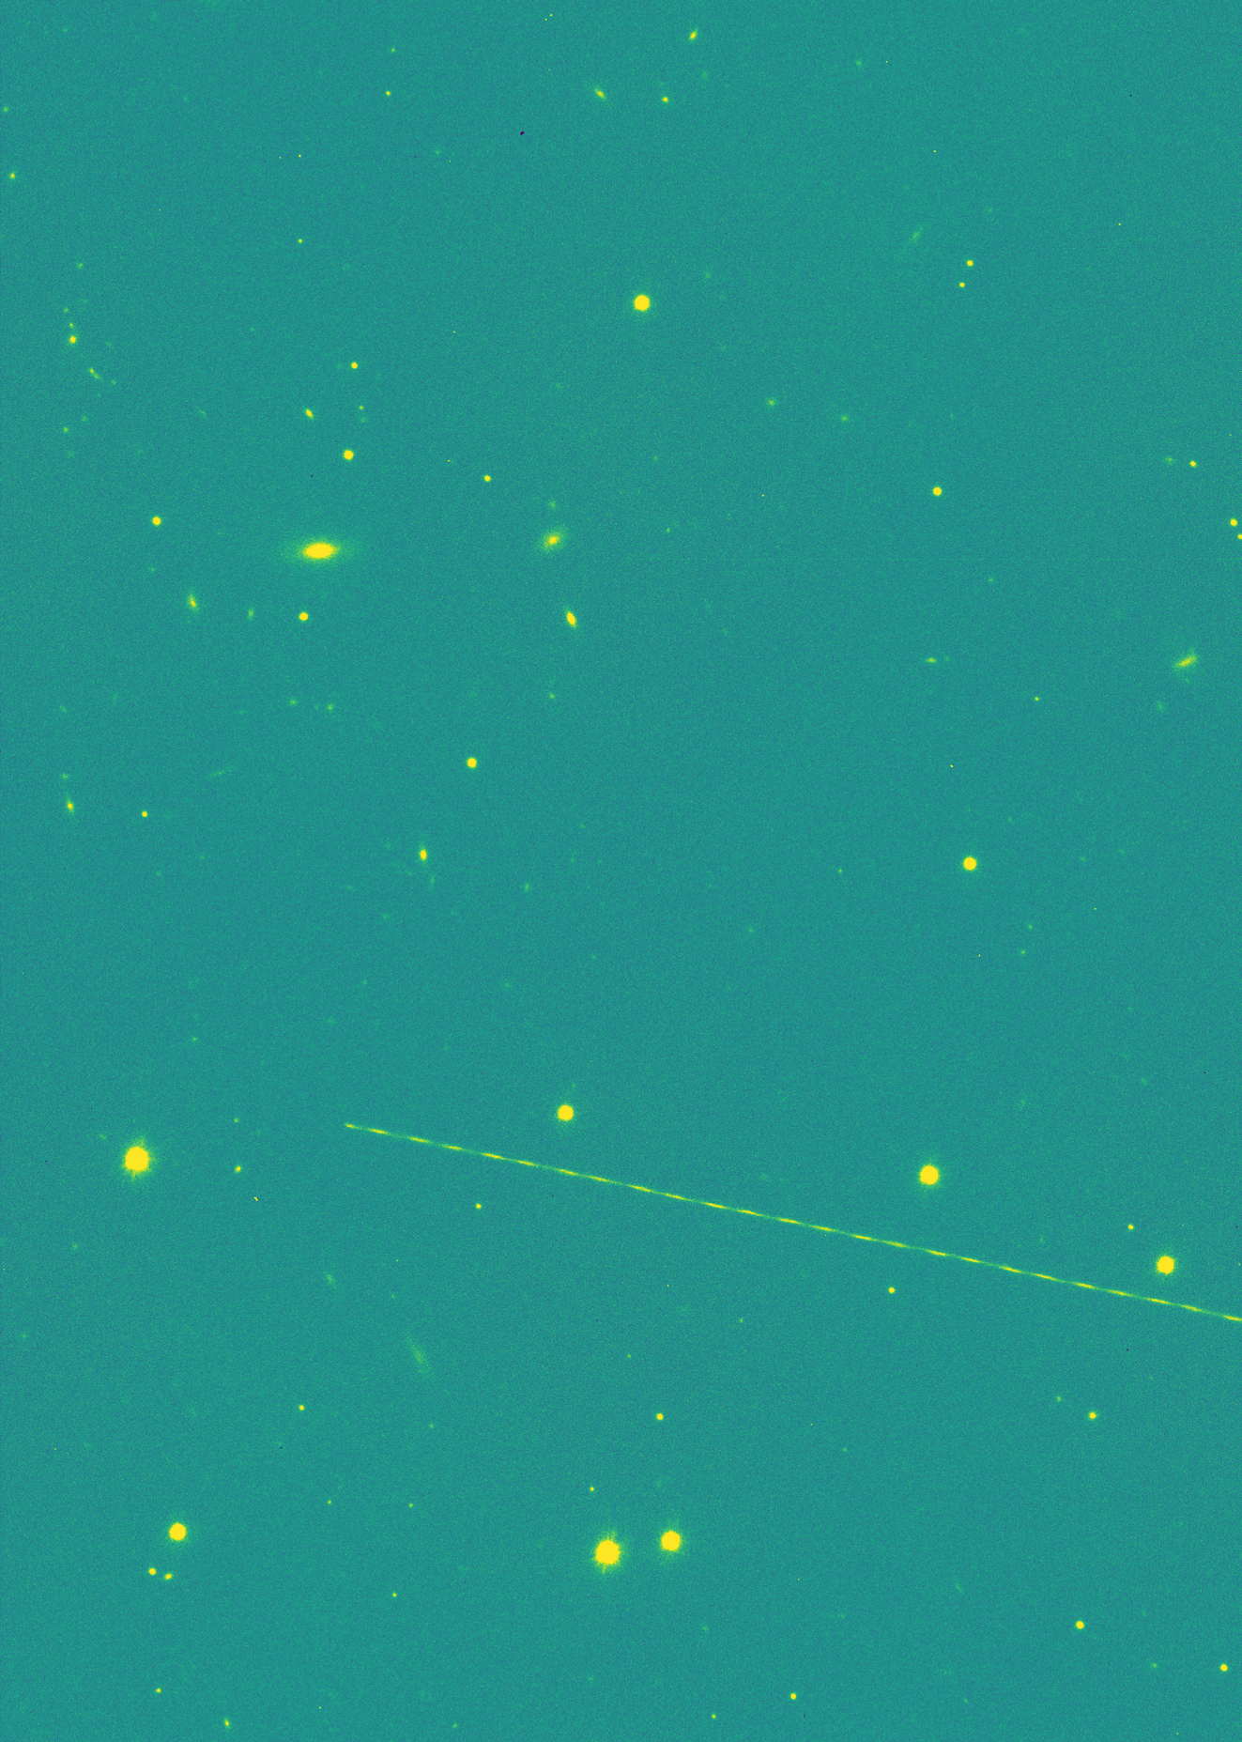
VST/OmegaCAM
Facility and images
Streak detection methods
Results
Photometric analysis

Slide 5
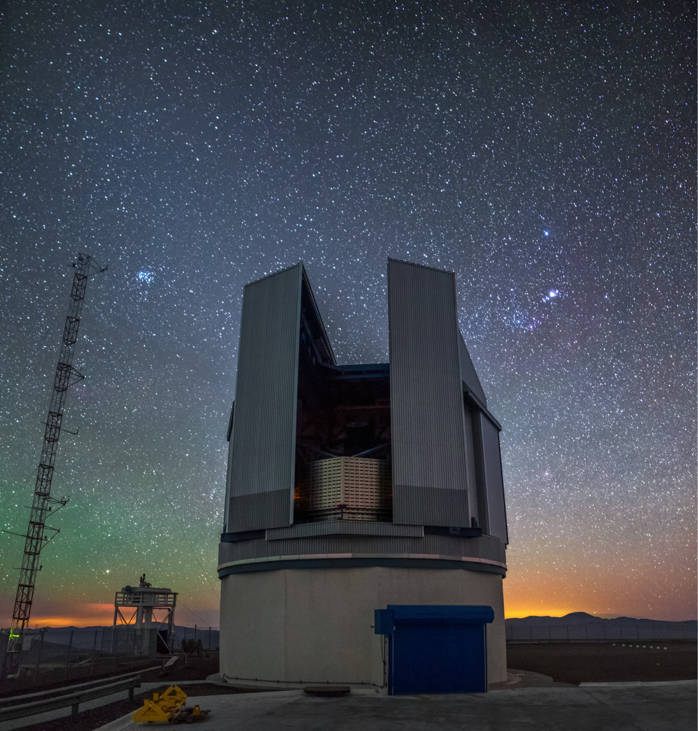
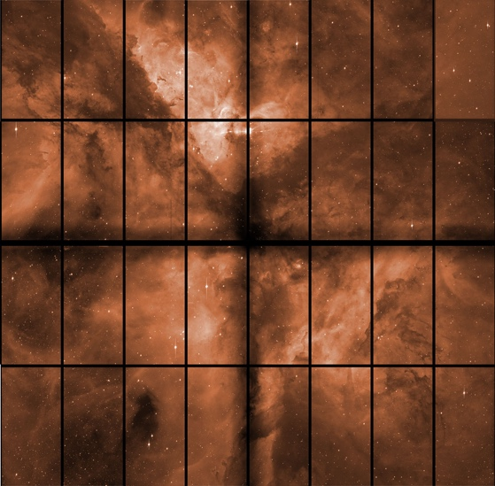
Facility and images
1º
OmegaCAM
ESO VLT Survey Telescope
2.6m telescope on Cerro Paranal
32 individual CCDs
400’000+ images in the archive
Space objects appear as streaks

Slide 6
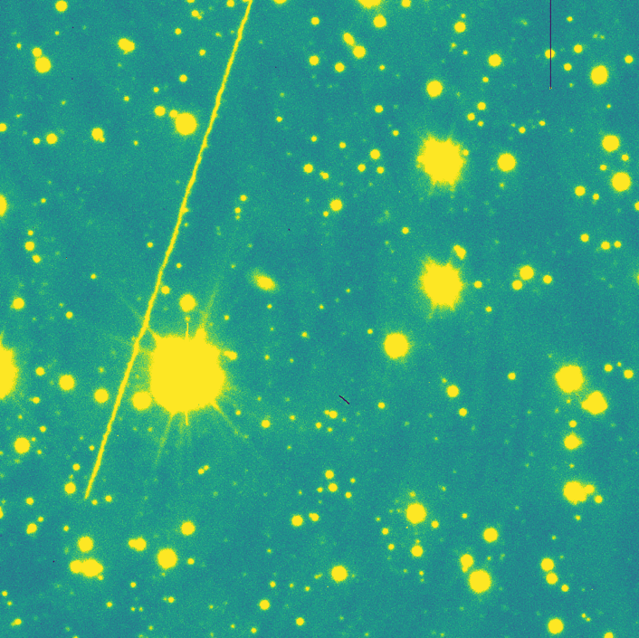
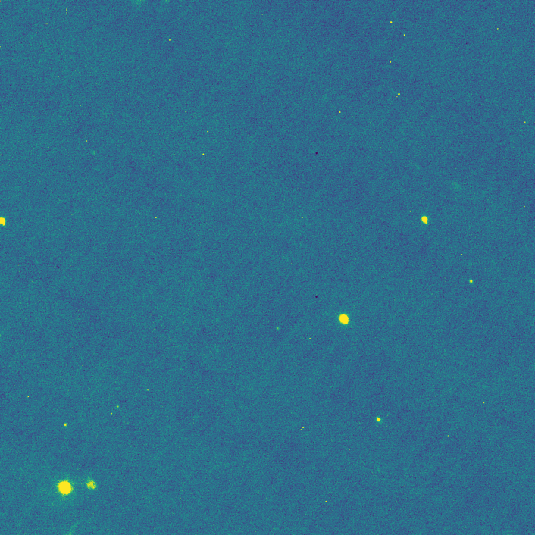
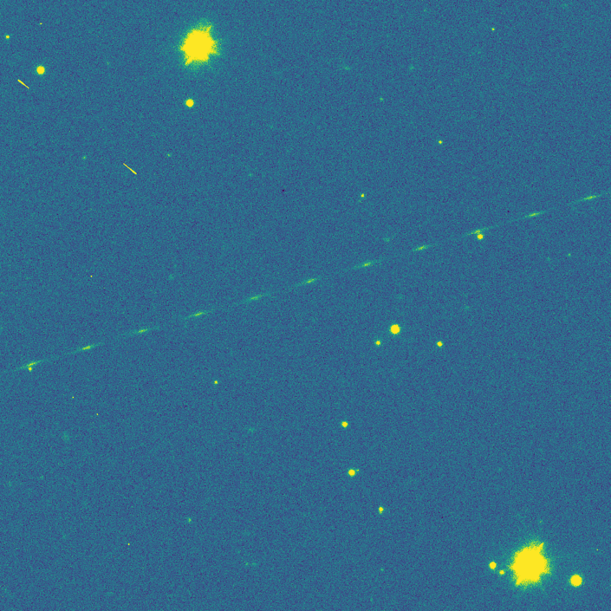
Streak detection methods
HT-LCNN by Lin et al. adapted for astronomical images
Training and validation on images from entire OmegaCAM archive
Datasets augmented with artificial streaks
Classifier to discard false positives detections
Streak is here!

Slide 7
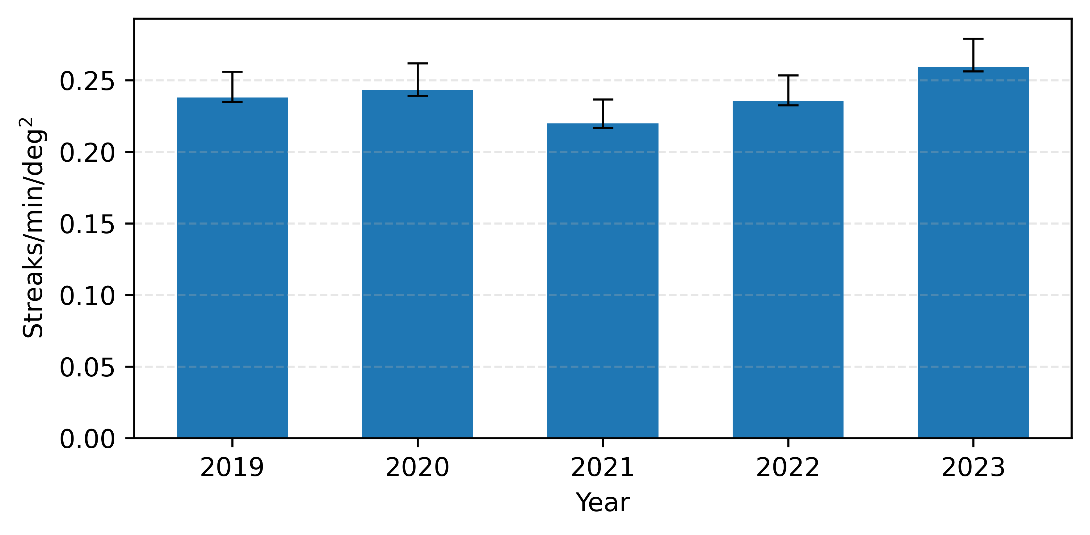
Results
~ 123’000 images analyzed (32 CCDs each)
80’564 streaks detected (at CCD level)
~17% of images affected each year

Slide 8
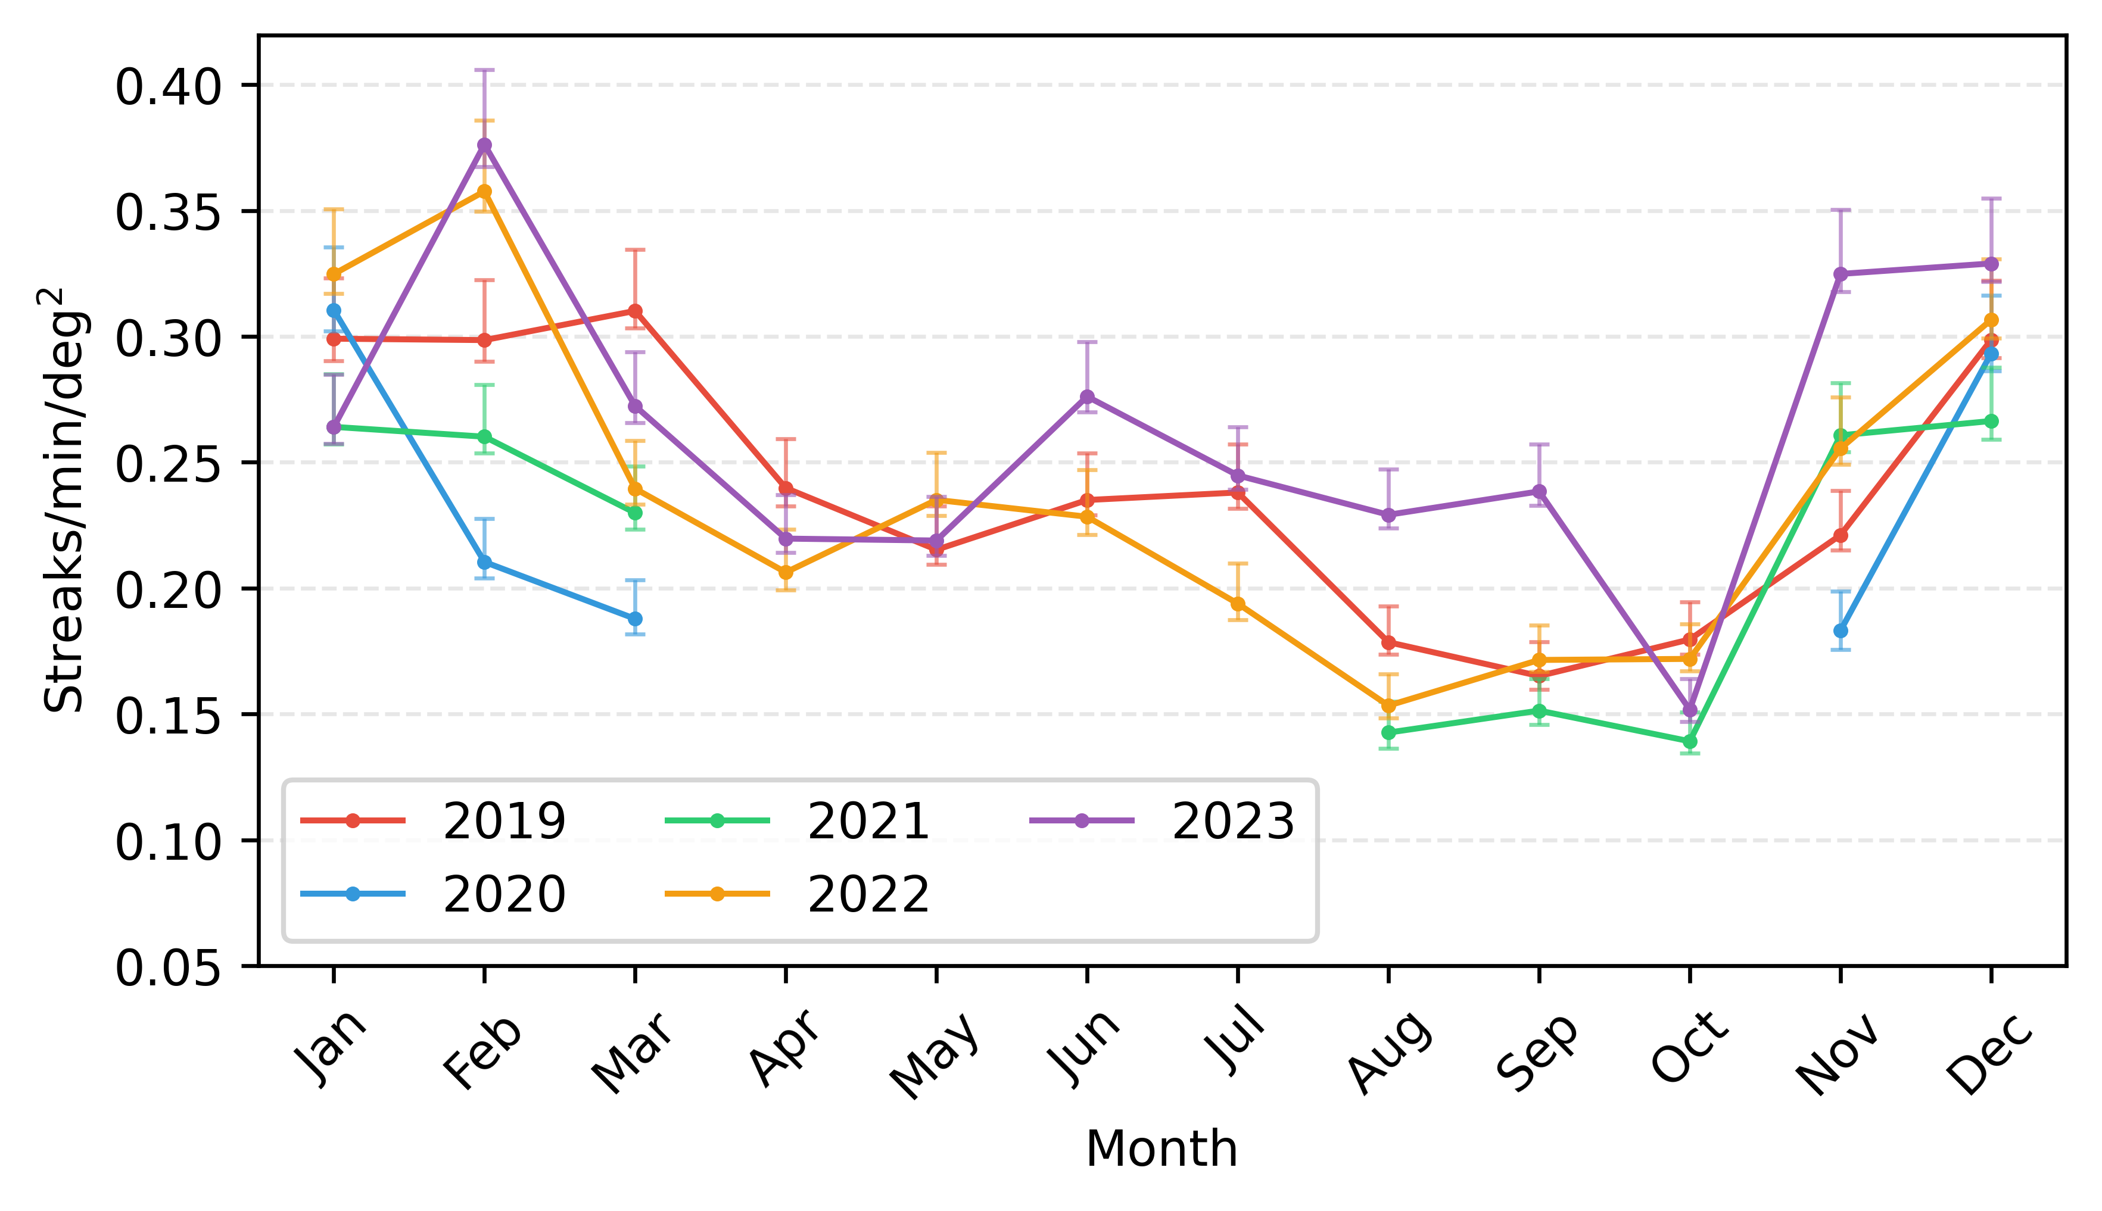
Results
Monthly variations

Slide 9
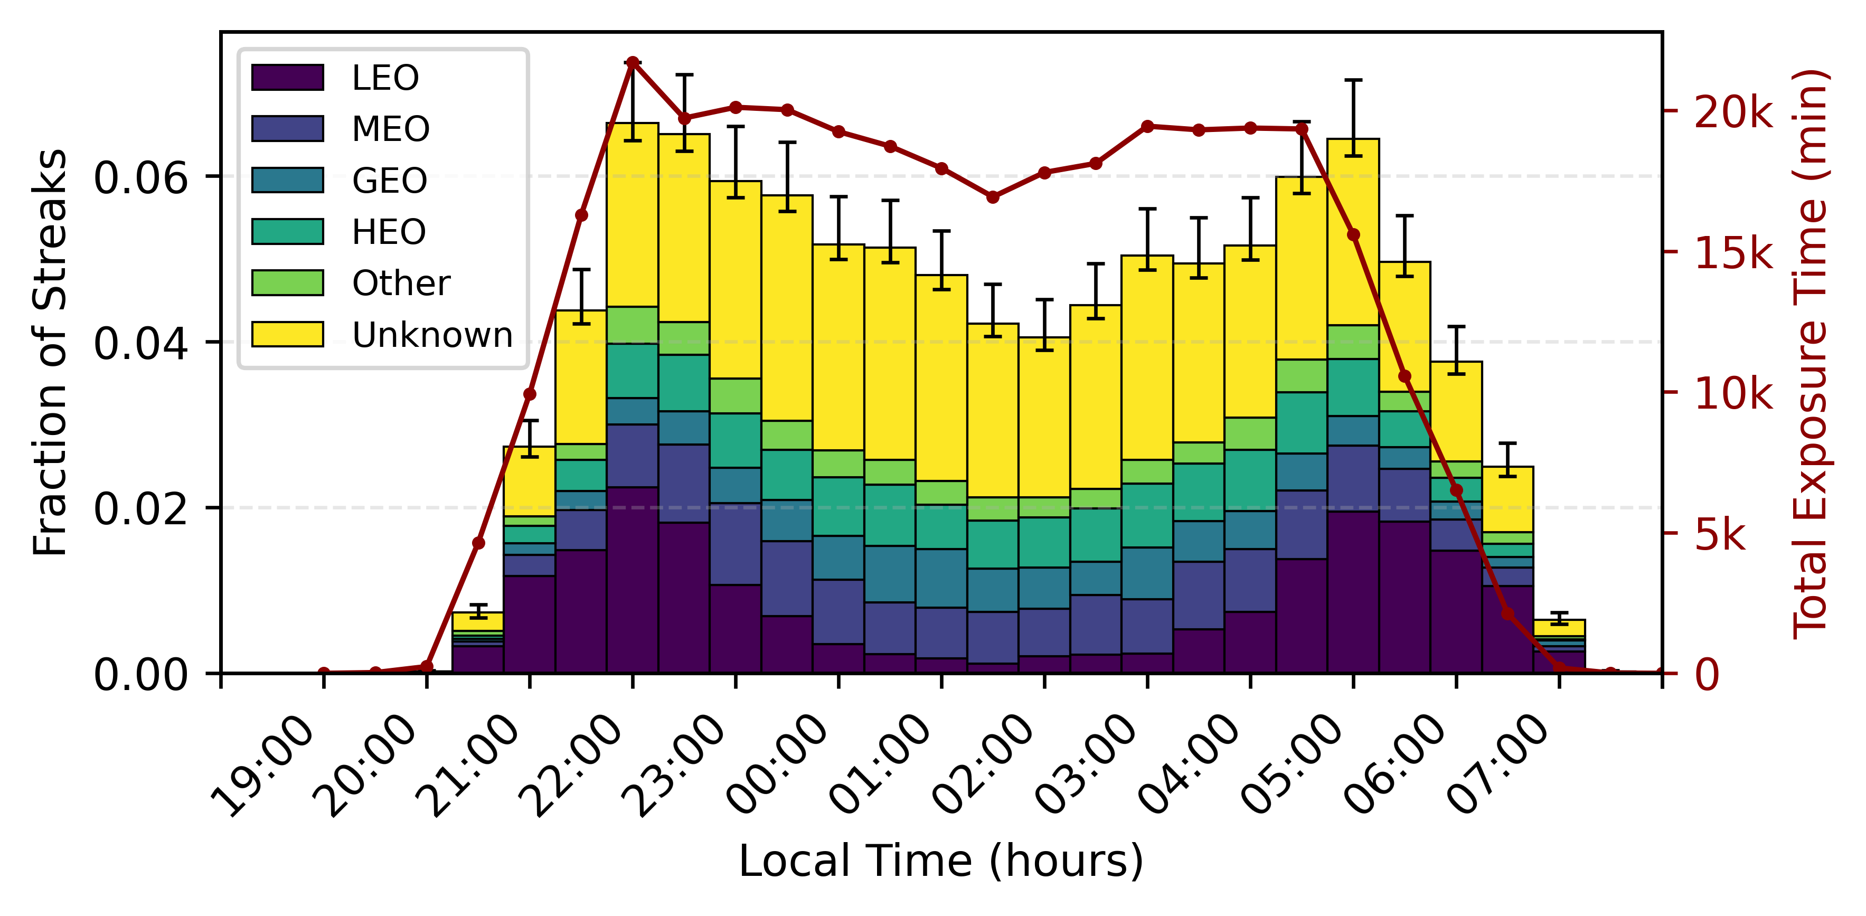
Results
Daily variations

Slide 10
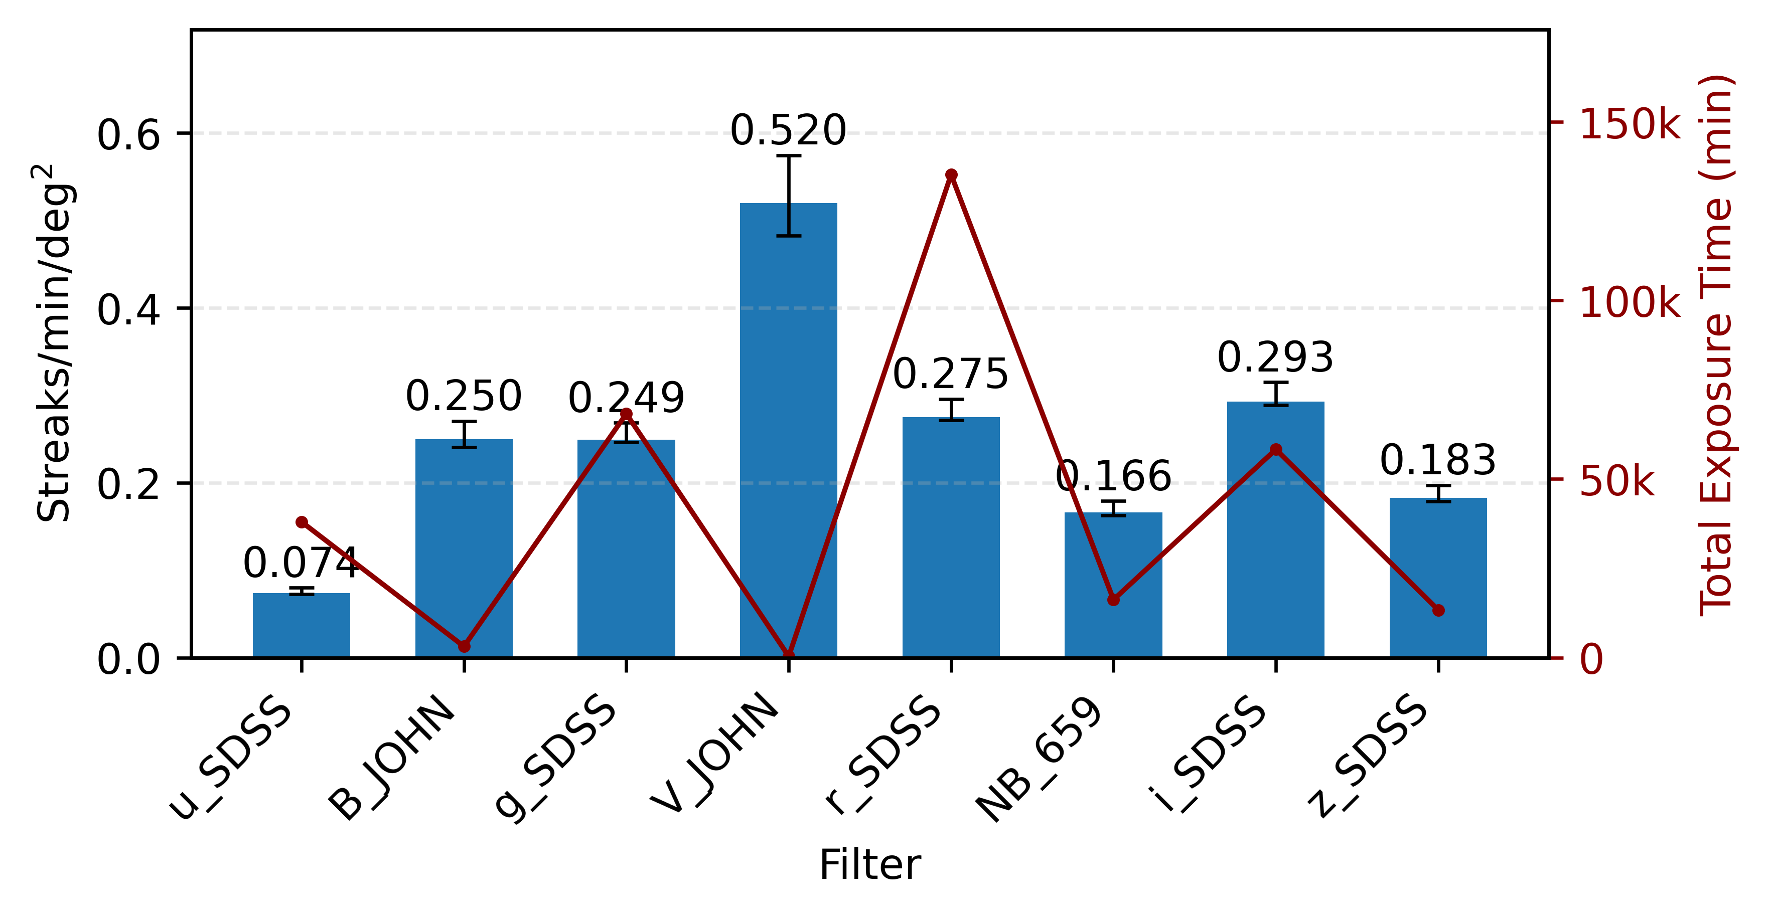
Results
Filter variations

Slide 11
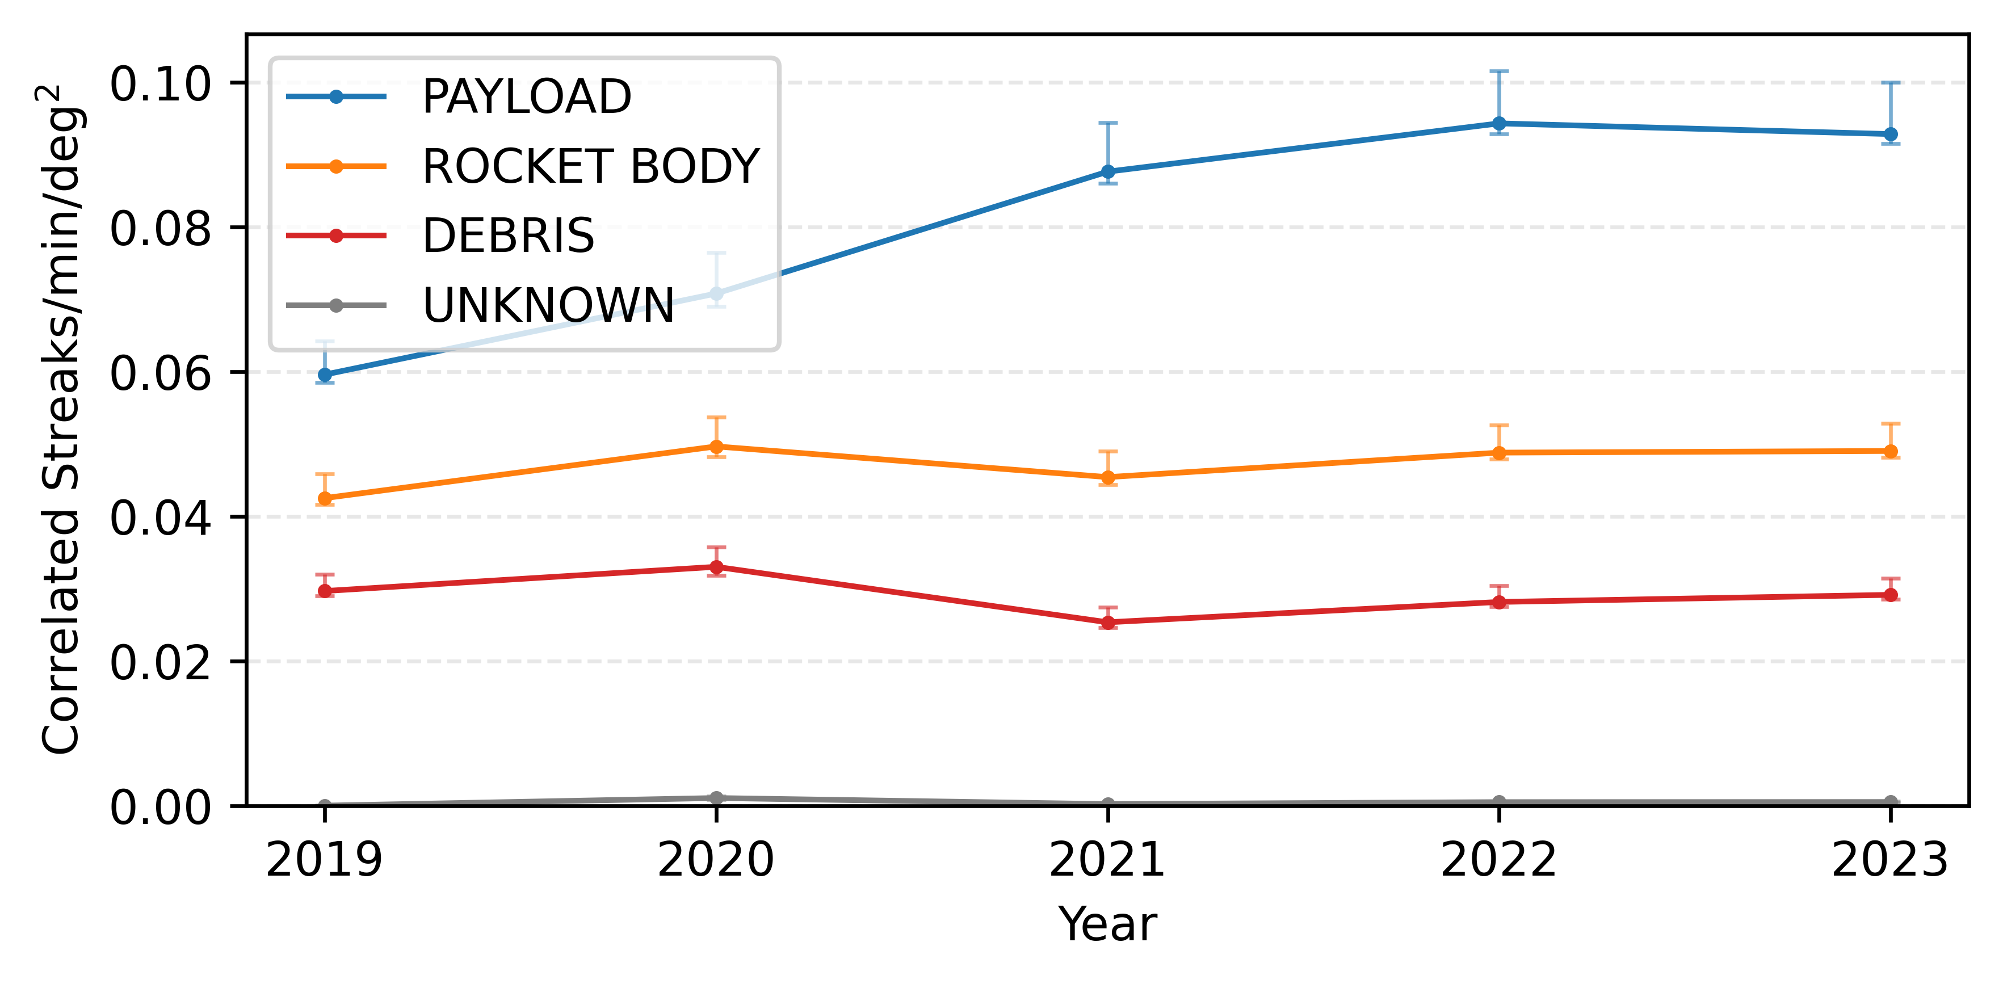
Results
Correlation with space-track catalogue
55% to 73% of streaks correlated with known objects
Megaconstellations (Starlink/OneWeb)
  → 4 streaks in 2019 to 2’131 streaks in 2023

Slide 12
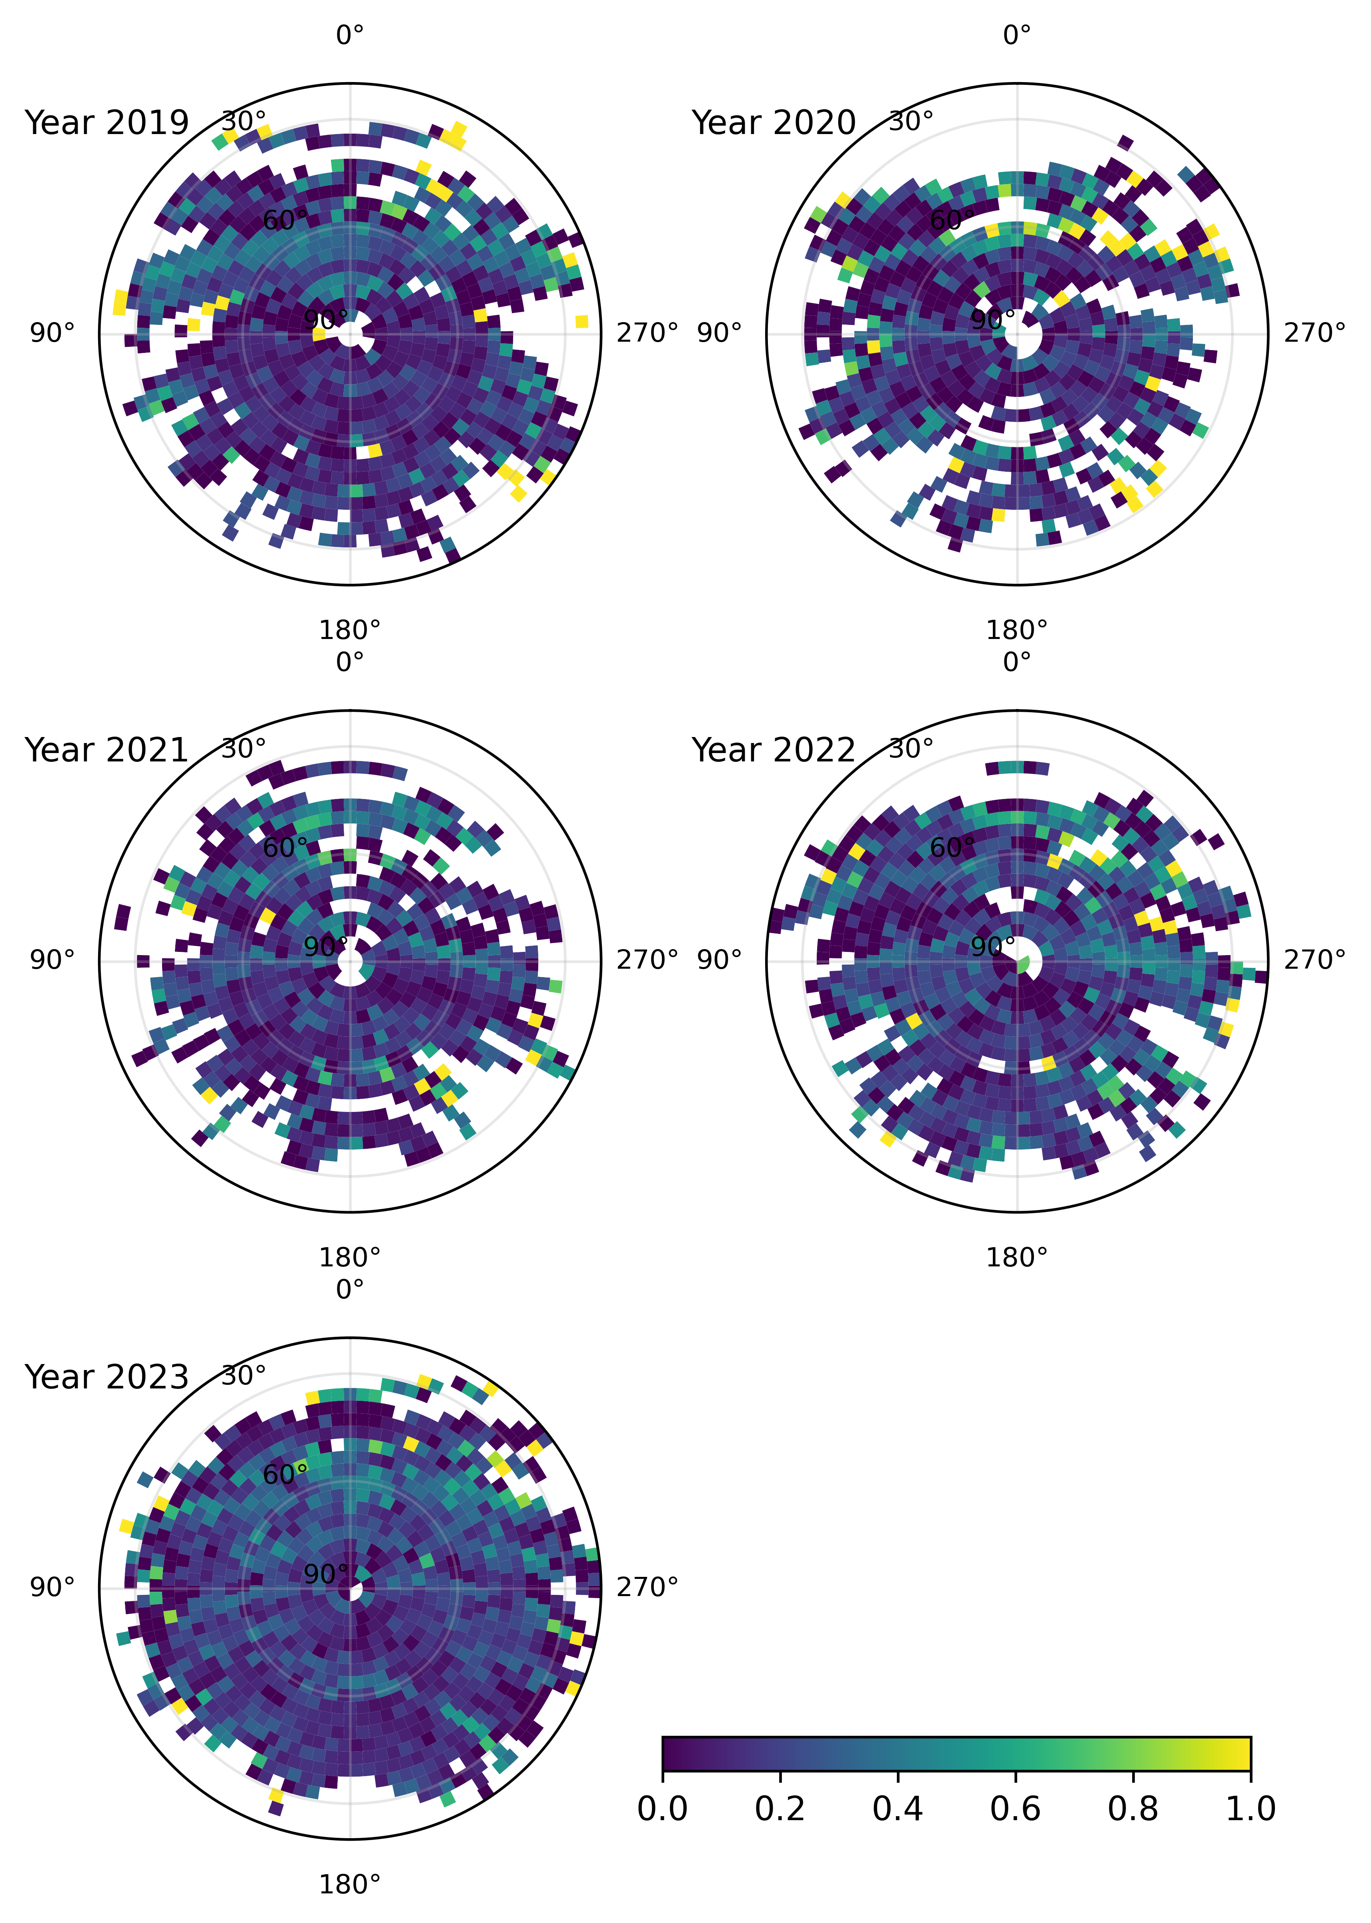
Results
Impact on observations
Fraction of images affected by at least one streak in alt-az projection

Slide 13
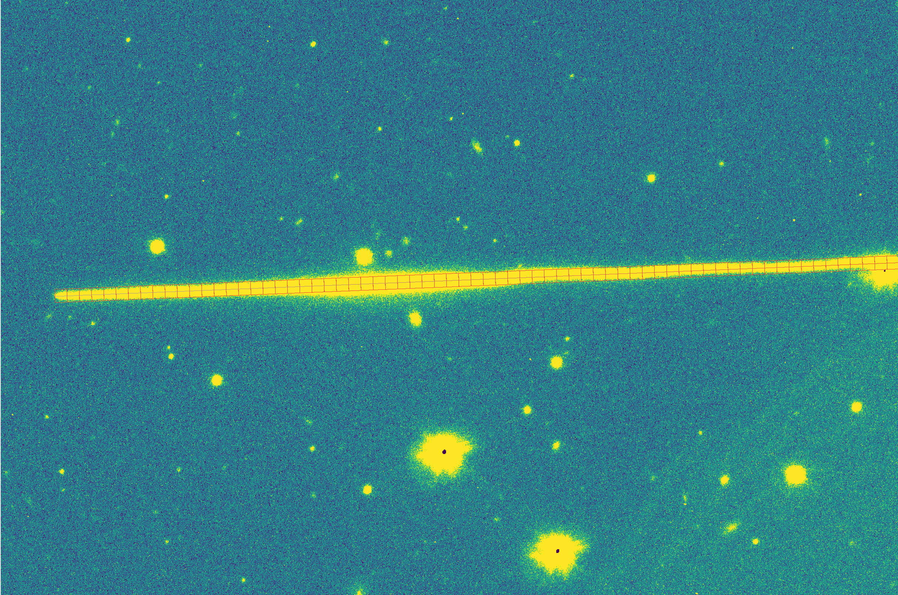
Photometric analysis

Slide 14
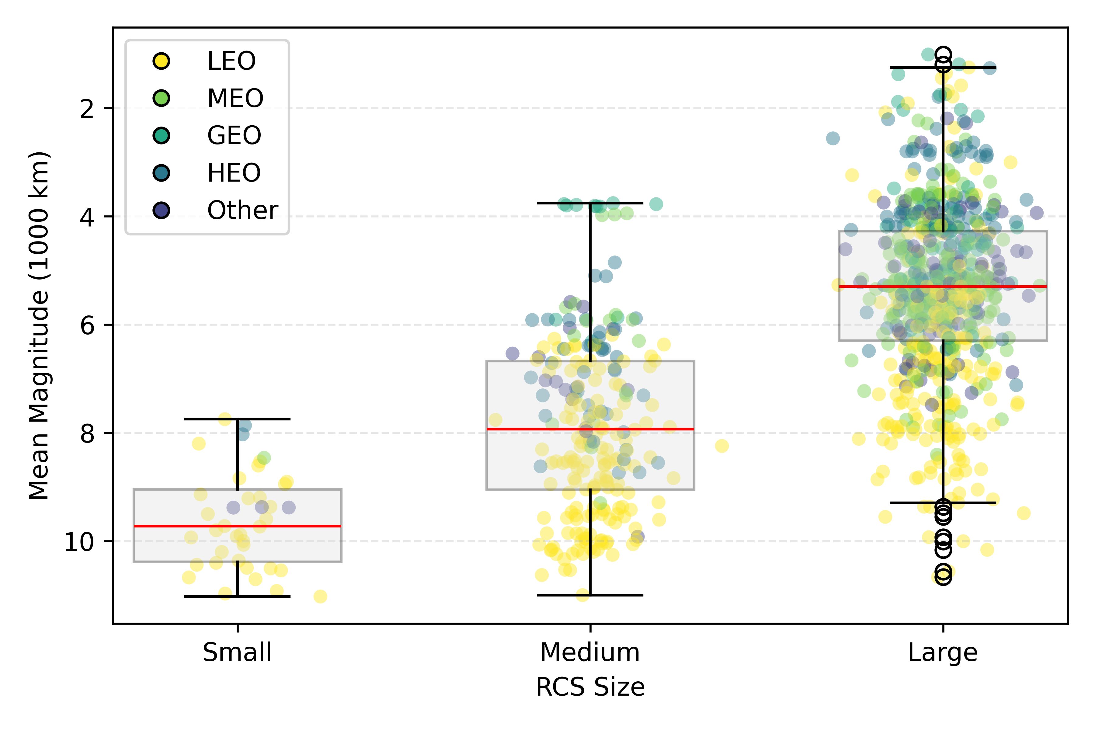
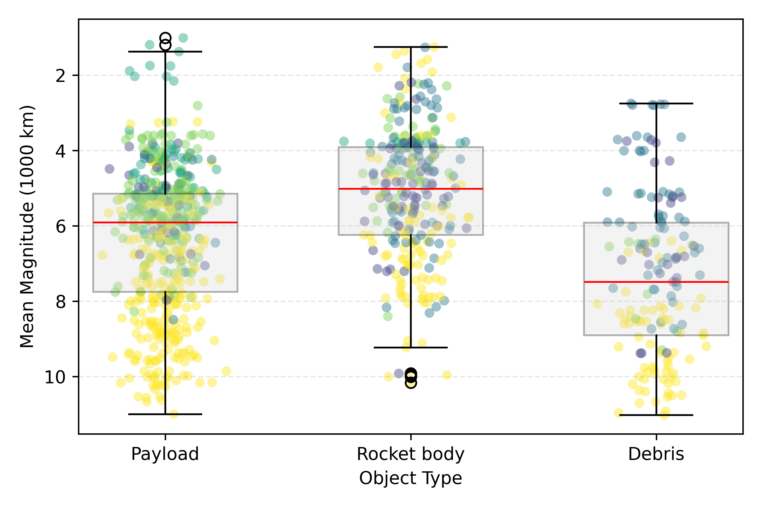
Photometric analysis

Slide 15
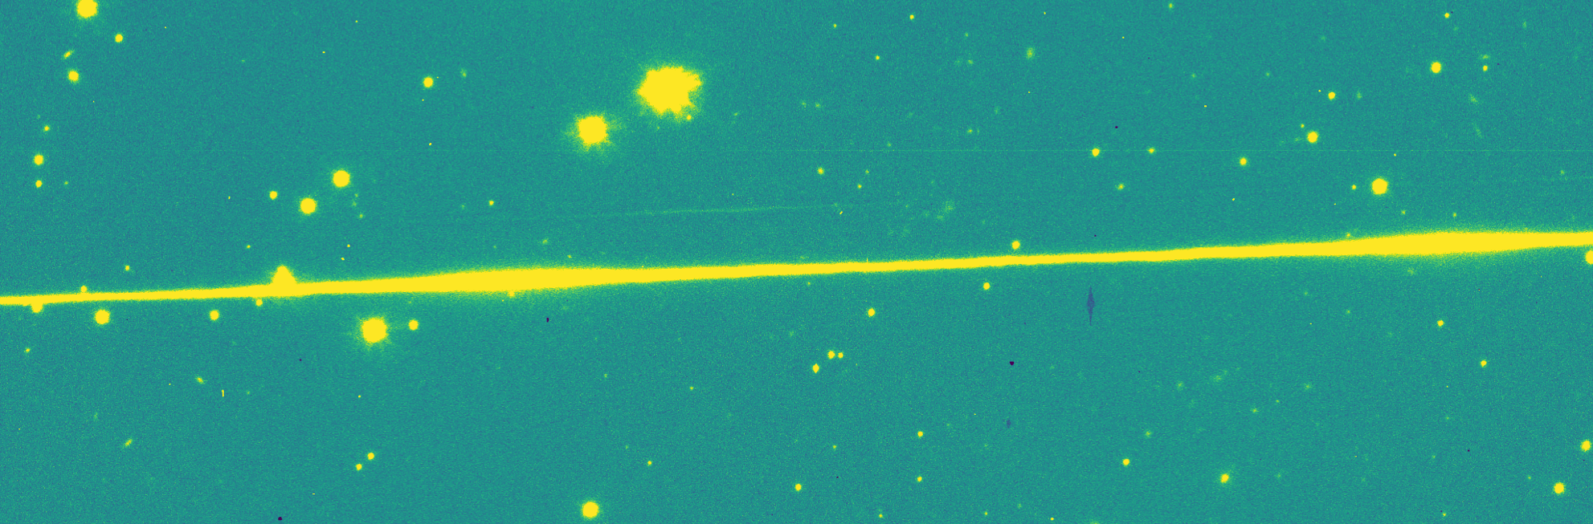
Photometric analysis
Atlas V Centaur R/B (2012-009B)
Detected on | 27.05.2022
Orbit | 3’235 X 35’247 km
Range at detection | 29’515 km

Slide 16
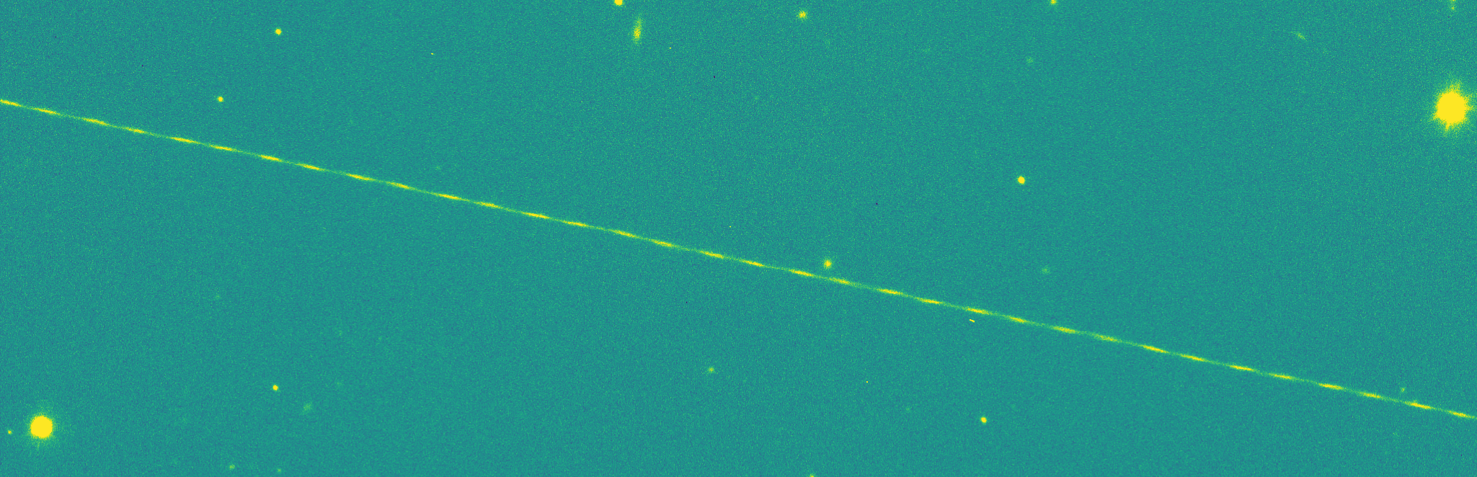
Photometric analysis
Breeze-M R/B (2004-031B)
Detected on | 09.06.2022
Orbit | 3’305 X 35’424 km
Range at detection | 22’688 km

Slide 17
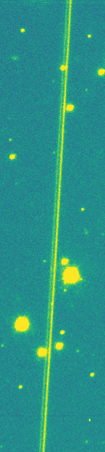
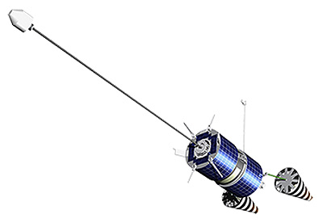
Photometric analysis
Cosmos 2145 (1991-033C)
Detected on | 11.03.2022
Orbit | 1’403 X 1’417 km
Range at detection | 1’505 km
Beam length
∼10 m
Gunter’s Space Page

Slide 18
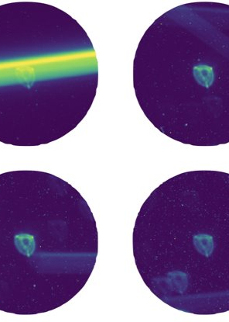
CHEOPS
Facility and images
Streak detection methods
Results

Slide 19
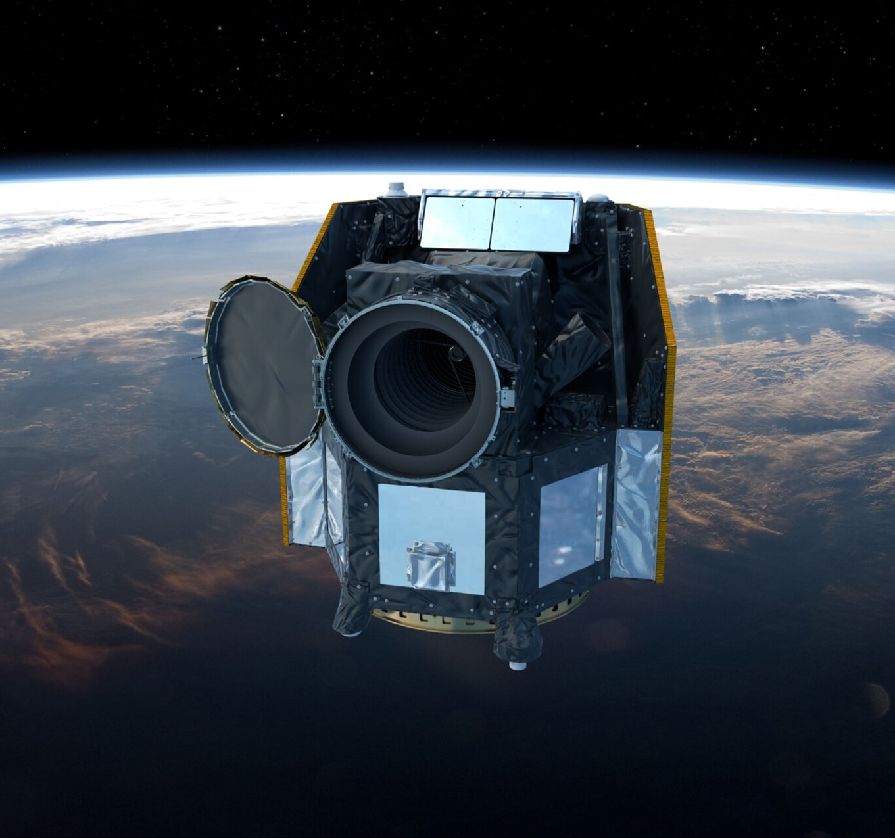
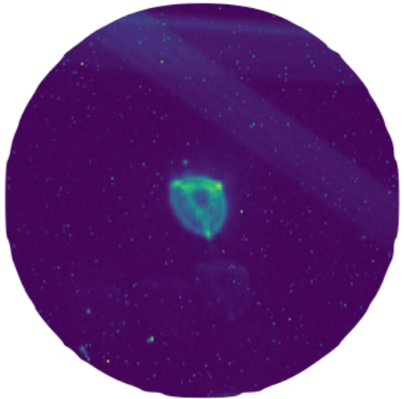
Facility and images
200 arcsec
CHEOPS space telescope
700 km Sun-synchronous orbit
1k x 1k CCD @ 1 arcsec/px
Circular ROI around observed star downloaded
1.8M+ images in the archive
Images intentionally defocused
Notes:
Cheops is located above starlink
Images very small compared with VST/OmegaCAM
Defocused images result in satellite streaks appear fainter

Slide 20
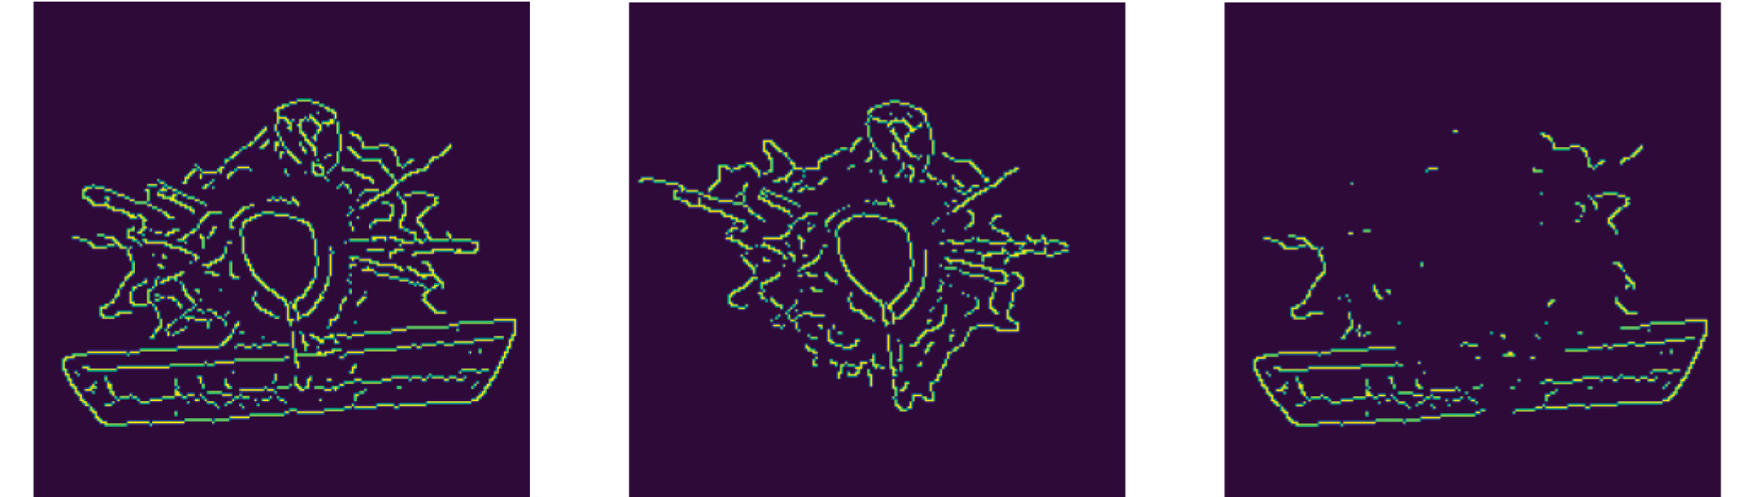
Streak detection methods
Canny edge detection to increase contrast
Subtract neighboring frame to remove central star
Apply Hough-transform to detect streaks
~5000 streaks detected on 1.5 million images
Edge map
Edge map from neighboring image
Difference image fed to streak detection
L. F. P. Gonçalves et al., “Space-based surveillance of Resident Space Objects with the CHEOPS space telescope”, Acta Astronautica, 2026, doi: https://doi.org/10.1016/j.actaastro.2025.10.064

Slide 21
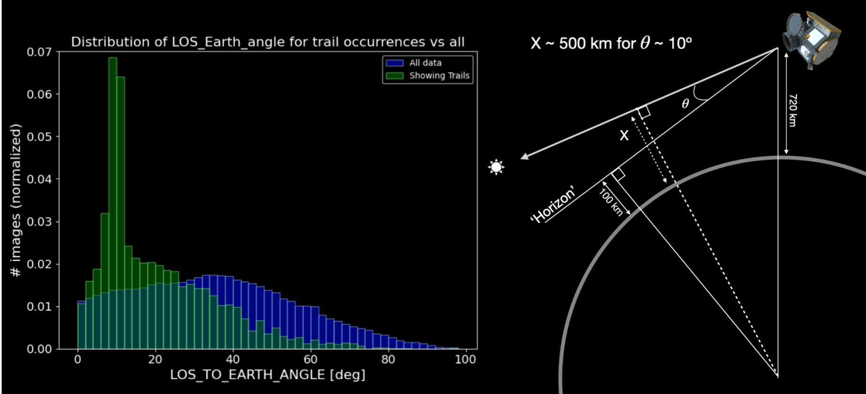
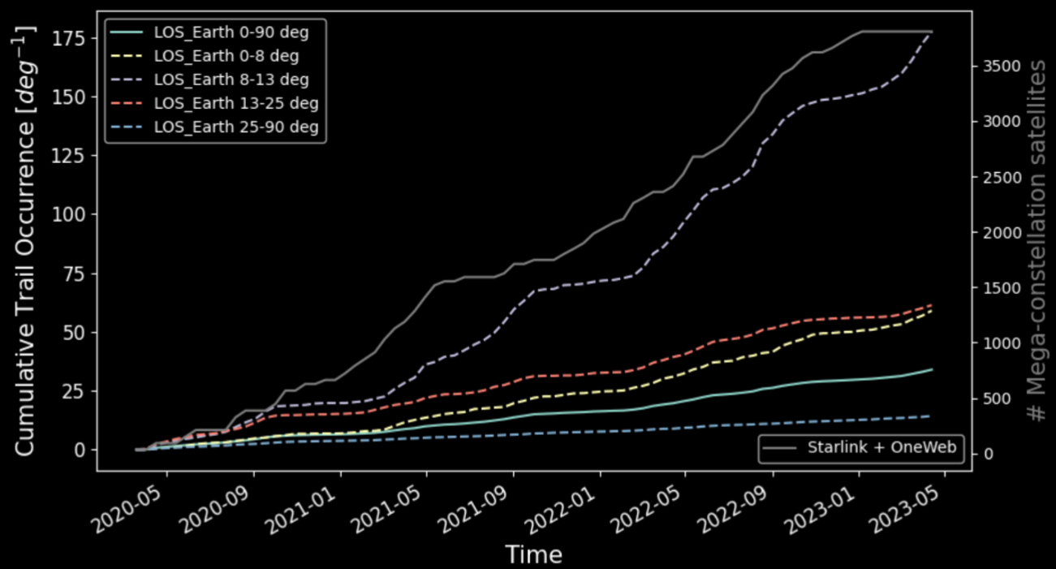
Streak detection methods
Binary classifier with custom classification head
Model trained with streaks detected by the Edge-Hough transform method
Hough transform with decreased detection threshold to recover orientation
>12'000 streaks detected on 1.8 million images
Starlink
N. Billot et al., “In-situ observations of resident space objects with the CHEOPS space telescope,” Journal of Space Safety Engineering, 2024, doi: 10.1016/j.jsse.2024.08.005
Notes:
The ML method was trained with detections made with the conventional algorithm
Because the classifier does not output the streak location, we applied the conventional algorithm with decreased detection thresholds to recover location and orientation
The 12k detections are not yet published (we just submitted the revised version) but the main author is OK to mention this number
9176 streaks could be correlated (5565 individual objects)
The left image shows the distribution of detected streaks over the Line of sight
CHEOPS is above starlink but it points so low to the horizon that it looks through the starlink shell
This is why starlinks are detected
The right image shows the increasing trend of detected streaks over the time of CHEOPS operations (for different lines of sights)

Slide 22
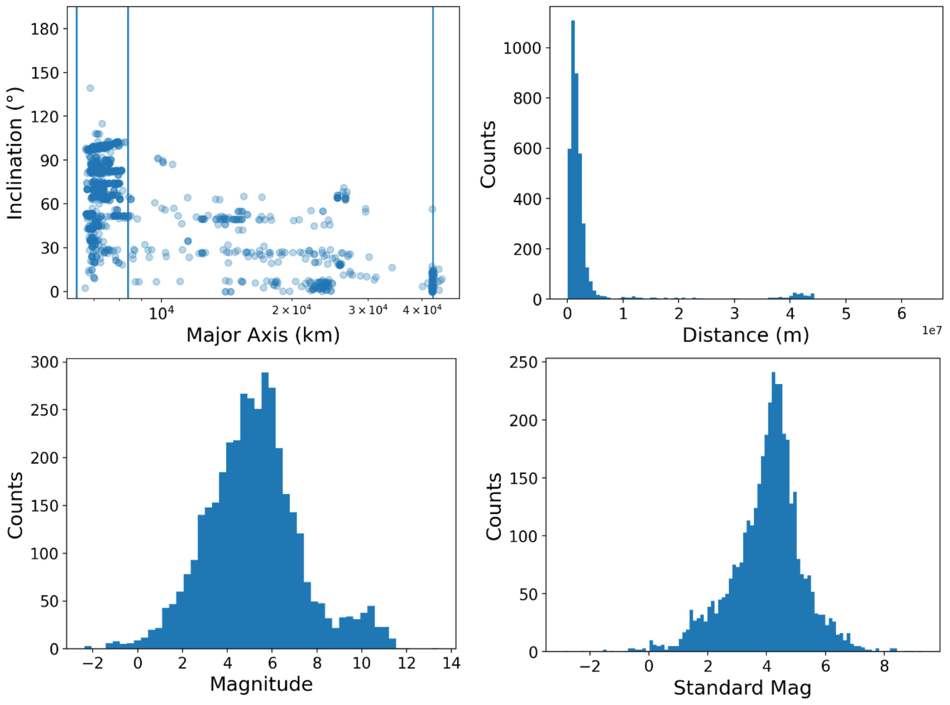
Results
Most detected satellites in LEO, few in GTO and GEO
No significant impact on CHEOPS science, but clear rising trend noticeable
Majority of detected satellites exceed IAU CPS satellite optical brightness recommendation
Starlink satellites 1 to 2 magnitudes brighter than on ground-based observations
LEO
GEO
IAU recommendation
L. F. P. Gonçalves et al., “Space-based surveillance of Resident Space Objects with the CHEOPS space telescope”, Acta Astronautica, 2026, doi: https://doi.org/10.1016/j.actaastro.2025.10.064
Notes:
The left plot shows the orbits of the detected objects, the middle is the apparent magnitude and the right the Standard 1000km magnitude
IAU recommendation for 1000km is ~7.7
Mean starlink 1000km std mag was 4.5 mag

