Slide 1
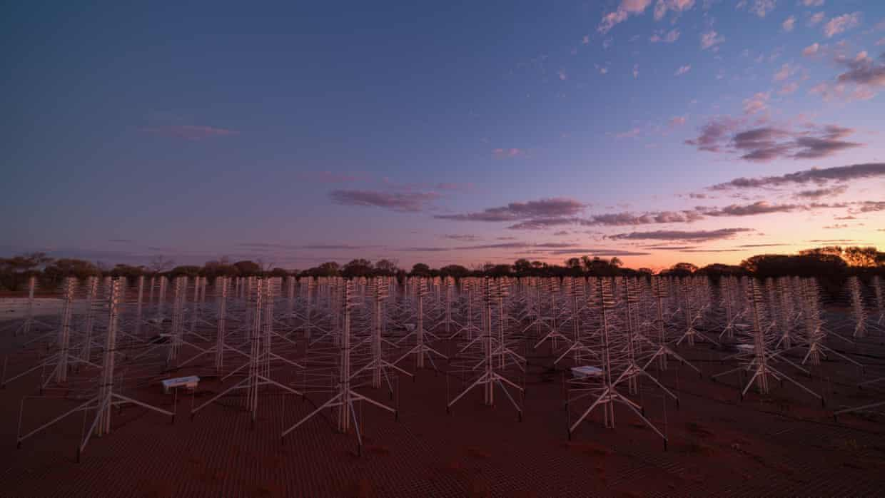
TABASCAL Improvements in Speed, Accuracy and Extensibility
Chris Finlay (EPFL)
Emma Tolley (EPFL), Simon Frasch (CSCS)
© SKAO

Slide 2
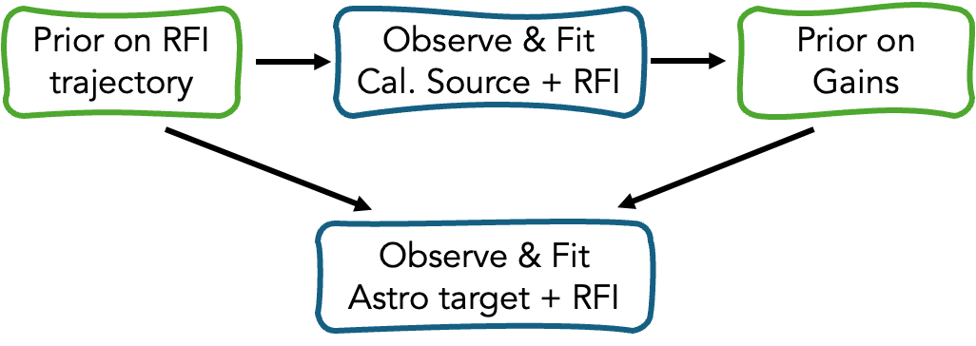
Trajectory-based RFI subtraction and calibration
TABASCAL - arXiv:2301.04188 (MNRAS 2023), arXiv:2502.00106 (A&A 2025)
Bayesian forward model for RFI signal, astronomical signal, and antenna gains
Use RFI trajectories to separate astronomical and RFI signals
Funded by PASC (2025-2028) to scale to Tier-0 HPC clusters

Slide 3
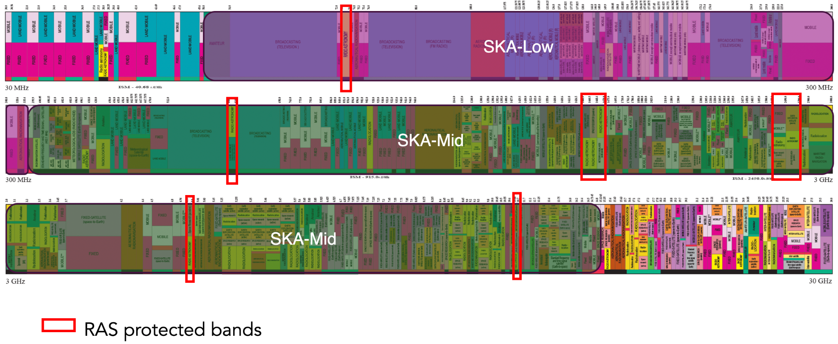
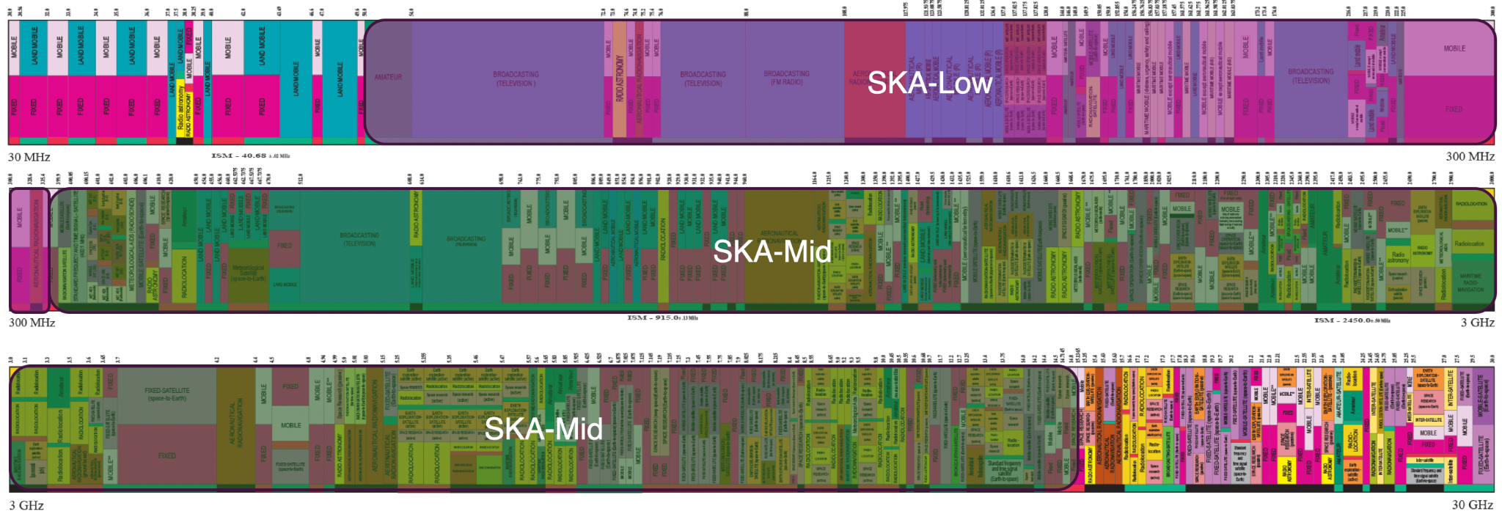
A Very Full Radio Spectrum
Cerardi

Slide 4
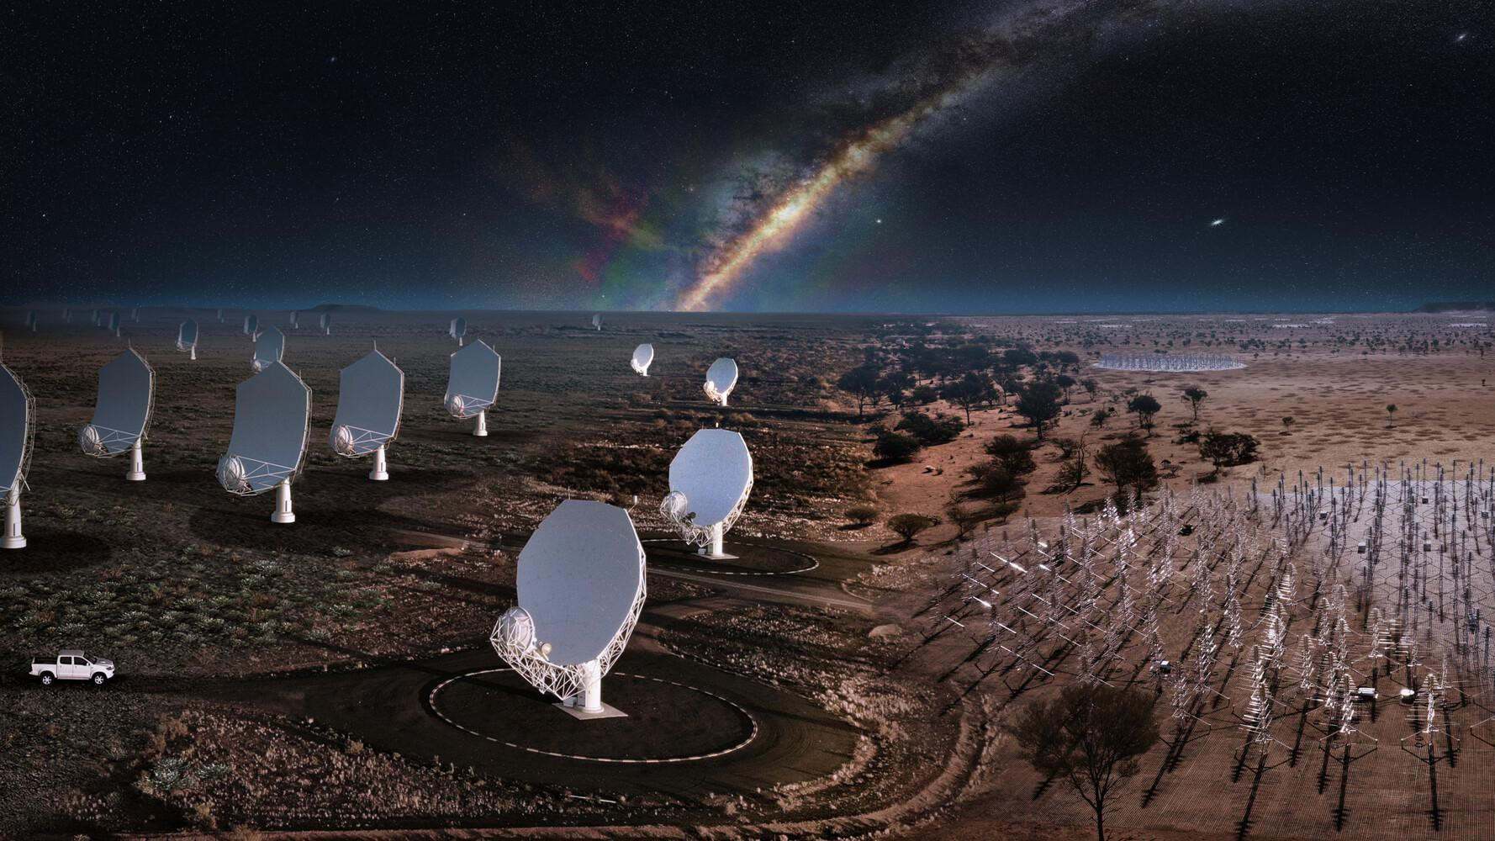
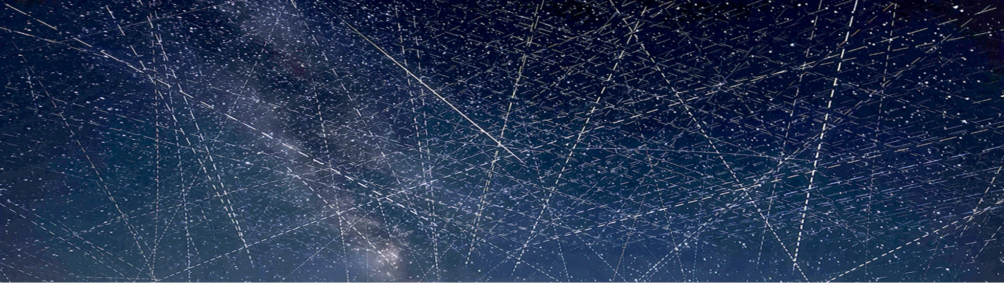
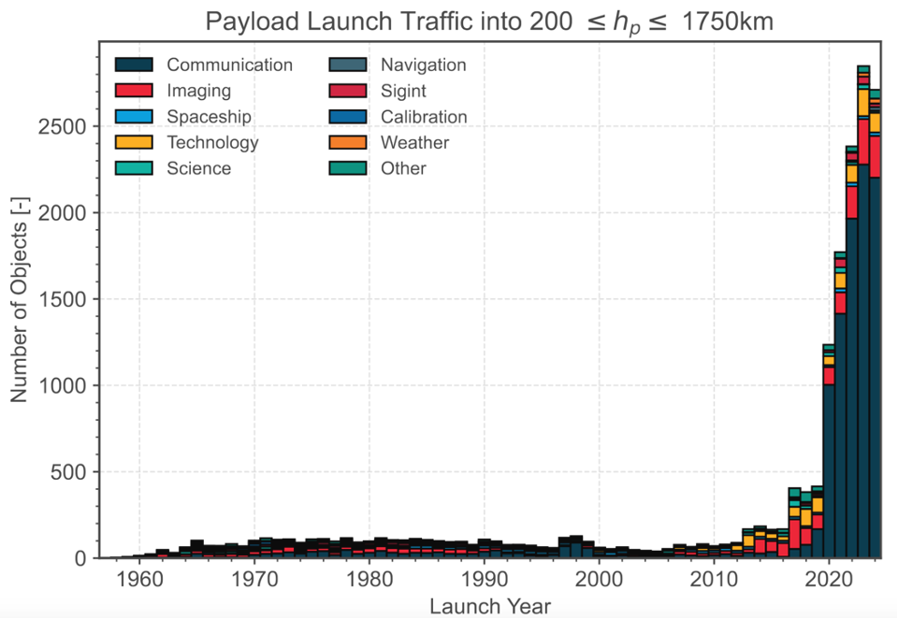
© Alan Dyer/AmazingSky.com
© SKAO

Slide 5
Flagging = Data loss = Financial cost
MeerKAT (SKA-Mid precursor)
Base cost ≅ € 300 million (2018)
Extension cost ≅ € 40 million (2020)
UHF band data loss ≅ 18%
L band data loss ≅ 31%
S band measurements in progress.
Estimated cost ≅ € 75 million
Full SKA
Construction with 10 years of operation ≅ € 2,1 billion (2021)
10% data loss for SKA-Low ≅ € 100 million

Slide 6
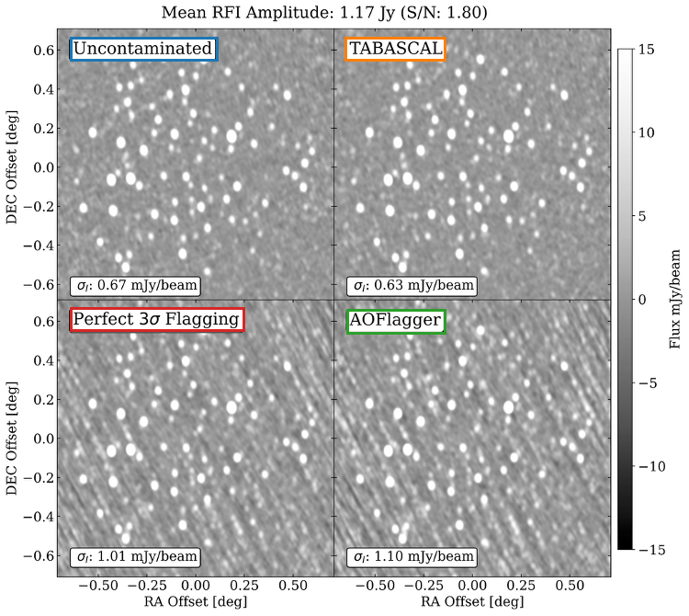
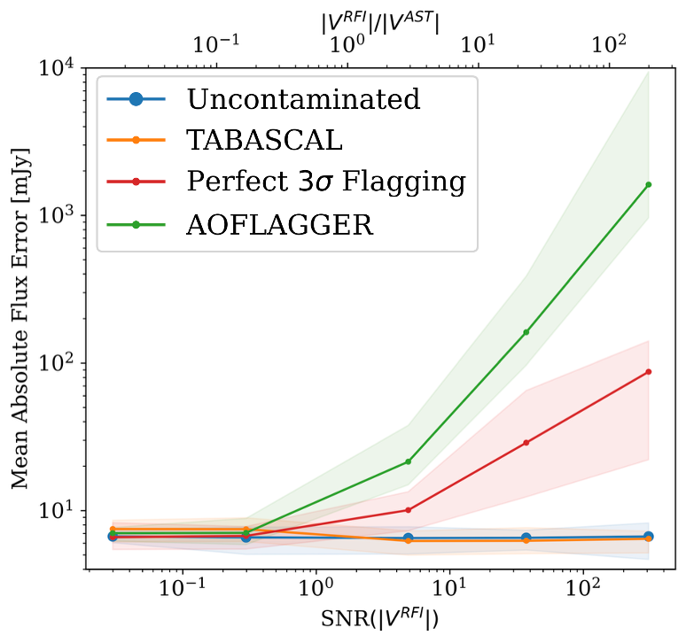
MeerKAT simulation results

Slide 7
Latest Results on Real Data

Slide 8
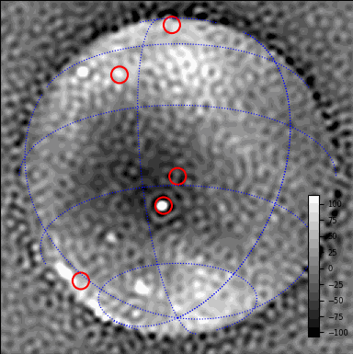
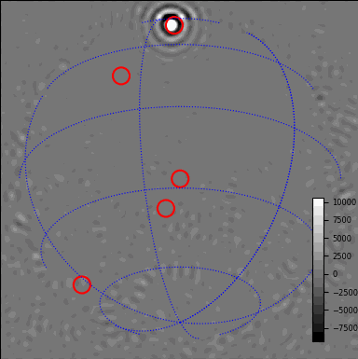
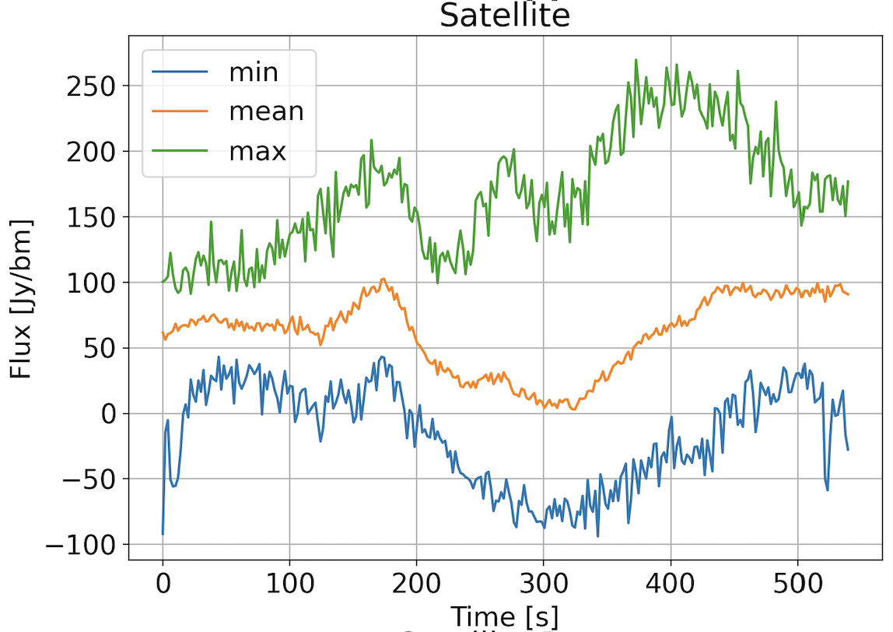
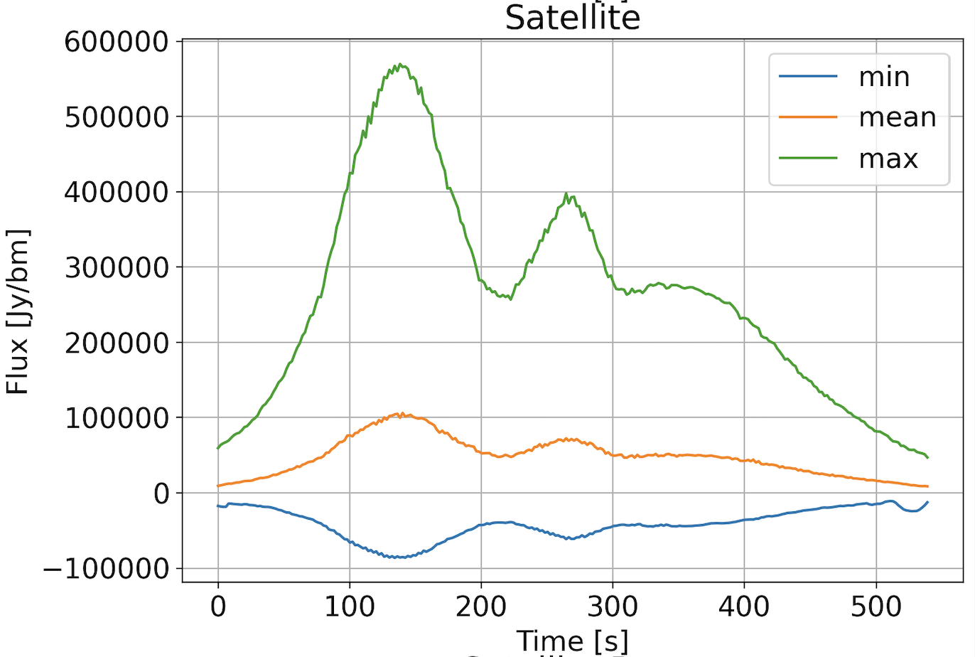
EDA 2 ≅ SKA-Low station - Raw Data
“Clean” Channel
Contaminated Channel

Slide 9
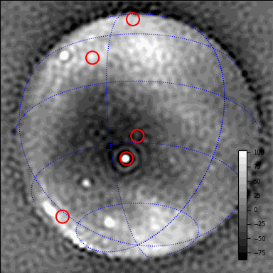

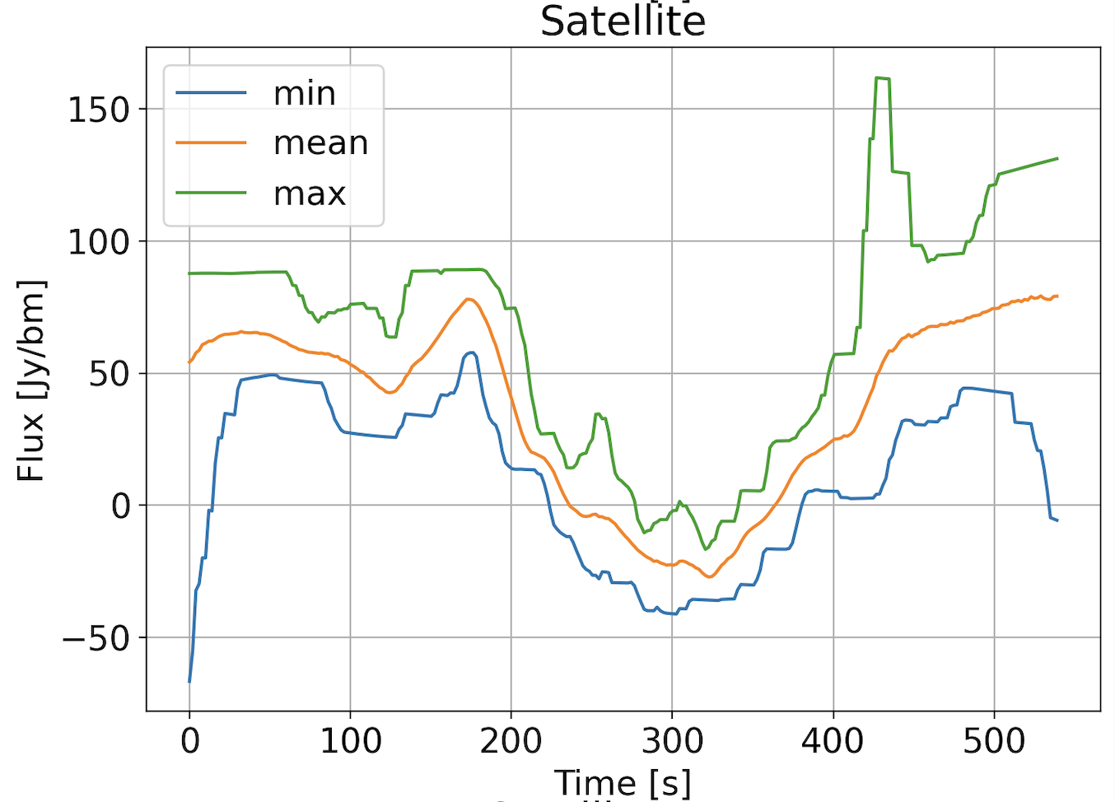
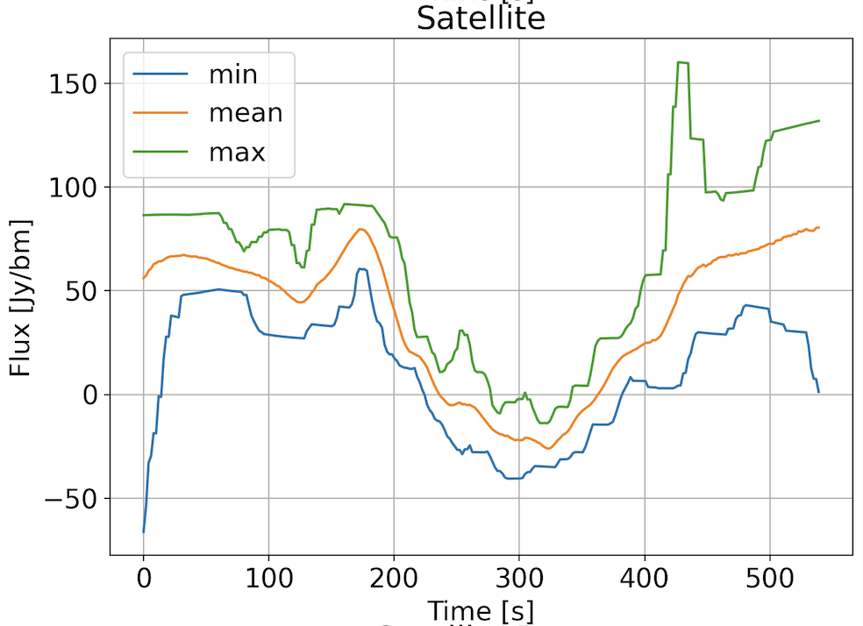
EDA 2 ≅ SKA-Low station - Astro Signal Estimate
“Clean” Channel
Contaminated Channel

Slide 10
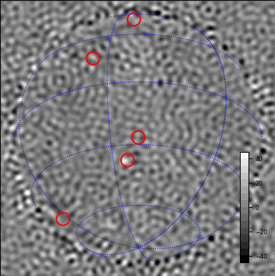
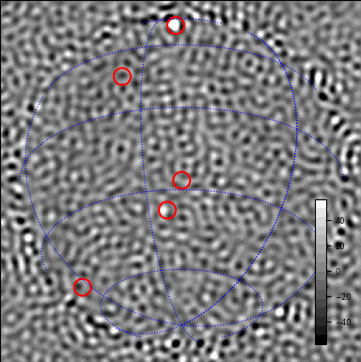
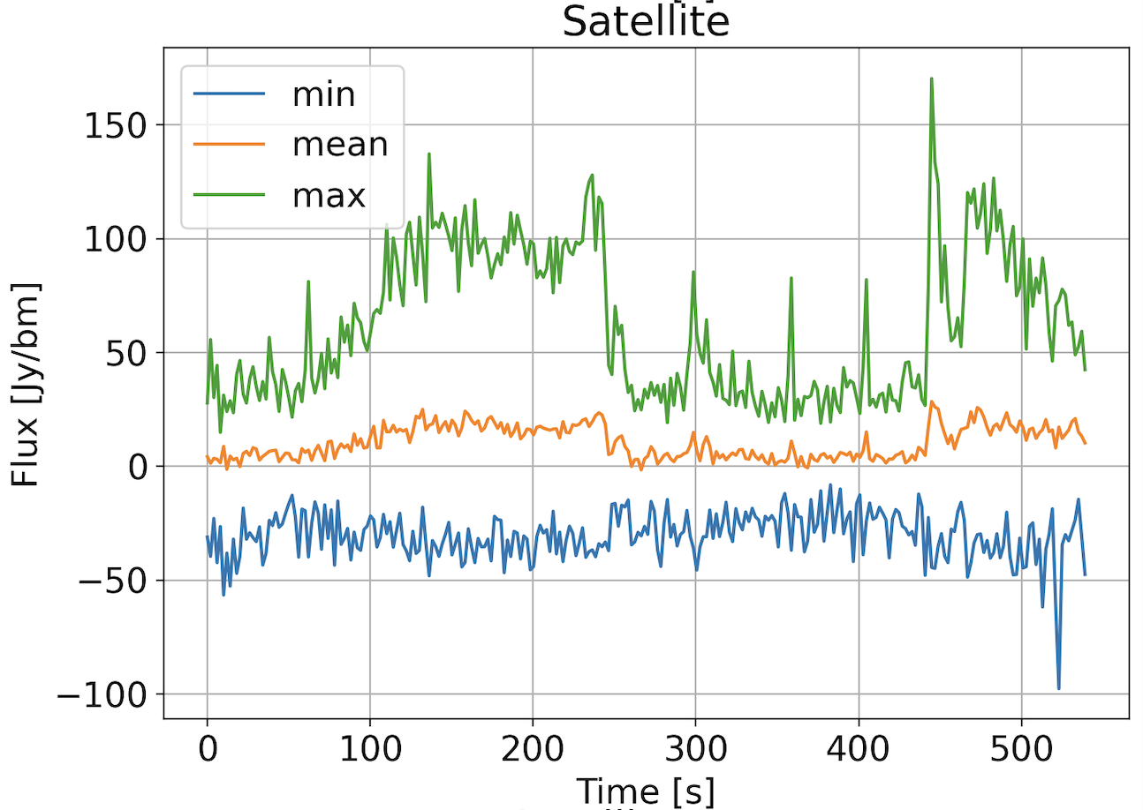
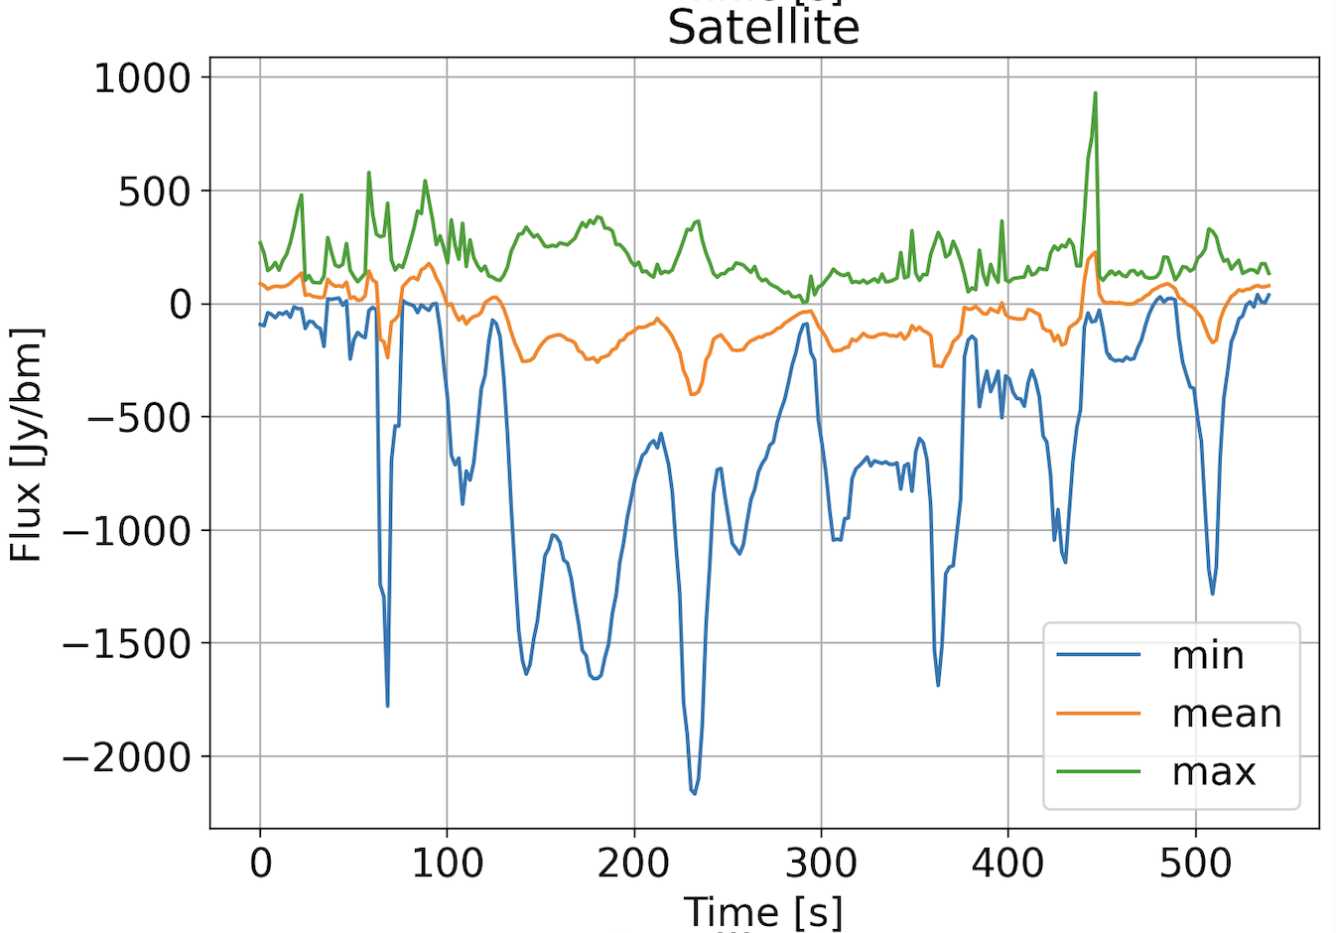
EDA 2 ≅ SKA-Low station - Residual (unmodelled) signal
“Clean” Channel
Contaminated Channel

Slide 11
Computational Improvements
Speed
Full FFT-based interpolation and Gaussian process regression
Custom CUDA kernels for RFI visibility calculation
Including gradient calculation
Features
2-d Gaussian processes to include time and frequency-axis correlations
Complete code refactor to modular component-based design

Slide 12
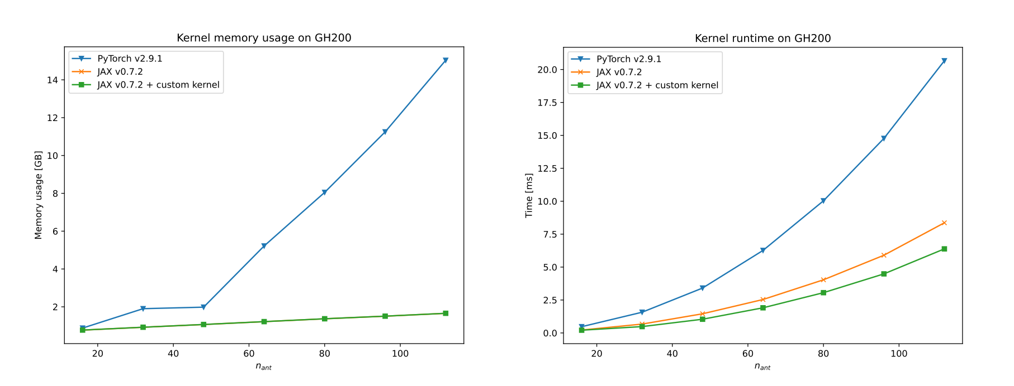
RFI Visibility Calculation - The Kernel

Slide 13
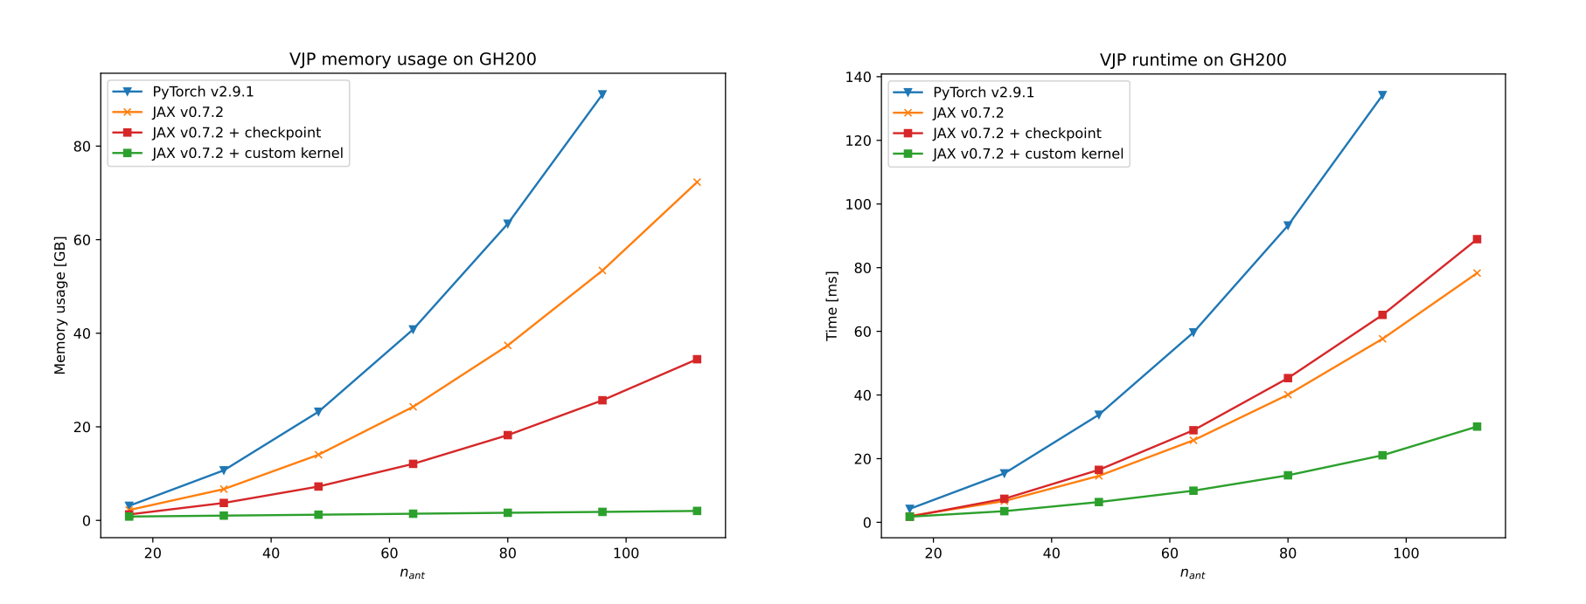
Reverse-mode Gradient Calculation

Slide 14
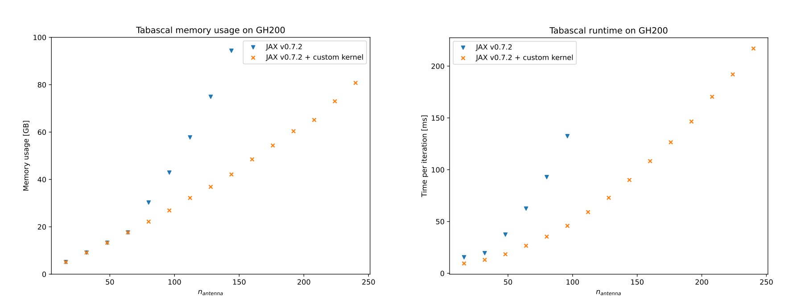
Full TABASCAL Run

Slide 15
Full TABASCAL Run
Computation and memory scale with problem size
Varying number of antennas O(n²)
32 satellites O(n)
1 frequency channel O(n)
1 minute observation with 50 Hz RFI sampling O(n)
~81 GB @ 240 antennas
~29 GB @ 144 antennas in SKA-Mid AA*
~132 GB @ 307 antennas in SKA-Low AA*

Slide 16
TABSCAL - Upcoming Computational Work
Improve startup time (~50% of overall cost)
Move to single precision (2x improvement expected)
Implement CI/CD pipeline
Scaling up : multi-GPU implementation

Slide 17
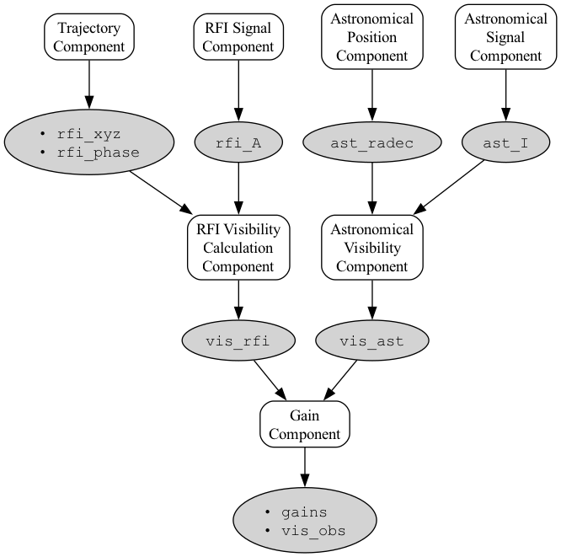
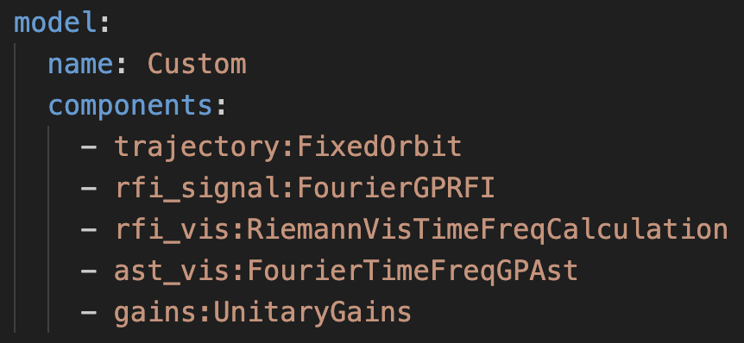
Modular TABASCAL - Code Extensibility

Slide 18
Modular TABASCAL - Code Extensibility
Modular component-based visibility model
One-line component changes of a model (configuration file)
Contributors can make components for any part of a visibility calculation:
Custom astronomical sky models e.g. power spectra or AI
Signal corruptions e.g. cross-talk, primary beams

Slide 19
Thanks for your attention
Email: christopher.finlay@epfl.ch
RFI simulations: https://github.com/chrisfinlay/tab-sim

Slide 20

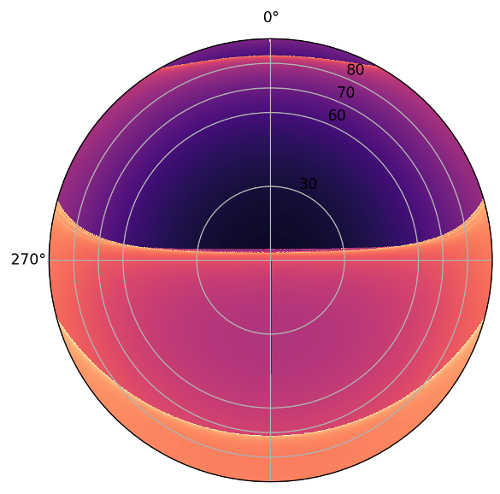
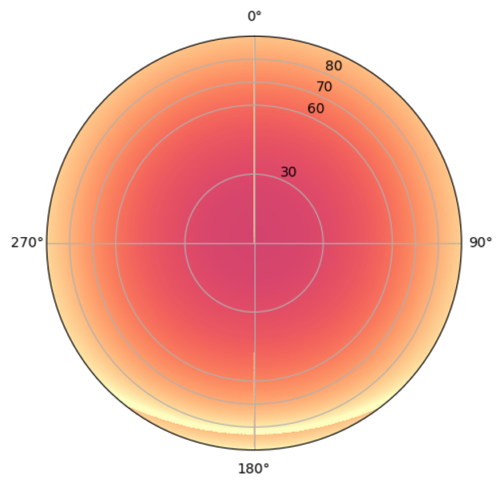
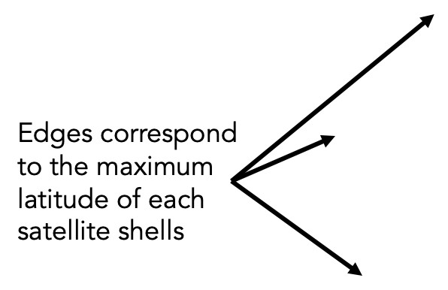
Sky occupancy based on 6 orbit shells
Cerardi
Above LOFAR
Above SKA-Low
Sats /h

Slide 21
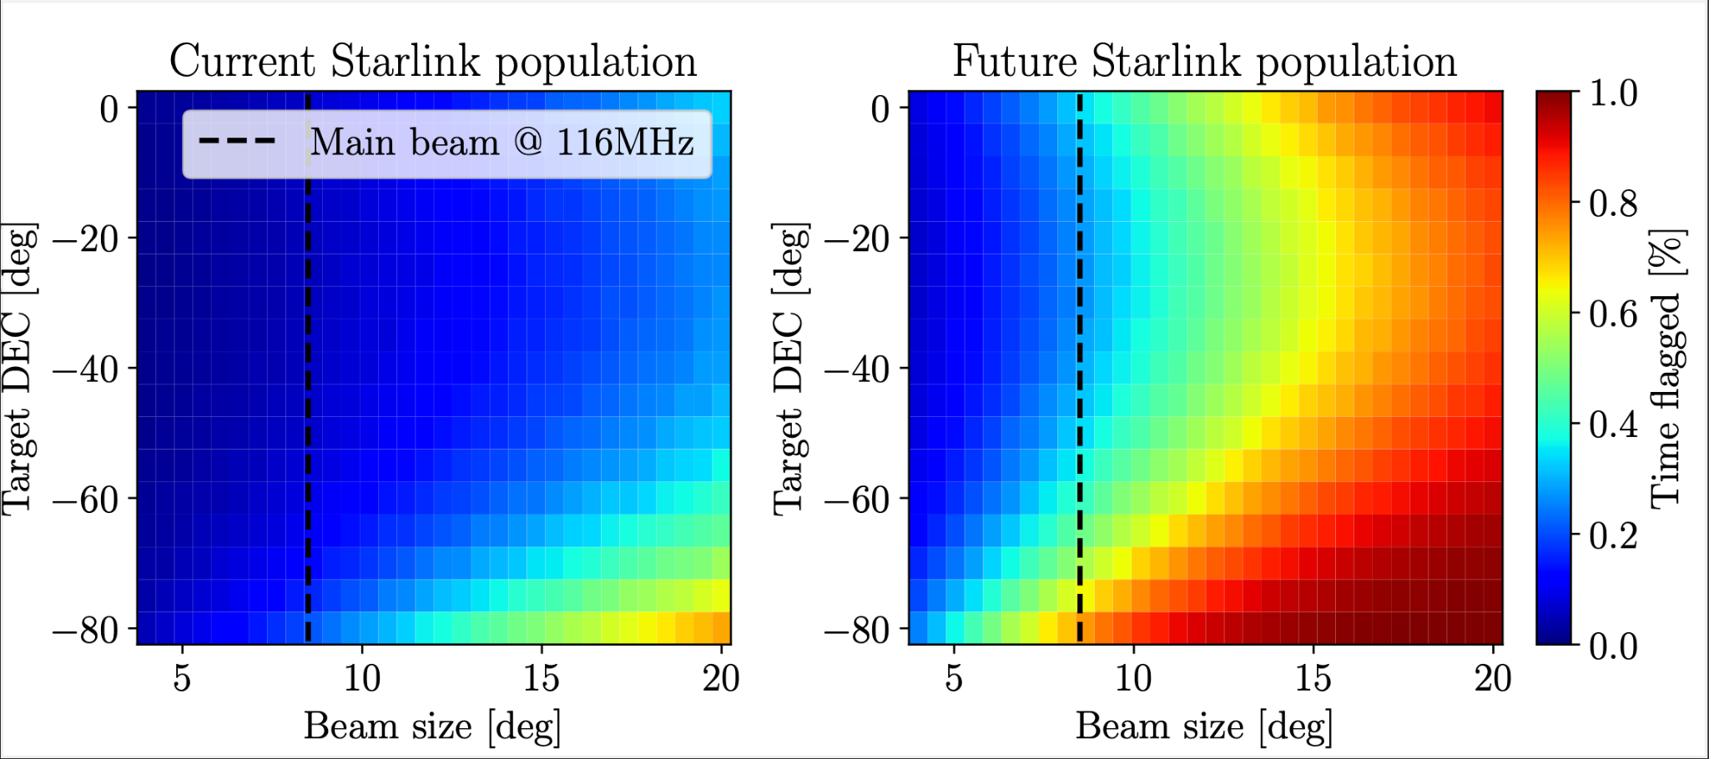
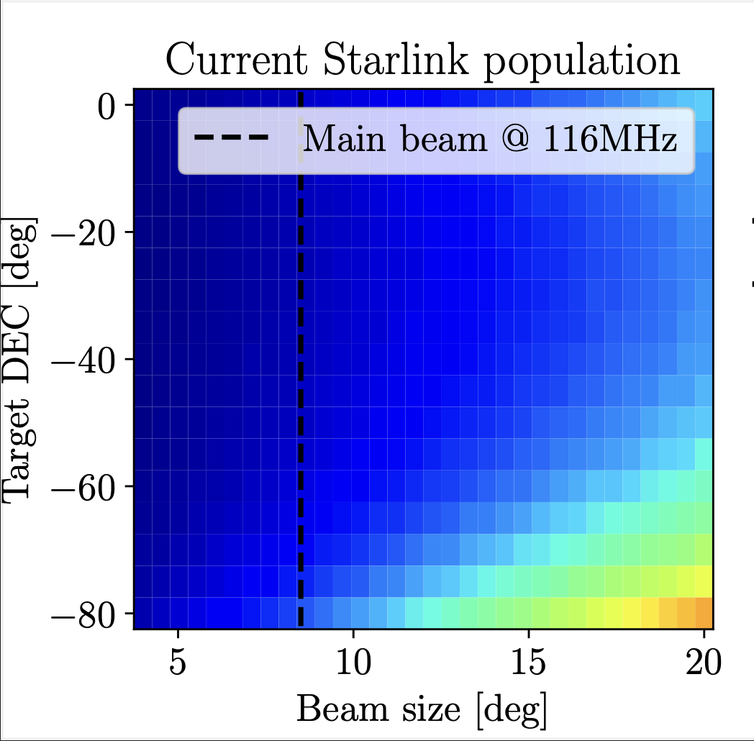
© Alan Dyer/AmazingSky.com
7’000 Starlink
40’000 Starlink
© SKAO

