Slide 1
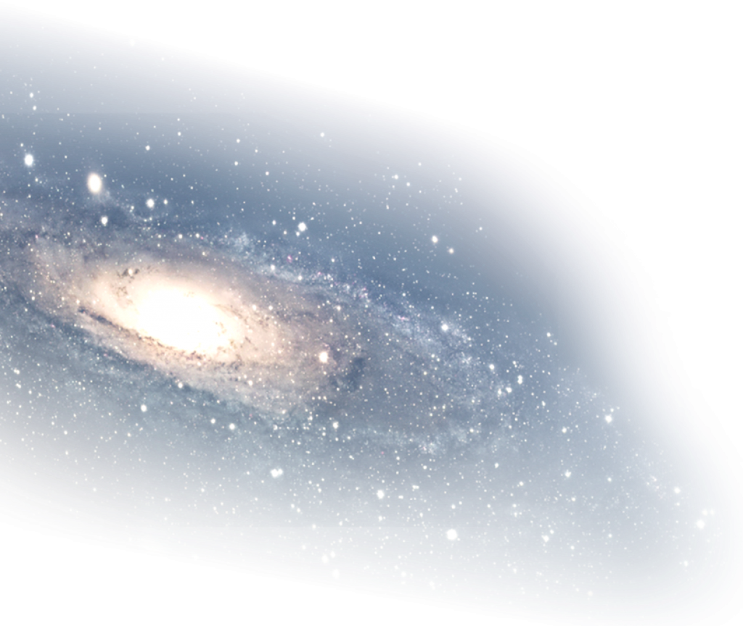








When to Rebalance?
Cost–Benefit Analysis of Domain Decomposition in SPH-EXA
Florina Ciorba (PI)
Ruben Cabezon (Co-PI)
Osman Seckin Simsek
José Escartin
Lucio Mayer (Co-PI)
Noah Kubli
Darren Reed
Sebastian Keller
Jean-Guillaume Piccinali
Jean Favre
Jonathan Coles
Axel Sanz (UPC)
Joseph Touzet (Paris-Saclay)
SKACH Winter Meeting 2026 January 26-27, 2026, Lugano
Osman Seckin Simsek
https://github.com/unibas-dmi-hpc/SPH-EXA
Notes:
1

Slide 2
Motivation
SPH-EXA is a scalable smoothed particle hydrodynamics simulation framework interdisciplinarily co-designed by computational physicists and computer scientists to exploit Exascale supercomputers.
SPH-EXA uses the cornerstone tree which implements space-filling curves for domain decomposition
Original implementation: full global synchronization of the domain every timestep
Domain rebalancing (particle redistribution across ranks)
Octree reconstruction
Halo particle exchange
Domain decomposition takes between 10-20% of each timestep depending on the simulation case
Reduce domain decomposition overhead while maintaining simulation accuracy

Slide 3
Domain Decomposition in Scientific Applications
The Goal:
Efficiently divide particles among compute nodes
Ensure each node has roughly equal work to avoid load imbalance
Minimize communication between nodes (data locality)
Enable particles to interact with their neighbors even across node boundaries
The Challenge:
We want to simulate billions to trillions of SPH & other particles with various physics
One single computer cannot hold all associated data in memory or compute forces fast enough
Need to split the work and data across thousands of computing nodes
Spatial Decomposition is difficult to keep track and load balance.
Solution: use space filling curves!

Slide 4
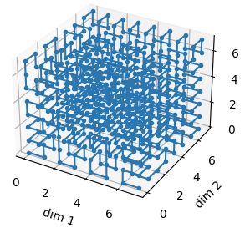
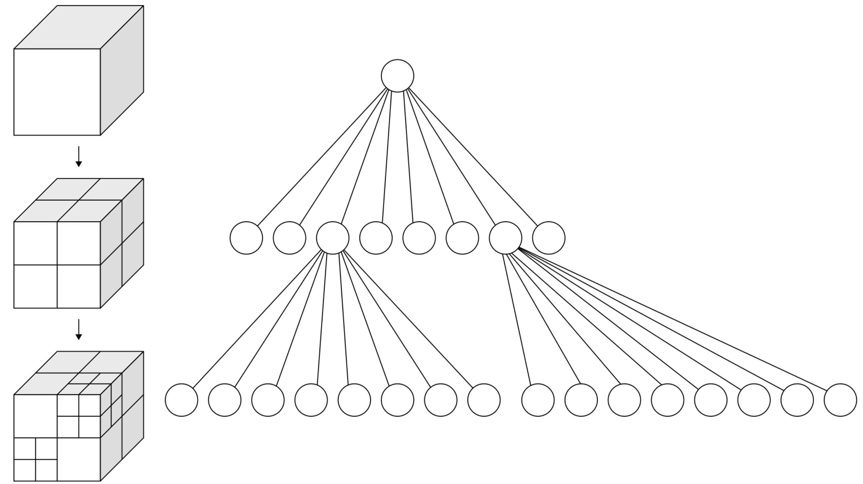
Domain Decomposition in SPH-EXA
Space-Filling Curve: Instead of dividing by x, y, or z coordinates, we map 3D particle positions to a 1D curve that:
Allows easy partitioning among the computing nodes
Self-adjusts to particle redistribution
Key Property:
Consecutive particles on the SFC are spatially nearby in 3D space providing good data locality!
What about particle neighbor search?
For each SPH particle, find all neighbors within smoothing length
Naive approach: Check all N particles → O(N²) → too slow!
Need spatial index structure
Solution: Oct-tree
An oct-tree recursively subdivides 3D space into 8 octants
SPH-EXA uses a special variant named Cornerstone Oct-tree¹
[1] Keller, S., Cavelan, A., Cabezon, R., Mayer, L., & Ciorba, F. (2023, June). Cornerstone: Octree construction algorithms for scalable particle simulations. In Proceedings of the Platform for Advanced Scientific Computing Conference (pp. 1-10).

Slide 5
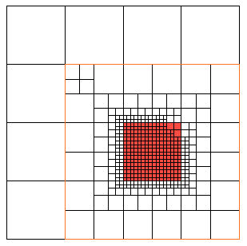
Domain Decomposition in SPH-EXA: Cornerstone Oct-tree
Oct-tree nodes are defined by SFC key ranges
Each node: [keyStart, keyEnd) on the SFC
Stored as a flat array of keys instead of a pointer-based oct-tree
Globally consistent: All ranks know the entire tree structure
Domain decomposition done in every time-step in SPH-EXA follows these steps:
Domain Assignment: assigning particles to MPI Ranks in a roughly uniform distribution
Particle Exchange: move particles to their assigned ranks, updating local and global data structures
Halo Exchange: determine ghost particles for neighbor interactions and copy them to the corresponding ran
Domain decomposition takes between 10-20% of each timestep depending on the simulation case

Slide 6
Proposed Solution
Observation: In many simulations, particle distribution changes slowly:
Smooth flows: particles move coherently
Small timesteps: limited displacement of particles per iteration
Load remains balanced for many steps
Key Insight: Can skip expensive particle redistribution while load stays balanced!
Approach:
Preserve the assignment from the previous timestep and decompose the domain in preset intervals
10-20% performance saving when we do not redistribute
Caveat:
Particles move and change positions anyway, so calculation accuracy is affected
Halo discovery is affected when the previous assignment is not updated
Let’s see the effects in practice!

Slide 7
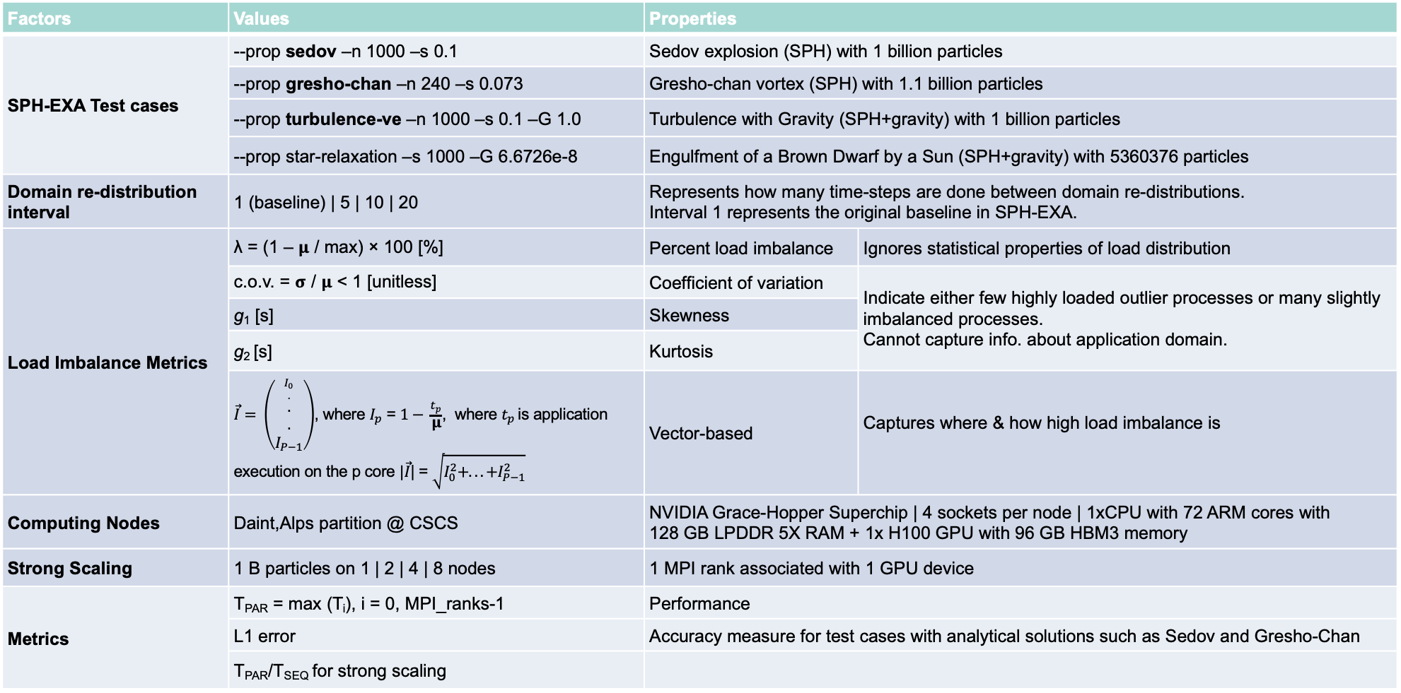
Factorial Design of Experiments For Rebalancing More Rarely
Factors | Values | Properties
SPH-EXA Test cases | --prop sedov –n 1000 –s 0.1 | Sedov explosion (SPH) with 1 billion particles
 | --prop gresho-chan –n 240 –s 0.073 | Gresho-chan vortex (SPH) with 1.1 billion particles
 | --prop turbulence-ve –n 1000 –s 0.1 –G 1.0 | Turbulence with Gravity (SPH+gravity) with 1 billion particles
 | --prop star-relaxation –s 1000 –G 6.6726e-8 | Engulfment of a Brown Dwarf by a Sun (SPH+gravity) with 5360376 particles
Domain re-distribution interval | 1 (baseline) | 5 | 10 | 20 | Represents how many time-steps are done between domain re-distributions. Interval 1 represents the original baseline in SPH-EXA.
Load Imbalance Metrics | λ = (1 – 𝛍 / max) × 100 [%] | Percent load imbalance | Ignores statistical properties of load distribution
 | c.o.v. = 𝛔 / 𝛍 < 1 [unitless] | Coefficient of variation | Indicate either few highly loaded outlier processes or many slightly imbalanced processes. Cannot capture info. about application domain.
 | g₁ [s] | Skewness
 | g₂ [s] | Kurtosis
 | $\vec{I}= \left(\begin{aligned}{I_{0} \atop .} \\ . \\ . \\ I_{P−1}\end{aligned}\right)$, where $I_{p}$ = $1− \frac{t_{p}}{\text{μ}}$, where $t_{p }$is application execution on the p core $|\vec{I}$| = $\sqrt{I_{0}^{2}+. ..+I_{P−1}^{2}}$ | Vector-based | Captures where & how high load imbalance is
Computing Nodes | Daint,Alps partition @ CSCS | NVIDIA Grace-Hopper Superchip | 4 sockets per node | 1xCPU with 72 ARM cores with 128 GB LPDDR 5X RAM + 1x H100 GPU with 96 GB HBM3 memory
Strong Scaling | 1 B particles on 1 | 2 | 4 | 8 nodes | 1 MPI rank associated with 1 GPU device
Metrics | T_{PAR} = max (T_{i}), i = 0, MPI_ranks-1 | Performance
 | L1 error | Accuracy measure for test cases with analytical solutions such as Sedov and Gresho-Chan
 | T_{PAR}/T_{SEQ} for strong scaling

Slide 8
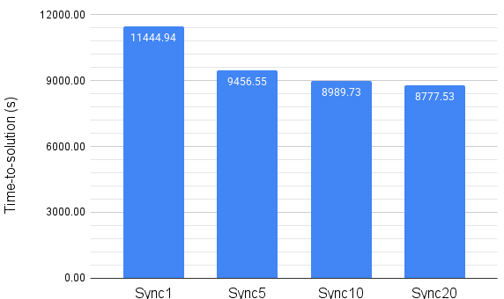
Proposed Solution – Performance testing
Gresho-chan vortex using N = 1’119’744’000 particles simulating 0.073 physical seconds
Notes:
5.40, 4.46, 4.24, 4.14

Slide 9
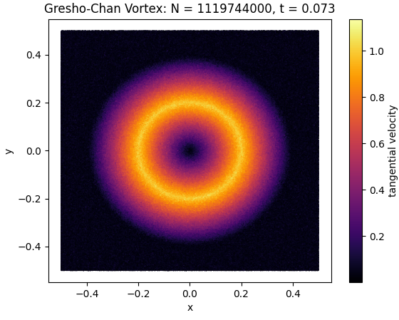
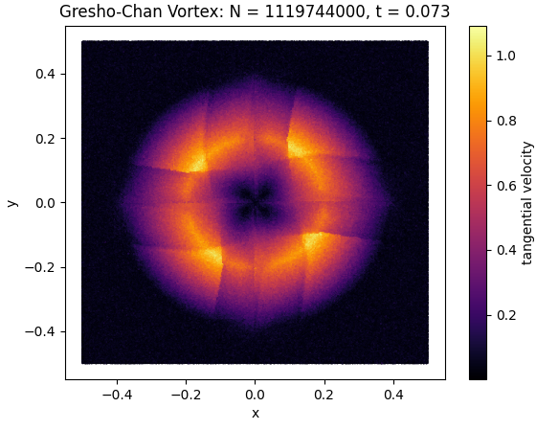
Proposed Solution – Correctness testing
Gresho-chan vortex using N = 1’119’744’000 particles simulating 0.073 physical seconds
original
Sync every 5 timesteps

Slide 10
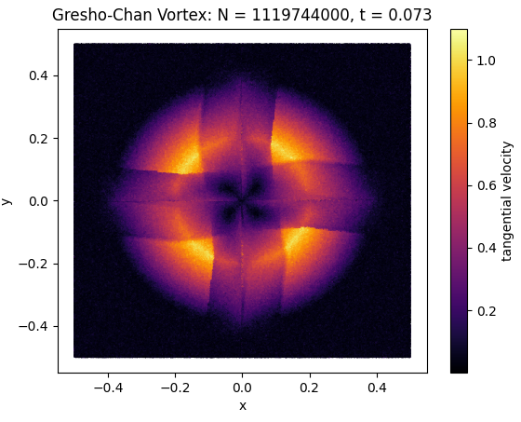
Proposed Solution – Correctness testing
Gresho-chan vortex using N = 1’119’744’000 particles simulating 0.073 physical seconds
original
Sync every 10 timesteps

Slide 11
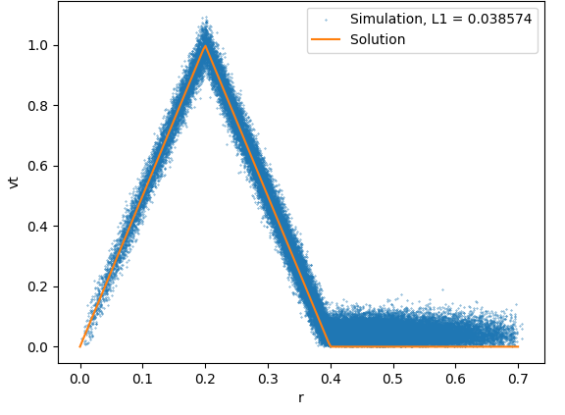
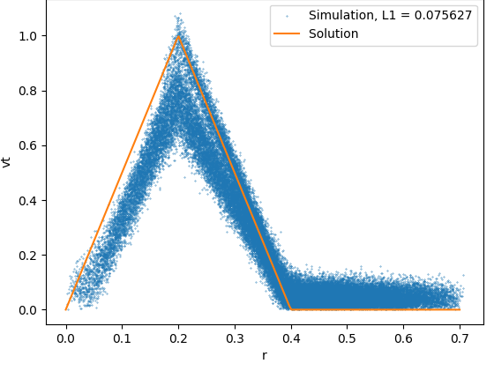
Proposed Solution – Correctness testing
Gresho-chan vortex using N = 1’119’744’000 particles simulating 0.073 physical seconds
original
Sync every 5 timesteps

Slide 12
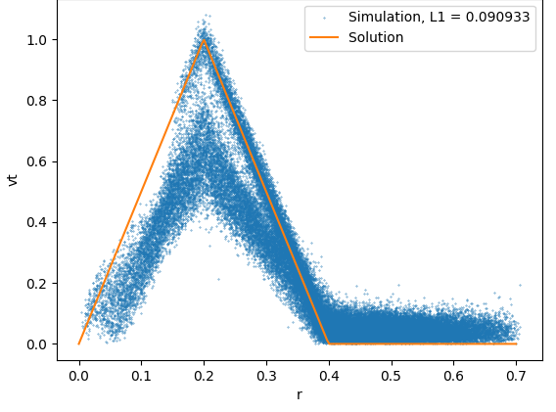
Proposed Solution – Correctness testing
Gresho-chan vortex using N = 1’119’744’000 particles simulating 0.073 physical seconds
original
Sync every 10 timesteps

Slide 13
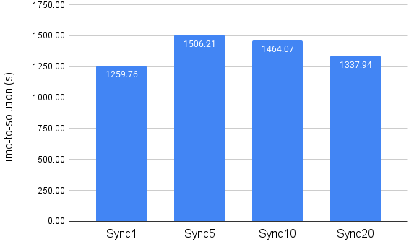
Proposed Solution – Performance testing
Turbulence using N=1’000’000’000 particles simulating 0.1 physical seconds
Notes:
5.40, 4.46, 4.24, 4.14

Slide 14
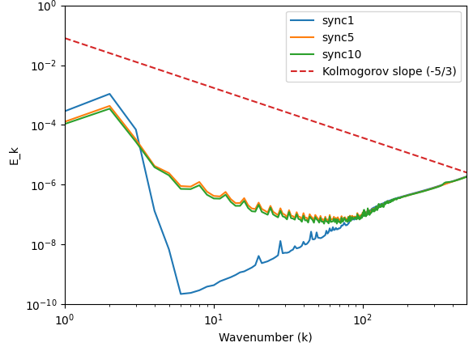
Proposed Solution – Correctness testing
Turbulence using N=1’000’000’000 particles simulating 0.1 physical seconds

Slide 15
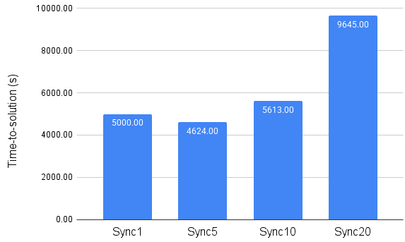
Proposed Solution – Performance testing
Sedov blast using N=1’000’000’000 particles simulating 0.01 physical seconds
Notes:
5.40, 4.46, 4.24, 4.14

Slide 16
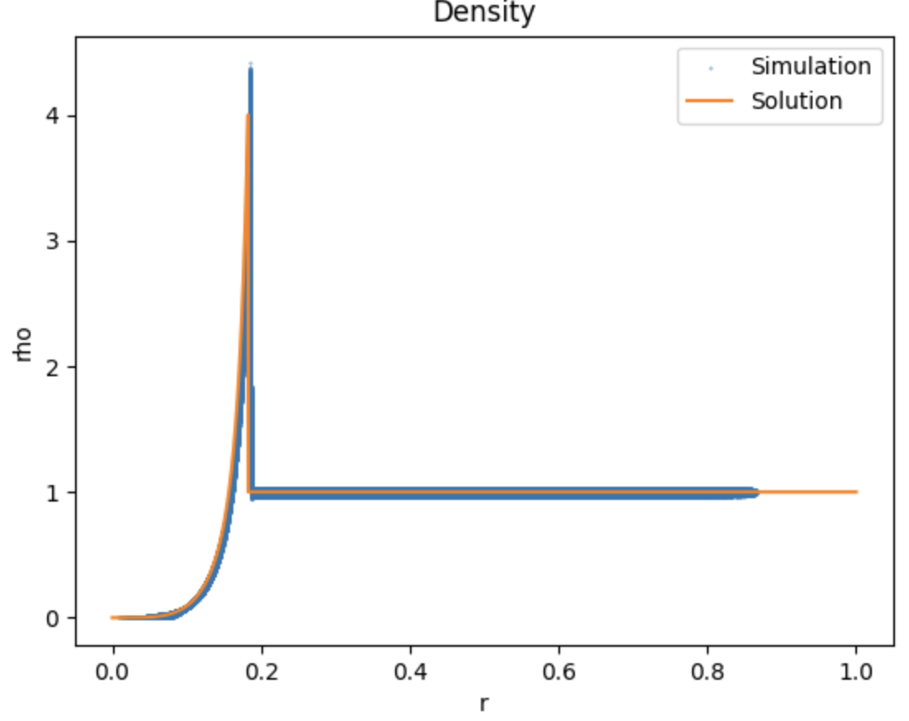
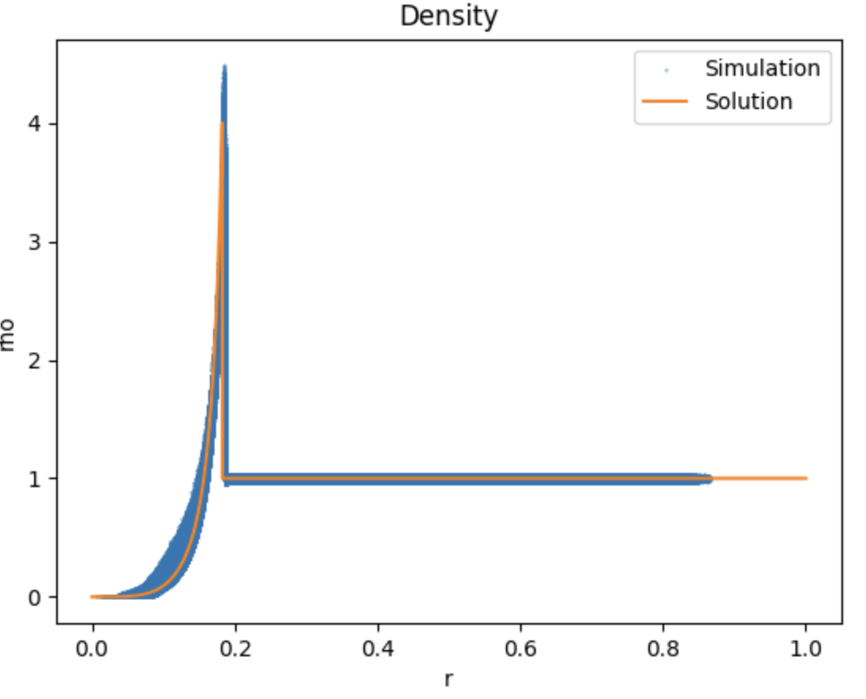
Proposed Solution – Correctness testing
Sedov blast using N=1’000’000’000 particles simulating 0.01 physical seconds
original
Sync every 10 timesteps
Notes:
5.40, 4.46, 4.24, 4.14

Slide 17
Proposed Solution 2
Observation: In many simulations, particle distribution changes slowly
The correctness of the simulation is affected greatly even in high resolution and particles move slowly
Domain Decomposition is SPH-EXA follows these steps:
Domain Assignment: assigning particles to MPI Ranks in a roughly uniform distribution
Particle Exchange: move particles to their assigned ranks, updating local and global data structures
Halo Exchange: determine ghost particles for neighbor interactions and copy them to the corresponding rank
Instead of updating the cornerstone tree every few timesteps, keep the distribution until load imbalance occurs!

Slide 18
Proposed Solution 2 - Details
New Domain Decomposition is SPH-EXA follows these steps:
Domain Assignment: check the number of particles per rank and re-distribute if the particle difference is above a certain threshold, for example 1%.
Every timestep, do the following without any changes:
Particle Exchange: move particles to their assigned ranks, updating local and global data structures
Halo Exchange: determine ghost particles for neighbor interactions and copy them to the corresponding rank
Domain Assignment is on average ~10% of the domain decomposition (which is on average 10-20% of the time per time-step).

Slide 19
Proposed Solution 2 – Correctness Testing
Gresho-chan vortex using N = 1’119’744’000 particles
No redistribution unless # of particles in a
rank is 1% more than the average particles per rank
original

Slide 20
Proposed Solution 2 – Correctness Testing
Gresho-chan vortex using N=1’119’744’000
original
No redistribution unless load imbalance > 1%

Slide 21
Proposed Solution – Correctness testing
Sedov blast using N=1’000’000’000 particles simulating 0.01 physical seconds
original
No redistribution unless load imbalance > 1%

Slide 22
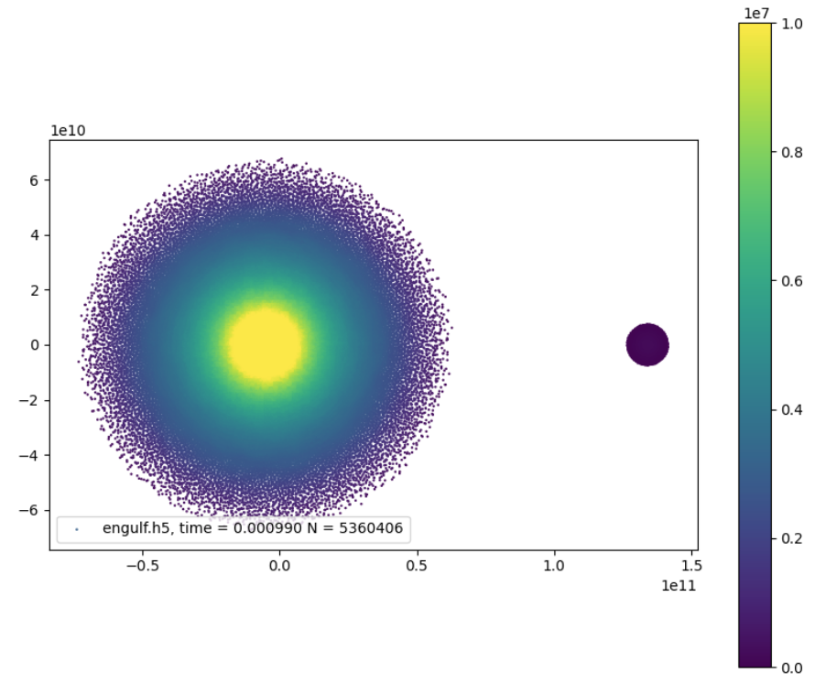
Proposed Solution 2 – Use case: Engulfment
Brown dwarf is engulfed by the sun.
5’360’406 global particles
5260406 Sun particles
100000 Brown Dwarf particles
After the clash, particle density is widely different through the domain.
Temp

Slide 23
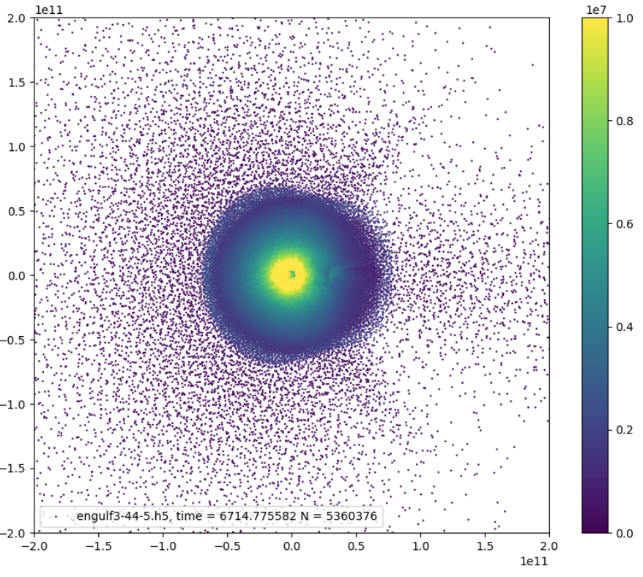
Proposed Solution 2 – Use case: Engulfment
We start testing the new approach to the domain decomposition from simulation time = 6’714.77 seconds
Simulate 1000 time-steps for testing
Density difference in the domain is apparent.
We re-distribute particles uniformly when the number of particles of a rank exceeds 1% of the average number of particles across all ranks.
Temp

Slide 24
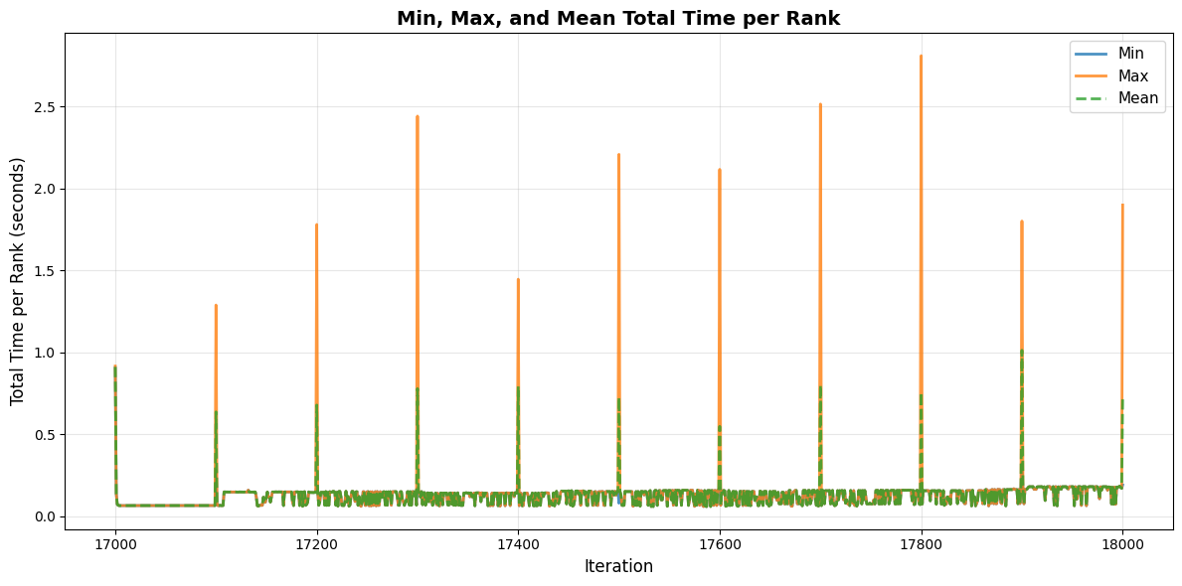
Proposed Solution 2 – Use case: Engulfment – Load imbalance evaluation
Load imbalance does not occur most of the time and re-balancing occurs when imbalance peaks as shown in the plot
Average performance benefit of not re-decomposing every timestep ~2%

Slide 25
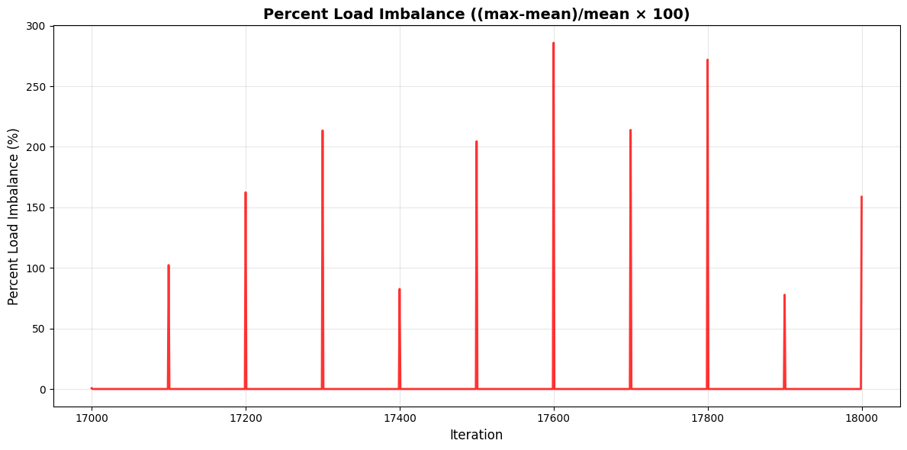
Proposed Solution 2 – Use case: Engulfment – Load imbalance evaluation
Load imbalance does not occur most of the time and re-balancing occurs when imbalance peaks as shown in the plot
Average performance benefit of not re-decomposing every timestep ~2%

Slide 26
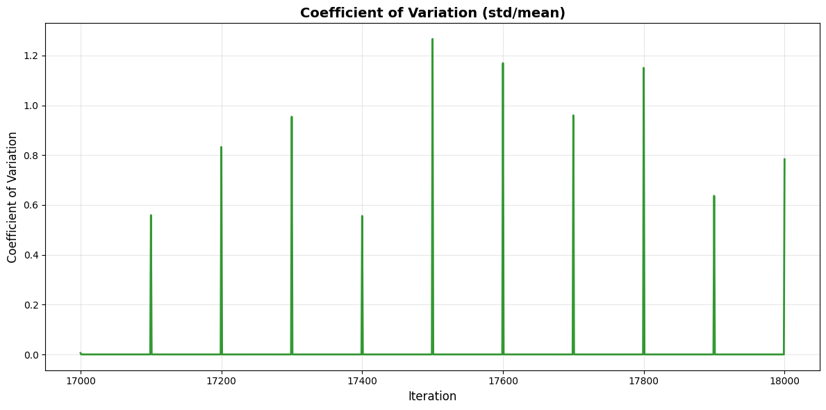
Proposed Solution 2 – Use case: Engulfment – Load imbalance evaluation
Load imbalance does not occur most of the time and re-balancing occurs when imbalance peaks as shown in the plot
Average performance benefit of not re-decomposing every timestep ~2%

Slide 27
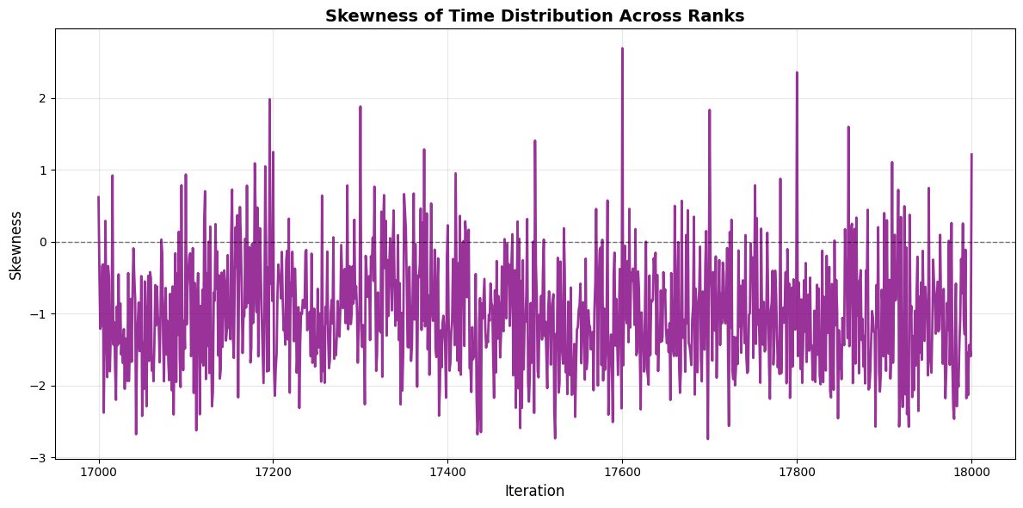
Proposed Solution 2 – Use case: Engulfment – Load imbalance evaluation
Load imbalance does not occur most of the time and re-balancing occurs when imbalance peaks as shown in the plot
Average performance benefit of not re-decomposing every timestep ~2%

Slide 28
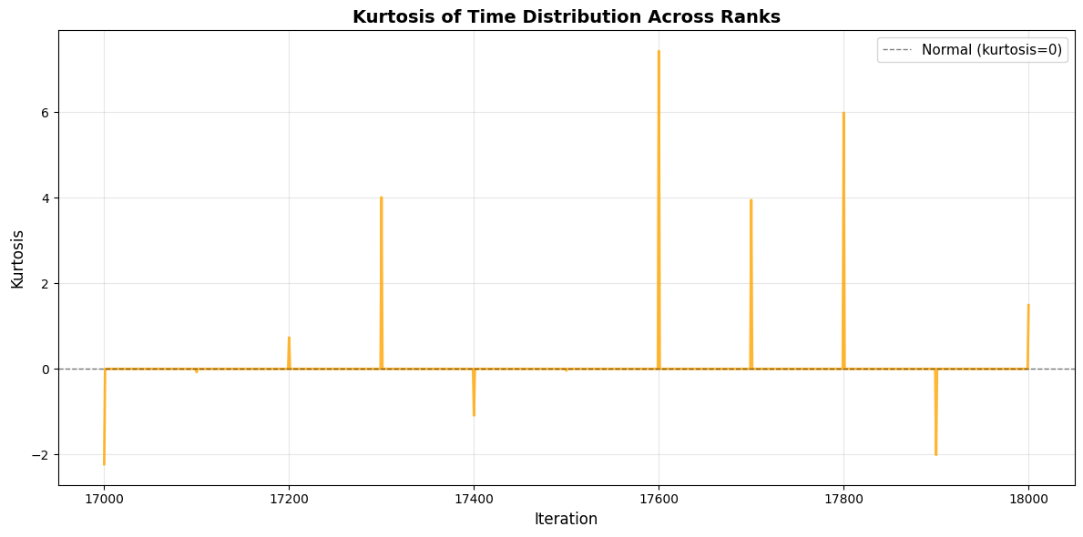
Proposed Solution 2 – Use case: Engulfment – Load imbalance evaluation
Load imbalance does not occur most of the time and re-balancing occurs when imbalance peaks as shown in the plot
Average performance benefit of not re-decomposing every timestep ~2%

Slide 29
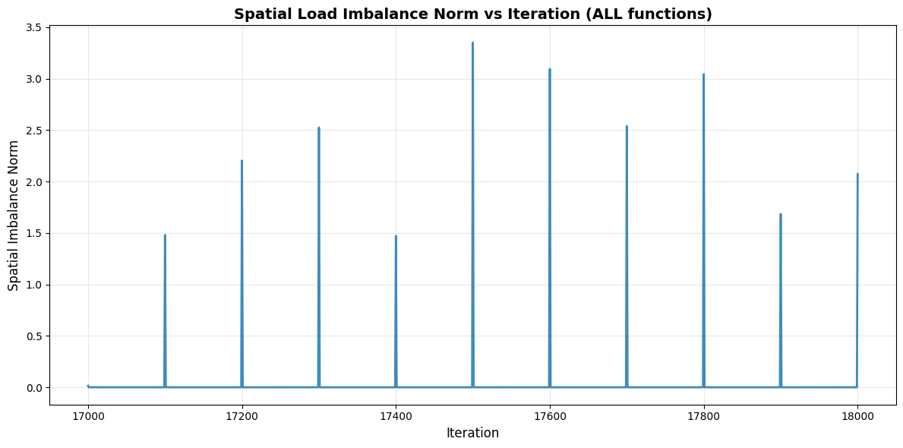
Proposed Solution 2 – Use case: Engulfment – Load imbalance evaluation
Load imbalance does not occur most of the time and re-balancing occurs when imbalance peaks as shown in the plot
Average performance benefit of not re-decomposing every timestep ~2%

Slide 30
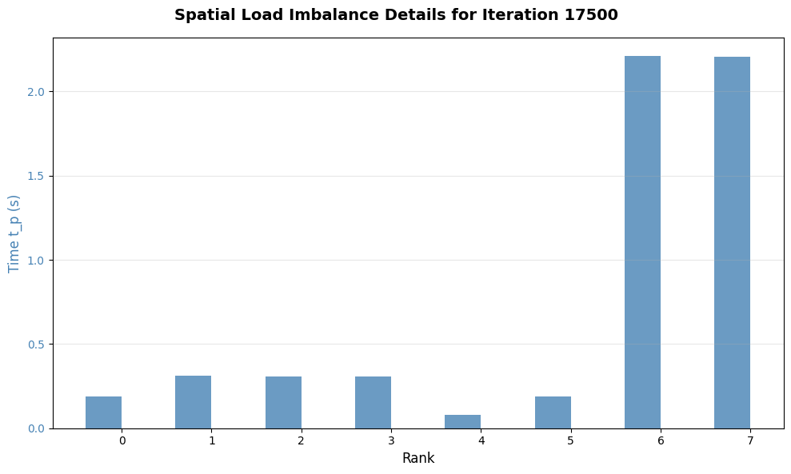
Proposed Solution 2 – Use case: Engulfment – Load imbalance evaluation
Load imbalance does not occur most of the time and re-balancing occurs when imbalance peaks as shown in the plot
Average performance benefit of not re-decomposing every timestep ~2%

Slide 31
Conclusion
Evaluated whether we need to re-balance the simulation domain every timestep
Preserving the previous assignment and re-decomposing the domain in preset intervals greatly impacts the simulation correctness due to stale neighbor information.
Disabling uniform distribution happening every timestep while updating the cornerstone tree fixes the correctness problem
Evaluated the proposed solution in a small Engulfment case with 2% performance improvement. Larger Engulfment simulations is expected to bring higher improvement.
Next Steps
Production project for Engulfment is ongoing, simulating 1 billion particles
Introduce the proposed re-distribution mechanism in larger engulfment simulations

