Slide 1
Karabo Pipeline
Massimo De Santis
Andreas Wassmer
Overview, Access, and Transition to SDP Configuration
SKACH Winter Meeting 2026, Lugano

Slide 2
About me
Andreas Wassmer
Physicist and Research Software Engineer
25+ years of experience in software engineering–Joined FHNW SKA team in January 2024
Focus on operations

Slide 3
Part 1: Karabo 101
Andreas Wassmer

Slide 4
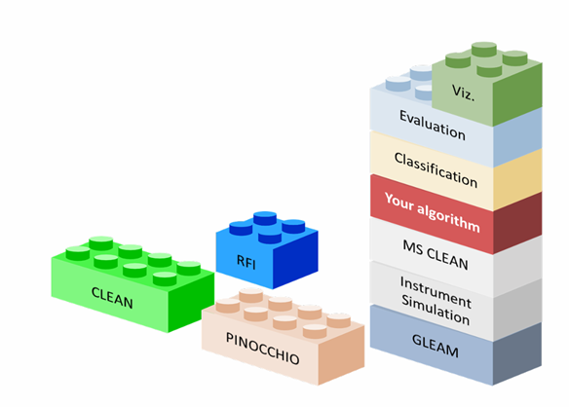
What is Karabo?
Karabo is a radio astronomy software distribution for validation and benchmarking of radio telescopes and algorithms. It can be used to simulate the behavior of the Square Kilometer Array or other supported telescopes. Our goal is to make installation and ramp-up easier for researchers and developers.
Source code and documentation
https://github.com/i4Ds/Karabo-Pipeline

Slide 5
Goals of Karabo (as a Physicist)
Make it easy to set up a data processing pipeline for radio astronomy
Easy way to compare established and new algorithms
Helps to develop and test new ideas quickly
Runs as Jupyter Notebook and a Python script
User doesn't need to deal with intermediate files

Slide 6
Who is behind Karabo?
Joint efforts from different contributors and institutions, mainly from Switzerland
Space, Planetary & Astronomical Sciences & Engineering (SPASE), Kanpur, India
Institute for Data Science, FHNW, Windisch
Institute for Particle Physics and Astrophysics, ETHZ, Zurich
Laboratoire d’Astrophysique, EPFL, Lausanne
HES-SO, Neuchâtel

Slide 7
Who is behind Karabo? (sorry if I forgot someone)
Michele Bianco, Devin Crichton, André Csillaghy, Simon Felix, Chris Finlay, Lukas Gehrig, Pascal Hitz, Rohini Joshi, Stefan Kögel, Luis Fernando Machado Poletti Valle, Dev Null, Alexandre Refregier, Jennifer Studer, Filip Schramka, Rohit Sharma, Marta Spinelli, Vincenzo Timmel, Massimo De Santis, Andreas Wassmer
Thank you to all contributors. And to everybody who provided us with valuable input.

Slide 8
Goals of Karabo (as a Research Software Engineer)
Use type hints
Maintain (almost) complete test coverage
Fixed versions of dependencies (upper bounds)
Consistent handling of intermediate files
Use Google docstyle throughout the project
Make Karabo run on new GraceHopper hardware at CSCS

Slide 9
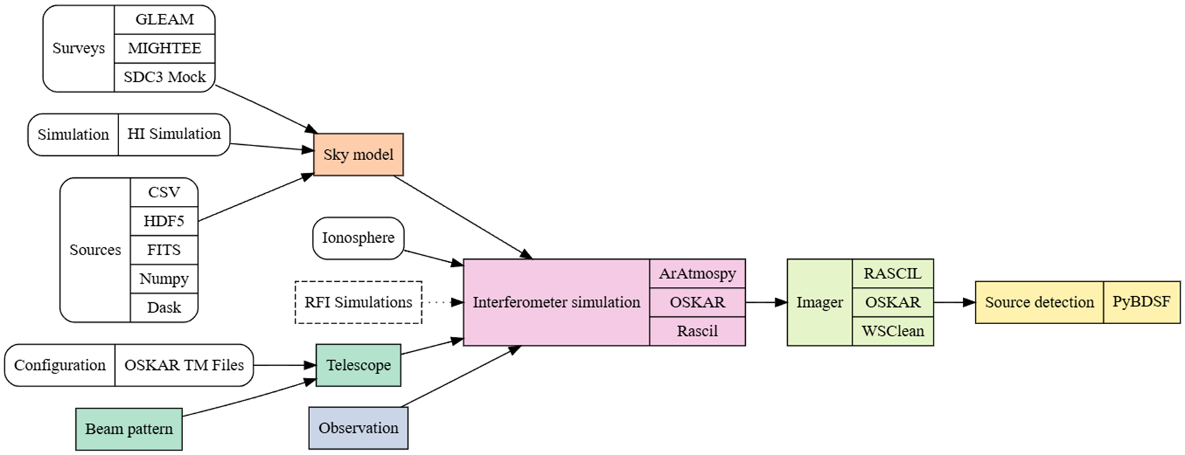
Karabo Pipeline Overview

Slide 10
How to run Karabo
Install Karabo in conda environment
Run it within a container (Docker, Singularity)
There is a demo installation (with limited resources) on Renkulab.io. You need to sign in.
https://renkulab.io/projects/menkalinan56/swissskadays-karabo-workshop

Slide 11
Paper about Karabo
Karabo: A versatile SKA observation simulation framework
Astronomy and Computing, Volume 54, January 2026
https://doi.org/10.1016/j.ascom.2025.101004

Slide 12
Part 2: Transition from RASCIL to SDP
Massimo de Santis

Slide 13
Why migrate RASCIL → SKA-SDP
Alignment with SKA reference software direction
Long term maintainability
Better portability for HPC environments
Notes:
1)
SKA development is moving toward the SKA-SDP software stack as the long-term reference.
So Karabo should follow that direction to avoid becoming outdated
2)
RASCIL is useful, but Karabo shouldn’t depend heavily on something that may:
change API unpredictably
Not the target ecosystem
3)
SDP is designed with HPC pipeline constraints in mind:
separation of data models vs functions (cleaner separation than rascil)
easier integration into cluster environments

Slide 14
Migration strategy
Cohabitation first : RASCIL + SDP both available
Backend-neutral API layer
Incremental wiring : one pipeline at a time
Validation plan : smoke tests → parity tests → change default later
Notes:
1)
We’re running both backends in parallel until SDP reaches feature parity
2)
We inserted a small abstraction layer so pipelines call Karabo APIs, not backend APIs
Example calling “invert()” for producing dirty and PSF image without calling directly any backend imagers
3)
Karabo has many entry points (scripts, notebooks, pipelines). Migrating everything in one PR is risky
We migrated a representative path end-to-end first, then expanded coverage
4)
Quality strategy in phases :
Smoke tests: “does it run and produce outputs?” Parity tests: “are outputs consistent with RASCIL within tolerance?” Change default: only once parity + docs + confidence exist

Slide 15
Migration strategy
Notes:
The migration is intentionally limited to two blocks: interferometer simulation and imaging.
We’re adding SKA-SDP alongside the existing RASCIL backend in those blocks, while keeping everything upstream and downstream unchanged.
That’s what makes the transition low-risk and easy to validate.
We are not rewriting Karabo. We are swapping the backend behind two modules
a

Slide 16
Migration strategy
Notes:
The migration is intentionally limited to two blocks: interferometer simulation and imaging.
We’re adding SKA-SDP alongside the existing RASCIL backend in those blocks, while keeping everything upstream and downstream unchanged.
That’s what makes the transition low-risk and easy to validate.
We are not rewriting Karabo. We are swapping the backend behind two modules

Slide 17
Simulation: status
SDP simulation runs side-by-side with existing OSKAR/RASCIL paths
Measurement Sets (MS) via SKA-SDP visibility data model
Single telescope definition reused across backends (no duplication)
Basic tests - SDP vs RASCIL, ensuring consistent outputs
Notes:
1)
Simulation is now backend-aware: OSKAR stays as-is, and we can run an SDP path in parallel without changing user pipelines.
2)
Visibilities are represented using the SKA-SDP visibility datamodel, and we export to standard Measurement Sets for interoperability
datamodel → It’s the in-memory structure and conventions used to represent visibility data, basically the ‘official’ container before writing MS
3)
We reuse the same telescope configuration object for both RASCIL and SDP paths so the telescope definition remains single-source-of-truth.
4)
We added smoke tests that run both backends on the same minimal setup and check that the output structures are produced correctly and consistently

Slide 18
Imaging: status
Backend-neutral imaging interface with selector (RASCIL default, SDP opt-in)
SDP inversion works: outputs dirty image + PSF from MS
Smoke tests exercise both backends and validate output presence/shape
Notes:
1)
Imaging now goes through one neutral interface, with a selector to run either RASCIL (default) or SKA-SDP.
2)
The SDP backend can invert visibilities into a dirty image and a PSF, using the SDP imaging functions
3)
We added smoke tests that run both backends end-to-end and confirm they generate the expected imaging products

Slide 19
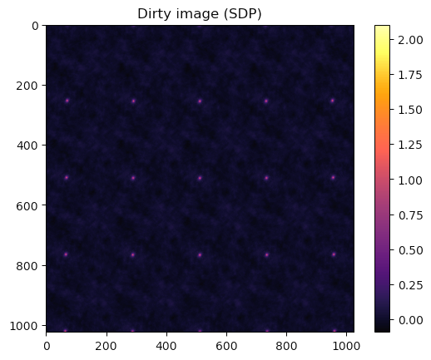
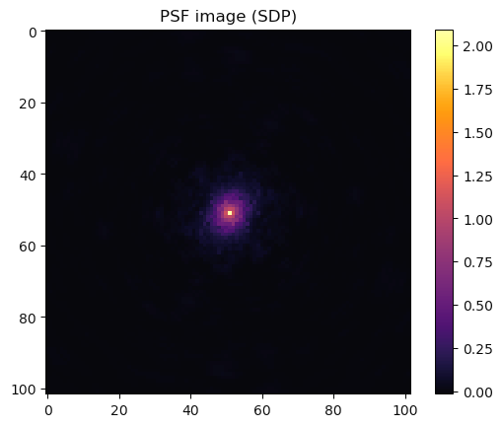
Imaging: status
Backend-neutral imaging interface with selector (RASCIL default, SDP opt-in)
SDP inversion works: outputs dirty image + PSF from MS
Smoke tests exercise both backends and validate output presence/shape
Notes:
1)
Imaging now goes through one neutral interface, with a selector to run either RASCIL (default) or SKA-SDP.
2)
The SDP backend can invert visibilities into a dirty image and a PSF, using the SDP imaging functions
3)
We added smoke tests that run both backends end-to-end and confirm they generate the expected imaging products

Slide 20
Challenges encountered
Time handling differences (observation time)
Parity ≠ equality: validate with tolerances/metrics, not exact matching
Notes:
1)
We also saw small but systematic differences in time handling: the same requested start datetime doesn’t always map to the exact same internal timestamps between stacks. It doesn’t break the run, but it matters for strict comparisons and reproducibility,
→ so we surface it clearly and account for it in tests.
2)
Exact numerical parity is hard: different toolchains use different gridding/weighting defaults and floating-point execution paths. So our validation target is scientific equivalence tolerances and metrics rather than bit-for-bit equality.

Slide 21
Impact
Karabo aligns with the SKA-SDP ecosystem
Backend flexibility (RASCIL / SDP / OSKAR) with one Karabo API
Safe migration path: no user breakage while transitioning
Better maintainability through clearer structure + testable interfaces
Notes:
1)
The main impact is that Karabo is now aligned with the SKA-SDP software direction, which is important for long-term sustainability.
2)
We reduce lock-in: users can keep using the same Karabo workflows while switching backend underneath.
3)
Because we migrated by cohabitation, we can eventually retire RASCIL without breaking existing pipelines.
4)
this introduces clearer interfaces and a better foundation for testing and maintenance.

Slide 22
What’s next
Wiring remaining entry points
Adding parity tests
Improve documentation
Later: deprecate RASCIL, once parity and docs are solid
Notes:
1)
Next we need to make the backend selection consistent everywhere users interact with Karabo especially notebooks and scripts.
2)
Then we move from smoke tests to parity tests: not just ‘it runs’, but ‘it matches within tolerance’ on controlled cases
3)
In parallel we document the backend switch and what features are implemented in SDP today.
4)
Only once that’s stable do we deprecate RASCIL.

Slide 23
Thank you
Massimo De Santis
Andreas Wassmer
https://github.com/i4Ds/Karabo-Pipeline

