Slide 1

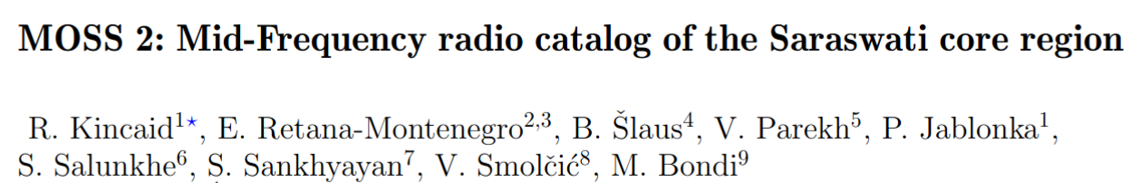


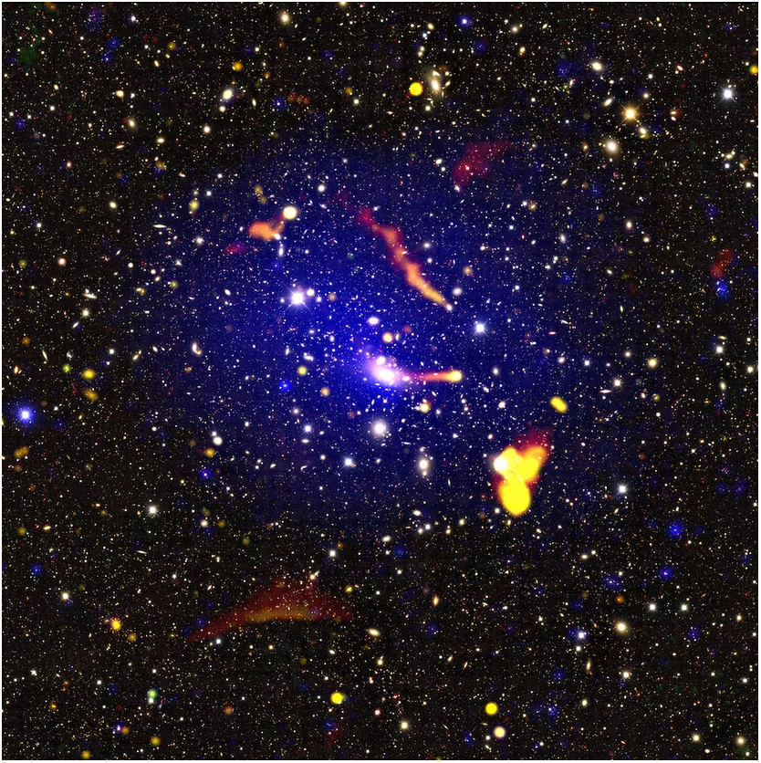
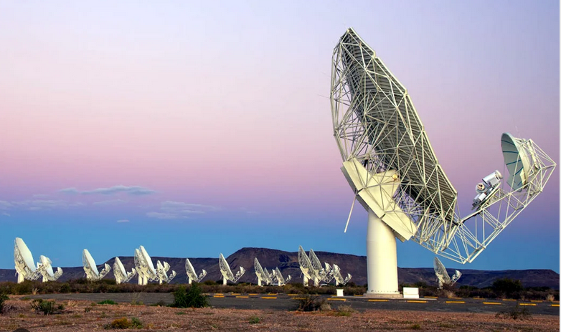
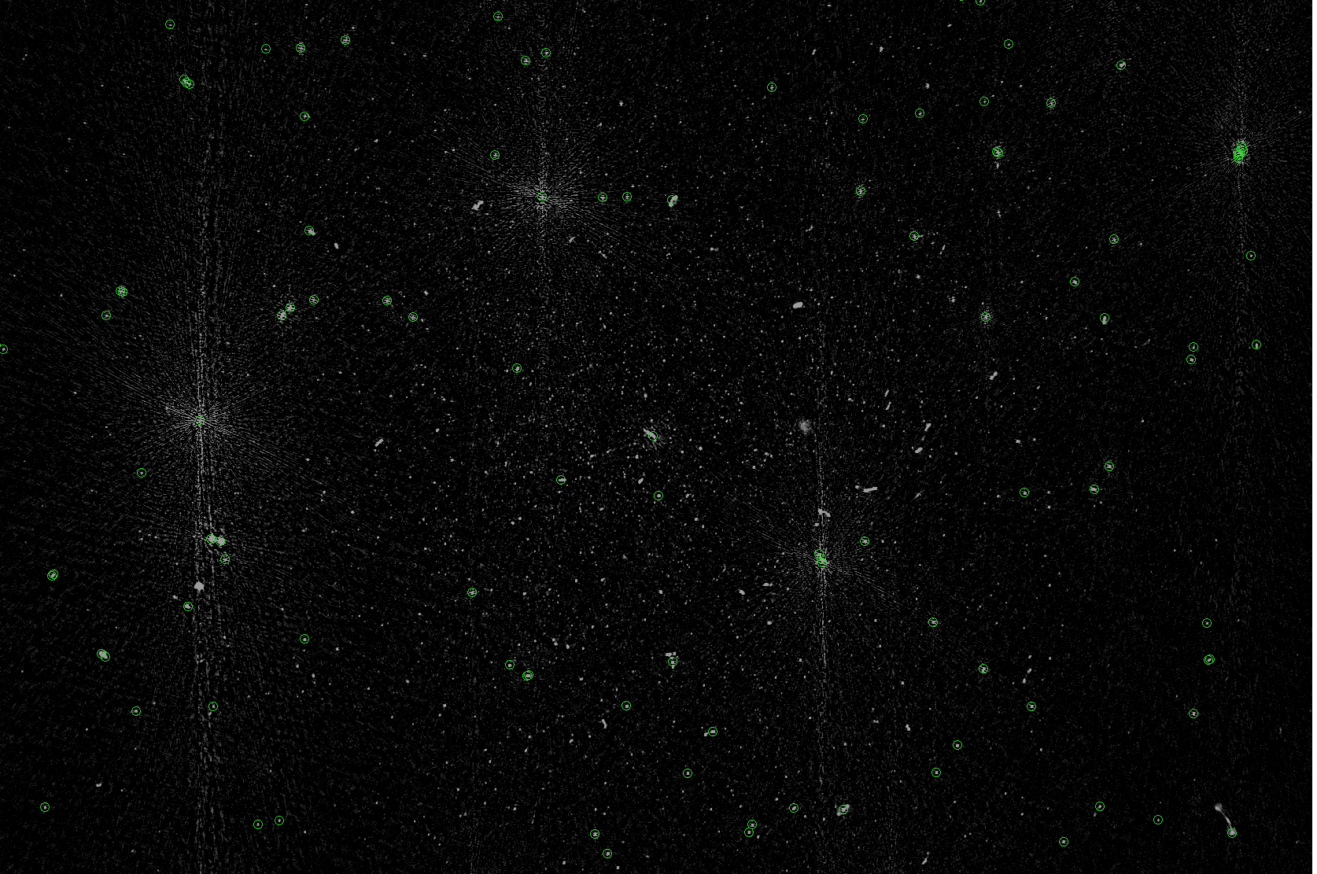
Noise

Slide 2
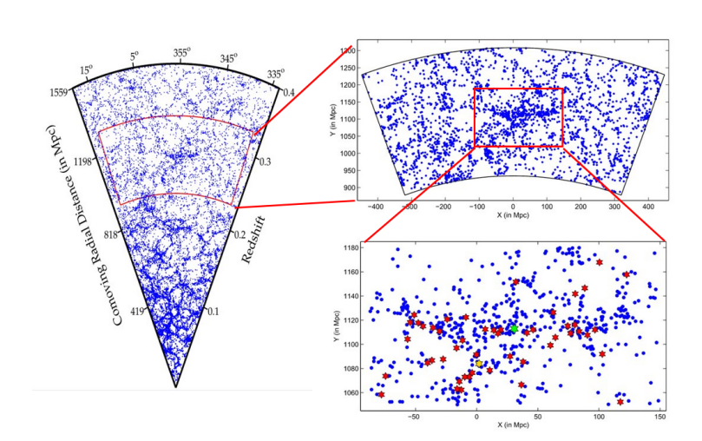
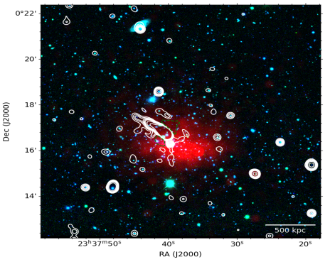
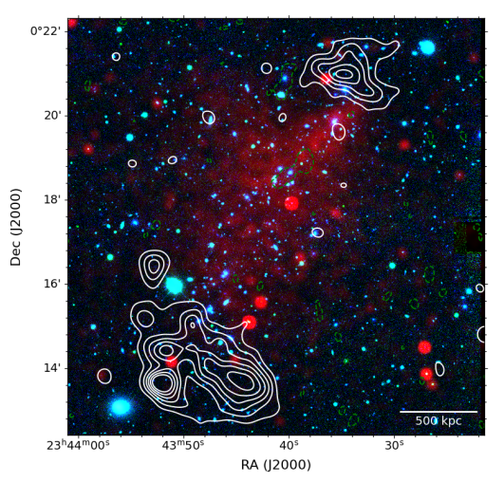
Saraswati supercluster
One of the most significant density enhancements found at medium-to-high redshifts (z ~ 0.27, universe ~ 10 billion years old).
Mass and density comparable to nearby superclusters like Virgo and Lanaeka.
Contains over 40 galaxy cluster and groups. The 2 largest galaxy clusters comprise 20% of its total mass (4x10^15 solar mass).
The largest and 2nd largest galaxy clusters situated at the core are A2631 and Zwcl2341.
Abell2631
AGN
ICM gas
Zwcl2341
Radio Relics
Galaxy clusters
ICM gas
Notes:
Superclusters are the largest over-dense, unbound and non-virialized systems in the universe. Virgo, BOSS great wall, Laneika
Peripheral radio relics indicative of recent cluster merger event.

Slide 3
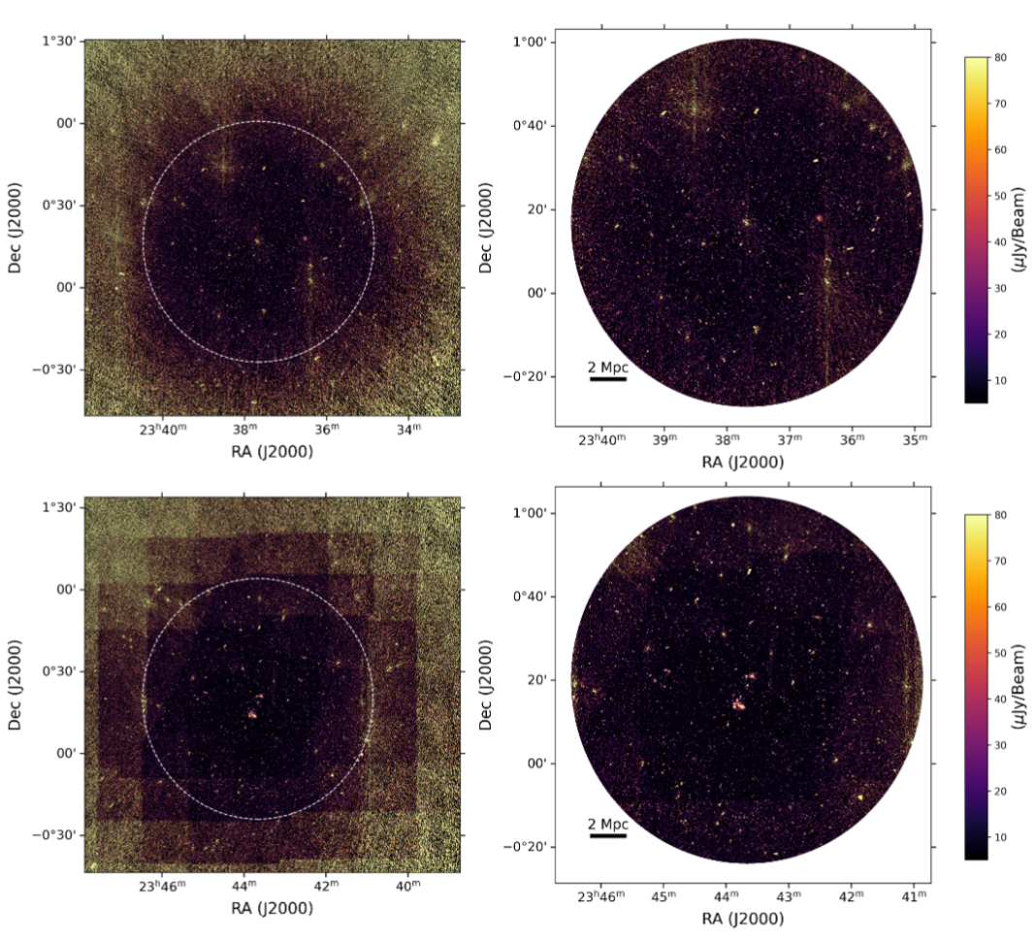
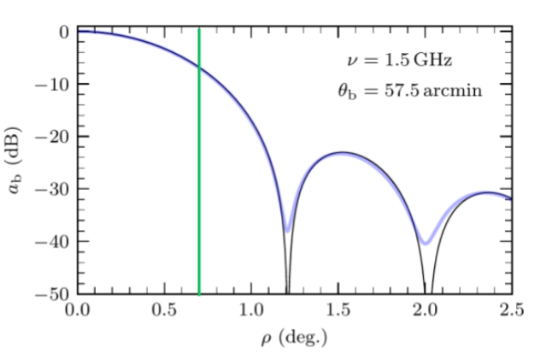
MeerKAT observations
Primary beam corrected maps
30% cutoff images
Each cluster observed for 8 hour observations (4096 channels, 16s int time) with MeerKAT.
8 arcsec resolution and 10uJy noise.
Primary beam pattern -> noise increase with increasing distance to edges.
Apply a cutoff where primary beam attenuation > 30%
Simplified beam model of KATBEAM -> cosine aperture taper
Noise increase
KATBEAM
Real

Slide 4
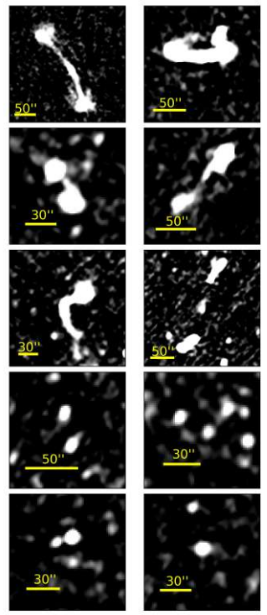
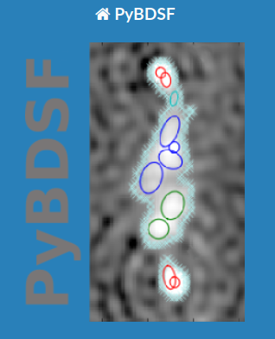
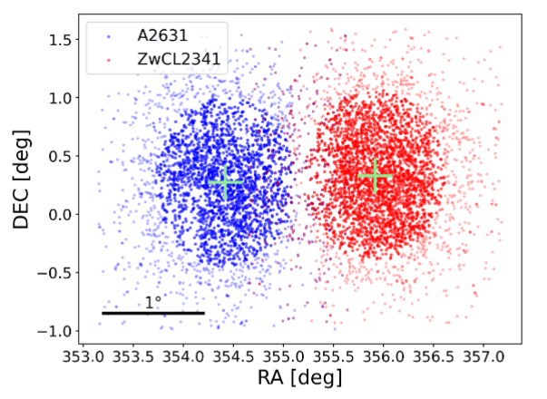
Catalog creation
Extended
Run the PyBDSF source finder to fit regions of emission with gaussians.
PyBDSF -> island threshold = 3, Pixel threshold = 5.
Sample of ~ 3000 radio sources with flux density 10uJy to 10mJy.
Resolved and unresolved sources existing in catalog.
Compact

Slide 5
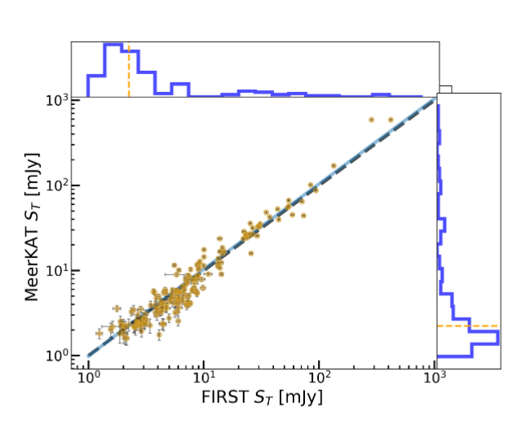
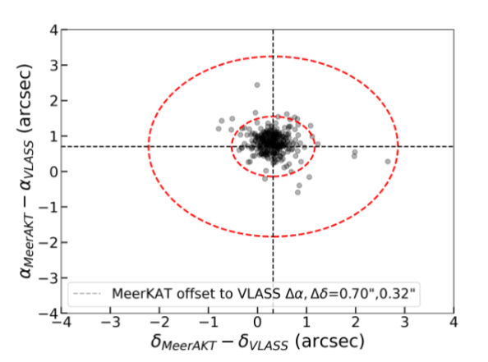
Systematic checks
Consistency check with existing radio surveys such as FIRST (VLA), VLA all sky survey (VLASS), TGSS(uGMRT).
Due to similar beam size (~5’’) and frequency (1.4GHz) we chose to compare flux with FIRST.
Due to large number of sources in VLASS we used this for astrometry check.
Bright unresolved well-separated sources are used for comparison.
Flux scale
Astrometry
Offset < 1’’
Error ~ 10%

Slide 6
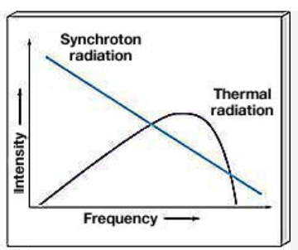
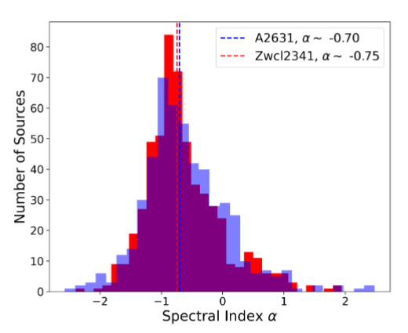

Spectral index distribution
Image cubes split into 3 at v1, v2, v3 = 0.8, 1.2, 1.6GHz to measure spectral index value.
Steep (a~0.7/0.8) and flat (a~0.3/0.4) spectrum source classifications. Steep -> Synchrotron dominated emission. Flat -> Free-free emission mechanisms.
At GHz frequencies sky is dominated by steep spectrum sources.
steep
Mostly Steep
flat
Notes:
Split MFS cube into separate images at a different frequency (800 MHz bandwidth split in 3).

Slide 7
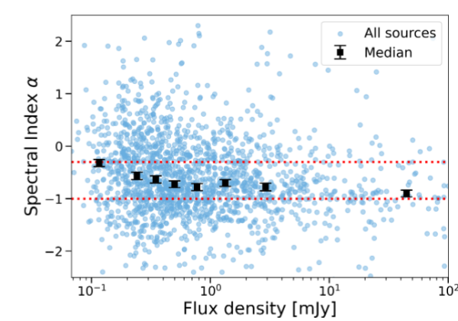
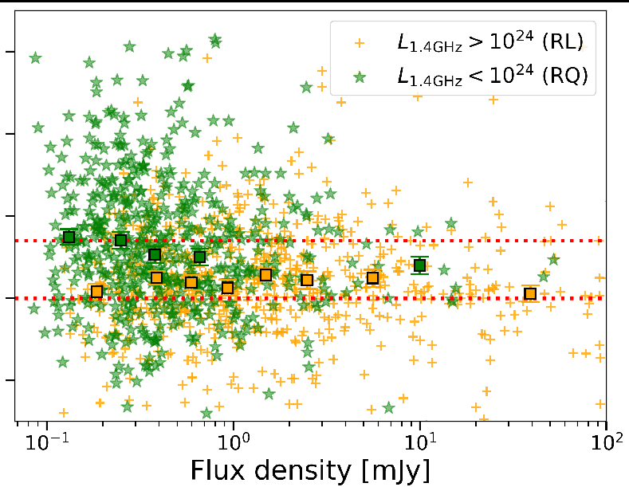
Spectral index as a function of flux density
A trend of spectral index flattening towards brighter fluxes is observed.
Clear seperation between radio loud (RL) and radio quiet (RQ) sources is observed.
High luminosity sources are associated with AGN sources while low luminosity sources are associated with SF galaxies.
Spectral index flattening
RQ~ SFGs
flat
Steep
RL~ AGNs
Notes:
Split MFS cube into separate images at a different frequency (800 MHz bandwidth split in 3).

Slide 8
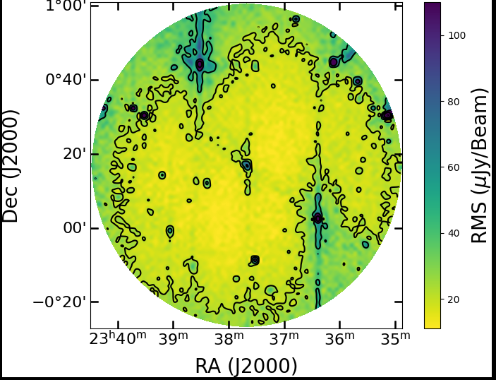
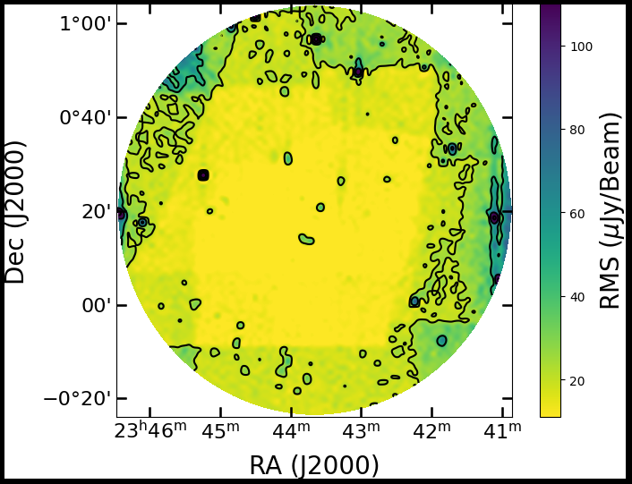
Completeness of radio catalog
Radio catalogs contains several biases due to different instrument, source finding procedures, etc
Sources in regions of high noise are more biased than sources in regions of lower noise.
Faint sources near noise peaks can have their flux density dip below detection threshold.
Noise peaks

Slide 9
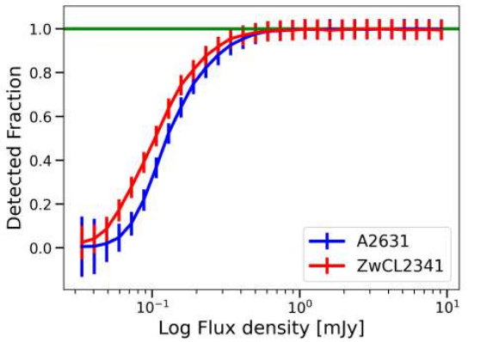
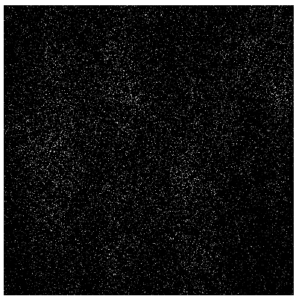
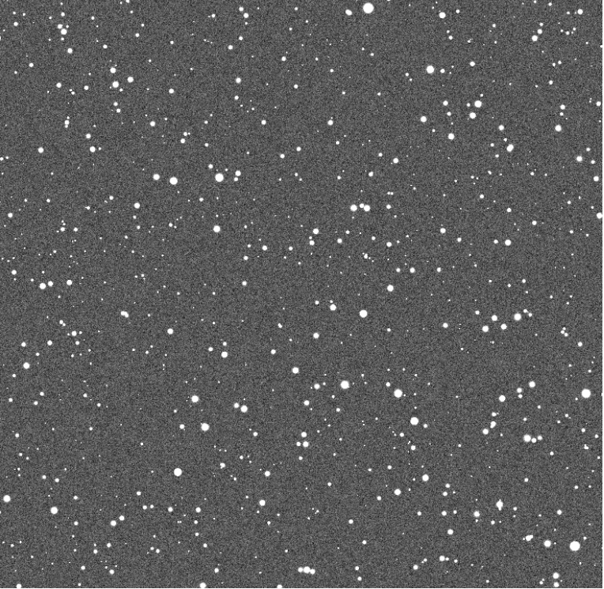
Estimation of correction factors
Use radio simulations we can estimate the correction needed as a function of flux.
Inject sources of known properties onto residual noise map.
Find the ratio of injected sources with recovered.
Injected sources
N Simulated catalog
N Injected catalog
Simulated Image
Source finder parameters
Residual noise

Slide 10
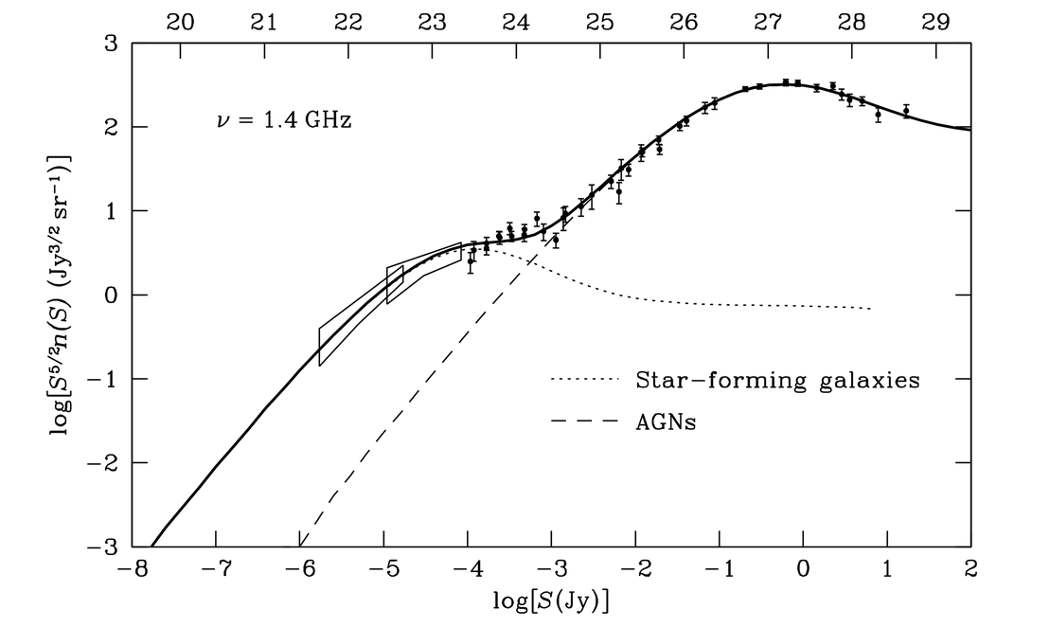
Radio source counts
Number of radio sources per unit area as a function of flux density -> source counts.
Gives information regarding relative galaxy populations existing in Universe.
Inflection point ~ 1mJy signalling the emergence of a new population of SF galaxies.
AGNs
transition
SFGs

Slide 11
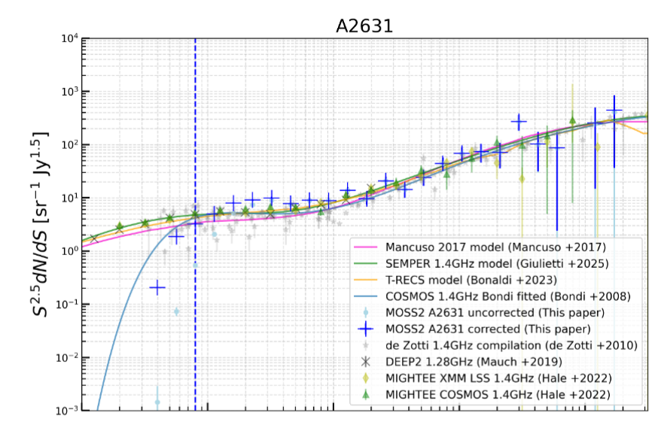
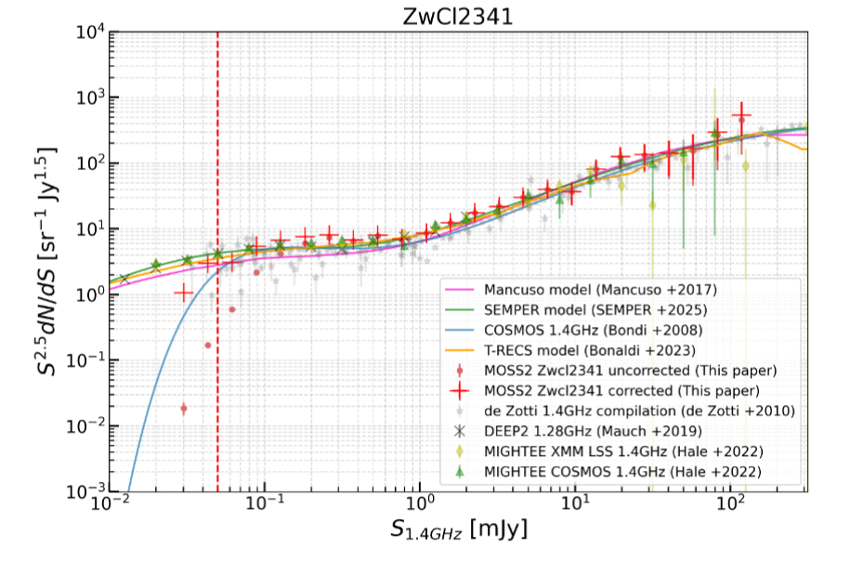
Radio source counts for cluster observations
Radio source counts plotted together with other MeerKAt data and simulated radio sky models.
The counts show a good agreement for the bright end.
Observed counts lie slightly higher at the transition region (0.1-1mJy) compared tothe other data.
Incomplete
Incomplete
agreement
agreement
Deviation
sub mJy
Deviation sub-mJy

Slide 12
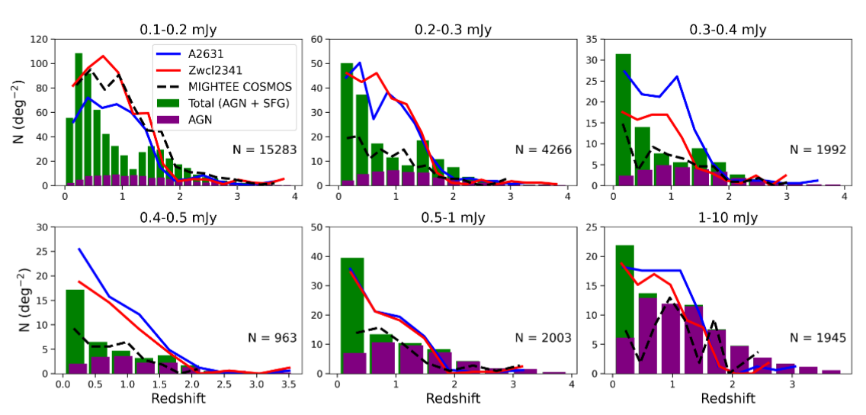
Redshift distribution comparison with evolutionary models
Compare the redshift distribution of our sources with that of extragalactic radio simulations to probe deviation.
Our radio data shows an excess of sources as compared with the extragalactic simulation and other MeerKAT data (of COSMOS).
This is due to Cosmic variance -> non-uniform distribution of sources in the universe.
Supercluster region contains different source population as compared to that of radio simulations and other data.
excess
0.1-1mJy
Simulated AGN+SF
excess
excess
Our data: A2631, Zwcl2341
excess
fewer excess
no excess
MIGHTEE COSMOS ---

Slide 13
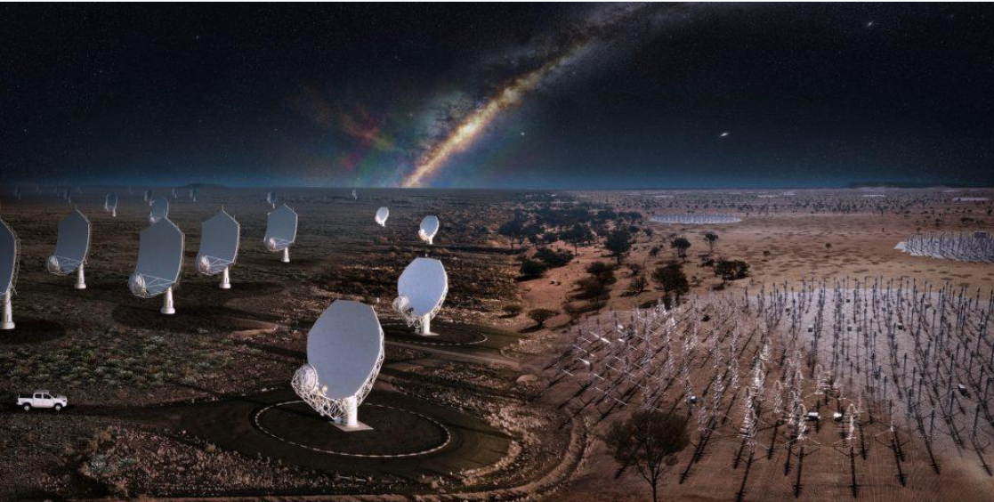
Thank you!

