Slide 1
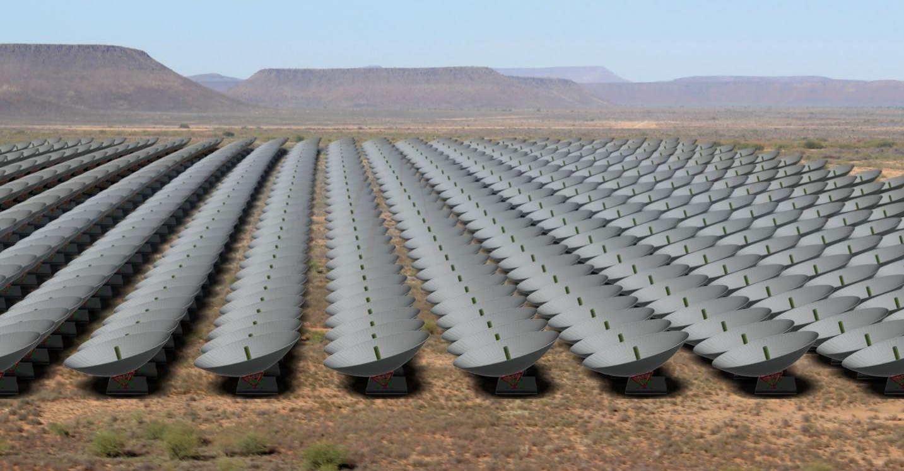




HIRAX : Overview, Status and Swiss involvement
AJITH SAMPATH
Postdoctoral fellow
University of Geneva.
(On behalf of the HIRAX collab.)
SKACH Winter meeting
26th & 27th January 2026
Lugano
Credits: Cynthia Chiang

Slide 2
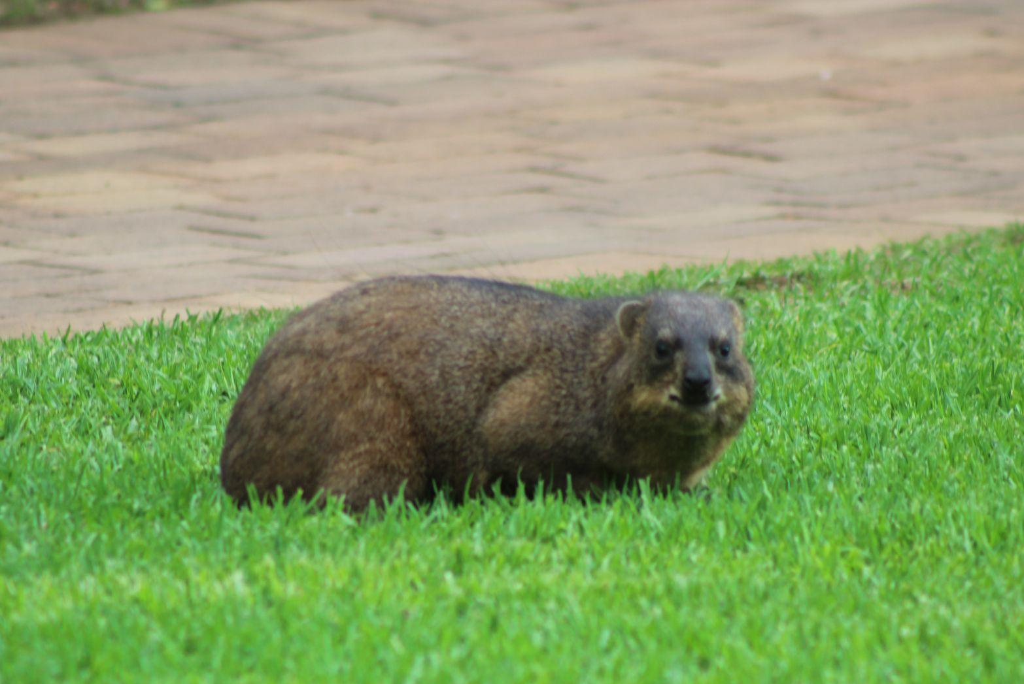
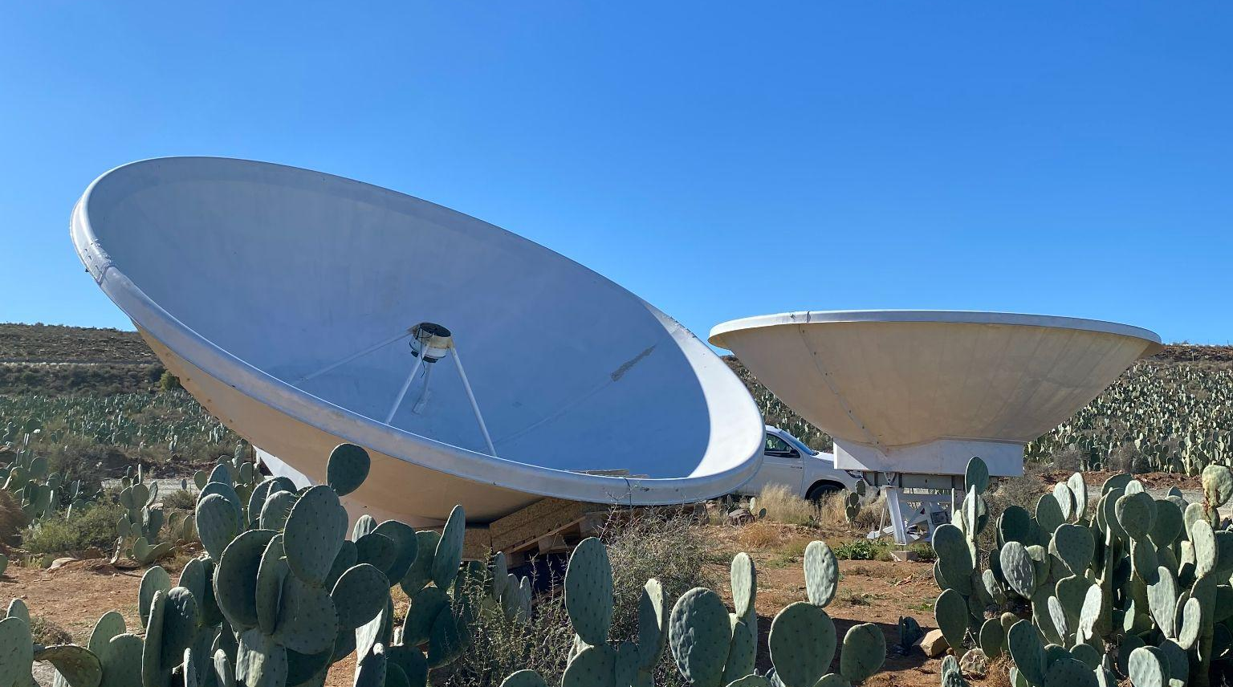
What is HIRAX?
Hyrax (the rock dassie) is a wild terrestrial mammal found in the bushes of Southern Africa.
HIRAX - Hydrogen Intensity and Real-time Analysis eXperiment - in development and deployment phase in Karoo desert. Guest instrument at the SKA site.
1024 element compact, redundant, radio interferometer array in drift-scan mode.
6m Diameter dishes with f=0.21
400 - 800 MHz : 0.775 < z < 2.55 : 37.5 - 75 cm
Covers ~15000 sq.degrees of Southern sky and scans for 17500 hrs.
Aims to constrain Dark energy equation of state parameters through 21cm intensity mapping.
Can also detect pulsars and FRBs as well as can do HI absorber science.
Credits: Me
Credits: Keshav Bechoo (UKZN)
Ajith Sampath- HIRAX Overview & Update - SKACH Winter meeting - 27th Jan 2026

Slide 3
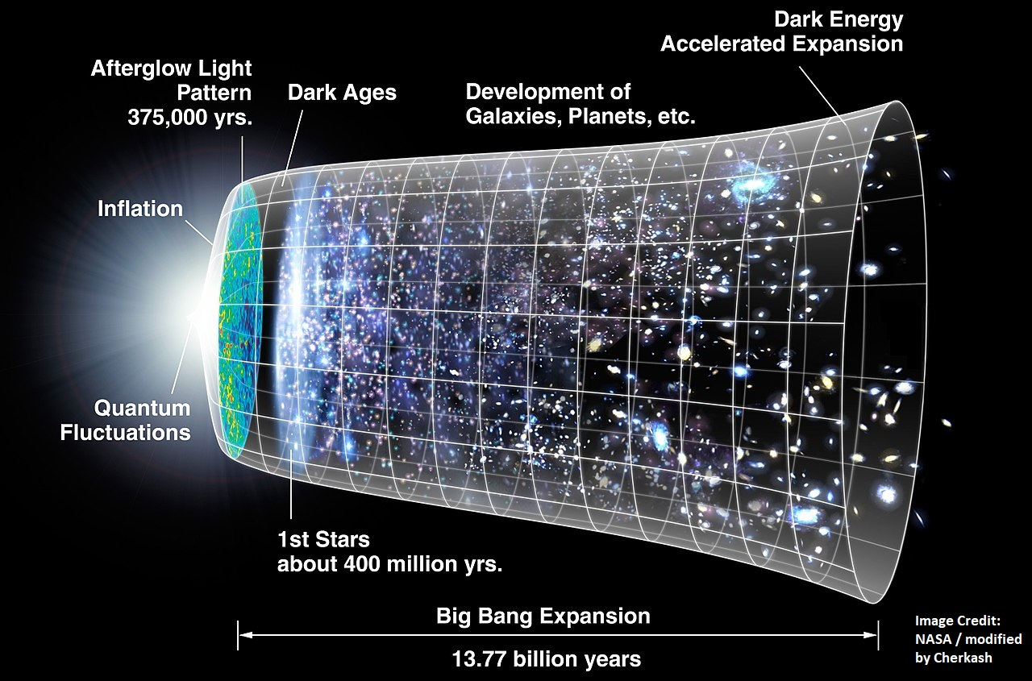
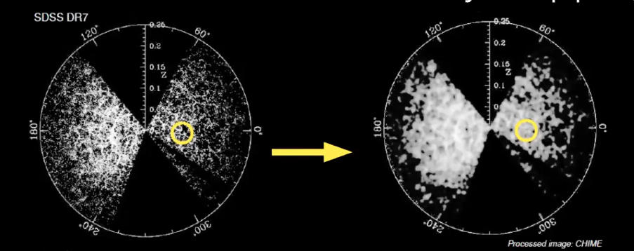
Why HIRAX? The Ultimate goal
Reveal the nature of Dark Energy.
Constrain Dark energy parameters.
Measure D_{A}(z) (transverse) and H(z) (radial) around z~1.
Detect BAOs - Primordial sound waves imprinted in the galaxy distribution
Intensity mapping of galaxy density distribution through HI 21cm line emission.
Build a Radio telescope to probe the scales and redshift interested.
Ajith Sampath- HIRAX Overview & Update - SKACH Winter meeting - 27th Jan 2026

Slide 4
How ? Designing a Dark Energy Telescope
Sensitive in scales of interest (large scales here)
Redshift range : 0.775 < z < 2.55 to capture DE domination at z~1 and for sufficient volume
BAO angular scale 150 Mpc : 3 to 1.3 degrees resolution at this redshift range
BAO radial scale : 20 to 12 MHz resolution
BAO signal level : ~0.1 mK
Use a compact array
Required frequencies 400 to 800 MHz
Required baseline lengths : 15 - 60 metres
Required frequency channels : at least 100 (more for FG removal and higher order peaks)
Credits: Cynthia Chiang
Low Tsys and large collecting area (many dishes)
Ajith Sampath- HIRAX Overview & Update - SKACH Winter meeting - 27th Jan 2026

Slide 5
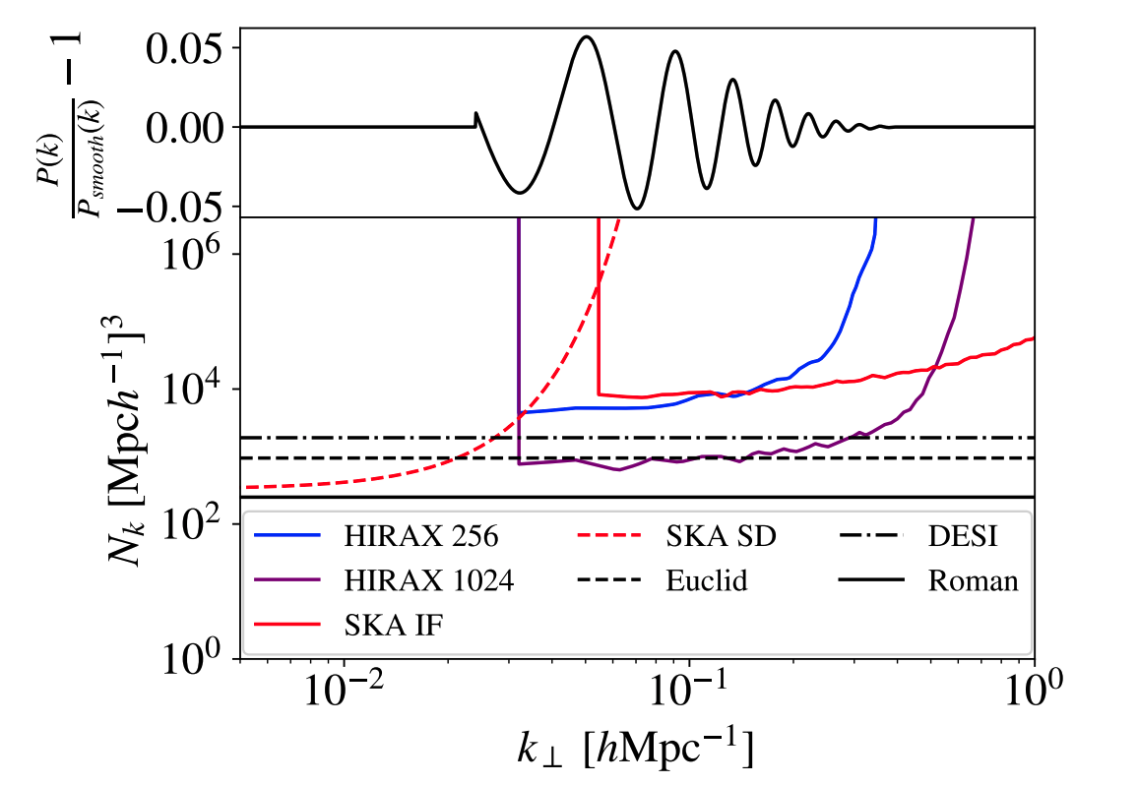
Sensitivity Comparison
P(k) sensitivity comparison with SKA-MID in both single dish and interferometric mode.
Shot noise estimates from DESI, Euclid and Roman. Comparable to these spectroscopic surveys at high sensitive regions.
Top panel BAO wiggle is at z = 1.2
Complimentary to SKA1-MID
SD survey - probing ultra large scale features - primordial non-Gaussianity
IF survey - smaller angular scales
- non-linear regime
HIRAX designed to achieve very high sensitivity at those specific scales.
D. Crichton et al. 2021
Ajith Sampath- HIRAX Overview & Update - SKACH Winter meeting - 27th Jan 2026

Slide 6
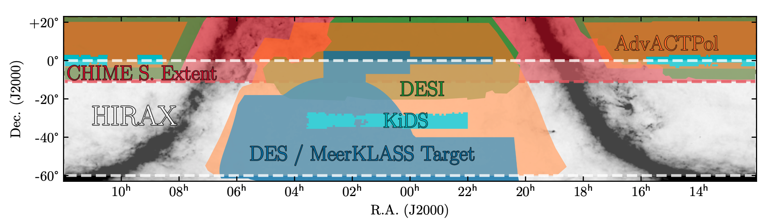
Overlapping surveys - Cross-correlation
Slight overlap with CHIME (0 to -10 deg Declination)
Entire image here lies within LSST survey area and accessible to SKA & its precursors.
Cross correlation with
eBOSS, DESI, Rubin LSST, KiDS, DESI, HSC, Euclid, Roman.
Ground based CMB experiments - AdvACTPol, SPT-3G.
D. Crichton et al. 2021
Ajith Sampath- HIRAX Overview & Update - SKACH Winter meeting - 27th Jan 2026

Slide 7
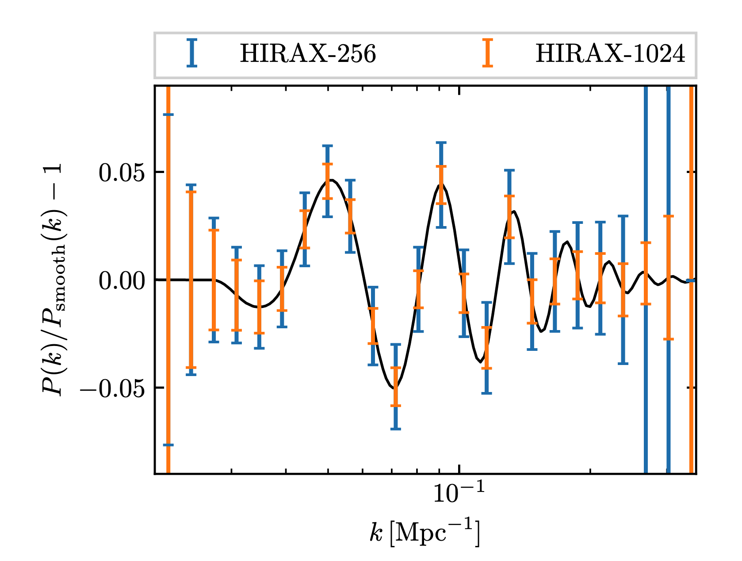
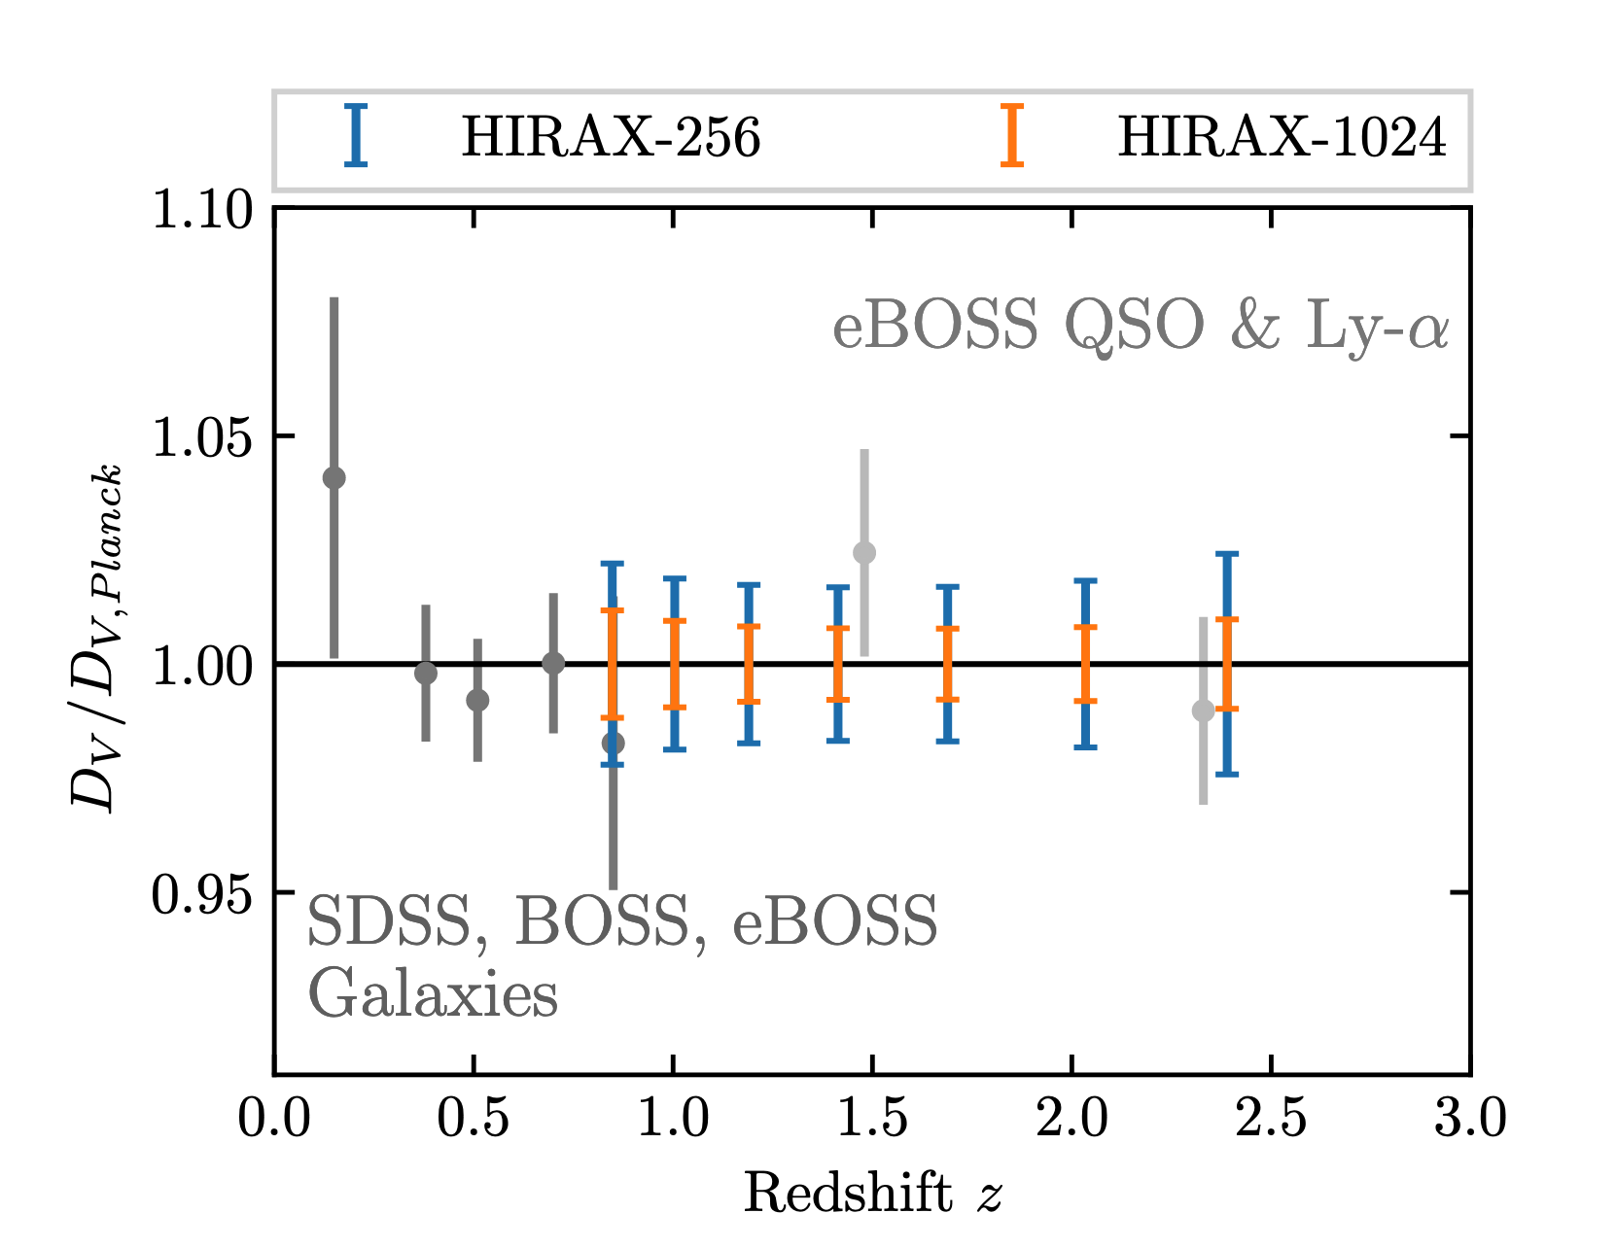
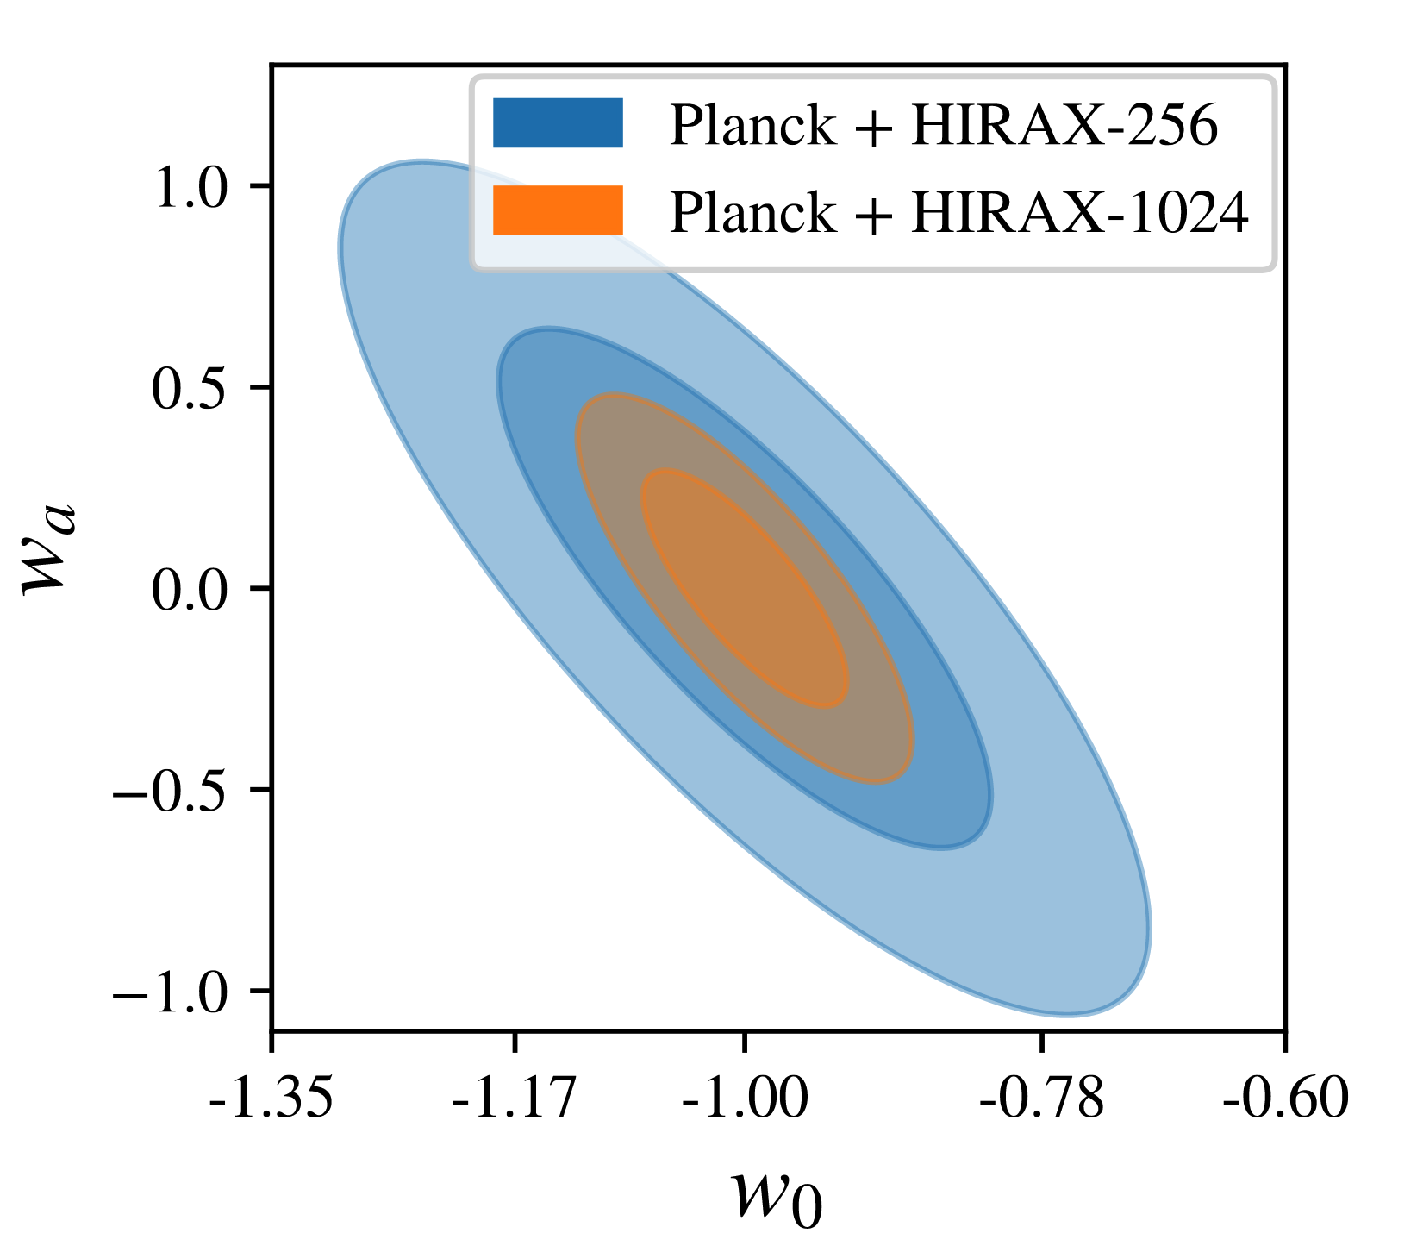
Detection forecasts
Even at 256 element stage, HIRAX has significant statistical power to constrain parameters.
Can achieve FoM = 360 for HIRAX 1024 element array.
More details - beyond Fisher, coming soon in a forecasts paper (in prep)
HIRAX 256 can detect multiple FRBs/week - similar collecting area to CHIME
HIRAX outriggers (like BIUST Botswana) - around 1000 km baseline - localisation of FRBs (0.1 arcsec)
FoM = 360
D. Crichton et al. 2021
Ajith Sampath- HIRAX Overview & Update - SKACH Winter meeting - 27th Jan 2026

Slide 8
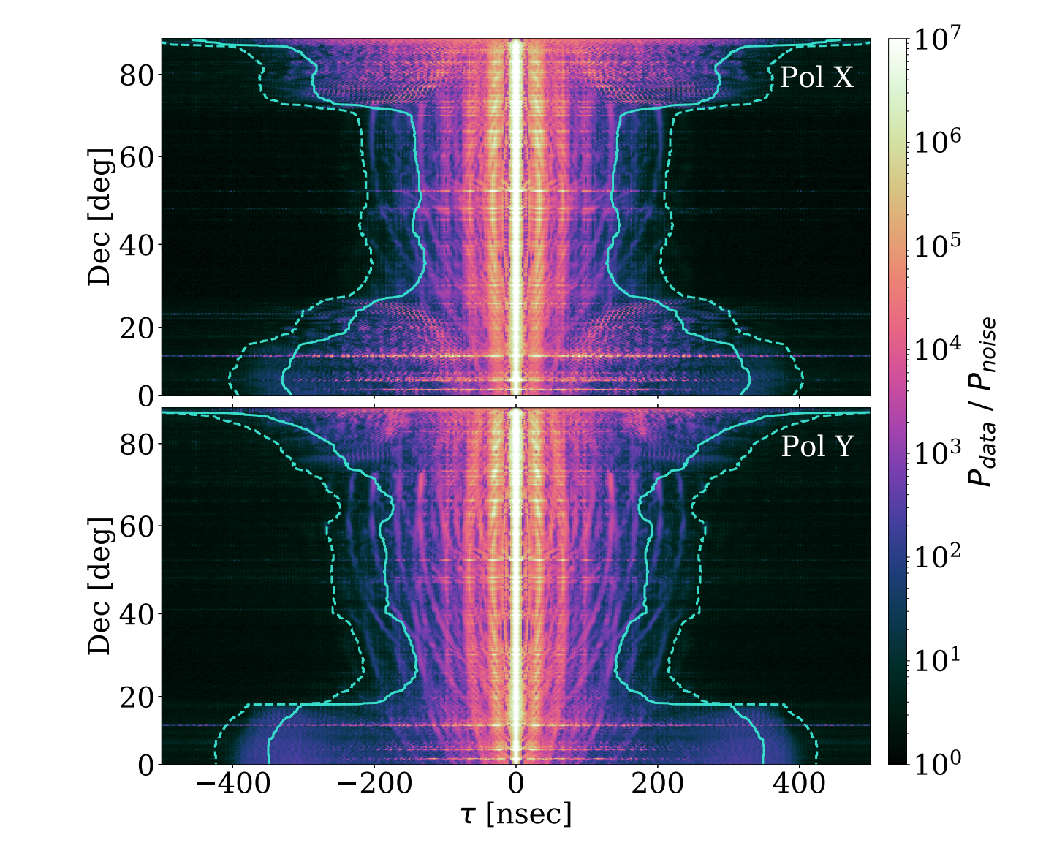
Practical Challenges
RFI
Foregrounds - strong, magnitudes higher than HI,
Galactic synchrotron
Faraday-rotated polarised FGs
Systematics
Primary beam (chromaticity - mode mixing, surface deformities, mutual coupling, standing waves, etc.,)
Non-redundancy - array layout errors, dish to dish changes, non-uniform beam responses.
Thermal noise / Sensitivity
Polarization leakage
Cable reflections
Data volume and computation
The 1024 (256) element array will produce a very large daily dataset: 150 (9) TB / day [220 (14) PB for full 4 year survey]
CHIME Collaboration 2022
Ajith Sampath- HIRAX Overview & Update - SKACH Winter meeting - 27th Jan 2026

Slide 9
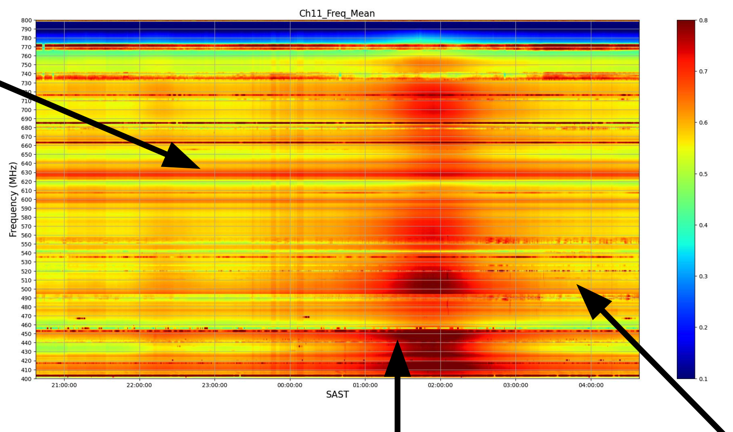
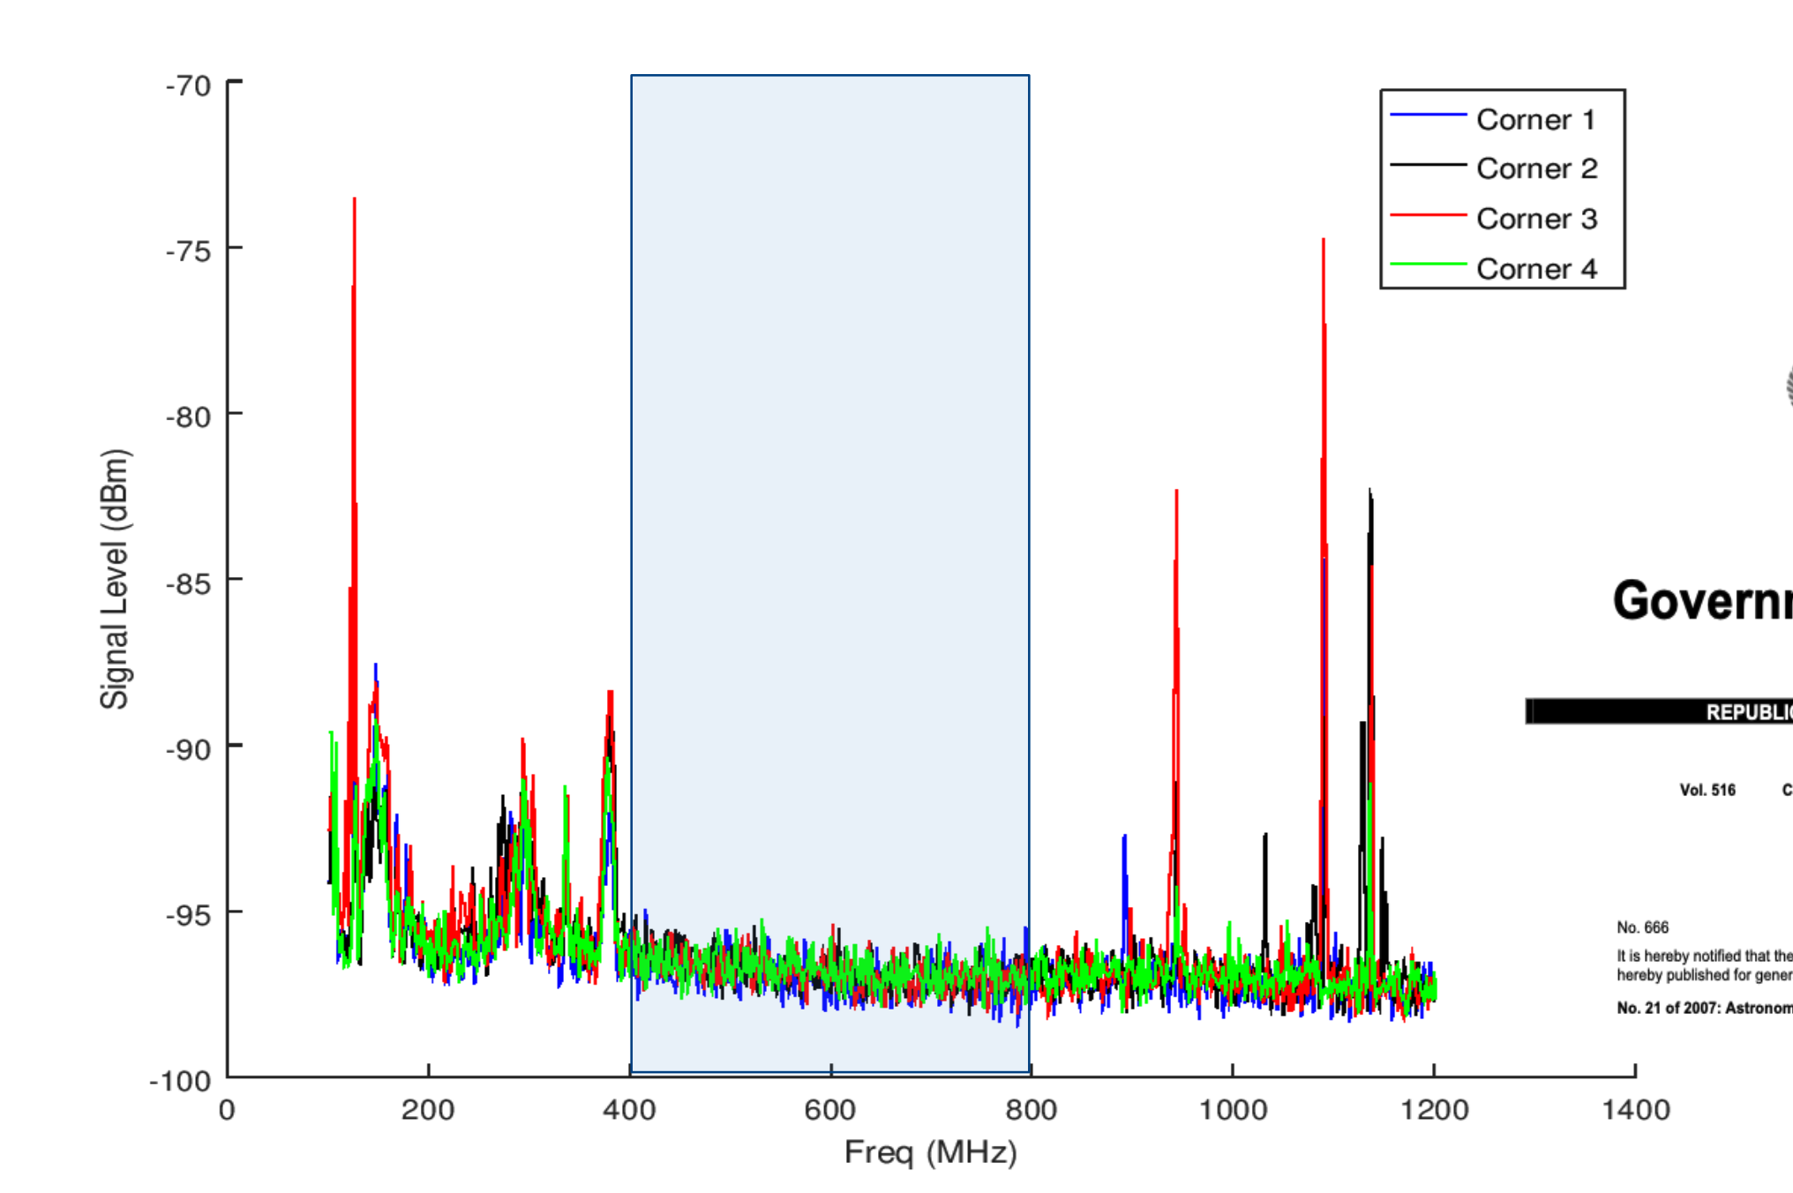

Practical challenge - RFI
Low levels of RFI - site protected
Still have some RFI issues that has to be studied and taken care of.
Klerefontein - Testbed Site
SKAO - main site
Corrupt channels
Time varying RFI
Galactic transit
Ajith Sampath- HIRAX Overview & Update - SKACH Winter meeting - 27th Jan 2026

Slide 10
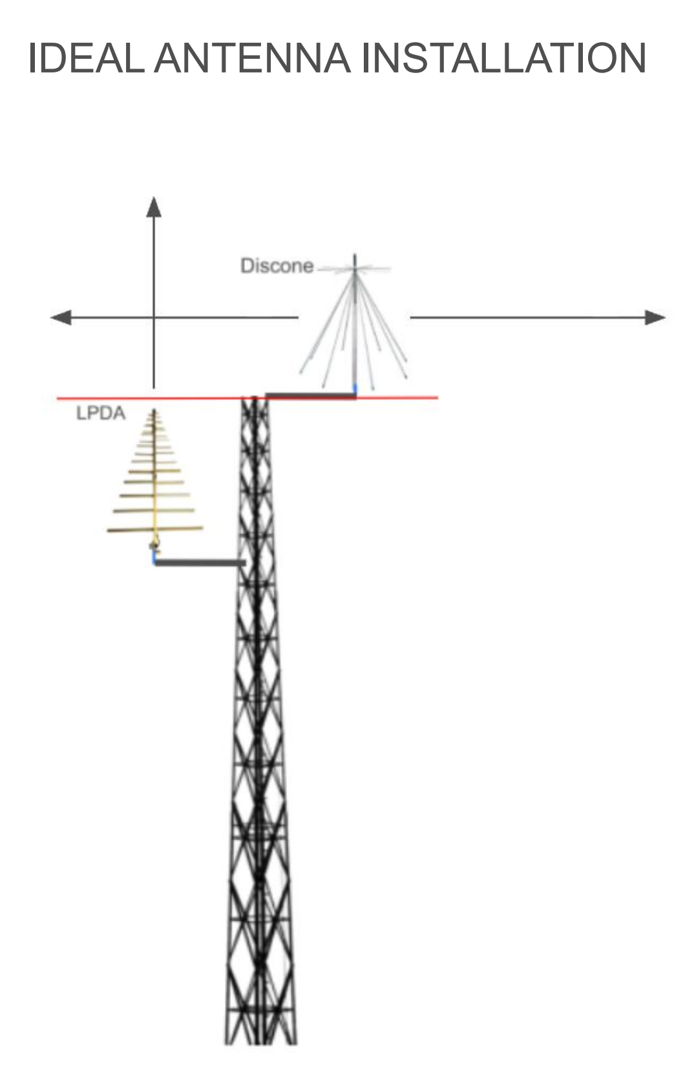
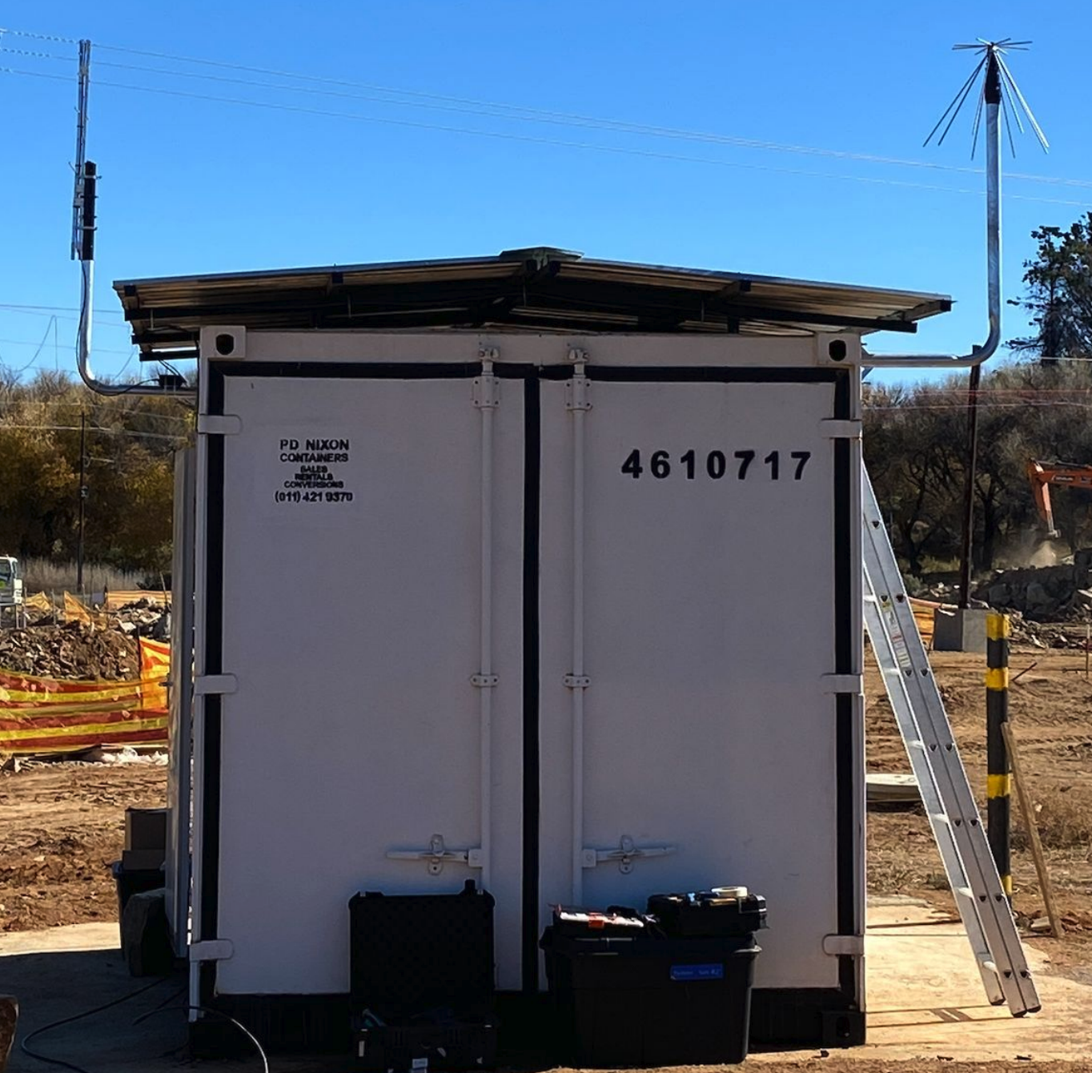
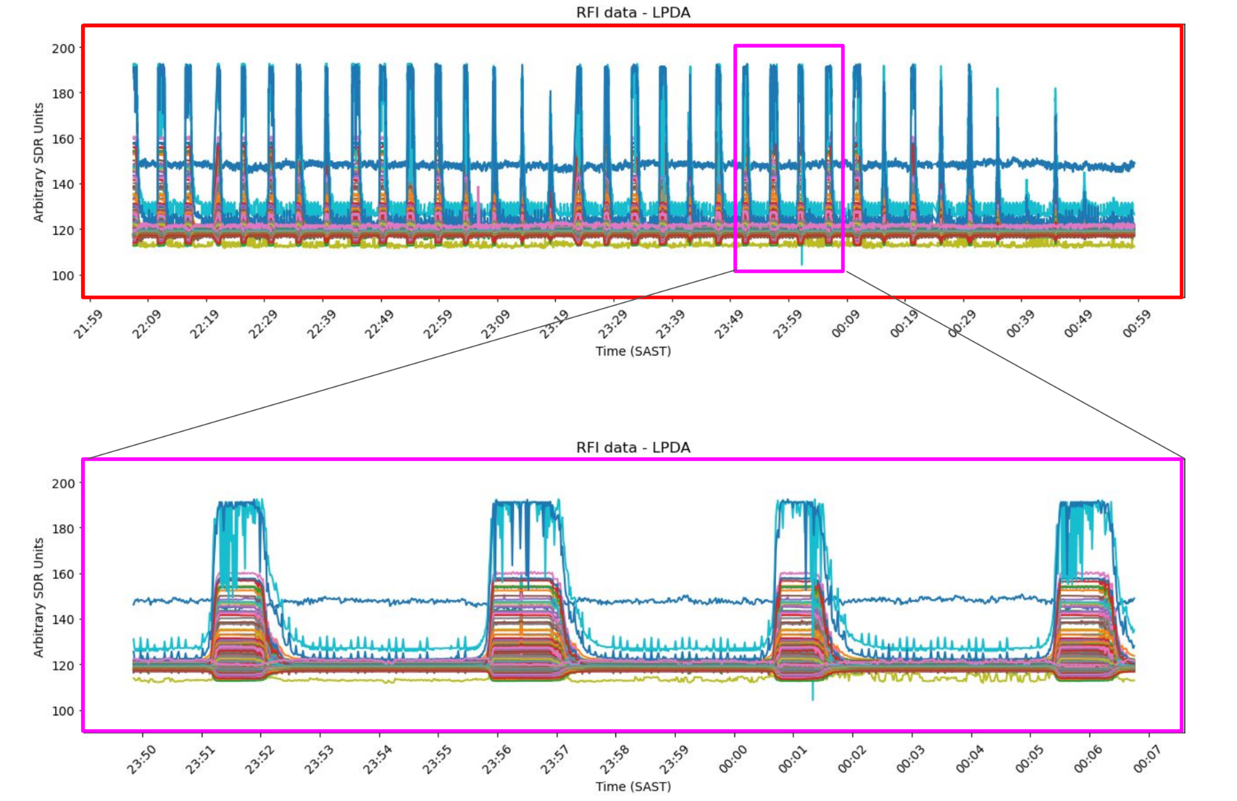
RFI - How do we tackle it?
Apart from other post-acquisition efforts like flagging strategies,
RFI monitoring system - developed and deployed by Keshav Bechoo (UKZN, South Africa).
LPDA - directive and tracking time varying sources.
Discone - omnidirectional and sensitive to horizon
Deployed and tested at Klerefontein - in the process of deploying in main site.
Ajith Sampath- HIRAX Overview & Update - SKACH Winter meeting - 27th Jan 2026

Slide 11
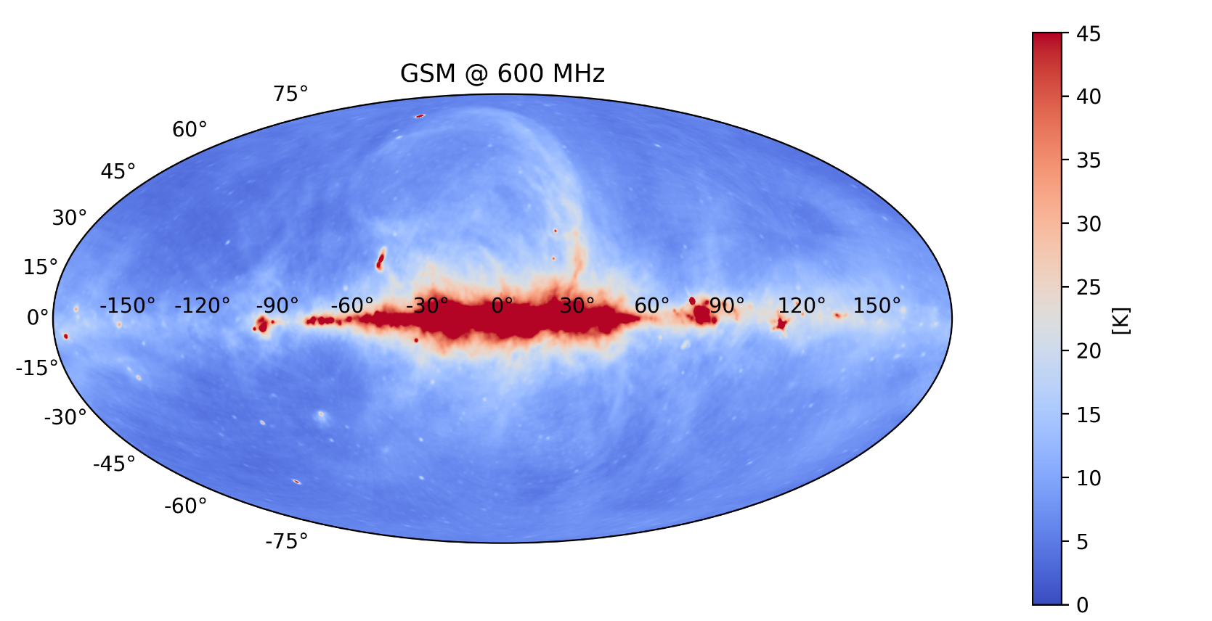
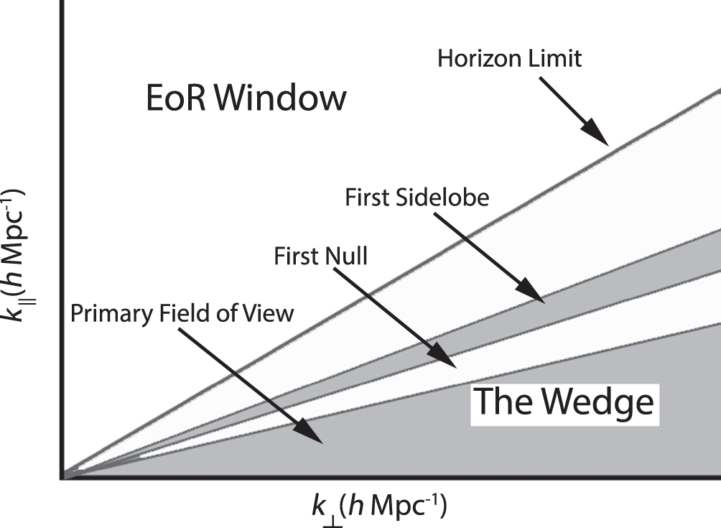
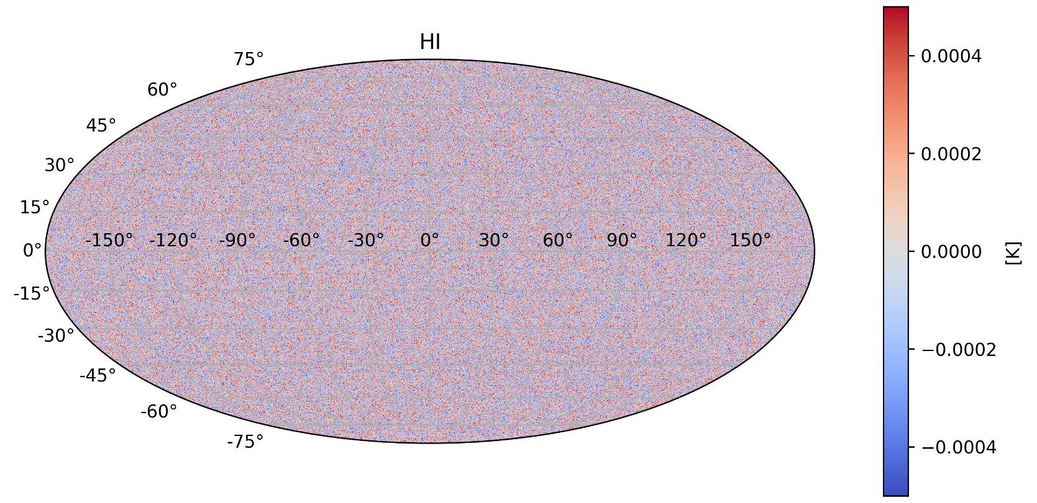
Practical challenge - Foregrounds
Brighter than signal by many orders of magnitude.
Galactic synchrotron and extra-galactic point sources.
Inherently smooth in frequency but instrumental chromaticity can complicate this.
Usually confined in the wedge region, but can leak into clean BAO window due to this.
Need extensive foreground and HI simulations as well as instrumental characterization.
Signal Window
J. C. Pober et al 2016
Ajith Sampath- HIRAX Overview & Update - SKACH Winter meeting - 27th Jan 2026

Slide 12

Foregrounds - What to do about it?
SERVAL - Spherical Expansions for Radio Visibility Analysis at Large-N
Devin Crichton and Marianna (ETH Zurich)
Spherical harmonics based visibility simulator - for extensive end-to-end simulations - with custom instrumental setup
Public beta release: https://cosmo-gitlab.phys.ethz.ch/cosmo_public/serval
Currently planning to publish and discuss a release paper around the same time as CosmoAlps.
HI sky simulations - based on Halo model
Pascal Hitz (ETH Zurich) (arXiv : 2410.01694)
Ajith Sampath- HIRAX Overview & Update - SKACH Winter meeting - 27th Jan 2026

Slide 13
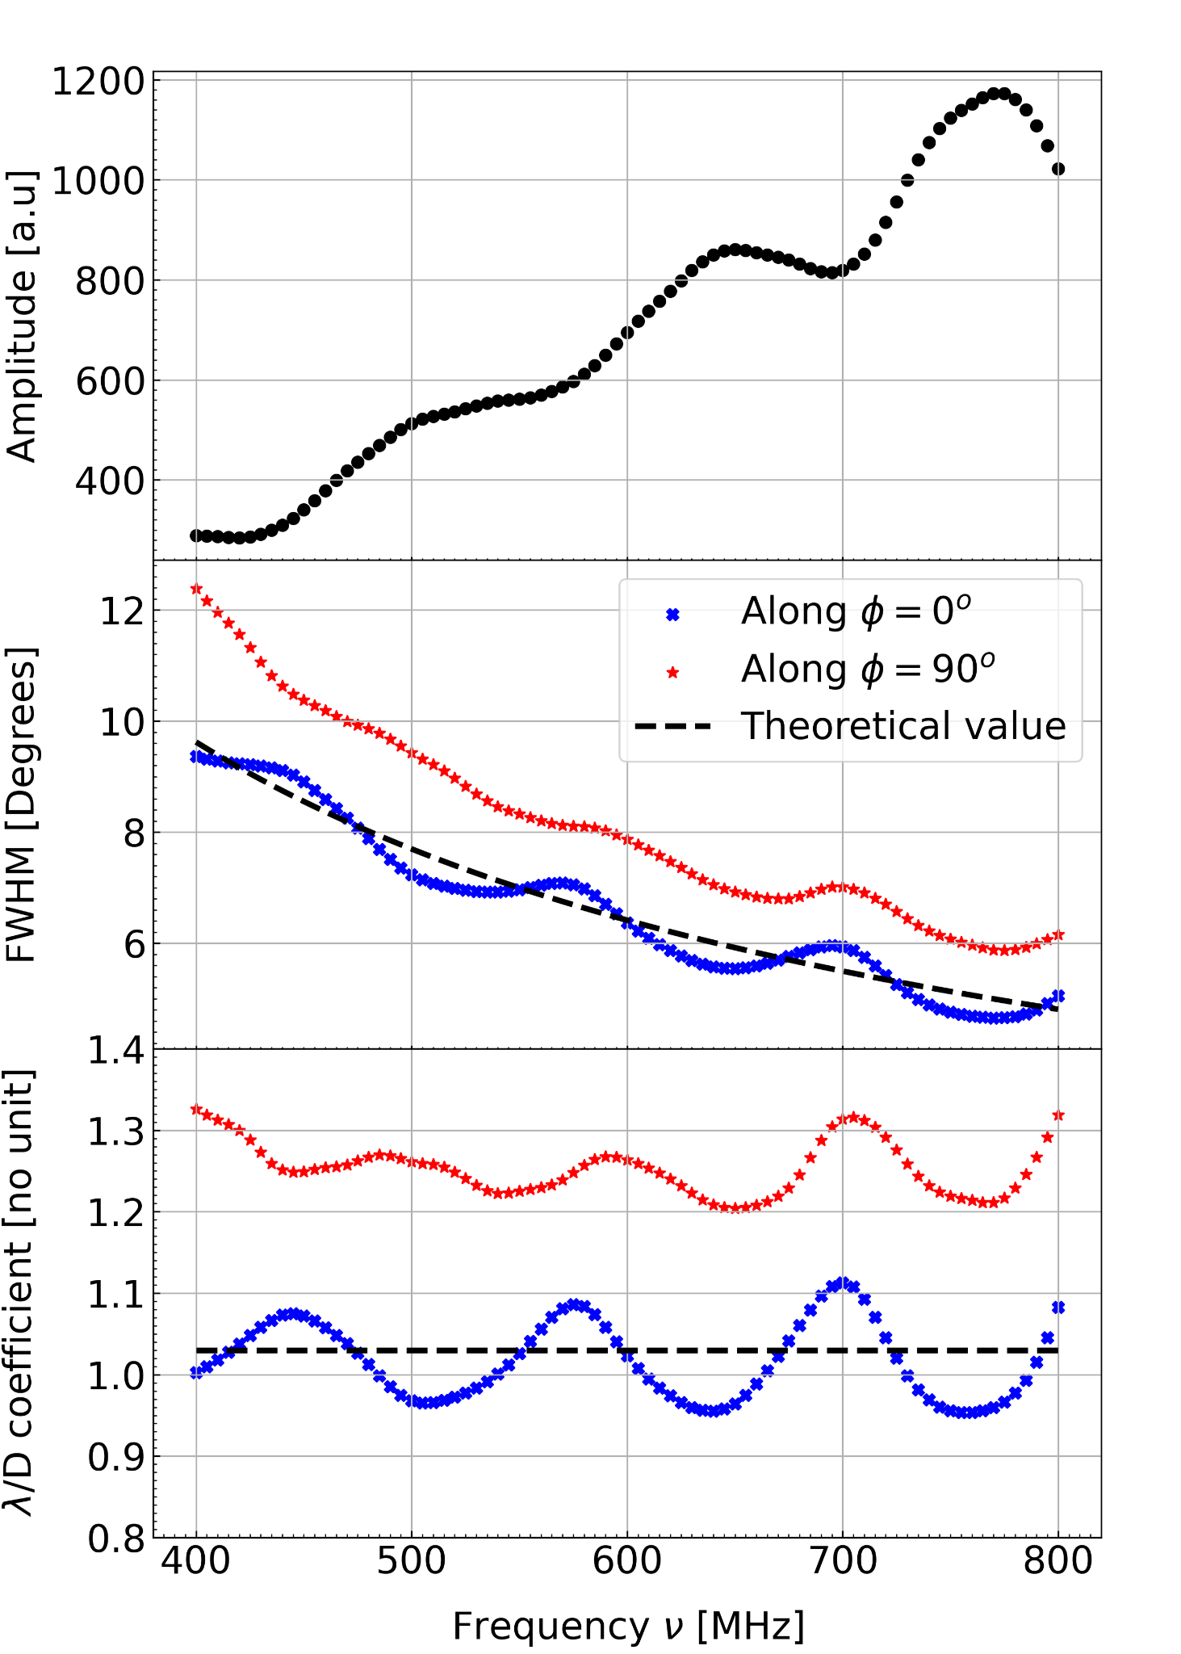
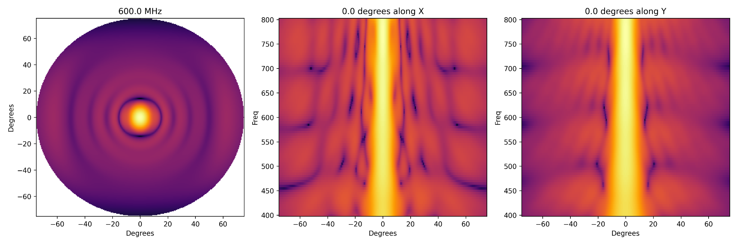
Primary beams
Critical systematic to address and control.
The radiation pattern/primary beam has structures in both angular and spectral axis.
The spectral non-smoothness/chromaticity causes attenuation of FGs and leaking into clean BAO window.
The sidelobes and their chromaticity causes much more problems.
There is also cross-pol beams - which can cause polarization leakage due to polarized FGs (Faraday rotated)
Sampath et al 2026
Ajith Sampath- HIRAX Overview & Update - SKACH Winter meeting - 27th Jan 2026

Slide 14
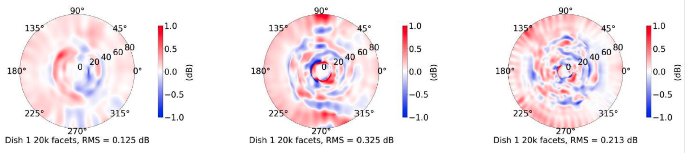
Primary beams - How to characterize them?
EM simulations (CST studio)
Benjamin Saliwanchik (BNL, US), Aditya (McGill, Canada)
Feed position perturbations, dish deformities, solver testing, and cosmo pipeline propagation.
Testing spectral and spatial interpolation for compressed storage
Neural network based beam compression - INR (Me)
Simulations of cross-talk in the array
Leslie Greengard, Manas Rach and Mike O’Neil (Simons Foundation - CCM Centre of Computational Mathematics) and Quentin Guening (Cambridge).
400 MHz
600 MHz
800 MHz
Difference between Fiducial and perturbed beams
Ajith Sampath- HIRAX Overview & Update - SKACH Winter meeting - 27th Jan 2026

Slide 15
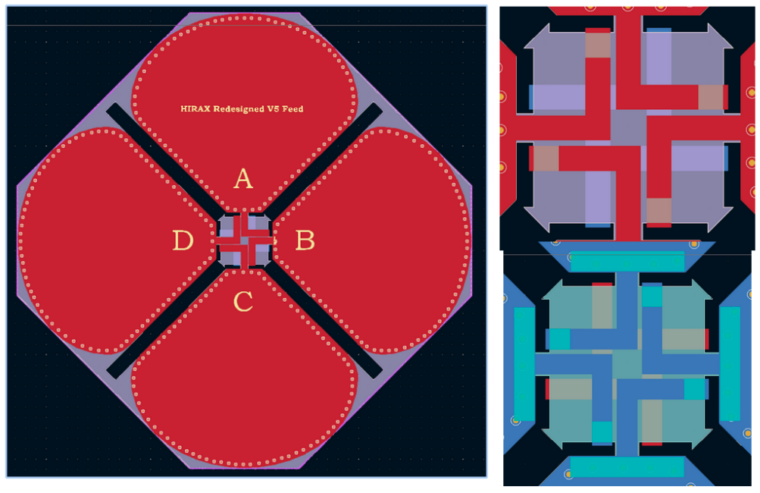
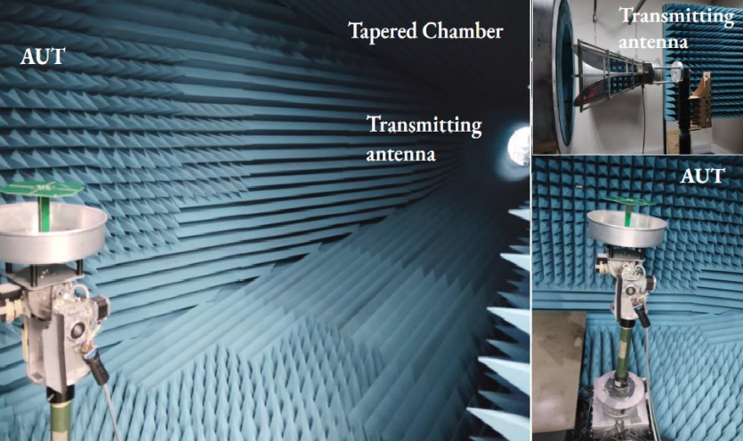
Primary beams - How to characterize them?
Updating telescope hardware (Feed design) before deployment
Dirk de Villiers, Madison Crews (Stellenbosch) and Sindhu Gaddam (UKZN).
Feed redesign to improve beam symmetry, S11, sidelobe level, squint and cross-pol.
Showing promising results - improved S11 and reduced squint.
Newly manufactured redesigned feeds are being tested in anechoic chambers in Stellenbosch and Pretoria.
Ajith Sampath- HIRAX Overview & Update - SKACH Winter meeting - 27th Jan 2026

Slide 16
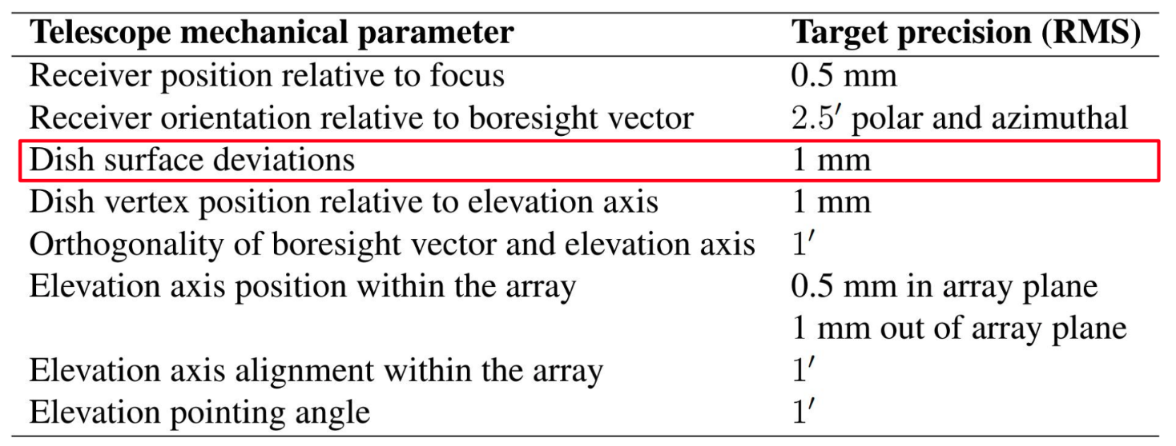
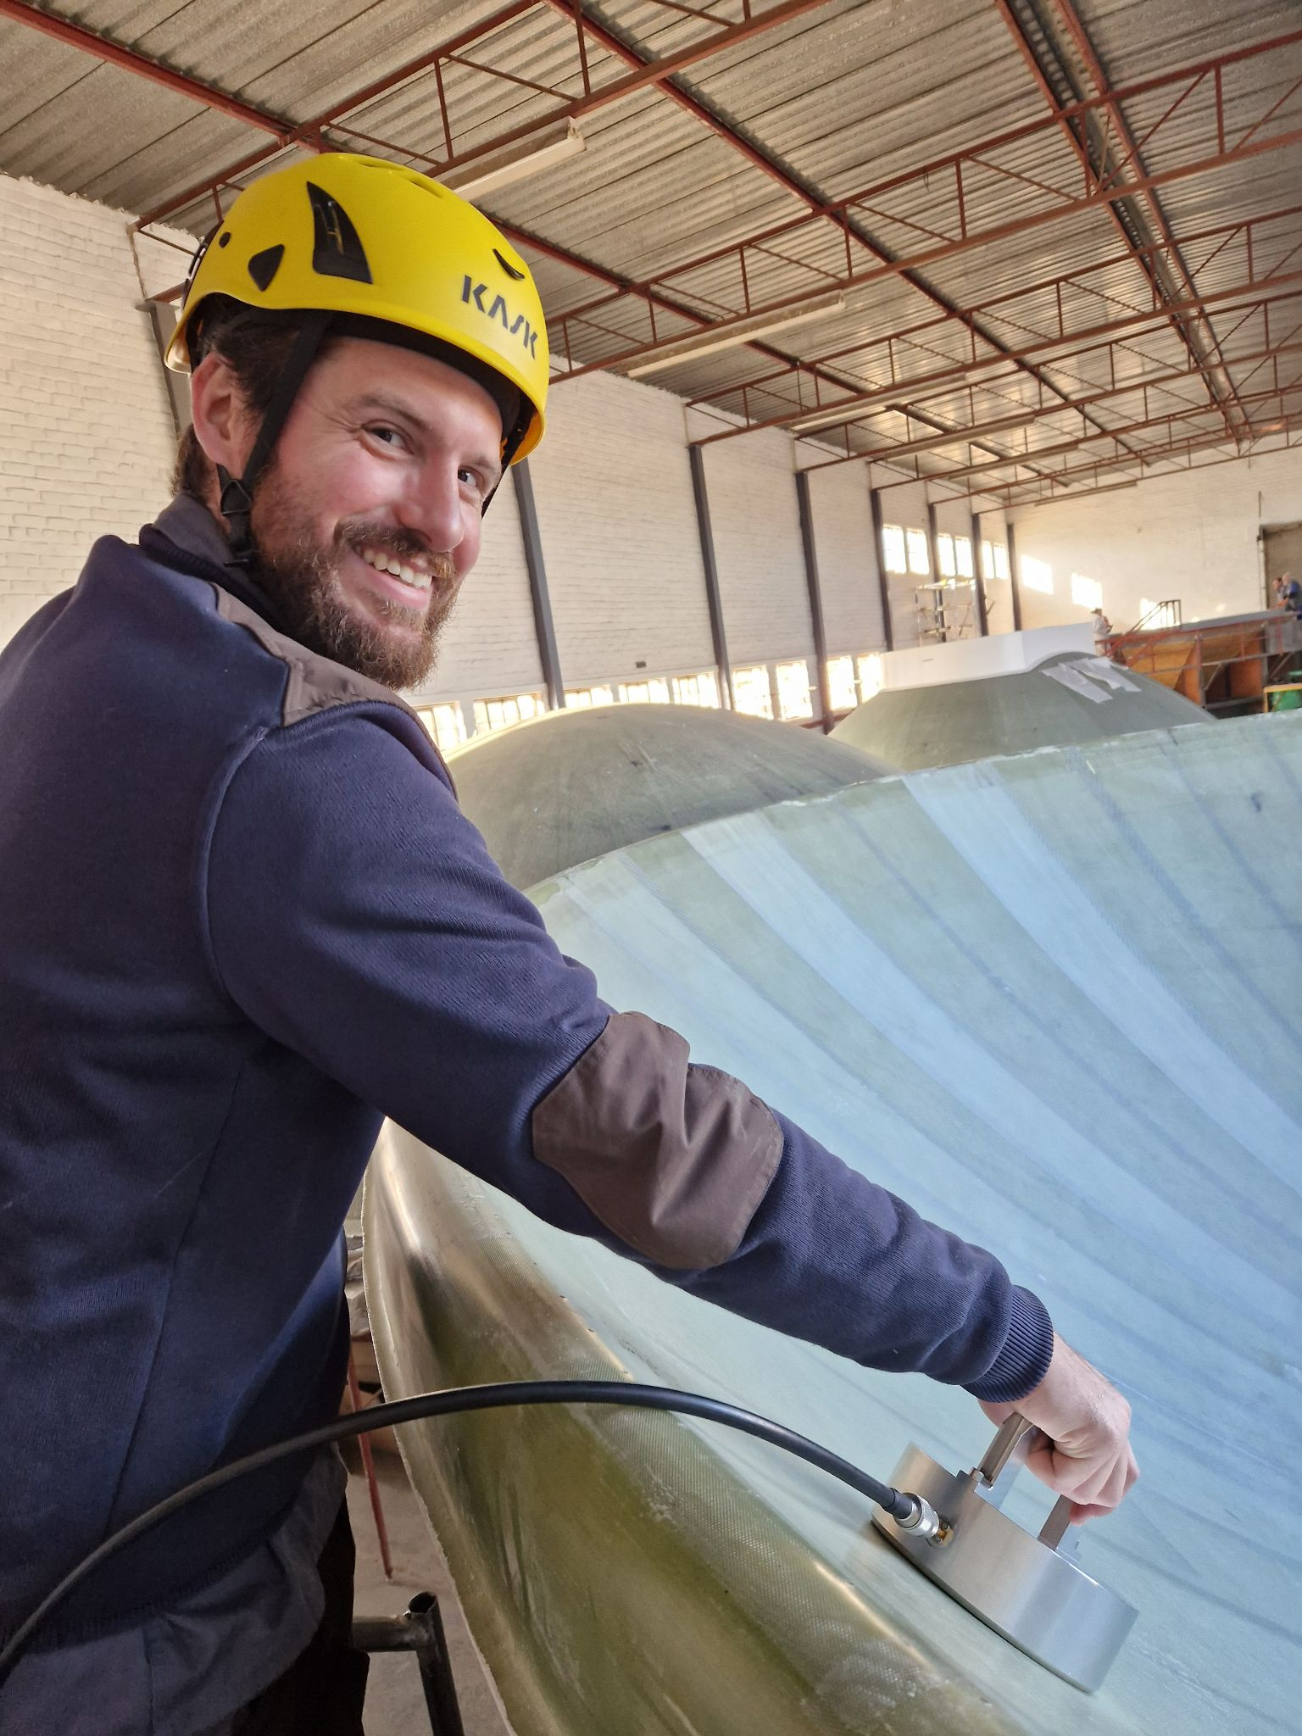
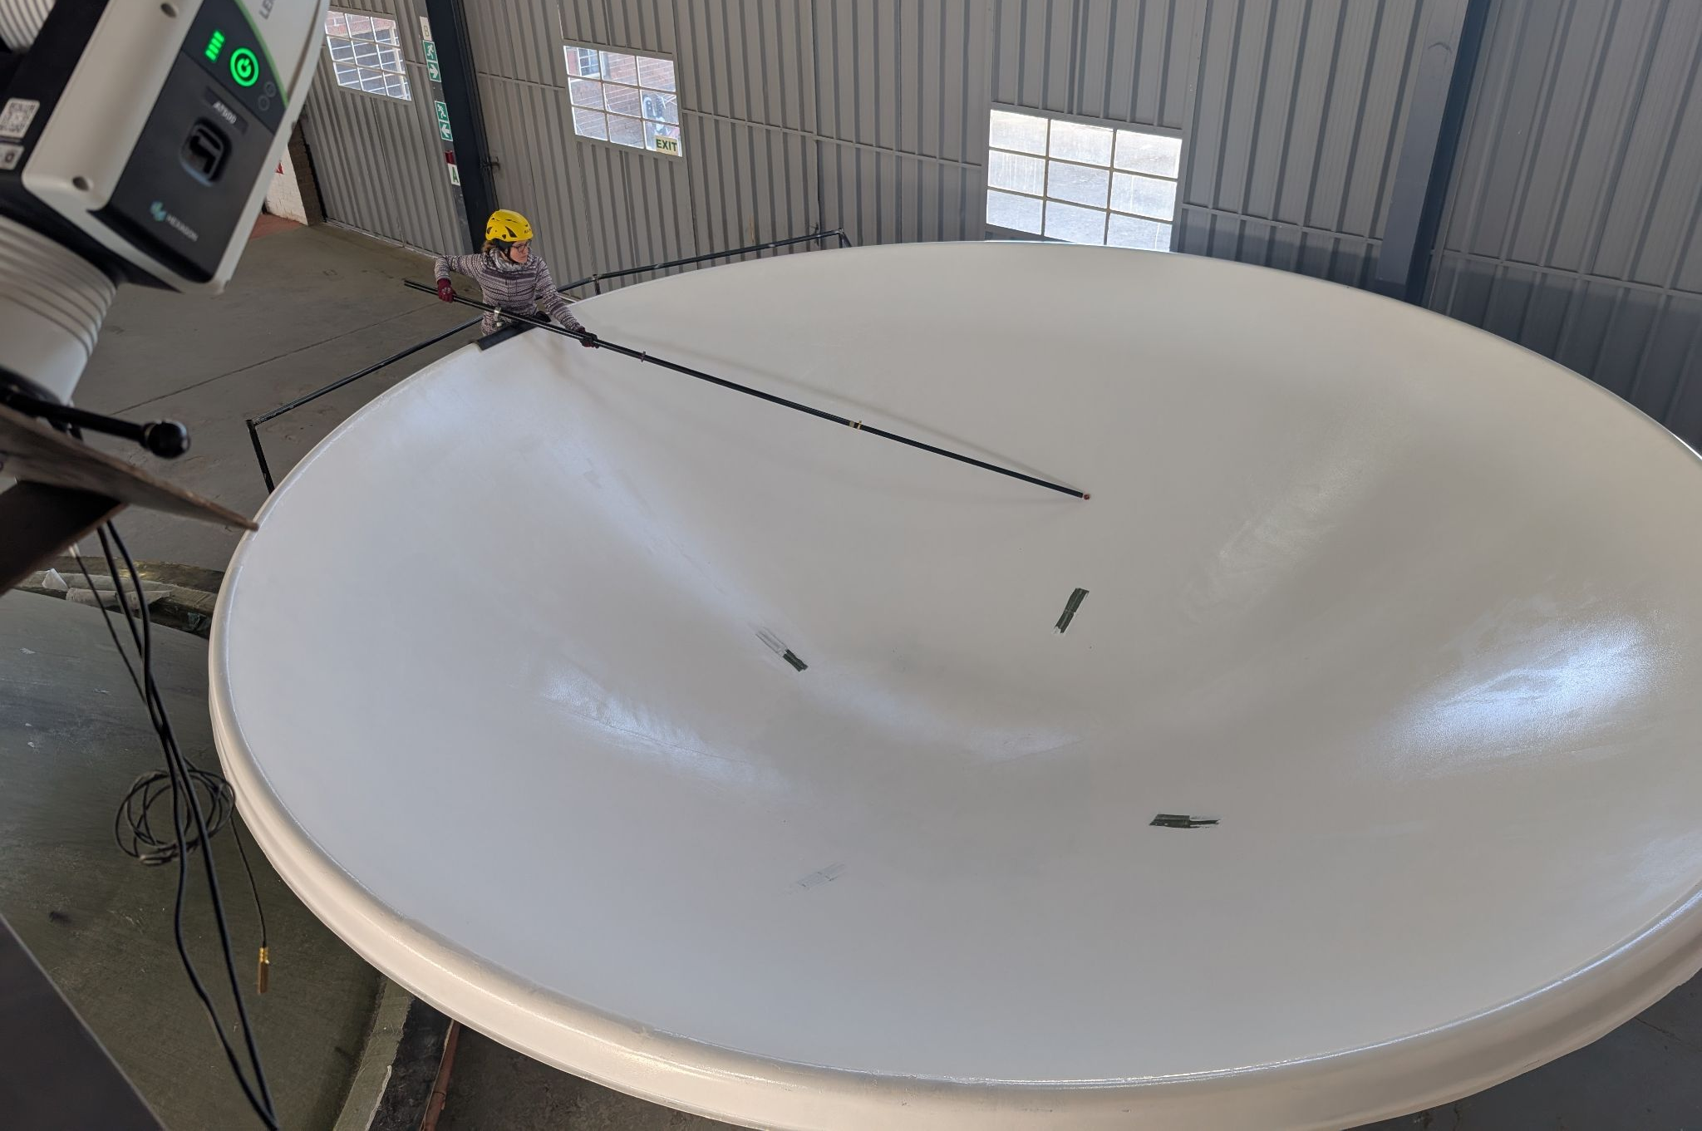
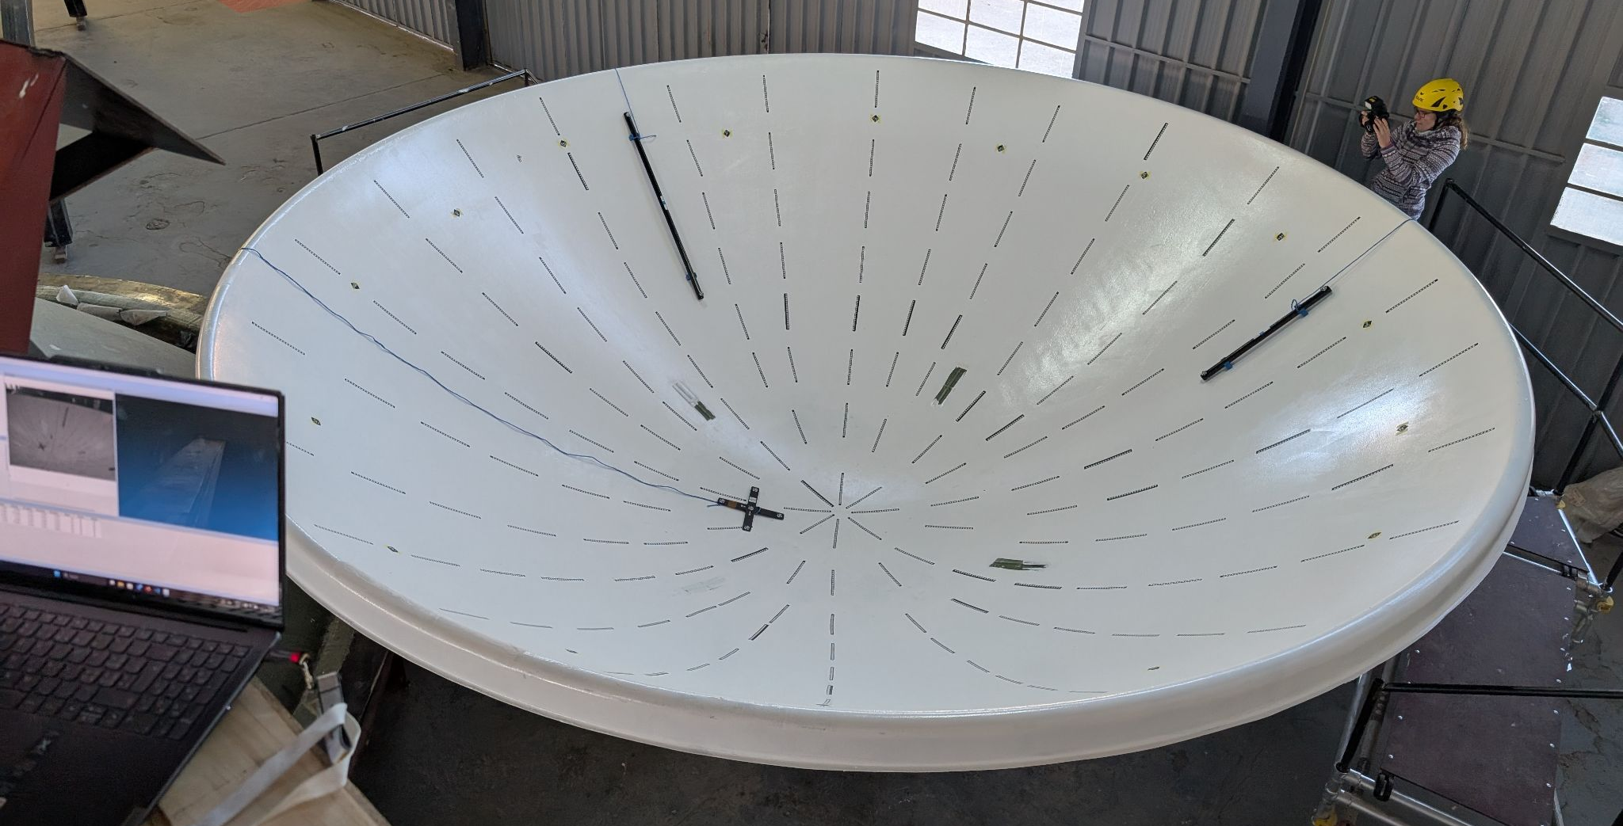
Primary beams - How to characterize them?
Prototyping - Metrology during dish production
Jennifer Studer and Devin (ETH Zurich)
Laser tracker, Photogrammetry and Reflectometer measurements.
Also propagating the measurements to EM sims to study the effects in beam pattern.
Ajith Sampath- HIRAX Overview & Update - SKACH Winter meeting - 27th Jan 2026

Slide 17
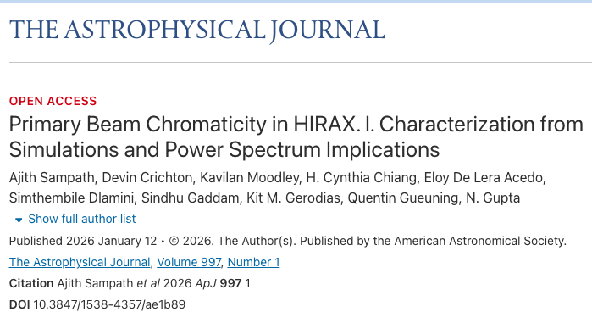
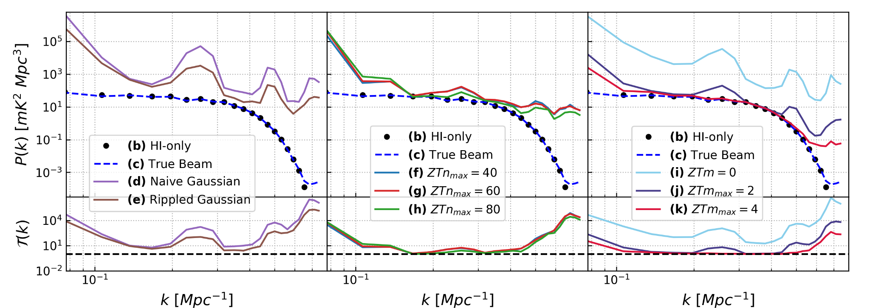
Primary beams - How to characterize them?
Studying the beam effects in Power spectrum space
Me and Devin
Will make use of the SERVAL to do extensive simulations
And propagate all kinds of beam sims and measurements.
Ajith Sampath- HIRAX Overview & Update - SKACH Winter meeting - 27th Jan 2026

Slide 18
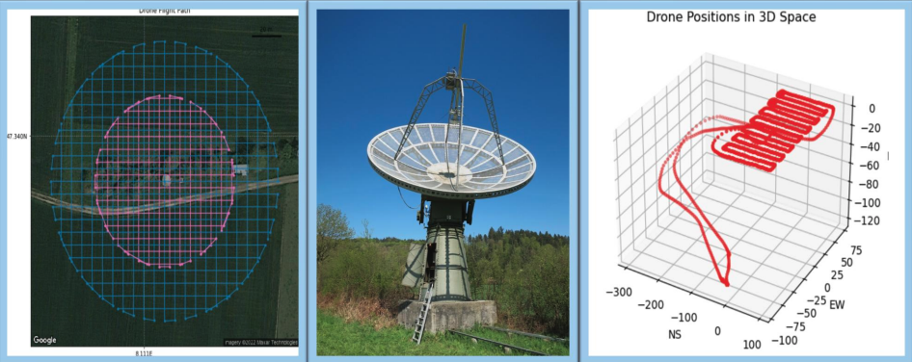
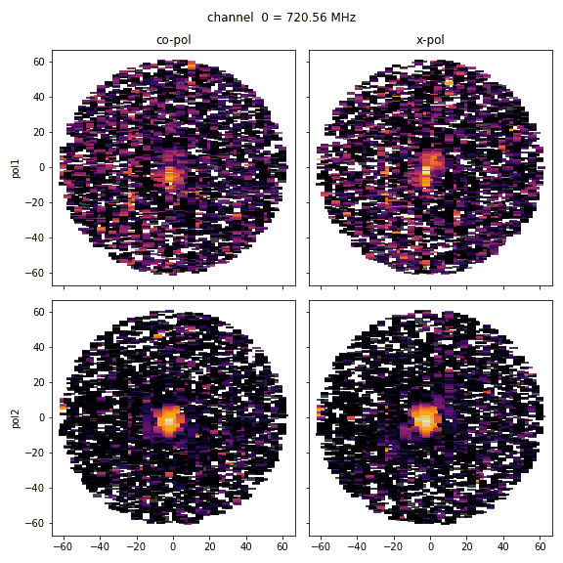
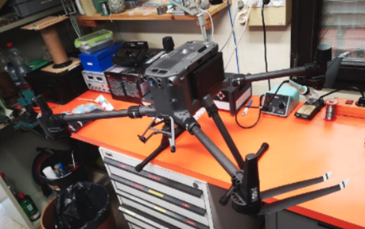
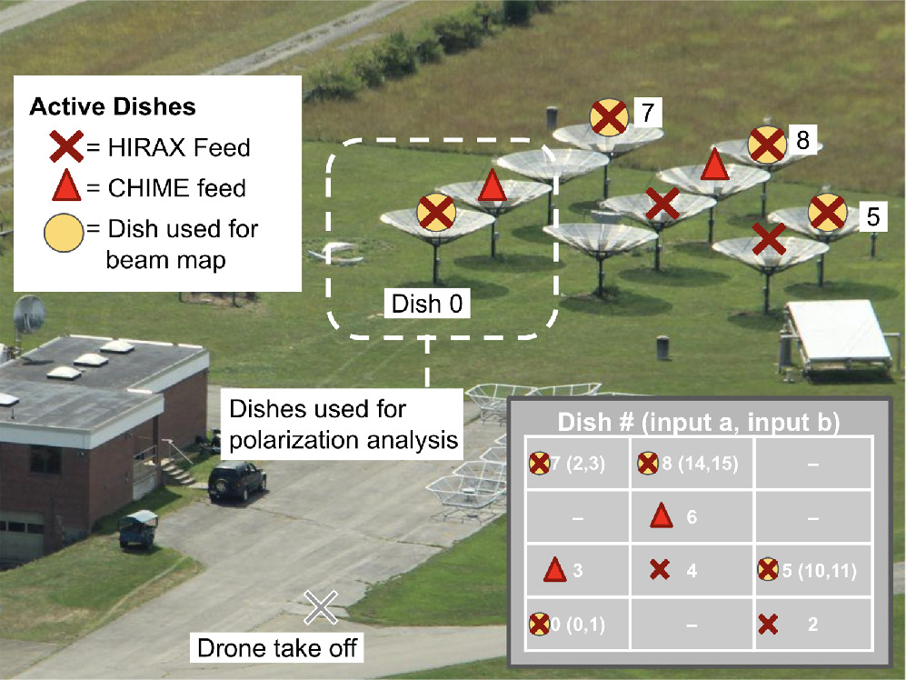
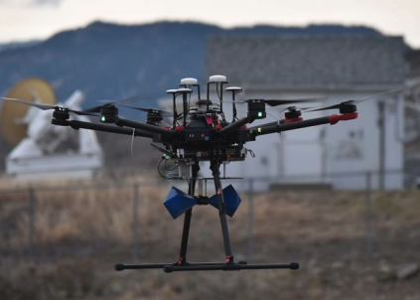
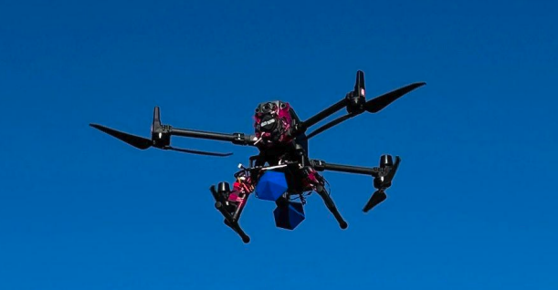
Primary beams - How to characterize them?
Bleien Tests 2023
Drone beam mapping
Laura Newburgh, Morgan Cole, Will Tyndall (Yale), Anthony Walters, Tasmiya (UKZN) and Me (simulating drone path and beam recovery and fitting drone beam measurements)
Testing at the KF test site and main site will be very soon - being planned at the moment.
UKZN Drone
TONE @ GBO
NS track
Yale Drones
Emily Kuhn et al 2025
Ajith Sampath- HIRAX Overview & Update - SKACH Winter meeting - 27th Jan 2026

Slide 19
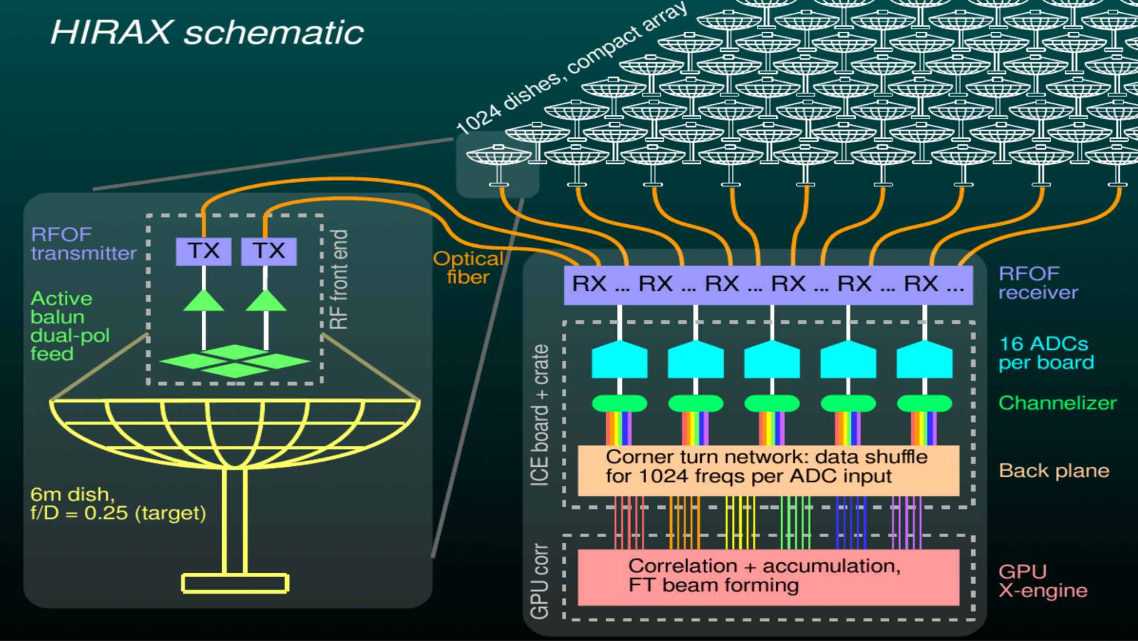
Practical Challenges - Data Rate
HIRAX FPGA channelizer and GPU correlator will output at a large data rate: 6.6 (1.6) Terabits per second
The 1024 (256) element array will produce a very large daily dataset: 32+32 bit vis x 1024 (256) bands x 20482 / 2 baselines x 8640 samples/day
= 150 (9) TB / day [220 (14) PB for full 4 year survey]
Ajith Sampath- HIRAX Overview & Update - SKACH Winter meeting - 27th Jan 2026

Slide 20
Data Rate - How to manage that?
Redundant average
Need to compress data to make it manageable (~ 1TB/day off-site transfer)
Can gain a compression factor ~ few hundreds if we redundantly average visibilities.
But, individual dishes deviating from fiducial setup could be a problem. → CorrCal could help here (J. Sievers 2017)
A new software engineer Julian Adamek (ETHZ) joined HIRAX - will develop the data and software orchestration system essential for the operation and data processing.
Ajith Sampath- HIRAX Overview & Update - SKACH Winter meeting - 27th Jan 2026

Slide 21
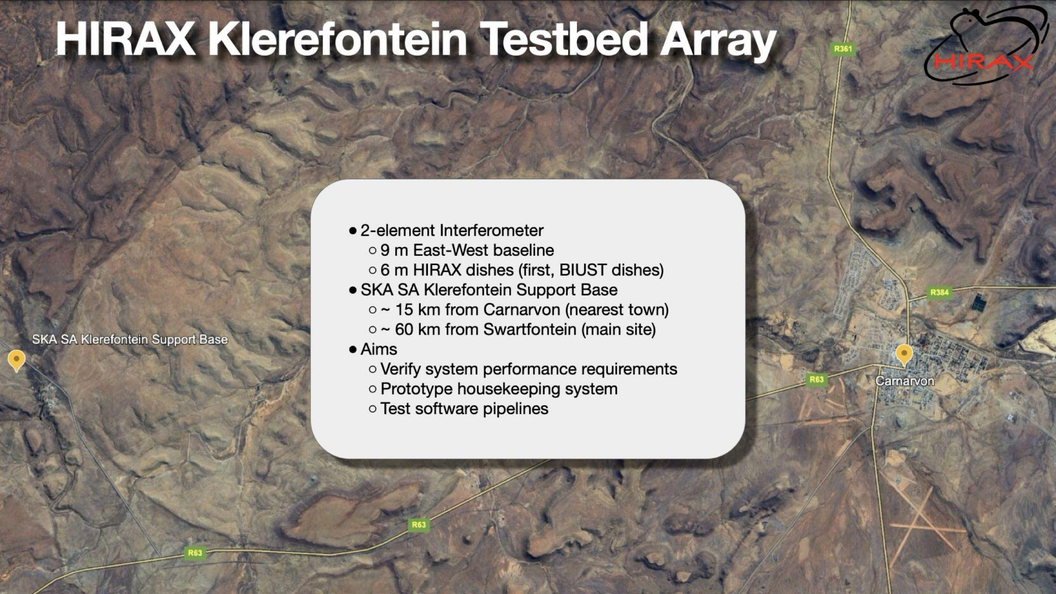
2-element interferometer array
9m East-West baseline
6m HIRAX dishes (BIUST version)
SKA SA KF support base
~ 15 km from Carnarvon (nearest town)
~ 60 km from Swartfontein (main site)
Credits : Anthony Walters

Slide 22
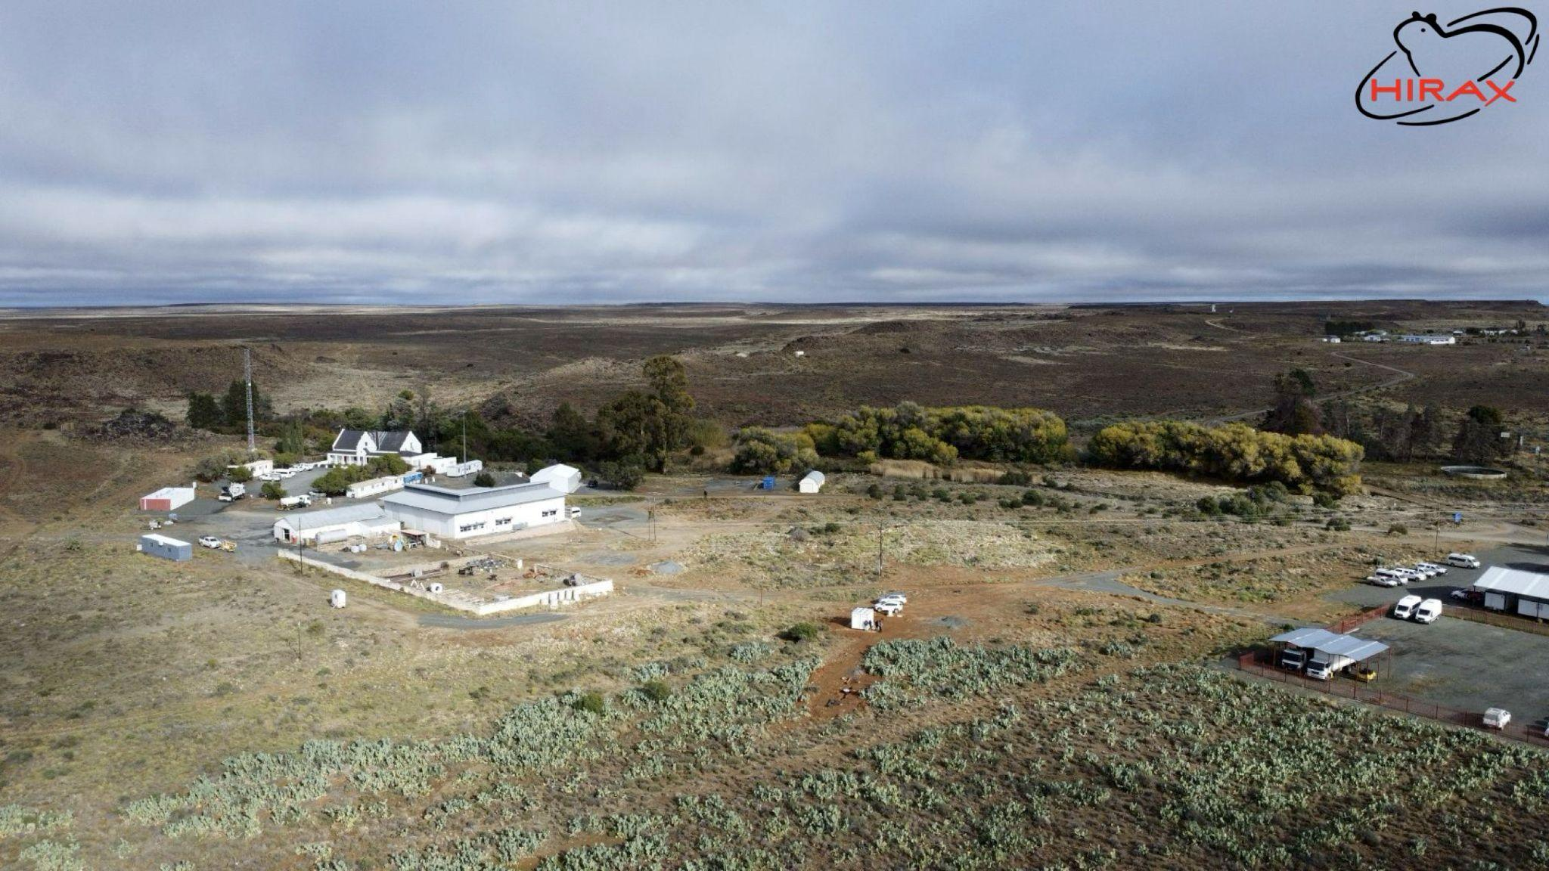
HIRAX Test bed site
Credits : Anthony Walters

Slide 23
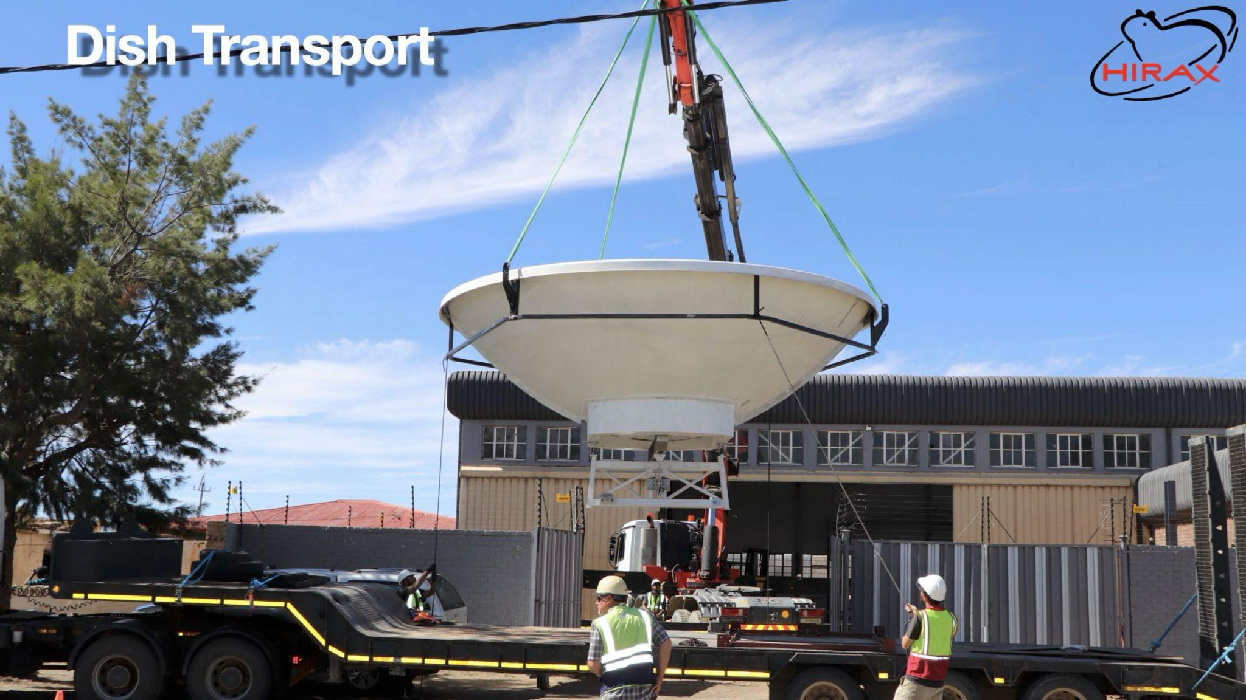
Credits : Anthony Walters

Slide 24
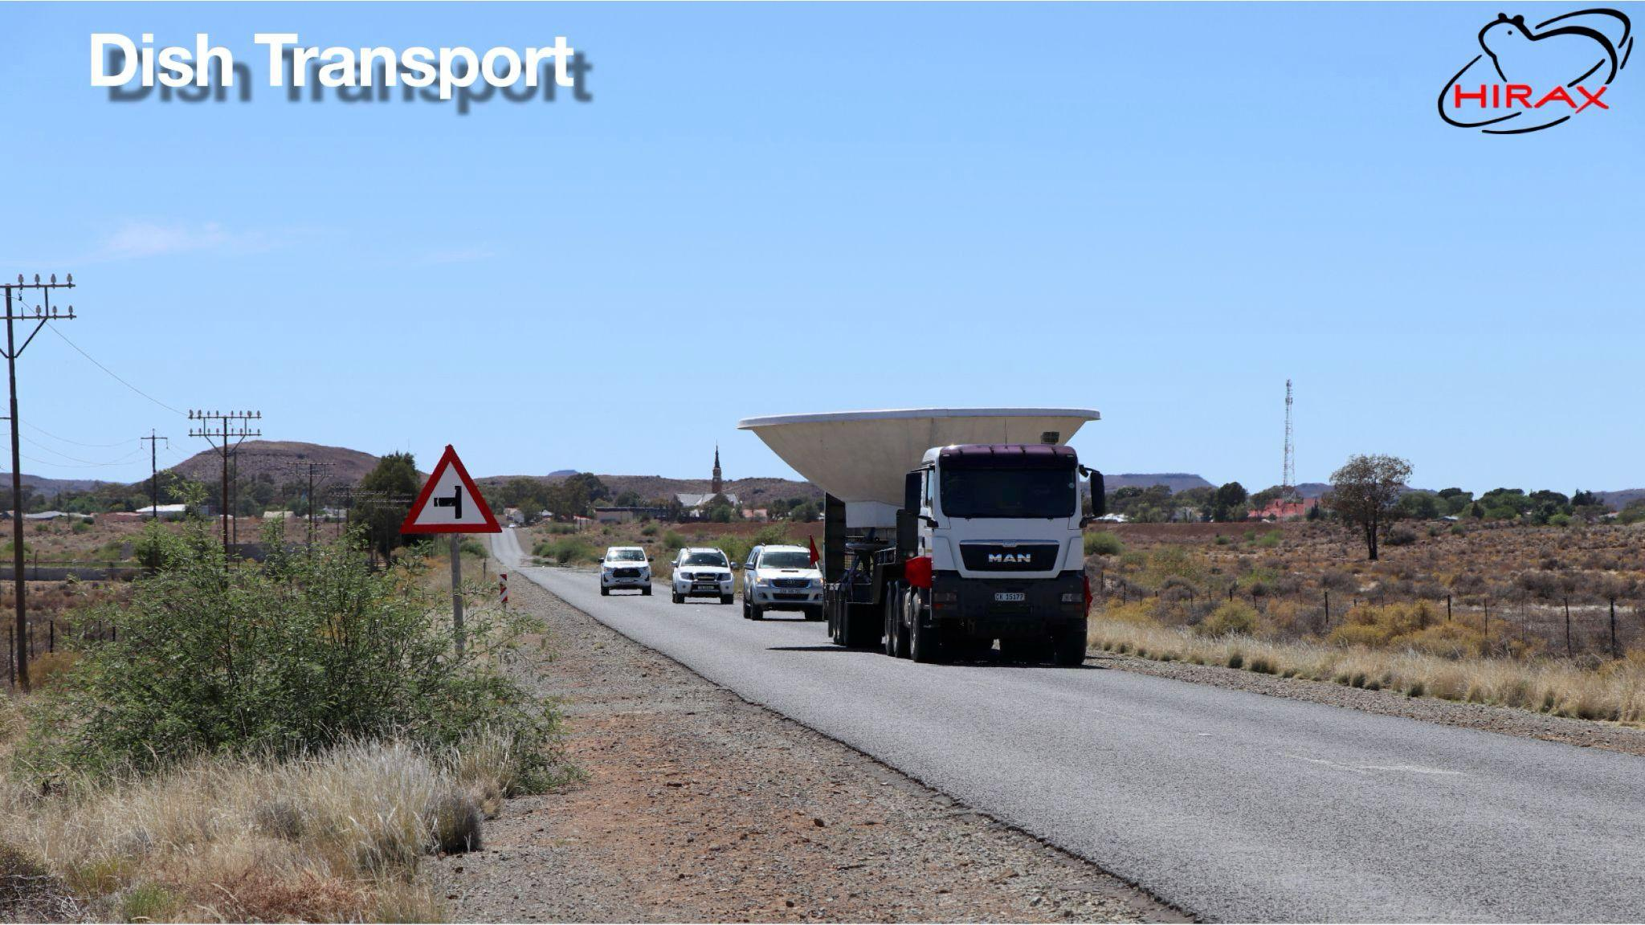
Credits : Anthony Walters

Slide 25
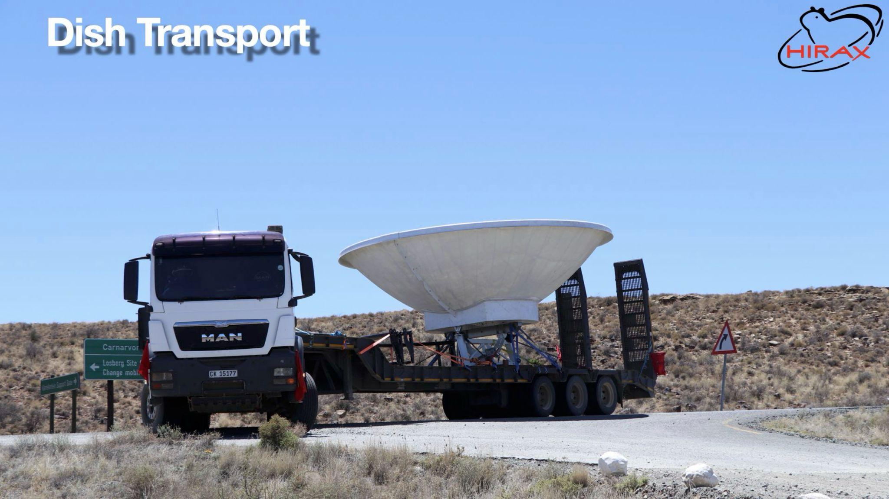
Credits : Anthony Walters

Slide 26
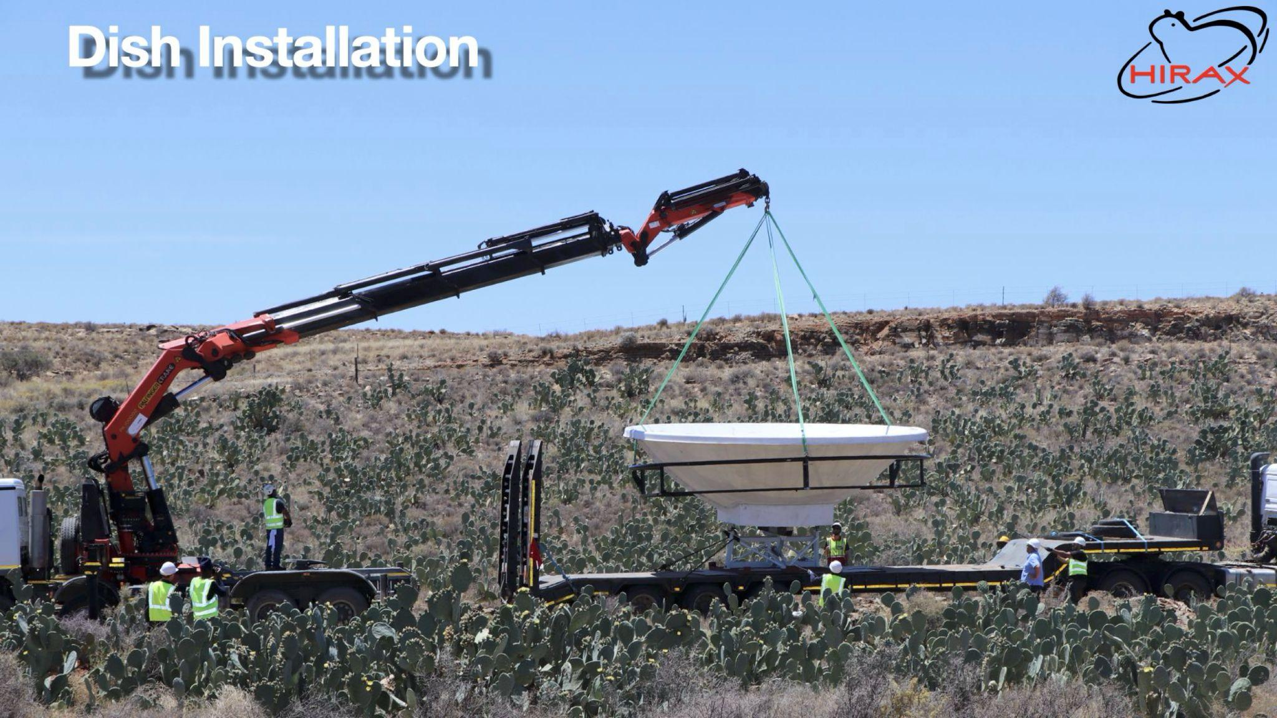
Credits : Anthony Walters

Slide 27
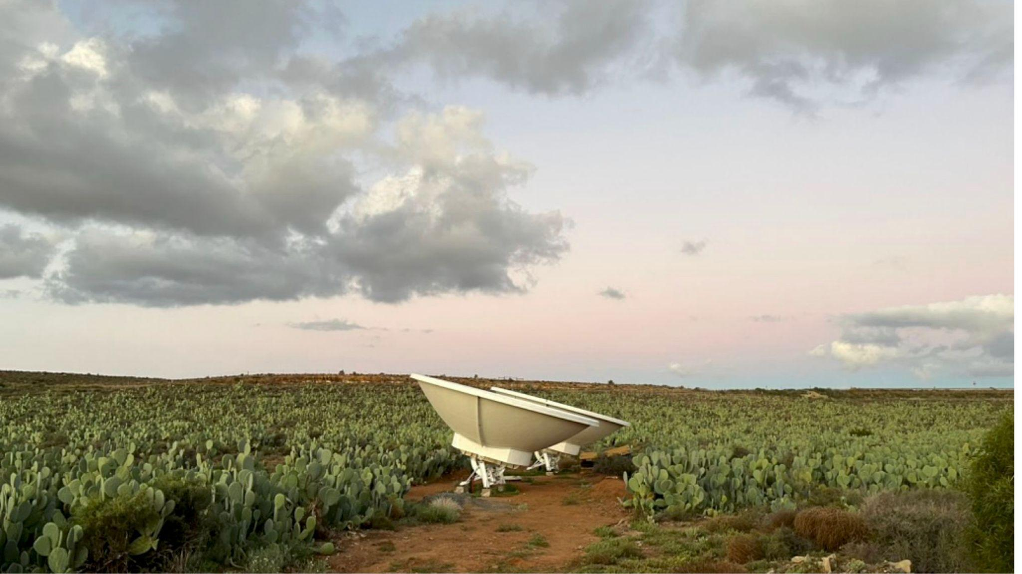
Installed dishes
Credits : Anthony Walters

Slide 28
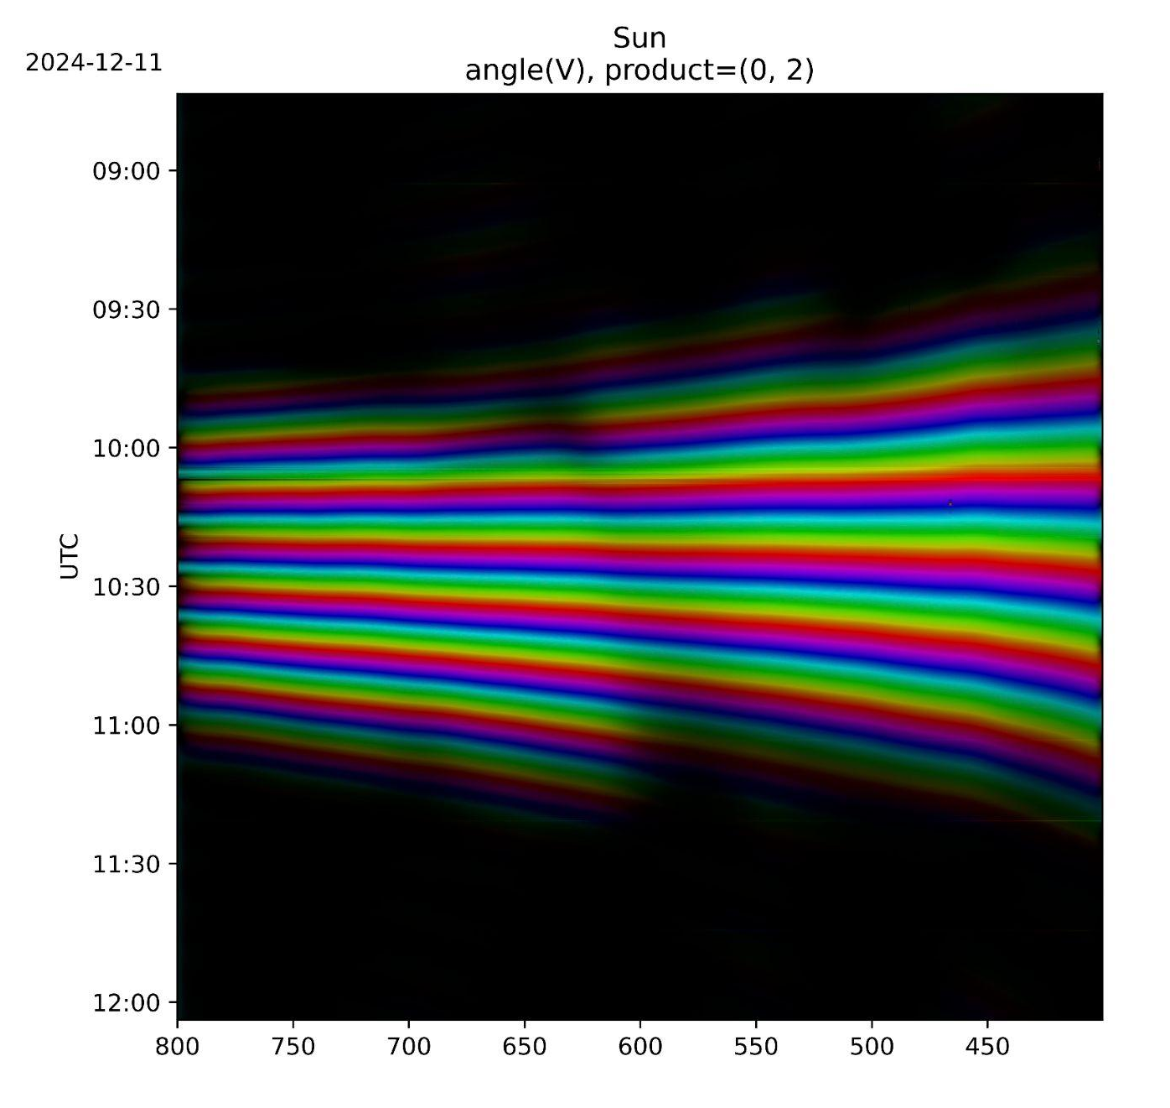
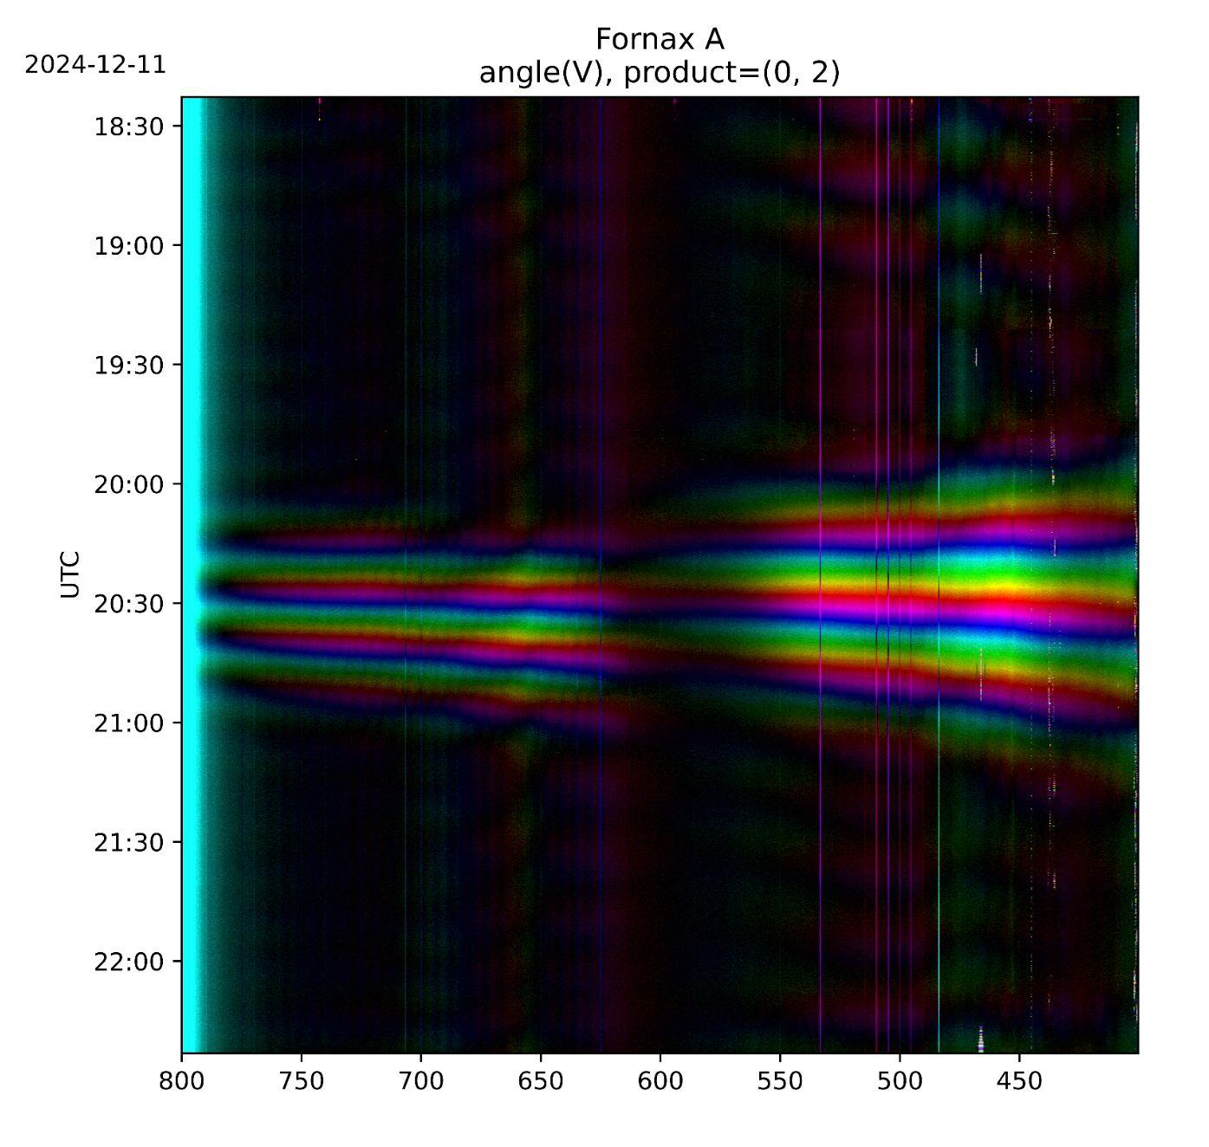
First light @ KF
Credits : Anthony Walters
Ajith Sampath- HIRAX Overview & Update - SKACH Winter meeting - 27th Jan 2026

Slide 29
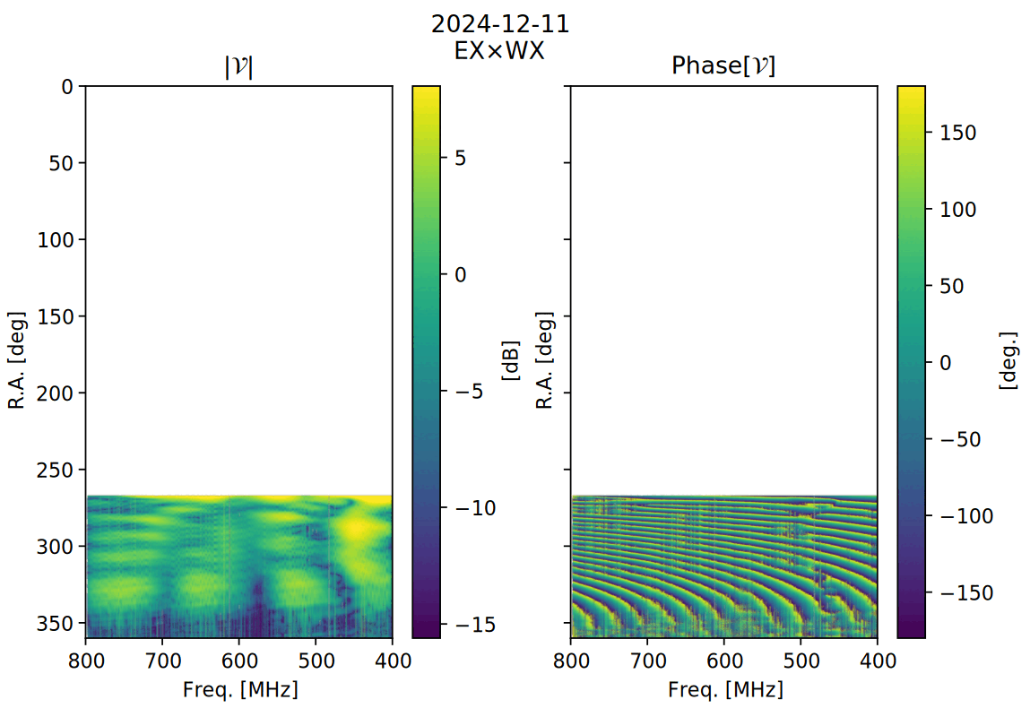
Sun beams @ KF
Sun transit - Stable visibilities
EM sims slice of beam
Ajith Sampath- HIRAX Overview & Update - SKACH Winter meeting - 27th Jan 2026

Slide 30
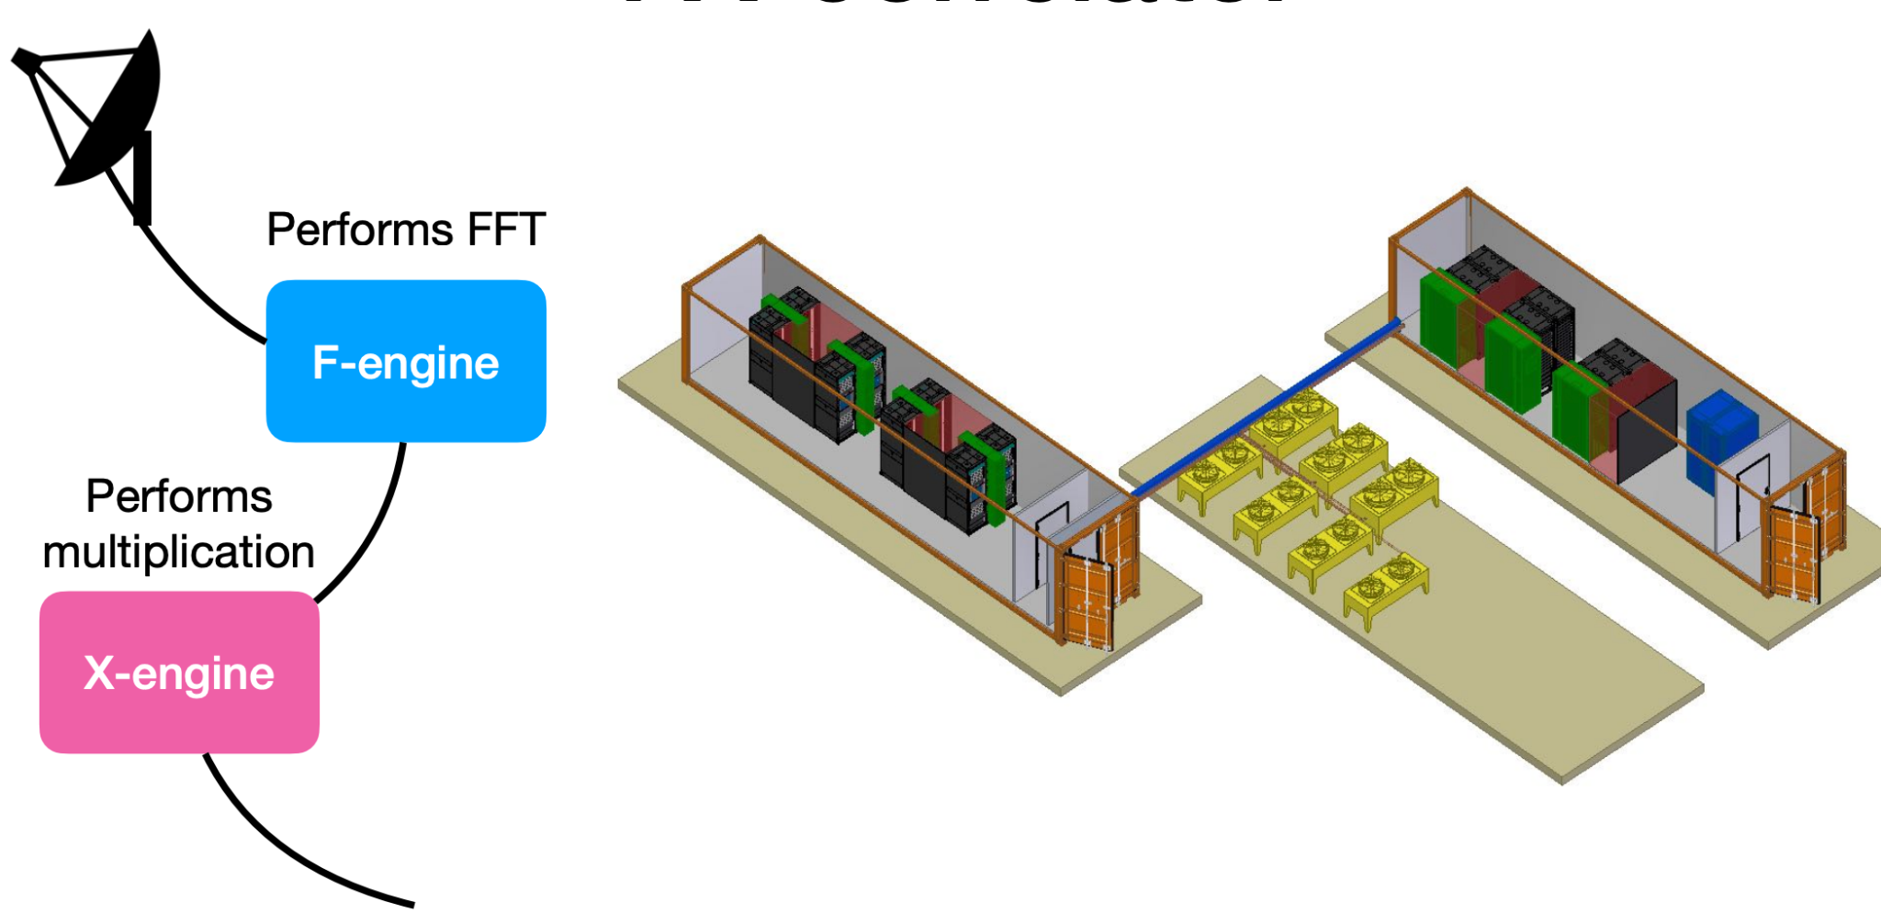
Other notable efforts
FX Correlator (Digital Backend)
Devin & Thierry Viant (ETHZ) , Vadym Bidula (McGill), Andre Renard & Keith Vanderlindt(U.Toronto)
Ajith Sampath- HIRAX Overview & Update - SKACH Winter meeting - 27th Jan 2026

Slide 31
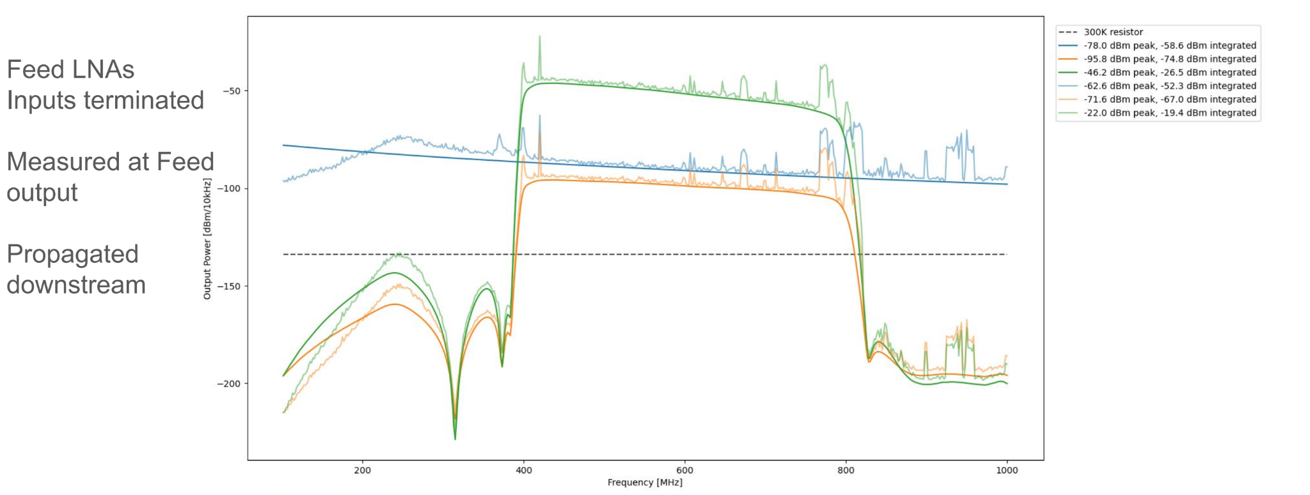
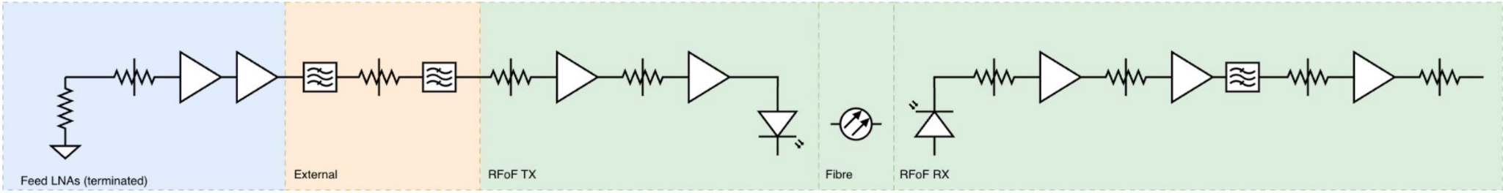
Other notable efforts
Analog Signal Chain Modeling
Anthony Walters (UKZN)
Ajith Sampath- HIRAX Overview & Update - SKACH Winter meeting - 27th Jan 2026

Slide 32


Other notable efforts
T_{sys} and Gain characterisation (Y-factor, hot-cold load, and on-sky KF data)
Keshav Bechoo (UKZN)
Ajith Sampath- HIRAX Overview & Update - SKACH Winter meeting - 27th Jan 2026

Slide 33

Other notable efforts
Back-end containers (Housekeeping)
Benjamin Lunsky (UKZN)
Ajith Sampath- HIRAX Overview & Update - SKACH Winter meeting - 27th Jan 2026

Slide 34




Other notable efforts
Temperature Sensor
Dish Inclinometer
Isibabale Qhoboshiyane (UKZN)
Tsepo Sekhoasha (UKZN)
Ajith Sampath- HIRAX Overview & Update - SKACH Winter meeting - 27th Jan 2026

Slide 35



Other notable efforts
Weather Station
Site infrastructure
Wind sensor
Temp & humidity sensor
Veruschka Simes (UKZN)
Corrie Ungerer (UKZN)
Ajith Sampath- HIRAX Overview & Update - SKACH Winter meeting - 27th Jan 2026

Slide 36


Swartfontein - Main site - Dish deployment
Before construction
8 dished mounted (Phase 1)
As we speak around 20 dishes are mounted and others being deployed…!
Credits : Corrie Ungerer
Ajith Sampath- HIRAX Overview & Update - SKACH Winter meeting - 27th Jan 2026

Slide 37

Collaboration, Partnership and Funding
Ajith Sampath- HIRAX Overview & Update - SKACH Winter meeting - 27th Jan 2026

Slide 38

Thank you for listening!
Swiss-HIRAX Team
Ajith Sampath- HIRAX Overview & Update - SKACH Winter meeting - 27th Jan 2026

