Slide 1
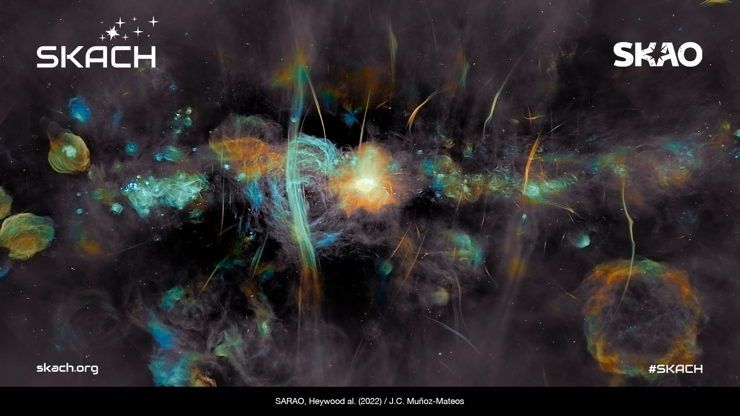
SKACH
Strategic Communications and Outreach
SKA Days Neuchâtel
August 2026

Slide 2


Agenda
The value of science communication
The Communication Landscape today
AI is changing everything
SKACH Communications and Outreach

Slide 3
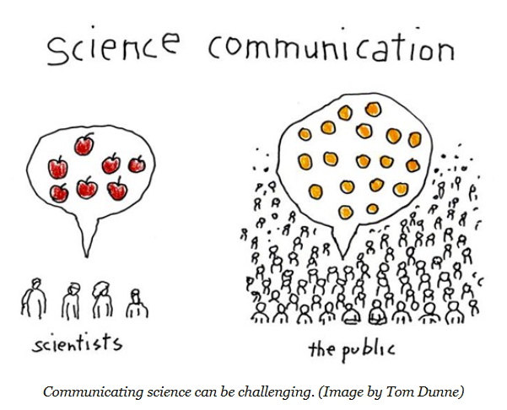
What is the value of science communication?
It helps people to understand the world around them
It helps to build trust in science
It encourages participation in science and may help to address
the labor shortage in science and engineering in the future
It promotes scientific literacy
All this helps to bridge the gap between science and society,
helping to foster informed policy and decision making.
Notes:
Deliberately used the word ‘value’ – how do we value science communication? Can we put a value on it?
Science communication is more than just disseminating scientific information; it's about making science accessible, engaging, and actionable for everyone. It involves translating complex concepts into digestible, relatable content that sparks interest and drives change.

Slide 4
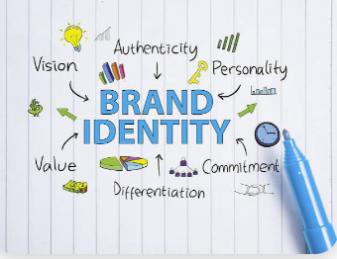
Branding is a part of communication
Funding and Support
Global Recognition
Trust and Credibility
Public Engagement
Global collaboration
Economic growth
Cultural inspiration
Notes:
Branding is a critical part of strategic communication for today’s mega science projects. I was a conference in April in Germany where CERN, the ESO, Eur XFEL, EUROFusion and Paul Scherrer Institute to name a few, were represented and the biggest topic of conversation after AI was strategic branding and communications for today’s mega-science projects for the reasons outlined on this slide.

Slide 5
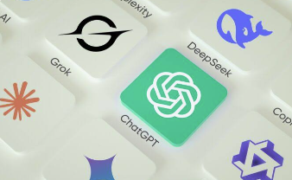
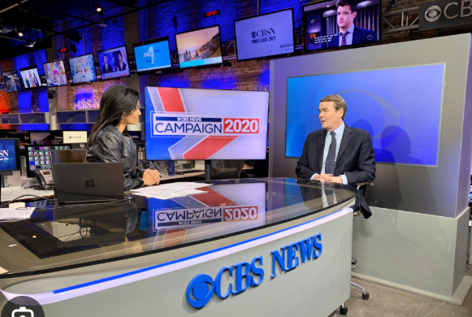
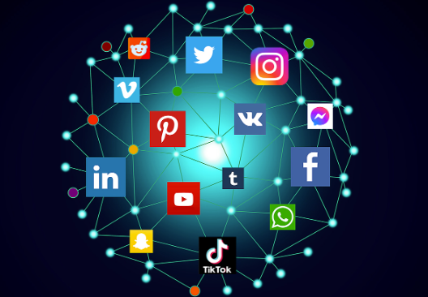
The Communications Landscape Today
Fun Fact #1
5.79 billion people around the world are on social media with the average user online for about three hours a day.
Fun Fact #2
54% of people get their information from social media, video networks and new content creators – driving the ‘platformisation’ of news consumption. For the first time, a majority – 77% - now watch online news video rather than broadcast TV.
Fun Fact #3
27% of respondents globally get news from individual creators or influencers.
Fun Fact #4
10% of people use AI chatbots for news, up from 7% last year.
Fun Fact #5
62% of people are concerned about fake news and misinformation yet third-party platform use continues to rise - convenience appears to trump concern.
Fun Fact #6
42% of those surveyed say they are active ‘news avoiders’, the highest figure ever recorded.
* Reuters Institute Digital News Report 2026
Notes:
Annual Reuters Institute Digital News Report surveys participants in 48 countries. I presented some of these findings last year so am revisiting with some updates from this year’s report.
5.79 is up from 1-billion a year ago
In 2025 54% of Americans got their information from social media and influencers – this has now spread globally. social media, video networks and new content creators are more popular than TV and owned news websites and apps as sources of news driving the ‘platformisation’ of news consumption. The 'platformization' of news consumption means people get their news through digital platforms like social media and search engines rather than going directly to traditional news websites or print papers. Tech companies now act as the main gatekeepers for what news people see and read and of course this means what they see is decided through Algorithmic Curation: Feeds choose what news stories appear based on user data and engagement, rather than a newspaper editor's traditional judgement – for better or worse.
27% of respondents globally get news from individual creators or influencers. saying creators are more entertaining, easier to understand, and more relatable than traditional news outlets.
In a nutshell, more people now get their news and information from social media and influencers than by any other means – only 6% get their information from traditional newspapers.
42%, compared to 40% last year say they are ‘active news avoiders’ which is a huge challenge for anyone trying to communicate anything to a large segment of the population.

Slide 6
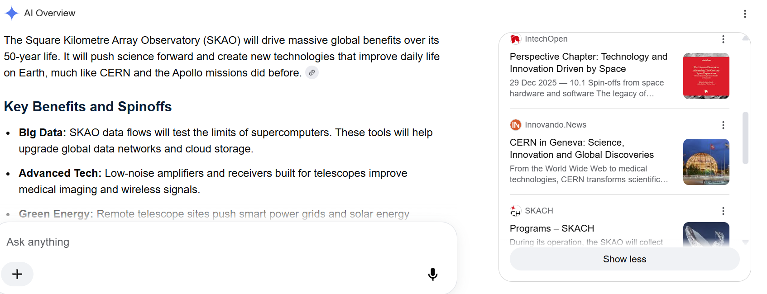
AI #1 – the audience journey has changed
Notes:
58% of people are already replacing traditional search with GenAI *CapGemini and of those searches 60% no longer result in a click *Bain&Co
This search was using google – gemini

Slide 7
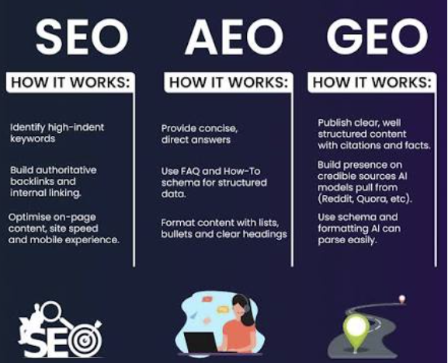
AI #2 – Our strategic comms approach needs to help us show up
Audiences are turning to GenAI which means GEO and AEO need to be layered over SEO
AI transforming personalized and automated communication
AI use in language translation
Notes:
AEO = Answer Engine Optimization
Optimizing your content so it becomes the direct answer AI search, Google snippets, and voice assistants use.
GEO = Generative Engine Optimization
What is fast coming: hyper personalized news as AI assistants become AI agents
AI use in real time voice language translation

Slide 8
Objectives 2026
Build awareness of SKACH
Bring Radio Astronomy and SKACH associated fields to a wide public audience
Promote the SKAO and Switzerland’s contributions
Promote Switzerland’s Industrial Return partners
Fundraising
Notes:
Our objectives haven’t varied much over the past few years as they are foundational but the way we are delivering them has evolved.

Slide 9
Key products and collaborations 2026
Meet the Team: The Stars Behind the Science
SKACH Media Day
Social Media Outreach
EAS and Australian Embassy collaboration - Participation Australian Swiss Academic Innovation Network (ASAIN)
Public/STEM Events
SKAO Science Book
Radio Cosmos Series #2

Slide 10
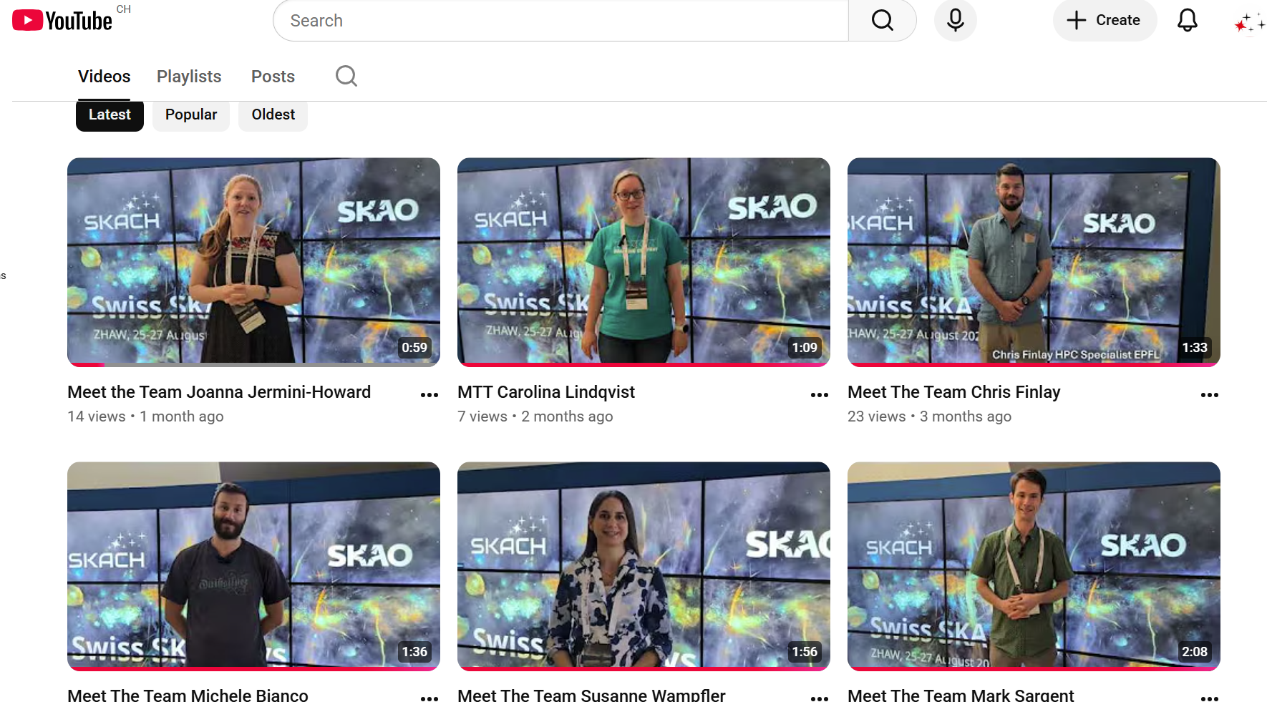
Meet The Team Video Series
Channel Handle
@SKASwitzerland
Notes:
Filmed at SKA Days in August
Vignettes of the SKACH team and what we do
12 episodes
.

Slide 11
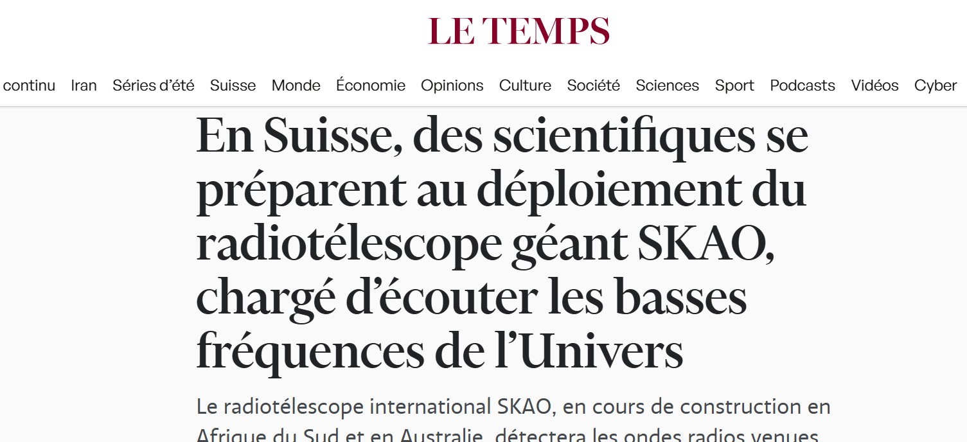
SKACH Media Day
@EPFL, February 4
Presentations on:
Looking ahead to near future developments
Sustainability in mega-science projects
Dark and Quiet Skies

Slide 12
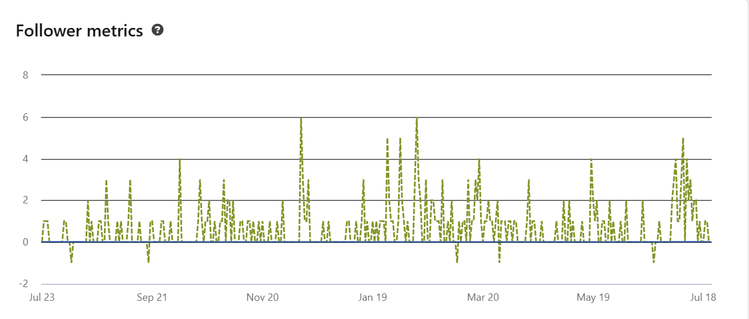
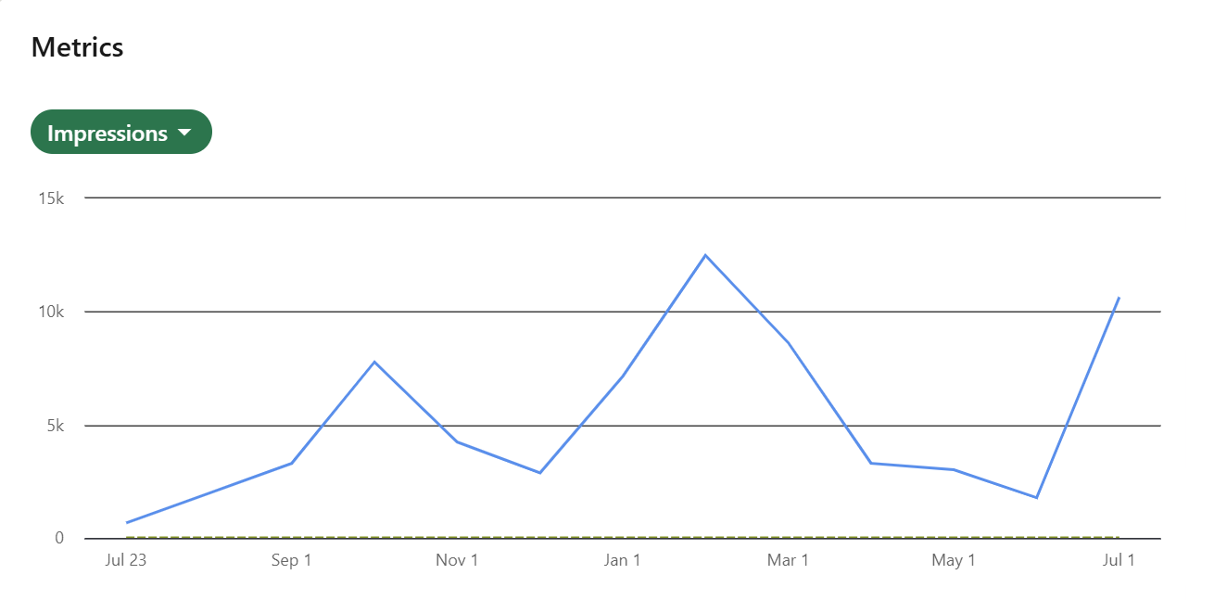
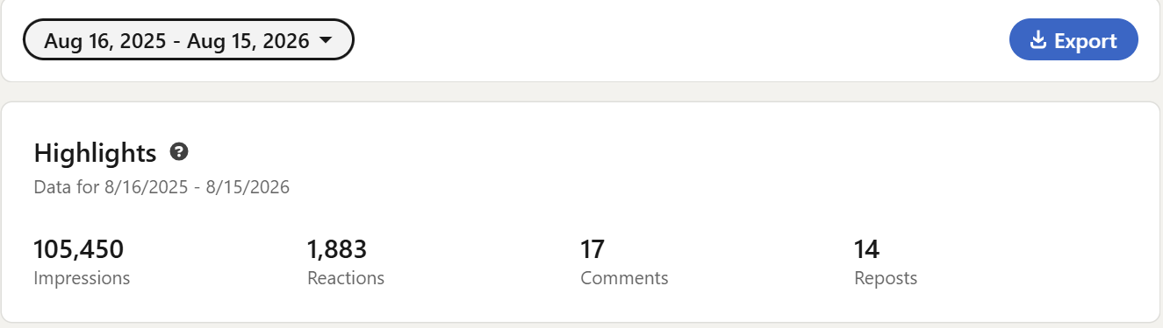
LinkedIn
LinkedIn - 963 followers, up 256 in 12 months
LinkedIn engagement 2025/26
Notes:
Spikes are:
October – Swiss Industrial Innovation Article, Jean-Paul and Carolyn meeting Australian Ambassador in Switzerland and the Swiss Embassy in South Korea
January-March – First fringes announcement with a Swiss tech recap, Cosmo in the Alps, SKA Winter meeting, launch of Stars behind the Science and a feature on Susanne Wampfler for the International Day of women and girls in Science
June/July – Fantasy Basel, event with Australian Embassy and EAS in Lausanne
Impressions up 60-thousand on the year before – shows that we are spreading our message widely and using our connections and networks to amplify our content.
Why is it important that we grow our following and amplify our content: some of the people who follow us: Paul Wood, chief editor of Nature Astronomy follows us on LinkedIn and liked a post about a meeting in Zermatt re the ngEHT; VC and investing; Directors of National Research Councils; a Titans Space Astronaut Candidate; and our funders SERI – Simon Berger just presented – we have to be serious about regularly communicating our work, our vision our results and our value to our community.

Slide 13
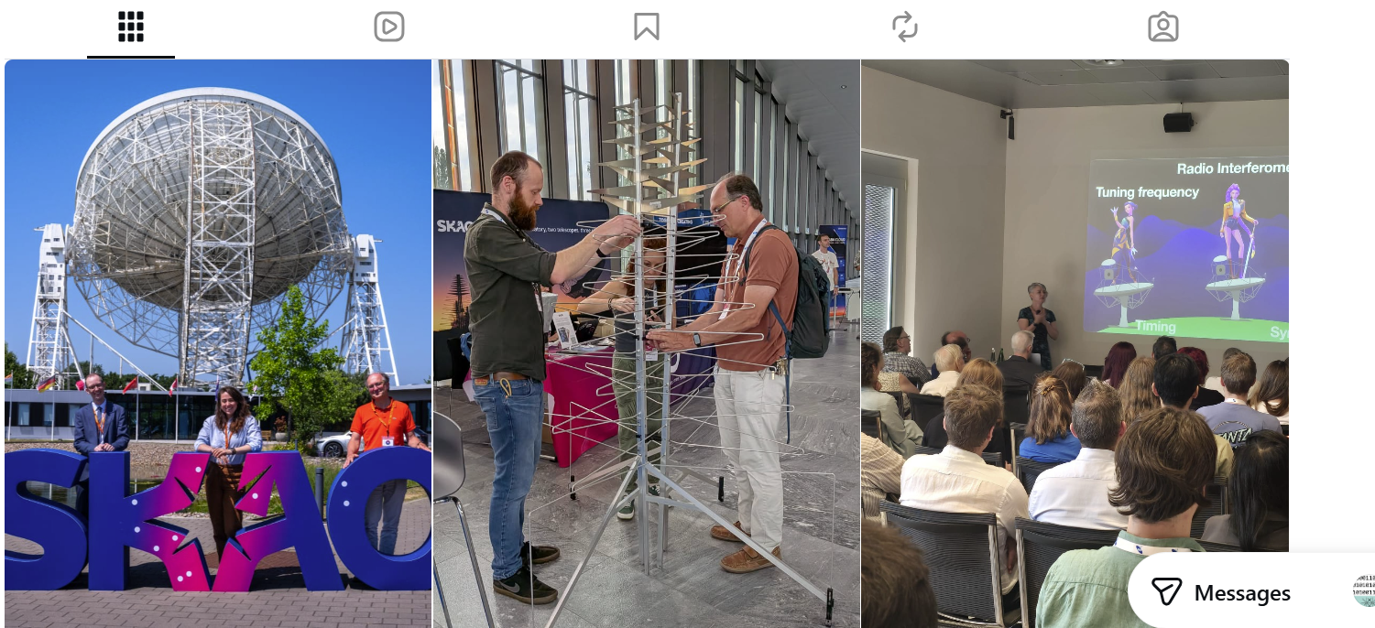
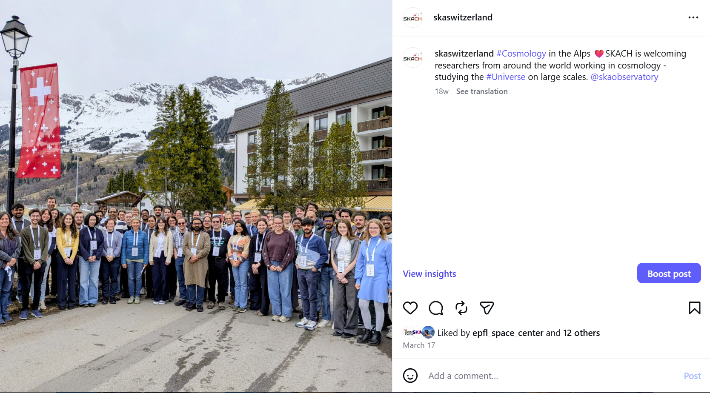
Instagram - 110 followers
SKACH handle:
skaswitzerland

Slide 14
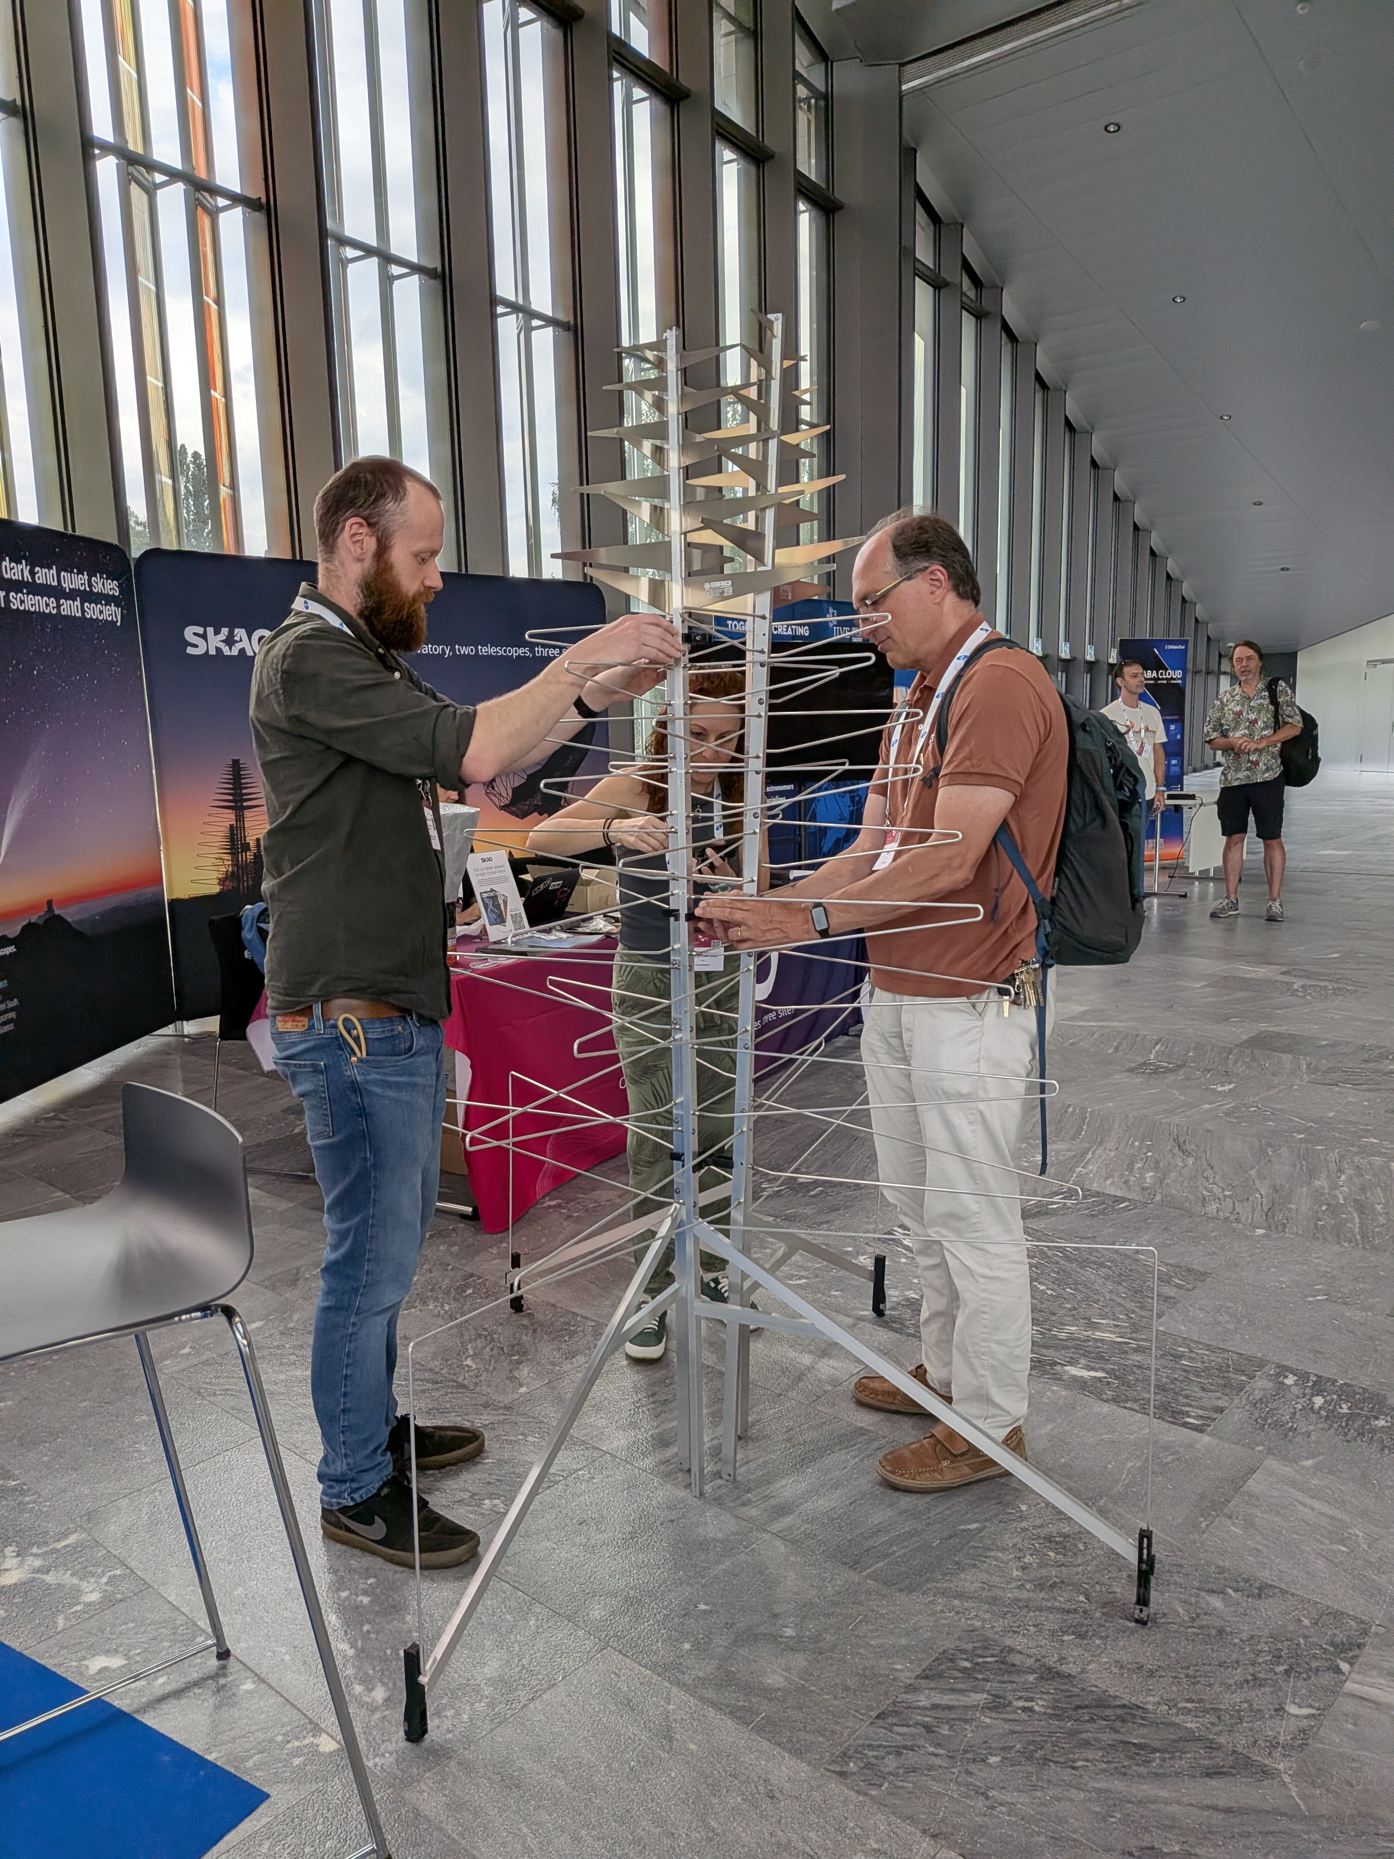
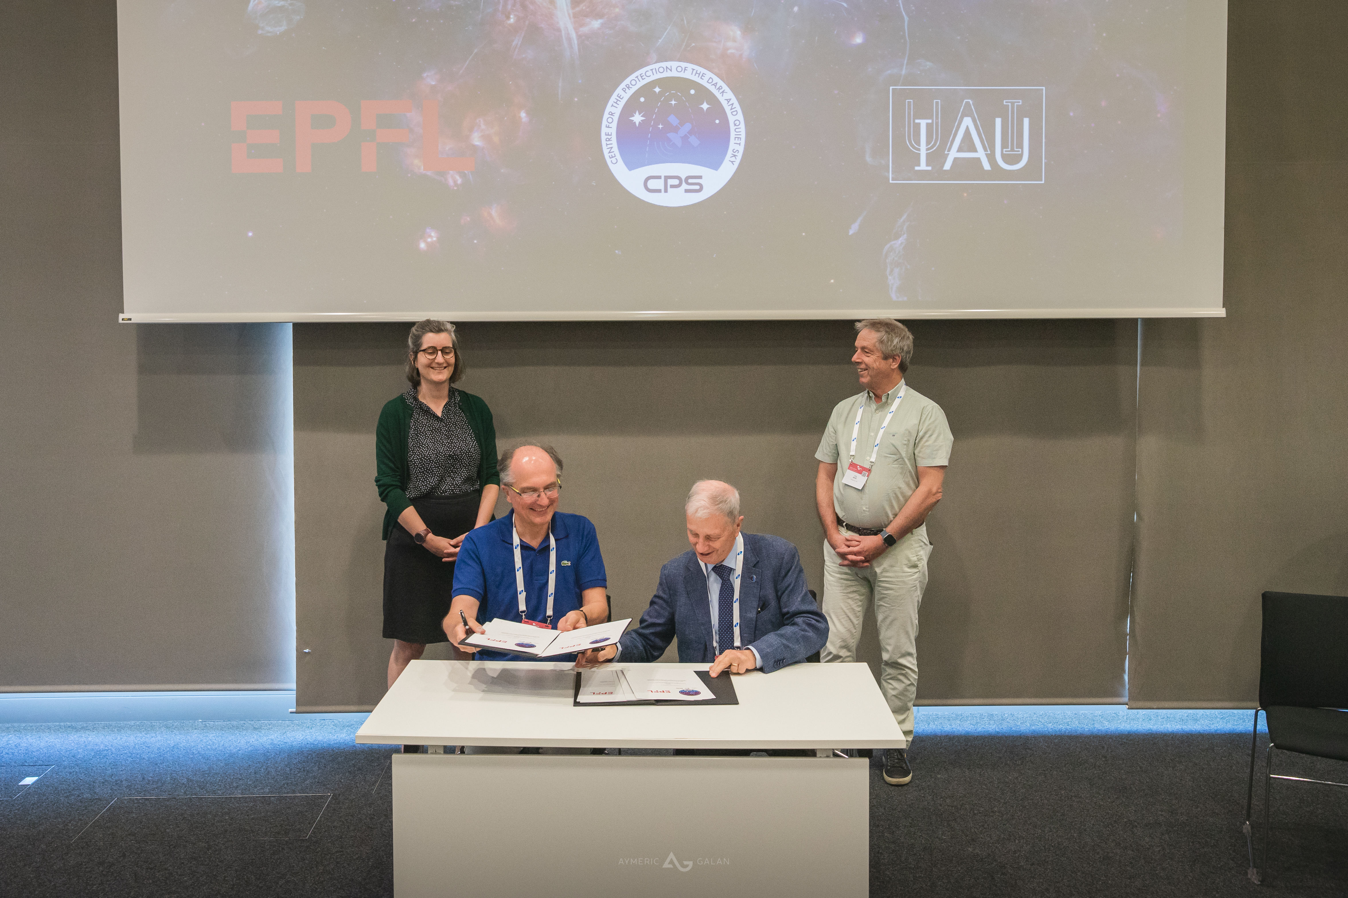
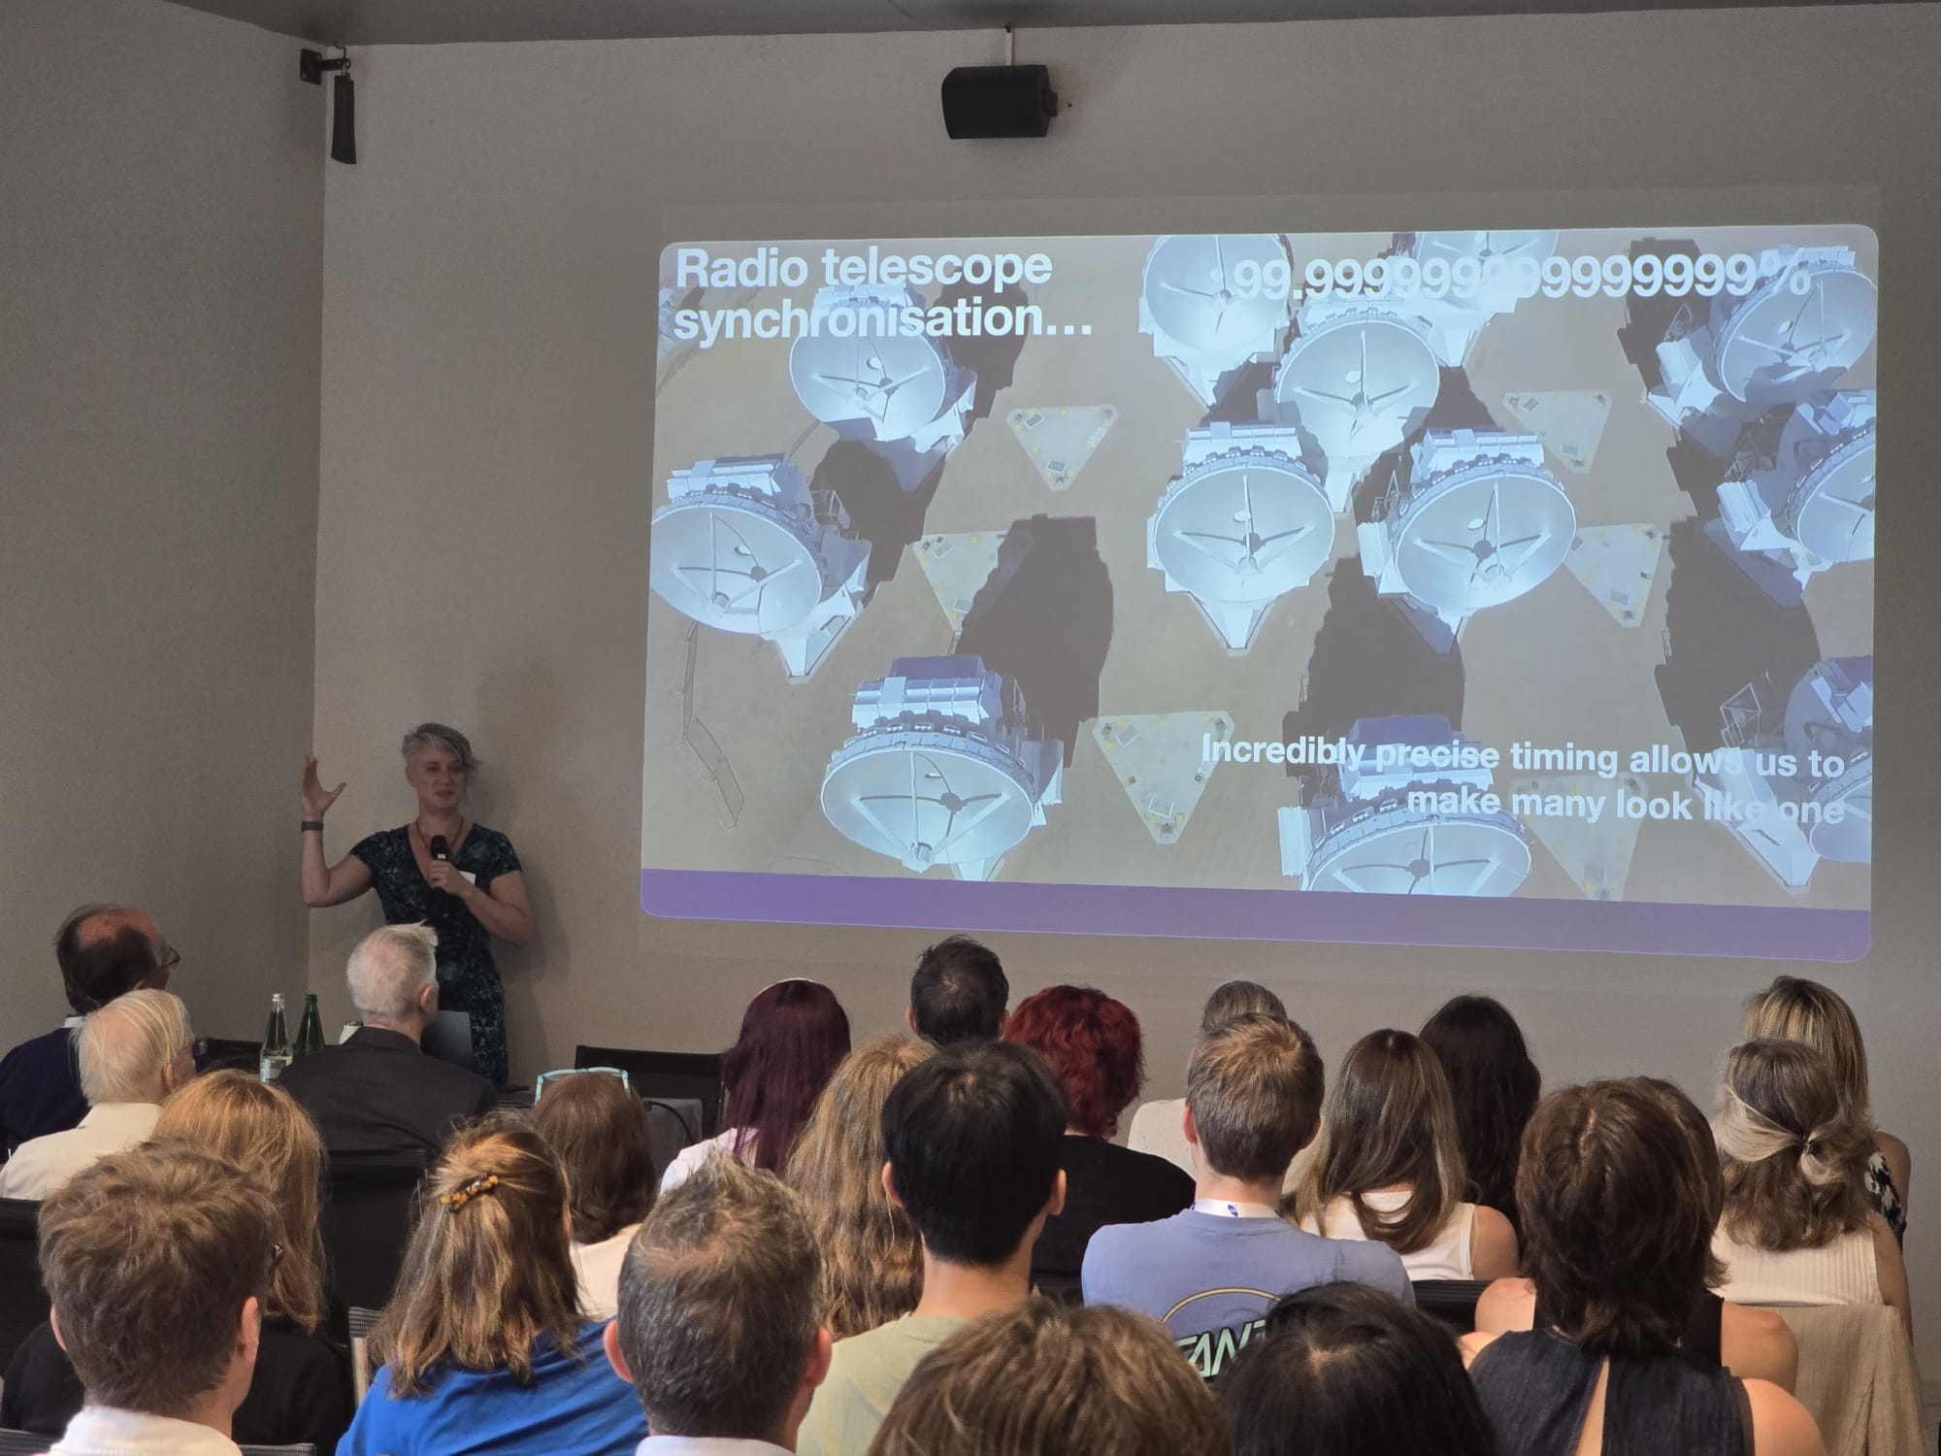
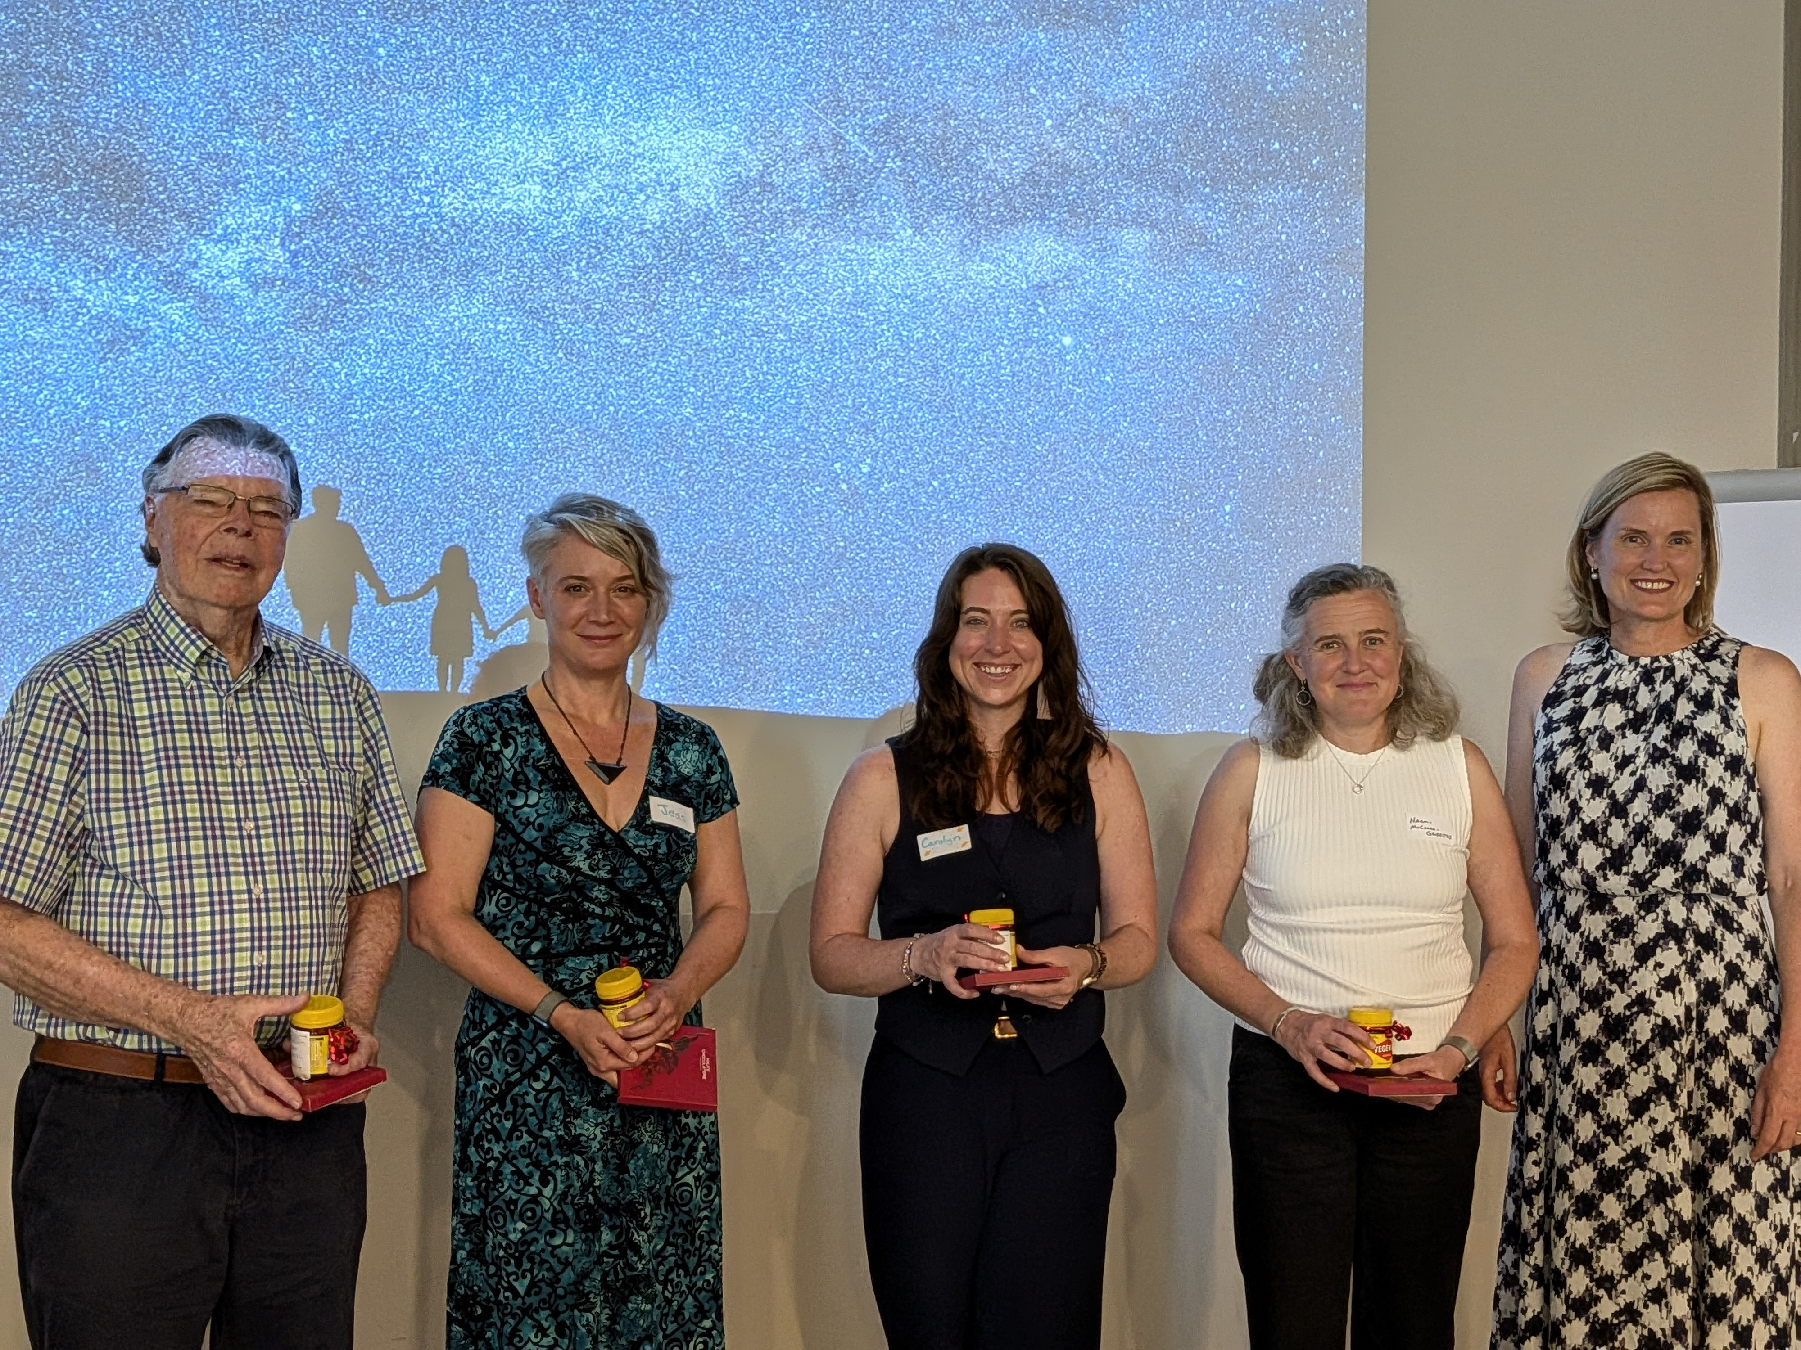
EAS / ASAIN /Australian Embassy / SKAO

Slide 15
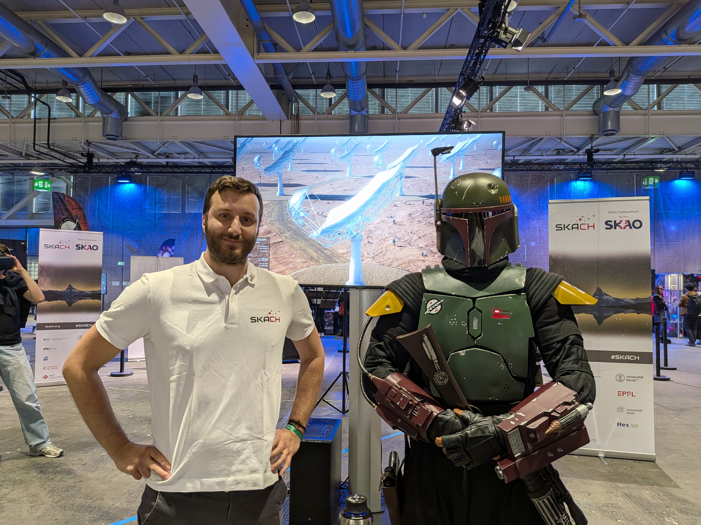
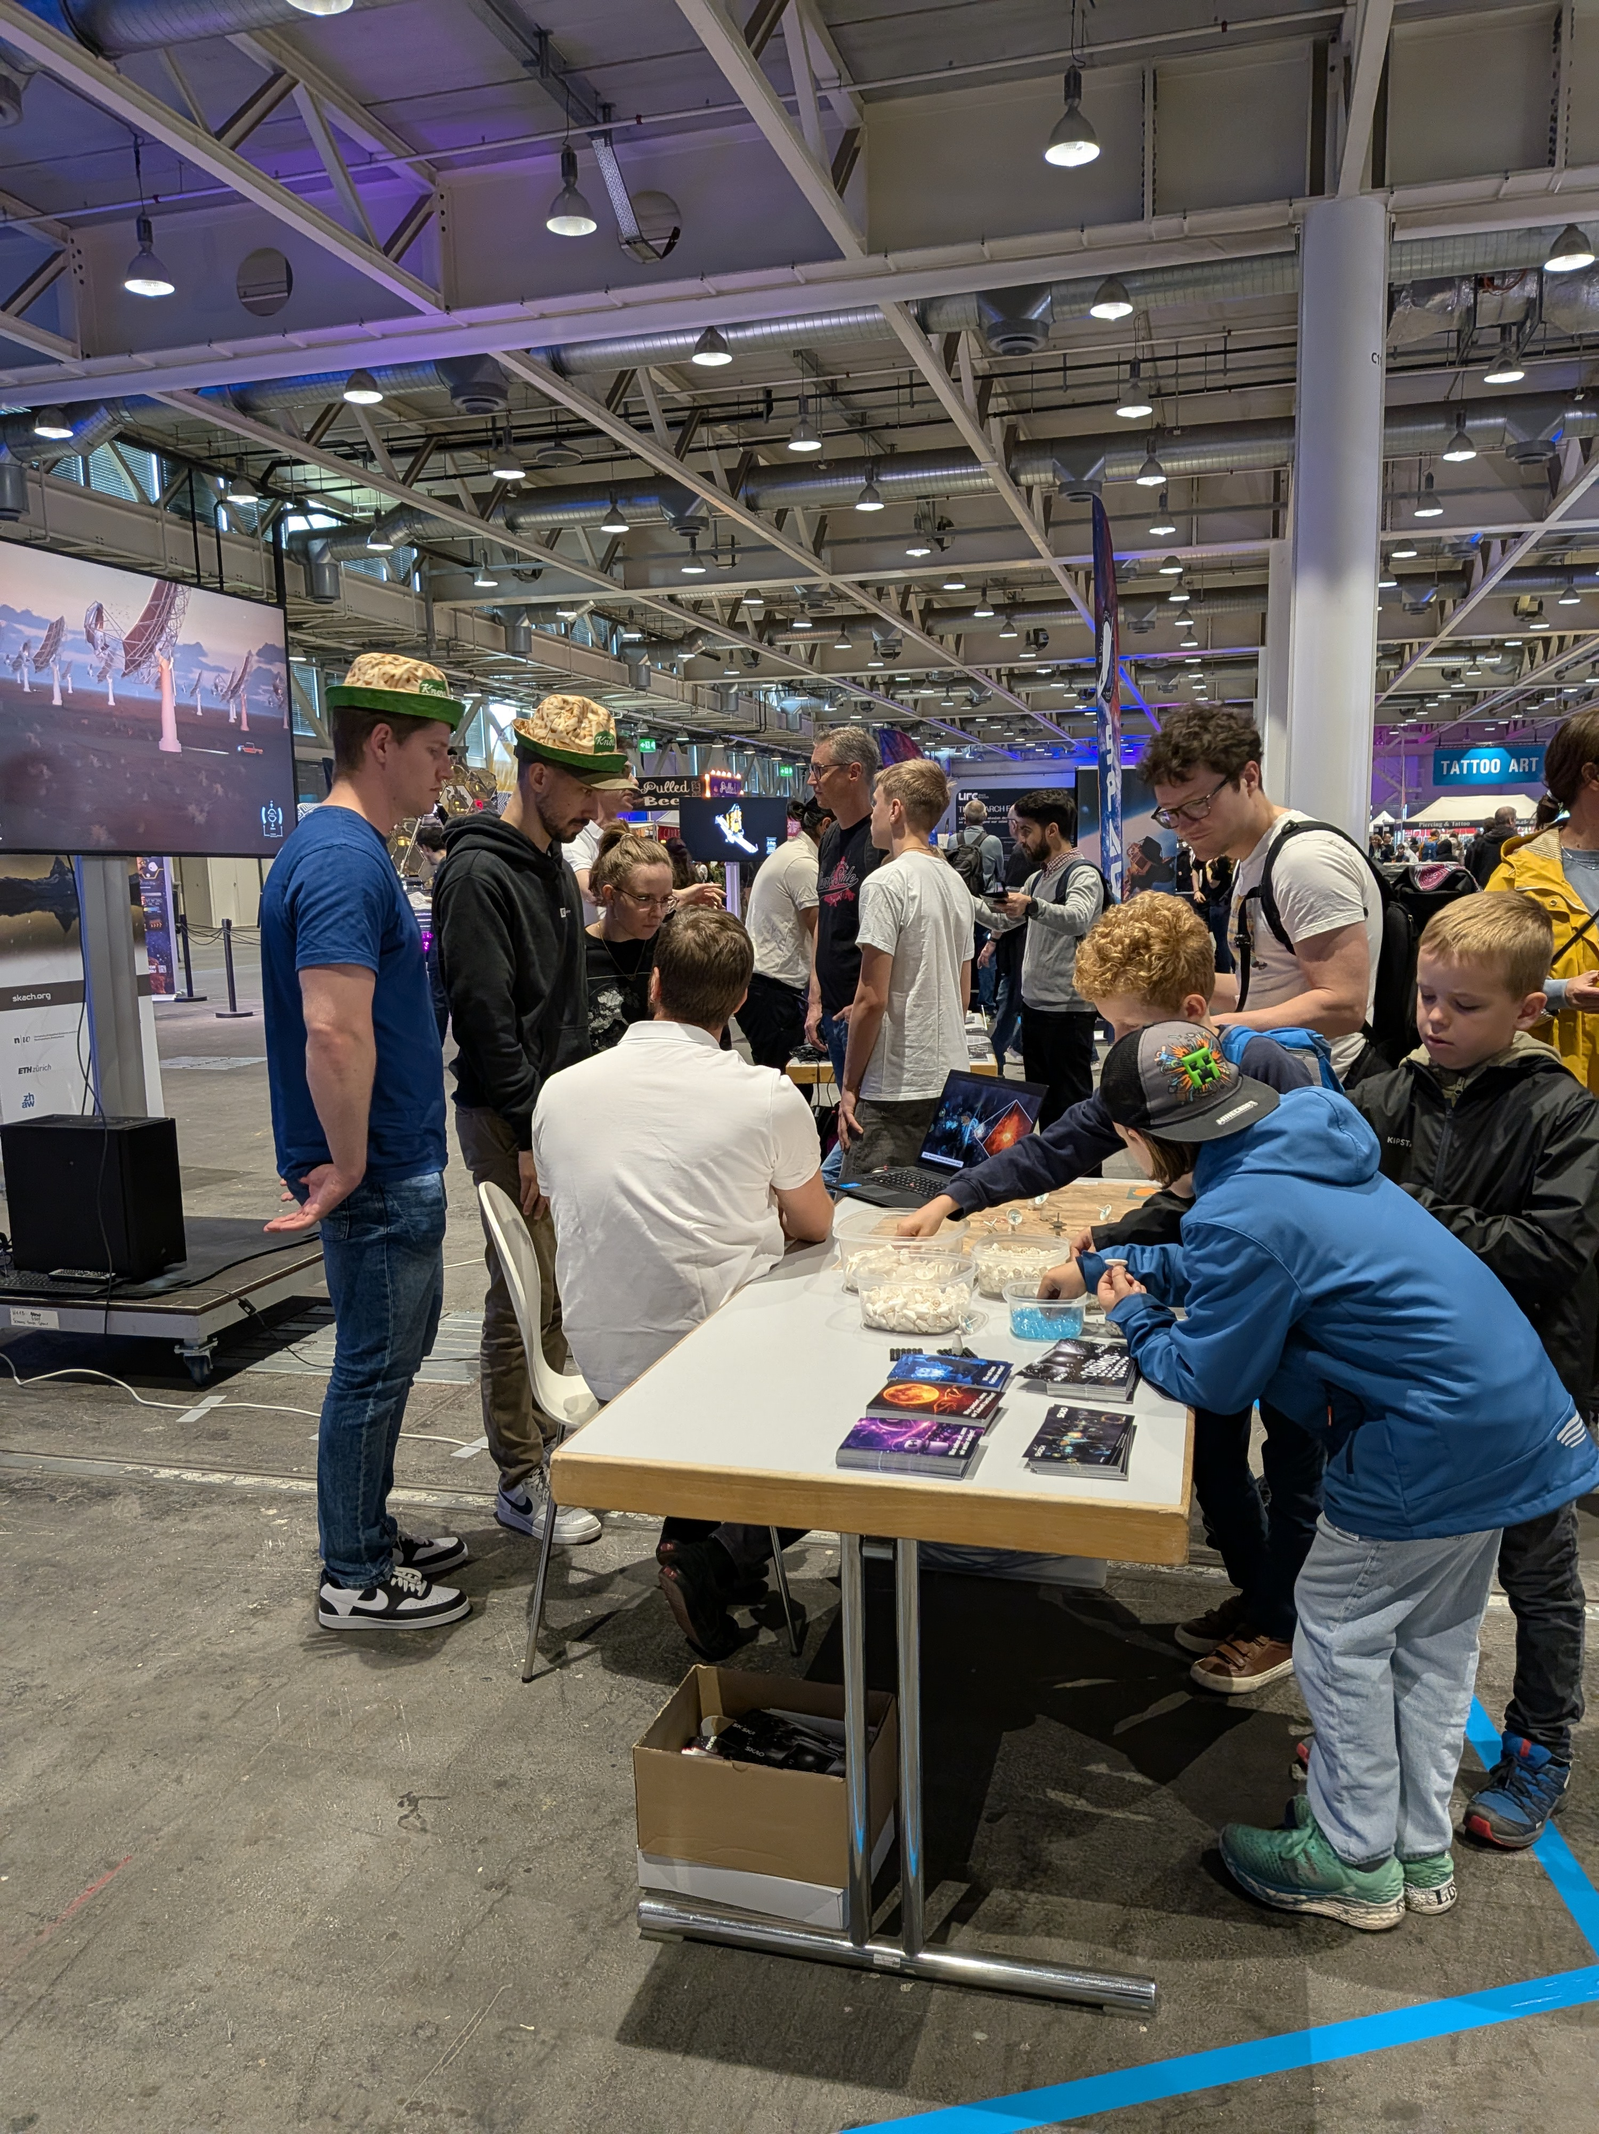
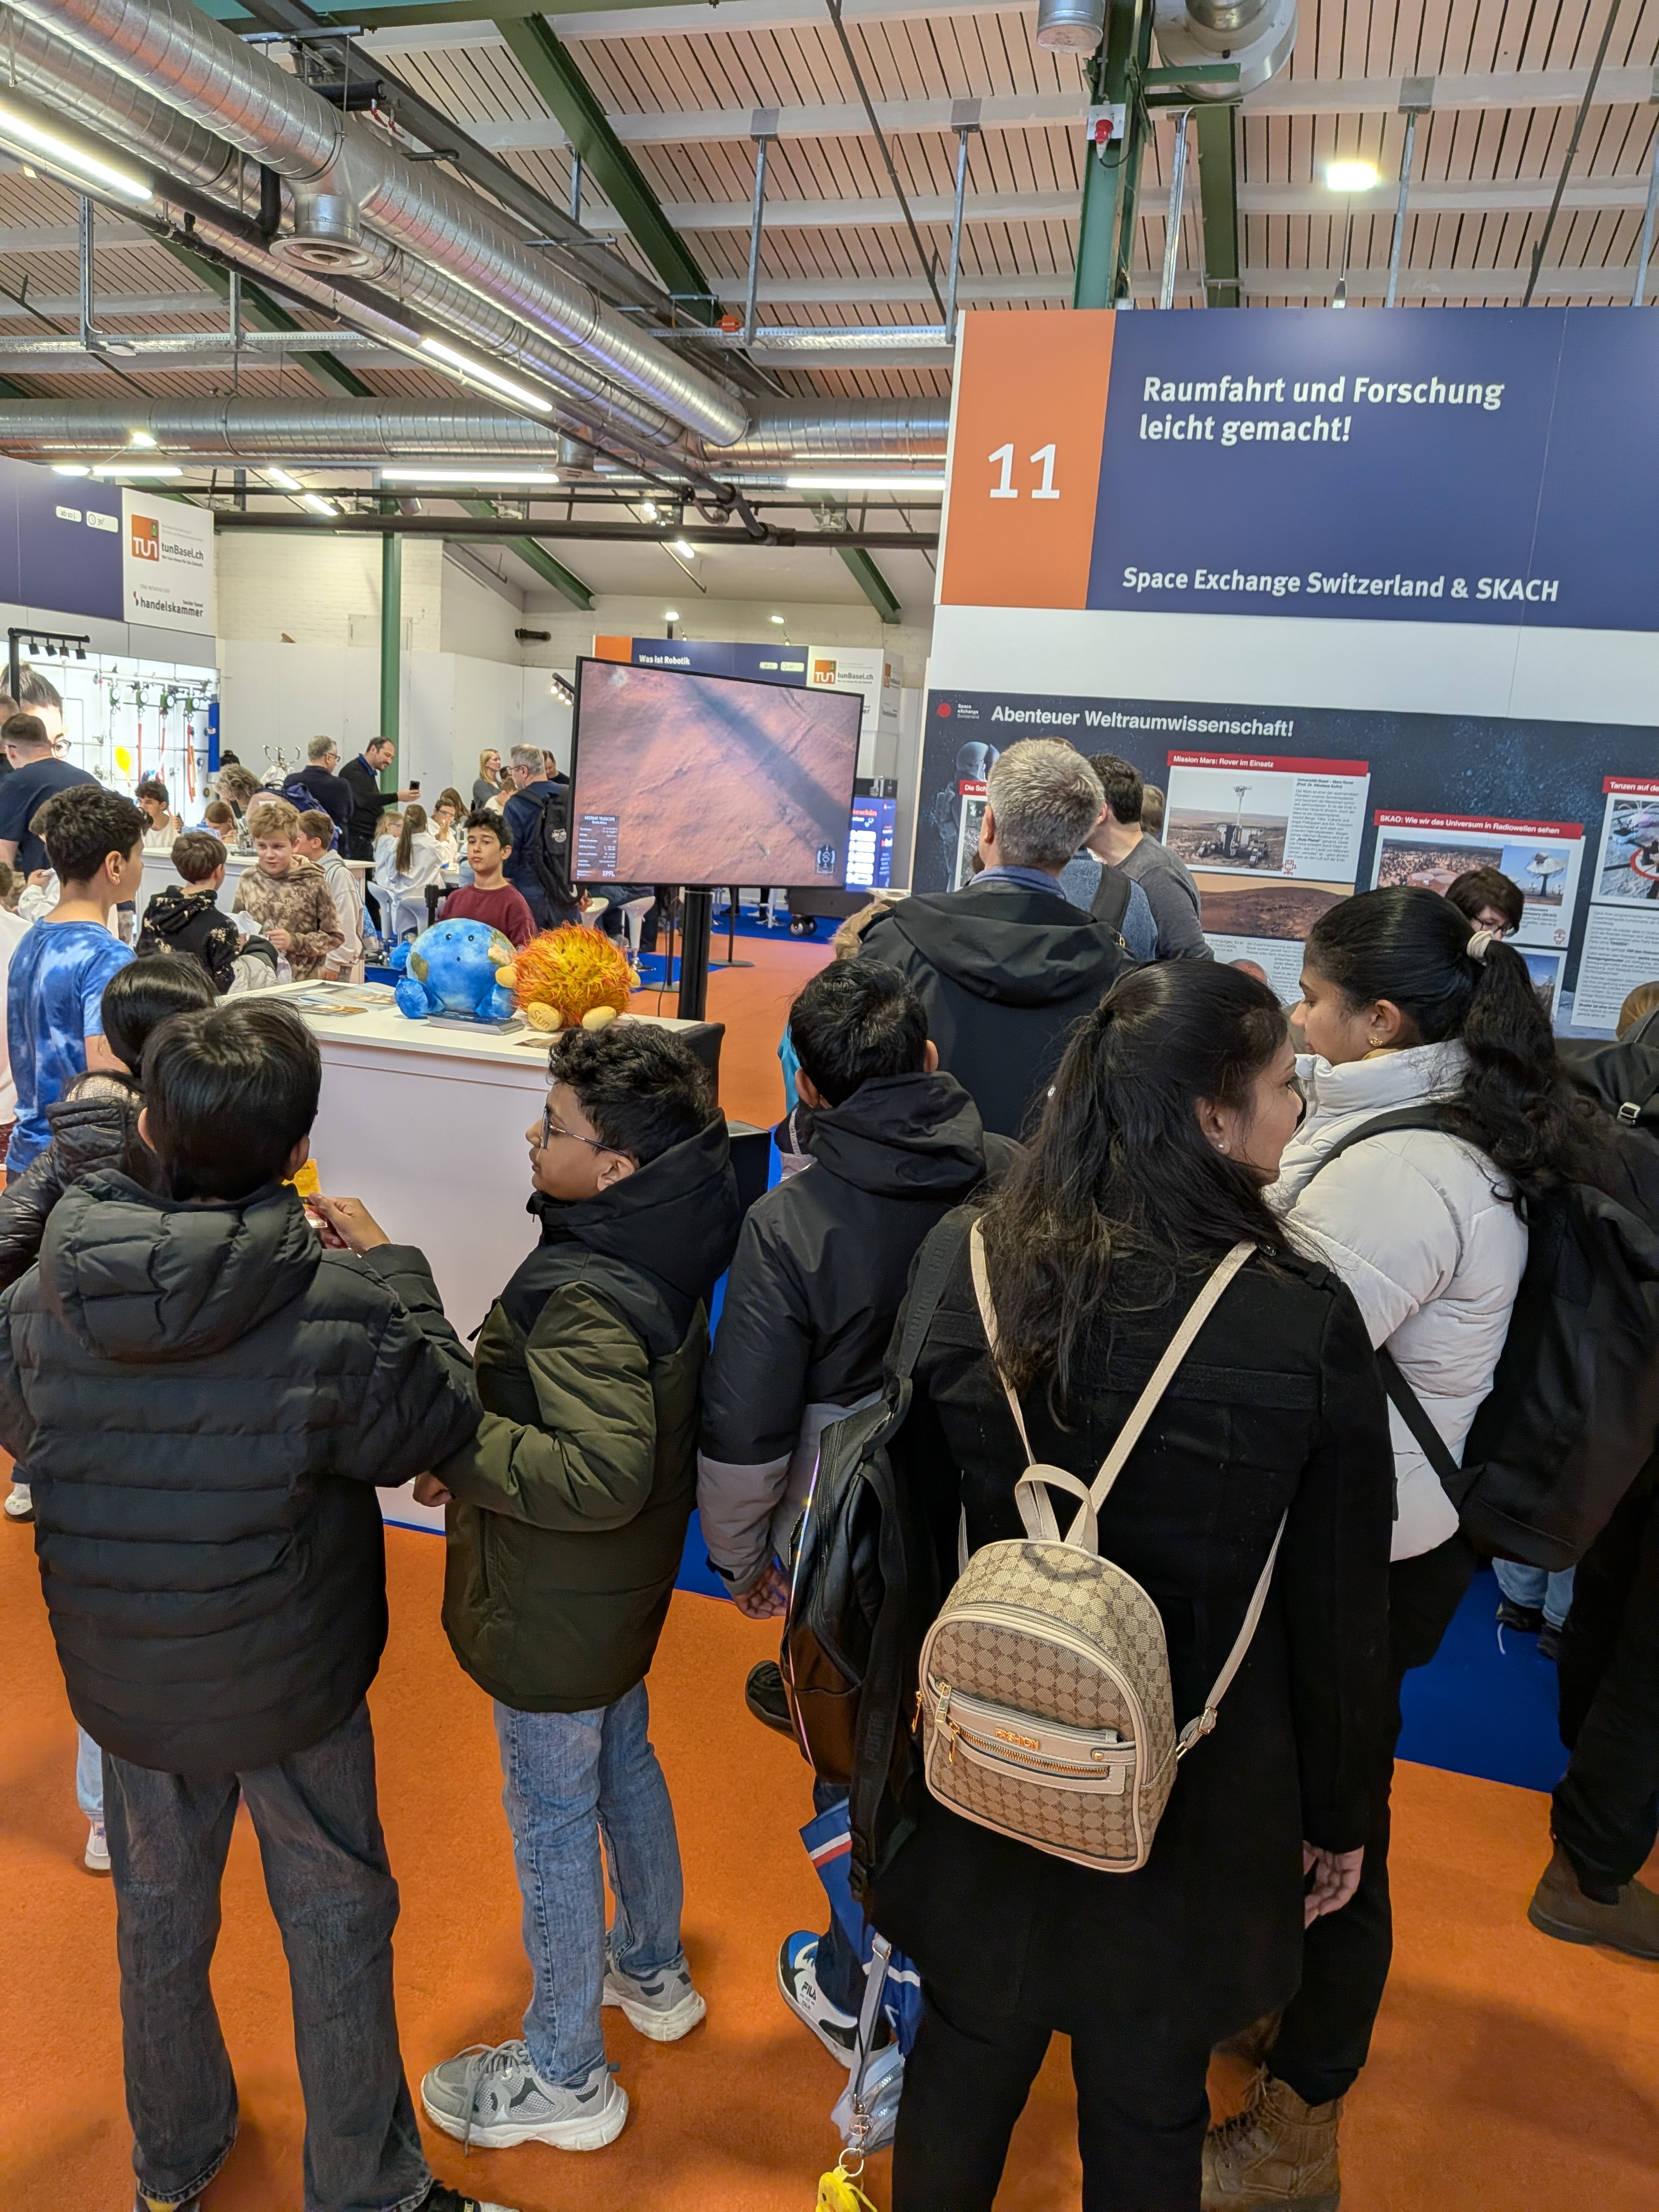
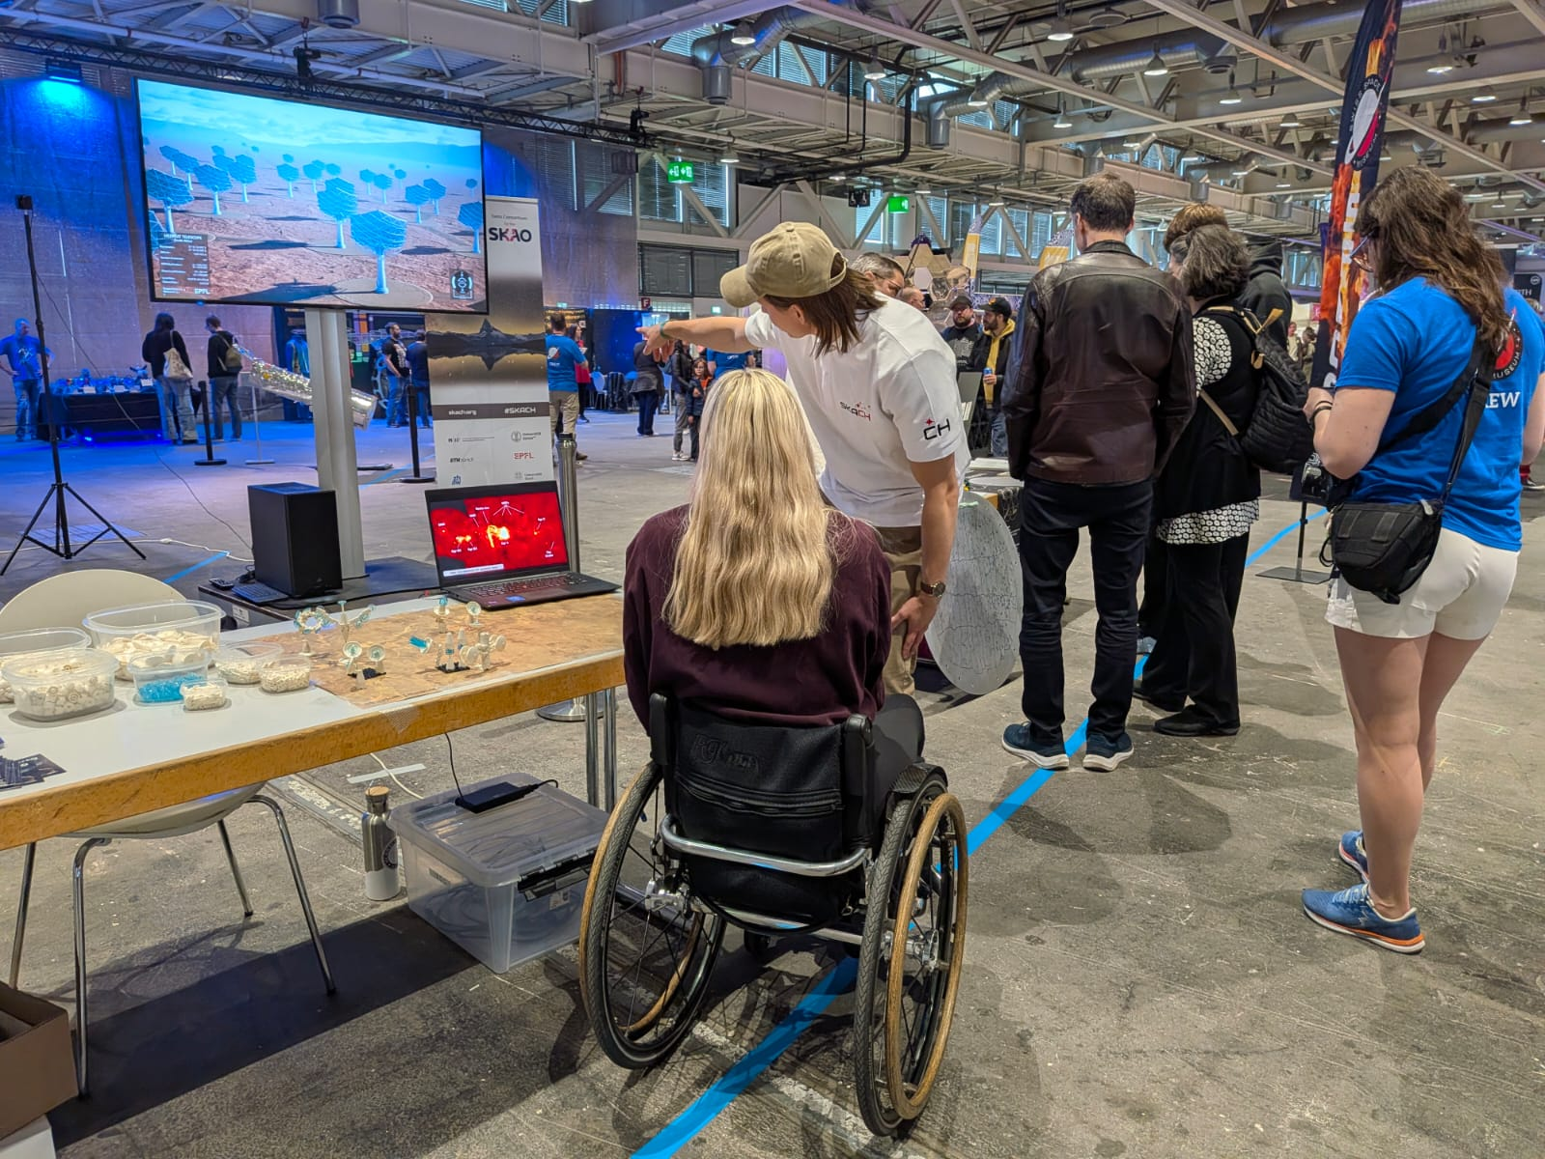
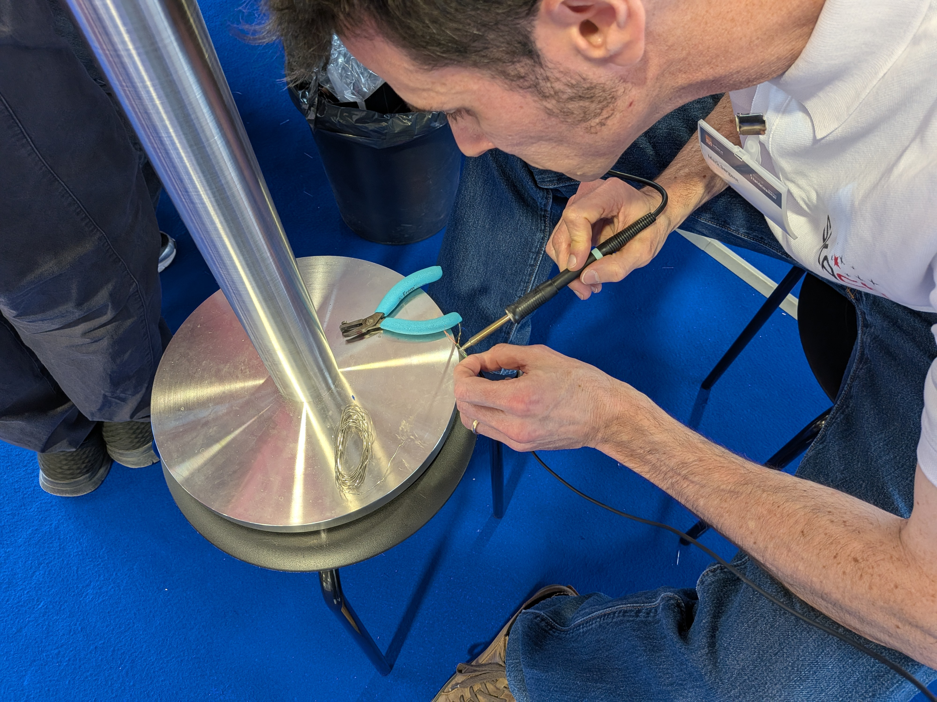
Public Outreach / STEM Events
Notes:
ESA astronaut Michaela Benthaus – first wheelchair user to go into space in 2025

Slide 16
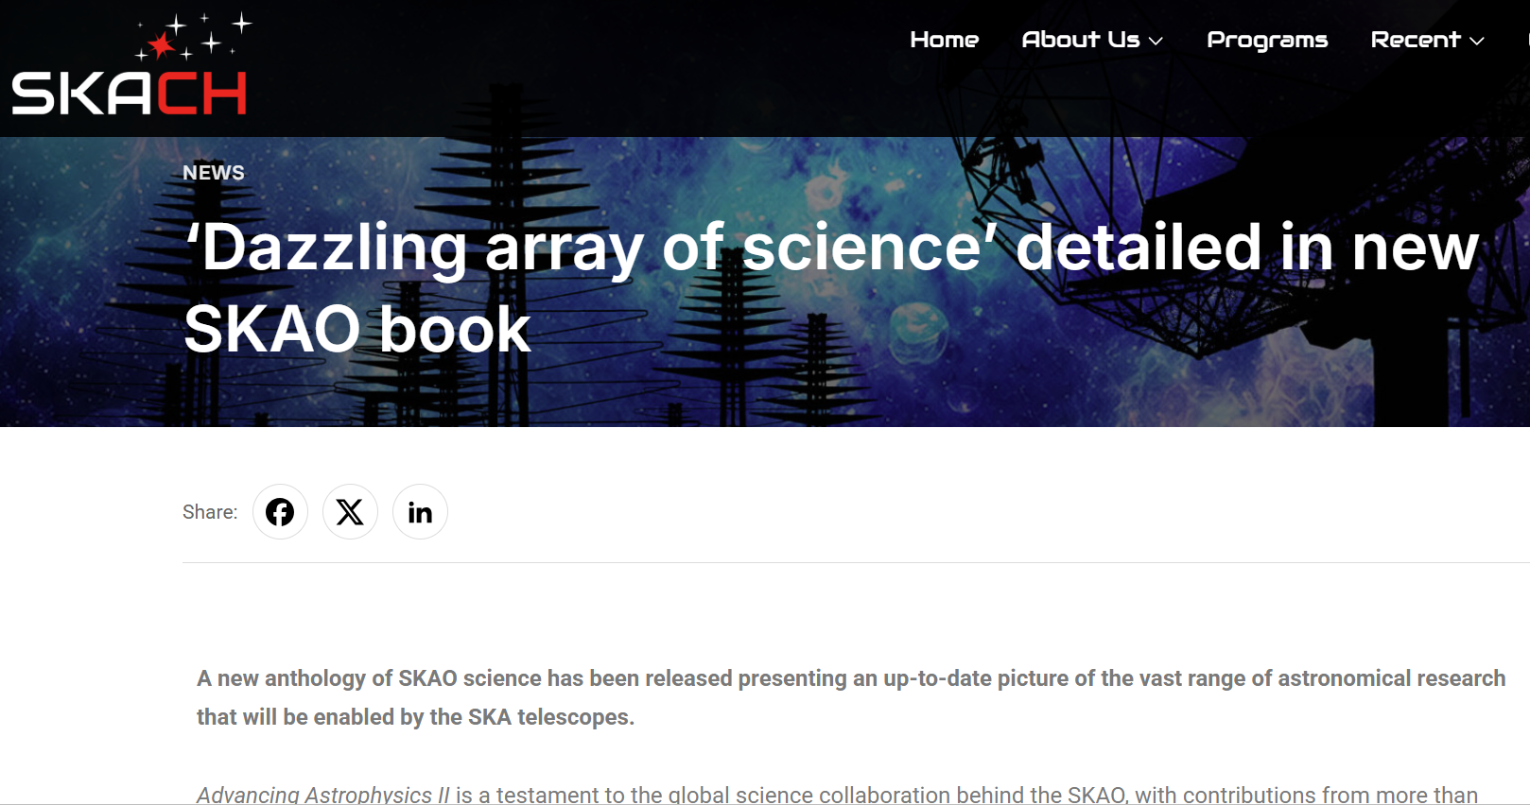
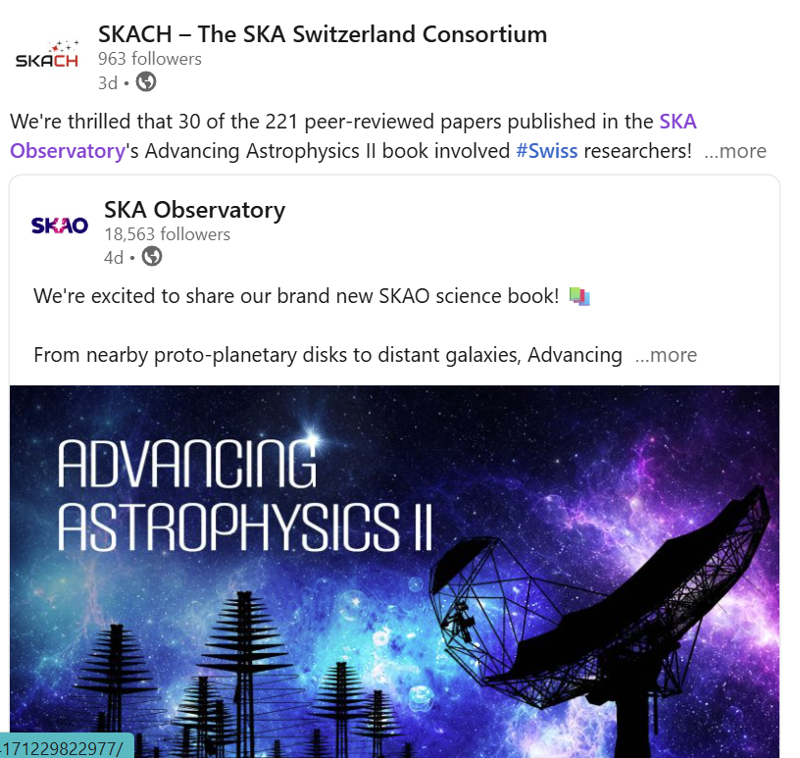
SKAO Science Book

Slide 17
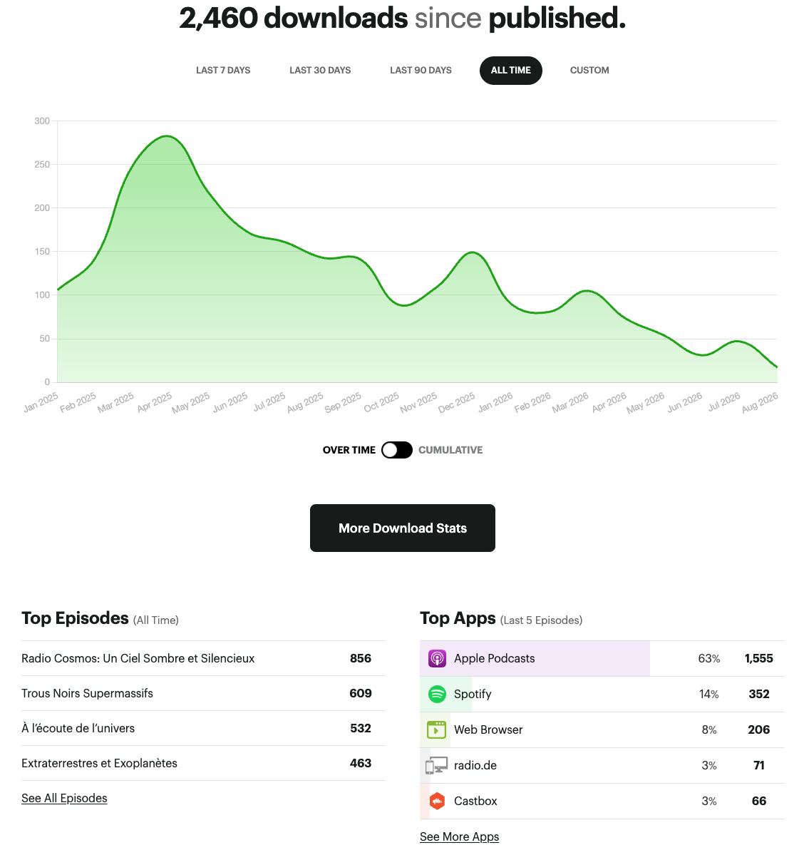

Notes:
Almost 2500 downloads – long tail
Done very well in France and Switzerland, Canada - we will continue to promote more at events
Introductory episode and black holes were most listened to last time I presented but there’s been a big uptick in listeners to Dark and Quiet Skies
Radio Cosmos Series #2!
Cogito Foundation and the Bern bergemindere.

Slide 18
Calendar
Production Radio Cosmos Season 2 – 2026, launch 2027
Launch ‘SKACH Science’ YouTube series Q4 2026/ Q1 2027
Arcana Festival, Lausanne Q3 2026 (18-21 September)
MINT VAUD - March 2027 (with Space Exchange Switzerland)
Fantasy Basel, May 2027
Various media articles scheduled Q4 2026

Slide 19
I need your help!
Share any new research, story or outreach ideas
Share images or timely news for social media
Feel free to use any SKACH resources that are developed
Volunteer for SKACH attended public events
Always get in touch if you need support or assistance
Notes:
Volunteer for Agora!

Slide 20
Thank-you and Questions?

Slide 21









Top ten global brands (recognition)
Top ten public science brands (recognition)
NASA
CERN
NIH
ESA
Max Planck
CNRS
NOAA
CDC
JAXA
CSIRO

Slide 22
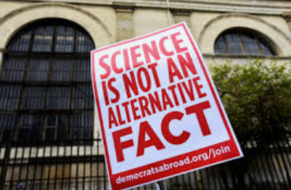
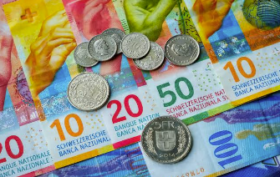
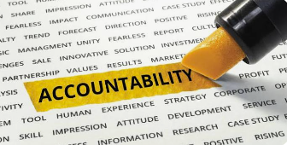
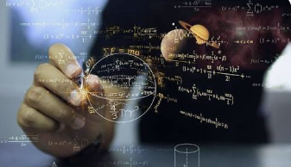
We live in a post-truth world
Shrinking public funding
Growing accountability demands
Public disconnect to fundamental research
Notes:
We are communicating our work and our brand, our vision, our authenticity, commitment, passion and value as best we can with almost no budget, but what social and media landscape are we communicating into?
Geopolitical instability, post-truth world – lack of trust in science and the value of science
Shrinking public funding – pressure to demonstrate value and link to societal benefits
Growing accountability demands from funders
Public disconnect to fundamental research
This landscape and these challenges influence how we need to communicate about ourselves and engage with our key audiences on who we are, what we do, why it is important and why we deserve the ‘social licence’ to continue.

Slide 23

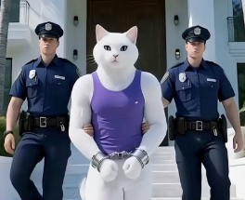
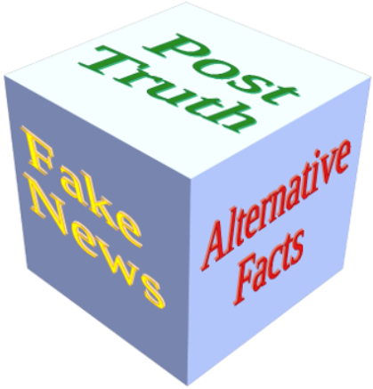

SKACH / Radio astronomy / Big Data / Open Science

Slide 24


What’s next?
AI Transforming Personalized and Automated Communication – AI assistants to AI agentic autonomous agents - highly targeted and tailored communication strategies
AI Use in Language Translation - bridging the communication gap between different languages allowing researchers and businesses to share knowledge and resources more efficiently

Slide 25
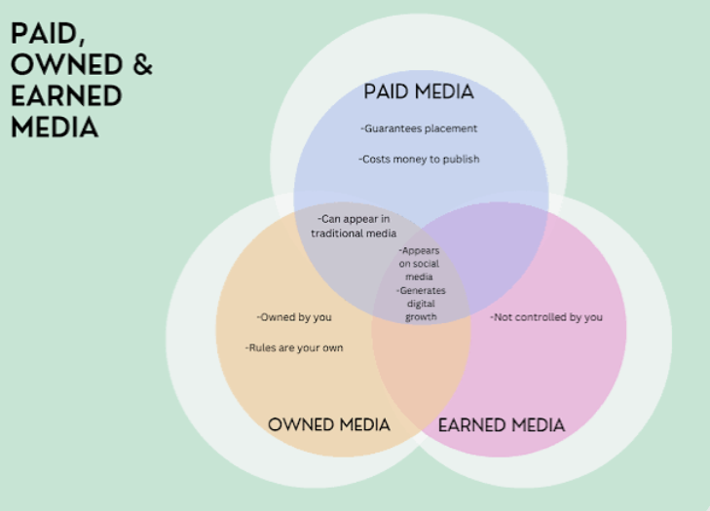
Notes:
Paid media – we don’t have a budget
In past presentations I’ve broken down our success between owned and earned owned are platforms such as our website, our social media channels, our events etc. and traditionally, owned has been media articles, interviews on radio and television etc. but as the media landscape changes faster than ever before the lines are increasingly blurred – for example when others share our social media posts and amplify our message to their followers this is ‘earned media’ even if it originated as owned.

