Slide 1
Distributed Fourier Domain Dedispersion on GPUs
Piyush Panchal (SCITAS, EPFL)
Supervisor: Emma Tolley (SCITAS, EPFL)
Collaborators: Ramesh Bhat, Bradley Meyers, Chia Min Tan, Christopher Lee (Curtin University)
Swiss SKA Days 2026, 31.08.2026

Slide 2
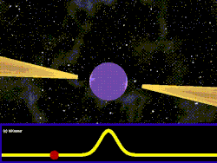
Pulsars
Rotating Neutron star
EM radiation from poles
Useful for Pulsar Timing Arrays, G.R., Equation of State etc.

Slide 3
SMART Pulsar Survey (2021)
4 Petabytes data collected by MWA Telescope
Detection pipeline: PRESTO-based, CPU only
20% data processed so far
25 new Pulsar discoveries, potential for many more
Pipeline speedup required. My work focuses on dedispersion

Slide 4
Dispersion
Channel dependent delay caused by ISM
Interstellar Medium

Slide 5
Dispersion
Channel dependent delay caused by ISM
Interstellar Medium

Slide 6
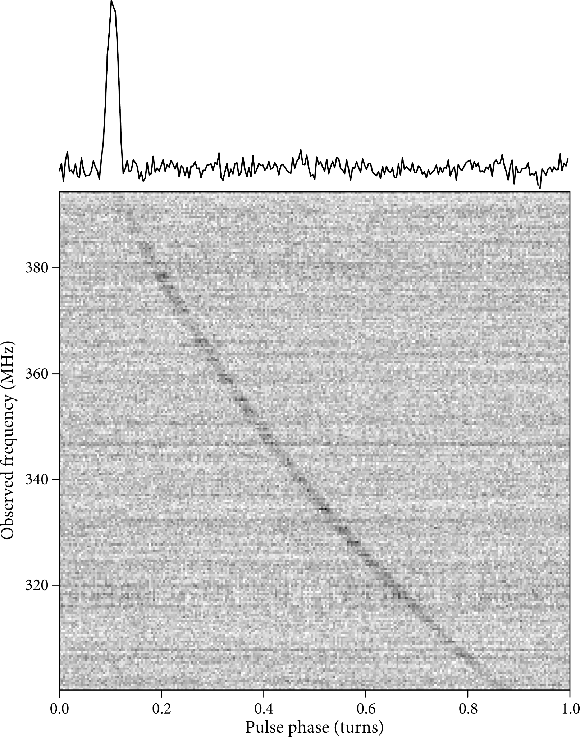
Dispersion
Channel dependent delay caused by ISM

Slide 7

Dispersion
Channel dependent delay caused by ISM. Characterized by DM
De-dispersion: Correct delays for trial DM values, sum channels
$$\text{Delay} α\frac{DM}{ν^{2}}$$

Slide 8
Fourier Domain Dedispersion

Slide 9
Fourier Shift Example
a | b | c | d | e

Slide 10
Fourier Shift Example
a | b | c | d | e
FFT
A | B | C | D | E

Slide 11
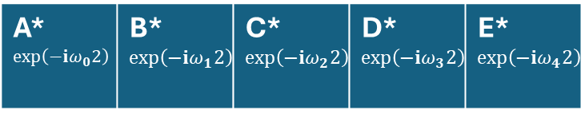
Fourier Shift Example
$$ω_{j}=2πj/N$$
a | b | c | d | e
FFT
X $\exp\left(−ⅈω_{j}2\right)$
A | B | C | D | E
A*$\exp\left(−ⅈω_{0}2\right)$ | B*$\exp\left(−ⅈω_{1}2\right)$ | C*$\exp\left(−ⅈω_{2}2\right)$ | D*$\exp\left(−ⅈω_{3}2\right)$ | E*$\exp\left(−ⅈω_{4}2\right)$

Slide 12
Fourier Shift Example
$$ω_{j}=2πj/N$$
a | b | c | d | e
c | d | e | a | b
FFT
IFFT
X $\exp\left(−ⅈω_{j}2\right)$
A | B | C | D | E
A*$\exp\left(−ⅈω_{0}2\right)$ | B*$\exp\left(−ⅈω_{1}2\right)$ | C*$\exp\left(−ⅈω_{2}2\right)$ | D*$\exp\left(−ⅈω_{3}2\right)$ | E*$\exp\left(−ⅈω_{4}2\right)$

Slide 13
Fourier Shift Example
$$ω_{j}=2πj/N$$
a | b | c | d | e
c | d | e | a | b
FFT
IFFT
X $\exp\left(−ⅈω_{j}2\right)$
A | B | C | D | E
A*$\exp\left(−ⅈω_{0}2\right)$ | B*$\exp\left(−ⅈω_{1}2\right)$ | C*$\exp\left(−ⅈω_{2}2\right)$ | D*$\exp\left(−ⅈω_{3}2\right)$ | E*$\exp\left(−ⅈω_{4}2\right)$
Multiplication $\exp\left(−ⅈω_{j}Δt\right)$, and IFT shifts left periodically by $Δt$

Slide 14
Fourier Domain Dedispersion
All shifts to left - zero padding on left
No shift for highest freq. channel
Channel sum in Fourier domain

Slide 15
Fourier Domain Dedispersion
Sum of channels
All shifts to left - zero padding on left
No shift for highest freq. channel
Channel sum in Fourier domain
Channel-wise FFT
Phase multiplication
Channel
Sum of channels
IFFT
Time
Max delay

Slide 16
Fourier Domain Dedispersion
Dedispersed time series for all trial DMs
DM #0
DM #1
Channel
DM #2
DM #3
Time
Max delay

Slide 17
FDD Implementation
Based on a fork of dedisp (github.com/svlugt/dedisp)
Status in December 2025
  PRESTO like CLI, FITS ingestion
  Separate HIP and CUDA implementation
  Correctness: comparison with PRESTO and Pulsar re-detections
  ~3 orders of magnitude faster than PRESTO

Slide 18
FDD Implementation: Current Status
Unified HIP/CUDA code
Implemented downsampling and barycentering
Distributed implementation using MPI
  Uses the single GPU algorithm per rank + Host side communication
  Data output using POSIX AIO
  NUMA awareness via srun params (Slurm)

Slide 19
Distributed FDD Algorithm
Input data present in multiple files
File 0
File 1
File N-1

Slide 20
Distributed FDD Algorithm
Input data present in multiple files
Each MPI proc handles same number of files
File 0
File 1
File N-1
Rank 0
Rank 1
Rank N-1

Slide 21
Distributed FDD Algorithm
Input data present in multiple files
Each MPI proc handles same number of files
Zero pad according to max delay
Run the sequential algorithm on all ranks
File 0
File 1
File N-1
Rank 0
Rank 1
Rank N-1

Slide 22
Distributed FDD Algorithm
Input data present in multiple files
Each MPI proc handles same number of files
Zero pad according to max delay
Run the sequential algorithm on all ranks
Rank 0
Rank 1
Rank N-1

Slide 23
MPI Communication Pattern
Communication only with neighbors using MPI_sendrecv (host)
N-1 messages of size #DMs X max_delay floats
Max delay
Max delay
Rank 0
Rank 1
Rank N-1

Slide 24
MPI Communication Pattern (3 Procs)
Max delay
Max delay
Rank 0
Rank 1
Rank 2

Slide 25
MPI Communication Pattern (3 Procs)

Slide 26
Output Using POSIX AIO
1 File per DM - #DM output files
MPI Comm. and async write handled by std::thread
Write for a DM overlaps with MPI Comm. for next DMs
Rank 0
Rank 1
Rank 2
DMs

Slide 27
Weak Scaling Tests
Tests on CSCS Daint & Setonix. Cray MPICH + Lustre.
#Nodes 1..6, –-ntasks-per-node=4. 1 FITS (~24 GB) per rank.
DMs = {1000, 2000, 3000, 4000}. 20 runs per DM.
Stripe count 1 for input fits, $SLURM_NTASKS for output files

Slide 28
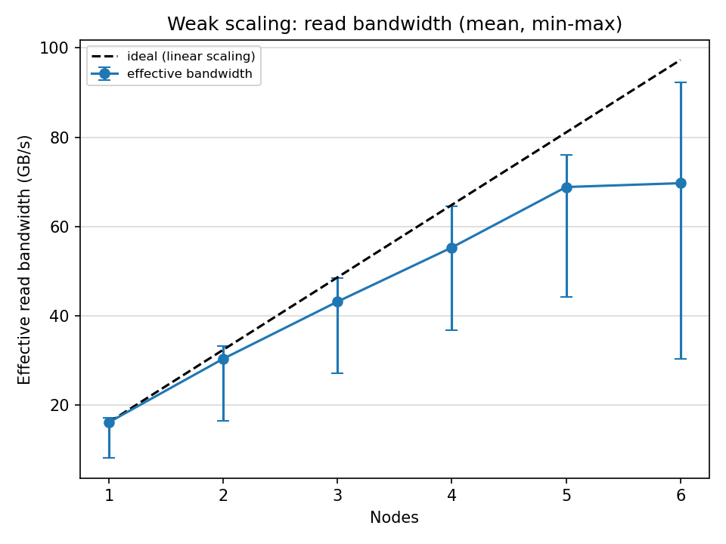
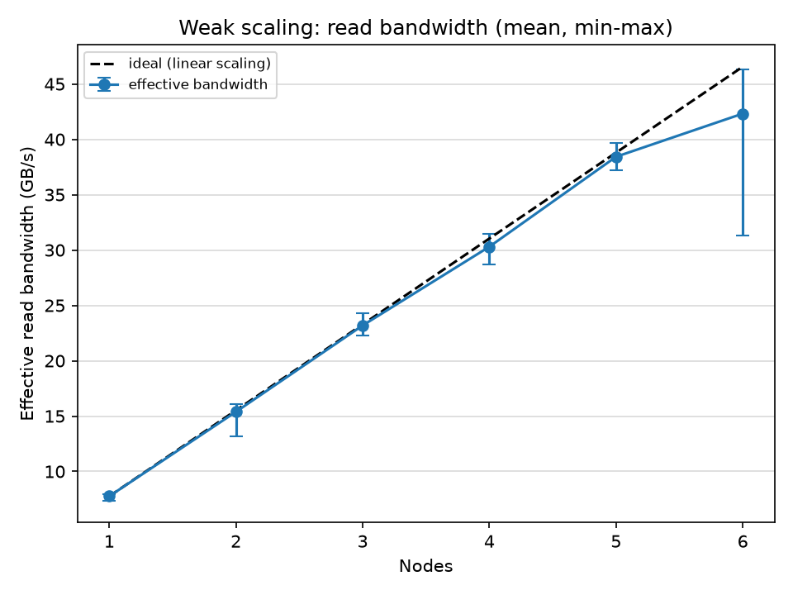
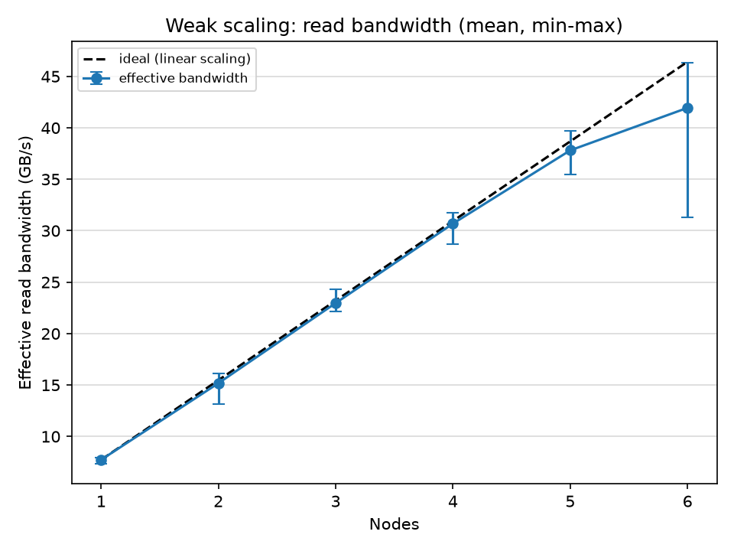
Weak Scaling Tests: Read Bandwidth
Effective B/W = total input size / max read time among procs
Mean of effective B/W across all runs (different DMs)
S
E
T
O
N
I
X
C
S
C
S

Slide 29
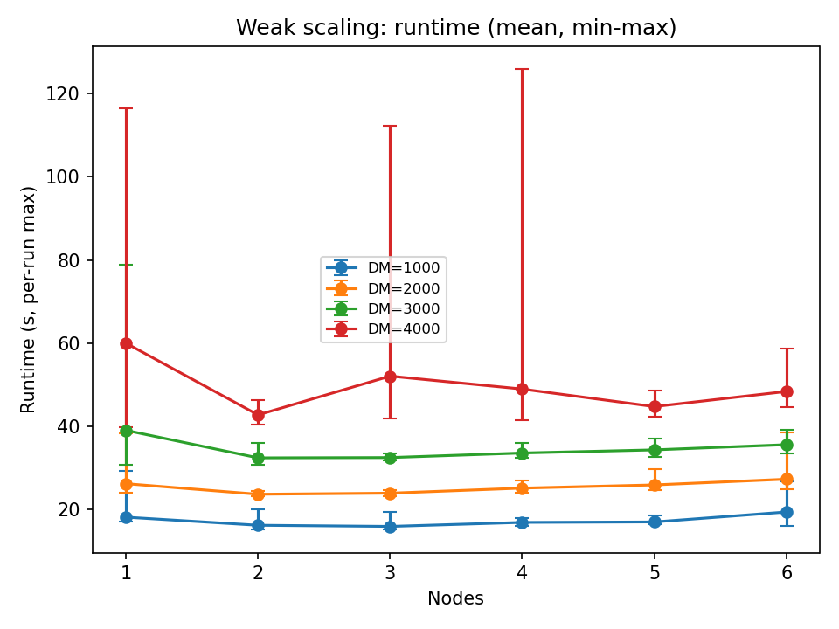
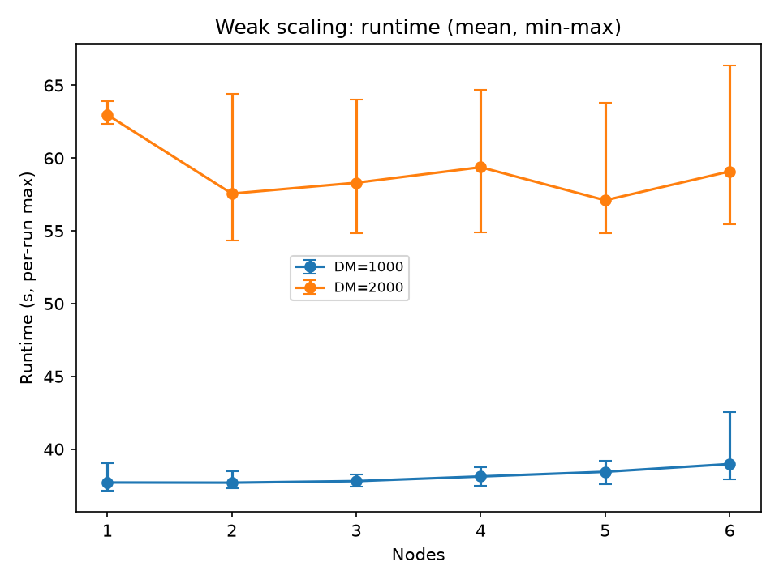
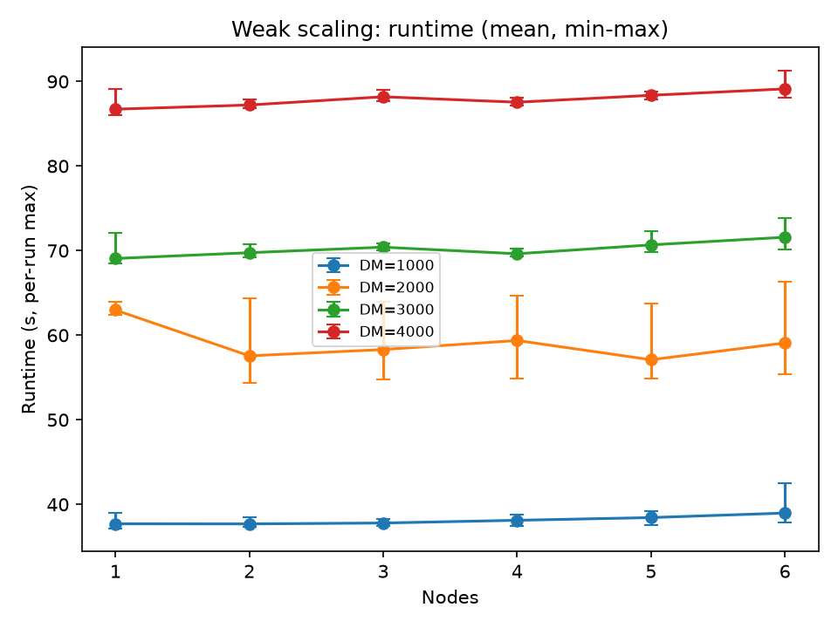
Weak Scaling Tests: Total Runtime
Excludes MPI_Init and Finalize times
S
E
T
O
N
I
X
C
S
C
S

Slide 30
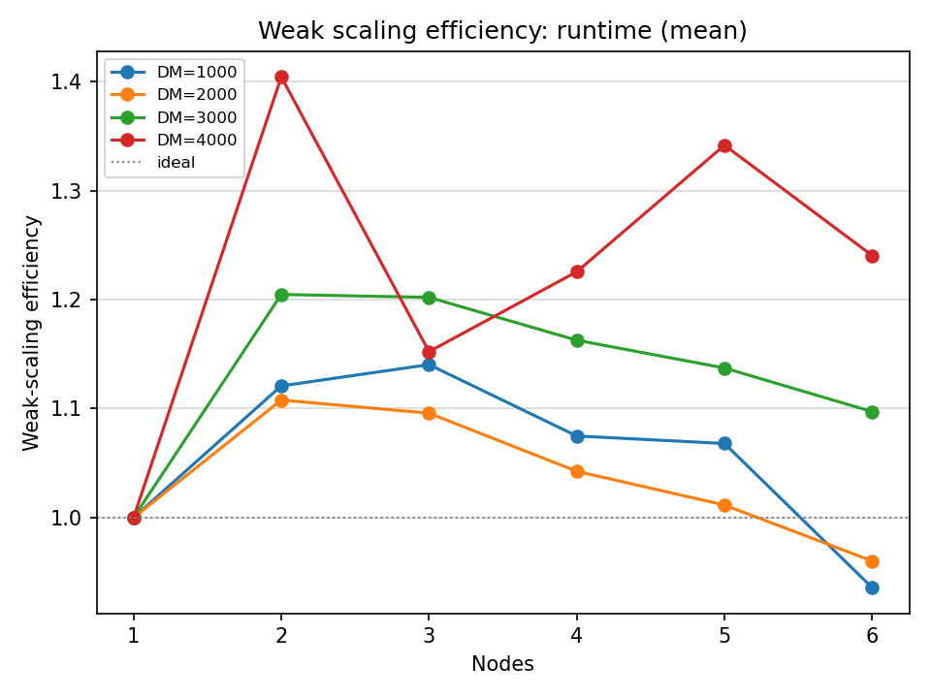
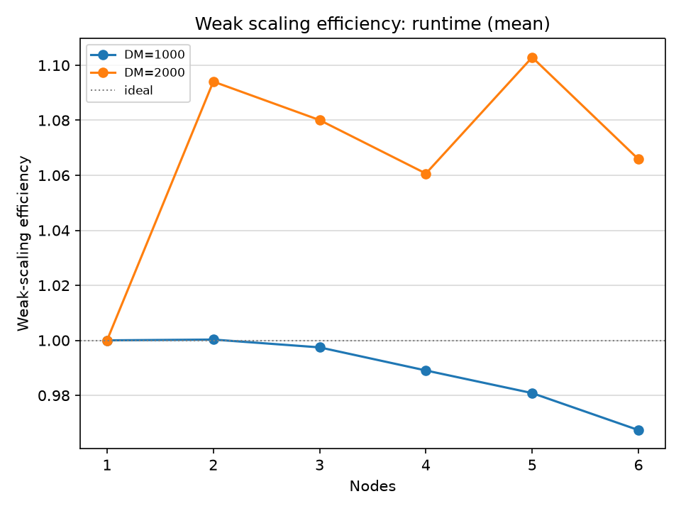
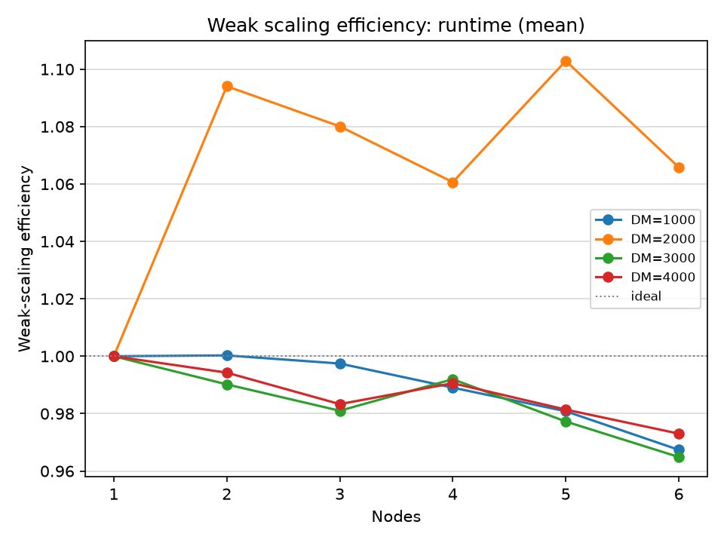
Weak Scaling Tests: Scaling Efficiency
Mean T_baseline / mean T_N (excluding MPI_Init and Finalize)
S
E
T
O
N
I
X
C
S
C
S

Slide 31
Summary & Outlook
Summary:
  Distributed FDD algorithm shows >90% scaling efficiency
  Almost linearly growing aggregate read bandwidth
  Allows dedispersing entire beamformed observation of ~550 GB
Next steps:
  Improve RAM usage per rank as host memory is split
  Experiment with communication directly on GPU buffers
  Trying output using ADIOS

Slide 32
Thank you for your attention!
Questions?

Slide 33
Distributed FDD Algorithm
Input data present in multiple files
Each MPI proc handles same number of files
Zero pad according to max delay
Run the sequential algorithm on all ranks
Rank 0
Rank 1
Rank N-1

Slide 34
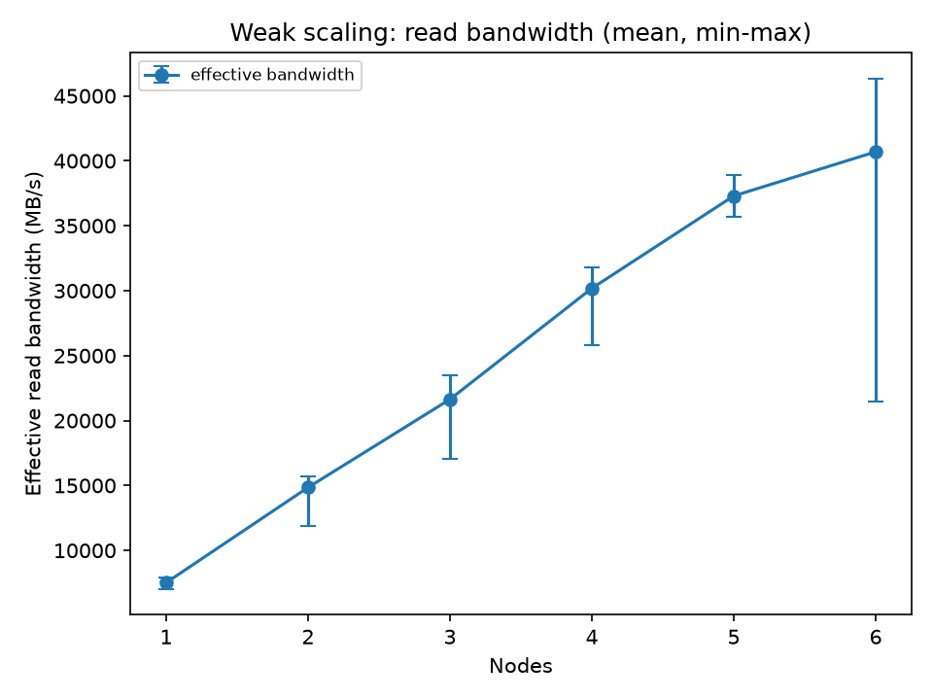
Weak Scaling Tests: Read Bandwidth
Effective b/w = total input size / max read time among procs
Mean value over all runs (different DMs)

Slide 35
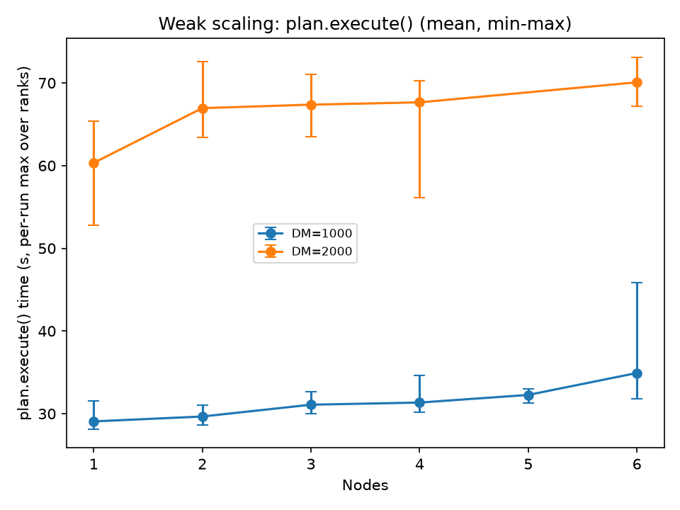
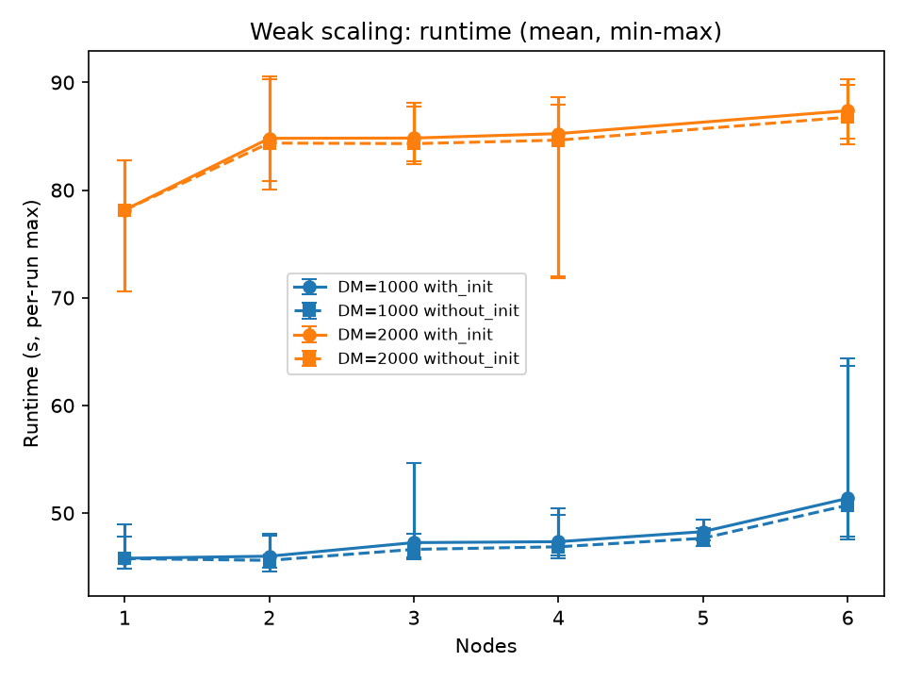
Weak Scaling Tests: Total Runtime
Plan.execute(): Excluding read time (GPU+ MPI comm & write)

Slide 36
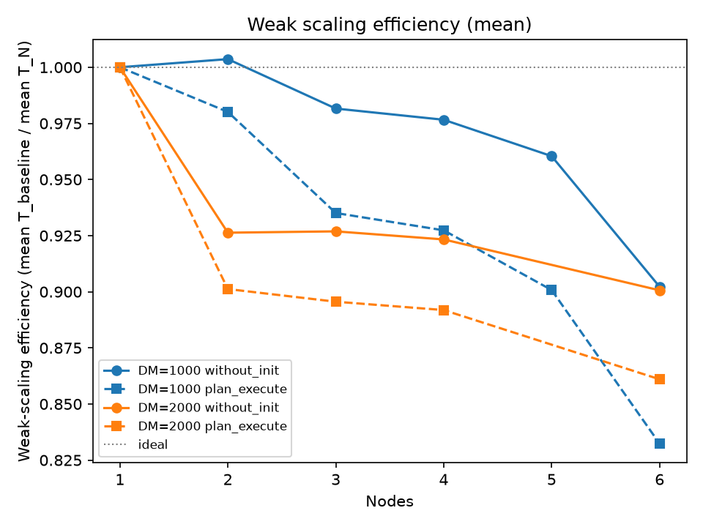
Weak Scaling Tests: Scaling Efficiency
Mean T_baseline / mean T_N

Slide 37
MPI Communication Pattern
Max delay
Rank 0
Rank 1
Rank N-1

Slide 38
Daint Compute Node

Slide 39
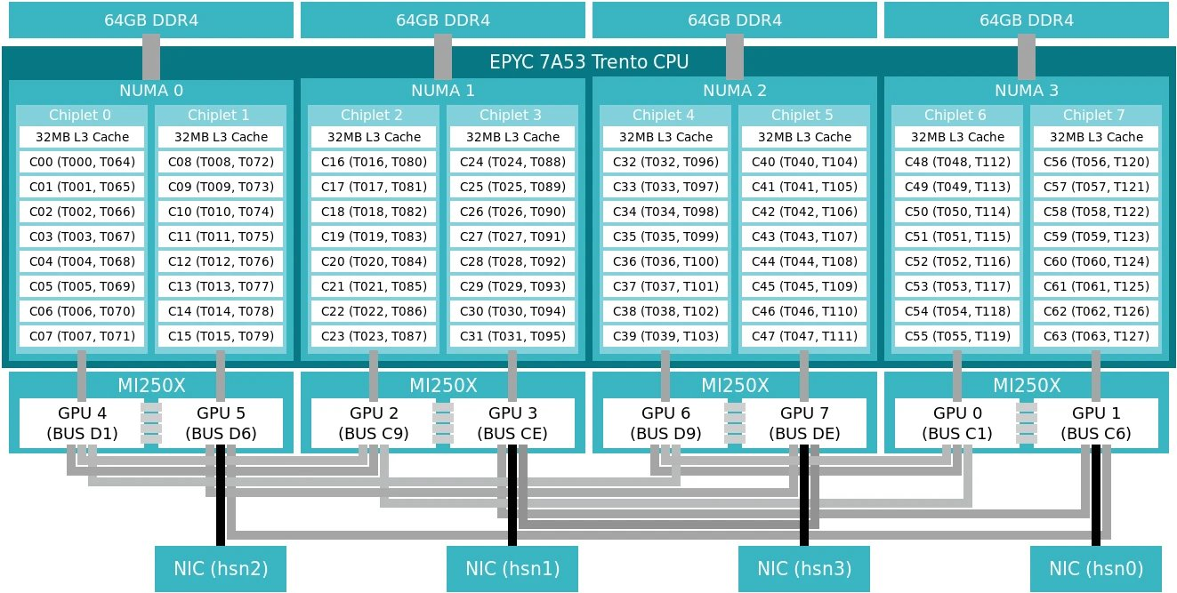
Setonix Compute Node

Slide 40
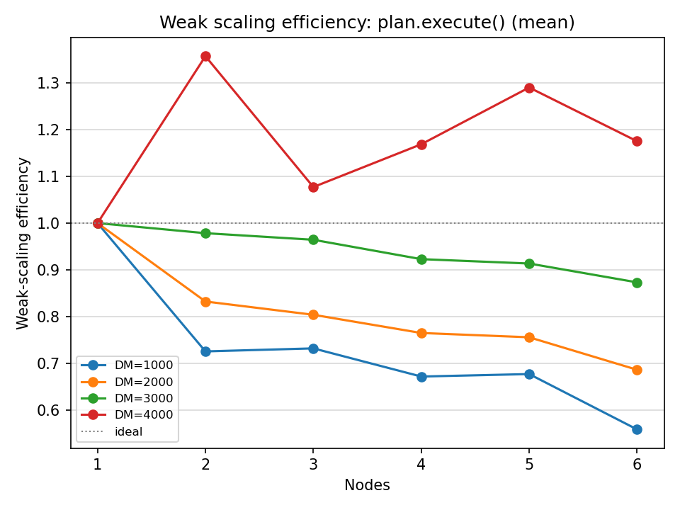
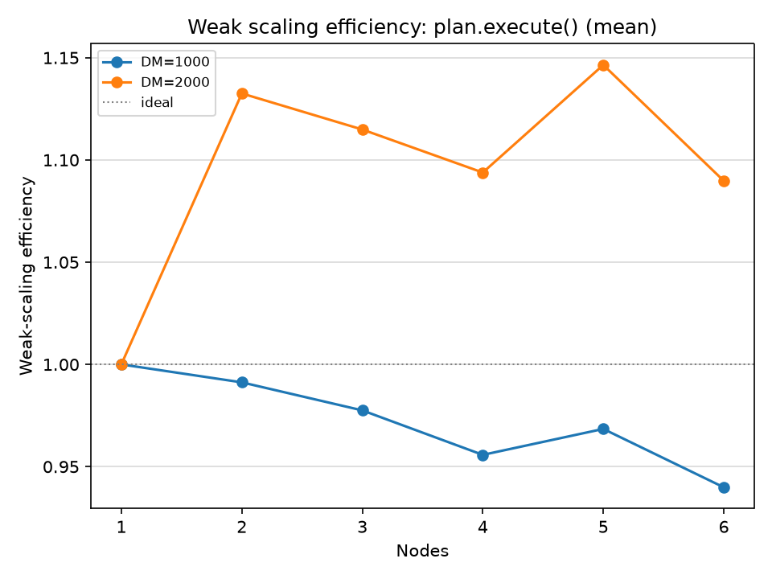
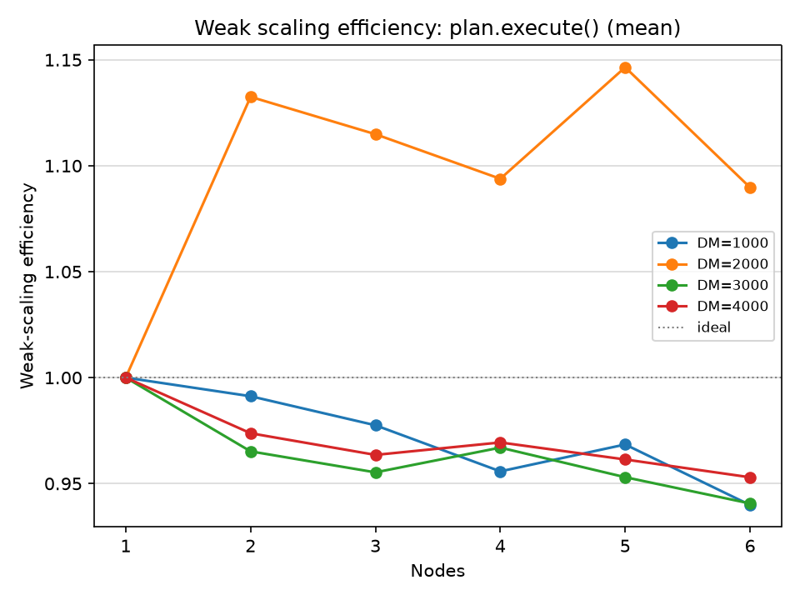
Weak Scaling Tests: plan.execute()
Includes only GPU run + MPI communication + output

