Slide 1
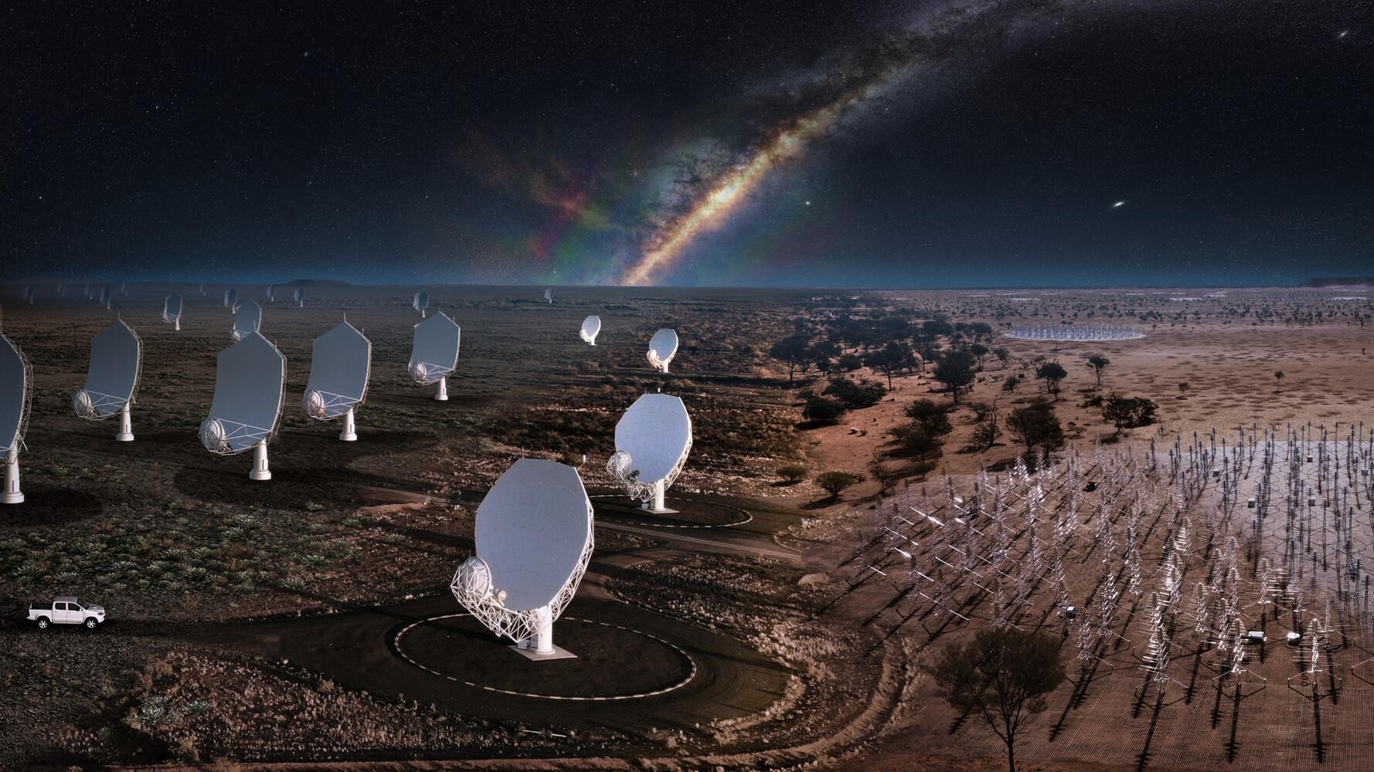
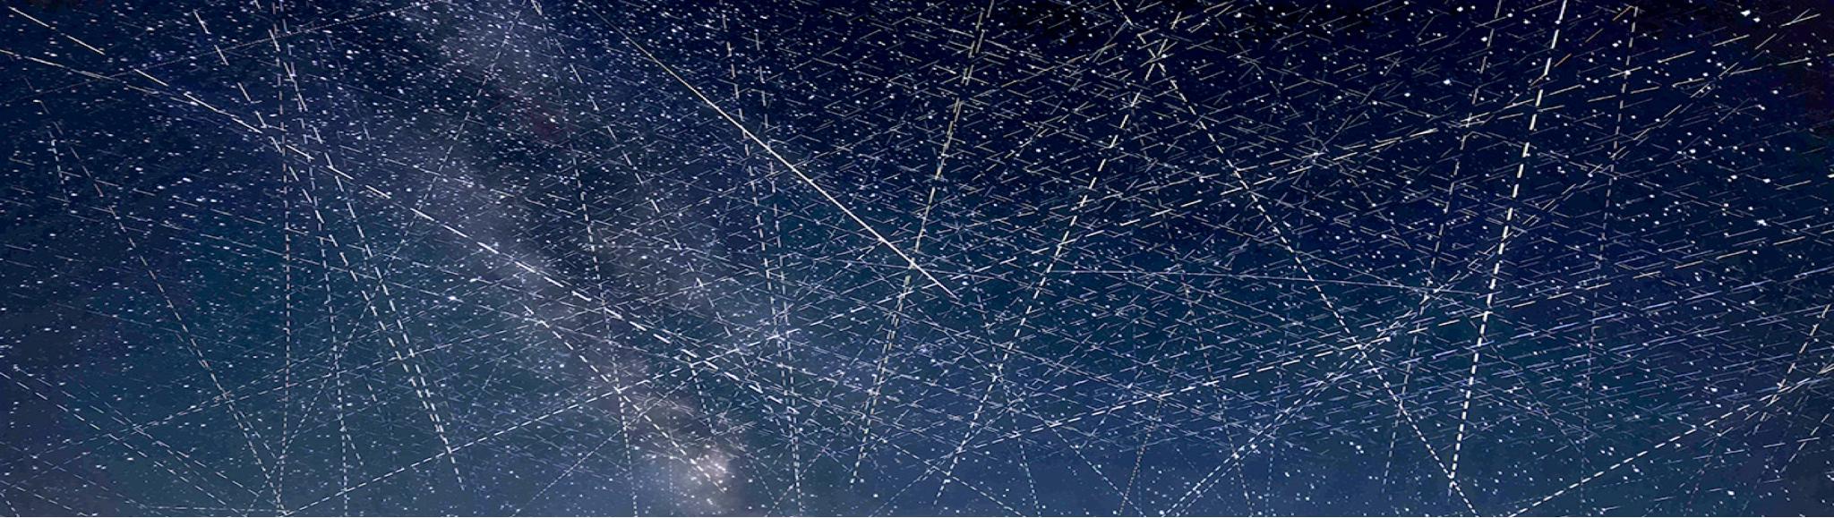

TABASCAL:
Latest Results on EDA2 Data
© Alan Dyer/AmazingSky.com
Chris Finlay (EPFL)
Dylan Grigg (Curtin), Simon Frasch (CSCS),
Steven Tingay (Curtin), Emma Tolley (EPFL)
Bruce Bassett (Wits), Martin Kunz (UniGe), Nadeem Oozeer (Rhodes)
© SKAO

Slide 2
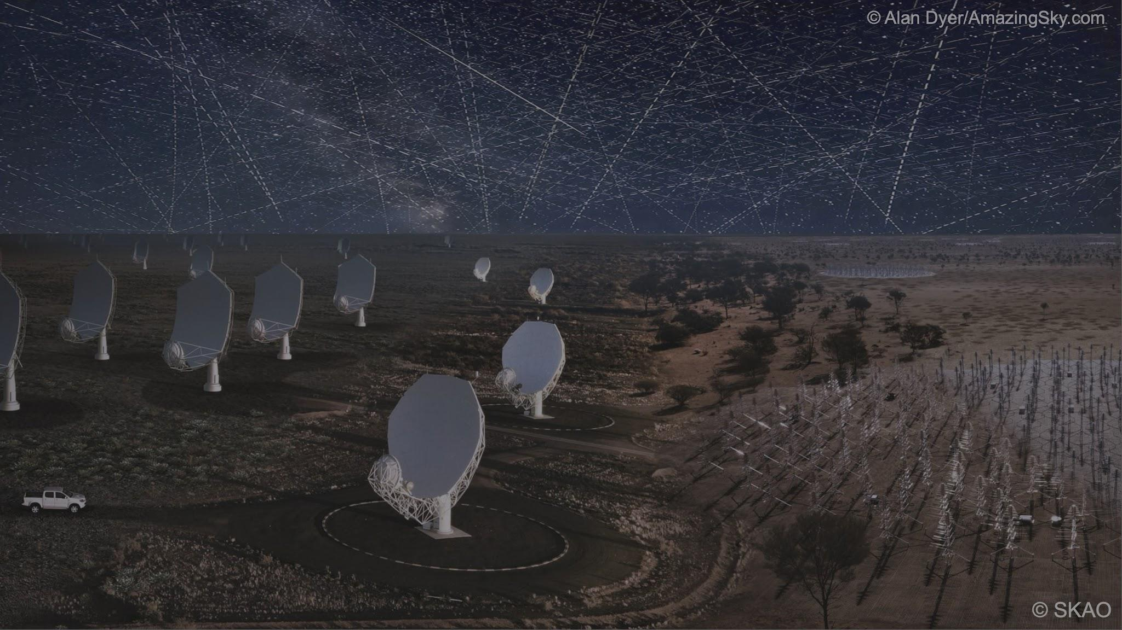
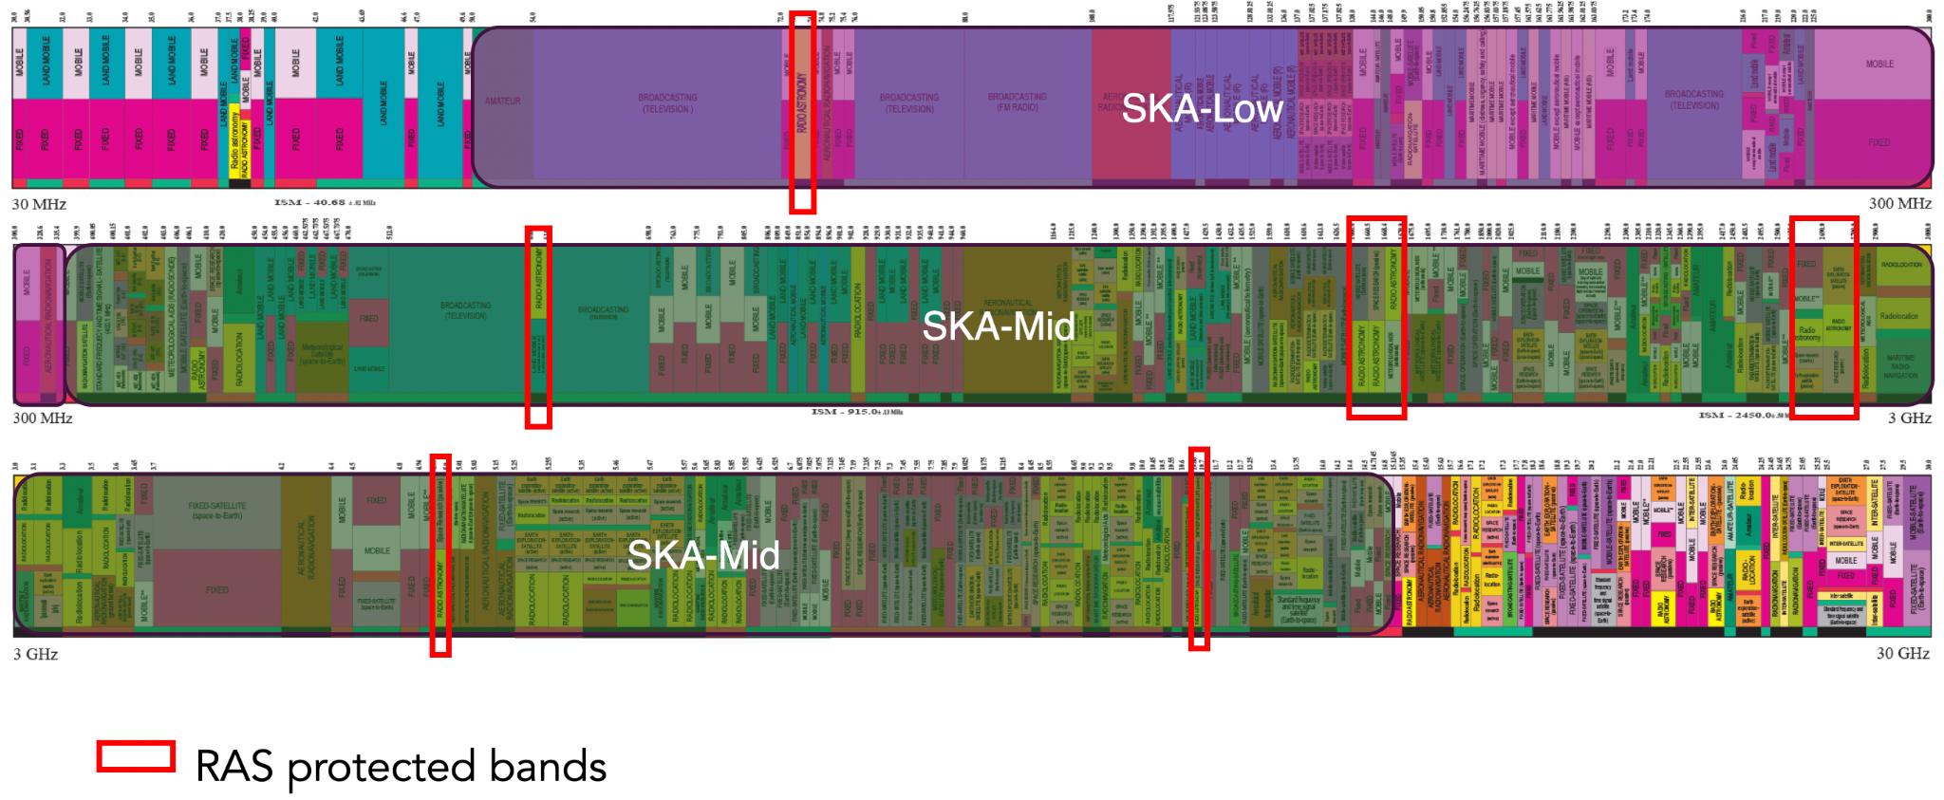
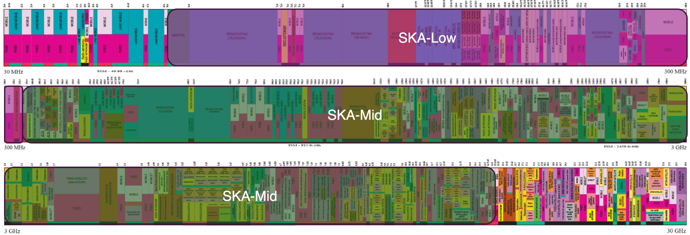
Crowded Radio Spectrum – Opportunistic Astronomers

Slide 3
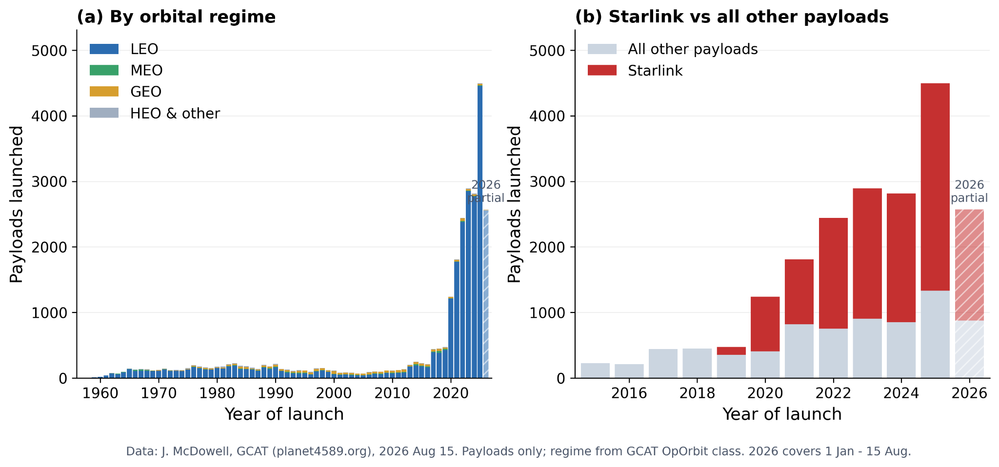
© Alan Dyer/AmazingSky.com
© SKAO

Slide 4
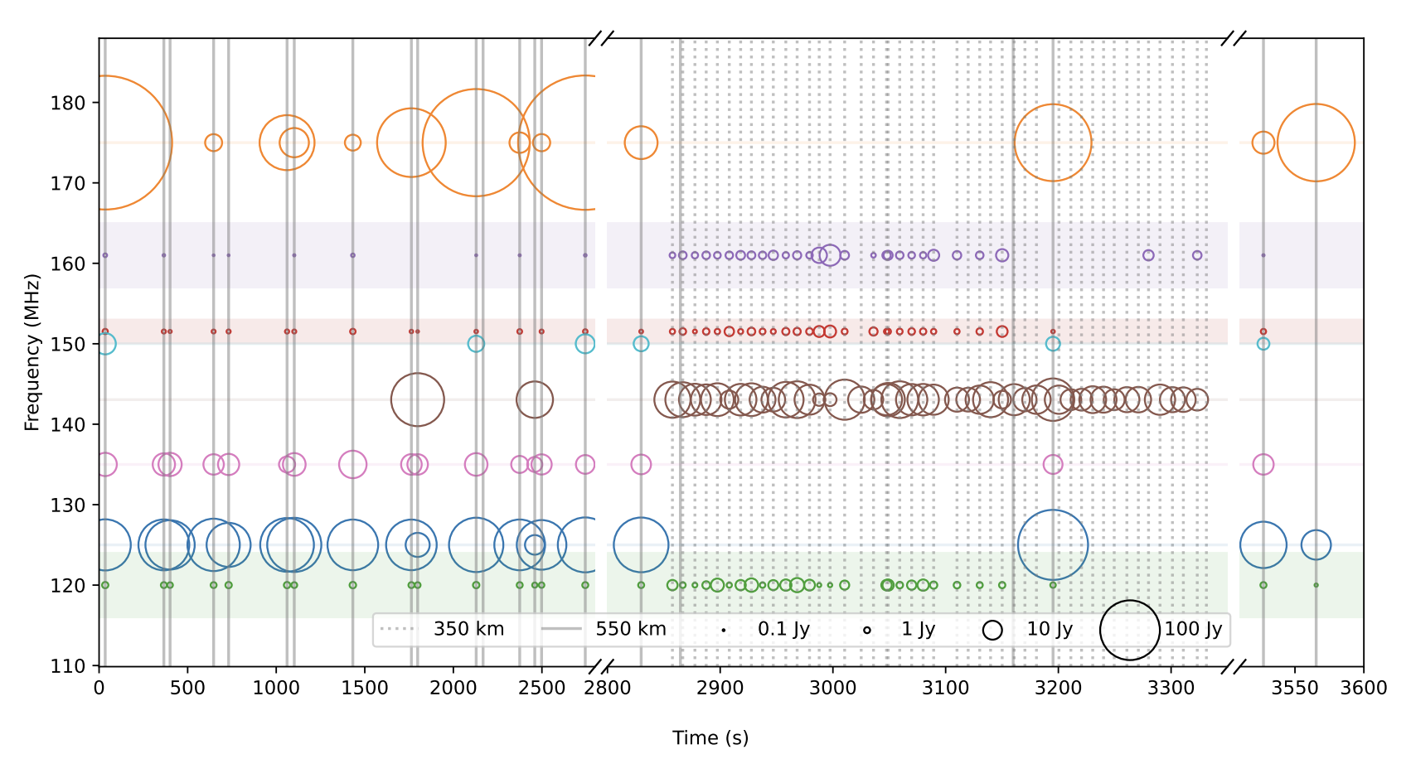
Unintended Electromagnetic Radiation (UEMR)
Starlink detection above LOFAR telescope (Netherlands)
110 - 188 MHz
Narrowband and broadband emission
Some FM reflections
RA protected band
Di Vruno et al. 2023

Slide 5
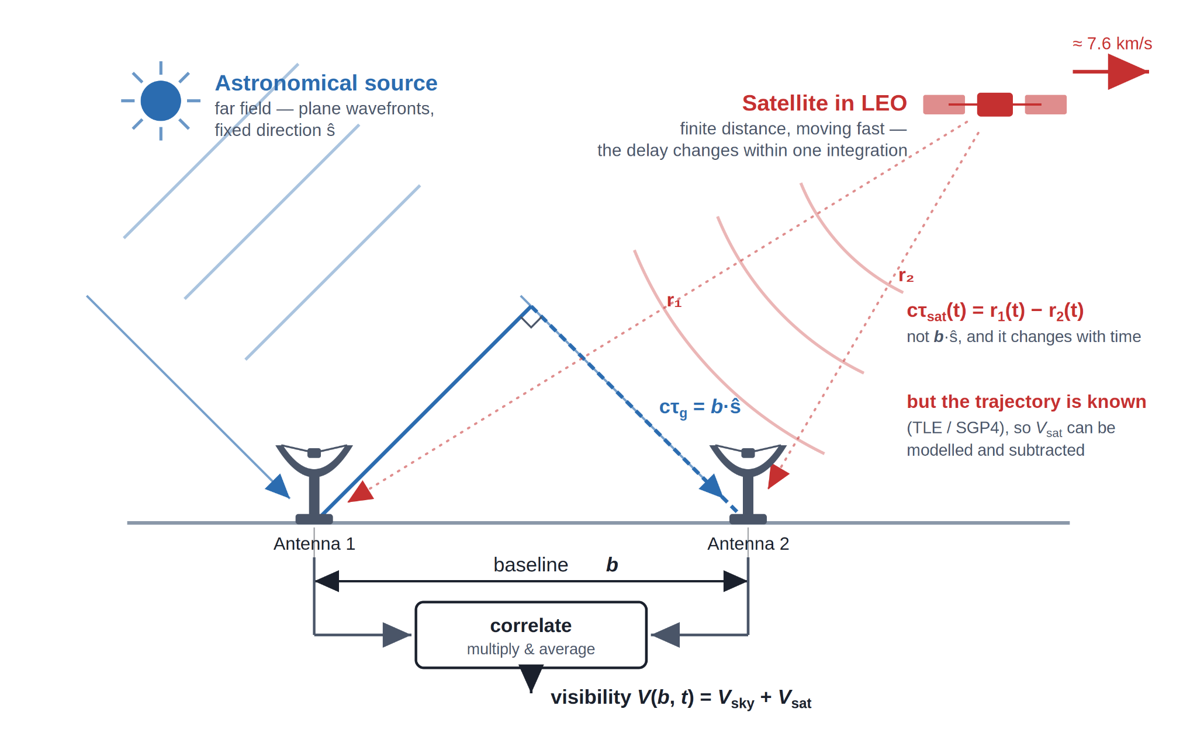
Radio Interferometry Primer

Slide 6
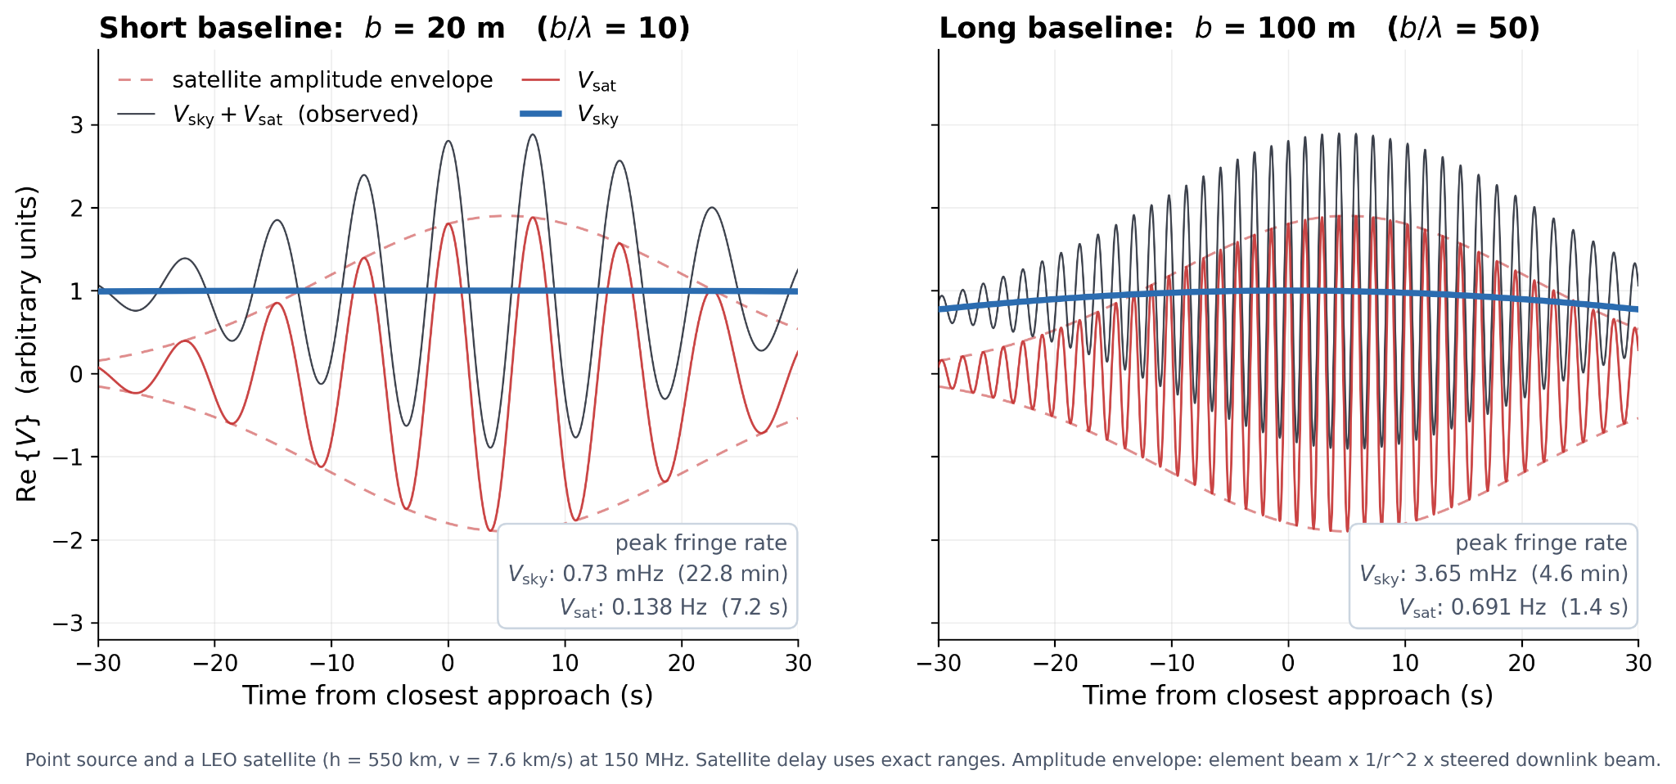
Trajectory-based RFI subtraction and calibration
TABASCAL - arXiv:2301.04188 (MNRAS 2023), arXiv:2502.00106 (A&A 2025)
Bayesian forward model for RFI signal, astronomical signal, and antenna gains
Use RFI trajectories to separate astronomical and RFI signals

Slide 7
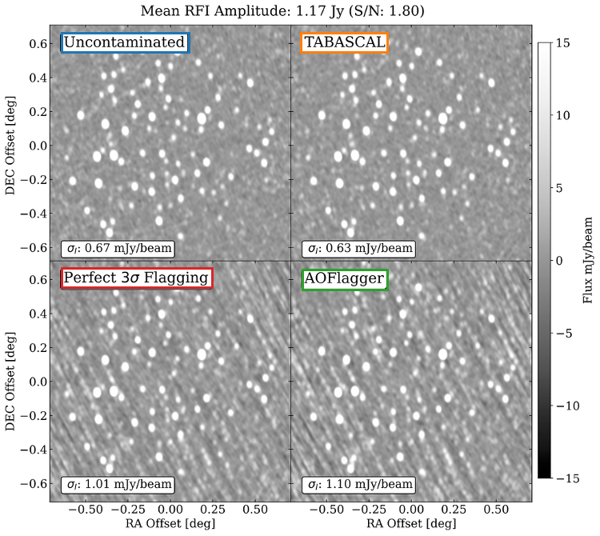
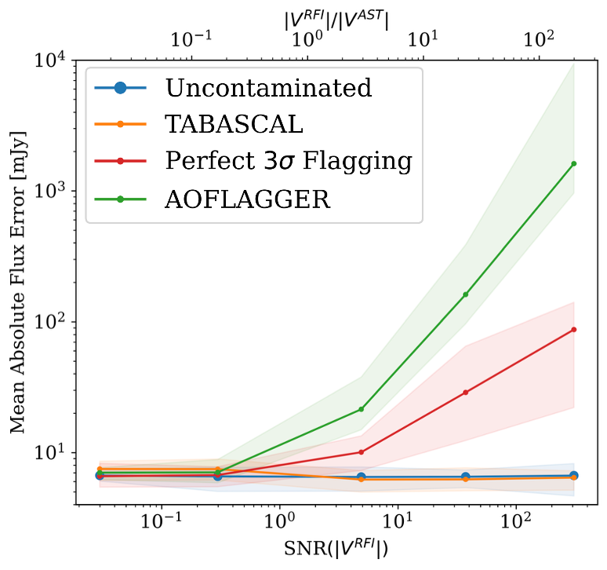
MeerKAT simulated data results
Finlay et al. 2025

Slide 8
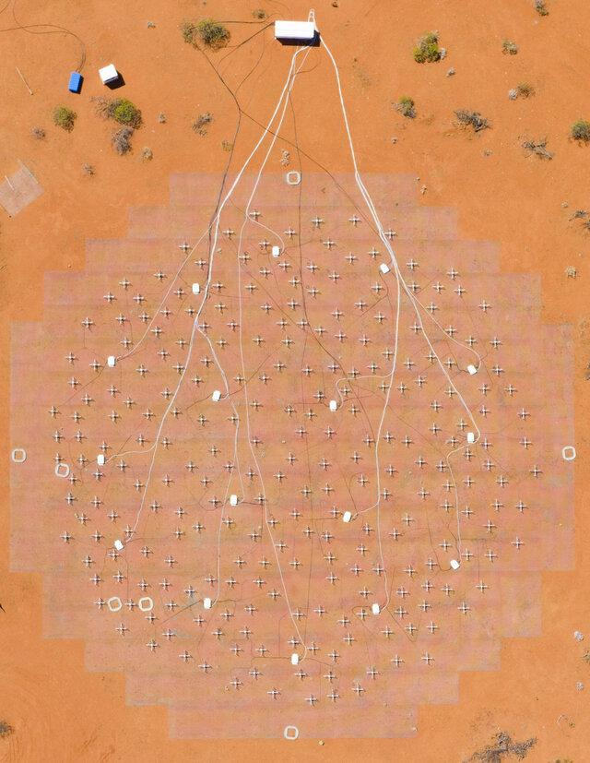
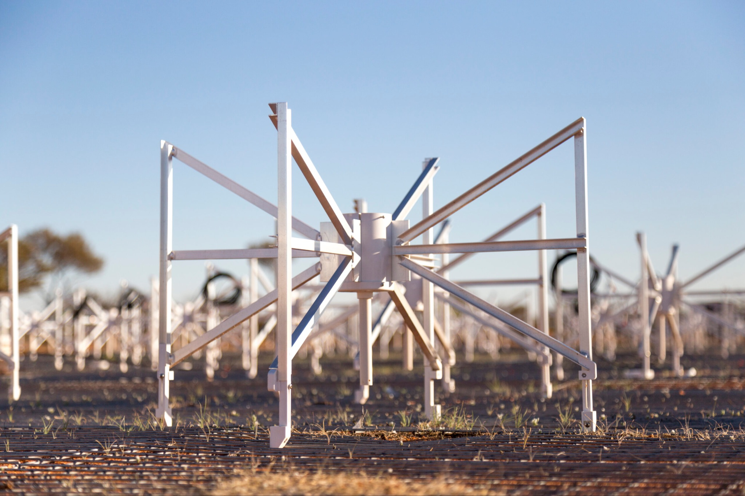
Engineering Development Array 2 - EDA2
SKA-Low Station from MWA dipoles
Used as an interferometer in our data
29 days - 1806 unique starlink sats

Slide 9
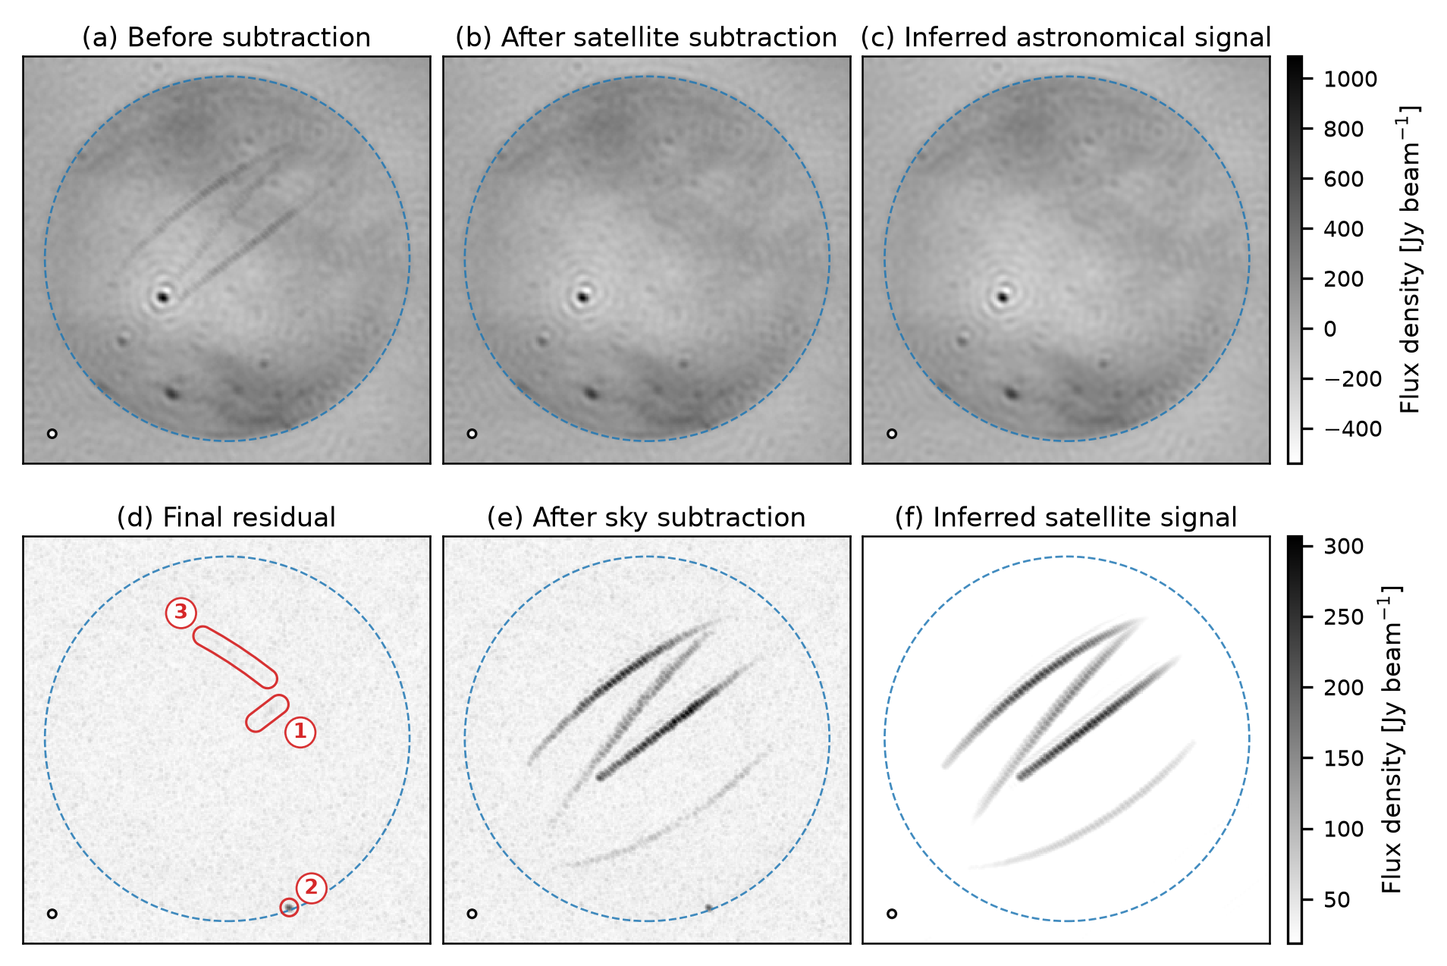
Starlink 150.8 MHz, 3 mins, ~800 kHz, XX polarisation
Residual signal from modelled Starlink satellite
Unmodelled horizon source of unknown origin single 2s spike
Unmodelled Starlink satellite

Slide 10
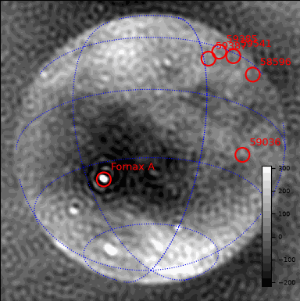

Starlink 150.8 MHz, 3 mins, ~800 kHz, XX polarisation
Raw Data
RFI Subtracted Data

Slide 11
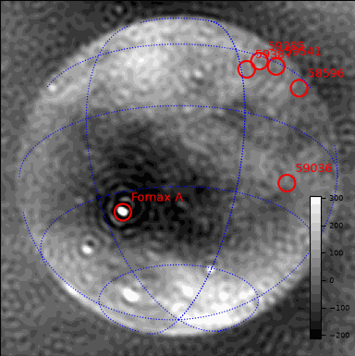
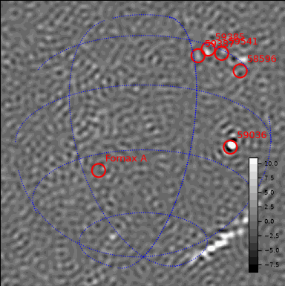
Starlink 150.8 MHz, 3 mins, ~800 kHz, XX polarisation
Astronomical Estimate
RFI Estimate

Slide 12
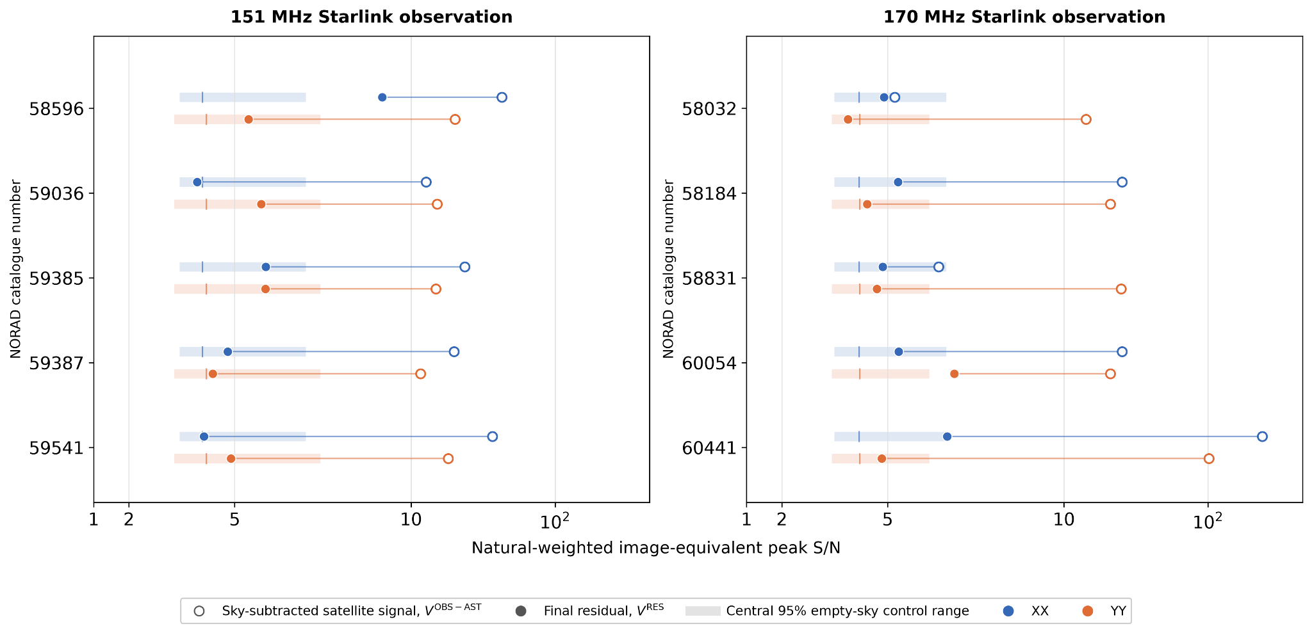
Results on Starlink across 151 MHz & 170 MHz

Slide 13

Conclusions & Upcoming Work
Successful separation of 19/20 modelled Starlink satellites with broadband emission into the image noise
Up to 8500 factor suppression for strong contamination – Ask me :-)
Current failure modes identified
  Need for more specific signal models per satellite
Paper on EDA2 data in preparation
Further GPU kernel refinements
Image-domain predictions (Imaging)
  Fixed sky and point source components
  Learnable point sources
  Learnable dense sky with diffuse and/or sparse structure
TABASCAL
Papers & Code

Slide 14
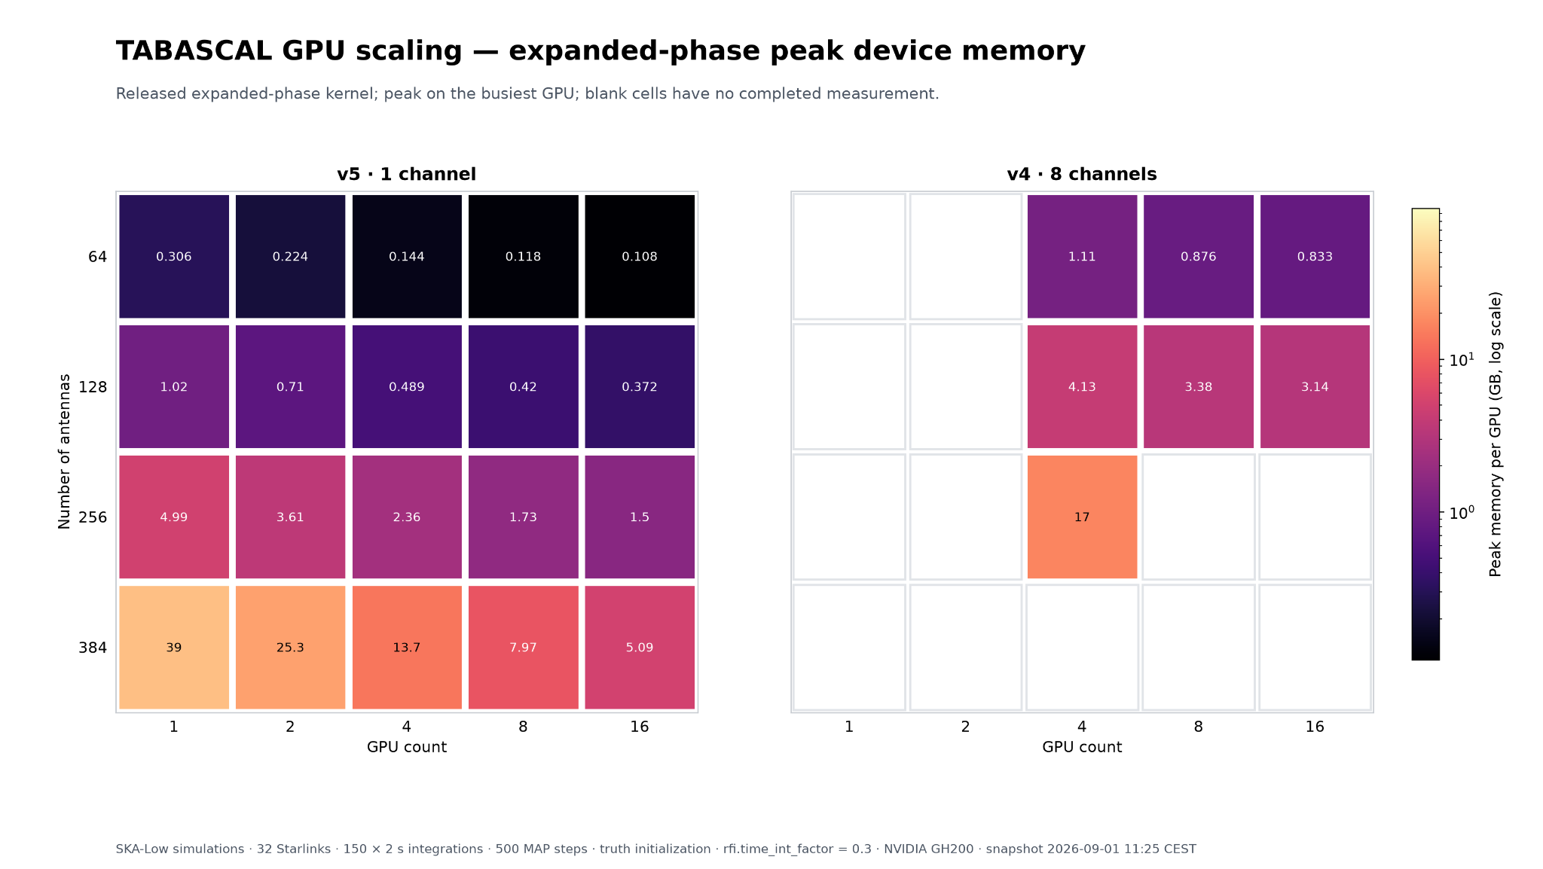
Peak Memory Usage - 32 100 Jy satellites

Slide 15
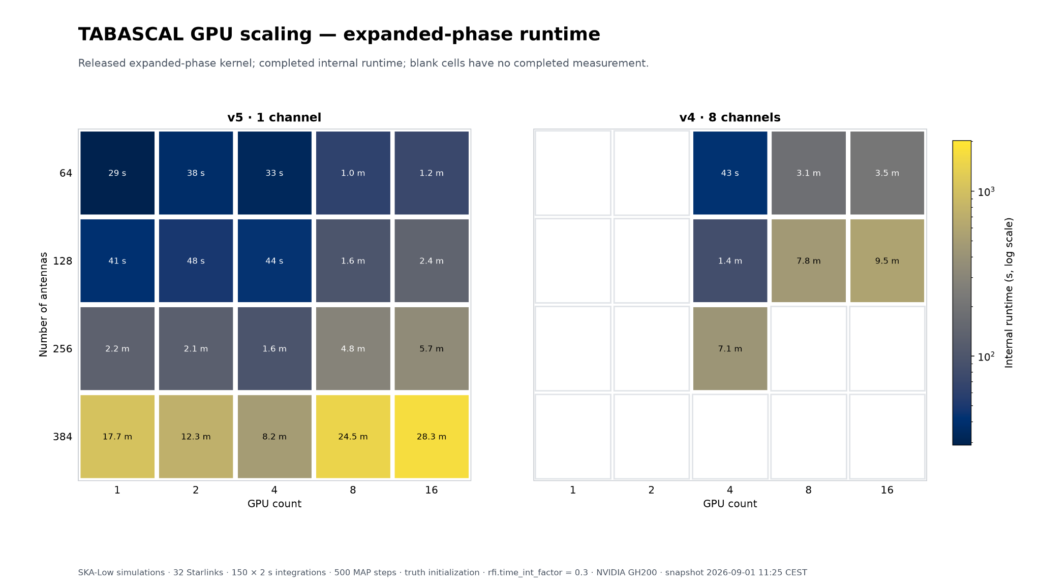
End-to-End Runtime - 32 100 Jy satellites

Slide 16
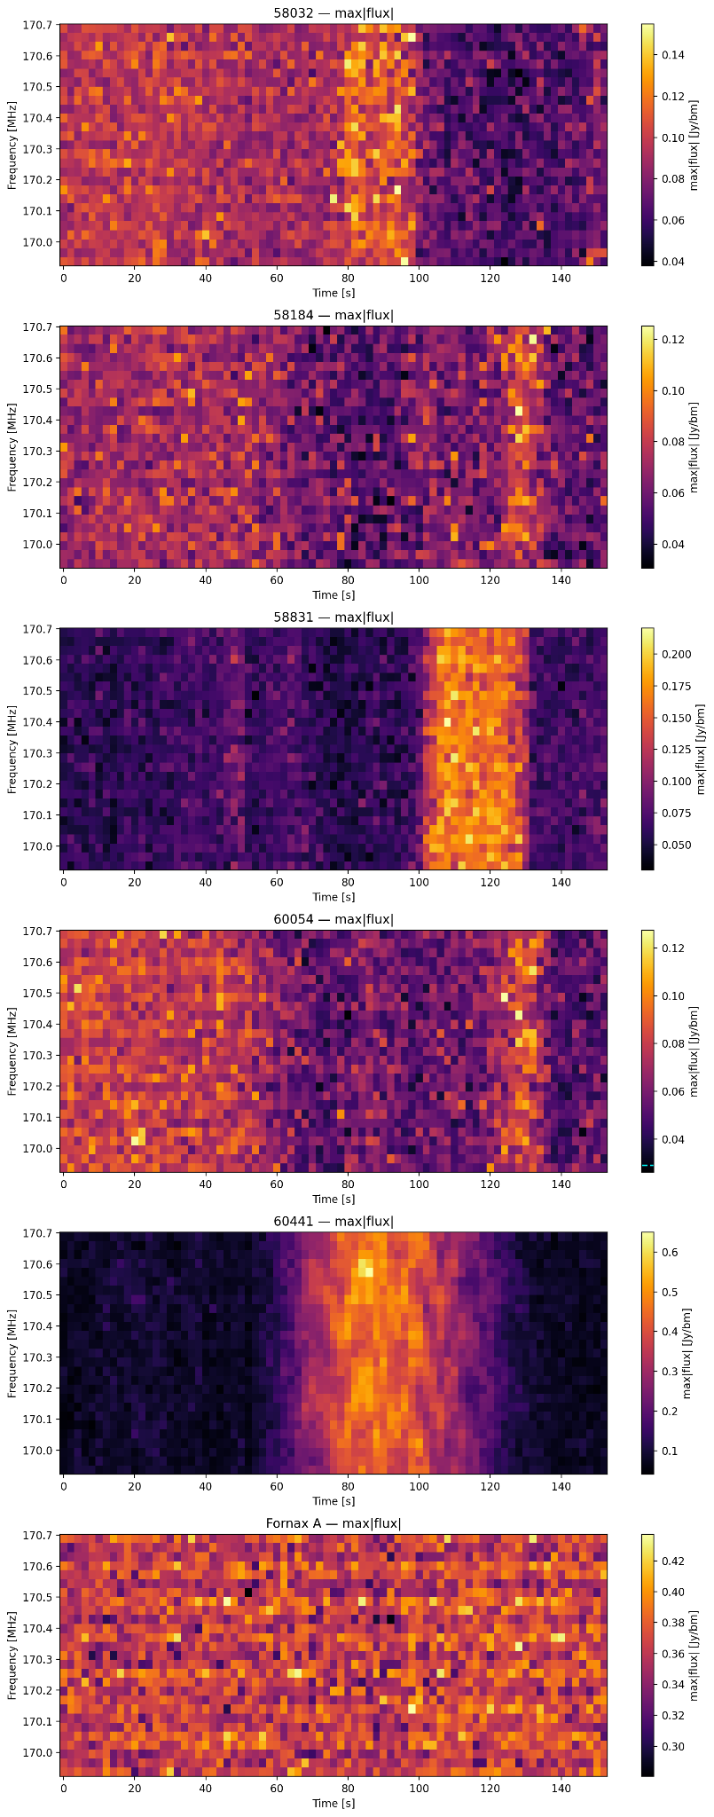
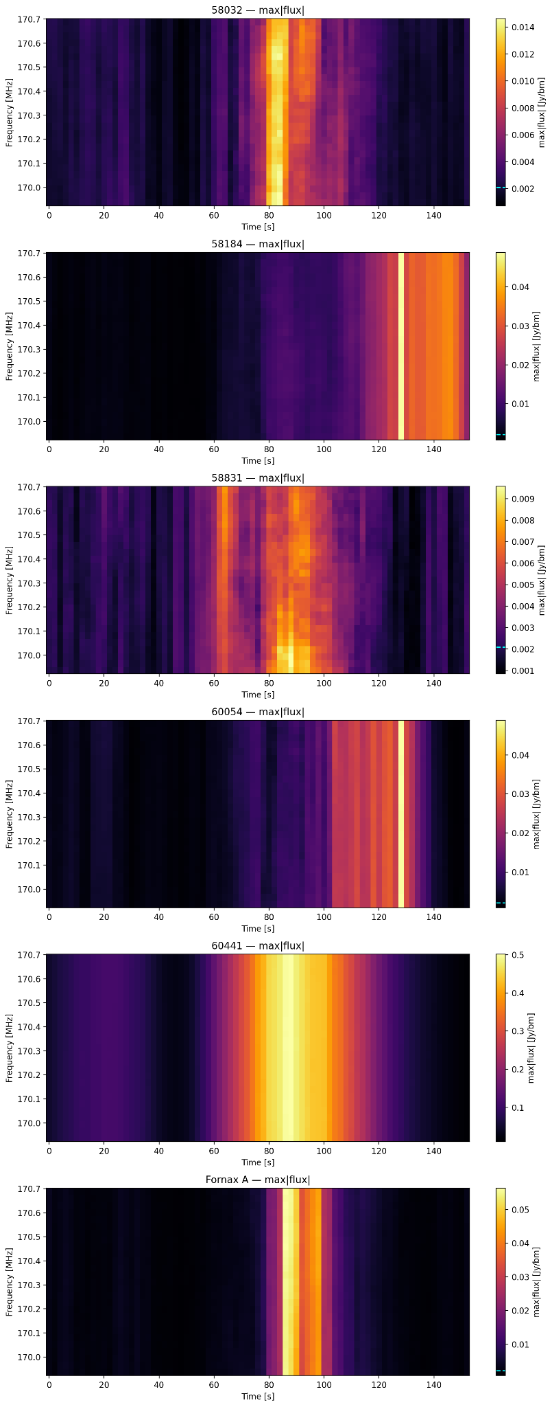
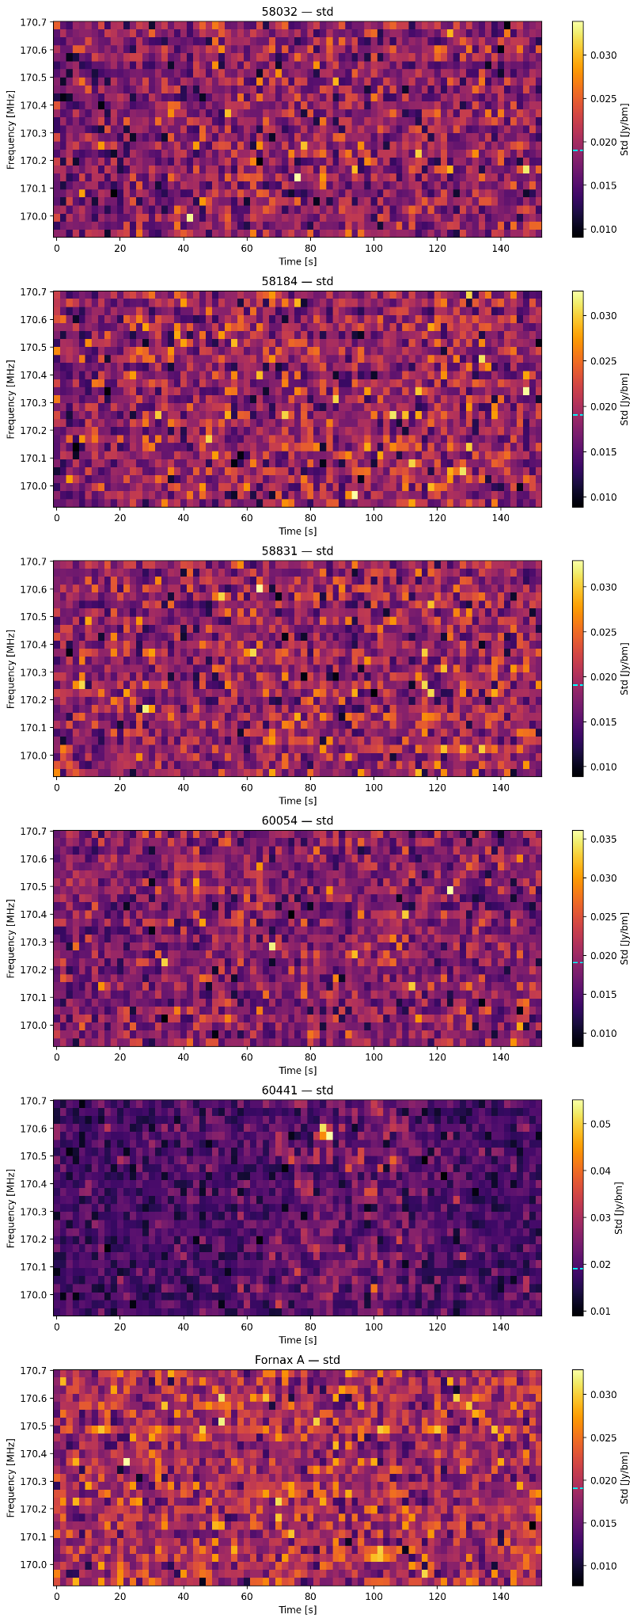
Starlink V2-Mini Observation - 144 s, 170.3 MHz, 26 Channel
Raw Data
RFI Estimate
Residuals

Slide 17
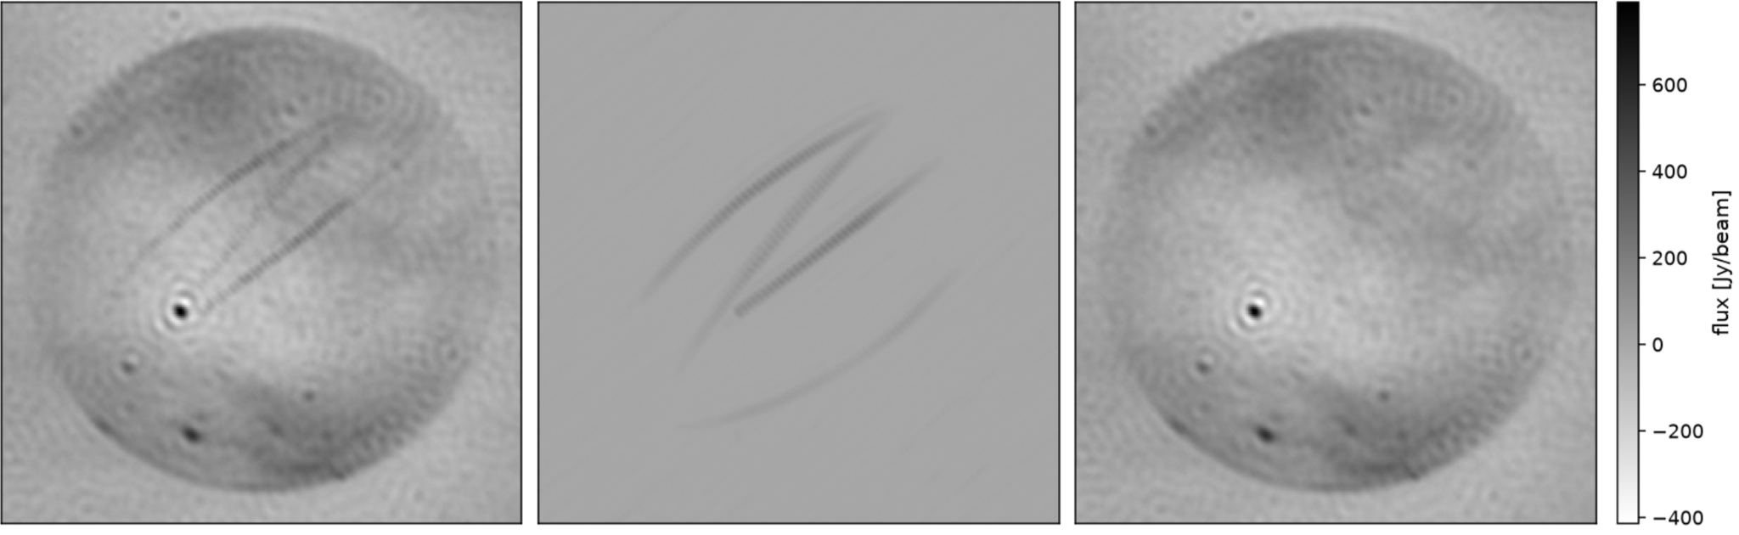
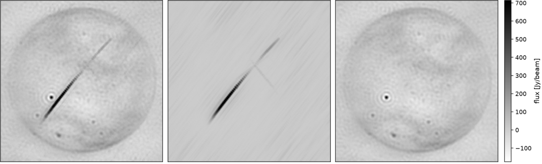
Starlink v2-Mini Observations
5 sats
5 - 73 SNR range
5 sats
< 10 SNR
2 - 114 SNR range

Slide 18
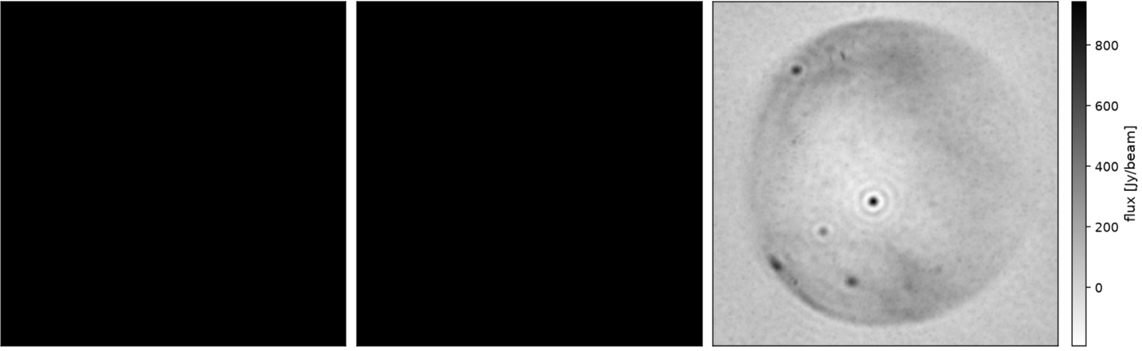
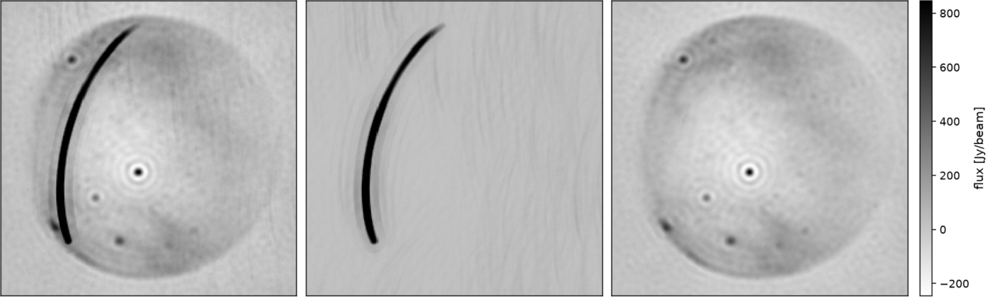
Solrad 7b Observation
1.2e6 Jy Peak
38 - 46 dB suppression
2.5e3 Jy MFS Peak
13 - 24 dB suppression

Slide 19
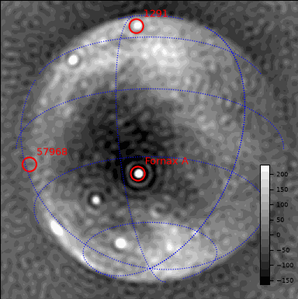
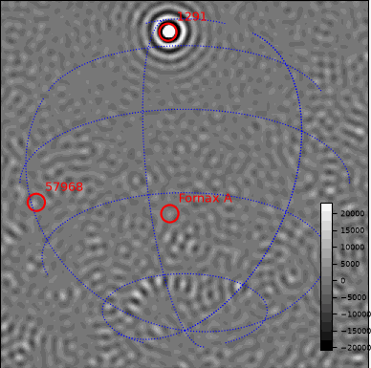
Solrad 7b Observation - Raw Data
Weak Contamination
Strong Contamination

Slide 20

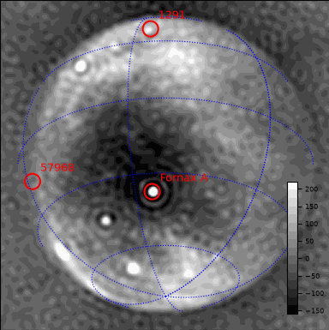
Solrad Observation - Astronomical Estimate
Weak Contamination
Strong Contamination

Slide 21
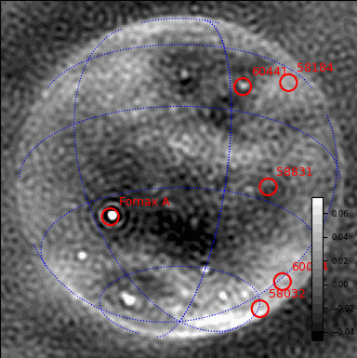

Starlink V2-Mini Observation - 144 s, 170.3 MHz, 26 Channel
Raw Data
RFI Subtracted Data

Slide 22
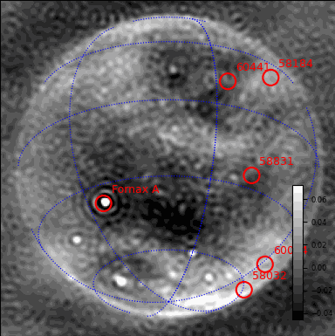
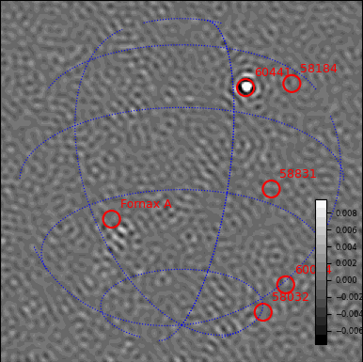
Starlink V2-Mini Observation - 144 s, 170.3 MHz, 26 Channel
Astronomical Estimate
RFI Estimate

