Slide 1
A Hybrid Kubernetes Infrastructure for the Swiss SKA Regional Centre
Elia Oggian – System Engineer, CSCS
Monday, August 31th, 2026

Slide 2
ALPS

Slide 3
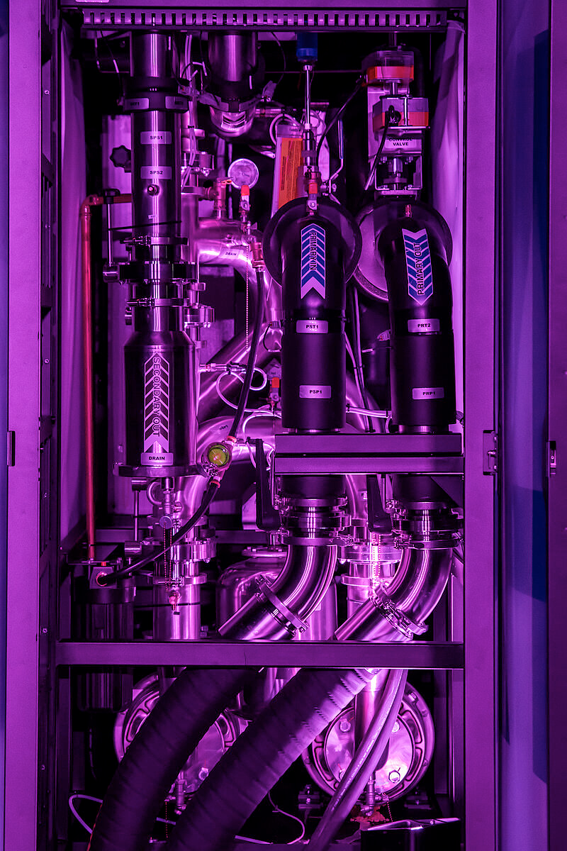
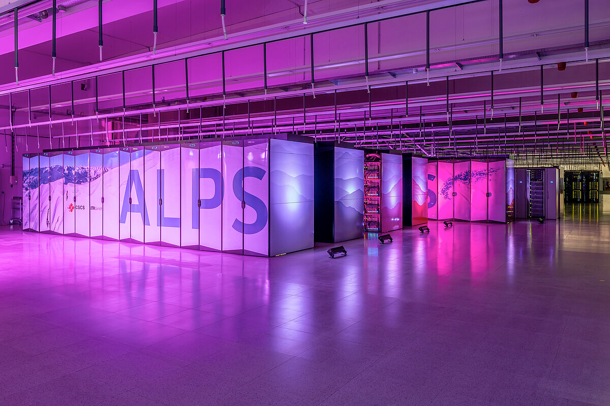
Alps
Notes:
Flagship machine at CSCS, inaugurated in September 2024
Cooling unit on the right picture

Slide 4
Alps - Technology
Science as a Service concept with innovative resource access
Versatile software-defined Cluster (vCluster) technology
  Convergence Cloud and HPC
  Multi Tenant infrastructure
Heterogeneous infrastructure (Nvidia GPU, AMD GPU, x86, ARM,…)
Managed by a micro service architecture control plane (CSM/OpenCHAMI)
Slingshot network: high performance and zone segregation
Distributed Alps (multiple geo-distributed infrastructures)
  Lausanne (AlpsE)
  Bologna (AlpsB)

Slide 5
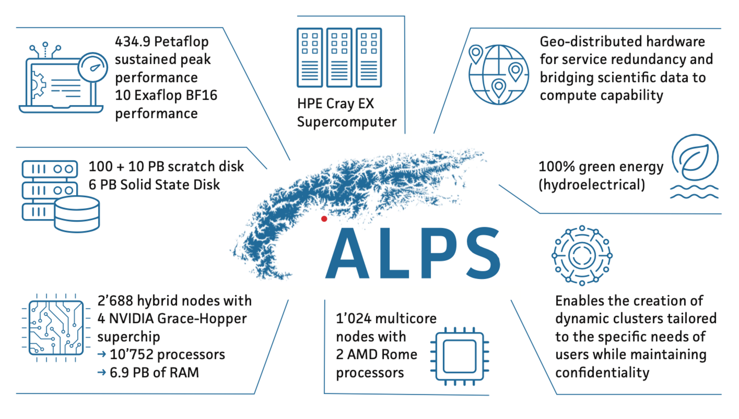

Slide 6
Storage

Slide 7
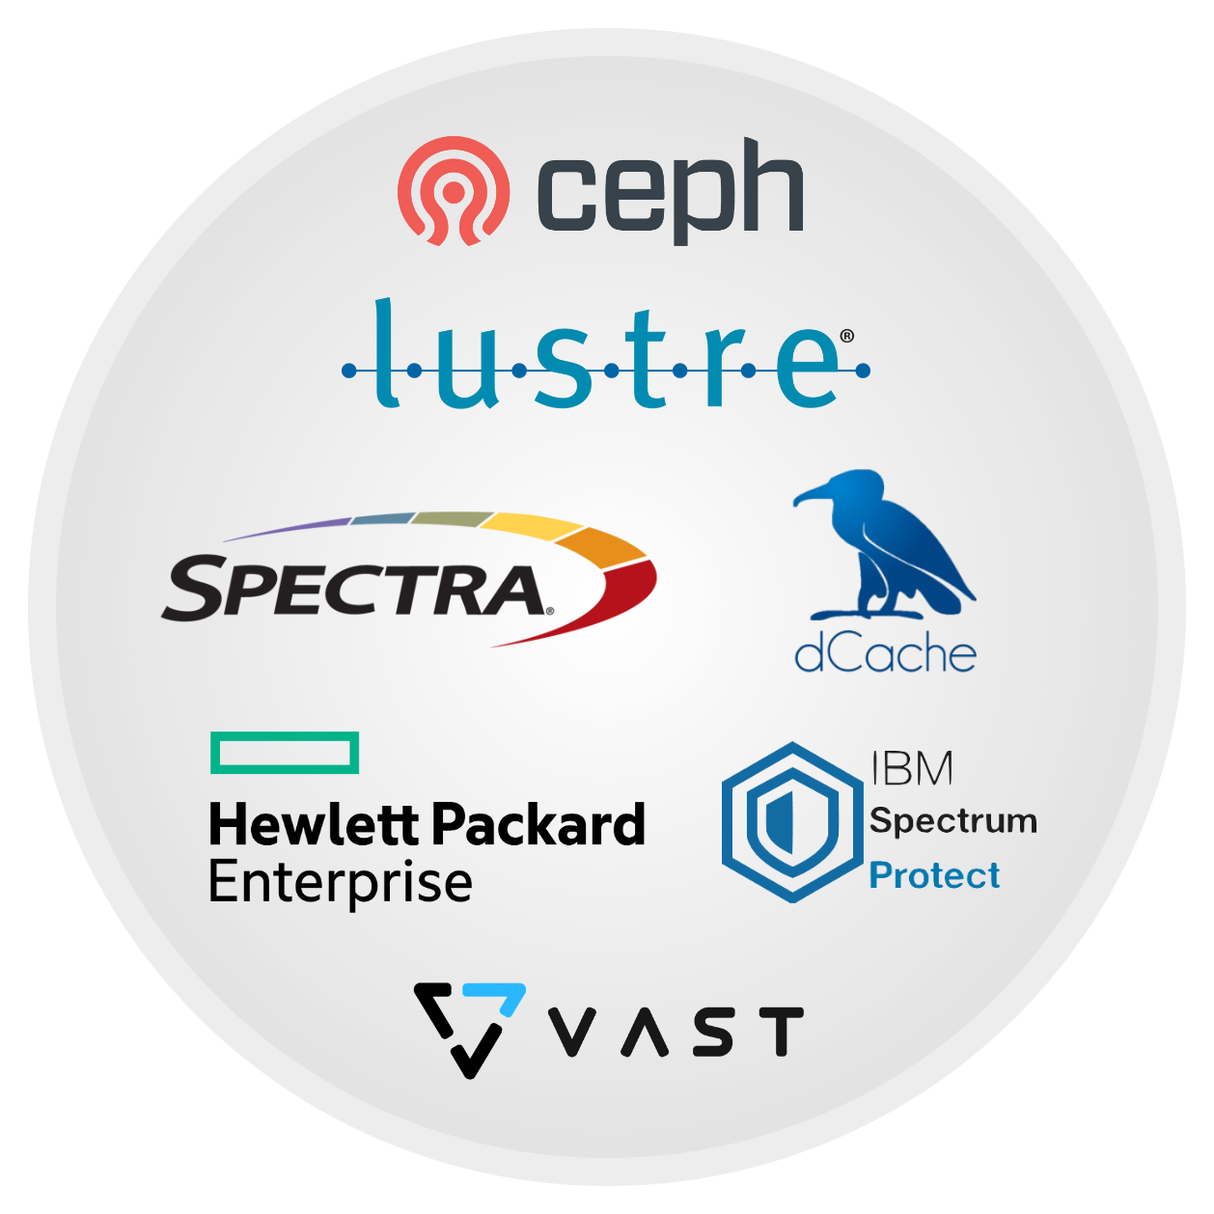
Storage - Technologies
IBM SSS (2026)
  160 PiB
VAST (2026)
  10 PiB
Lustre
  CAPSTOR: 129 PiB raw, 1TB/s write, 1TB/s read
  IOPSTOR: 7 PiB raw , 24M IOPS write, 8M IOPS read
Ceph
  40 PiB
  RBD + CephFS + RGW
dCache
  20 PiB (WLCG + CTAO + SKAO)
Tape
  Spectra Tfinity + IBM TS4500
  Spectra Blackpearl (S3)
Backup
  IBM Spectrum Protect
  HPE DMF, ZWS
Notes:
IBM SSS -> Storage Scale System (Spectrum Scale, GPFS)
dCache is using Ceph as backend storage

Slide 8
Introducing Cloud Native Key Components

Slide 9

Introduction to SUSE Virtualization (Harvester)
SUSE Virtualization is an open-source hyperconverged infrastructure solution for managing virtual machines in a cloud-native way.
Kubernetes serves as the orchestration engine.
Based on KVM and KubeVirt, it enables virtualization and orchestration of virtual machines.
Storage management is handled through Longhorn, providing persistent storage for the VMs.
Networking, based on Multus, enables network isolation across multiple VLANs.
Notes:
Harvester: Cloud-Native Virtualization
Harvester is itself a Kubernetes cluster, leveraging KVM and KubeVirt to orchestrate virtual machines in a cloud-native way.
VM storage is provided by Longhorn, a distributed, cloud-native block storage system.
Networking is handled via Multus, enabling multiple network interfaces per pod or VM.

Slide 10

Introduction to SUSE Rancher
Rancher is an open-source Kubernetes cluster manager.
Centrally manage multiple Kubernetes clusters
Simplified provisioning and scaling of clusters, node management, and upgrades.
Strong security features, including role-based access control (RBAC), network policies and integration with identity providers to enhance security and compliance.
Rancher has its own Kubernetes distribution called RKE2
Notes:
Rancher: Kubernetes Management Made Easy
Rancher simplifies the management of multiple Kubernetes clusters
Supports provisioning, scaling, and lifecycle management
Includes strong security features, such as role-based access control (RBAC)

Slide 11

Introduction to ArgoCD
Argo CD is an open-source continuous delivery tool specifically designed for Kubernetes that follows the GitOps methodology.
Application deployments are declared using Kubernetes manifests or Helm charts stored in Git repositories.
  Argo CD then ensures that the actual cluster state matches the desired configuration
Graphical UI for visualizing and managing application deployments status. Additionally, it offers a command-line interface (CLI) for scripting and automation.
Notes:
Declarative, Git-based deployment tool for Kubernetes
Continuously syncs desired state from Git to clusters
Visual UI, CLI, and API for real-time app management
Supports multi-cluster deployments and RBAC

Slide 12
Hyperconverged Cloud Infrastructure at CSCS

Slide 13
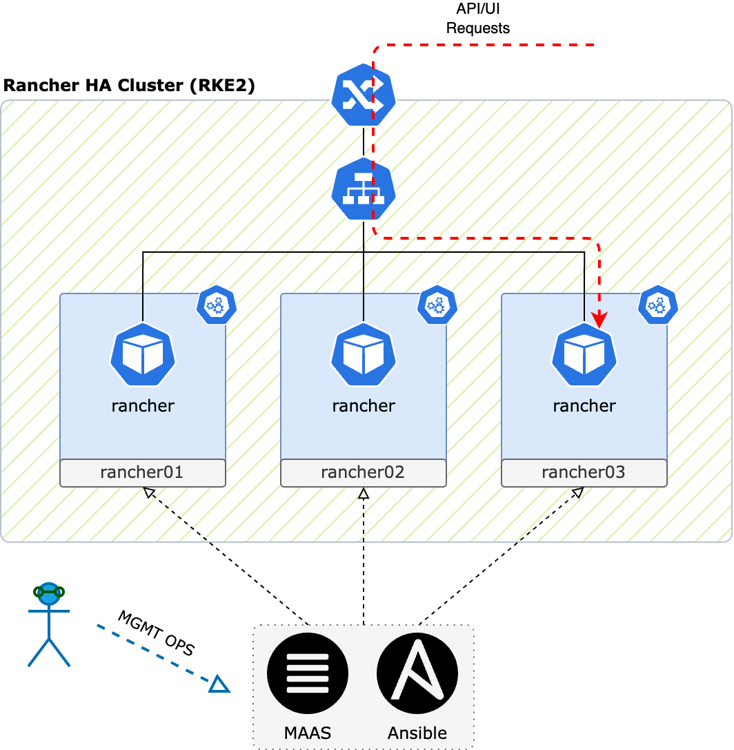
Rancher cluster architecture
RKE2 Cluster
3 nodes both master and worker
Each node is expected to have a Rancher pod
kube-vip enables external access to the UI/API
Node management:
Node lifecycle through MAAS
RKE2 installed and managed with Ansible
Rancher deployment managed with Helm
Notes:
This is the only “manual” process (first step)

Slide 14
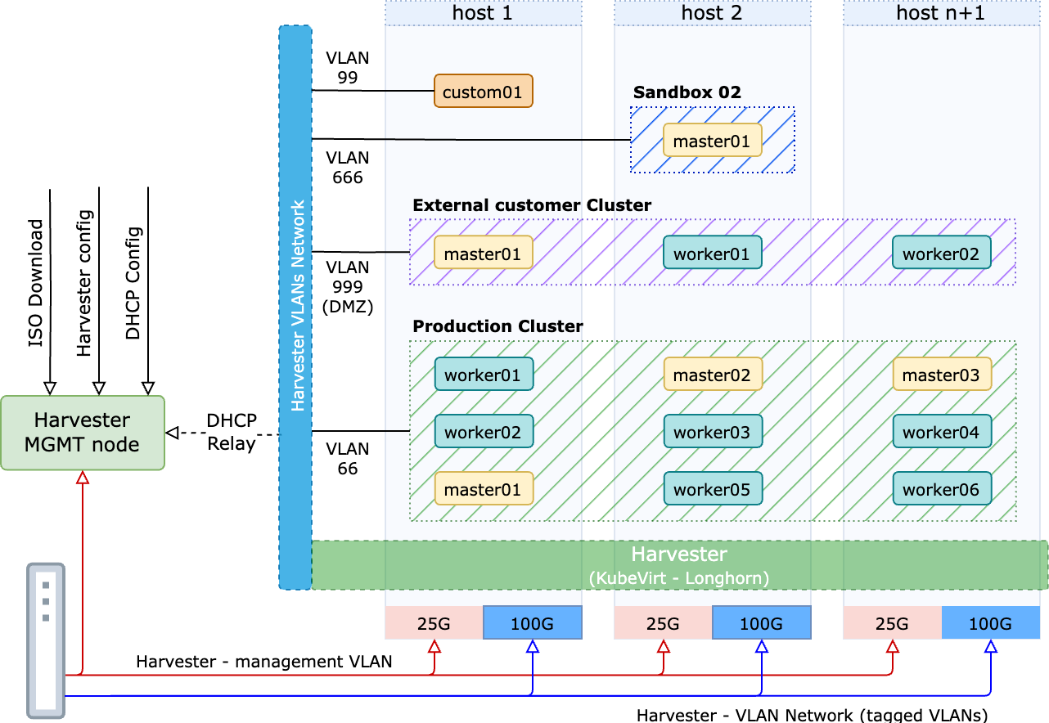
Harvester architecture
16 Hosts
Networks
  Management (25G)
  VLANs (100G)
Local 8 TB NVMe SSD
512G/768G RAM
AMD EPYC 64 Cores
Management node:
  DHCP Relay for VMs
  iPXE Boot
  ISO Repository
  Hosts config

Slide 15

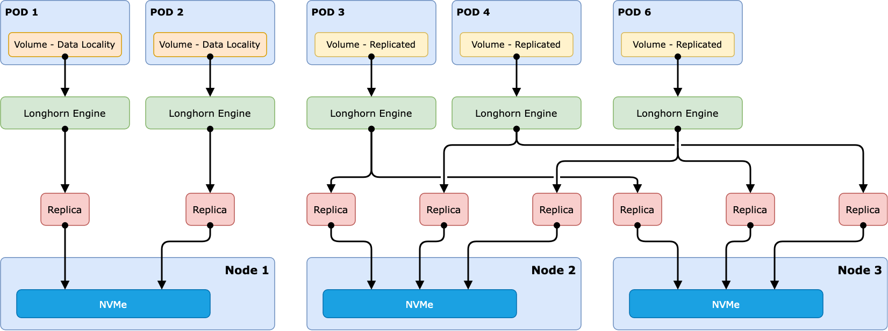
Longhorn – detailed view
Notes:
Longhorn as a distributed block storage for Kubernetes
Very simple installation and configuration
100% opensource
View of replicated Volumes
A new volume created
A number of replicas are spawned on multiple nodes
Fault tolerant
View of Data Locality engine
Set data locality to Strict Local
Theoretically should benefit from the local storage

Slide 16
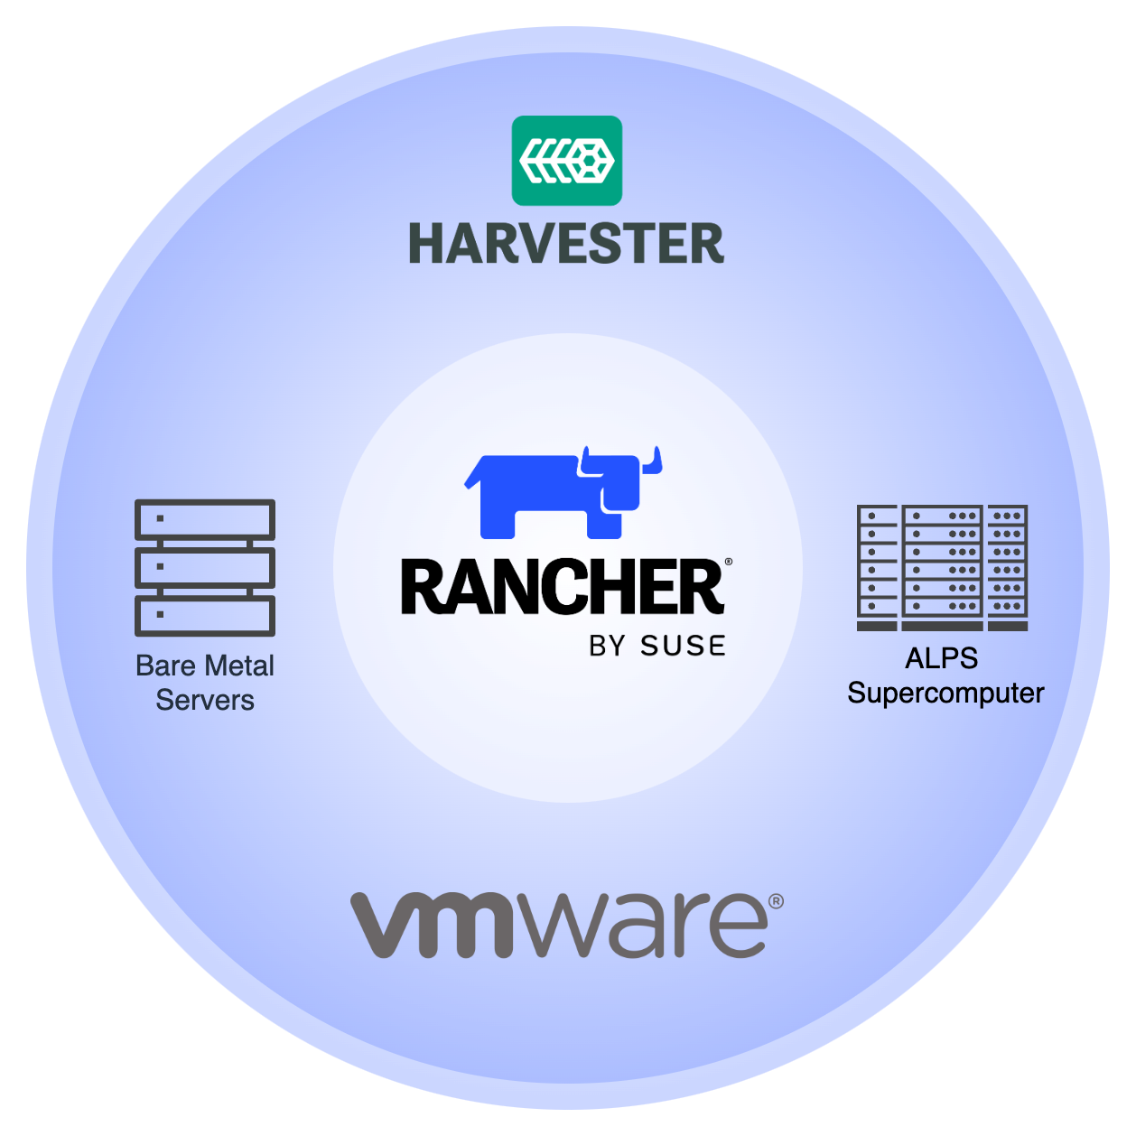
Where CSCS runs Kubernetes
Upstream Rancher Cluster
Downstream RKE2 Clusters
  SUSE Virtualization
  VMWare
  Bare Metal
  Alps (HPC)
Notes:
Direct deployment on Harvester and VMware:
Kubernetes nodes are provisioned automatically when cluster creation is triggered.
Deployment on Bare Metal and HPC:
Nodes must be pre-provisioned and running before cluster creation.

Slide 17
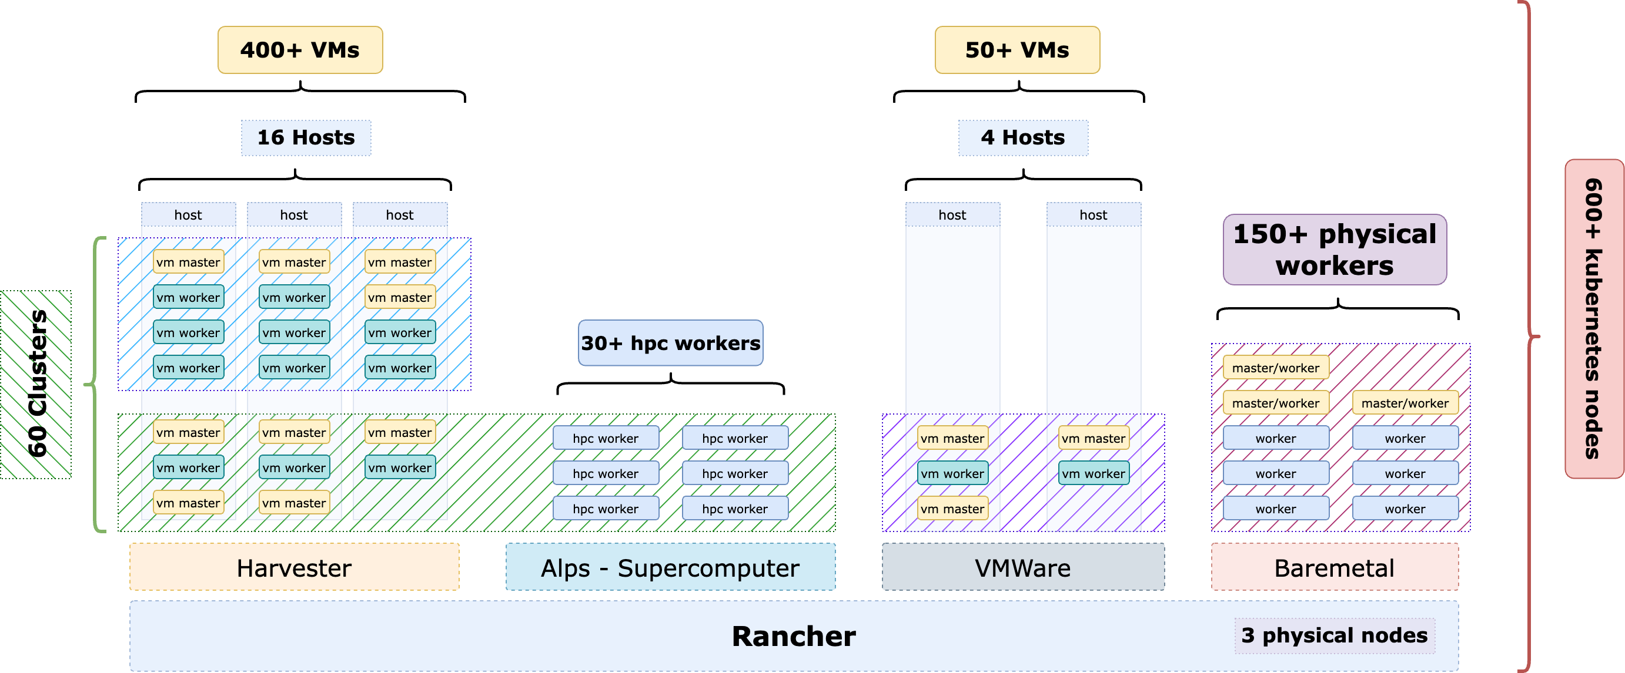
Tenants overview – Kubernetes clusters distribution
Notes:
Different infrastructures (SUSE Virtualization, VMWare, Bare Metal, ALPS) are all managed in the same way using Rancher
The interesting part is on the bottom left, this is an hybrid Kubernetes solution that we call Alpernetes, which spans nodes across two different infrastructures. Will cover it in more detail later.

Slide 18
Infrastructure as a code and GitOps

Slide 19
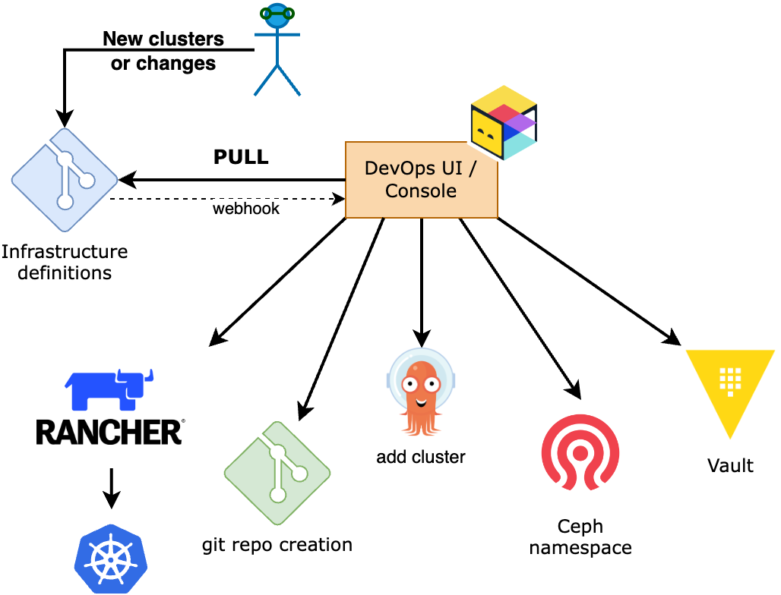
IaC cluster provisioning
Declarative approach
Define cluster
  Node specs
  Network isolation
OpenTofu + Terragrunt
  Community providers
  CSCS cluster modules
  Bootstrap RKE2 (Ansible on HPC nodes)
Notes:
we are using a declarative approach
The cluster definition is defined in a git repo
Then Terragrunt will run and....
Create the rancher cluster definition..
git repo for the cluster
add the cluster to ArgoCD
create a ceph namespace
Vault
...
and in 5 to 6 minutes we have a fully usable k8s cluster

Slide 20
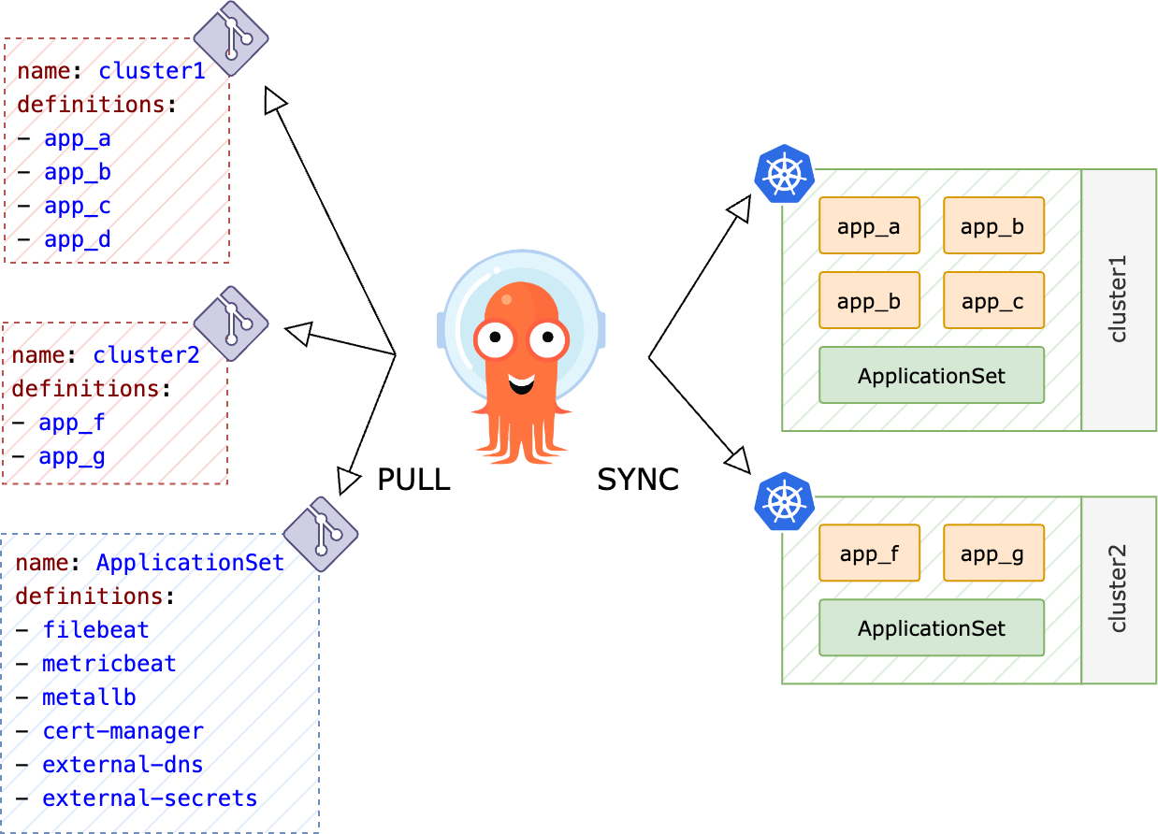
GitOps with ArgoCD
Controller (git repo)
  Clusters
  Repositories
  Projects
  Applications
ApplicationSets
  CSI (Ceph + Vast)
  Ingress Controller
  Certificate Management
  Observability
App of Apps
  Declarative and hierarchic deployments
  1650 Applications across 69 clusters
Notes:
Hierarchic pronunciation: high-uh-RAR-kick

Slide 21
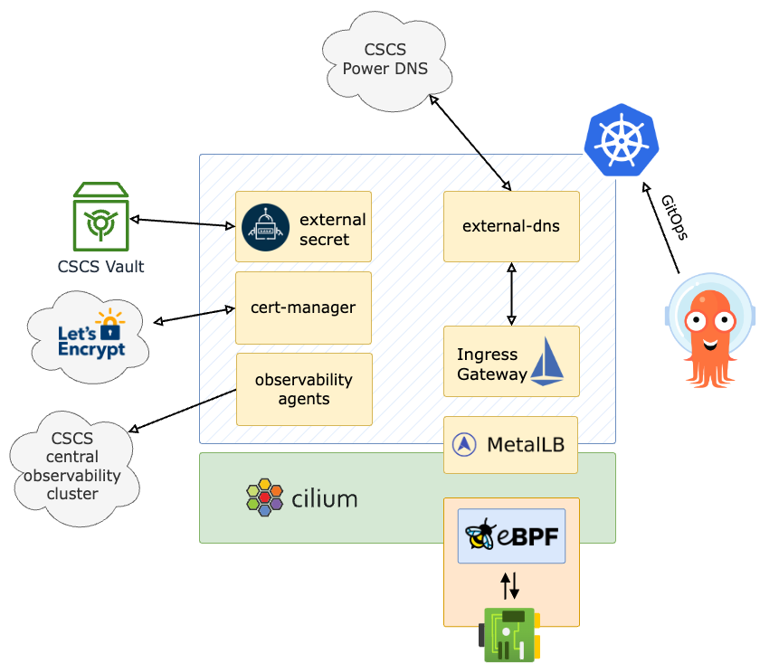
Kubernetes clusters common features
CNI: Cilium
  Service mesh (eBPF)
  Hubble (observability UI)
CSI:
  cephfs
  ceph rbd
  rancher-local provisioner for ALPS Nodes
Ingress controller
  Istio (no sidecars)
    Started migration to new API Gateway
  Nginx
MetalLB
  Gratuitous ARP
Automated DNS and Certs
External Secret
  For all Vault secrets
Observability agents
  Filebeat and Metricbeat
  Prometheus remote write to VictoriaMetrics
Kured
  Auto automatically manage nodes reboot
Notes:
Cilium is based on eBPF and also come with an observability UI (Hubble UI)
Istio/Traefik ingress gateway and in the future Gateway API (still limited)
IP assignment, DNS entries and Let’s Encrypt certificates are fully automated
ArgoCD for GitOps automation. All changes are pushed to a git repo and ArgoCD will apply them
External Secrets Operator to interface HashiCorp Vault

Slide 22
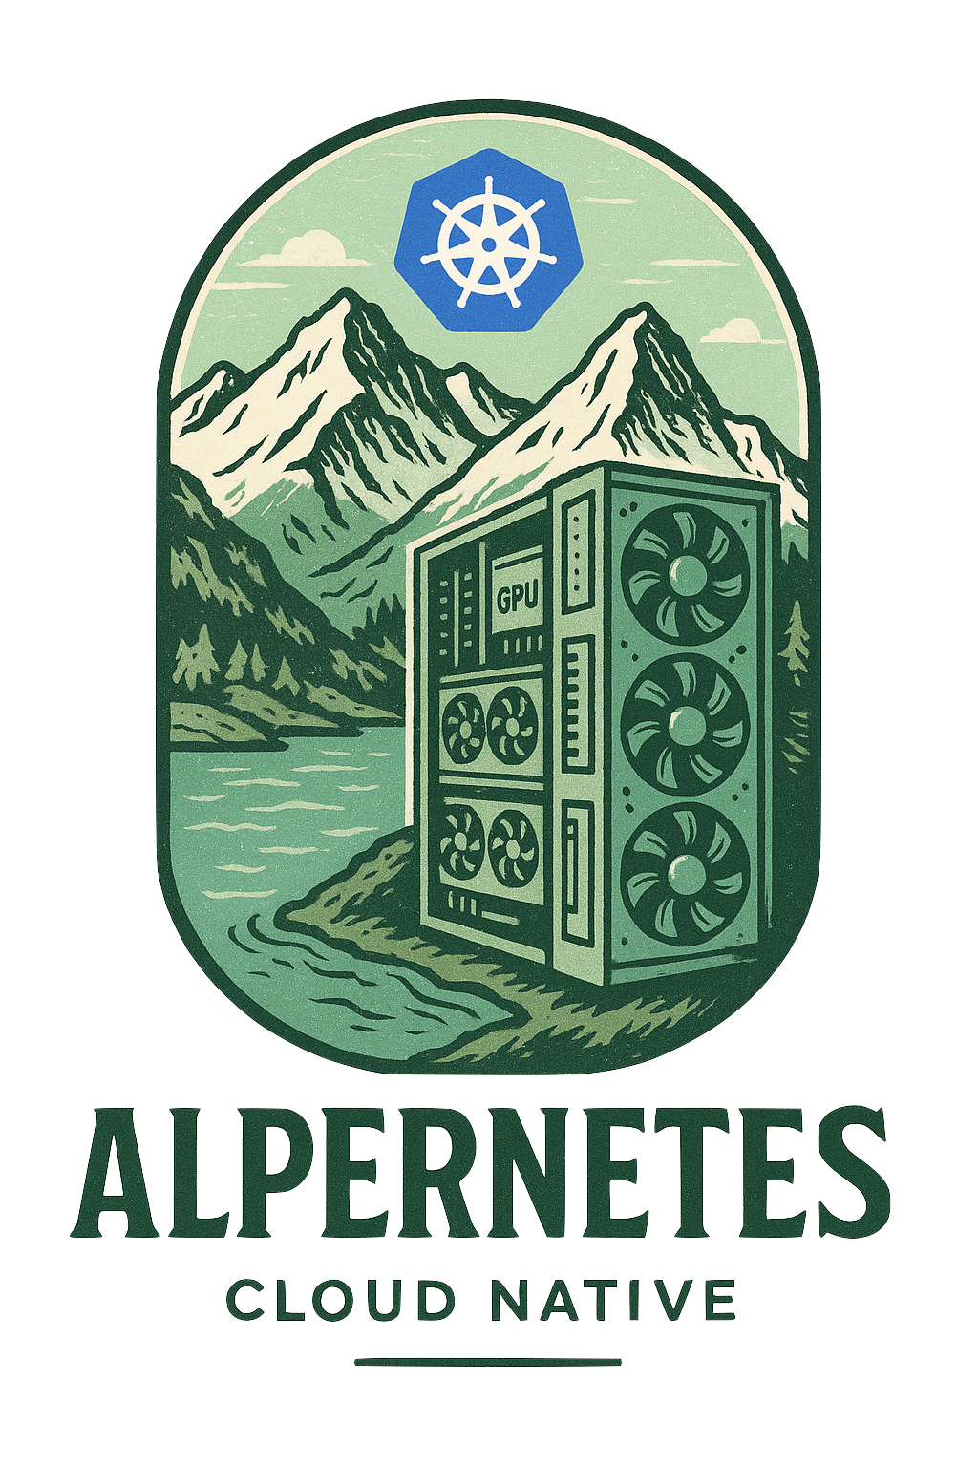
Alpernetes
A special blend of Alps + Kubernetes

Slide 23
Alpernetes – version 2.0
To provision a hybrid Kubernetes infrastructure (Alpernetes), we combine Harvester VMs and ALPS HPC nodes. The result is a Kubernetes cluster with:
Master nodes and worker nodes running on Harvester
Additional HPC worker nodes for compute-intensive workloads from ALPS
This setup allows for the deployment of mixed services. For example:
JupyterHub: The hub, which doesn't require high performance, runs on VM-based worker nodes, while the actual user notebooks, which may demand significant computing power, run on HPC nodes.
Inference services: The Chat UI runs on VM-based workers, while the LLM service is deployed on HPC GPU nodes to handle large language models efficiently.

Slide 24
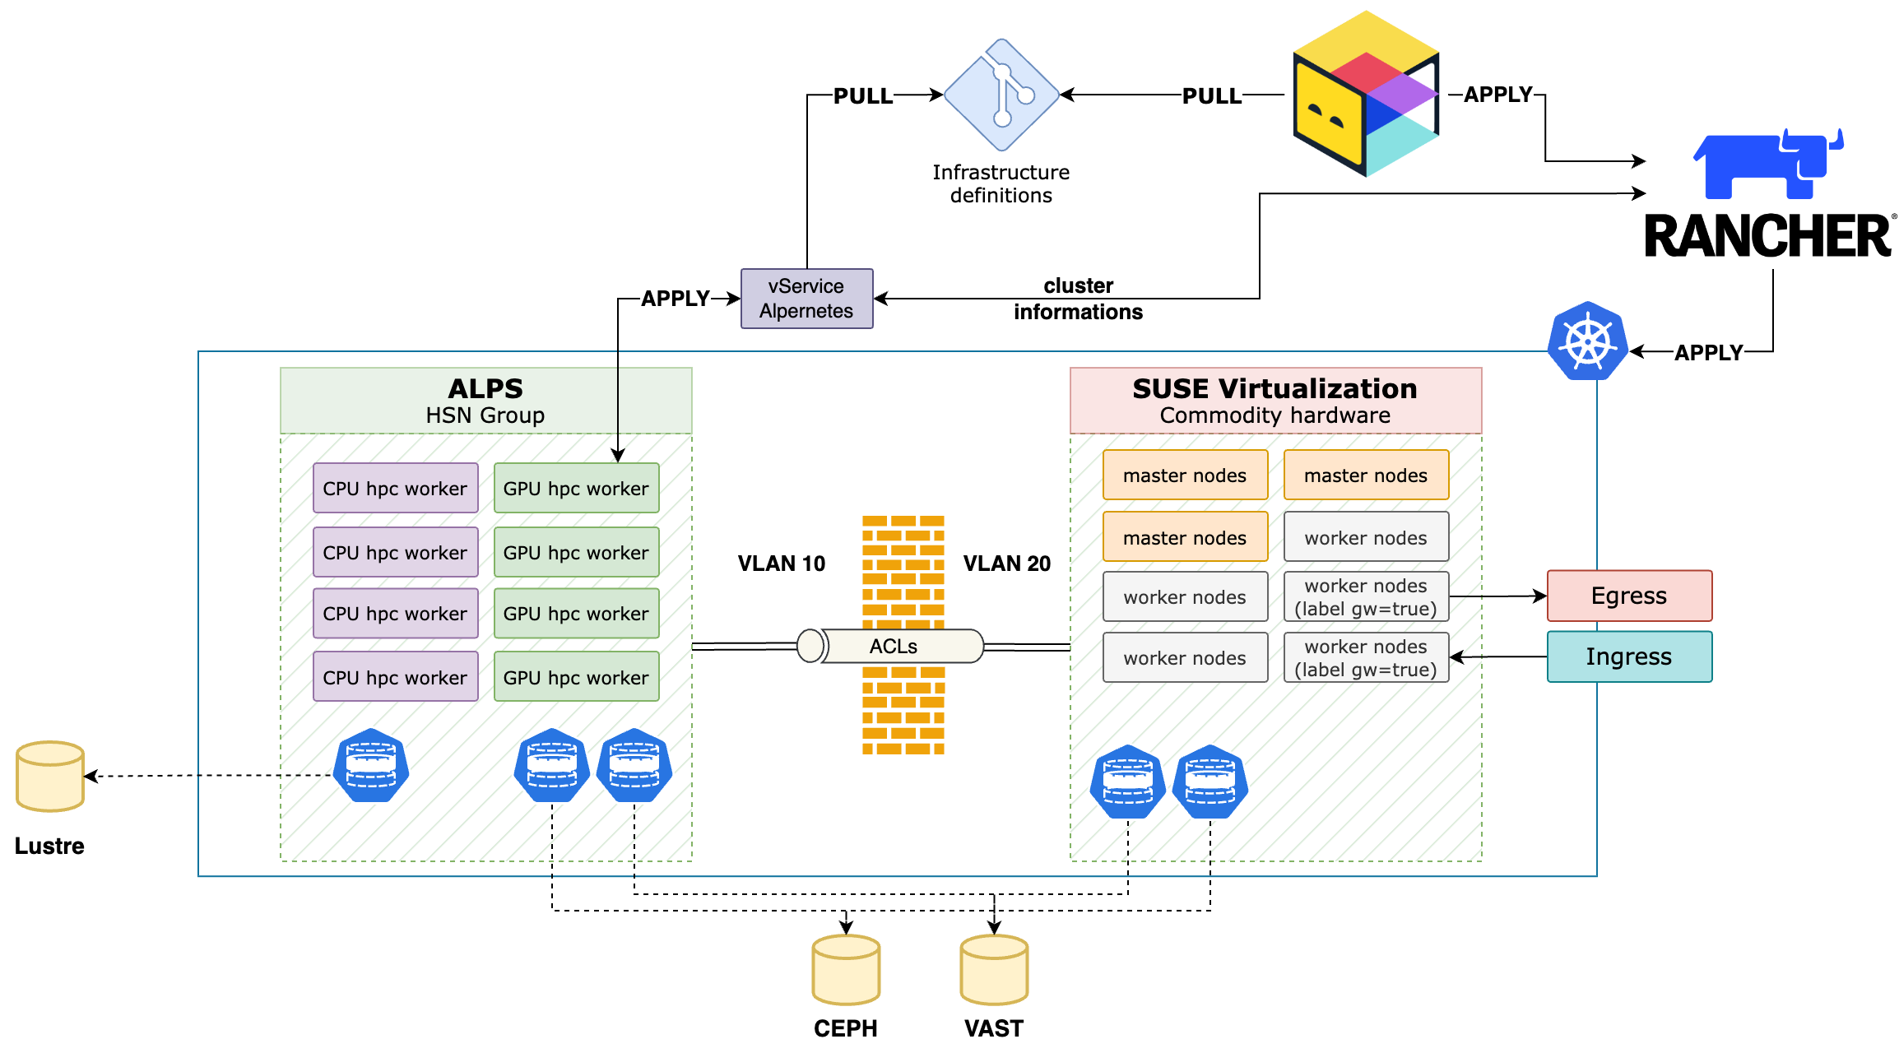
Alpernetes – Architecture
Notes:
ALPS nodes are diskless, some options:
Ceph
Ramdisk
Newer and more performant shared Storage Options are being tested in addition to Ceph
VAST
IBM SSS (GPFS)
Terragrunt + OpenTofu + Ansible + Semaphore UI
Create and provision the cluster
Check node status via ALPS API
Trigger node configuration and cluster join
Node migrations (move nodes across Kubernetes clusters)

Slide 25
dCache on Kubernetes

Slide 26
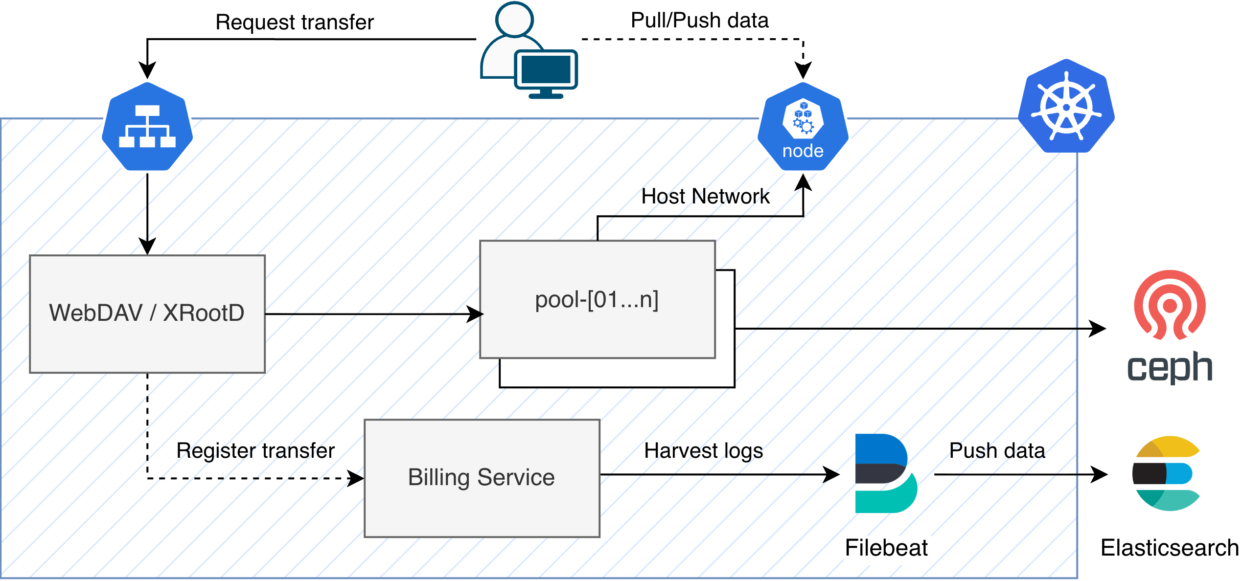
dCache on Kubernetes for SKACH

Slide 27
Use cases

Slide 28
Use cases
We are running a total of 69 downstream clusters, with ~500 VMs and ~200 bare metal nodes
Here are some of the Kubernetes clusters:
dCache
  24 bare metal nodes
  ~420 pools
  48TiB of PVCs via Ceph RBD (Total 20PiB WLCG + CTA + SKA)
WLCG Services
  Frontier Squid
    With multus and whereabouts (IPAM)
  Nordugrid ARC CEs
  site-bdii
Observability cluster
  120 bare metal nodes
  Local NVMe storage
    Local Path for Elasticsearch data nodes
    Longhorn for all other persistent services
Central CSCS services
  Vault
  Jfrog
  Gitlab-runners
  Slurm Control Daemons
Alpernetes
  GH200 cluster on RKE2 – Inference Service
  SKAO
  CTAO

Slide 29

Questions?

