Slide 1
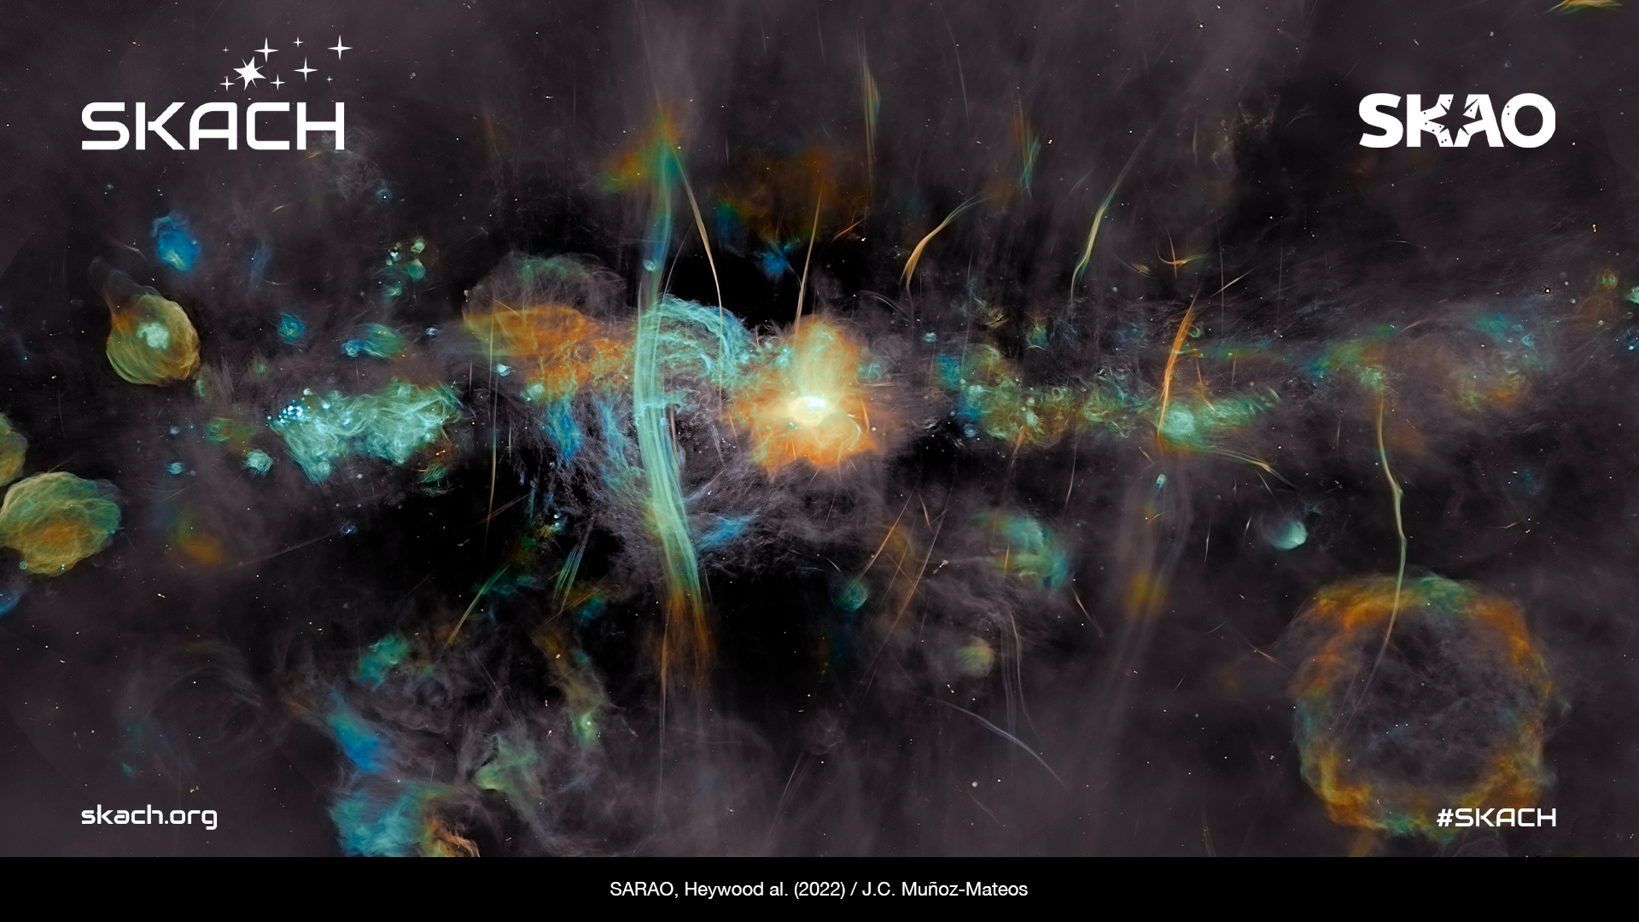
Swiss SRC Roadmap to Science Verification
Rohini Joshi
Swiss SRC Lead Software Architect
Swiss SKA days, Neuchâtel, 31.08.2026

Slide 2



Overview
SRCNet highlights
CHSRC node and roadmap
Community Engagement

Slide 3

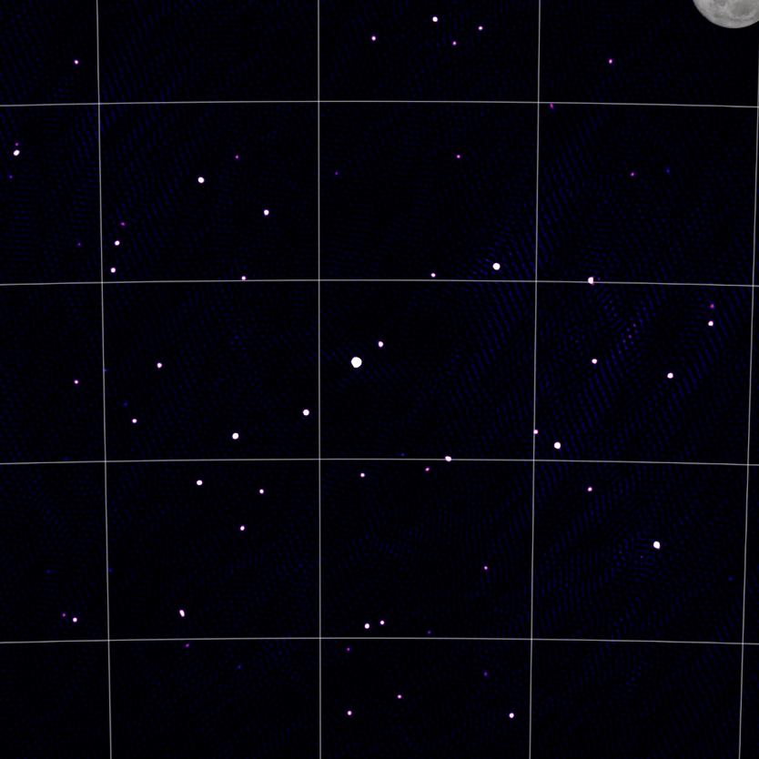



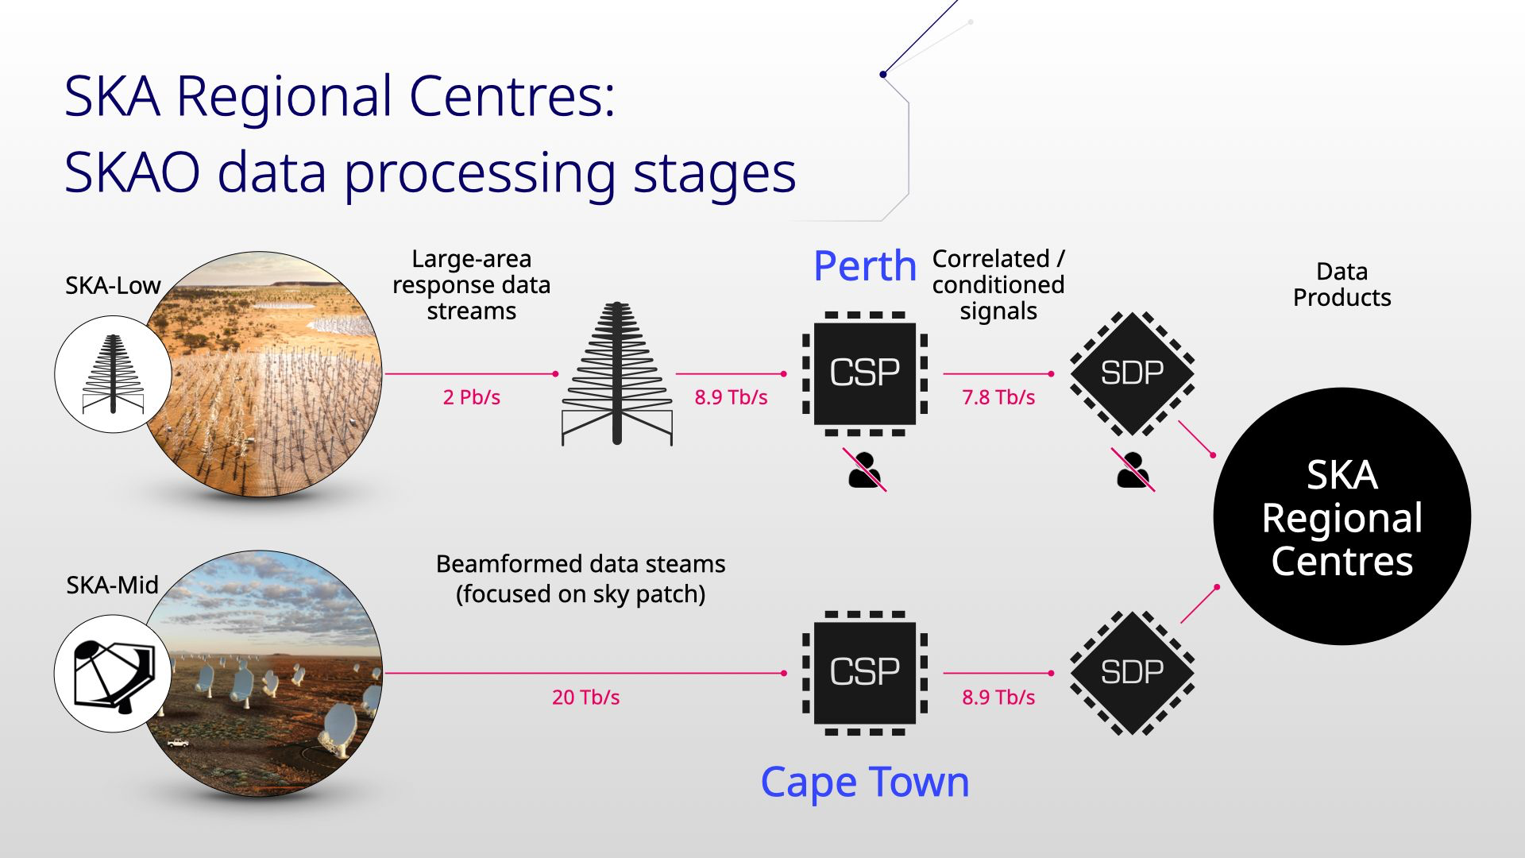
SKAO milestones
Slide credit: Shari Breen
Community involvement starts
Credit: I. Heywood, SARAO
Construction
Commissioning
Science Verification
A full dress rehearsal of the end-to-end system for every mode of operation
Modes and capabilities rolled out over time
Data will be publicly available for scrutiny
Number 1 goal is verification, science secondary
Feedback crucial, for SKAO and SRCNet
Cycle 0
AA2
AA*
Building antennas, dishes, roads etc!
Followed by Assembly, Integration and Verification
SKAO activity
Collaborative across system verification and science commissioning
Shared-risk PI projects
SRCNet resources ready for user
proprietary periods
SRCNet real users doing real things!!!
Now
Now
See Sarrvesh’s talk tomorrow!
2030
First half 2027
First half 2029
Now
Soon
First half 2029
First half 2031
2032

Slide 4
CHSRC pledge updates
With the updated rules on Operations pledging — and given our limited resources — we're concentrating effort where it counts most in the run-up to SV:
Science delivery & Operations, to secure our position as an SV node
Playing to our strengths, recognising our status as a low-percentage country
This is also a chance to reassess priorities, align more closely with our SERI commitments, and build a roadmap for where we want CHSRC positioned by SV.
Team kickoff: the CHSRC development and operations team is now up and running — a mix of familiar faces and new additions. The cross-institute collaboration has been excellent, and remains one of SKACH's core strengths.
Notes:
CHSRC team, raise your hands

Slide 5
CHSRC Node, Roadmap, Evolution
Current state of the node, the CHSRC roadmap, how it will/may evolve for SV and beyond, Risks

Slide 6
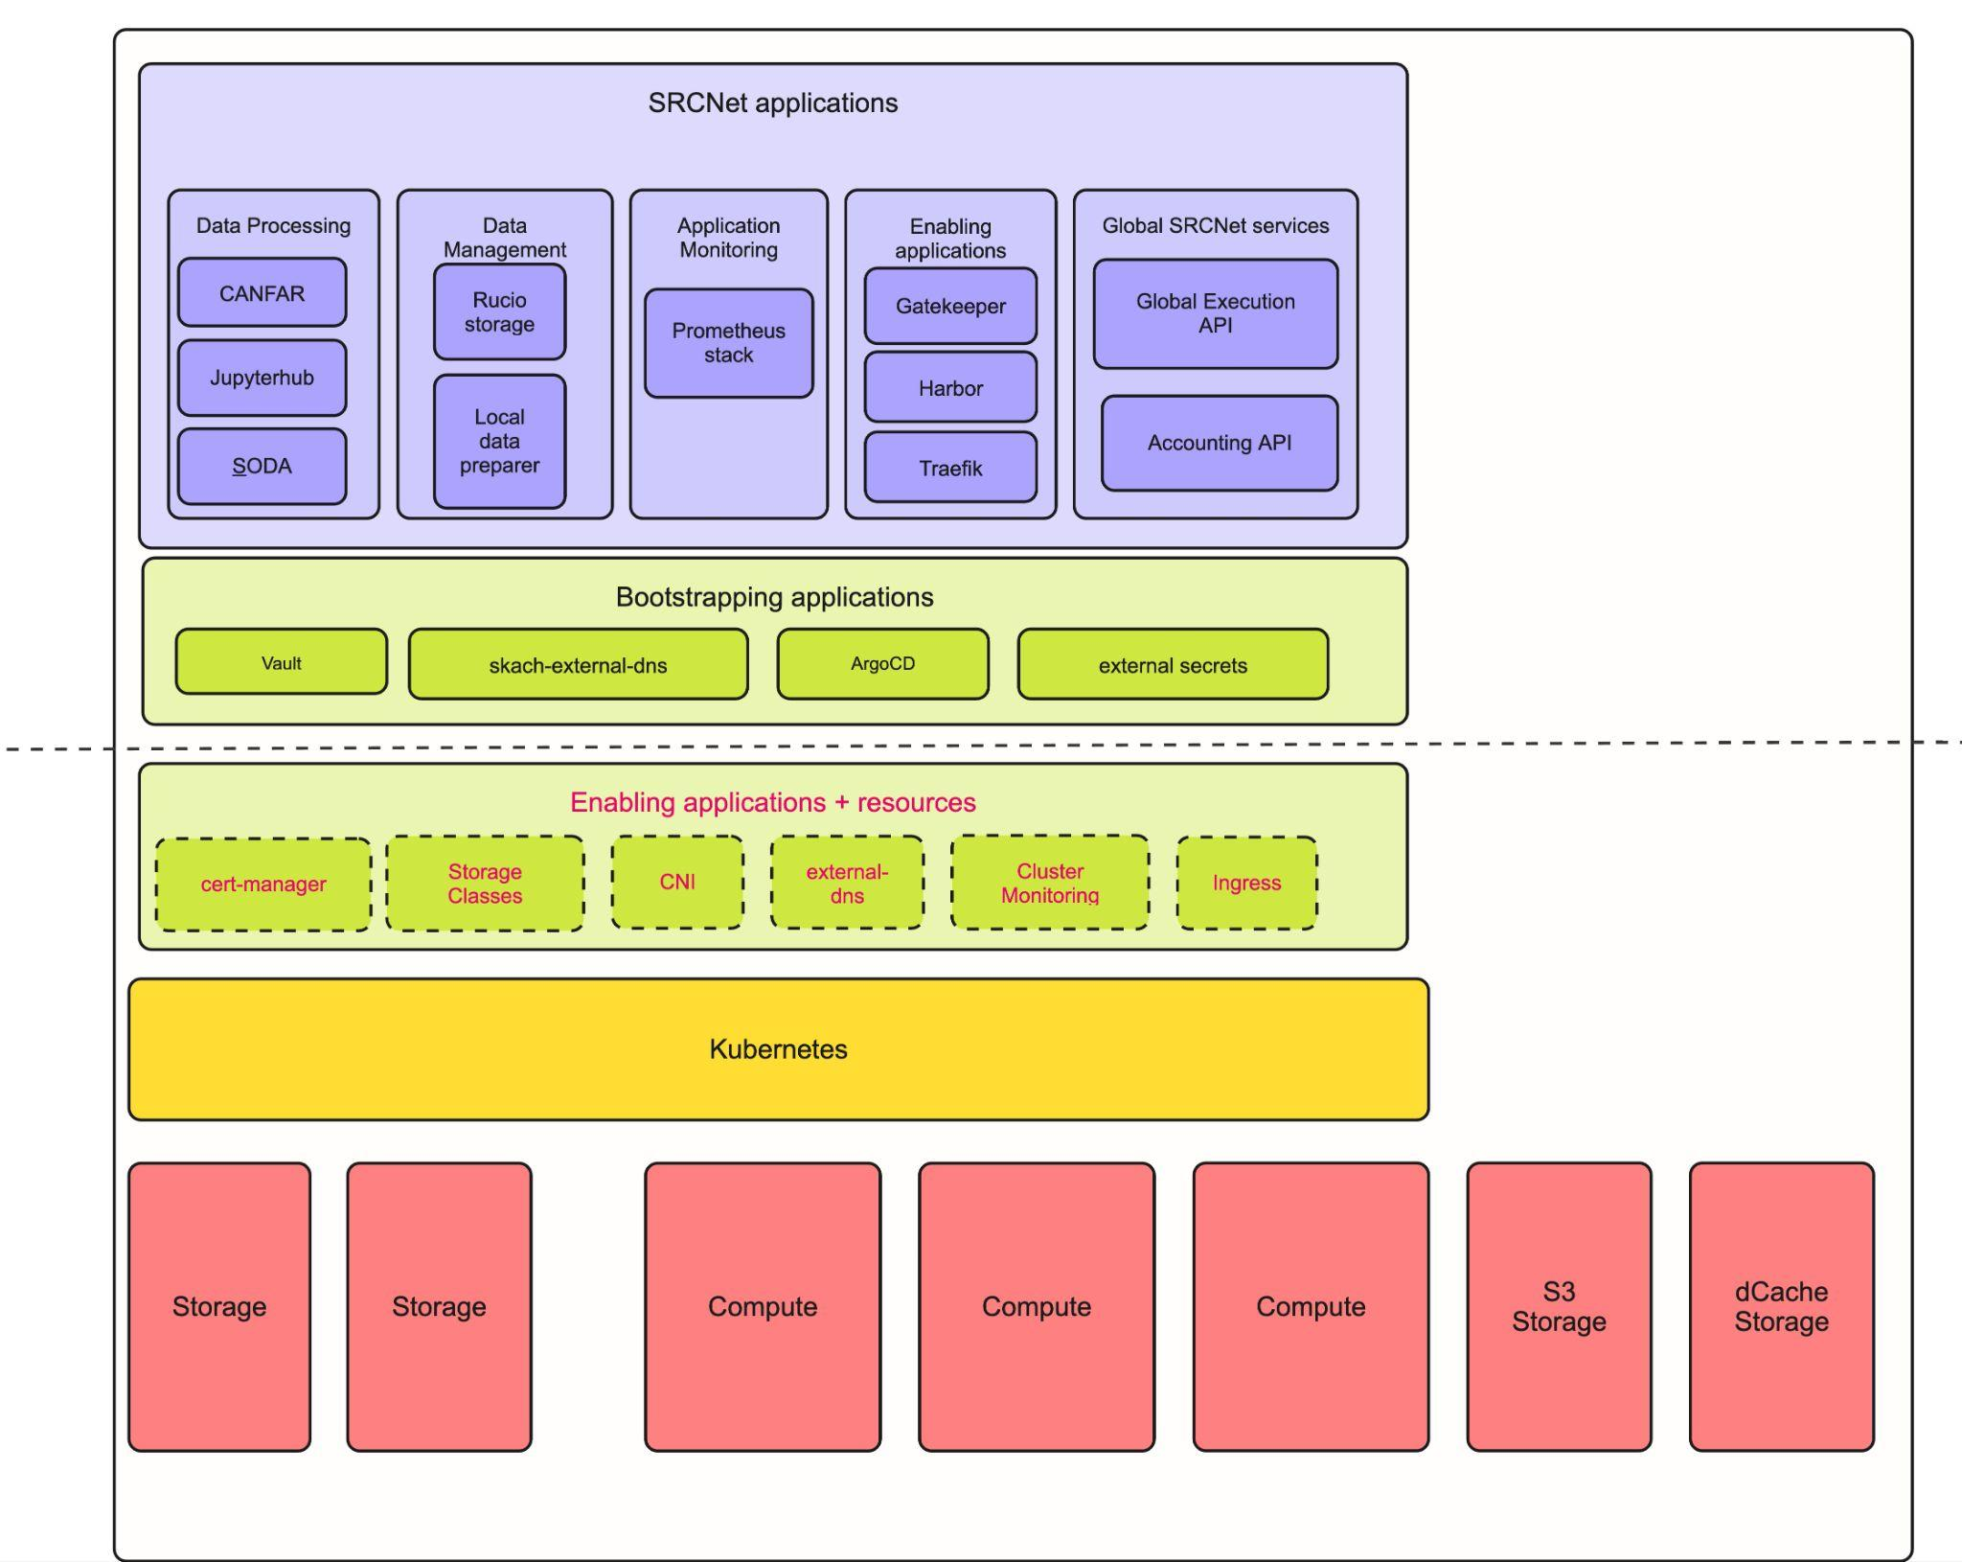
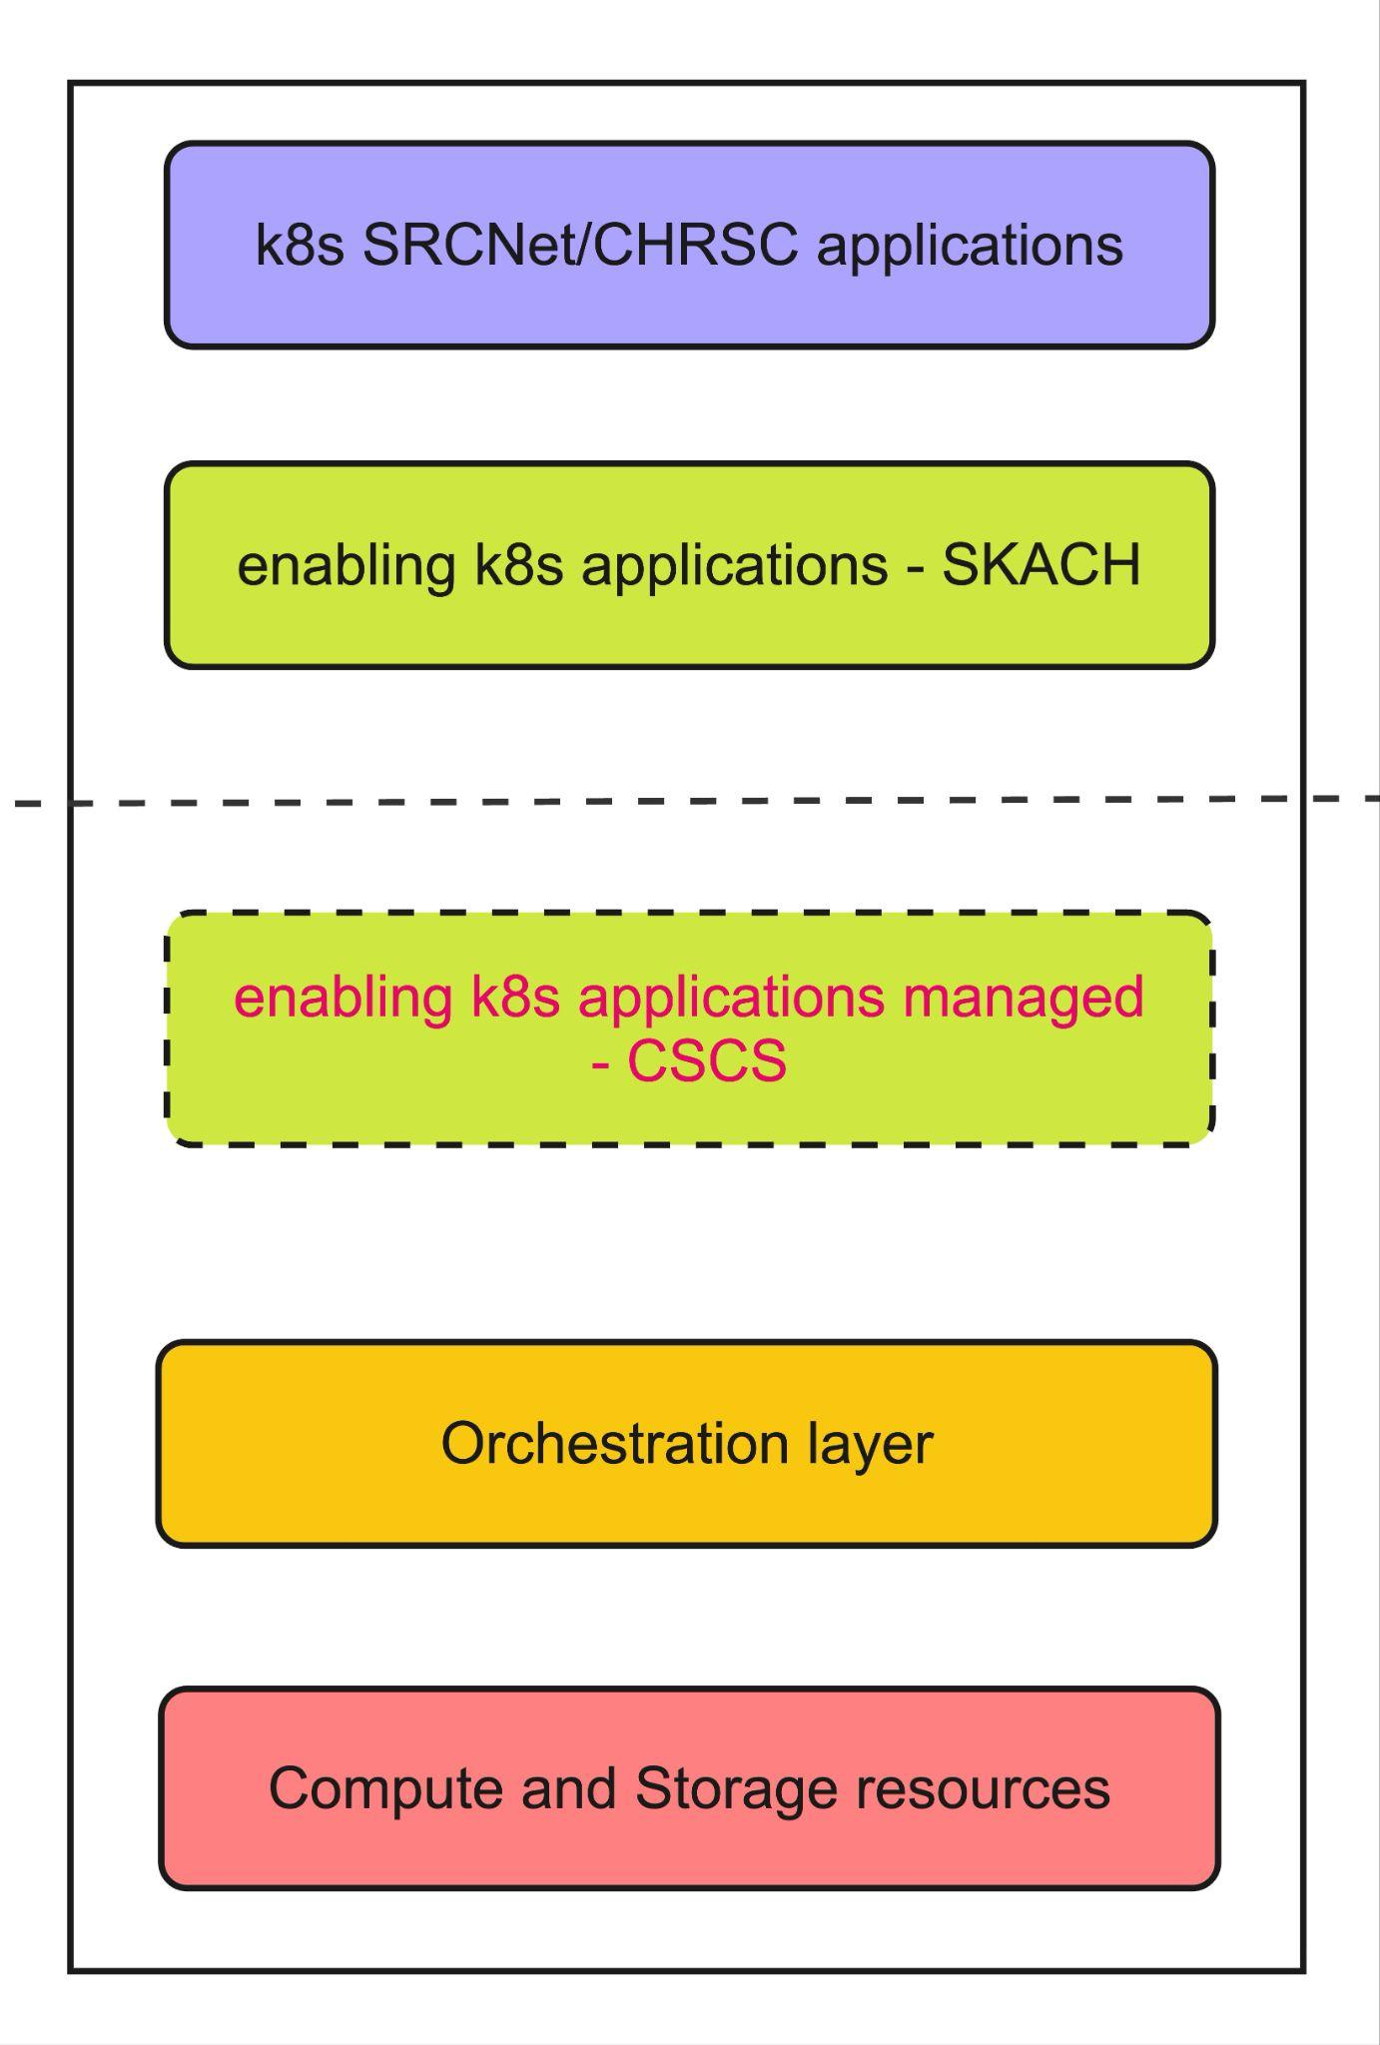
CHSRC node architecture
Shaped by
SRCNet v0.1 requirements, further SRCNet development, CSCS hardware and k8s architecture
We host Global Services for SRCNet
For simplicity, this is a modules view thus some details are hidden
Everything above the k8s orchestration layer is duplicated across two clusters - TDS and production
Link to diagram

Slide 7
CHSRC upgrades
SRCNet/CHSRC application services
  GitOps strategy with different envs, mergeable branches and a secret store
  A setup replicated by several other SRCNodes
  More in last year’s talk
Enabling applications
  GitOps strategy
  CSCS/CHSRC managed based on the application + slack for communication
Orchestration layer - CSCS
  Kubernetes control plane
Hardware layer - CSCS
  Alps nodes, OS upgrades, critical vulnerabilities
TDS before Prod! *
Link to diagram

Slide 8
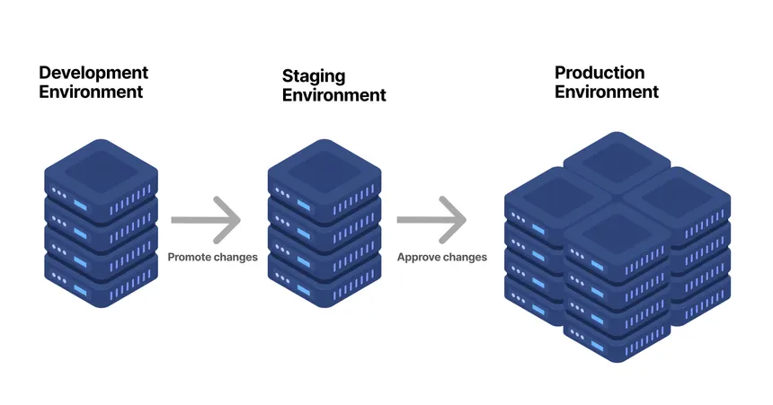
CHSRC upgrades
SRCNet release management is an active area of development.
Since we host SRCNet global services,
we are involved in shaping this
Some possibilities
Introduction of a pre-production environment
  This would be CHSRC TDS or
  New cluster + new overlay
CHSRC inclusion in SRCNet staging environment
We should be able to realise these possibilities. Some changes to our operations procedures while maintaining our original CHSRC GitOps design goals.
Current SRCNet environments

Slide 9
CHSRC roadmap - workstreams upto SV
1. SV Readiness ★★★ : Qualifying as a Swiss SRC node for Science Verification. Expression of Interest, aligning with SV policies and deploying new services
2. CHSRC User Access ★★★: Ensuring Swiss users can access SV data through a CHSRC platform, even where SRCNet cannot support them directly. User feedback and support, Swiss science community priorities for SV
3. Maintenance & Improvement ★★★ : The ongoing baseline that keeps everything else running.
4. Exploratory Initiatives ★★ : Using the runway before SV to experiment while we have time.
5. External Positioning ★★ : Building international collaborations and delivering concrete pilots that support future EU funding applications beyond 2029.
Notes:
4. Current focus areas include interactive compute integration (FirecREST/JupyterHub), a local compute API service, and Open OnDemand platform deployment.

Slide 10
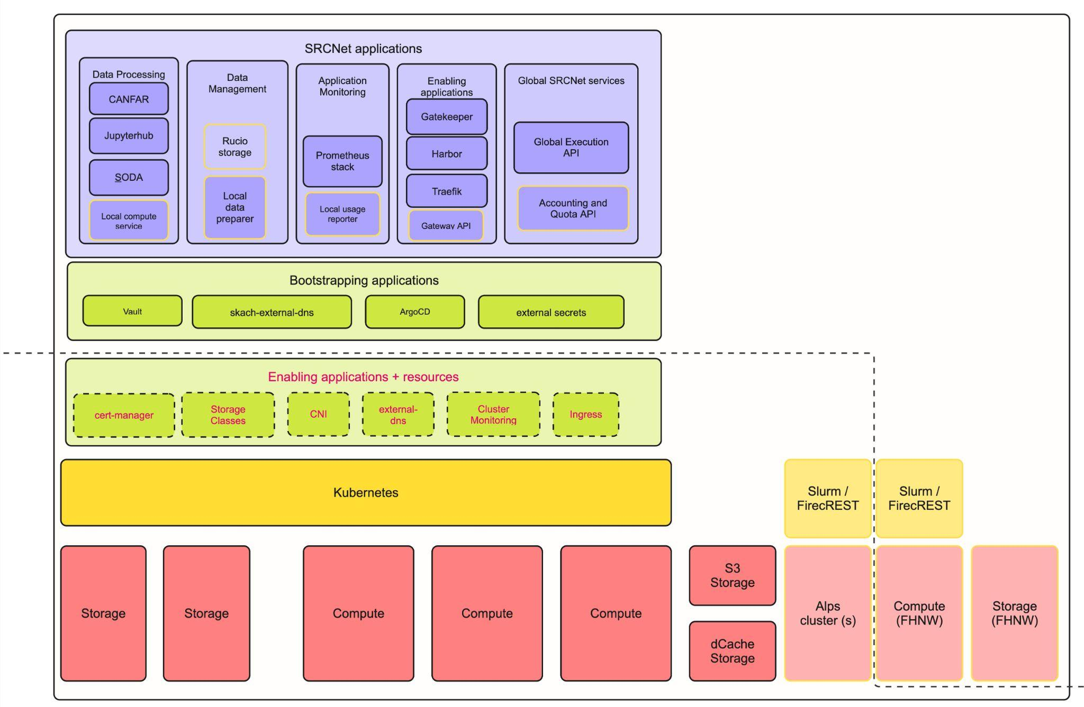
CHSRC node evolution
Link to diagram

Slide 11
CHSRC eligibility for SV and growth beyond SV
Our path forward will be shaped by four factors:
SRCNet requirements and policies
Local development progress and funding (in collaboration with CSCS)
CHSRC user engagement
Scaling under funding constraints: with limited funding to expand our node further, we're exploring creative technical solutions — including FirecREST. More on this in a later talk.
Open questions: detailed eligibility criteria — policies, security audits, and more — are still being developed. We're following this closely.
Published CHSRC Roadmap and to be updated every Quarter

Slide 12
Risks to CHSRC SV roadmap
Risks
SRCNet Development is moving rapidly - AI based development
SRCNet Development - Operations value streams interfaces weak - is what is being developed actually deployable especially when it comes to compulsory local services?
  Global services - important for us to continue hosting these services
SRCNet SV eligibility unclear
Small fractions of CHSRC team members
Short term lack of scalability
Long term funding
CHSRC: Mitigating, reduction in pledge and involved in Operations VS
Accepted
Owned: RJ
CHSRC: Mitigating with exploring alternate solutions
SKACH Board: Mitigating with exploring funding options

Slide 13
Community Engagement
Getting SRCNet and CHSRC users involved…

Slide 14
SRCNet Community Engagement
Starting to engage with Teal team (Science delivery value stream team)
They will run the representative use cases developed in collaboration with SRCNet project scientists, SKAO Science Operations with representative datasets.
We’re in the process of setting up their access, getting their data copied over and making our node available to them.
What it means for us -
On-call operations will be crucial to ensure we can give them what they need, and get successful DSC runs on our node (maybe a SV eligibility criteria)
First time we are starting to see concrete user payload requirements for data and compute - adjustments to the CHSRC stack may follow from this.
  Cluster Observability for CHSRC operators - crucial. More on this in a later talk.
Can expect more CSCS tickets, requests as we forward them from the users. An example of this is needing to swap out/add an Alps node with more memory.

Slide 15

Swiss community engagement
This community is one of our key stakeholders! More on stakeholders in the roadmap.
We hope to continue and improve this engagement in the form of
Workshops (join us on Wed!)
  Science ideas, priorities, what would you like to do?
CHSRC platform trainings
  Let us show you what the platform can do and how
Field tests
  Bring your use cases to the platform and let’s
  run something
  Together
Your ideas are very welcome!
Do you want to be one of our representative stakeholders?
Please come talk to me, come to SV ideas workshop, slack me, email me.

Slide 16

Stay tuned for CHSRC talks today
Discussion sessions tomorrow
Workshop Wednesday!

Slide 17

Thank you for your attention !
Rohini Joshi
rohini.joshi@fhnw.ch

Slide 18
title
words

