Slide 1
CSP.LMC: Five Years of Progress and the Challenges Ahead
Swiss SKA Days 2026
Ivana Novak
ivana.novak@cosylab.com

Slide 2
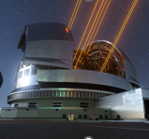


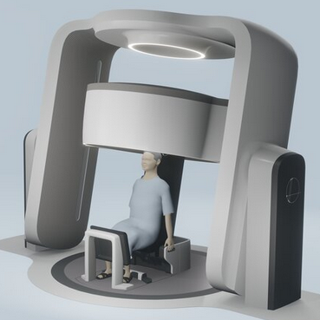














Cosylab’s profile
Company
Powered by Cosylab
The leading provider of turnkey software solutions and electronics
for the world's most complex, precise and advanced systems
20+ years of experience
Global team of 300+ highly skilled developers and engineers
Exceptional expertise and innovation
Established processes, ISO certified and IEC compliant
HQ in Europe; subsidiaries worldwide
Cancer therapy systems / Complex medical devices / Particle accelerators / Large telescopes / Fusion reactors / Space industry
Switzerland
Slovenia HQ
Japan
China
United States
References

Slide 3
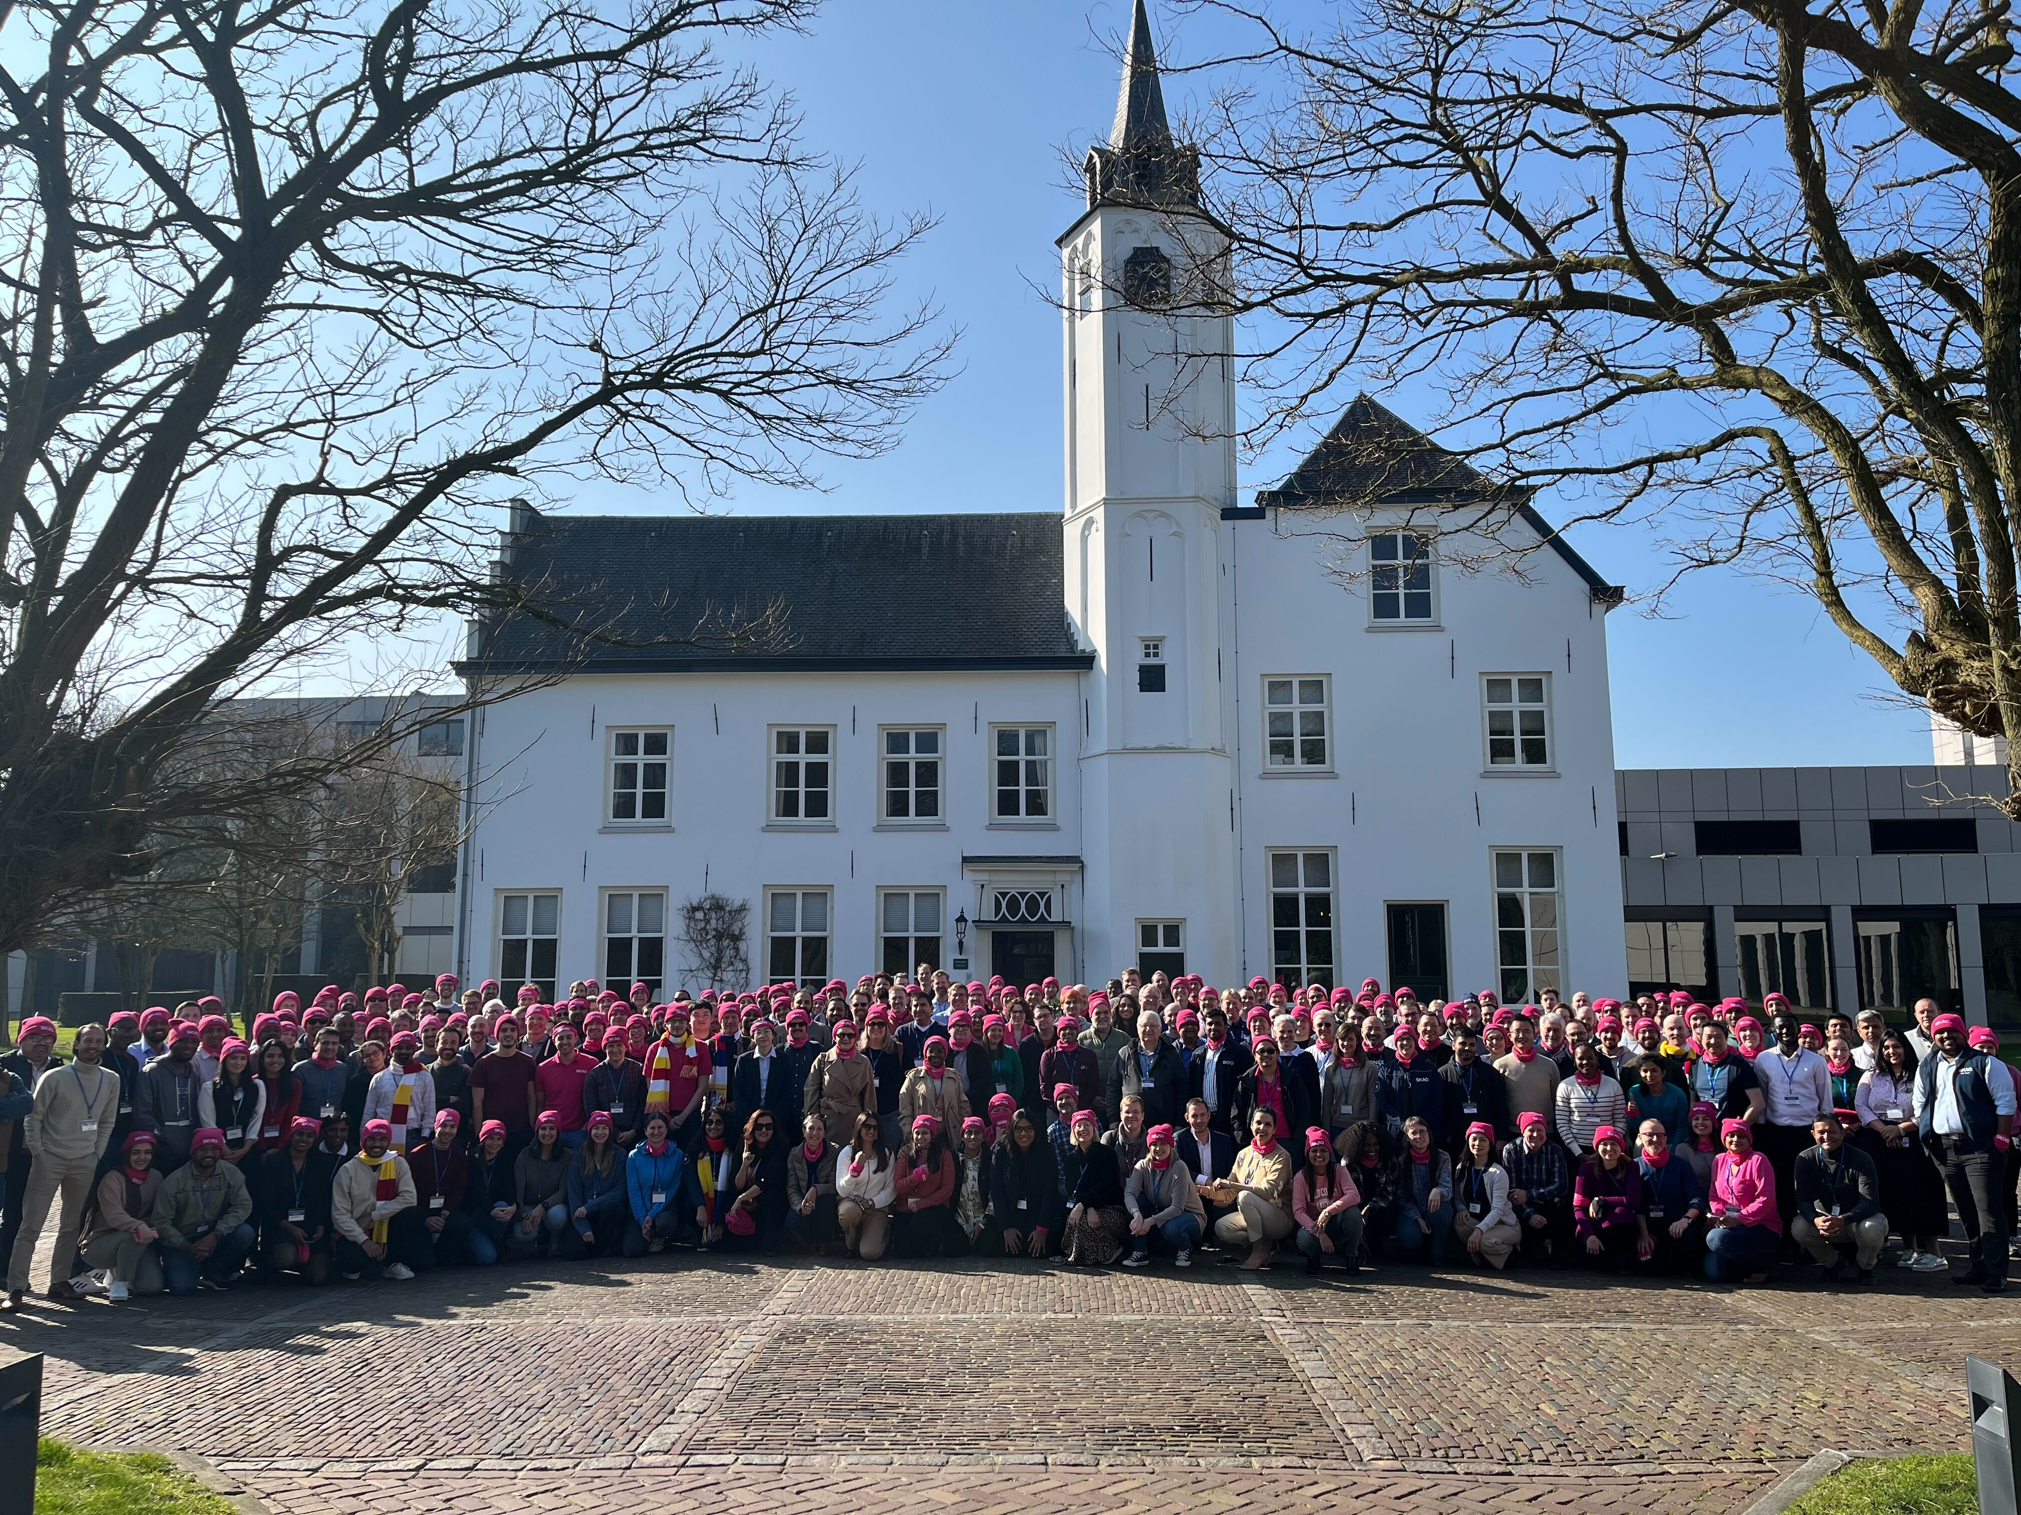
Participation in OMC ART in 2025-2026
2 FTEs within Cream Team – OMC
  Members from INAF (Italy), Cosylab CH (Switzerland),
  Atlat Innovation (Portugal), Persistent (India)
Team‘s Product Owner replacement
  Carlo Baffa (INAF) -> Ivana Novak (Cosylab CH)
Observation
Management and
Control
Agile
Release
Train
PI Planning in Einhoven, Netherlands, March 2026

Slide 4
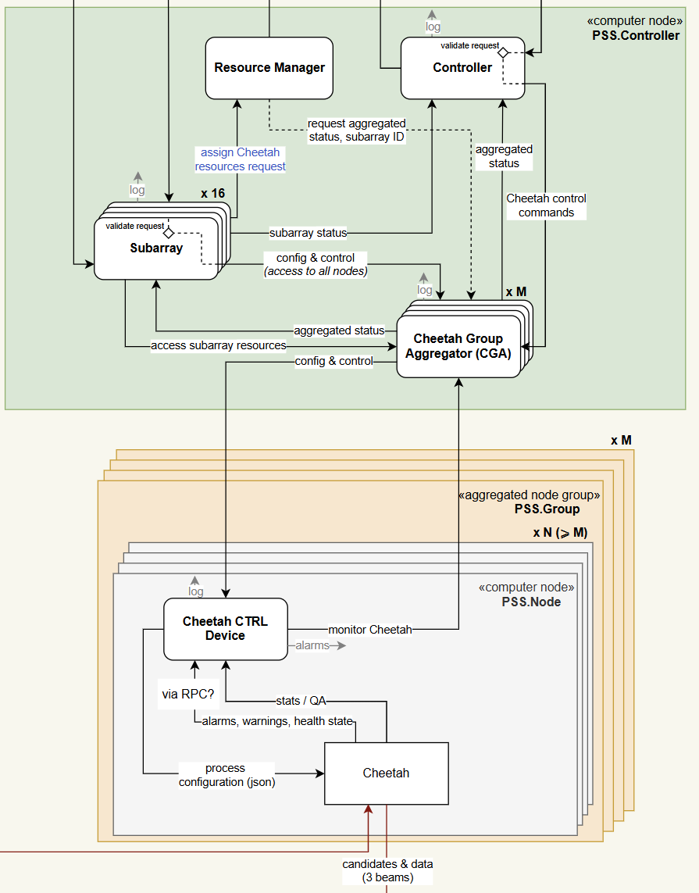
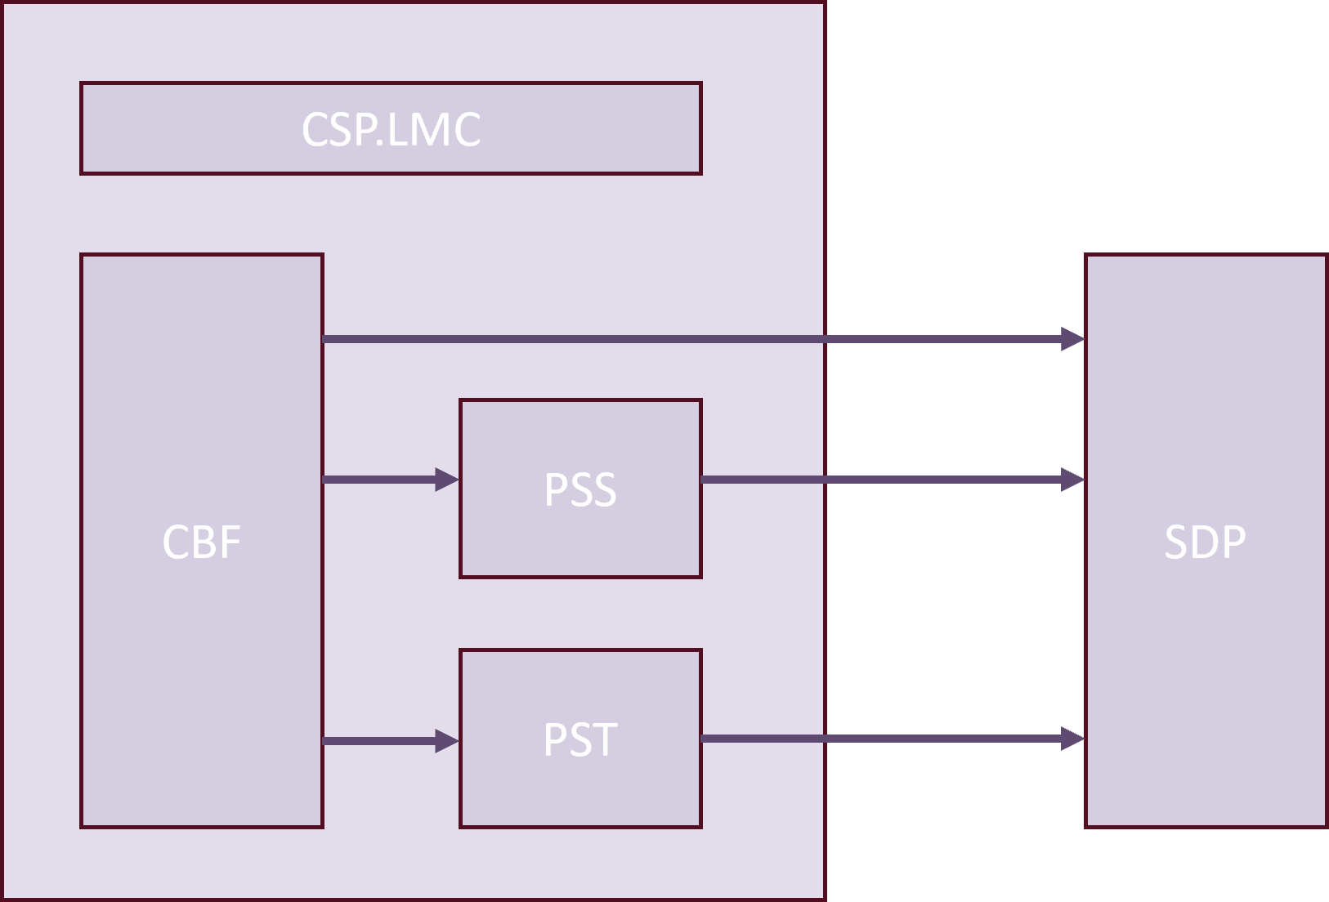
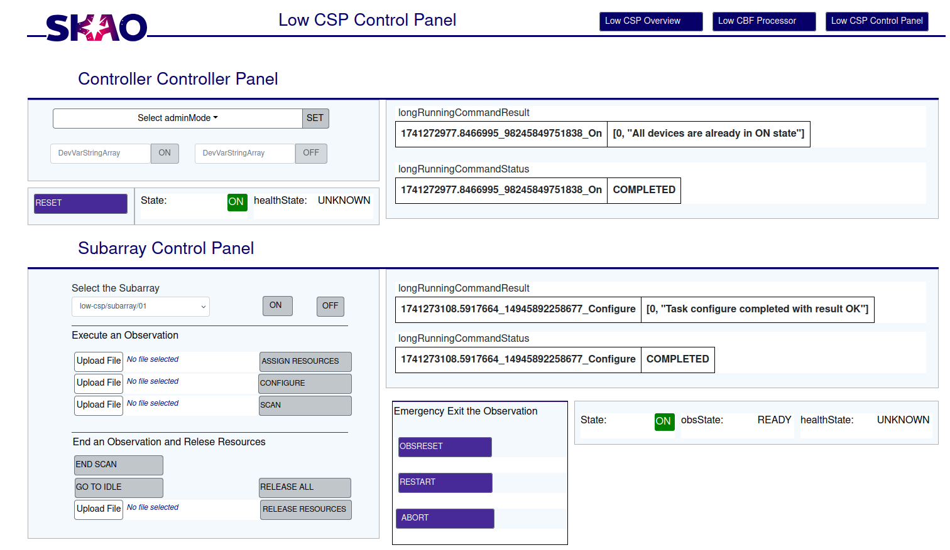
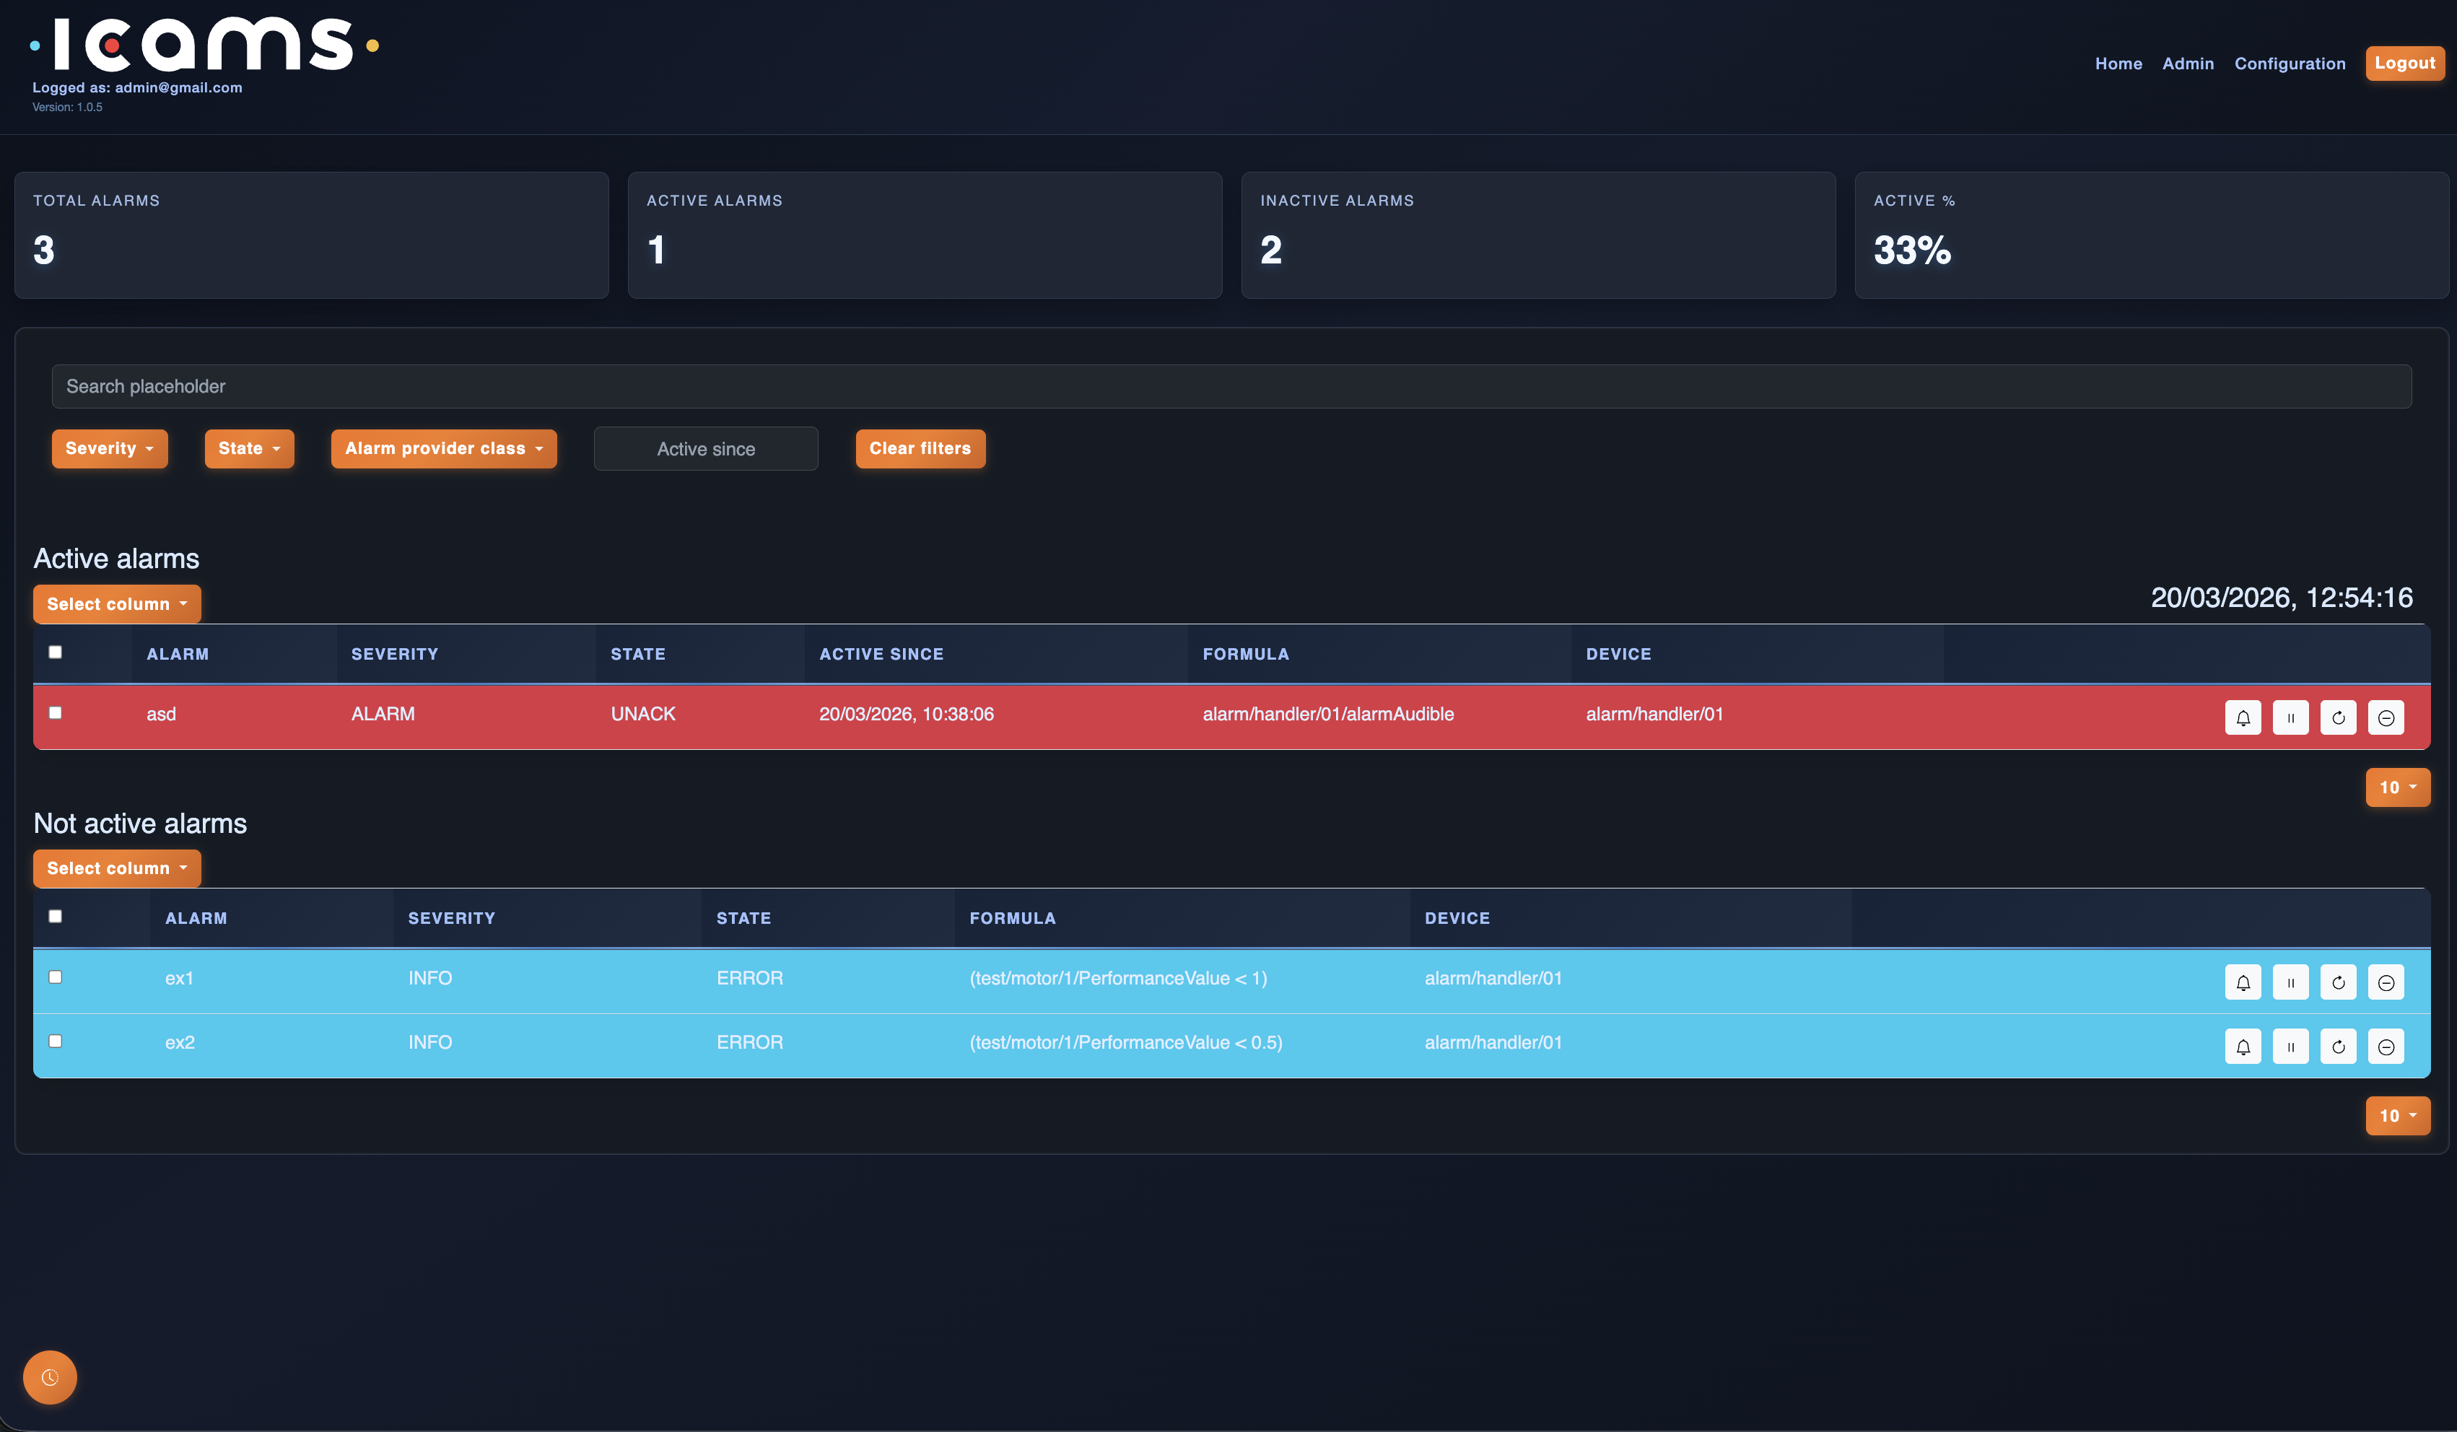
Products
CSP.LMC
PSS.LMC
Control Layer of CSP as a whole
Ensuring CSP acts as a single unit interfacing with TMC
Coordinating workflow between CBF, PSS and PST
Managing commands, reporting monitoring data, aggregating status
Cheetah = a set of computational pipelines for processing beamformed data and producing pulsar candidates
PSS.LMC = Control layer of Pulsar Search component
Integration with CSP.LMC
Central
Signal
Processor
PulSar
Search
Local
Monitoring and
Control
Telescope
Monitoring and
Crontrol
Taranta
IC@MS
Correlator
and BeamFormer
Web UI tool developed in collaboration with MaxIV
Used for engineering dashboards and by development teams for testing, integration and demos
Dashboards can be built by anyone using specialized widgets
Interface layer for the SKA Alarm Management System
Connects applications and operator interfaces to alarm services
Provides access to current alarms, states, and history
PulSar
Timing

Slide 5
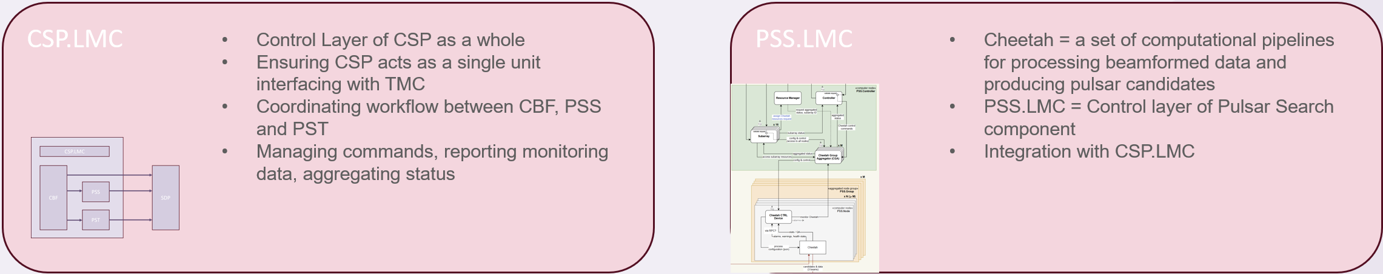
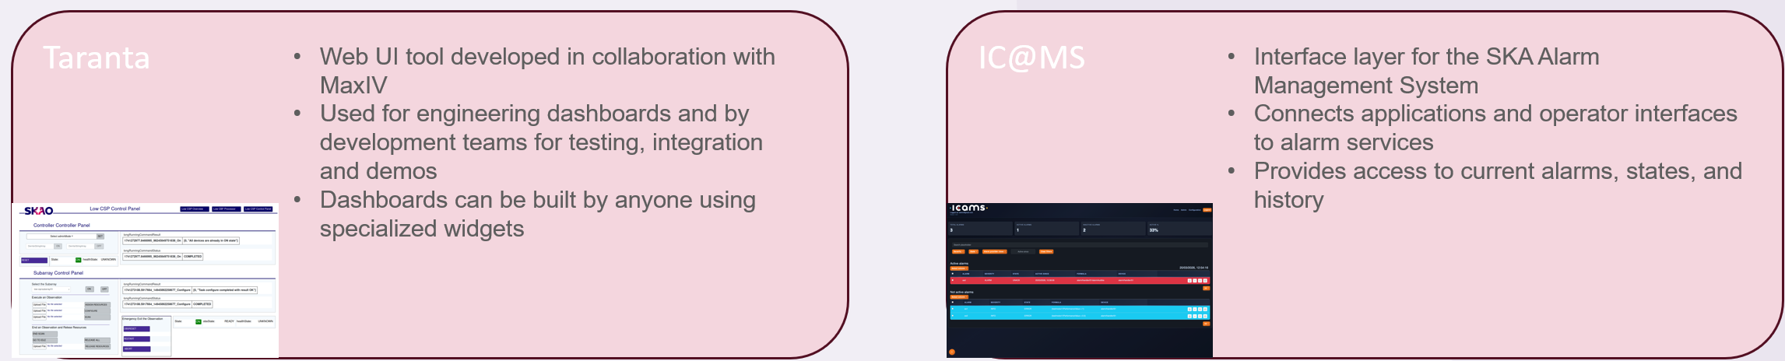
Products
Components of telescope control system
TANGO based
UI tools

Slide 6
Taranta
CSP.LMC
PSS.LMC
Control Layer of CSP as a whole
Ensuring CSP acts as a single unit interfacing with TMC
Coordinating workflow between CBF, PSS and PST
Managing commands, reporting monitoring data, aggregating status
Cheetah = a set of computational pipelines for processing beamformed data and producing pulsar candidates
PSS.LMC = Control layer of Pulsar Search component
Integration with CSP.LMC
Taranta
IC@MS
Web UI tool developed in collaboration with MaxIV
Used for engineering dashboards and by development teams for testing, integration and demos
Dashboards can be built by anyone using specialized widgets
Interface layer for the SKA Alarm Management System
Connects applications and operator interfaces to alarm services
Provides access to current alarms, states, and history

Slide 7
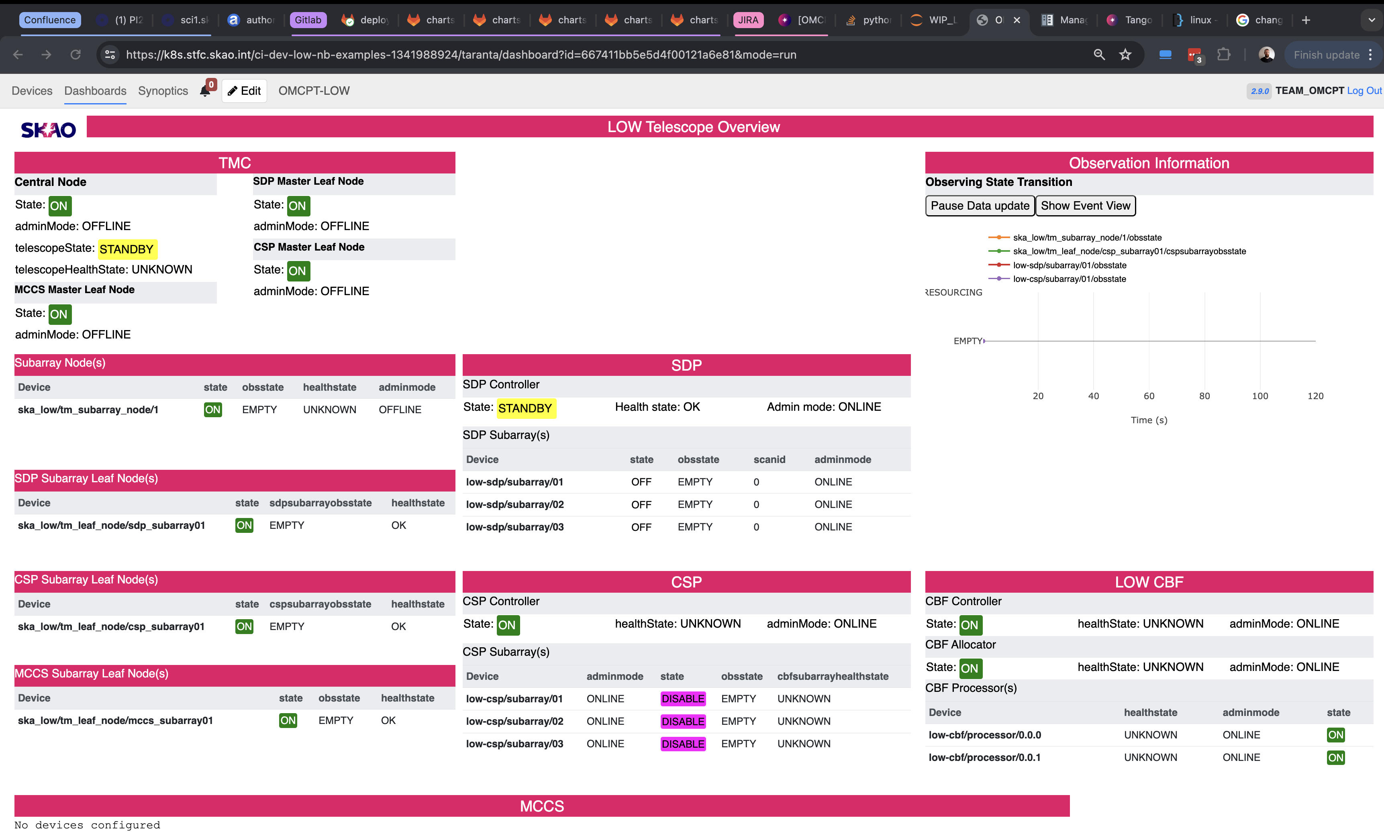
Taranta

Slide 8
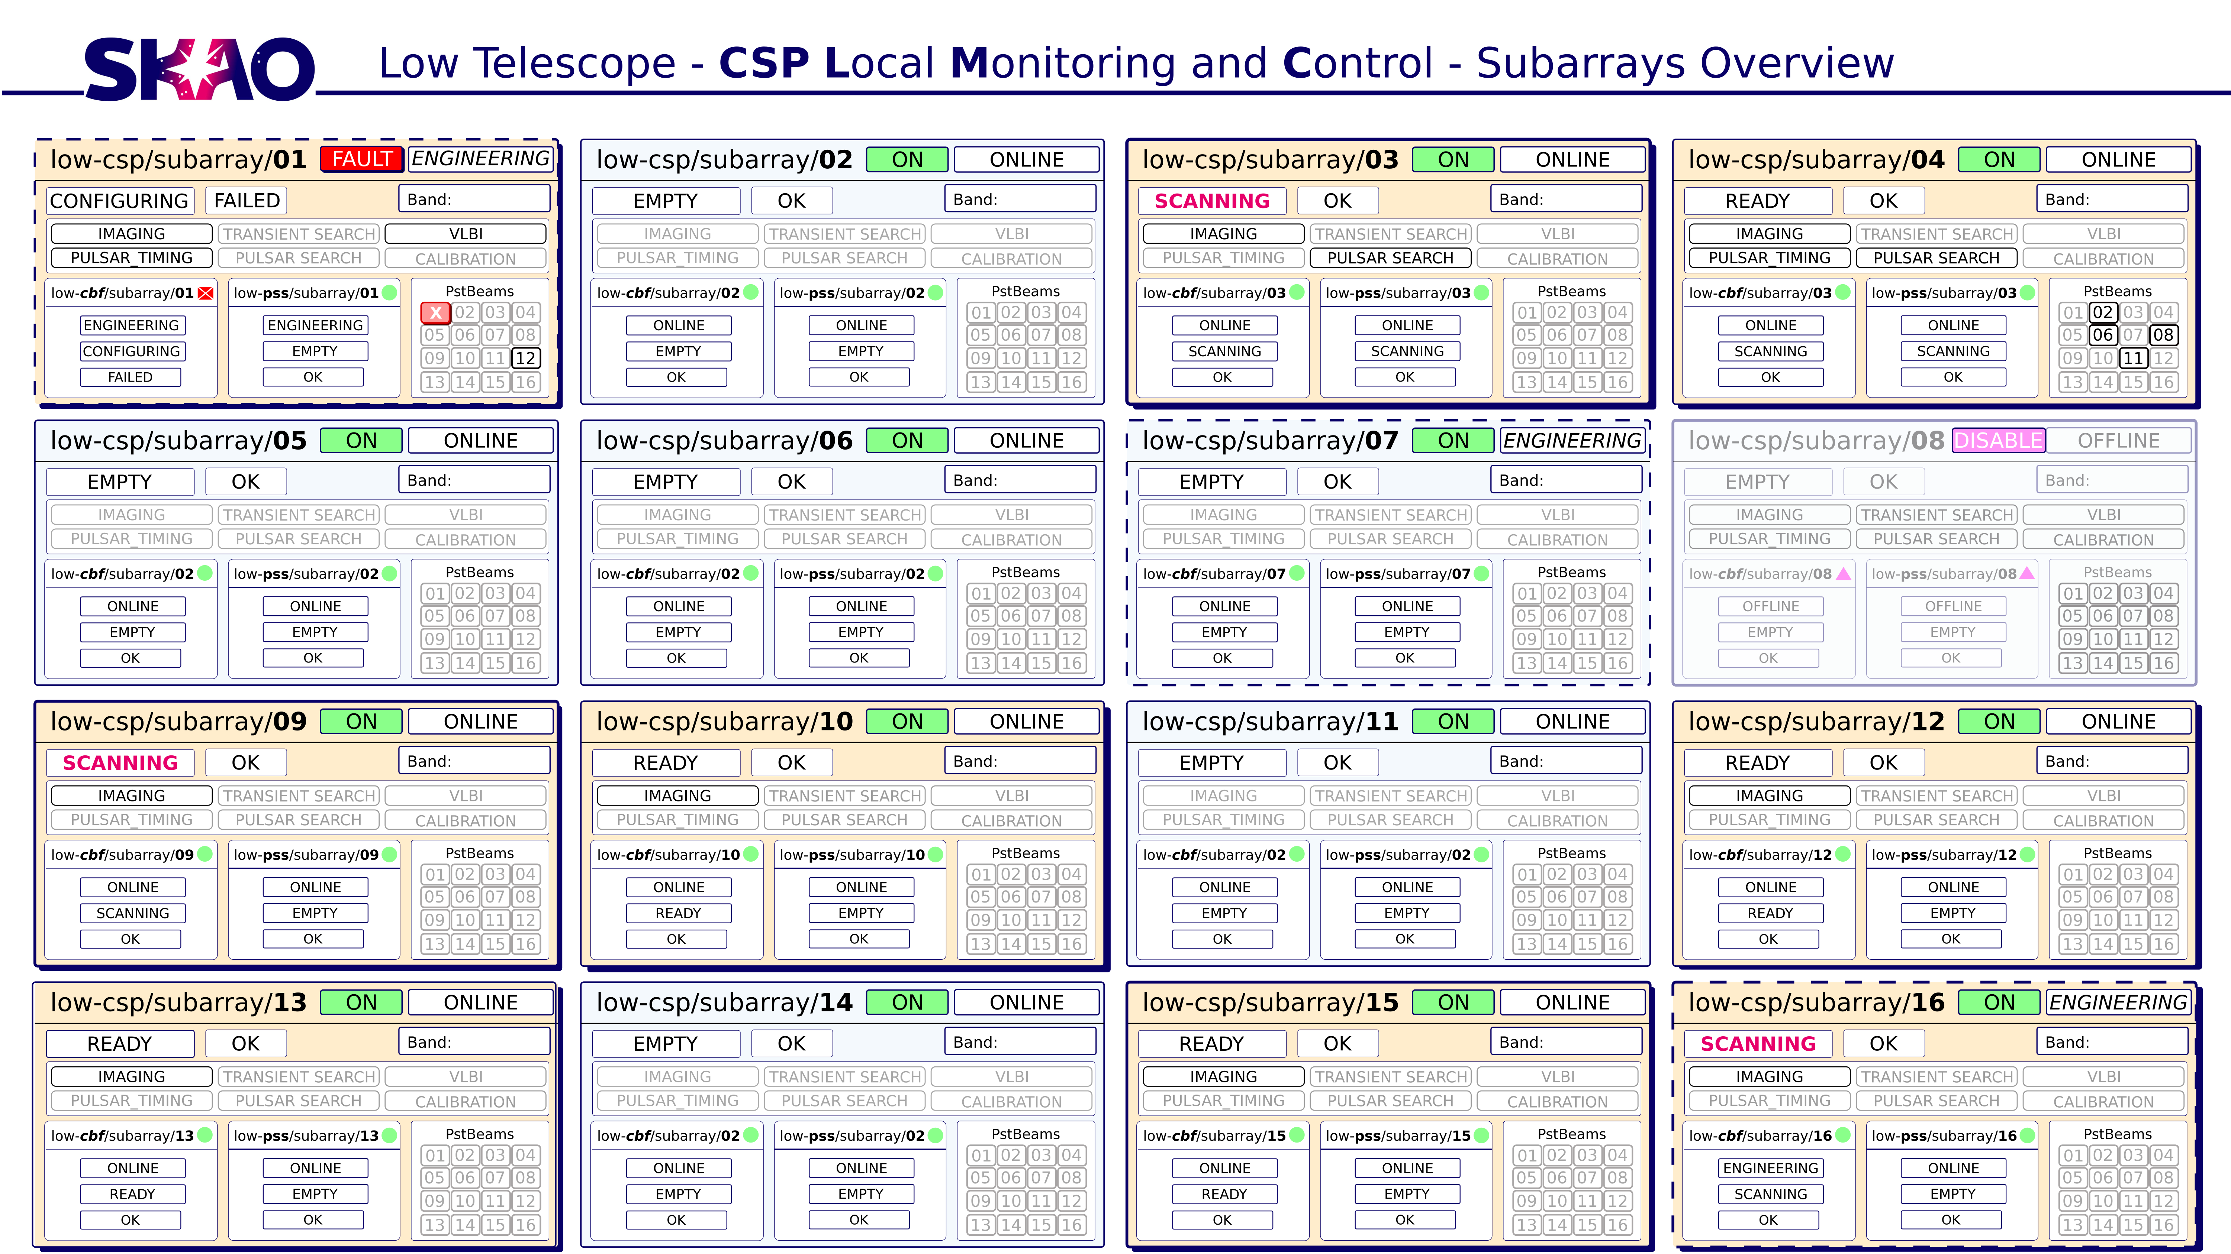
Taranta

Slide 9
IC@MS
CSP.LMC
PSS.LMC
Control Layer of CSP as a whole
Ensuring CSP acts as a single unit interfacing with TMC
Coordinating workflow between CBF, PSS and PST
Managing commands, reporting monitoring data, aggregating status
Cheetah = a set of computational pipelines for processing beamformed data and producing pulsar candidates
PSS.LMC = Control layer of Pulsar Search component
Integration with CSP.LMC
Taranta
IC@MS
Web UI tool developed in collaboration with MaxIV
Used for engineering dashboards and by development teams for testing, integration and demos
Dashboards can be built by anyone using specialized widgets
Interface layer for the SKA Alarm Management System
Connects applications and operator interfaces to alarm services
Provides access to current alarms, states, and history

Slide 10
IC@MS (Integrated Control Alarm Management System)
Thousands of devices continuously publish telemetry and state information.
Operators must be able to detect abnormal conditions quickly and react appropriately.
IC@MS receives events from Tango devices and evaluates them against configurable alarm rules. When a rule is triggered, the system generates an alarm that can be displayed to operators or consumed by other software components.
IC@MS provides:
  alarm rule evaluation
  alarm state management
  alarm history
  integration with Tango-based control systems

Slide 11
Products
CSP.LMC
PSS.LMC
Control Layer of CSP as a whole
Ensuring CSP acts as a single unit interfacing with TMC
Coordinating workflow between CBF, PSS and PST
Managing commands, reporting monitoring data, aggregating status
Cheetah = a set of computational pipelines for processing beamformed data and producing pulsar candidates
PSS.LMC = Control layer of Pulsar Search component
Integration with CSP.LMC
Taranta
IC@MS
Web UI tool developed in collaboration with MaxIV
Used for engineering dashboards and by development teams for testing, integration and demos
Dashboards can be built by anyone using specialized widgets
Interface layer for the SKA Alarm Management System
Connects applications and operator interfaces to alarm services
Provides access to current alarms, states, and history

Slide 12
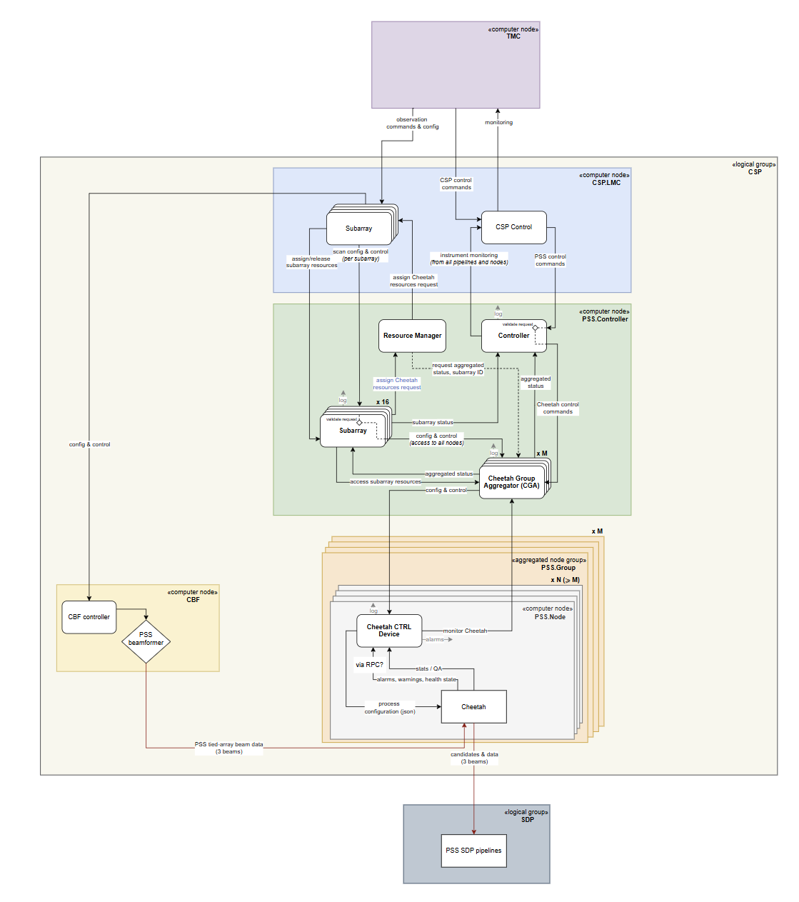
Pulsar Search Integration
Last year
PSS.LMC Subarray and Controller devices implementation
Integration with CSP.LMC
Allowing for first tests of pulsar detection with real hardware
using Low ITF and data from Low station
Current focus
Integration of RPC protocol to expand the interface between
Cheetah application and PSS.LMC Cheetah Ctrl Device
Future work
Expansion of interface and refinement of command behavior
Handling of PULSAR_SEARCH mode in the background
Scaling up to planned number of PSS beams
Integration of PSS in Mid telescope

Slide 13
Products
CSP.LMC
PSS.LMC
Control Layer of CSP as a whole
Ensuring CSP acts as a single unit interfacing with TMC
Coordinating workflow between CBF, PSS and PST
Managing commands, reporting monitoring data, aggregating status
Cheetah = a set of computational pipelines for processing beamformed data and producing pulsar candidates
PSS.LMC = Control layer of Pulsar Search component
Integration with CSP.LMC
Central
Signal
Processor
PulSar
Search
Local
Monitoring and
Control
Telescope
Monitoring and
Crontrol
Taranta
IC@MS
Correlator
and BeamFormer
Web UI tool developed in collaboration with MaxIV
Used for engineering dashboards and by development teams for testing, integration and demos
Dashboards can be built by anyone using specialized widgets
Interface layer for the SKA Alarm Management System
Connects applications and operator interfaces to alarm services
Provides access to current alarms, states, and history
PulSar
Timing

Slide 14
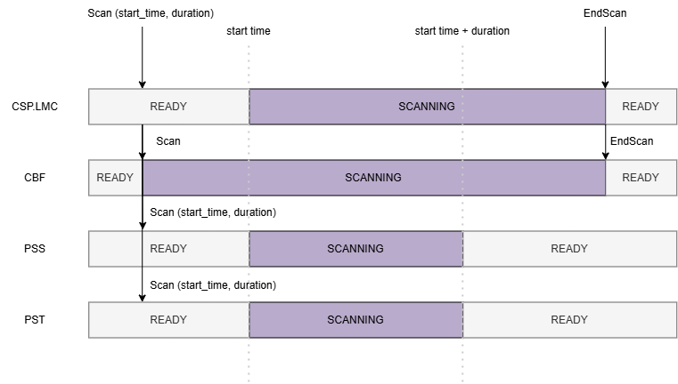
Scan duration
Problem
Telescope is not actually ready when it says it is
Application of delays and Jones matrices included in the scan
Invalid data incuded in the scan means that sensitivity of the
telescope will be overestimated
Solution
Separate observing workflow state from science-data quality
Mechanisms added
  QA metrics
  start_time and duration parameters
Device | Attribute
CBF Subarray | processorsReadyPercent
CBF Subarray | stationBeamDelayReadyPercent
PST Beam | percentageValidPolarisationCorrection

Slide 15
CSP.LMC Progress
SW Integration
HW Integration
2021
Resilient command execution
Mid CBF & Low CBF
2022
Improved monitoring and status aggregation
Low CBF & PST
Scan consistency checks
2023
Low CBF & PST in Low PSI
Fault detection and handling
Mid CBF in Mid PSI
2024
User friendly logs
Alignment with other systems
Low CBF & PSS
2025
Low CBF & PSS: Low CLP & Low ITF
Scaling up
Mid CBF & PST
Mid CBF & PST in Mid PSI
2026
Higher test coverage
Mature product
Mid CBF & PSS

Slide 16
Planned Team Rampdown and Product Handover
Planned conclusion of the work for the team at the end of 2027 (end of PI36)
Products need to be ready for handover
    Documentation
    Testing record
    Code and artefacts
  Challenges
    Alignment with other teams roadmap
    Scope changes
Remaining work
  Mid support for Agilex based architecture and scaling up
  PSS integration in Mid
  PSS development
    Interface still not stable
    Support for Pulsar Search mode
    Scaling up
  IC@MS refactoring and missing functionalities

Slide 17
Ivana Novak
ivana. novak@cosylab.com

