Slide 1

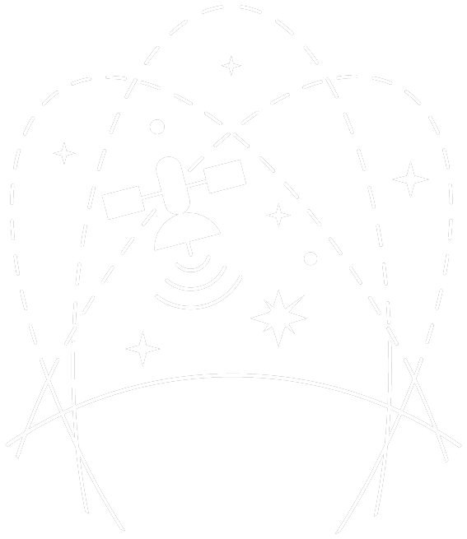

PROTECTING THE DARK & QUIET SKY · SWISS SKA DAYS 2026
Protecting the radio sky
in the SKA era
An update from the IAU Centre for the Protection of the Dark and Quiet Sky
Chris Finlay, EPFL — on behalf of the IAU CPS / SatHub
with M. Peel, F. di Vruno, M. Rawls, S. Eggl, M. Dadighat, D. Barron and the CPS community
cps.iau.org
Notes:
Welcome / thanks to organisers. I'm speaking on behalf of the IAU Centre for the Protection of the Dark and Quiet Sky. CPS is hosted by the SKAO, NSF NOIRLab and ESO. Today: a broad update, but framed for this audience — what satellite constellations mean for radio astronomy and the SKA, what CPS has learned and built, and how you can help. ~15 minutes, then questions.

Slide 2
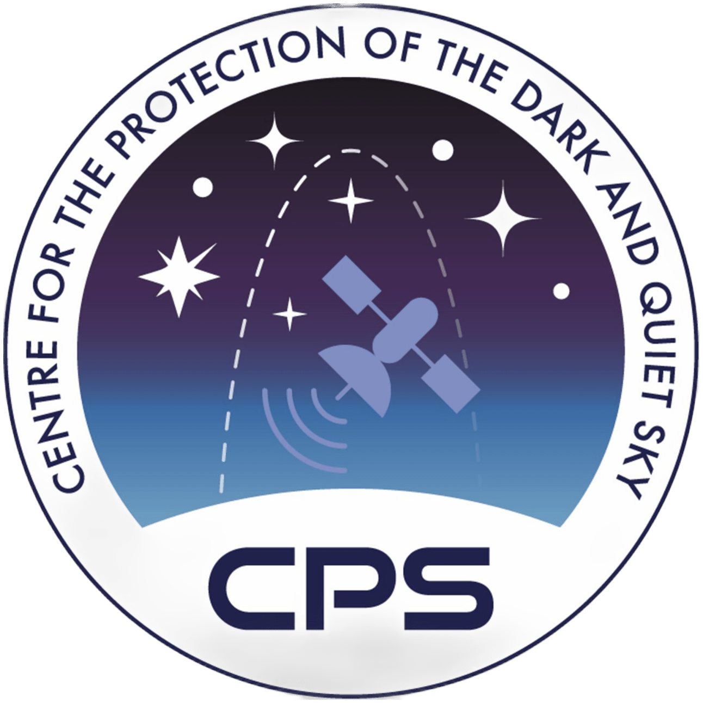
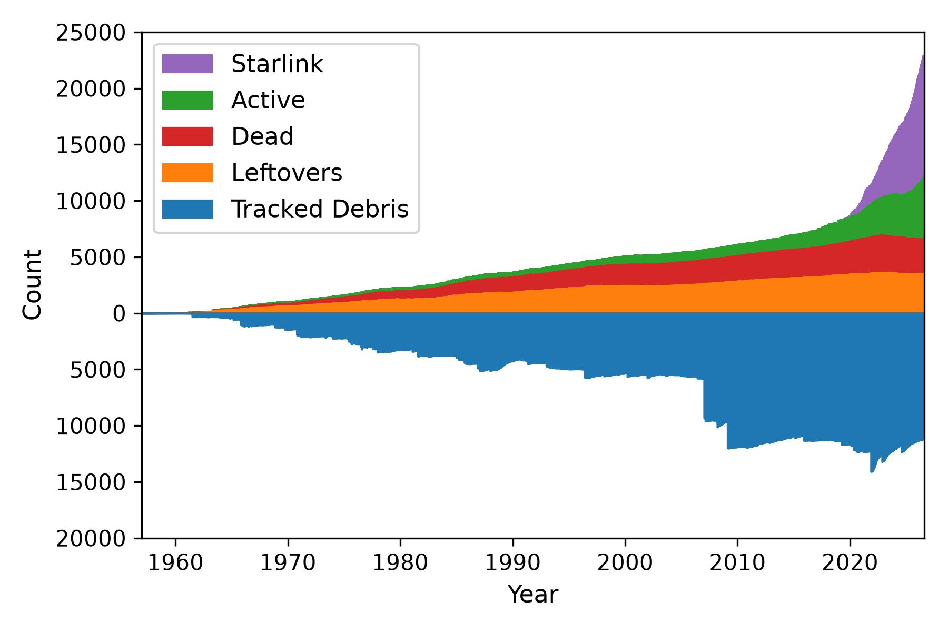

THE CONTEXT
Space is changing rapidly
15,000+
active satellites in low-Earth orbit — about 10,000 are Starlink
>3 million
satellites in filings submitted for the 2030s
70 yrs
of launches — but most of this growth is in the last five
Concerns span optical & radio astronomy, the night sky, space-traffic management and debris.
Tracked objects in orbit, 1960–present.
IAU CPS · cps.iau.org
1
Notes:
Headline numbers: ~15k operational satellites today, ~10k of them Starlink. Filings now total several million. The chart shows tracked objects over time — note the sharp upturn in the last few years (Starlink in purple), plus the growing debris population below the axis. The point for this room: the radio environment above every telescope is changing faster than at any time in the history of the field.

Slide 3
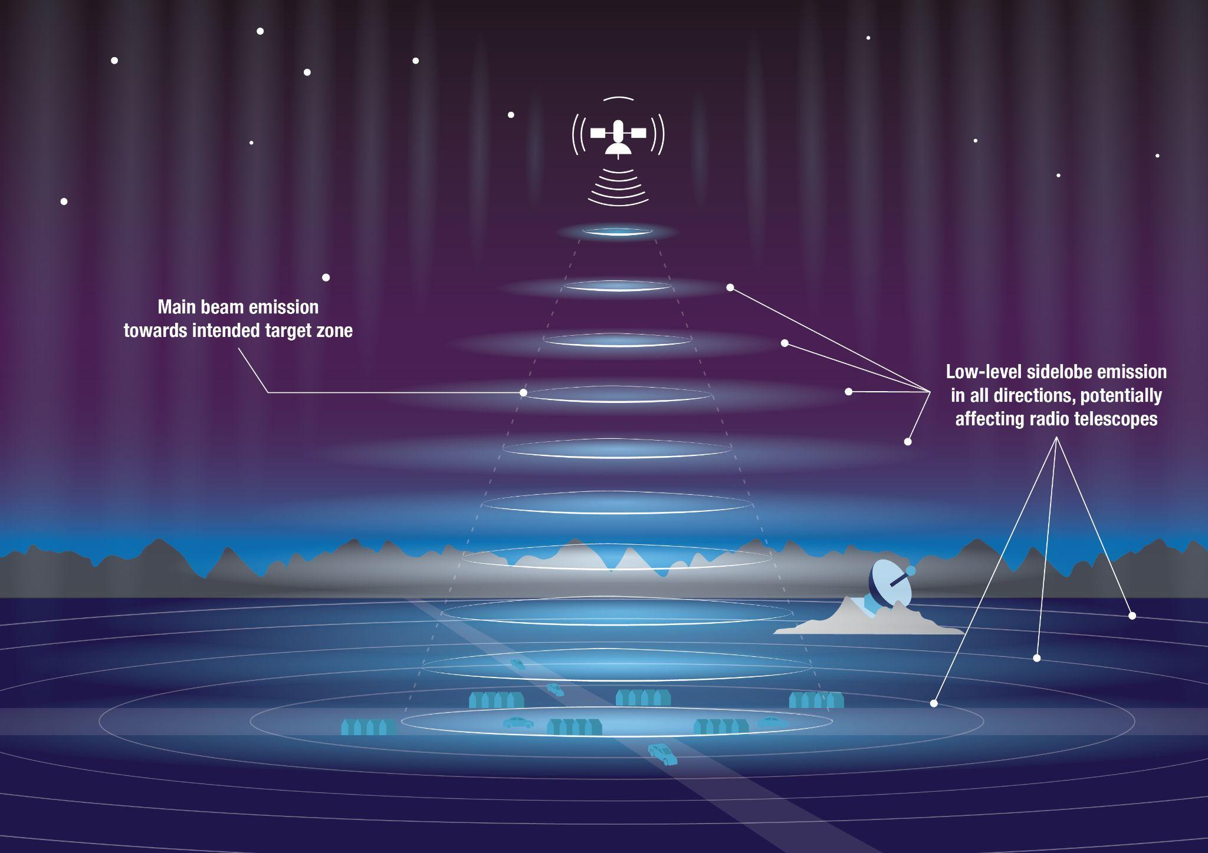
WHY RADIO ASTRONOMY CARES
Three ways satellites reach our receivers
1
Intended downlinks
Strong transmissions, currently ~10–20 GHz, with 40 GHz coming and filings up to 120–180 GHz. Protected RAS bands are narrow; normally observations use far wider bandwidths.
2
Unintended electromagnetic radiation (UEMR)
Leakage from on-board electronics, appearing even in bands where nothing is licensed to transmit — and even when a satellite is not actively downlinking.
3
Reflection & thermal emission
Satellites reflect strong terrestrial signals, and their warm bodies are intrinsically bright at mm wavelengths — present in sunlight and in Earth's shadow.
These effects already span SKA-Low (50–350 MHz) to SKA-Mid (0.35–15 GHz) and beyond.
Main-beam transmissions plus low-level sidelobe emission in all directions.
IAU CPS · cps.iau.org
2
Notes:
Three mechanisms. (1) Intended downlinks — the obvious one, but note frequencies are climbing and protected bands are tiny relative to the bandwidth we actually observe. (2) UEMR — leakage from electronics, the most insidious because it shows up in 'quiet' bands and even with no active downlink. (3) Reflection and thermal — they're bright even passively. The illustration: it isn't only the main beam pointed at a city; sidelobes spray emission everywhere, including toward the telescope.

Slide 4
WHO WE ARE
The IAU Centre for the Protection of the Dark and Quiet Sky
SatHub
Industry & Technology
Observation campaigns, brightness & data analysis, open-source tools — our focus today.
Collaboration with satellite operators on mitigations & best practice.
Policy
Community & Engagement
A centre of expertise of the International Astronomical Union, hosted by the SKAO, NSF NOIRLab and ESO.
National & international regulation; spectrum at the ITU & UN.
A bridge between all affected stakeholders & the public.
Uniting software engineers, observers, astronomers, satellite operators, policy experts and lawyers to protect the dark and quiet sky.
IAU CPS · cps.iau.org
3
Notes:
CPS exists because no single observatory or country can tackle this alone. Crucially for this room: it's hosted by the SKAO — radio astronomy is built into its DNA — alongside NOIRLab and ESO. Four hubs. I'll spend most time on SatHub (tools and observations), then touch Policy, because the ITU and UN work is where radio-band protection actually happens.

Slide 5
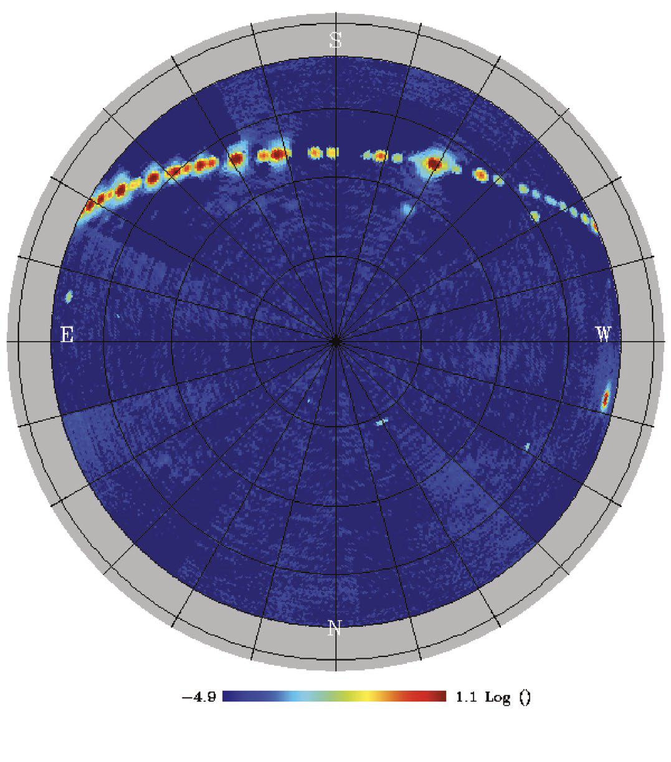
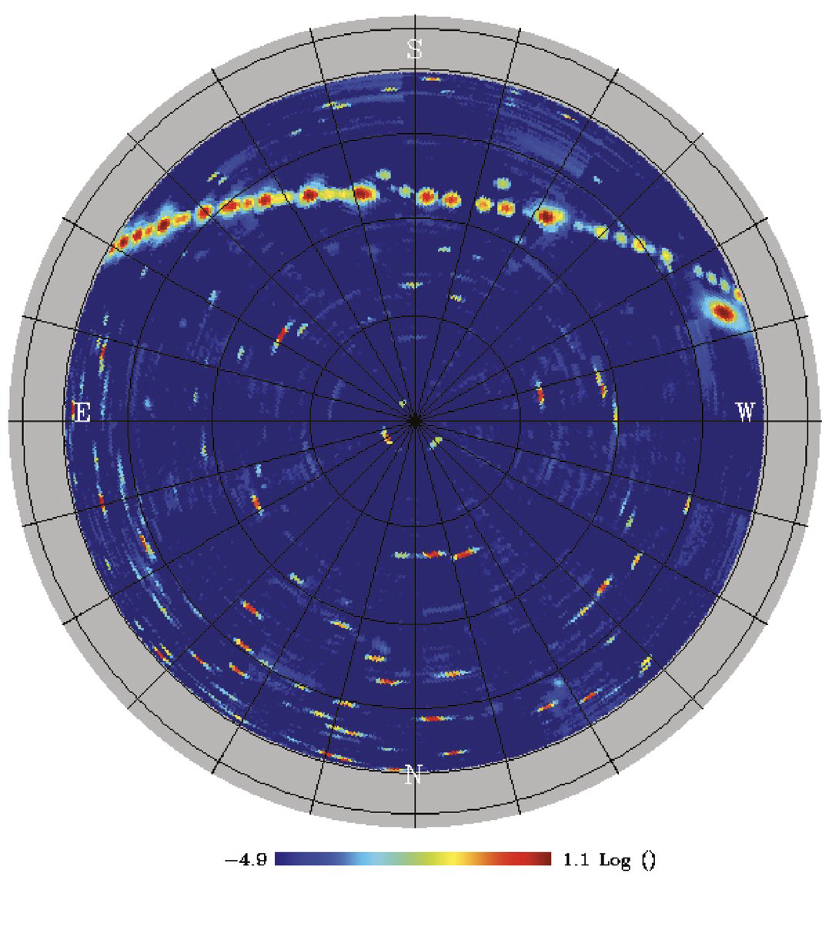
WHAT WE'RE SEEING · 10–40 GHZ
The radio sky is visibly changing
2014
2024
In 2014 the only persistent structure is the bright band of geostationary satellites.
Ten years later the same telescope sees a sky peppered with new sources — LEO constellations passing overhead.
Same site, same telescope. The change is the satellites, not the astronomy. These sources are as bright as the Sun.
QUIJOTE all-sky maps, Teide Observatory · QUIJOTE collaboration.
IAU CPS · cps.iau.org
4
Notes:
This is my favourite single demonstration. Two all-sky maps from the same QUIJOTE telescope on Tenerife, ten years apart. 2014: the bright arc is geostationary satellites — a known, fixed nuisance. 2024: the whole sky is dotted with new emission from low-Earth-orbit constellations sweeping through. Nothing changed about the instrument or the Galaxy — this is purely the satellites.

Slide 6
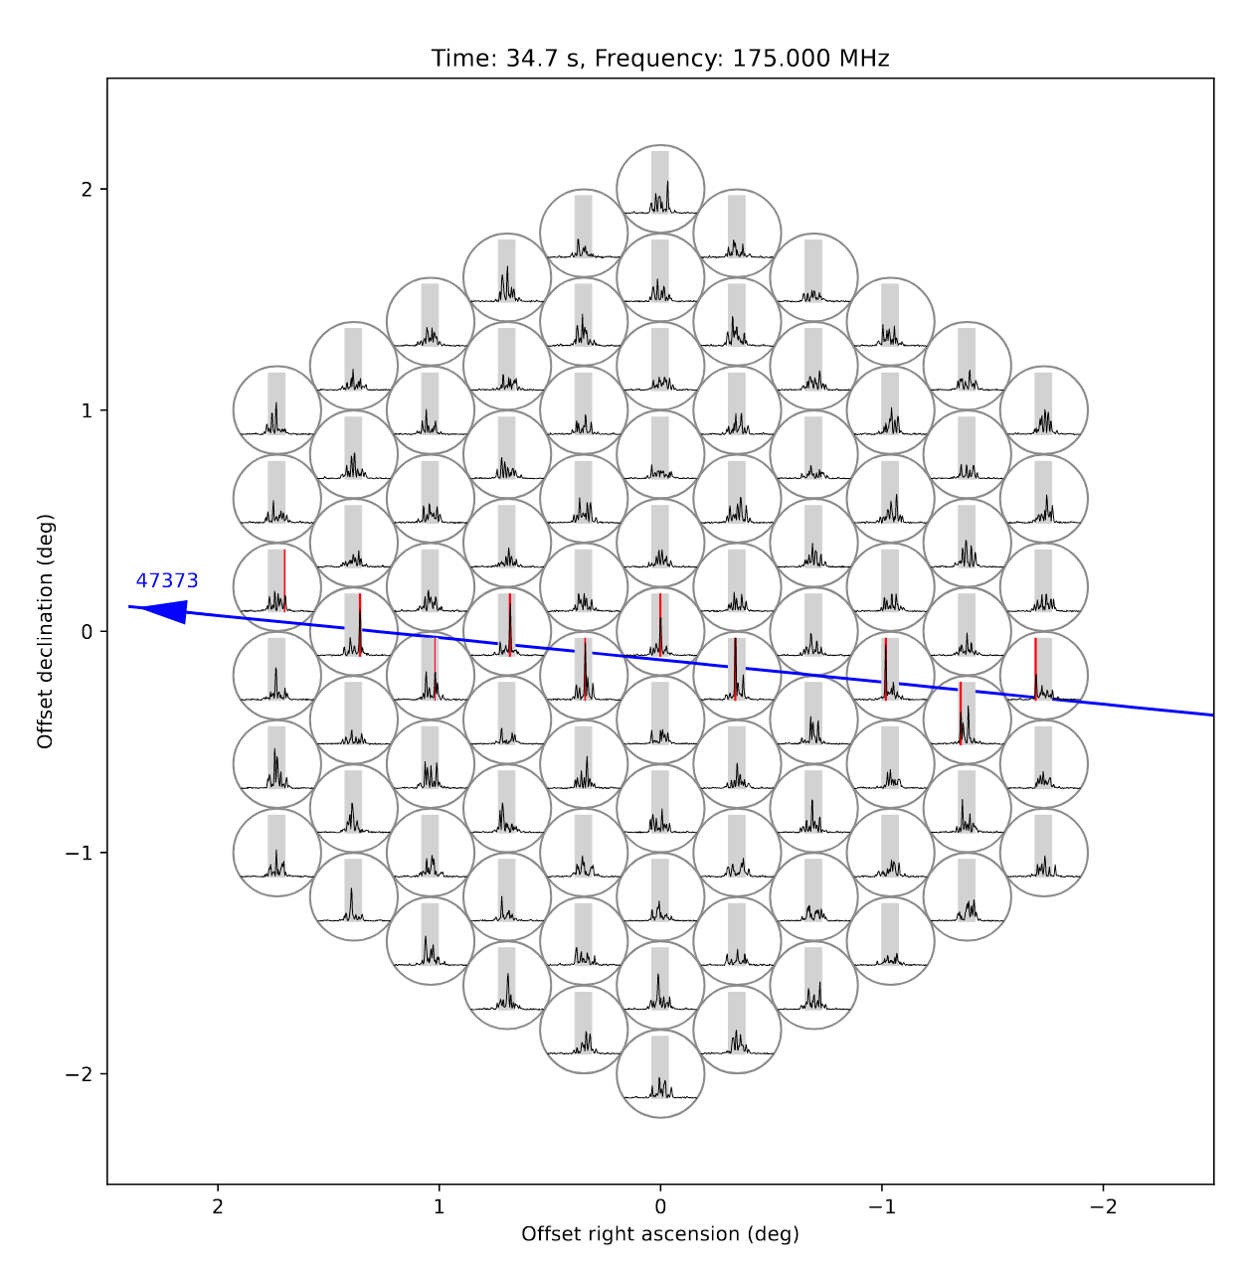
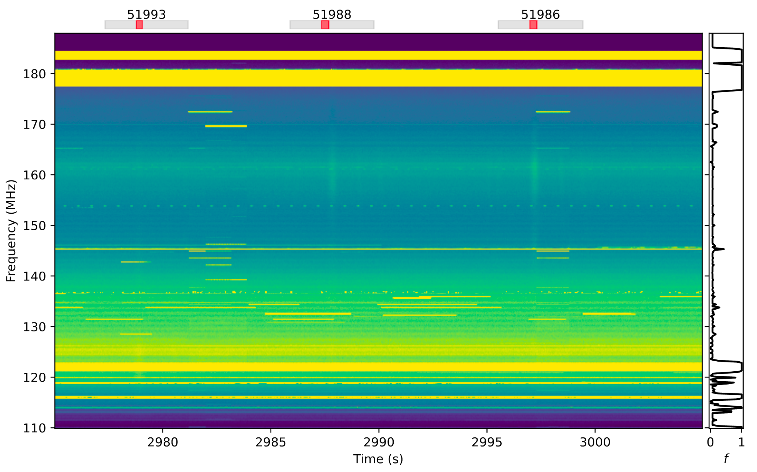
WHAT WE'RE SEEING · 110–180 MHZ
Unintended emission reaches SKA-Low frequencies
LOFAR detects UEMR from Starlink across 110–188 MHz (Di Vruno et al. 2023).
These bands are not allocated for satellite downlink — this is electronics leakage.
It overlaps SKA-Low (50–350 MHz) directly.
Di Vruno et al. (2023), A&A · arXiv:2307.02316
LOFAR dynamic spectrum — satellite passes detected ~110–180 MHz.
IAU CPS · cps.iau.org
5
Notes:
This is the slide that should worry an SKA-Low audience. LOFAR — same frequency regime as SKA-Low — sees clear unintended emission from Starlink between roughly 110 and 190 MHz. The key point: nobody is licensed to transmit there. It's leakage from the spacecraft electronics. The dynamic spectrum on the left shows individual passes; the panel on the right is a single 175 MHz snapshot with a satellite tracking across the array. SKA-Low will be exquisitely sensitive in exactly this band.

Slide 7
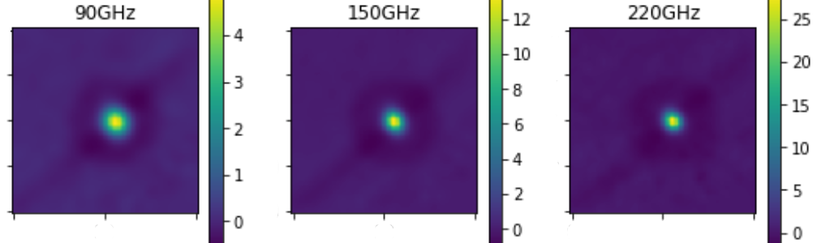
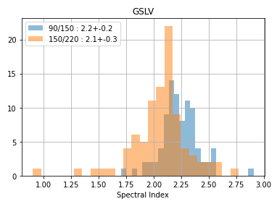
WHAT WE'RE SEEING · MM WAVELENGTHS
Bright even when not transmitting
CMB experiments such as SPT-3G routinely detect satellites and rocket bodies as ~Jy-level sources at 90 / 150 / 220 GHz.
The spectral index (~2) is consistent with thermal blackbody emission from a ~300 K body.
Seen both in sunlight and in Earth's shadow — so it is intrinsic, not reflected.
A growing concern for every mm / sub-mm facility.
Foster et al. (2025),The Open Journal of Astrophysics, arXiv:2411.03374 — SPT-3G detections.
IAU CPS · cps.iau.org
6
Notes:
Even passive satellites are a problem at high radio / mm frequencies. CMB telescopes like SPT-3G see satellites and spent rocket stages as bright, Jansky-level sources at 90, 150 and 220 GHz — the beam maps on the left. The measured spectral index near 2 matches a 300 K blackbody, and crucially they're seen in Earth's shadow too, so this is thermal self-emission, not reflected sunlight. Relevant to the high end of SKA-Mid and to mm facilities generally.

Slide 8
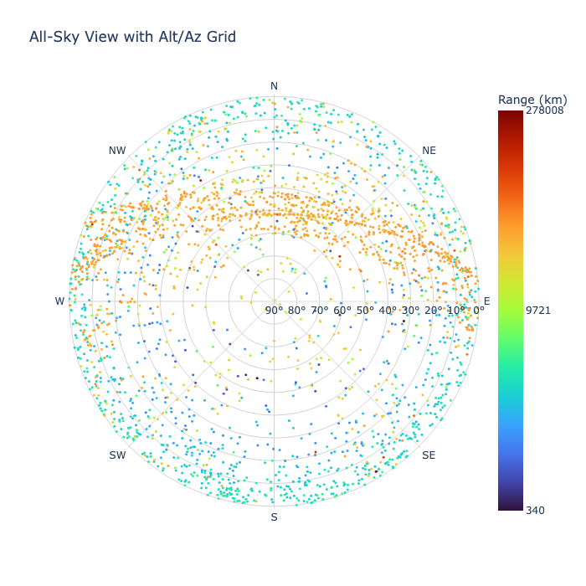
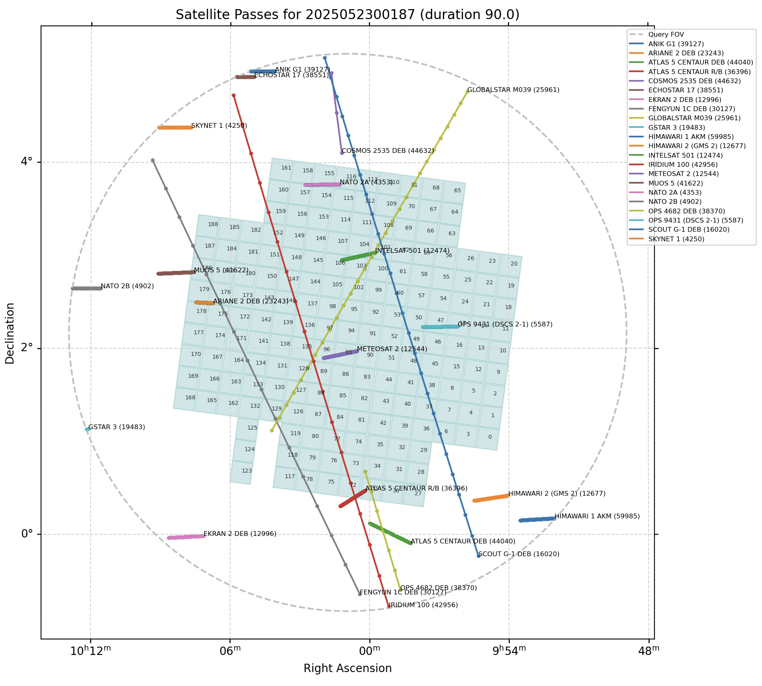
CPS TOOLS · PREDICT
SatChecker — knowing where the satellites are
Open API for satellite pass and field-of-view prediction.
Give it an RA/Dec centre, radius and time window — get every satellite overhead.
Archive of >200 million historical TLEs, back to 1959.
Returns full metadata: NORAD / COSPAR IDs, launch & decay dates.
satchecker.cps.iau.org
All-sky pass prediction (left) and a single field-of-view query (right).
IAU CPS · cps.iau.org
7
Notes:
SatChecker is the prediction engine. It's an open API: you hand it a pointing and a time, it tells you which satellites are in or near your field. It's backed by a huge TLE archive going back to the dawn of the space age. For radio, the field-of-view service is the useful bit — you can plan around predicted passes, or flag them in processing.

Slide 9
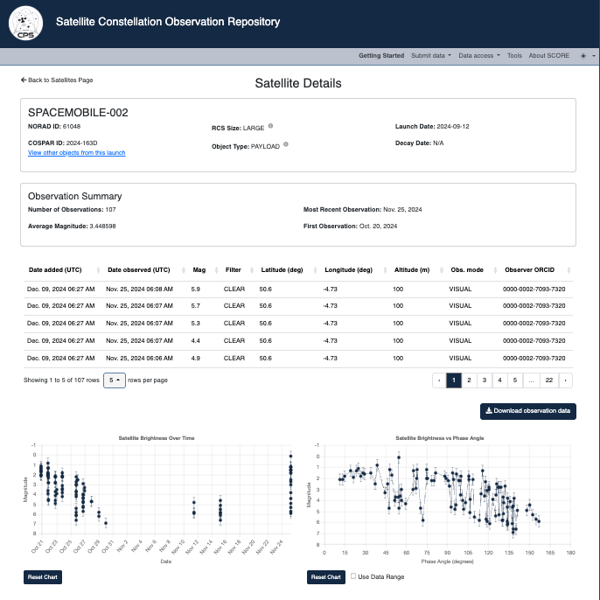
CPS TOOLS · MEASURE
SCORE — a community observation repository
A central store for measured satellite brightnesses and positions.
Each entry is cross-checked against SatChecker's predicted position.
Feeds satellite-brightness models and interference simulations.
Now extending to radio — standard submission format and upload API in development.
score.cps.iau.org
The Satellite Constellation Observation REpository web interface.
IAU CPS · cps.iau.org
8
Notes:
SCORE is the data side. It's where observers deposit calibrated brightness and position measurements, automatically cross-referenced against SatChecker so we know we're looking at the right object. Until now it's been optical-magnitude focused. The development that matters for this audience: we're building radio support — a standard format and an upload API so radio detections can live alongside the optical ones. This is exactly where the SKA community can contribute data.

Slide 10
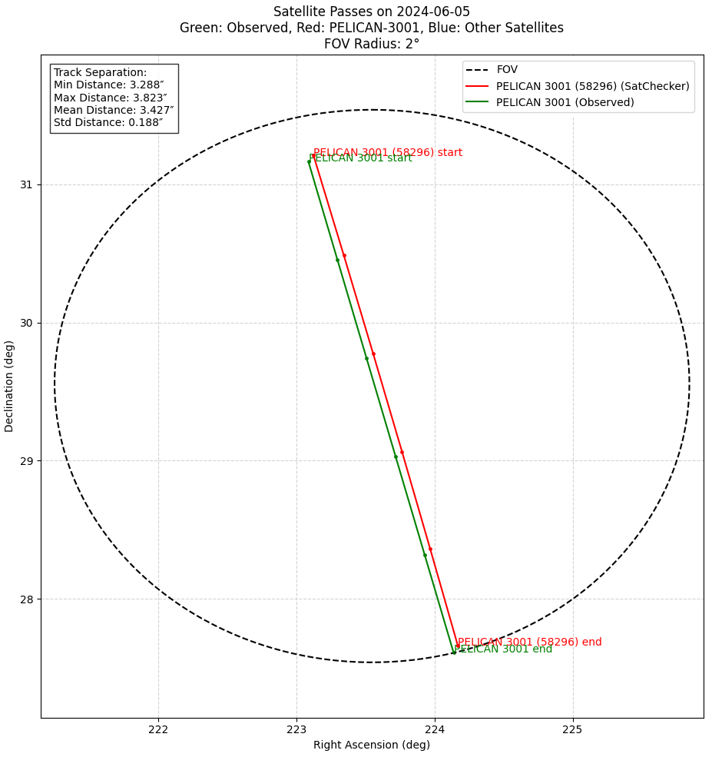
CPS TOOLS · MODEL
From predictions to impact modelling
Validation first: SatChecker predictions are continuously compared against observed passes (right) to quantify how well TLEs locate fast-moving LEO objects.
TLEs have limited precision, carry no uncertainties, and can miss manoeuvres — driving work on covariance-based ephemerides.
This feeds radio-impact modelling (SCEPTER): combining orbits, emission characteristics and a telescope's response — including sidelobes — to estimate the aggregate interference at an observatory.
Supports observation planning, avoidance and EPFD-style assessments.
Predicted vs observed satellite track in a telescope field.
IAU CPS · cps.iau.org
9
Notes:
Tools are only as good as the orbits behind them. We continuously validate SatChecker against real observed passes — the plot shows predicted vs observed tracks. TLEs are the weak link: low precision, no error bars, blind to manoeuvres, so there's active work on covariance-bearing ephemerides. All of this feeds CPS's radio-impact modelling effort (SCEPTER): fold orbits, emission and the telescope's full response — sidelobes included — into an estimate of aggregate interference. That's what underpins both observation planning and the formal EPFD-type assessments regulators ask for.

Slide 11


PROTECTION · POLICY
Protecting the spectrum: the ITU & the UN
ITU
UN COPUOS
Where radio spectrum is actually governed
Committee on the Peaceful Uses of Outer Space
WRC-27 AI 1.16: impacts on RAS bands & Radio Quiet Zones from satellite systems.
AI 1.18: EESS and RAS above 76 GHz.
Ongoing UEMR report (Working Party 7D).
Resolutions 219 & ITU-R 74: sustainable use of spectrum and orbits.
Dark & Quiet Skies is now an agenda item at the Scientific & Technical Subcommittee.
A "Group of Friends for Dark and Quiet Skies" promotes awareness and best practice.
National measures are emerging — including Switzerland's Space Sustainability Rating.
IAU CPS · cps.iau.org
10
Notes:
Tools mitigate; policy prevents. Two arenas. The ITU is where spectrum is legally governed — and WRC-27 has, for the first time, an agenda item (1.16) is discussing protections of RAS bands from satellites and recognition of RQZs in the radio regulations. That is very important for the SKA, which depends on its radio-quiet zone. CPS also contributes the UEMR report at WP7D. Separately, at the UN COPUOS, Dark & Quiet Skies is now a standing agenda item with a Group of Friends — and note Switzerland's own Space Sustainability Rating as a national example.

Slide 12
GET INVOLVED
How the SKA community can help
1
2
3
4
Observe & share
Build radio SCORE
Speak up on policy
Join CPS / SatHub
If you detect a satellite, don't bin the data. Calibrate it and upload to SCORE — even rough measurements help.
Help define formats and priority targets; contribute existing datasets of satellite detections.
Support RAS-band and Radio-Quiet-Zone protections at WRC-27 through your national bodies.
Membership is free. Help us quantify the real impact on the SKA across the spectrum.
IAU CPS · cps.iau.org
11
Notes:
Concrete asks for this room. One: observe and share — any calibrated satellite detection is valuable; please upload to SCORE rather than discarding it. Two: help us build the radio side of SCORE — formats, priority targets, legacy datasets. Three: policy — your national society's voice at WRC-27 on RAS bands and RQZs genuinely matters. Four: just join — it's free, and SKA-relevant expertise is exactly what we need.

Slide 13
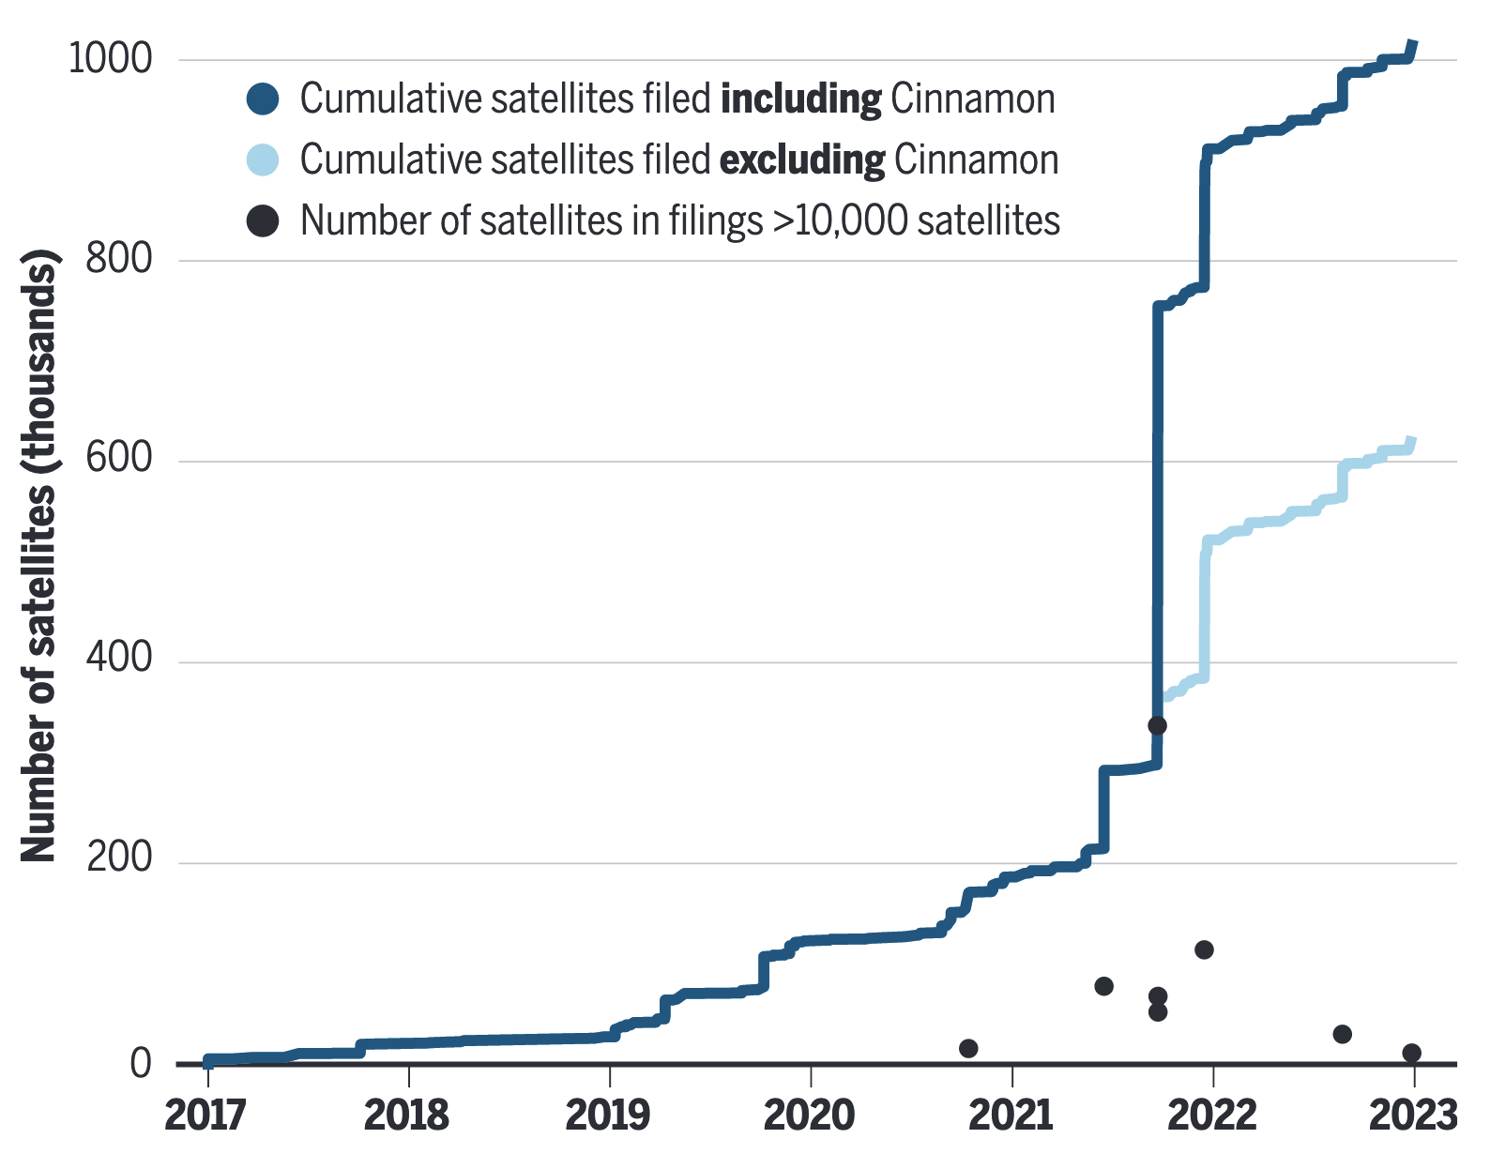
ON THE HORIZON
It's only getting busier
Larger spacecraft & direct-to-cell: AST SpaceMobile-style phased arrays, with hundreds more approved.
Orbital data centres: SpaceX has filed for a ~1-million-satellite compute constellation; others are following.
Entirely new uses: "daylight as a service" from orbital mirrors (Reflect Orbital).
Filings already total well over 3 million satellites.
Cumulative satellites in filings · Falle et al. (2023), Science.
IAU CPS · cps.iau.org
12
Notes:
And the trend line points up. Bigger satellites and direct-to-cell arrays (which are optically and radio-bright). Orbital data centres — SpaceX has literally filed for around a million satellites to run compute in orbit. Novel uses like orbital mirrors selling 'daylight as a service.' The chart shows cumulative filings already exceeding a million. The planning we do now — tools, data, policy — has to be sized for this, not for today.

Slide 14

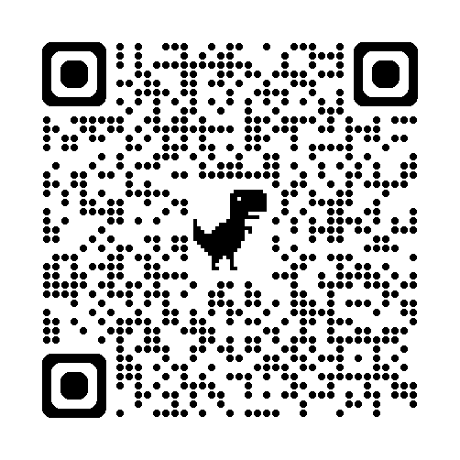
CONCLUSIONS
The radio sky needs the SKA community
Satellite numbers are rising fast — and the radio impact already spans MHz to mm.
CPS offers open tools — SatChecker & SCORE — plus impact modelling and spectrum policy.
What we most need now is observations and voices from the radio / SKA community.
Join CPS
Is this an existential moment for radio astronomy? Not if we act together.
cps.iau.org
Thank you — questions?
Notes:
To close. The numbers are rising fast and the radio footprint already runs from SKA-Low frequencies up to mm. CPS gives the community open tools — SatChecker and SCORE — plus the modelling and the policy machinery at the ITU and UN. But the missing ingredient is you: radio observations and radio voices. Please scan the code, join CPS, and bring your SKA expertise. Thank you — happy to take questions.

