Slide 1
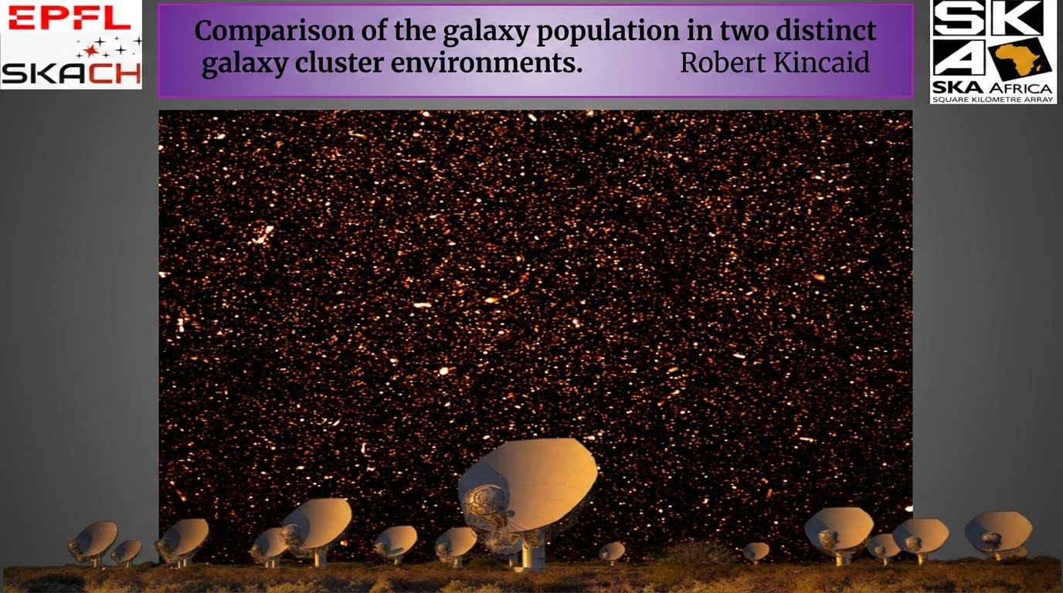
MeerKAT Observations of the Saraswati Supercluster (MOSS III):
Comparisons of the galaxy populations in two distinct cluster environments
Robert Kincaid with Mark Sargent and Pascale Jablonka

Slide 2
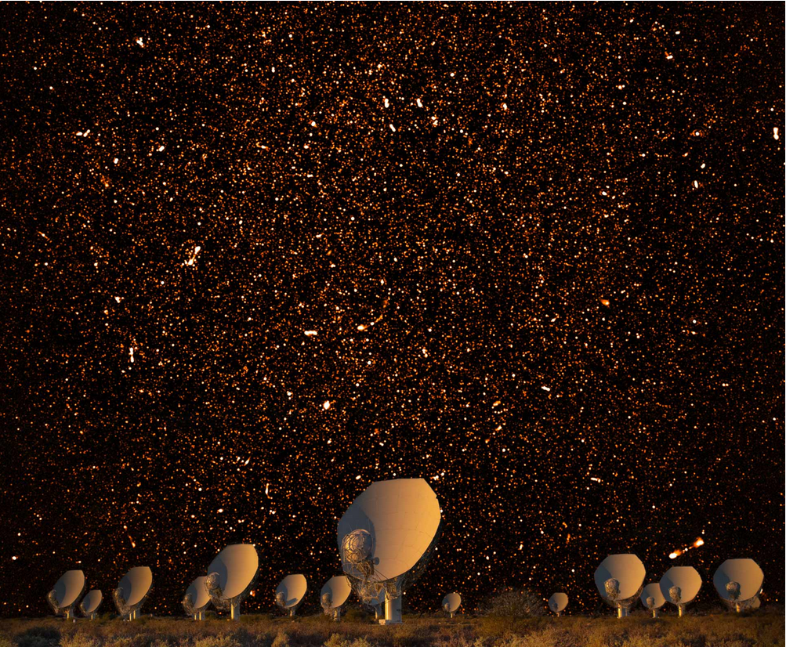
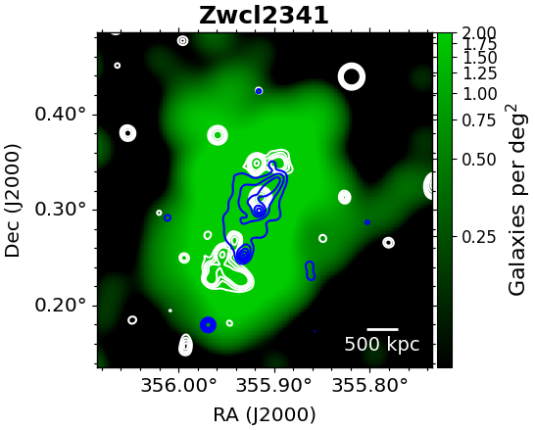
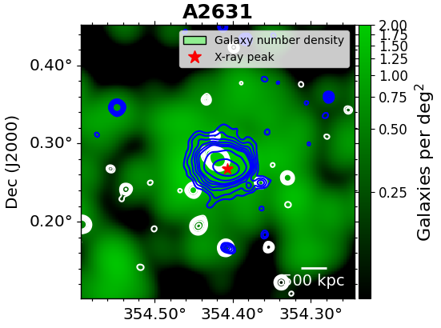
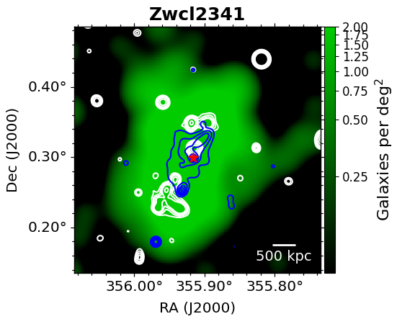
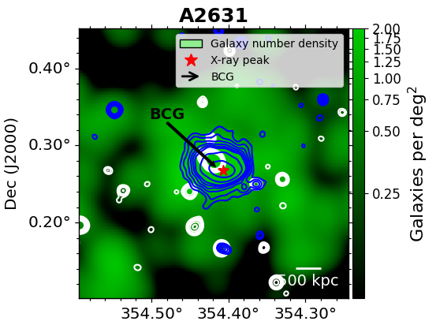
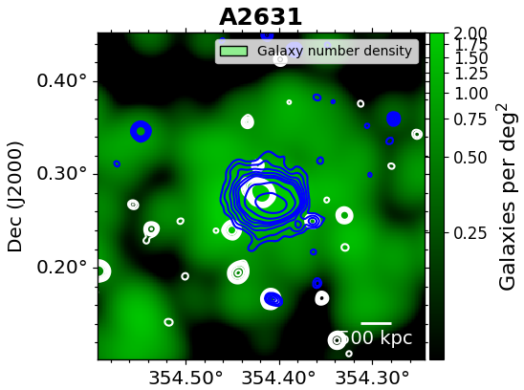
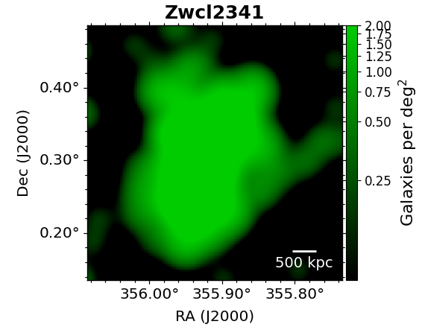
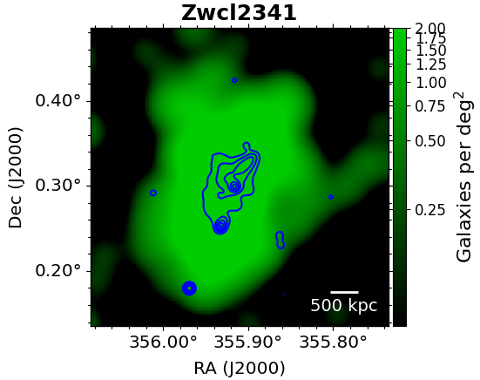
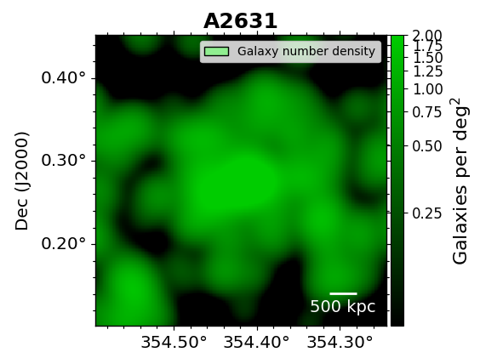

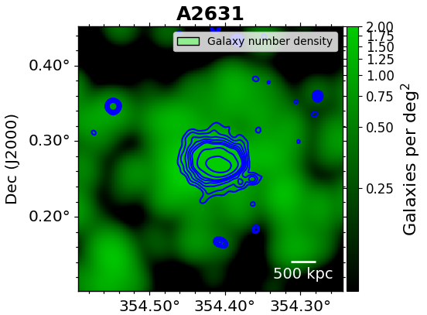
Two distinct cluster environments: Multi-wavelength view
relaxed cluster environment
Active cluster environment
relics
Large offset
Small offset
A2631 → X-ray emission rounded and symmetric. BCG slightly offset from X-ray/optical peak.
Zwcl2341 → cluster-wide diffuse relics. X-ray/optical morphology elongated in the direction of the merger.

Slide 3

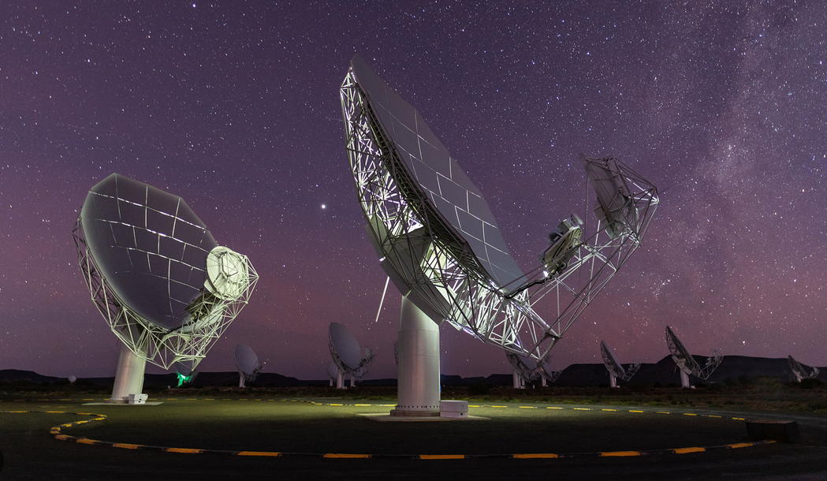
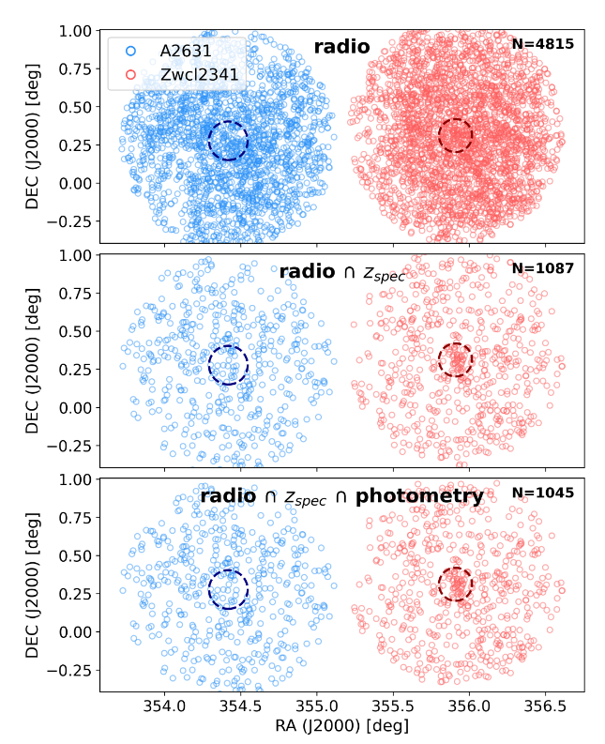
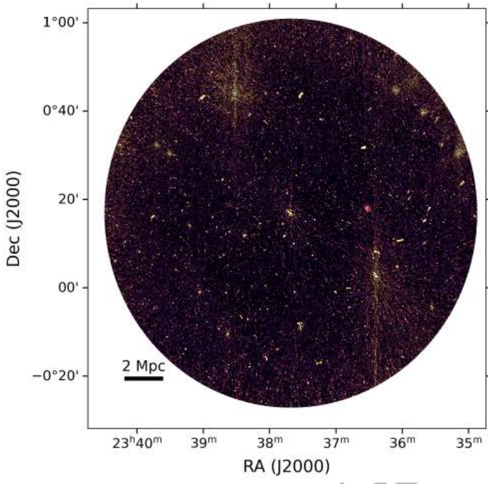
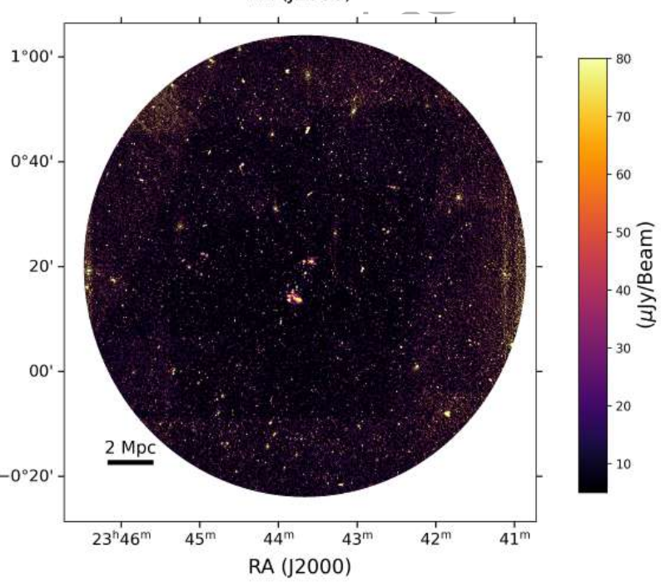
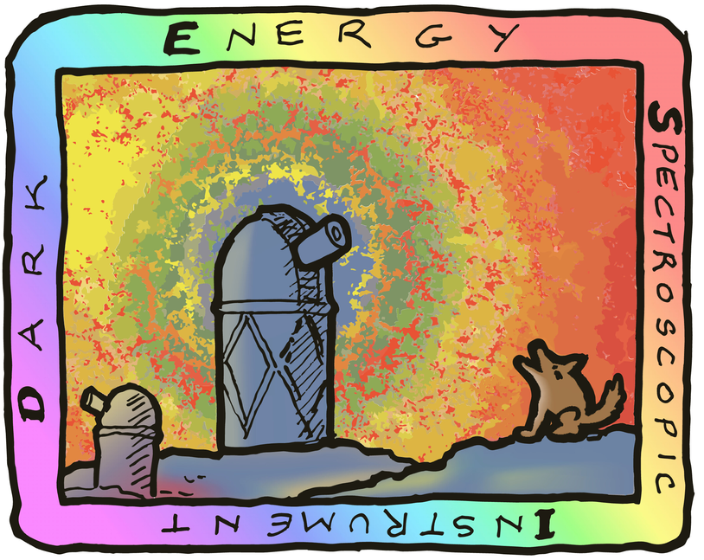

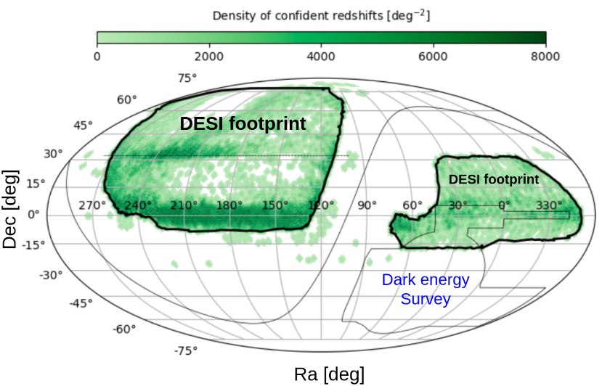

Multi-wavelength data
Deep radio observation
Shallow Large sky optical survey

Slide 4



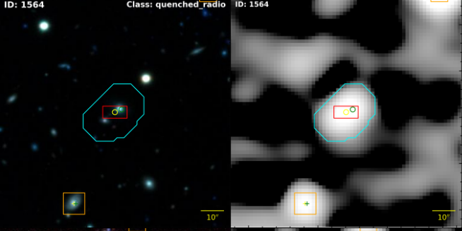
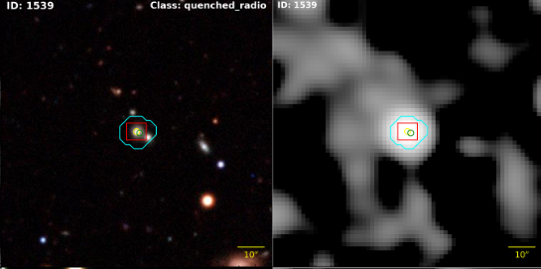
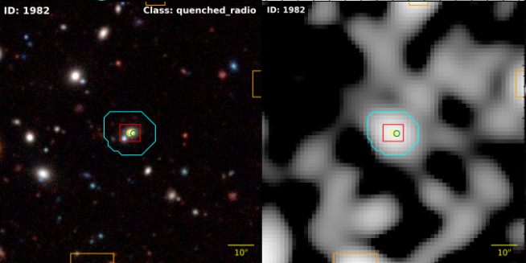
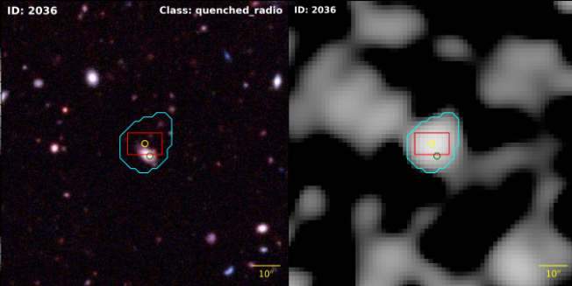
Multi-wavelength images of observed galaxies
optical
Radio
optical
Radio
rms =10 uJy
beam = 8 arcsec
Flux estimation

Slide 5
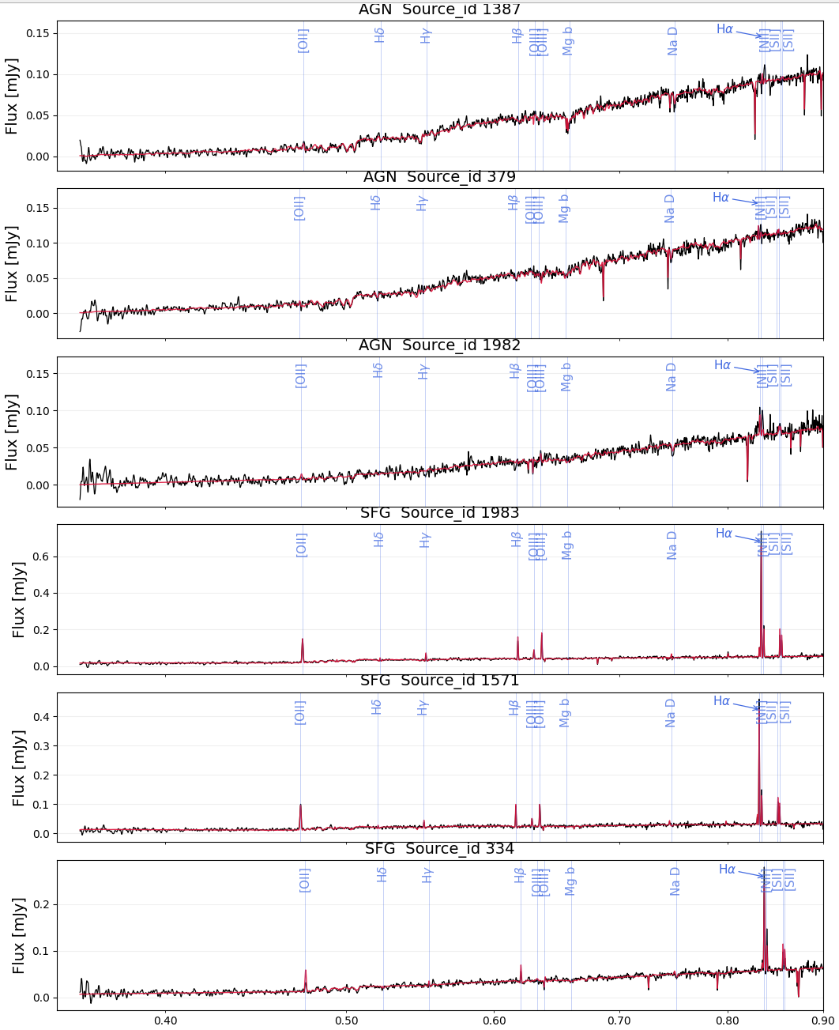
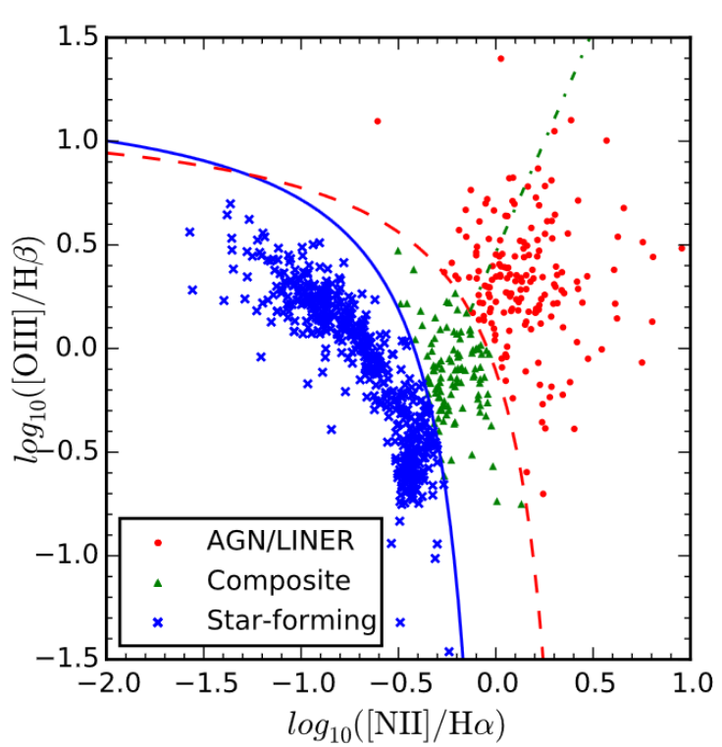
Galaxy Spectra
AGN
Spectra: High resolution over a narrow band g,r,z (optical)
Best for galaxy redshift and emission line ratios
Can use BPT diagram for galaxy classifications
AGN
SFG
SFG

Slide 6
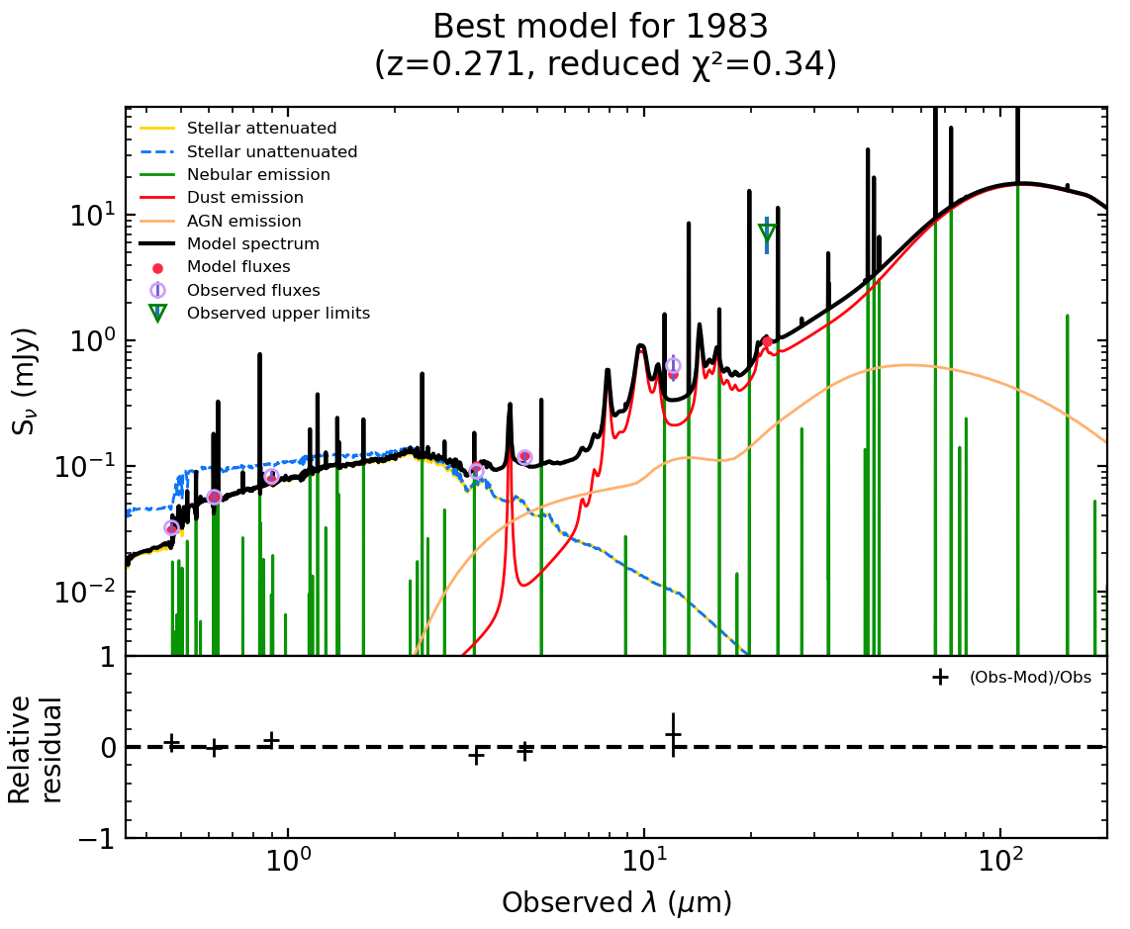
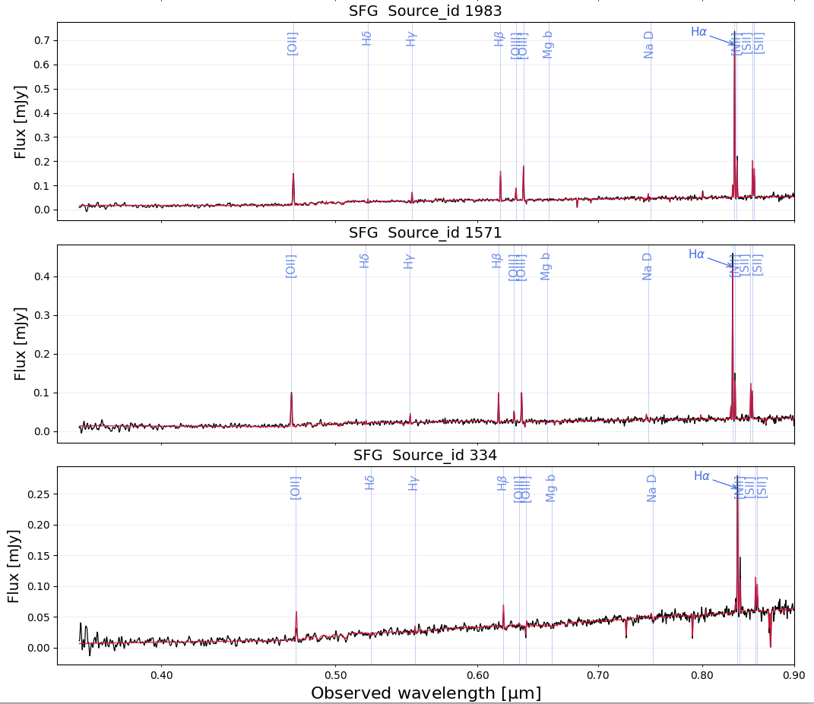
Galaxy SED
SED spans broader wavelength from optical to mid-IR g,r,i,z,w1,w2,w3,w4 (0.4-200 um)
SED fitting was performed using CIGALE software from optical to mid-IR (0.4-200 um)
Total mass is set by total light from stars -> SED better than spectra.
Mid IR
optical

Slide 7
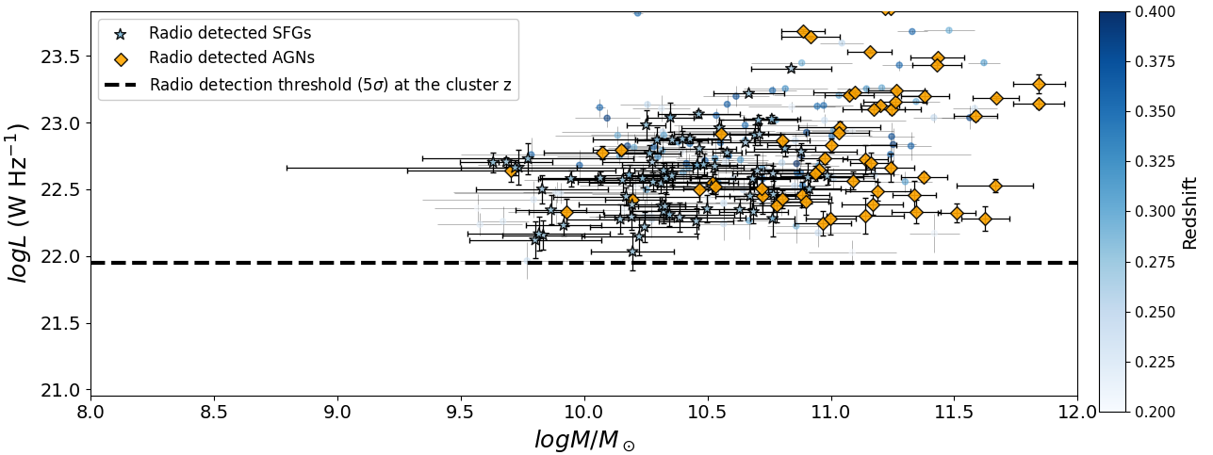

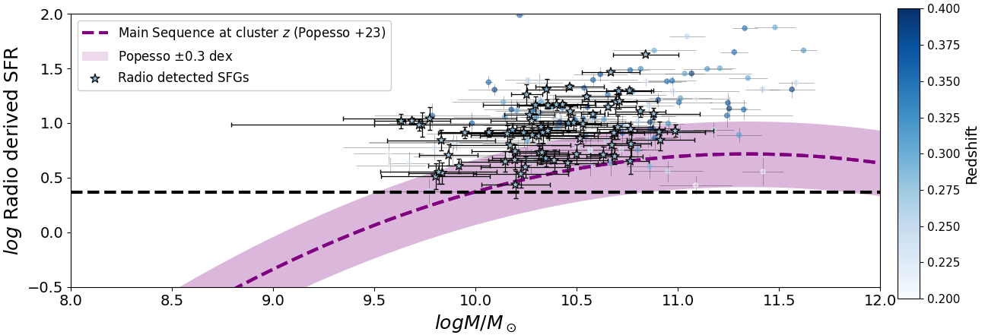
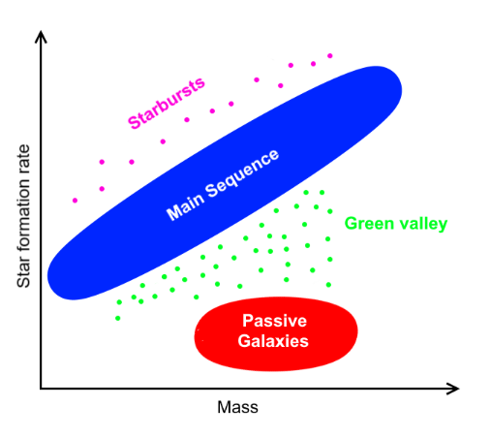
Radio luminosity and SFR
MS of SFGs
Detection limit

Slide 8
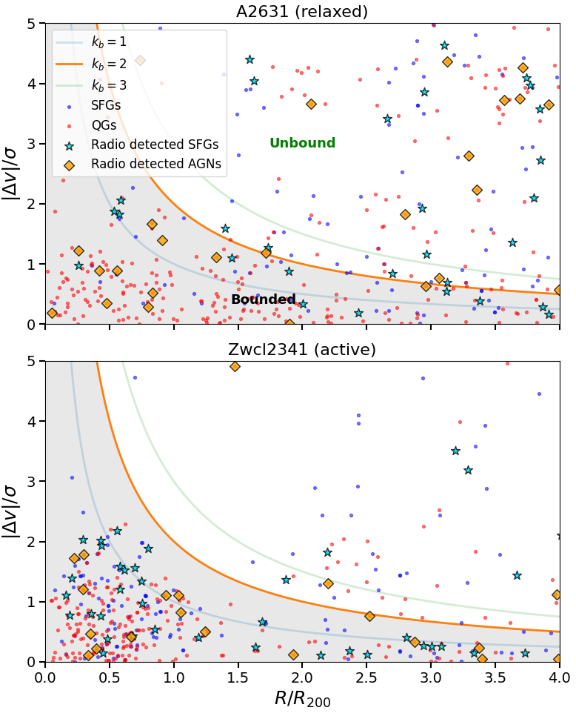
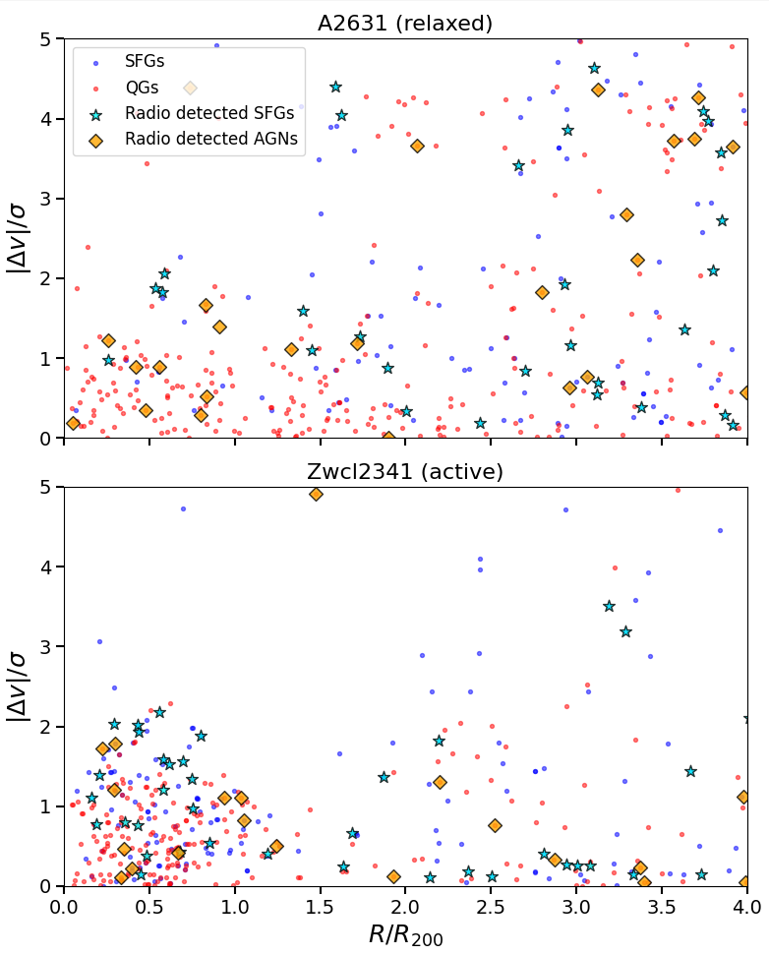
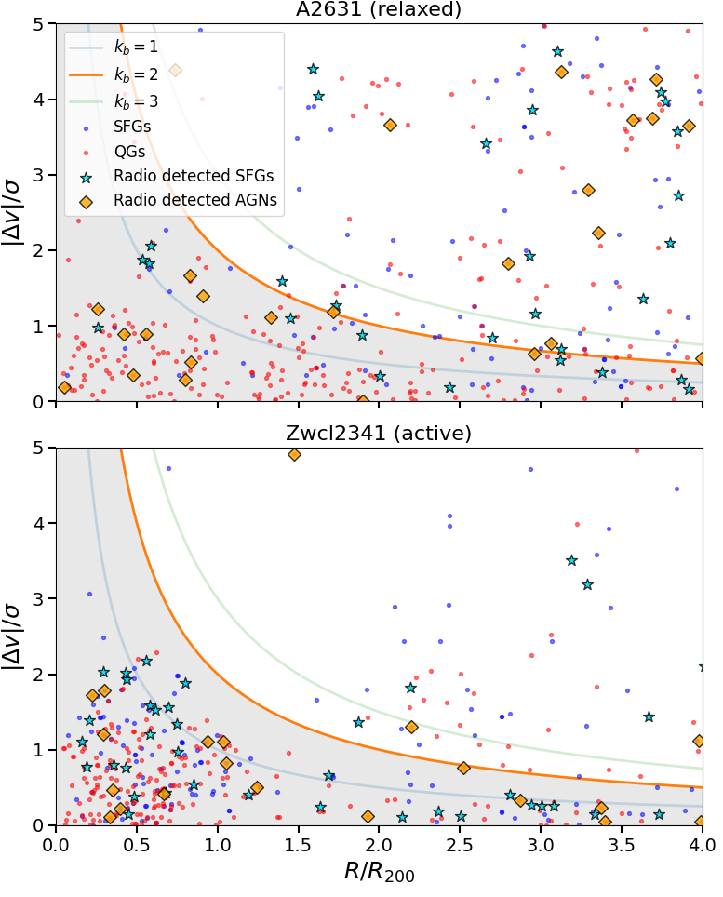
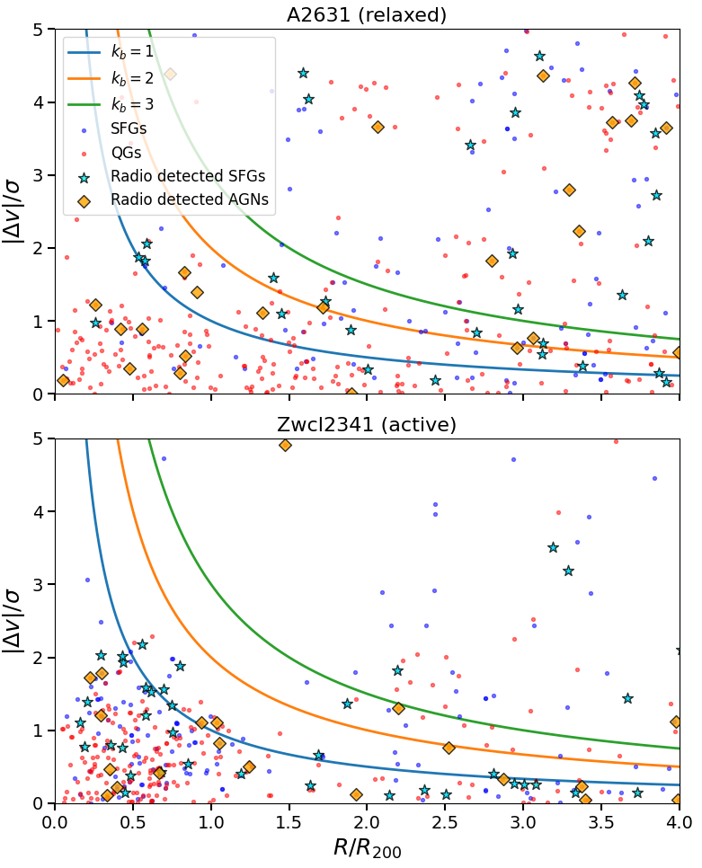

Spatial and kinematic profiles: Phase space diagram
Galaxy kinematics probed through phase space diagrams.
kb parameter tells us the boundedness of a galaxy.
A2631 shows no clustering and an even spread of galaxy populations.
Zwcl2341 shows clustering at the core with majority Quenched galaxies.
Notes:
$3^{4^5} + \frac{1}{2}$$

Slide 9
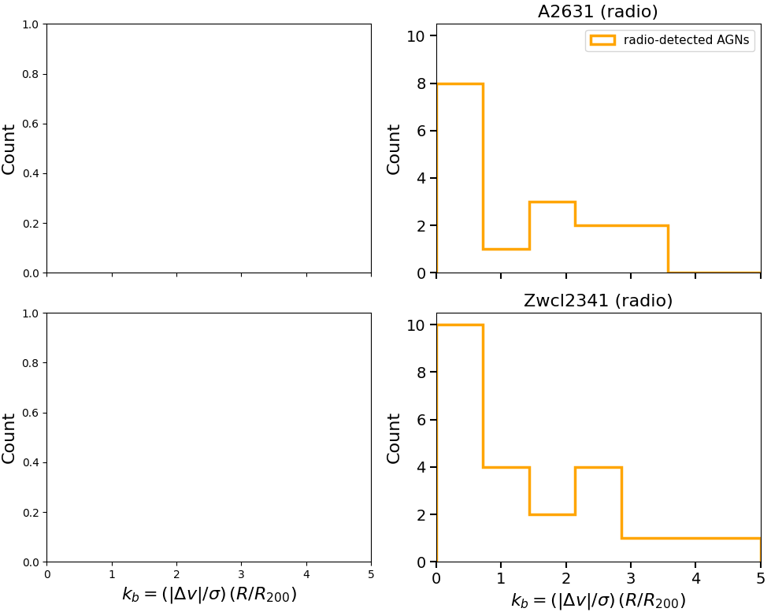
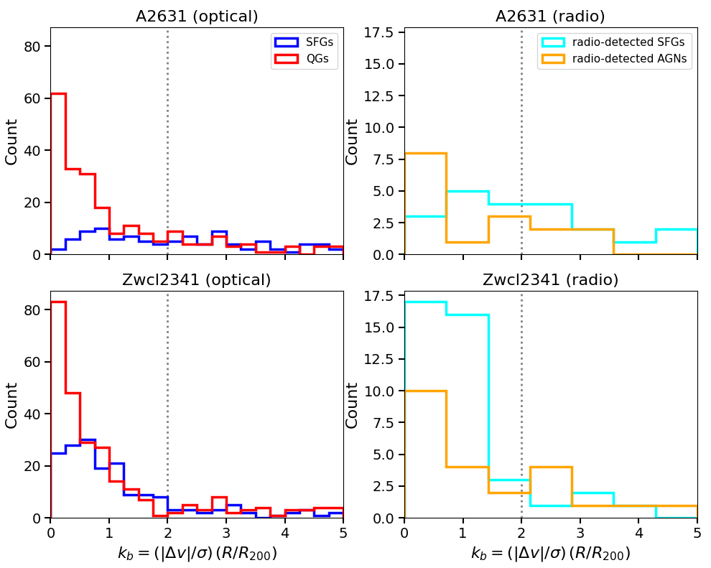
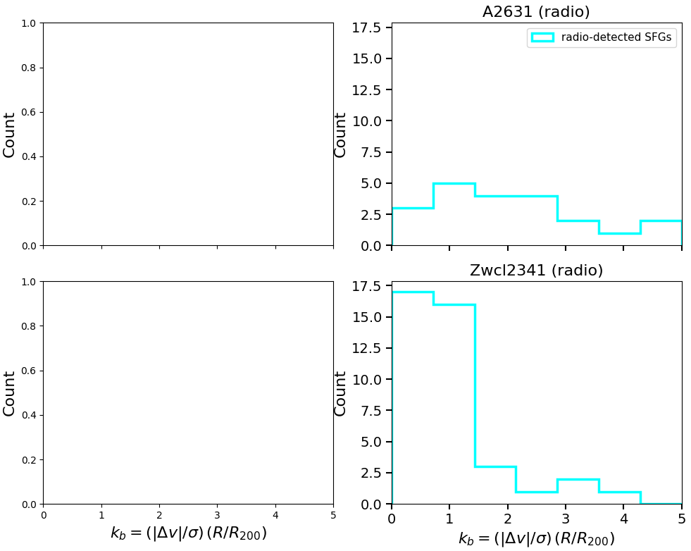
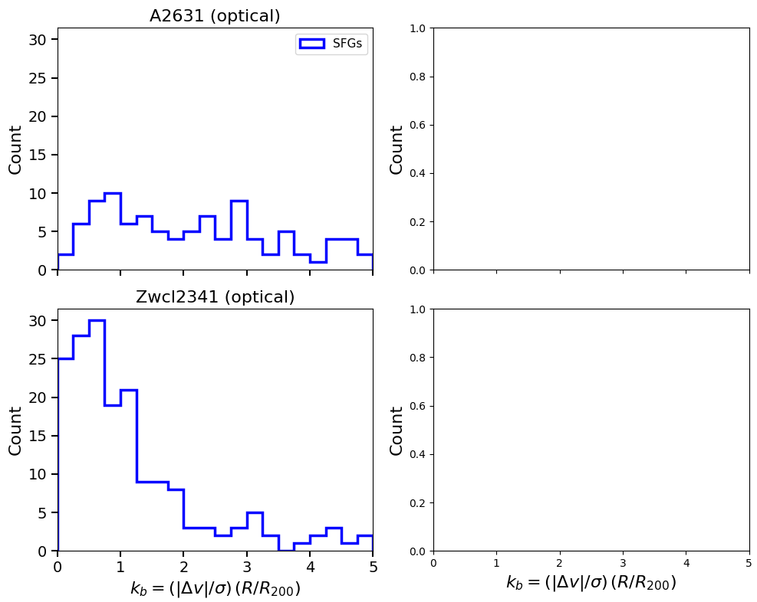
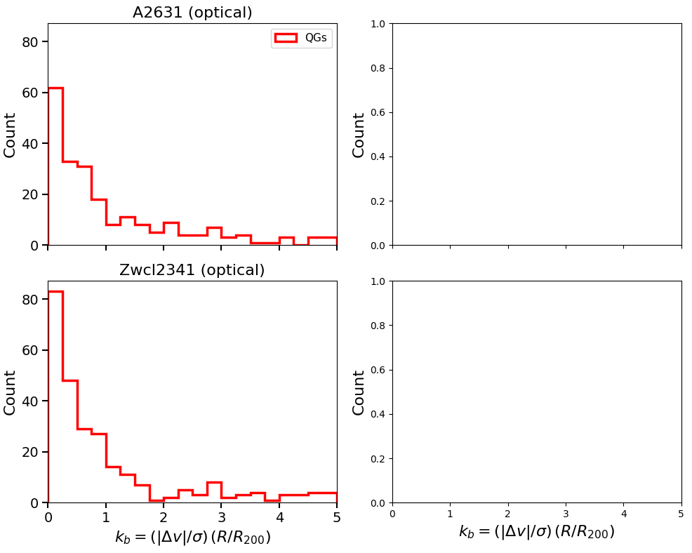
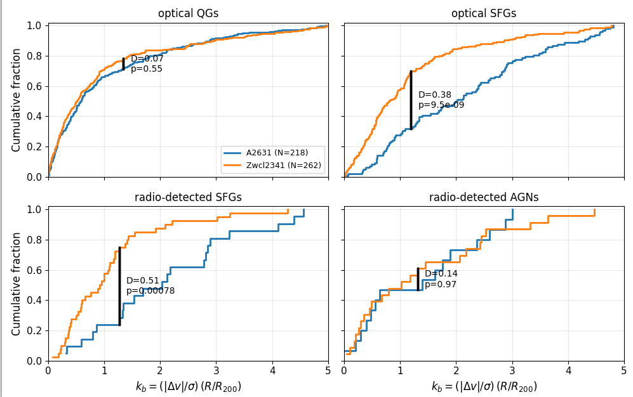
Quantitative difference of different galaxy types
KS test: Compares two independent data samples to see if they are drawn from the same underlying distribution.
Radio-detected and non-radio detected SFGs differ the most when comparing the active cluster with the relaxed one.

Slide 10
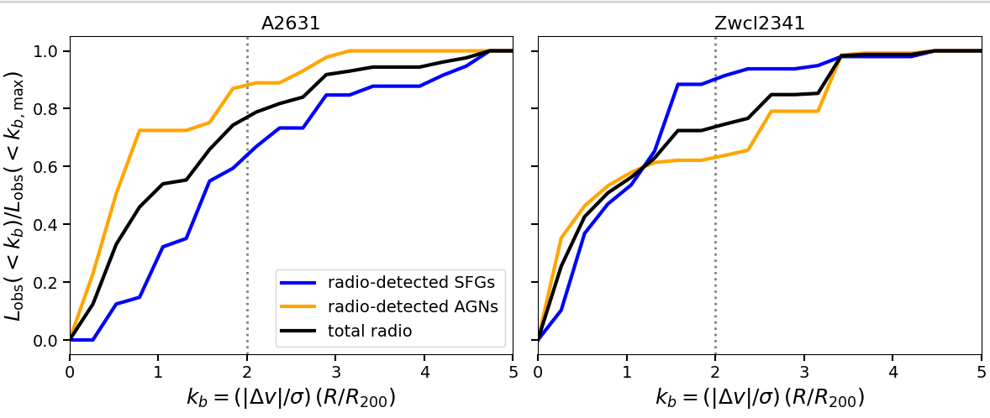
Contribution of different radio powered processes
Total radio luminosity concentration of radio-detected SFGs/AGNs at different kb.
A2631 → 80% of AGN light is concentrated in the bounded core region. SFG radio-related processes continue for kb > 2.
Zwcl2341 → 90% of SFG light is coming from radio galaxies bounded at the core. AGN radio-related processes continue for kb > 2.
80%
90%
60%
60%

Slide 11
Conclusion
Population of star forming galaxies both radio and non-radio detected differ the most.
Merging clusters have an increased population of star-forming galaxies.
Radio-related star-forming dominate in merging clusters and are concentrated at the core.
Physics behind: Merging funnels fresh gas into the cluster environments, amplifies RMP → more gas, compression of GMC causing gas to collapse → increased star-formation
Increase of sample size including other Saraswati core clusters is needed for a comprehensive overview (MOSS IV)

Slide 12
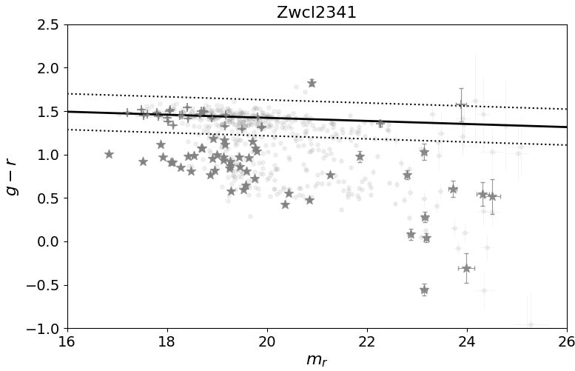
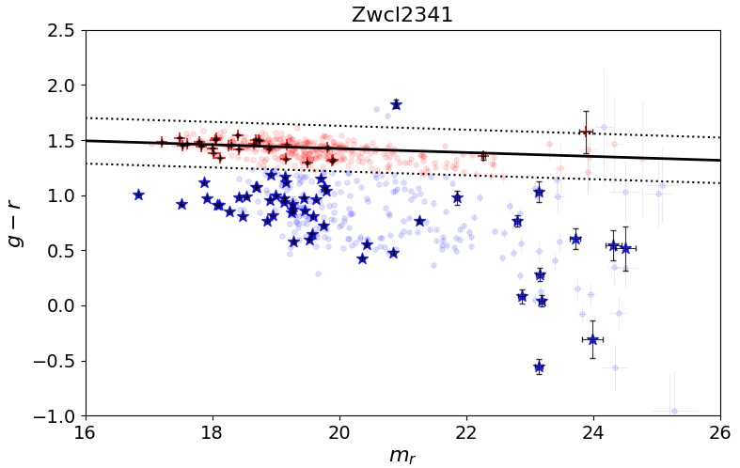
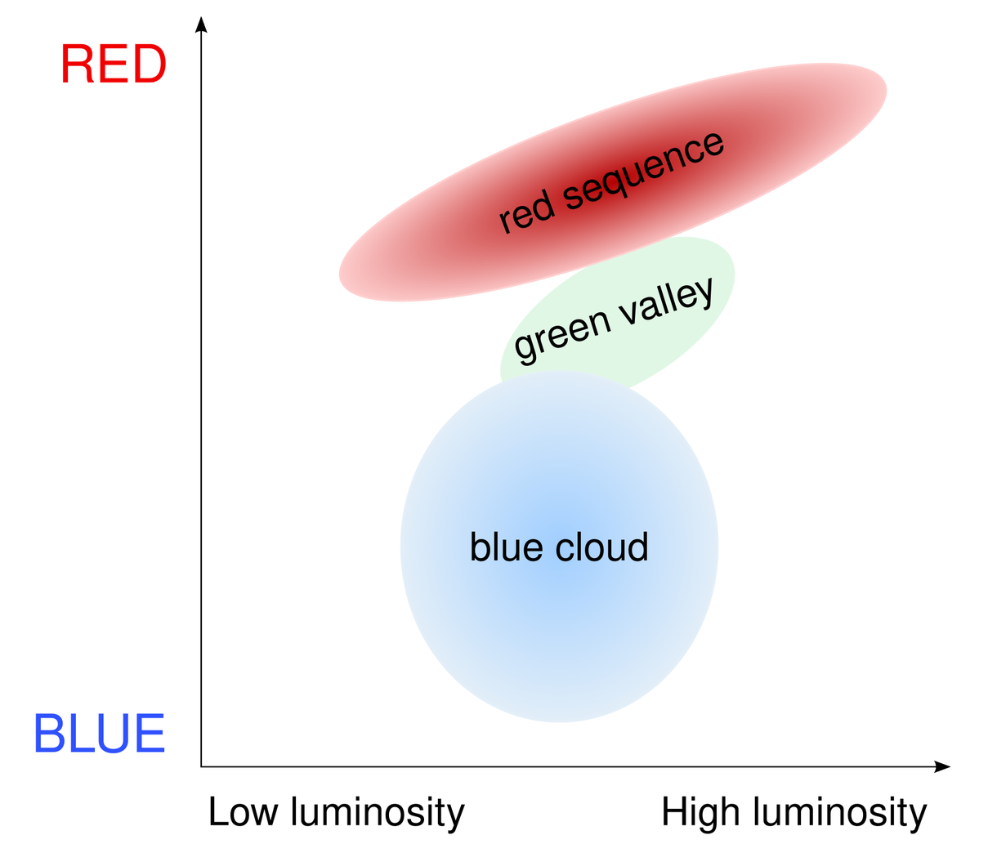
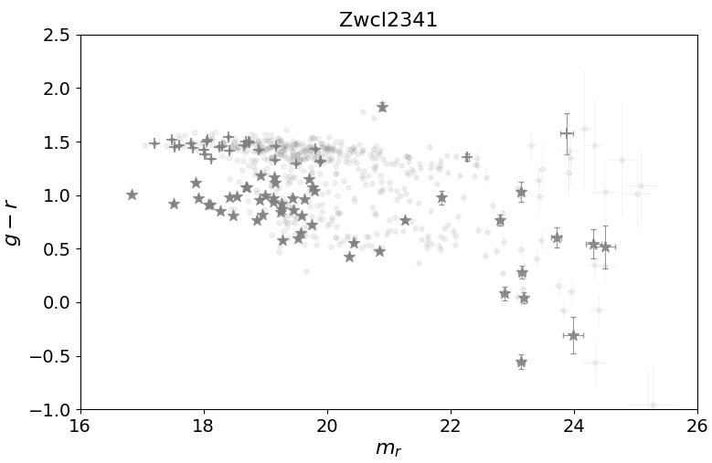
Galaxy classifications
We use the colour-magnitude for classifying SFGs and QGs.
Radio galaxies situated far away from red-sequence → Radio-detected SFGs
Radio galaxies situated with 3 sigma of red-sequence → Radio-detected AGNs
QGs
g-r
SFGs
Mr

