Slide 1
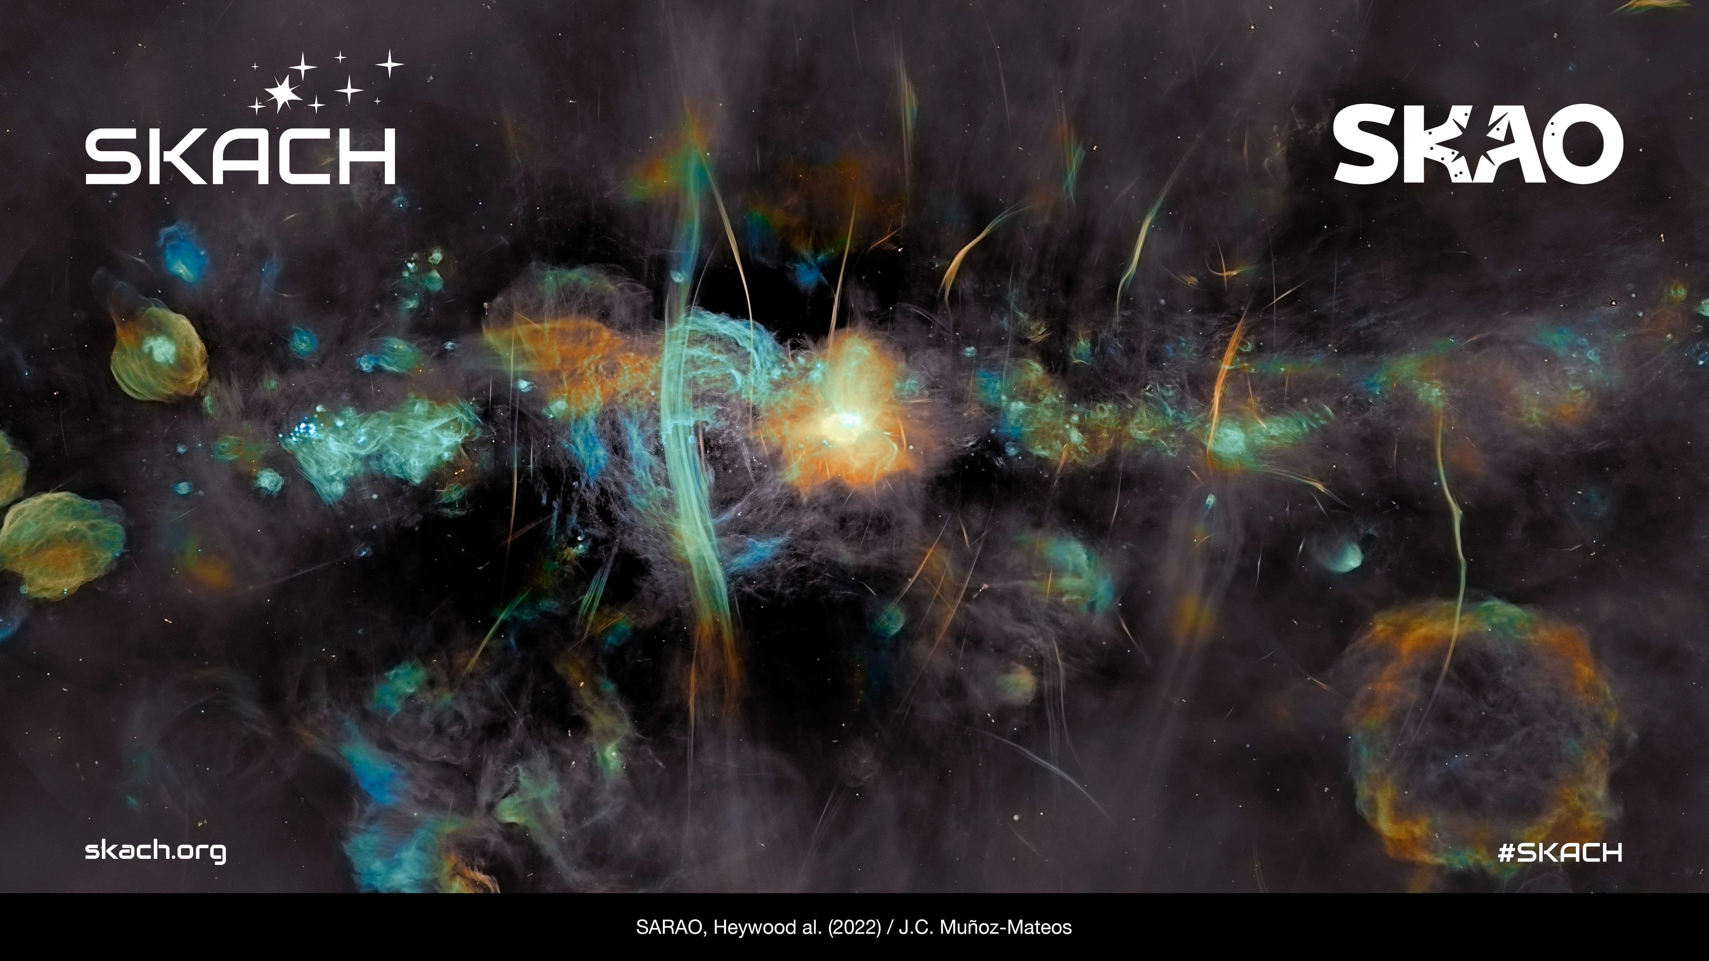
Welcome!
Swiss SKA Days 2026 @ HES-SO//HE-Arc Neuchâtel
Tristan Maillard
Director HE-Arc
August 31st, 2026

Slide 2
Welcome!
Swiss SKA Days 2026 @ HES-SO//HE-Arc Neuchâtel
Hatem Ghorbel
Leader of the Data Analytics Group at the HE-Arc Ingénierie
August 31st, 2026

Slide 3
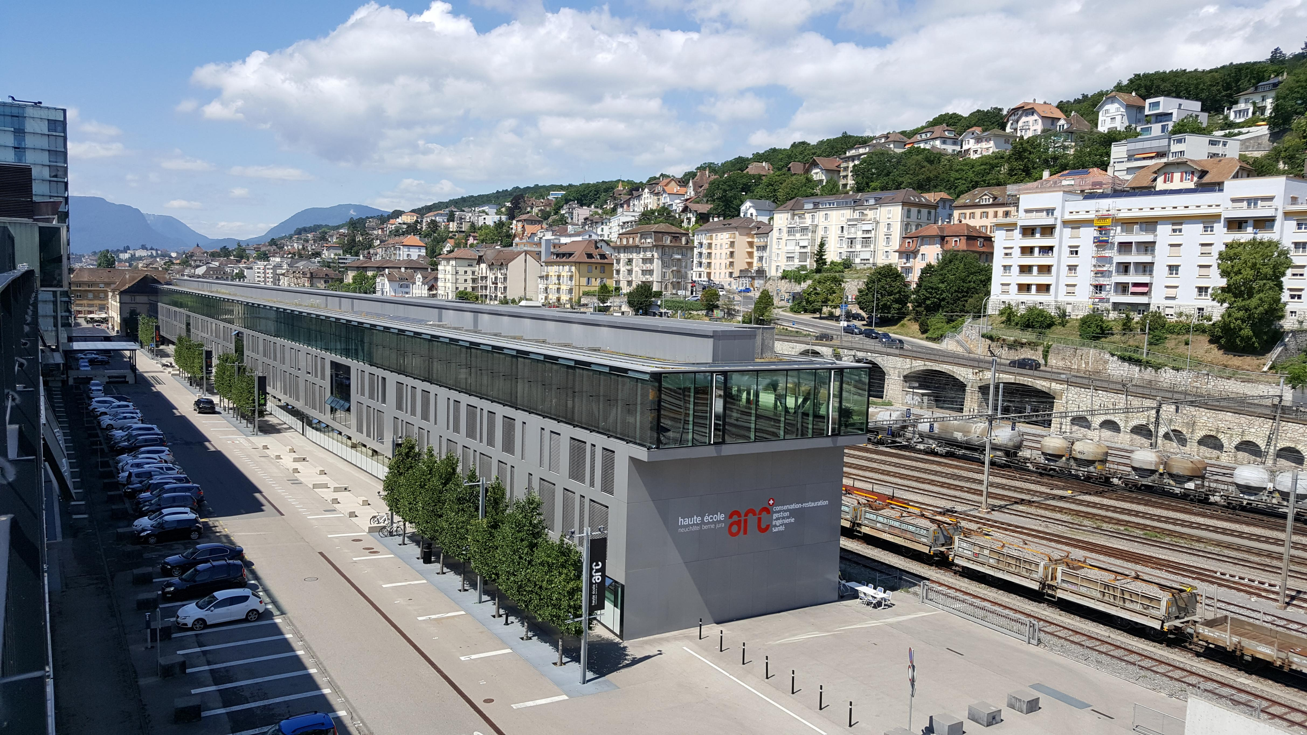


Welcome at the Haute École Arc and Neuchâtel

Slide 4
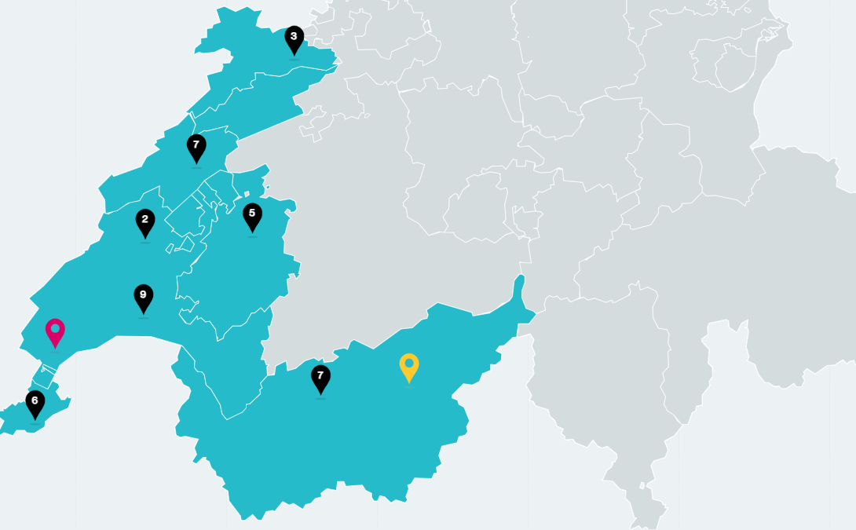
HES-SO
Founded in 1998, HES-SO (University of Applied Sciences and Arts Western Switzerland)
28 schools of higher education,
7 cantons in Western Switzerland,
More than 21’000 students.
Missions
Practice-oriented higher education
Applied research and innovation

Slide 5
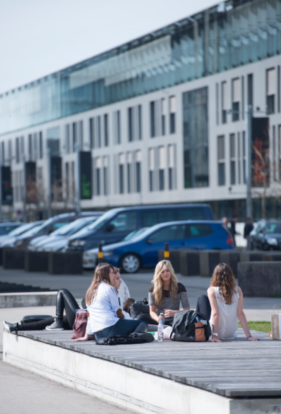
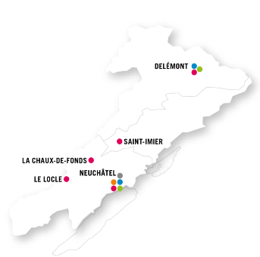
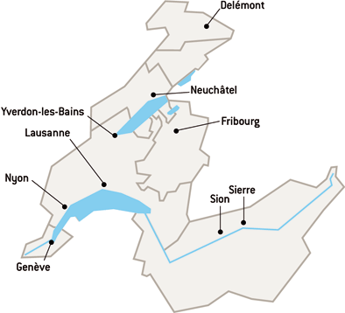
HE-Arc
The Haute Ecole Arc is a tri-cantonal public institution.
It is a part of the HES-SO and it brings together expertise of the cantons of Neuchâtel, Jura, and the French-speaking part of the canton of Bern.
1,500 Bachelor’s and Master’s students
10 Bachelor’s degree programs
1 Master’s degree program

Slide 6
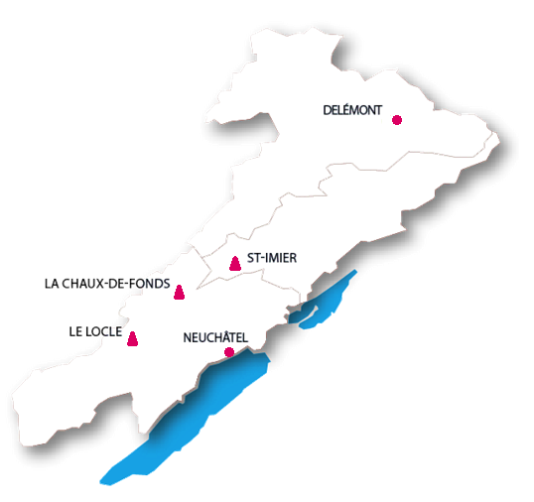
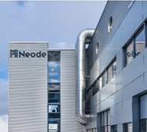
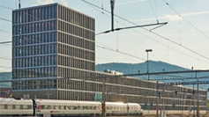

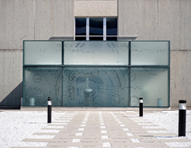
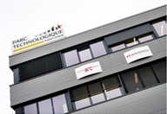
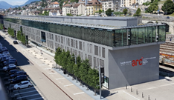
Research at the HE-Arc ingénierie
Medical devices
Surface engineering
Embedded systems
Interaction technologies
Data analytics
Computer vision
Machine design
Metrology & industrial vision
Automation
Watchmaking engineering
User-centered Design

Slide 7






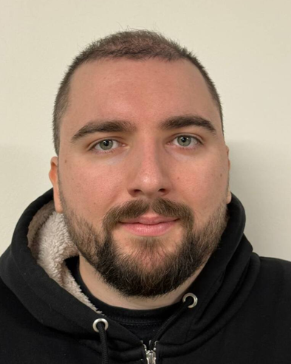

HE-Arc Ingénierie: Data Analytics Group
20 researchers
  Innosuisse projects
  HES-SO projects
  Direct industrial mandate
  FNS, Bridge, Hasler, etc.
4 researchers working on SKACH
  Emmanuel de Salis
  Massimo De Santis
  Jean-Daniel Rouveyrol
  Hatem Ghorbel
Applied Artificial intelligence
Machine and Deep Learning
Natural Language Processing (LLMs) and Text mining
Computer vision

Slide 8
Swiss SKA Days Agenda
Mon 31 Aug
10:00–10:30 Registration & welcome coffee
10:30–12:00 Opening Session Day 1
12:00–13:00 Lunch + group photo
13:00–15:05 SKAO Regional Centers (SRCs)
15:05–15:35 Coffee break
15:35–17:15 Data Science & Imaging — Part 1
17:15–17:35 SKAO Science Book
18:00–21:00 Welcome reception — Hotel Alpes & Lac
Tue 1st Aug
08:30–09:00 Arrival & coffee
09:00–10:00 Opening Session Day 2
10:05–10:55 Industry Session
10:55–11:15 Coffee break
11:15–12:45 Special Session: Atomic Clocks in CH
12:45–13:45 Lunch
13:45–15:35 Dark & Quiet Skies
13:45–14:45 Parallel: Data Science & Imaging — Part 2
14:45–15:45 Parallel: SRCNode Operations discussion
16:30–18:00 Afternoon activity — Town visit

Slide 9
Swiss SKA Days Agenda (continued)
Wed 2nd Aug
08:30–09:00 Arrival & coffee
09:00–09:05 Opening Session — Day 3
09:05–10:15 Astro Science
10:15–10:45 Coffee break
10:45–11:45 Parallel: Workshop: SKA-LOW Science Verification (room 328)
10:45–11:05 Parallel: Theory & Simulations (room 324)
11:05–12:25 HPC & Eco-Computing (room 324)
12:35–12:55 End of Sessions & Conference (no lunch provided)

Slide 10

Conference Venue
We have several buildings, but Swiss SKA Days 2026 will take place only at Campus Arc 2 (where we are currently located)
Plenary Session: 328 (here)
Parallel Session: 324
Demo (VIRUP): 320
Wi-Fi
Network : HE-ARC-guest
Username: skad26
Password : jBT!U2F@

Slide 11
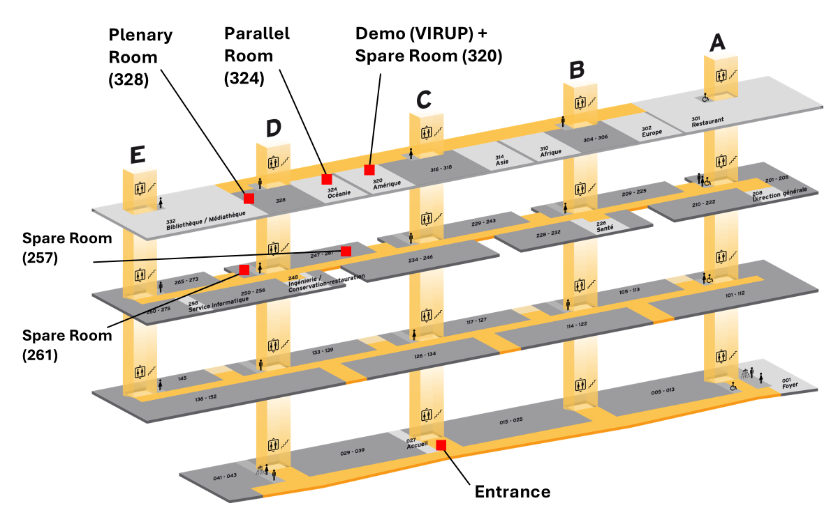
Navigating Campus Arc 2

Slide 12
Navigating Campus Arc 2

Slide 13
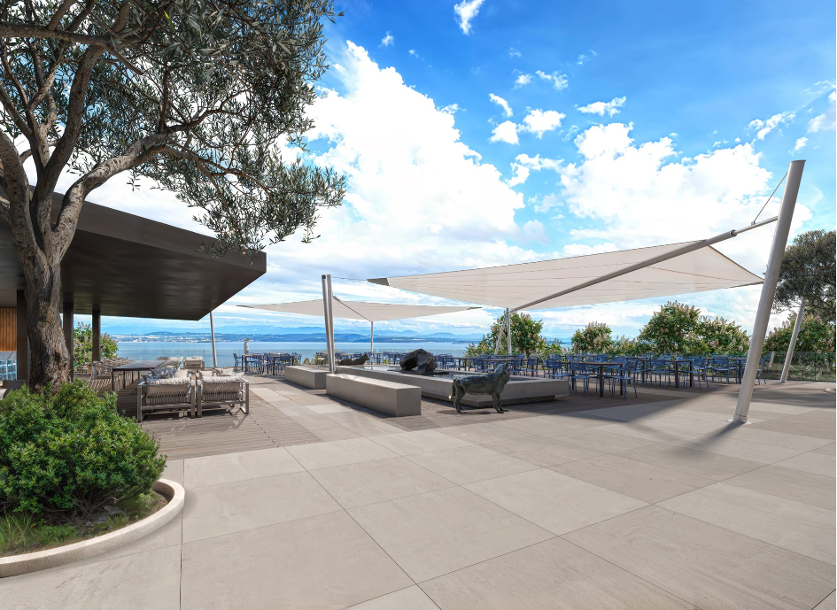
Welcome Reception @Hotel Alpes et Lac, Terrasse
Tonight from 18:00 to 21:00
Adress : Place de La Gare 2, 2000 Neuchâtel (2 minutes walk from here)
Keep your badge to access the Terrasse

Slide 14
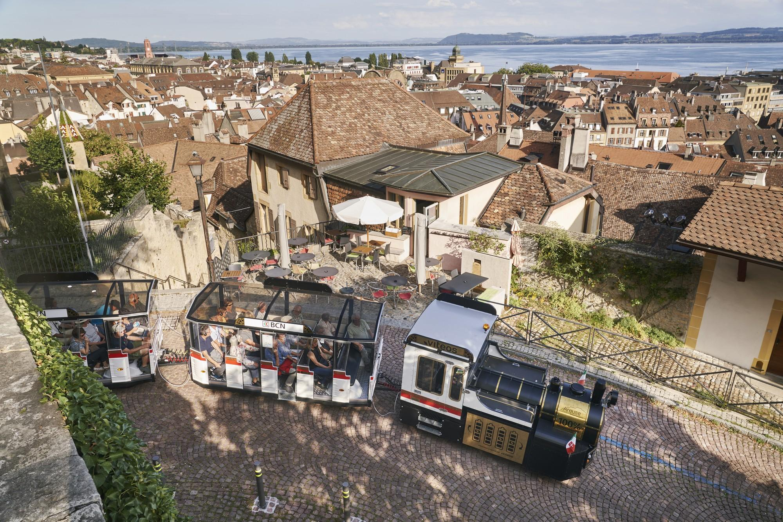
Social activity
There are still plenty of spots available for the guided e-train tour of the old town.
Group departure from HE-Arc tomorrow at 16:10 (15-minutes walk).
Duration of the train tour : approximately 1 hour.
Languages: English, French, German (headphones).
Come see me today or tomorrow morning to sign up !

Slide 15
Questions ?
Joanna Jermini-Howard (SKACH) – for room reservation and question about the program
Emmanuel de Salis (HE-Arc) – for logistical and social activity questions
Staff – for any information

