Slide 1
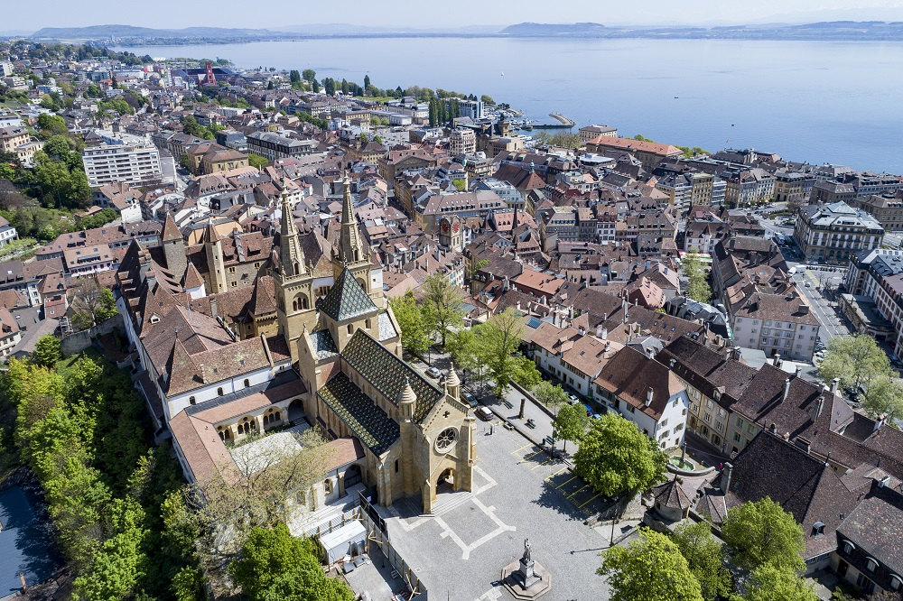
Welcome to the Swiss SKA Days
2026
Jean-Paul Kneib (EPFL)

Slide 2
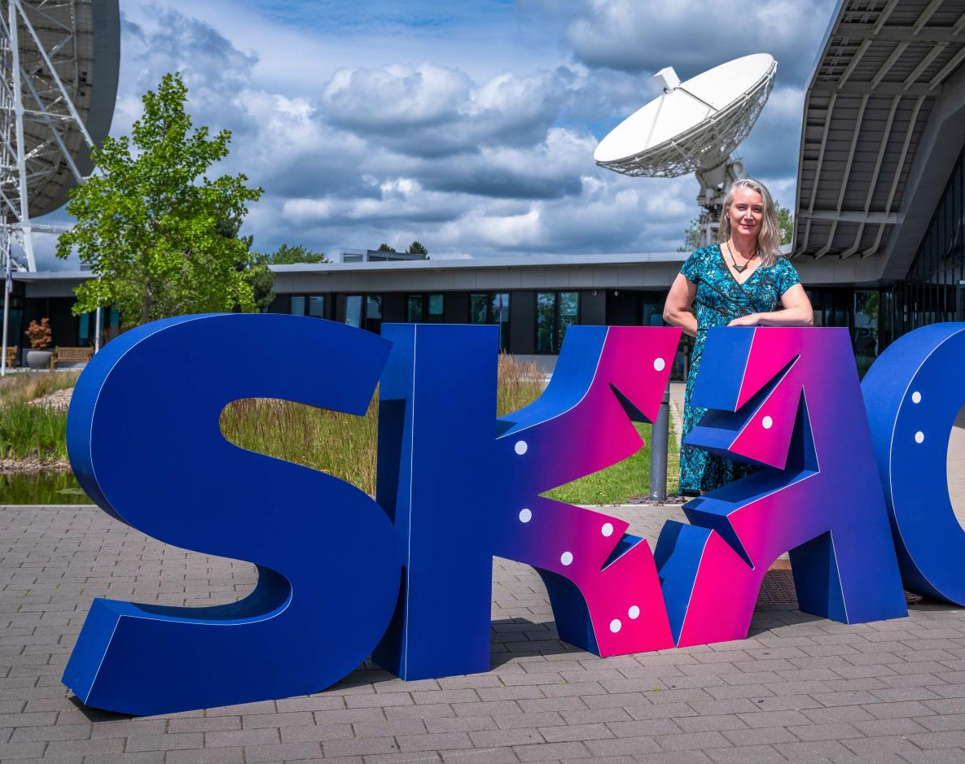
SKAO has a new DG
Jessica Dempsey

Slide 3
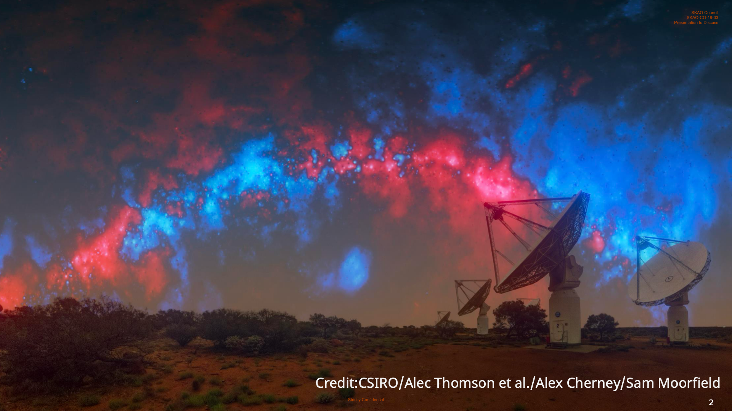

Slide 4
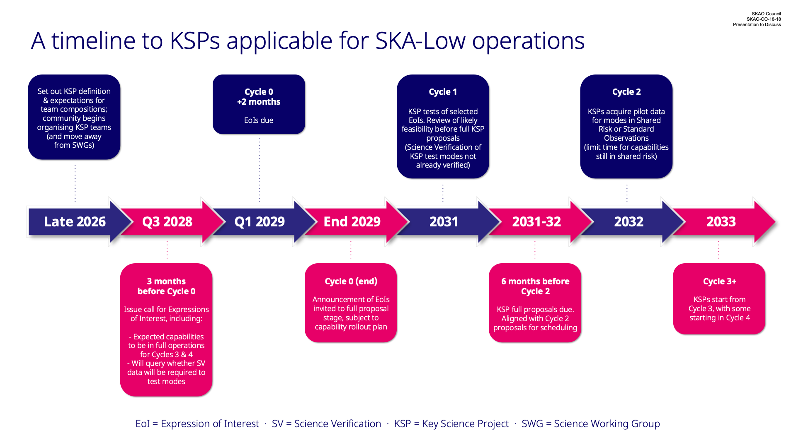

Slide 5
Key discussion points to follow during this meeting
News from SKAO (see SKAO’s presentationon Tuesday)
  New funding for 2030+ at SKAO level
  New funding model?
  Continue construction to reach AA4, which timeline?
  Include SRC within the scope of SKAO?
New funding cycle in CH from 2029 (for SERI – See Simon Berger presentation)
  Continue SRC engagement, and better define the Swiss SRC work and overall contribution
  Continue community coordination (SRC and Science)
  Difficult Science funding environement (SNF)

Slide 6
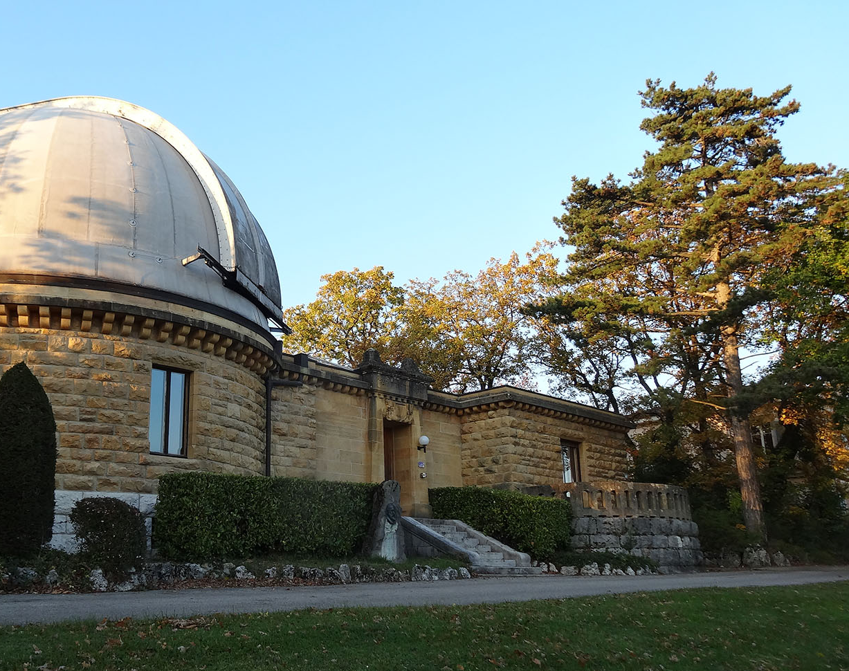
Enjoy the meeting

