Slide 1
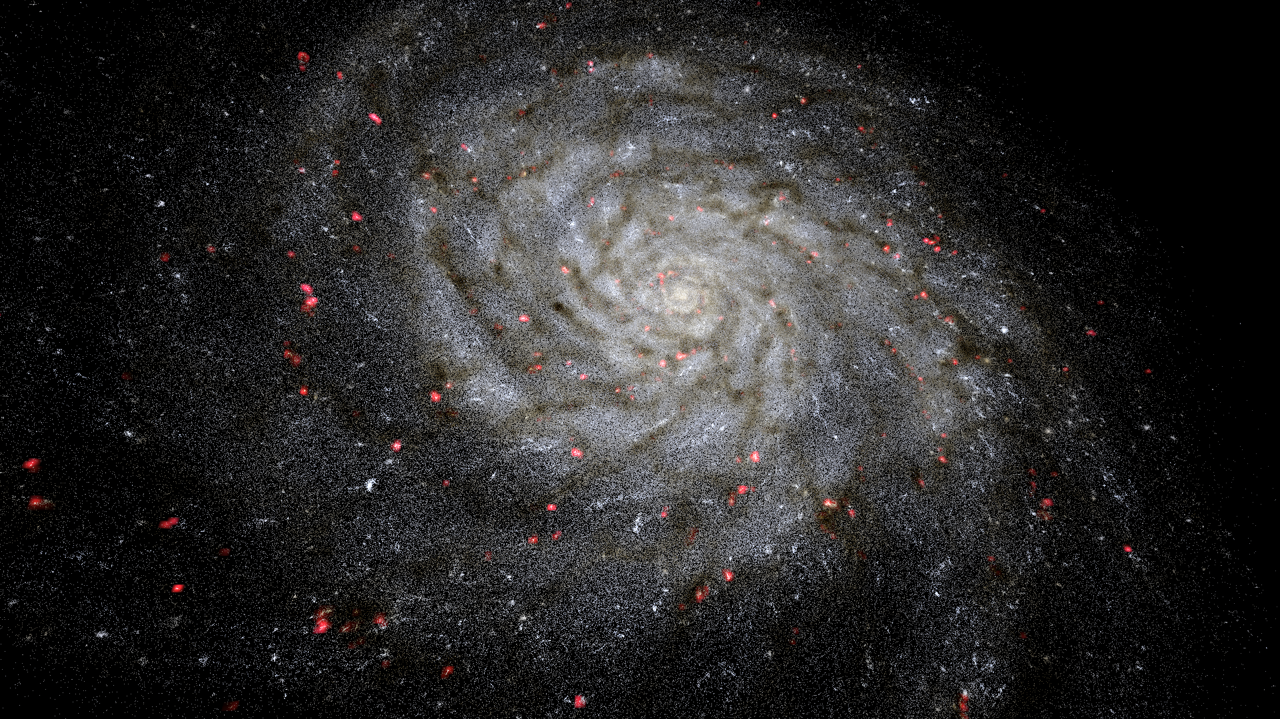


VIRUP:
Project Updates
Florian CABOT
Swiss SKA Days 2026
31.08.2026

Slide 2
OUTLINE
Quick refresh about what VIRUP is
Newest published features
Latest development
  Precision (time + space)
  M87
  Repositories / New Datasets
Future work

Slide 3
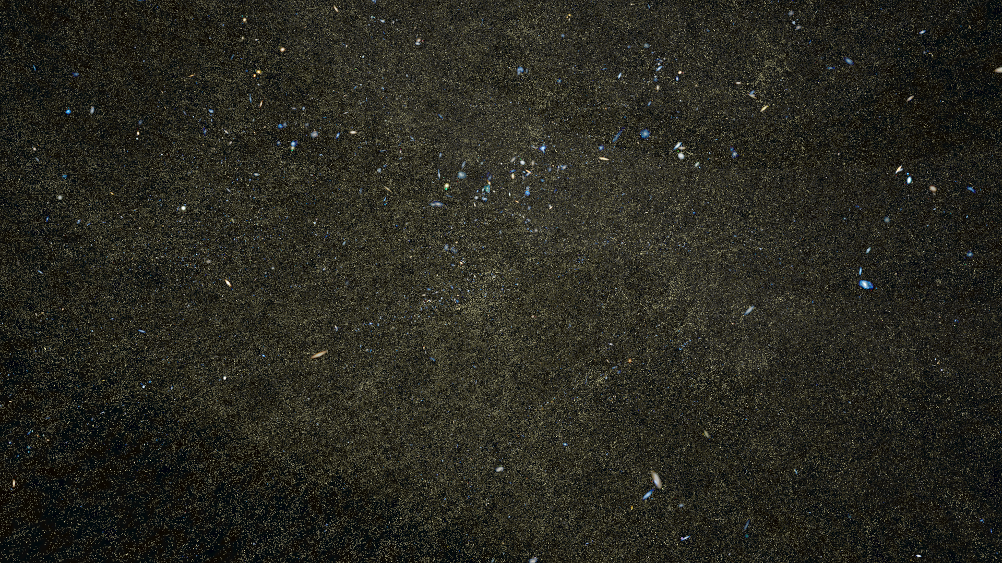
THE VIRUP SOFTWARE

Slide 4
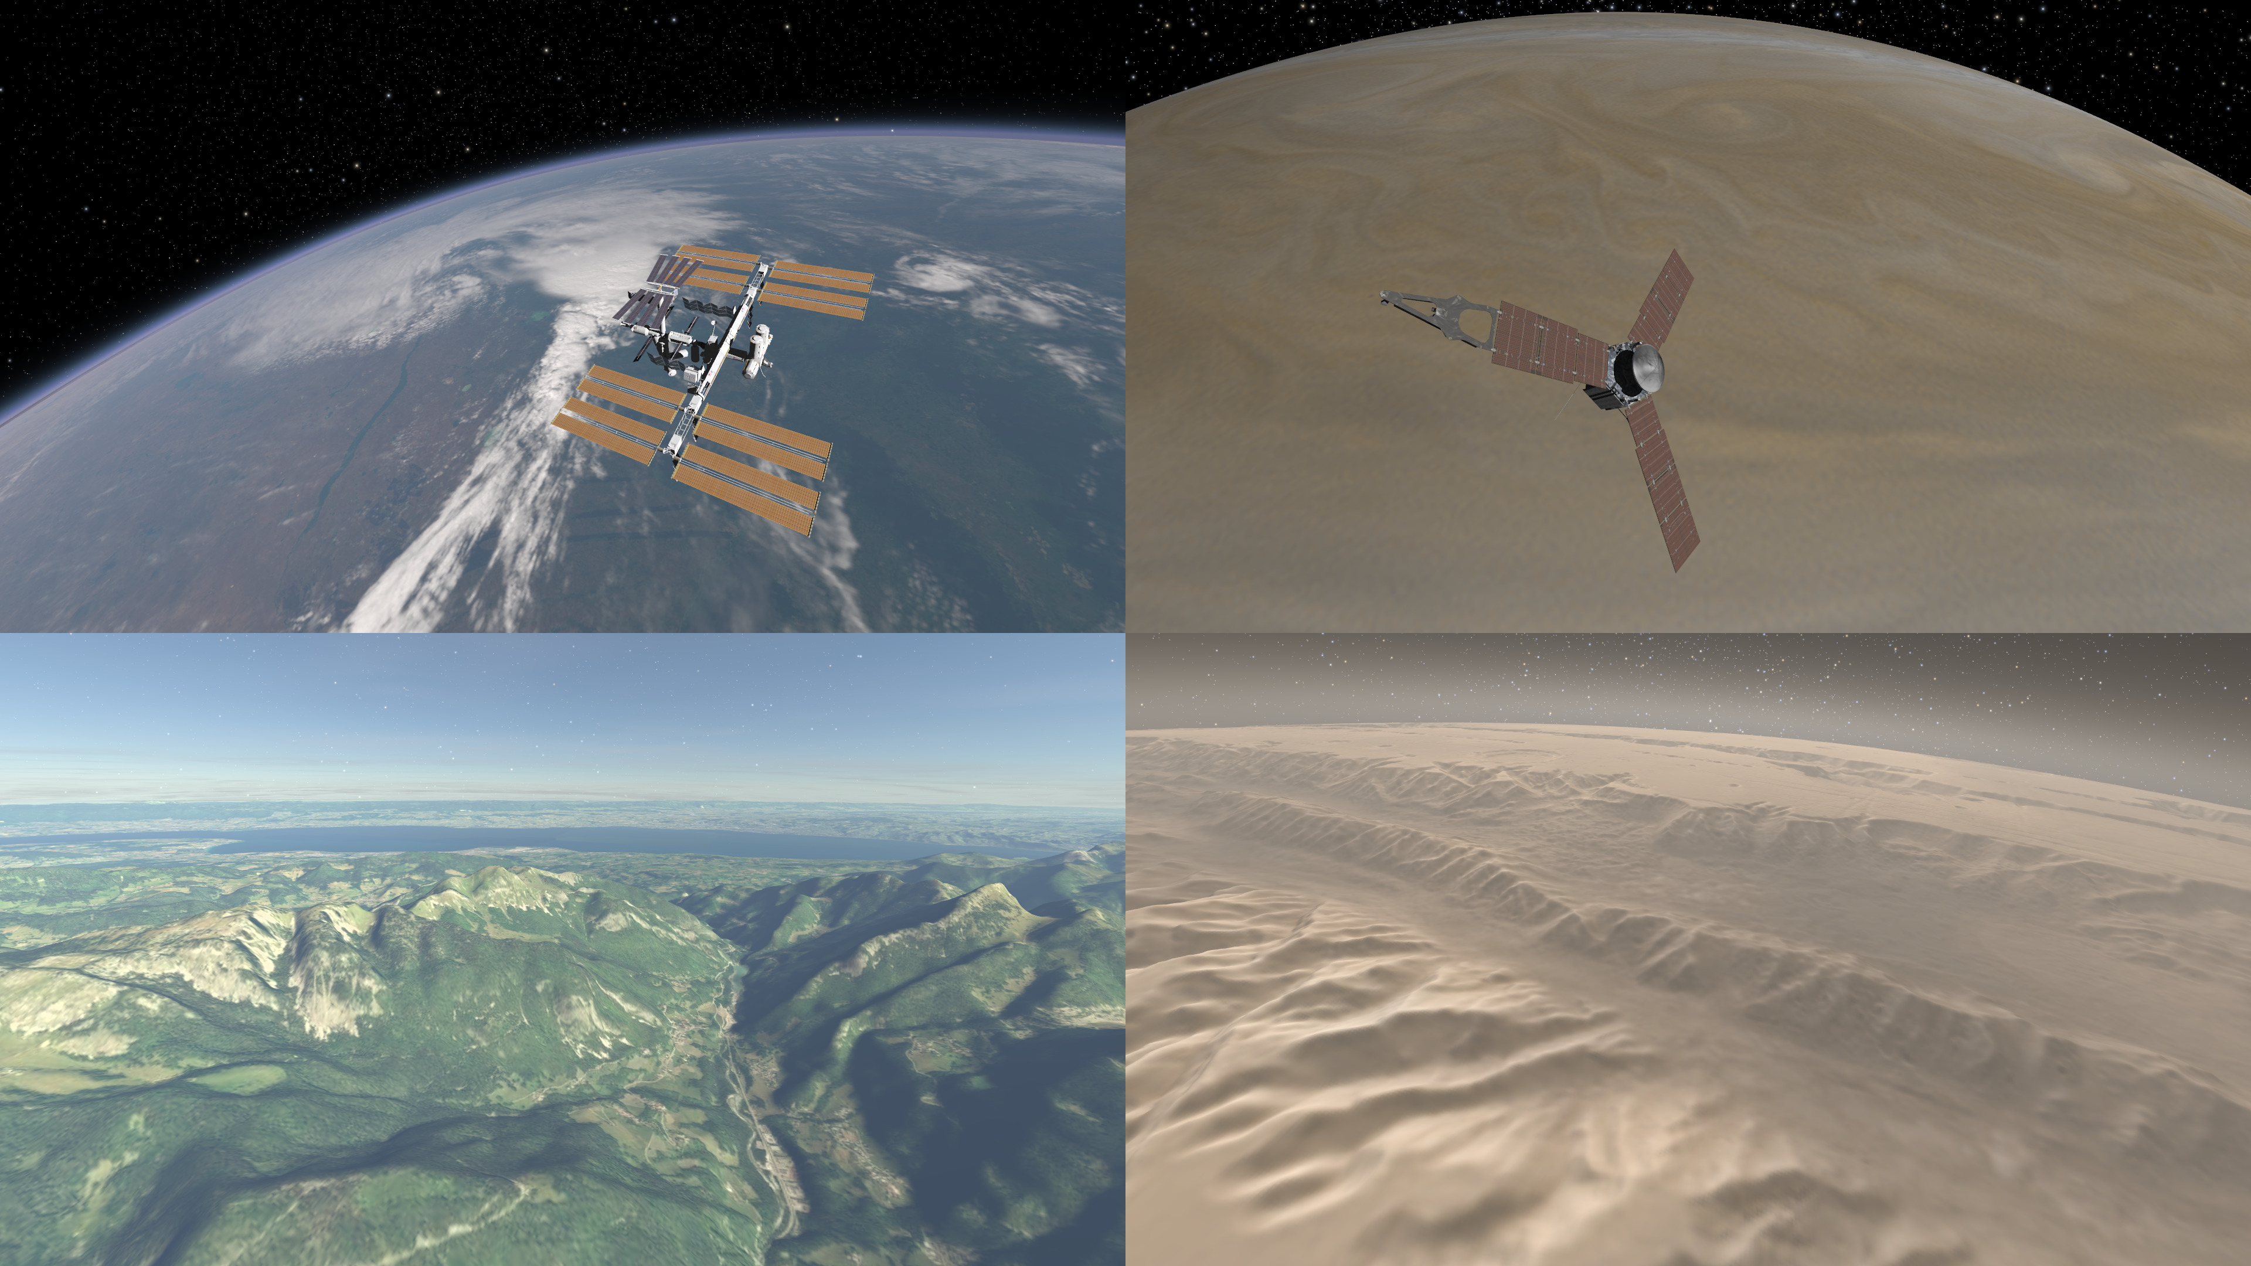

Slide 5
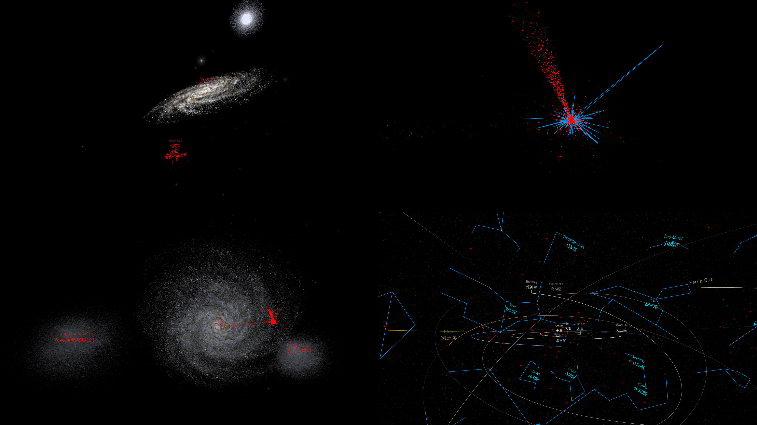

Slide 6
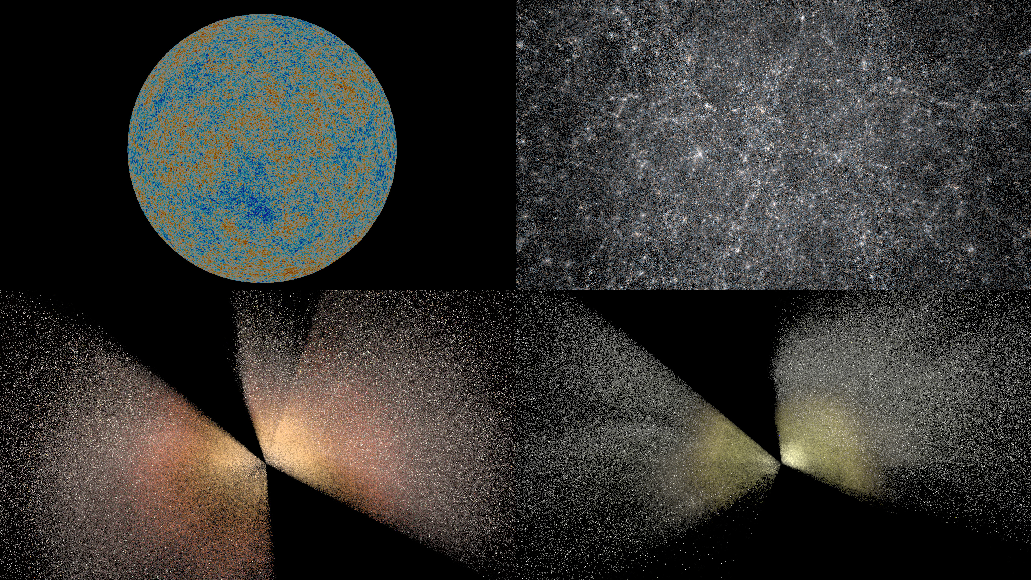

Slide 7
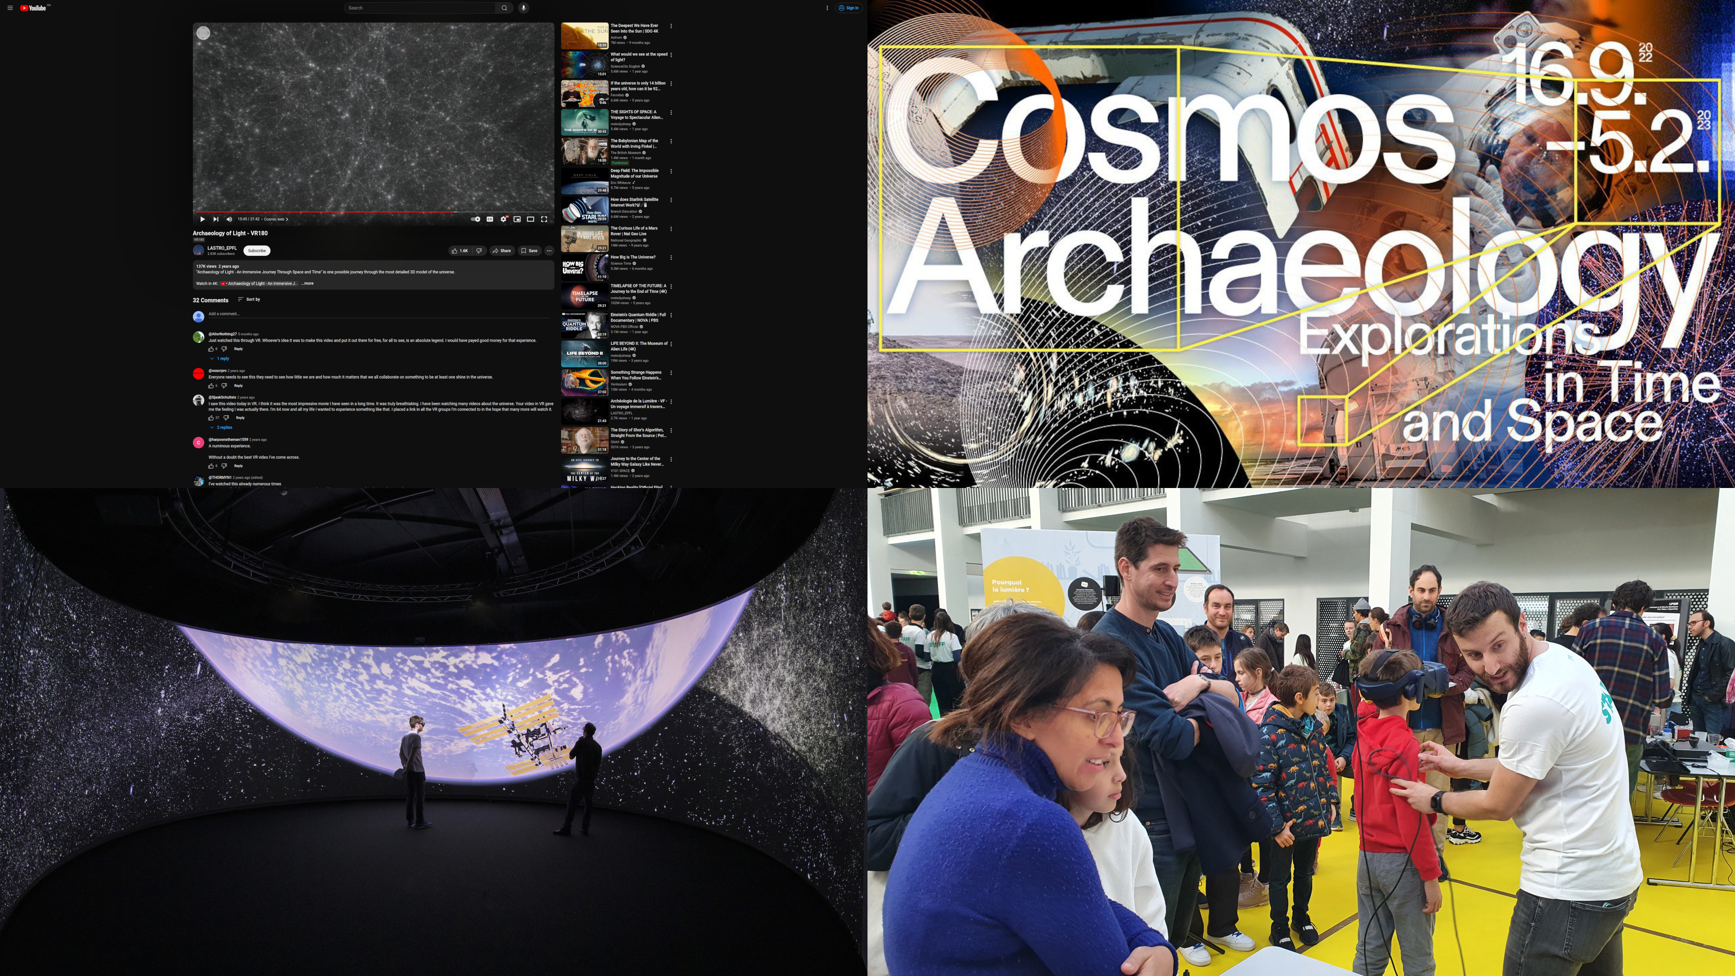

Slide 8
NEWEST FEATURES

Slide 9
NEWEST FEATURES
0.15 published including
  The complete version of the voice-enabled ChatBot
  Halved VRAM usage of volumetric dust and H-alpha emission for the same quality (switch to half precision floats)

Slide 10
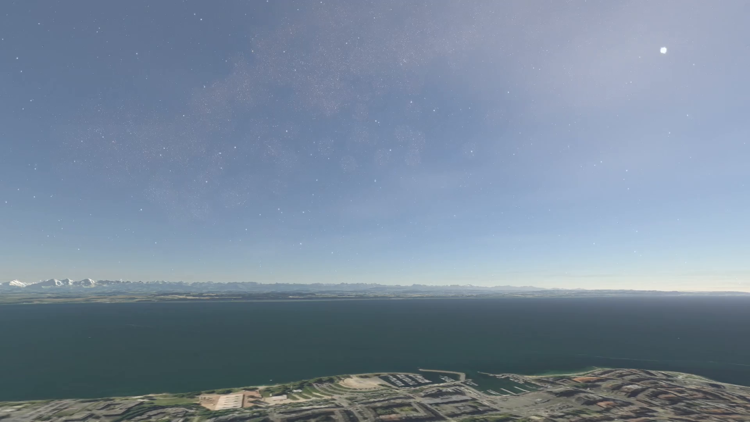
NEWEST FEATURES
0.15 published including
  Ground Coordinates Selector to go to a specific Earth location by name or GPS coordinates
  Better controls especially to navigate the ground

Slide 11
NEWEST FEATURES
0.15 published including
  Support added for: Wayland, Ubuntu 26.04, AlmaLinux 9 (RHEL 9)
  AI-assisted scripting for animations
  Better time-keeping accuracy (more on that later)
  Terrain: Fixed holes in Earth poles, high resolution night texture

Slide 12
LATEST DEVELOPMENTS

Slide 13
LATEST DEVELOPMENTS: TIME PRECISION
VIRUP used to confuse TDB and UTC (~70s difference), which is unnoticeable for most events but crucial for others
This is now fixed!
VIRUP now also keeps time as accurately as possible down to the nanosecond thanks to a pair of clocks
  One millisecond clock synchronized with the OS,
  One CPU-nanosecond clock that subdivides the millisecond and gets a correction factor once every few milliseconds to match the OS clock without any noticeable jump
This will enable high precision real-time N-body simulations
Events as seen from Earth surface are still a bit off by a few tens of seconds because of VIRUP’s Earth rotation model being too simple
This is hopefully the last step to fix for precise sky map at a given time from a given place

Slide 14
LATEST DEVELOPMENTS: SPACE PRECISION
The high precision multi scale algorithm was only applied for planetary systems
It was fine as most objects in the datasets outside of planetary systems have a large subtended angle (the further away they are, the larger they are, roughly)
This broke when confronted to the M87* black hole ("tiny" object Very far away)
The multi scale algorithm is now applied to every dataset
The ground precision has been greatly enhanced but needs more work until we can properly walk on it (two instability sources have been resolved already, there seems to be a few more)

Slide 15
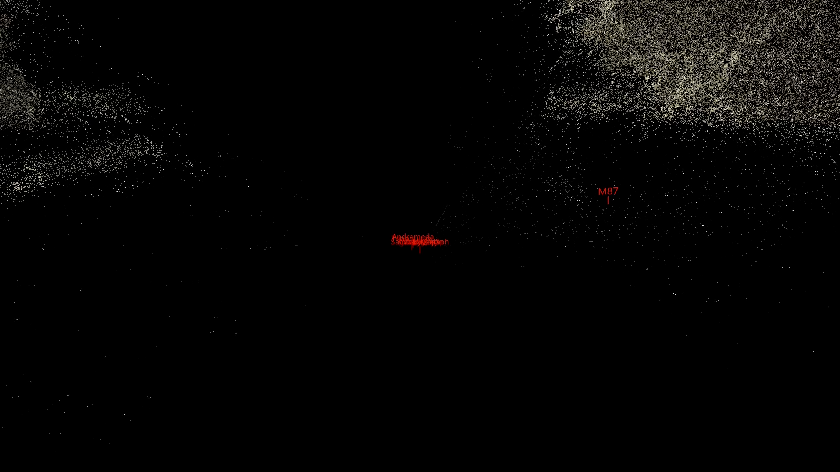
LATEST DEVELOPMENTS: M87

Slide 16
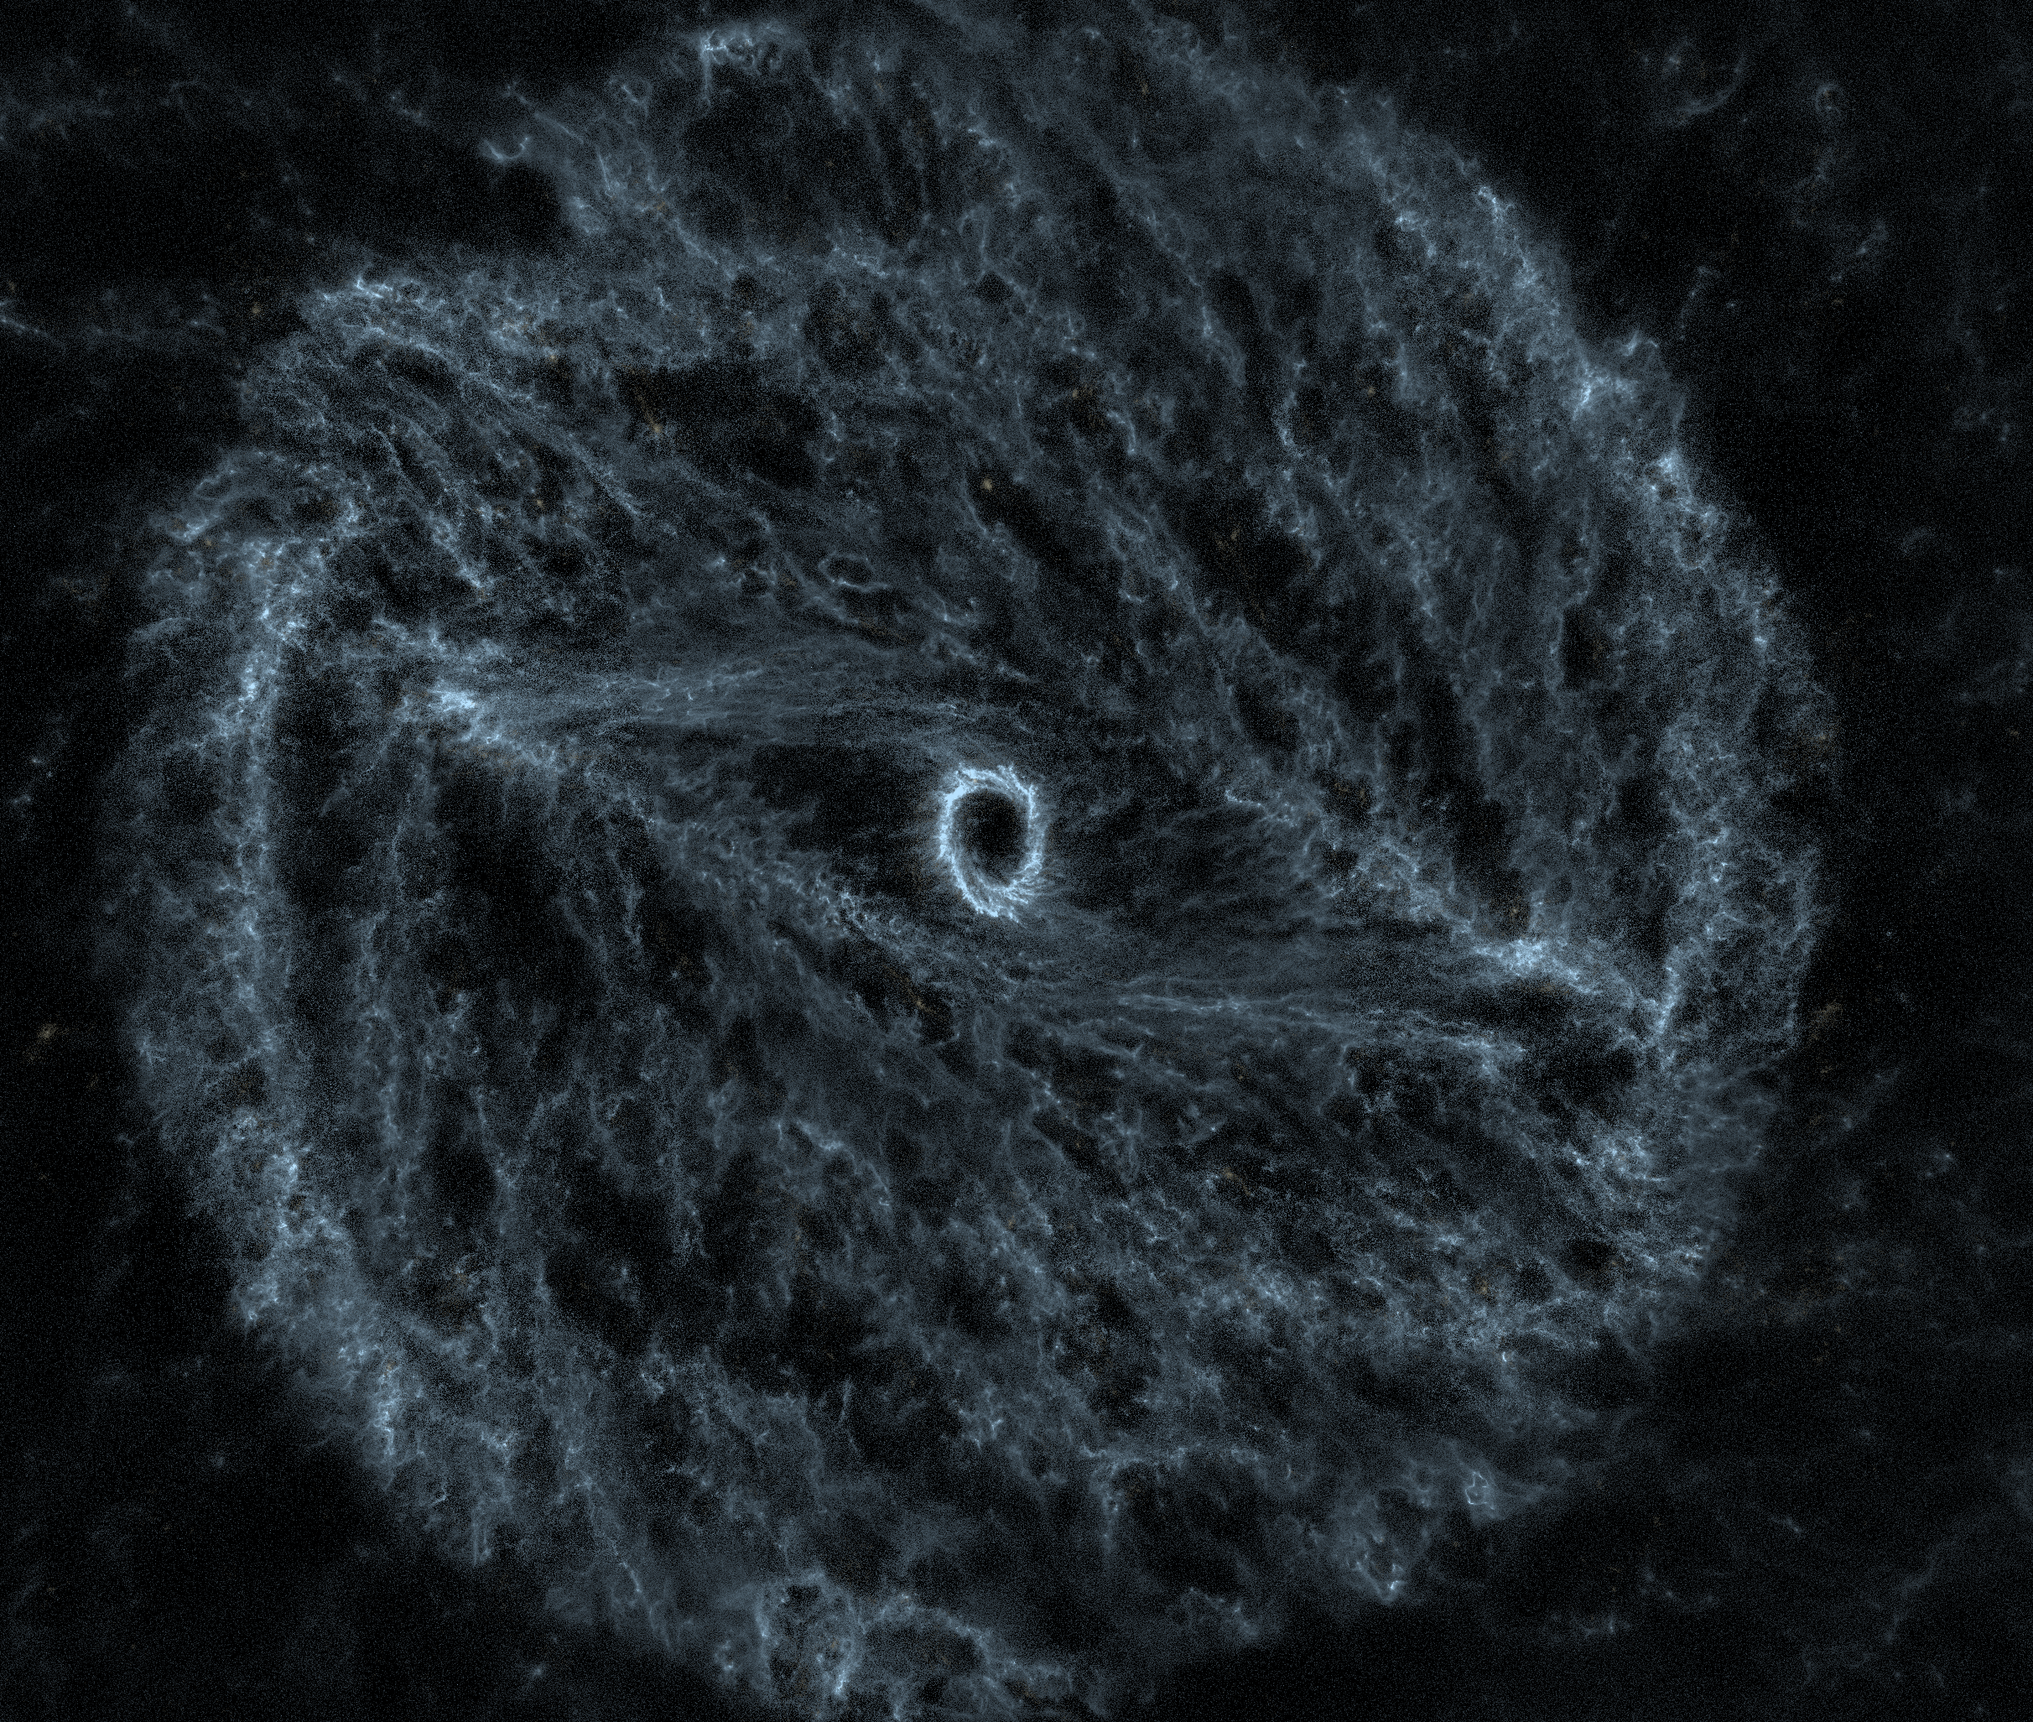
LATEST DEVELOPMENTS: REPOSITORIES
Repositories have moved to the beta
branch and are the main source of data
now during dev and testing ; old data
source has been removed
New Milky Way in the works,
with a bar! (Thanks to Robin Tress)

Slide 17
FUTURE DEVELOPMENTS
Finish integrating current datasets (3D M87-related data, new Milky Way, images in the sky)
New datasets
Proper ground views in VR
Continue the Vulkan port from OpenGL
Publish repositories and put them in your hands!

Slide 18
Thank you !
COME SEE ME
AT THE VIRUP
ROOM
DURING BREAKS
TODAY ONLY!
go.epfl.ch/VIRUP
Florian CABOT
Swiss SKA Days 2026
31.08.2026

Slide 19
BACKUP

Slide 20
THE VIRUP SOFTWARE
Visualization software
  3D reconstruction of the Universe based on scientific data
  Real-time rendering of multiple large astrophysics datasets
  In-house rendering engine (C++20/Qt6, OpenGL 4.5, OpenVR, PythonQt)
Flexible
  Scriptable
  Multiple visualization system types supported (Virtual Reality, 3D screens, ...)
  Dynamic data input (no pre-conceived data of what’s in the Universe)

