Slide 1

SKAO Procurement Update
Engaging with SKAO Procurement
Paul Oosthuizen – Senior Procurement Specialist
August 2026

Slide 2
Topics
A Look Back at 2025
Global Collaboration
Role of the SKAO Procurement Team
Procurement Principles
Construction Allocation
What do we and what will we Procure?
Construction Procurement Status Update
Switzerland’s contracts and future opportunities

Slide 3

A Look Back at 2025
The SKAO recognises and acknowledges the Indigenous peoples and cultures that have traditionally lived on the lands on which the SKAO facilities are located. In Australia, the SKAO acknowledges the Wajarri Yamaji as the Traditional Owners and native title holders of Inyarrimanha Ilgari Bundara, the CSIRO Murchison Radio-astronomy Observatory.

Slide 4















Who is Involved: SKA-Low
Australia
China
India
Italy
Netherlands
Spain
Switzerland
UK

Slide 5












Who is Involved: SKA-Mid
Australia
Canada
China
Germany
Italy
South Africa
Spain
Sweden
Switzerland
UK

Slide 6
What is the Role of the SKAO Procurement Team ?
Primary objective is to effectively and efficiently acquire Contracts and In-Kind Contribution Agreements supporting the delivery of the SKAO’s mission.
Play a crucial role in building and maintaining strong relationships with suppliers and ensuring ethical and sustainable practices.
Owns and ensures compliance with the Procurement Policies and Procedures related to:
    sourcing of goods, works and services,
    Fair Work Return, and
    administering the acquisition of Member in-kind contributions.
Leads all sourcing activities for goods, works and services.
Develops procurement strategies and leads through to Contract Award approval.
Administers the Observatory’s insurance portfolio, including claims.

Slide 7
Procurement Principles
SKAO’s procurement activity built on the following principles:
Integrity and Transparency – all procurement activities are open and transparent
Fairness and Equality – all suppliers from Member countries are treated equally
Fair Work Return - procurement opportunities are first provided to suppliers from within Member countries
Competition – unless there is strong justification, procurement is competitive to ensure value for money

Slide 8
Allocation of Construction Work Between Member Countries
SKAO applied an ‘allocative’ procurement methodology – virtually all construction work-packages (contracts) were allocated to SKAO Member countries from the outset based on their strategic interest and levels of funding.
The methodology enabled Members to continue with the work they were historically invested in during pre-construction.
Therefore, the vast majority of SKAO Constructing contracts have been competed between domestic suppliers rather than internationally.
Country of origin:
  Supply Contracts – country of last significant transformation
  Service Contracts – country in which the service provider has their legally registered office
The methodology has largely met its objectives, with the majority of Members on track to achieve minimum promised FWR.
Whilst nearly all SKA Construction work-packages were allocated to Members there are, non-allocated, commercial opportunities for suppliers in Member countries – opportunities are advertised on the SKAO Supplier Portal.

Slide 9





What do we Procure?
Civil Engineering
Power and utilities - renewables
Metallic structures - dishes and antennas
Low RFI electromechanical equipment
Shielding and shielded enclosures
Receivers and digitisers
Cryogenic equipment
Computing devices and networks
Software development
Shipping, transport and logistics
Engineering services
Corporate services – travel, audit, banking, insurance
Most products procured are non-standard………

Slide 10
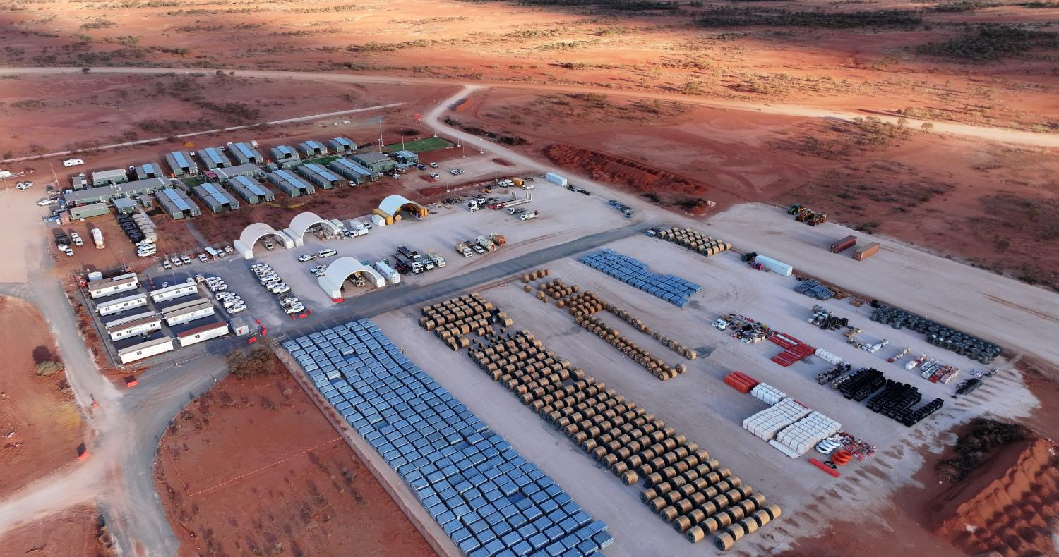


What Will we Procure Post-Construction?
SKAO, once operational, will need to procure a broad range of goods and services to support both the science mission and the day-to-day running of the observatory.
Wide range of requirements, such as:
  Computing hardware and network upgrades
  Software development
  Facilities and site services
  Infrastructure maintenance
  Spares parts and replacement of key array work packages and components
  Site vehicles
  Sustainability and environmental management
  Professional & technical services
  Shipping, transport and logistics
  Corporate services – travel, audit, banking, insurance

Slide 11
High Value Invitation to Tender Process
Invitation To Tender process:
Led by Procurement Services with independent Technical Evaluation Panel
SKAO Industrial Liaison Officer Network given 21 days prior notice of procurement opportunities
Market Survey (EoI) published on the Supplier Portal (Proactis)
Pre-qualification of potential tenderers
Invitation to tender stage requiring technical and commercial response
Shipping costs are excluded from commercial evaluations (all bids assumed FCA, seller’s works)
Two envelope system
Weighted, value for money award criteria (‘most economically advantageous bid’) i.e., quality and price are weighted.

Slide 12
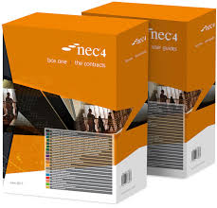
Type of Agreements
Purchase orders – always preferred for COTS products with a catalogue part number
NEC4 Contracts used when a purchase order isn’t suitable - the SKAO buys an eclectic mix of goods, works and services and a ‘standard’ contract just won’t cover all the bases.
The NEC4 suite of contracts meets most of our contracting needs:
    Professional Services Contract (PSC) and its subcontract and short form
    Engineering and Construction Contract (ECC) and its subcontract and short form
    Term Services Agreement (TSA) and its short form
    Supply Contract (SC) and its short form
    Framework Contract (FC)
NEC4 contracts were developed by the UK Institution of Civil Engineers to be collaborative, fair and non-adversarial.
The NEC4 contract ethos align perfectly with SKAO culture and values.

Slide 13
Relational Contracting… Software Development
The SKAO has been successfully developing software using Scaled Agile Framework (SAFe®).
Took the already collaborative NEC4 Framework Contract and applied the principles of Vested Governance (relational contracting) with support from experts from the University of Tennessee, who are world leaders in developing win-win relationships.
Created an innovative Software Development Framework Contract that commits SKAO and the Consultants to the following common shared vision:
  “We are a global collaboration committed to building and delivering a world-class software and computing ecosystem, enabling the SKAO community to achieve transformational science”.
  “Our culture of innovation, shared governance, and respect for diversity creates mutual value for all”.
The approach reflect SKAOs values around EDI, Innovation, Excellence and Collaboration.
There is currently one Swiss organisation working under the SKAO Software Development Framework with great success and another Swiss organisation recently successfully completed a similar contract….

Slide 14
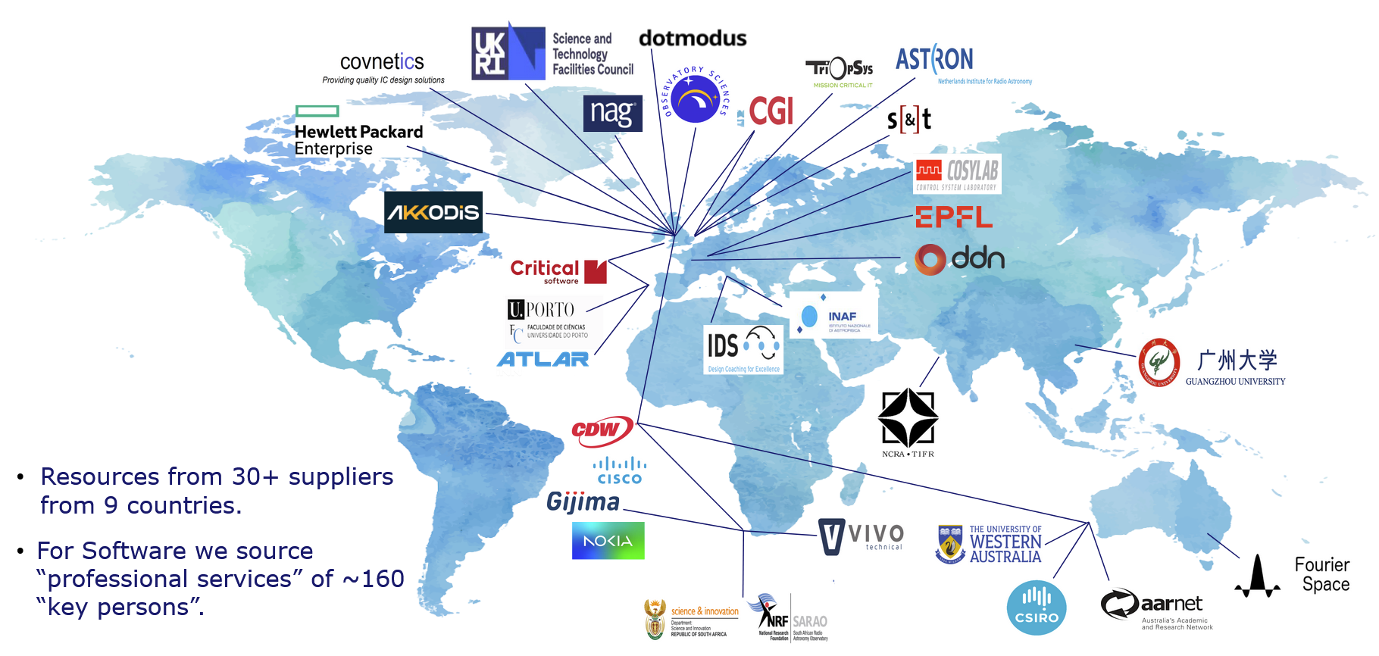
Who is involved: Computing, Software & Networks
Australia
China
India
Italy
Netherlands
Portugal
South Africa
Switzerland
UK

Slide 15
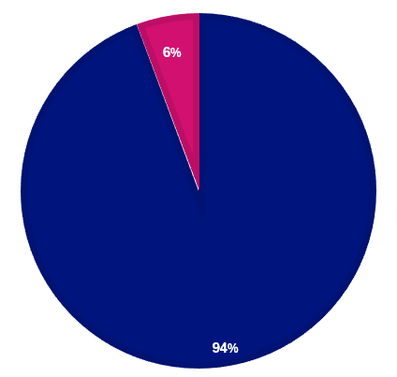
Construction Tier 1 Procurement Update
Since July 2021 approx. 100 high value tier 1 construction contracts awarded and total of approx €950M committed across all contracts”.
There are approximately 6 Tier 1 high value construction contracts to award and most of these are well underway.
Tier 1 Construction Contracts Awarded to date (approx).
Note: Approximate, naturally open to change given the fast-paced construction environment and not % in terms of value.

Slide 16
Swiss contracts to date and future opportunities
Significant and successful contract awards to Switzerland include:
  Software development: first Swiss contract awarded May 2022. Successful progress with the Monitoring and Control of the Central Signal Processor (CSP LMC) software.
  SPC High Performance Computing (HPC) Co-design: HPC benchmarking to help reduce risks and identify ways of optimising both performance and costs.
  Mid and Low Frequency and Timing (Masers): cutting-edge high-performance atomic clocks.
  Mid Band 1 Feed Horns (as a sub-contract with the Swedish Tier 1 Band 1 Contractor): key receiver component of the Mid Dishes.
  Audit of the SKAO Engineering Processes and Resources: Swiss Business awarded this contract in 2026.
Current opportunities on the SKAO portal that have been advertised globally:
  Third Party Logistics and Leadership Coaching Services
SKAO is committed to exploring all potential opportunities for Switzerland’s FWR.

Slide 17
Introduction to Proactis (SKAO Supplier Portal) and Its Role in the Procurement Workflow
Proactis Source-to-Contract (S2C) is SKAO's new comprehensive, digital procurement tool designed to manage the entire lifecycle of supplier engagement, from identifying needs to final contract management. It streamlines sourcing, enhances spend analysis, facilitates RFx processes, and offers a secure Supplier Network Portal and SRM.
Key components of Proactis S2C include:
Supplier Management
Strategic Sourcing
Contract Management
Spend Analysis
Compliance & Risk Mitigation

Slide 18


Supplier Self-Registration and Marketplace
Self-Registration & Management
    Easily create and activate your account to join the SKAO vendor network - 100% Free of Charge to suppliers.
    Maintain your own company data securely.
    Immediately access pages and opportunities relevant to you upon invitation [SKAO Requirements.
Marketplace & Procurement Notices
    Safely view open procurement notices and expressions of interest.
Seamless Interaction
    Exchange messages and clarifications directly with SKAO procurement staff.
    Register interest in specific opportunities.
    Submit tender responses securely, 24/7.

Slide 19

Sourcing
Prior Notice to ILOs
Publication of Market Surveys (Expression of Interest)
Pre-qualification
Invitation to Tender
Questions and Answers
Tender Evaluation
Notifications

Slide 20
For Further Information…
Any questions about registering on the Portal contact:
  SKAO central procurement email address: procurement@skao.int
To discuss opportunities on the Portal either/and:
  The nominated Procurement Officer
  Ryan Leadbetter – Head of Procurement Services and Insurance
  Michel Hübner - Swiss Industrial Liaison Officer (ILO)
SKAO Procurement and Industry Website: https://www.skao.int/en/opportunities/165/procurement-industry

Slide 21
Thank you…

