Slide 1
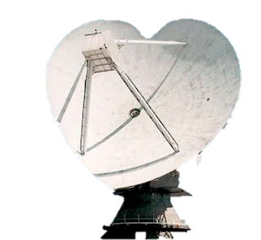
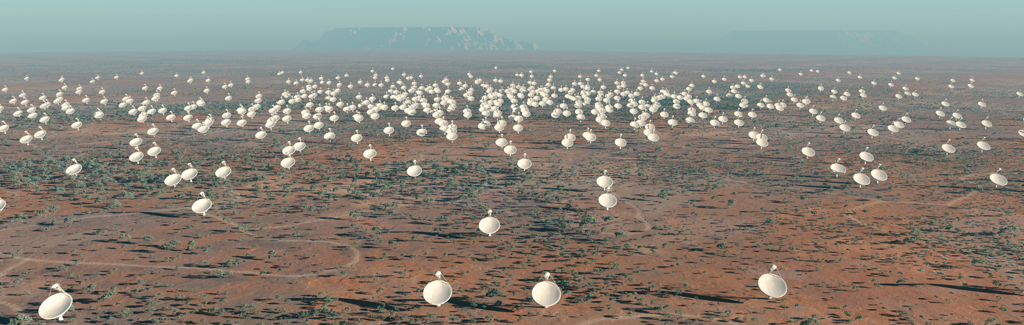

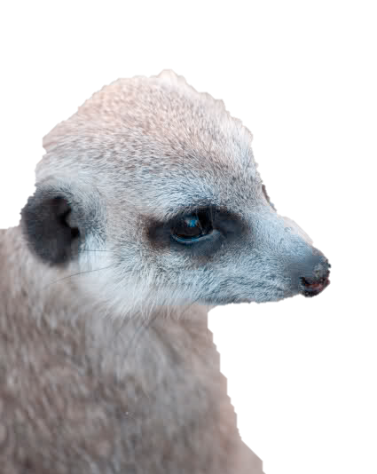

Radio Astronomy in 2049
What we learned from the Square Kilometre Array
Dr. Lisa Harvey-Smith | CSIRO Square Kilometre Array Project Scientist
20th April 2012
ASTRONONY & SPACE SCIENCE

Slide 2
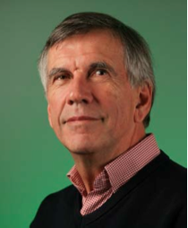
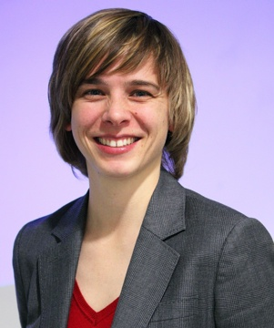
University of Sydney
Caltech
JIVE
University of Manchester
University of Sydney
CASS
JIVE
University of Manchester
Are you
following me?

Slide 3

I never predict anything, and I never will - Paul Gascoigne

Slide 4
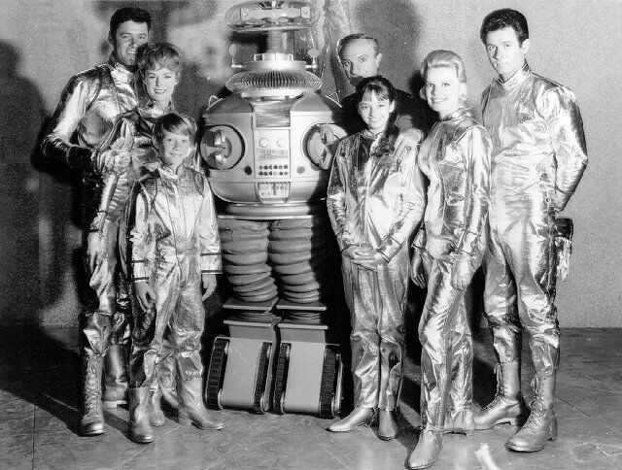

Slide 5
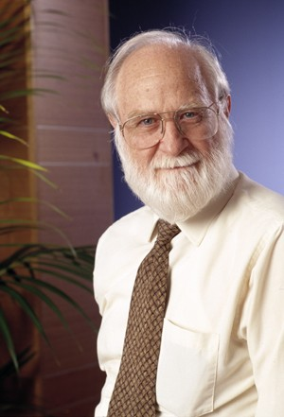
If the improvement in sensitivity has reached a ceiling, the rates of new discoveries will decline and the field of radio astronomy will become uninteresting and die out.
On the other hand if we can shift to new technology or find new ways to organise our resources, the exponential increase in sensitivity can continue.

Slide 6
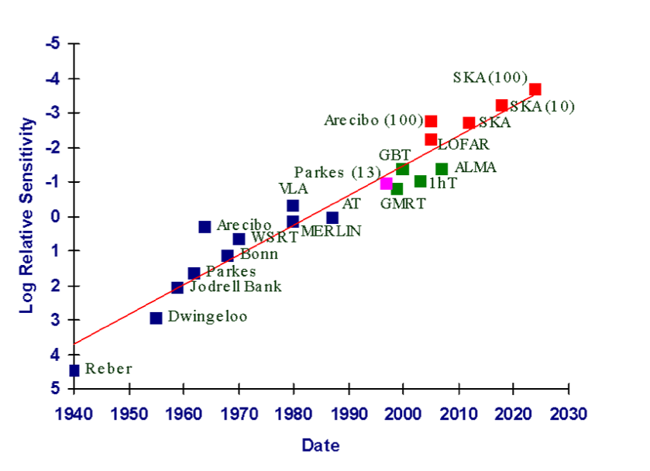
Ekers and Bell (2000)

Slide 7
Stay ahead of the curve
Saturate
Higher sensitivity
Wider Field of View
Wider Bandwidth
High Time Resolution
Powerful Computing
Co-Operate
Global Science Collaborations
Leverage Existing Resources
Citizen Science
Innovate
Smart Receivers
Intelligent Software
Clever Array Design
RFI Excision/nulling

Slide 8
Imminent Innovations in Radio Astronomy

Slide 9
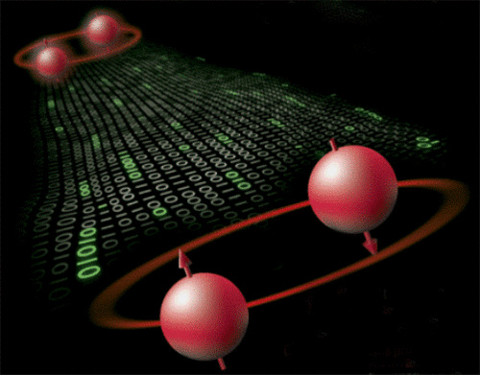
Low-power quantum electronics
New generation of microchips will combine conventional and tunnel-FET technology.
Reduces power consumption by up to 100 times.
"The current prototypes have been developed in a pre-industrial setting. Mass production expected by around 2017.”
http://phys.org/news/2011-11-impending-revolution-low-power-quantum.html

Slide 10

Power Consumption: The Golden Bullet
Reducing power consumption increases capabilities of SKA
Also enables meaningful renewable energy development.
Industry develop solutions
Radio Astronomy benefits via:
Access to new funding streams
Public / government support
‘Doing the right thing’
By SKA₂ build, should aim for renewable energy providing at least 50% power and cooling needs
Image: Horizon Power’s 1.1 MW Solar-Diesel hybrid power station at Marble Bar, Australia

Slide 11

Prediction: Explosion in Time-Domain Astronomy
Wide-FoV SKA Pathfinders will transform time-domain astronomy.
Single freq. band insufficient to identify and localise transient sources.
Aim to set up a multi-wavelength transient network
Suitable astronomical facilities set aside chunks of time to monitor the same area of sky at many frequencies.
Also perform rapid follow-up of predetermined types of event.
Allow us to really study transient sources, not just detect them.

Slide 12
SKA Computing: Can we cope?

Slide 13
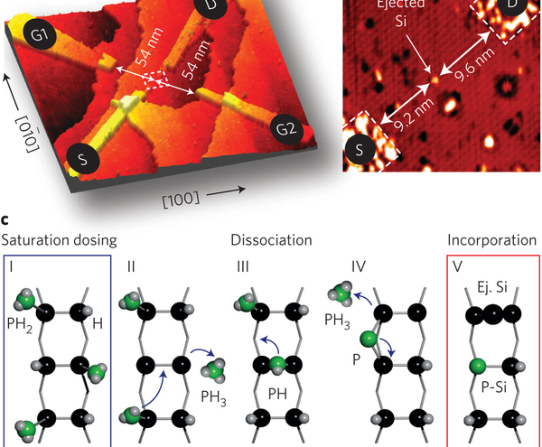
How much Moore will we get?
A single-atom transistor
Fuechsle et al. (2012)
Nature Nanotechnology 7, p 242, 19 February 2012.

Slide 14
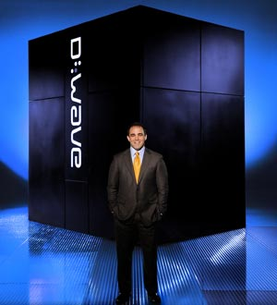
Quantum Computing
Ready for SKA?
Probably not, but mouthwatering prospect
“Quantum Optimiser” sold to Lockheed Martin for $10 million.
D-Wave also claim to be testing three 128-qubit systems. Many skeptics.
By 2049, could have superceded classical computers.

Slide 15
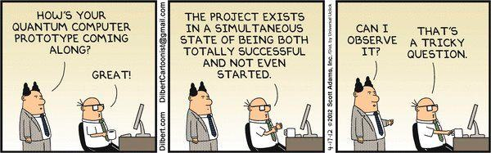

Slide 16
Highlights of SKA Science

Slide 17
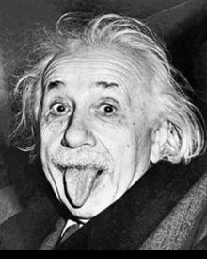
Scientific Highlights of SKA
We found and timed all the pulsars in the Galaxy.
GR is still 100% right.

Slide 18
Scientific Highlights of SKA
Pulsar timing array wins Nobel Prize for discovery of Grav Waves.
The 7341 PIs each receive $190 prize money.
Pre-biotic molecules are evident in a significant proportion of planetary systems, pointing to evidence of cosmic genesis.
Determination of source polarisation becomes the norm.
Extreme scattering events found to be widespread. Caused by Galactic ‘ball lightning’ generated by magnetic reconnection events.
Gravitational (micro)lensing one of the major science successes of SKA, probing unseen mass in our Galaxy and beyond.

Slide 19
Scientific Highlights of SKA
Dark energy survives - it is given a new name to celebrate. We still have no idea what it is.
SKA₂: Weak transient sources dominated by reflections of strong celestial RFI from aircraft, satellites and space junk. World’s greatest tracking network. Massive political headache. We decide not to tell anyone.

Slide 20
Co-operation: Broadening Participation in Radio Astronomy

Slide 21

Citizen Science
Two important functions:
(1) Provides low-cost research assistance
(2) Builds public support and understanding
SKA@Home very powerful for certain projects, but security and IP issues may have to be carefully managed.
Restrictions on international WWW and internet usage could make it a less attractive option globally.
Each national SKA Science Centre manages SKA@Home programs?

Slide 22
SKA – the gift that keeps on giving
Upgrade path
Sensitivity Add collecting area / Increase bandwidth
RFI Site & Design Choices / Spectrum Management / Removal
Resolution Size of Earth / Maximum Frequency
Computing Moore’s Law / Quantum Computing
VLBI Cost effective, leverages existing infrastructure
promotes international co-operation.

Slide 23
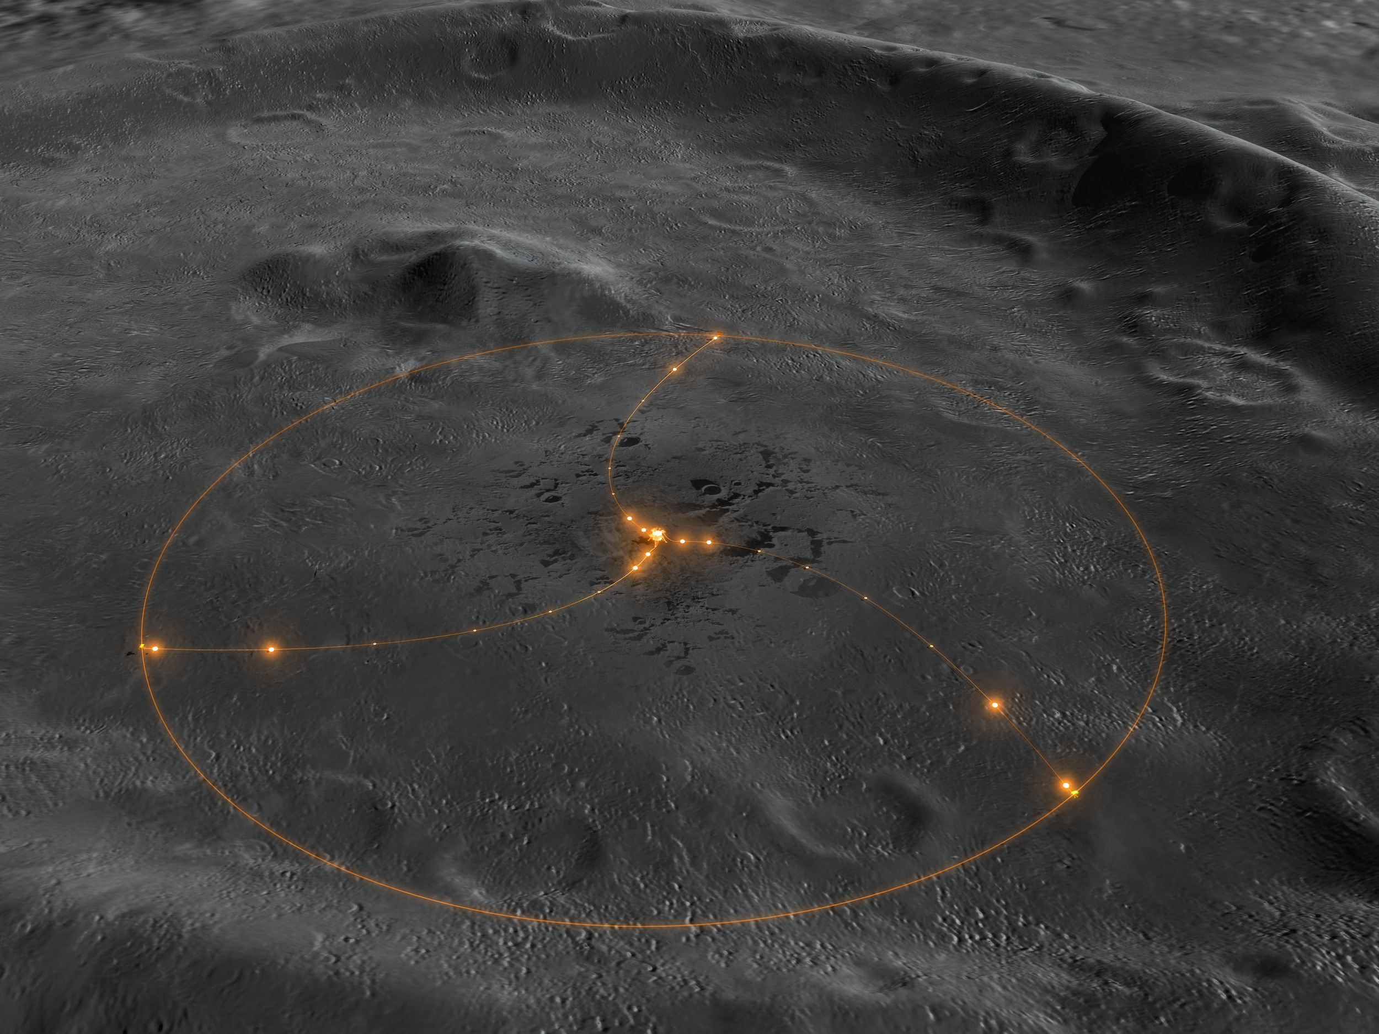

Slide 24
The world is our interferometer
Notes:
SKA central supercomputer will require the power of 1 billion desktop PCs. Such a computer does not exist currently, but increases in processing power should put us in the right place by 2020!
Data speeds of 100 terabits per second
A supercomputer running at a billion billion calculations per second
Generating around 5 exabytes of data per day.

Slide 25
Thank you
CSIRO Astronomy & Space Science
  Dr. Lisa Harvey-Smith
  CSIRO SKA Project Scientist
    e lisa.harvey-smth@csiro.au
    w www.atnf.csiro.au
    w www.lisaharveysmith.com
CSIRO Astronomy and space science

