Slide 1
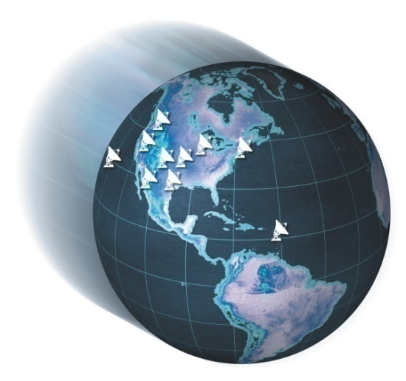
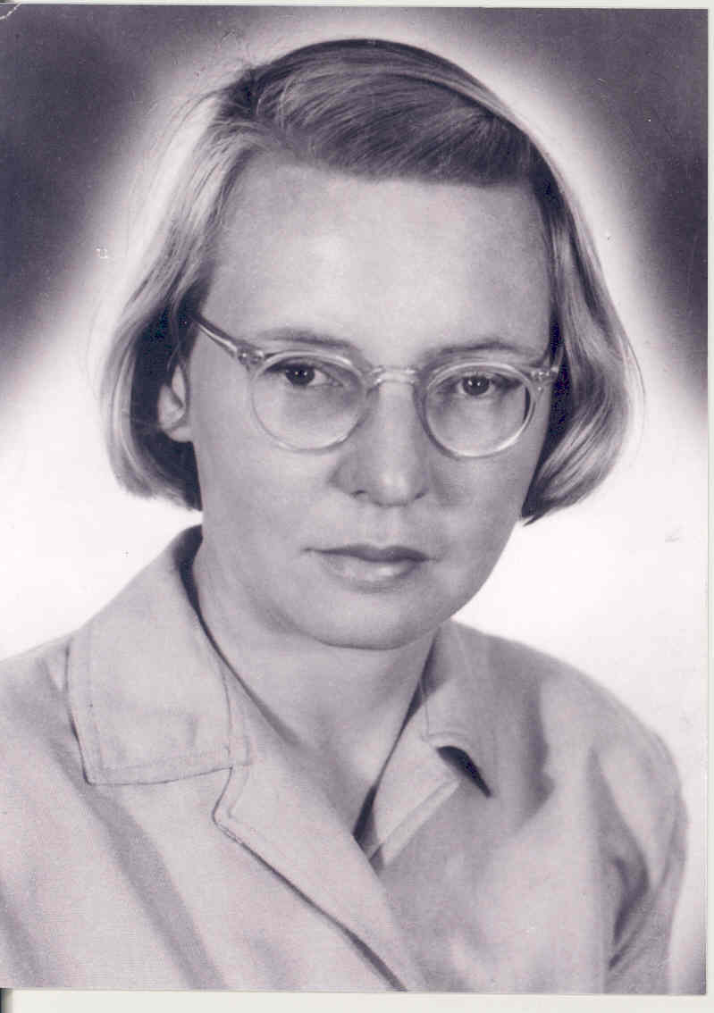
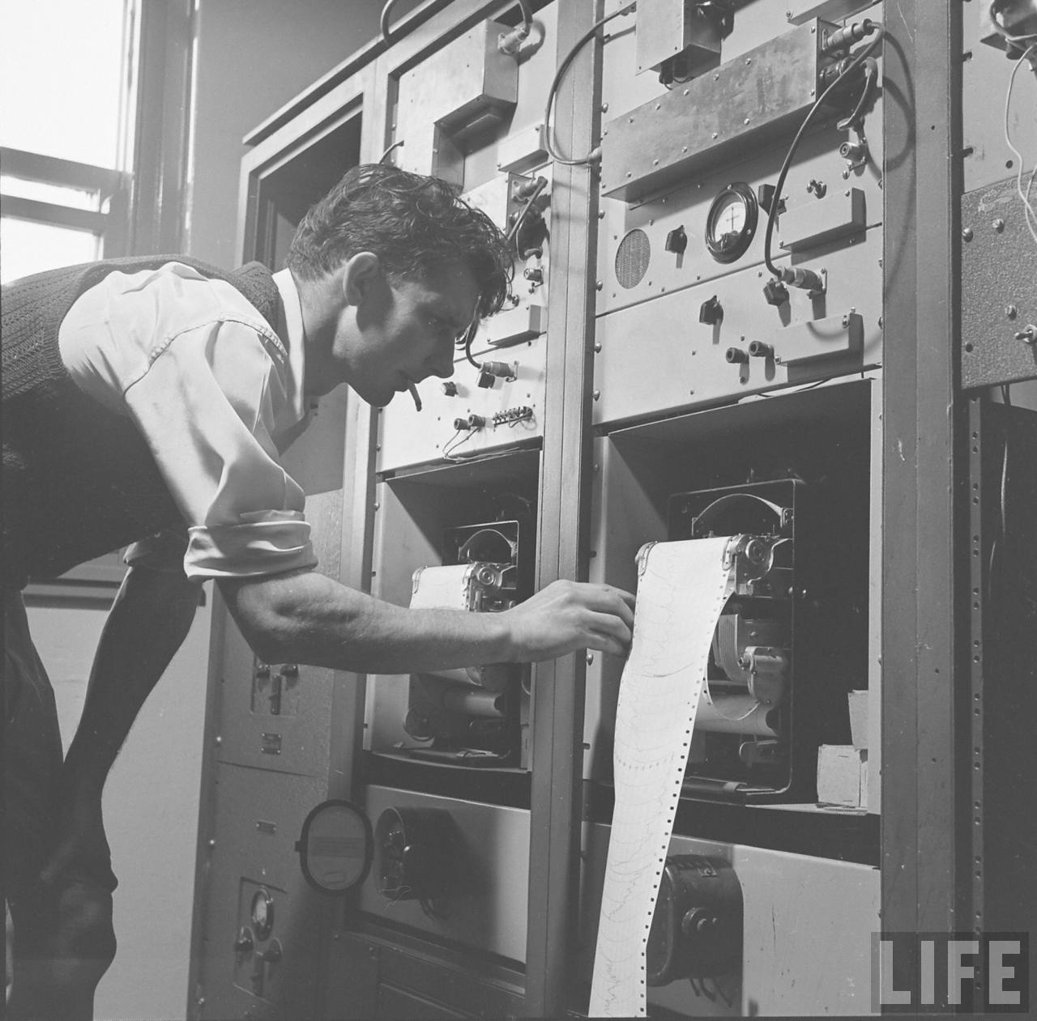
First Interferometry in Radio Astronomy: Ruby Payne-Scott Observes Type I Solar Bursts Australia Day 26 January 1946
Miller Goss
National Radio Astronomy Observatory
Socorro, New Mexico, USA
18 April 2012
Manchester RTS-2012
http://www.nrao.edu/

Slide 2
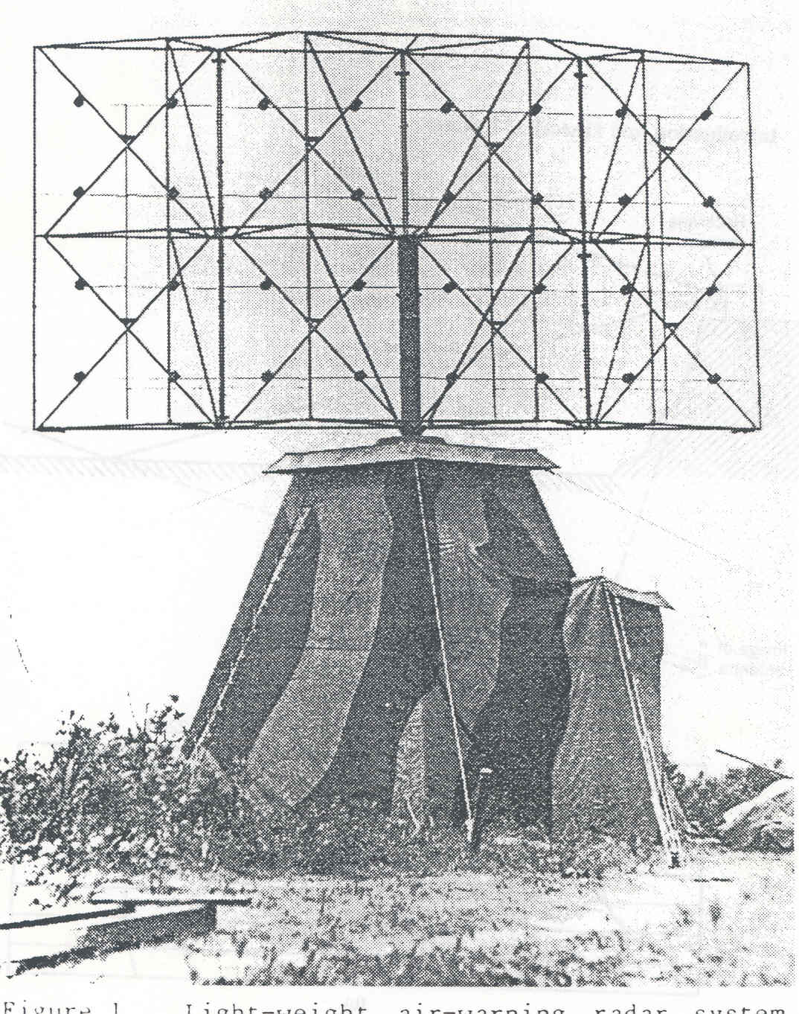
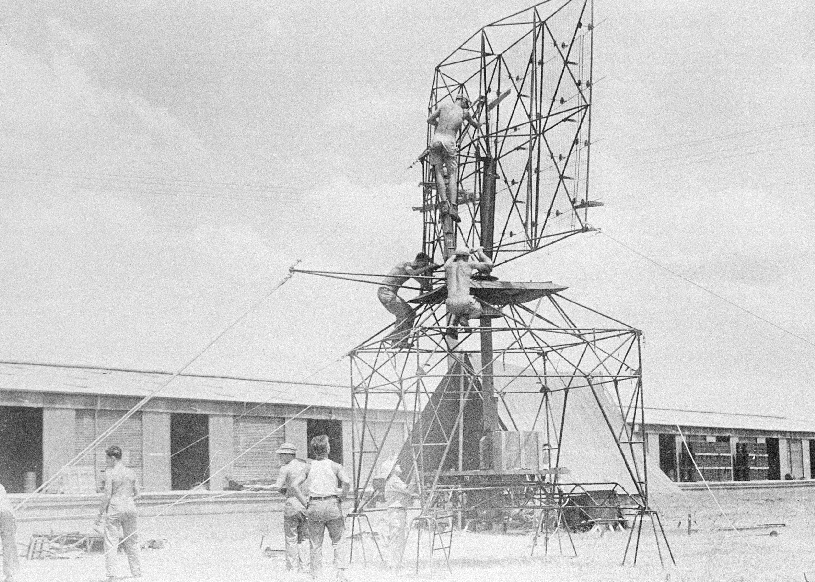
Dover Heights WWII Shore Defence and Light Weight Aircraft Warning 200 MHz

Slide 3
The Sea Cliff Interferometer- first use of radio astronomical interferometry 26 Jan. 1946- Australia Day- by Ruby Payne-Scott , Pawsey and McCready

Slide 4
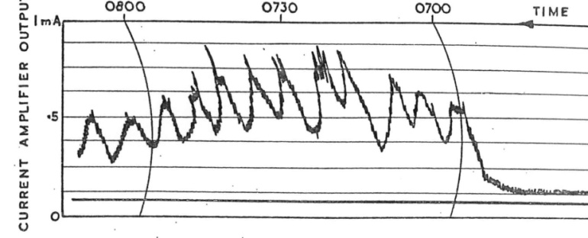
The Sea-cliff interferometer and lobe pattern for the radar
Cygnus A – 100 MHz 10000 Jy
With noise of 300 Jy
Quiet Sun June 1947

Slide 5
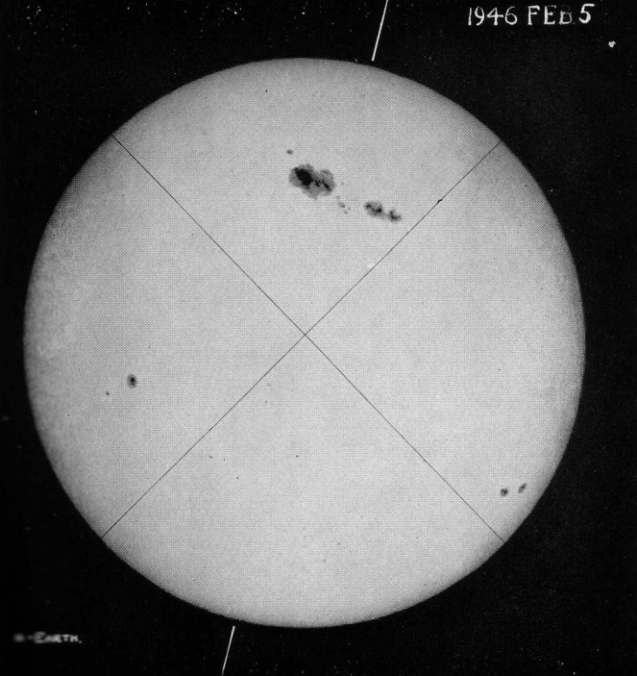
Incredible good fortune
One of the larger sunspots of recorded history in first days of Feb. 1946

Slide 6
Type I Noise Storm associated with the huge Sunspot of Feb. 1946

Slide 7
Limits on T_{b}
Size is less than 6.5 arc min. Peak flux density is 10⁷ Jy or T_{b} > 3 x 10⁹ K. ‘ Gross electrical discharges…. ‘ Type I bursts are now known to be the fundamental frequency plasma emission, explaining the high brightness temperature and the strong o-mode polarization

Slide 8
Aperture Synthesis

Slide 9
The details

Slide 10
Ryle in ‘A New Radio Interferometer and its Application to the Observation of Weak Radio Stars’, from 1952 in the Proc Royal Society
The relation between the magnitude of the varying component of power intercepted by an interferometer and the Fourier transform of the distribution across the source was first pointed out by McCready, Pawsey and Payne-Scott (1947).’

Slide 11
The publication- Proc of the Royal Society. August 1947

Slide 12
6 months later in mid 1946
First Interferometry at the Cavendish . 17 July 1946 by Ryle and Vonberg
At 175 MHz and baselines from 17 m to 240 m. Called the ‘cosmic radio pyrometer’
In late July large sunspot group and detected the Type I bursts and also circular polarization

Slide 13
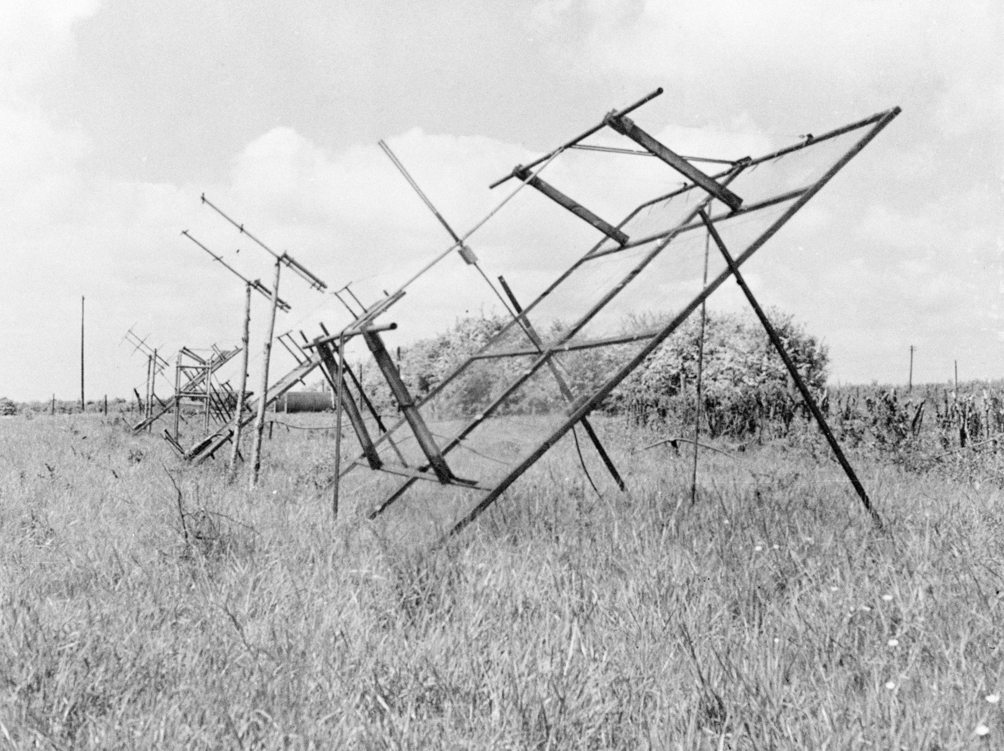
Photo by John Bolton during his visit to Cambridge May 1950

Slide 14
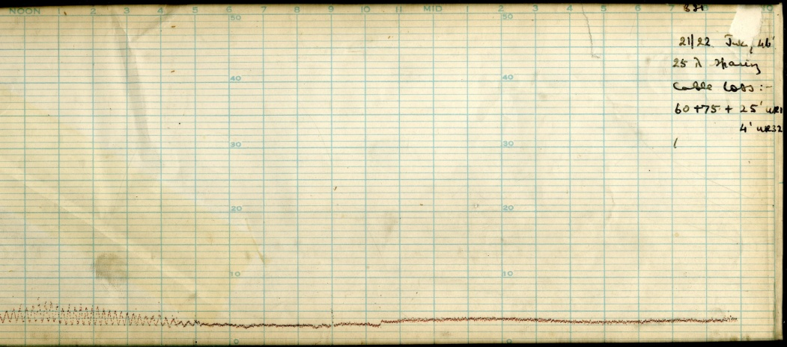
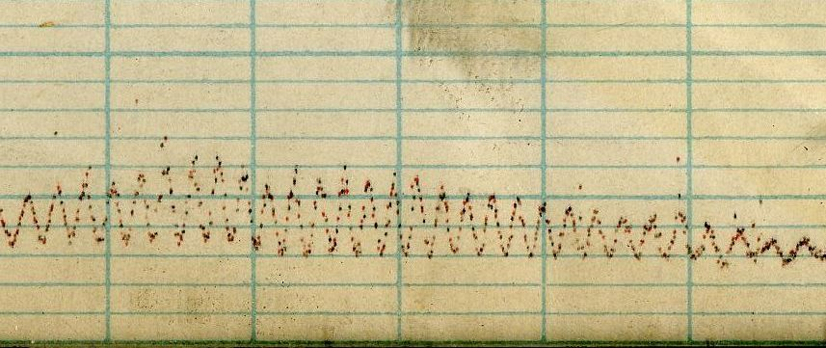
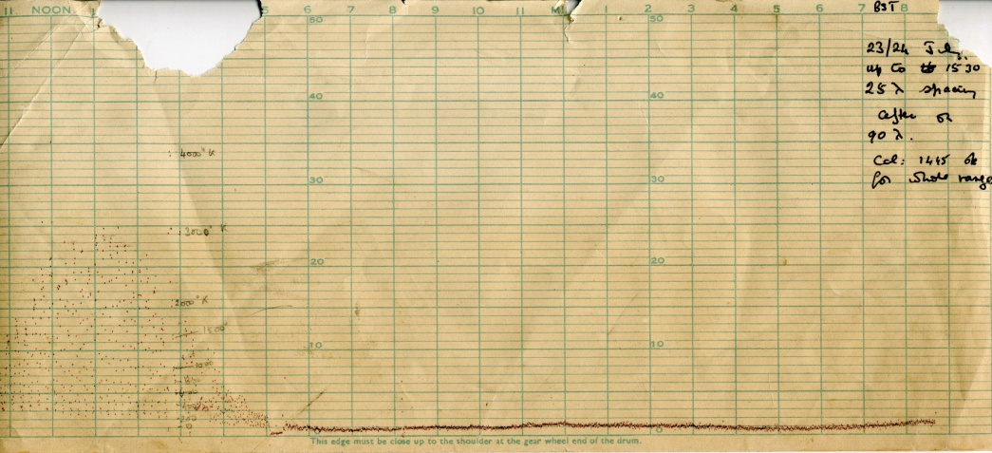
Some images ‘Rifle Range’ off Grange Road - John Baldwin July 2010

Slide 15
Ryle and Vonberg

Slide 16
Key Result of Sydney and Cambridge in 1946 at Cambridge
Sydney group – bursts associated with sunspots, size limits and position determination. Non-thermal
Sydney: First mention of the principle of aperture synthesis- need cliffs of variable heights
Sydney: Determined a method to correct phases of the sea-cliff interferometer for REFRACTION
Cambridge: First Michelson Interferometer in radio astronomy. Their first interferometry mid July 1946 – note incorrect year in abstract !
Ryle and Vonberg: size 175 MHz less than 10 arc min with baseline of 240 m. First detection of circular polarization along with two other groups in July 1946; no position determination

Slide 17
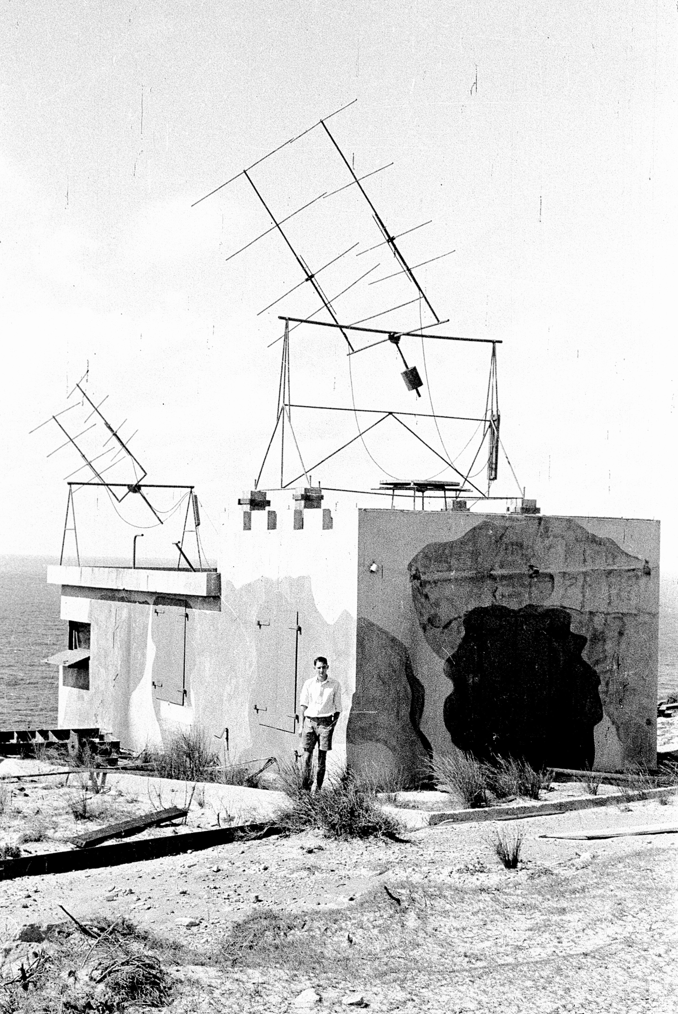
March 8 1947 Giant Outburst – first Type II – Payne-Scott, Yabsley and Bolton

Slide 18
Details
Type II and Type III bursts are proposed
This was another giant sunspot- few days after the Type II aurora observed in Sydney !
Two different versions of how this paper came about – Sullivan and Goss have heard two discrepant versions from Bolton and then Yabsley
Pawsey should have been an author
Claim is that the flux density at 60 MHz is 10¹¹ Jy

Slide 19
URSI 1952 Sydney University- show case for Australian radio science

Slide 20
List of Australian Participants from NSW

Slide 21
Schilizzi family just before they leave for Australia circa Dec 1950- arrival Sydney was Australia Day 1951

Slide 22
The Sydney Newspapers

Slide 23
Chris Christiansen- then CSIRO RPL- is quoted
‘Radio astronomy was not born with a silver spoon in its mouth. Its parents were workers. One parent was the radio-telephone; the other was radar.’
astro-ph obituary of Chris by Frater and Goss: arXiv:1109.4880

Slide 24
Summary
Amazing good fortune that the sunspot maximum close to the end of WWII
Solar noise research (term radio astronomy only used after 1948) gave : interferometry, dynamic spectra, enhanced understanding of free-free emission (eg solar corona), new insights into physics (plasma emission, synchrotron emission etc), aperture synthesis
The complete story on radio astronomy history up to the early 1950s in Woody Sullivan’s book ‘ Cosmic Noise , A History of Early Radio Astronomy’ Cambridge U Press (2009)

Slide 25
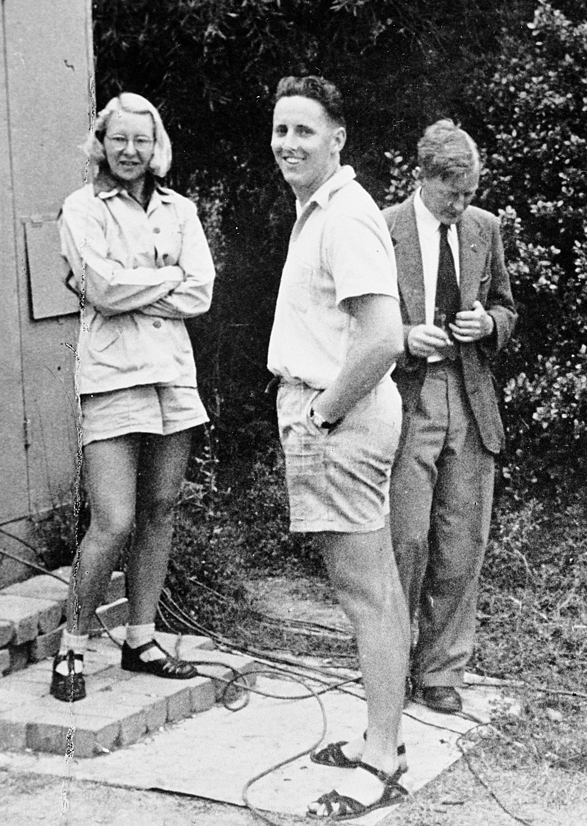
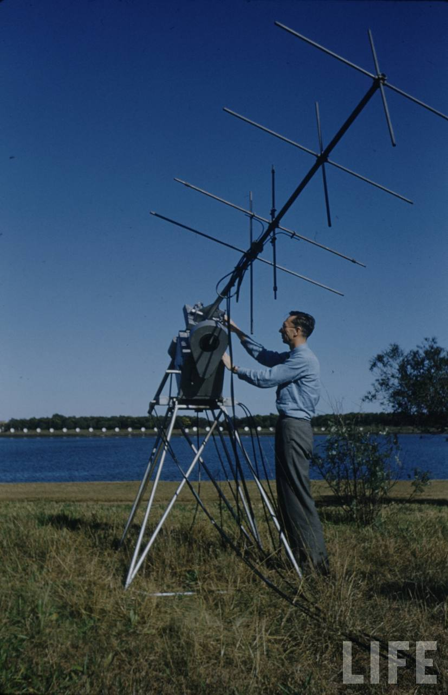
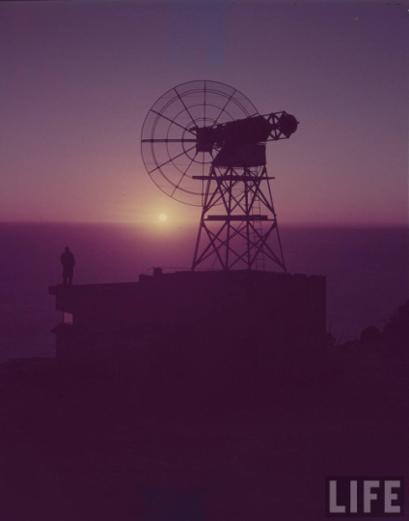
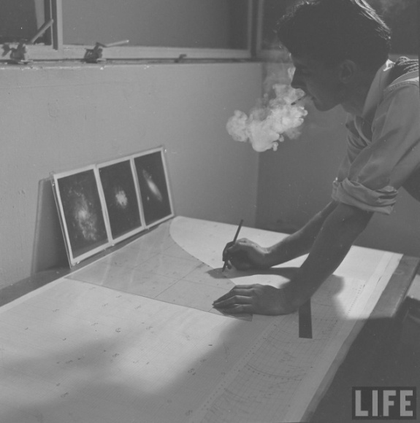
Some shameless ads
Some additional details about early solar noise in Goss and McGee ‘ Under the Radar , the First Woman in Radio Astronomy, Ruby Payne-Scott’ Springer (2009)
‘Making Waves, The Story of Ruby Payne-Scott, Australian Pioneer Radio Astronomer’ by Goss, Springer (2013) , popular version at a cheaper price in the series ‘Astronomer’s Universe’

