Slide 1
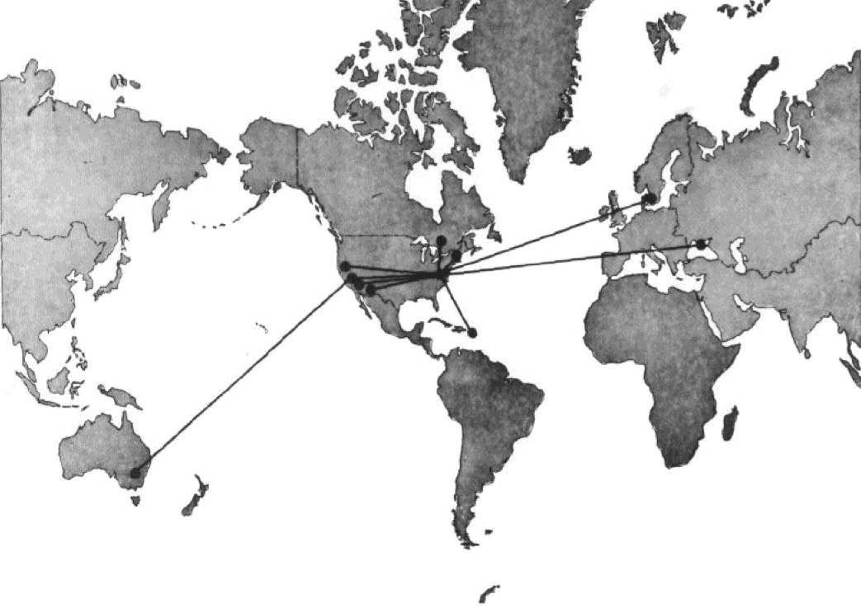
Breaking the Milliarcsec Barrier
Ken Kellermann
NRAO
RTS2012

Slide 2
Pre-history
Intensity Interferometry
Handbury Brown & Twiss (1954)
Goal was to resolve “radio stars” using transatlantic baselines
Radio link interferometry indicated very long baselines unnecessary
Concentrated on optical studies
Carr et al. (1965)
B = 55 km, ν = 18 MHz, 3300 λ
Jupiter
Audio tape recorder and independent crystal oscillators
Gubbay & Robertson (1967)
3C 273 < 0.01 arcsec
Independent-oscillator tape-recording coherent interferometry
Matveyenko, Kardashev, & Sholomitskii (1965, Radiophysika, 8, 651)

Slide 3
The Beginning
Canadian LBI
2 MHz analogue recordings
Studio TV recorders
H masers
Quasars
448 MHz (70 cm)
NRAO/Cornell MK I VLB
Cohen: IPS and lunar occultations
Kellermann: spectra and variability
Clark: Interferometry
Jauncey: Cosmic rays and computing
Raising the funds, Sept 1965
MIT/Haystack
Driven by OH masers

Slide 4
MK I Simple and Cheap
Jan/Feb 1967
2 failed experiments between 140-ft/ Arecibo
March 6: Green Bank
85-ft/140-ft
B = 650 m = 1300 λ
May 8; 140-ft /NRL
220 km = 460,000 λ
140-ft/Haystack
845 km @ 18 cm = 5 x 10⁶ λ
θ ~ 0.01 arc sec
Confirmed SSA (B ~ 10⁻⁴ G)
140-ft/Hat Creek
3500 km = 20 x 10⁶ λ
θ ~ 0.004 arc sec
Observing frequency: 611 MHz
Rb frequency standard
Multiplied x122 to LO frequency
Time synchronization LORAN
Digital recording - Self clocking
720 kbps
Software correlator
0

Slide 5
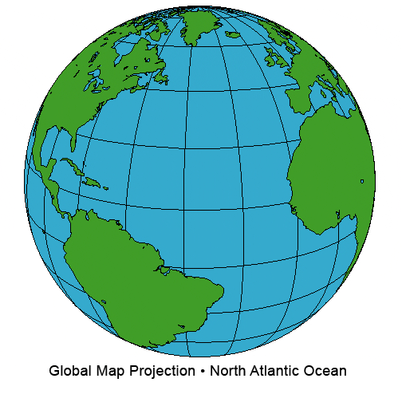
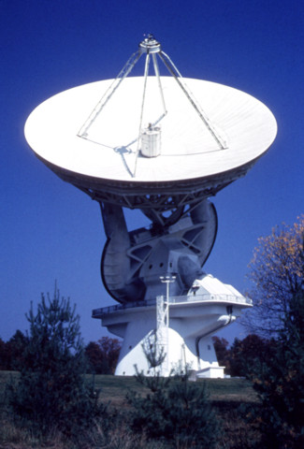
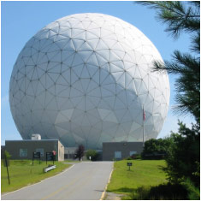
Crossing the Atlantic
140-ft/Haystack/Onsala
Jan, 1968:
18 cm: 6, 300 km = 35 x 10⁶ λ
6 cm: 105 x 10⁶ λ
θ ~ 0.001

Slide 6
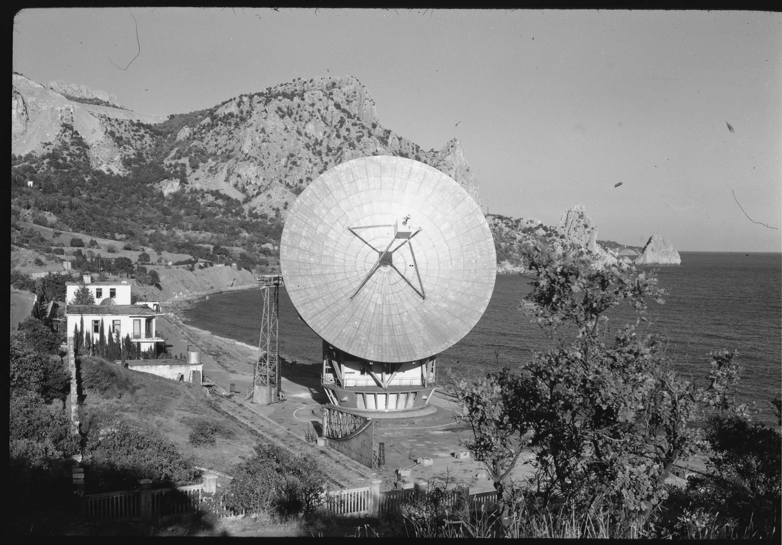
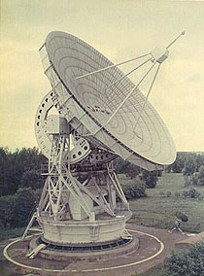
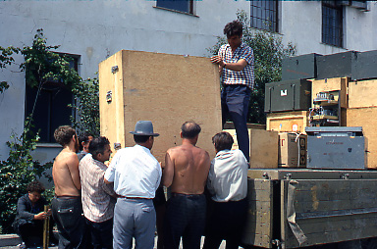
Penetrating the Iron Curtain
Green Bank/Crimea
Oct 1969
B = 8035 km
135 x 10⁶ λ (6 cm)
286 x 10⁶ λ (2.8 cm)
θ ~ 0.0004

Slide 7
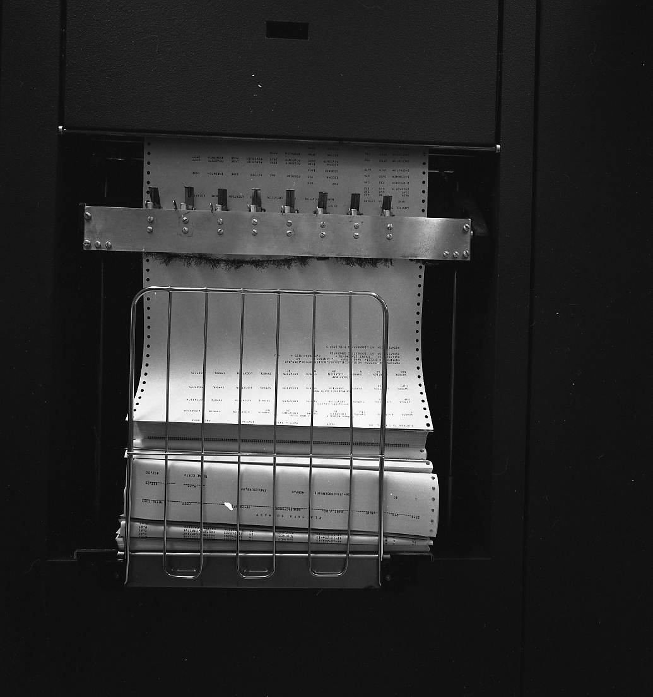
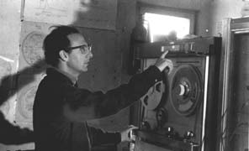
Living with MK I
Record system
BW 360 kHz (720 kbps)
7 track computer tapes – 3min
100 MB total
Difficult to handle
Software correlator
NRAO IBM 360/50 (1 .5 hour)
Caltech IBM 360/75 (10 min)

Slide 8
MKII
TV recorders/digital data
Ampex VR 660C: 2 inch tape/helical scan
IVC 825 1 inch tape
VCR: ½ inch VHS cassette tape
Developed by Allen Yen during visits to Caltech, MPIfR and NRAO
Hardware correlator (Barry Clark)
Real time equivalent playback

Slide 9
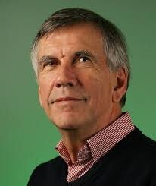
Observation with a VLBI Array
I. Introduction and Procedures, Cohen et al. 1975
II. The Sources 4C 39.25, NRAO 150, VRO 42.22.01, 3C 345, and 3C 454.3, Shaffer et al. 1975
III. The sources 3C 120, 3C 273B, 2134+004, and 3C 84, Schilizzi et al. 1975

Slide 10
Then and Now
VLBA
VLBA
3C 84 (NGC 1275)
3C 273
3C 84 (NGC 1275)

Slide 11
Lessons learned
Check and recheck and recheck again.
Measure twice, cut once
Don’t waste time and effort on bad data
You get what you pay for
Trust your data
not all radio sources are Gaussians
Avoid bureaucracy
Listen to advice – phase closure
Bad data is worse than no data. Good data is like the cool evening breeze.
Marshall Cohen

Slide 12
Acknowledgements
Marshall Cohen, Barry Clark, Dave Jauncey
Claude Bare, George Grove, & Al Moffet
Canadian LBI & Haystack Groups
Allen Yen
Russian Group
Leonid Matveyenko
Nicolai Kardashev

