Slide 1
The origins of the EVN and JIVE Early VLBI developments in Europe
Richard Schilizzi – 2012

Slide 2
The earliest long baseline work was at Jodrell Bank late ‘50s and ‘60s with Radio links – Henry Palmer, Barry Rowson and Bryan Anderson;
1967 OH MASER Davies, Rowson, Booth and Cooper- 700 kλ).
VLBI:
US – Onsala 1968,
US - Simeiz 1968,
Canada-JB (Canadian system 1968)
JB – Onsala (B.Anderson system) 1967.

Slide 3
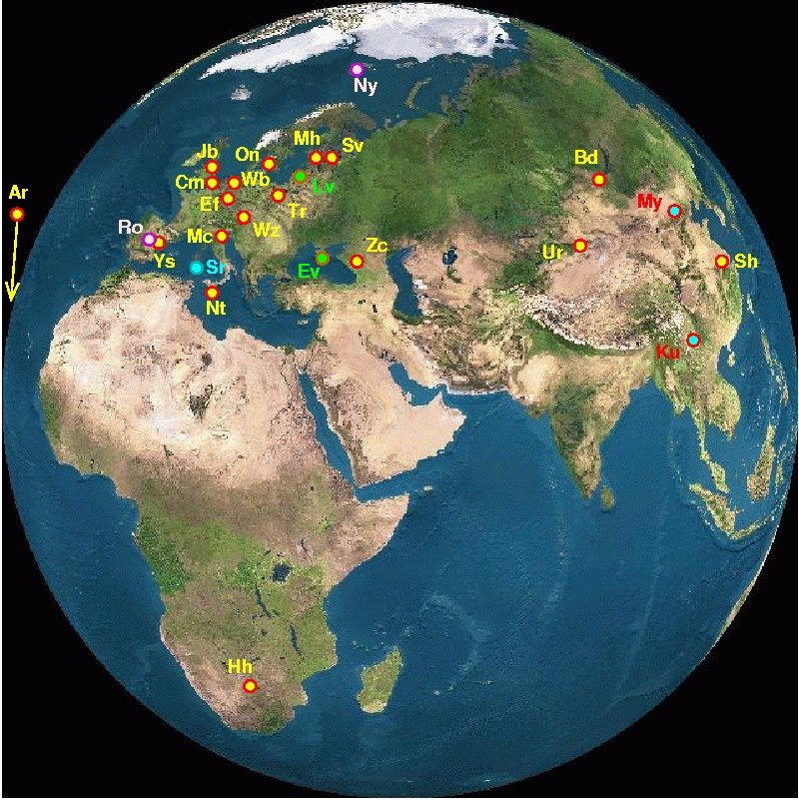
The EVN Network today
20 telescopes in 15 institutes at 18 locations in 12 countries spanning 4 Continents (Porcas), 2011

Slide 4
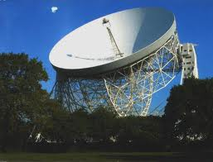
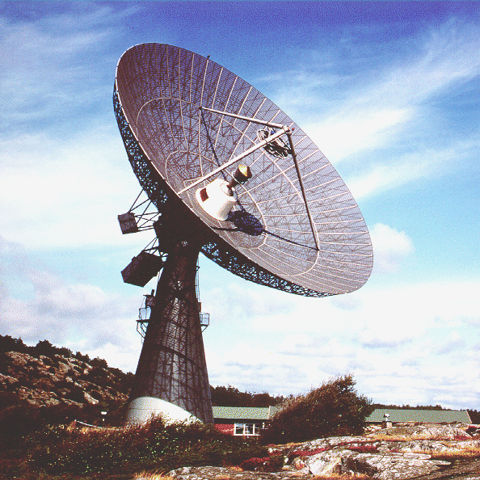
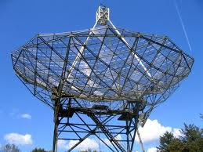
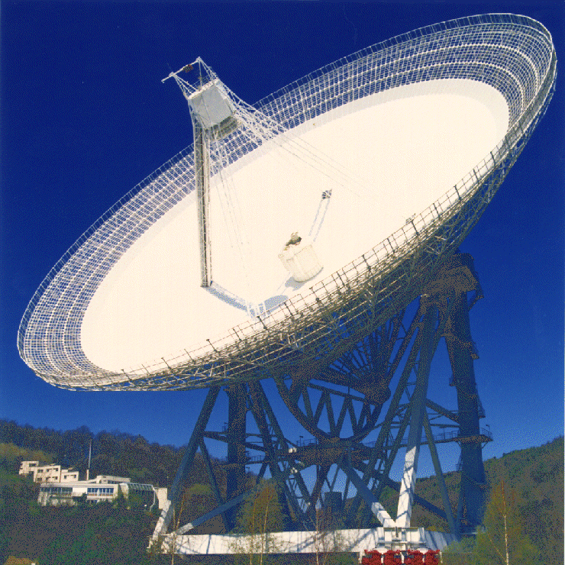
The first European VLBI antennae

Slide 5
The beginnings of the EVN
7 Apr 1975 MPIfR cafeteria Bonn ( Pauliny-Toth, Preuss, Miley and Booth) discuss a European VLBI Network.
Decide to call a meeting of European radio astronomers

Slide 6
1975-1979: The early days
Sep 1975 first meeting of interested astronomers, Bonn
Mar 1976 second informal European VLBI meeting in Bonn
Oct 1976 first intra-European observations Onsala-Dwingeloo- Effelsberg (ODE) on 3C236 and NML Cygnus
Oct 1976 third “EURO-VLBI” meeting in Onsala

Slide 7
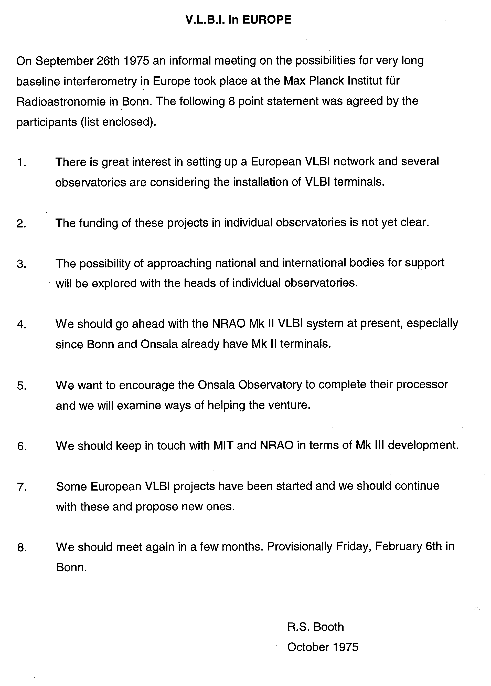
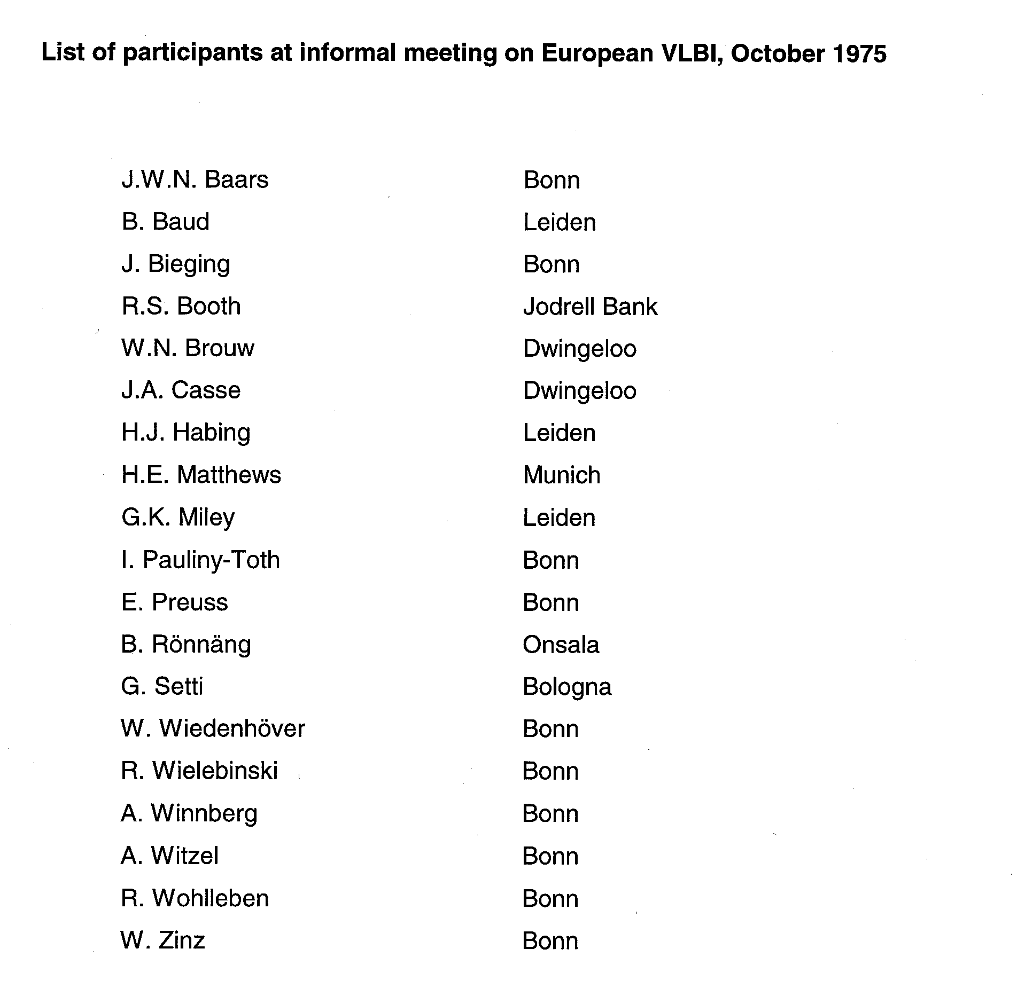

Slide 8
1975-1979: The early days
Sep 1975 About 20 people each meeting. Germany ,Holland, Italy, UK
Mar 1976 Finnish interest, + Geodesists
Oct 1976 first intra-European observations Onsala-Dwingeloo- Effelsberg (ODE) on 3C236 and NML Cygnus
RTS came, he observed and he published!
Oct 1976 third “EURO-VLBI” meeting in Onsala (Richard’s 1st)

Slide 9
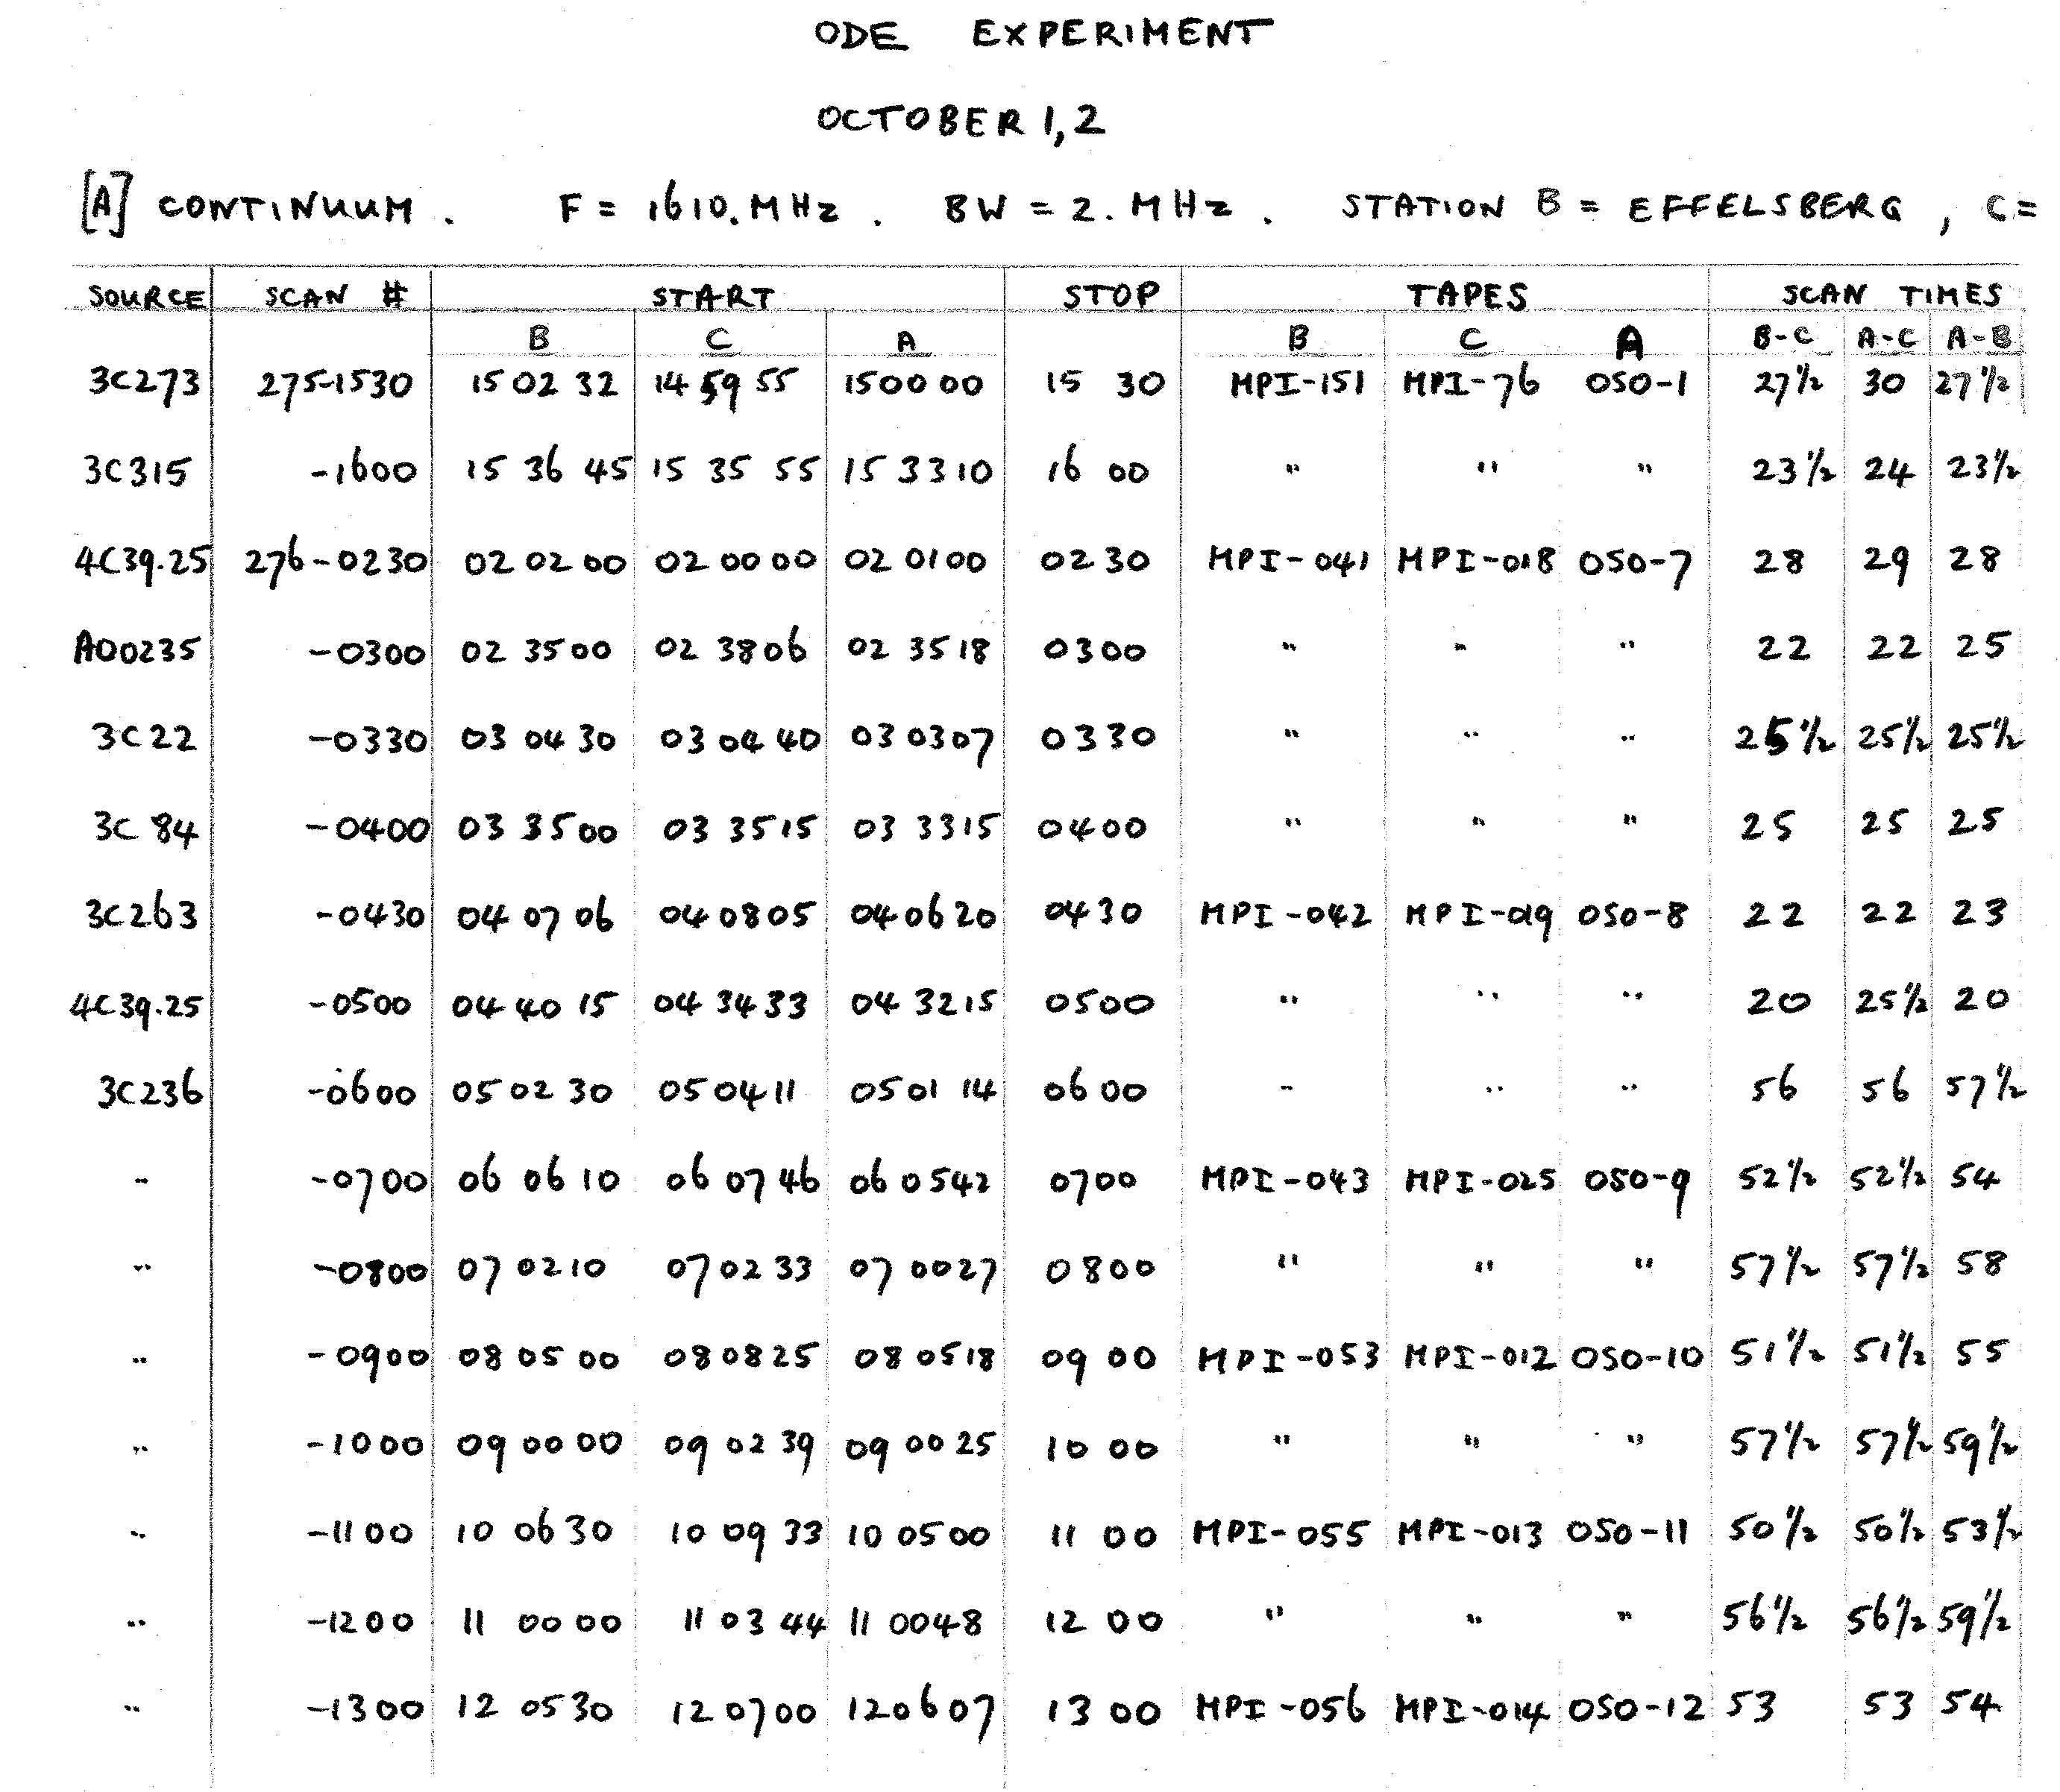

Slide 10
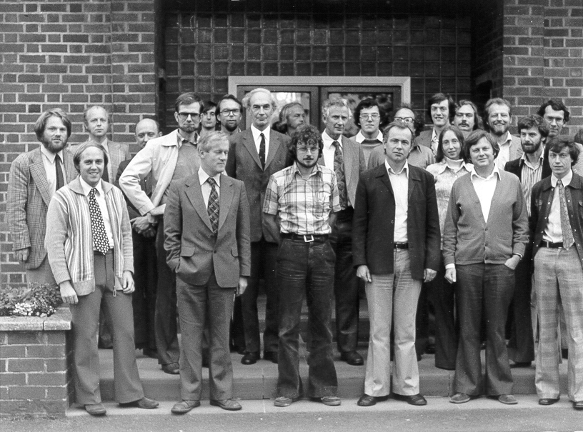
4th European VLBI meeting at Jodrell Bank, September 1977
The early days (2)
Sep 1977 Fourth informal meeting in Jodrell Bank
Oct 1977 European Study of satellite linked VLBI using L-SAT (Olympus) initiated Jan 1978 Second observation session J-O-D-E (resulted in 2 baselines!)
Jun 1978 3-station Mk2 correlator in Bonn started operation Nov 1979 Fifth meeting in Bonn. Future instrumental developments (MkIII, H-masers) discussed.

Slide 11
The early days (2)
Sep 1977 Fourth informal meeting in Jodrell Bank
Oct 1977 European Study of satellite linked VLBI using L-SAT (Olympus) initiated (Schilizzi, Ardenne) Jan 1978 Second observation session J-O-D-E (resulted in 2 baselines – crossed polarisations) and 2 publications!
Jun 1978 3-station Mk2 correlator in Bonn started operation Nov 1979 Fifth meeting in Bonn. Future instrumental developments (MkIII, H-masers) discussed. MPIfR decides to buy a Mk3 processor

Slide 12
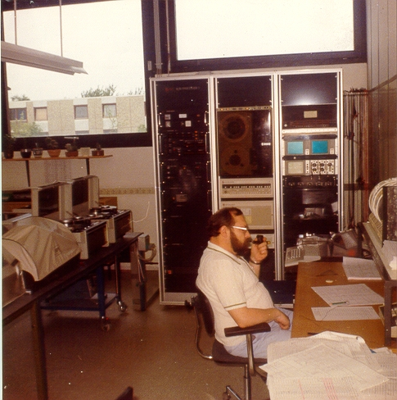
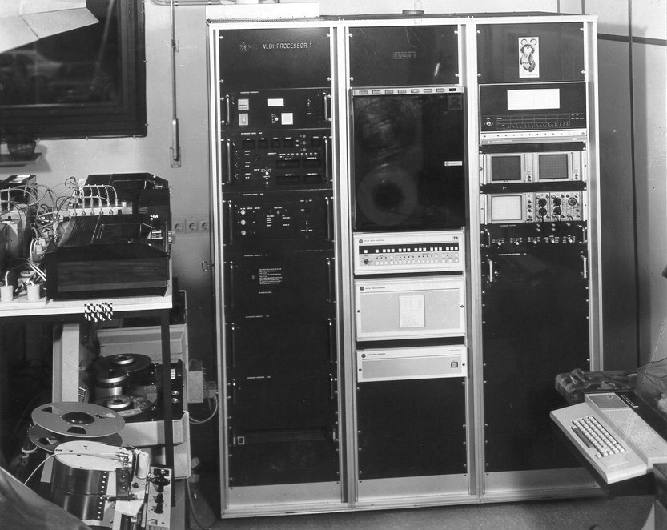
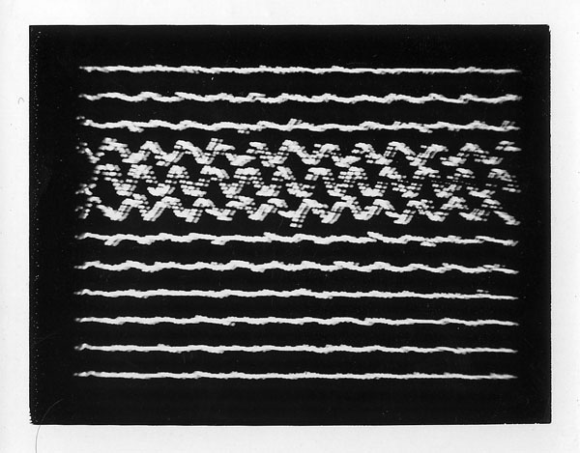
*Horst Blaschke
chief operator
MPIfR correlator
*Great help with
Correlation by
MPI staff!
Mk 2 correlator + playback systems at MPIfR
The early days (2)
Sep 1977 Fourth informal meeting in Jodrell Bank
Oct 1977 European Study of satellite linked VLBI using L-SAT (Olympus) initiated Jan 1978 Second observation session J-O-D-E (resulted in 2 baselines!)
Jun 1978 3-station Mk2 correlator in Bonn started operation Nov 1979 Fifth meeting in Bonn. Future instrumental developments (MkIII, H-masers) discussed.

Slide 13
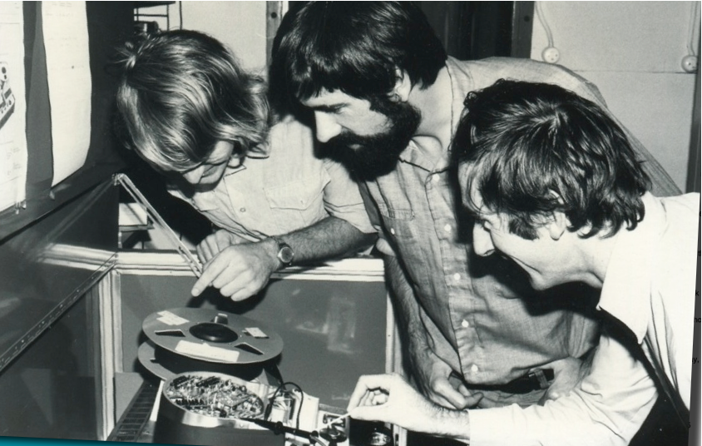

Slide 14
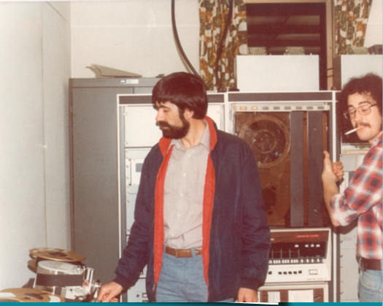

Slide 15
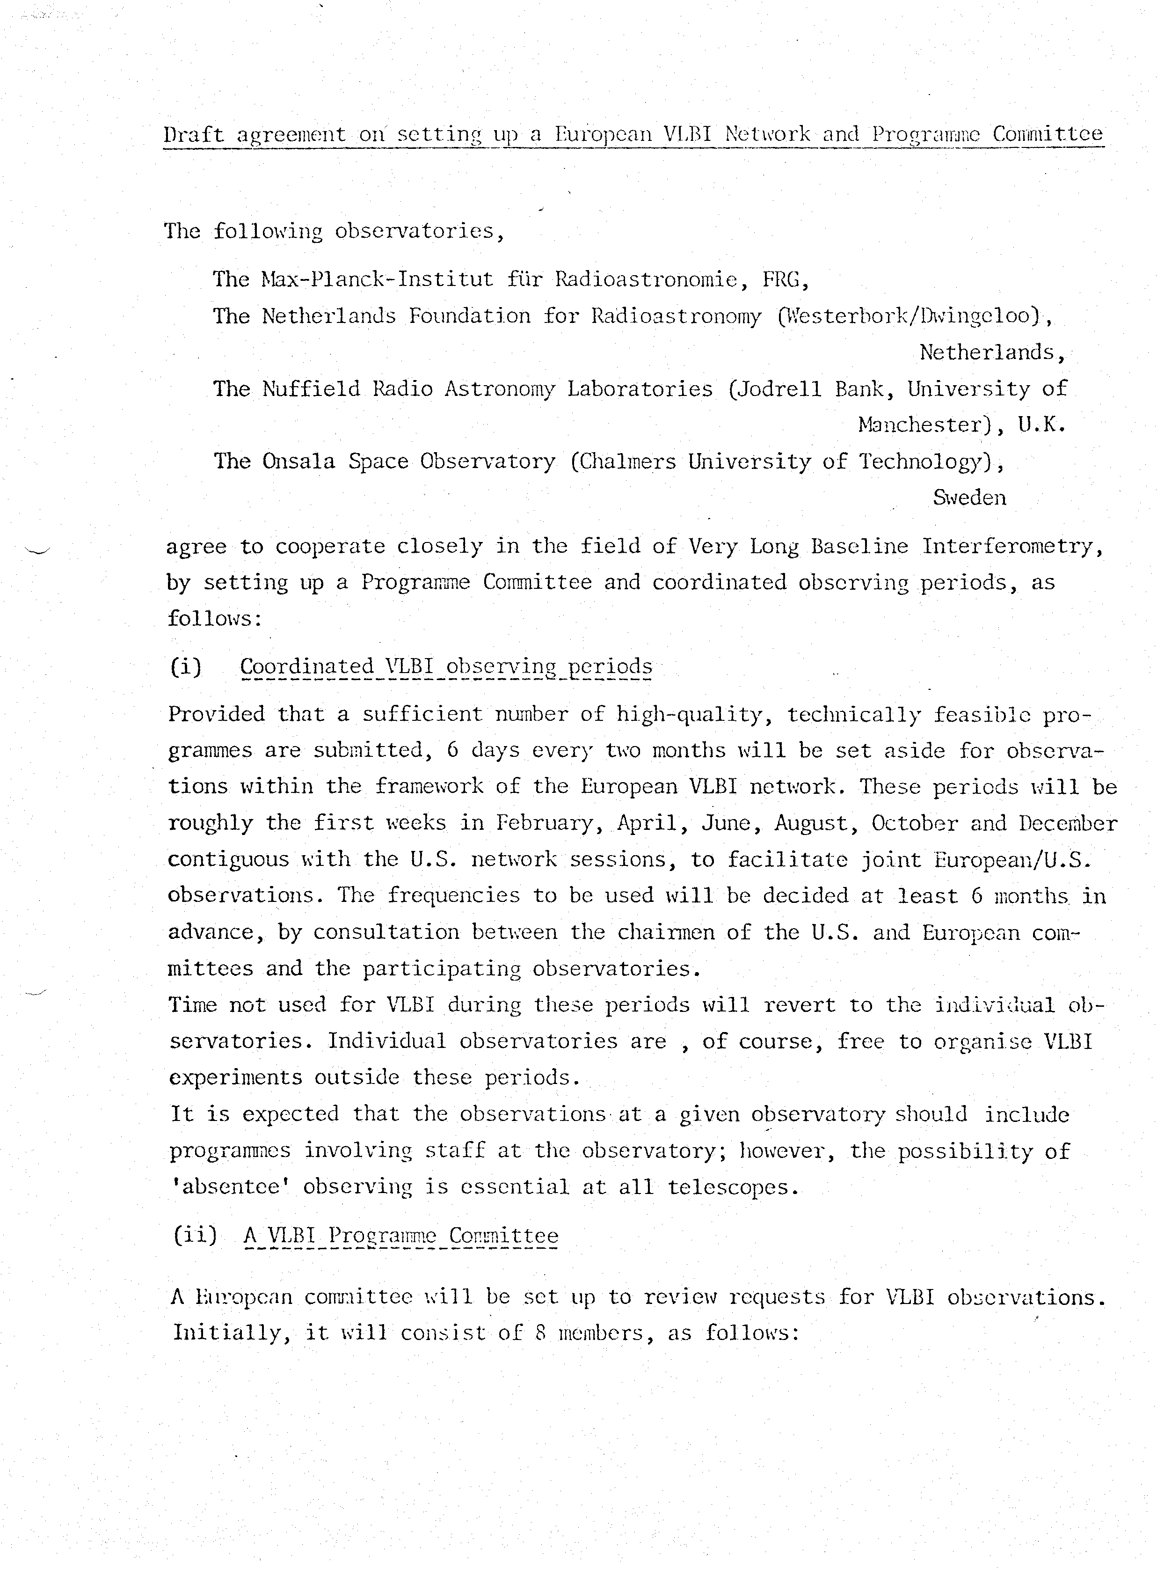
EVN and EVN Program Committee

Slide 16
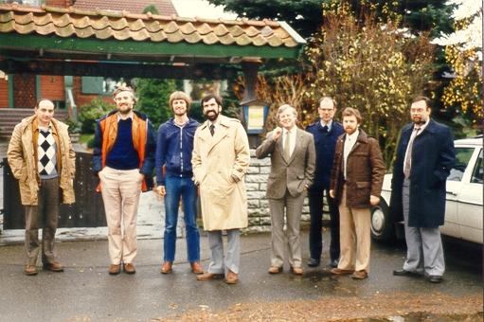
1980-1992: initial expansion
1980 Bonn: first meeting of institute directors. Agreement on six observing sessions/year and setting up EVNPC. Mk3 terminals.
1981 Leiden: Director’s Meeting discussed the data processor needs of the EVN in general terms. Demise of satellite-linked VLBI
1982 3 station Mk3 processor at MPIfR started operation
QUASAT was born in Toulouse
EVN Technical Working Group formed, Wolfgang Zinz first chair
EVNPC meeting in Onsala in 1984

Slide 17
1980-1992: initial expansion
1980 Bonn: first meeting of institute directors. Agreement on six observing sessions/year and setting up EVNPC. Mk3 terminals.
1981 Leiden: Director’s Meeting discussed the data processor needs of the EVN in general terms.
1982 3 station Mk3 processor at MPIfR started operation
QUASAT was born in Toulouse
EVN Technical Working Group formed, Wolfgang Zinz first chair
1983 two alternative proposals for future processing needs in Europe
upgrade Mk3 processor at MPIfR to 8 stations
develop new generation (12 station) data processor in Dwingeloo
European Foundation for Radio Astronomy discussed
Contact with ESF president Hubert Curien

Slide 18
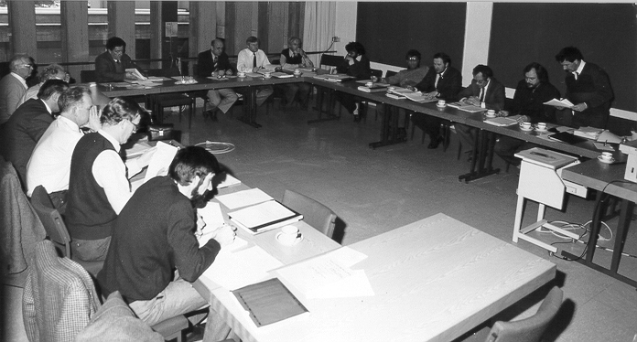
First formal meeting of the European Consortium in Bonn, in Feb 1980
First formal meeting of the European Consortium Board of Directors, in Bonn, February 1985

Slide 19
1980-1992 (2)
Jun 1984 EVN directors meet in Vienna before ESA QUASAT symposium in Grossenzersdorf (Austria), decide to establish Consortium
Jul 1984 MoU establishing European Consortium for VLBI (Bologna, MPIfR, Jodrell Bank, Onsala, Westerbork )
Feb 1985 Consortium meets for the first time in Bonn. Giancarlo Setti first chairman, Richard Wielebinski vice-chair.
Consortium agrees to seek funding for new generation processor in Dwingeloo as part of the EVN Upgrade Program
Nov? 1985 EVN telescopes outfitted with Mk3
May 1986 first contacts with EC in Brussels on funding

Slide 20
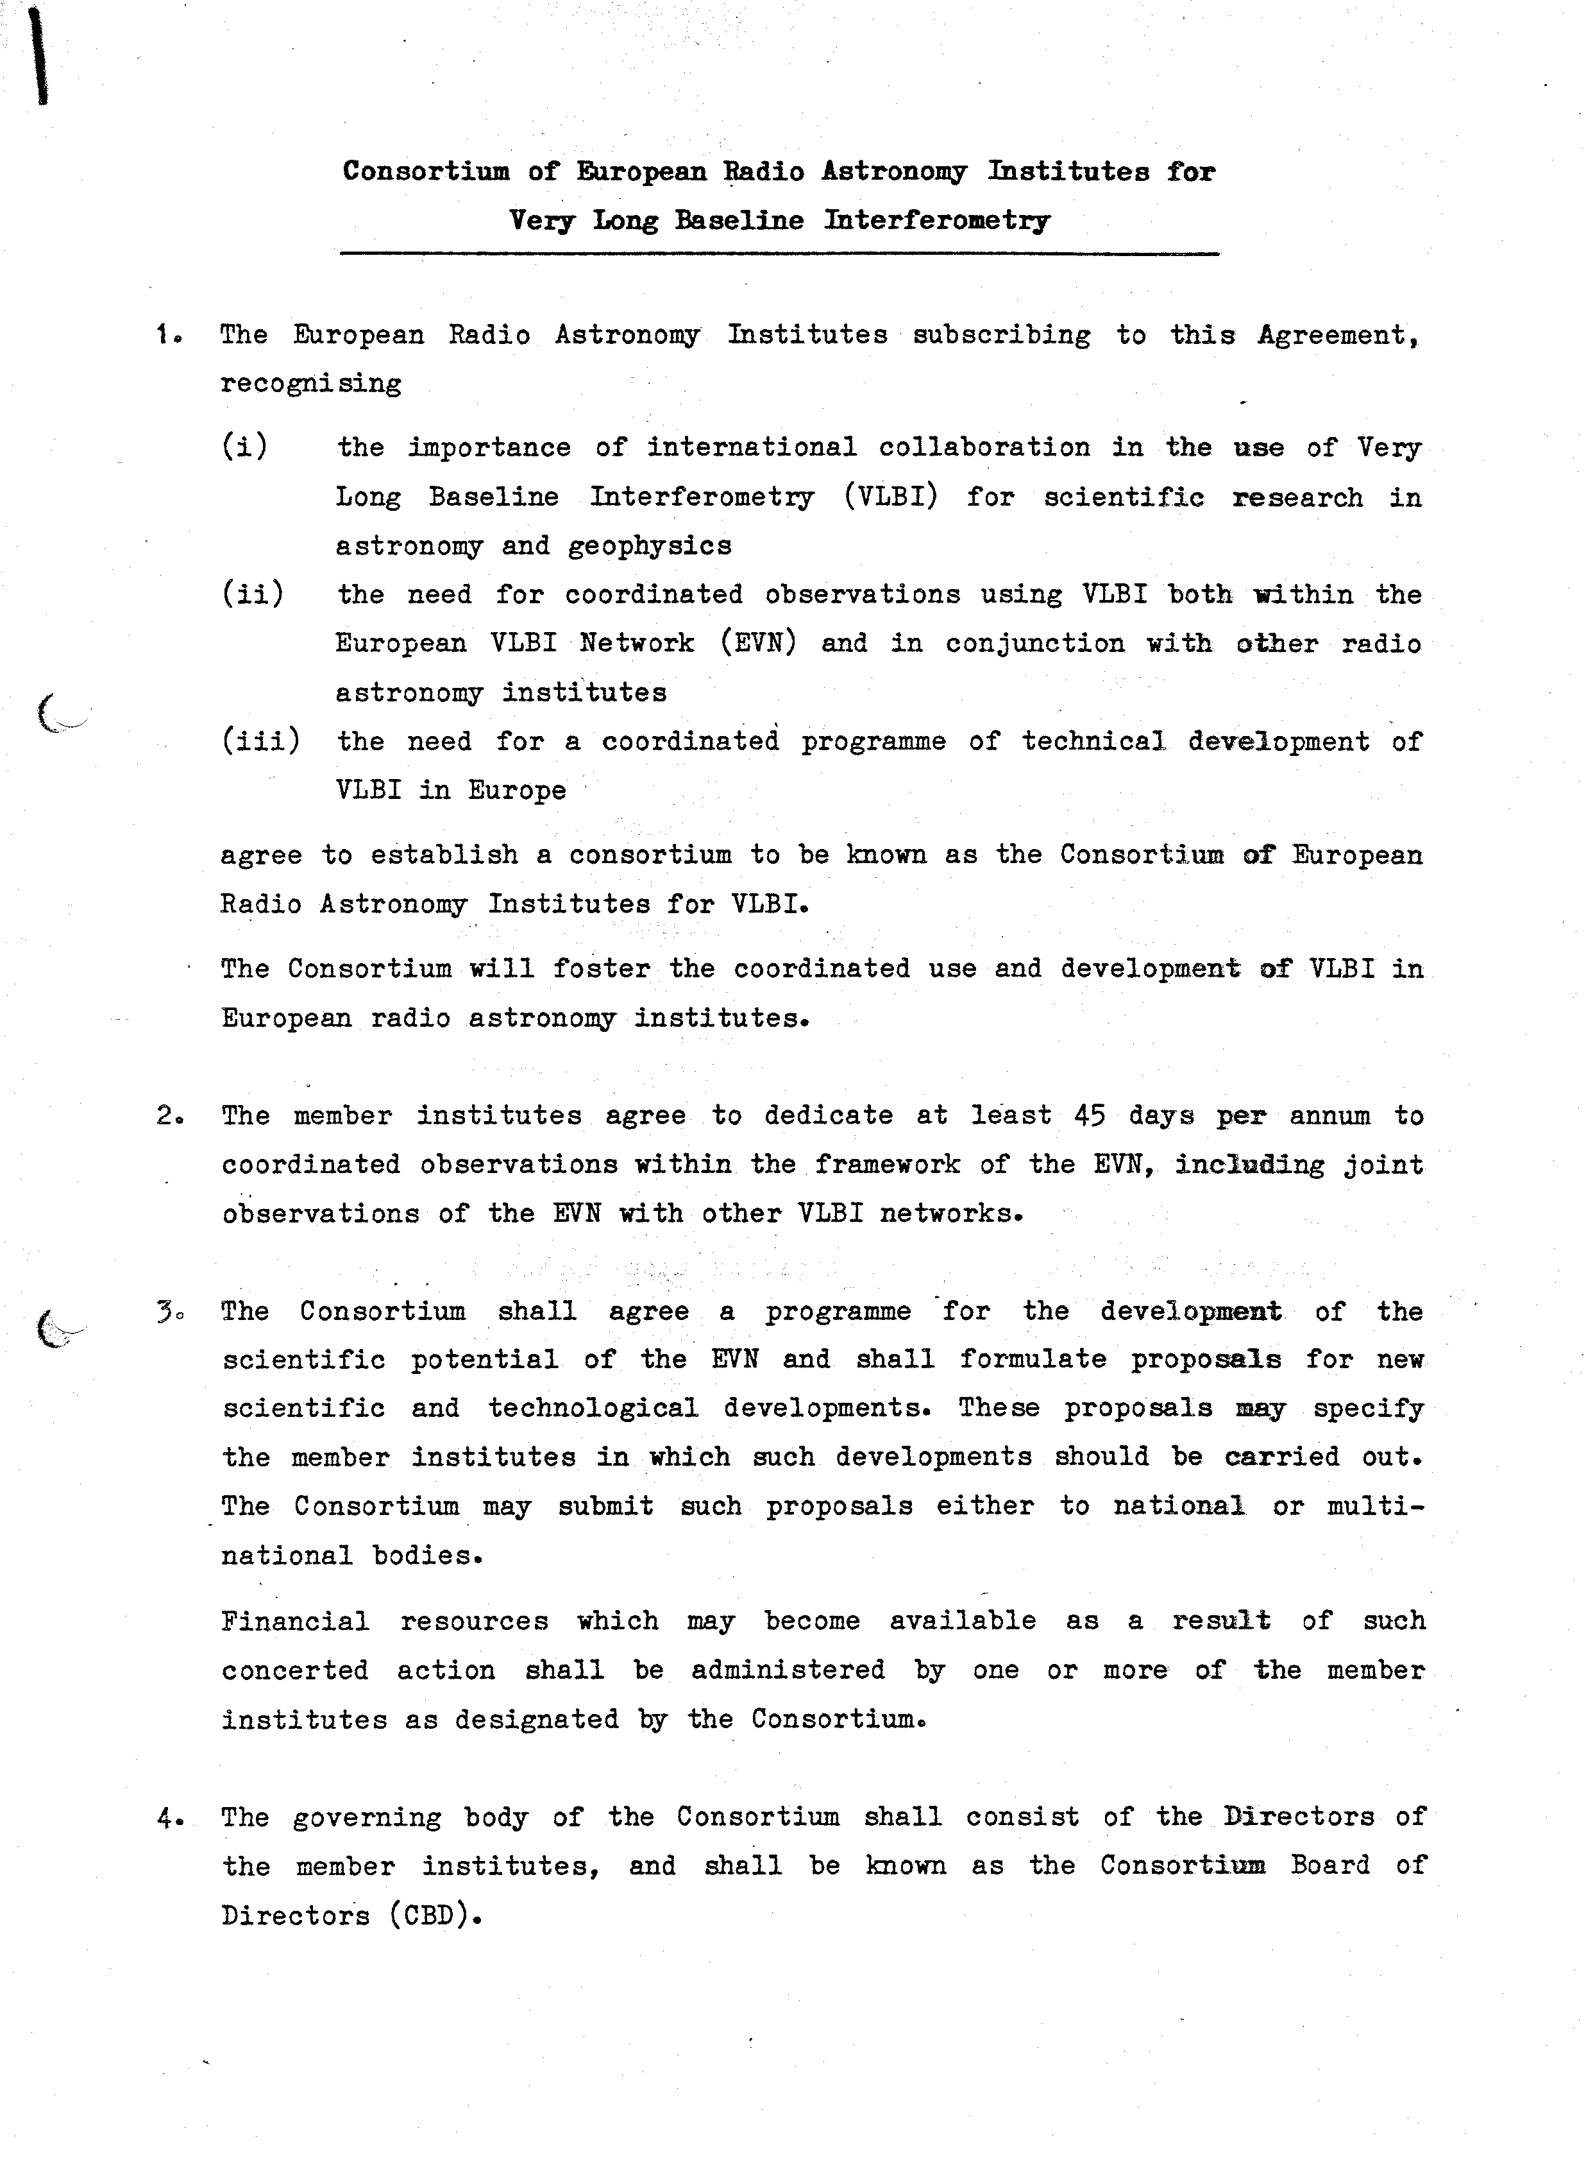
EVN Consortium agreement

Slide 21
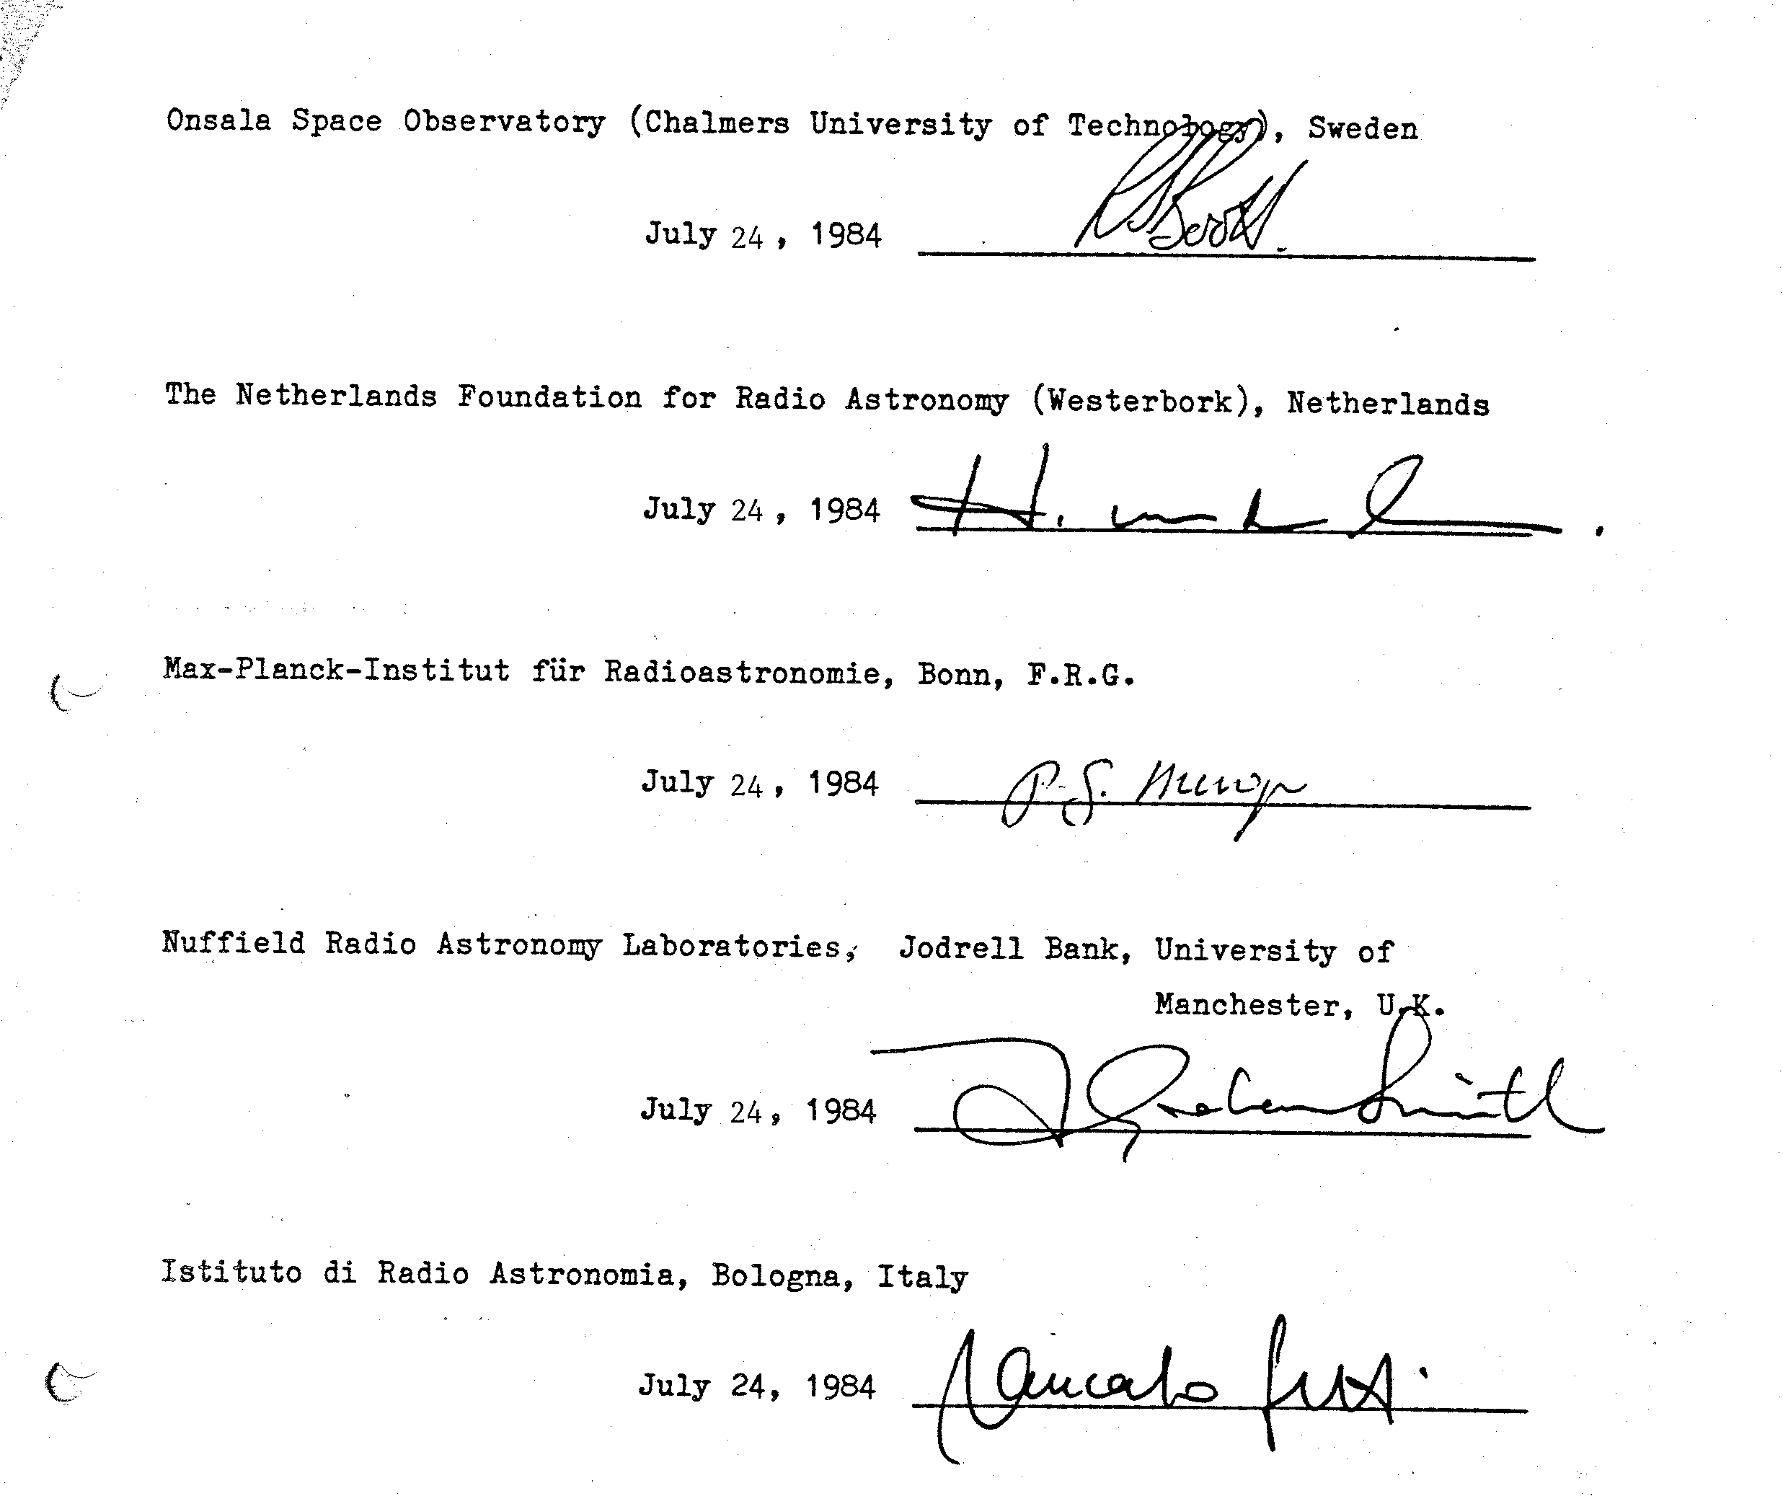

Slide 22
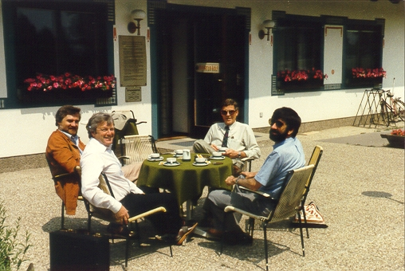
Relaxing after the big decision at Grossenzersdorf……
1980-1992 (2)
Jun 1984 EVN directors meet in Vienna before ESA QUASAT symposium in Grossenzersdorf (Austria), decide to establish Consortium
Jul 1984 MoU establishing European Consortium for VLBI (Bologna, MPIfR, Jodrell Bank, Onsala, Westerbork ) Feb 1985 Consortium meets for the first time in Bonn. Giancarlo Setti first chairman, Richard Wielebinski vice-chair.
Consortium agrees to seek funding for new generation processor in Dwingeloo as part of the EVN Upgrade Program
May 1986 first contacts with EC in Brussels on funding

Slide 23
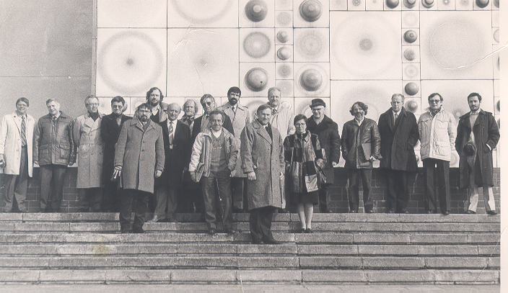
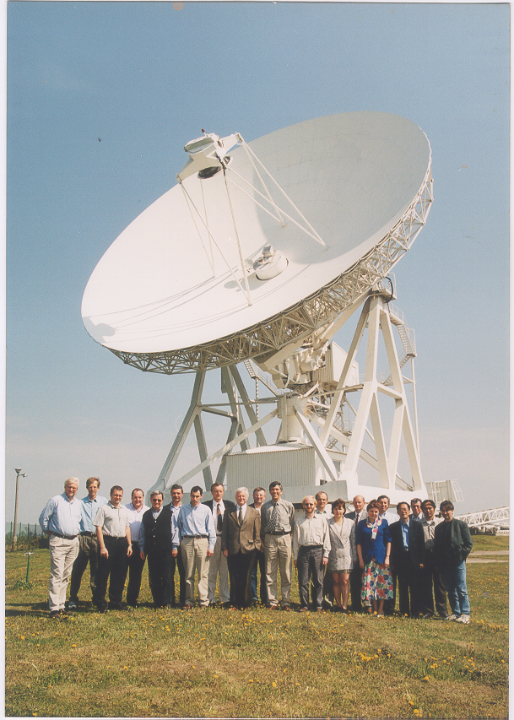
Torun 1988
Consortium meetings
Torun, 2001
Note RTS face change

Slide 24
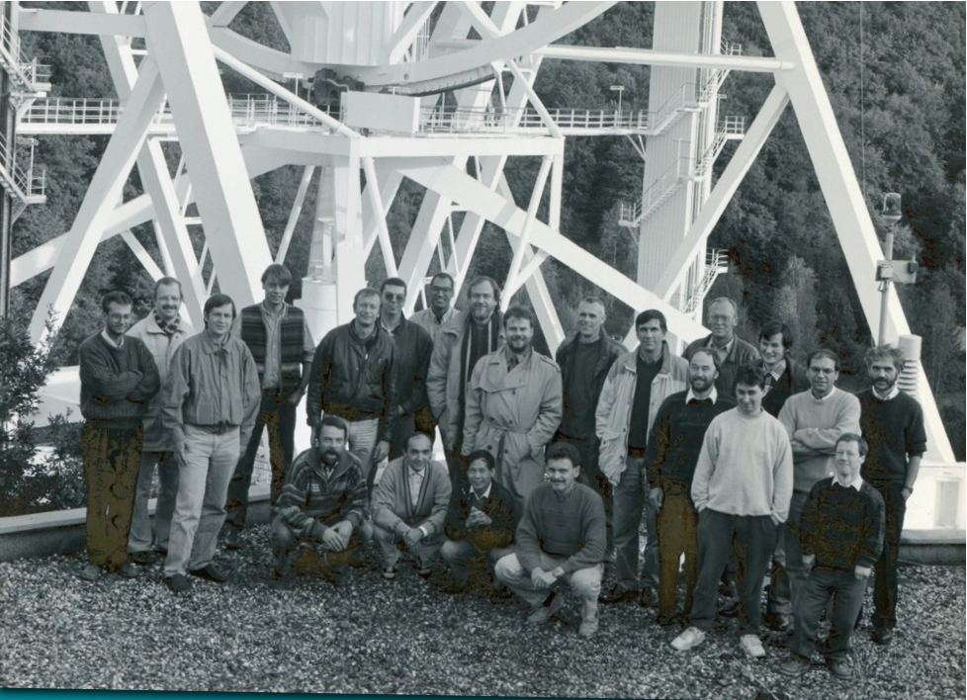

Slide 25
1980-1992 (3)
1988-1991
QUASAT (R.I.P); International VLBI Satellite (R.I.P.); VSOP/HALCA (Japan)
1988 proposals to EC in Brussels (20 stations, 17.8 M€)
1989 ESF Space Science Committee endorses processor
1990 ESF Review Panel on ground-based astronomy gave strong support to processor
1992 FP3 HCM grant (1M€) to EVN for Access to Large Scale Facilities.
Triggered action by Ministries on funding for the data processor

Slide 26
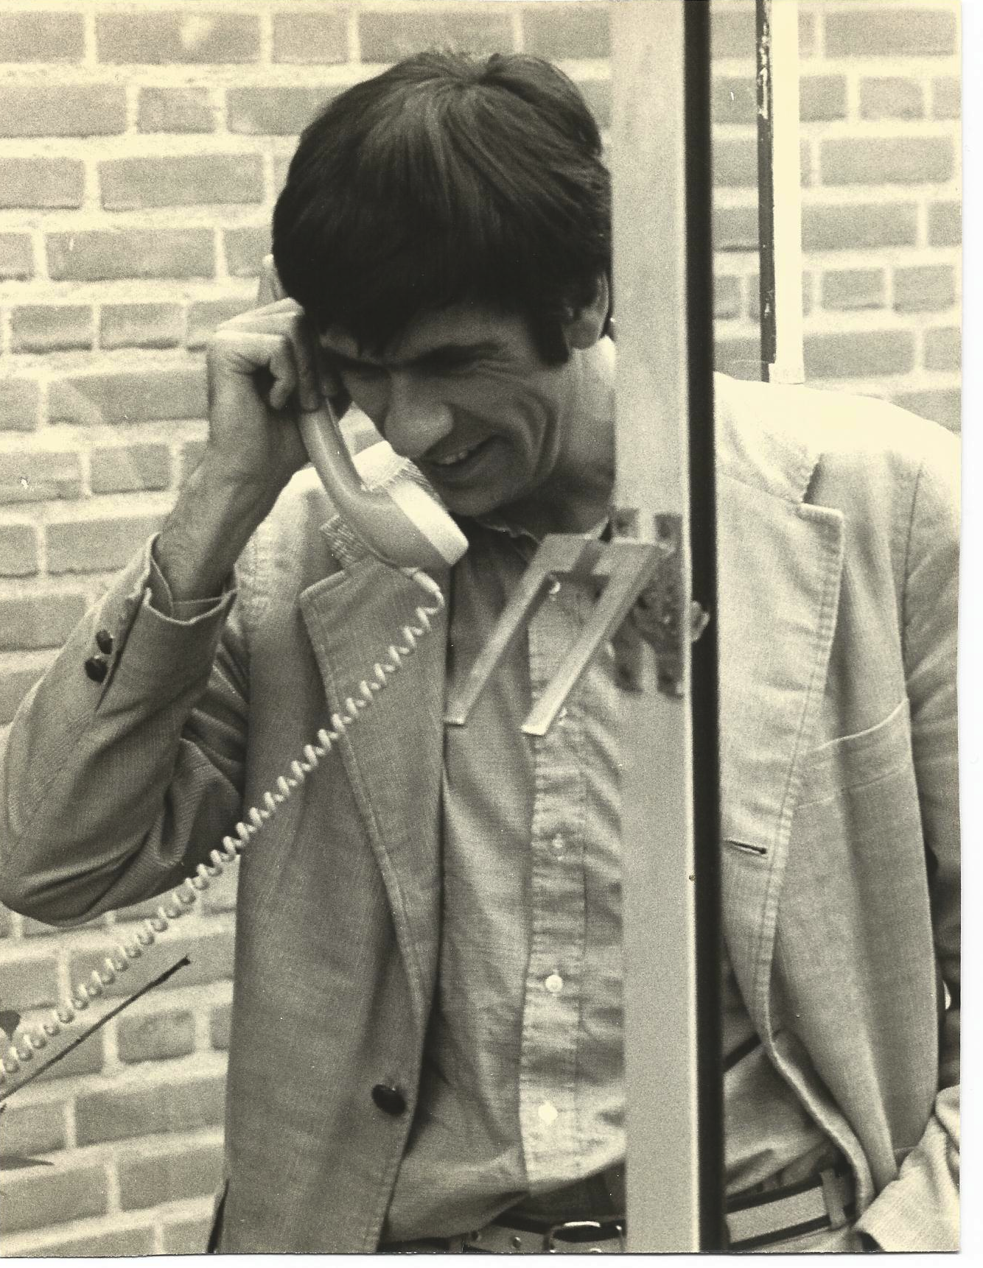
Richard in typical pose.
I just need to take this call!

Slide 27
1993-2002: Major expansion
1992 Funding at last!
5.5 M€ from Ministry of Education and Science in NL
0.3 M€ from CNRS in France
0.55 M€ from the Swedish Wallenberg Foundation
1993 JIVE formally established as a Foundation in the Netherlands
Roy Booth first chairman
1993 –1998
design, prototyping, and construction of EVN 16 station processor by international consortium (8.7 M€ including manpower)
22 October 1998
official opening of EVN Data Processor at JIVE

Slide 28
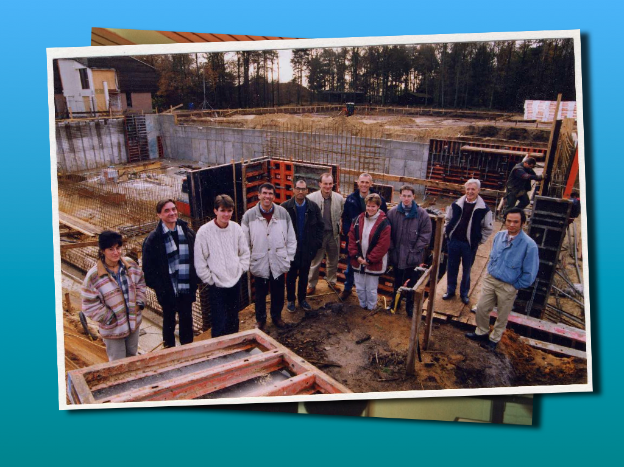

Slide 29
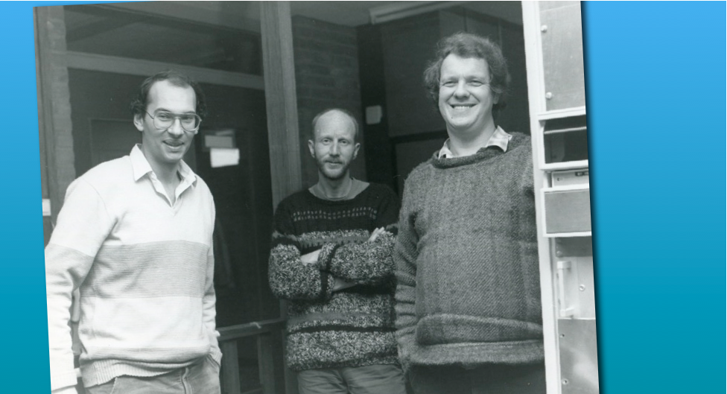

Slide 30
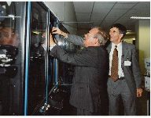
JIVE opening by Mr Relus ter Beek, the Queen’s Commissioner in the Province of Drenthe

Slide 31
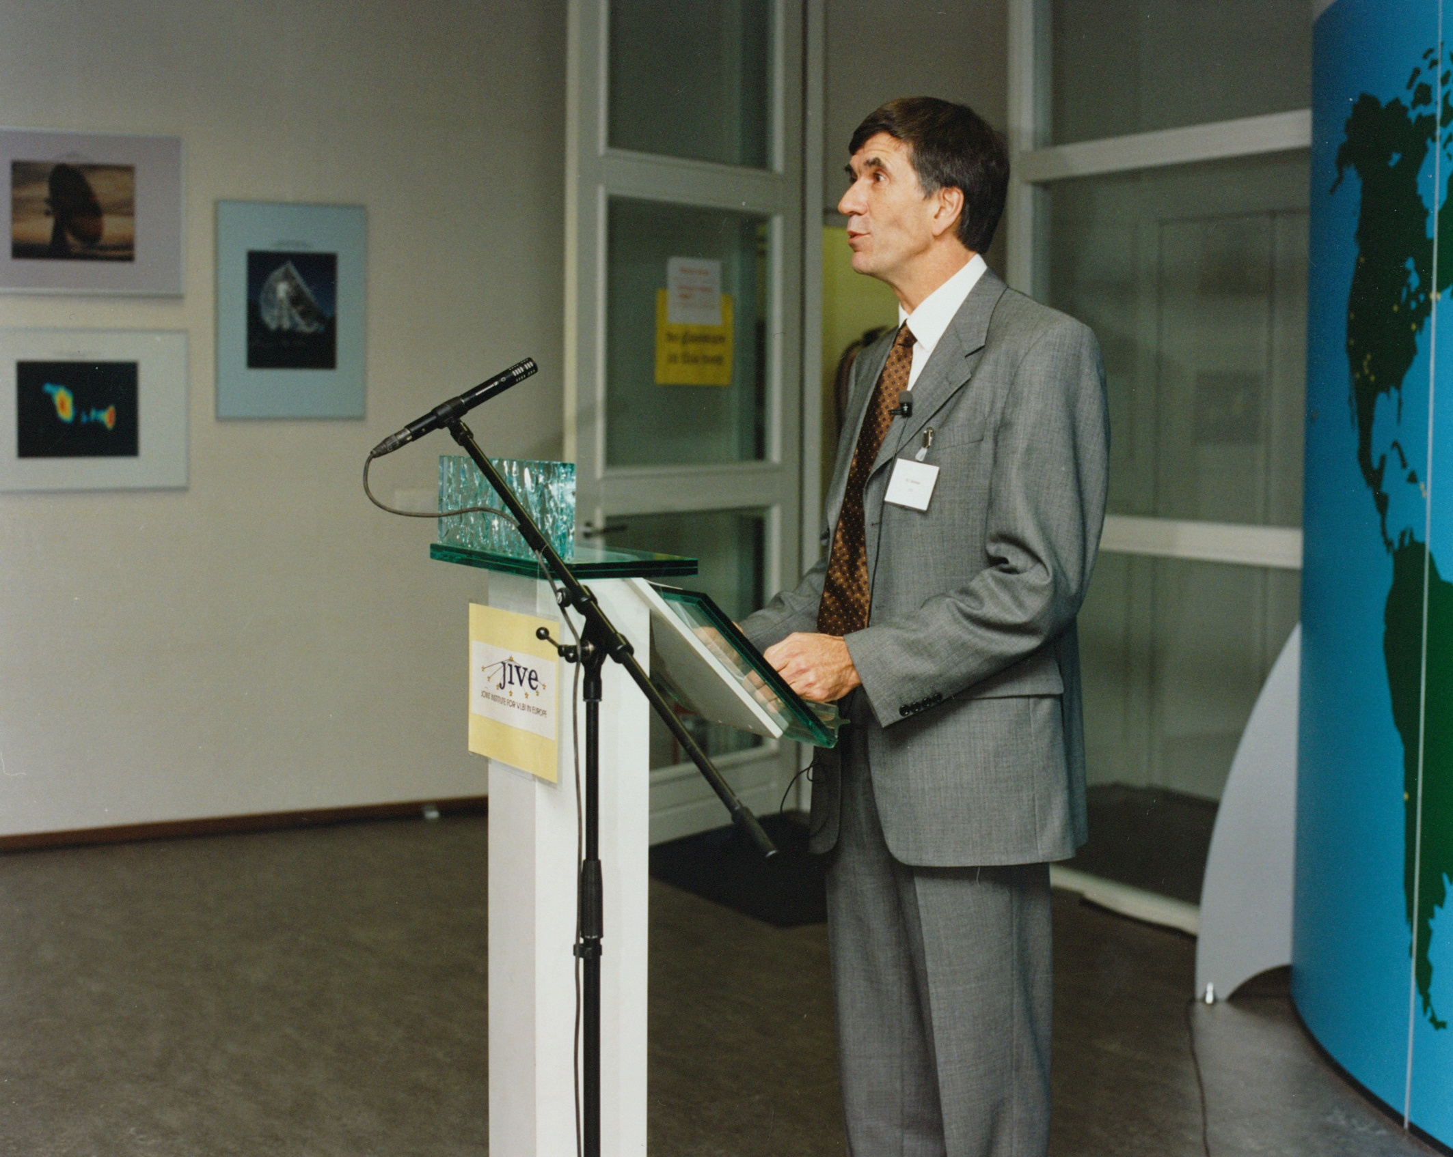
The founding director at the JIVE opening

Slide 32
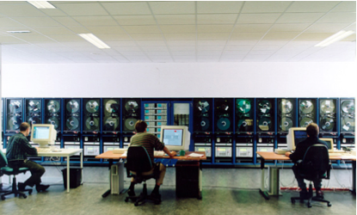
The JIVE correlator

Slide 34
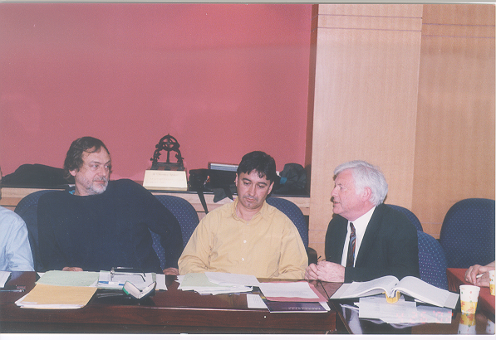
The new JIVE Director getting it from both sides!

