Slide 1
Highlights of the expansion of SN 1993J
Jon Marcaide
RTS 2012 april 18

Slide 2
Alberdi, A. | Preston, R. | 10 ref papers
Baath, L. | Rius, A. | Numerous conf papers
Davies, R. | Rogers, A.
deBruyn, G. | Ros, E.
Diamond, P. | Schmidt, B. | 2 ref papers
Elosegui, P. | Shapiro, I.
Guirado, J. | RTS | 4 ref papers
Jones, D. | Sramek, R.
Krichbaum, T. | Stockdale, C.
Lara, L. | vanDyk, S.
Mantovani, F. | Weiler, K.
Marcaide, J. | Whitney, A.
Marti-Vidal, I. | Witzel, A.
Perez, E. | Trigilio, C.
Perez-Torres, M. | Zensus, A.

Slide 3
Cosmic Explosions:
SN & GRB
2-3/day
GRB (z=8.2)
SN (z=6.4)
very few nearby

Slide 4
M81
d= 3.6 Mpc
Type II(b)
strong radio emitter

Slide 5
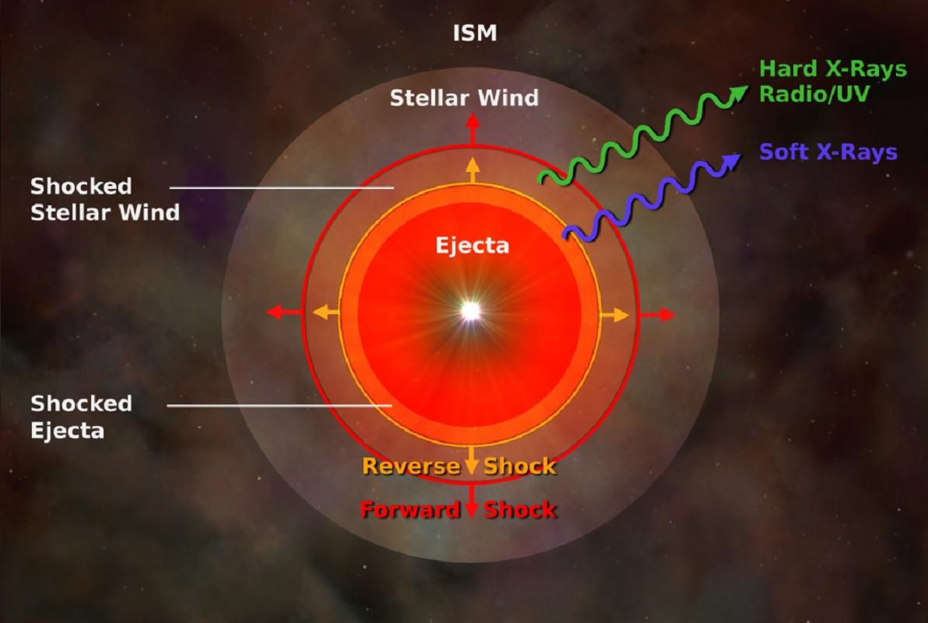

Slide 6




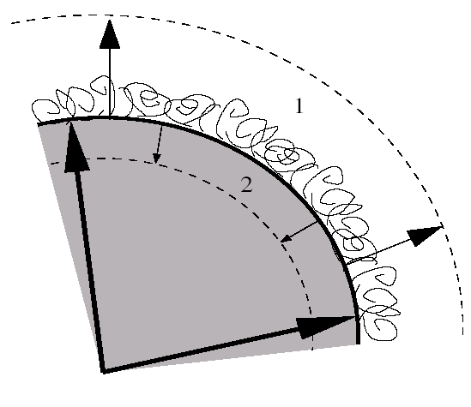
Chevalier’s Model (1982)
→{
Describes a shocked region formed by a contact discontinuity and two shock waves travelling in- and out-wards into the ejecta and into the CSM, respectively.

Slide 7
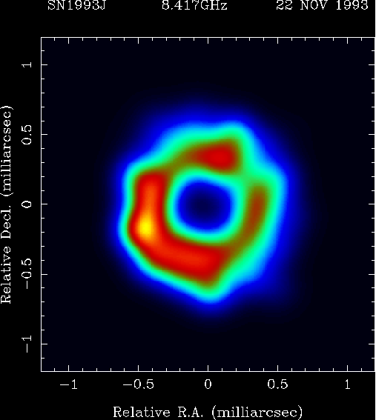
Shell-like structure discovered
Age: 239 días
Nature 373, 44-45 (1995)

Slide 8
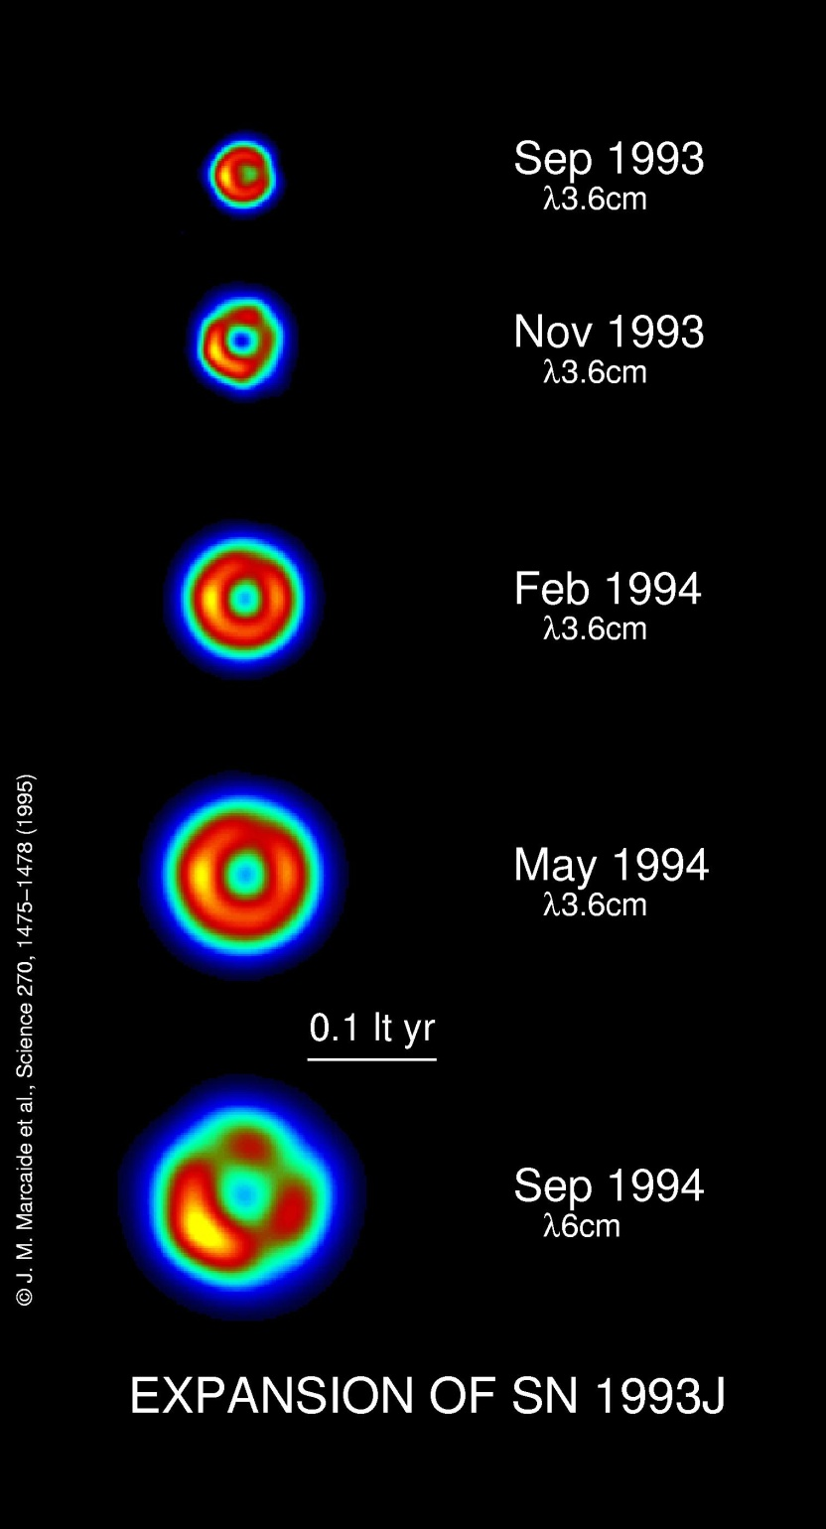
Expansion de SN1993J
Expansion: 2.39±0.03 μas/d (14,900±200 km/s)
Self-similar
Science 270, 1475-1478 (1995)

Slide 9
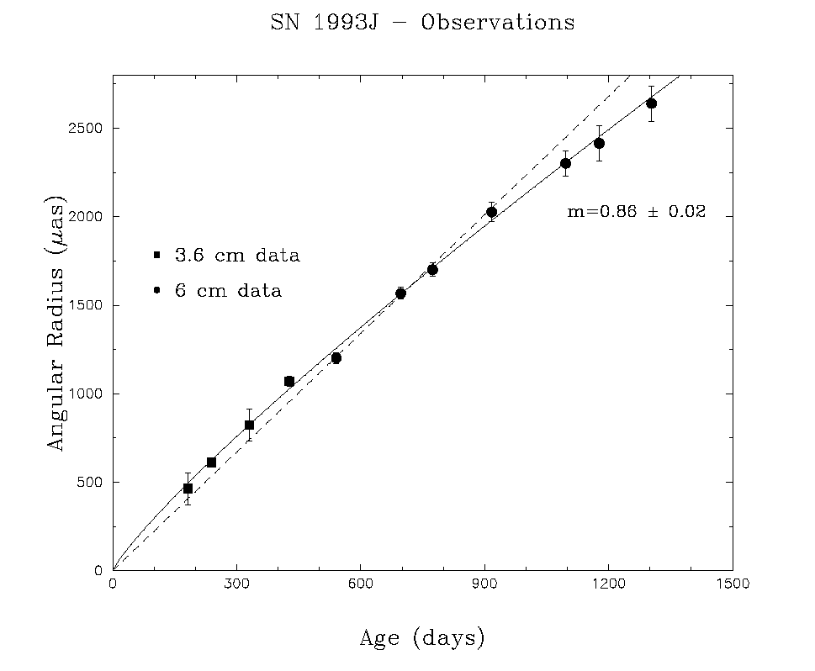
Deceleration measured
Ap.J. 486, L31-L34 (1997)

Slide 10
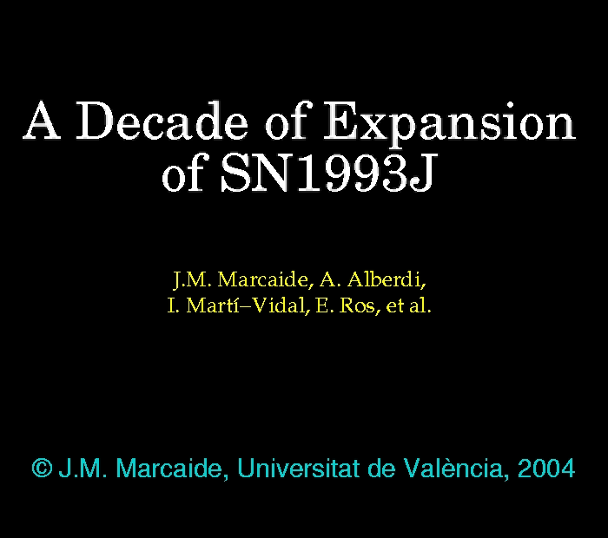

Slide 11
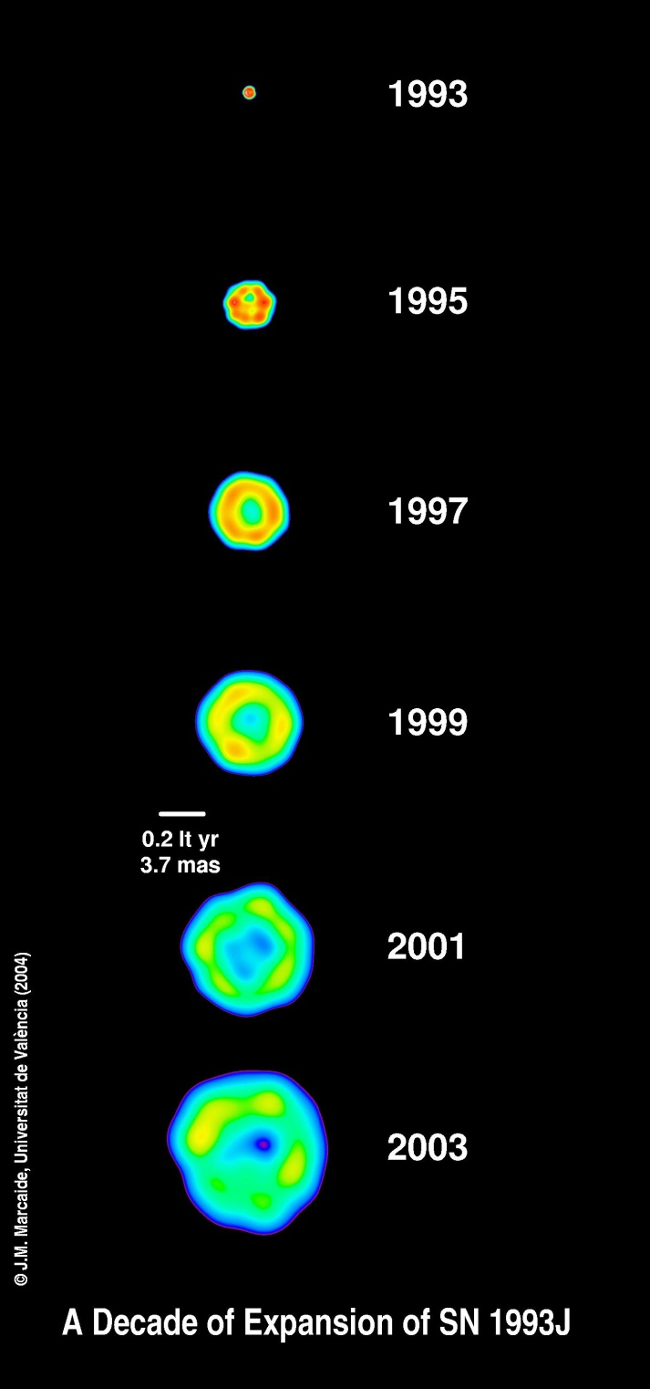
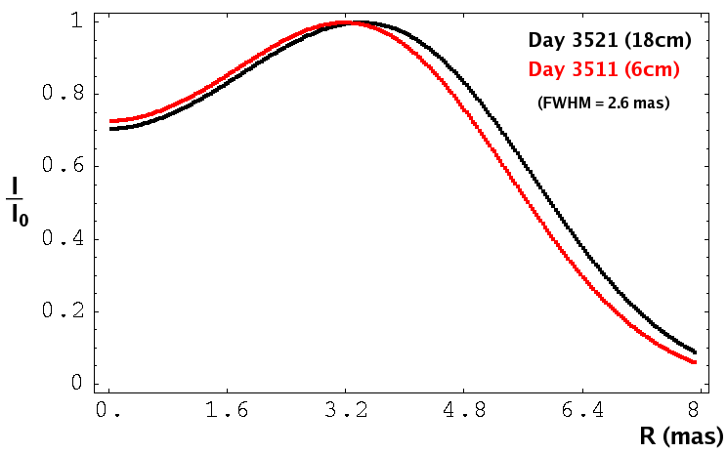

Slide 12
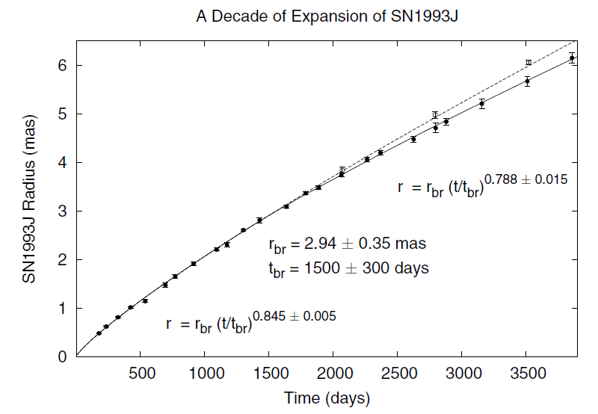

Slide 13


Slide 14
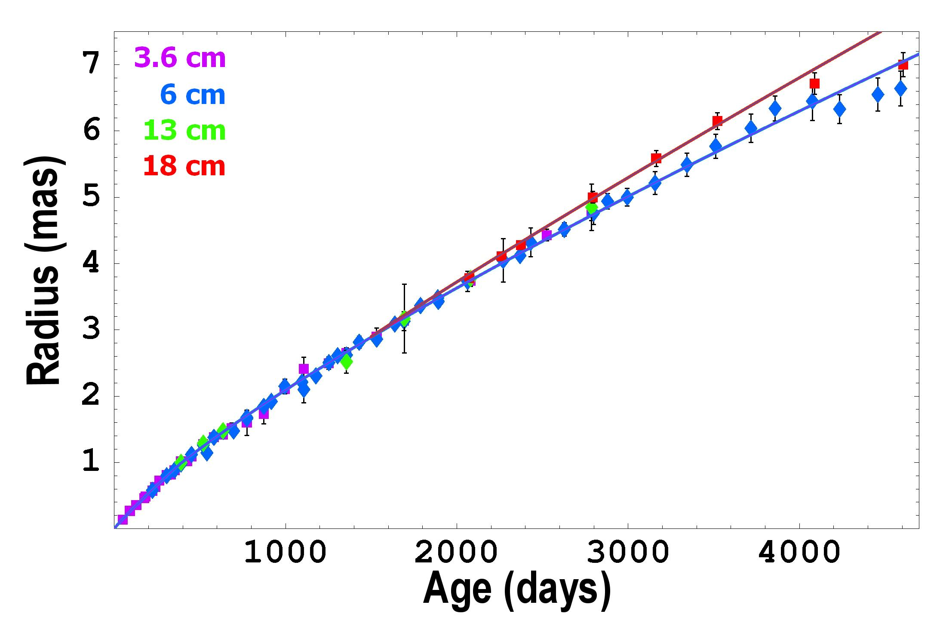
Complete Expansion Curve
R ∝ t ^{m}
m1 = 0.928 ± 0.010
m2 = 0.795 ± 0.005
tbr = 390 ± 30 days
m = 0.87 ± 0.02
Notes:
14

Slide 15
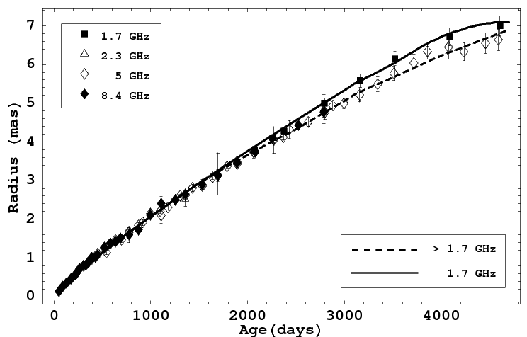
RAMSES Results

Slide 16
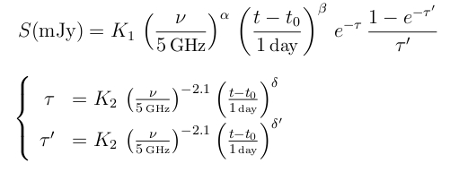
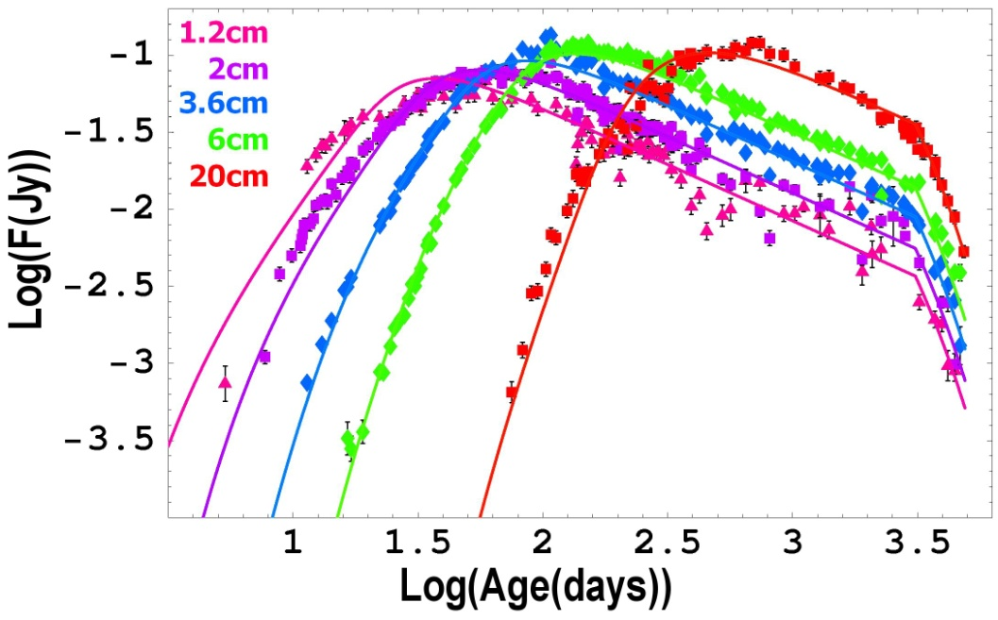
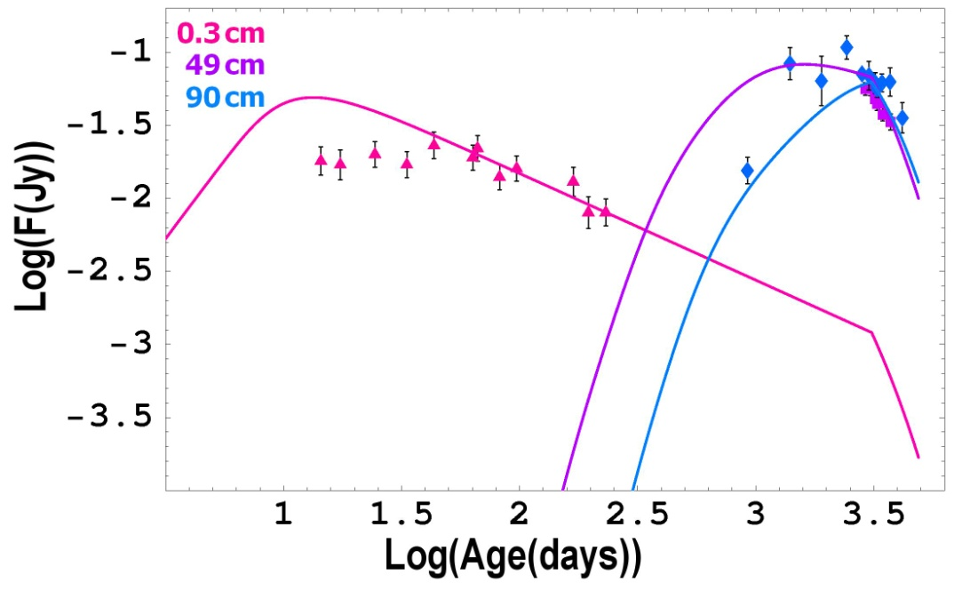
Complete Radio-Light Curves
Model used by Weiler et al. (2007)

Slide 17

RAMSES Results
RAMSES

Slide 18
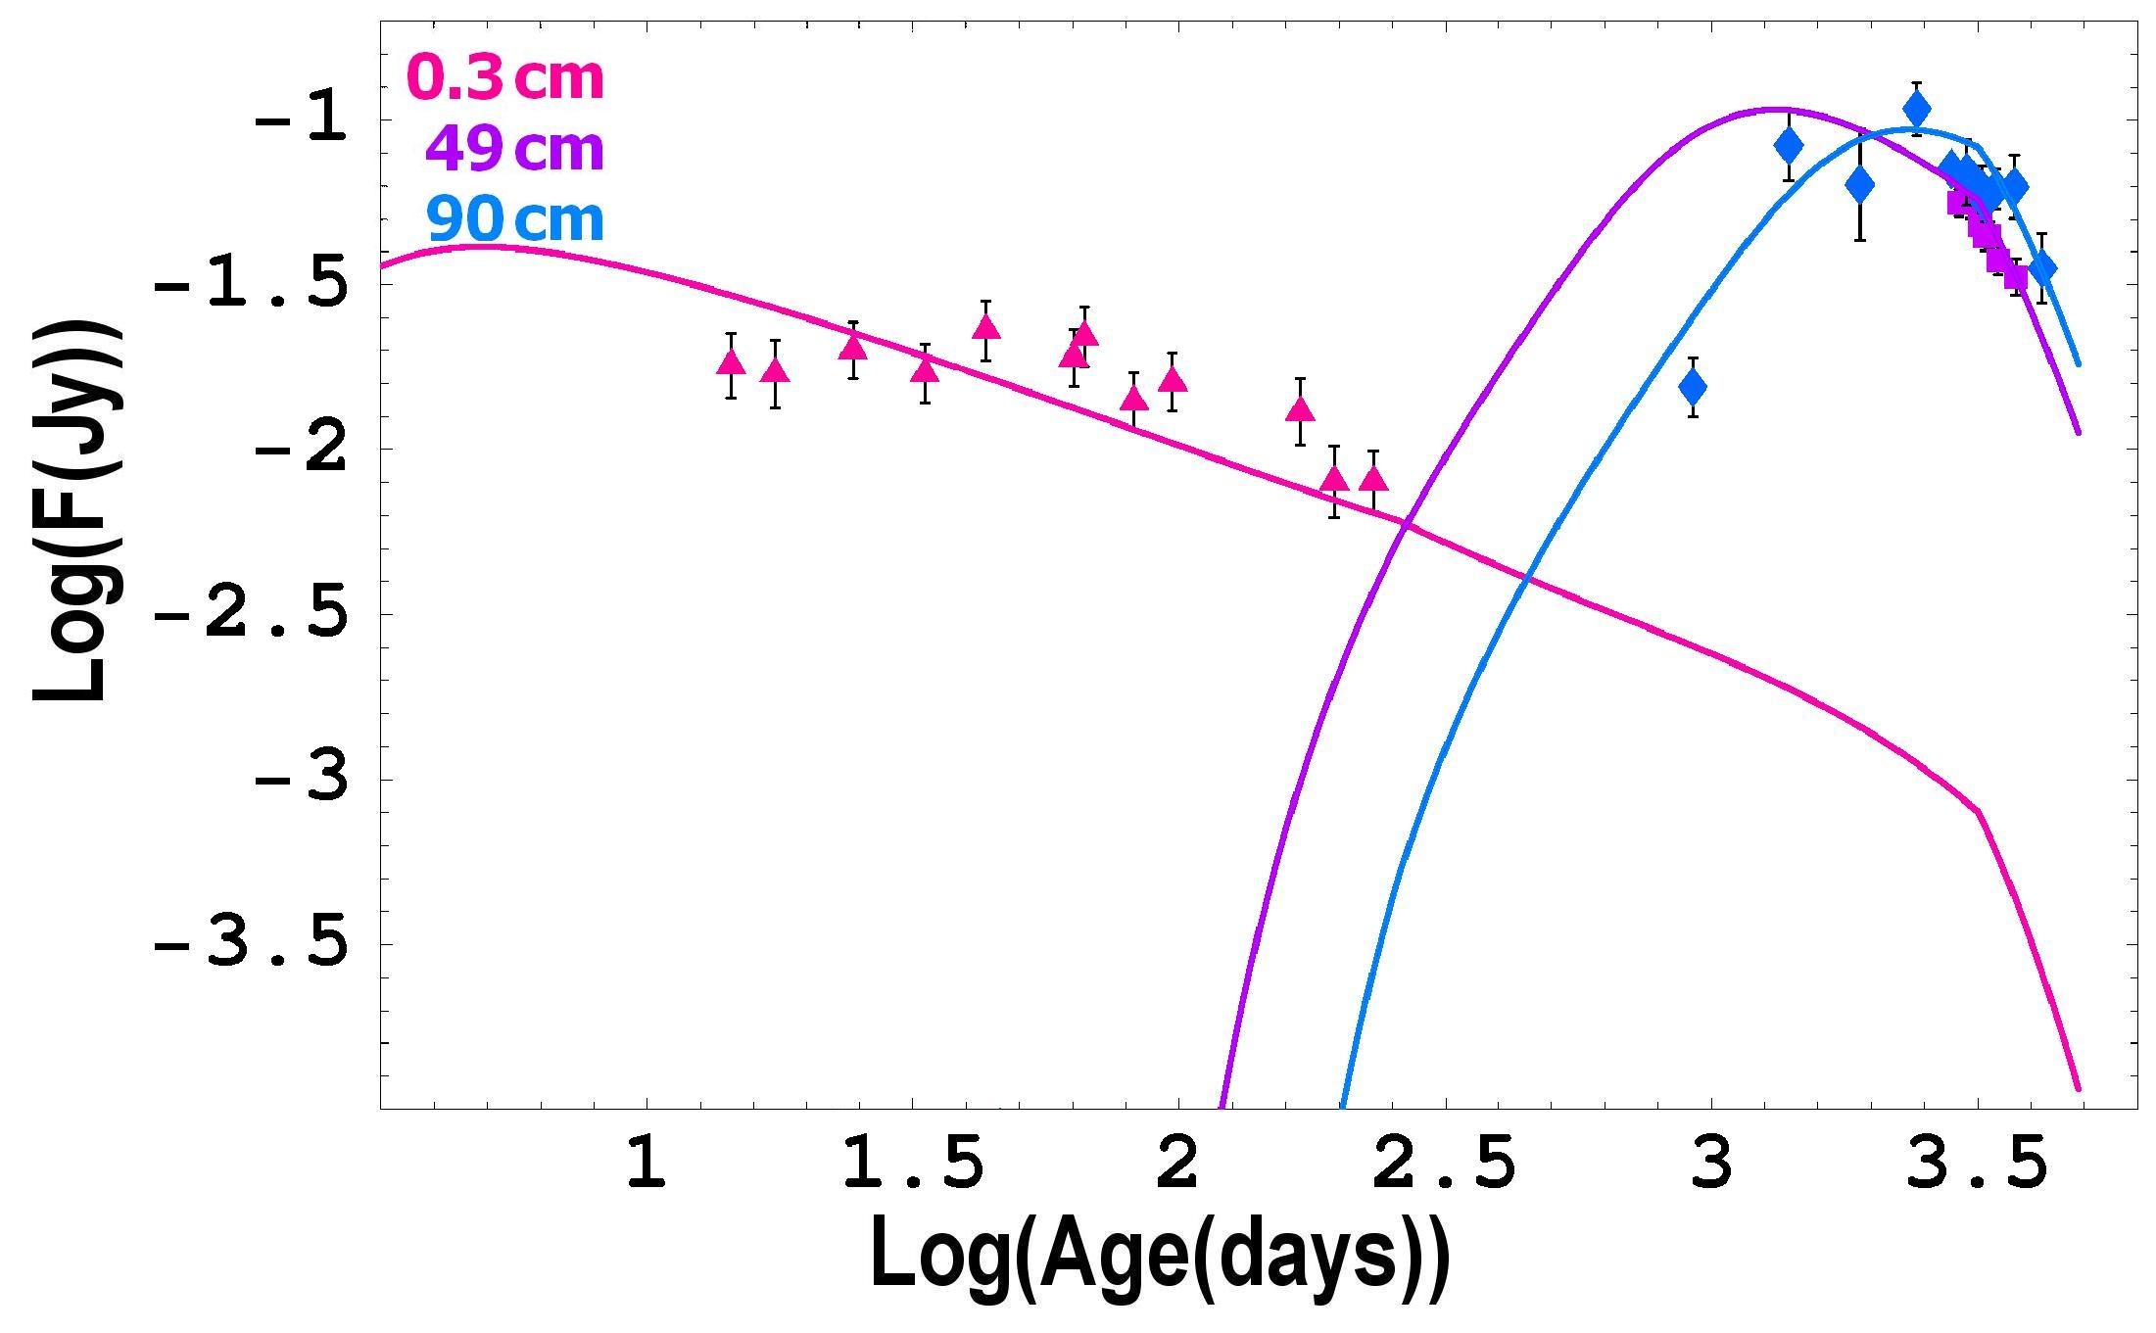
RAMSES Results
RAMSES

Slide 19
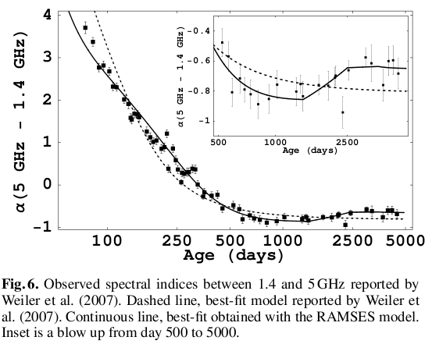
RAMSES Results

Slide 20
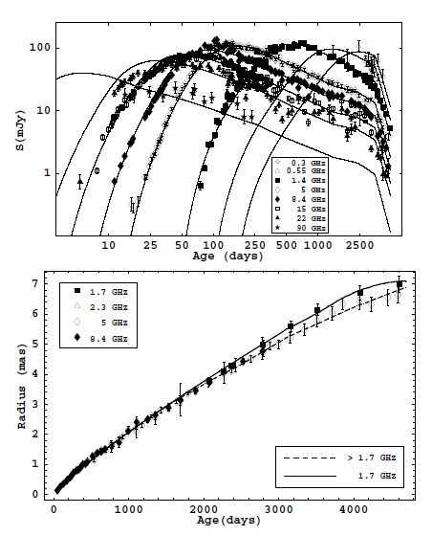

Slide 21






ASSUMPTIONS
Explosion date
Distance to M81
Reference epoch for fitting physical parameters
Size 10¹⁵cm
Constant pre-supernova mass-loss wind
Following Chevalier
Magnetic energy density proportional to shock energy
Instantaneous particle-field energy equipartition
+ a “rapid drop” of CSM density beyond radial distance
corresponding to day 3100 after explosion (suggested by light curves)‏
Notes:
21

Slide 22
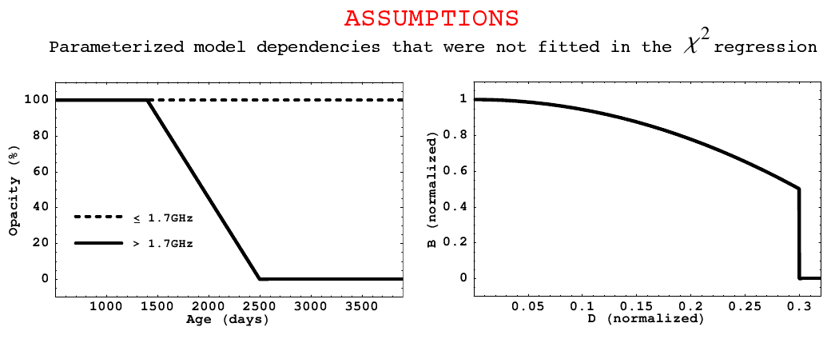
OTHER ASSUMPTIONS
1.- Evolution of ejecta opacity (frequency-dependent expansion curve and late spectral indices).
2.- Radial drop of magnetic field inside radiating region (late expansion curves)
3. Spherical shell-like structure of fractional shell width 0.3

Slide 23

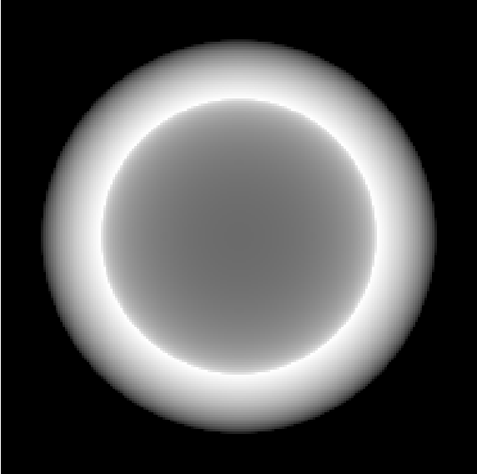
Ejecta Opacity
All frequencies
All frequencies but 1.7 GHz
Changing ejecta opacities translate into changing biases of the shell-size estimates (Marcaide et al. 2009)…also required by the radio light curves!

Slide 24
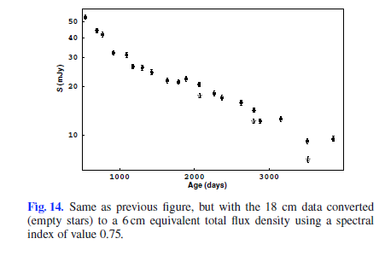

Slide 25
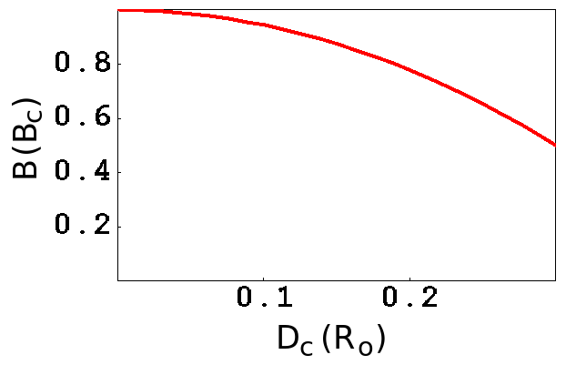
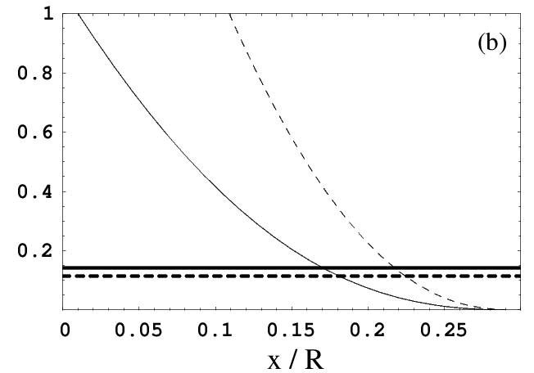
Radial Decay of B
6cm
18cm
The frequency-dependent noise cuttoff of the interferometers could also contribute to the wavelength effect in the expansion curve
Notes:
25

Slide 26
OTHER ASSUMPTIONS
1.- Evolution of ejecta opacity (frequency-dependent expansion curve and late spectral indices).
2.- Radial drop of magnetic field inside radiating region (late expansion curves)
3. Spherical shell-like structure of fractional shell width 0.3

Slide 27









FITTED PARAMETERS FOR SN1993J
Expansion curve (R α t^{m})‏
Physical quantities at reference epoch
Maximum temperature of CSM electrons
(radial profile; Fransson & Bjornson)‏
Electron escape time (depends on how
the CSM drops beyond day 3100!)‏
Fraction of accelerated electrons
Index of relativistic-electron population
Notes:
27

Slide 28
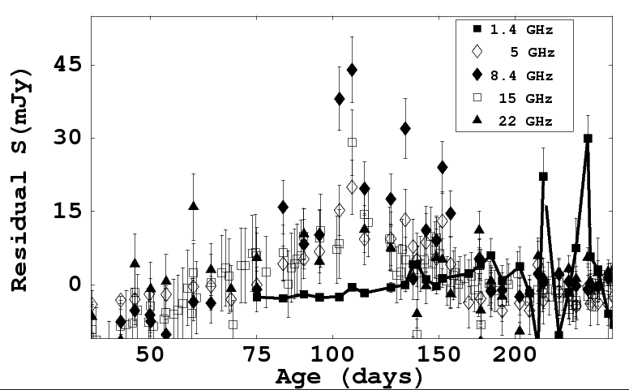
Flux-density flare at ~100 days. Evidence of an over-density in the CSM (factor ~2) at ~1150 AU from the explosion center.

Slide 29
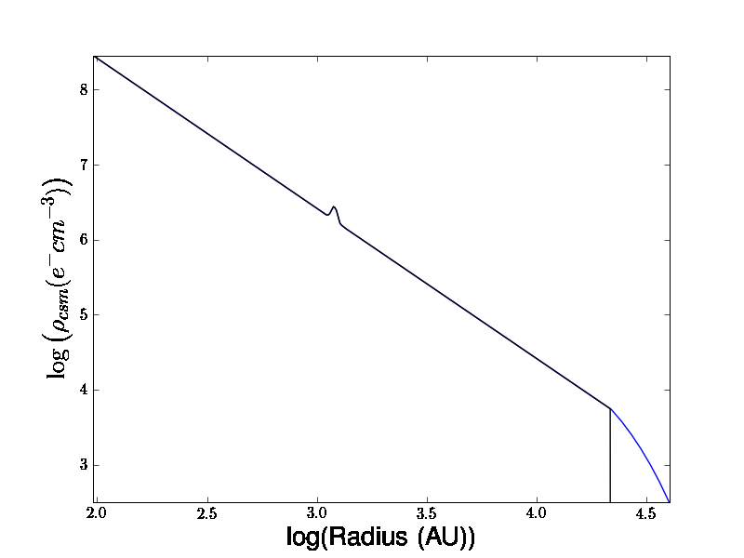
ABOUT THE CSM PROFILE
Derived from a “flare” in the residuals
Depends on the electron-escaping term
s = 2 + “blob/ring” at ~1150 AU + drop beyond ~21000 AU

Slide 30
FITTED PARAMETERS FOR SN1993J
Expansion curve (R α t^{m})‏
Physical quantities at reference epoch
Maximum temperature of CSM electrons
(radial profile; Fransson & Bjornson)‏
Electron escape time (depends on how
the CSM drops beyond day 3100!)‏
Fraction of accelerated electrons
Index of relativistic-electron population
Notes:
30

Slide 31
Conclusions
A spherical expansion: deviations from circularity at ~2% level
A self-similar expansion in a constant wind CSM
A wide shell: 30% of outer radius
Ejecta partially transparent at high freqs after day 1500, but not at 1.7GHz
A large, radially decreasing, magnetic field
CSM features at ~100d and beyond 3100d

Slide 32
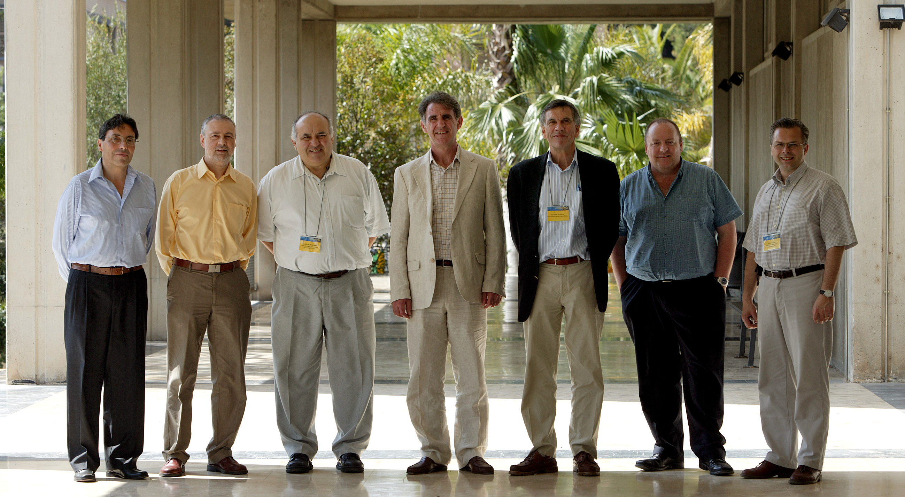
Richard, wish you a happy “retirement”….
Keep in touch and visit us again!!!

Slide 33
Thank you !

