Slide 1
Two special radio AGN:
BL Lac and J1819+3845⁺
Ger de Bruyn
⁺ work with J-P. Macquart
ASTRON, Dwingeloo &
Kapteyn Institute, Groningen

Slide 2
Outline
BL Lac: mysteries in Faraday space:
BLLac – structure & confusion on RM values
L-band and P-band polarization: exquisite RM resolution
RM synthesis: multiple components in Faraday space, within PSF
J1819+3845: once…. the most dramatic scintillator
flux & scintillation evolution from 1999-2006, 2007-2012
polarization results, VLBI imaging and screen distance
what happened in 2007, and some physical models ?

Slide 3
BL Lacertae

Slide 4
Faint haloes around Superluminal Sources
WSRT-work with Richard:
Schilizzi & de Bruyn, Nature, 1983: 3C120, 3C345,….
De Bruyn & Schilizzi, IAU Symp 110, 1984: BLLac,…

Slide 5
BLLac: VLBI polarization imaging
z=0.069, 10 mas = 15 pc
~ 45-year variability record
Strongly core dominated,
Inverted spectrum core
Many 1.3, 2, 3.6, 6 cm VLBI polarization studies (e.g. Denn etal, 2000; Reynolds etal, 2001; Zavala & Taylor, 2003, 2010)
Polarized shocks in relativistic flow
Core RM-values in literature:
-550, -380, -250, -205, -108 rad/m2
Taylor & Zavala, 2010

Slide 6
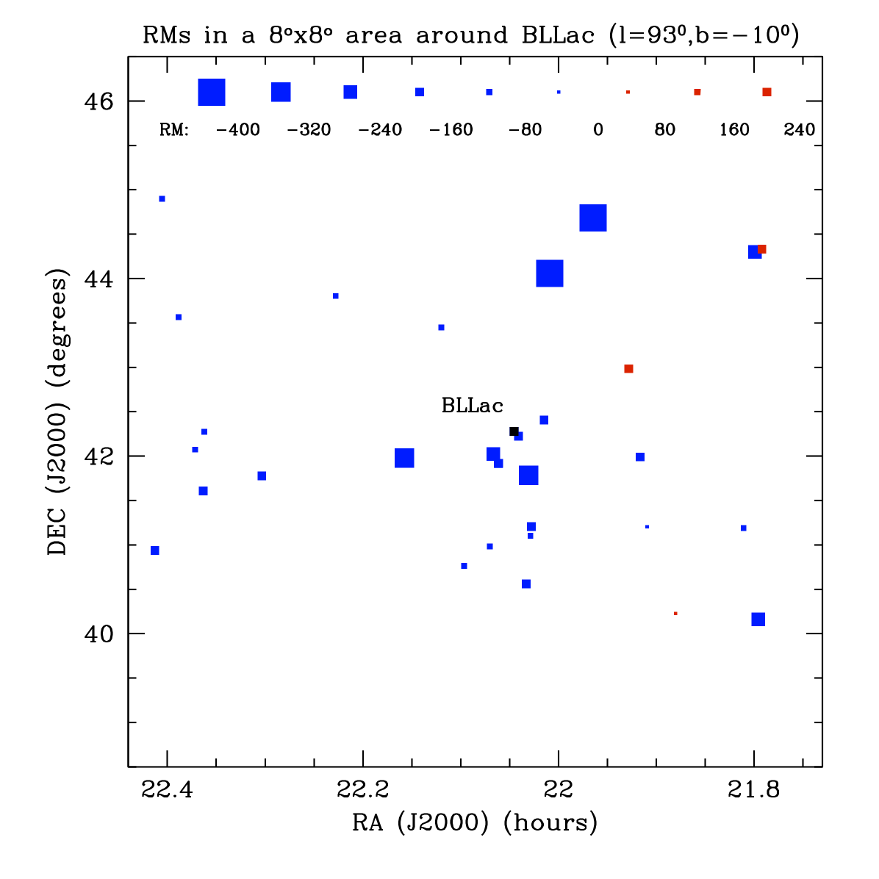
Large RM contribution due to our Galaxy !
The median value of extragalactic RM’ s is around - 200 rad/m² , close to the values observed at 2cm VLBA, and 21cm and 92cm (WSRT, see later)
subtract this →
RM contributions from the jet of BLLac and the host galaxy are both small.
RMs based on data from Taylor et al (2009, NVSS) and recent WSRT data.

Slide 7
Recent 21cm (1320-1460 MHz) data: Stokes I and PolInt
Large increase in % polarization: from 6→ 12%
Note the slight curvature in the % polarization

Slide 8
RM values from standard PA - λ² fitting
Slight deviations from a ‘straight’ line suggest that in addition to the dominant RM= -205 rad/m² there is another polarized feature with an RM different by about 200 rad/m²

Slide 9
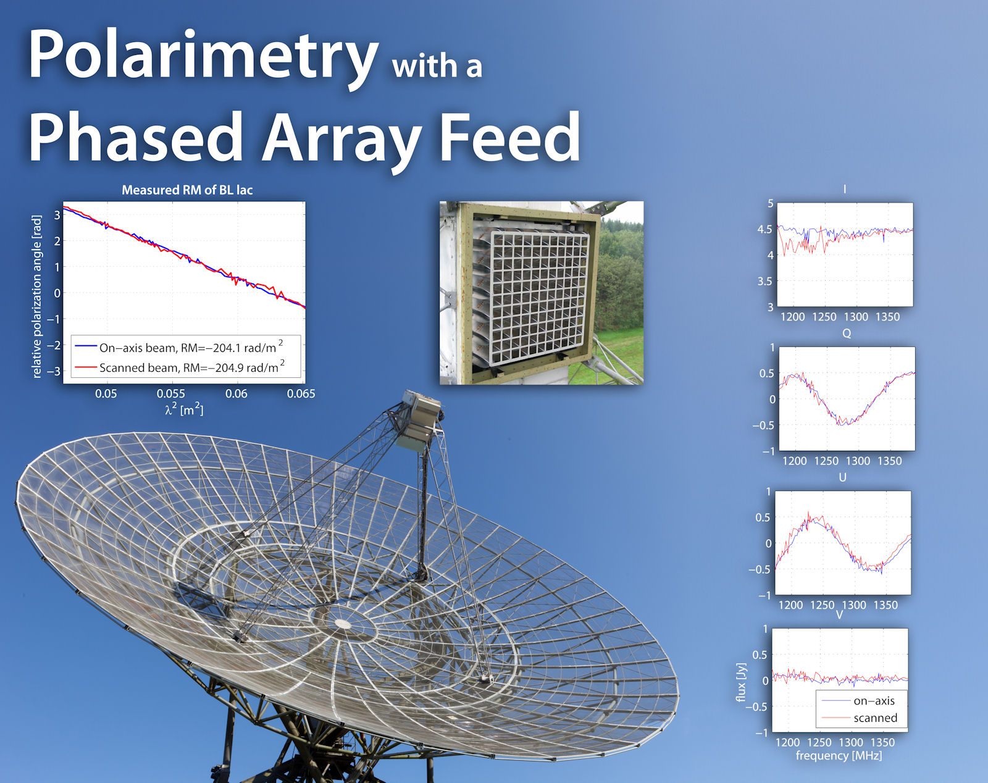
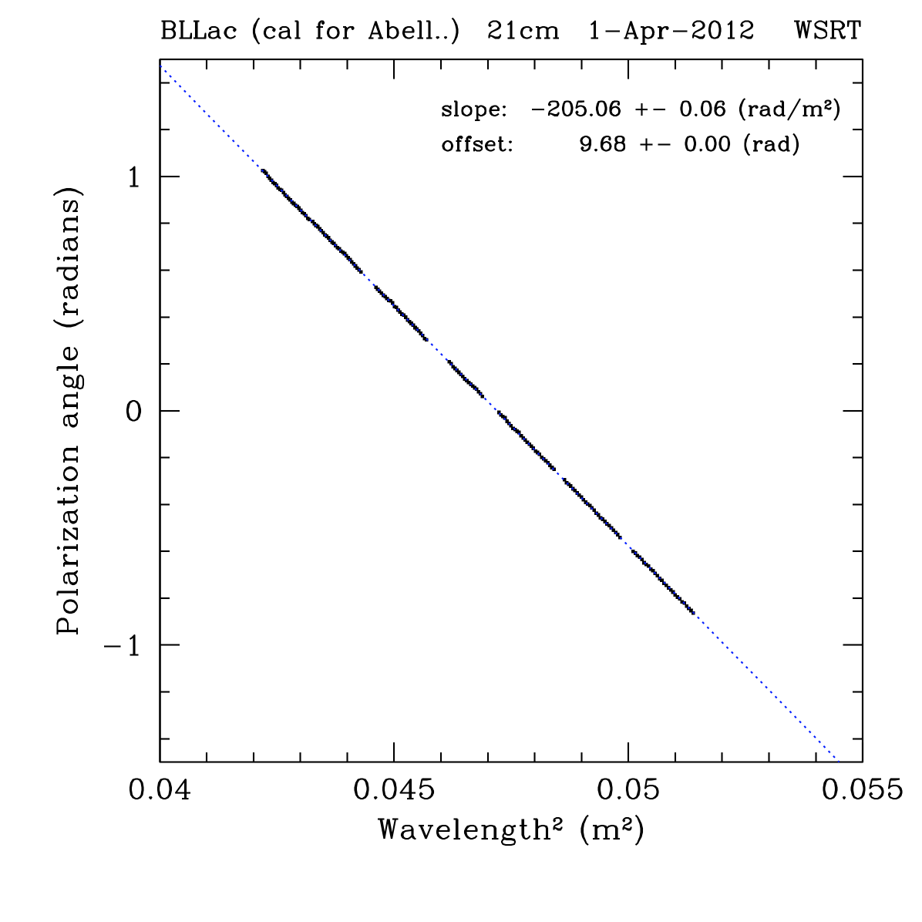
Comparison WSRT and ‘Apertif’ polarimetry !
See Wim van Cappellen etal, AJDI, 18 April 2012

Slide 10
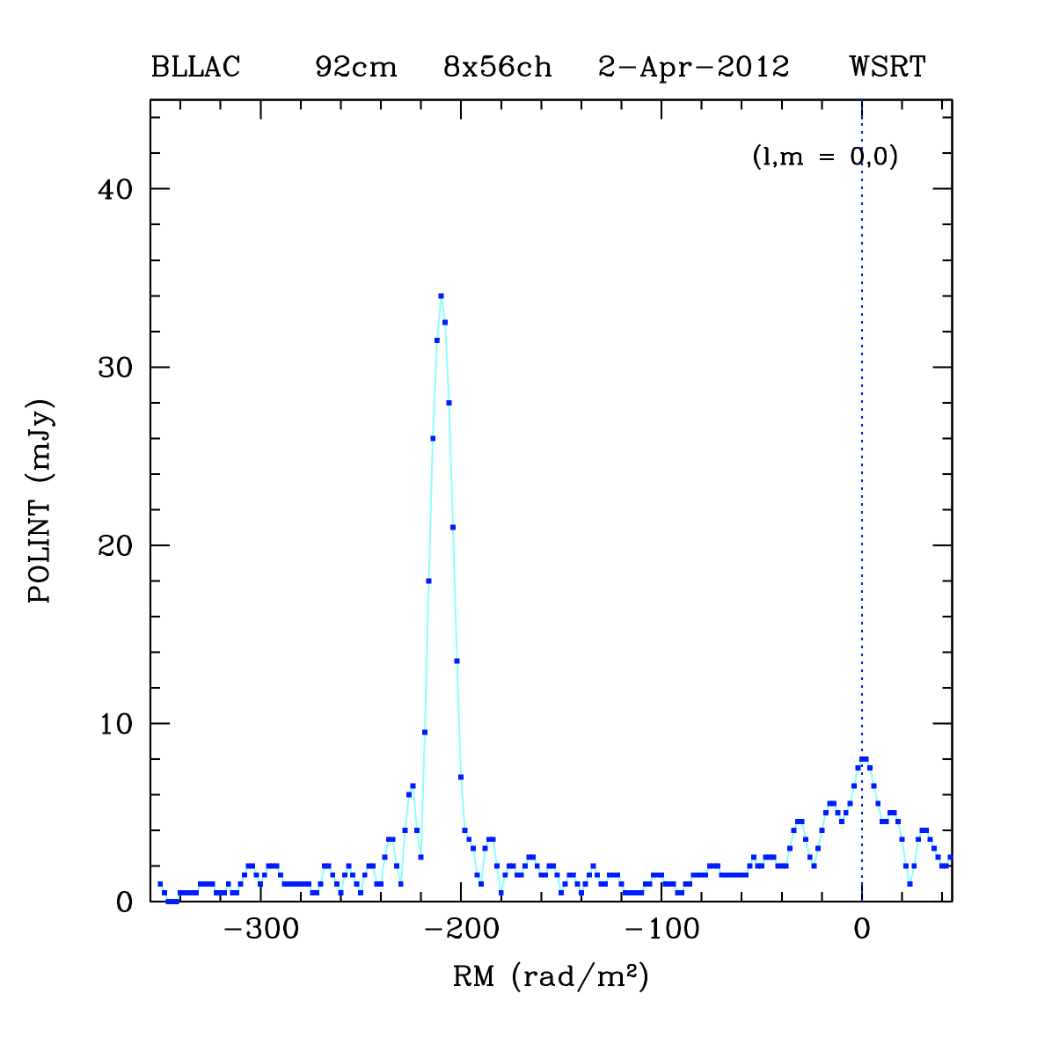
P-band (310 -385 MHz) polarization
At low frequencies we need to use RM-synthesis to unambiguously unravel polarized signals
RM = -211 rad/m² is significantly different from the 21cm value
However, there is more !!
The % polarization also changes within the 80-96cm band.

Slide 11
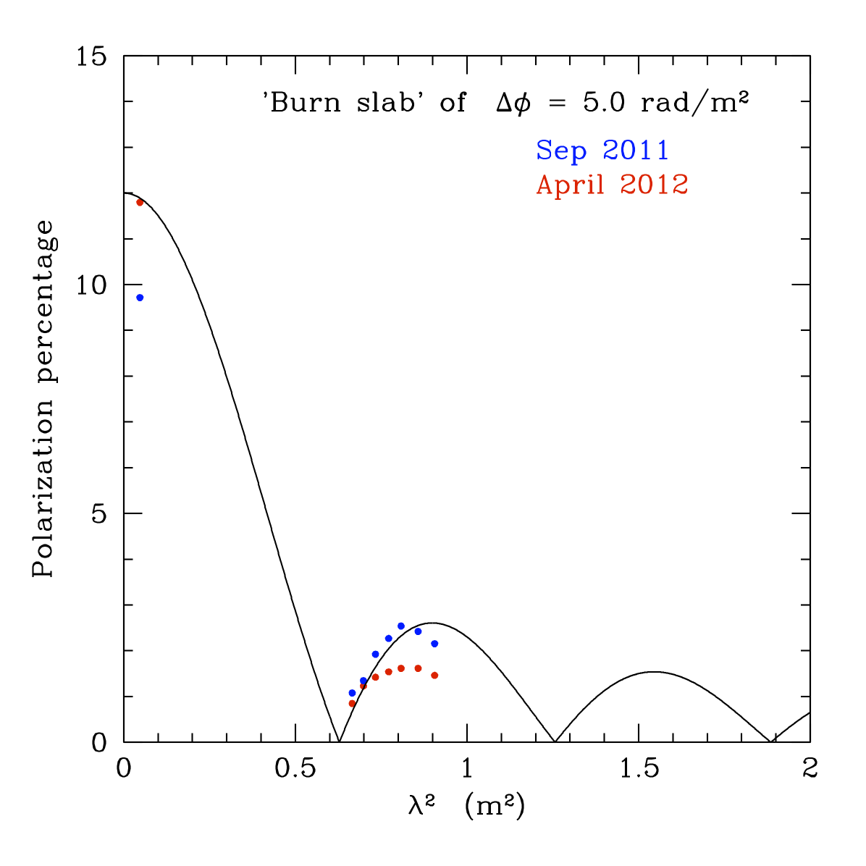
Some simple modelling attempts
The P-bands (80-95cm) polarization results are suggestive of a ‘beating’
multiple RM components at various places along the jet ?
or
the signal is coming from a Faraday-thick feature in the jet ?
RM1 RM2 ΔRM

Slide 12
J1819+3845

Slide 13
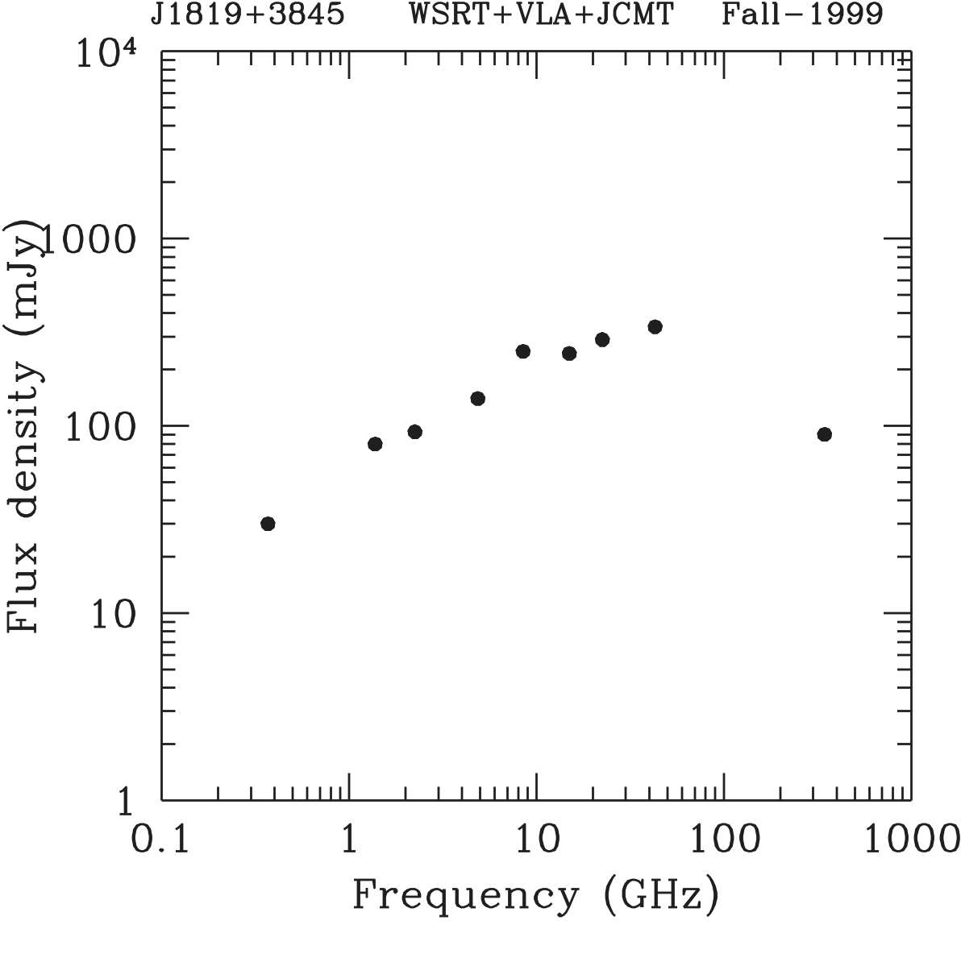
J1819+3845: a ~21^{m} quasar at z=0.55
Peaking at 50 GHz in 1999 !

Slide 14
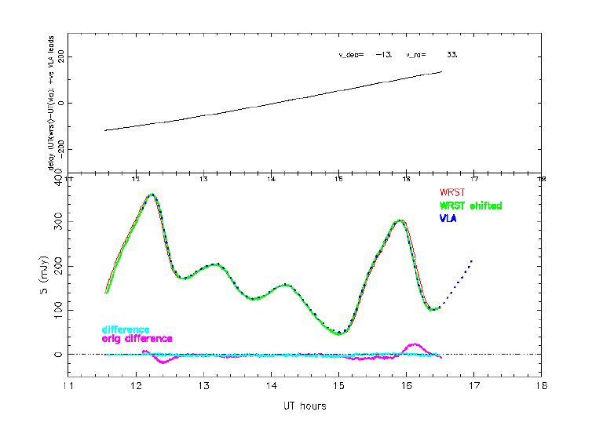
Early results on J1819+3845
Dennett-Thorpe & de Bruyn (2000,2001,2003)
Very clear timedelays between WSRT and VLA
(7 Jan 2001)
An almost stable source: AO0235+164,
Peng & de Bruyn (2004)

Slide 15
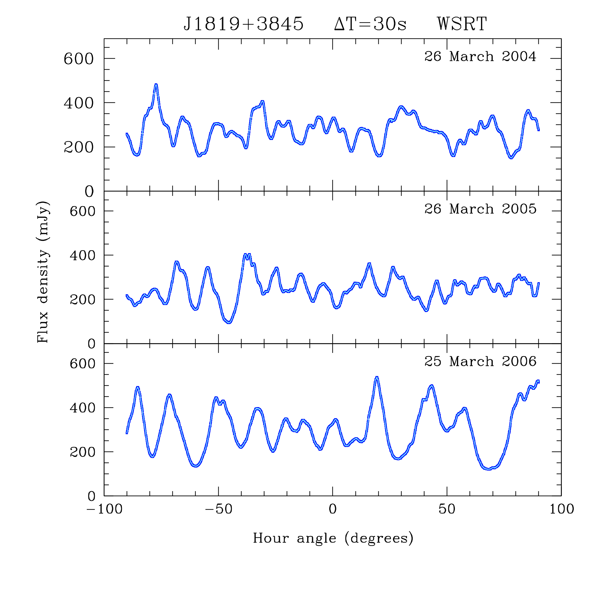
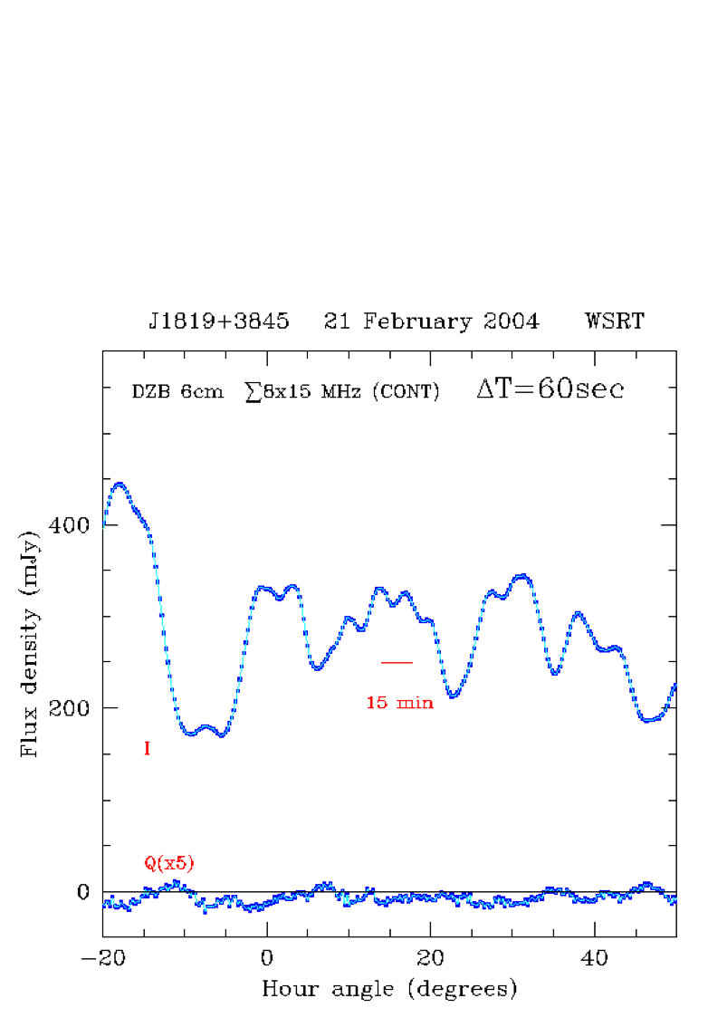
The ultra-fast season
From Macquart & de Bruyn, 2007

Slide 16
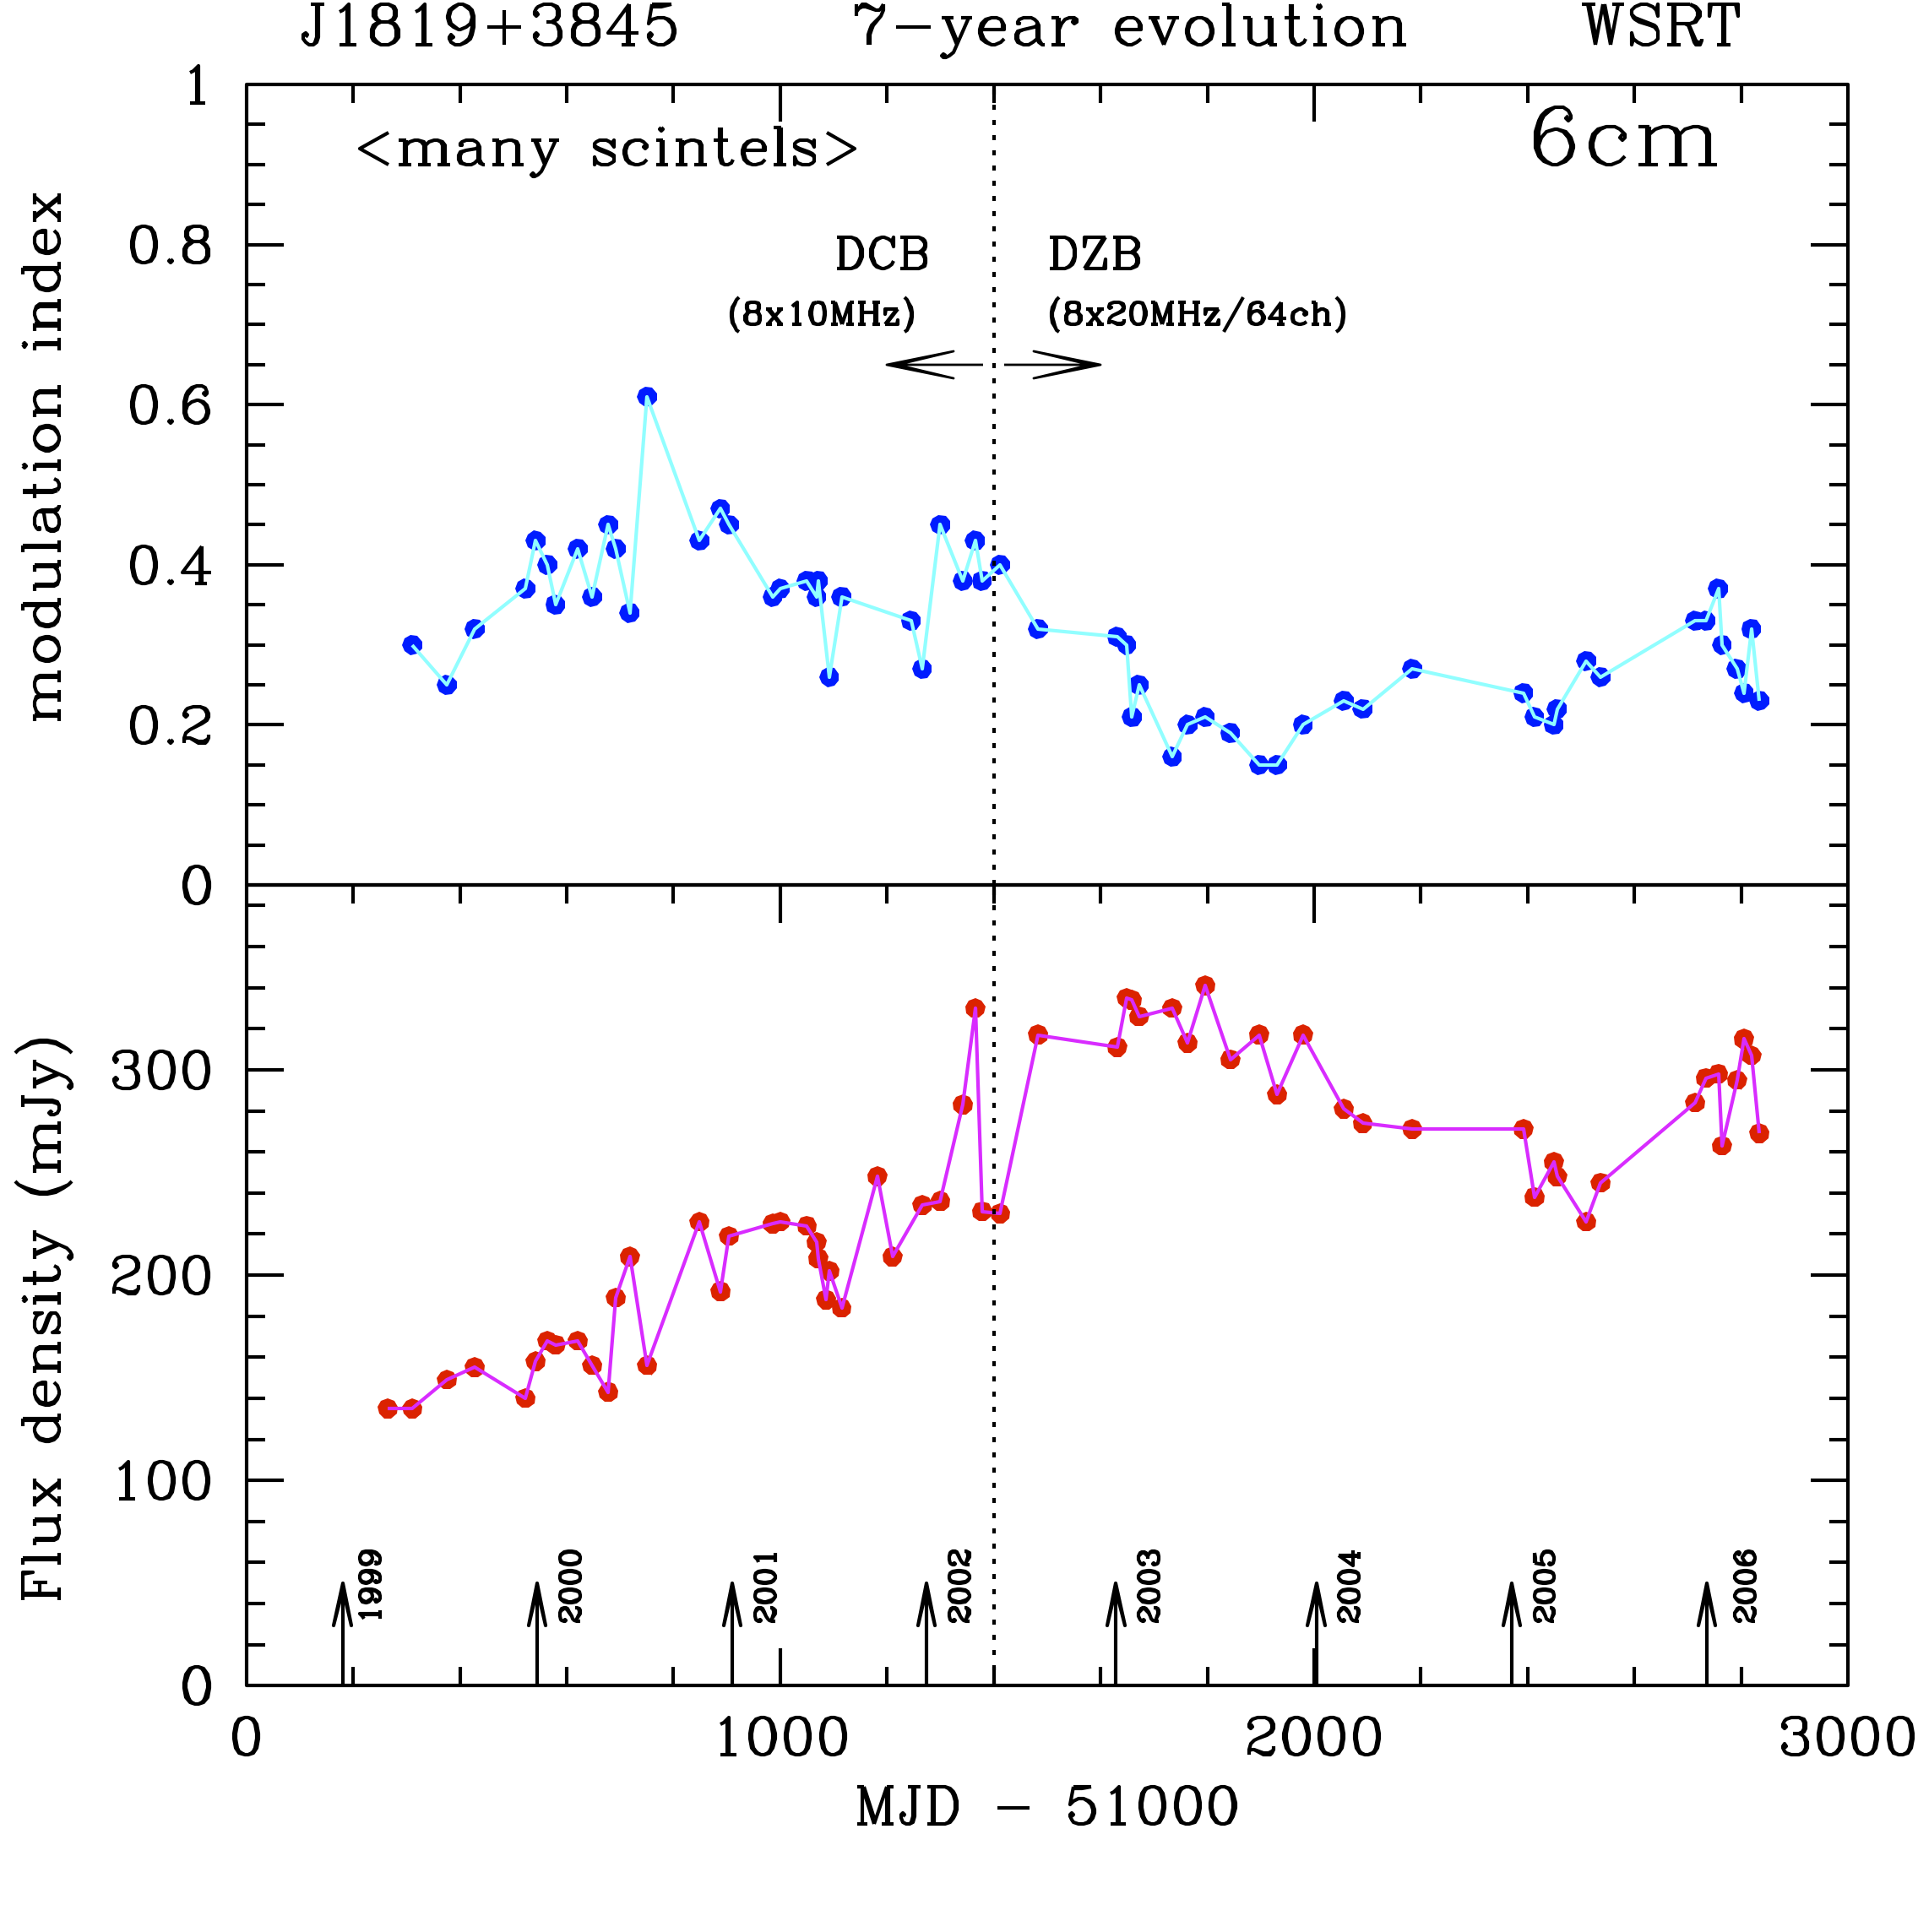
J1819+3845: the exciting first 7-years ….
(de Bruyn & Macquart, in prep)

Slide 17
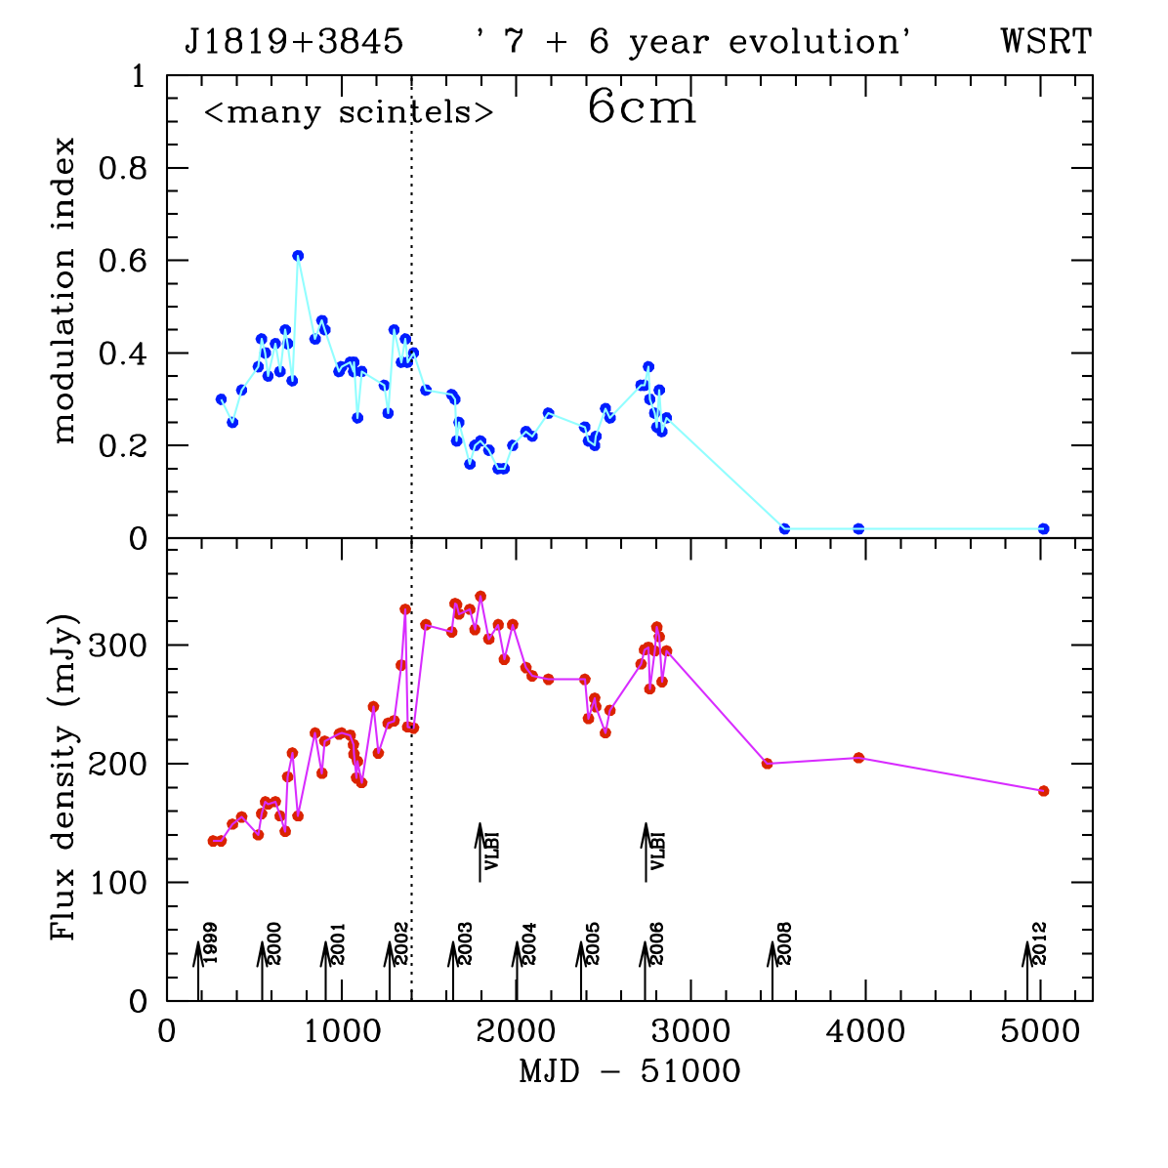
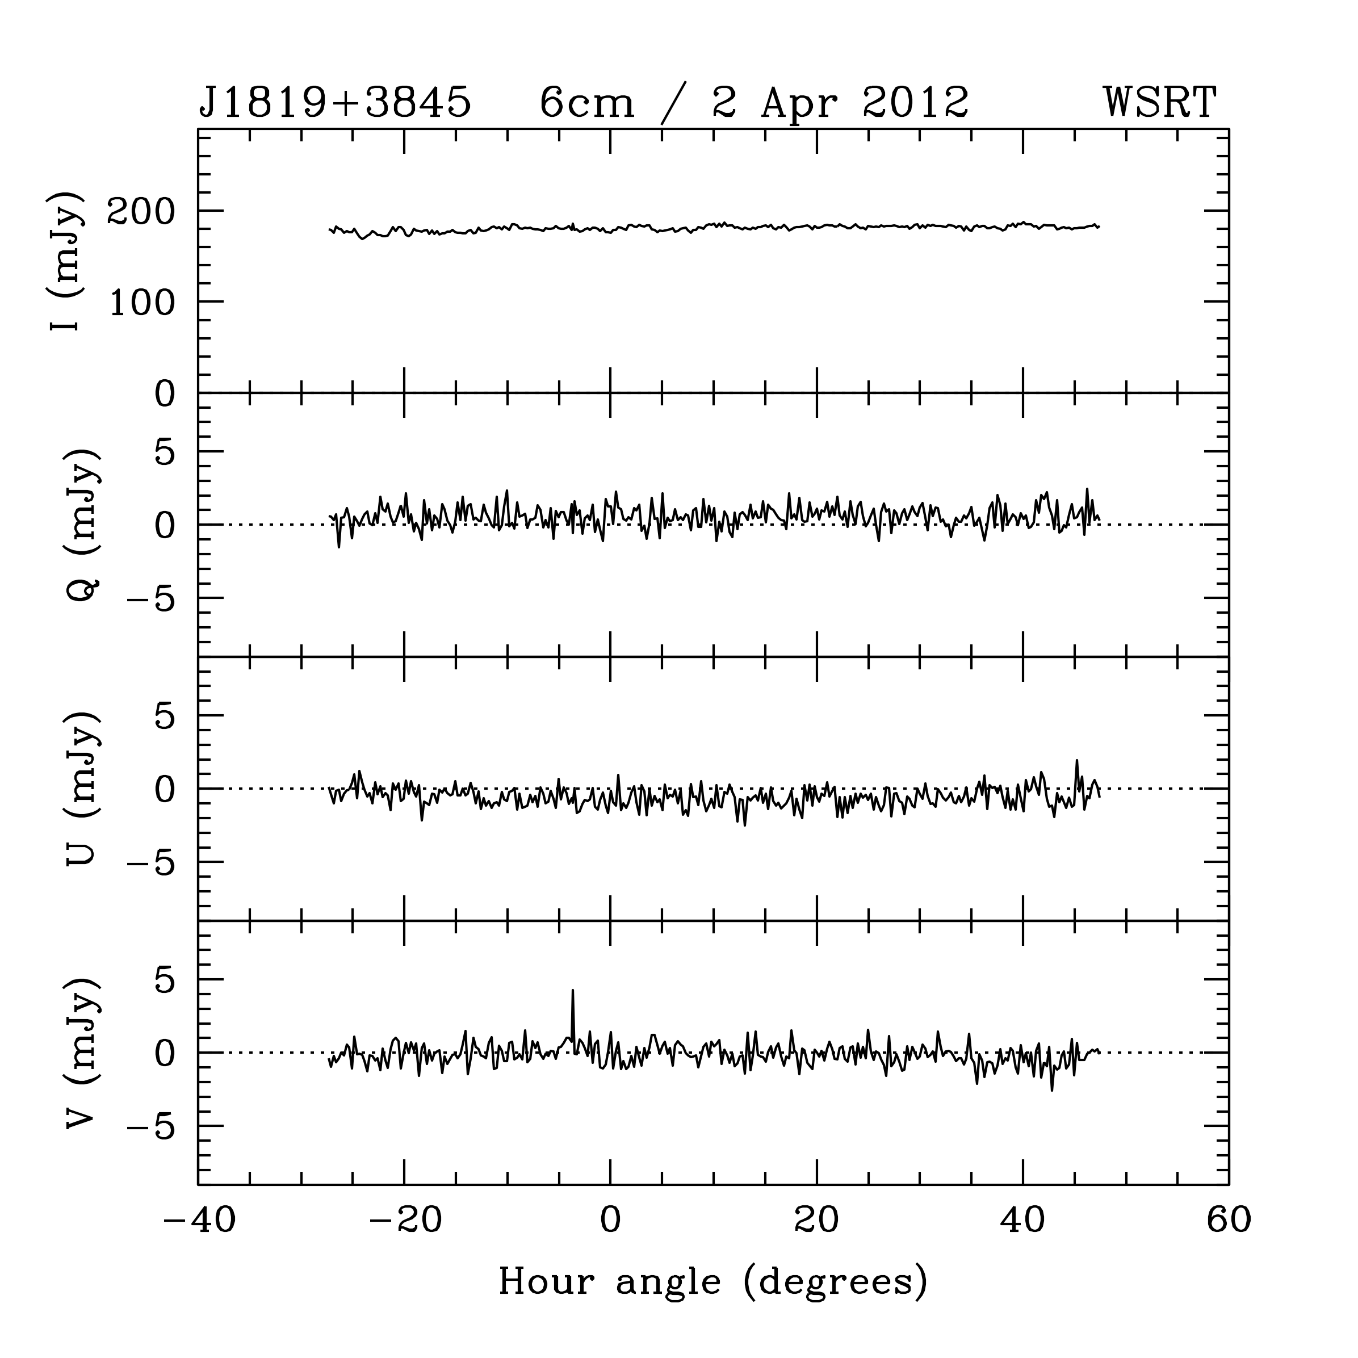
…followed by 5-6 very boring years

Slide 18
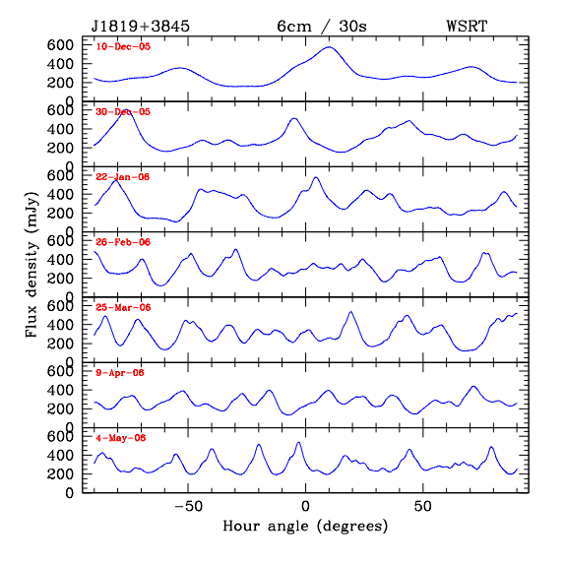
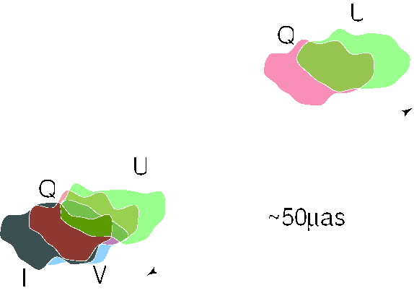
Stokes I,Q,U,V variations in Winter/Spring ‘05/’06
22 Jan 2006
Time delay between I and Q/U varies smoothly from > 4^{h} in Dec 2005 to 55^{m} in May 2006 → small displacement between I in core and Q/U in jet
cartoon

Slide 19
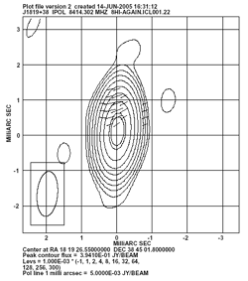
8 GHz VLBI image 4-Jun-03
Moloney, Gabuzda etal (2007, unp)
Source unresolved in Stokes I at 8 GHz < 0.3 mas
But clear separation between Stokes I and Stokes Q,U
N-S displacement ~ 600 μarcsec

Slide 20
Deriving the distance of the scattering screen
Q 5 GHz
U 5 GHz
Separation at 8.4 GHz Stokes I and PI
θ ~ 600 μarcsec
ΔT ≈ 55^{m}
I 5 GHz
ΔT ≈ 20^{m}
I 8.4 GHz
= (55^{m}+20^{m}) x 30 km/s = 1.4 10¹⁰ cm / D_{screen} = 600 / 2.06 10¹¹
⇒ D_{screen} ≈ 4.9 10¹⁸ cm = 1.6 ± 1 pc !!

Slide 21
What happened in 2007 ??
J1819+3845 appeared from behind a turbulent screen
Screen properties:
Sharp edge: ~ 1 year x 30 km/s → ~ 10¹⁴ cm = 6 AU !!
Scattering: → column density: N_{e} ~ 10¹⁷ cm⁻² → n_{e} ~ 10³ cm⁻³
Strongly anisotropic turbulence
Very elongated screen ? Walker et al (2009)
Linear size: ~ 10 years x 30 km/s = 10¹⁵ cm
→ transverse size > 40”
1.5º

Slide 22
Conclusions
J1819+3845 and its past behaviour:
- IHV/scintillations coincided with presence of very compact and active core-jet
large m aided by nearby (1-2 pc), dense n_{e} ~ 10³ cm⁻³, and turbulent ‘screen’
source not as small as originally thought: 10s – 100s microarcsec
Proposed physical models:
‘Local’ cloud collisions (Linsky, 2006) + transient strong turbulence
‘magneto-tails (Walker, 2006)
?
Continuous monitoring may still be rewarding and bring surprises …
BL Lac Faraday structure in/around core/jet:
- Low frequency → great resolution in Faraday-space
- RM synthesis needed if poor PSF (21cm, 92cm, ….200cm)
Subtract Galactic RM contribution of -200 rad/m²
Multiple RM components in core and jet of BLLac (-400, -200 rad/m²)
Faraday-thick (at 92cm) material in outer jet (Δϕ ~ 5 rad/m²) ?

