Slide 1
Towards SKA Studies of the Radio Transient Universe
Peter Hall, Tim Colegate, J-P Macquart, Nathan Clarke, Steven Tingay, Cathryn Trott and Randall Wayth
ICRAR / Curtin Institute of Radio Astronomy

Slide 2
Overview
Fast transients in radio astronomy
< 5 s duration for the purpose of this talk
Current state of the art
Recent developments at ICRAR/Curtin
Event rate formulations
Joint ICRAR – JPL work in machine learning + scalable FPGA architecture
Strong ASKAP / CRAFT and LOFAR links
SKA1 and transients
Pathfinders, trail-blazer experiments
VLBA , LOFAR (now)
DSN, MWA (this year)
KAT 7, MeerKAT (2012 onwards)
BETA / ASKAP (2013?)
System architecture implications
Cost considerations
Transients instrument affordable in SKA1 context
Representative SKA1 transients system
Major new capability, with plenty of room to grow

Slide 3
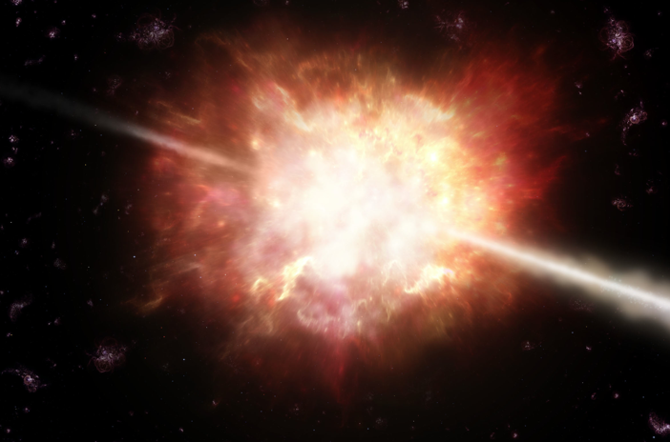
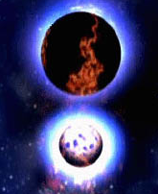
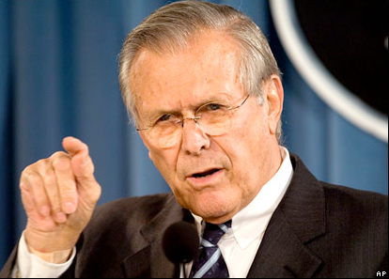
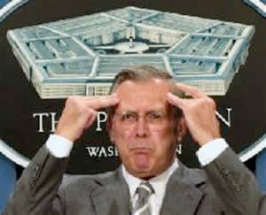
Fast radio transients – astrophysics
Fast transients probe
high brightness temperature emission
extreme states of matter
physics of strong gravitational fields
Extragalactic impulsive transients would afford a new view of the huge reservoir of baryons in the ionized IGM
“Known Knowns”
Giant pulses
Magnetars
RRATs
“Known Unknowns”
Lorimer Burst
Annihilating Black Holes
Gravitational Wave Events
“Unknown Unknowns”

Slide 4
Transients parameter space
Multi-dimensional detection optimization, e.g.
Frequency range
Field-of-View (targeted vs untargeted surveys)
Sensitivity limit (→luminosity, distance limits)
Dispersion measure (→ distance)
Polarization
When detections are one-off (or nearly so) we think in terms of “probability of intercept”
Raw receptor sensitivity (A/T)
Arraying sensitivity (if applicable)
FoV
Observing time (commensal or non-commensal)
Detector characteristics (time resolution, goodness of matched filter approximation, ...)
Event duration, repetition characteristics
(Quasi) periodicity?
Maximizing real + reducing false detections is central to SKA-era thinking
Observe as much parameter space as possible (esp. single dish)
Minimize and/or mitigate RFI
Spatially localize candidate events using array
Coherent (“voltage”): classical interferometry or tied-array beams
Incoherent (“power”): element or sub-array processing
Combination: e.g. incoherent-triggered interferometry on stored voltage samples
Automated pipeline needed for all but early experiments

Slide 5
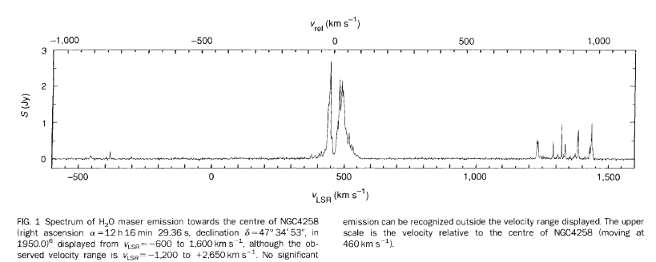
Astronomy – technology nexus
Discoveries typically follow within 5 years of innovation
Sometimes serendipitously
No innovation → no discovery
Watch closely the LOFAR, MWA ... space
In the absence of other information, maximum parameter space access is our goal
Many SKA design and operation insights – especially for transients – sit at the astronomy-engineering interface
RTS-relevant serendipity
Nakai et al. 1993

Slide 6
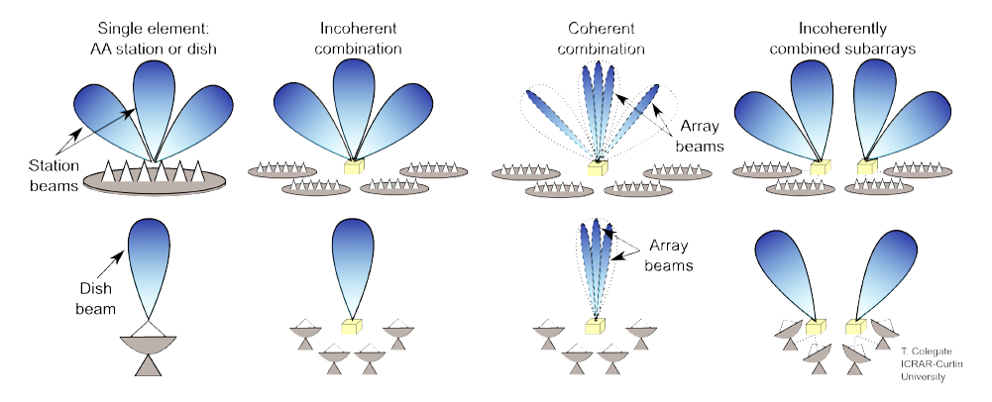
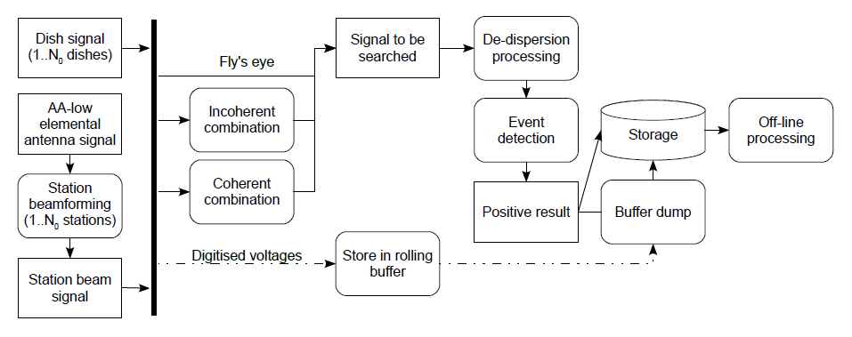
Large-N arrays: combining signals

Slide 7
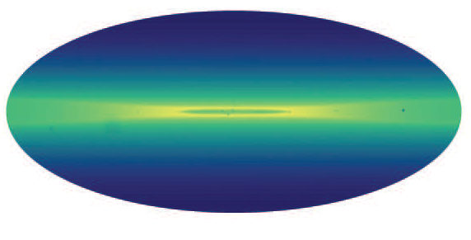
Metrics and Figures of Merit in transient detection
Event rate is key FoM
How good is my transients telescope?
Relates properties of a population of radio transient events to its expected detection rate in a survey of finite sensitivity
Shows inadequacy of survey speed as a FoM for transients
FoV is an important, independent parameter
Important insights into large-N arrays
1 GHz
Courtesy J-P Macquart

Slide 8
Event rate analysis
Models telescope performance and science requirements
Specifies optimal solutions, but only for subsets of parameter space
Reveals hitherto “hidden” compromises
Born of science – engineering dialog and provides common ground for continued development
Quantifies many characteristics of a search
Optimal strategy maximises the number of events detected
Increasing observation time maximises events detected → commensal observations
Not all virtues are easily quantified (e.g. localisation capability)
But we are working on it !)
Affected by numerous dependencies
Astrophysical characteristics of expected population and intervening medium
Telescope sensitivity and field-of-view
Search processing hardware and algorithms
Many dependencies vary with frequency

Slide 9
Event rate dependencies
Intrinsic luminosity
usually unknown, but can assume various population (Macquart, 2011)
frequency (spectral index)
Event rate density
usually unknown
Intrinsic pulse width
usually unknown
Processed field of view
combination mode (incoherent, coherent)
array dimensions
number of beams formed and searched
frequency
Observed pulse duration
due to scatter-broadening
direction
frequency
Minimum detectable flux density
receptor type
combination mode
fraction of collecting area used
frequency
8

Slide 10
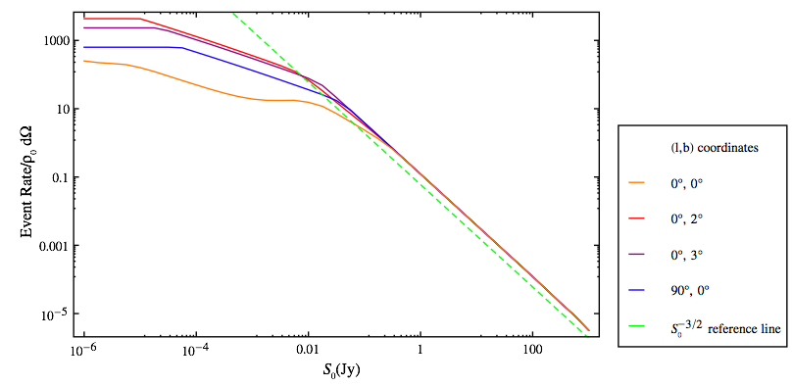
Example: wide or deep surveys? How much do we gain by increasing sensitivity?
(δ ~ 0 when sensitivity-limited and scattering small)
12

Slide 11
Fly’s eye, incoherent wide-field, or coherent survey?
For an array of N elements, each with limiting sensitivity S₀
Fly’s eye covers N x primary field of view to S₀
Collimated Incoherent covers 1 x primary FoV to S₀/N^{1/2}
Coherent covers ξ Ωsynth=ξ π(λ/d)² [Ωsynth ≪ Ωprimary] to S₀/N
Which is best? Depends on the slope of the Event Rate vs S₀ line
13

Slide 12
Fly’s eye, incoherent wide-field, or coherent survey?
number of tied-array beams
Fly’s eye or coherent?
ξ must be large for the coherent approach to win
If δ>0.5 we never win with a coherent survey
- e.g high-sensitivity Galactic survey
Coherent or collimated incoherent?
14

Slide 13
Trail-blazers and Pathfinders
Trailblazer = pre-pathfinder
Indicates how little we really know about finding transients !
What is an appropriate investment in pathfinder transient systems ?
Probe parameter space
New science (we hope)
Provide reasons for SKA to favour particular regions of parameter space ?
New architectures and technologies
Commensal + upgradable: forces spigot + instrument thinking
Hardware scalability + firmware/software re-usability
New detection algorithms
Machine learning to spot statistical anomalies in large data hyper-cubes
Fast imaging, u,v-plane detection, fundamental estimation limits (Cath Trott presentation)
Both classical matched filtering and/or fast imaging can feed new detectors
Investigate system trade-offs
e.g. close algorithm – architecture matching is efficient, but at what cost to flexibility ?

Slide 14
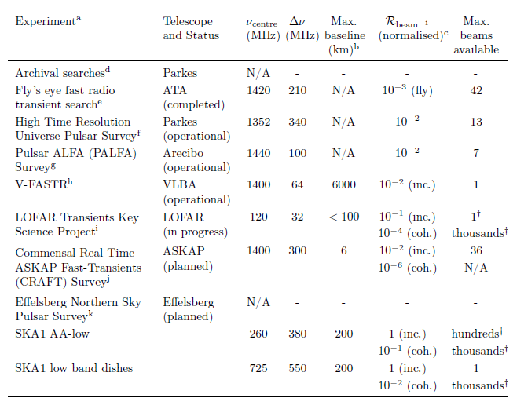
State of the survey art

Slide 15
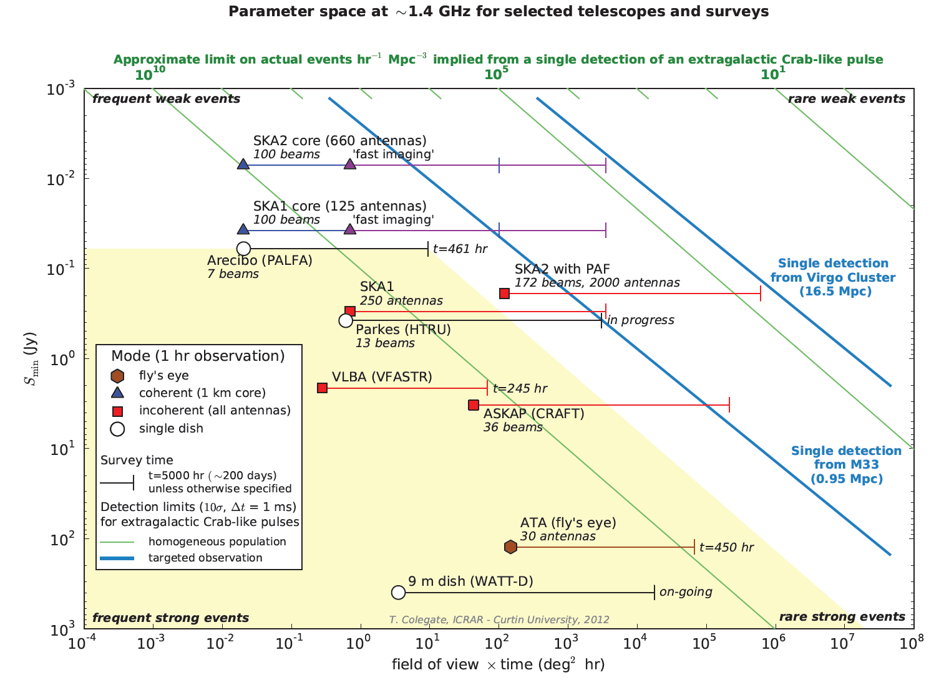

Slide 16
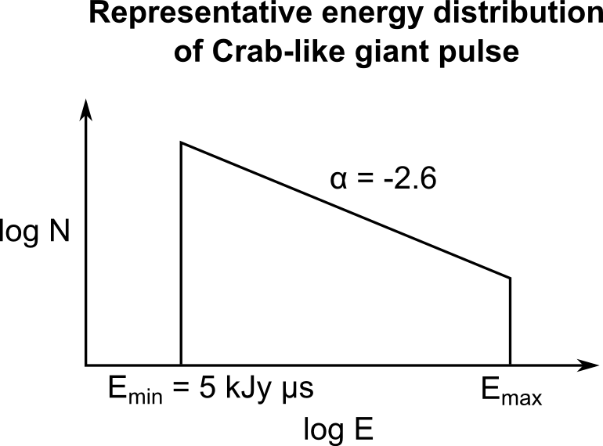
Example: extragalactic giant pulses
Giant pulses from a Crab-like pulsar:
- giant pulse frequency = 0.06 s⁻¹ for E > 5 kJy μs
- power-law energy (i.e. luminosity) distribution
- no known maximum energy
- assume no pulse broadening

Slide 17
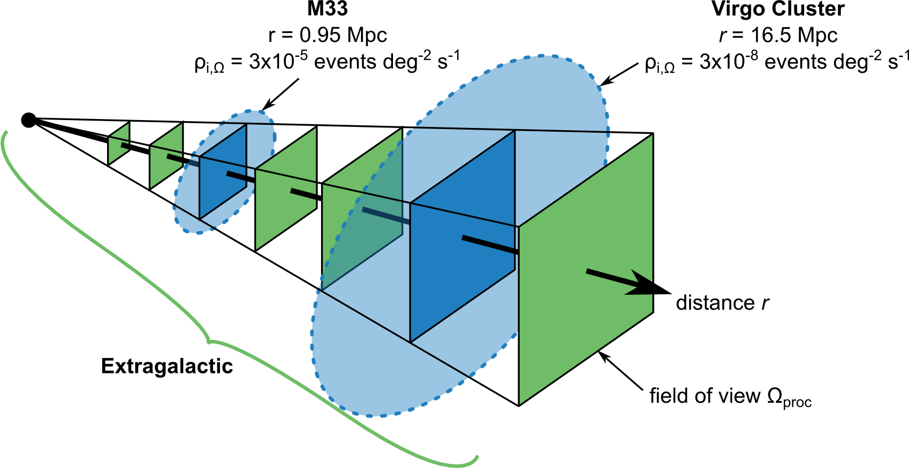
Example: extragalactic giant pulses
On the plot:
Blue lines: for a targeted observation of sensitivity S_{min}, after what FoV x time do we expect to detect a single event?
Green lines: if we detect a single event with an observation of some S_{min} and FoV x time, what limit does that place on ρ_{i} (events hr⁻¹ Mpc⁻³)?
For targeted observations (blue)
- estimate an intrinsic event rate per solid angle: ρ_{i,Ω}
- at larger distances, a smaller fraction of events are detectable
- more sensitive telescopes see a larger fraction of events
- FoV x time increases probability of seeing an event
For an extragalactic search (green)
- homogeneous population with intrinsic event rate per unit volume ρ_{i}
- integrate along line-of-sight to determine total detected event rate

Slide 18
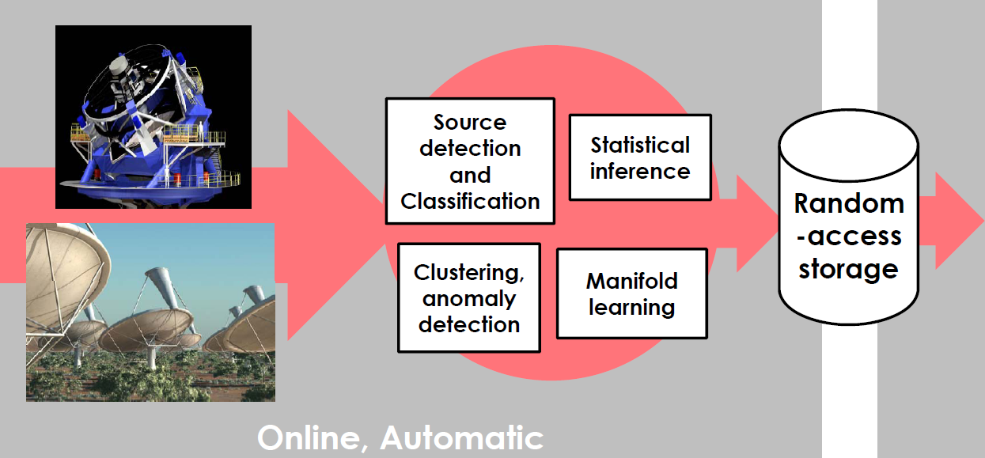
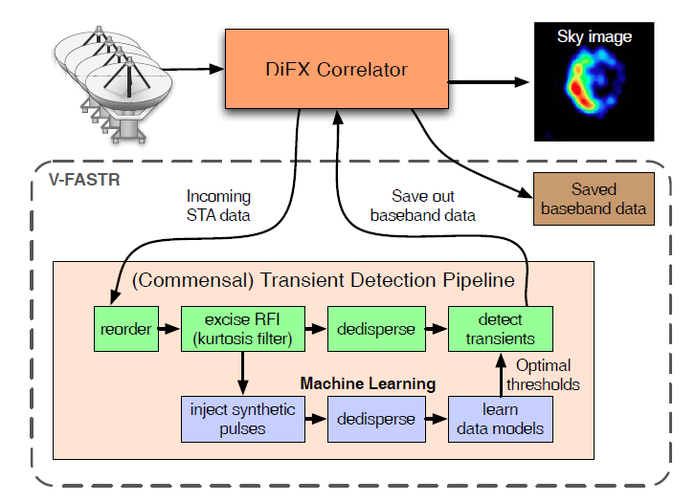
Search innovations: machine learning
Adaptive self-tuning system
Cannot store or analyze peta-scale data volumes.
Need immediate, real-time follow-up
Solution: adaptive processing chains to handle streaming data
Data mining is continuous
Pattern recognition permits immediate triage and follow-up
Courtesy D. Thompson (JPL) and V-FASTR

Slide 19
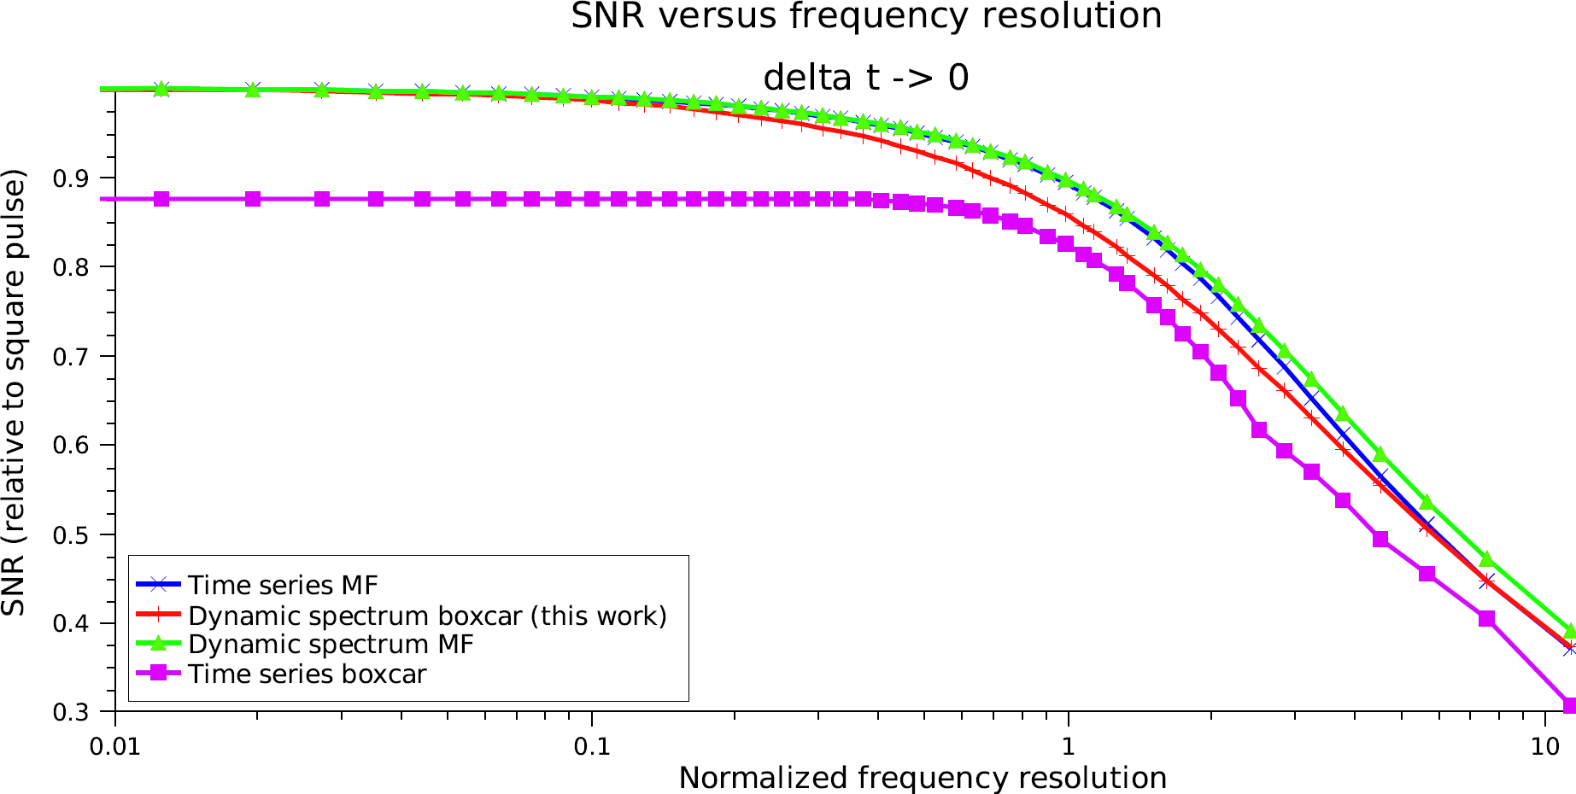
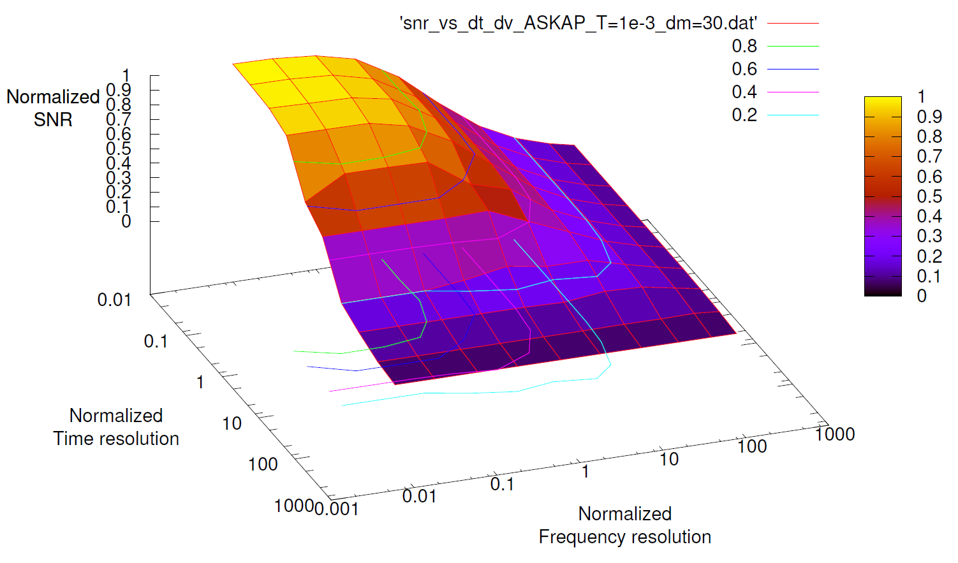
Efficient incoherent de-dispersion
New algorithm for selecting samples from the dynamic spectrum (per trial DM) to maximize SNR
New algorithm for selecting trial DMs maintaining good SNR performance across the chosen DM range
SNR performance comparable to matched filters
Efficient, scalable FPGA implementation possible
Courtesy N. Clarke, J-P Macquart and C. Trott

Slide 20
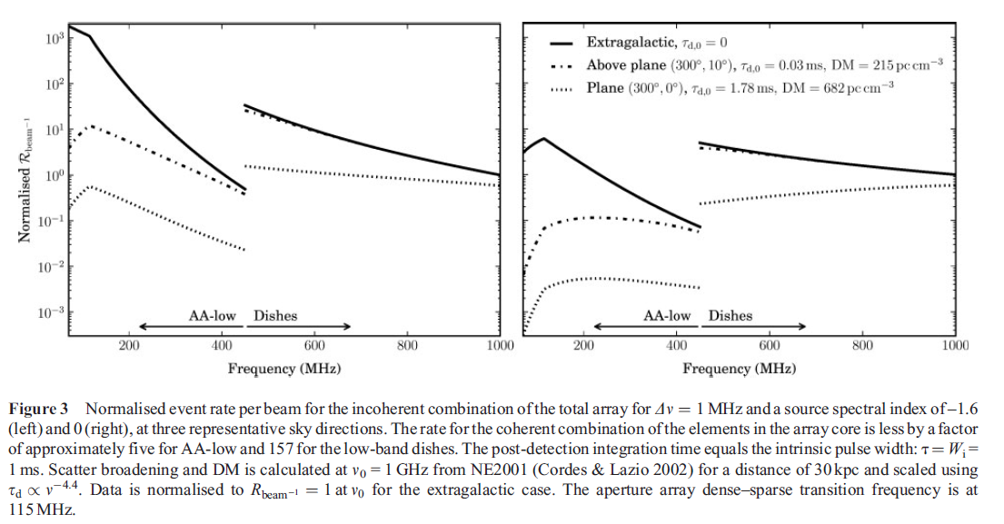
Event rate per beam - a.k.a. “bangs per buck”
Measures the processing (“cost”) efficiency of searches conducted on a per beam basis
beamforming, de-dispersion, detection algorithms, ...
Informs choices of receptor combination and search processing modes
Spectral index = -1.6
Spectral index = 0
Courtesy T. Colegate and N. Clarke

Slide 21
SKA1
SKA1-low will be efficient as a transients telescope
Much to learn from LOFAR, MWA, ...
AAs more efficient when scattering is lower or source spectrum steeper
Close-packed AA core makes coherent combination much more efficient than for the dish core
Incoherent combination with single pixel feed dishes limited to one beam
Not the case for AAs
Dense/sparse SKA1-low transition frequency a key input to event rate per beam models
SKA1 will still be a pathfinder in transients science
Plan “appropriate” initial investment + upgrade path
Maximize advantages of large-N array
Exploit SKA1-low potential
Future-proofing requires “spigot + instrument” architectural approach
Initial strategy:
Incoherent search (collimated commensal)
Coherent localization
Provision of memory buffers in coherent signal path
Instrument-side equipment + pipeline supplied by user consortium?

Slide 22
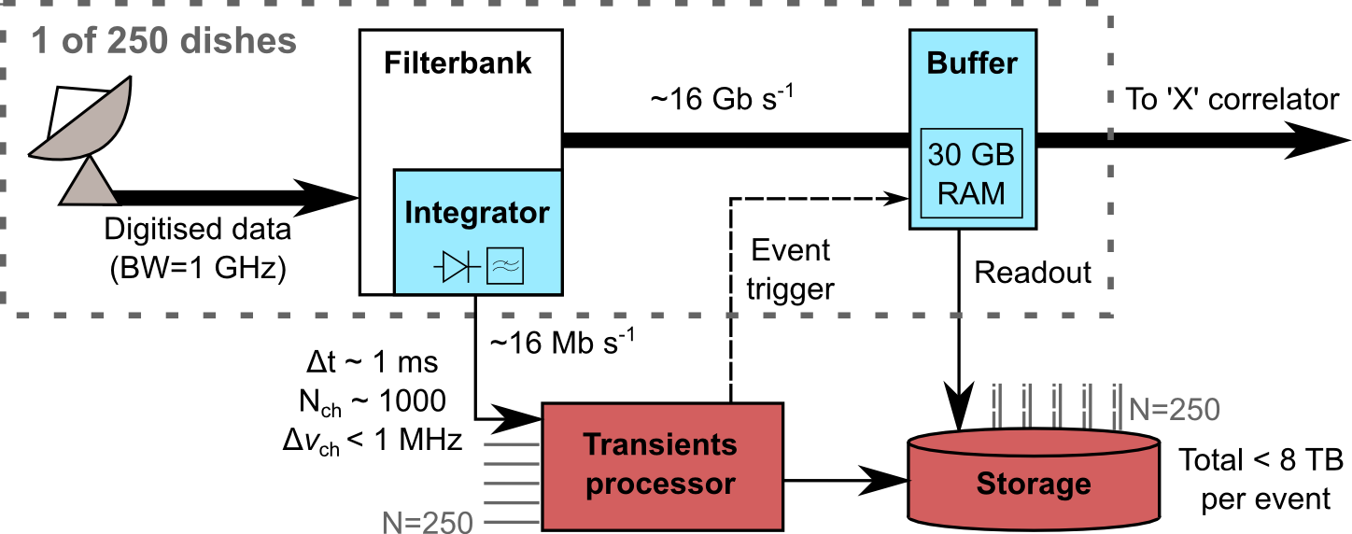
Basic transients system for SKA1 dishes
Incoherent detection with coherent follow-up
Order-of-magnitude component costs:
FX Uniboard correlator (Szomoru et al., 2011)
Transients processor
Hybrid CPU / FPGA
>500 trial DMs
Max DM > 4000 pc cm⁻³
 | Quantity | Cost (k€)
Integrator | 250 | 60
Buffer boards | 64 Uniboards | 640
Buffer RAM | 250 | 60
Transients processor | 1 | 100
Storage | > 1 PB | 100
TOTAL |  | 960

Slide 23
Conclusion
Tantalizing hints of one-off, fast transients (Lorimer etc.)
A confirmed detection would be welcome and significant
Contemporary surveys – many with SKA pathfinders – are beginning to probe truly interesting parameter space and set meaningful astrophysical limits
We expect information on the worth of fast transients investment
With these (often commensal) surveys has come the impetus to develop algorithms, architectures and information handling techniques for SKA1 and beyond
SKA1 can provide great additional insight for relatively little cost
Selected recent references
Clarke N., Macquart J-P., and Trott C., “Performance of a Novel Fast Transients Detection System”, ApJ, submitted Jan. 2012
Colegate T. and Clarke N., “Searching for Fast Radio Transients with SKA Phase 1”, PASA, 28(4), Nov. 2011
Macquart J-P., “Detection Rates for Surveys for Fast Transients with Next Generation Radio Arrays”, ApJ 734(1), 2011
Wayth R., Tingay S., Deller A., Brisken W., Thompson D and Wagstaff K., “Limits on the Event Rates of Fast Radio Transients from the V-FASTR Experiment”, ApJ, submitted Mar. 2012

