Slide 1
The MeerKAT radio telescope (and some other animals)
Justin Jonas
Associate Director: Science & Engineering SKA South Africa
Professor: Dept. Physics & Electronics, Rhodes University
RTS 2012 – Manchester, 19 April 2012

Slide 2
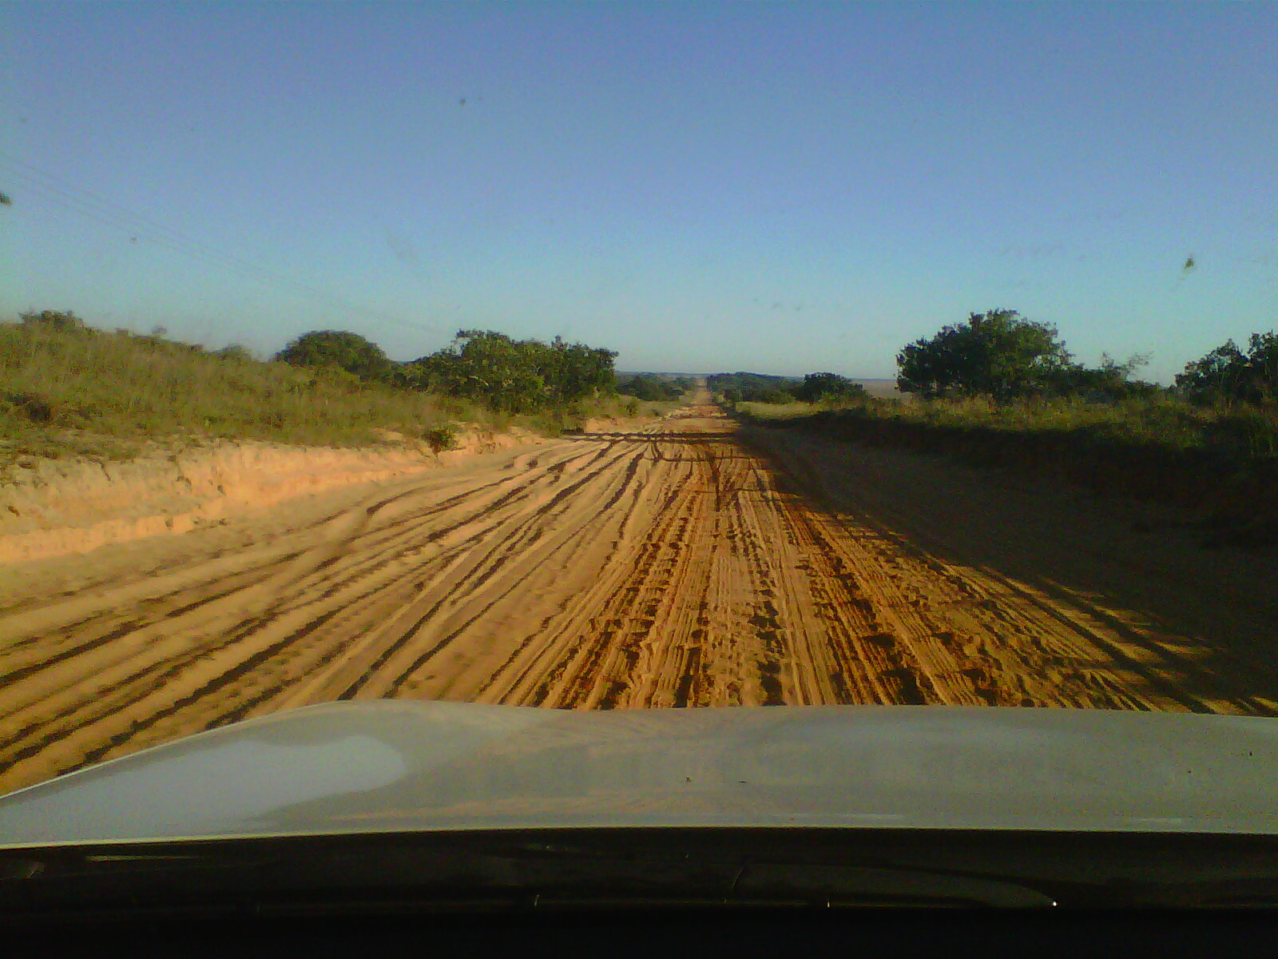
Road to RTS 2012

Slide 3
From Ponta Malongane …

Slide 4
… to Manchester
What we do for our science …
Thank You Richard!

Slide 5
Overview
Context
MeerKAT Science & Specifications
System engineering and design
Establishing the Karoo site
XDM
KAT-7
African VLBI Network

Slide 6
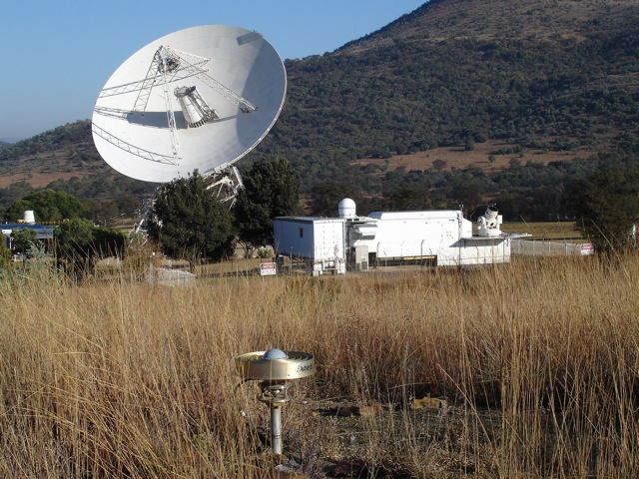
26-m antenna (ex NASA/DSN)
MOBLAS-6 (NASA)
GNSS (IGS)

Slide 7
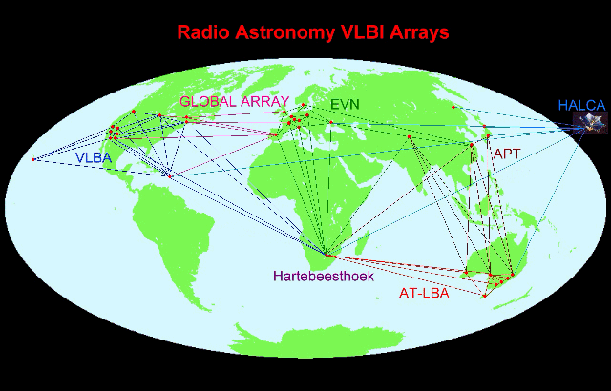
VLBI Global Array

Slide 8
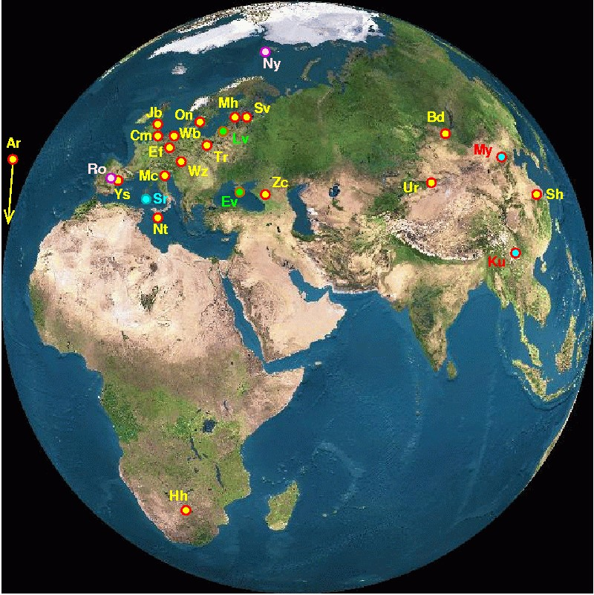
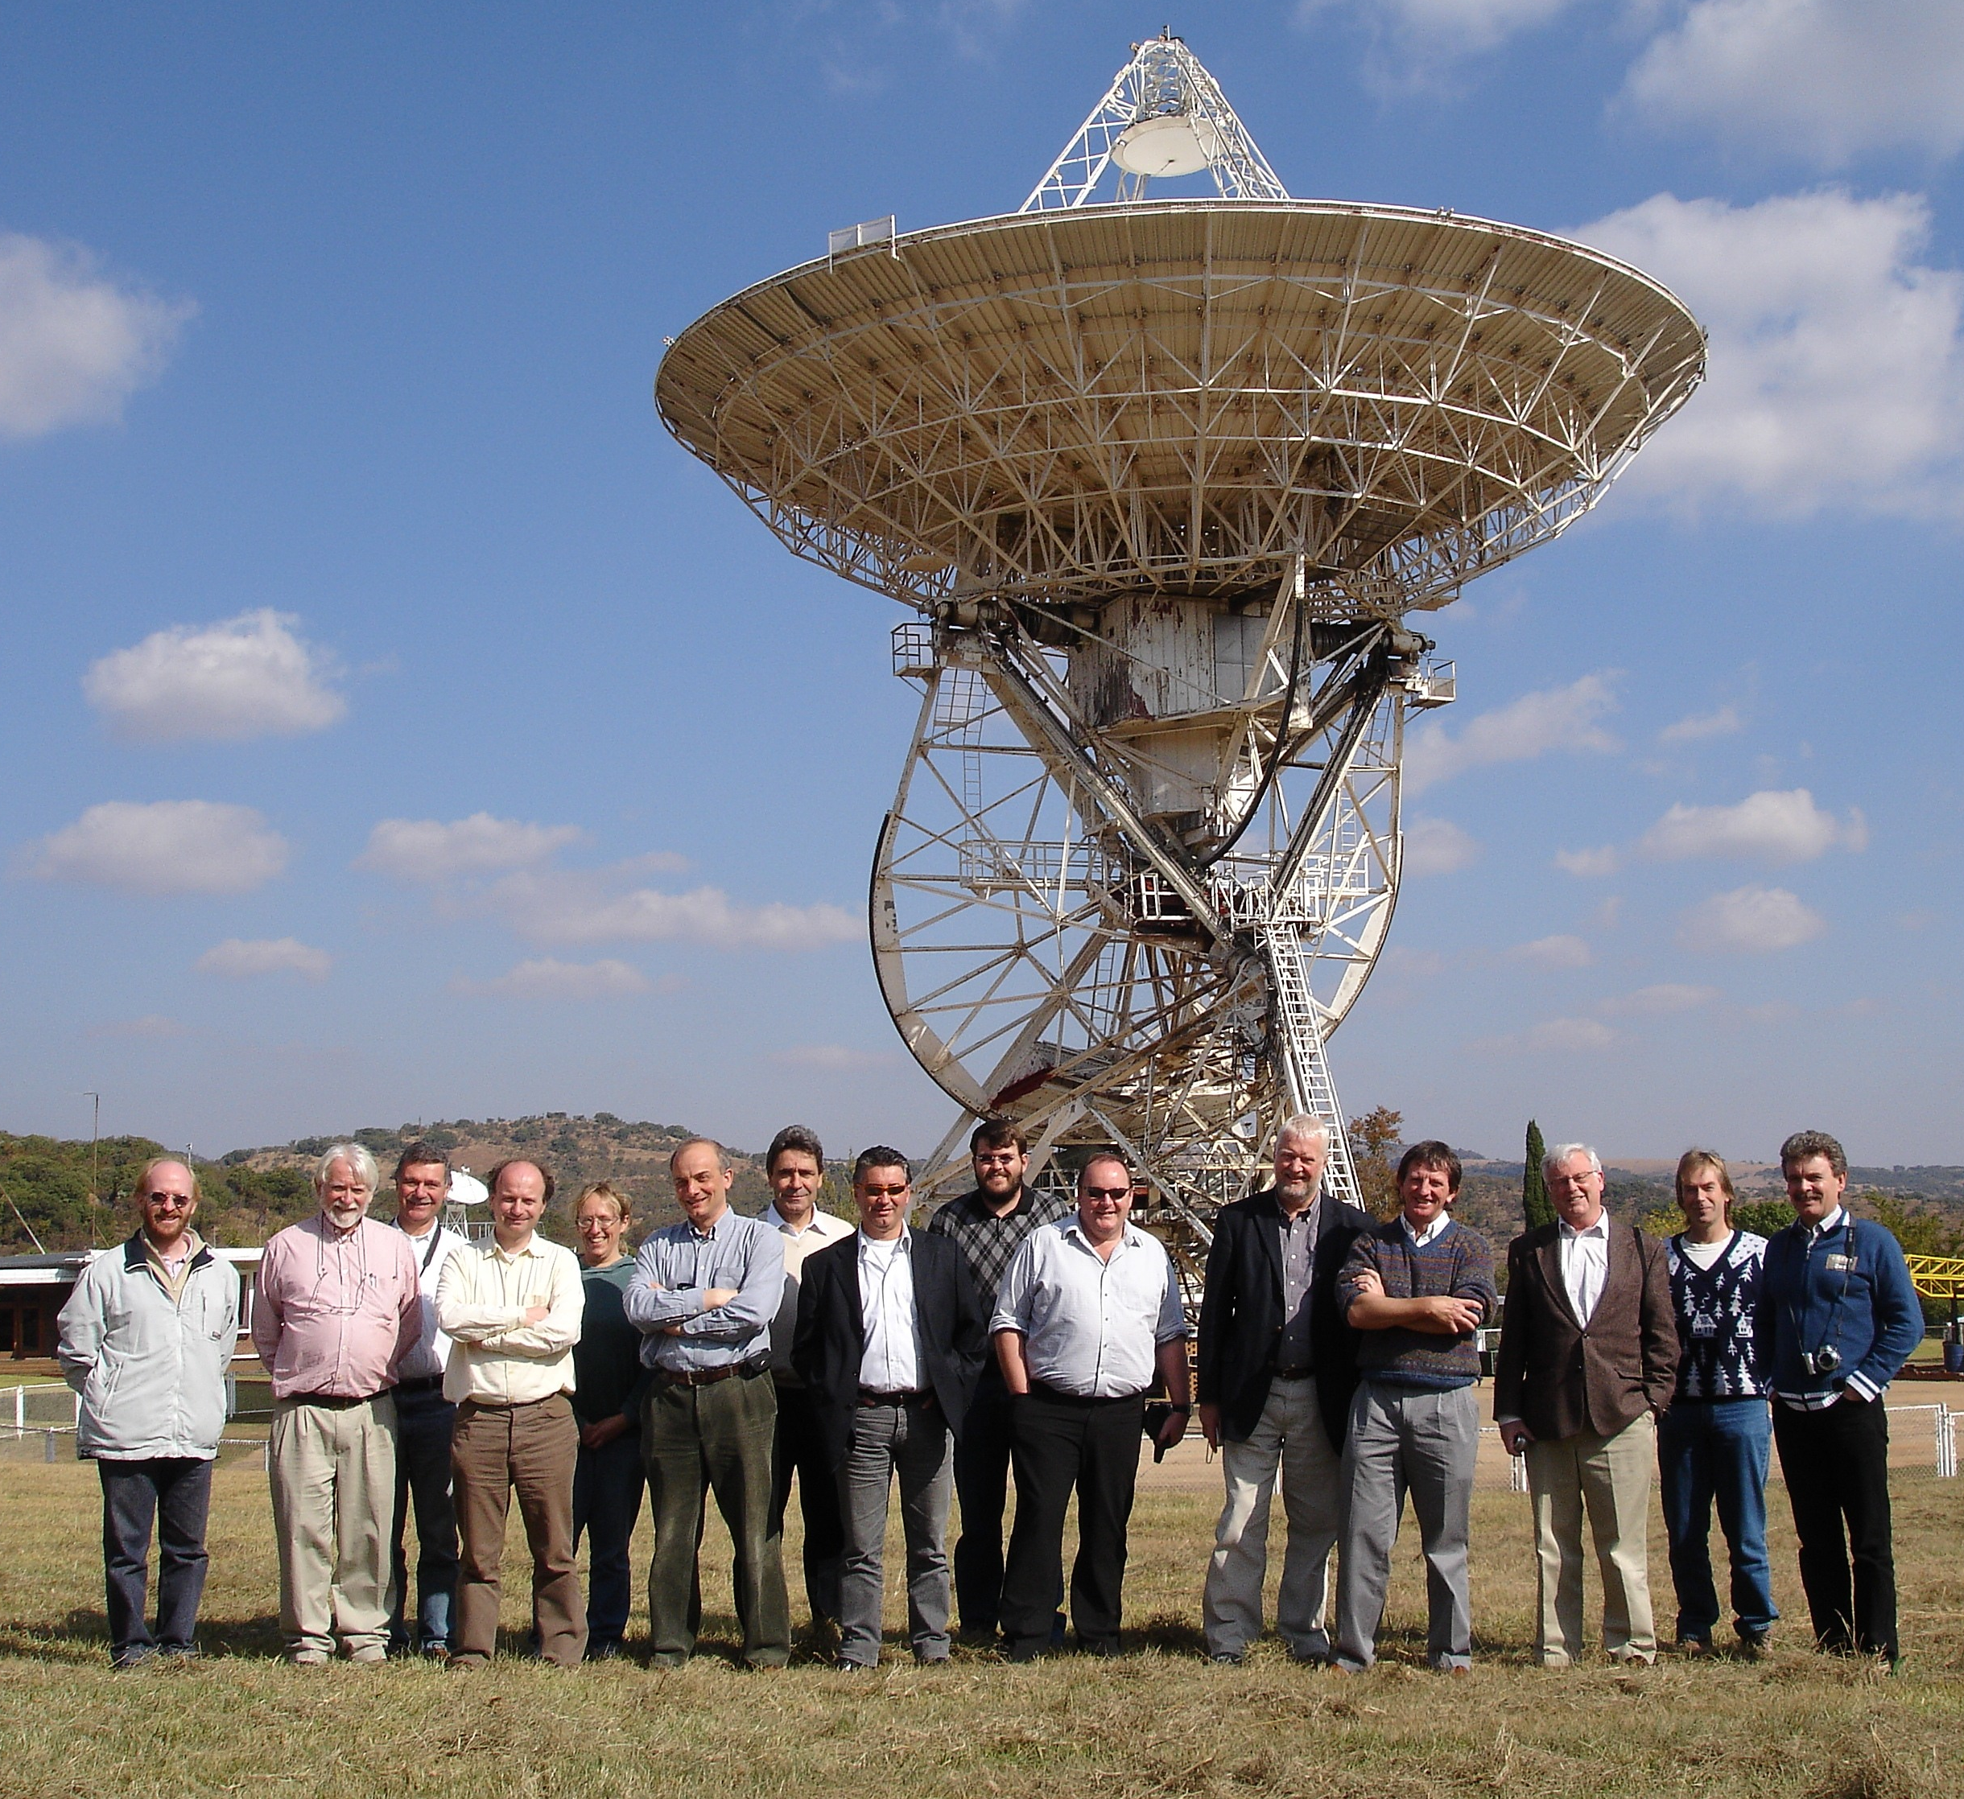
European VLBI Network

Slide 9
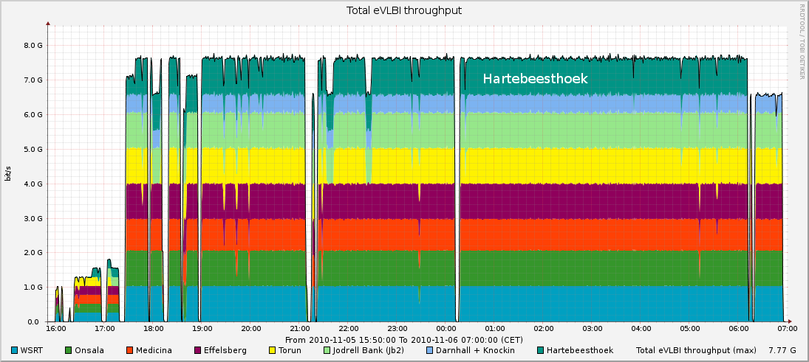
Gigabit link to JIVE

Slide 10
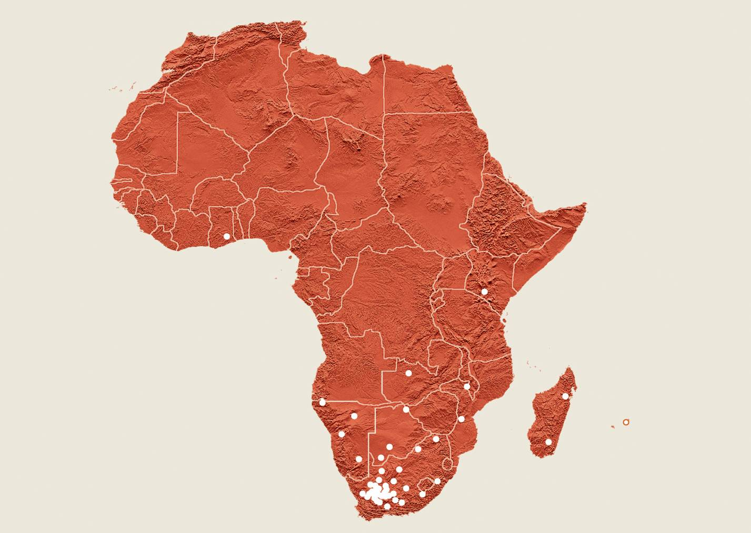
The SKA in Africa

Slide 11
The MeerKAT Programme
Africa will have a legacy of a large radio telescope.
Irrespective of the outcome of the SKA site competition.
But not independent of the SKA.
Largest radio telescope in southern hemisphere, one of the largest in the world.
MeerKAT is an SKA “precursor”.
Engineering prototype and early science (SKA-mid “Phase 0”).
Drive the establishment of the Karoo Radio Astronomy Reserve.

Slide 12
MeerKAT high-level spec
The most sensitive cm-wavelength telescope in the southern hemisphere (aspiration: world)
580 MHz – 15(+) GHz (i.e. SKA-mid +)
Imaging and non-imaging modes
High filling factor for baselines < 1 km
Baselines out to ~8 km (but expansion planned)

Slide 13
MeerKAT Phase 1 (2016)
64 x 13.5 m gregorian offset antennas
>> 220 m²/K (300 m²/K goal)
8 km maximum baseline
70 % in < 1km diameter core
0.9-1.726 GHz (note change) cryogenic single-pixel receiver (L-band)
Multiple feed indexer
Direct digitization
DFX architecture

Slide 14
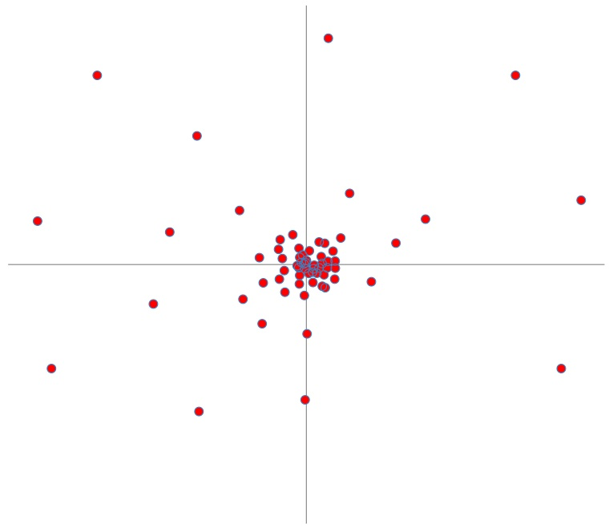
Configuration (64 antennas)
8 km

Slide 15
Future Phases
Phase 2: 580-1000 MHz (UHF)
Phase 3: 8-14.5 GHz (X/Ku-band)
Aspirations (contingent on money and/or technology availability):
20+ km baselines
1.5-3 GHz for NanoGrav
5-22 GHz wideband receiver

Slide 16
MeerKAT Large Surveys
Highest priority (cf SKA₁):
Deep HI field
Radio Pulsar Timing
Compelling:
HI and continuum mapping of 30 nearby galaxies
Absorption line survey
Molecules in the EoR
Detecting fast transients and pulsars
HI survey of Fornax
X-band Galactic plane survey
Tiered continuum survey
Slow radio transient survey
Also
VLBI
Cosmic Magnetism

Slide 17
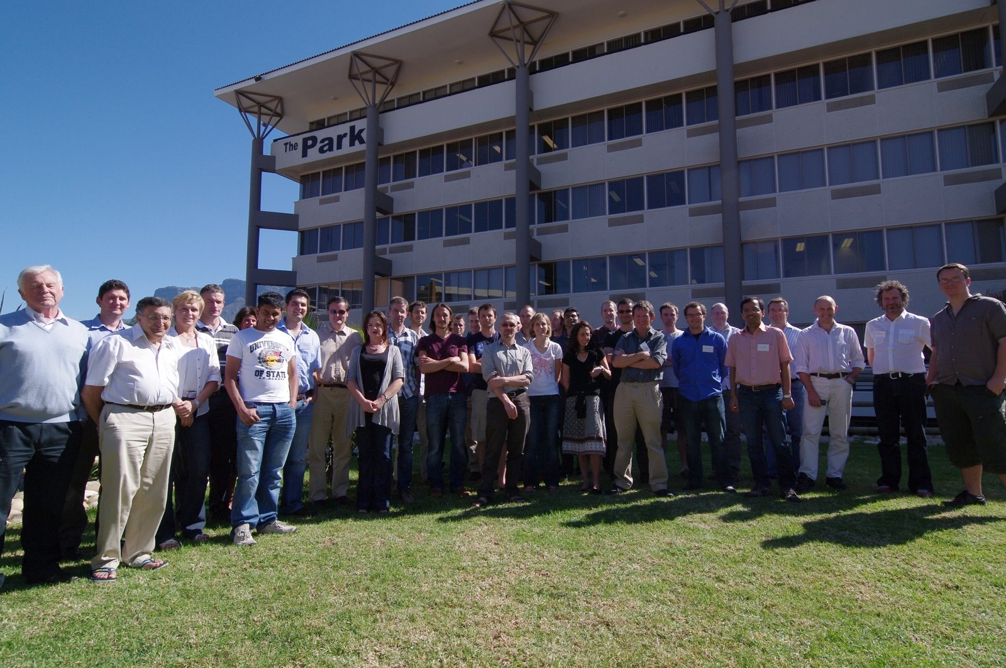
MeerKAT Large Survey PIs (17-18 April 2011)
MeerKAT office

Slide 18
MeerKAT Large Surveys
22 countries

Slide 19
System engineering & Design
Science-led process
Science case
➔ User Requirement Specification
➔ Requirements Review
➔ System Specification
➔ Concept exploration and prototypes
➔ Concept and Preliminary design reviews (system)
➔ Subsystem specifications, design and reviews

Slide 20
System CoDR (5-8 July 2010)
Gregorian offset antennas
Multiple receivers
RFI rejection
Spectral & imaging dynamic range
Sensitivity
64 x 13.5 m
Cryo-cooled, octave band, single pixel receivers
Sensitivity
Direct digitization
Spectral dynamic range
Software collaboration
CASA

Slide 21
Measurement Equation
Calibration of antenna-based “errors”. Generalized from Hamaker, Bregman & Sault to include “image plane effects” (DDEs):
Kemball, Cornwell & Yashar, CPG Memo #4
Noordam & Smirnov, MeqTrees

Slide 22
Sensitivity and Dynamic Range
“Sensitivity (A_{e}/T_{sys}) is king (HI and pulsars), and DR is the dominant queen” (SJ Marais, EMSS)
Interpretation:
T_{sys} not compromised/traded with e.g.:
ultra-wide bandwidth receivers
rather have multiple ~octave bandwidth receivers
wide FoV receivers
survey speed comes from (A_{e}/T_{sys})²
A_{e} driven by primary beam performance (as a proxy for imaging DR, see later)
including sidelobes, polarization and T_{spill}
Spectral DR also considered
gain ripple

Slide 23
Implications for receptor
Low contributions to T_{sys}
Low spillover & correlated ground signals
Minimize scattering structures
Maximize A_{e} for specified sidelobe envelope
Minimize/eliminate aperture blockage
Multiple receivers
A_{e}/T_{sys} and DR have priority over Rx BW, therefore >1 Rx
Predictable, time-stable, frequency-smooth and limited (l,m) support E-Jones
Solid angle used for calibration/imaging
Pointing variation within characteristic calibration timescale
Polarization
Gain ripple
Rotational symmetry of inner beam pattern (P-Jones)
Gain variation within characteristic calibration timescale
Low far-out sidelobes
Minimize scattering structures
Clean RF signal path (G- and B-Jones)
Cable routing
Direct digitization
Self-generated RFI

Slide 24
Prior to Concept Design Review
KAT-7 antenna
Single cryogenic octave-band receiver
Single-reflector symmetric centre-fed antenna with aperture blockage
Analogue signal transport and remote digitization

Slide 25
SKA Baseline Design
Dual offset reflectors
Multiple cryogenically-cooled octave-band receivers
Gregorian offset dual-reflector antennas
Allows multiple receivers without aperture blockage
Superior RFI rejection
Superior sensitivity and signal fidelity
Cryogenically cooled octave-band receivers
Superior sensitivity and signal fidelity
Direct digitization
Superior signal fidelity
Direct digitization at the receiver

Slide 26
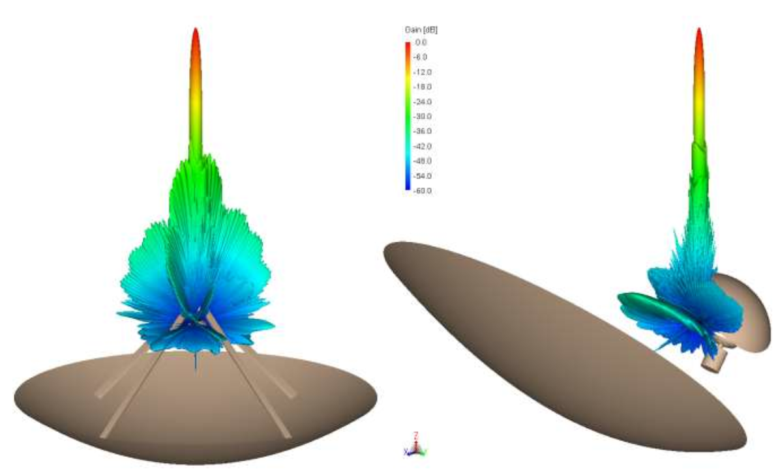
Comparative beam patterns

Slide 27
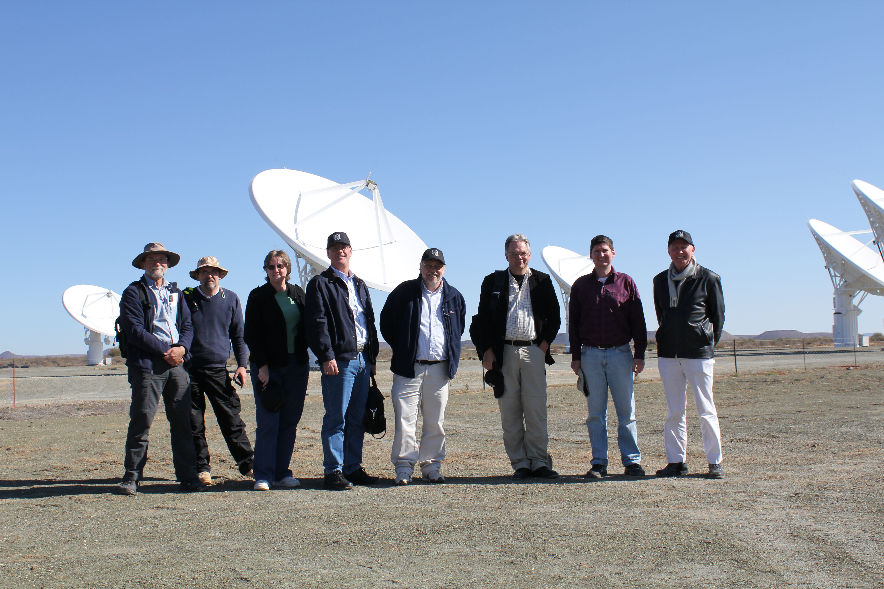
PDR Panel 18-22 July 2011
NL/ALMA
UK/SKA
USA
AU
NL
UK

Slide 28
MeerKAT PDR – July 2011
Extensive trade off between optical and mechanical aspects of antenna
Mechanical tolerance impacting optical performance
Materials testing and component durability
Accelerated environmental and operational tests
Receiver cryogenic refrigeration options
Stirling cycle vs G-M cycle

Slide 29
Mechanical & EM modeling

Slide 30
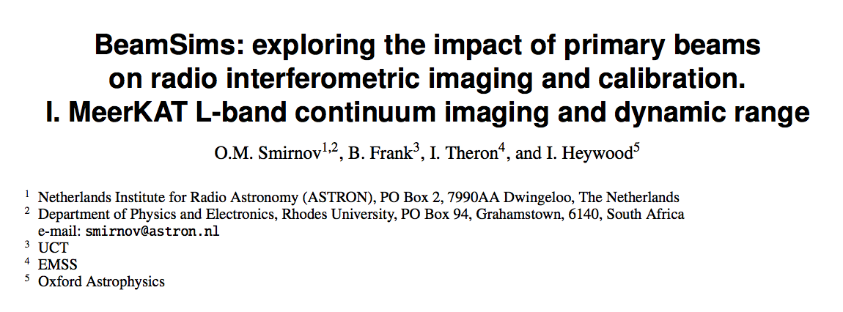
DR simulation work

Slide 31
Virtual MeerKAT

Slide 32
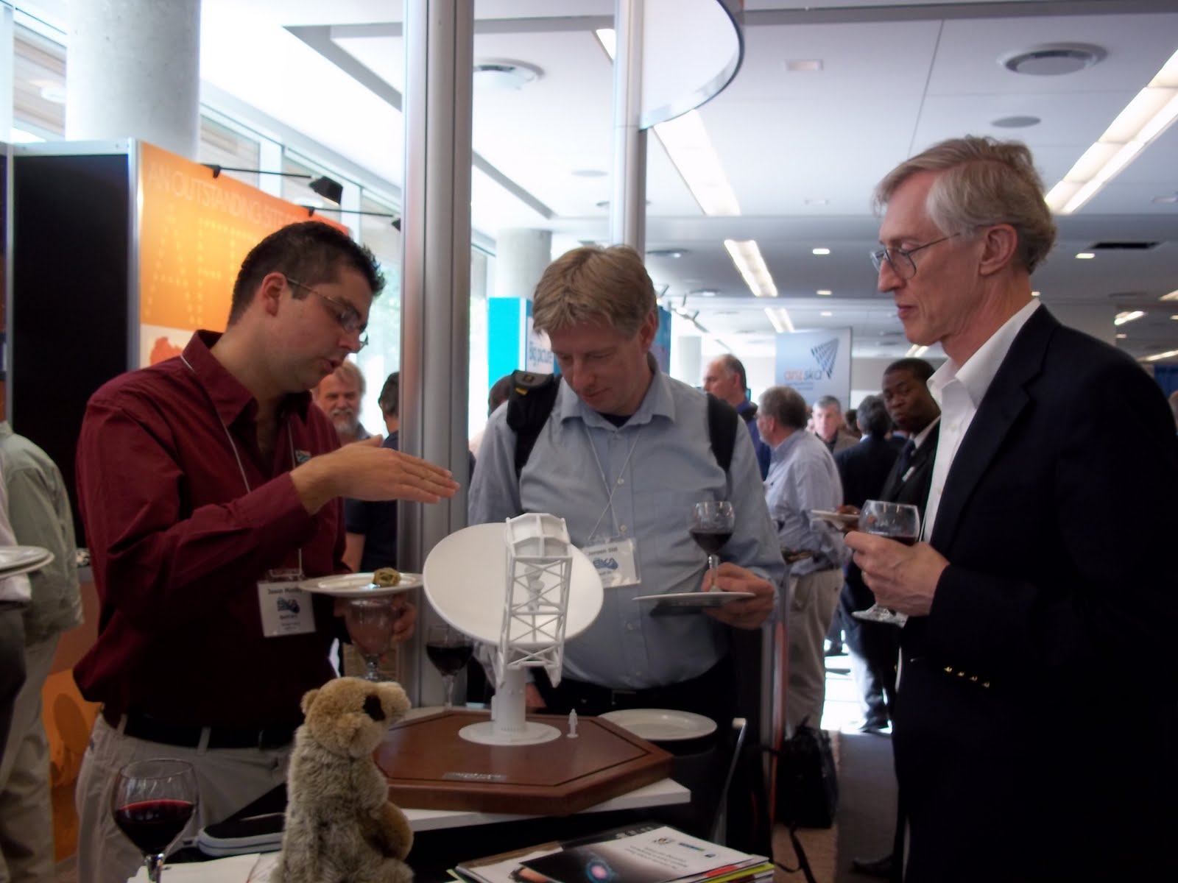
SKA 2011 - Banff

Slide 33
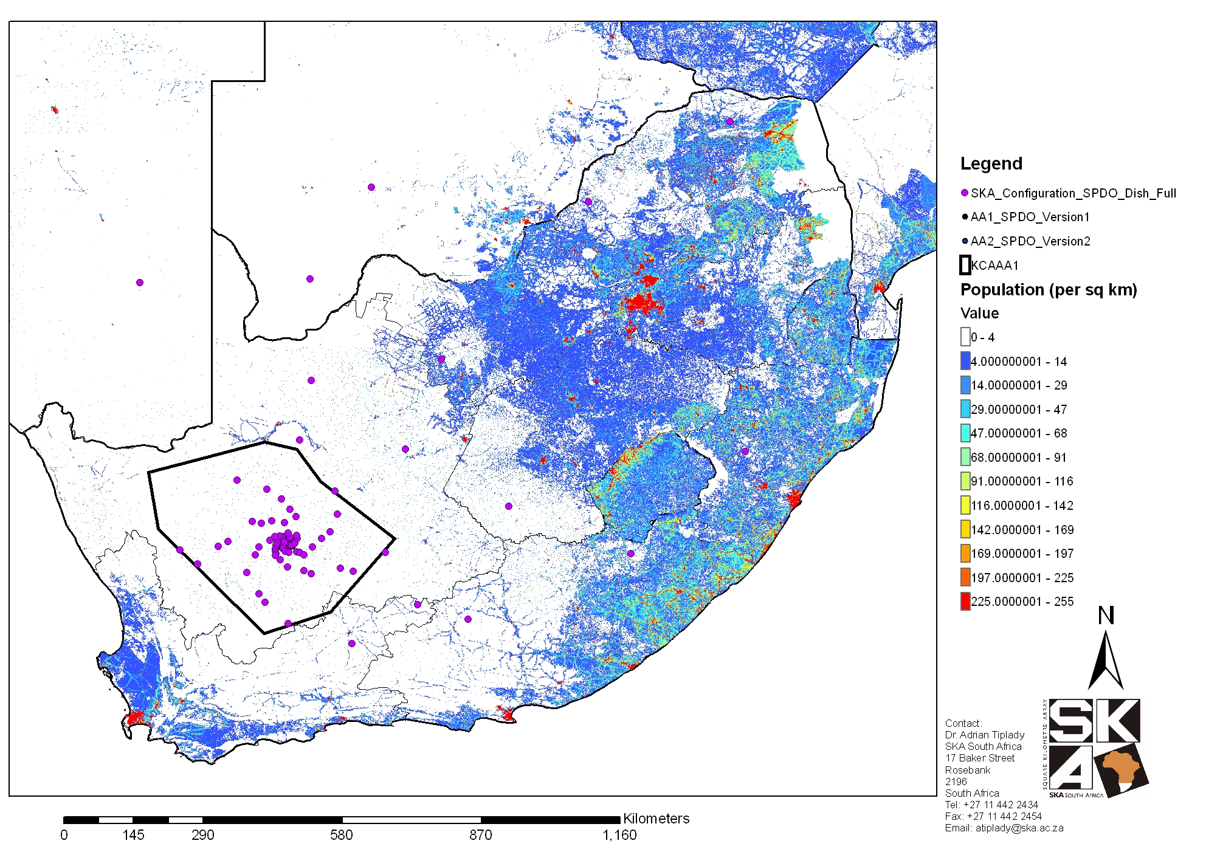
Karoo Radio Astronomy Reserve
500 km

Slide 34
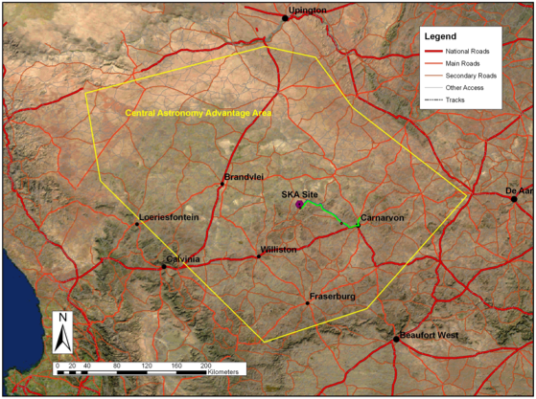
Karoo Radio Astronomy Reserve
500 km

Slide 35
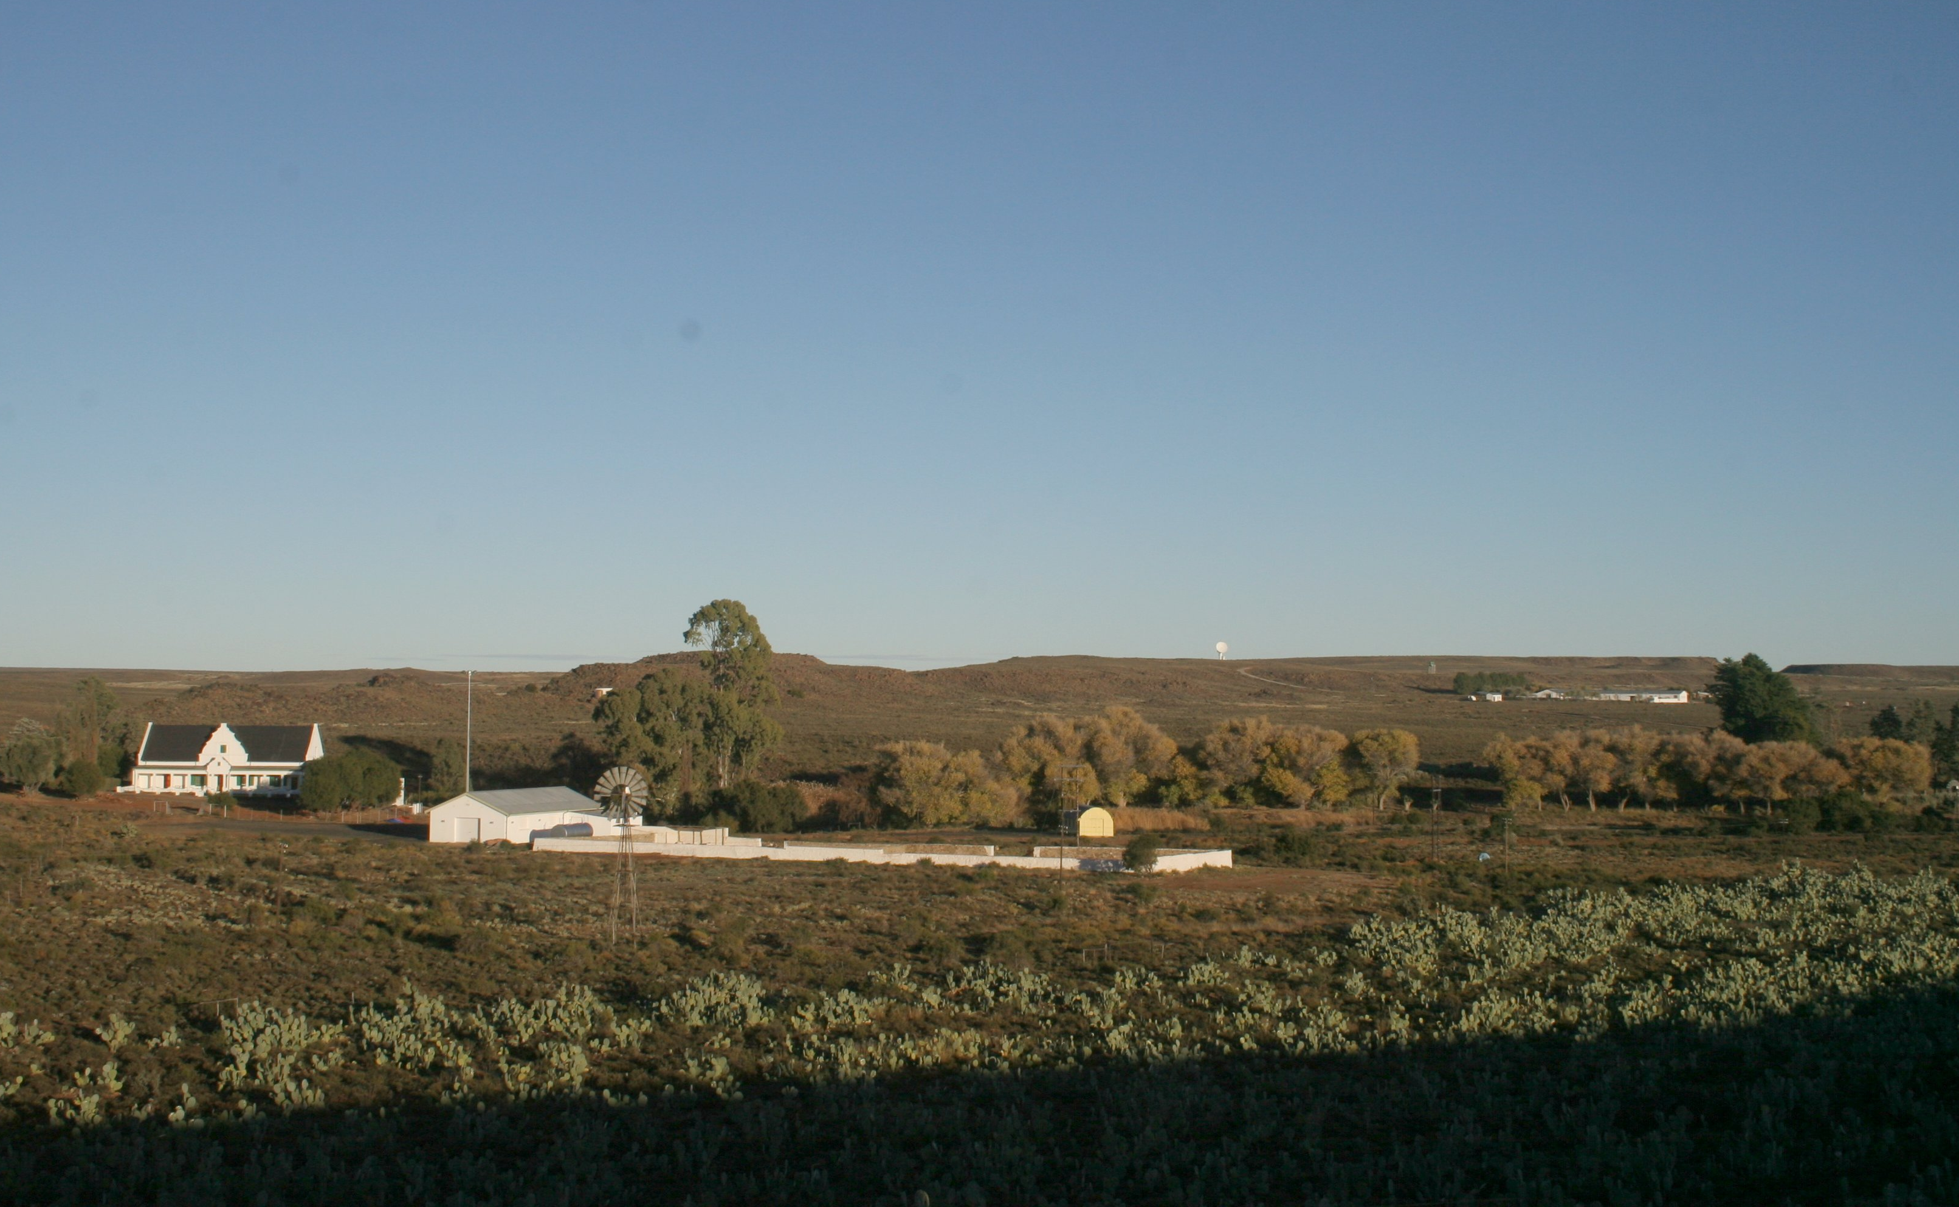
Klerefontein operations centre

Slide 36
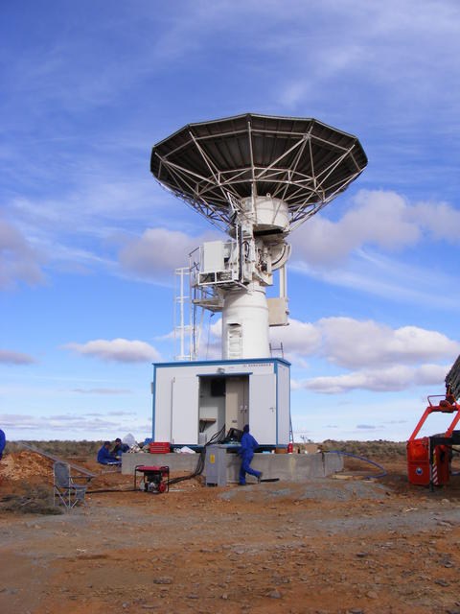
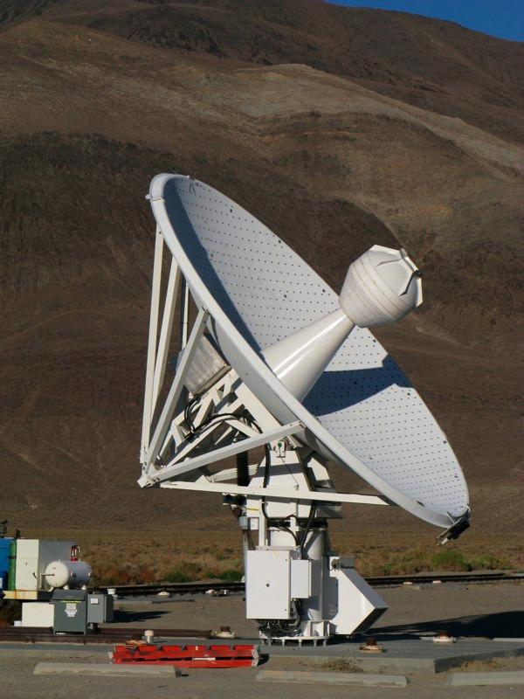
C-BASS
C-BASS South
Karoo
C-BASS North
OVRO

Slide 37
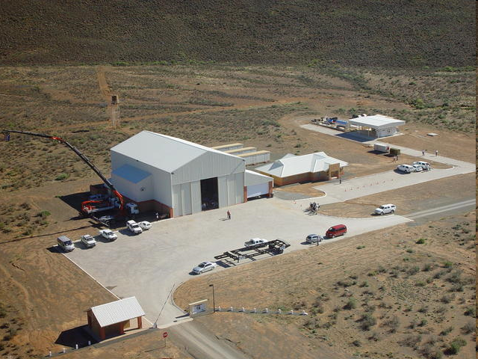
On-site dish shed, accommodation and container sheds

Slide 38
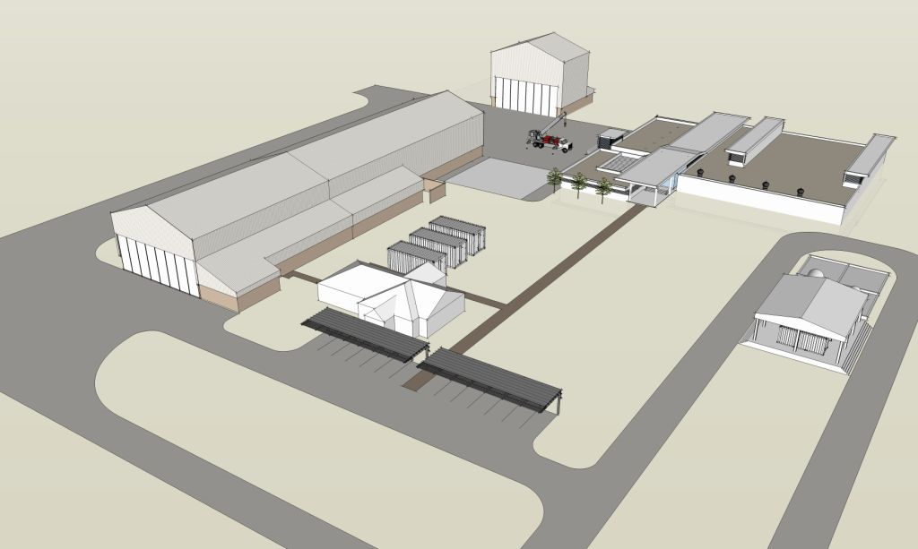
Site Complex extension for MeerKAT
Pedestal integration shed
Dish Assembly shed
Bunkered & RFI shielded processor building and power room

Slide 39
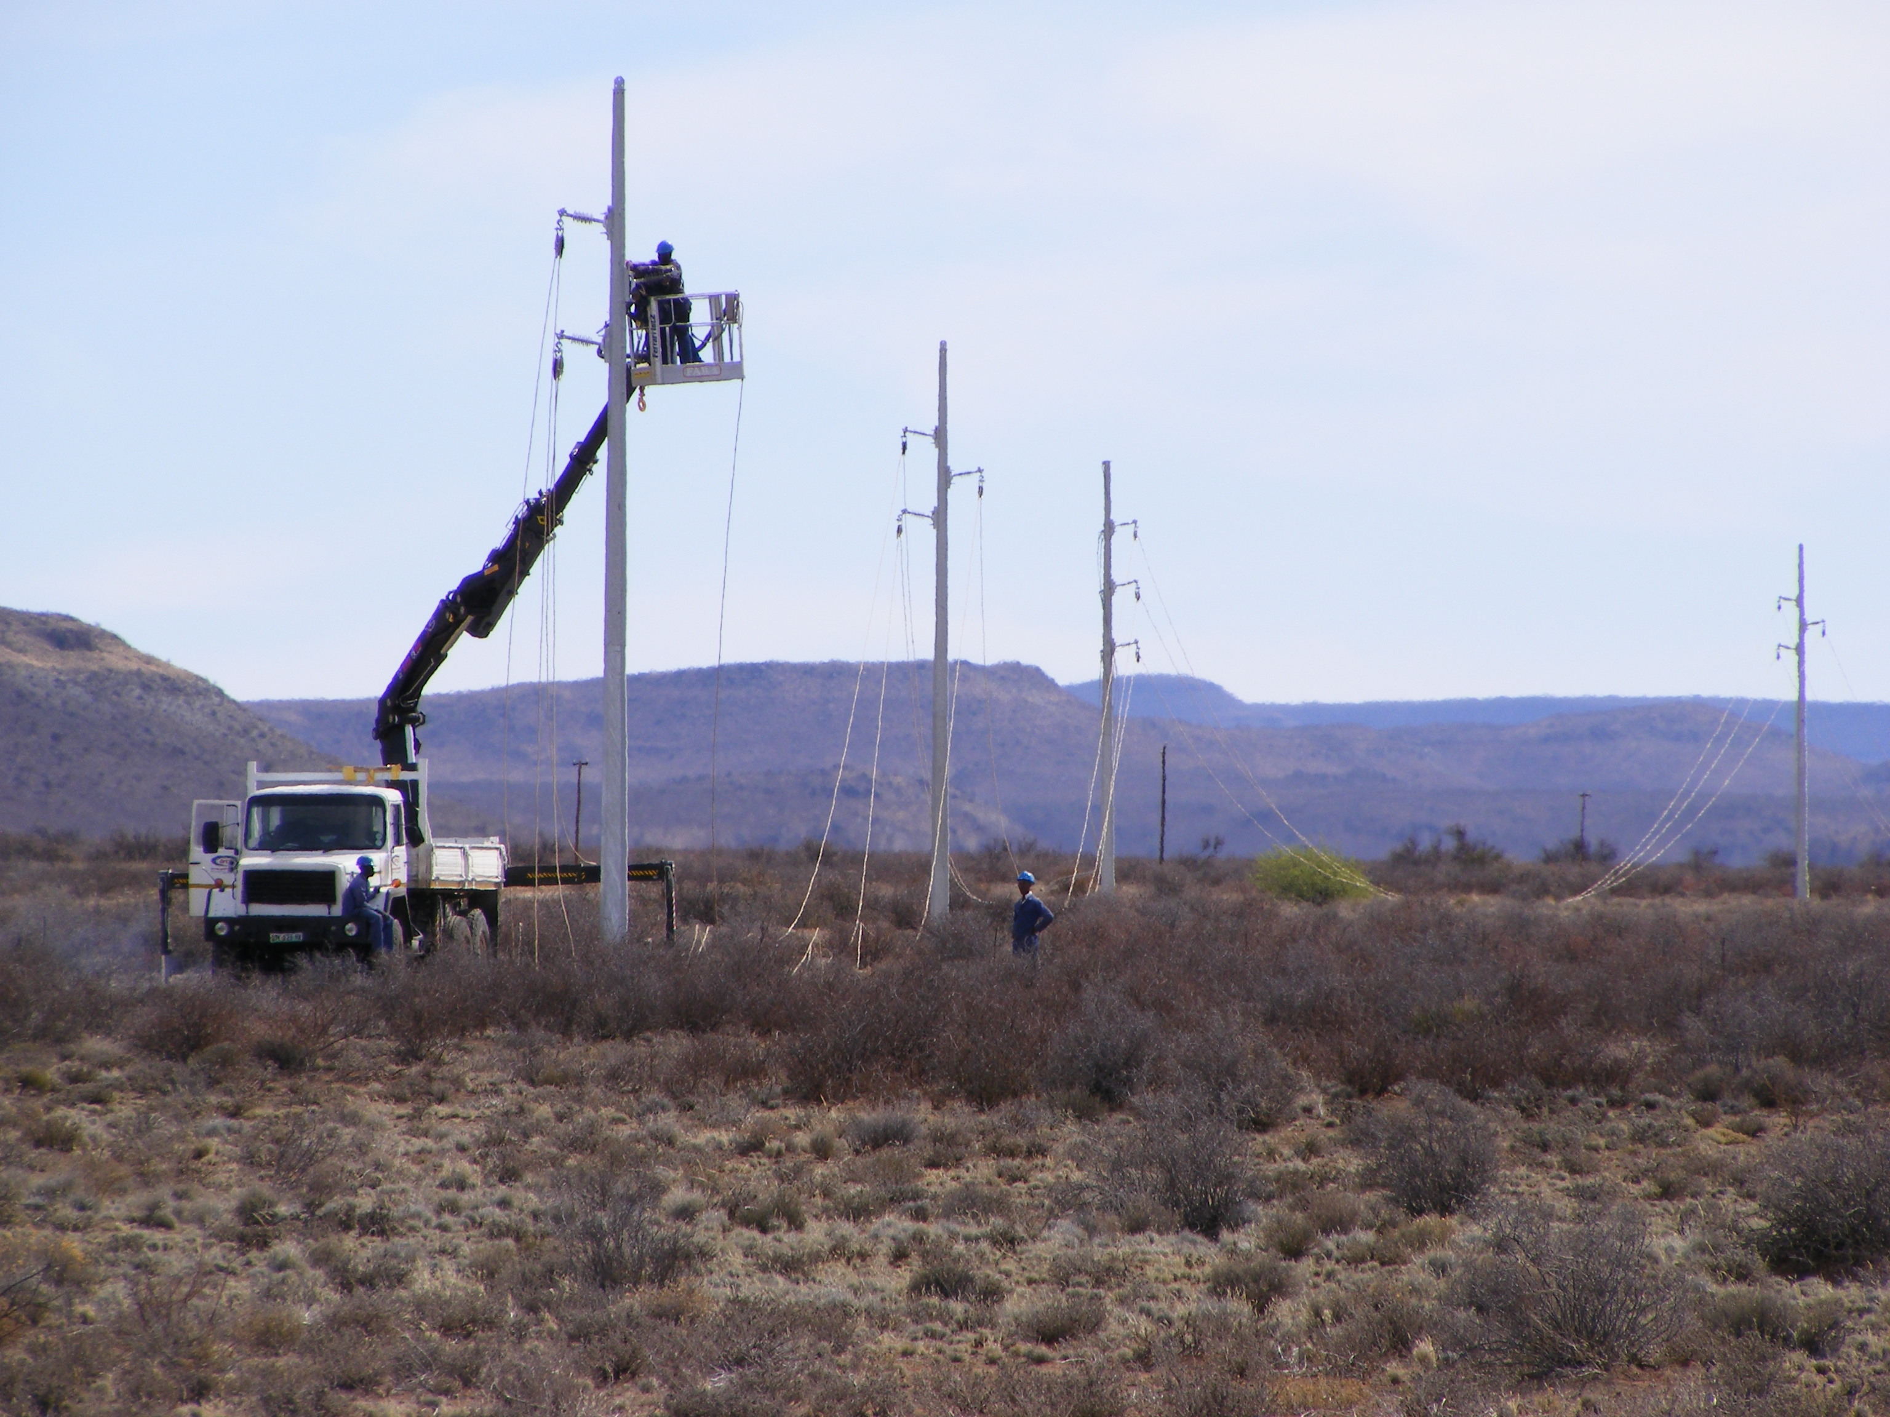
Grid power to site

Slide 40
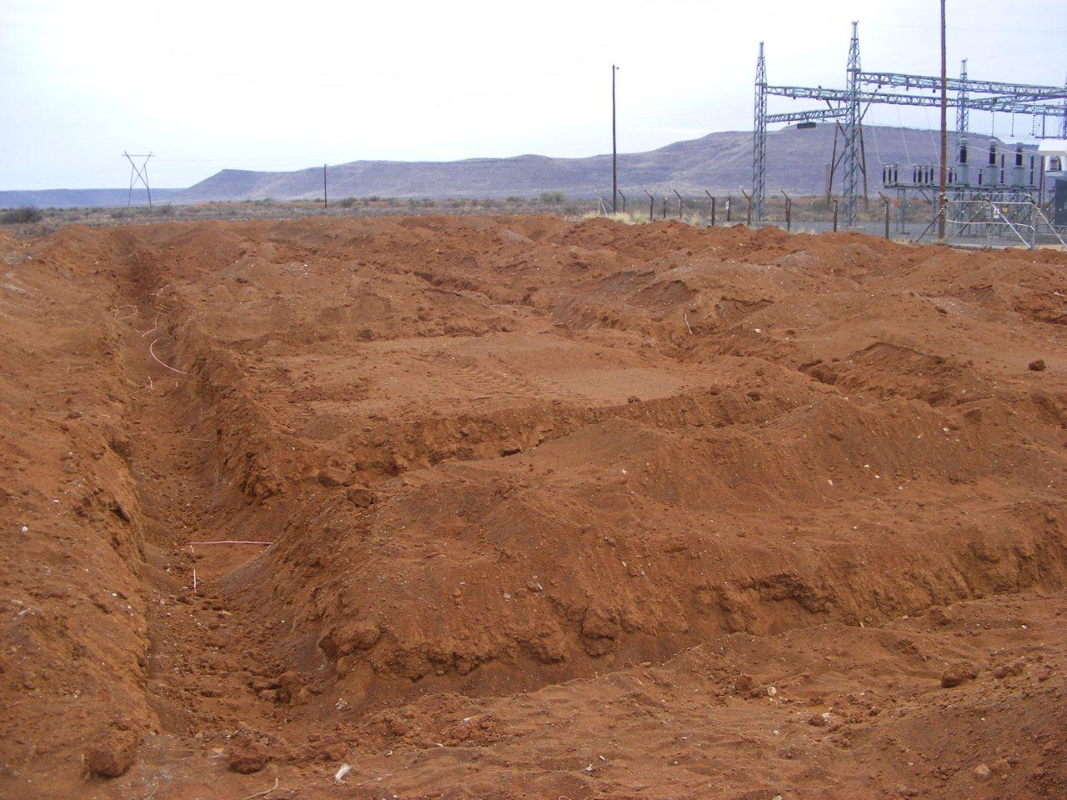
Carnarvon S/S upgrade to 10 MVA

Slide 41
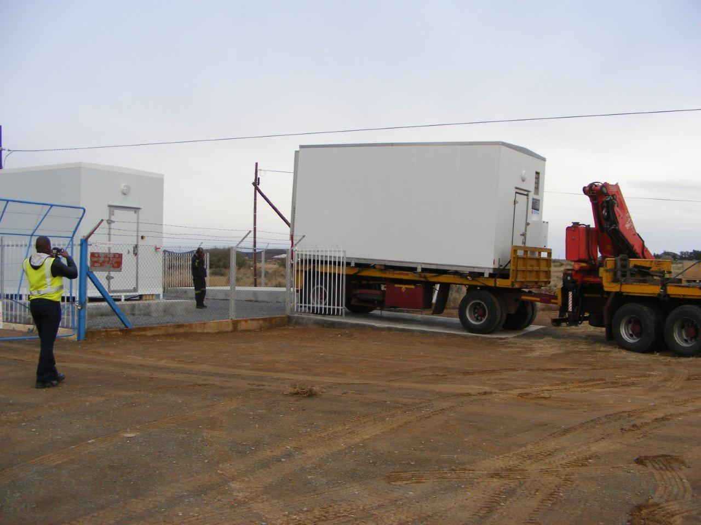
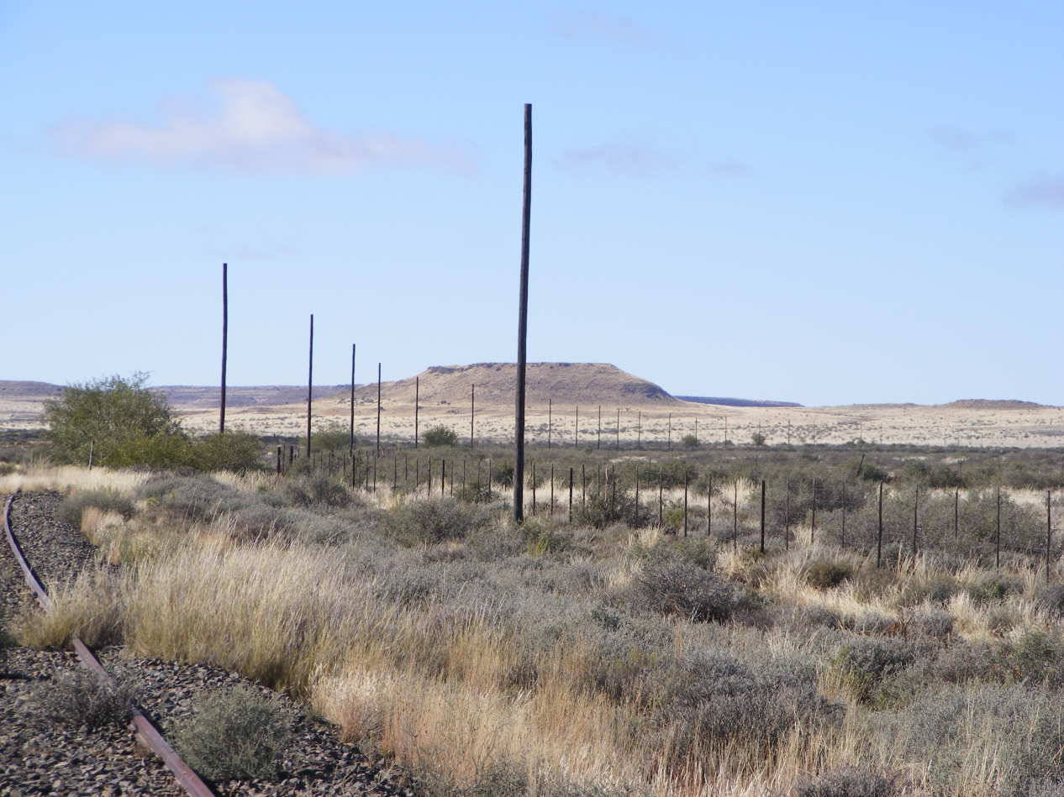
10 Gb/s to the heart of the Karoo
Broadband InfraCo container arrives at Carnarvon SKA POP Station
New overhead optical fibre cable being installed between Hutchinson and Carnarvon as part of Broadband InfraCo’s long-haul fibre network

Slide 42
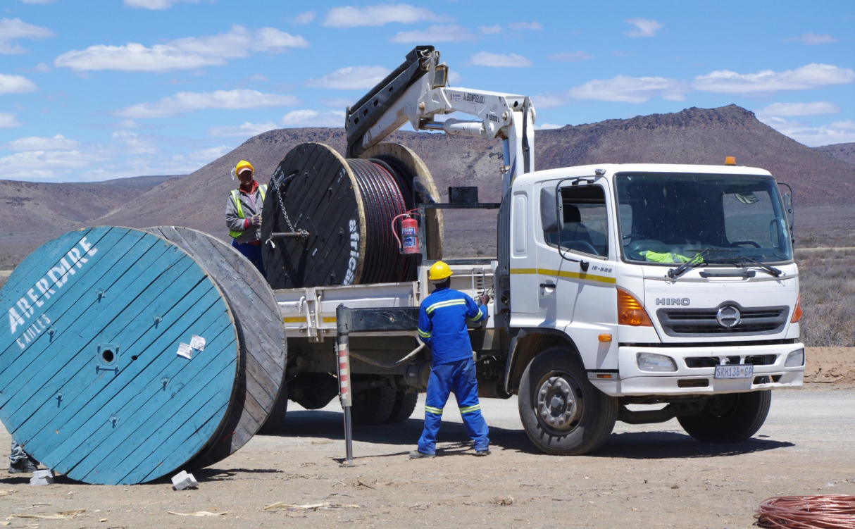
On-Site power & data reticulation

Slide 43
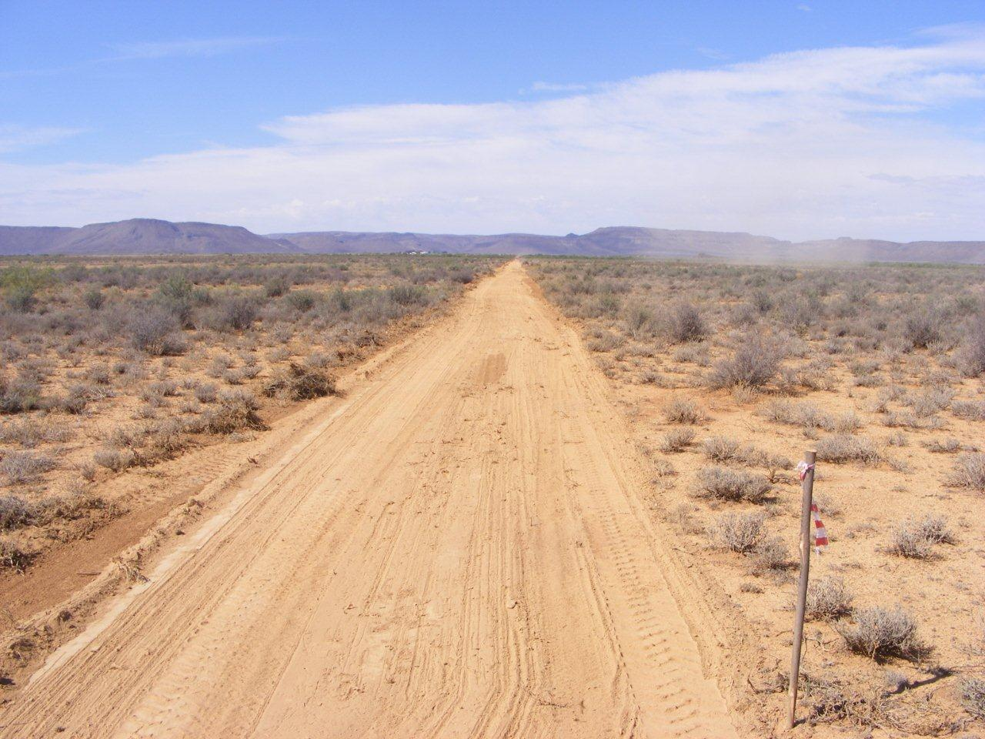
Road between antennas 33 & 57

Slide 44
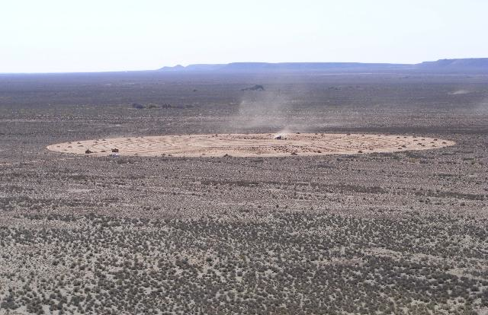
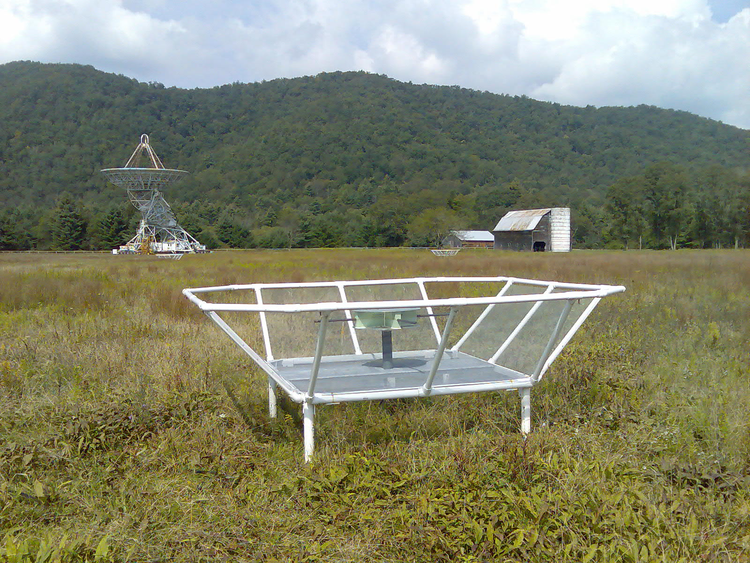
PAPER (Precision Array to Probe Epoch of Reionization)
Karoo
Galford Meadow
NRAO:Greenbank

Slide 45
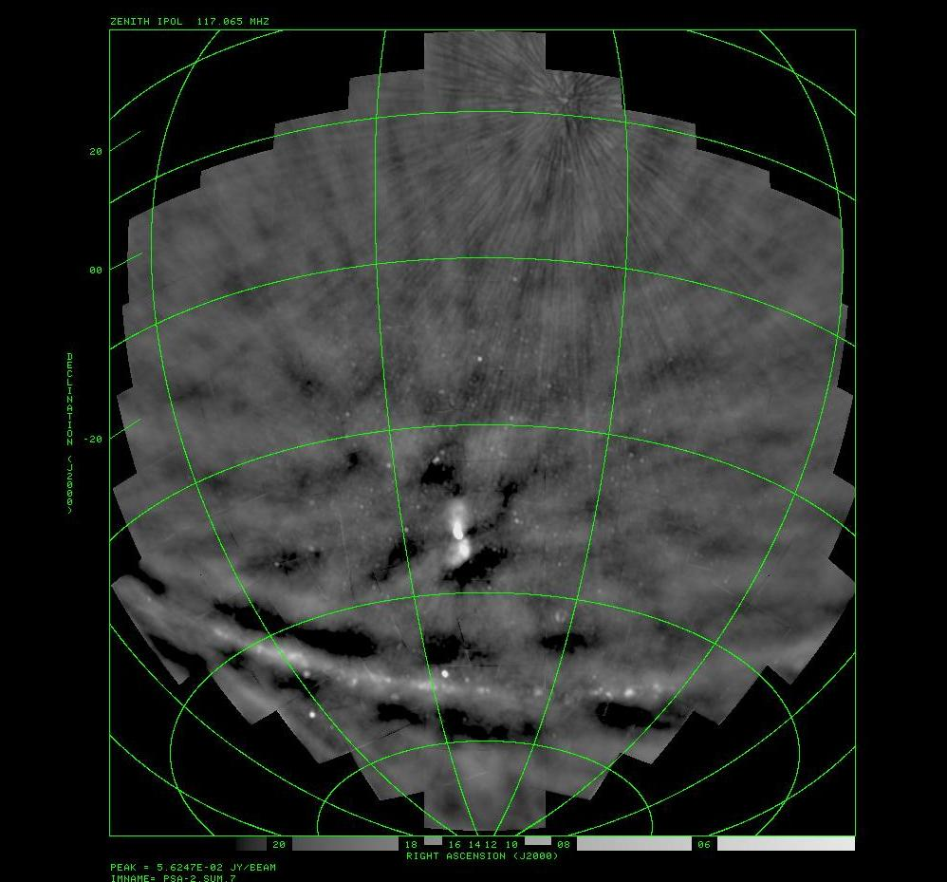
10 min – minimal RFI flagging
Image courtesy of Chris Carilli and PAPER consortium

Slide 46
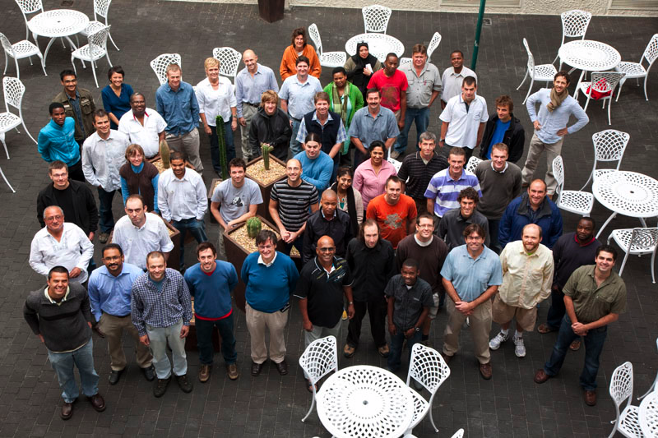
MeerKAT team (about half)

Slide 47
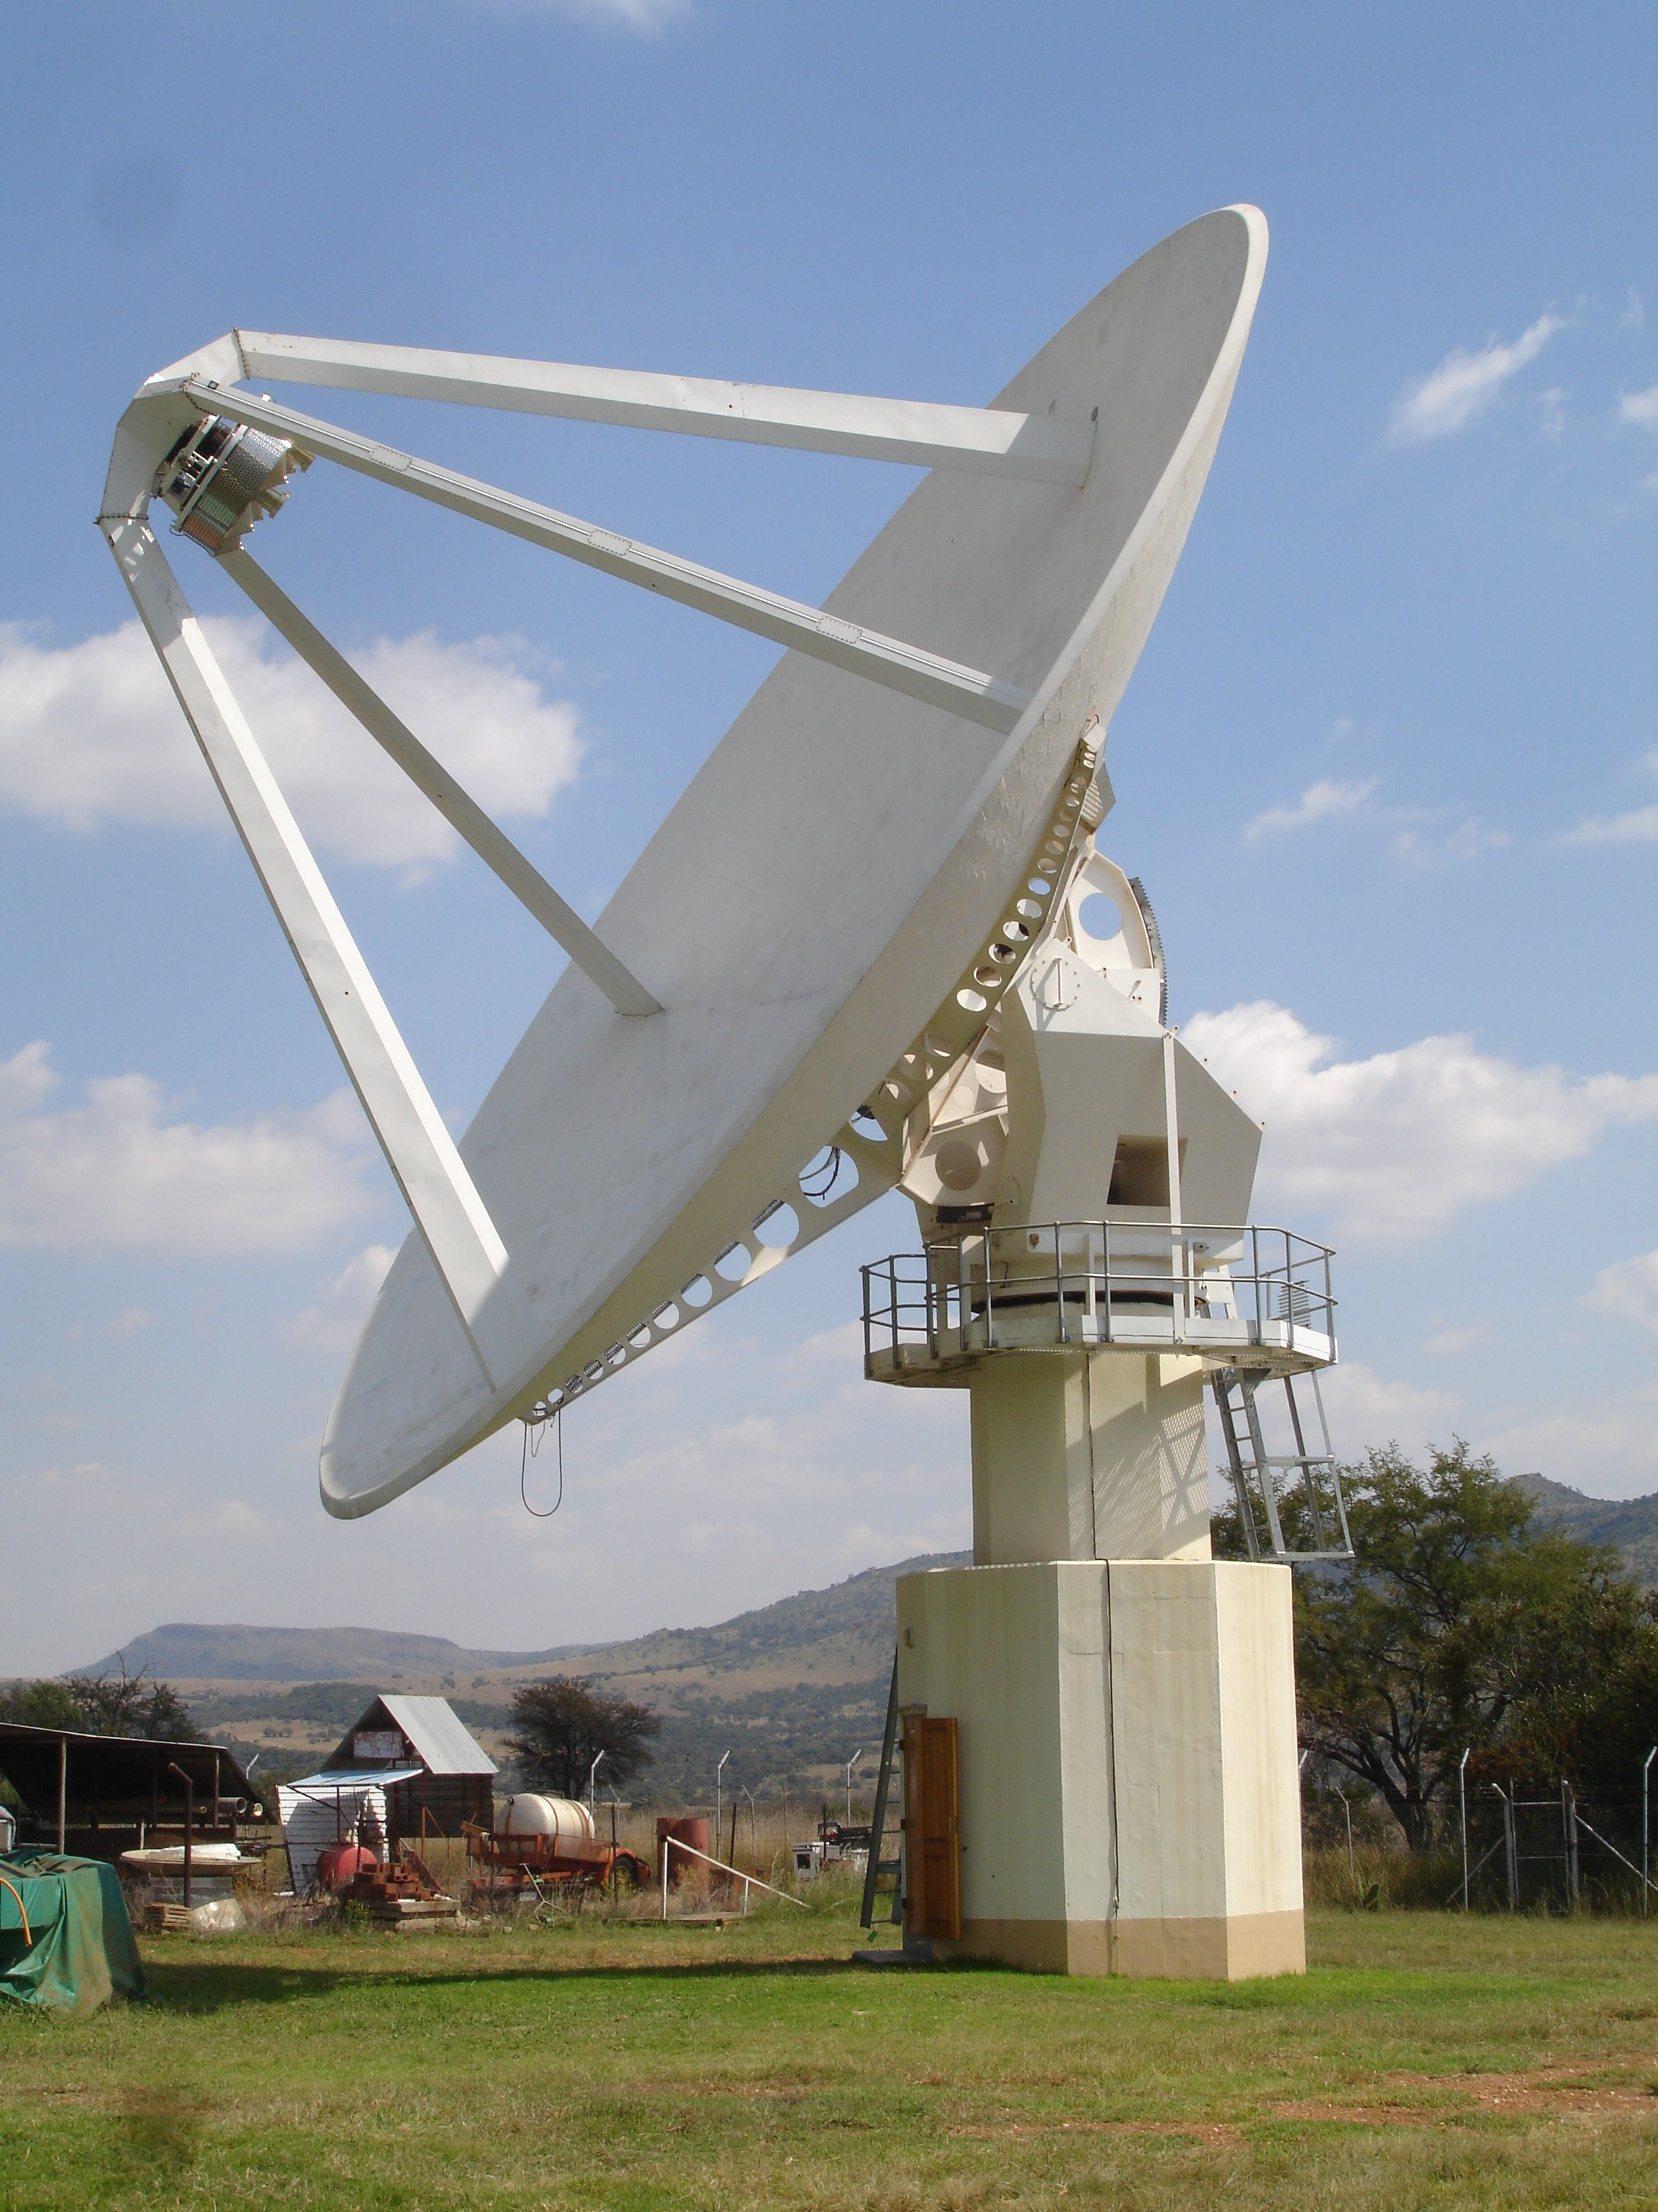
XDM 15-m
First MeerKAT prototype antenna
Composite structure
Being fitted with S/X-band receiver for (geodetic) VLBI

Slide 48
KAT-7
Array of 7 antennas
Component and system level prototyping
Build experience in science and engineering teams
Establish infrastructure in the Karoo
Engage with local industry
Produce publishable science

Slide 49
Notes:
49

Slide 50
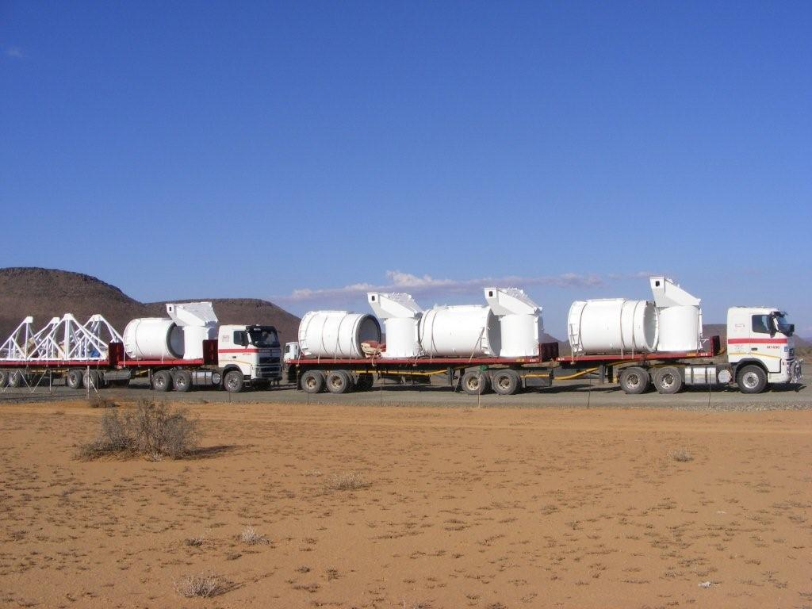
Notes:
50

Slide 51
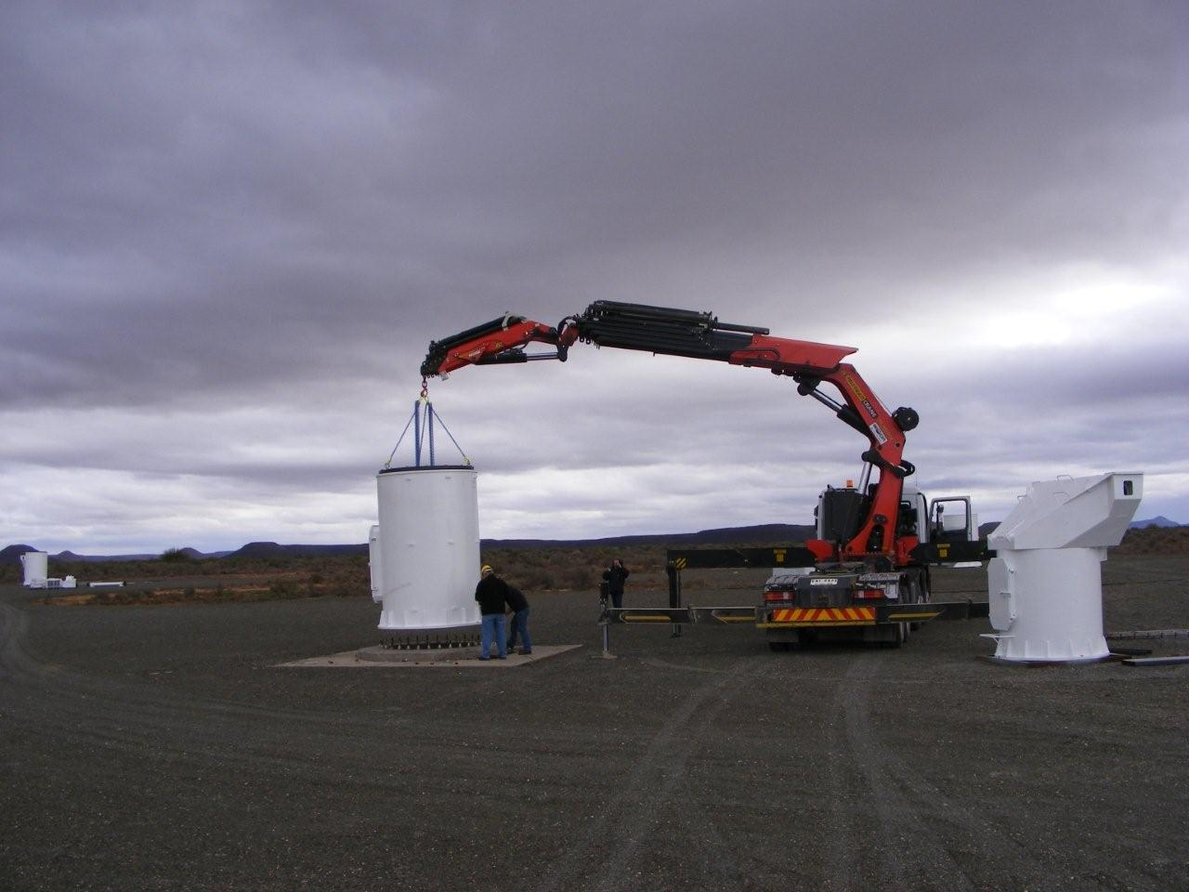
Notes:
51

Slide 52
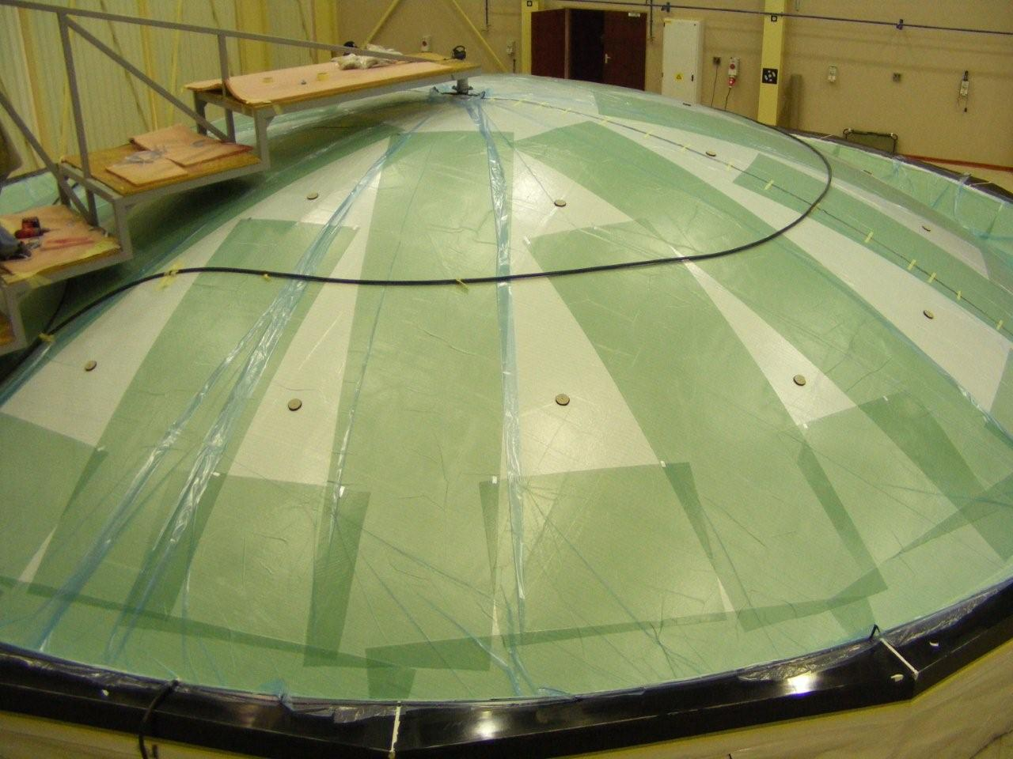
Notes:
52

Slide 53
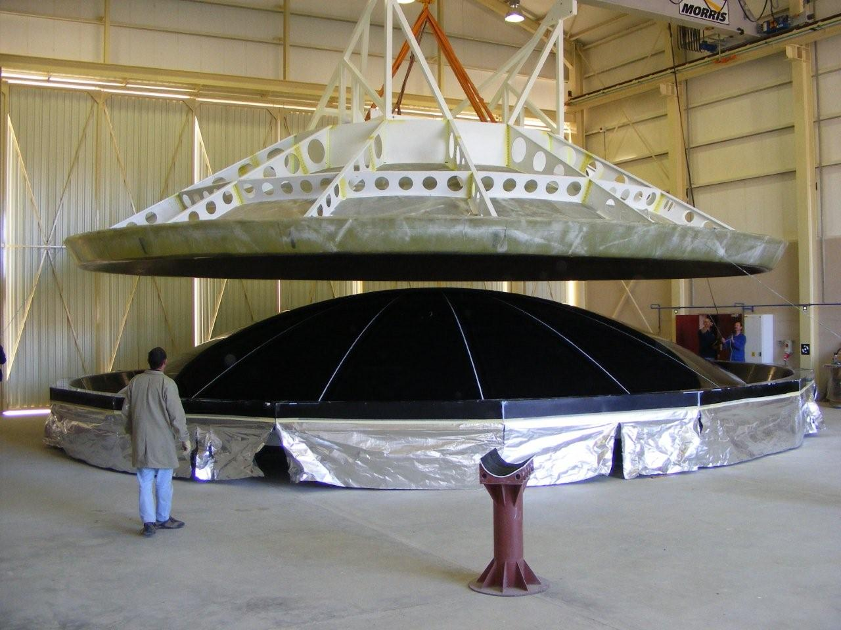
Notes:
53

Slide 54
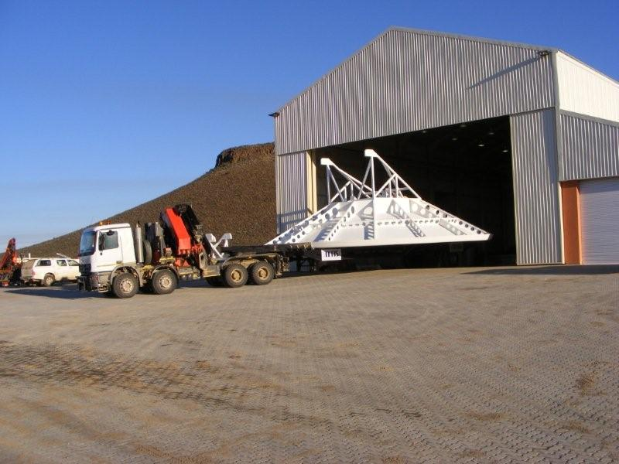
Notes:
54

Slide 55
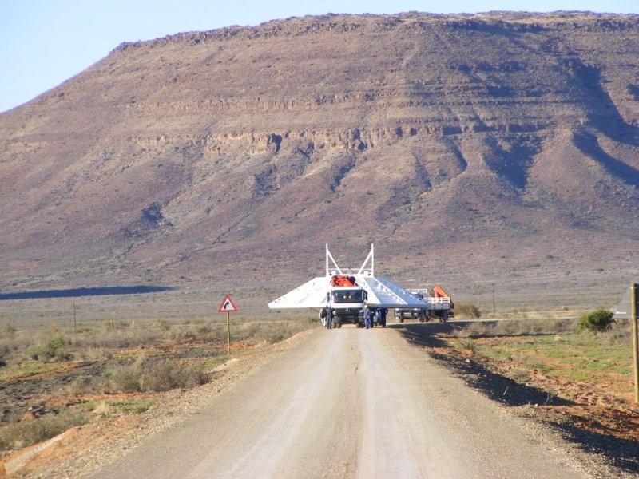

Slide 56
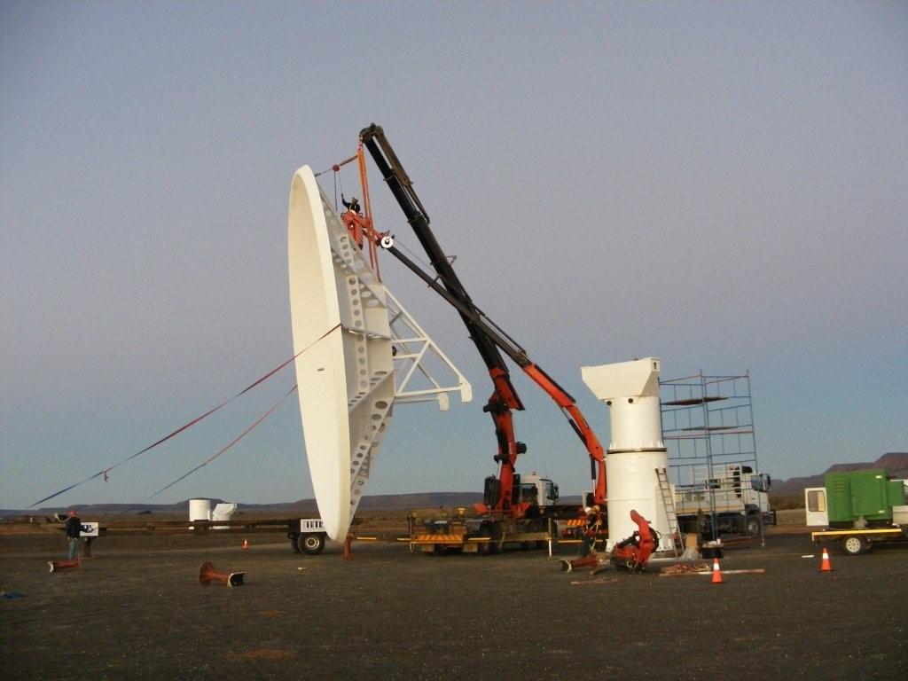

Slide 57
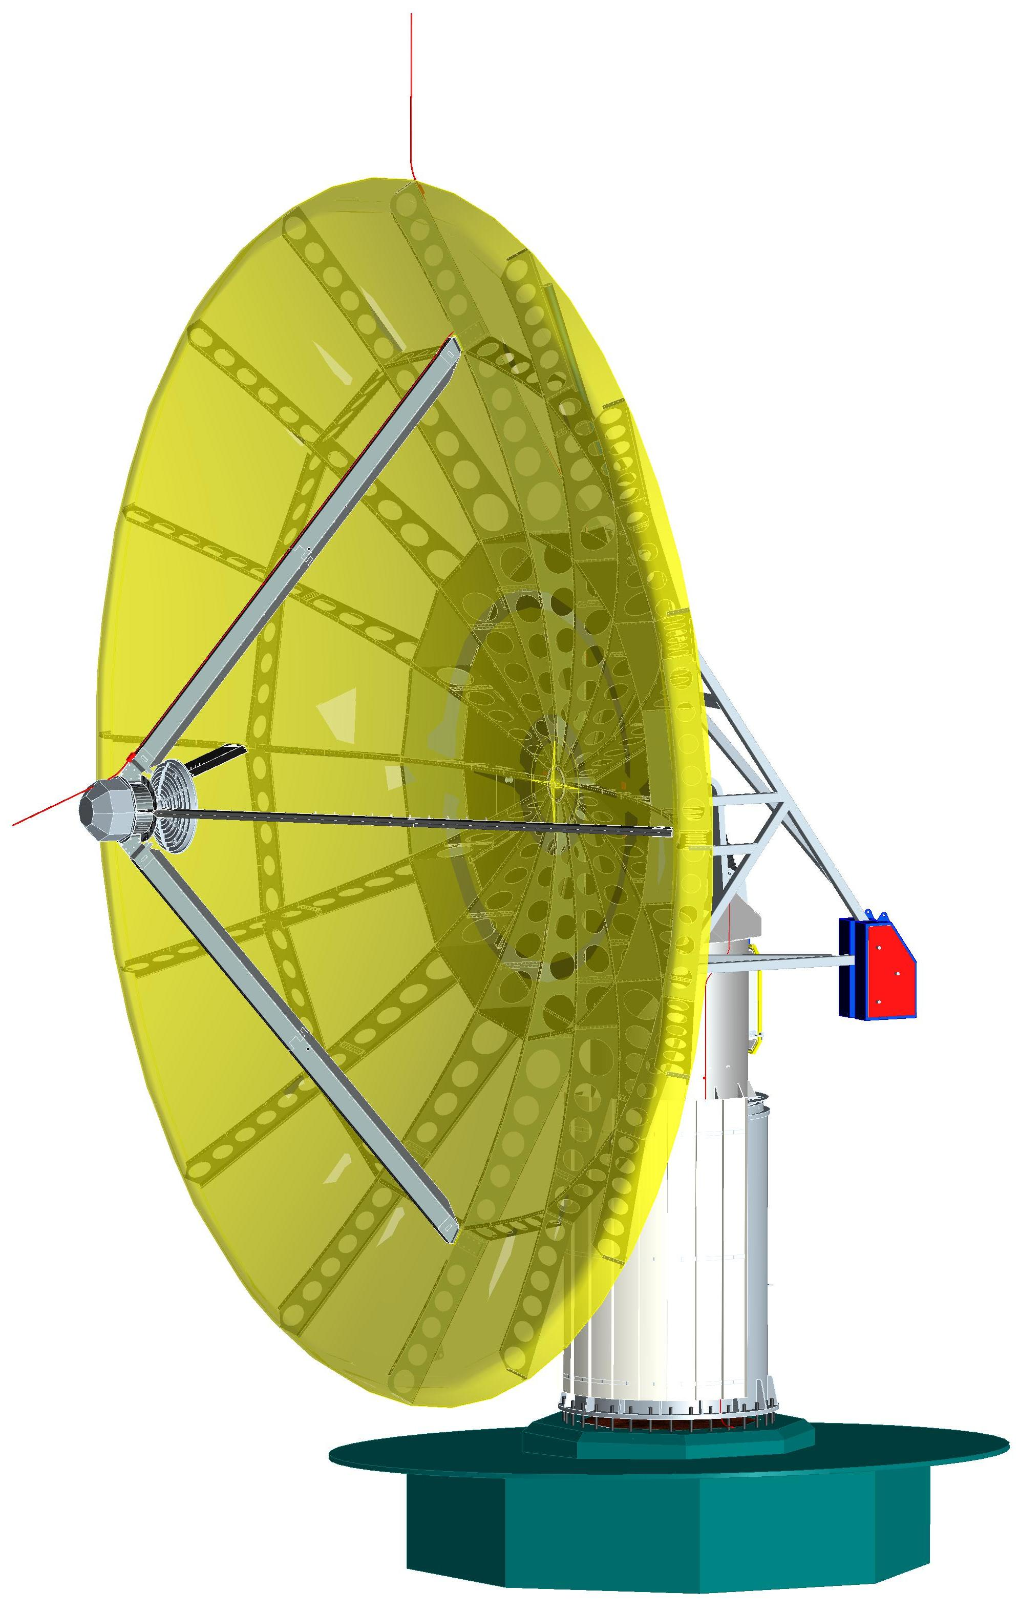
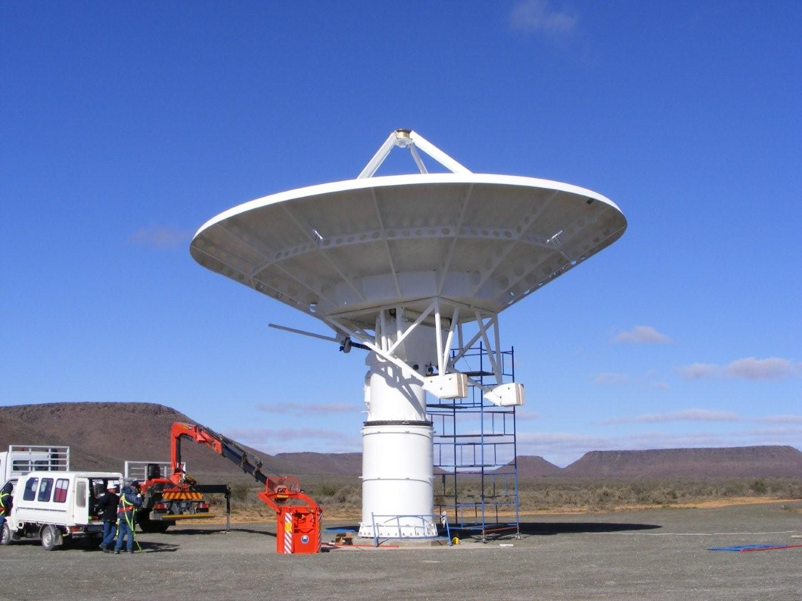
KAT-7 Dish

Slide 58
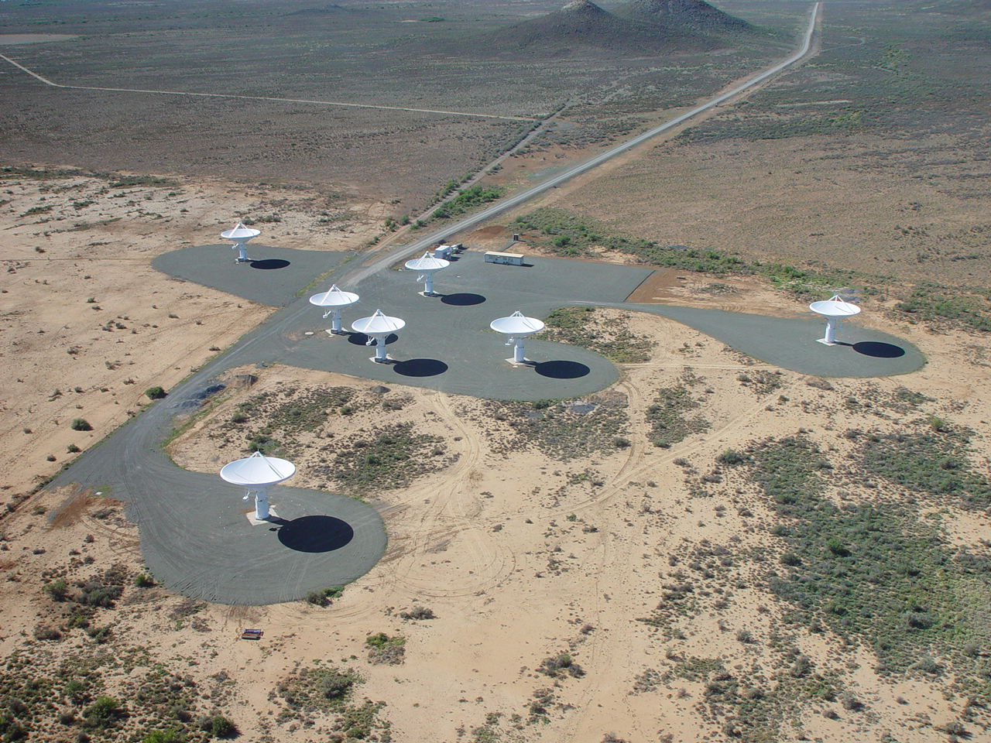
KAT-7

Slide 59
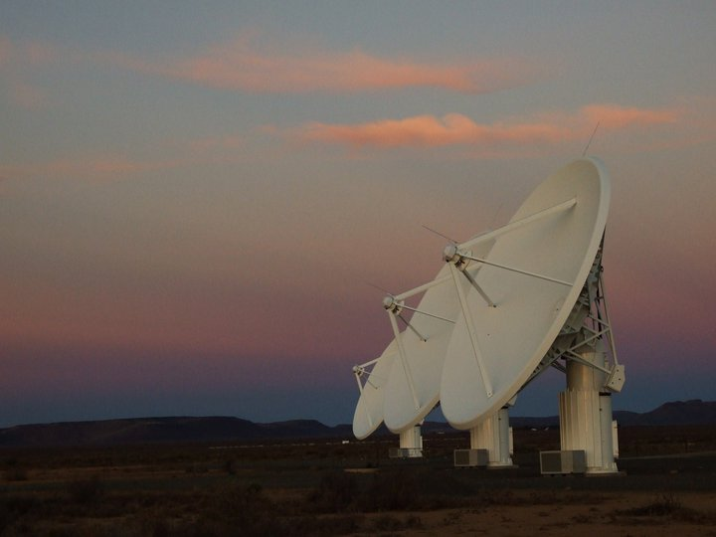
KAT-7

Slide 60
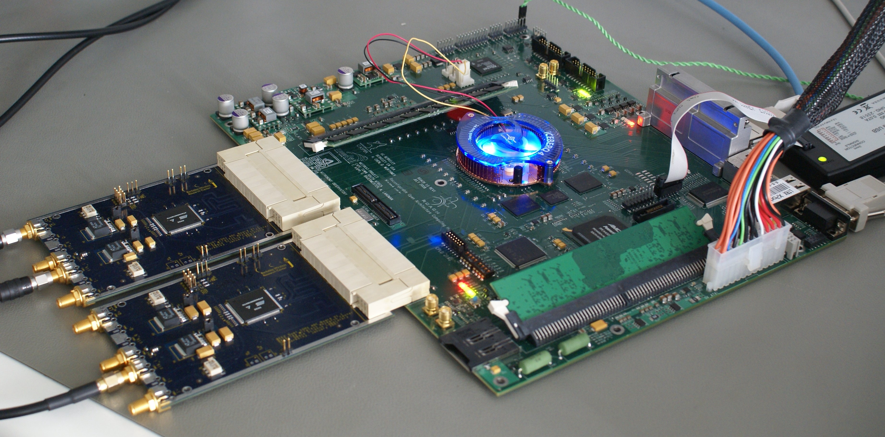
CASPER / ROACH

Slide 61
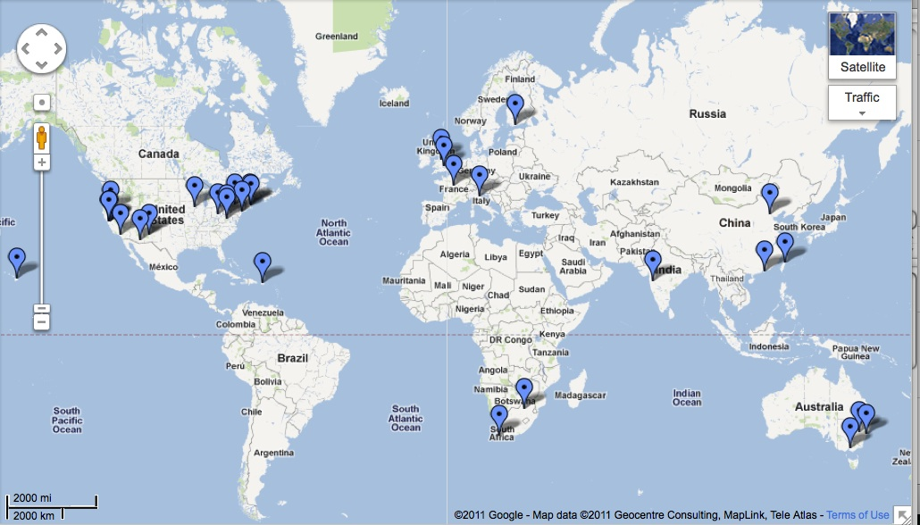
CASPER / ROACH

Slide 62
Cape Town KAT-7 Control Room

Slide 63
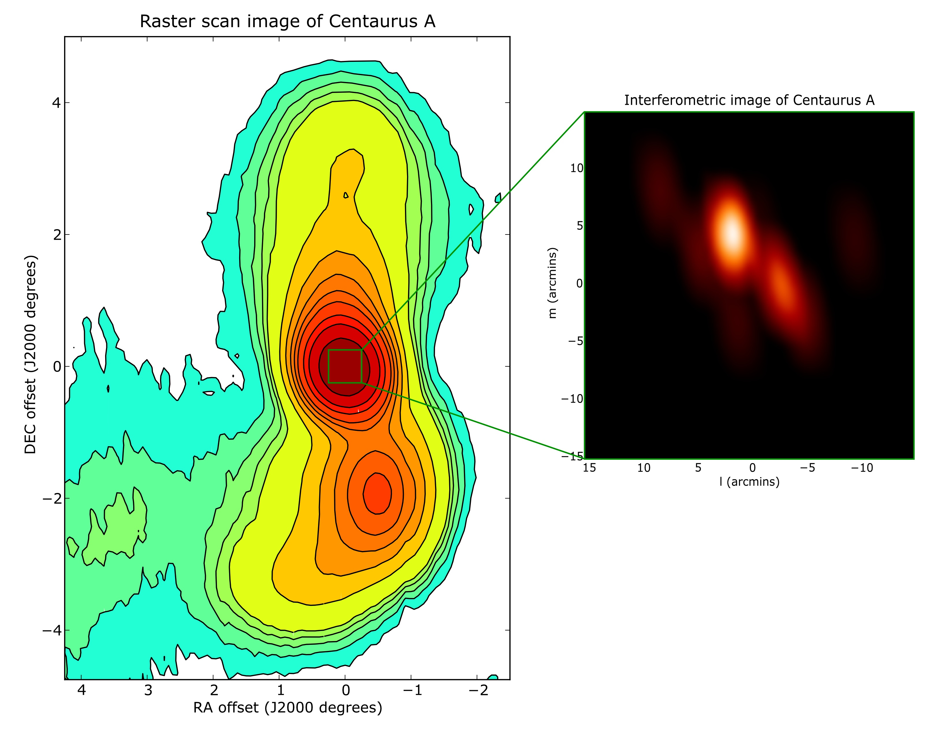
CEN A

Slide 64
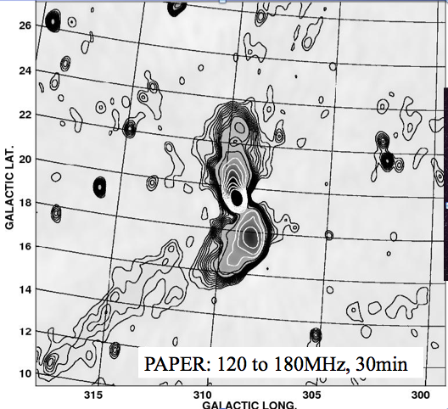
Cen A (PAPER – Carilli)

Slide 65
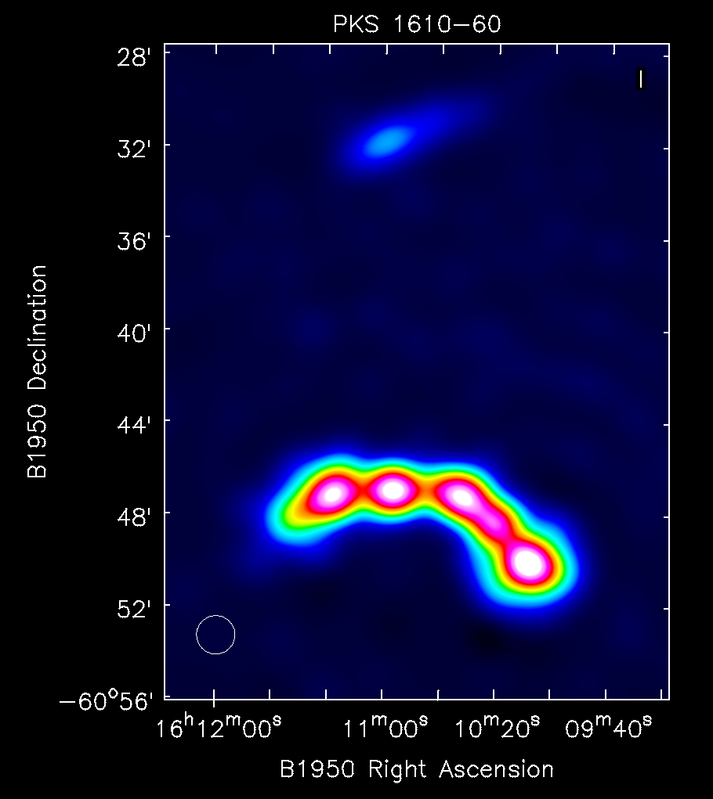
PKS 1610-60

Slide 66
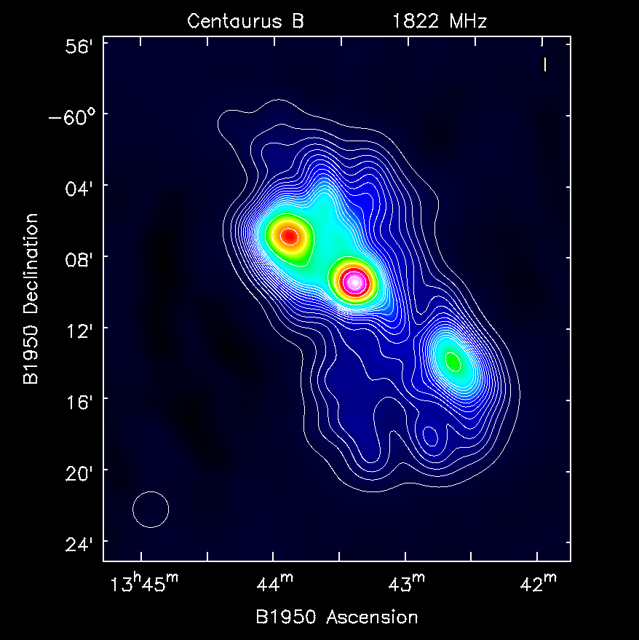
Cen B

Slide 67
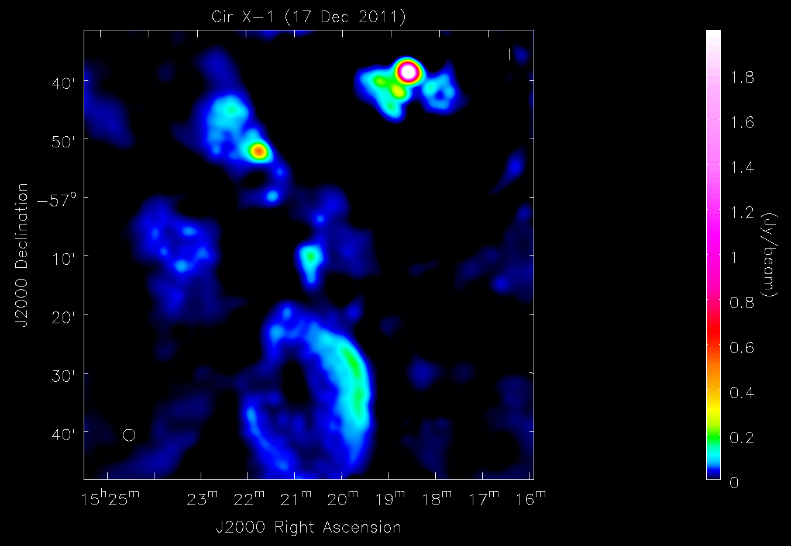
Cir X-1 - off

Slide 68
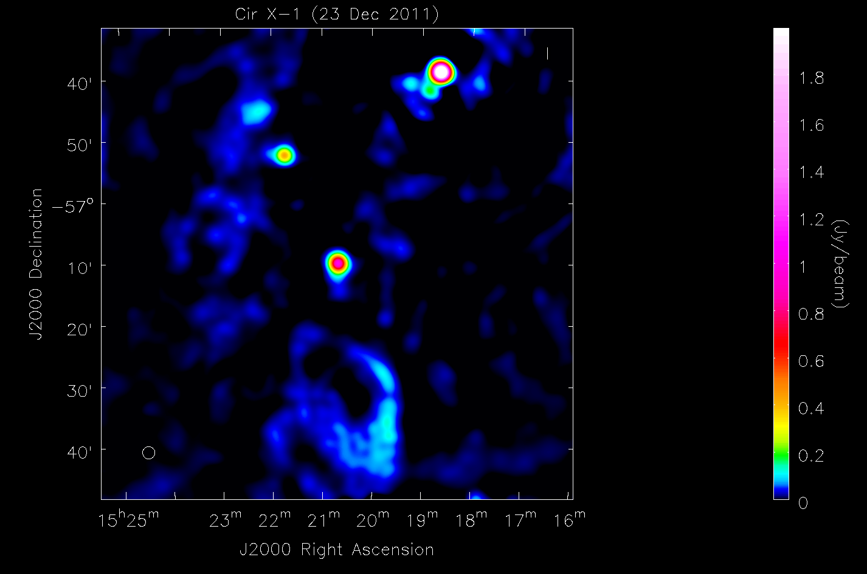
Cir X-1 - on

Slide 69
HDF-S & NVSS contours

Slide 70
NGC 3109 (HI)

Slide 71
African VLBI Network (AVN)
Need to fill in this gap

Slide 72
30-m class antennas in Africa

Slide 73
Nkutunse - Ghana

Slide 74
Nkutunse

Slide 75
EVN + Ghana

Slide 76
EVN + AVN

Slide 77
African origins
Humanity and technology originated in Africa
Intellectual and abstract thought originated in Africa
And this continues today …

Slide 78
www.ska.ac.za

