Slide 1
SKA Status Update
John Womersley
Chief Executive, Science and Technology Facilities Council
Chair, SKA Organisation Board
April 2012

Slide 2
Top level schedule and Phasing
2008-12 Preparatory Phase: system design and costing
2011 establish SKA organisation as a legal entity
2012 site selection
2012-16 detailed design & pre-construction phase
~2014 construction funding approved for Phase 1 (~350 M€, 2007)
~2016-19 Phase 1 construction
2020→ full science operations with Phase 1
~2017 construction funding approved for Phase 2 (~1.5 B€, 2007)
~2018-23 Phase 2 construction
2024→ full science operations with Phase 2
now

Slide 3
Pre-construction phase (2012-16)
Now entering a new phase, technical and political:
Needed if we are to:
Progress the SKA design to Production Readiness Review and complete preparation of related data packs
Progress infrastructure roll-out on selected site to allow sub-systems to be deployed
Prepare the policy aspects (approval, funding, governance etc) for construction 2016 +

Slide 4
2011: Several significant steps for the project
Definition of SKA1 – First phase of the SKA
Scientifically focussed 20% cost to deliver exciting sub-set of SKA science very well
Production and review of Project Execution Plan
Defines processes and work in detail
Major international review gave a very positive recommendation that the project should proceed to “Pre construction”

Slide 5
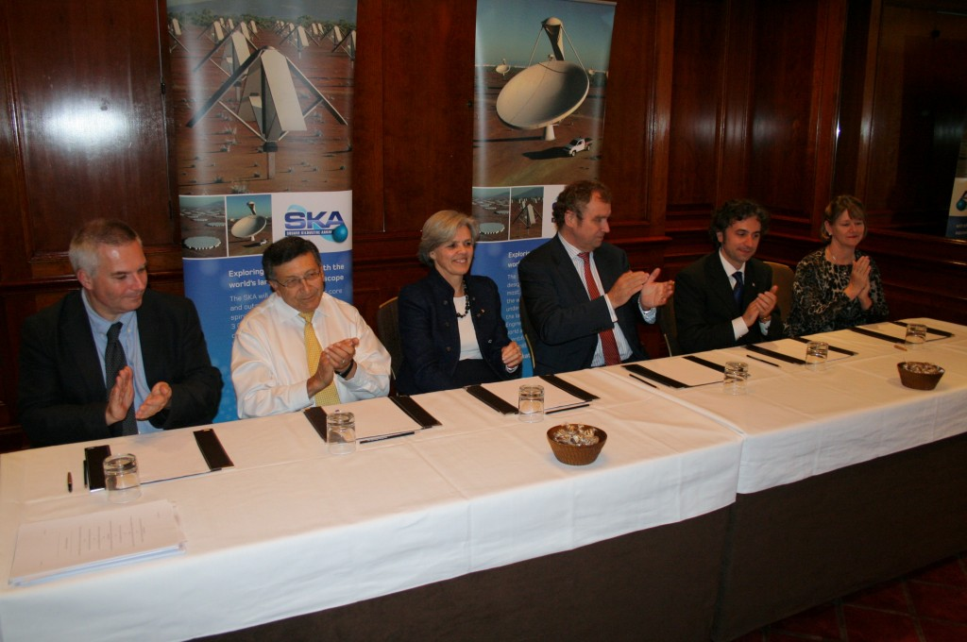
2012: Creating a New Organisation
Creation of SKA as a new legal entity
Truly independent status for the project
Letter of Intent signed in April 2011 at INAF
Legal documents signed in November at Heathrow
7 initial Members (UK, RSA, NZ, NL, IT, AU, CN)

Slide 6
The SKA organisation is a not-for-profit company under English law, limited by guarantee
Full Members (minimum €1M 2012-2016)
Associate Members
The new SKA Project Office is located at Jodrell Bank Observatory
New purpose built building, funded by University of Manchester

Slide 7
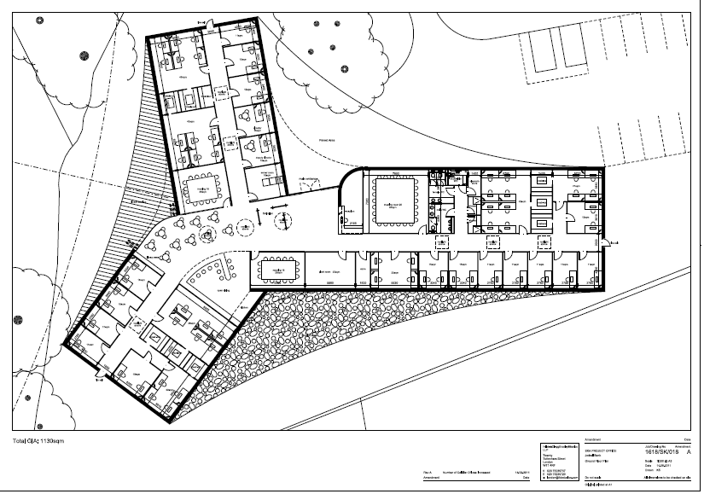
The SKA Project Office
Since 2008, the ‘SPDO’ was hosted at University of Manchester
Competitive process in 2011 resulted in UK as host of SPO in pre-construction phase
Jodrell Bank Observatory:
New building (~£3M) being constructed by UoM
To house 20 staff (Director, Engineering, Science, Support)
Up to ~60(?) by 2016

Slide 8
The SKA Organisation is growing
Canada joined as a Full Member in March
In April the Board approved Associate Membership for India, as a precursor to expected full membership later this year
Good progress in Sweden (Onsala observatory)
Positive discussions underway with others

Slide 9
Current Board activities
Site selection
Staffing the SPO and transition from SPDO to SPO
Policies for the new organisation
SKA Director and Interim Director searches
Implementation of the new building at JBO
Next board meeting in May

Slide 10
Resourcing for 2012-16
Business Plan was developed on the following profile (based on Founding Board discussions and national statements):

Slide 11
Potential resourcing including Associate Members discussions

Slide 12
Aims of the SKA Organisation – from the business plan
Progress the SKA design and prototyping through the pre-construction phase to the point that production readiness reviews have been successfully completed and related data packs prepared ;
Establish industry participation strategies, procurement processes, and the protocols governing the selection of work package consortia, ready for use in accordance with the PEP timeline;
Work towards identifying funding commitments for SKA Phase 1 (SKA1) construction and operations on a timescale commensurate with the planned start of construction;
Prepare the long term SKA organisational structure and arrangements for the construction, verification and operation of the SKA;
Build relationships with relevant national and international astronomy organisations to leverage skills and ensure SKA 1 science and opportunities are fully integrated into a global astronomy perspective.

Slide 13
Work Packages
Currently undertaking conceptual design reviews for all sub-systems
WP organisation and resourcing:
Cash
(Common Fund)
Local resourcing
(In country)

Slide 14
Current Status
Now in Stage 1 of the Pre-construction phase
January 2012 – March 2013
Up to System Requirements Review (SRR)
Followed by Stage 2
April 2013 – December 2015
Includes PDR, CDR
and subsequently PRR and Phase 1 construction

Slide 15
Telescope Site Selection
Two candidate sites were short-listed in 2006:
Australia + NZ
Southern Africa
Selection Process and timeline was agreed in 2011
Site Selection Advisory Committee appointed
2010
2011
2012
Site characterisation
Decision
selection criteria
info acquisition & analysis
evaluation

Slide 16
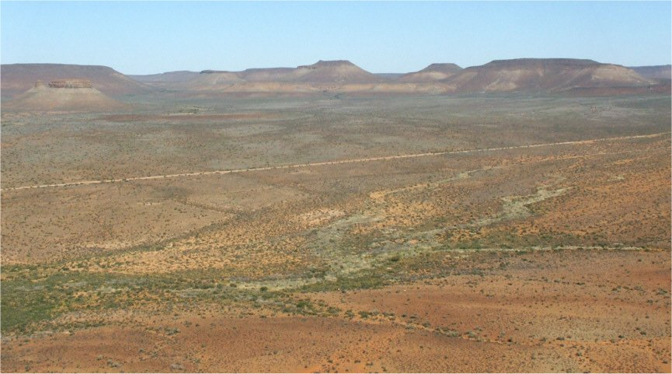

Slide 17
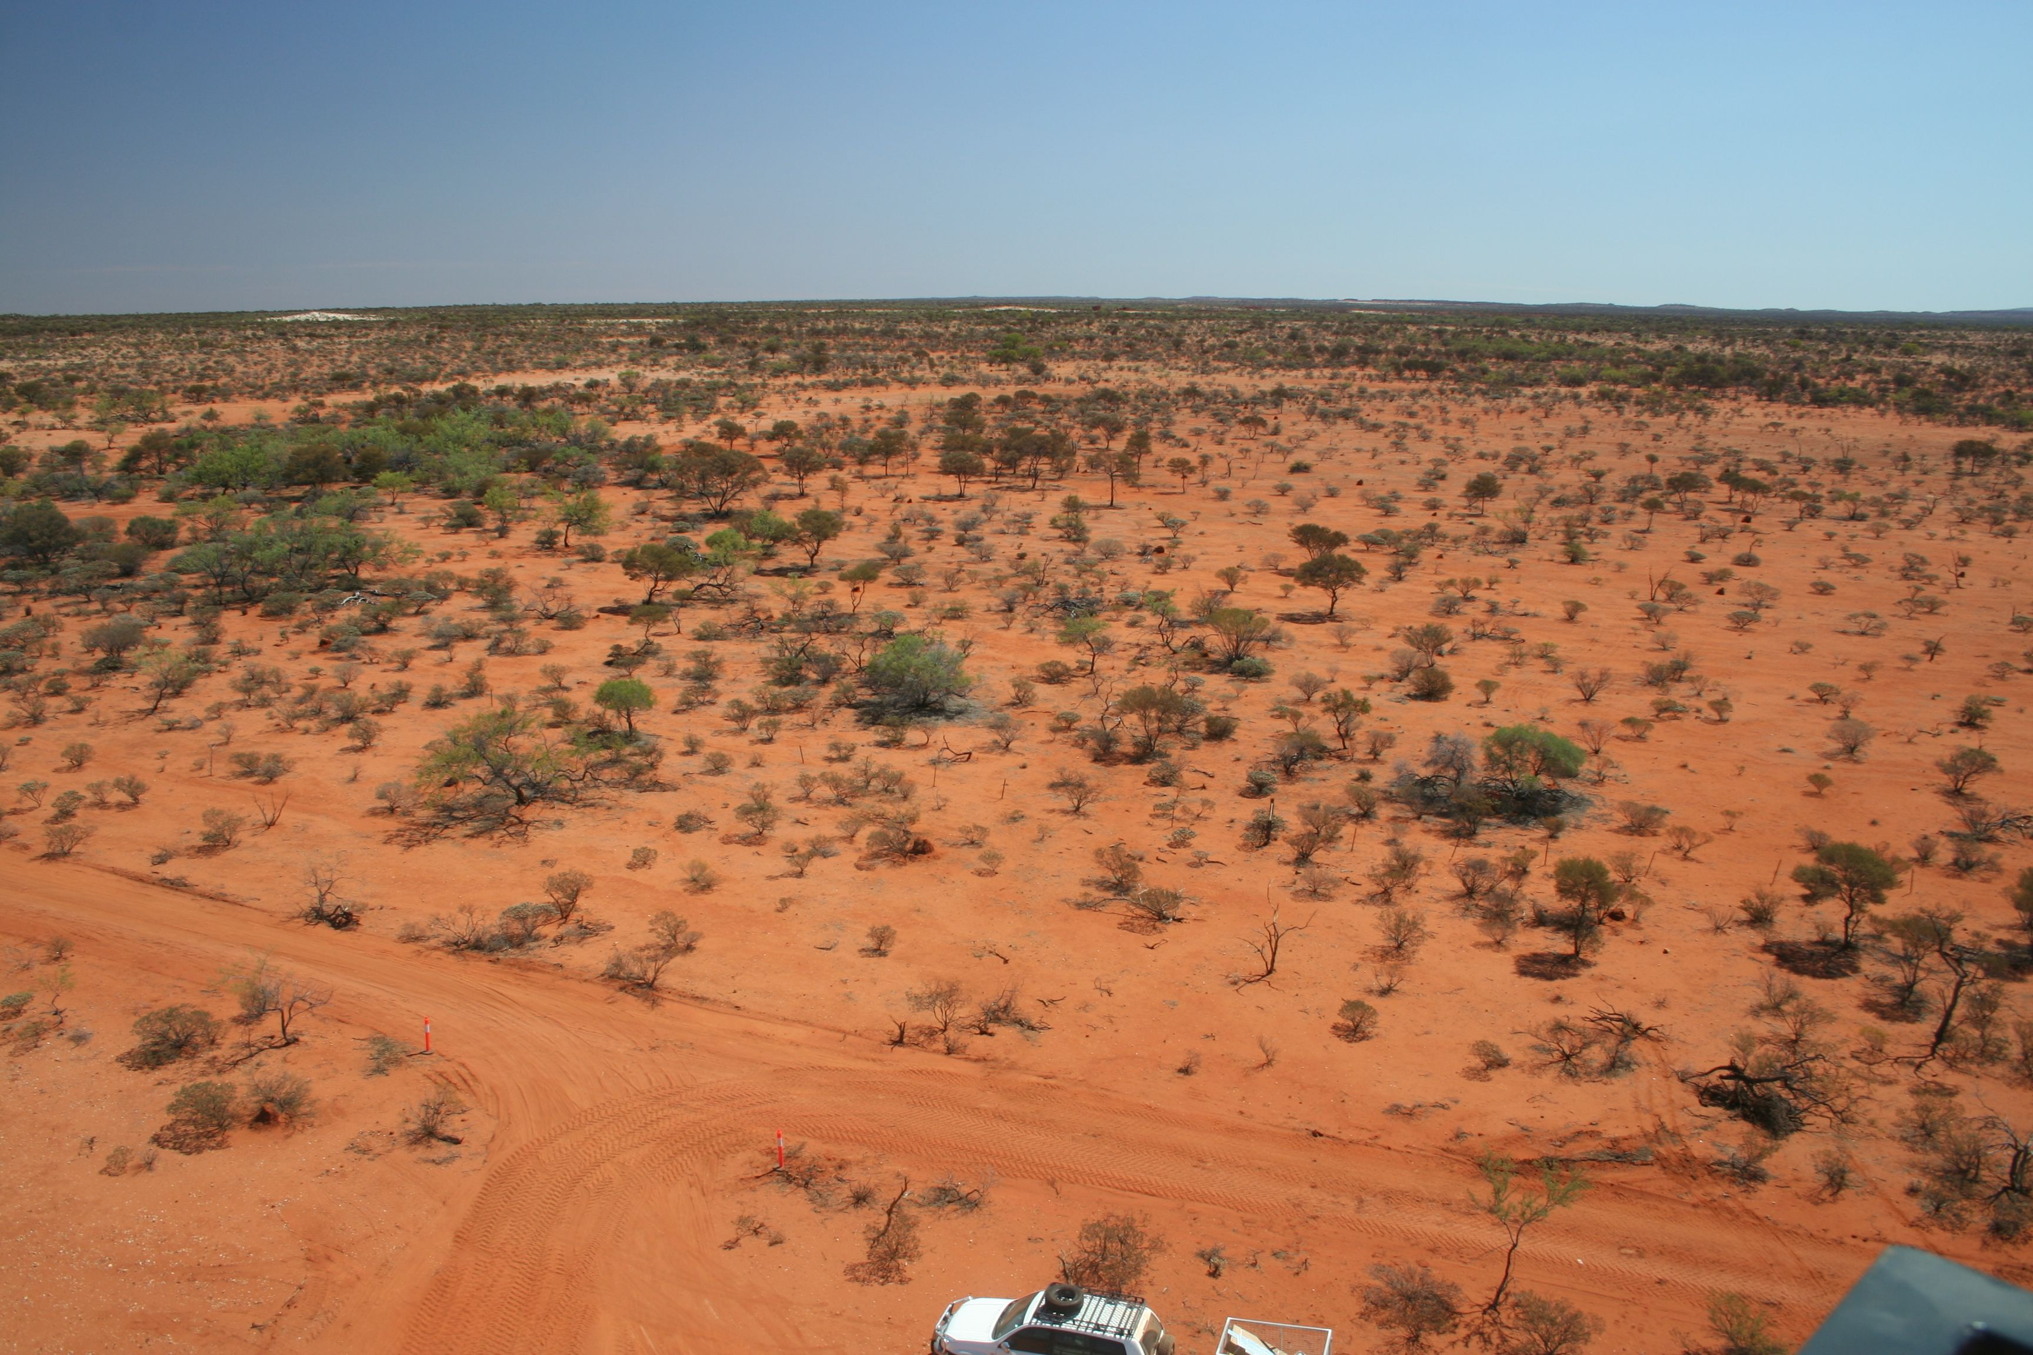

Slide 18
Selection Criteria
Science & technical
Current and long-term RFI environment
Ionospheric scintillation
Tropospheric turbulence
Array science performance
Site physical characteristics
Other
Customs and excise
Security
Legal
Employment
Working and Support Conditions
Political, Socio-economic and Financial Situations

Slide 19
Site Selection Process
Site selection process moving forward
SSAC report presented to Board in Manchester
Board then passed the report on to the Members (shareholders) of the organisation, together with a commentary
The Members met at Schiphol on April 4
Agreed to establish a science based working group to look at options
Will report back to the Members in May

Slide 20
Conclusions
The SKA is entering a new era:
With increasing momentum
With a new organisational framework
With firm commitments from the partner nations
With a clear plan for the next phase
With a new home at Jodrell Bank
We are on track to build one of the world’s most exciting and transformative science projects!

Slide 21
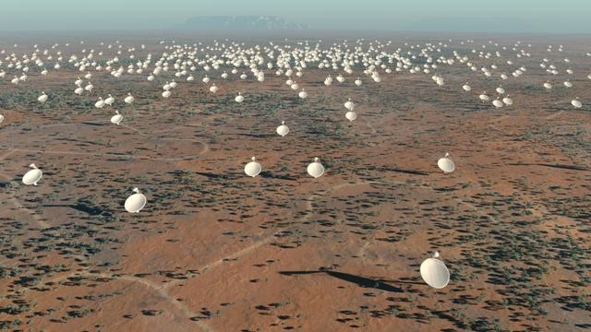
Thank you

Slide 22
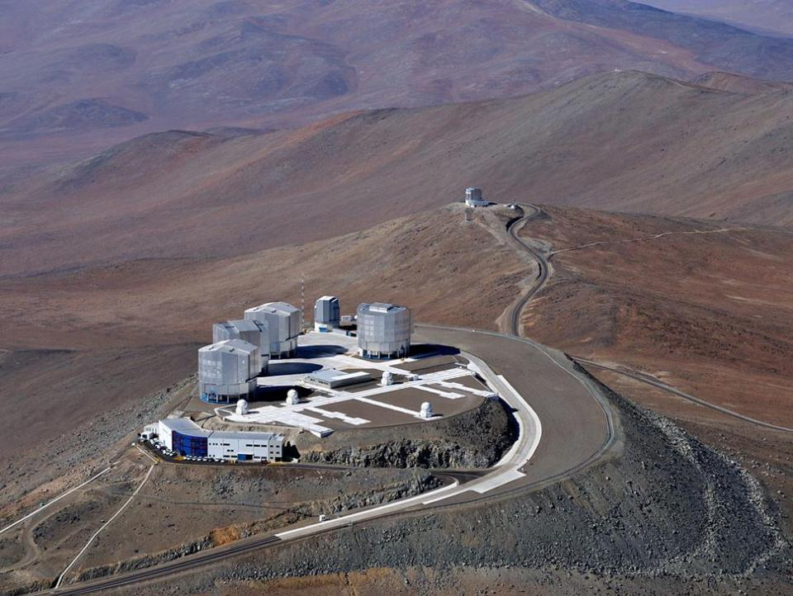
European Astronomy Journalism Prize
Entry: students, astronomers and journalists
Prize: a trip to the Very Large Telescope in Chile
Closing date: 27 July 2012
Full details: www.stfc.ac.uk/astroprize/

