Slide 1
The History of the Square Kilometre Array born global
Ron Ekers
CSIRO
Resolving the Sky - Radio Interferometry:
Past, Present and Future
Manchester 17- April 2012

Slide 2
Summary
Pre 1990 roots
1990: the vision and the challenges,
VLA 10th anniversary meeting
A very brief history……
2002: Richard Schilizzi becomes the first project director
Evolution of the Science
Evolution of the Technology
What have we learned

Slide 3
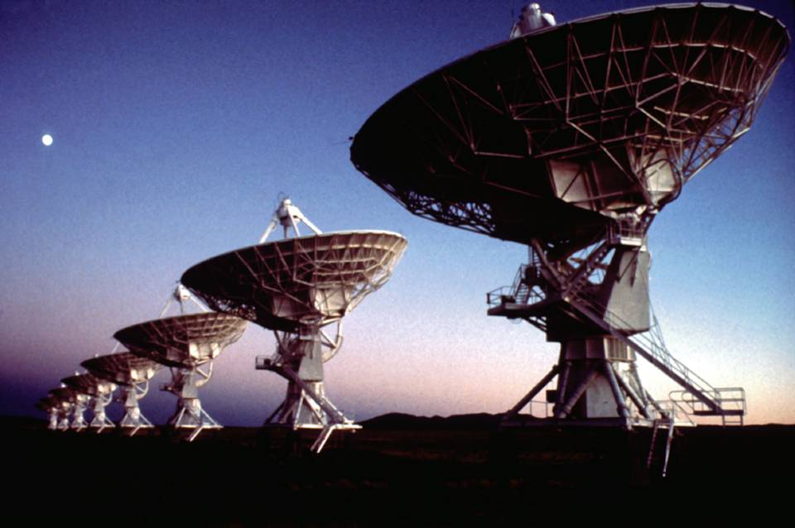
VLA New Mexico
1980

Slide 4
Pre 1990
1986-9 Canadian proposal for Radio Schmidt
Peter Dewdney 100x12m antennas
1989 Penticton Radio Schmidt Workshop
1988-1990 Dutch extragalactic HI telescope
Robert Braun, Ger DeBrujn and Jan Noordam
1988-1991 Swarup proposals
International Radio Astronomy telescope (ITRA)
160 75m dishes, centrally concentrated and baselines to 200km
1990 URSI General Lecture Prague
exponential growth and discovery arguments

Slide 5
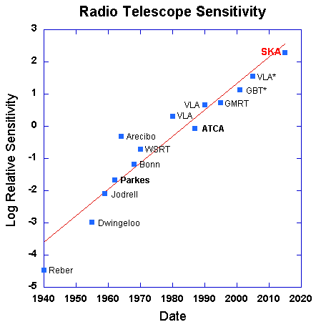
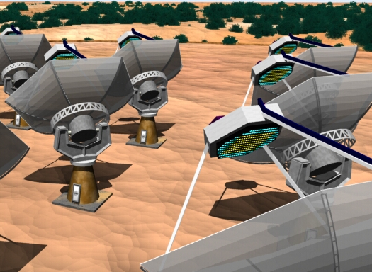
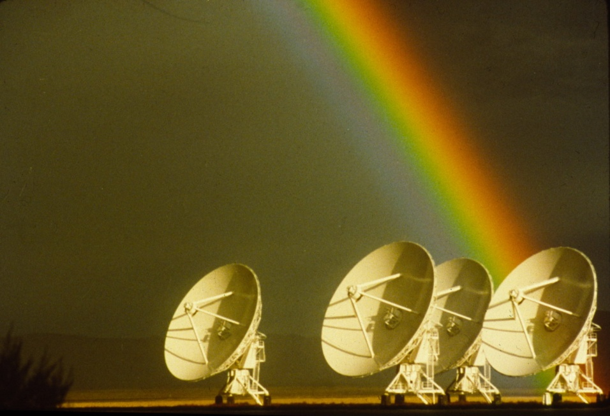
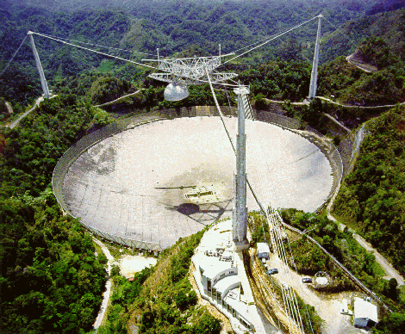
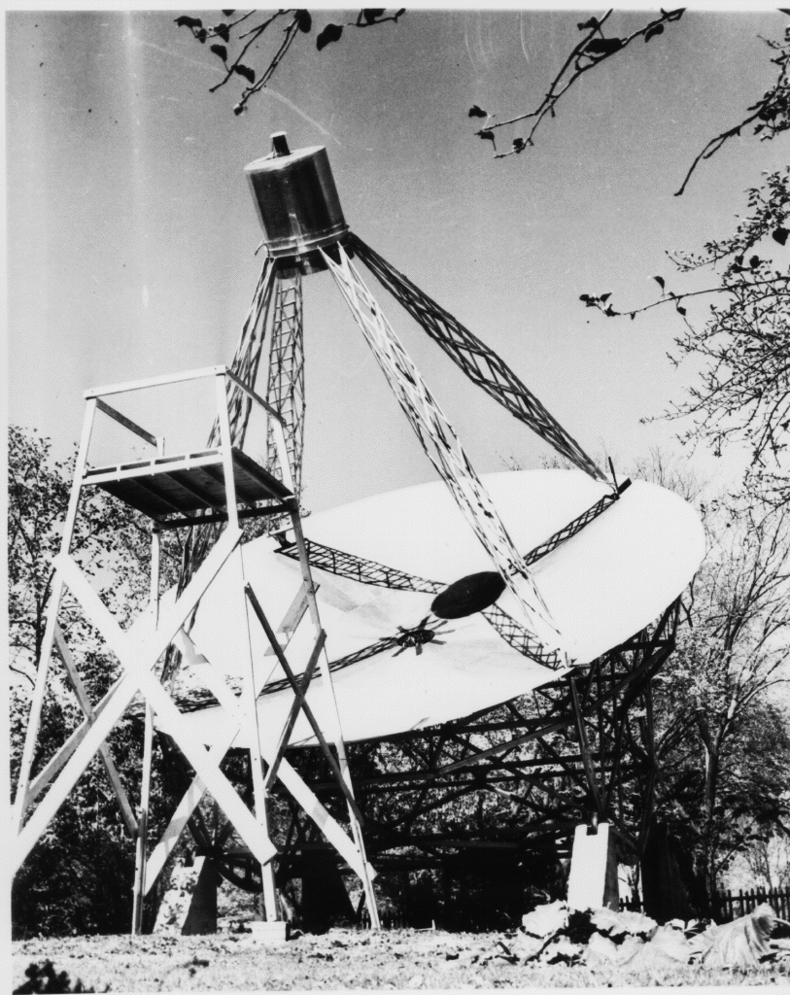
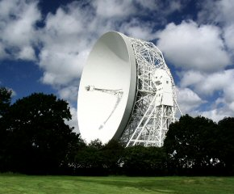
Radio Telescope Sensitivity

Slide 6
VLA 10th anniversary 8 Oct 1990
IAU colloq 131, Albuquerque, NM
Jan Noordam tells Peter Wilkinson about the NFRA large HI telescope
Peter Wilkinson includes the case for 1sqkm collecting area for extragalactic HI in his talk
The Hydrogen Array
Pariski talk on the need to maintain exponential growth and to beat the RFI threat
need a 1sqkm telescope by 2000.

Slide 7
Achieving the vision International Collaboration
To build facilities which no single nation can afford
Broader knowledge base, cross fertilisation
High impact showpiece for science and technology from collaborating countries
international benchmarking
Coordination of international activity
Avoiding wasteful competition
Open Sky Policy
Best science return for investment
Funding should be based on investment opportunity not access

Slide 8
Born Global
From the beginning SKA was conceived as an international project
The scientists and engineers involved were accustomed to working together
A shared radio Astronomy culture
Open Sky policy
Links were made to existing International organizations
IAU, URSI, OECD, EU

Slide 9
Brief history of the SKA
1988 Independent suggestions for a Large Radio Telescope
1990 10th anniversary of VLA – the visions merge
1993 URSI GA Kyoto resolution
1994 IAU forms a Large Telescope WG
1996 OECD Global Science Forum activities start
1998 “SKA” name adopted (1kT, SKAI, …
2000 International MOU signed
2001 Logo competition
2008 SPDO formed
2009 Agencies SKA Group formed (ASG)

Slide 10
Brief history of the SKA
1988 Independent suggestions for a Large Radio Telescope
1990 10th anniversary of VLA – the visions merge
1993 URSI GA Kyoto resolution
1994 IAU forms a Large Telescope WG
1996 OECD Global Science Forum activities start
1998 “SKA” name adopted (1kT, SKAI, …
2000 International MOU signed
2001 Logo competition
2008 SPDO formed
2009 Agencies SKA Group formed (ASG)

Slide 11
Union Radio Science International Sep 1993 – Born Global
Large Telescope Working Group
URSI Commission J,
Considering,
The strong scientific case for a new, internationally accessible radio telescope with one or two orders of magnitude greater sensitivity than that of any existing or planned facility;
The need for innovative technical developments to realize such a facility at an affordable price;
The likely need for international collaboration to allow realization of this facility,
resolves to appoint a Working Group with the following terms of reference:
to explore the range of scientific problems to be addressed by the instrument.
to discuss the technical specifications and general design considerations needed to maximize the scientific return of such a facility.
to identify and, in so far as possible, resolve the major technical challenges to realization of an affordable radio telescope with the required sensitivity.
strong scientific case
internationally accessible
innovative technology
international collaboration

Slide 12
URSI LTWG Members
Ron Ekers (ATNF, Australia)
Lloyd Higgs (DRAO, Canada)
Wu Shengyin (Beijing Obs, China)
Wolfgang Reich (MPIfR, Germany)
Govind Swarup (TIFR, India)
Yuri Parijski (SAO, Russia)
Peter Wilkinson (NFRA, UK)
Dick Thompson (NRAO, USA)
Robert Braun (NFRA, Netherlands)

Slide 13
SKA timeline (brief)
1988 Independent suggestions for a Large Radio Telescope
1990 10th anniversary of VLA – the visions merge
1993 URSI GA Kyoto resolution
1994 IAU forms a Large Telescope WG
1996 OECD Global Science Forum activities start
1998 “SKA” name adopted (1kT, SKAI, …
2000 International MOU signed
2001 Logo competition
2008 SPDO formed
2009 Agencies SKA Group formed (ASG)

Slide 14
OECD Global Science Forum
1996 Mega Science Forum
Looked at big science models
1998 Task Force on Radio Astronomy
Astronomers
Regulators
Satellite Communications Industry
International protection from Satellite communications
2003 GSF on Astronomy
Global collaboration on funding processes - failed

Slide 15
SKA timeline (brief)
1988 Independent suggestions for a Large Radio Telescope
1990 10th anniversary of VLA – the visions merge
1993 URSI GA Kyoto resolution
1994 IAU forms a Large Telescope WG
1996 OECD Global Science Forum activities start
1998 “SKA” name adopted (1kT, SKAI, …
2000 International MOU signed
2001 Logo competition
2008 SPDO formed
2009 Agencies SKA Group formed (ASG)

Slide 16
SKA gets a name 1998 – e-mail vote
KARST
SLA
VLRT
SKAI
SKY
NGAT
SKIRT
SKA
Argo
1kT
OSKAR
NGRO

Slide 17
SKA timeline (brief)
1988 Independent suggestions for a Large Radio Telescope
1990 10th anniversary of VLA – the visions merge
1993 URSI GA Kyoto resolution
1994 IAU forms a Large Telescope WG
1996 OECD Global Science Forum activities start
1998 “SKA” name adopted (1kT, SKAI, …
2000 International MOU signed
2001 Logo competition
2005 EC funding starts
2009 Agencies SKA Group formed (ASG)

Slide 18
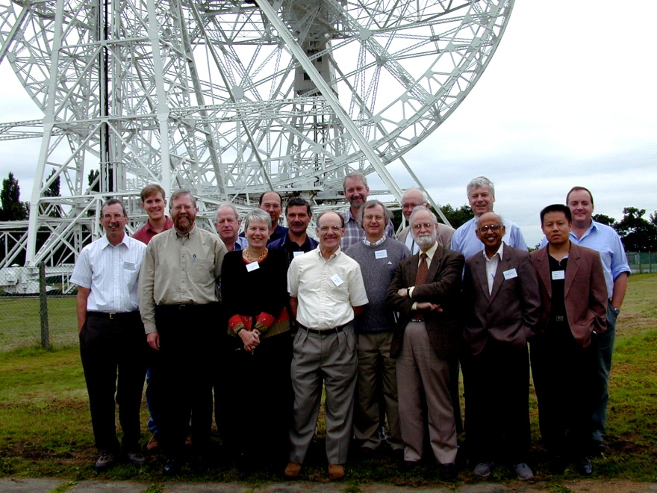
SKA International Steering Committee
18 members representing 11 countries
6 European (UK, Germany, Netherlands, Sweden, Italy, Poland)
6 United States
2 Canada
2 Australia
1 China
1 India
2 at large members
MOU signed IAU Manchester August 2000

Slide 19
SKA timeline (brief)
1988 Independent suggestions for a Large Radio Telescope
1990 10th anniversary of VLA – the visions merge
1993 URSI GA Kyoto resolution
1994 IAU forms a Large Telescope WG
1996 OECD Global Science Forum activities start
1998 “SKA” name adopted (1kT, SKAI, …
2000 International MOU signed
2001 Logo competition
2005 EC funding starts
2009 Agencies SKA Group formed (ASG)

Slide 20
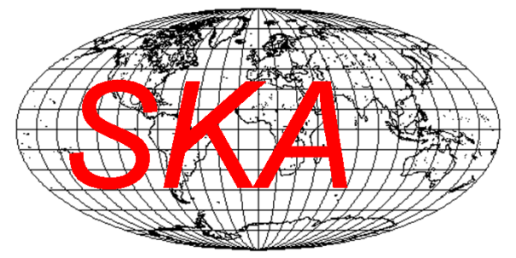
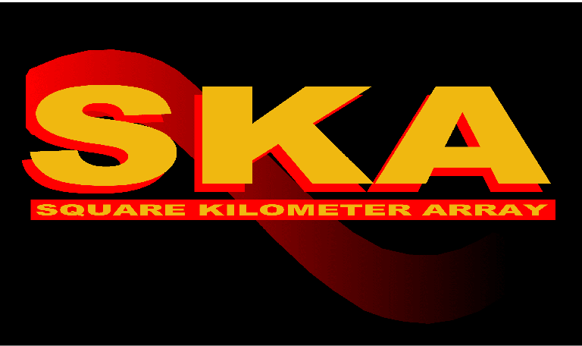
Choosing a logo
International
competition

Slide 21
SKA Logo

Slide 22
The Technology Challenge
The SKA has always been aperture arrays at lower frequencies and dish arrays at higher frequencies.
The transition frequency to be determined by technology development
The technology challenge has always been: How to do it at an affordable price
Innovative technology riding on Moore’s law

Slide 23
Technology evolution (1)
1994 (IAU den Hague)
Dense AA tiles
Canadian long focal length telescope (LAR)
FAST
1996 (Delft)
Hierarchical beam forming
Multiple simultaneous beams, PAF’s
1997 (Sydney)
RFI mitigation – adaptive nulling
1997 (Oort worksop Leiden)
LOFAR

Slide 24
Technology Evolution (2)
1997-1999 (SETI workshops, California)
Large n small d arrays
Wideband receivers
ATA
1999 Luneburg lens
2000 Deep Space Network Array
2004 Cylinders
2004 Dishes with PAF’s
Use electronic advantage to move cost into components which will get cheaper in time
2005 Beginning of the Reference Design

Slide 25
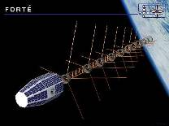
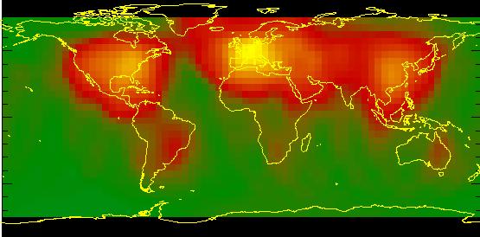
The Quietest Locations in the World Radio Noise Levels
Forte satellite: 131MHz
2nd site select 2012
1st site select 2006
FORTÉ satellite: 131 MHz

Slide 26
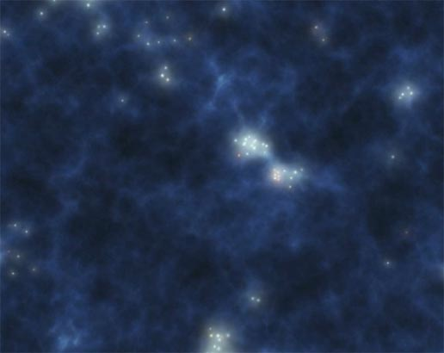
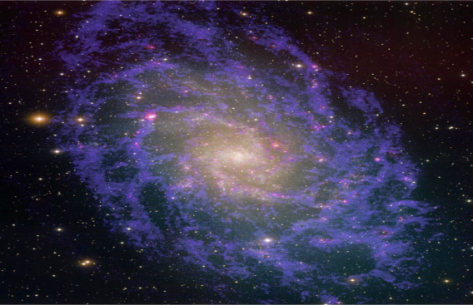
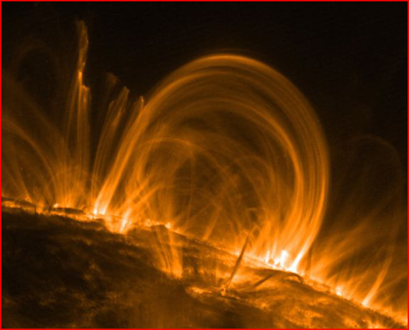
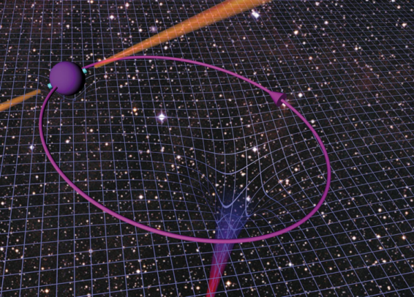
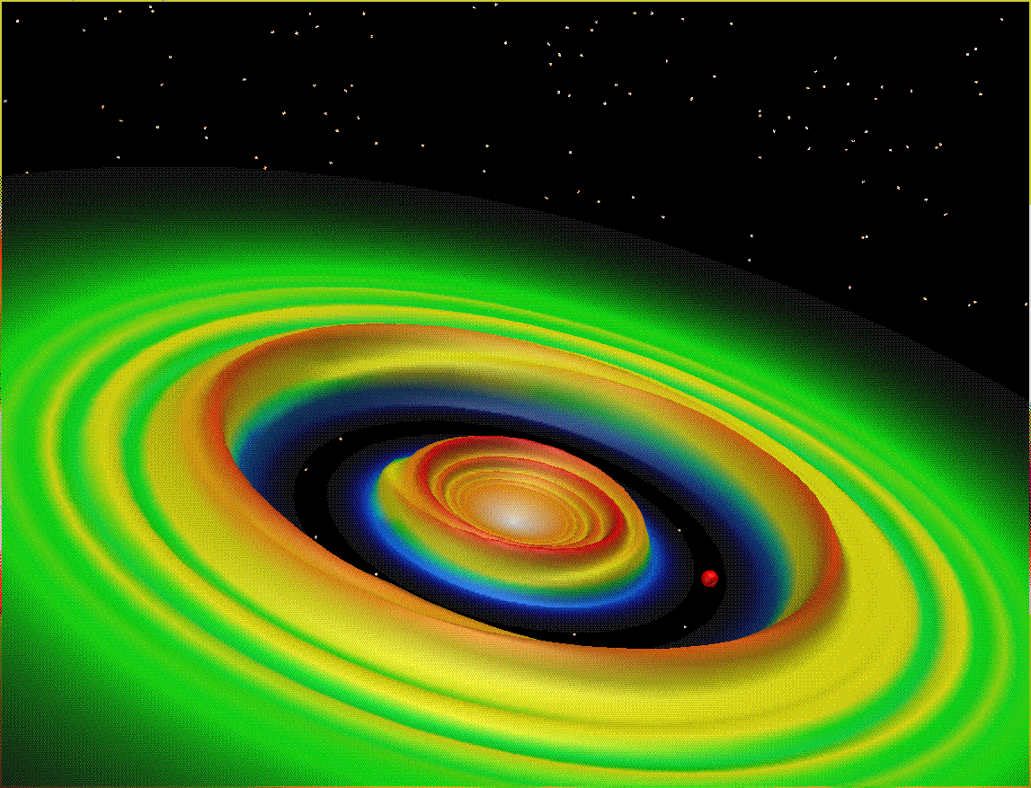
The Science Case
The First Stars
Cosmic Evolution
Cosmic Magnetism
Gravitational Physics
Origins of Life

Slide 27
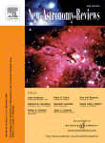
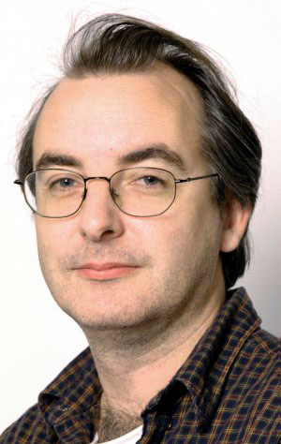
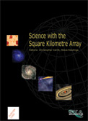
SKA Science Case #2
Commissioned Bologna 2002
published 2004
Edited: Steve Rawlings and Chris Carilli

Slide 28
Evolution of the Science case
HI at cosmological distances – unchanged from beginning
What we do with the HI has changed a lot
Zeldovitch pancakes are replaced by large scale structure probes…….
Pulsars have slowly gained importance
GR tests (stimulated by the double pulsar)
Gravitational wave detection (stimulated by physics community
Need high Ae/T not survey speed
EoR first becomes an SKA goal in 2002
First predictions in 1997
Plausibility of detection 2000

Slide 29
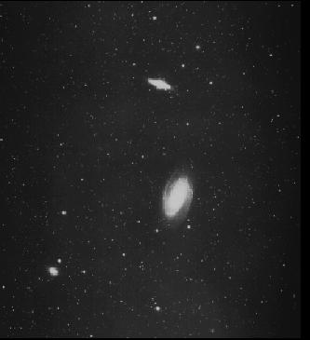
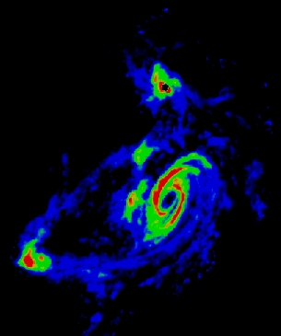
A Universe of Stars
A Universe of Hydrogen gas
But HI gives a weak signal !

Slide 30
Whispers from the Universe
“The encyclopaedia of the Universe is written in very small (21-cm) typescript, to read it one requires a very sensitive telescope.”
Peter Wilkinson
1990

Slide 31
What have we learned?
It takes a long time (22 + years)
Radio astronomy culture played a critical role
Open policies: science, engineering, sky
Strong engineering – science link
Now threatened by site, implementation and National competition
Secret documents, lack of trust, IP protection
Governments involved
International
International structures can be created
Achieved broad community involvement
But that also resulted in a failure to control scope

Slide 32
Outcomes and Expectations vary with stakeholders
Astronomers want the best science
But specific current science should not be driving the specifications
Governments want wealth creation, International links and prestege
Industry wants contracts and cross fertilization

Slide 33
The Pathfinders and the SPDO
Scale of pathfinders has been an issue
Astronomers want useful steps hence big projects
Technology development needs small diverse R&D activity
National interests may not be aligned with the International vision
Early centralization leads to paper designs
SKA triggered pathfinders have been a huge success
LOFAR, MWA, MeerKat, ASKAP, FAST
But are we any closer to realizing the SKA vision!

