Slide 1
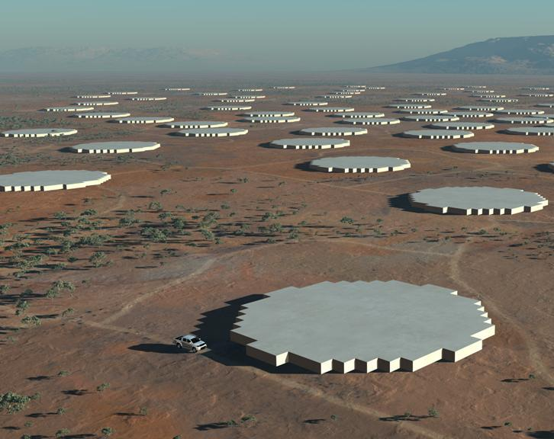
Implementing a high performance AA-mid in SKA₂
Acknowledgements to the SKA Design Studies FP6 programme and Aperture Array Verification Programme
Andrew Faulkner

Slide 2
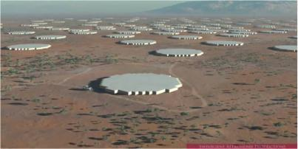
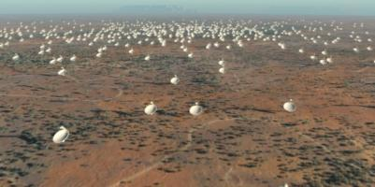
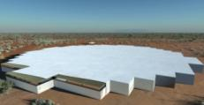
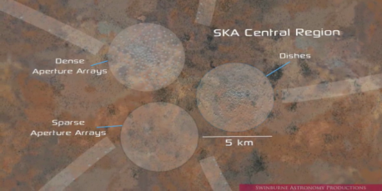
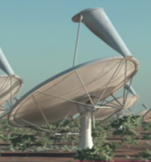
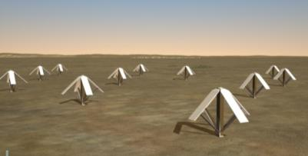
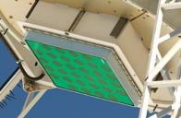
SKA Phase 2 Receptor Technologies
250 Dense Aperture Arrays
1-3000 Dishes
3-Core Central Region
Wide Band Single Pixel Feeds
AA-low - 250 Arrays
Phased Array Feeds
Artist renditions from Swinburne Astronomy Productions

Slide 3
SKA Phase 2 Receptor Technologies
250 Dense Aperture Arrays
1-3000 Dishes
3-Core Central Region
Wide Band Single Pixel Feeds
AA-low - 250 Arrays
Phased Array Feeds
Artist renditions from Swinburne Astronomy Productions

Slide 4
An ideal telescope …..
Fully samples the incoming EM field at all frequencies
“Sees” the whole of the available sky
Constructs many beams observing in all directions
Supports multiple concurrent experiments
Corrects for all system and atmospheric errors
Every design has limitations
However….

Slide 5
AA-mid is pretty close…
Limited in frequency range
  Higher frequencies = many more elements
Sees a lot of the available sky
  Limited by element pattern
Not perfect sampling
  E.g. elements couple with each other
Needs and can support exquisite calibration
Top freq critical
Large survey speed
Can be corrected
Performance limited by Cost,
Processing, algorithms and comms

Slide 6
SKA₂ Science requirements
1.4 GHz rest hydrogen line
Frequency range: | 400-1450 MHz
No. of arrays: |  |  | 250
Array diameter: |  |  | 56m
Sensitivity (800MHz): |  |  |  | 10,000 m²/K
Scan angle: |  |  | ±45º
Field of View: |  |  | ~200deg²
Output data rate: |  |  |  | 16 Tb/s
Dynamic range: |  | >10⁷:1
Configuration: | 60% within 5km
Max. baseline: |  |  | 180km

Slide 7
Frequency range
Increasing freq. is very expensive:
  # of elements proportional to freq²
  Digitiser rate increases linearly
But: HI rest line is a vital break point
  Sensitivity/survey speed drop >~1GHz OK
All low frequencies covered by AAs
  Cross over with AA-low determined by sky ~400MHz
400
1450
AA-mid
AA-low
Dishes
150
450
750
1050
1350
1650
MHz

Slide 8
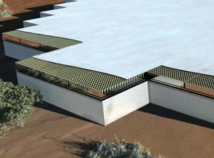
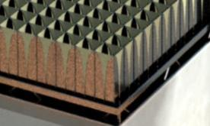
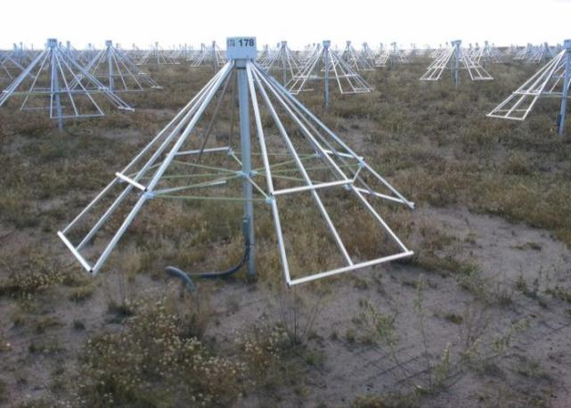
Aperture array configurations
Dense:
Constant A_{eff}
Element spacing ≤ λ /2
Fully sampled wavefront
Regular layout pattern
Sparse: AA-low
A_{eff} increases as λ²
Element spacing >λ /2
Layout irregular to
control grating lobes

Slide 9
Dynamic Range requirements:
AA is operating at low frequency ? Tricky
Physical stability (wind etc.) ✓ Good, study details
Unblocked aperture ✓ Inherent
Smaller beams are better ✓ ~60m dia. collectors
Narrow band is important ✓ AA is Wide Band but
many channels
Calibration capability ✓ Excellent, by channel
Trade DR for sensitivity ✓AA v. flexible

Slide 10
Array Calibration: comments
Dense AA calibration is finally limited by the stability of its components
There is total physical stability (or should be!)
Can be calibrated for every small frequency band
Can calibrate every element - if required
Can cal at every scan angle
Does not add to the real-time processing load
How to find
all the
Coefficients?
But...
Design time calibration
Build time calibration
Pre-observation element calib.
Pre-observation system astronomical calibration
During observation calibration
Ongoing work…

Slide 11
Some deployment considerations:
Environmental
  Temp, water, wind, etc
Minimise work on site
  Build in factories where possible
Minimise site preparation reqts.
  Easy foundations
  Reduce need to level ground – just smooth it
  Use surface cabling if possible
Minimise transport reqts.
  Reduce material used
  Tight packing with easy
Local control
  Test and maintenance need to take over control locally
Cooling in a desert
  Transport of heat away from processing heat sources
  Disposing of heat – particularly in the core
Site substrate.
  Could be a major impact: how hard? What support? Conductivity?
  Not a choice really!

Slide 12
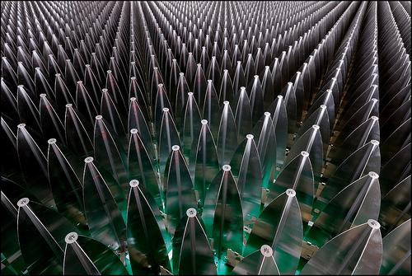

AA-mid elements
Regular array of elements
Pitch: 15cm (λ/2 at 1GHz)
Each station 56m dia. 110,000 dual pol elements
Low noise ambient temp LNA
Vivaldi array
Octagon Ring Antenna -ORA

Slide 13
AA-mid design
Parameter | Value | Comments
Type of array | Single element | Dense array using Vivaldi or ORA.
Number of elements | 110,000
Pitch of elements | 15 cm | λ/2 at 1000MHz
No. of polarisations | 2 | Each element has two receiver chains
Diameter of station | 56m
Cluster size | 4 elements | Uses true time delay beamforming
Tile size | 16 x 16 elements | Built out of 4 x 4 clusters
No. of Tiles | 430 | Each tile is ~2.4m square
Number of stations SKA₂ | 250 | Anticipated number of Phase 2 SKA Stations
Element communication | Copper | Includes Phantom power
Layout | Dense rectangular | Regularly spaced
Frequency range | 400-1450 MHz
Digitisation rate | 3GSamples/s | There is no frequency conversion,
Digitisation depth | 6-bit | Required for RFI environment at these frequencies
Beamforming technology | Digital | Using cluster outputs
Max output data rate | 16Tb/s | Organised as 4+4bit complex data

Slide 14
AA-mid signal path
Tile processing unit
True Time Delay
4-element clusters
Element & gain. Phantom power

Slide 15
Two stage beamforming
Filling “Tile beams” with station beams leads to discontinuities in the beamforming for off-centre beams
Can be resolved with a higher data rate Tile to station processor

Slide 16
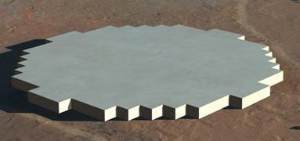
AA-mid construction outline
Top View
......
......
......
......
......
......
Non-conducting
Guideframe
“Sea” of elements
Built as tiles
Tile interconnect
Able to extract a Tile
Enclosed volume
Membrane
Guideframe
Beamformer
Beamformer
Ground plane
The join!
Ground
Tile support

Slide 17
Signal Processing and Digitisation
Processing: ~10¹⁶ MACs/array
  Custom ASIC
  FPGA
  Multi-core processors
Digitisers: 6-bit, ≥3GS/s
  Driven by WB data &
  radar applications
  Low bit count
  Flash, TDC
  Commercial Si is capable
ADC 128 x 3GS/s
This is becoming very feasible – certainly by 2020…

Slide 18
Station processor
Requirements:
High bandwidth in
High bandwidth out
Largely cross connected
Programmable beamforming
~10PMACs – (10¹⁶)…
Hierarchical structure: Linked with comms

Slide 19
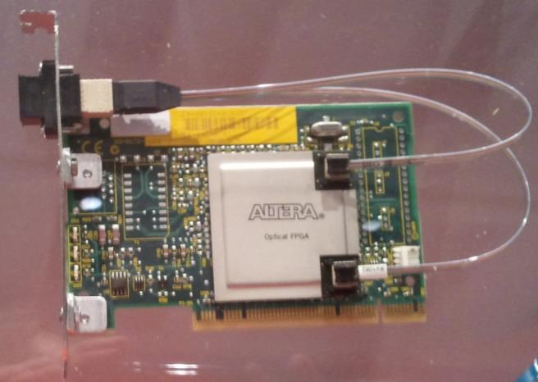
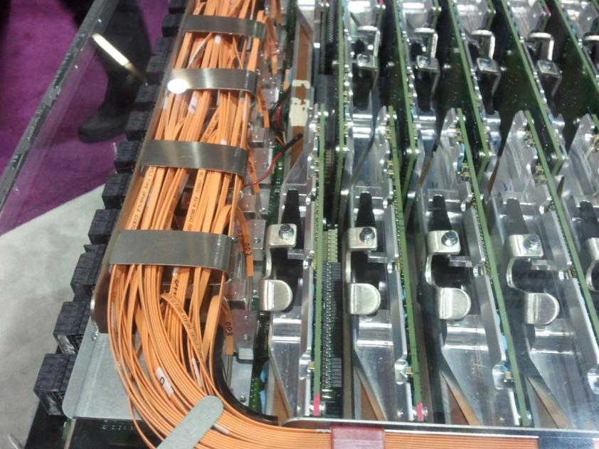
Short range optical Communications

Slide 20
AA-mid Power
Budget
Subsystem | mW | Remarks
Front-end (Quads of 4 elements):
LNA total | 120 | 4xLNAs at 30mW each
Antenna gain block | 120 | 4 units at 30mW each
Tile beamformer:
Analogue sig conditioning | 160 | 4 channels at 40mW each
Analogue beamforming | 100 | Combine 4 elements
ADC | 50 | 2.5 GS/s, 10Gb/s each channel
Clock distribution | 10 | estimate
Coms: ADC to processor |  | Integrated ADC and processor
Tile Processor | 200 | 25 W for 128 digital channels
Tile Control ccts etc. | 100 | 13 W for 128 digital channels
Copper comms: Proc – opt. driver | 10 | 1.2 W for 128 digital channels
Opt. Coms: Tile to Station proc. | 20 | 2.5 W for 128 digital channels
Station Processor:
Primary Station processor | 130 | 600 W for 4608 digital channels
Copper comms: Proc –opt. driver | 10 | 1.2 W for 128 digital channels
Opt. Coms: 1st – 2nd Station proc. | 20 | 2.5 W for 128 digital channels
Secondary Station processor | 130 | 600 W for 4608 digital channels
Copper comms: Proc – opt. driver | 10 | 16 Tb/s station output
Long Distance comms:
Wide area comms |  | Accounted for separately
Electrical power used | 1,190 | Per digital channel
Power supplied @ 85% efficiency | 1,400
Power incl cooling at +25% | 1,750
Total station power | 96 | kW
Consider a single signal path......
96kW

Slide 21
AA-mid Technology Shopping list
T_{sys} for AA-mid (LNA+matching etc) | <40K
Array scan angle range | ±45º (±60º)
Analogue system power | 100mW per Rx
True Time Delay | integrated
>3GS/s 6/8-bit ADC power | <100mW
DSP processor chip performance | >20TMACs
DSP Power for 20TMAC | ~25W
DSP chip comms, I/O capability | >1300 Gb/s
DSP-digitiser integration | Implemented
50m optical links, pluggable | >120Gb/s
50m 120Gb/s link power | 2.5W
Flash storage module capacity | 20TB
Many-core streaming processor | 50TFlop
50TFlop processor power | <300W
Industry Roadmaps* projections show all these requirements are realistic
* e.g. International Technology Roadmap
for semiconductors, ITRS

Slide 22
Summary
AA-mid has huge scientific benefits
There is a lot of electronics in the system, but it is on the ICT development path
AAs depend on high speed comms and processing
More communications gives more performance
Development schedule for SKA Phase 2 is very realistic
AA-mid can be done!

Slide 23

SKA Director
wearing
Two hats
visiting a site
Thank you…

