Slide 1
The status and science of ASKAP
Philip Diamond
Chief, CSIRO Astronomy & Space Science
RTS 2012 19 April 2012

Slide 2
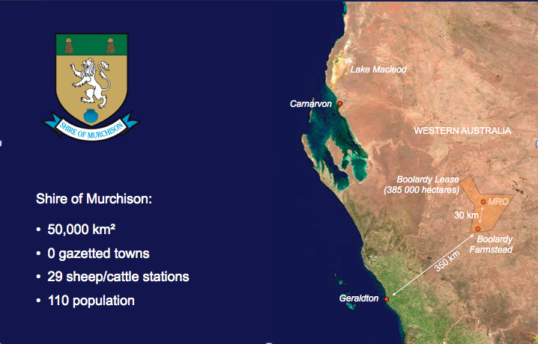
Australian SKA Pathfinder (ASKAP)
ASKAP, currently being developed by CSIRO, at the Murchison Radio-astronomy Observatory (MRO) in Western Australia
A next generation stand-alone telescope and test-bed for the future international SKA project
36 antennas, each 12 metres in diameter
Utilising innovative Phased Array Feed technology, allowing for increased survey speed and sensitivity
Will be one of the most powerful survey radio astronomy instruments in existence

Slide 3
Australian SKA Pathfinder (ASKAP)
ASKAP is a ‘Pathfinder’ because:
  We are establishing the Murchison Radio Astronomy Observatory for the SKA
  We are developing and testing technologies and techniques for the SKA
  We are exploring the science themes to be addressed by the SKA

Slide 4
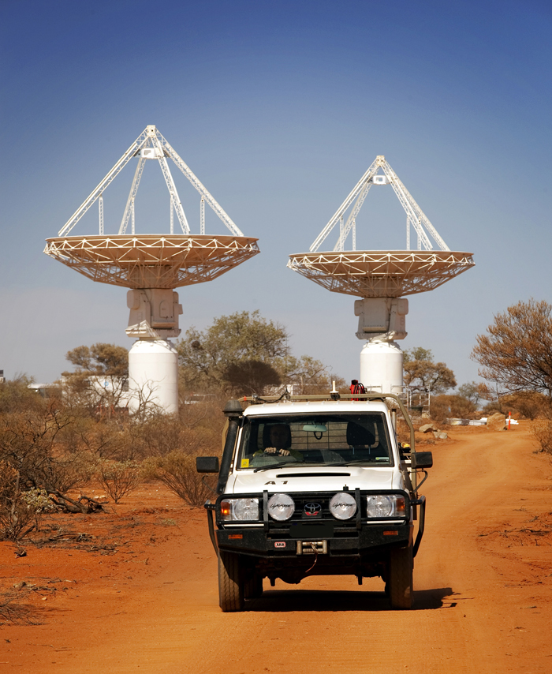
ASKAP

Slide 5
ASKAP
Design goals:
High-dynamic range imaging
Wide field-of-view science
Number of dishes 36
Dish diameter 12 m
Maximum baseline 6 km
Resolution 30”
Sensitivity 65 m²/Kelvin
Survey Speed 1.3x10⁵ m⁴/kelvin²/deg²
Tsys/η 63 Kelvin
(e.g. Tsys = 50K, η = 80%)
Observing frequency 700 – 1800 MHz
Field of view 30 deg²
Processed bandwidth 300 MHz
Spectral channels 16384
Focal Plane Phased Array 188 channels (94 beams)

Slide 6
ASKAP
Quick summary:
Design and build the world’s premier radio survey telescope
Located in Western Australia
Total cost: ~$170M
Status:
  Construction well-advanced
  6 antenna sub-array being equipped with phased-array feeds
  Next-generation MkII phased-array feed under development
  Engineering commissioning to start in May
  ASKAP complete by end 2013
  Early science in Q1 2014

Slide 7

SKA Key Science goals
SKA Key Science Goals
  Probing the Dark Ages
  Galaxy Evolution, Cosmology and
  Dark Energy
  Origin and Evolution of Cosmic
  Magnetism
  Was Einstein right?
  Cradle of Life

Slide 8
ASKAP Key Science Goals
ASKAP Key Science Goals
  Probing the Dark Ages
  Galaxy Evolution, Cosmology and
  Dark Energy
  Origin and Evolution of Cosmic
  Magnetism
  Was Einstein right?
  Cradle of Life
Wallaby: HI survey (500k galaxies to z=0.26)
EMU: continuum survey (10 μJy/beam rms)
GASKAP: Galactic & Magellanic HI & OH
DINGO: evolution HI from z =0 – 0.5
FLASH: HI absorption survey
POSSM: polzn survey, RM synthesis
VAST: variables and slow transients
CRAFT: transients < 5s
VLBI: capability
COAST: pulsar capability

Slide 9
ASKAP – Antennas
  Ten CETC54 engineers have been at MRO assembling antennas
  34 antennas on site; 17 antennas complete, rest under construction
  Final 2 antennas in transit from China.
  Antennas continue to exceed surface RMS specification –
    Specification is 1.0mm
    Delivered RMS averaging 0.52 mm RMS (20 GHz ?)
  Completion of all 36 scheduled for mid 2012

Slide 10
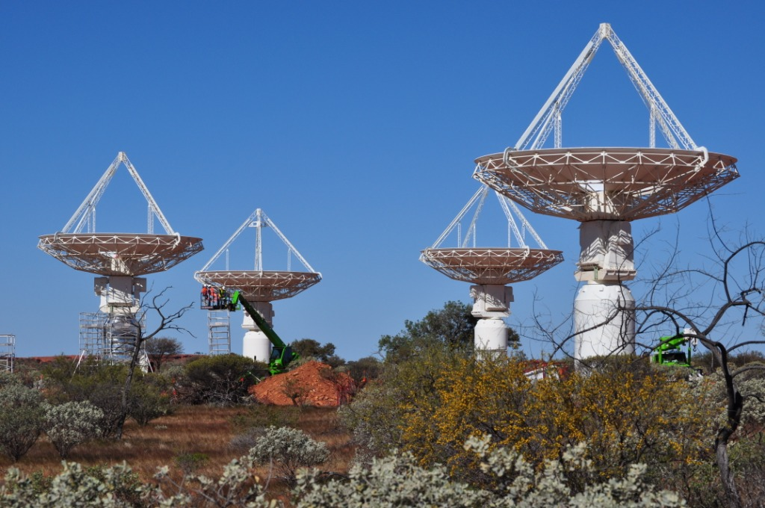
ASKAP - Antennas

Slide 11
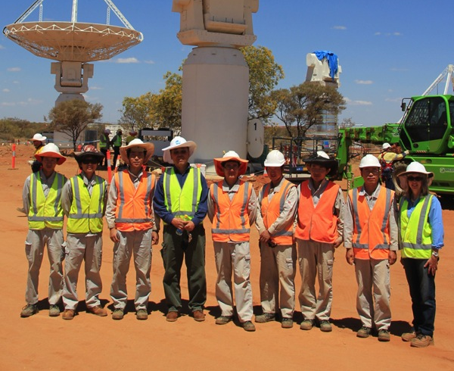
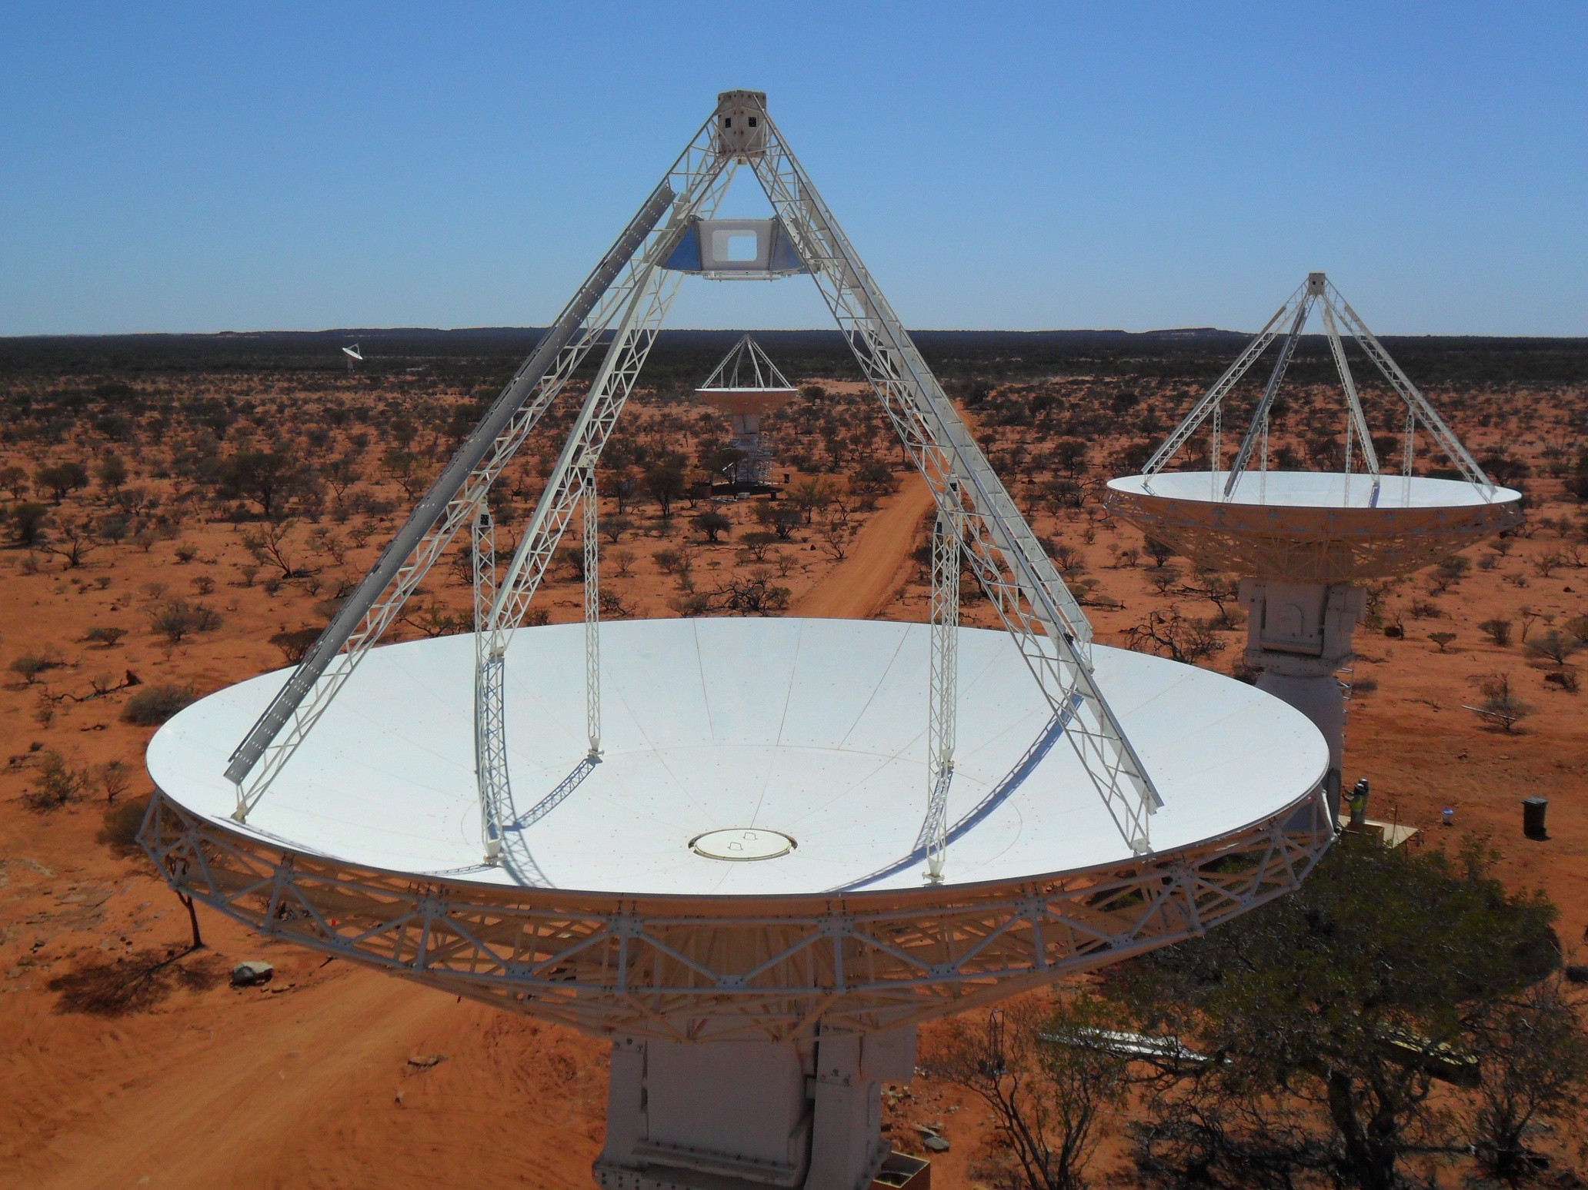
ASKAP - Antennas
CETC54 team

Slide 12
ASKAP – Phased Array Feeds
  First full size Phased Array Feed deployed to Parkes in 2011
  Initial tests very successful
    Tsys ~sub 50 K temp across much of the band
  MkI PAFs being deployed on ASKAP
  MkI PAFs are heavy (> 200kg), complex, expensive
  MkII redesign, ~ 50% of cost of MkI:
  - RF over Fibre
  - recent rapid price drop of optical components
  - minimise cable loses, stability,
  - continuous fibre from PAF to beamformer in central building
  - removes 95% of equipment from pedestal – cooling, RFI, elec
  - Virtex 7 – newest Xilinx FPGA family – factor of 4++ reduction
  - Direct sampling – deletes entire heterodyning sub-system
  - Mk II systems will be compatible with Mk I

Slide 13
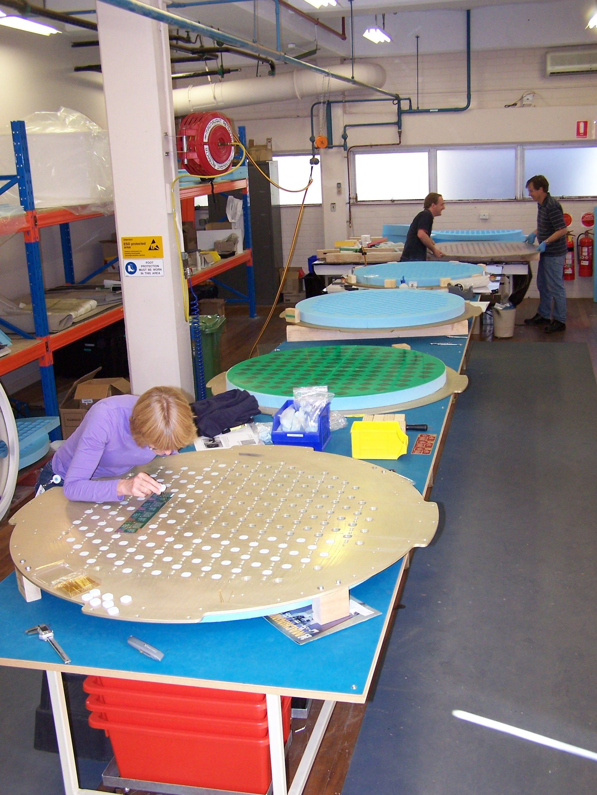
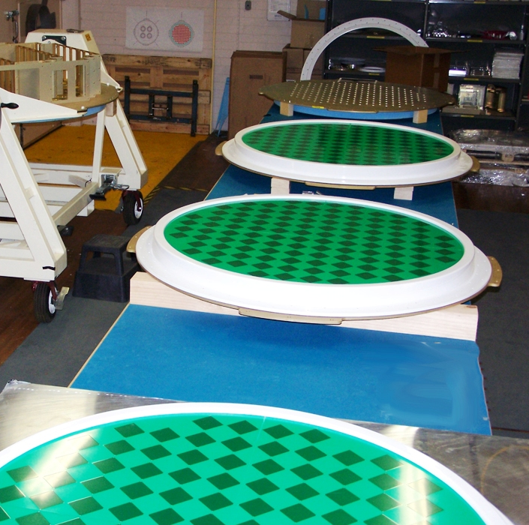
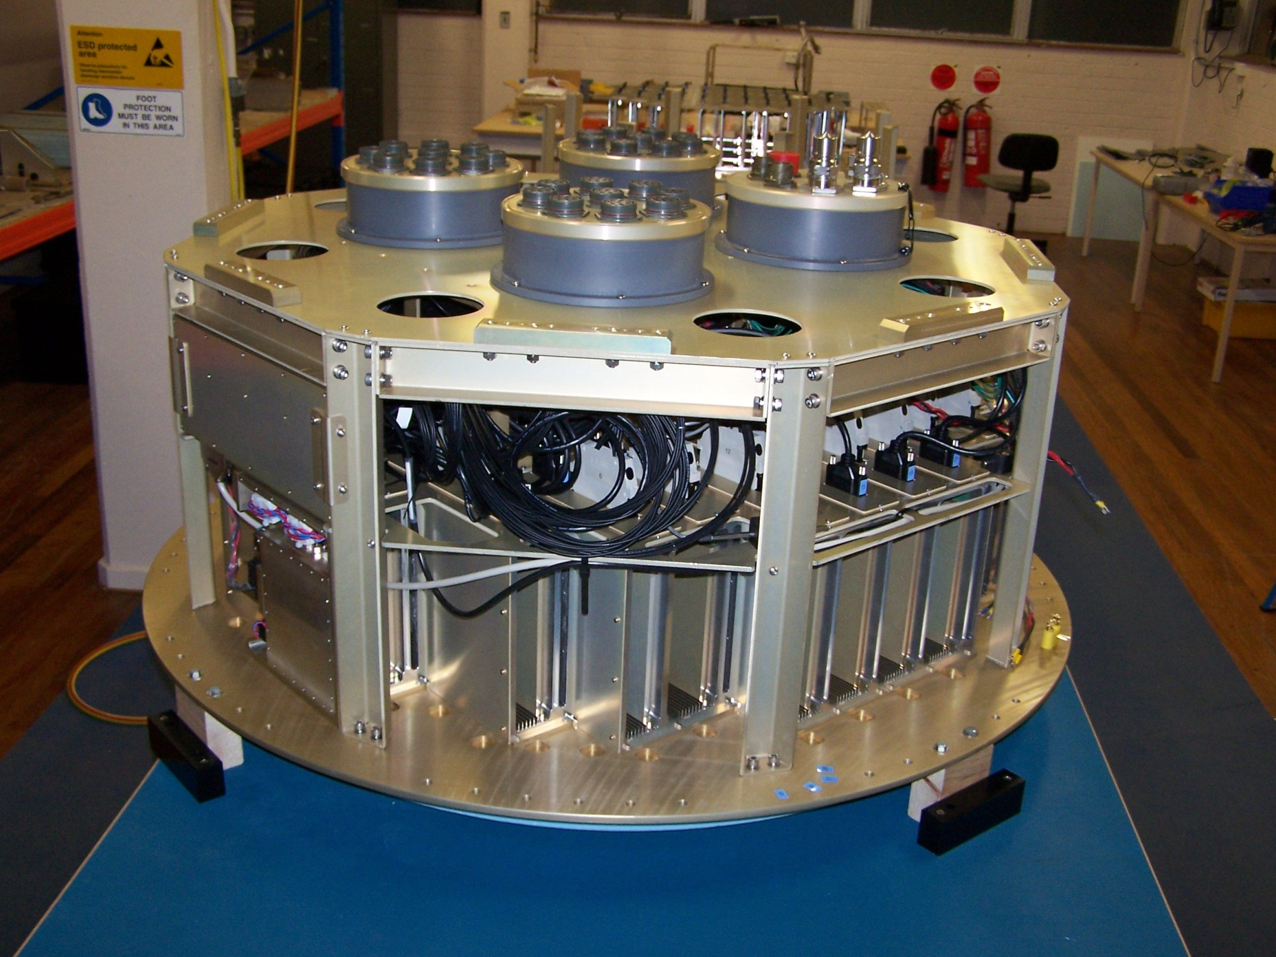

Slide 14
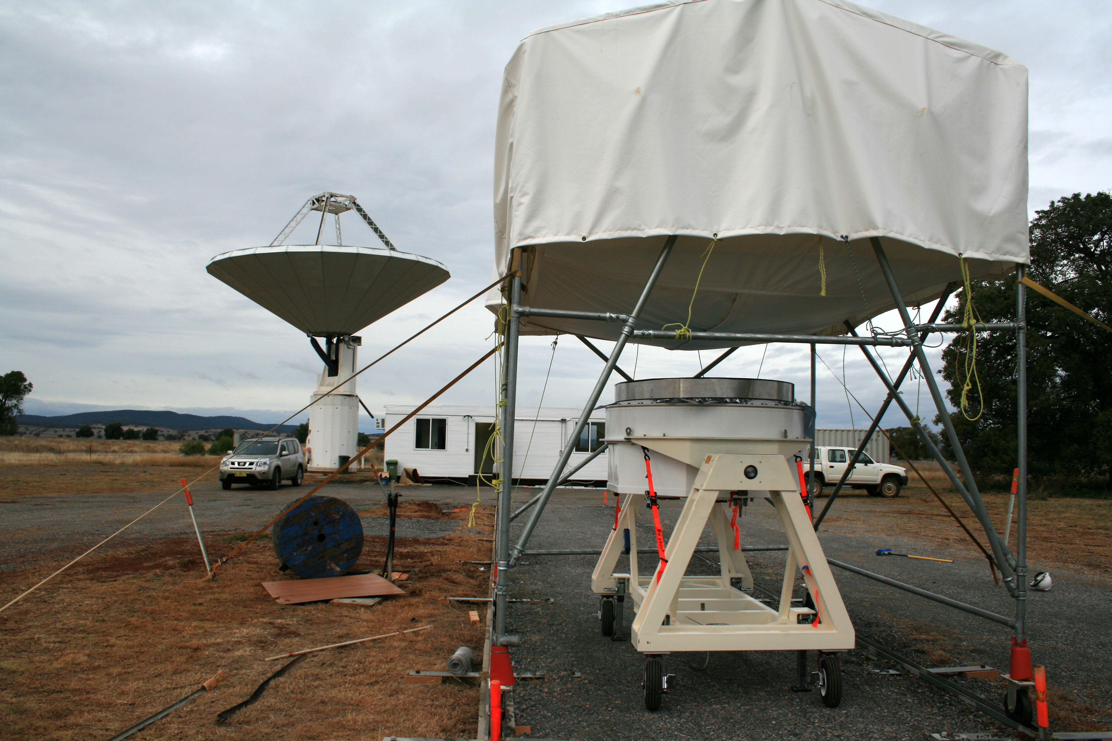

Slide 15
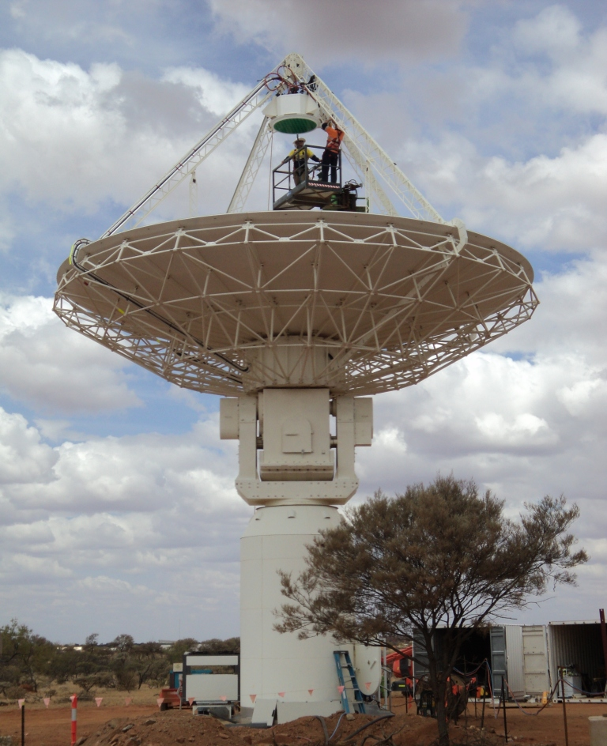

Slide 16
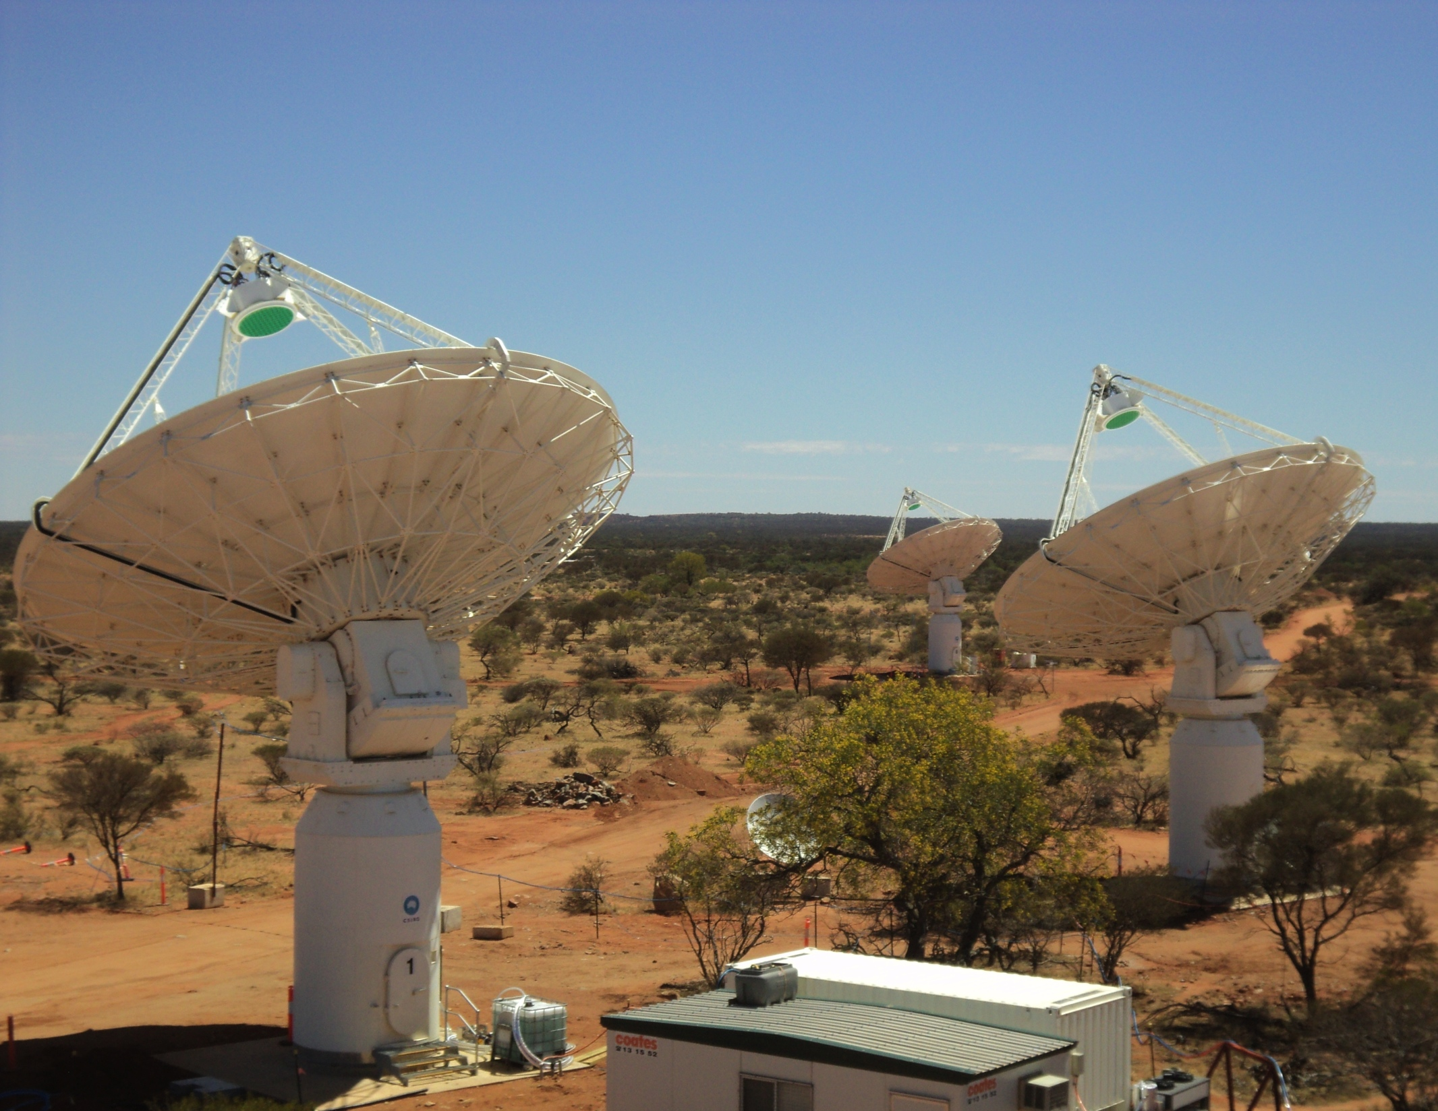

Slide 17
ASKAP – Digital Systems
2 Tera-bits/second (2Tbps) communications from the digital receiver to the beamformer operational
First full ACM (Array Covariance Matrix) in real-time achieved using ASKAP hardware
Deployed to MRO for BETA

Slide 18
ASKAP – Computing
ASKAP commenced software development on the Pawsey HPC for SKA Computing, phase 1A machine at Murdoch University in Perth; Ib (Fornax) now at UWA.
Spectral line imager demonstrated on 1024 cores
Version 0.4 of the Telescope Operating System released (ToS)
ASKAP Computer group in top 10 HPC users in Australia

Slide 19
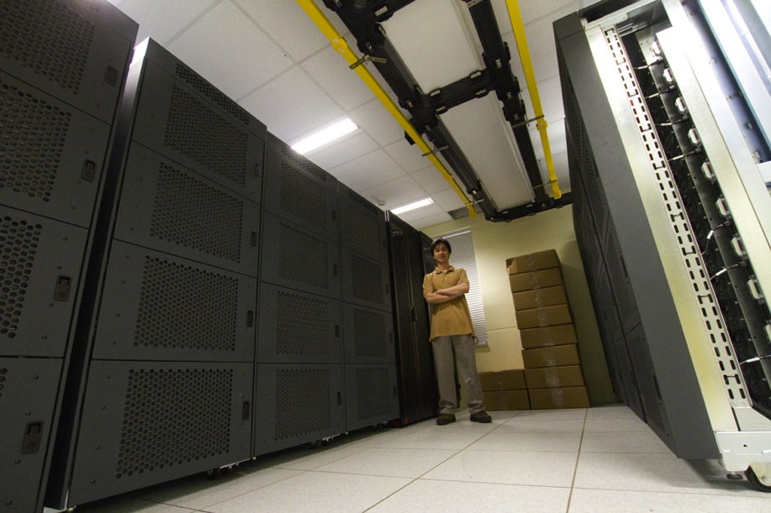
ASKAP – Pawesey Centre – 1B computer
‘Fornax’ at UWA
~100 Tflop
500 TB disk
Dual network
100 GPU
1000 X86 cores

Slide 20
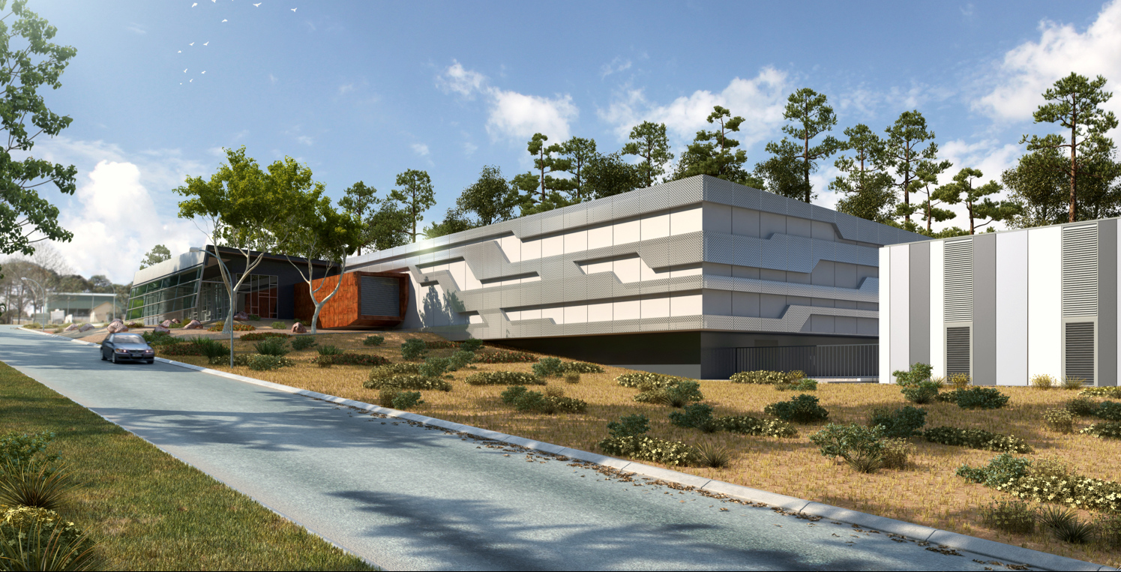
Pawsey Centre by March 2013
Full Petaflop machine procurement underway
  Commission by mid-2013

Slide 21
ASKAP – MRO Construction
Infrastructure essentially complete:
  roads
  fibre and power reticulation around site
  SKA-capable fibre installed from MRO to Pawsey centre; 40 Gbps lit
  from June 2012
  36 antenna foundations
  runway refurbishment
  Control building
  geothermal cooling system for central building
    96 bores completed
  Support for other projects (MWA etc) – in place

Slide 22
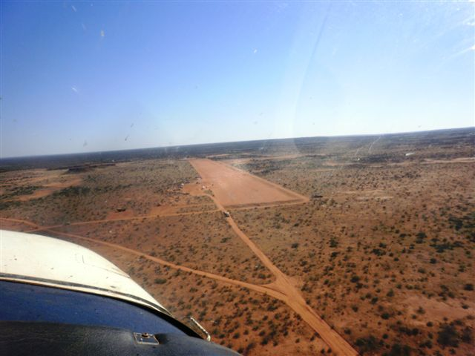

Slide 23
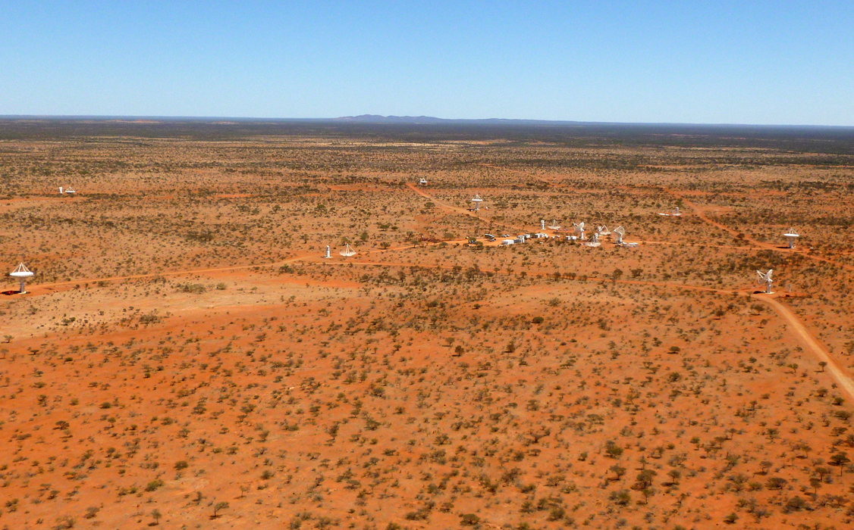
23

Slide 24
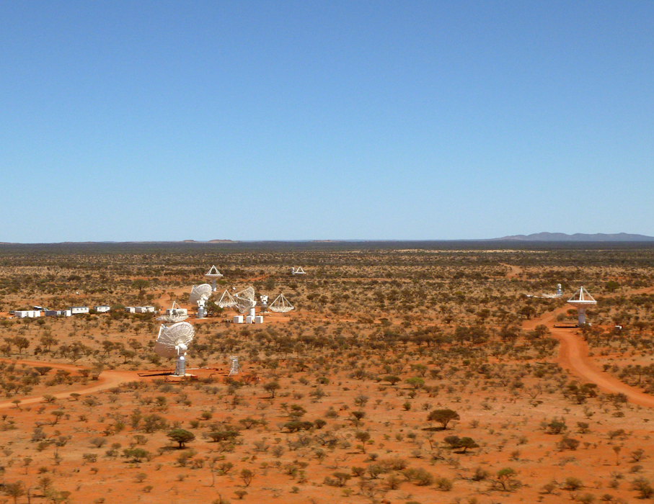
24

Slide 25
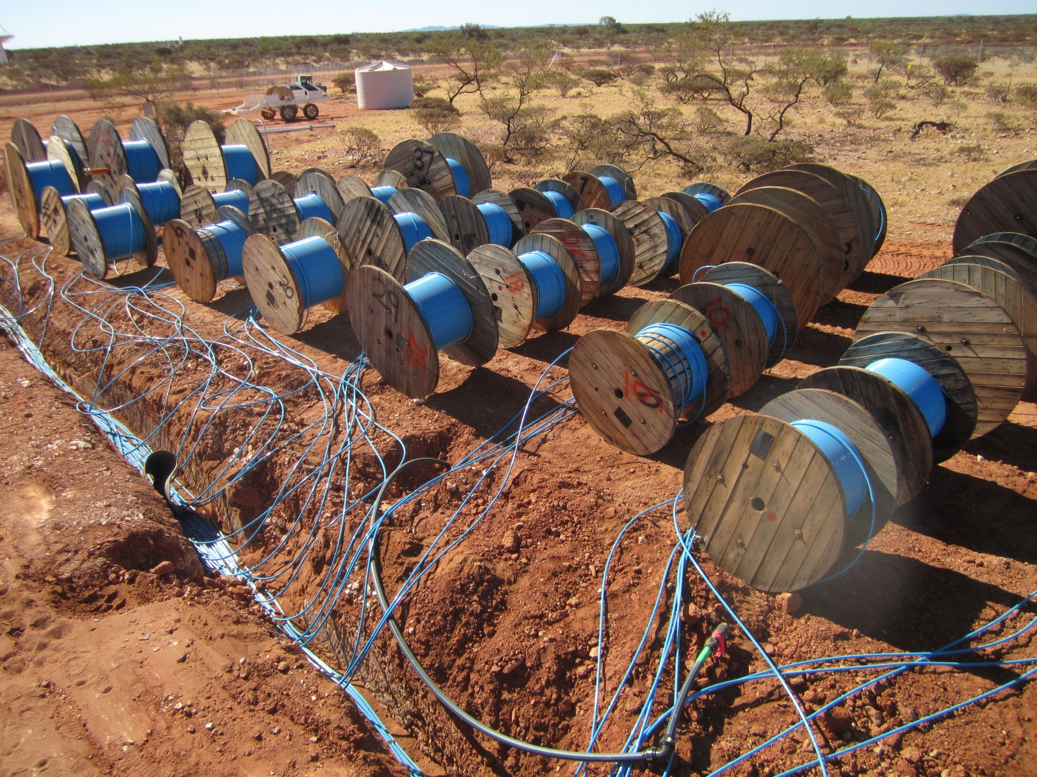
ASKAP – 7776 ASKAP and 432 MWA fibres

Slide 26
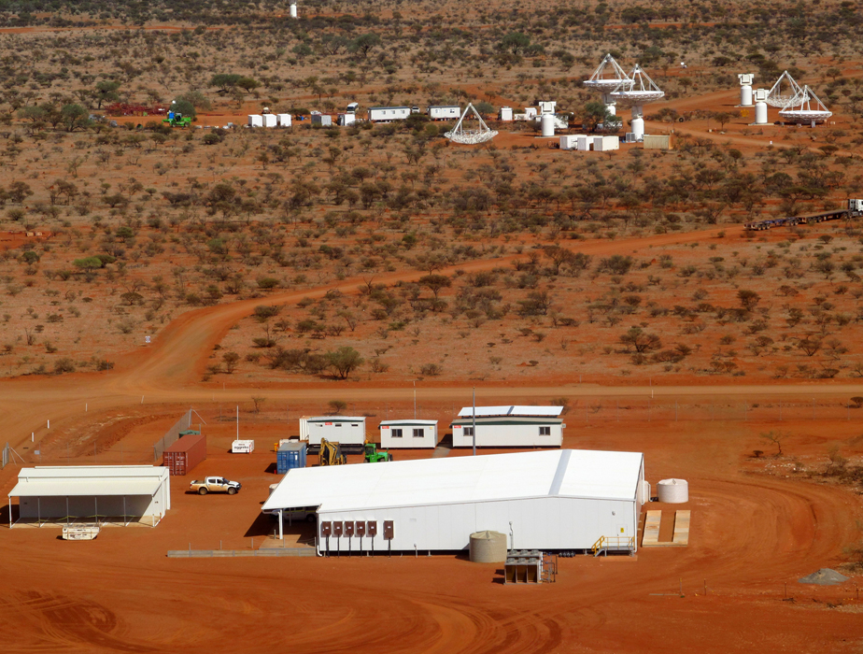
26

Slide 27
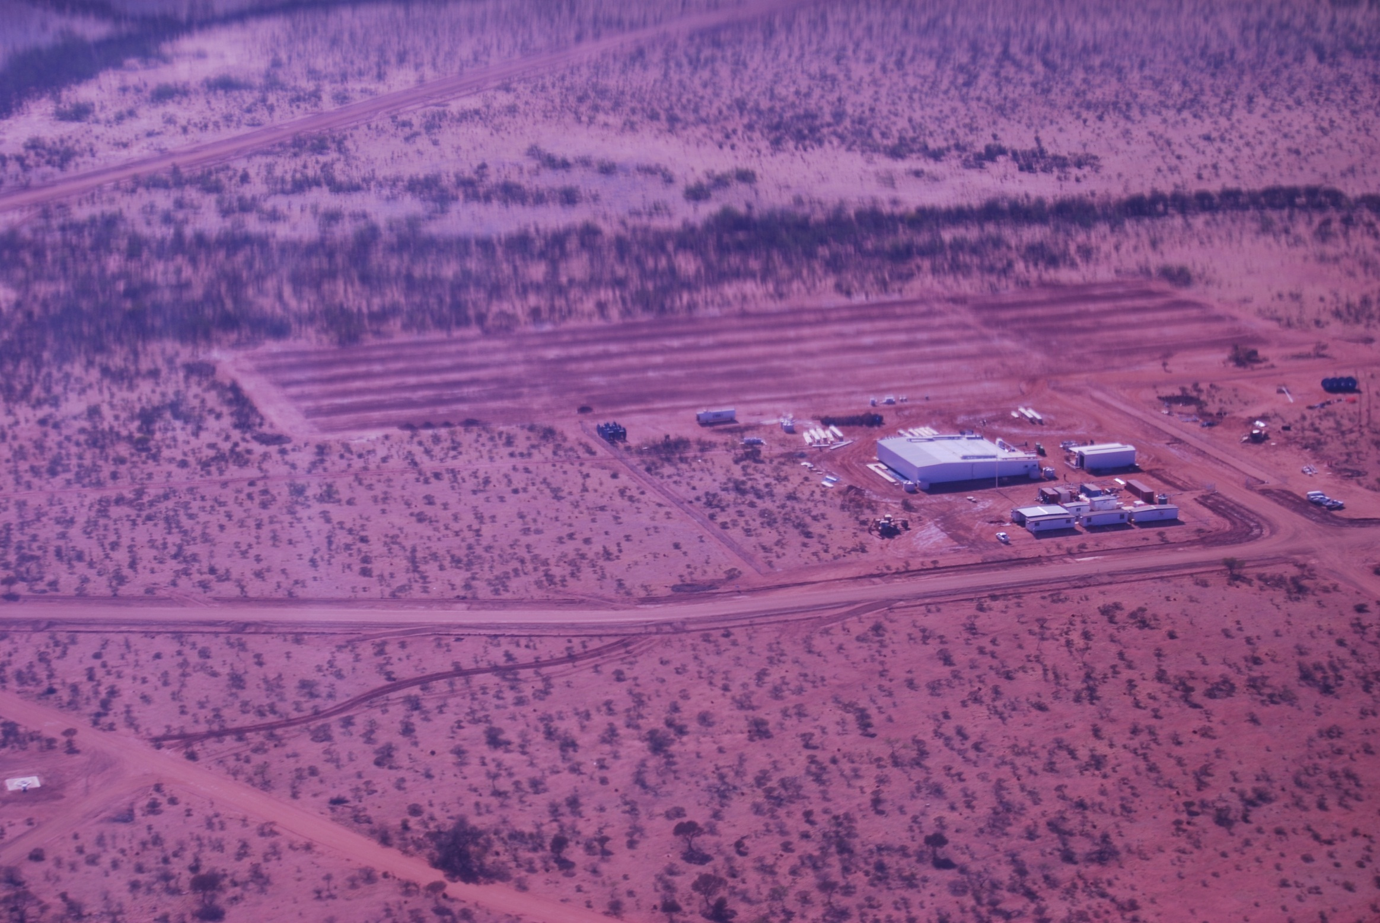
27

Slide 28
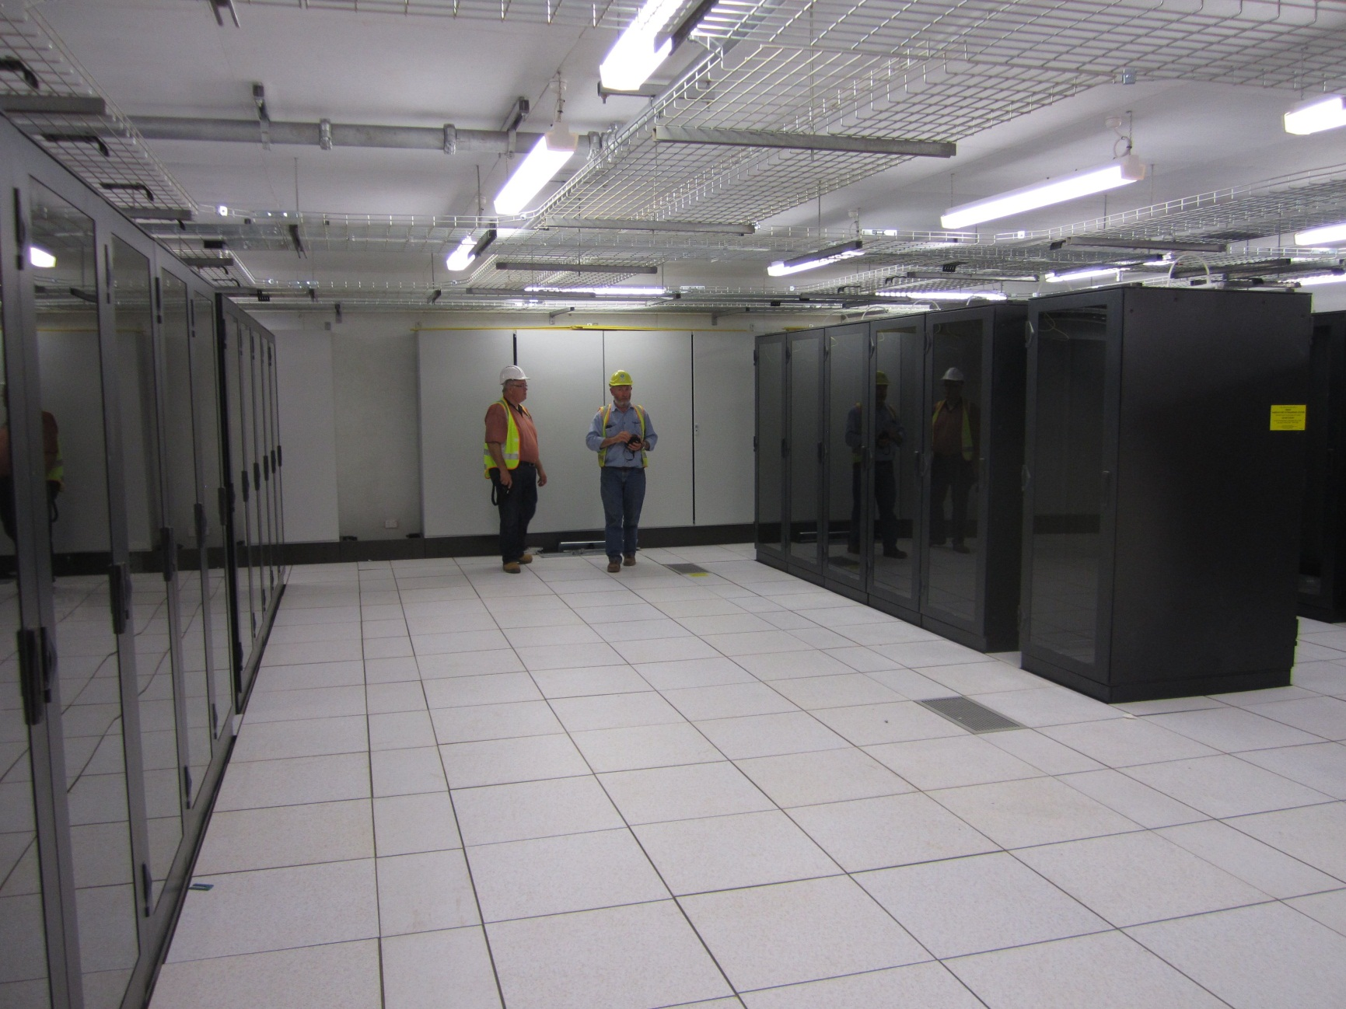
160db shielding

Slide 29
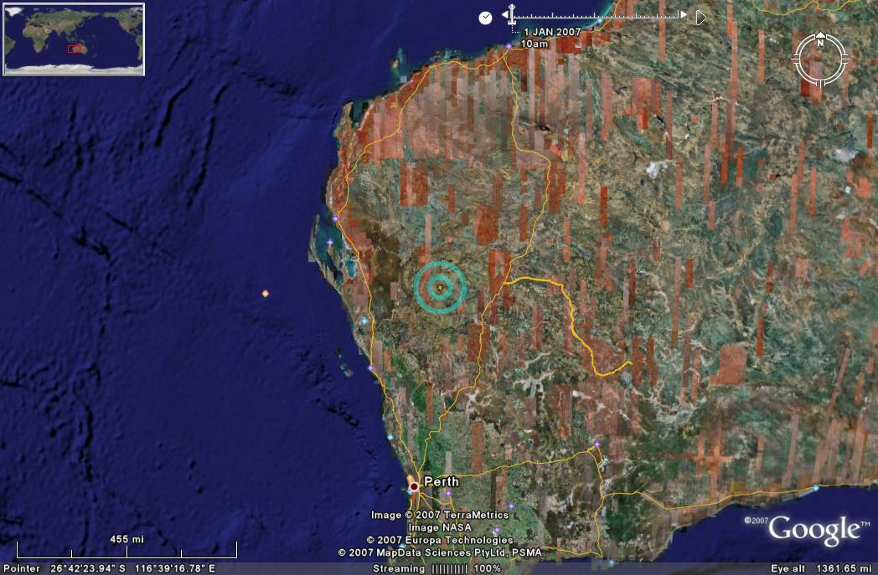
2 % of Australia is now a
Radio-quiet zone!!
Murchison Radio-astronomy
Observatory (127km²)
Radio Quiet Coordination Zone
(260km radius)
Geraldton
Perth

Slide 30
MRO - Power Generation and Cooling
ASKAP requires 1.1 MW power station
Constructing an RFI compliant hybrid diesel and solar power
plant for ASKAP at the MRO
Design well underway
Completion expected in Q2 2013

Slide 31
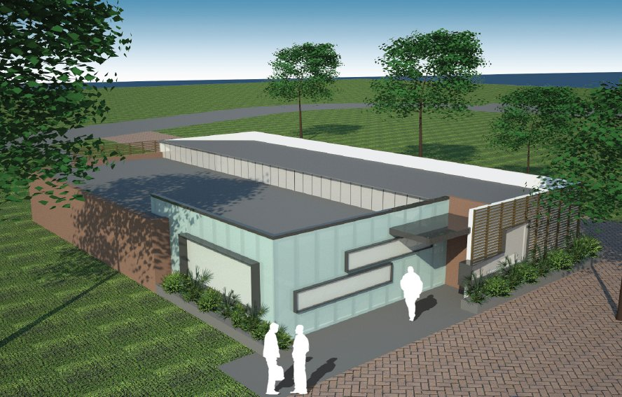
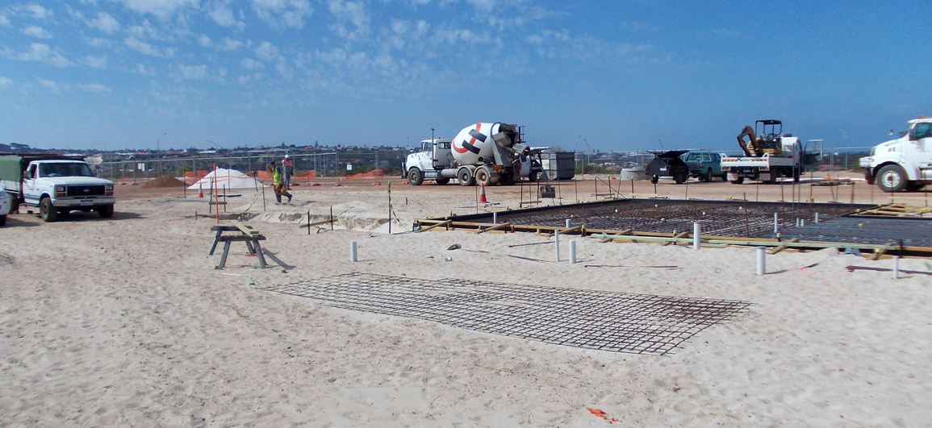
MRO Support Facility (Geraldton)
Base for MRO support staff
  800 sqm building located next to Geraldton University Centre.
  Offices for 12-15 CSIRO staff, including visitors.
  Laboratories (for electronics repairs) & small mechanical workshop.
  Termination point for fibre link from MRO.
  Connection to Pawsey Centre via fibre to Perth.
  Operations control room..
Occupancy in November 2012

Slide 32
ASKAP Key Milestone Overview
Fringes PAF to single pixel feed December 2011
MRO Infrastructure complete March 2012
Closure phase between 3 PAFs May 2012
Six Mk I PAFs deliver July 2012
(digital systems included)
Limited BETA observing – start June 2012
- commissioning focus
- aim is to generate basic data files
- primary BETA capability early 2012
- preliminary BETA data measurement sets Q3 2012
Six Mark II PAFs and Digital subsystems March 2013 (total 12 PAFs)
Breaking news: new CSIRO WLAN settlement has resulted in additional
$4m for ASKAP from 1 July 2012, will deliver another 6 MkII PAFs

Slide 33
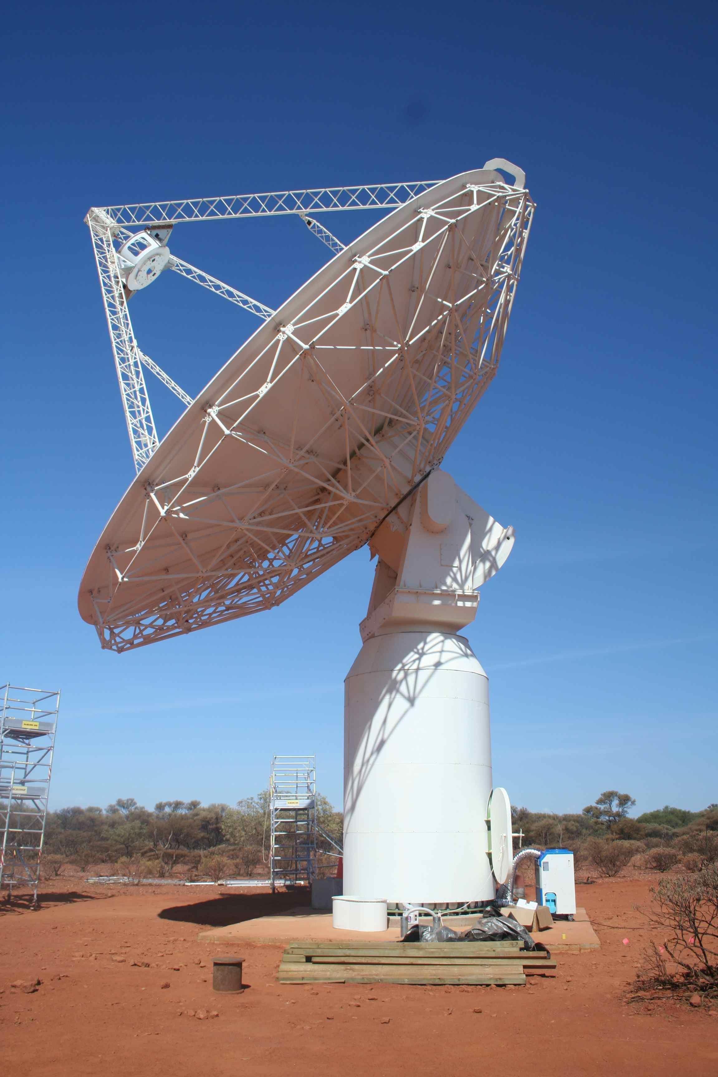


Thank you
Phil Diamond
Phone: 02 9372 4300
Email: philip.diamond@csiro.au

