Slide 1
Submm VLBI toward Shadow Image of Super Massive Black Hole
Inoue, M.¹, Blundell, R.², Brisken, W.³, Chen, M.T.¹, Doeleman, S.⁴, Fish, V.⁴, Ho, P.^{1,2}, Moran, J.², Napier, P.³,
and the Greenland Telescope (GLT) Team
(¹ASIAA; ²CfA; ³NRAO; ⁴MIT Haystack Observatory)

Slide 2
ABSTRACT
We are deploying a new submm VLBI station in Greenland as part of an effort to get shadow images of Super Massive Black Hole (SMBH).
For the Greenland Summit Station, we are designing the infrastructure and monitoring the opacity at submm wavelengths.
The Station enables long baselines with ALMA in Chile and SMA in Hawaii. Submm VLBI is thought to be the only way to get the direct image of SMBH by its shadow, thanks to the superb angular resolution, and low plasma scattering and synchrotron opacity.
In parallel, we are retrofitting the ALMA-NA prototype telescope (renamed as Greenland Telescope: GLT) for the cold weather condition.

Slide 3
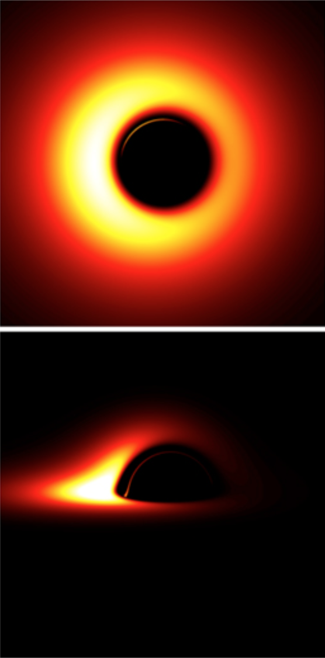
1.Shadow image of SMBH
By strong gravitational lensing, a shadow image is seen with a diameter of about 5 times of the Schwarzschild radius.
M87 and Sgr A* give the largest size of 40-50 μarcsec.
Submm VLBI is the only way to achieve such extreme angular resolution, and to detect emission originating in the immediate vicinity of SMBH.
Questions to be answered:
Does there really exist a SMBH and event horizon?
What is the spin of BH?
How does General Relativity behave in the strong field regime?
How is the energy transferred from the accretion flow to the SMBH?
What is the launching mechanism of relativistic jets?
Courtesy of R. Takahashi

Slide 4
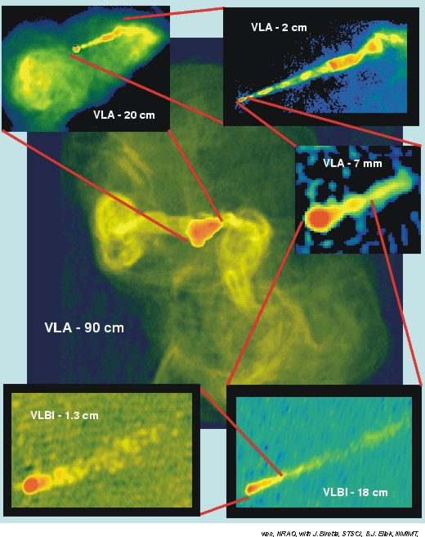
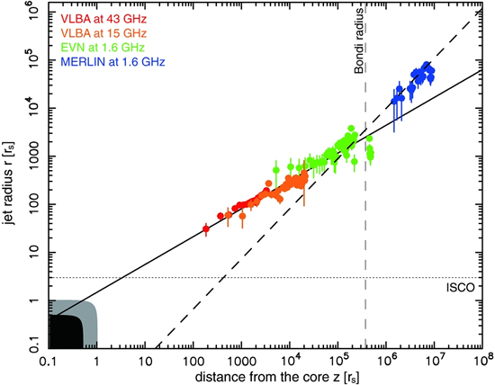
2.Primary target M87
Radio galaxy in Virgo cluster with a prominent jet (top left panel)
Compared to Sgr A*
Comparable shadow size of 40 μarcsec.
Orientation of the accretion disk is known by jet direction
Much longer rotation period (20 days)
Enable to study jet launching and acceleration mechanism (bottom left panel)
Asada & Nakamura 2011

Slide 5
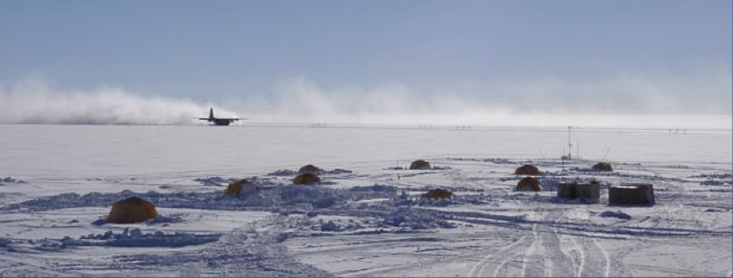
3.Site Selection & Test
Because of low water vapor, and potential VLBI baselines to ALMA and SMA for M87, Greenland was selected for the site of the telescope.
At the Summit Station (below), near the peak of the ice sheet, there are other polar research facilities supported by NSF, USA.

Slide 6
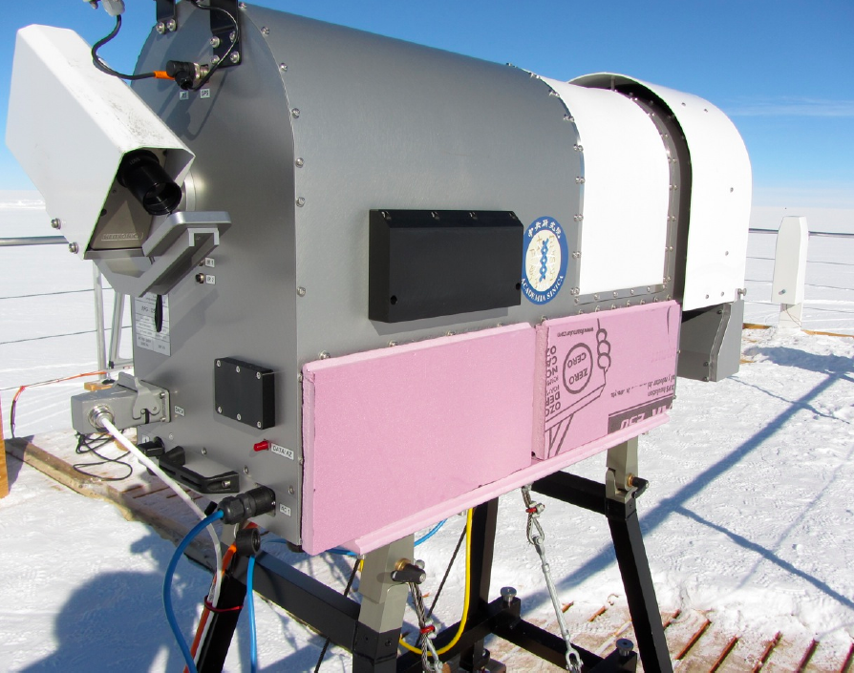
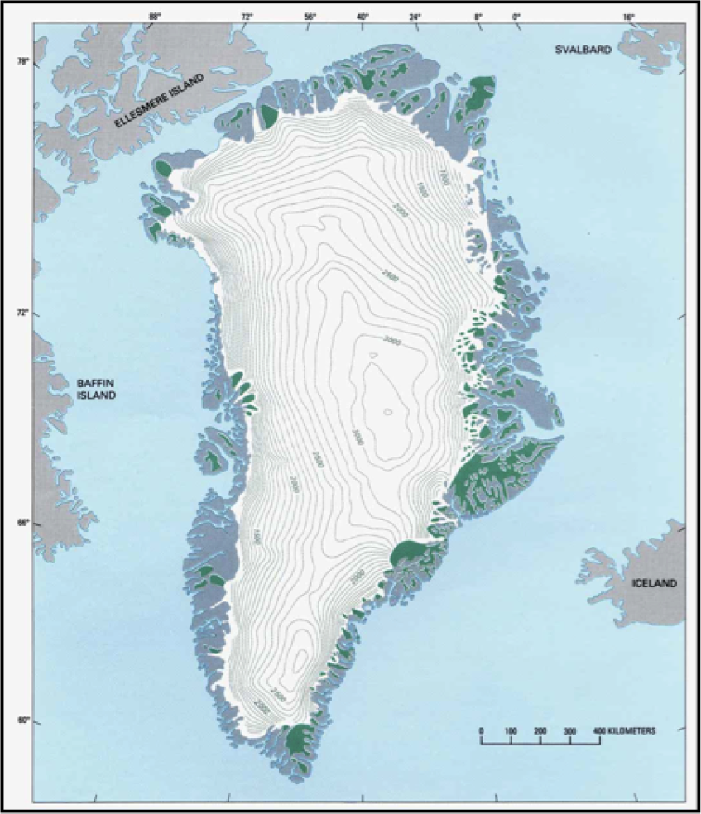
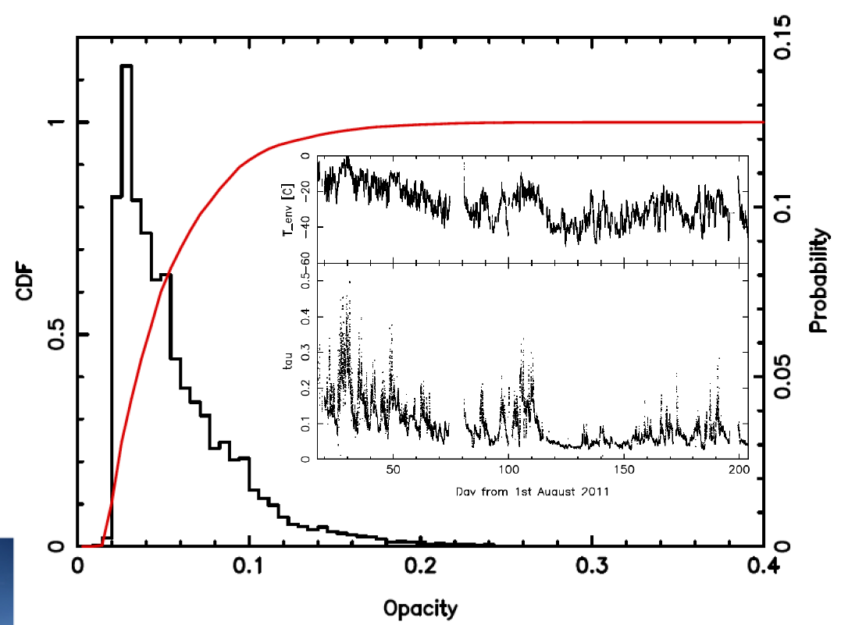
4.The Summit Station
In August 2011, the ASIAA radiometer (top right) was deployed to the Summit Station (red star on the left panel).
Preliminary conclusions for opacity monitoring at 225 GHz
Opacity tau < 0.04 for 50% of time (bottom right)
Better than SMA site in Hawaii
Better than ALMA site in summer, and almost the same as the South Pole
Excellent site for submm observations
VLBI & single dish

Slide 7
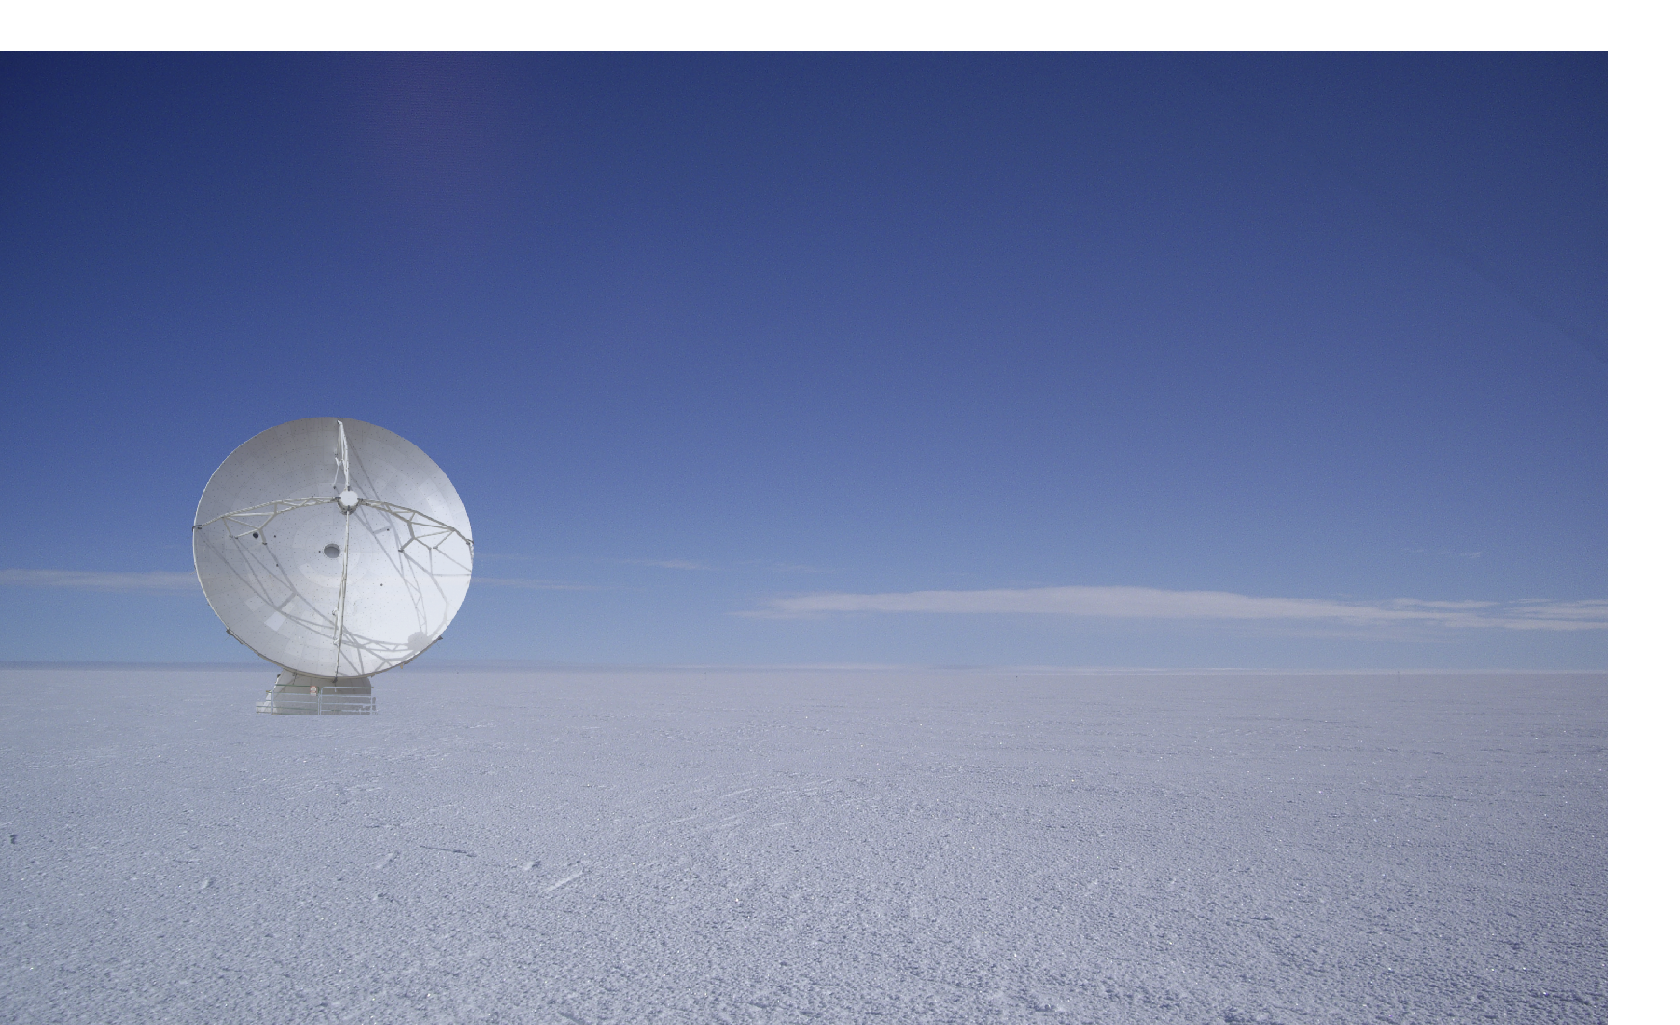
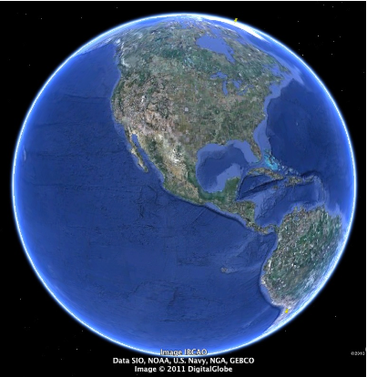
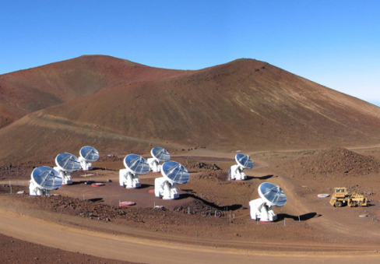
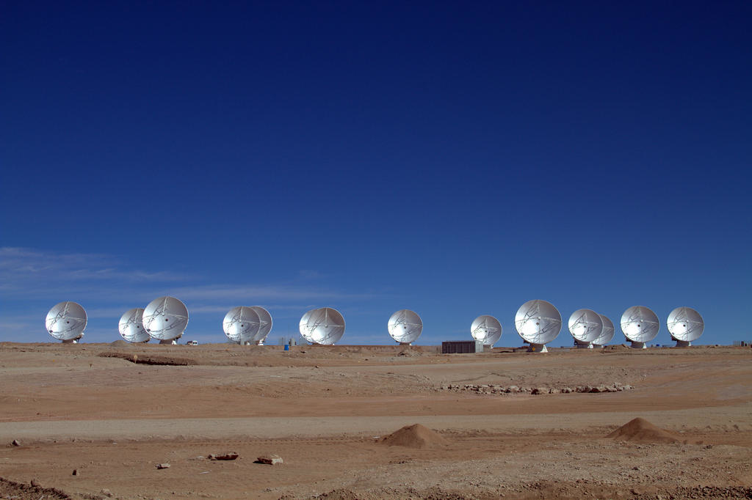
5.Submm VLBI network
Baselines are 9,000 km long, and the angular resolution reaches 20 μas at 345 GHz.
Phased ALMA and SMA provide higher sensitivity.
Other telescopes,
IRAM 30m, SMT (AZ), LMT (Mexico), etc. will provide good imaging capability.
Greenland
GLT; artist's impression
Hawaii
Phased SMA
Chile
Phased ALMA
ASIAA is a partner in both SMA and ALMA. Phase-up ALMA is in progress, and the phased “SMA, JCMT, and CSO” is already at work.

Slide 8
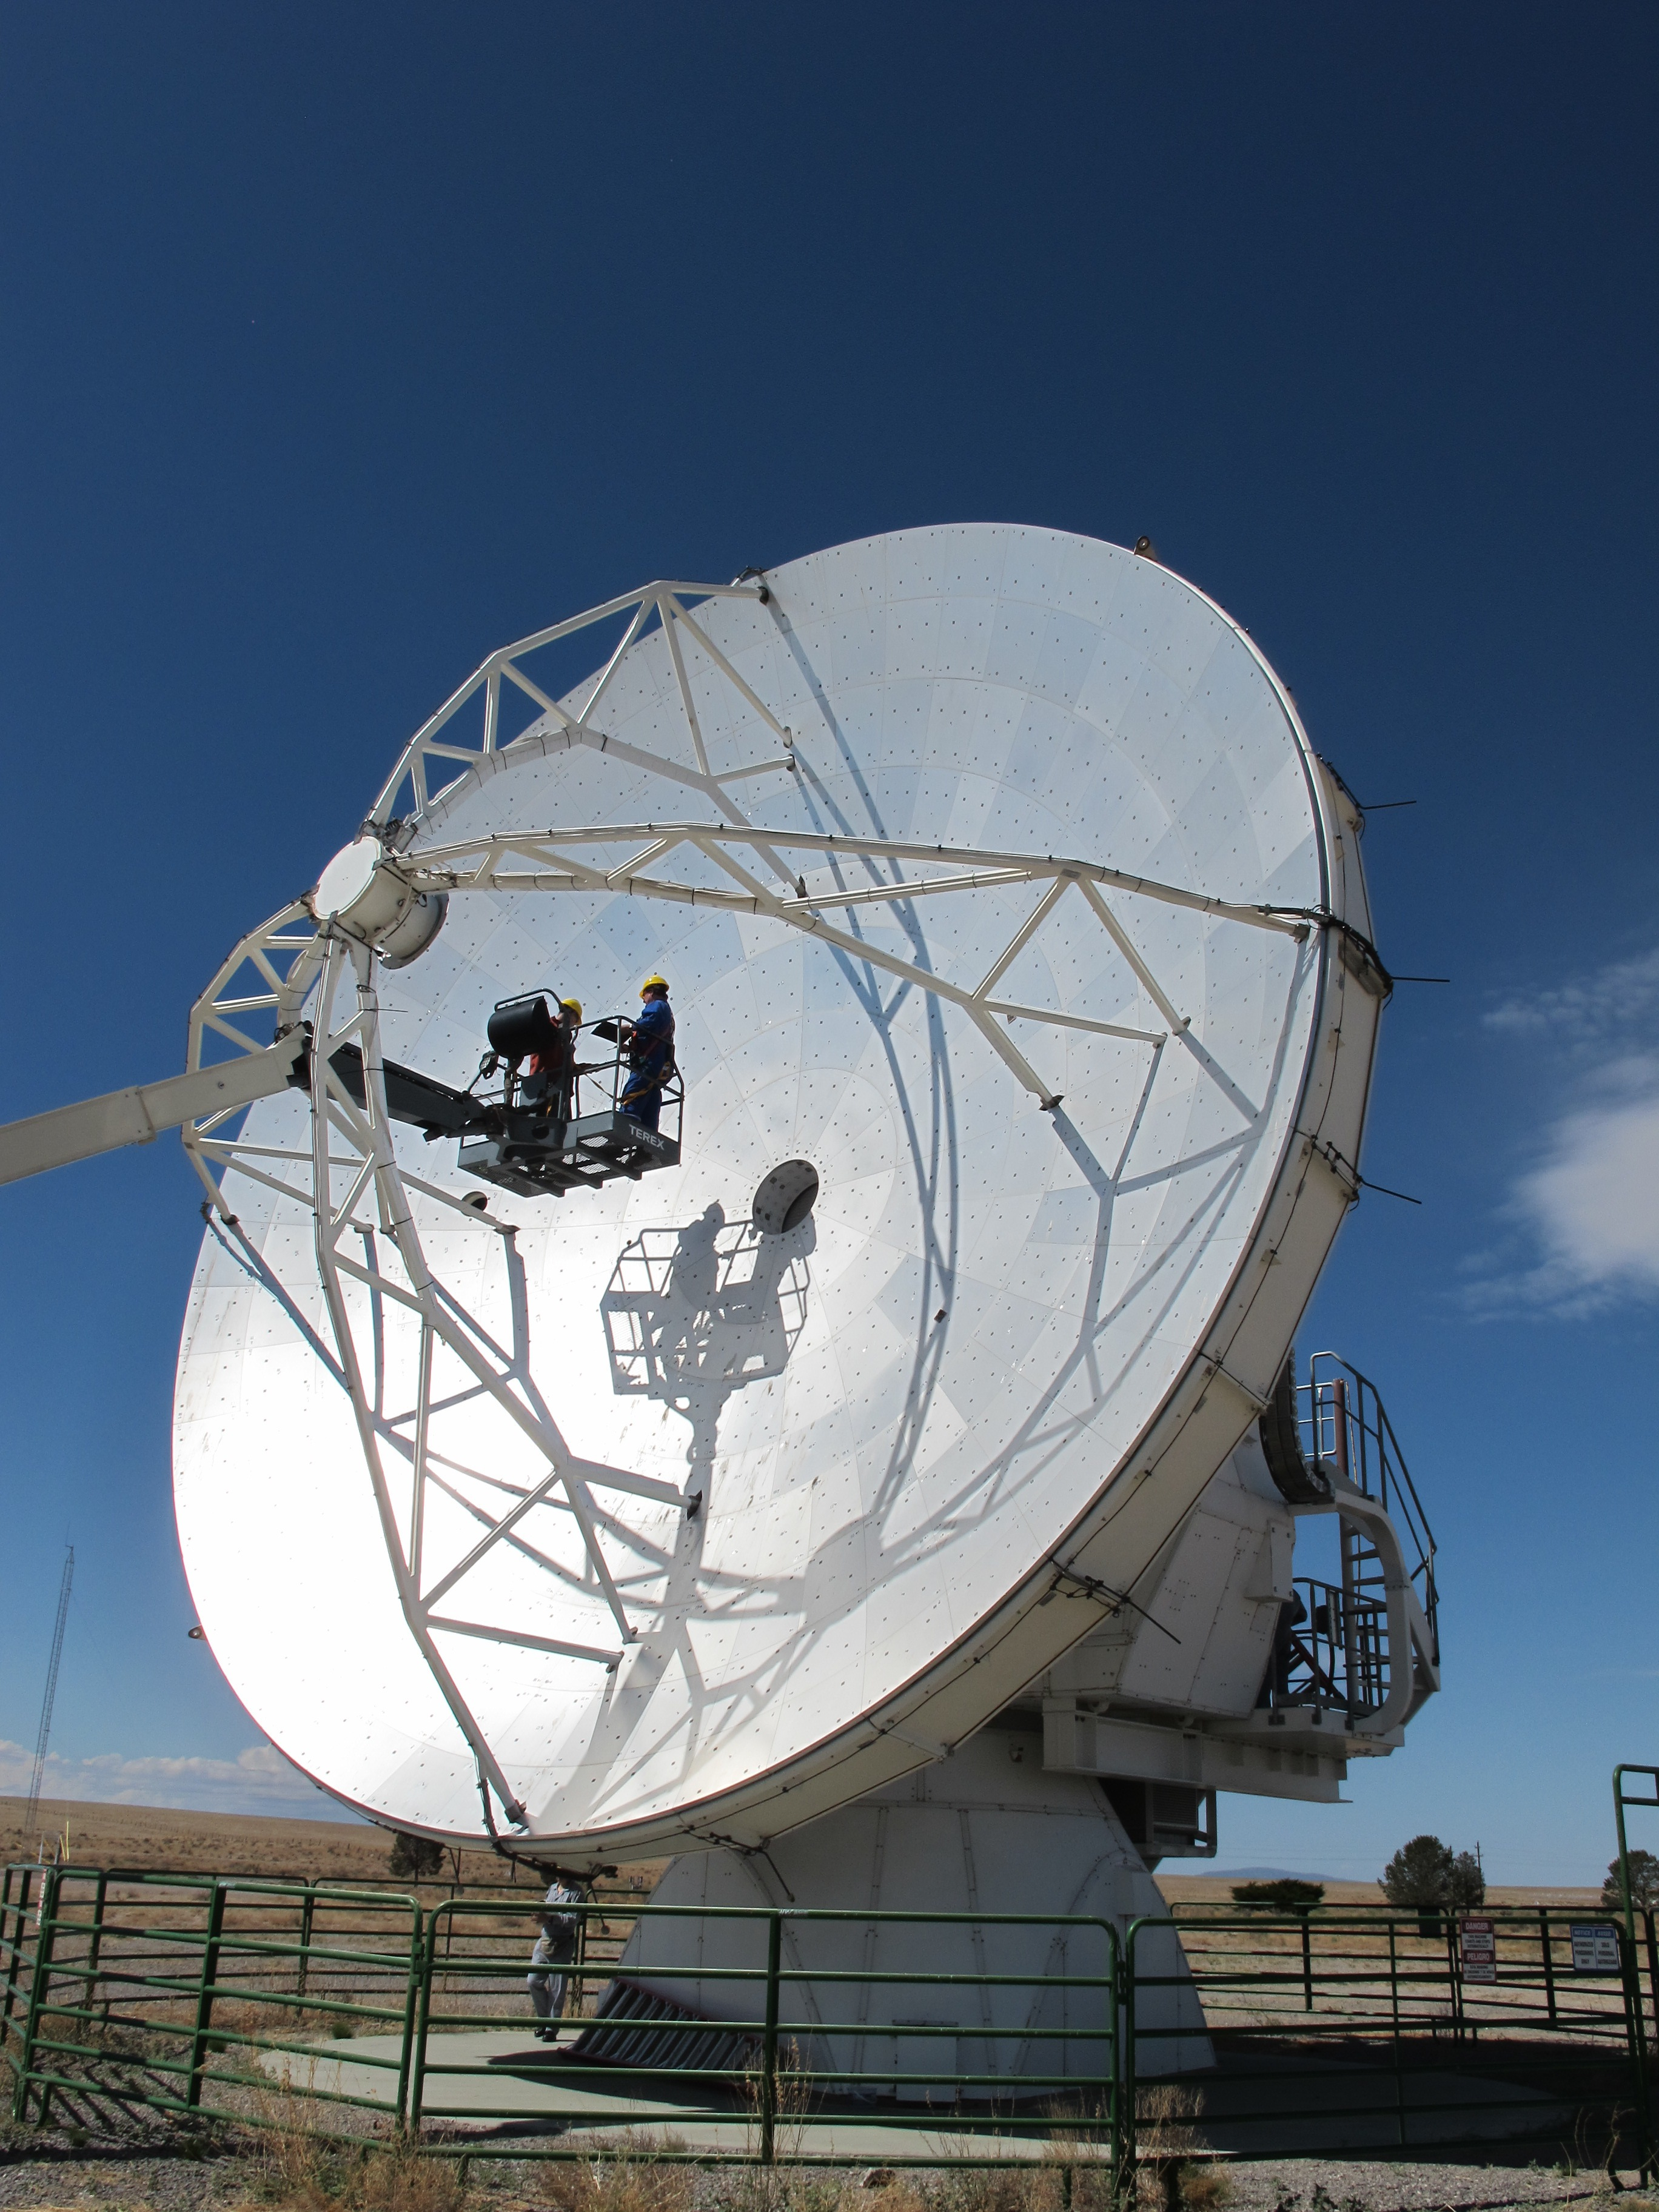
6.Retrofitting telescope
Since April 2011, the ALMA prototype telescope has been tested and the design modifications for operation in the cold environment in Greenland studied.
After being retrofitted, the telescope will be shipped to Greenland in 2014.
Instruments:
Submm VLBI receivers: 230, 350, & 650 GHz
Single dish receivers (≤ 1.5 THz)
heterodyne multi feed receivers
multi-pixel bolometers

Slide 9
7.Conclusions
ASIAA has been developing a new submm VLBI station in Greenland with international collaboration, e.g., The Event Horizon Telescope.
The Greenland Telescope (GLT) will be part of a submm VLBI network for observing the black hole shadow of M87.
The site forms long baselines with ALMA and SMA, providing 20 μas resolution at 345 GHz for M87.
The atmospheric opacity is excellent for submm and higher frequency observations at the GLT site.

